Slide 1
Convergence & Improvement
Alex Samalot
MS ENVE Candidate

Slide 2
Table of Contents
Instructed by
Project Purpose
Notes
Procedure
Results
Future work

Slide 3
1. Instructed by
Marina/Manos at defense (April 24th)

Slide 4
2. Project Purpose
Determine the improvement with the dataset
Determine an optimal training period in for stability and adequate representation of Q and R
Not really meantioned apart from ‘a few days was deemed adequate’
List
Best existing article and starting off point is:
On the Identification of Variences and adaptive KF (RAMAN MEHRA)
Should replace with something more modern

Slide 5
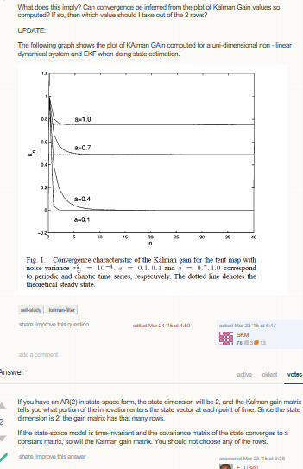
3. Notes
https://stats.stackexchange.com/questions/142956/convergence-and-trend-of-kalman-gain
Similar to the correlogram the convergence I am looking to describe is the incorporation of past information
The Kalman Gain itself is the “slope” of the incorporation of new information
The percentage of the past residual

Slide 6
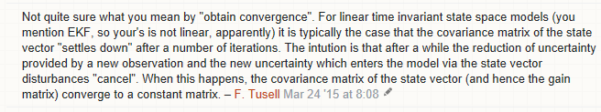
3. Notes
Plotting the Kalman Gain shows expected correlation
A stable state covariance would also be good

Slide 7
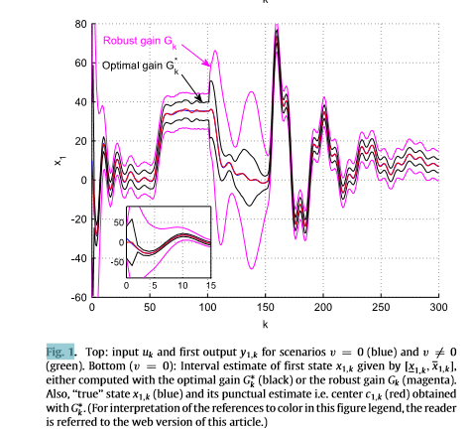
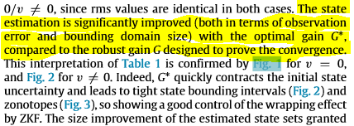
3. Notes
Zonotypes and Kalman Observers: Gaom Optimally Under Distinct uncertainty pardigrams and robust convergence
Christope Combaste 2014
Showed converbence of a traditional Kalman filter compared to his bounding/other alterations to the algorithm

Slide 8
3. Notes
Statistical Process Control of a Kalman Filter
Sonja Gamse 2014
Very thorough analysis of how the Kalman Filter works and how to statistically asses the accuracy of each state

Slide 9
3. Notes
Because the output results depend strongly on input model paramaters and the normal distribution of residuals is not always fulfilled it is very important to perform all possible tests on output results.
We describe indicators of inner convidence such as controllability and observability, there determinant of state transition matix and obwerving the properties of the a posteriori system state covariance matrix and the properties of the Kalman Gain
The statistical tests include the convergence of standard deviation of the system state components and normal distribution beside standard tests

Slide 10
3. Notes
Models are influenced by various sources of uncertainty such as model noise, imprecision, incompleteness, ambiguity, vagueness and maybe most importantly the lack of complete knowledge and the influence of mathematical over-simplification
Therefore deterministic mathematical modeling of dynamic systems is usually imperfect and a statistical approach is necessary to estimate unkown parameters and evaluate their accuracies
KF overcomes the problem of uniformity defined unkown parameters, ensures computational integrity when dealing with redundant observations, minimizes the influence of measurement errors on the system state estimation and allows one to compute the accuracy of their estimate
In the case of KF modeling, very well known hypothesis testing and identification of significant inconsistencis is performed in the domain of measurements and the system state domain

Slide 11
3. Notes
1) indicators of inner confidence
Controllability and observability
Determinant of state transition matrix
Properties of the a posteriori system state covariance matrix
Properties of the KG matrix
2) Statistical tests
Standard deviations of the system state components
Test statistics in the domain of the measurements
Test statistics for the system state domain

Slide 12
3. Notes
KF modeling provides indicators that enable the evaluation of estimated outputs
Because these values are computed through the KF process, they can be only used as indicators of inner confidence
Consistency checks of the model must be performed using additional statistical methods and paramaters and must be addressed as more global tests
The controllability condition states that the process noise enters into each state compoenent and prevents the covariance of the state from converging to zero
This condition causes the covariance to be positive definite
All of the eigenvalues are positive
The observability condition on the state garuntees a steady flow of information about each state com onent
This prevents the uncertainty from becoming unbounded
This condition yields the existence of a (not necessarily unique) steady-state solution for the covariance matrix that is positive-definite or positive semidefinite
With finite positive or nonegative eigenvalues respectively

Slide 13
In general, the determinant provides important information about the design matrix of a linear system
The system has a unique solution only when the determinant is non-zero
When the determinant is zero there are either no solutions or many solutions
In the case of KF we asses and monitor the determinant value of the state transition matrix Fk which defines the transition from the previous state to the current state

Slide 14
Properties of the a posteroiri system state covariance matrix P^(+)sub(k) are generally used to obtain preliminary characteristics of the reliability of a KF model
The importance of convergence of the trace of system state covariance matrix lies in its definition
Trace P^(+) is the sum of the diagonal elements of the matrix P^(+)sub(k), which represents variances (sq std of the system state covariances
If the sum of diagonal elements converges towards some values we reason that single elements also converge towards the same solution

Slide 15
The solution of covariance matrix Psub(k) should theoretically always be a symmetric-positive, semi definite(non-negative definite) matrix
Symmetry and postitive definiteness can be lost due to round off errors in the course of calculating its propogation equations
? Might delete this slide

Slide 16
Mathematically, matrix P^+ sub(k) is nonsingular
However, numerical problems sometimes make matris P^+ sub(k) indefinite or nonsymetric
Numerical problems can for example arise in cases in which some elements of the state-vector x are estimated to a much greater precision than other elements of x
This could arise because discrepancies can be identified using different eigenvalues of the matrix P^+ sub(k) specifically these reflecting the condition # of matrix P^+ sub(k) defined as the common log of the ratio of its largest to smallest eigenvalue
The value of the condition number depends strongly on the value of the process noise intensity scalar sigma sub w
The condition number can therefore reflect the ratio between process and measurement noise
https://www.youtube.com/watch?v=Y-Ih1j-LA4I
A good condition number is low because want a small chane in the coefficient x for comparatively larger changes in the measurement b with the trainsition matrix H
Would mean a good system representation

Slide 17
The inclusion of measurements into system state estimates are determined by Kalman gain K which is influenced by the uncertainty in a apriori state estimates and uncertainty in measurement estimates
Intuitively measurements with high precision should results in precise state estimates
Input measurements define the system state, directly or indirectly and thus if they have high precision, the KF can rely on them as good indicators of the system state

Slide 18
Equations for the estimation of measurement prediction covariance, innovation covariance, Kalman gain, innovation or measurement residual , updated state estimate and its updated covariance all yield filter calculated covariances which are exact if all of the modeling assumptions used in the filter derivation are perfect
In practice, this is not the case and the validity of the accuracy of these filter estimates has to be tested

Slide 19
Through filter tuning, the performance can be evaluated by assessing its associated a posteriori covariance matrix P^+ sub(k).
This is demonstrated by the fact that any estimated system state tends to be bounded between one standard or two standard deviations (66% or 95% confidence respectively)
These standard deviation bounds are defined by the square roots of the corresponding diagonal elements in the computed P^+ sub(k) matrix
Sigmak(i)=plus/minus sqrt(P^+ sub(k) (ii))
If an estimation error is exceeded by the sigma or 2sigma bound then the performance of the KF under the parameter setting may have been set to unacceptable values

Slide 20
A global test of KF estimation could in theory be done by comparing predicted and true values of measurements
The measurement residual called innovation dk can be estimated and computed as a difference between the actual measurement zk and the best available prediction based on system model and previous measurement

Slide 21
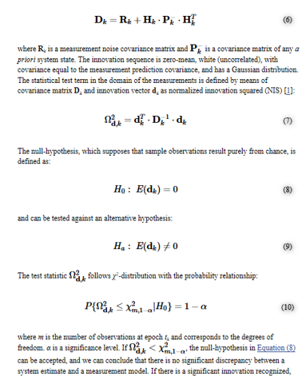
CNT’d Topic
If the null-hypothesis can be accepted
we conclude there is no significant discrepancy between a system estimate and measurement model
If there is a significant innovation recognized, the null-hypothesis should be rejected.
The causes for incompatability must then be localized
The reasons for such discrepancy could be either in the prediction, the stocahastic model used in the KF or the observatiosn

Slide 22
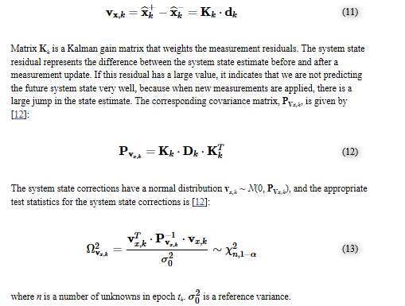
In the system state domain we test to see whether the KF system filtered system state is comparable to any previous knolege we may have about the system
To address this comparison, the difference between the filtered and predicted state should be analyzed
Correction residual vxk=Kkdk
Correaction as in adaptation not predictor corrector
If this residual has a large value, it indicates that we are not predicting the future system state very well
If this residual has a large value, it indicates that we are not predicting the future system very well because when new measrurements are applied, there is a large jump in the state estimate

Slide 23
Next section
https://math.stackexchange.com/questions/668/whats-an-intuitive-way-to-think-about-the-determinant
Implementation and Numerical Analysis

Slide 24
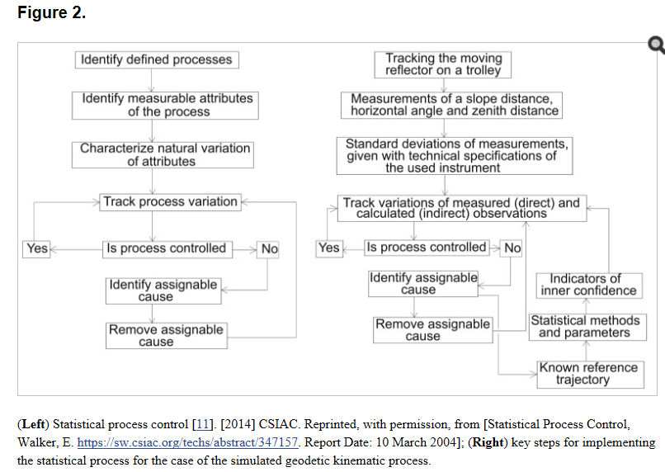
Implementation and Numerical Analysis
Fig 2~
Listed under Trace of Matrix P+k
Citation 10 listed
The condition of the convergence of the a posteriori system state covariance matrix P^+sub(k) is satistied for our KF
I BELIEVE THIS IS DISCUSSED LATER IN DETAIL

Slide 25
Eigenvalues of Matrix P+k
The symmetry and positive definiteness of the covariance matrix Psubk for our KF were controlled using MATLAB operations
Is this part of the Kalman calculation or does this differentiate the my study from this one
Condition Number of Matrix P+k
If we look at the standard devations of the system state components computed through the process in Figure 3, 4, 5
We notice different ranks for the precision of position, velocity and acceleration
This is due to the different unbits on each parameter and because position components are better observed than velocity and acceleration
Generally speaking this still feals like the introduction to the results

Slide 26
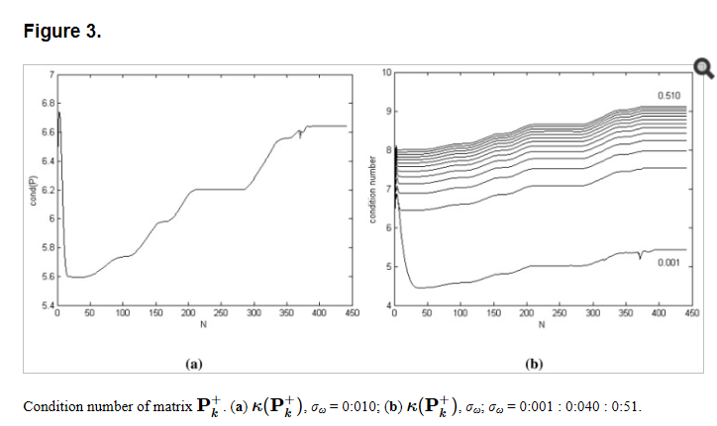
The condition number of matrix P^+ subK for sigma w is 0.01
A large condition number indicates near singularity
For this KF we determine that the condition number is acceptable
Because the value of the condition number depends strongly on the value of the process noise intensity scalar sigmaw, the k(P+k)? Value was performed for different values of sigmaw
Figure 3b representents the condition number for the lowest sigmaw (0.001)

Slide 27
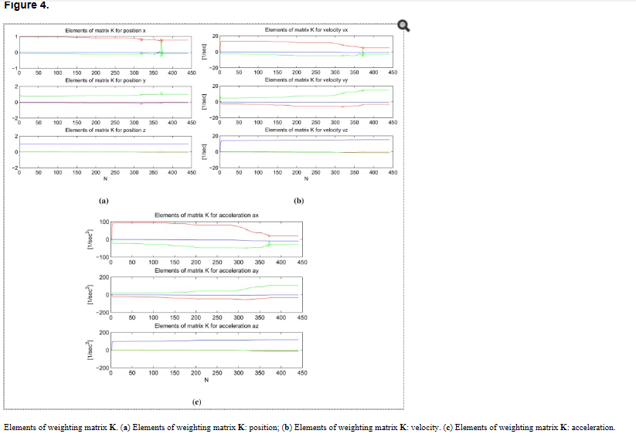
Properties of the KG
In Fig 4, graphs of the elemt of the weighting matrix K are plotted for the position, velocity and acceleration component in all three dimensions
In each graph the red, green and blue lines represent the element of matrix K for the x, y, and z component of measurement correction

Slide 28
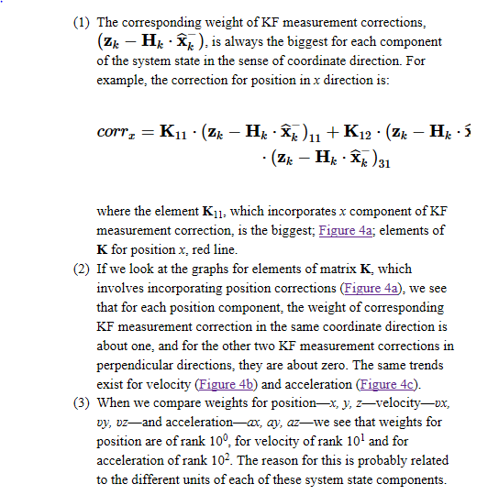
Properties of the KG

Slide 29
The previous slide indicates there are no correlations to other directions when performing this particular Kalman gain
The different elements of the KG indicate what is correlated
In this model the values of the elements in matrix K are dependent ofn the covariance matrix of the KF measurements Rk
Eq 13, and cannot be computed off line
The elements of weighting matrix K depend heavily onb the value of process noise intensity scalar sigmaw, specifically the elements that define velocity and acceleration corrections
We perform several tests with different values of sigmaw to conrifm numerically the mathematical validity of our KF model algorithm
i.e. when the process noise is small there is a high confidence in the model and predicted values;
Therefore the measurement corrections are weighted less heavily than in the case of big process noise

Slide 30
Statistical tests of the Kalman filter standard deviation of system compoenent vectors xhat+k
The main intent of our simulation and KF model was to estimate the position of the moving reflector in three dimensions
For all 3 estimated position compoentns we observed a bigger dispersion of predicted better fitting of filtered values when compared to the true/reference positions
Ideally variances of the system state estimates should always include the true state within their errors
We visually present this test by plotting the standard deviaitons of the sustem state estimates
That is the square roots of the variances with the estimation of error plots
The standard deviations computed with the KF indicate how certain it is that the true state lies within a certain distance from the estimated state
The KF is about 66(95) percent certain that the true state element lies within the 1sigma(2sigma) confidence interval
Within one(two) deviation from the estimated elemene

Slide 31
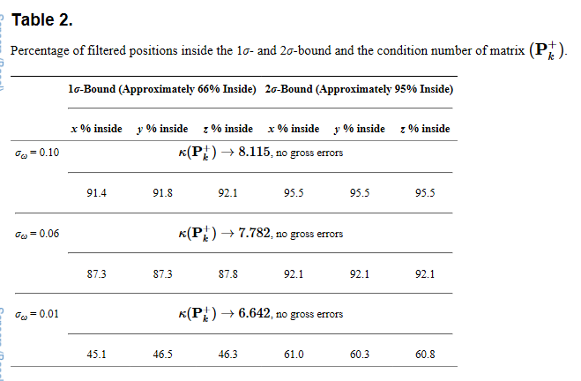
If we plot the derivations into the error plot, ideally the error stay s under the deviation lines
For KF and sigmaw=0.01 the 1sigma and 2sigma bounds are drawn for each position compoenent seperatley
Figure 5 Numerical values are given in Table 2
The # of steps where the position error exceeds the 2sigma bound is also plotted. In all three figures the position error is represented with a red solid line sigma bound with a given solid line and 2sigma bound with a dased solid line
All plots represent cases where no gross errors (large outliers) were [resemt fpr sigmaw=0.1
Table 2 shows the reduction of the condition #
@ the same time there is better convergence of trace P+subk
With bigger confidence into the model (smaller sigmaw value)
However at the same time there is a big reduction of position error, where less true states lie inside the 1sigma or 2sigma bound of estimated psotions which means a higher discrepancy between the estimated and true poitition sytem state components

Slide 32
However at the same time there is a big reduction of position error, where less true states lie inside the 1sigma or 2sigma bound of estimated psotions which means a higher discrepancy between the estimated and true poitition sytem state components
For sigmaw=0.1 we deduce that position state estimate are consistent with their computed standard deviation and sigma bounds
Position errors for all 3 position componenets fall about 91% and 95.5% within 1sigma and 2sigma uncertainty regions
For sigmaw=0.01, position state estimates are inconsistent with their computed standard deviation
Only approximately 46% and 61% of estimated positions lie within the 1sigma and 2sigma bound respectively
We also observe that there is an increasing trend in the deviation in the different position state estimates variables byt still bounded

Slide 33

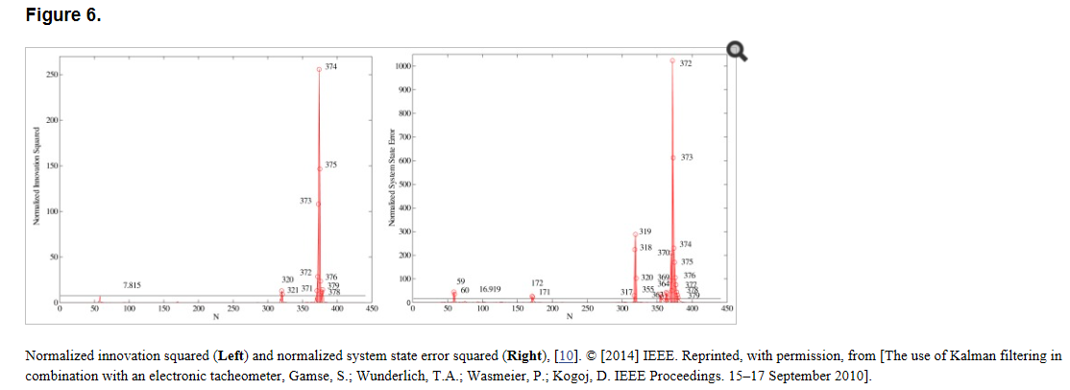
Consistency of the model in the Domain of the measurements
We next test the KF measurement innovations together with their covariances using the normalized innovation squared (NIS)(eq7)
And the probability relationship given in equation 10
For KF the value of dof is equal to r=3 and a significance level value of 0.05 was used

Slide 34
Consistency of the model in the Domain of the measurements
At the 95% confidence level, for measurement vector that includes 3 variables, the confidence region of the upper one sided test is chi square sub 3,1-0.05=7.85
The normalized innovation squred for KF is plotted below

Slide 35
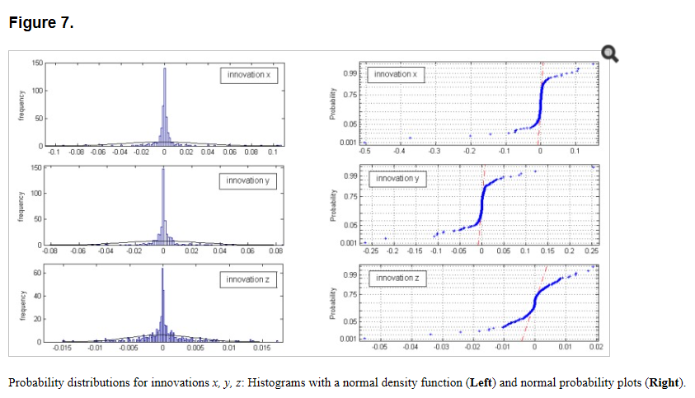
The innovations represent measurement residuals and for this analysis it is assumed that they are normal (Gaussian) distributed variables with 0 mean and covariance given in dk~N(0,Dk)
The normal probability plots for all three innovation sets (x,y,z innovation) do not show linear patterns on the whole data
Fig 7 data are plotted against a theoretical normal distribution in such a way that the points should form an approximately straight line
Departures from this state line indicate departures from normality
Our data show a resonalby linear patter in the center of the data but the tails show departure from the fitted line
In our case we must deal with short tail normal probability disturbed data [13]
In the middle of these plots the data show a weak s like pattern

Slide 36
The first few and last few data on each plot show marked departures from the reference fitted line
In the case of short tails, the first few points overestimate the fitted line above the line and the last few points underestimate the fitted line
These tail-end outliers may indicate significant deviation from the assumed normal distribution of the measured innovations

Slide 37
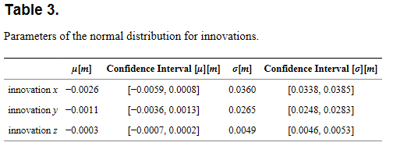
In table 3, the estimates of the mean mu and the estimate of the standard deviation sigma of the normal distribution for each innovation set are given at 95% confidence interval

Slide 38
Test statistics of the model in the system state domain
We next run a second formal test for the consistency of the model by examining the normalized system state errors
We ran single-run tests with different process noise scalars sigmaw to check if the KF consistently in the domain of the system state
Using a process noise variance sigmaw=0.1, the normalized system state error squared is shown in Figure 6
The KF estimation resulted in 26 points out of N=441 to be outside the 2sigma confidence region;
This represents 6% of the total
The statistical test for testing model consistency in the system domain was computed using Equation B with the a propri variance computed using a preliminary adjustment and its value set accordingly to sigmaw=0.01

Slide 39
Conclusions
In this contribution we presented…
Just summarized project

Slide 40
http://www.cs.unc.edu/~tracker/media/pdf/SIGGRAPH2001_Slides_08.pdf
Source one in the article
http://eds.b.ebscohost.com/ehost/ebookviewer/ebook/bmxlYmtfXzk4NzUwX19BTg2?sid=bb5168bc-5891-4ec1-bed3-e59c29c6b003@sessionmgr103&vid=0&format=EB&rid=1

Slide 41
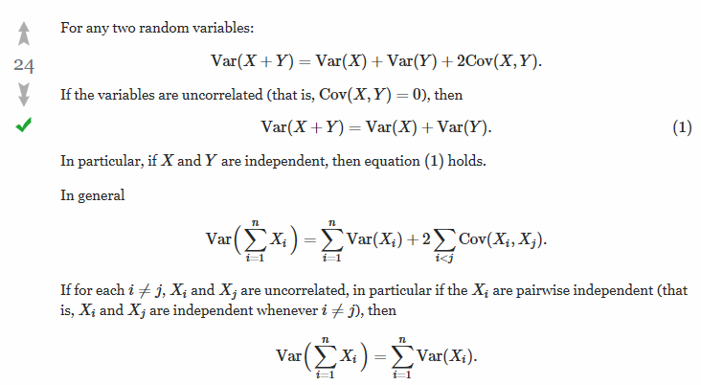
math.stackexchange.com/questions/115518/determining-variance-from-two-random-correlated-variables
https://www.fig.net/resources/proceedings/2006/baden_2006_comm6/PDF/MOD1/Lippitsch.pdf

Slide 42
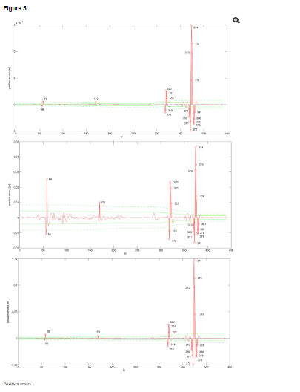
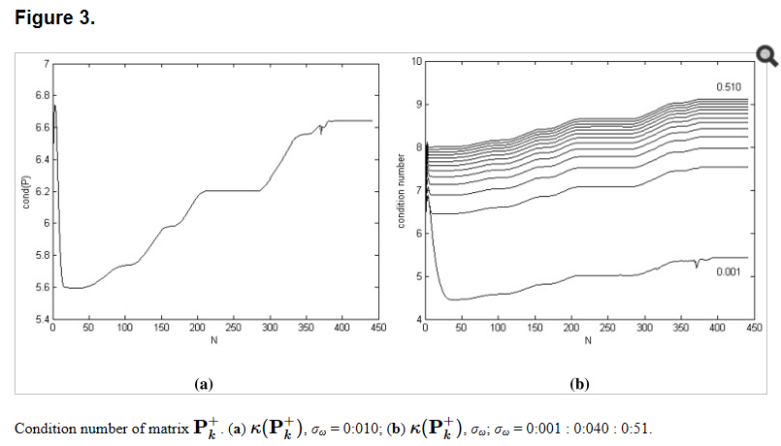

Slide 43
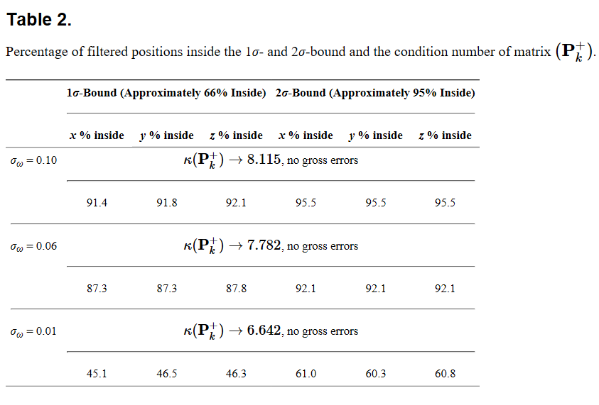

Slide 44
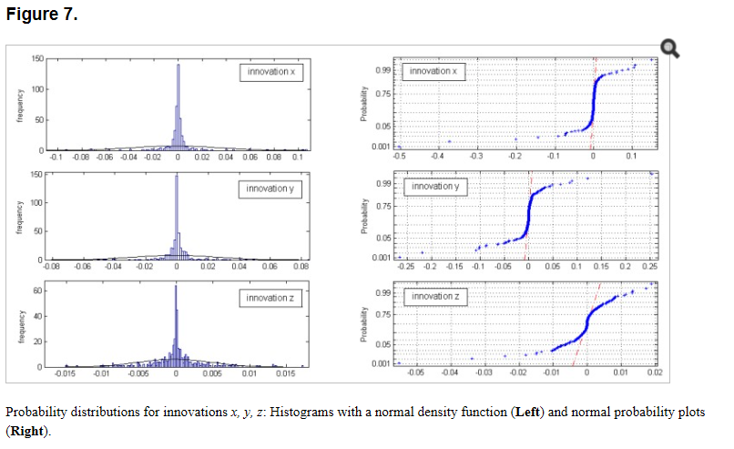

Slide 45
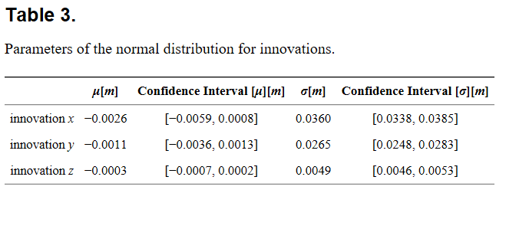

Slide 46
3. Notes
Project took three steps
1) Determine evolution of bias and RMSE to determine if a common convergence time/improvement of all stations through time
2)Plot the KG progression through time
3) output all relevant parameters (P is the next set of plots)

Slide 47
3.1 Notes
Delle Monache 2011
However, a disadvantage of this method is that it is not likely to predict sudden changes of the forecast error caused by rapid transitions from one weather regime to another. Initially KF may not be able to correctly estimate the forecast error when these changes happen, but it then quickly adapts to these changes in the following cycles (Delle Monache et al. 2006).
This is for the paper
Spearman correlation coefﬁcient thatcan be thought of asthe Pearson correlation coefﬁcient between the ranked variables, and is referred to here as the ‘‘rank correlation’’ (Wilks 2006).
Common vocab

Slide 48
4.1 Procedure (existing Line Plots with Error Bars)
Base=F:/Meth34nBase/
BiasLPEB
B3DivSta
bridgeSeasv4p1-3
Obviously the first season Code

Slide 49
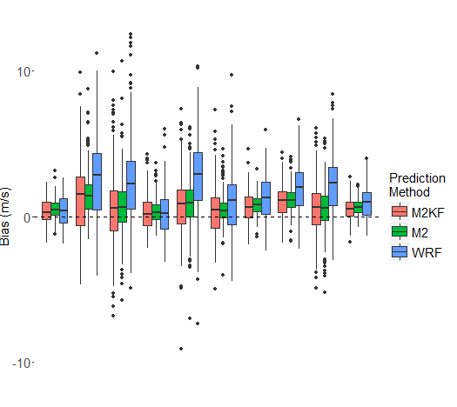
4.1.2 Procedure (existing Line Plots with Error Bars)
Base=F:/Meth34nBase/
BiasLPEB: Taken out because standard deviation and mean not accurate representation
F:/KrIC/BoxUn111Sta.m
F:/KrIC/BoxPlotsSeasv5.R
B3DivSta
bridgeSeasv4p1-3
Obviously the first season Code

Slide 50
4.2 Procedure Attempted run on F: drive NOT FINAL
Azula…/Documents/Meth34nBase/DriveBase.m
Due to the need for files on the computer and what a hastle it is referencing the drive, this contain contains just the copyfiles necessary to avoid referencing the drive from azula or vice versa.
Physically move necessary files to drive and change foldername to
F:/M2par/KGKFd2Met/
Run an edited version of TITLEKGmat1fi.m in folder listed above to produce the rest of the files
https://www.youtube.com/watch?v=BmVmJi5dR9c
https://www.youtube.com/watch?v=MFQpdELKTLc
Run KF
Chmod 777
Was not possible to change permissions due to the formatting of the external drive, encountered this before but it is possible to change files made under different circumstances

Slide 51
4. Procedure (Azula Procedure) FINAL
Kalman is run out of Azula…/Documents/Meth43nBase/KGKFTSd2Met/
Kgconv.f90
Doesn’t have gaps in the file outputs
Azula…/Documents/Meth43nBase/TITLEKGmat1fi.m
All KF inputs
Azula…/Documents/Meth43nBase/KGKFTSd2Met/
KrInMetKGLi.m
Azula…/Documents/Meth43nBase/Kgout.m

Slide 52
4.3 Procedure sensor article Metar
Azula…/Documents/Meth34nBase/TITLEAGIC?.m
Azula…/Documents/Meth34nBase/M2D2AGIC/M2D2AGIC.f90?
Kriging:
F:\M2D2AGIC\ (Metar)
KrInMetHTDiff.m
F:\MadD2IC\ (Madis)
KrInMadHTDiff.m
F:\KrIC\
Compiling:
Bias111eval.m
BiasTC111
BiasTC111M3.m
BSCVGC111.m
IC111TDp1-3.m
briTDp1-3.m
On Laptop (optional), Run results
F:/M2D2AGIC/M2d2G1V6.m
F:/M2D2AGIC/M2d2G2.m
F:/M2D2AGIC/M2d2G4V6.m
F:/M2D2AGIC/M2d2G6.m
F:/M2D2AGIC/M2d2G8.m

Slide 53
4.4 Procedure sensor article MADIS
Azula…/Documents/Meth34nBase/TITLEAGIC?.m
Azula…/Documents/Meth34nBase/M2D2AGIC/M2D2AGIC.f90?
Copy files to F:/M2D2AGIC/
On Laptop (optional), Run results
F:/M2D2AGIC/M2d2G1V6.m
F:/M2D2AGIC/M2d2G2.m
F:/M2D2AGIC/M2d2G4V6.m
F:/M2D2AGIC/M2d2G6.m
F:/M2D2AGIC/M2d2G8.m

Slide 54
Writeup

Slide 55
5.1 Results: All station Bias and RMSE
Current: F:/Meth34nBase/BiasLPEB.m

Slide 56
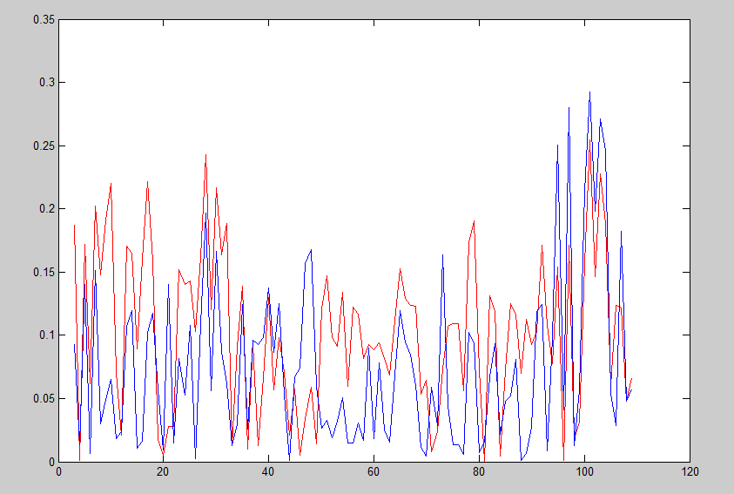
5.1 Results: Percent RMSE reduction through time
After extensive research a few of the Kalman filter articles say it should happen after a few timesteps and does not go further than that.
As far as improve forecast with more training, percent RMSE reduction seems to be the best
F:/Meth34nBase/PBRLPEB.m

Slide 57
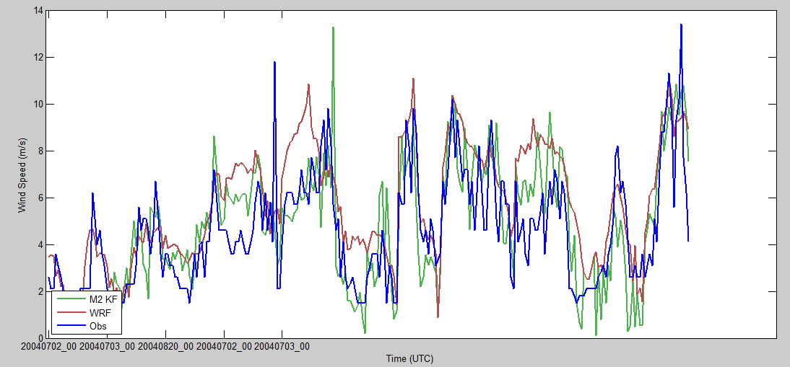
5.2 Results: Kalman Gain progression and associated forecast adjustment
Figure top:
F:/M2par/AzulaRun/Kgplot.m
Kalman Gain first ~250 hours
?Covariances are based on previous 24 hours, how does it spike so severely
Figure Bottom:
F:/Meth34nBse/M2kgGR.m
Line plot of the observed wind, Kalman, mod for the first 24 hours
This is 24 hours previous
Requires an extra 24 hours at the end?

Slide 58
5.3 Order of Results (in contradiction to the binder)
5.3.1 Results: Condition Number of State Covariance
(Gamse 2014) 3.3.4 Properties of the A Posteriori System State Covariance Matrix P^+subk
5.3.2 Results: Properties of the Kalman Gain Matrix
(Gamse 2014) 3.3.5 Properties of the Kalman Gain Matrix

Slide 59
5.3.1 Results: Condition Number of State Covariance
The noticeably and consistently large condition number indicates the system is ill conditioned
The condition number reflects the sensitivity of the system to changes and the ill conditioned means too sensitive?
It also indicates near singularity
This could be a result of the simplification of the process to one of the covariance terms for the denominator of the Kalman Filter
Which highlights the underlying issue of one measurement evaluating multiple “dimensions” or state representations

Slide 60
5.3.1 Results Notes
(Gamse 14): 3.3.4 Properties of the A Posteriori System State Covariance Matrix P^+subK
Condition Number of Matrix P^+subK
Large condition number indicates near singularity (Figure 3a)
(Gamse 14): 2.1.5 Properties of the A Posteriori System State Covariance Matrix
Condition Number of the A Posteriori System State Covariance Matrix
Numerical Problem can for example arise in cases in which some elements of the state vector are estimated with greater precision than other elements of x. This could arise because of discrepencies in units of the state vector (their experiment). The discrepancy can be identified using different eigenvalues of the matrix P^+subK. Specifically those reflecting the condition number
After the equation mentions sensitivity to their experiment
Youtube: Jeffery Adams: Matrix norm and condition number
Ax=b (where x and b are vectors)~smaller change in x with changes in b is his aim. This occurs with a small condition number
Math.stackexchane: what is the practical impact of a matrixs condition number
Note: singularity is the matrix inverse does not exist~ look into this deeper later
A common answer is that in practice 10^3-10^6 is pretty common (AND in this case the article is exact estimation) but, you loose a decimal for every 10^#. If condition #’s are big, then matrix is closer to singularity
Math.stackexchane: what does it mean for a matrix to be nearly singular
Ill conditioned & sensitive to numerical errors
This confirms Jeffery Adams high condition has to do with sensitiviey

Slide 61
5.3.2 Results: Properties of the Kalman Gain Matrix
Correlation varies highly
Good additional tests would be separating by time
Determining where the large peaks come from
Is this just more proof of the lack of convergence
Created by: F:/M2D2AGIC/M2d2G2.m
Created today come back
Determined better route than using old KG code from previous invest

Slide 62
5.3.2 Results Notes
The Kalman Gain state added to the linear transformation of the model forecast is significantly more unstable
The Kalman Gain state associated with the WRF forecast (in the first dimension) appear to be more stable having a correlation between .1 and .5

Slide 63
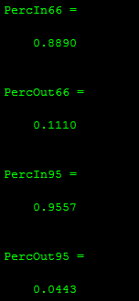
5.3.2 Results:
Any Estimated system state tends to be bounded between one or two standard devaitions (66 or 95% confidence)
Ideally variances of the system state should always include the state within their errors

Slide 64
5.3.2 Notes
(Gamse 2014) 2.1.5 Properties of the A posteriori system state covariance
The impratnce of the convergence of the trace system state lies in its definition
Trace P^+ subK is the sum of the diagonal elements of the matrix.
Represents the variances of the system state composnents. If the sum of the diagonal elements converges towards some value, then we reason that single elements also converge towards some solution
Just sum of diagonal, good plot to add

Slide 65
5.3.2 Notes
(Gamse 2014) 2.2.1 Standard Deviations of System State Components
Through filter training, performance can be evaluated by assessing its associated covariance matrix P^+subK. This is demonstrated by the fact that any estimated system state tends to be bounded by one or two standard deviations
(Gamse 2014) 3.4.1 Standard Deviations of the System State Components in vector xhatplus
Ideally variances of the system state estimates should always include the true state witnin their errors. The standard deviation of the system state computed with the Kalman filter can indicate how certain it is that the true state lies within a certain distance of the estimated state 66% and 95% certain it lies within one or two standard deviations

Slide 66
5.3.3 Results:
Cannot perform normal matrix multiplication because of the use of one set of measurements evaluated with multiple state variables
The driving theory behind the normalized innovation squared is mahalobis distance
Assuming it has to do with transforming to the normal representation and a kind of grouping
Identified a negative covariance?, visible on plot and not many

Slide 67
5.3.3 Results: Notes
(Gamse 2014) 3.4.2 Consistency of the Model in the Domain of the Measurements
We test KF measurement innovations together with their covariances using normalized innovation squared (by using first innovation squared over the covariance it is possible ruined statistical meaning)
95% confidence level one sided test. The innovations represent measurement residuals and for this analysis it is assumed that they are normal distributed vairables with zero mean and covariance Dk
dk~N(0,Dk)

Slide 68
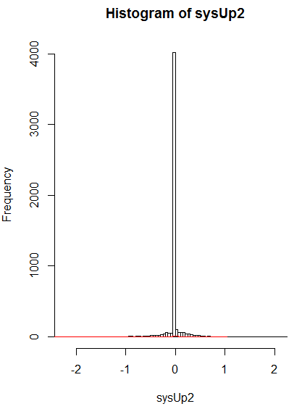
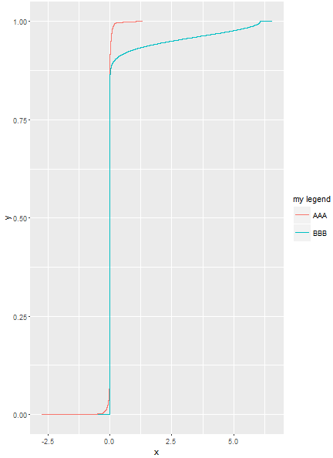

Slide 69
Note ridiculous amount of zero influence is due to lack of use of loc out or an end based on the size of the available data

Slide 70
5.3.3 Results: Notes
(Gamse 2014) 3.4.2 Consistency of the Model in the Domain of the Measurements
The normal probability plots do not show linear patterns on the hwole data.
In gerenral the data are plotted against a theoretical noral distribution in such a way that the points should form an approx. straight line
Departures from the straight line indicate departures from normality
Our data show a reasonably linear pattern in the center of the data, but the tails of the distributed data [13]/ In the middle of these plots, the data show a weak S-lkike pattern
For the first few and last few data on each plot show marked departures from the referenc e fitted line. In the caste of short tails the first few points overestimate dhte fitted line above and the last few points underestimate the fitted line
These tail-end outliers may indicate significant deviations from the assumed normal distribution of the measurement innovations

Slide 71
innovations

Slide 72
Footnotes on production

Slide 73
Directory structure and I/O
Title will output data (in UBUNTU) to ‘KGKFTSd2’
There is another code that creates rest of KF inputs required to finish input folder
Laptop/ Desktop/Storm3Test/Meth3Met/Method34n.m

Slide 74
Laptop/ Desktop/Storm3Test/Meth3Met/Method34n.m
KGKFTSd2.m
L9:foler=fullfile(‘F:’,‘KGKFTSd2’)
NOO
Note will need to redirect WRF inputs due to G: being broken

Slide 75
F:/Meth34nBase/TitleMet.m (Edits)
Azula/Documents/Meth34nBase/KGKFTSd2/TitleKGMet.m
Check foldering as go but KF usually run out of KalWRF folder
Azula/Documents/Meth34nBase/M03d2Met/KalmanCV.f90
Listed in KriKal03 but look at KalWRF
Edits performed in notepad++ for template:
F:/Deliverables/M2KF/Kgconv.f
Will be easier to perform these edits before getting to Azula IO2 avoid VI editor

Slide 76
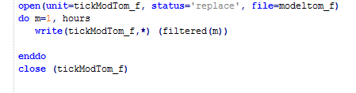

KG
What is the size of KG?
2x2 for this dimension
For KG
Unit=tickKG
DNE need to initialize and add writes
Will need to adjust the unit separator
File=Kgname
Need a second loop in the write to get all the values
Will need other parameters. At least Q and R, would be good to have x and P too

Slide 77
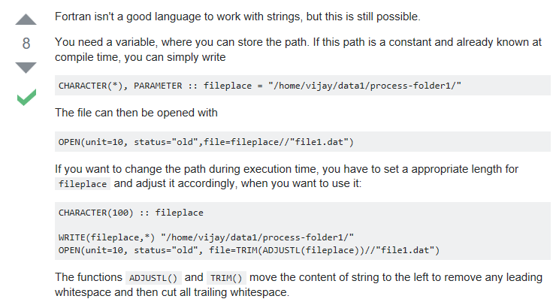
https://stackoverflow.com/questions/16142292/defining-path-for-file-in-fortran

Slide 78
KG
L11: tickKG
+1
L121-129 tickKG=tickKG+11
+1
L144: write(TFname, '(“TF",I1)') hour
L145: write(KGname, ‘Tfname//(“KG",I1,".txt")') station
+1
L159: write(TFname, '(“TF",I2)') hour
L160: write(//KGname, 'Tfname// (“KG",I2,".txt")') station
+1
174: write(TFname, '(“TF",I3)') hour
L175: write(//KGname, 'Tfname// (“KG",I3,".txt")') station
+1
L189: write(TFname, '(“TF",I4)') hour
L190: write(//KGname, 'Tfname// (“KG",I4,".txt")') station
+1
L1204: write(TFname, '(“TF",I5)') hour
L1205: write(//KGname, 'Tfname// (“KG",I5,".txt")') station
+1
L444: open(unit=tickKG, status='replace', file=KGname)
do n=1, dim
write(tickKG,*) (KG(m,n), m=1,dim)
enddo
close (tickKG)
Following a single file system
I loops are grid cells
Does Filt/KG require new source +1’s
Also station based, iterator bumps to 10
This writes the first two values, or overwrites?
Put in, but not in powerpoint, the original set of the tick values, they are ~500

Slide 79
X
L11: TOTx
+1
L121-129 : TOTx=TOTx+12
+1
L145: write(TOTXname, 'Tfname// (“TOTX",I1,".txt")') station
+1
L160: write(TOTXname, 'Tfname// (“TOTX",I2,".txt")') station
+1
L175: write(TOTXname, 'Tfname// (“TOTX",I3,".txt")') station
+1
L190: write(TOTXname, 'Tfname//(“TOTX",I4,".txt")') station
+1
L1205: write(TOTXname, 'Tfname// (“TOTX",I5,".txt")') station
+1
L444: open(unit=TOTx, status='replace', file=TOTXname)
do n=1, dim
write(TOTx,*) (x (m,n), m=1,dim)
enddo
close (TOTx)
Do not confuse with the existing x writes and rewrites that only contain hour at a time
2x2

Slide 80
P
L11: TOTp
+1
L121-129 : TOTp=TOTp+12
+1
L145: write(TOTpname, 'Tfname// (“TOTp",I1,".txt")') station
+1
L160: write(TOTpname, 'Tfname// (“TOTp",I2,".txt")') station
+1
L175: write(TOTpname, 'Tfname// (“TOTp",I3,".txt")') station
+1
L190: write(TOTpname, 'Tfname//(“TOTp",I4,".txt")') station
+1
L1205: write(TOTpname, 'Tfname// (“TOTp",I5,".txt")') station
+1
L444: open(unit=TOTp, status='replace', file=TOTpname)
do n=1, dim
write(TOTp,*) (p(m,n), m=1,dim)
enddo
close (TOTp)
Do not confuse with the existing x writes and rewrites that only contain hour at a time
2x2

Slide 81
Q
L11: TOTq
+1
L121-129 : TOTq=TOTq+12
+1
L145: write(TOTqname, 'Tfname// (“TOTp",I1,".txt")') station
+1
L160: write(TOTqname, 'Tfname// (“TOTX",I2,".txt")') station
+1
L175: write(TOTqname, 'Tfname// (“TOTX",I3,".txt")') station
+1
L190: write(TOTqname, 'Tfname//(“TOTX",I4,".txt")') station
+1
L1205: write(TOTqname, 'Tfname// (“TOTX",I5,".txt")') station
+1
L444: open(unit=TOTq, status='replace', file=TOTqname)
do n=1, dim
write(TOTq,*) (q (m,n), m=1,dim)
enddo
close (TOTq)
Do not confuse with the existing x writes and rewrites that only contain hour at a time
2x2

Slide 82
R
L11: TOTr
+1
L121-129 : TOTr=TOTr+12
+1
L145: write(TOTrname, 'Tfname// (“TOTr",I1,".txt")') station
+1
L160: write(TOTrname, 'Tfname// (“TOTr",I2,".txt")') station
+1
L175: write(TOTrname, 'Tfname// (“TOTr",I3,".txt")') station
+1
L190: write(TOTrname, 'Tfname//(“TOTr",I4,".txt")') station
+1
L1205: write(TOTrname, 'Tfname// (“TOTr",I5,".txt")') station
+1
L444: open(unit=TOTr, status='replace', file=TOTrname)
do n=1, dim
write(TOTr,*) (r (m,n), m=1,dim)
enddo
close (TOTr)
Do not confuse with the existing x writes and rewrites that only contain hour at a time
2x2

Slide 83
Test outputs on a small sample
L177 DO justatick=1,11

Slide 84
Small sample of outputs
Analysis is not in KriKal because not as relevant.
Build your own KF timeseries
Is there a smart way to loop through all…
Could literally start by just doing stations used in the Thesis
For Mon5/22/17
F:/Meth34nBase/KrInMetKaLi.m
F:/Meth34nBase/M2GR.m
Some form of KG plot

Slide 85
F:/Meth34nBase/KrInMetKaLi.m
F:/Meth34nBase/KrInMetKGLi.m
L6: folderin=‘KGKFTSd2’
L92: KGbeg=‘KG’
L92: Tfol=[‘TF’,num2str(j),’.txt’];
L62: fKG=[‘KGbeg’,Gcloc,ender];
KalGain=dlmread(fullfile(Tfol,folderin,fKG));
KG11(1,GC(i))=KalGain(1,1)
L141: save(‘MetLiKG.mat’)
L146:load((‘MetLiKG.mat’)
L181: KGbeg=‘KG’
L181: Tfol=[‘TF’,num2str(i),’.txt’];
L181: fKG=[‘KGbeg’,Gcloc,ender];
L181: KalGain=dlmread(fullfile(Tfol,folderin,fKG));
L181: KG11(1,GC(i))=KalGain(1,1)
L193: PloKG11=KG11(1,1)
L222: Plot(time(1:timeslot),PloKG111(1:timeslot),’k’)
Determine if a section should be commented out
NOO
Inputs:

Slide 87
5. Results

