Slide 1
Publication Overview
From Thesis To publication Going in reverse order until full location and backup

Slide 2
TOC: Objectives attempting to overview
Maps: List of where exe located
Current Map of draft submitted (digital)
Major differences between drafts and general timeline
Emails objectives and tagged
Content
Scrap
Project list:
(Ongoing) Taylor Diagrams
(SemiOngoing) Estimator Vs. Predictor MSE
(SemiOngoing) Maps and Verification Excel
Generating Measured MSE
Skew and Kurtosis
Types of Distribution behavior
Getting up to date with the recent literature on the topic
(slide 26 of previous topic)
Outlier removal
Normality of UK
SemiOngoing: Is enormous sample size reason cant pass a P form of evaluation and why
(Not in thesis) Line plot connecting KF and kriged and obs
(Not in thesis) RK histos
Remaining Formatting (Including references)

Slide 3
General Timeline: PHASE 10
Start-end
Nov10-Dec5
Overview powerpoint:
Documents/ThesisMaps/Jo925/DNotes12052017.pptx
Updates:
In draft: Stats relevant to methodology assumptions
Other of future benefit: Max Maps, trial run with all map files
Made without use yet
Extra histograms
Line plots with RK
Relevant Maps:
(Laptop)/Documents/Thesis Maps/Jo925/DNotesJo925as2.pptx
(Laptop)/Documents/Thesis Maps/Jo925/Dnotes11172017.pptx
(Laptop)/Documents/Thesis Maps/Jo925/Dnotes12052017.pptx
(Laptop)/Documents/Thesis Maps/Jo925/Samalot_KalmanPaper120417.docx
(Laptop)/Documents/Thesis Maps/Jo925/Samalot_KalmanPaper120517.docx
NEXT VERSION
Max scatter replacing mean
Fix ordering to represent max’s and tie into normality of hourly and try to prove skew of max?
R2(Exp) CV and RO
Just note the overestimation is most likely due to large H’s amplifying state… could be useful in paper

Slide 4
General Timeline: Phase 9
Phase 9:Dates: Oct-Nov
Overview powerpoints
Email Chain: Results of the distribution
Oct13: Difficulty RMSE^2=/=Bias^2+CRMSE^2
Associated draft
In email: Samalot_KalmanPaper_10122017.docx
Oct15:Marina wants new Q-Q’s explained better
Oct17:What is better about this?
In email: Samalot_KalmanPaper_10122017.docx
Nov 10: What is better about this?
In email: Samalot_KalmanPaper_10122017.docx
Dec 22: What is better about this?
In email: Samalot_KalmanPaper_10122017.docx
Dec 23: What is better about this?
In email: Samalot_KalmanPaper_10122017.docx
Dec 27: What is better about this?
In email: Samalot_KalmanPaper_10122017.docx
Assignment on December 27
It is not necessary to show geographic maps but we should discuss the implications of this method to the temporal and spatial error. In an older presentation (attached) you have Taylor diagrams in slides 10, 11. Are these current? If yes, can you explain the differences in more details

Slide 5
Maps (Going in reverse order)
Relevant Maps:
(Laptop)/Documents/Thesis Maps/Jo925/DNotesJo925as2.pptx
(Laptop)/Documents/Thesis Maps/Jo925/Dnotes11172017.pptx
(Laptop)/Documents/Thesis Maps/Jo925/Dnotes12052017.pptx
(Laptop)/Documents/Thesis Maps/Jo925/Samalot_KalmanPaper120417.docx
(Laptop)/Documents/Thesis Maps/Jo925/Samalot_KalmanPaper120517.docx
(Laptop)/Documents/Thesis Maps/Jo925/JourMap110217.docx
(Laptop)/Documents/Thesis Maps/Jo925/KBOSFSWwu.docx
(Laptop)/Documents/Thesis Maps/Jo925/FigsNEq3.docx
(Laptop)/Documents/Thesis Maps/Jo925/RKKF.docx?
(Laptop)/Documents/Thesis Maps/Jo925/Just4p1(…).docx
(Laptop)/Documents/Thesis Maps/Jo925/JourMap120517.docx
Thesis: F:/Thesis Maps/AKAL.docx
Procedure of ___: (Laptop)\Documents\TimeLine\ConvImp.pptx
This powerpoint will cover the rest
Start-end
Nov10-Dec5
Updates:
In draft: Stats relevant to methodology assumptions
Other of future benefit: Max Maps, trial run with all map files
Made without use yet
Extra histograms
Line plots with RK

Slide 6
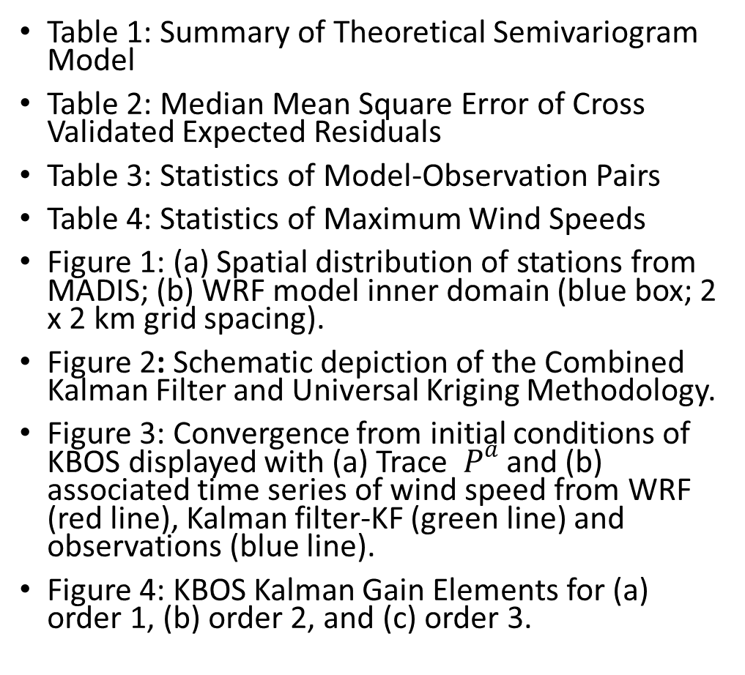
U2D Publication Map
Figure 5: Cross Validation Results of (a) First Order Regression Spherical R1(Sph) and (b) Second Order Regression Spherical R2(Sph) model of the Kriging application.
Figure 6: Normal Quantile-Quantile Plot Excluding outliers of (a) WRF bias and (b) KF bias.
Figure 7: Histogram and Theoretical Normal Distribution Excluding Outliers of (a) WRF bias and (b) KF bias.
Figure 8: Boxplots of WRF Bias for Stations (a) KBOS, (b) KMMK and (c) KUKT.
Figure 9: Normal Q-Q Plots of WRF Bias for Stations (a) KBOS, (b) KMMK and (c) KUKT.
Figure 10: Histograms of WRF Bias With Theoretical Normal Distribution for Stations (a) KBOS, (b) KMMK and (c) KUKT.
Figure 11: Boxplot of (a) Bias and (b) RMSE calculated at every station for every available storm.
Figure 12: Evaluation of average storm observed wind speed at a location for (a) WRF, (b) Kalman Filter, (c) R1(Exp) and (d) R1(Sph).
Table 1: Summary of Theoretical Semivariogram Model
Table 2: Median Mean Square Error of Cross Validated Expected Residuals
Table 3: Statistics of Model-Observation Pairs
Table 4: Statistics of Maximum Wind Speeds
Figure 1: (a) Spatial distribution of stations from MADIS; (b) WRF model inner domain (blue box; 2 x 2 km grid spacing).
Figure 2: Schematic depiction of the Combined Kalman Filter and Universal Kriging Methodology.
Figure 3: Convergence from initial conditions of KBOS displayed with (a) Trace ${ P}^{a}$ and (b) associated time series of wind speed from WRF (red line), Kalman filter-KF (green line) and observations (blue line).
Figure 4: KBOS Kalman Gain Elements for (a) order 1, (b) order 2, and (c) order 3.

Slide 7
U2D Publication Map
Skew And Kurt (in Pub WO table)
F:\ADIA\3StatOut.m
F:\ADIA\NormTest.R
Table 1: Summary of Theoretical Semivariogram Model
(Ryu et al., 2002)
Table 2: Median Mean Square Error of Cross Validated Expected Residuals
Was: F:\KrIC2\MseTheta.m
Now: F:\KrIC2\MSEFinal.m
Table 3: Statistics of Model-Observation Pairs
Col 1:3: F:\KrIC2\B3DimKF2.m
Col 4: F:\KrIC2\B3SphGraph.m
Table 4: Statistics of Maximum Wind Speeds
Col 1:3: F:\KrIC2\B3MaxGr.m
Col 4: F:\KrIC2\B3sphMax.m

Slide 8
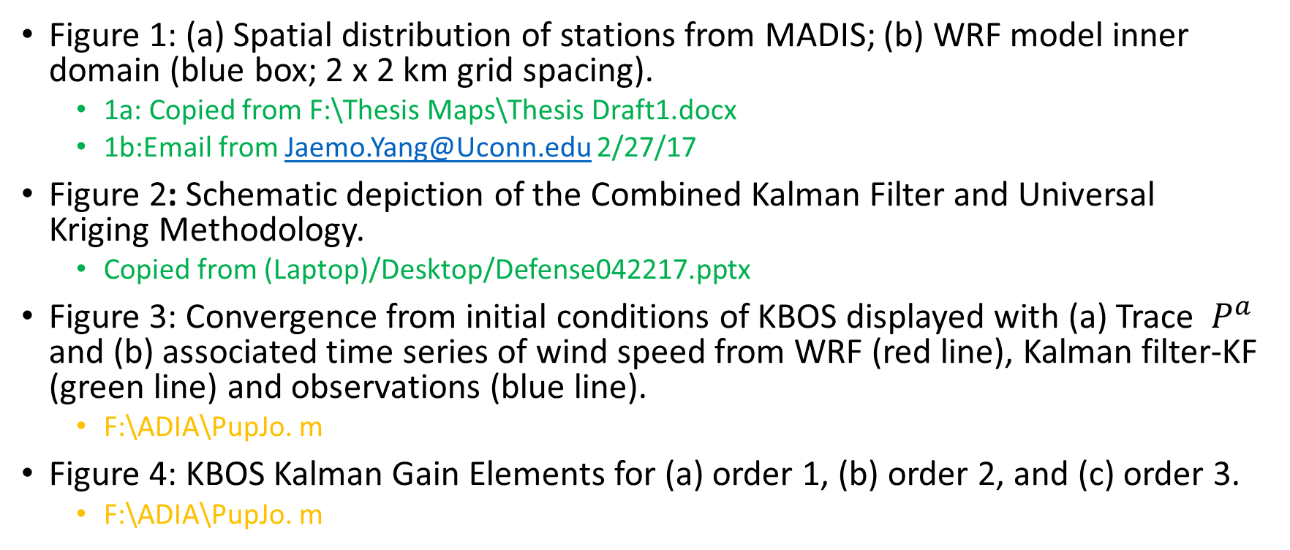
U2D Publication Map
Figure 1: (a) Spatial distribution of stations from MADIS; (b) WRF model inner domain (blue box; 2 x 2 km grid spacing).
1a: Copied from F:\Thesis Maps\Thesis Draft1.docx
1b:Email from Jaemo.Yang@Uconn.edu 2/27/17
Figure 2: Schematic depiction of the Combined Kalman Filter and Universal Kriging Methodology.
Copied from (Laptop)/Desktop/Defense042217.pptx
Figure 3: Convergence from initial conditions of KBOS displayed with (a) Trace ${ P}^{a}$ and (b) associated time series of wind speed from WRF (red line), Kalman filter-KF (green line) and observations (blue line).
F:\ADIA\PupJo. m
Figure 4: KBOS Kalman Gain Elements for (a) order 1, (b) order 2, and (c) order 3.
F:\ADIA\PupJo. m

Slide 9
U2D Publication Map
Figure 5: Cross Validation Results of (a) First Order Regression Spherical R1(Sph) and (b) Second Order Regression Spherical R2(Sph) model of the Kriging application.
5a:F:\KrIC2\sphCVR1gra.m
5b:F:\KrIC2\sphCV.m
Figure 6: Normal Quantile-Quantile Plot Excluding outliers of (a) WRF bias and (b) KF bias.
F:\ADIA\exOWRFFS.R
F:\ADIA\exOKFFS.R
Figure 7: Histogram and Theoretical Normal Distribution Excluding Outliers of (a) WRF bias and (b) KF bias.
F:\ADIA\exOWRFFS.R
F:\ADIA\exOKFFS.R
Figure 8: Boxplots of WRF Bias for Stations (a) KBOS, (b) KMMK and (c) KUKT.
F:\ADIA\KBOSKFFS.R

Slide 10
U2D Publication Map
Figure 9: Normal Q-Q Plots of WRF Bias for Stations (a) KBOS, (b) KMMK and (c) KUKT.
F:\ADIA\KBOSKFFS.R
Figure 10: Histograms of WRF Bias With Theoretical Normal Distribution for Stations (a) KBOS, (b) KMMK and (c) KUKT.
F:\ADIA\KBOSKFFS.R
Figure 11: Boxplot of (a) Bias and (b) RMSE calculated at every station for every available storm.
F:\SphPlot\H107sphR1only.R
Figure 12: Evaluation of average storm observed wind speed at a location for (a) WRF, (b) Kalman Filter, (c) R1(Exp) and (d) R1(Sph).
9a-c: F:\KrIC2\B3DimKF2Graph.m
9d: F:\KrIC2\B3SphGraph.m

Slide 11
Not Currently In Publication Map
(Not in thesis) Line plot connecting KF and kriged and obs
F:/ADIA/KBOSsphli2.m
(Not in thesis) RK histos
F:\ADIA\exOR2Exp.R
F:\ADIA\exOR1Exp.R
F:\ADIA\exOR2Sph.R
F:\ADIA\exOR1Sph.R

Slide 12
Content achieved from projects/sources
Skew and Kurtosis
Types of Distribution behavior
Getting up to date with the recent literature on the topic
(slide 26 of previous topic)
Outlier removal
Normality of UK

Slide 13
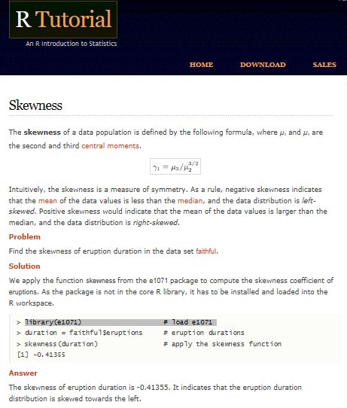
Measureing skew with an online function
http://www.r-tutor.com/elementary-statistics/numerical-measures/skewness
Remaining work is all data than 95/5
Therefore adding 95/5

Slide 14
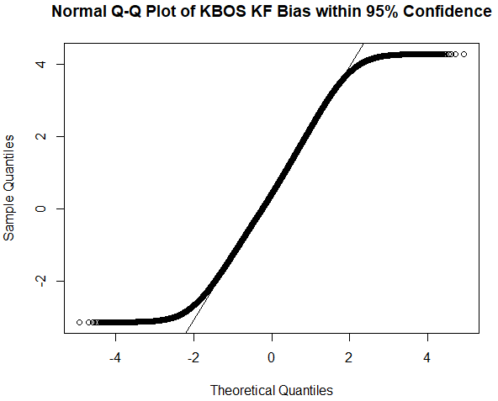
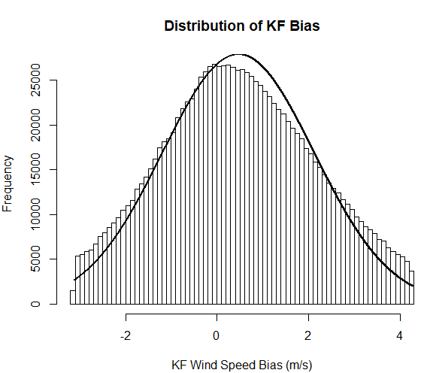
KF results after 95/5
0.09026047
After the removal of outliers, the QQ indicates a high degree of normality with deviation towards the end of the distribution. Calculating skew did not yield significant results
Is removing the bias outside the 95/5% confidence interval the same as removing the outliers?
Code for the KF QQ and histo: F:\ADIA\KBOSKFFS.R
Relevant (intro over citation) sources
http://emp.byui.edu/BrownD/Stats-intro/dscrptv/graphs/qq-plot_egs.htm
https://stats.stackexchange.com/questions/52293/r-qqplot-how-to-see-whether-data-are-normally-distributed/52295#52295

Slide 15
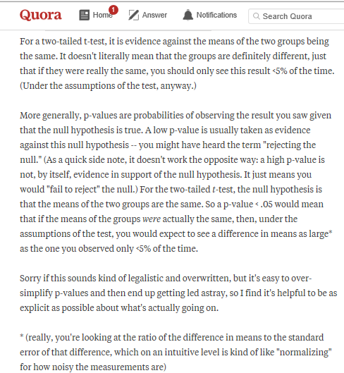
Results P test original code:
Code
Just a sign test the median is the mean
Editing -> added to
F:\ADIA\KBOSKFFS.R
Still fails test, VERY NARROW RANGE BELIEVED TO BE DUE TO ENORMOUS SAMPLE SIZE NOT CONFIRNED

Slide 16
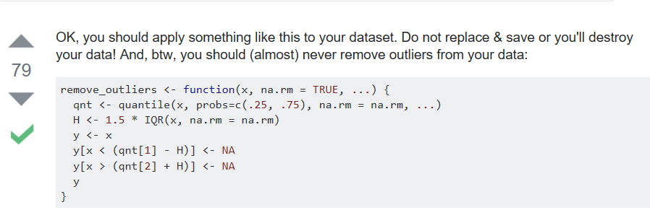
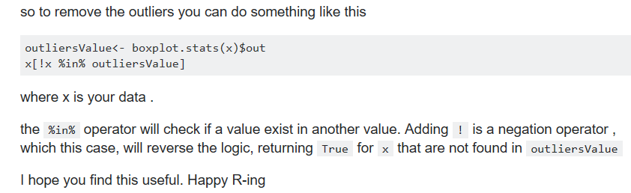
5*IQR
IQR is between first and third

Slide 17
https://stats.stackexchange.com/questions/125750/sample-size-too-large
Yes sample size is too large-> causing the median within 95% confidence range to be tiny to capture the nean
Yes there is some skew BUT THESE PLOTS SHOW THE NORMALITY OF THE DISTRIBUTION
NOT PERFECT EXPLANATION: STILL LOOKING FOR A GOOD EXAMPLE OF AN ACADEMIC PAPER REMOVING OUTLIERS, MORE OF A KIND OF HOMEWORK THING
SAVE ABOVE RESPONSE AS A WORD DOC OR PRINT VERY THOROUGH

Slide 18
Scap about KF
Welch Bishop
The Kalman filter is a set of mathematical equations that provides an efficient computation of recursive means to estimate a process in a way that minizes the mean of minimizes the square error
Supports estimations of past, present and even futre states, even when the precise nature of the modeled system is unkown

Slide 19
Quick research project about normality UK
RYU:
Optimal predictions are calculated under the assumprion the process is 2nd order stationary and normal
Ordinary Kriging
The normality assumption is AFTER data is detreneed for UK
OilArt: tests normality to determine if trend removal necessary
Self: Other point, while the data does not benefit from trend removal in the hourly, higher order trends exist at the maximum (most unstable part) of the storms.
Need to note somewhere the ordinary is propably best for hourly and the skewness is not really there at all overall so R1 will not effect
The general concept is that there is no benefit to higher order trends until max w.s. E.R. used
Instuructions based on information
Original Goal Write the paragraph about skew etc stating the normality is satistfied CAN ALSO TIE INTO THE FACT R2 WAS NO BENEFIT
Adjustments: mention while there was no skew in the overall data higher order trends did improve results for more unstable=maximum wind speeds

Slide 20
12/09/17
Performed outlier analysis in terms of a scatterplot
Had previously done in terms of the individual (5*IQR)
Changed to Cook’s distance
http://r-statistics.co/Outlier-Treatment-With-R.html
One of the best sources used to date
Was a good plan but even if worked too ambitious to change the aim of the paper to be about max first
Moving on to R0 outputs
Good documentation of R1
Want/need Exp CV to make sense but long run time
Maps
Or just the skew difference that was a result of R2
To learn from this only doing max based paper results Max first, Max maps only, a limitation was hourly improvement

Slide 21
Future work Publication Map: Phase 11
(Ongoing) Taylor Diagrams
(SemiOngoing) Maps and Verification Excel
(SemiOngoing) Estimator Vs. Predictor MSE
SemiOngoing: Is enormous sample size reason cant pass a P form of evaluation and why

Slide 22
Current Status of TD
Did not update past R2 but did include Sph and a Max file
Note some population R files do not work, highly likely had one or two working files and saved over
Labels still RK
Storm STavg (R2Sph)
F:\SphPlot\TaylorDRSph.R
Population Storm STavg
F:\SphPlot\TaylorStat___.R
Hr Stavg (R2Sph)
F:\SphPlot\TaylorDR.R
Population Storm STavg
F:\SphPlot\TaylorStorm___.R

Slide 23
Notes on Original Procedure
Storm Avg TD and HR TD ORIGINAL PROCEDURE AND DATA CREATION:
Source(Laptop):/Documents/Timeline/TaylorD.pptx
F:/Meth34nBase/SDT111p1-3.m
F:/Meth34nBase/briTDp1-3.m
F:/Meth34nBase/FMOTDstd2.m
F:/Meth34nBase/TaylorFin.R
F:/Meth34nBase/TaylorABT.R
Then everything was moved to F:/SphPlot

Slide 24
Maps AND VERIFICATION EXCEL (ONGOING)
F:\JoMap\MinMax.R
F:\KrIC2\MesoMapMax.R
F:\KrIC2\MesoR1NAom.R
F:\KrIC2\MesoR1R2MapWi.m
F:\KrIC2\MesoR1WINDNAom.R
(Laptop)\Documents\Thesis Maps\JoMap925\JourMap112017
(CEELab24)\Documents\ArcGIS\JOMAP\MaxWS.mxd
Everything Moved to F:\JOMAP\OUT
RAN ONE OUT OF MORE REQ’ ACCURACY TESTS
F:\JOMAP\OUT\CheckMap.xlsx
F:\JoMap\MinMax.R
F:\JOMAP\OUT\MesoDD1222
Note old one is weirdly close because been about a year… make sure has R1 etc
HCO Location:Binder\Codes\Creating ArcGIS MAps

Slide 25
12/13/17
Citations for Edit 1:
A comparative study of typhoon wind profiles derived from field measurements, meso-scale numerical simulations and wind tunnel physical modeling
Reference: Tse, Li, & Fung. (2014). A comparative study of typhoon wind profiles derived from field measurements, meso-scale numerical simulations, and wind tunnel physical modeling. Journal of Wind Engineering & Industrial Aerodynamics, 131, 46-58.
Citation:(Tse et al., 2014)
Modeling and sensitivity of the seasonal ocean winds to lcal effects at weat and south coasts of south Africa
Reference: Olaofe, Z. (2017). Modeling and sensitivity of the seasonal ocean winds to local effects at west and south coasts of South Africa. Sustainable Energy Technologies and Assessments, 19, 24-41.
Citation: (Olaofe 2017)
The impact of model physics on numerical wind forecasts
Reference: Cheng, William Y.Y., Liu, Yubao, Liu, Yuewei, Zhang, Yongxin, Mahoney, William P., & Warner, Thomas T. (2013). The impact of model physics on numerical wind forecasts. Renewable Energy, Renewable Energy.
Citation: (Cheng et al., 2013)

