Slide 1
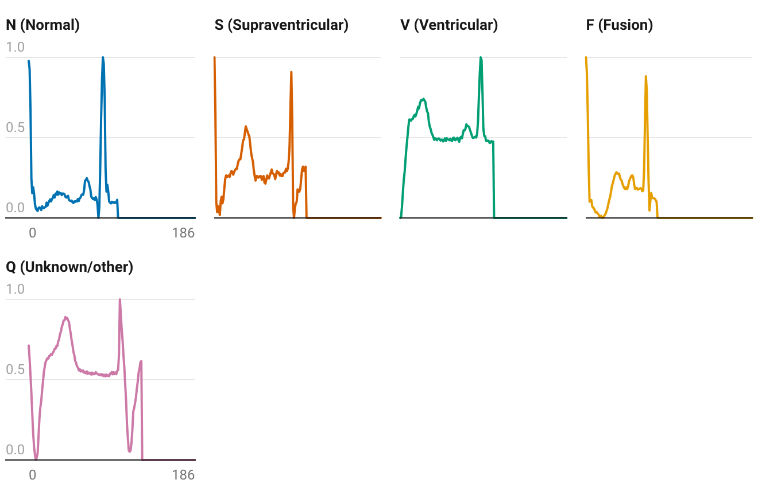
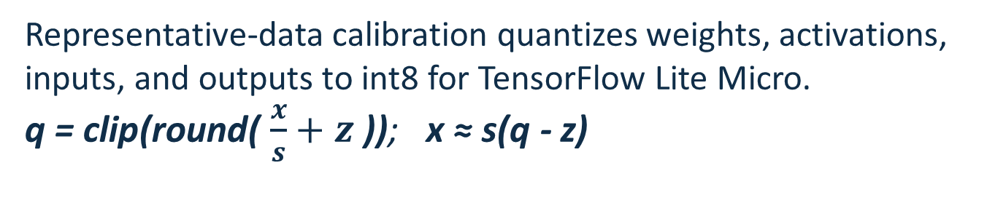
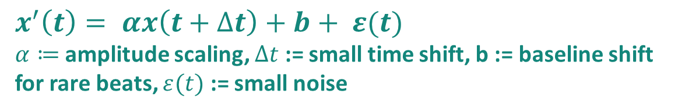
Tiny ECG Classification on ESP32
A 23 KiB full-int8 CNN with 95.1% test accuracy and 52.09 ms ESP32 inference
Aleksandar Toslev | Luka Zotovikj
FROM-SCRATCH CNN / TFLITE MICRO
Heidelberg University | Beginner's Practical Neural Networks from Scratch | 2026
Project Goal 🎯
Develop a 1D CNN from scratch in NumPy to accurately classify different heartbeat types, apply INT8 quantization to reduce the model size, and optimize it for efficient deployment on an ESP32.
95.12%
73.9%
52.09 ms
INT8 TEST ACCURACY
SMALLER MODEL
ESP32 MEAN INFERENCE / BEAT
1. Heartbeat data are highly imbalanced
2. Compact CNN, explicit imbalance controls
3. Full-int8 compression keeps model quality
Five heartbeat types must be separated from 187-point ECG segments. Normal beats dominate training, so overall accuracy alone can hide minority-class failure.
The complete forward pass, backward pass, weighted loss, and Adam updates are implemented in NumPy. Keras is used only as an export bridge.
Representative-data calibration quantizes weights, activations, inputs, and outputs to int8 for TensorFlow Lite Micro.
q = clip(round( $\frac{x}{s}+z \text{))}$; x ≈ s(q - z)
Representative normalized beats
11,173 trainable parameters
Model Size
187 x 1 ECG beat
normalized heartbeat segment
Three convolution blocks
16 (k=7) -> 32 (k=5) -> 64 (k=3)
Global average pooling
small representation, no large flatten layer
Stored 0-1 amplitudes; flat tails are zero-padding. One real training sample per class.
Source: PhysioNet MIT-BIH; Kachuee et al. (2018).
Dense 32 + dropout
-73.9% size | -0.14 percentage points accuracy
compact nonlinear classifier
INT8 normalized confusion matrix
Training class distribution
Five-class softmax
N / S / V / F / Q
N
N
S
V
F
Q
Three complementary strategies
0.96
0.01
0.02
0.01
0.00
1
Capped class-weighted loss
S
0.37
0.56
0.04
0.01
0.01
$w_{c}$ = min(4,$\frac{N}{5n_{c}}$) limits minority gradients.
V
0.02
0.00
0.95
0.02
0.00
Rare errors matter without unstable minority gradients.
F
0.10
0.00
0.09
0.81
0.00
2
Morphology-preserving augmentation
$x^{′}\left(t\right)= αx\left(t+∆t\right)+b+ ε(t)$
$α≔$ amplitude scaling, $∆t$ := small time shift, b := baseline shift for rare beats, $ε(t)$ := small noise
Q
0.02
0.00
0.01
0.00
0.97
F has 113x fewer training beats than N.
Noise and small shifts preserve the ECG beat shape.
Stable convergence without clear overfitting
3
Tested sampler: keep shuffle
Predicted class
Weighted and balanced mini-batches overcorrected.
Class S remains hardest: 37% are confused with normal beats.
Natural shuffle retained 95.3% test accuracy.
Deployment path
Quantization preserves per-class F1
Float32 CNN
Full INT8 TFLite
ESP32 + TFLM
90,361 B
23,576 B
52.09 ms / beat
80 KiB tensor arena | full-int8 input/output | real MIT-BIH beats
Prototype scope
Validated on stored test beats. Live ADC acquisition, heartbeat segmentation, patient-wise clinical validation, and confidence handling remain future work.
TAKEAWAY
Full-int8 quantization is the deployment sweet spot: 23 KiB, 95.1% accuracy, and 52.09 ms ESP32 inference.
MIT-BIH heartbeat classification | Academic prototype - not a medical device
Notes:
[Sources]
- Luka poster reference: C:/Users/alext/Documents/heidelberg/2Semester/AP_NN/ECG_Model_Compression_A0_Poster.pdf
- Dataset and class definitions: MIT-BIH Arrhythmia Database, PhysioNet, https://physionet.org/content/mitdb/
- Beat representation: Kachuee et al. (2018), ECG Heartbeat Classification, https://doi.org/10.1109/ICHI.2018.00092
- Final full-test metrics and model size: results/final_cap4_comparison/baseline_vs_int8_summary.md
- ESP32 latency and hardware validation: results/esp32_final_cap_4/hardware_run_25_samples.md
- Representative-beat image: output/pdf/8QmZg-representative-model-inputs-one-real-187-sample-beat-per-class-.png
[/Sources]

