Slide 1
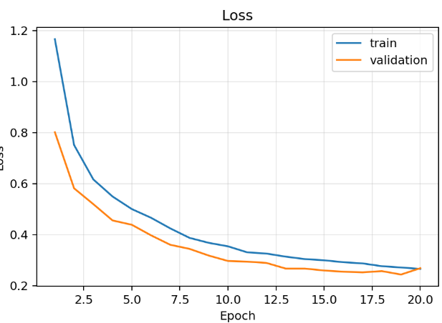
Tiny ECG Classification on ESP32
A 73.9% smaller full-int8 CNN with 95.1% test accuracy
Aleksandar Toslev | Luka Zotovikj
FROM-SCRATCH CNN / TFLITE MICRO
Heidelberg University | Beginner's Practical Neural Networks from Scratch | 2026
Project Goal Develop a 1D CNN from scratch in NumPy to accurately classify different heartbeat types, apply INT8 q quantization to reduce the model size, and optimize it for efficient deployment on an ESP32.
Project Goal
95.12%
73.9%
52 ms
INT8 TEST ACCURACY
SMALLER MODEL
ESP32 INFERENCE / BEAT
1. Heartbeat data are highly imbalanced
2. Compact CNN, explicit imbalance controls
3. Full-int8 compression keeps model quality
Five heartbeat types must be separated from 187-point ECG segments. Normal beats dominate training, so overall accuracy alone can hide minority-class failure.
The complete forward pass, backward pass, weighted loss, and Adam updates are implemented in NumPy. Keras is used only as an export bridge.
Representative-data calibration quantizes weights, activations, inputs, and outputs to int8 for TensorFlow Lite Micro.
Representative normalized beats
11,173 trainable parameters
Model Size
N Normal
187 x 1 ECG beat
normalized heartbeat segment
S Supraventricular
Three convolution blocks
V Ventricular
16 (k=7) -> 32 (k=5) -> 64 (k=3)
Global average pooling
F Fusion
small representation, no large flatten layer
Q Unknown
Dense 32 + dropout
compact nonlinear classifier
-73.9% size | -0.14 percentage points accuracy
Five-class softmax
INT8 normalized confusion matrix
Training class distribution
N / S / V / F / Q
N
S
V
F
Q
Three complementary strategies
N
0.96
0.01
0.02
0.01
0.00
1
Capped class-weighted loss
S
0.37
0.56
0.04
0.01
0.01
Inverse-frequency penalties, capped at 4 to avoid unstable minority gradients.
0.02
0.00
0.95
0.02
0.00
2
Mild rare-class augmentation
V
Noise, amplitude scaling, baseline shift, and small time shifts preserve beat shape.
F
0.10
0.00
0.09
0.81
0.00
3
Sampling controls
0.02
0.00
0.01
0.00
0.97
Natural shuffle, inverse-frequency weighted sampling, or balanced mini-batches.
Q
Class F has 113x fewer examples than class N.
Predicted class
Quantization preserves per-class F1
Class S remains hardest: 37% are confused with normal beats.
Stable convergence without clear overfitting
Deployment path
Float32 CNN
Full INT8 TFLite
ESP32 + TFLM
90,361 B
23,576 B
52 ms / beat
80 KiB tensor arena | full-int8 input/output | real MIT-BIH beats
Prototype scope
Validated on stored test beats. Live ADC acquisition, heartbeat segmentation, patient-wise clinical validation, and confidence handling remain future work.
TAKEAWAY
Full-int8 quantization is the deployment sweet spot: 23 KiB, 95.1% accuracy, and real-time ESP32 inference.
github.com/alexToslev/ecg-model-compression
MIT-BIH heartbeat classification | Academic prototype - not a medical device
Notes:
[Sources]
- C:/Users/alext/Documents/heidelberg/2Semester/ecg-model-compression/results/final_cap4_comparison/baseline_vs_int8_summary.csv - final float32 and int8 accuracy, loss, macro metrics, model size, tensor arena, and ESP32 latency.
- C:/Users/alext/Documents/heidelberg/2Semester/ecg-model-compression/results/final_cap4_comparison/comparison_plots/baseline_vs_int8_per_class_f1.png - final per-class F1 values used to recreate an editable chart.
- C:/Users/alext/Documents/heidelberg/2Semester/ecg-model-compression/results/final_cap4_comparison/quantized_plots/int8_confusion_matrix_normalized.png - normalized final int8 confusion values used to recreate an editable matrix.
- C:/Users/alext/Documents/heidelberg/2Semester/ecg-model-compression/results/improved_cnn_scratch/metrics.json - training class counts, final architecture, parameter count, and augmentation configuration.
- C:/Users/alext/Documents/heidelberg/2Semester/ecg-model-compression/src/models/cnn1d.py - from-scratch CNN architecture and weighted softmax-cross-entropy implementation.
- C:/Users/alext/Documents/heidelberg/2Semester/ecg-model-compression/src/train_cnn.py - capped balanced class weights, rare-class augmentation, and shuffle/weighted/balanced sampling implementations.
- C:/Users/alext/Documents/heidelberg/2Semester/ecg-model-compression/src/compression/quantize_tflite.py - full-integer TensorFlow Lite conversion and representative-dataset calibration.
- C:/Users/alext/Documents/heidelberg/2Semester/AP_NN/ecg-classification/ecg-classification/main/main_functions.cc - ESP32 TensorFlow Lite Micro tensor arena, inference, timing, and output handling.
- C:/Users/alext/Documents/heidelberg/2Semester/ecg-model-compression/data/processed/mitbih_test.csv - local ECG beat segments used only to render representative editable signal charts.
[/Sources]

