Slide 1
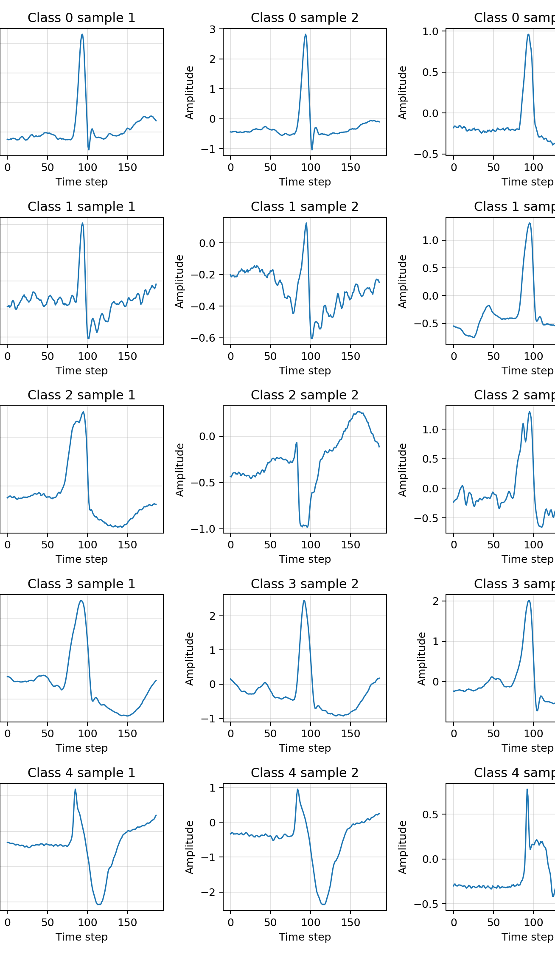
MIDTERM UPDATE
1D CNN Improvements for MIT-BIH Heartbeat Classification
Current focus: improve the 1D CNN under class imbalance, keep quantization ready, and plan realistic ESP32 feasibility checks.
11.9 KB
87.0%
23.8%
quantized model size
best rare-class direction
current limitation
small enough for first feasibility tests
class 3 recall after weighting/augmentation
class 1 precision remains low
Assistants meeting | 10 min presentation + 10 min Q&A
Notes:
I will give a short update on where the project is now.
The main story is: the CNN pipeline works, but rare classes are still difficult.
ESP32 is not presented as finished deployment; it is planned feasibility work.

Slide 2
ECG MODEL COMPRESSION MIDTERM UPDATE
1-slide topic overview
Input and task
Model goal
- MIT-BIH heartbeat CSV data: 187 signal values + class label per heartbeat.
- Five labels: 0=N normal, 1=S supraventricular, 2=V ventricular, 3=F fusion, 4=Q unknown/paced/other.
- Main challenge: very strong class imbalance, especially classes 1 and 3.
- Train a compact 1D CNN for heartbeat classification.
- Compare baseline, improved Keras, and from-scratch CNN behavior.
- Keep the model simple enough to quantize and later test on ESP32.
metric focus: per-class recall + precision, not only accuracy
later hardware focus: size, RAM, latency
MIT-BIH heartbeat classification | 1D CNN | quantization | ESP32-WROOM-32
Notes:
Each heartbeat is a short one-dimensional signal.
Accuracy alone is dangerous here because normal beats dominate the data.
So I focus on per-class metrics, especially classes 1 and 3.

Slide 3
ECG MODEL COMPRESSION MIDTERM UPDATE
What has been done so far
1
Baseline data pipeline
Load processed MIT-BIH CSVs, train/test split handling, metrics + reports.
2
Manual/from-scratch CNN
Forward/backward passes for Conv1D, ReLU, pooling, dense, loss, and updates.
3
Quantization workflow
Export Keras-compatible model, convert to int8 TFLite, evaluate int8 accuracy and size.
4
ESP32 setup started
Board connection and simple sketches/quantization path checked; full model deployment is planned work.
5
Imbalance experiments
Class weights, rare-class augmentation, smaller improved CNN structure, macro-F1 reporting.
MIT-BIH heartbeat classification | 1D CNN | quantization | ESP32-WROOM-32
Notes:
This is the project pipeline so far.
The code now covers training, evaluation, quantization, and early hardware preparation.
The newest work is about improving the CNN behavior on rare classes.

Slide 4
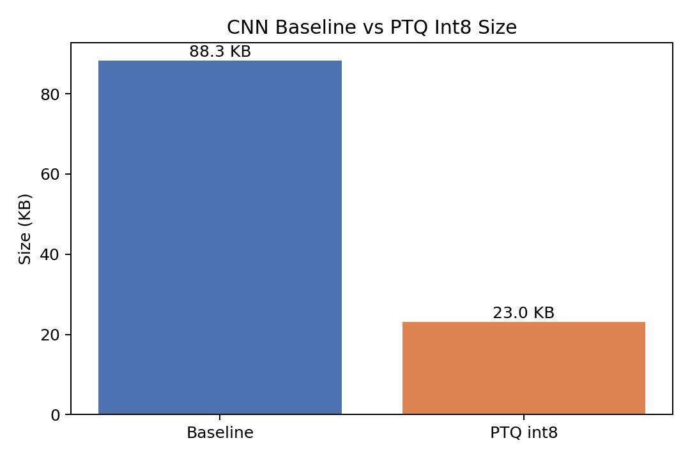
ECG MODEL COMPRESSION MIDTERM UPDATE
What worked well
87.5%
90.9%
87.9%
23.0 KB
baseline test accuracy
improved Keras accuracy
improved scratch int8
int8 size
from-scratch baseline, but imbalanced
macro F1 improved strongly
int8 did not hurt accuracy
about 74% smaller than Keras export
Takeaway
- The CNN training and evaluation loop is reproducible.
- Quantization seems feasible and does not destroy accuracy on this run.
- The model size suggests ESP32 testing is realistic, but still needs careful memory/latency checks.
MIT-BIH heartbeat classification | 1D CNN | quantization | ESP32-WROOM-32
Notes:
The good news is that quantization is not causing a big accuracy drop.
The compressed model is much smaller.
So the next question is not only size, but whether the CNN predicts all classes well enough.

Slide 5
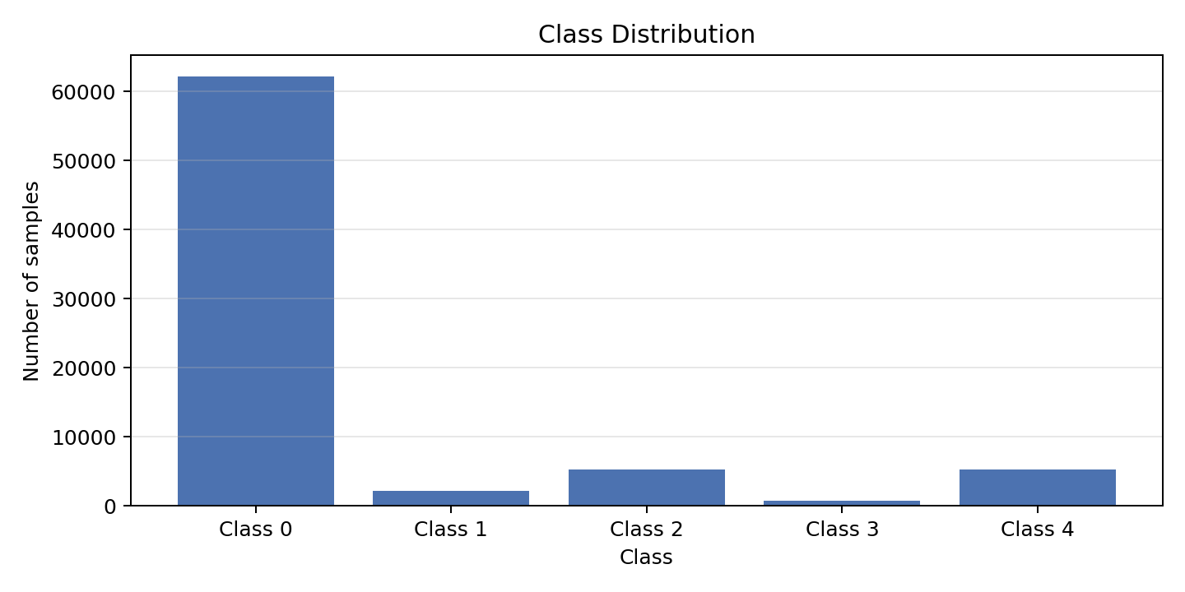
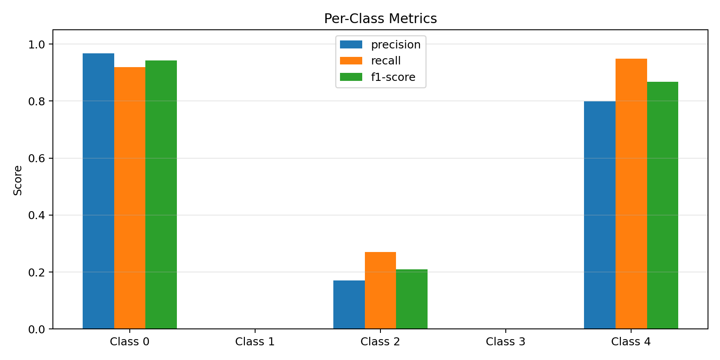
ECG MODEL COMPRESSION MIDTERM UPDATE
What did not work well: class imbalance
Baseline symptom
- Overall accuracy: 87.5% looks acceptable.
- Class 1 recall: 0.0%; class 3 recall: 0.0%.
- Conclusion: accuracy alone hides clinically important rare-class failures.
MIT-BIH heartbeat classification | 1D CNN | quantization | ESP32-WROOM-32
Notes:
This is the main problem in the project.
The model can look good overall while ignoring rare classes.
That is why we need confusion matrices and per-class metrics.

Slide 6
ECG MODEL COMPRESSION MIDTERM UPDATE
Improvement experiment: weights + augmentation
Changes made
- Class-weighted softmax cross entropy: mistakes on rare classes cost more.
- Rare-class augmentation only for minority classes: small noise, shift, scaling, baseline drift.
- Smaller improved CNN: Conv1D blocks + global average pooling + dropout + dense head.
- Macro F1 added because it treats all classes more equally than accuracy.
Rare-class recall improved clearly, but this creates more false positives.
class 3 weight capped at 10x
augmented class 3: +1455 samples
scratch training time: 73 min
MIT-BIH heartbeat classification | 1D CNN | quantization | ESP32-WROOM-32
Notes:
Here we tried to force the model to pay attention to rare classes.
This helped recall a lot.
But the tradeoff is more false positives, especially normal beats predicted as rare classes.

Slide 7
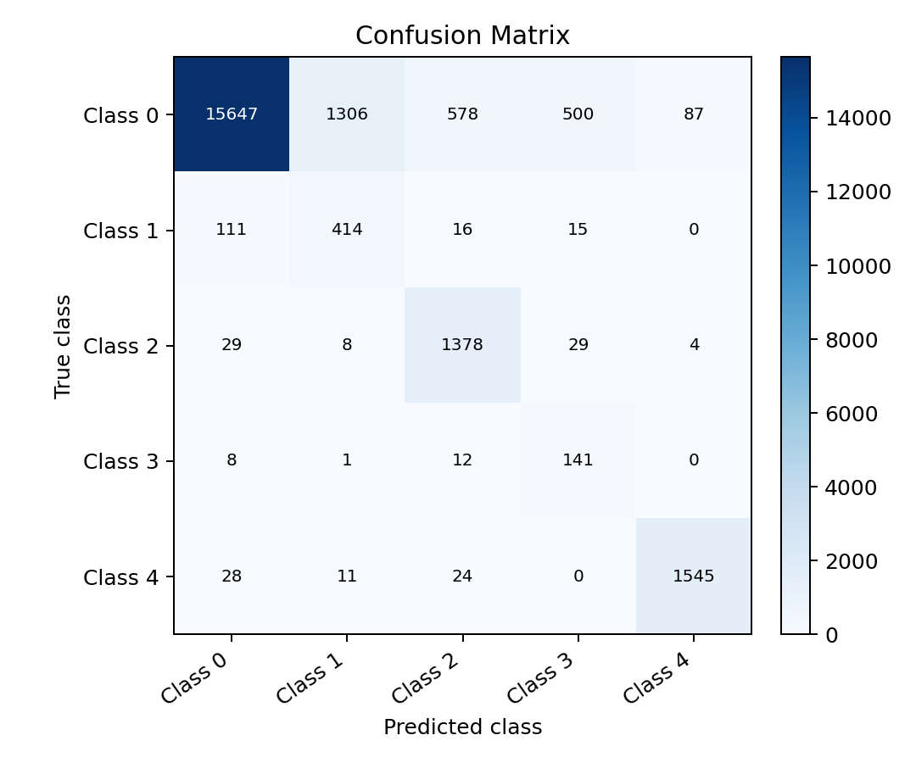
ECG MODEL COMPRESSION MIDTERM UPDATE
Current result and remaining problem
What improved
- Class 1 recall reached 74.5%.
- Class 3 recall reached 87.0%.
- Macro recall is now 87.8%.
What is still weak
- Class 1 precision is only 23.8%.
- Class 3 precision is only 20.6%.
- Many normal beats are now predicted as rare abnormal classes.
Interpretation: the model became more sensitive to rare classes, but less specific. The next tuning step is to find a better balance.
MIT-BIH heartbeat classification | 1D CNN | quantization | ESP32-WROOM-32
Notes:
This slide is the honest result.
We solved one side of the problem: rare classes are detected more often.
But now we must reduce false alarms, otherwise the model is not practically useful.

Slide 8
ECG MODEL COMPRESSION MIDTERM UPDATE
ESP32 feasibility: planned work, not final deployment
Current hardware status
11.9 KB
latency
- ESP32-WROOM-32 board connection and simple sketches were checked.
- Quantized model export exists and is small enough for first experiments.
- Next step is a controlled TinyML test with a selected CNN candidate.
small int8 model
target to measure
candidate size for feasibility
must be tested reliably
RAM
fit check
target to measure
planned analysis
arena/free heap budget
estimate ops + arena before testing
Meaning
- ESP32 testing should not be presented as finished deployment yet.
- We first need to estimate model size, tensor arena/RAM, and runtime for the chosen CNN.
- Then upload the trained int8 model and read predictions from the serial monitor.
MIT-BIH heartbeat classification | 1D CNN | quantization | ESP32-WROOM-32
Notes:
I want to be careful with wording here: this is not finished ESP32 deployment.
The ESP32 will not train the model. It only runs inference with an already trained quantized model.
Next we need to calculate and test whether the chosen CNN fits in memory and runs fast enough.

Slide 9
ECG MODEL COMPRESSION MIDTERM UPDATE
Next planned steps and open questions
Next steps
Open questions for Q&A
- Tune class-weight cap and augmentation amount to reduce false positives.
- Add weighted sampling: draw rare-class examples more often during training.
- Compare candidates fairly: tiny quantized CNN, improved Keras CNN, improved from-scratch CNN.
- Estimate ESP32 fit: model size, tensor arena/RAM, latency, supported operators.
- Which metric should be primary: overall accuracy, macro F1, rare-class recall, or false-alarm rate?
- How much loss of normal-class precision is acceptable when improving rare-class recall?
- Should we stay strictly with MIT-BIH CSVs or include another dataset only for comparison?
- What ESP32 latency/memory target would be considered good enough for this project?
Main message: the CNN can be improved, but the key challenge is balancing rare-class detection against false alarms.
MIT-BIH heartbeat classification | 1D CNN | quantization | ESP32-WROOM-32
Notes:
For the next work package, I would tune the data imbalance strategies first.
Weighted sampling is another way to make rare classes appear more often during training.
After choosing the best CNN, I would quantize it and do a careful ESP32 fit test.

