Slide 1
Emotional and Behavioral Disorders in the Community College Classroom
Brian Bird
GCC Math Faculty
Summer 2019

Slide 2
IDEA, Section 504 and ADA
IDEA (The Individuals with Disabilities Education Act) is a federal law that governs early intervention, special education and related services for disabled students ages 3-21 (or until HS graduation). Individual Education Plans (IEP) are required.
Section 504 of the Rehabilitation Act of 1973 is a federal law that protects individuals from discrimination based on their disability in connection with any public or private program or activity receiving federal financial assistance. Postsecondary students must be granted the opportunity to compete with their non-disabled peers.

Slide 3
IDEA, Section 504 and ADA
The ADA (The Americans with Disabilities Act of 1990) is a federal civil rights law designed to provide equal opportunity for qualified individuals with disabilities. It prohibits discrimination on the basis of a qualified disability and ensures students can have equal access and opportunity for participation in programs, services and activities.
IDEA is a law of entitlement guaranteeing success.
ADA/Section 504 is a civil rights law guaranteeing access.

Slide 4
IDEA Eligibility
Federal law requires schools to provide special education services to eligible students. 13 conditions are covered by IDEA.
1. Specific learning disability (SLD)
Affects a child’s ability to read, write, listen, speak, reason or do math. Some of the conditions are: dyslexia, dysgraphia, dyscalculia, auditory processing disorder, and nonverbal learning disability.
2. Other health impairment
An umbrella term that covers conditions that limit a child’s strength, energy or alertness like ADHD.
3. Autism spectrum disorder (ASD)
Developmental disability that has a wide range of symptoms and skills. Mainly affects social and communication skills, but can also affect behavior.

Slide 5
IDEA’s Eligibility (continued)
4. Emotional disturbance
Disorders such as anxiety disorder, schizophrenia, bipolar disorder, obsessive-compulsive disorder and depression.
5. Speech or language impairment
Covers a number of communication problems such as stuttering, impaired articulation, language impairment or voice impairment.
6. Visual impairment, including blindness
A child who has vision problems is considered to have a visual impairment. This condition includes both partial sight and blindness. If eyewear can correct a vision problem, then it doesn’t qualify.
7. Deafness
Children with a diagnosis of deafness have a severe hearing impairment. They aren’t able to process language through hearing.
8. Hearing impairment
Hearing loss not covered by the definition of deafness. This type of loss can change or fluctuate over time.

Slide 6
IDEA Eligibility (continued)
9. Deaf-blindness
Both hearing and visual impairments. Their communication and other needs are so great that programs for the deaf or blind can’t meet them.
10. Orthopedic impairment
Any impairment to a child’s body is considered an orthopedic impairment.
11. Intellectual disability
Below-average intellectual ability. They may also have poor communication, self-care and social skills. Down syndrome is one example of an intellectual disability.
12. Traumatic brain injury
Caused by an accident or some kind of physical force.
13. Multiple disabilities
Creates educational needs that can’t be met in a program for any one condition.

Slide 7
ADA Eligibility
There is not an exclusive list of conditions. Rather, an individual with a disability is someone who has "a physical or mental impairment that substantially limits one or more major life activities; has a record of such an impairment; or is regarded as having such an impairment." The regulations define "physical or mental impairment" as any physiological disorder or condition, cosmetic disfigurement, or anatomical loss affecting one or more body systems, such as neurological, musculoskeletal, special sense organs, respiratory (including speech organs), cardiovascular, reproductive, digestive, genitourinary, immune, circulatory, hemic, lymphatic, skin, and endocrine. The regulations also cover any mental or psychological disorder, such as intellectual disability (formerly termed mental retardation), organic brain syndrome, emotional or mental illness and specific learning disabilities.

Slide 8
Disabled or Not Disabled???
Who cares!
Instead focus on the accommodation requested, whether it is reasonable, whether it can be provided without an undue hardship, and whether other accommodations can be considered.

Slide 9
Emotional Disturbances
An emotion disturbance is a condition that has one or more of the following characteristics over time that adversely affects learning.
Inability to learn that can't be explained by intellectual, sensory or health factors
Inability to have healthy relationships with peers and teachers
Inappropriate behavior or feelings
Habitual depression or unhappiness
Tendency to develop fears or physical symptoms associated with personal/educational problems

Slide 10
Emotional Disturbances Characteristics
Hyperactivity (short attention span, impulsive behavior)
Aggression or self-hurting (acting out, fighting)
Withdrawal (fear, anxiety, not interacting)
Immaturity (crying, temper tantrums, poor coping mechanisms)
Learning difficulties (performing below grade level)
Note that there are many terms related to emotional disturbances such as emotional and behavior disorders (EBD), emotional conflict (EC), and serious emotional disturbance (SED)

Slide 11
Emotional Disturbances Causes
Biological
Illness, disability, brain damage, genetics, malnutrition
Family
Divorce or separation, discipline that is unhealthy or inconsistent, poor attitude towards education, coercion/force/pressure from parents
School
Intimidation from teacher, fear of failure, embarrassing moment

Slide 12

Teaching Strategies – Physical Classroom
Be cognizant of lights and sounds
Allow the use of gum, stress balls, or silly putty
Place distracted students in front (left-handed in front right and right-handed in front left).
Allow PTSD (post-traumatic stress disorder) students to sit in back and/or near door (nothing behind and easy exit)

Slide 13

Teaching Strategies – Lecture
Keep it simple, follow a pattern, and teach at an appropriate level
Pause during lecture to allow for mental breaks
Give short physical breaks
Don’t single out students but don’t leave them out either
“It’s better to be bad than stupid”
Utilize group responses
Consider using yellow stickies or notes to check in with students while walking around the classroom

Slide 14

Teaching Strategies – Testing
Quiet space (DRS, Testing Center, your office)
Consider alternative testing (1-on-1 oral exams, portfolios, projects, etc.)
Allow headphones (noise cancelling or music)
Use white noise machines

Slide 15

Teaching Strategies – Behavior Modification
Sincere praise
Negative feedback only in private
Follow rules consistently
Refer to counseling (walk the student over or call from your office to schedule appointment) then follow-up with student
Sometimes the squeaky wheel needs the grease. Look for students seeking attention.

Slide 16
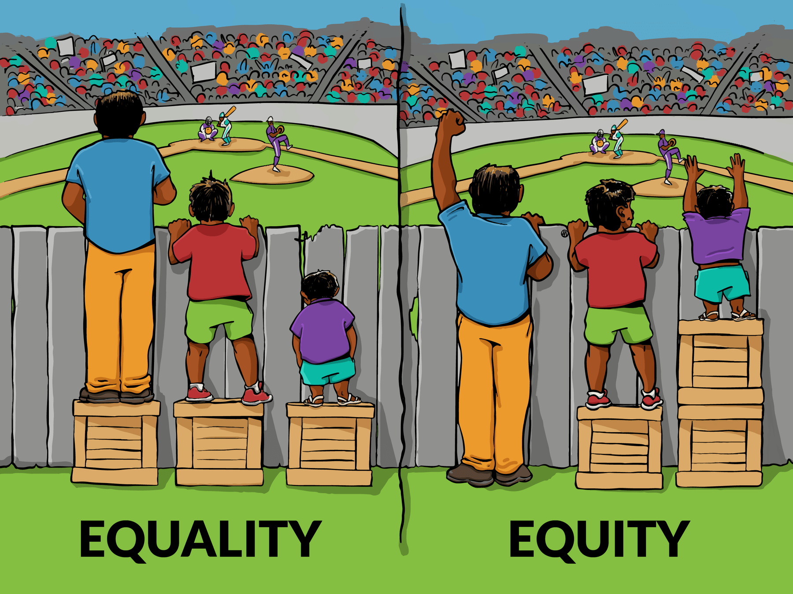
Final Quote
“There is nothing more unequal than
the equal treatment of unequal people.”
Perhaps Thomas Jefferson paraphrasing Aristotle

Slide 17
References
https://sites.ed.gov/idea/
https://disabilities.uchicago.edu/idea-ada-and-section-504
http://community.cec.sped.org/ccbd/about/ebddefintion
https://www.nsta.org/disabilities/behavioral.aspx
https://www.gccaz.edu/counseling/get-counseling
https://www.gccaz.edu/disability-services/disability-forms

