Slide 1
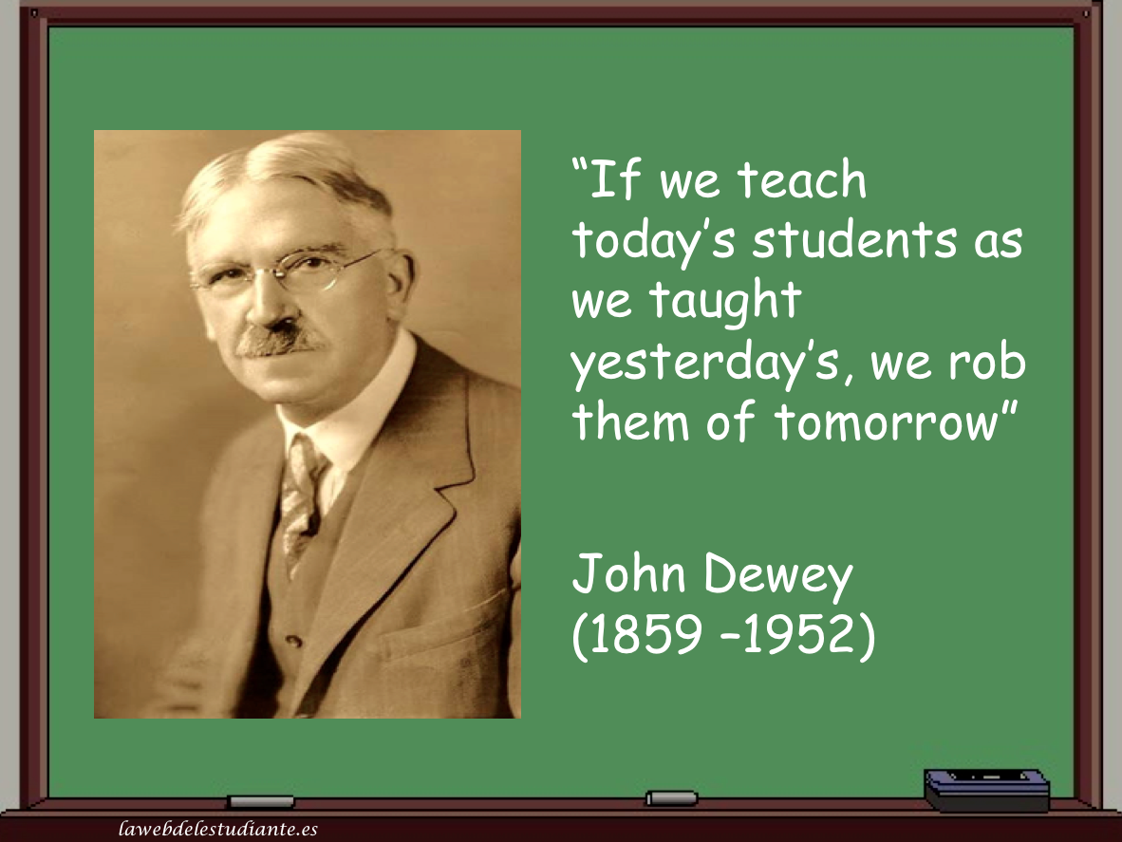
Who was John Dewey and what can he teach us 100 years later?
Brian Bird
GCC Math Faculty
Spring 2018

Slide 2
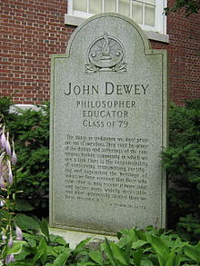
John Dewey Biographical
Born: 1859 in Vermont
Died: 1952 (age 92) in New York
Alma Matter: University of Vermont and Johns Hopkins University
Educator: 2 years high school and 1 year elementary school
University of Michigan, University of Chicago, and Columbia University

Slide 3
Dewey’s Big Thoughts
Democracy, democracy, democracy
Defined critical thinking as reflective thought
Active Learning
Experiential Learning
Balance of teacher and student

Slide 4
Democracy
Huge proponent of democracy
Schools should be an “embryonic community”
The school’s function is to prepare students to become citizens
Students should learn skills to help them contribute to society

Slide 5
Critical Thinking
Reflective thought
Suspend judgement
Maintain a healthy skepticism
Exercise an open mind
Requires an active, persistent and careful consideration of any belief in light of the ground that supports it
Intellectual and emotional components
Connection to Carl Sagan and “The Fine Art of Baloney Detection” written in 1995

Slide 6
Active Learning
Learning must be active (against rote learning)
Students must be invested
Connection to Piaget and Bruner
Discovery learning
Learn by doing
Learn by actively exploring the environment

Slide 7
Experiential Learning
Students should be involved in real life tasks and challenges
Activities should be relevant to students’ lives
Development of practical life skills
Harbinger for “experiential education”, “problem-based learning” and “inquiry based learning”

Slide 8
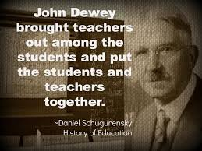
Balance of Teacher and Student
Schooling is unnecessarily long and restrictive
Against authoritarianism
Against behaviorist theory (too simplistic)
Teachers are not just instructors, rather they are guides and facilitators
A teacher’s function is to provide opportunities for students to discover for themselves (ala Bruner)
Need to link new with previous experiences and knowledge
Vygotsky’s ZPD (Zone of Proximal Development)
Ausubel’s Advance Organizer and Prior Knowledge

Slide 9
Summary
One of the greatest education thinkers of all time
“Big picture” learning theory that tied into democracy
Predates and includes some of the best parts of the Cognitive Learning Theory of Vygotsky, Piaget, Bruner and Ausubel
One of the earliest reformers and promoted learning strategies such as Discovery Learning, Experiential Learning, Problem Based Learning, and Inquiry Based Learning long before we coined those labels
Published more than 700 articles in 140 journals, and approximately 40 books

Slide 10
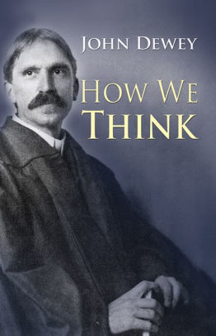
Suggested Reading How We Think by John Dewey
References
http://www2.gsu.edu/~dschjb/wwwcrit.html
https://en.wikipedia.org/wiki/John_Dewey
http://www.pbs.org/onlyateacher/john.html
https://www.brainpickings.org/2014/08/18/how-we-think-john-dewey/
https://www.teachthought.com/learning/pedagogy-john-dewey-summary/
http://www.wilderdom.com/experiential/JohnDeweyPhilosophyEducation.html

