Slide 1
MBA · BUSINESS ANALYTICS
Predictive Lead Scoring &
Decision Support System
0.884
ROC-AUC SCORE
B2C Analytics Pipeline
Using Machine Learning
38.5% → 70%+
Presented By
Alex Abraham -25121007
PROJECTED CONVERSION LIFT
Program
MBA – Business Analytics
Champion Model: Random Forest Classifier
Notes:
The goal of this project is to help businesses identify which customers are most likely to convert before the sales team spends time contacting them.
Traditionally, companies rely on manual judgment and intuition to prioritise leads. This often leads to wasted effort and missed opportunities.
So, in this project, I developed a machine learning-based system that:
predicts conversion probability,
assigns lead scores,
and helps sales teams focus on high-value customers.

Slide 2
PROBLEM STATEMENT
Business Challenge
SALES FUNNEL WITHOUT DSS
Organizations generate thousands of leads daily with no systematic qualification.
Sales teams waste ~60% of effort on leads that will never convert.
10,000
Total Leads Generated
8,000
Lead prioritization relies on intuition, not predictive analytics.
Manual qualification is inefficient and unscalable.
Non-Converting (~80%)
2,000
Valuable HOT Leads
Objective:
Develop an ML-based DSS that predicts conversion probability, prioritizes leads mathematically, and reduces sales waste.
2 / 11
Notes:
Today, organizations generate thousands of customer leads every day through:
websites,
social media,
advertisements,
and campaigns.
However, most companies still do not have a scientific method to identify which leads are actually valuable.
As a result:
sales teams spend a large amount of time contacting customers who may never convert,
while potentially valuable customers may not receive enough attention.
Research and industry reports show that sales teams can waste nearly:
60% of their effort
on low-quality or non-converting leads.
Another issue is that lead prioritization is often based on:
intuition,
experience,
or manual judgement,
rather than predictive analytics.
This creates:
inefficiency,
poor scalability,
and inconsistent decision-making.
The funnel on the right visually represents this issue.
For example:
out of 10,000 generated leads,
around:
8,000 may never convert,
while only:
2,000 are actually valuable high-intent leads.
The objective of this project was to solve this inefficiency by building a machine learning-based Decision Support System that can mathematically predict which leads are most likely to convert.”

Slide 3
DATA FOUNDATION
Dataset Overview & Data Quality
9,240
37
38.5%
Binary
Records
Raw Features
Conv. Rate
Target Var.
Data Quality Assessment
Preprocessing Pipeline
Missing Values Treated: ~41% of columns had >5% nulls
High-Missing Columns Removed: 7 columns dropped (>40% null)
Features Engineered: 1 custom (Engagement Score)
Outlier Treatment: IQR clipping on 3 numeric features
Replaced 'Select' placeholders → NaN
Median imputation: numeric features
Mode imputation: categorical features
Binary + One-Hot Encoding applied
StandardScaler Z-score normalization
Key Feature Groups:
Behavioral (time, visits, pages)
Demographic (occupation, origin)
Interaction History (source, last activity)
Engineered (Engagement Score)
3 / 11
Notes:
WHAT YOU SAY DURING THE PRESENTATION
“ This slide explains the dataset used for the project and the preprocessing steps performed before training the machine learning models.
For this project, I used the:
X Education Lead Scoring Dataset.
The dataset contains:
9,240 customer lead records
and 37 raw features.
The overall historical conversion rate in the dataset was:
38.5%.
The target variable is binary, meaning:
1 represents a converted customer,
and 0 represents a non-converted customer.
The dataset included different categories of information such as:
customer behavior,
website activity,
interaction history,
and demographic information.
However, real-world business data is usually incomplete and inconsistent.
So, before training the model, extensive preprocessing was required.
The preprocessing steps included:
handling missing values,
removing low-quality columns,
treating outliers,
and converting categorical variables into numerical form.
For example:
the dataset contained many ‘Select’ placeholder values which do not carry real business meaning, so they were replaced with null values.
Missing numerical values were treated using:
median imputation,
while categorical variables used:
mode imputation.
I also applied:
Binary Encoding,
One-Hot Encoding,
and StandardScaler normalization
to prepare the data for machine learning.
Additionally, I engineered a custom feature called:
Engagement Score
which mathematically combines multiple customer engagement behaviors into one predictive metric.”
SHORTER VERSION (IF PRESENTATION TIME IS LIMITED)
“ This slide explains the dataset and preprocessing pipeline.
The dataset contained:
9,240 records
and 37 features.
Since real-world datasets contain missing and inconsistent values, preprocessing was essential.
I handled:
missing values,
encoding,
normalization,
and outlier treatment
before training the machine learning models.
I also created a custom Engagement Score to better capture customer behavior and intent.”
EXPLANATION OF EACH SECTION (VERY SIMPLE LANGUAGE)
1. RECORDS = 9,240
What You Say
“This means the dataset contains information about 9,240 customer leads.”
2. RAW FEATURES = 37
What You Say
“These are the original variables available in the dataset, such as:
website visits,
lead source,
occupation,
and time spent on the website.”
3. CONVERSION RATE = 38.5%
What You Say
“This means approximately 38.5% of customers in the dataset eventually converted into buyers.”
4. TARGET VARIABLE = BINARY
What You Say
“The prediction output has only two possible outcomes:
converted,
or not converted.”
5. MISSING VALUE TREATMENT
What You Say
“Some customer records had incomplete information.
So I used statistical methods to intelligently fill missing values instead of removing all records.”
6. MEDIAN IMPUTATION
What You Say
“For numerical variables, I used the median value because it is less affected by extreme outliers.”
7. MODE IMPUTATION
What You Say
“For categorical variables, I replaced missing values using the most frequently occurring category.”
8. ONE-HOT ENCODING
What You Say
“Machine learning models cannot directly understand text categories.
So categories like:
Google,
Facebook,
or Direct Traffic
were converted into numerical columns.”
9. STANDARDSCALER NORMALIZATION
What You Say
“Normalization ensures all numerical variables operate on a similar scale so that no single feature dominates the model unfairly.”
10. IQR OUTLIER TREATMENT
What You Say
“IQR clipping helps reduce the impact of extremely abnormal values.
For example:
if someone accidentally leaves the website open overnight,
that unusually large time value should not distort the model.”
11. ENGAGEMENT SCORE
What You Say
“I created a custom Engagement Score by combining:
website time,
visits,
and page views
because customer intent is better captured using combined behavioral activity rather than isolated variables.”

Slide 4
METHODOLOGY
Framework & Feature Engineering
📥
🧹
🔢
⚙️
🌲
📊
Data
Collection
Cleaning &
Imputation
Encoding &
Scaling
Feature
Engineering
RF Model
Training
DSS
Output
Custom Feature: Engagement Score
Technical Methods
EngagementScore = 0.45(T₀) + 0.35(V₀) + 0.20(P₀)
Binary Encoding
One-Hot Encoding
StandardScaler
MinMaxScaler
70/30 Stratified Split
Class Weight Balancing
T₀ = Normalised Total Time Spent on Website [Weight: 45%]
V₀ = Normalised Total Visits [Weight: 35%]
P₀ = Normalised Page Views per Visit [Weight: 20%]
MinMaxScaler applied before aggregation → score ∈ [0, 1]
4 / 11
Notes:
“Project Methodology”
WHAT YOU SAY DURING THE PRESENTATION
“ This slide explains the overall workflow of the project and how the machine learning pipeline was built.
The process starts with:
Data Collection
where the raw lead dataset was imported into Python.
Next comes:
Cleaning and Imputation
where missing values, inconsistent entries, and low-quality data were treated.
After cleaning, the data was transformed using:
Encoding and Scaling
because machine learning algorithms cannot directly understand text-based categories.
Then comes:
Feature Engineering
which is one of the most important stages of the project.
Here, I created a custom feature called:
Engagement Score.
This score mathematically combines:
total website time,
number of visits,
and page views per visit
into a single behavioral metric.
The reason for creating this score is that customer intent is better captured through combined engagement behavior rather than isolated variables.
Higher engagement generally indicates higher purchase intent.
After feature engineering, the dataset was divided into:
training data
and
testing data.
I used:
70% training data
and 30% testing data.
The training dataset was used to teach the model historical customer behavior patterns, while the testing dataset was used to evaluate how well the model performs on completely unseen customer data.
I also applied:
Stratified Sampling
to ensure both datasets maintained similar conversion ratios.
After the Train-Test Split, the processed data was used for:
Random Forest model training.
Finally, the trained model generates:
DSS outputs
such as:
lead scores,
lead categories,
and business recommendations.”
UPDATED PIPELINE FLOW (IMPORTANT)
Your framework flow should now be:
Data Collection
↓
Cleaning & Imputation
↓
Encoding & Scaling
↓
Feature Engineering
↓
Train-Test Split
↓
RF Model Training
↓
DSS Output
SIMPLE SHORT VERSION (IF TIME IS LIMITED)
“This slide explains the complete machine learning workflow.
The project follows:
data cleaning,
preprocessing,
feature engineering,
Train-Test Split,
model training,
and DSS generation.
The most important engineered feature was the Engagement Score, which combines customer engagement behavior into one predictive metric.”
SIMPLE LAYMAN EXPLANATION OF TRAIN-TEST SPLIT
“The model first studies historical customer behavior using one portion of the dataset, and then its prediction accuracy is tested on completely new unseen customer data.”
WHY TRAIN-TEST SPLIT IS IMPORTANT
Without Train-Test Split:
the model may memorize the dataset
instead of learning generalized customer behavior patterns

Slide 5
TECHNOLOGY STACK
Libraries, Tools & ML Framework
pandas
seaborn
ML Models & Outputs
Preprocessing & cleansing large customer lead datasets
Statistical visualization of conversion patterns
Logistic Regression (Baseline)
Random Forest Classifier (Champion, 300 trees)
ROC Curves & AUC Comparison
Confusion Matrix + Classification Report
Feature Importance Rankings
Model Serialization via Joblib
Interactive DSS Dashboard (ipywidgets)
numpy
joblib
Numerical computation for feature engineering & scoring
Production model serialization & deployment pipeline
scikit-learn
ipywidgets
Predictive lead conversion modeling & evaluation
Real-time interactive DSS dashboard for sales teams
matplotlib
Business performance visualization (ROC, importance charts)
Ensemble Learning
Stratified Sampling
Class Balancing
Production-Ready
5 / 11
Notes:
1. Pandas
What to say (Your Presentation Script): "Pandas is the backbone of our data manipulation. Think of it as a highly advanced, automated version of Excel. I used it to load the raw CSV files, clean the missing values, create new columns like our Engagement Score, and format the data perfectly before feeding it to the AI."
Viva Defense Answer:
Q: Why use Pandas instead of just cleaning the data in Excel?
A: "Scalability and automation. If we get a new batch of 50,000 leads tomorrow, doing it in Excel requires manual work and risks human error. With Pandas, the cleaning pipeline is coded; I just run the script and it processes millions of rows instantly and identically every time."
2. NumPy (Numerical Python)
What to say: "NumPy is the mathematical engine of the project. While Pandas handles the rows and columns, NumPy performs the heavy mathematical calculations behind the scenes, specifically when we needed to apply custom weights to our features to calculate the normalized Engagement Score."
Viva Defense Answer:
Q: Where exactly did you use NumPy in your pipeline?
A: "I used NumPy arrays when calculating the Engagement Score. It allowed me to take the user's web time, visits, and page views, mathematically clip them to a maximum threshold, and multiply them by our custom weights (e.g., 0.45 for time, 0.35 for visits) in a fraction of a second."
3. Scikit-Learn (sklearn)
What to say: "Scikit-Learn is the actual Machine Learning brain of the project. I used this library to do three critical things: standardize the data so large numbers didn't overpower small numbers, train the Random Forest and Logistic Regression algorithms, and finally, generate the mathematical scores to prove how accurate the models were."
Viva Defense Answer:
Q: Scikit-Learn has many modules. Which specific ones were the most critical for your project?
A: "The most critical were train_test_split to prevent overfitting by hiding 30% of the data, the RandomForestClassifier which served as our champion model, and the metrics module which generated our ROC-AUC scores and Confusion Matrix to validate the business ROI."
4. Matplotlib & Seaborn
What to say: "Data science is only useful if business leaders can understand it. Matplotlib and Seaborn are visual analytics libraries. I used them to translate complex mathematical outputs into the clear, executive-friendly charts you see in the presentation, like the ROC Curve and the colored Confusion Matrix."
Viva Defense Answer:
Q: Why use both Matplotlib and Seaborn?
A: "Matplotlib is the foundational plotting library; it builds the basic structure of the charts. Seaborn is built on top of Matplotlib and is specifically designed for statistical graphics. I used Seaborn for the Confusion Matrix because it easily generates color-coded heatmaps, making it immediately obvious to a non-technical user where our True Positives and False Negatives lie."
5. Joblib
What to say: "Joblib is a serialization library, which is crucial for taking a model out of the lab and into the real world. Training the Random Forest takes significant computing power. Joblib allowed me to save that fully trained 'brain' as a file, so the sales dashboard can load it instantly without having to relearn the data every single time."
Viva Defense Answer:
Q: What happens if you don't use Joblib or a similar serialization tool?
A: "Without serialization, the Decision Support System would have to re-read the entire 9,240-row CSV and re-train the Random Forest algorithm every time a sales rep opened the dashboard. Joblib compresses the trained model into a lightweight .pkl file, dropping the scoring time down to milliseconds."
6. IPyWidgets
What to say: "IPyWidgets is the library I used to build the actual product—the interactive Decision Support System. It allowed me to create sliders, dropdown menus, and color-coded scorecards so that a sales rep with zero coding experience can easily input lead behaviors and get an instant business directive."
Viva Defense Answer:
Q: Why build a UI in Python instead of sending the data to a BI tool like Tableau?
A: "BI tools are great for looking at past data, but our sales reps need real-time predictive scoring for new, incoming leads. IPyWidgets allows the user interface to talk directly to the underlying Python machine learning model instantly, creating an active tool rather than just a passive dashboard."
7. Standard Libraries (JSON, OS, Time, Datetime)
What to say: "Finally, I used a few built-in Python libraries to handle the backend 'plumbing.' These libraries track the timestamps of when a lead was scored, save the session data to a JSON file so reps don't lose their work, and allow the system to export the day's Hot leads into a CSV file ready for CRM upload."
Viva Defense Answer:
Q: How is session data managed if the user closes the dashboard?
A: "I used the json library to actively write every scored lead into a local session_data.json file. If the system closes, the data persists. When the rep clicks 'Export CRM CSV', the os and time libraries generate a time-stamped Excel-ready file containing all the saved leads from that JSON state."

Slide 6
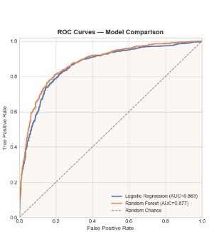
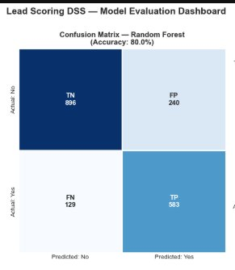
MODEL PERFORMANCE
Model Evaluation & Statistical Insights
0.884
80.0%
81.9%
Random Forest
ROC-AUC
Accuracy
Recall (Conv.)
Champion
ROC Curve — Model Comparison
Confusion Matrix — Random Forest
AUC 0.884: Excellent discriminatory power between converting and non-converting leads across all thresholds.
Recall 81.9%: High recall minimizes missed high-value customers — missing them is more costly than false positives.
6 / 11

Slide 7
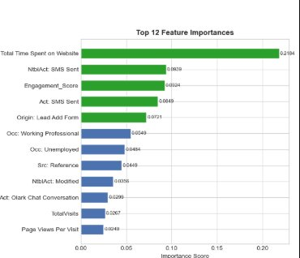
FEATURE ANALYSIS
Key Drivers of Conversion
#1 Predictor
Total Time on Website
Score: 0.2184 — dominant signal
SMS Activity
2nd strongest signal
Engagement via SMS = high intent
Engagement Score
Custom engineered feature
Ranks #3 — validates methodology
Behavioral > Demographic
Key insight
Activity vars outperform demographics
Insight: Customers spending more time on the website exhibit significantly higher purchase intent. Behavioral engagement variables outperform demographic attributes in predicting conversion probability.
7 / 11

Slide 8
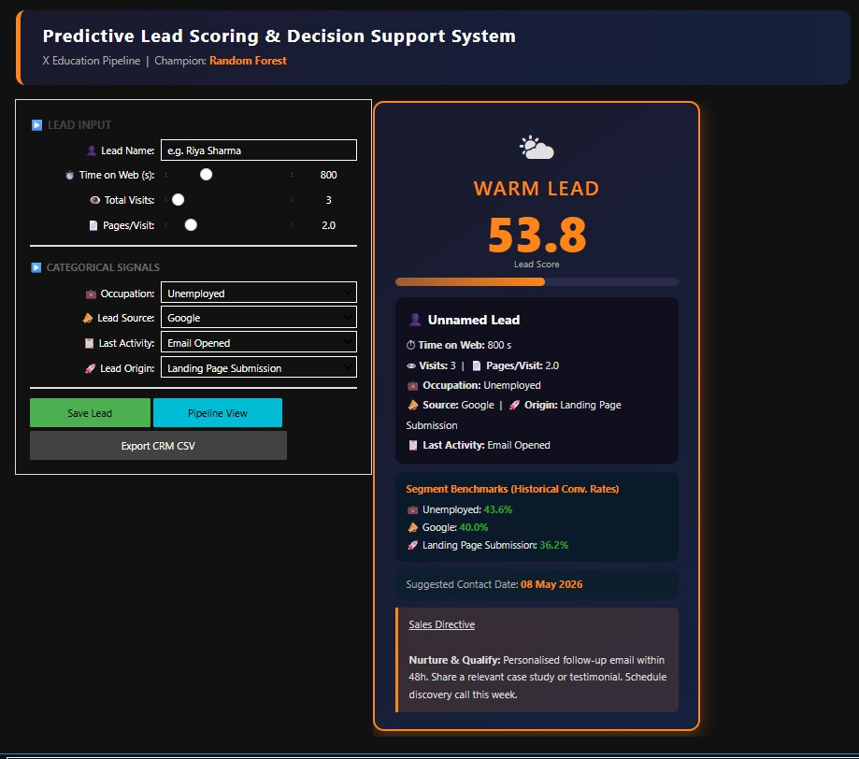
DECISION SUPPORT SYSTEM
Interactive DSS Dashboard
Interactive DSS generates real-time mathematical lead prioritization for sales teams.
HOT
Score: >=70
Senior Rep call
WARM
Score: 45-69
Nurture email
COLD
Score: 25-44
Drip campaign
DEAD
Score: <25
Newsletter
8 / 11

Slide 9
SYSTEM ARCHITECTURE
ML Pipeline Architecture
INPUT LAYER
PROCESSING LAYER
OUTPUT LAYER
Dataset
(9,240 rows)
Preprocessing
& Cleaning
Feature
Engineering
Random Forest
Model
Lead Scoring
Engine (0-100)
DSS Dashboard
Business
Recommendations
Raw CSV
Null handling
Outlier clipping
Engagement Score
One-Hot Encoding
300 Trees
Class-balanced
Probability × 100
ipywidgets
Real-time UI
HOT/WARM/COLD/DEAD
Lead_Scoring.csv
Mode/Median impute
MinMaxScaler
ROC-AUC: 0.884
Tier classification
Pipeline View
Sales Directives
Serialized Artifacts: champion_model.pkl | data_scaler.pkl | model_columns.pkl | norm_stats.pkl
9 / 11

Slide 10
BUSINESS IMPACT
Strategic Business Impact & Quantified ROI
38.5% → 70%+
Projected Conversion Lift
(Among RF-scored HOT leads, ~72% historically converted vs 38.5% baseline)
~50-60%
2× Faster
Reduction in low-quality outreach
Sales Prioritisation Efficiency
Concentrating only on HOT leads eliminates wasted sales calls.
Automated scoring replaces manual qualification pipeline.
81.9%
Real-Time
Recall on Converting Leads
Lead Scoring Speed
Minimises missed high-value customers — most costly error.
Instant 0-100 score + directive from DSS dashboard.
10 / 11

Slide 11
CONCLUSION & FUTURE SCOPE
Conclusion &
Future Scope
Roadmap
1
Current DSS
ipywidgets · Jupyter Notebook
"Machine Learning enables scalable, intelligent,
and data-driven customer acquisition strategies."
2
Streamlit App
Full SaaS-style web deployment
3
FastAPI REST API
ROC-AUC 0.884 — Random Forest champion
Real-time DSS with 4-tier lead classification
38.5% → 70%+ projected conversion lift
Production pipeline with serialised artifacts
Real-time prediction endpoint
4
SHAP Explainability
Model interpretability & fairness
5
CRM Integration
Salesforce / HubSpot plugin
11 / 11

