Slide 1
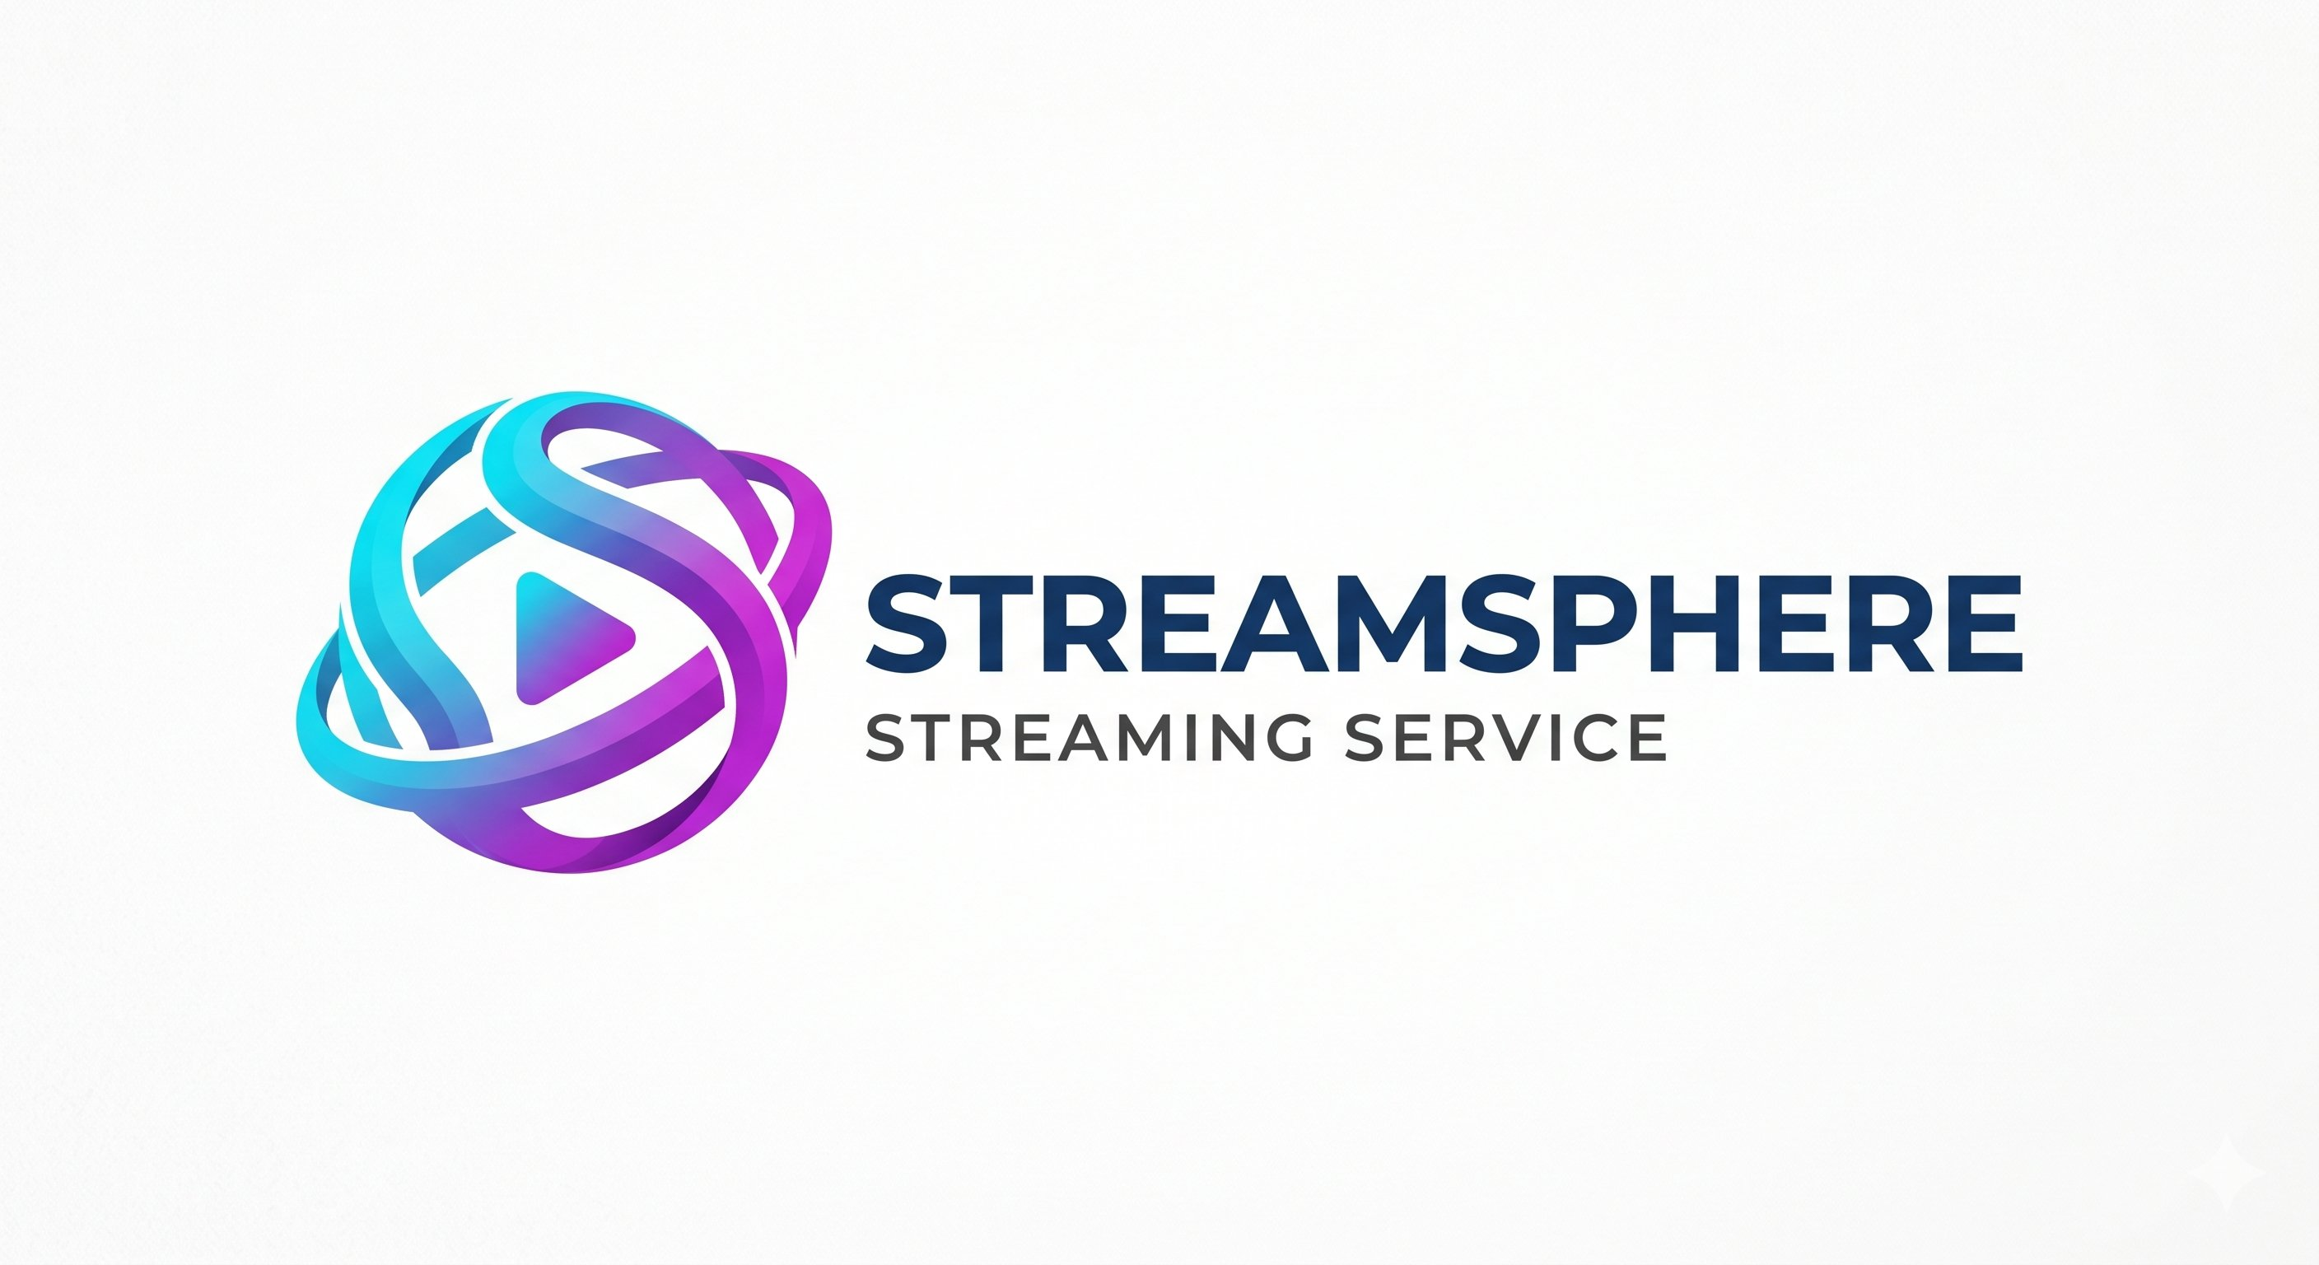
Unlocking
"The Engagement Puzzle"
A CRISP-DM Based SQL & Power BI Analysis
of User Behavior and Content Performance
Core Business Problem:
StreamSphere generates thousands of clicks, views, and interactions every minute. Operationally, the platform looks successful. But our analysis revealed a dangerous blind spot — the company knew exactly what users were doing, but had no idea why.
Why users disengage
What drives retention
What truly creates engagement
SQL
Power BI
CRISP-DM Methodology
MBA Business Analytics Capstone
StreamSphere Analytics Project
1

Slide 2


Activity vs. Understanding
Operational Success
Behavioral Complexity
Continuous streaming activity
Browsing without watching
We see what users are doing
Growing subscriptions
Early exits before completion
≠
Repeated pauses mid-content
Expanding content library
Inconsistent subscription renewals
High user traffic
Exploratory viewing patterns
We understand WHY they are doing it
Traditional metrics (views, watch time, clicks) fail to explain engagement quality, user intent, and churn behavior.
StreamSphere Analytics Project
2

Slide 3
Key Business Questions
1
What factors influence whether users complete or abandon content?
2
Does excessive browsing indicate exploration or choice paralysis?
3
Is content successful because of quality — or homepage placement?
4
What behaviors differentiate loyal users from churn-risk users?
5
How do time-of-day and viewing patterns affect engagement quality?
StreamSphere Analytics Project
3

Slide 4
Building the Behavioral Intelligence Engine
Star Schema Design
The Analytical Engine
Key Behavioral Metrics
Data Foundation
Behavioral Tracking
Intelligence Output
dim_users
Browsing sessions
Completion Percentage
dim_content
Search behavior
Browse Duration
dim_time
Watch sessions
Watch Duration
▶
▶
fact_interactions
Pause events
Pause Count
fact_subscriptions
Early exits
Placement Tier
Renewals & cancellations
Early Exit Rate
Transform fragmented interaction data into engagement intelligence.
StreamSphere Analytics Project
4

Slide 5
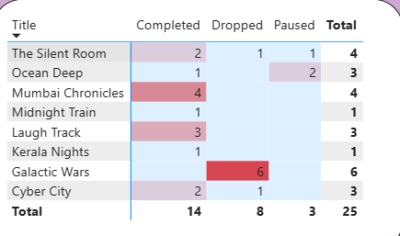
The Visibility Paradox: High Views ≠ High Value
Is content successful because users value it — or because the platform promotes it?
Tier 1 — Homepage Featured Content
Content Performance Matrix | Completed / Dropped / Paused
2.1M+
44.2%
Title | Completed | Dropped | Paused | Total
Mumbai Chronicles | 4 | — | — | 4
The Silent Room | 2 | 1 | 1 | 4
Cyber City | 2 | 1 | — | 3
Ocean Deep | 1 | — | 2 | 3
Laugh Track | 3 | — | — | 3
Galactic Wars | — | 6 | — | 6
Kerala Nights | 1 | — | — | 1
Views
Early Exit Rate ⚠️
Creates the illusion of success through visibility
Tier 3 — Organic / Search Content
88.1%
Completion Rate ✓
Represents genuine engagement and intentional viewing
Visibility creates attention. Completion reflects actual engagement quality.
StreamSphere Analytics Project
5

Slide 6
Browse Fatigue: The Silent Driver of Churn
Definition
Browsing > 10 minutes + minimal watch activity
User Segments
🟢 Intentional Viewers
🟡 Moderate Explorers
🔴 High Browse Fatigue Users
52.6%
9.4%
vs
Churn Rate
(Browse Fatigue Users)
Churn Rate
(Intentional Viewers)
Users who endlessly scroll are not engaged — they are experiencing choice paralysis. Browse Fatigue becomes an early warning signal for churn risk.
StreamSphere Analytics Project
6

Slide 7
Decoding Intent: When and How Users Watch
Temporal Analysis Findings
Peak Engagement:
▶ Late evenings & weekend nights
▶ Friday & Saturday binge windows
▶ Sustained watch sessions (45–120 min)
Low Engagement:
▶ Weekday daytime sessions
▶ Fragmented viewing behavior
📢 Strategic Action
Pause Behavior Analysis
Schedule push notifications & major content drops during Friday evening binge windows.
1–3 Pauses
4+ Pauses
Intentional continuation • Deep narrative engagement • High completion probability
Distraction signals • High abandonment probability • Trigger re-engagement prompts
💡 Strategic Action
Trigger "Resume Watching?" emails for users who pause content 4+ times mid-session.
StreamSphere Analytics Project
7
Notes:
This slide explains:
“When users watch content and what their viewing behavior tells us about engagement.”
In simple language:
TOP LEFT — Temporal Analysis Findings
This section studies:
what time users are most active.
Peak Engagement
Late evenings & weekend nights
Meaning:
users are most active during:
evenings,
weekends,
leisure/free time.
This is when users spend more time watching content.
Higher viewing activity during weekends
Meaning:
weekends have more continuous viewing compared to weekdays.
People have more free time,
so engagement increases.
Longer and more consistent viewing activity during weekends
Meaning:
users are more likely to:
stay longer,
complete content,
binge-watch during weekends.
Low Engagement
Weekday daytime sessions
Meaning:
during work/study hours,
users watch less.
Fragmented viewing behavior
Meaning:
users:
start and stop frequently,
multitask,
watch inconsistently.
TOP RIGHT — Heatmap
This chart visually shows:
when viewing activity is highest.
Darker cells mean:
more activity.
Simple interpretation:
evenings and nights show stronger activity,
weekends show more engagement.
BOTTOM RIGHT — Pause Behavior Analysis
This explains:
what pauses tell us about user engagement.
1–3 Pauses
Meaning:
moderate pausing is normal.
Possible reasons:
checking phone,
short break,
discussing content,
continuing later.
This often indicates:
users are still engaged.
Deep narrative engagement
Meaning:
users are interested enough to continue watching.
High completion probability
Meaning:
they are more likely to finish the content.
4+ Pauses
Meaning:
too many pauses may indicate:
distraction,
boredom,
low interest.
High abandonment probability
Meaning:
users may stop watching completely.
Trigger re-engagement prompts
Business action:
platform can send:
“Resume Watching?”
reminder notifications.
BOTTOM LEFT — Strategic Actions
This section explains:
how the business can use these insights.
Friday evening push notifications
Meaning:
release or promote content during high-engagement time periods.
Because:
users are more active then.
Resume Watching emails
Meaning:
if users pause too much,
the platform should remind them to continue.
This helps:
reduce abandonment,
improve retention.
FINAL MESSAGE OF THE SLIDE
This slide basically says:
“User engagement changes depending on time and viewing behavior, and these patterns can help platforms improve retention and content strategy.”
SIMPLE ONE-LINE EXPLANATION FOR VIVA
Say this:
“This slide analyzes when users are most engaged and how pause behavior can indicate either strong engagement or possible abandonment risk.”

Slide 8
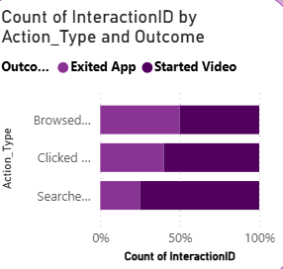
Power BI Dashboard: From Metrics to Decisions
Operationalize engagement intelligence into daily decision-making.
10
10
40.1
56%
Total Users
Subscriptions
Avg Watch (min)
Completion Rate
Subscription Status
Interaction Friction
80%
20%
Browsed Category:
7
Clicked Rec.:
5
Active
Cancelled
Searched Title:
3
Operational Tool — Retention Managers
Strategic Tool — Content Teams
- Monitor Browse Fatigue spikes
- Identify churn-risk users
- Trigger retention campaigns before cancellation
- Identify high-retention Tier 3 content
- Optimize promotion strategy
- Allocate marketing budget efficiently
StreamSphere Analytics Project
8
Notes:
This slide explains:
“How we converted our SQL analysis into a business decision-making dashboard using Power BI.”
In simple language:
TOP LINE
“Operationalize engagement intelligence into daily decision-making.”
Simple meaning:
“We used the dashboard to help the company make smarter business decisions using user behavior data.”
TOP KPI CARDS
These are:
quick summary metrics.
Total Users = 10
Shows:
how many users are in the sample dataset.
Subscriptions = 10
Shows:
total subscription records being analyzed.
Avg Watch = 40.1 min
Shows:
average viewing time per user/session.
Simple meaning:
users watch around 40 minutes on average.
Completion Rate = 56%
Shows:
how much content users actually finish watching.
Simple meaning:
slightly more than half of started content gets completed.
BOTTOM LEFT — Watch Time by Genre
This chart shows:
which genres users spend the most time watching.
Regional Drama & Thriller
Highest watch time.
Meaning:
these genres generate stronger engagement.
Comedy
Lower watch time.
Meaning:
users spend less time on that genre.
CENTER — Subscription Status
Shows:
Active users
Cancelled users
80% Active
Most users are still subscribed.
20% Cancelled
Some users have churned/cancelled.
RIGHT SIDE — Action Type Chart
This compares:
users who browsed,
clicked,
searched,
and whether they:
started watching,
or exited the app.
Simple Meaning
Not every interaction leads to actual viewing.
Some users:
browse,
click,
then leave without watching.
This helps identify:
engagement quality.
BOTTOM LEFT — Operational Tool for Retention Managers
This explains:
how the dashboard helps retention teams.
Monitor Browse Fatigue
Identify users spending too much time browsing.
Identify churn-risk users
Detect users likely to cancel.
Trigger retention campaigns
Send offers, reminders, or recommendations before users leave.
BOTTOM RIGHT — Strategic Tool for Content Teams
This explains:
how the dashboard helps business/content teams.
Identify high-retention Tier 3 content
Find less-promoted content with strong engagement.
Optimize promotion strategy
Promote content users genuinely enjoy.
Allocate marketing budget efficiently
Spend money on content with better retention performance.
FINAL MESSAGE OF THE SLIDE
This slide basically says:
“The Power BI dashboard transforms raw SQL analytics into interactive business insights that help improve engagement, retention, and content strategy.”
SIMPLE ONE-LINE EXPLANATION FOR VIVA
Say this:
“This dashboard visualizes engagement metrics, churn indicators, and content performance insights to support retention and strategic business decisions.”

Slide 9




Strategic Recommendations
01
02
Redefine Success Metrics
Re-Weight Recommendation Algorithms
Shift KPI focus from Raw Views to Start-to-Completion Ratio. Completion quality signals true content value.
Reward retention quality and sustained engagement instead of raw click-through.
03
04
Deploy Real-Time UI Interventions
Optimize Content Acquisition Strategy
Trigger localized "Surprise Me" prompts when browse time exceeds 10 minutes to combat choice paralysis.
Prioritize regional niche content and high-retention titles over heavily marketed low-retention content.
StreamSphere Analytics Project
9
Notes:
This slide explains:
“Based on our analysis, what business actions should the OTT platform take?”
In simple language:
these are the final recommendations from your project.
1. Redefine Success Metrics
Current Problem
Platforms usually measure success using:
views,
clicks,
impressions.
But:
high views do not always mean users enjoyed the content.
Recommendation
Focus more on:
Start-to-Completion Ratio
Meaning:
how many users actually finish the content after starting it.
Simple Business Meaning
“Completion rate is a better measure of true engagement than raw views.”
2. Re-Weight Recommendation Algorithms
Current Problem
Recommendation systems often promote content just because:
many users clicked it.
But users may:
click,
then leave quickly.
Recommendation
The algorithm should prioritize:
retention,
watch completion,
sustained engagement.
Also:
promote hidden Tier 3 content with high completion rates.
Simple Business Meaning
“Recommend content users genuinely enjoy, not just content they click once.”
3. Deploy Real-Time UI Interventions
Current Problem
Some users browse too long without choosing content.
This creates:
choice paralysis / browse fatigue.
Recommendation
If users browse too long,
the platform should intervene.
Example:
“Surprise Me” button,
personalized suggestions,
quick recommendations.
Simple Business Meaning
“Help confused users decide faster to reduce churn risk.”
4. Optimize Content Acquisition Strategy
Current Problem
Platforms often spend heavily on:
highly marketed content,
even if retention is poor.
Recommendation
Invest more in:
regional niche content,
high-retention content,
content users actually complete.
Simple Business Meaning
“Spend money on content that keeps users engaged, not just content that creates hype.”
FINAL MESSAGE OF THE SLIDE
This slide basically says:
“Our analysis helps the platform improve engagement, reduce churn, optimize recommendations, and make smarter content investment decisions.”
SIMPLE ONE-LINE EXPLANATION FOR VIVA
Say this:
“This slide presents strategic business recommendations based on our behavioral analytics findings to improve retention, engagement quality, and recommendation effectiveness.”

Slide 10

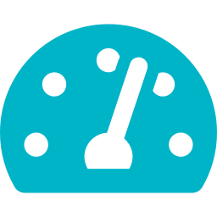


Future Scope & Conclusion
Future Scope
FROM:
Predictive Churn Models
ML-based early warning system identifying at-risk subscribers 30 days before cancellation.
"We see what users are doing"
Real-Time Analytics Pipeline
▼
Live engagement scoring enabling same-session intervention triggers.
TO:
AI-Powered Recommendations
"We understand WHY they are doing it"
Contextual engine adapting to time-of-day, device, and historical completion patterns.
Dynamic User Segmentation
Automatic re-clustering based on behavioral drift across subscription lifecycle.
10
Transforming interaction data into engagement intelligence, retention strategy, and business decision support.
Notes:
This slide explains:
“What future improvements can be added to the system and what is the final conclusion of the project.”
It is basically:
the closing summary of your entire project.
LEFT SIDE — Future Scope
This section explains:
how the project can become more advanced in the future.
1. Predictive Churn Models
Simple meaning:
Use Machine Learning to predict:
which users may cancel subscriptions before they actually do.
Example:
If a user:
browses too much,
exits early,
stops completing content,
the system can warn the company early.
Business Benefit
The company can:
send offers,
recommendations,
retention campaigns,
before users leave.
2. Real-Time Analytics Pipeline
Simple meaning:
Analyze user behavior instantly while they are using the platform.
Example:
If a user is confused or inactive,
the system can immediately:
recommend content,
show prompts,
improve engagement.
Business Benefit
Faster intervention improves retention.
3. AI-Powered Recommendations
Simple meaning:
Use Artificial Intelligence to make smarter recommendations.
Instead of basic recommendations,
AI can consider:
viewing time,
device,
user habits,
completion history.
Business Benefit
More personalized recommendations improve user satisfaction.
4. Dynamic User Segmentation
Simple meaning:
Automatically group users based on changing behavior.
Example:
A user may move from:
engaged viewer
to
churn-risk user.
The system updates segments automatically.
Business Benefit
Better targeting and personalization.
RIGHT SIDE — FINAL CONCLUSION
This is the MOST IMPORTANT message of the entire project.
FROM:
“We see what users are doing”
Simple meaning:
traditional analytics only track:
clicks,
views,
watch time.
TO:
“We understand WHY they are doing it”
Simple meaning:
your project goes deeper and analyzes:
behavior,
intent,
engagement quality,
churn signals.
MAIN PROJECT MESSAGE
Your project is not just:
activity tracking.
It is:
behavioral intelligence.
That is the core theme of your entire presentation.
BOTTOM LINE
“Transforming interaction data into engagement intelligence, retention strategy, and business decision support.”
Simple meaning:
“We converted raw user activity data into useful business insights that help improve retention and strategic decision-making.”
SIMPLE ONE-LINE EXPLANATION FOR VIVA
Say this:
“This slide summarizes how the project can evolve using AI and predictive analytics, while concluding that behavioral analytics provides deeper engagement intelligence than traditional activity metrics.”

