Slide 1
Real-Time Short-Term Rental Analytics for Airbnb
An ELT pipeline, SQL KPI engine and Power BI dashboard comparing New York and London
Alex Abraham | 25121007 | 4MBA BA PLC
Business Decision Intelligence (MBA443B) | Faculty: Dr. Himani Sivaraman
CHRIST (Deemed to be University), Pune Lavasa Campus | 11 October 2026
Notes:
Good morning. My project asks a practical question: how can Airbnb's regional team monitor and compare two of its biggest city markets, New York and London, using a real analytics workflow rather than a spreadsheet. I built the full chain myself: an ELT pipeline in MySQL, a set of SQL KPIs, and a Power BI dashboard that refreshes as new data arrives. In the next ten minutes I will walk through the workflow, show the dashboard, and end with what I would recommend to management.

Slide 2
Airbnb needs one trusted view of two very different city markets
Business scenario
121,872
A regional strategy team at Airbnb, a long-time Hadoop user, must decide where to act in New York and London as regulation reshapes both markets.
listings (29,918 New York, 91,954 London)
Questions the project answers
3.32 million
How much supply is genuinely active?
How has regulation changed demand?
Which hosts and areas carry the business?
What should managers do next?
guest reviews, 2009 to Sep 2026
Sep 2026
Inside Airbnb snapshots, prices in USD (GBP x 1.3371)
Source: Inside Airbnb (2026); Mayfield et al. (2016) on Airbnb's Hadoop platform.
Notes:
The scenario is a regional strategy team at Airbnb. Airbnb is a good fit for this assignment because its data platform was built on Hadoop: HDFS, Hive, Presto, Spark, and it created Apache Airflow. I used the public Inside Airbnb snapshots from September 2026: almost 122,000 listings and 3.3 million reviews. New York and London make a natural experiment, because New York started enforcing Local Law 18 in September 2023 while London kept its 90-night rule. The four questions on the left drive everything that follows.

Slide 3
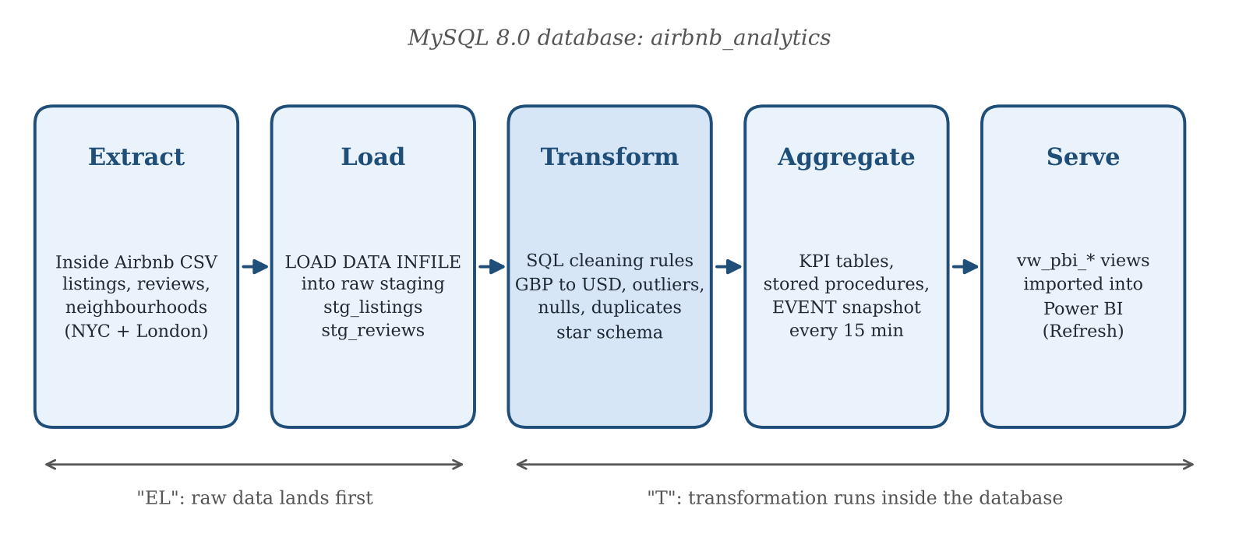
ELT lands raw data first, then transforms it inside MySQL
Raw storage: CSV upload folder = HDFS / S3
Transform: MySQL SQL = Hive / Spark
Scheduling: MySQL EVENT = Apache Airflow
Notes:
This is the workflow. I chose ELT rather than ETL. Extract and Load means the six CSV files go into raw staging tables untouched, using server-side LOAD DATA INFILE. Transform happens inside the database with SQL, so the raw rows are always there if a cleaning rule needs to change. Then aggregates and a scheduled snapshot, and finally semantic views that Power BI imports. The chips at the bottom show the Hadoop equivalent of each layer: at Airbnb scale the folder would be HDFS or S3, the SQL would run in Hive or Spark, and Airflow would replace the MySQL event. The logic does not change, only where it runs.

Slide 4
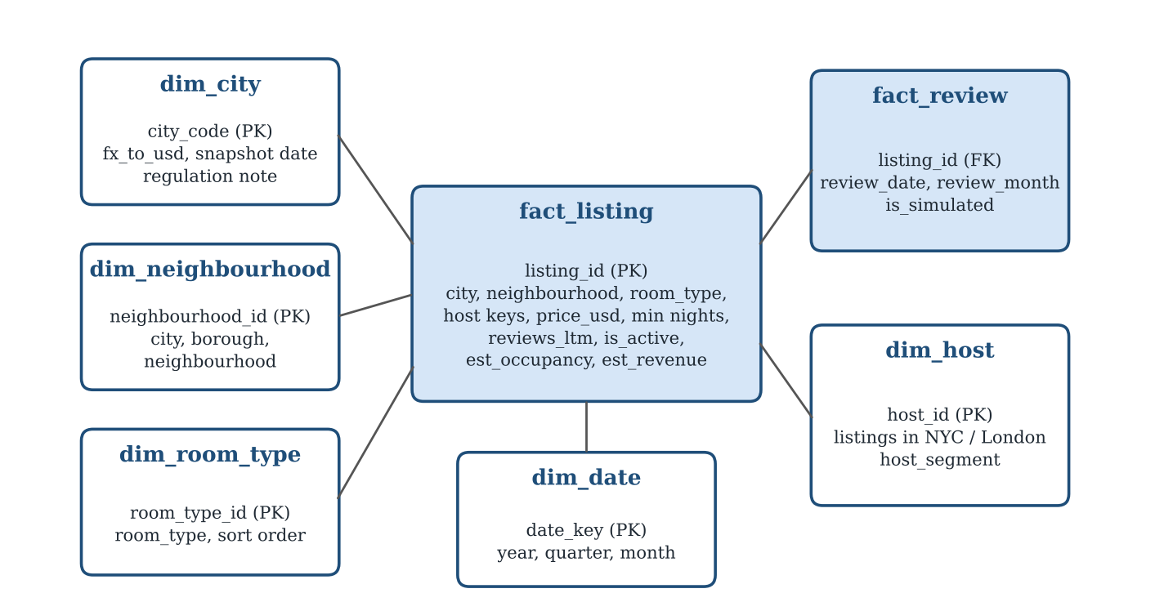
Twelve logged cleaning rules feed a star schema built for analysis
42,561
listings with no price kept and flagged, not deleted
793
price outliers above the city 99th percentile left out of price KPIs
0 rows
dropped silently: every rule logs its count in data_quality_log
Source: author's data_quality_log on the full dataset; design follows Kimball & Ross (2013).
Notes:
Twelve cleaning rules turn staging data into analysis-ready tables. The key design choice was to flag rather than delete. About 35 percent of listings had no price in the snapshot. Deleting them would hide a third of the supply, so they are kept with a status flag and simply excluded from price and revenue measures. Every rule writes how many rows it touched to a log table. The clean data sits in a star schema: a listing fact and a review fact, surrounded by city, neighbourhood, room type, host and date dimensions.

Slide 5
Advanced SQL defines each KPI once and answers sixteen business questions
SQL technique | Business question
Joins across five dimensions | Which boroughs earn the most?
CTE + ROW_NUMBER window | What is a typical (median) price?
LAG and rolling 12-month sums | How did demand react to Local Law 18?
NTILE and Pareto running share | Do a few hosts and areas dominate?
Prepared statements, stored procedures | Same report for any city, room type or price band
KPIs tracked
Active % target 50%
Est. occupancy % target 15%
Median price (USD)
Est. revenue (USD)
Long-stay % (30+ nights)
Top 10% host share
Last refreshed live proof
Example: CALL sp_top_areas('LON', 'revenue', 10) ranks London boroughs; the sort column comes from a whitelist, so no SQL injection.
Notes:
Script five has sixteen queries, each tied to one business question. The table shows the main techniques: joins across the star schema, a CTE with ROW_NUMBER to get a true median since MySQL has no median function, LAG and rolling sums for the regulation trend, NTILE and running shares for concentration, and prepared statements and stored procedures for dynamic filters. On the right are the KPIs. Each is defined once in SQL and once in DAX with the same logic, and two have targets so the dashboard shows performance, not just numbers. The targets are my management benchmarks, not industry standards.

Slide 6
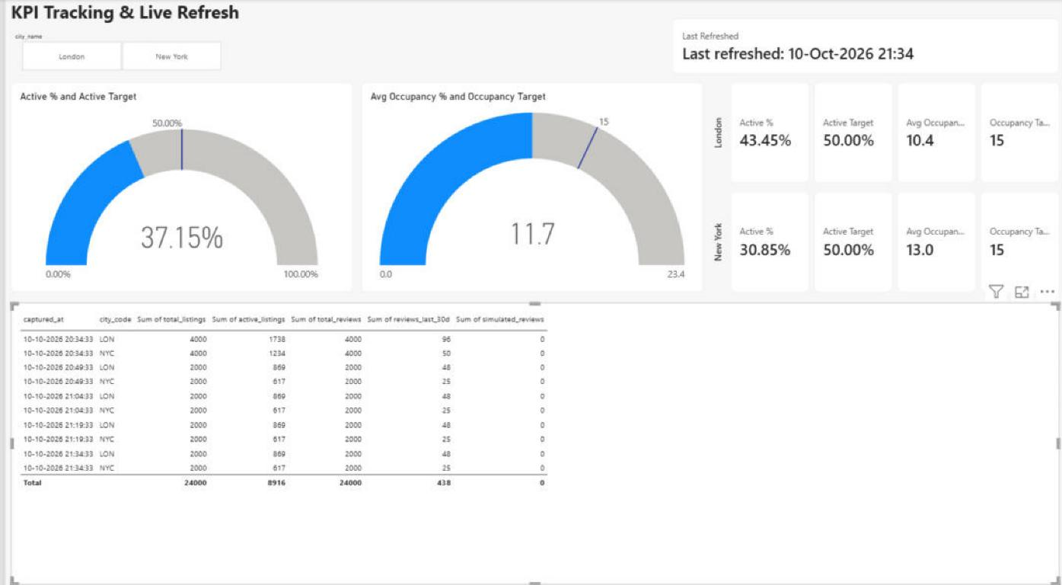
A 15-minute MySQL event makes the dashboard near-real-time
1
MySQL EVENT
every 15 minutes calls sp_capture_kpi_snapshot
2
Live data
sp_simulate_live_reviews adds new reviews for the demo
3
Refresh
Power BI re-imports the vw_pbi_* views
4
Track
KPI Tracking page: Active % vs 50% target, occupancy vs 15%, and five snapshots captured 15 minutes apart.
gauges, targets and a timestamped snapshot log update
Notes:
Real-time here means near-real-time micro-batching, which is how most business dashboards work. A MySQL event runs every fifteen minutes and writes a KPI snapshot with a timestamp. For the demonstration, a procedure inserts simulated live reviews, refreshes the aggregates and takes a snapshot. When I press Refresh in Power BI, the new row appears in the snapshot log and the last-refreshed card changes. You can see the captures at 20:34, 20:49, 21:04 and so on. Simulated rows can be removed with one call, so the demo never pollutes the real data. In production this would be Power BI Service with a scheduled refresh through a gateway.

Slide 7
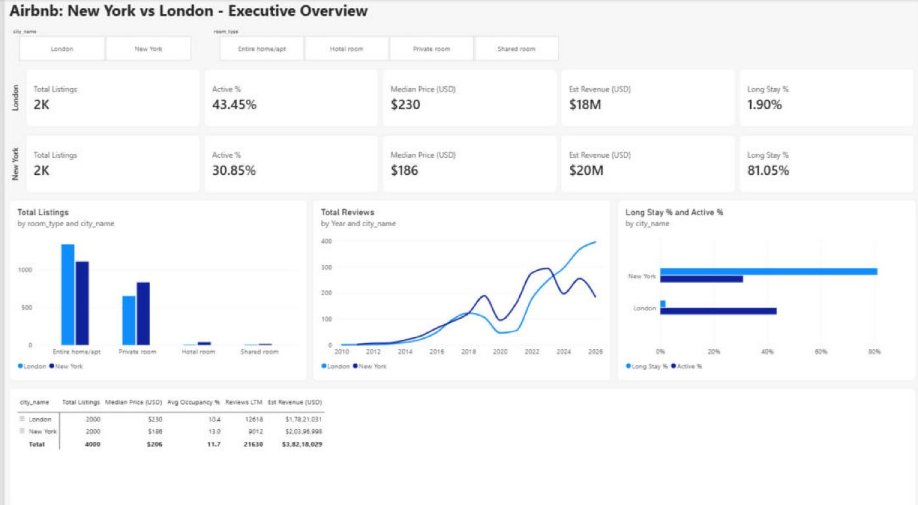
Four Power BI pages take managers from city level down to one neighbourhood
Filters
City and room-type slicers narrow every visual on the page.
Drill-down / drill-up
In the matrix, + opens a city's room types; - or the up arrow returns to city level.
Drill-through
Right-click a neighbourhood > Drill through opens a filtered Neighbourhood Detail page with a back button.
Storyline
Overview > Neighbourhoods > Detail > KPI Tracking.
Overview page: slicers, KPI cards by city, trends and a drill-down matrix (2,000-listing demo sample per city).
Notes:
Power BI connects to MySQL with the native connector in Import mode and reads the clean views. The report has four pages that follow one storyline: the Overview compares the cities, the Neighbourhoods page shows where the business sits on the map, the Neighbourhood Detail page opens one area, and the KPI page shows targets and freshness. Three kinds of interaction: slicers filter the whole page; drill-down and drill-up stay inside one visual, for example the matrix goes from city to room type with the plus and minus signs; and drill-through jumps to another page. I can show that live: right-click Westminster, choose Drill through, and the detail page opens filtered to Westminster. The dashboard runs on a 2,000-listing sample per city for laptop speed; the full pipeline was validated on all the data.

Slide 8
After Local Law 18, New York demand fell while London's doubled
80.7%
of New York listings now need 30+ nights (London 2.1%)
31% vs 43%
of listings actually active, New York vs London
About 45%
of listings held by the top 10% of hosts in both cities
Source: author's SQL on the full Inside Airbnb dataset (Sep 2026). Index = rolling 12-month review count, Aug 2023 = 100.
Notes:
Here are the findings. Until 2023 the two lines move together. After New York began enforcing Local Law 18 in September 2023, its twelve-month review volume fell to 66 within a year and has only climbed back to 95, while London rose to 226. The supply data explains it: 80.7 percent of New York listings now require stays of 30 nights or more, against 2 percent in London. Headline counts also overstate both markets: only 31 percent of New York listings and 43 percent of London listings are active. And concentration is high in both cities: the largest 10 percent of hosts hold about 45 percent of listings. One more number for the viva: an active New York listing earns about 34,000 dollars a year, 1.7 times an active London listing.

Slide 9
Booking Holdings is twice Airbnb's size and less exposed to city rules
FY 2025 | Airbnb | Booking Holdings | Expedia (incl. Vrbo)
Revenue | $12.2 bn (+10%) | $26.9 bn (+13%) | $14.7 bn (+8%)
Gross bookings | $91.3 bn | $186.1 bn | $119.6 bn
Nights booked | 533 m | 1,235 m | 415 m
Exposure to city rules | High: private homes | Lower: hotel-led | Medium: holiday homes
So what: where rules push short stays back to hotels, as in New York, Airbnb's advantage is weakest and Booking and Expedia are strongest. Airbnb's edge is homes, long stays and experiences, which rivals do not match at the same scale.
Sources: Short Term Rentalz (2026) for Airbnb; Booking Holdings (2026); Expedia Group (2026) full-year 2025 releases.
Notes:
Airbnb does not compete in a vacuum. On full-year 2025 results, Booking Holdings is more than twice Airbnb's revenue and is pushing into alternative accommodation, so an unhappy London host has an obvious alternative. Expedia, with Vrbo, is similar in revenue to Airbnb but leans to holiday areas. The key point is exposure to city rules: Airbnb's supply is private homes, so regulation hits it hardest, and in New York guests can simply book a hotel instead. Airbnb's distinctive asset is long stays and experiences.

Slide 10
Recommendations: build mid-term stays in New York and protect London's core
New York
London
Platform
Launch a 30+ night product for corporate and relocation guests
Help 757 unlicensed short-stay hosts register or switch to 30-night minimums
Protect the core: 11 of 33 boroughs earn 80% of revenue
Recruit hosts in under-supplied areas such as Haringey and Newham
Reactivate dormant listings: 1,000 at today's active rate = about $34 m
Account management for top hosts; move the pipeline to S3, Spark, Airflow and Power BI Service
Conclusion: one strategy will not fit both cities. The pipeline and dashboard give managers live evidence to treat them differently.
Key references: Inside Airbnb (2026); Mayfield et al. (2016); Kimball & Ross (2013); NYC OSE (n.d.); full list in the written report.
Notes:
To close, three sets of recommendations. In New York, accept that it is now a mid-term market and build a product for stays of 30 nights and more, aimed at corporate and relocation guests; and deal with the 757 unlicensed short-stay listings, because 513 of them are active. In London, protect the eleven boroughs that make 80 percent of revenue and recruit hosts in high-occupancy areas with thin supply. Across the platform, dormant listings are the cheapest growth: bringing back 1,000 of them at today's active-listing earnings is worth about 34 million dollars to hosts. Technically, the same pipeline can move to S3, Spark and Airflow with Power BI Service for hourly refresh. The main message: one strategy will not fit both cities, and the dashboard gives the evidence to treat them differently. Thank you, I am happy to take questions or show the live drill-through.

