Slide 1
HTML,
Flask,
SQL
Conquering a Fundamental Web Stack.

Slide 2
There is a lot to cover, so strap in!
Questions are encouraged!

Slide 3
Roadmap
SQL
git
HTML
Flask
Start!

Slide 4
HTML
SECTION:1
The foundation of every web page.

Slide 5

Hypertext Markup Language
The language for specifying web pages.
Tags are the building blocks.
What you want the page to look like.
<tag>content</tag>

Slide 6
<!DOCTYPE html>
<html>
  everything lives here
</html>

Slide 7
<!DOCTYPE html>
<html>
  <body>
      main content of web page
  </body>
</html>

Slide 8
Basic Tags
<p> -- Paragraph.
<h1> -- Header.
<h2> -- Subheader.
<h3> -- Subsubheader.
<h4> -- You get the idea... (goes down to 6).
<strong> -- Bold text.
<em> -- Italic text.
<br> -- Line break (no content => does not need end tag).

Slide 9
<!DOCTYPE html>
<!-- This is a comment. -->
<html>
  <body>
      <h1>Welcome to my webpage!</h1>
      <p>
        HTML is <strong>really</strong> <em>cool</em>.
      </p>
  </body>
</html>

Slide 10
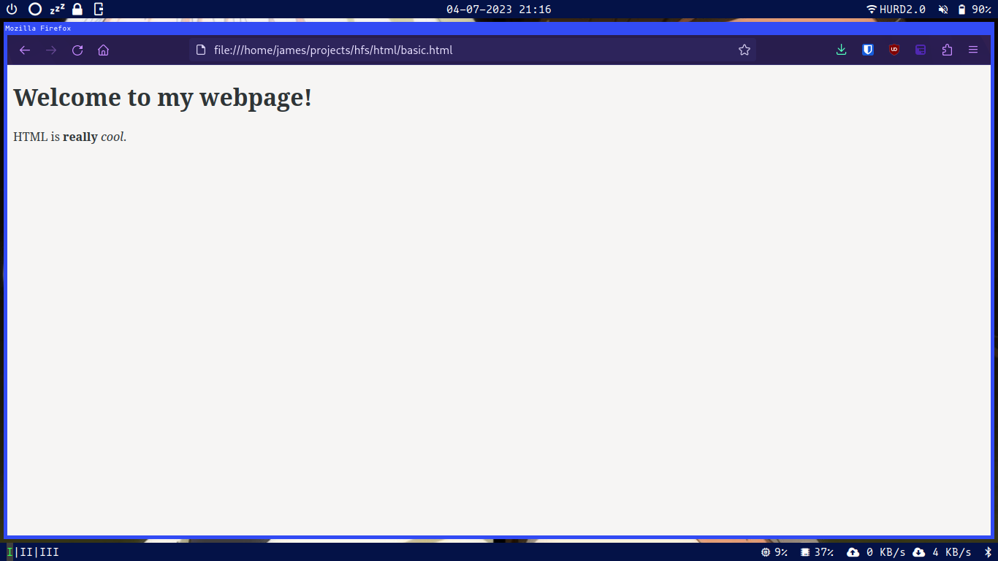

Slide 11
HTML Lists
Can be ordered or unordered.
<ul> -- Unordered list (e.g. bullets).
<ol> -- Unordered list (e.g. 1, 2, 3...).
<li> -- Item in both lists.

Slide 12
<!DOCTYPE html>
<html>
  <body>
    <h1>Unordered List.</h1>
    <ul>
      <li>item one</li>
      <li>item two</li>
    </ul>
  </body>
</html>
<!DOCTYPE html>
<html>
  <body>
  <h1>Ordered List.</h1>
    <ol>
      <li>item one</li>
      <li>item two</li>
    </ol>
  </body>
</html>

Slide 13
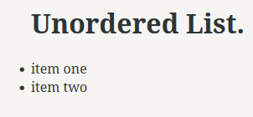
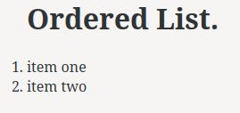

Slide 14
HTML Tables
<table border=“border_size”> -- Table container.
  Border size can be many things:
    e.g. px, em, pt
<tr> -- Table row container.
<th> -- Table heading.
<td> -- Table cell contents.

Slide 15
<!-- Outer tags omitted for readability. -->
<table border="5pt">
<tr>
<th>Name</th>
<th>Flavor</th>
</tr>
<tr>
<td>Ethan</td>
<td>Cookies and Cream</td>
</tr>
<tr>
<td>Sandy</td>
<td>N/A</td>
</tr>
</table>

Slide 16
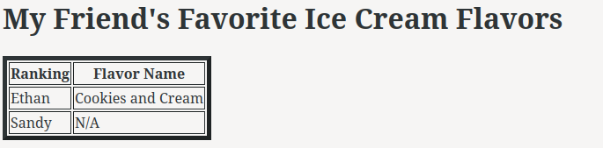

Slide 17
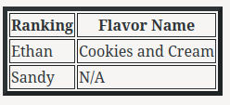
<table>
<td>
<th>
<tr>

Slide 18
HTML Links
<a href=“link destination”> -- Hyperlink.
Link destination could be many things:
  Local HTML page.
    e.g. “path/to/page.html”
  Other things on the web.
    e.g. “https://youtu.be/dQw4w9WgXcQ”

Slide 19
<!-- Outer tags omitted for readability. -->
<h1>Links!</h1>
<ul>
<!-- basic.html is another page in the current directory. -->
<li><a href="basic.html">Check out my awesome page!</li>
<li><a href="https://youtu.be/dQw4w9WgXcQ">Look at this cool video.</li>
</ul>

Slide 20


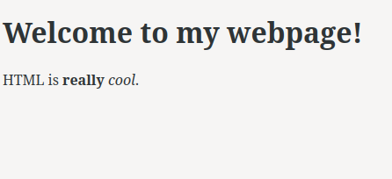

Slide 21
Hypertext Transfer Protocol
How you actually talk with the web.
Many flavors of requests.
Client
(you)
Server
(Website lives here)
HTTP Request
Response

Slide 22
GET Requests
“Get” the state of the server.
Retrieve data, no changes.
Client
(you)
Server
(Website lives here)
GET Request
Webpage

Slide 23
POST Requests
Hand new data to the server.
Useful in form responses, file uploads.
Client
(you)
Server
(Website lives here)
POST Request
Acknowledgement

Slide 24
HTML Forms – Container and Actions
<form method=“http method” action=“where to send data”>
  method -- HTTP method to send data with.
    GET is default, appends data to new URL and goes there.
      e.g. myform.com → myform.com?response=form_response.
    We will use POST, which sends data in POST request.
  action -- Where form sends data, default is to current page.
    We will use the default, but could use PHP, Web API, etc.

Slide 25
HTML Forms – Input and Labels
The <input> tag can take many forms, a couple are:
  <input name=“name”> -- Text input identified by name.
    Add required to make it a required input.
      e.g. <input name=“input_name” required>
  <input name=“submit” value=“text”> -- From submit button.
    text will appear on the button.
  <input> tags do not require an end tag.
<label for=“name”> -- Label for input identified by name.

Slide 26
<!-- Outer tags omitted for readability. -->
<h1>Innocent Form</h1>
<form method="post">
<label for="ssn">Social Security #</label>
<input name="ssn" required>
<input type="submit" value="Press here for free stuff!">
</form>

Slide 27
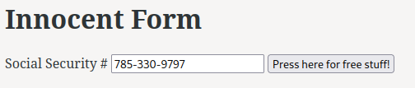
POST
Request
POST Request
ssn=785-330-9797
What do we do with this request? Just wait...

Slide 28
Still with me?
Questions? Speak now or forever hold you peace!

Slide 29
SQL
SECTION:2
Persistently storing data.

Slide 30
What is a Database?
A persistent way to store and access data.
  Could be as simple as a txt file.
Two main flavors:
  Relational (e.g. SQLite)
    We will focus on these.
  Non-relational (e.g. MongoDB)

Slide 31
What is a Relational Database?
Data is organized into tables.
Each table is rows and columns
A unique key identifies each row.
  Called the “primary key”.
Sort-of like a spreadsheet.

Slide 32
Employees
219300
Denji
828919
Power
029283
Aki
000000
Makima
Employee ID
(Primary Key)
Other fields

Slide 33
Employees
219300
Denji
828919
Power
029283
Aki
000000
Makima
Table
Record
Field

Slide 34
Database Management System (DBMS)
How you interact with the database.
Allows you to CRUD, or
  Create
  Read
  Update
  Delete
We will use SQLite, but there are many options:
  e.g. MySQL, MariaDB.
Specifically, we will use an RDBMS

Slide 35
Structured Query Language
Standard language for interacting with an RDBMS.
Nonstandard across different RDBMS.
  Basics are more or less the same everywhere.
Use “statements” to do things to database.
  End with a semicolon.
  Not case-sensitive.
Input statements:
  Directly at RDBMS prompt.
  In a .sql file.

Slide 36
Creating/Deleting a Table
We create a table by specifying a Schema.
  Schema => What a typical record looks like.
CREATE TABLE name(f1 datatype, f2 datatype, …);
  CREATE TABLE IF NOT EXISTS is another way to do this.
Fields can be many types.
  e.g. integer, text, float
Each field can also have special options after it.
  AUTOINCREMENT is useful for ints.
    Automatically generates new int on insert.
DROP TABLE name; -- Deletes table “name”.

Slide 37
CREATE TABLE todo(
id INTEGER AUTOINCREMENT,
task_name TEXT
);
todo
id
task_name

Slide 38
Messing With Records
INSERT INTO name VALUES (f1_value, f2_value, ...);
  Creates a new record with given field values in table name.
  Fields with AUTOINCREMENT will be automatically created.
DELETE FROM name WHERE condition;
  Delete all records where condition is true.
  No WHERE => all records deleted!!!!!
UPDATE name SET f1=newval1, f2=newval2, ... WHERE condition;
  Changes f1 to newval1, f2 to newval2, etc. where condition is true.
Condition can be any expression that evaluates to a bool.
  e.g. field = value, field < value.

Slide 39
todo
1
make workshop
INSERT into todo VALUES (make workshop);

Slide 40
todo
1
make workshop
2
homework
INSERT into todo VALUES (homework);

Slide 41
todo
1
make workshop
2
homework
3
download movies
INSERT into todo VALUES (download movies);

Slide 42
todo
1
make workshop
2
homework
3
download linux isos
UPDATE todo SET task_name=’download linux isos’ WHERE id=3;

Slide 43
todo
2
homework
3
download linux isos
DELETE from todo WHERE id=1;

Slide 44
Getting Records
Querying == getting records form a database.
SELECT * from name WHERE condition;
  Returns all records from name where condition is true.
SELECT f1, f2, ... from name WHERE condition;
  Returns fields f1, f2, ... from name where condition is true.
condition is the same as before.

Slide 45
todo
2
homework
3
download linux isos
SELECT * from todo WHERE id=2;
(2, homework)

Slide 46
todo
2
homework
3
download linux isos
SELECT task_name from todo WHERE id=2;
(homework)

Slide 47
Everyone Still Onboard?
I know this is a lot of information. Please ask questions!

Slide 48
Okay, this is all cool but how do we actually use these things?

Slide 49
Flask
SECTION:3
Putting it all together.

Slide 50
What is a Web Framework?
A collection of tools to build and deploy web applications.
Manages:
  Web server connection.
  Database connection.
  Templating.
  Much more!

Slide 51
What is a Web Framework?
A collection of tools to build and deploy web applications.
Manages:
  Web server connection.
  Database connection.
  Templating.
  Much more!

Slide 52

A Brief Note on Decorators
What they actually are isn’t important.
Adds extra functionality to our functions.
We will only import these from Flask.
For nerds: Decorators == higher order functions.
@

Slide 53
A Brief Note on Decorators
#!/usr/bin/python
@do_twice
def hello_world():
  print(“hello, world!”)
hello_world()
hello, world!
hello, world!

Slide 54

What is Flask?
A web framework written in Python.
Get it by running pip install flask in your terminal.
Uses decorators to specify different “routes”.
  For example, the default route is /.
  e.g. 127.0.0.1/

Slide 55
Flask Basics
Your app is an instance of the Flask object from the flask library
  Say app is the name of your Flask object in the following.
@app.route(‘/route/path’, methods=(‘m1’,’m2’,...)
  Will load what is returned by decorated function in the browser.
  methods = Tuple of valid HTTP request methods for endpoint.
    (‘GET’) is default.
@app.teardown_appcontext
  Flask will execute decorated function upon the end of a session.
  Decorated functions must take one positional argument.
    This is because of under the hood Flask stuff we won’t get into.

Slide 56
from flask import Flask
app = Flask(__name__)
@app.route("/")
def hello():
return "Hello World!"
if __name__ == "__main__":
app.run()
app.py file
(Must be named this).
Run app by typing flask run in the terminal.
Address of the web app (type this in your address bar).
[james@localhost ~]$ flask run
* Debug mode: off
WARNING: This is a development server. Do not use it in a production deployment. Use a production WSGI server instead.
* Running on http://127.0.0.1:5000
Press CTRL+C to quit

Slide 57
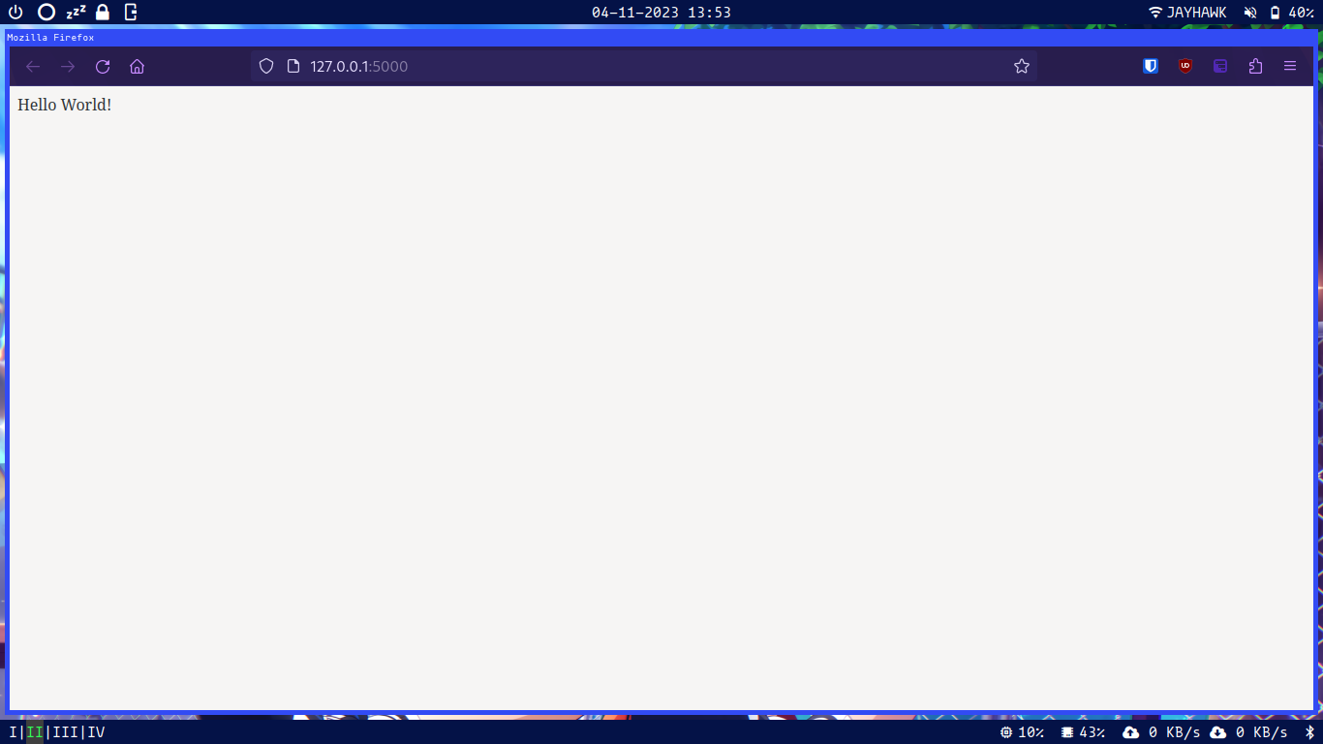

Slide 58
Rendering HTML With Flask
Flask can show an HTML page using render_template(‘filename.html’).
  File must be in a folder called templates located in the same directory as app.py.
However, Flask lets us do more...

Slide 59
HTML Templates With Jinja
The Jinja template engine is used by Flask to dynamically generate HTML based on an input.
Pass data to a template in the render_template.
  e.g. render_template(‘temp.html’, var1=val1, var2=val2, …) would give us access to all variables passed within the HTML.
Access variables in template using {{ varname }} syntax. You can include any valid Python in this block.
  e.g. {{ var1 + var2 }}

Slide 60
from flask import Flask, render_template
app = Flask(__name__)
@app.route('/')
def hello():
return render_template('hello.html', name='james')
if __name__ == '__main__':
app.run()
app.py

Slide 61
<!DOCTYPE HTML>
<html>
<body>
<p>Hello, {{name}}!</p>
</body>
</html>
templates/hello.html

Slide 62
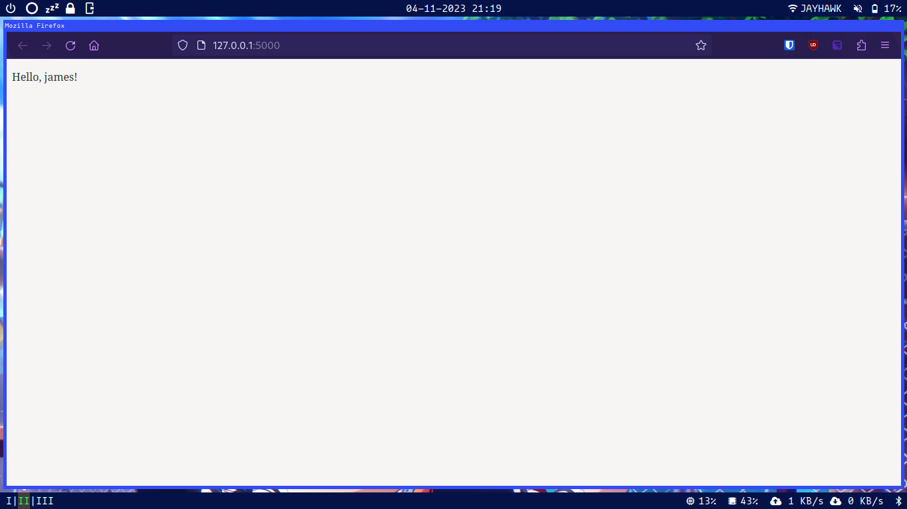

Slide 63
More Fun with Templates
Templates also support:
  if statements.
  for loops.
Works just like Python.
{% if condition %}
Some html goes here…
{% else %}
Some more html goes here…
{% endif %}
{% for var in obj %}
Some html goes here…
{% endfor %}

Slide 64
Connecting to a Database
Connect to a sqlite database using the sqlite3 library built into Python.
The g object in Flask allows us to add a database connection to our current session.
  e.g. g.db = sqlite3.connect('database.db')

Slide 65
Interacting With a Database
After connecting, run g.db.execute(‘sql commnd’) to interact with your database.
‘sql command ?’, var is used to pass variables to SQL strings.
  Protects from SQL injection attacks.
  e.g. db.execute('INSERT INTO names VALUES (?)', (request.form['name'],))
Commands that change the DB will need to be followed by g.db.commit() to write changes.
If querying, use .fetchall() to get all results.
  e.g. db.execute('SELECT * FROM names').fetchall()

Slide 66
from flask import render_template, Flask, g
import sqlite3
app = Flask(__name__)
def get_db() :
g.db = sqlite3.connect('database.db')
g.db.row_factory = sqlite3.Row
g.db.execute('CREATE TABLE IF NOT EXISTS names(name TEXT)')
return g.db
@app.teardown_appcontext
def close_db(exception):
g.db.close()

Slide 67
Processing Requests
Import the request object from Flask to view request data.
POST form responses will be in the dictionary request.form
  Keys are the names of the input tags.
request.method = HTTP method used.

Slide 68
from flask import render_template, request, Flask, g
import sqlite3
app = Flask(__name__)
#database functions from earlier go here
@app.route('/', methods=('GET', 'POST'))
def index():
db = get_db()
if request.method == 'POST':
db.execute('INSERT INTO names VALUES (?)',(request.form['name'],))
db.commit()
names = db.execute('SELECT * FROM names').fetchall()
return render_template('index.html', names=names)
if __name__ == '__main__':
index()
app.py

Slide 69
<!DOCTYPE HTML>
<h1>Workshop Check-In!</h1>
<form method="post">
<label for="name">Please enter your name: </label>
<input name="name" required>
<input type="submit" value="Check In!">
</form>
<h1>People Checked In</h1>
<table border=6pt>
<tr>
<th>name</th>
</tr>
{% for name in names %}
<tr>
<td>{{name['name']}}</td>
</tr>
{% endfor %}
</table>
</section>
templates/index.html

Slide 70
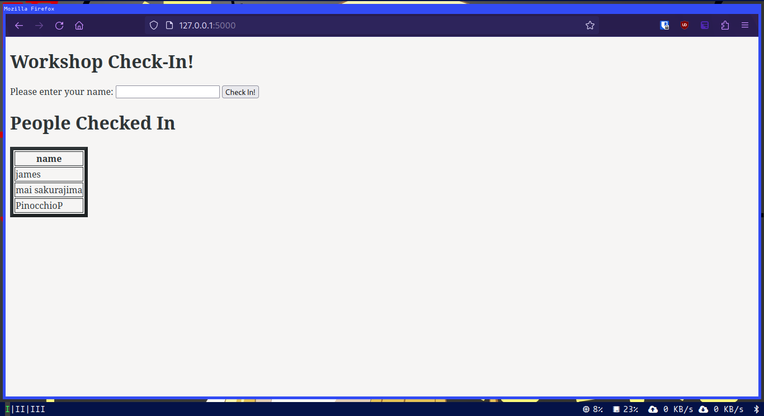

Slide 71
I am very tired, are we almost done?
One last thing! But first, questions?

Slide 72
git
SECTION:4
Effective collaboration.

Slide 73
What is git and GitHub?
git is a version control system (VCS).
  Saves snapshots of your code at different points called “commits”.
  Download link on the GitHub for this talk.
git is useful for many things.
  We will focus on its use as a collaborative tool.
GitHub is an online platform for hosting git repositories.
  This is how you share your code with the world!

Slide 74
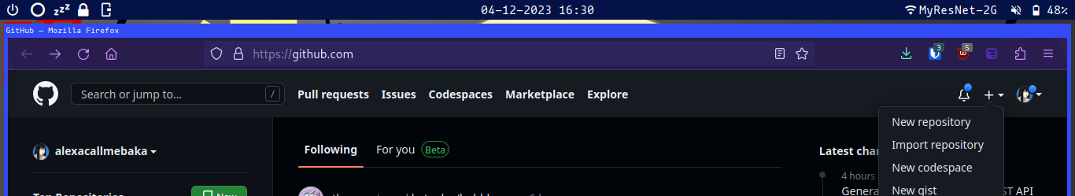
Setting Up GitHub
Create a GitHub account.
  github.com
Create a new repository on the home page.

Slide 75
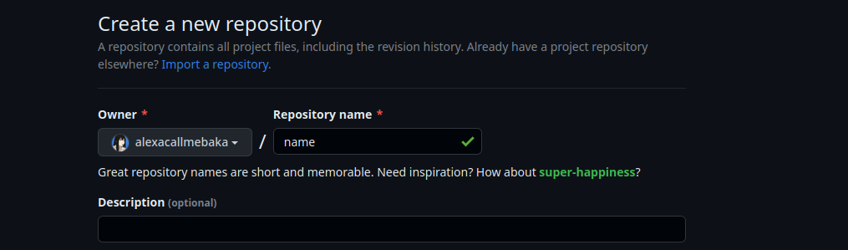

Give it a name.
Scroll down...
Click this.

Slide 76
Whohoo! You made your first GitHub repo!
Now how do you add your friends?

Slide 77
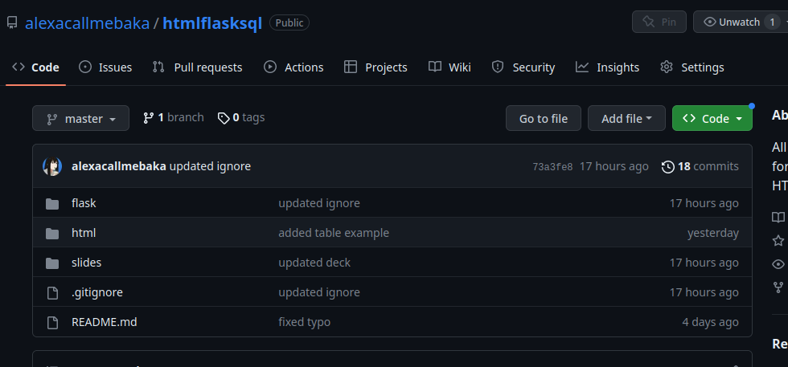

Slide 78
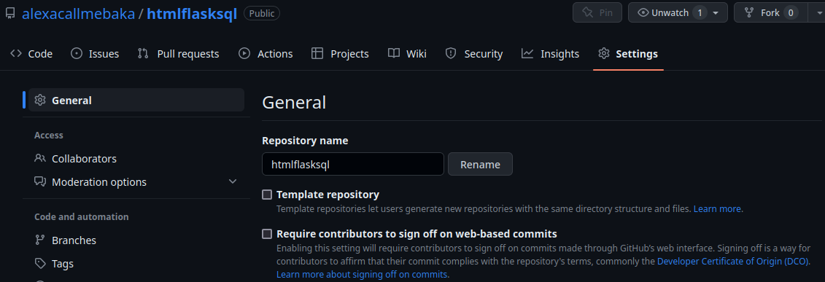

Slide 79
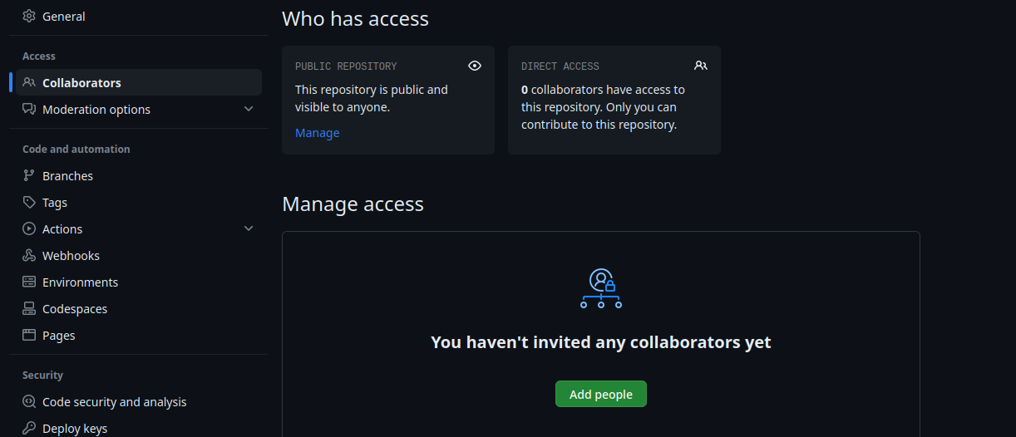
Add them here.

Slide 80
Now we need to actually make a repo to push to GitHub.

Slide 81
Baby’s First git Repo
Configure git:
  git config --global user.name "james"
  git config --global user.email "jmh@ku.edu"
  NOTE: THESE WILL BE PUBLICLY VISIBLE!!
On the command line, navigate to the directory you want your repo to be in, and run:
  git init
Connect your GitHub repo located at url:
  git remote add origin url
Now make some files, go wild!

Slide 82
Doing Things in git
git add filename
  Add filename to next commit. Called “staging”.
git commit -m ‘message’
  Commit all staged files to repo with message message.
git push
  Push changes to GitHub.
  May need to run git push -u origin master the first time in a new repo.
git clone url
  Copy git repo located at url onto your local machine.
git pull
  Pull changes from GitHub.

Slide 83
That is just a taste of what you can do.
Questions?

Slide 84
Our whirlwind journey has come to an end.

Slide 85
Where to go next?
This deck, and all example code on GitHub!
You will also find links to helpful resources.
Flag me down at HackKU or ping me on the Discord!
https://github.com/alexacallmebaka/htmlflasksql

Slide 86
Thank you
FIN.
Contact: jameshurd@ku.edu

