Slide 1
Capstone Project - The Battle of Neighborhoods (Weeks 1-2)
Parisian restaurants

Slide 2
A description of the problem and a discussion of the background
The last 2 lessons of the IBM Applied Data Science Capstone course allow us to use machine learning techniques on real-world projects. During this course we've learned segmentation and clustering methods. For this we've used Toronto, Ontario, Canada and New York city, the USA datasets. This data included 2 data sources: neighborhoods and Foursquare API data with its users reviews. So now, I'll try to implement received knowledge using Paris, France data about its Arrondissements (districts) and corresponding Quarters (neighborhoods).
The main goal of this project is to make a recommendation where in a city of my choice I would suggest to open a restaurant. I was interested in Paris, France as a city of my choice. The task for this project says about Paris - "very diverse and is the financial capital of country". In France there's a lot of tourist places, but with Paris it is very difficult to compete with any other city in France, and probably there will be enough data on restaurants and cafes.

Slide 3
A description of the data and how it will be used to solve the problem
The following data (20 boroughs and 80 neighborhoods) was used to determine the best place to open a restaurant in Paris:
Arrondissements data (This dataset comes from a certified public service - data.gouv.fr). This data include information about districts names, postal_codes, their coordinates, and perimeter as well as density information. File name - arrondissements.csv
https://www.data.gouv.fr/en/datasets/arrondissements-1/#_
Quarters data (Wikipedia). This data includes quarter names and their areas, as well as corresponding arrondissements. To get this data BeautifulSoup module was used.
https://fr.wikipedia.org/wiki/Liste_des_quartiers_administratifs_de_Paris
https://en.wikipedia.org/wiki/Quarters_of_Paris (English version)
Latitude and longitude of the given address using OpenStreetMap's Nominatim service. Neighborhood names, arrondissements' postal codes and "Paris, FR" info were used to get neighborhood coordinates through geolocator.geocode
https://geopy.readthedocs.io/en/stable/
Foursquare API. It was used to get information about neighborhood venues.
https://foursquare.com/developers/apps

Slide 4
Methodology
There were made 3 steps to achieve a goal of this project:
Part 1: Load and prepare data (data collection, cleaning, joining all datasets together).
Part 2: Get the latitude and the longitude coordinates of each neighborhood.
Part 3: Exploring and clustering the neighborhoods in Paris (visualization the resulting clusters). Clustering (K-Means) was used to analyze neighborhood data.

Slide 5
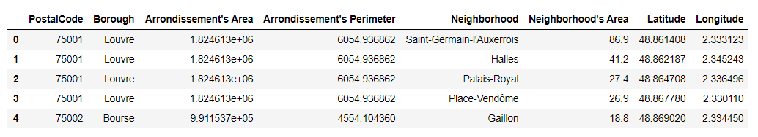
Boroughs, Neighborhoods datasets with corresponding Latitude and Longitude
(top 5 rows)

Slide 6
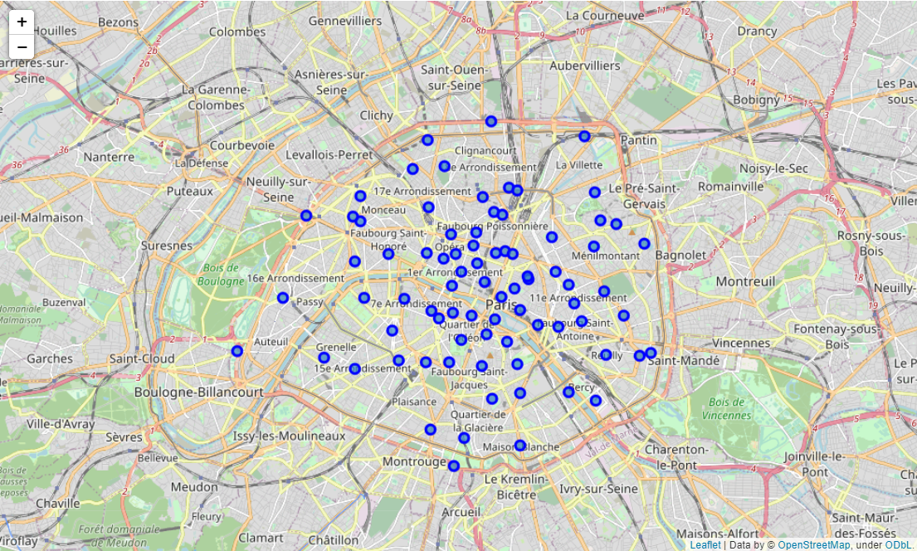
Map of Paris with neighborhoods superimposed on top

Slide 7
Neighborhoods Venues dataset
(top 5 rows)
 | Neighborhood | 1st Most Common Venue | 2nd Most Common Venue | 3rd Most Common Venue | 4th Most Common Venue | 5th Most Common Venue | 6th Most Common Venue | 7th Most Common Venue | 8th Most Common Venue | 9th Most Common Venue | 10th Most Common Venue
0 | Amérique | Bar | Bakery | French Restaurant | Café | Restaurant | Japanese Restaurant | Gourmet Shop | Doner Restaurant | Theater | Beer Store
1 | Archives | French Restaurant | Japanese Restaurant | Cocktail Bar | Art Gallery | Italian Restaurant | Wine Bar | Bakery | Burger Joint | Sandwich Place | Bistro
2 | Arsenal | French Restaurant | Hotel | Plaza | Park | Gastropub | Italian Restaurant | Tapas Restaurant | Pedestrian Plaza | Vegetarian / Vegan Restaurant | Boat or Ferry
3 | Arts-et-Métiers | Diner | Kebab Restaurant | Theater | Middle Eastern Restaurant | Brasserie | Pizza Place | BBQ Joint | Park | Japanese Restaurant | Italian Restaurant
4 | Auteuil | Tennis Court | French Restaurant | Plaza | Sporting Goods Shop | Brewery | Stadium | Pool | Roof Deck | Museum | Shopping Plaza

Slide 8
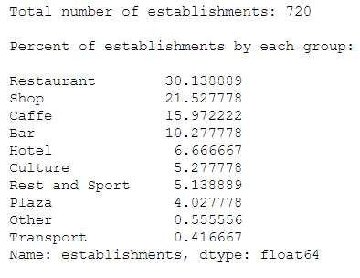
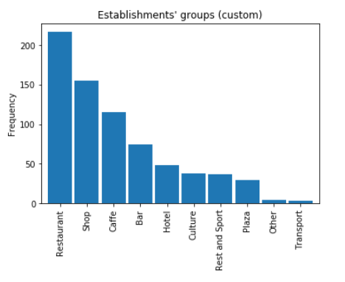
Establishments' frequencies in dataset

Slide 9
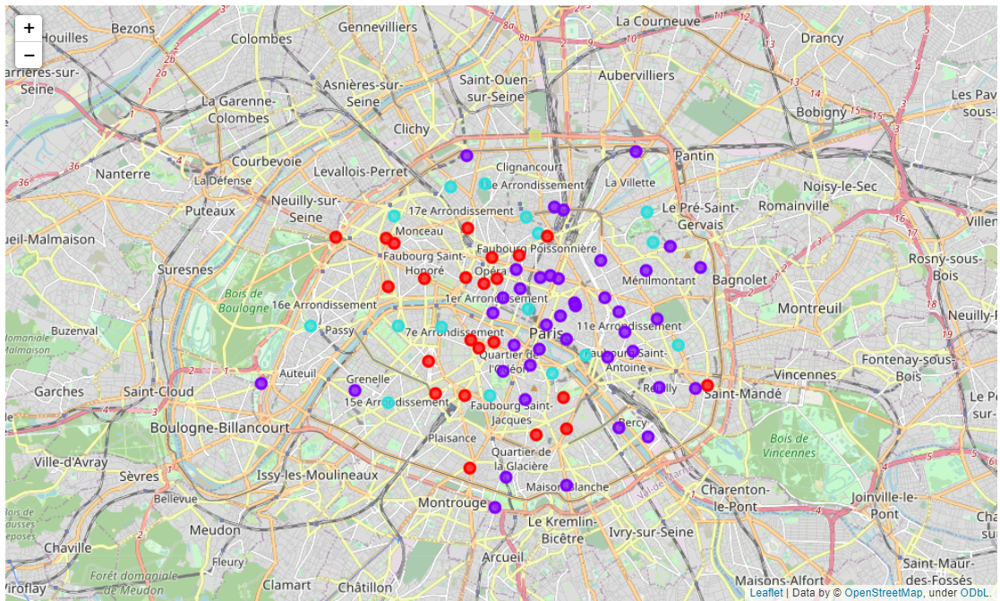
Visualize the resulting clusters

Slide 10
Results
After conducting K-Means algorithm, the data was clustered into 4 groups / clusters.
1st cluster consists of 23 neighborhoods with hotels and french restaurants as their 1st Most Common Venue (marked with red color on the map above). This establishments are located on the western part of Paris.
2nd cluster consists of 40 neighborhoods with restaurants, bars and hotels as their 1st Most Common Venue (marked with violet / purple color on the map above). This establishments are located on the central, eastern, and southern part of Paris.
3rd cluster consists of 16 neighborhoods with only french restaurants as their 1st Most Common Venue, bars and hotels as their 2nd Most Common Venue (marked with blue color on the map above). This establishments are evenly distributed throughout the city.
4th cluster include the only Flea Market in the data (marked with yellow color on the map above). It is located on the north of Paris.

Slide 11
Discussion and Conclusion
In future research it would be additional help to use population data of each neighborhood in Paris. Since the most preferable place to open a restaurant is that where the number of competitors is the lowest. For our data it's western part of Paris up to public park Bois de Boulogne. However, it's not possible to conclude decisively about the exact place.
The best way to determine the exact place for opening a restaurant in western part of Paris is to use additional data, for example, anonymized data of mobile operators. These data will show a more detailed picture of potential visitors to the new restaurant

