Slide 1
SES 3 B Product Assessment
Team 4
Graphics created by Ullupta conecum re volupta evelignis pe et doluptuam.

Slide 2
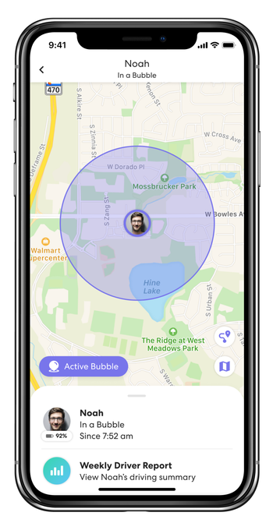
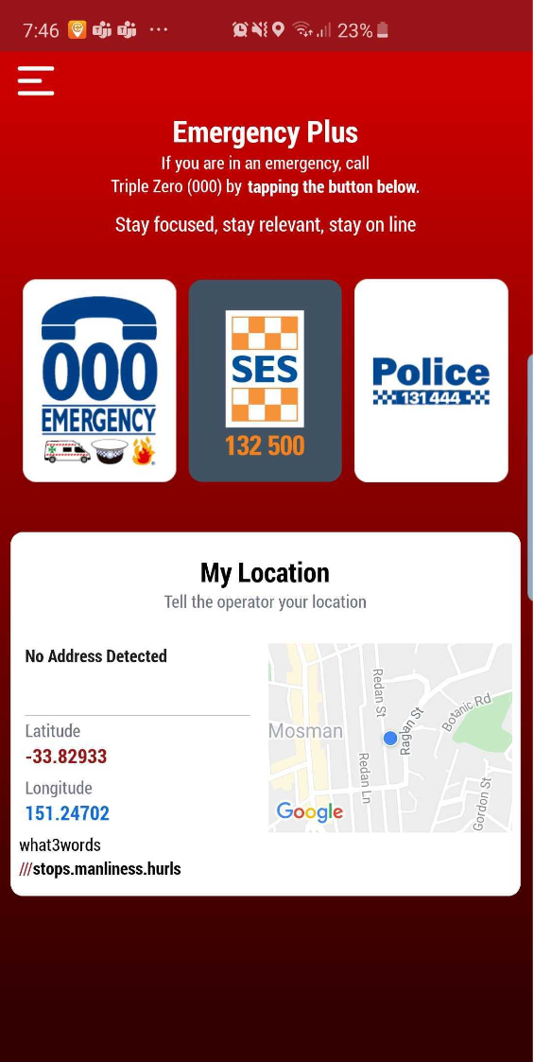
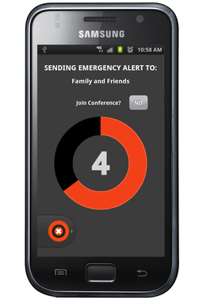
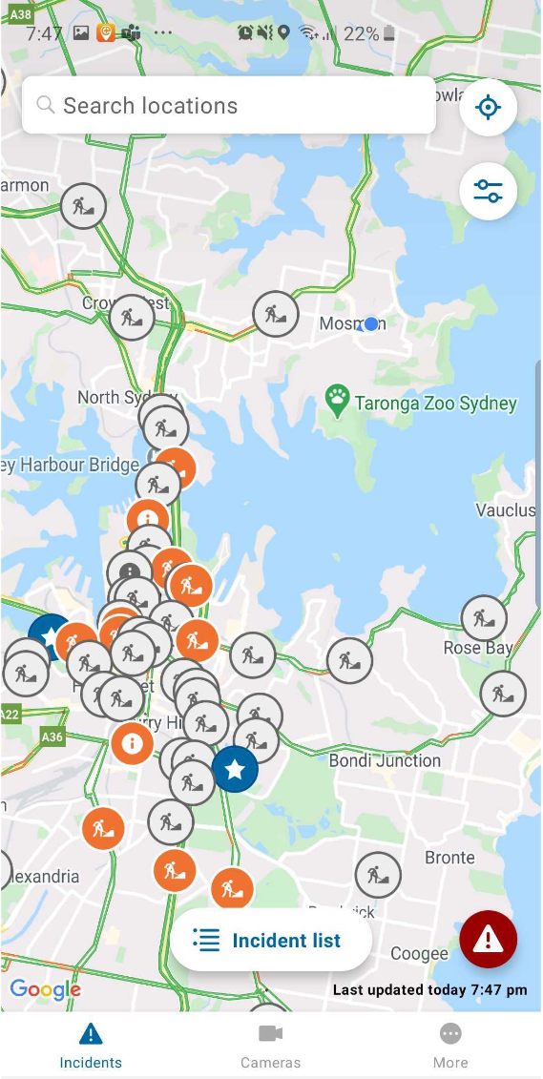
The Problem
People have a huge AMOUNT and VARIETY of risks they can be exposed to
How should they approach these? What is best?
Currently no centralised solution
LIFE360
EMERGENCY PLUS
GAURDLY
LIVE TRAFFIC NSW

Slide 3

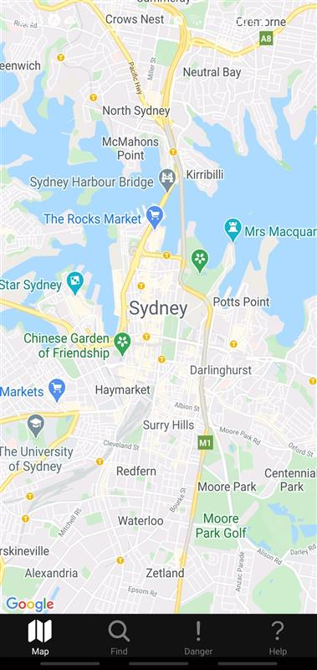
The Solution: FRIENDS
For
Rescue
In
Emergency
aNd
Daily
Situations
Notes:
FRIENDS is a scalable, secure and intuitive system which centralises the existing approaches taken to help civilians minimise their risk in their everyday lives.

Slide 4
Key Users and their Needs
CIVILIANS
Avoid dangers relative to themselves
Communicate with authorities
Be able to quickly receive help at their location
Be informed of what to do in a crisis
Bottom Line: Be Protected
AUTHORITIES
Inform Civilians of dangers
Reassure civilians in danger
Be able to reach at risk civilians quickly
Be able to track resources and events in a crisis
Bottom Line: Protect Others

Slide 5
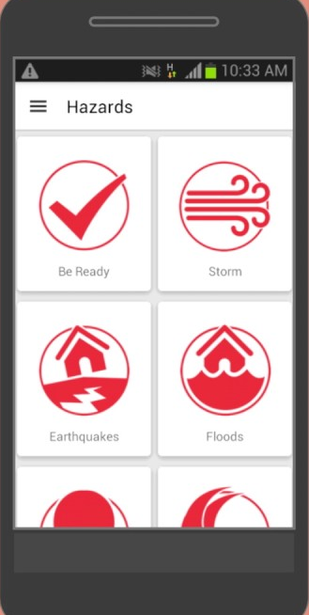
How our Product Compares
TRACK
INFORM
MAP
COMMUNICATE
Notes:
Mention how we bring everything together into one product. Maybe switch arrow directions?? Or find a central icon?

Slide 6
Project Scope
Crisis Management and Avoidance system
Minimise civilian exposure to danger
Offload work from emergency services
Priorities of the product:
Secure
Scalable
Adaptable
Notes:
In the end, what are we making:

Slide 7
App Features
Ability to track Events near the user
Message both authorities and other users
Request help from authorities when in a crisis
Be able to have ease of access to the app
Have the app be able to store and share relevant information about myself (example: location in a crisis)
Have my stored information be secure
Notes:
Review wording later

Slide 8
Demo
Add video here

Slide 9
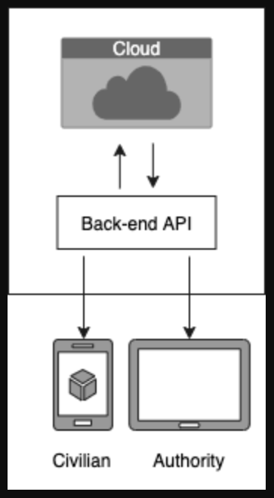
Architecture Overview
MySQL cloud storage
API built in python using Flask
React front-end
Notes:
Expand API to include key functionality such as the API requests, ML chatbot, etc.

Slide 10
Secure, Scalable, Adaptable
SECURE
SHA256 encryption
OTP multi-factor authentication
SCALABLE
Cloud storage
Rest API core with Web app Front-End
ADAPTABLE
Easy to develop on different front-end platforms
Flexible database objects
Notes:
Add advanced architecture diagram that shows security features.

Slide 11
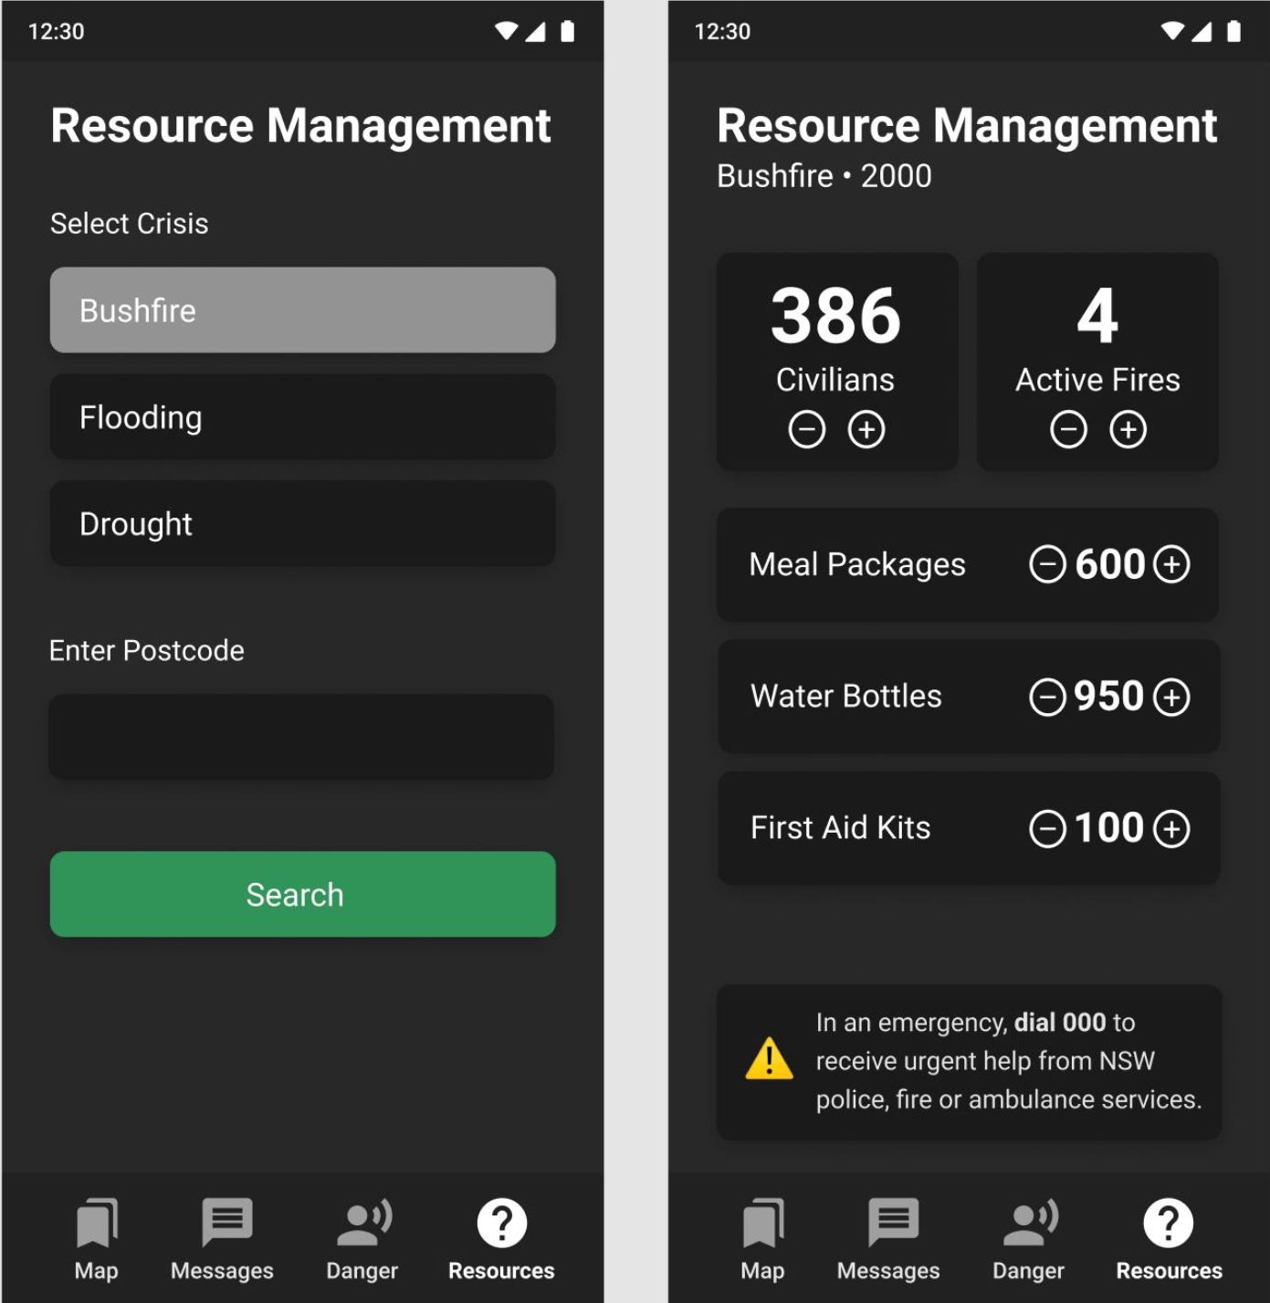
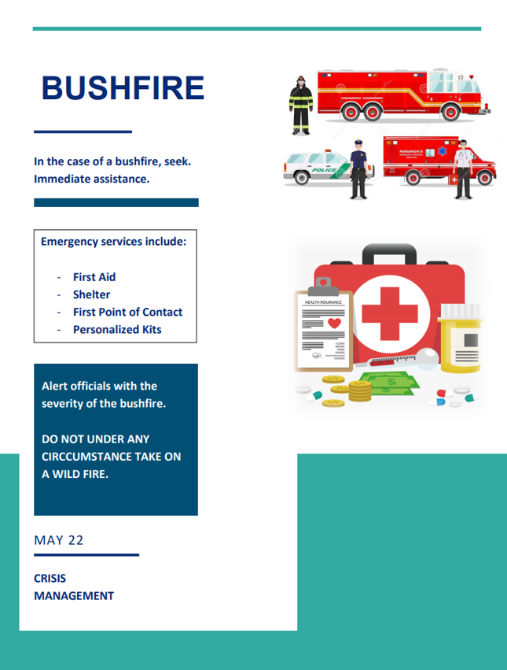
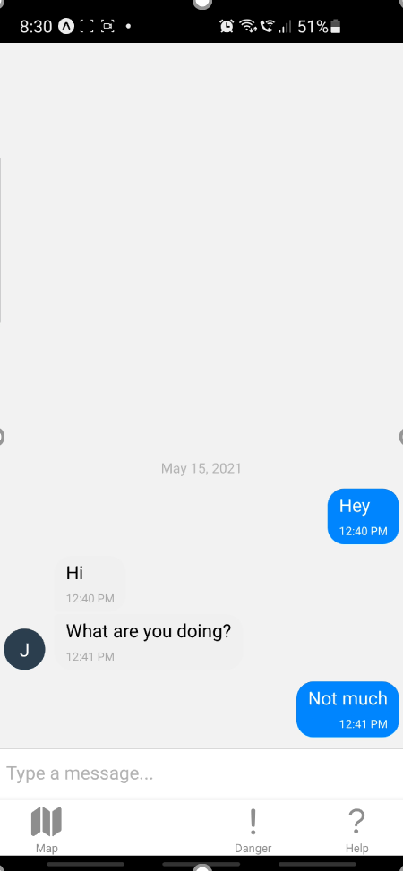
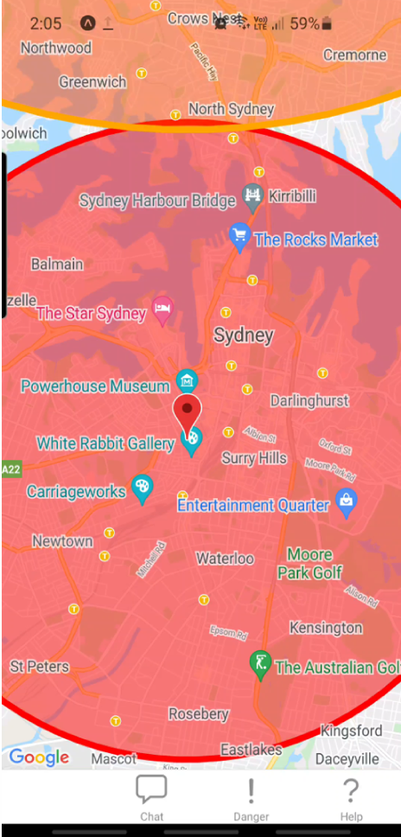
At the End of 3A
RESOURCES
HELP
MAP
COMMUNICATE

Slide 12
Key 3B Features
Front-end Webapp Redo
Improved Messaging
Improved Map
ML Chatbot
Security
User Tracking
Notes:
Take clips for each feature from Demo and other sources (user tracking pending, proper chatbot pending). Front-end redo should show before and after. List tools for injection and penetration testing in regards to the SHA256.

Slide 13
Next Step
How to get profit or investment?
Pitch API to government for authority use. Emphasise on the Chatbot ability to free up 000 operators. There is also potential in the ability to gather large scale data on emergencies.
A bigger market in the future?
Insurance companies may be interested in location based emergency trends in order to customise there pricing further
More functions
Make capable of having data inputted automatically from existing Event tracking sites (e.g. NSW traffic)

Slide 14
Teamwork/management Review
Good | Alright | Bad
Peer Review of work Submission of Meeting Minutes and Weekly Journals Weekly Agenda Randomly selecting scribe for Meeting Minutes | Sub-team attendance. While sometimes these meetings were missed updates were always followed through later on in the day/week | Full-team attendance. Rarely could everyone attend due to other commitments
Notes:
Get other stuff to add here?

Slide 15
Expected Timeline
Sprint 1
Onboarding
Expand test data
Begin Quality Assurance
Sprint 2
Finish Quality Assurance
Finish Messaging from 3A
Finish Geolocation from 3A
Create Chatbot model
Begin Encryption (Security)
Sprint 3
Begin Google Authenticator (Security)
Begin User Tracking
Train Chatbot
Sprint 4
Prepare Chatbot for Messenger integration
Penetration test Security updates
User Tracking Done
Setup Authority controls on frontend (create, edit, delete Events)
Sprint 5
Bug fixes
Security Done
Chatbot Done
Refinements/Non-required Features

Slide 16
Actual Timeline
Sprint 1
Completed as planned
Sprint 2
Front-end suffering code decay. Determined redo plan
Help migrated
Chatbot started
Encryption scoping
Sprint 3
Chatbot base function complete. Empathy functionality started
Google Authenticator started (Security)
Encryption started
Sprint 4
Google Authenticator API shutdown. Switched to OTP multi-factor authentication. Completed.
Map migrated.
Sprint 5
Chatbot modularised and integrated to frontend
Front-end Navigation
Notes:
Need to go through weekly journals/meeting minutes in depth.

Slide 17
Thanks Q&A

