Slide 1
Software Engineering Studio 3 Product Assessment
FRIENDS
Graphics created by Ullupta conecum re volupta evelignis pe et doluptuam.

Slide 2
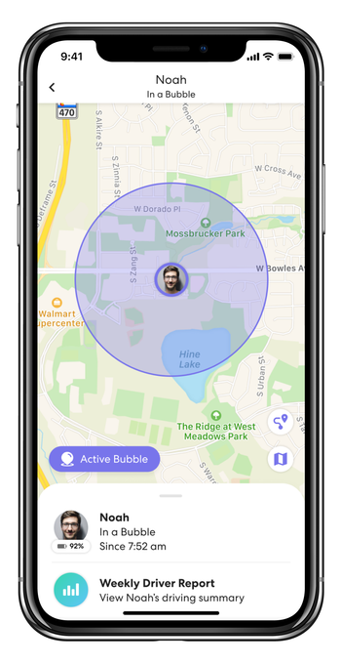
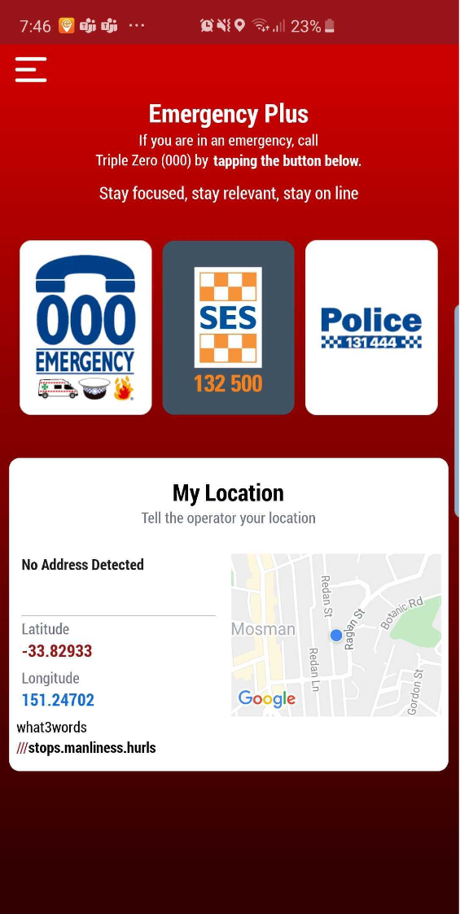
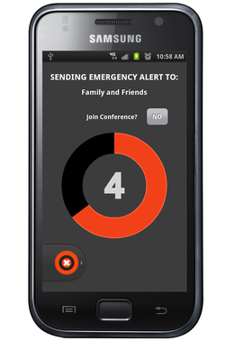
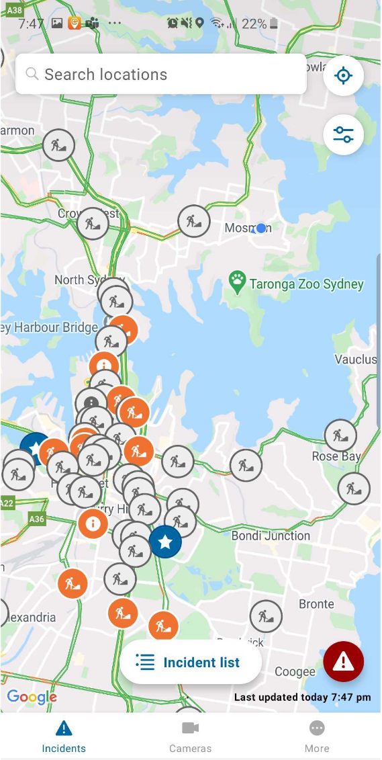
The Problem
People have a huge AMOUNT and VARIETY of risks they can be exposed to
How should they approach these? What is best?
Currently no centralised solution
LIFE360
EMERGENCY PLUS
GAURDLY
LIVE TRAFFIC NSW

Slide 3

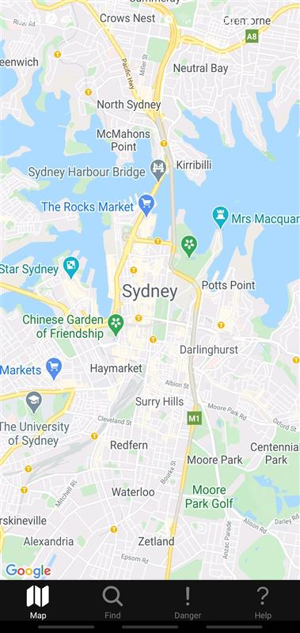
The Solution: FRIENDS
For
Rescue
In
Emergency
aNd
Daily
Situations
Notes:
FRIENDS is a scalable, secure and intuitive system which centralises the existing approaches taken to help civilians minimise their risk in their everyday lives.

Slide 4
Key Users and their Needs
CIVILIANS
Avoid dangers relative to themselves
Communicate with authorities
Be able to quickly receive help at their location
Be informed of what to do in a crisis
Bottom Line: Be Protected
AUTHORITIES
Inform Civilians of dangers
Reassure civilians in danger
Be able to reach at risk civilians quickly
Be able to track resources and events in a crisis
Bottom Line: Protect Others

Slide 5
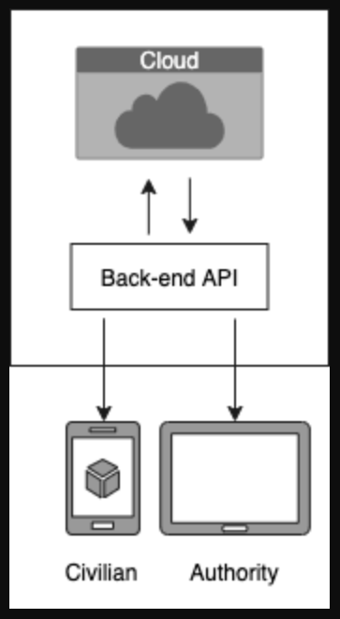
Architecture Overview
MySQL cloud storage
API built in python using Flask
React Native front-end

Slide 6
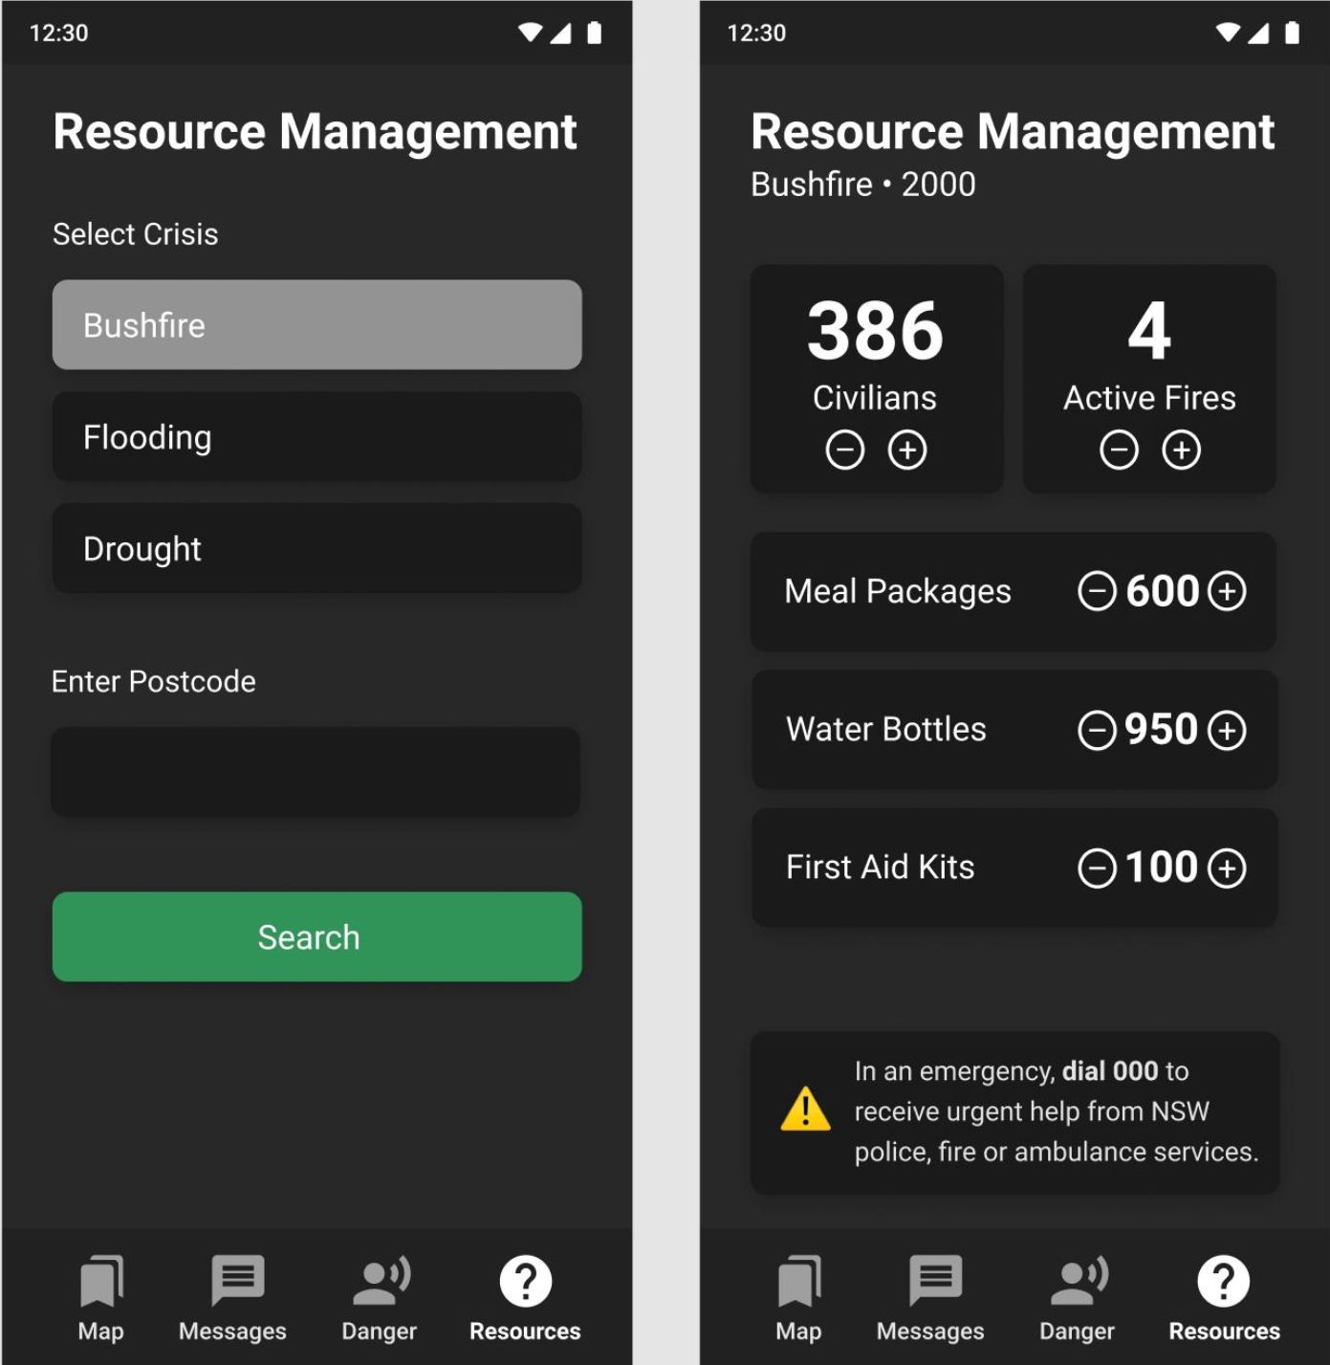

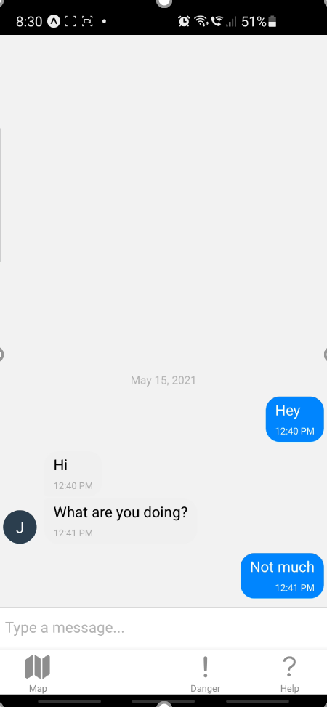
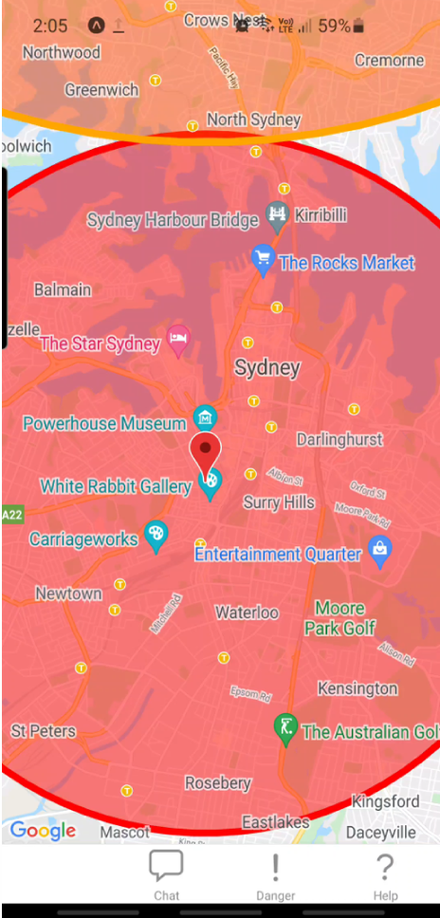
At the End of 3A
RESOURCES
HELP
MAP
COMMUNICATE

Slide 7
Going Forward in 3B

Slide 8
3B Features
Improved Messaging
Improved Geolocation
Including user tracking
Security
Encryption using AES, JWT tokens hashed with sha256
Google Authenticator
ML Chatbot
Data gather for Event creation
Calm Down
Quality Assurance
Automated Testing
Overall Improvement

Slide 9
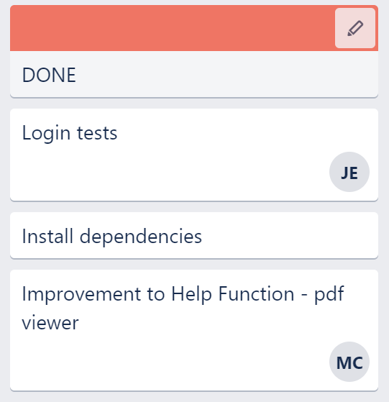
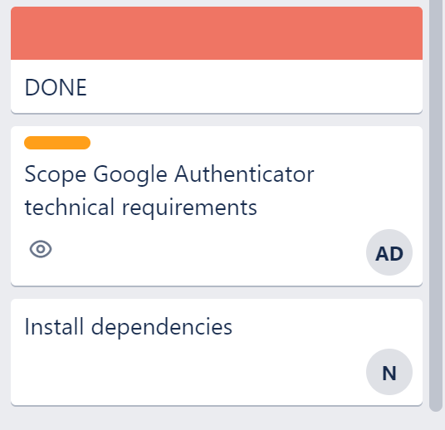
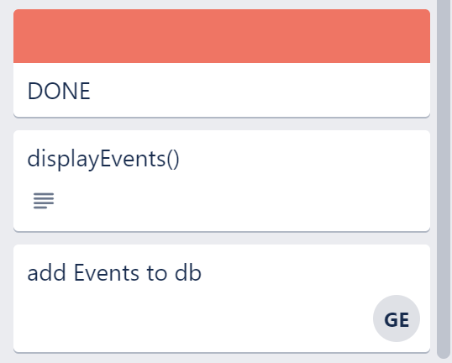
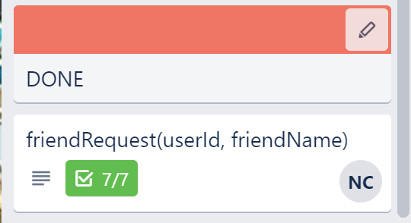
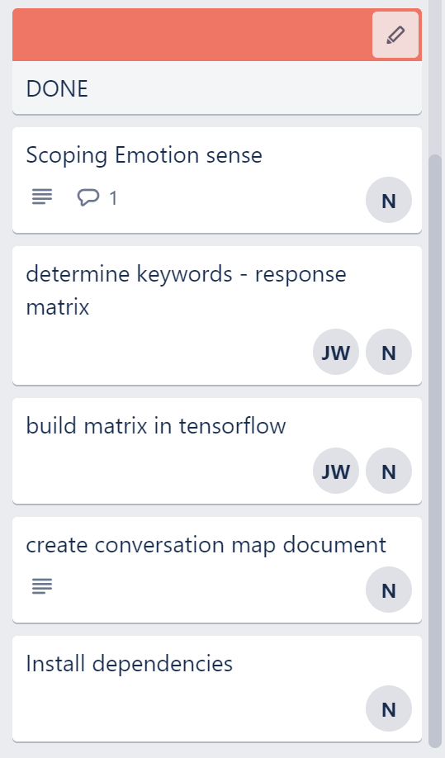
Completed Work
QUALITY ASSURANCE
SECURITY
IMPROVED GEOLOCATION
IMPROVED MESSAGING
ML CHATBOT

Slide 10
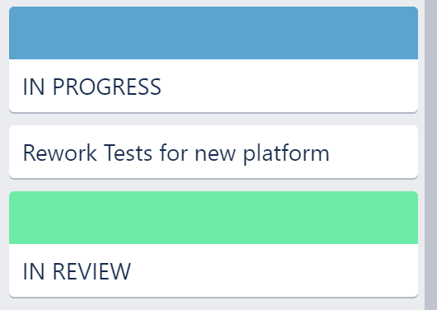
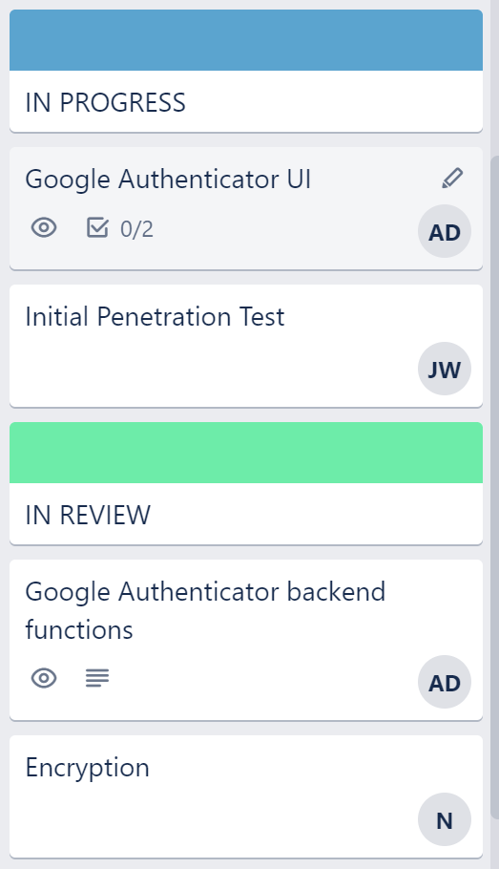
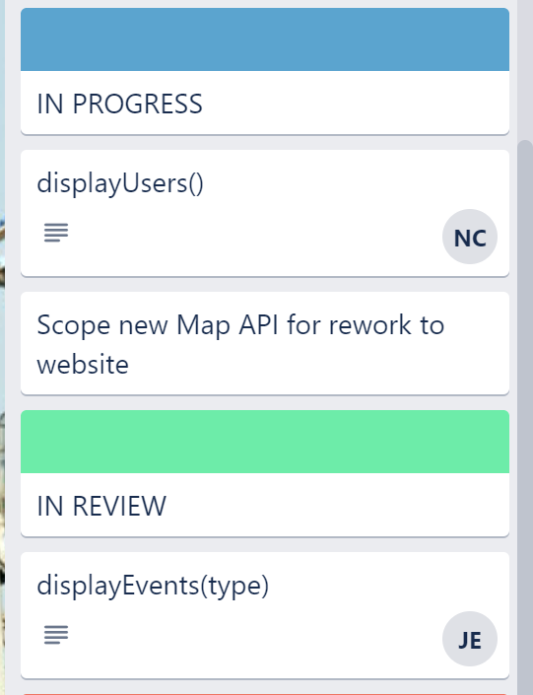
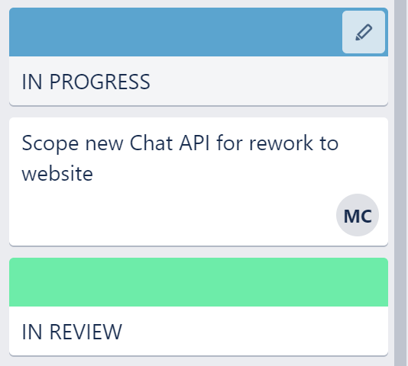
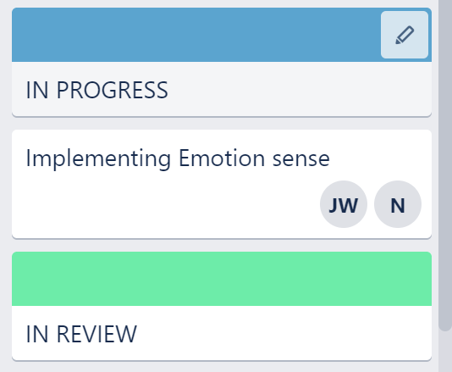
In Progress Work
QUALITY ASSURANCE
SECURITY
IMPROVED GEOLOCATION
IMPROVED MESSAGING
ML CHATBOT

Slide 11
Chatbot Demo

Slide 12
SETBACKS
PROBLEM
Code decay on front-end repo. Several out-of-date dependencies causing system crash.
SOLUTION
Front-end to be reworked as a React website for easier testing, access and build
REASON
React Native and Expo.Go proved to be unnecessary complex. When code decay issues arose it was determined more worth while to simply migrate the JavaScript across to an easier to manage webpage platform. Additionally, this proves the versatility of the backend API across platforms
AFFECTS
Messaging, Geolocation, Quality Assurance, legacy functions from 3A

Slide 13
Progress Expectations
Meet
Quality Assurance
Over
Chatbot
Security
Under
Geolocation
Messaging

Slide 14
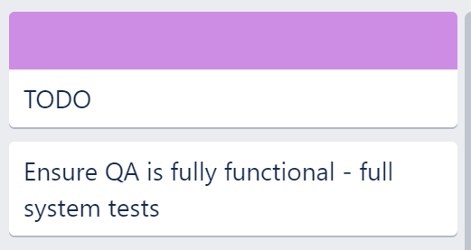
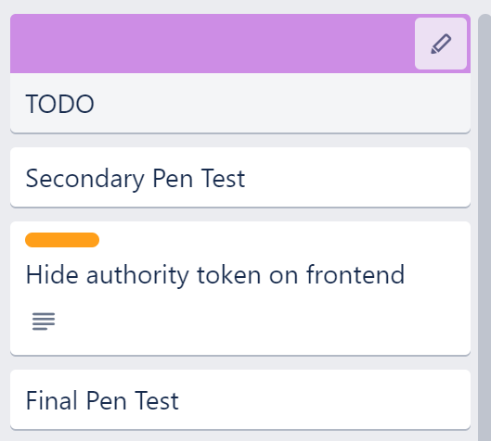
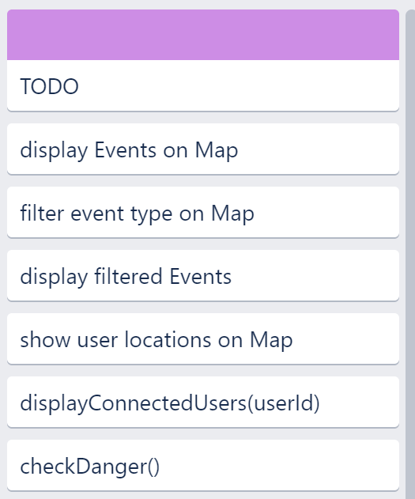
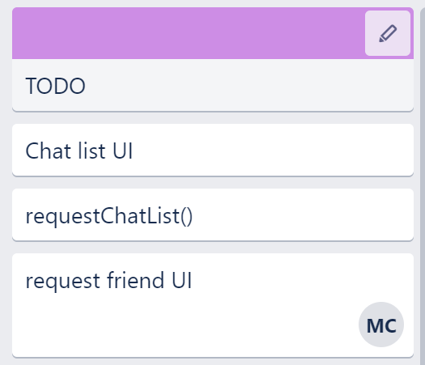
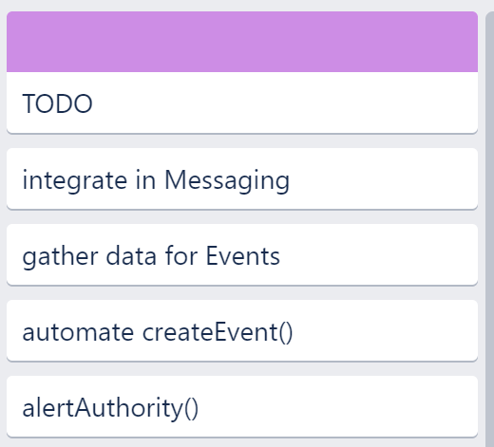
To Do Work
QUALITY ASSURANCE
SECURITY
IMPROVED GEOLOCATION
IMPROVED MESSAGING
ML CHATBOT

Slide 15
Thanks Q&A

