Slide 1
Agenda
1. The Problem — why manual assessment doesn't scale
2. Solution Overview — the AI-driven health check pipeline
3. Architecture — how MCP, CIRCUIT LLM & CAT work together
4. LLM Role — what the AI does at each stage
5. Why LLM is the right approach
6. Live Demo — run, analyse, chart, Q&A
7. Key Outcomes — measured results
8. Setup & Next Steps
Cisco CX Hackathon 2026 · CS-IC-62 · Bridging the Observability Gap

Slide 2
The Problem — Manual Assessment Doesn't Scale
Time-to-insight is too slow — multi-tab Excel & PowerPoint require 30–60 min of manual review before any recommendation reaches the customer.
Expertise barrier is high — deep AppDynamics API knowledge and maturity-model familiarity don't scale across the entire CS org.
01
02
Reports go stale and get lost — assessment outputs are rarely archived consistently; trend analysis is nearly impossible.
Follow-up questions restart the cycle — every clarifying question ('Which apps are blocking Gold tier?') triggers another manual report review.
03
04
Result: observability data that exists but doesn't flow. The gap between raw telemetry and business-level guidance stays wide — and expensive.
Cisco CX Hackathon 2026 · CS-IC-62 · Bridging the Observability Gap

Slide 3
Solution — AI-Driven Health Check Pipeline
Automates the full assessment lifecycle — from metric collection to report delivery to conversational Q&A — using:
MCP
CIRCUIT LLM
CAT Engine
Knowledge Base
Model Context Protocol
Cisco's internal AI gateway
Config Assessment Tool
Persistent context store
Structured tool-calling between LLM and backend engine
Secure, on-network reasoning; no data leaves Cisco
Deterministic AppDynamics API extraction + Excel/PPT reports
Historical reports feed cumulative cross-run intelligence
Every run is archived to SharePoint. Report data is injected into LLM context for instant conversational Q&A — no re-running required.
Cisco CX Hackathon 2026 · CS-IC-62 · Bridging the Observability Gap

Slide 4
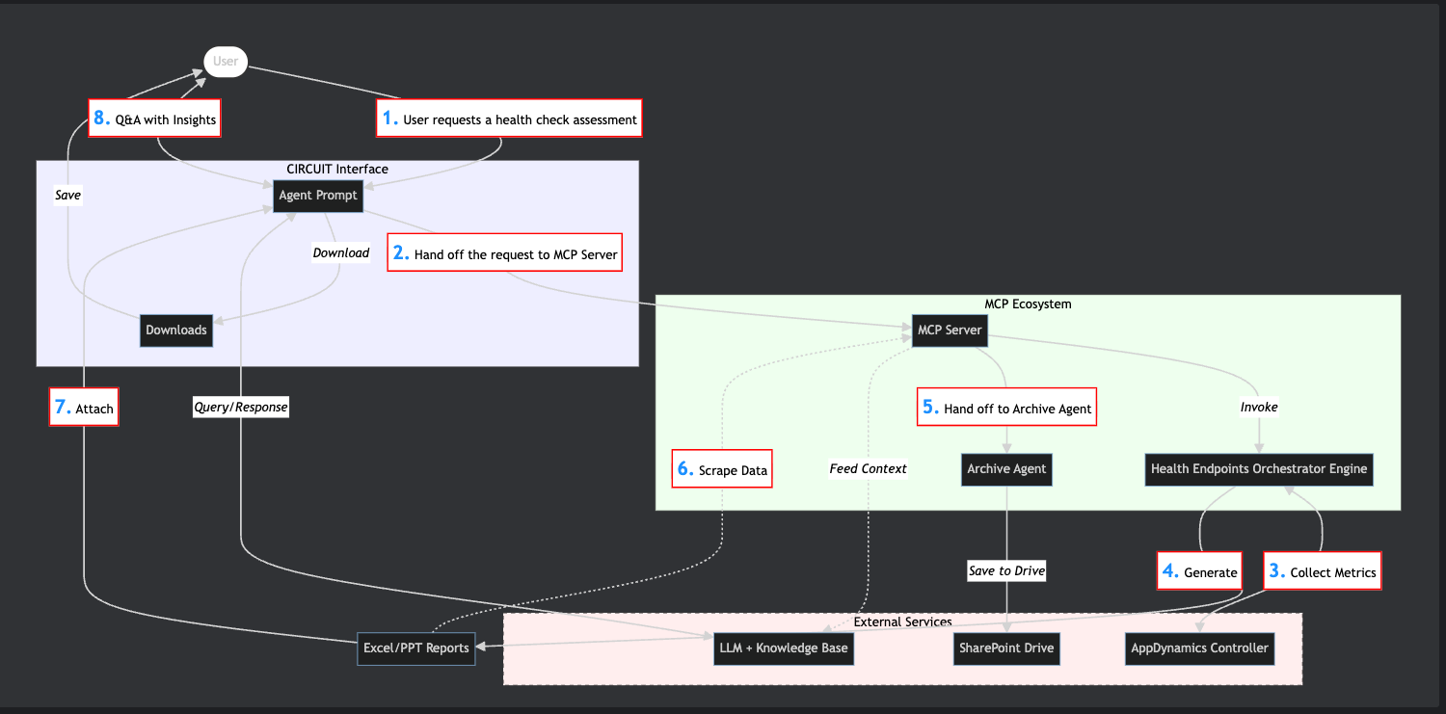
Architecture — Advanced Health Check & LLM Insight Flow
Cisco CX Hackathon 2026 · CS-IC-62 · Bridging the Observability Gap

Slide 5
How the LLM Powers Each Stage
Step | What Happens | LLM's Role
1 — Request | User asks for a health check in plain English | Parses intent, identifies target environment & job parameters
2 — Orchestration | CIRCUIT hands off a structured tool call to the MCP Server | Selects the correct MCP tool and arguments autonomously
3 — Collection | Health Endpoints Engine queries AppDynamics Controller APIs | — deterministic engine —
4 — Report Gen | Engine produces Excel and PowerPoint reports | — deterministic engine —
5 — Archiving | Archive Agent saves reports to SharePoint Drive | LLM can trigger archiving in the same conversation turn
6 — Knowledge | Report data is scraped and fed into the LLM's context | Builds cumulative understanding across runs and customers
7 — Delivery | Reports attached to CIRCUIT prompt, available for download | Narrates key findings and highlights critical gaps
8 — Q&A | User asks follow-up questions | Answers from loaded context — no re-running any tools
Cisco CX Hackathon 2026 · CS-IC-62 · Bridging the Observability Gap

Slide 6
Why LLM is the Right Approach
Tool-Use Reasoning
Structured → Natural Translation
CIRCUIT receives the full MCP tool schema at session start and autonomously decides which tool to call, when, and with what arguments — no scripting required.
Dense multi-sheet Excel data (maturity scores, agent matrices, threshold breaches) is converted into concise, human-readable summaries and prioritised recommendations.
Persistent Knowledge Base
Conversational Memory
Each run feeds the LLM's context, enabling cross-run and cross-customer pattern recognition that no single-session tool can provide.
The full report is injected into context once. Follow-up questions are answered from memory — no re-running, no re-downloading.
Cisco CX Hackathon 2026 · CS-IC-62 · Bridging the Observability Gap

Slide 7
Live Demo — Assessment to Insight in One Conversation
1
2
3
Run assessment
Instant summary
Drill down
User: "Run health check for DefaultJob"
CIRCUIT: Overall APM maturity is 68% (Silver). 3 apps blocked from Gold.
User: "Which apps are furthest from Gold?"
4
5
6
LLM answers
Archive
Done
CIRCUIT answers from loaded context — no tool re-run needed.
User: "Archive this and send the download link"
CIRCUIT: Report archived to SharePoint. Download link: https://...
Tip: the LLM answers follow-up questions from in-context memory — no re-running, no re-downloading reports.
Cisco CX Hackathon 2026 · CS-IC-62 · Bridging the Observability Gap

Slide 8
Key Outcomes — Measured Results
Faster Time-to-Insight
Tool Expertise Required
Automated Archiving
10×
Results previously requiring 30–60 min of manual Excel review summarised in seconds
0
Any CS engineer or SA can request a health check and receive consultant-grade guidance via natural language
100%
Every run saved to SharePoint via Archive Agent — searchable, time-stamped, zero manual effort
Cumulative Knowledge
Context Load, Any Questions
Cisco-Native & Secure
∞
Report data feeds the LLM knowledge base enabling cross-run trend & cross-customer pattern recognition
1×
The full report is injected into context once; all follow-up Q&A answered from memory
✓
Runs entirely over CIRCUIT (Cisco's internal AI gateway) — all data stays on-network
Cisco CX Hackathon 2026 · CS-IC-62 · Bridging the Observability Gap

Slide 9
Setup & Quick Start
Prerequisites
5 Steps to First Insight
✓ Python 3.12+
✓ Cisco CIRCUIT LLM API credentials (app key, client ID, client secret)
✓ AppDynamics controller + a CAT job file in input/jobs/
1
git clone <repo> && cd <repo>
2
pip install pipenv && pipenv install && pipenv shell
3
Copy properties.py.template → properties.py and fill in CIRCUIT credentials
Key Environment Variables
4
Create input/jobs/DefaultJob.json with your controller URL + credentials
$ CIRCUIT_LLM_API_APP_KEY
$ CIRCUIT_LLM_API_CLIENT_ID
$ CIRCUIT_LLM_API_CLIENT_SECRET
$ CIRCUIT_LLM_API_MODEL_NAME (e.g. gpt-5-nano)
5
python mcp_llm_client.py — and start chatting!
Cisco CX Hackathon 2026 · CS-IC-62 · Bridging the Observability Gap

