Slide 1

Splunk AppDynamics
Maturity Assessment Comparison Results
Notes:
The configuration assessment tool is amazing for showing us the current maturity of an AppDynamics controller.
Now we have developed a way to utilize the outputs from the Configuration Assessment to compare a pervious output against a current output.
Using this we can now determine what direction we are going with regards to Maturity – this direction can help identify areas for improvement – to improve application performance monitoring and help you get the most out of your investment

Slide 2
Assessment Result - Key Callouts
Maturity
Status
The table below shows the Overall Assessment APM result.

Slide 3

Why is a Comparison Assessment needed?
Direction!!
"The right direction in IT comes from comparing outputs to understand how far you've come and where to go next."

Slide 4
Which Applications have improved?
Applications Improved
An Increase in Maturity, is a sign we are going in the right direction.
It leads to enhanced visibility and better application performance monitoring.
Total Number of Applications:
Notes:
This is a comparison of the summary tab from a previous config assessment against a current assessment.
Bronze basically means little, or no configuration has taken place on the business application – so we want that value to lower.
For Silver, Gold and Platinum – we want to see these increase – this shows us we are going in the right direction with improving the maturity of our AppDynamics Business Applications

Slide 5
The table below shows the summary of your previous APM maturity assessment
The table below shows the summary of your current APM maturity assessment
The table below identifies the changes in maturity from the compared APM assessments
Maturity Assessment - Levels Guide:
•Platinum - 50% of criteria for an application must be Platinum, all remaining criteria must be at least Gold
*Gold - 50% of criteria for an application must be Gold or higher, all remaining criteria must be at least Silver
«Silver - 80% of criteria for an application must be Silver or higher
•Bronze - All remaining applications

Slide 6
Assessment Result - APM Application Health
Bronze
Silver
Gold
Platinum
Any apps that do not meet the minimum Silver Criteria will be classified as bronze
To be considered silver, at least 70% of the criteria for an application must be silver or higher
To be considered gold, at least 70% of the criteria for an application must be gold or higher, and the remaining criteria must be at least silver
To be considered platinum, at least 70% of the criteria for an application must be platinum, and the remaining criteria must be at least gold.
YOUR LEVEL
YOUR TARGET

Slide 7
The table below shows the Overall Assessment APM result.
Notes:
This table compares the output from a previous Overall Assessment against the output from a current Overall Assessment.

Slide 8
The table below shows the comparison result of each APM entity. Improvement is highlighted in Green
Notes:
This table is generated from the Analysis Tab on the Maturity Assessment APM Output file

Slide 9
Next Steps
Suggested Plan of Action for Maturity Improvements
Priority 1
Priority 2
Priority 3
Priority 4
Example – Agent Upgrades
Example – BT Enablement sessions
Accelerators
Working sessions
Example – Health Rules
Example – move business applications from gold to platinum
Notes:
This slide is not automated with detail for next steps – if you choose to keep this in the presentation, please update with what you feel are priority updates based on results

Slide 10
Monthly Review – Quarterly CAT Runs – Maintain Progress
AppD Monthly Meeting Run Config Assessment
Discuss Target for next month
AppD Monthly Meeting Deliver Session Check on target progress
AppD Monthly Meeting Deliver
AppD Monthly Meeting Run Config Assessment
Compare Findings
Deliver Session Check on target progress
1
3
5
7
Month 2
Jan
Mar
MM DD YY
MM DD YY
MM DD YY
Month 1
Month 3
Feb
Apr
MM DD YY
MM DD YY
MM DD YY
MM DD YY
2
4
6
AppD Monthly Meeting Deliver Session Check on target progress
AppD Monthly Meeting Run Config Assessment
Compare Findings
Deliver Session Check on target progress
AppD Monthly Meeting Deliver Session

Slide 11
APM Entity Downgrade Deep dive

Slide 12
Metric Limits
APM Agents – Maturity Downgrades
Item
# of Apps with Downgrades
# of Apps
Metric Limits Reached increased
Agent Age > 1 year increased
Agent Age > 2 year increased
Agents not Reporting Data increased
% Agents Running same version increased
Notes:
The table shows what has downgraded maturity to Gold, Silver and Bronze
The Maturity Downgrades takes a count of the individual items which have downgraded from the previous Maturity assessment against the current maturity assessment.

Slide 13
Metric Limits
Machine Agents – Maturity Downgrades
Item
# of Apps with Downgrades
Agents Age > 1 year increased
Agents Age > 2 year increased
Agents not Reporting data increased
% Agents Running same version
Machine Agent not Installed with App Agent
Notes:
The table shows what has downgraded maturity to Gold, Silver and Bronze
The Maturity Downgrades takes a count of the individual items which have downgraded from the previous Maturity assessment against the current maturity assessment.

Slide 14
Metric Limits
Business Transactions – Maturity Downgrades
Item
# of Apps with Downgrades
BT limits increased
BT Load % increased
BT Lockdown
# of Custom Match Rules
Notes:
The table shows what has downgraded maturity to Gold, Silver and Bronze
The Maturity Downgrades takes a count of the individual items which have downgraded from the previous Maturity assessment against the current maturity assessment.

Slide 15
Metric Limits
Backends – Maturity Downgrades
Item
# of Apps with Downgrades
Backend Load % increased
Backend Limits increased
# of custom backend rules
Notes:
The table shows what has downgraded maturity to Gold, Silver and Bronze
The Maturity Downgrades takes a count of the individual items which have downgraded from the previous Maturity assessment against the current maturity assessment.

Slide 16
Metric Limits
Service Endpoints – Maturity Downgrades
Item
# of Apps with Downgrades
Custom rules have decreased
limits reached
service endpoints load
Notes:
The table shows what has downgraded maturity to Gold, Silver and Bronze
The Maturity Downgrades takes a count of the individual items which have downgraded from the previous Maturity assessment against the current maturity assessment.

Slide 17
Metric Limits
Error Configuration – Maturity Downgrades
Item
# of Apps with Downgrades
% of Error transactions
# of Custom Rules
Notes:
The table shows what has downgraded maturity to Gold, Silver and Bronze
The Maturity Downgrades takes a count of the individual items which have downgraded from the previous Maturity assessment against the current maturity assessment.

Slide 18
Metric Limits
Health Rules and Alerting – Maturity Downgrades
Item
# of Apps with Downgrades
HR violations increased
Default HR Modified
Actions bound to policies
# of Custom Match Rules
Notes:
The table shows what has downgraded maturity to Gold, Silver and Bronze
The Maturity Downgrades takes a count of the individual items which have downgraded from the previous Maturity assessment against the current maturity assessment.

Slide 19
Metric Limits
Data Collectors – Maturity Downgrades
Item
# of Apps with Downgrades
# of Data Collectors
# of Data collectors in snapshots
# of Data Collectors in Analytics
Enabled for BiQ decreased
Notes:
The table shows what has downgraded maturity to Gold, Silver and Bronze
The Maturity Downgrades takes a count of the individual items which have downgraded from the previous Maturity assessment against the current maturity assessment.

Slide 20
Metric Limits
Dashboards – Maturity Downgrades
Item
# of Apps with Downgrades
Dashboards decreased
Dashboards modified in last 6 months
Dashboards using BiQ
Notes:
The table shows what has downgraded maturity to Gold, Silver and Bronze
The Maturity Downgrades takes a count of the individual items which have downgraded from the previous Maturity assessment against the current maturity assessment.

Slide 21
Metric Limits
Overhead – Maturity Downgrades
Item
# of Apps with Downgrades
Dev Mode for BT
Find Entry Points
Aggressive Snapshots
Developer Mode for App
Notes:
The table shows what has downgraded maturity to Gold, Silver and Bronze
The Maturity Downgrades takes a count of the individual items which have downgraded from the previous Maturity assessment against the current maturity assessment.

Slide 22
Thank you

Slide 23
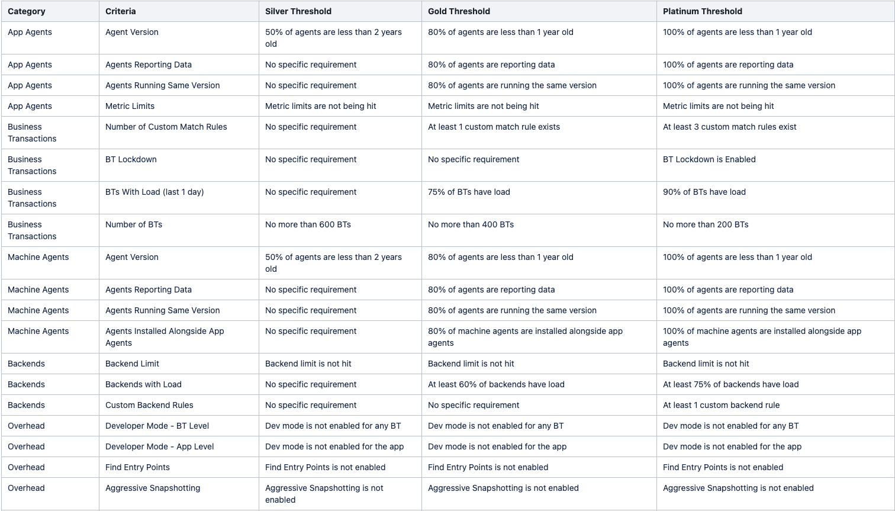
Configuration Assessment Tool (CAT) Criteria

Slide 24
