Slide 1

Splunk AppDynamics
Maturity Assessment Comparison Results - MRUM
Notes:
The configuration assessment tool is amazing for showing us the current maturity of an AppDynamics controller.
Now we have developed a way to utilize the outputs from the Configuration Assessment to compare a pervious output against a current output.
Using this we can now determine what direction we are going with regards to Maturity – this direction can help identify areas for improvement – to improve application performance monitoring and help you get the most out of your investment

Slide 2
Assessment Result - Key Callouts
Maturity
Status
The table below shows the Overall Assessment BRUM result.

Slide 3

Why is a Comparison Assessment needed?
Direction!!
"The right direction in IT comes from comparing outputs to understand how far you've come and where to go next."

Slide 4
Which Applications have improved?
Applications Improved
An Increase in Maturity, is a sign we are going in the right direction.
It leads to enhanced visibility and better application performance monitoring.
Total Number of Applications:
Notes:
This is a comparison of the summary tab from a previous config assessment against a current assessment.
Bronze basically means little, or no configuration has taken place on the business application – so we want that value to lower.
For Silver, Gold and Platinum – we want to see these increase – this shows us we are going in the right direction with improving the maturity of our AppDynamics Business Applications

Slide 5
The table below shows the summary of your previous MRUM maturity assessment
The table below shows the summary of your current MRUM maturity assessment
The table below identifies the changes in maturity from the compared MRUM assessments
Maturity Assessment - Levels Guide:
•Platinum - 50% of criteria for an application must be Platinum, all remaining criteria must be at least Gold
*Gold - 50% of criteria for an application must be Gold or higher, all remaining criteria must be at least Silver
«Silver - 80% of criteria for an application must be Silver or higher
•Bronze - All remaining applications

Slide 6
Assessment Result - Mobile Application Health
Bronze
Silver
Gold
Platinum
Any apps that do not meet the minimum Silver Criteria will be classified as bronze
To be considered silver, at least 70% of the criteria for an application must be silver or higher
To be considered gold, at least 70% of the criteria for an application must be gold or higher, and the remaining criteria must be at least silver
To be considered platinum, at least 70% of the criteria for an application must be platinum, and the remaining criteria must be at least gold.
YOUR LEVEL
YOUR TARGET

Slide 7
MRUM Overall Assessment
The table below shows the Overall Assessment MRUM result.
Notes:
This table compares the output from a previous Overall Assessment against the output from a current Overall Assessment.

Slide 8
MRUM Entity Assessment
The table below shows the comparison result of each MRUM entity. Improvement is highlighted in Green
Notes:
This table is generated from the Analysis Tab on the Maturity Assessment APM Output file

Slide 9
Monthly Review – Quarterly CAT Runs – Maintain Progress
AppD Monthly Meeting Run Config Assessment
Discuss Target for next month
AppD Monthly Meeting Deliver Session Check on target progress
AppD Monthly Meeting Deliver
AppD Monthly Meeting Run Config Assessment
Compare Findings
Deliver Session Check on target progress
1
3
5
7
Month 2
Jan
Mar
MM DD YY
MM DD YY
MM DD YY
Month 1
Month 3
Feb
Apr
MM DD YY
MM DD YY
MM DD YY
MM DD YY
2
4
6
AppD Monthly Meeting Deliver Session Check on target progress
AppD Monthly Meeting Run Config Assessment
Compare Findings
Deliver Session Check on target progress
AppD Monthly Meeting Deliver Session

Slide 10
MRUM Entity Downgrade Deep dive

Slide 11
Network Requests Deep Dive
Metric Limits
BRUM Network Requests – Maturity Downgrades
Item
# of Apps with Downgrades
Collecting Data Past One Day
Network Request Limit Not Hit
# Custom Match Rules
Has BT Correlation
Has Custom Event Service Include Rule
Notes:
The table shows what has downgraded maturity to Gold, Silver and Bronze
The Maturity Downgrades takes a count of the individual items which have downgraded from the previous Maturity assessment against the current maturity assessment.
Collecting Data Past One Day
Network Request Limit Not Hit
# Custom Match Rules
Has BT Correlation
Has Custom Event Service Include Rule

Slide 12
Health Rules and Alerting Deep Dive
Metric Limits
BRUM Health Rules – Maturity Downgrades
Item
# of Apps with Downgrades
# of Apps
# Number Of Health Rule Violations
# Of Actions Bound To Enabled Policies
# Of Custom Health Rules
Notes:
The table shows what has downgraded maturity to Gold, Silver and Bronze
The Maturity Downgrades takes a count of the individual items which have downgraded from the previous Maturity assessment against the current maturity assessment.
numberOfHealthRuleViolations numberOfActionsBoundToEnabledPolicies numberOfCustomHealthRules

Slide 13
Thank you

Slide 14
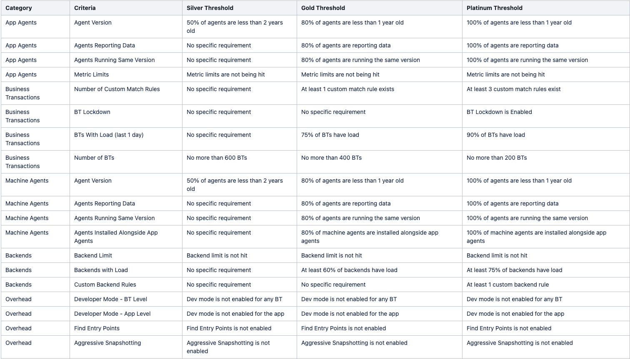
Configuration Assessment Tool (CAT) Criteria

Slide 15
