Slide 1
New Tools for Quantifying Turbulent Behaviour in Black Hole Accretion Discs
Alexander Agedah
Supervisor: Mark Avara
UTO: Chris Reynolds

Slide 2
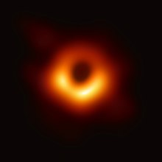
Introduction: Accretion Discs
Accretion discs are circular structures which occur in various astrophysical systems
Planets
Active galactic nuclei
Black holes
The magnetorotational instability (MRI) is a well-studied process
Discs where the MRI governs angular momentum transport are called standard and normal evolution (SANE)
The accretion disc around the black hole in the centre of the galaxy Messier 87.

Slide 3
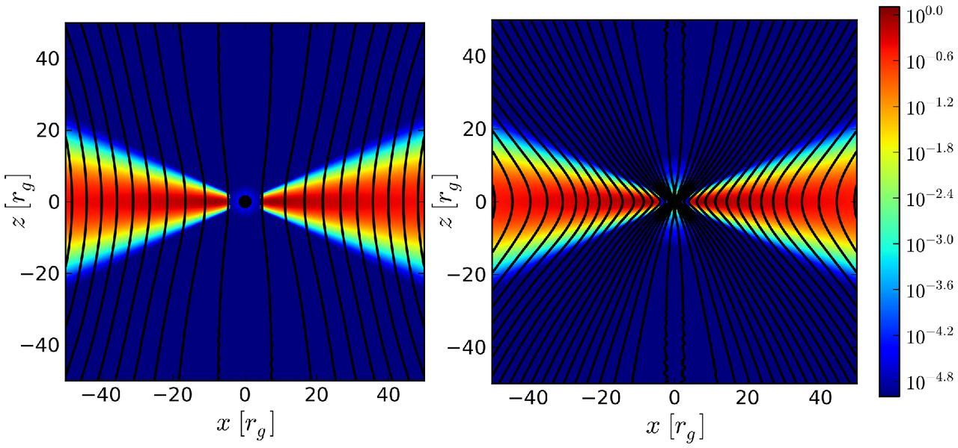
Introduction: Magnetically Arrested Discs (MADs)
SANE
MAD
A large vertical magnetic flux can cause a disc to become magnetically arrested
MADs are less well understood than SANE discs
Traditional methods cannot distinguish the states well
Avara et al., 2016

Slide 4

Introduction: A New Tool For Identification
This project introduces artificial neural networks (ANNs) as a new tool for identifying SANE and magnetically arrested regions.
Learn in Local Simulations
Take small regions as inputs and predict the net vertical magnetic flux in the disc
Predict in Global Simulations
Predict the net vertical magnetic flux that would be required in a local simulation to produce the given region
Identify Regions
Use the prediction to identify the region as SANE or magnetically arrested.

Slide 5
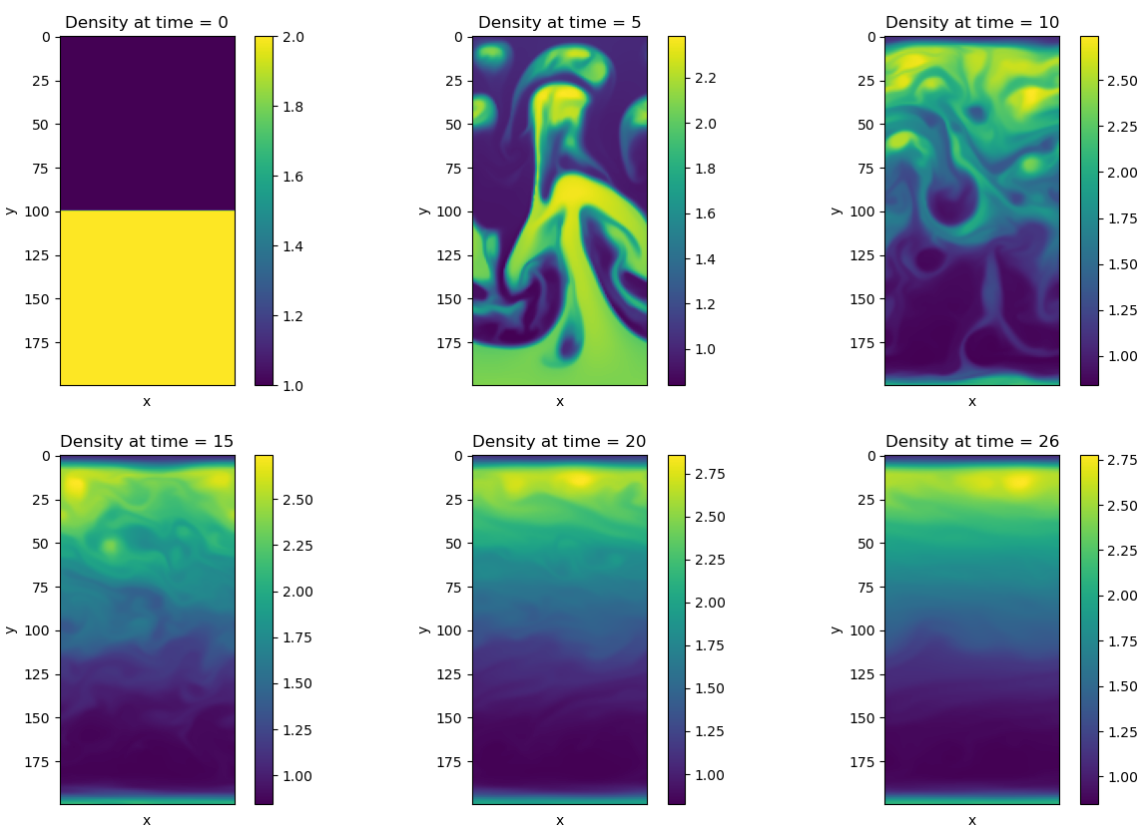
Introduction: Simulation Data
Used 2D data instead of 3D
Used the magnetic Rayleigh-Taylor instability (RTI) instead of the MRI
Predicted the net horizontal magnetic flux instead of the net vertical magnetic flux
In PLUTO, χ represents the net horizontal magnetic flux
Density snapshots of the simulation with χ = 0.1

Slide 6
Deep Learning: Overview
The data set comes in pairs $\left(X_{1},Y_{1}\right), …, \left(X_{n}, Y_{n}\right).$
The data set comes in pairs (𝑋_1,𝑌_1 ), …, (𝑋_𝑛, 𝑌_𝑛 ).
The $X_{i}$ are called features, predictors or inputs
The 𝑋_𝑖 are called features, predictors or inputs
The $Y_{i}$ are called responses or outputs
The 𝑌_𝑖 are called responses or outputs
The goal is to find a relationship between the features and the responses $f\left(X_{i}\right)≈Y_{i}$
The goal is to find a relationship between the features and the responses 𝑓(𝑋_𝑖 )≈𝑌_𝑖

Slide 7
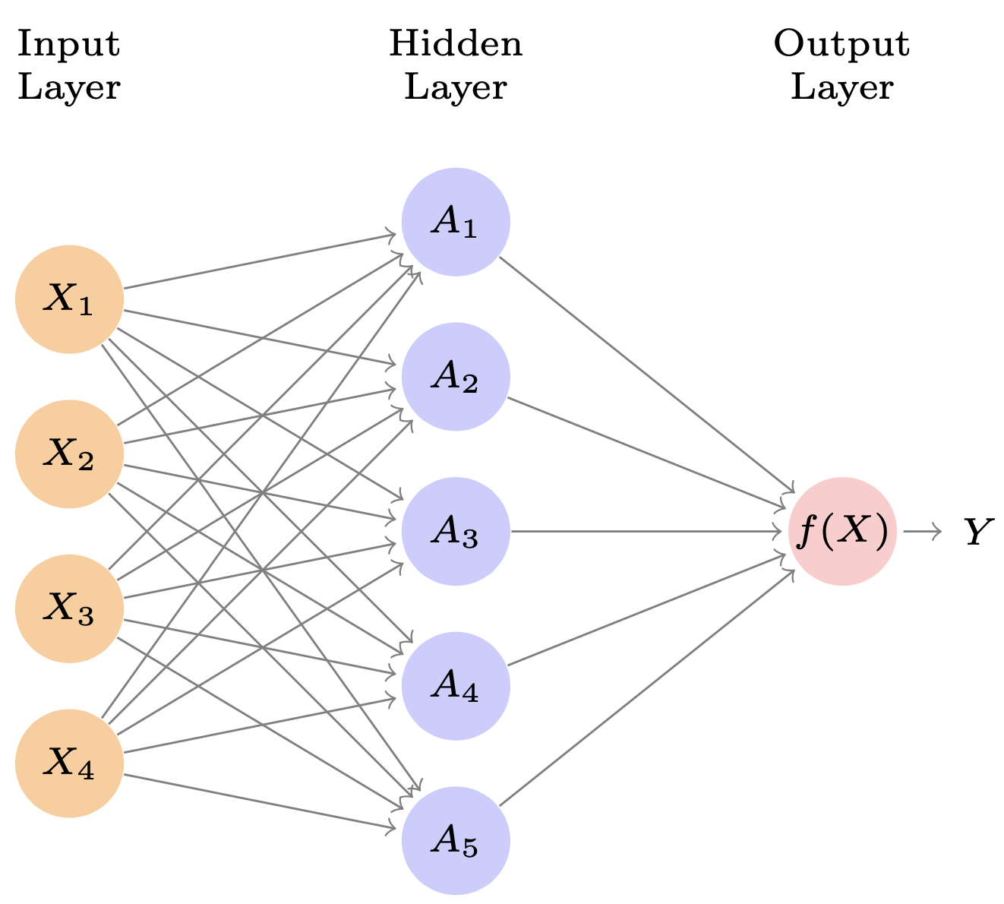
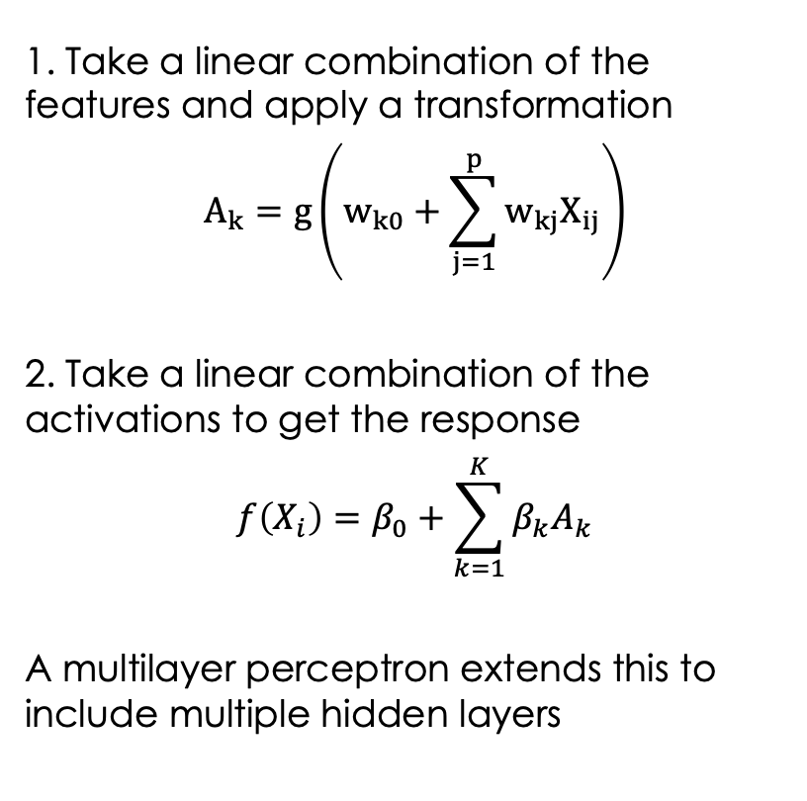
Deep Learning: Multilayer Perceptron
1. Take a linear combination of the features and apply a transformation
$$A_{k}=g\left(w_{k0}+\sum_{j=1}^{p}{w_{kj}X_{ij}}\right)$$
2. Take a linear combination of the activations to get the response
$$f\left(X_{i}\right)=β_{0}+\sum_{k=1}^{K}{β_{k}A_{k}}$$
A multilayer perceptron extends this to include multiple hidden layers
A single-layer perceptron with 4 inputs, 5 units in the hidden layer and a single output (James et al., 2013, p. 405)

Slide 8
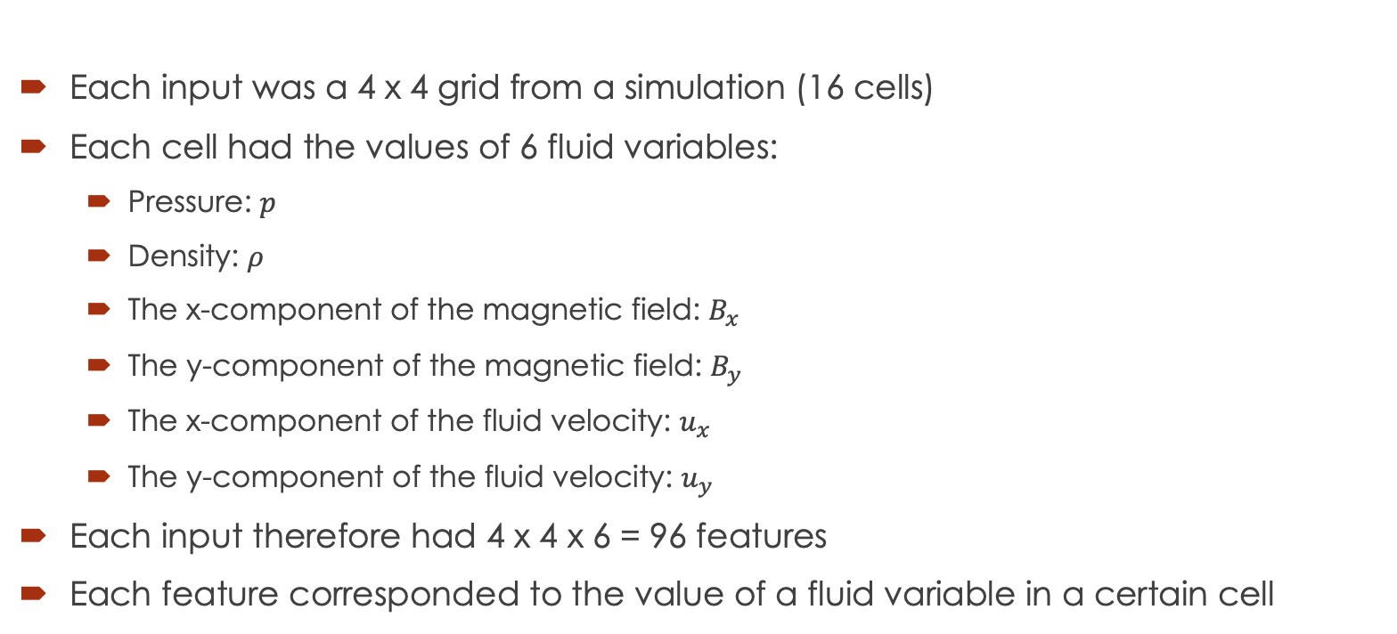
Deep Learning: Features
Each input was a 4 x 4 grid from a simulation (16 cells)
Each cell had the values of 6 fluid variables:
Pressure: $p$
Density: $ρ$
The x-component of the magnetic field: $B_{x}$
The y-component of the magnetic field: $B_{y}$
The x-component of the fluid velocity: $u_{x}$
The y-component of the fluid velocity: $u_{y}$
Each input therefore had 4 x 4 x 6 = 96 features
Each feature corresponded to the value of a fluid variable in a certain cell

Slide 9
Deep Learning: Features
Pressure in the top left cell
Density in the top left cell
The x-component of the magnetic field in the top left cell
The y-component of the magnetic field in the top left cell

Slide 10
Deep Learning: Responses
The net horizontal magnetic flux for the simulation the observation came from
In PLUTO, χ represents the net horizontal magnetic flux
The time snapshot that the observation came from
This was used while comparing models since it was computationally cheaper
We hypothesized that the best model with time as the response would also do well with χ as the response

Slide 11
Deep Learning: Responses
Pressure in the top left cell
Density in the top left cell
time or χ
The x-component of the magnetic field in the top left cell
The y-component of the magnetic field in the top left cell

Slide 12
Comparing Models With Time as The Response
Wide MLPs should be used over deep MLPs
Features and responses should be standardised before training
Dimension reduction techniques should aim to preserve information about the direction of the the magnetic field and velocity
MLPs should have ∼100,000 parameters
The ReLU should be used as the activation function

Slide 13
Wide MLPs Outperformed Deep MLPs
Number of Units | Number of Hidden Layers | Mean Squared Error
128 | 8 | 0.0023
256 | 2 | 0.0030
128 | 4 | 0.0032
256 | 8 | 0.0037
128 | 16 | 0.0056
32 | 16 | 0.0076
64 | 16 | 0.0097
The deep learning community has found that deep MLPs outperform wide MLPs
In this setting, wide MLPs outperformed deep MLPs
Wide MLPs may be better because the physically important quantities in MHD are easy to compute

Slide 14
Wide MLPs Outperformed Deep MLPs: Pressure Gradient
The pressure gradient can be computed by taking the difference between pressure in different cells
Pressure in the top left cell
Pressure in the top right cell
time
Pressure in the bottom left cell
Pressure in the bottom right cell

Slide 15
Wide MLPs Outperformed Deep MLPs: Speed of Sound
The speed of sound can be computed by taking the difference between pressure and density in the same cells
Pressure in the top left cell
Density in the top left cell
time
Pressure in the top right cell
Density in the top right cell

Slide 16
Wide MLPs Outperformed Deep MLPs
Physically important quantities are easy to compute
Deep MLPs may have a level of complexity that is undesirable for quantifying MHD turbulence

Slide 17
Predicting The Net Horizontal Magnetic Flux
Trained the MLP with observations from 7 simulations:
χ = 0.03, 0.05, 0.06, 0.07, 0.09, 0.1 and 0.13
Did not use 4 simulations during training:
χ = 0.08, 0.15, 0.20 and 0.80
Predicted the net horizontal flux for observations from all 11 simulations

Slide 18
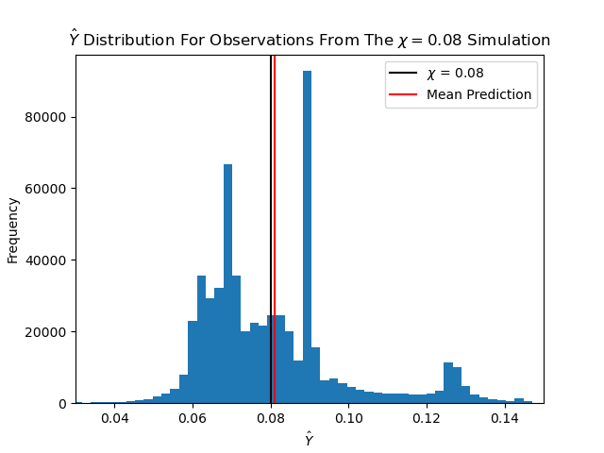
χ = 0.08
The predictions unbiased
The standard deviation of the predictions was 0.012
Some level degree of variability is inevitable
In a practical application, the predictions could be averaged over multiple observations
Averaging over many predictions would reduce the impact of variability

Slide 19
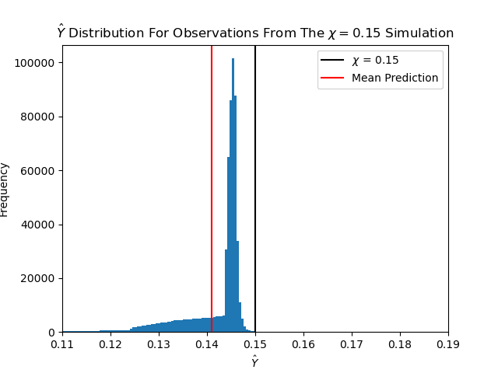
χ = 0.15
The predictions were biased low
The standard deviation of the predictions was 0.010
The model could still indicate observations were coming from a simulation with a flux outside the range that was seen in training

Slide 20
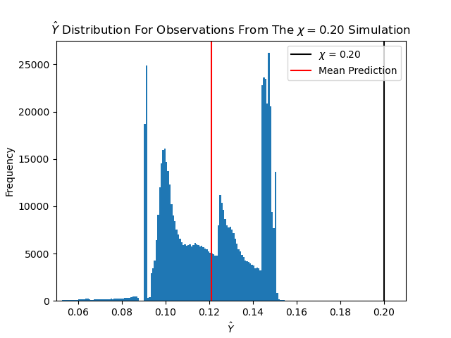
χ = 0.20
The predictions were biased low
The standard deviation of the predictions was 0.021
This was ~2x higher than for any other simulation
The model was failing to show observations were coming from a simulation with a flux outside the range that was seen training
High variability in predictions could be used to show where the model was failing

Slide 21
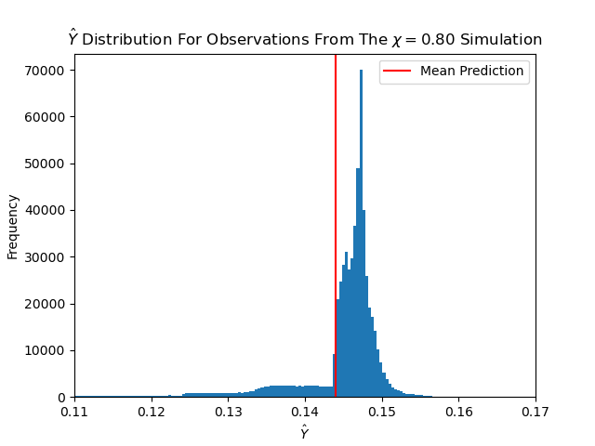
χ = 0.80
The predictions were biased low
The standard deviation of the predictions was 0.007
This was the lowest across all 11 simulations
The model could still indicate observations were coming from a simulation with a flux outside the range that was seen in training

Slide 22
Conclusion
A number of guidelines have been proposed for MLPs
The best MLP could predict the net horizontal magnetic flux in 2D to sufficient accuracy in most cases
The next stage is to use a similar model to predict the net vertical magnetic flux in 3D
If similar results are achieved in 3D, the model could be used to identify SANE and magnetically arrested regions in global simulations

Slide 23
References
Mark J. Avara, Jonathan C. McKinney, and Christopher S. Reynolds. Efficiency of thin magnetically arrested discs around black holes. Monthly Notices of the Royal Astronomical Society, 462 (1):636–648, 07 2016. ISSN 0035-8711.
Gareth James, Daniela Witten, Trevor Hastie, and Robert Tibshirani. An Introduction to Statistical Learning with Applications in R. Springer, New York, 2013

