Slide 1
The Challenge
MLPC 2026 Task 5: Challenge
Team Unified Decoders
Alexandre Escudier Agostinho | Jakob Hinterholzer

Slide 2
System Architecture
Segment-level SED: a per-class detector chain over 1-second windows
Features
960 features per 1-s window (0.5 s hop)
Temporal context
concatenate ±2 neighbour segments
CatBoost × 15
one-vs-rest gradient-boosted trees
Thresholds
per-class tuning on the validation set
Post-process
median filter (w=3) → onset/offset intervals
One-vs-rest
15 independent binary detectors — a natural fit for the polyphonic, multi-label setting.
Temporal context
The decisive SED enhancement: neighbour evidence localises and disambiguates events.
Balanced & tuned
Balanced class weights and per-class thresholds counter the strong class imbalance.
Final config: 15 one-vs-rest CatBoost · 1500 iterations · depth 6 · learning_rate 0.05 · balanced weights · ±2 context

Slide 3
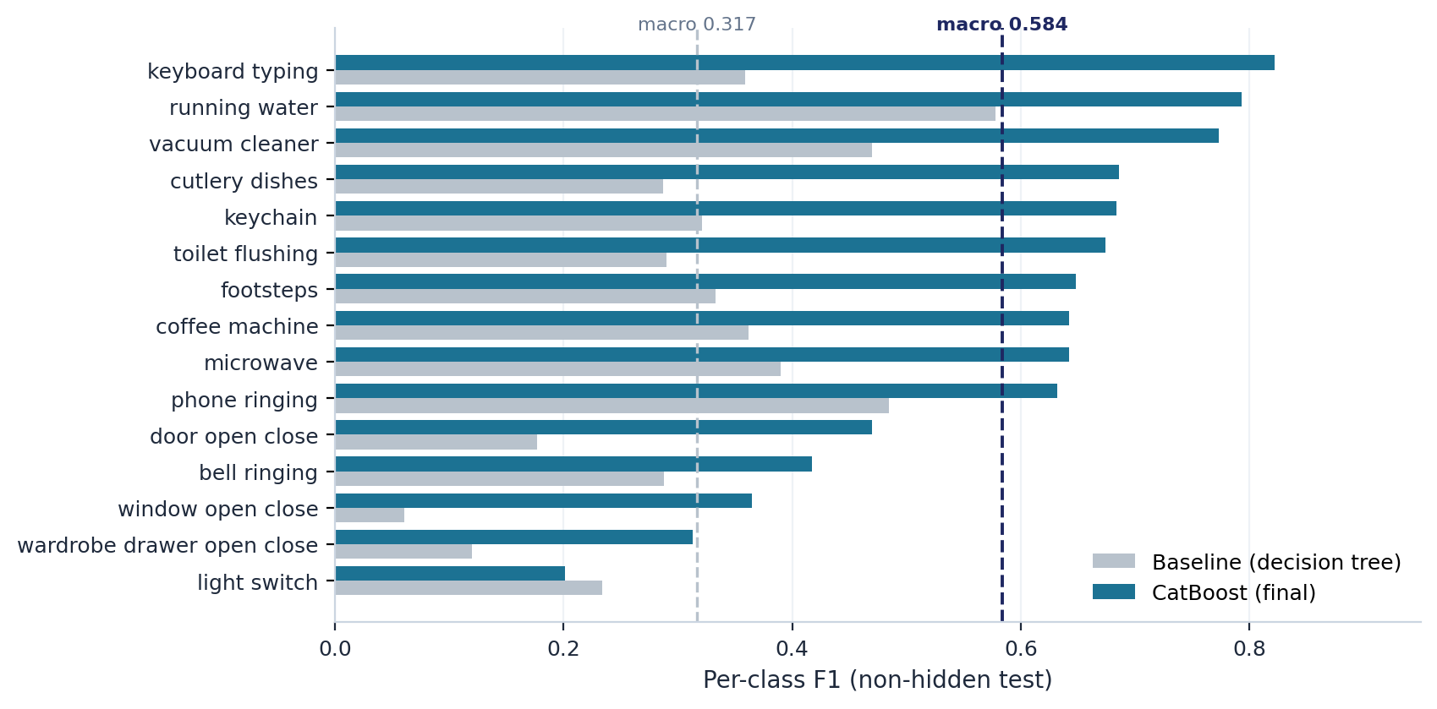
From Baseline to CatBoost
0.584
Macro F1 (non-hidden test)
+0.267 vs 0.317 baseline
What changed. 15 single decision trees → 15 one-vs-rest CatBoost ensembles, plus ±2 temporal context.
Biggest gains land on the hardest baseline classes — keyboard_typing +0.46, cutlery_dishes +0.40, footsteps +0.32. Precision and recall are now balanced (0.59 / 0.59); only light_switch regresses.

Slide 4
Hypotheses & Outcomes
Three questions tested on the validation and non-hidden test split
±2 temporal context improves detection
Augmenting each segment with its neighbours raised macro-F1 from 0.535 to 0.584 — the single decisive challenge-specific change.
CONFIRMED
Tuning depth, learning rate & L2 moves the needle
Largely flat: all sweeps stay within ≈0.006 F1. Best at depth 6, lr 0.05, l2 6; only lr 0.2 overshoots and collapses to 0.521.
ROBUST
Temporal median filtering cleans up flicker
Only w=3 helps marginally (+0.0006); wider windows erase short events (w=9: −0.041). Context features already make predictions coherent.
MOSTLY NO

Slide 5
Where It Wins and Loses
Sustained sounds — easy
Running water (0.79), vacuum cleaner (0.77) and phone ringing (0.63) fill the 1-second window with clean, distinctive spectra.
Short transients — hard
Sub-second events sit at the bottom: window 0.37, wardrobe 0.31, light_switch 0.20 — diluted by surrounding silence inside the window.
Confusions are perceptually plausible
Residual errors cluster within sound families, not at random — bell ↔ phone (both tonal ringing), door ↔ window (near-identical open/close), and cutlery ↔ water / keychain (co-occurring kitchen clatter).
Per-class quality spans roughly 4x — from running_water (0.79) down to light_switch (0.20)

Slide 6
Reflection & Real-World Use
A credible non-critical assistive logger — not yet reliable enough for autonomous control
1
Temporal-resolution mismatch
2
Independent per-class detectors
The 1-second window dwarfs sub-second open/close events. A CRNN on raw log-mel frames could localise onsets instead of averaging them away.
15 one-vs-rest models ignore co-occurrence. A joint multi-label or confusion-aware stage could separate same-family sounds.
3
Efficient by design
4
Deployment caveats
15 boosted trees over cheap MFCC/mel/spectral features run comfortably on an edge hub or on-device, unlike deep alternatives.
The ±2 context lags ≈2 s behind real time, per-class quality varies fourfold, and always-on audio raises privacy concerns.

