Slide 1
Evaluation
MLPC 2026 Task 4: Data Classification
Team Unified Decoders
Alexandre Escudier Agostinho | Jakob Hinterholzer

Slide 2
Why Macro-Averaged F1?
Why not accuracy?
The dataset is highly imbalanced. Most segments have no active sound event for most classes. A trivial all-zeros classifier achieves high accuracy but detects nothing useful.
Why F1?
F1 is the harmonic mean of precision and recall. It rewards classifiers that both detect events (recall) and avoid false alarms (precision).
Why macro over micro?
Macro-averaging computes F1 per class, then averages — giving equal weight to every sound class. Micro-averaging would be dominated by frequent classes (e.g., footsteps at 14%), hiding poor performance on rare but important events like light_switch (0.5%).
Complementary metrics: per-class F1, micro F1

Slide 3
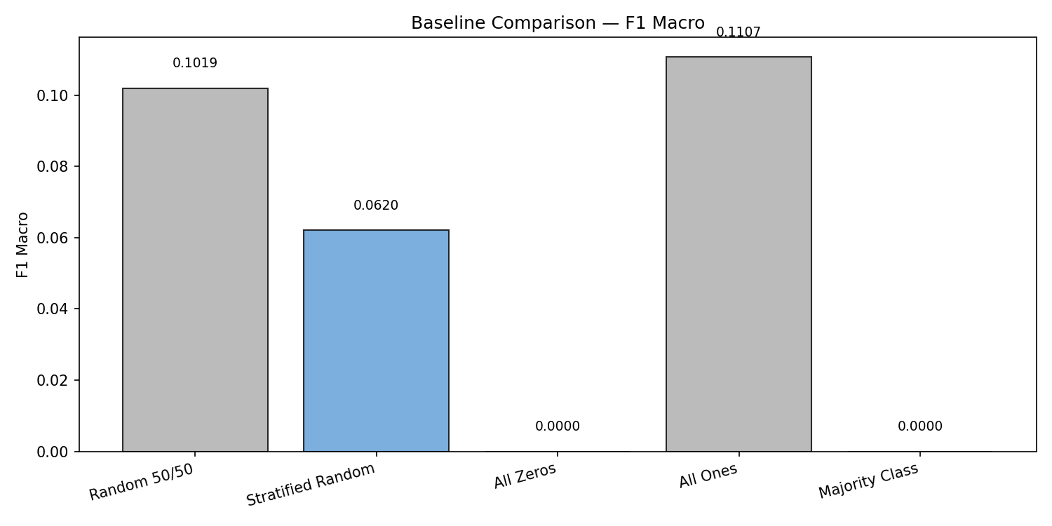
Baseline Performance
0.060
Macro F1 (test set)
Stratified Random Baseline
How the stratified random baseline works. Predicts each class active with probability equal to its training-set frequency — no acoustic features used.
Trivial baselines (All Ones 0.111, Random 50/50 0.102) also stay well below 0.12 macro F1, confirming class frequency alone is insufficient. Any trained classifier should substantially exceed this.

Slide 4
Is Perfect Performance Achievable?
F1 = 1.0 is not achievable. Realistic upper bound: F1 ≈ 0.7–0.9 (class-dependent)
1
Annotator Disagreement
2
Temporal Resolution
Multiple annotators often disagree on event boundaries. Labels are consensus estimates, not ground truth.
1-second windows with 0.5s hop blur event boundaries. Onset/offset segments get ambiguous labels.
3
Feature Limitations
4
Acoustic Ambiguity
Summary statistics (mean, std, min, max) may lose fine-grained temporal patterns needed for transient events.
Some classes sound similar (e.g., different impacts). Hard to separate from spectral features alone.

