Slide 1
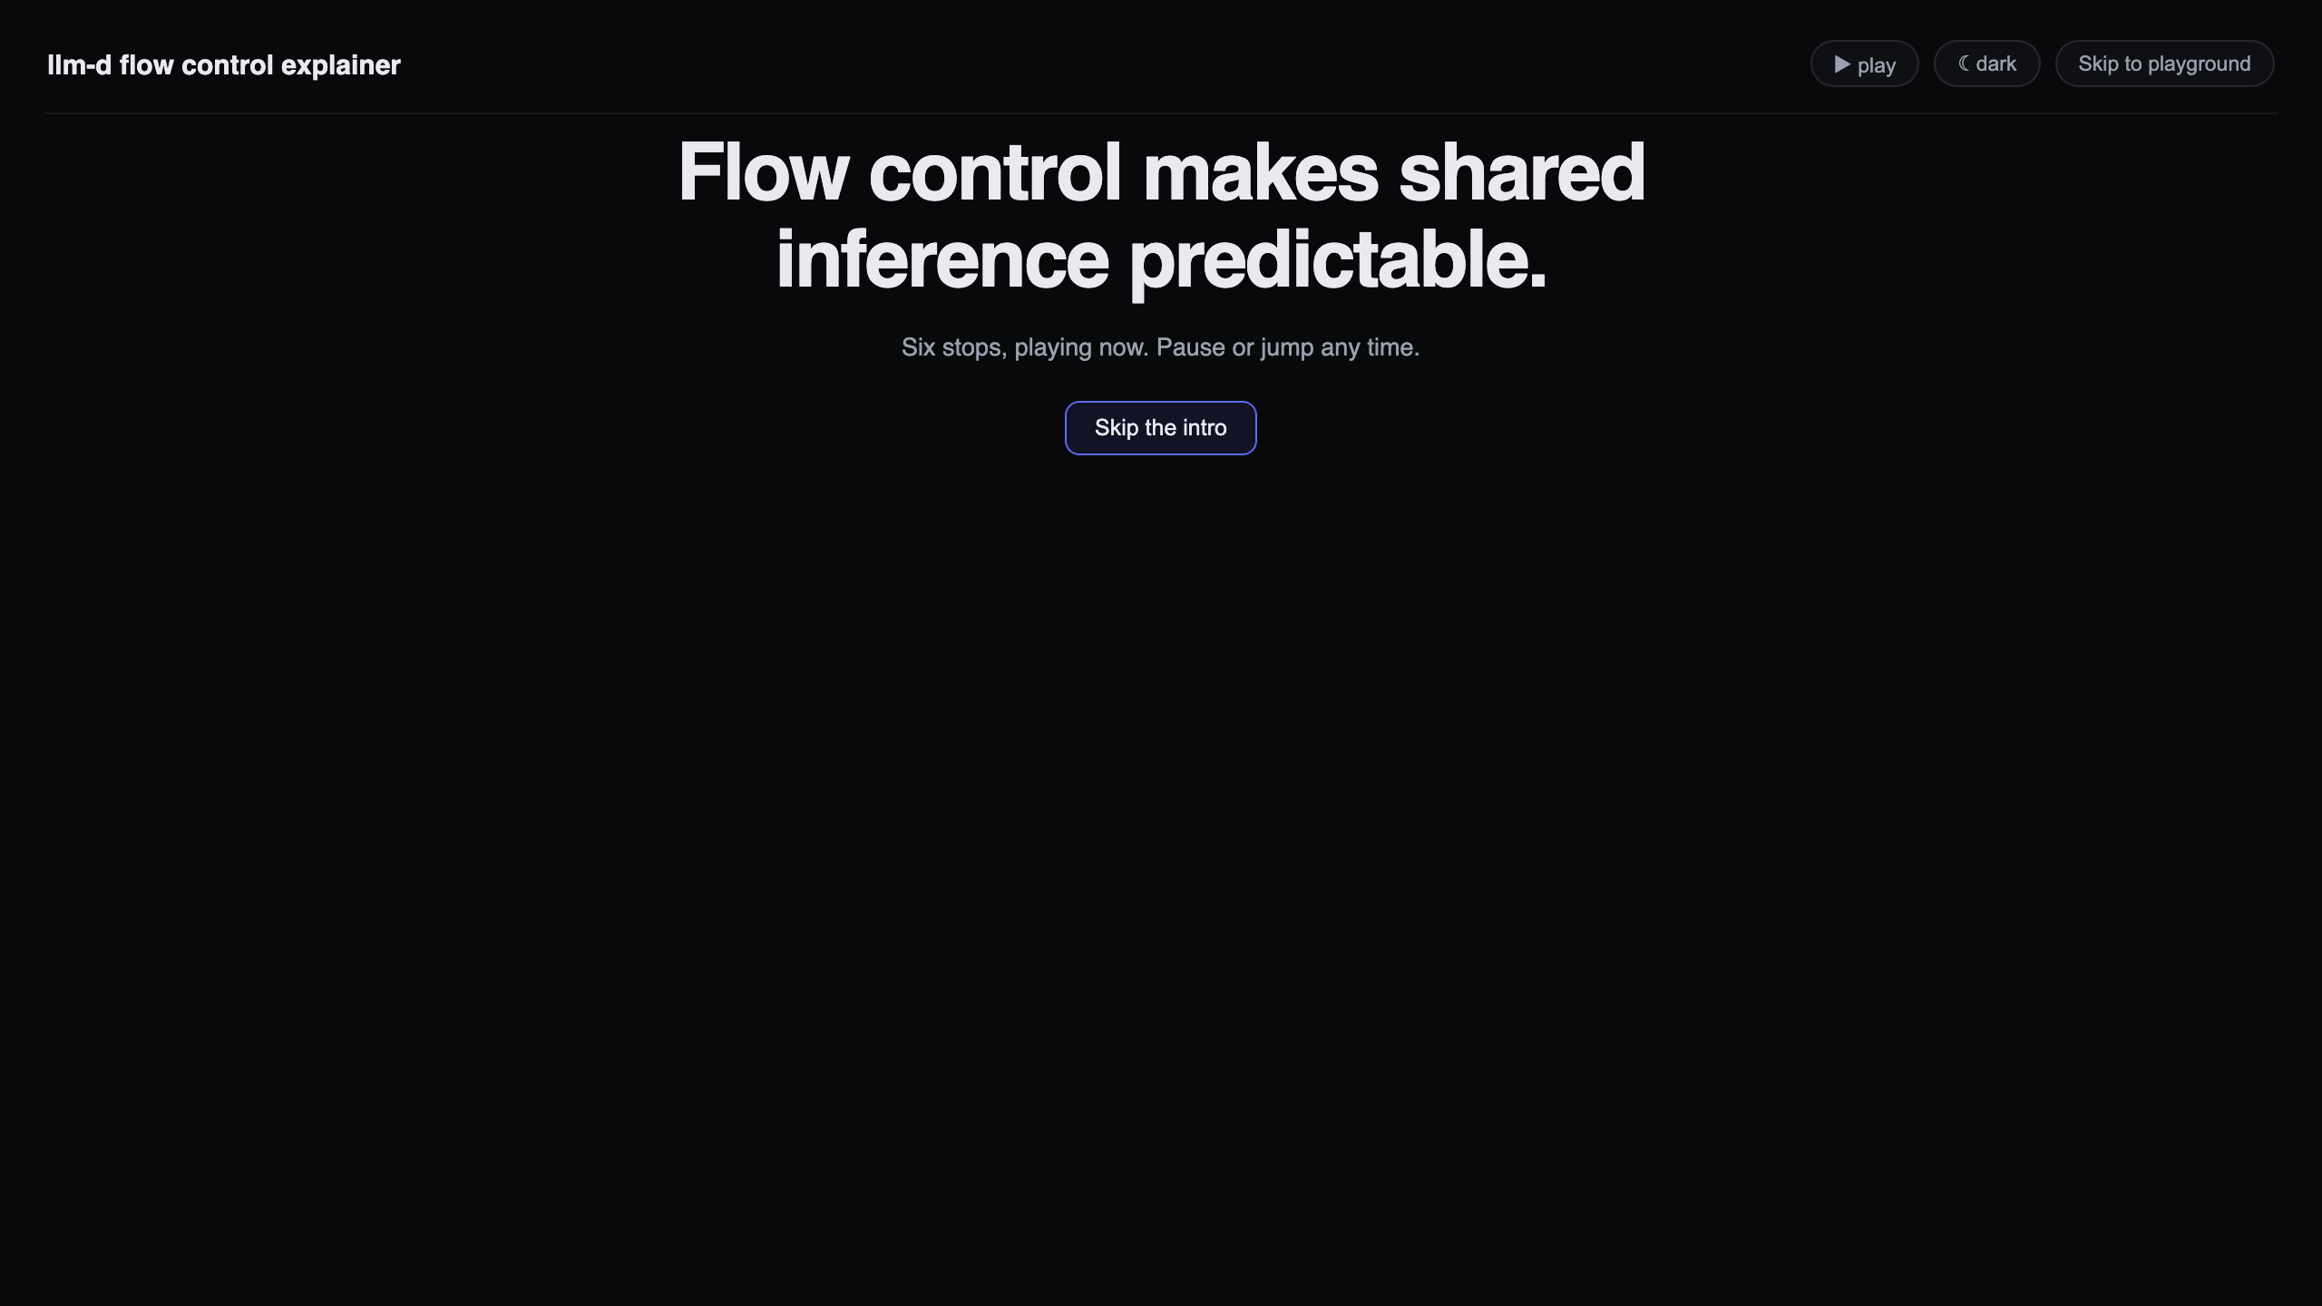
Stop 1

Slide 2

Stop 2

Slide 3
Stop 3

Slide 4
Stop 4

Slide 5
Stop 5

Slide 6
Stop 6

Slide 7
Stop 7

Slide 8
Stop 8

Slide 9
Stop 9

Slide 10
Stop 10

Slide 11
Stop 11

Slide 12
Stop 12

Slide 13
Stop 13

Slide 14
Stop 14

Slide 15
Stop 15

Slide 16
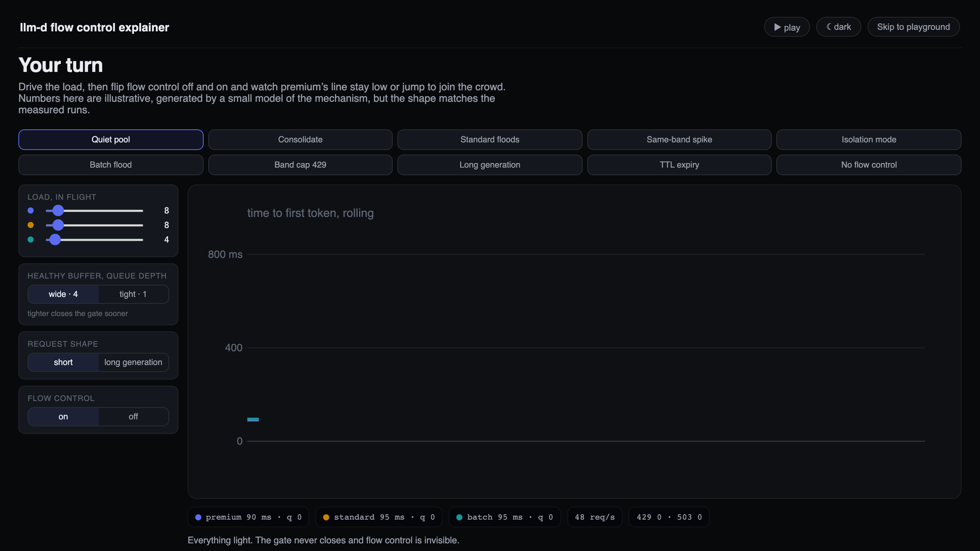
Your turn

