Slide 1
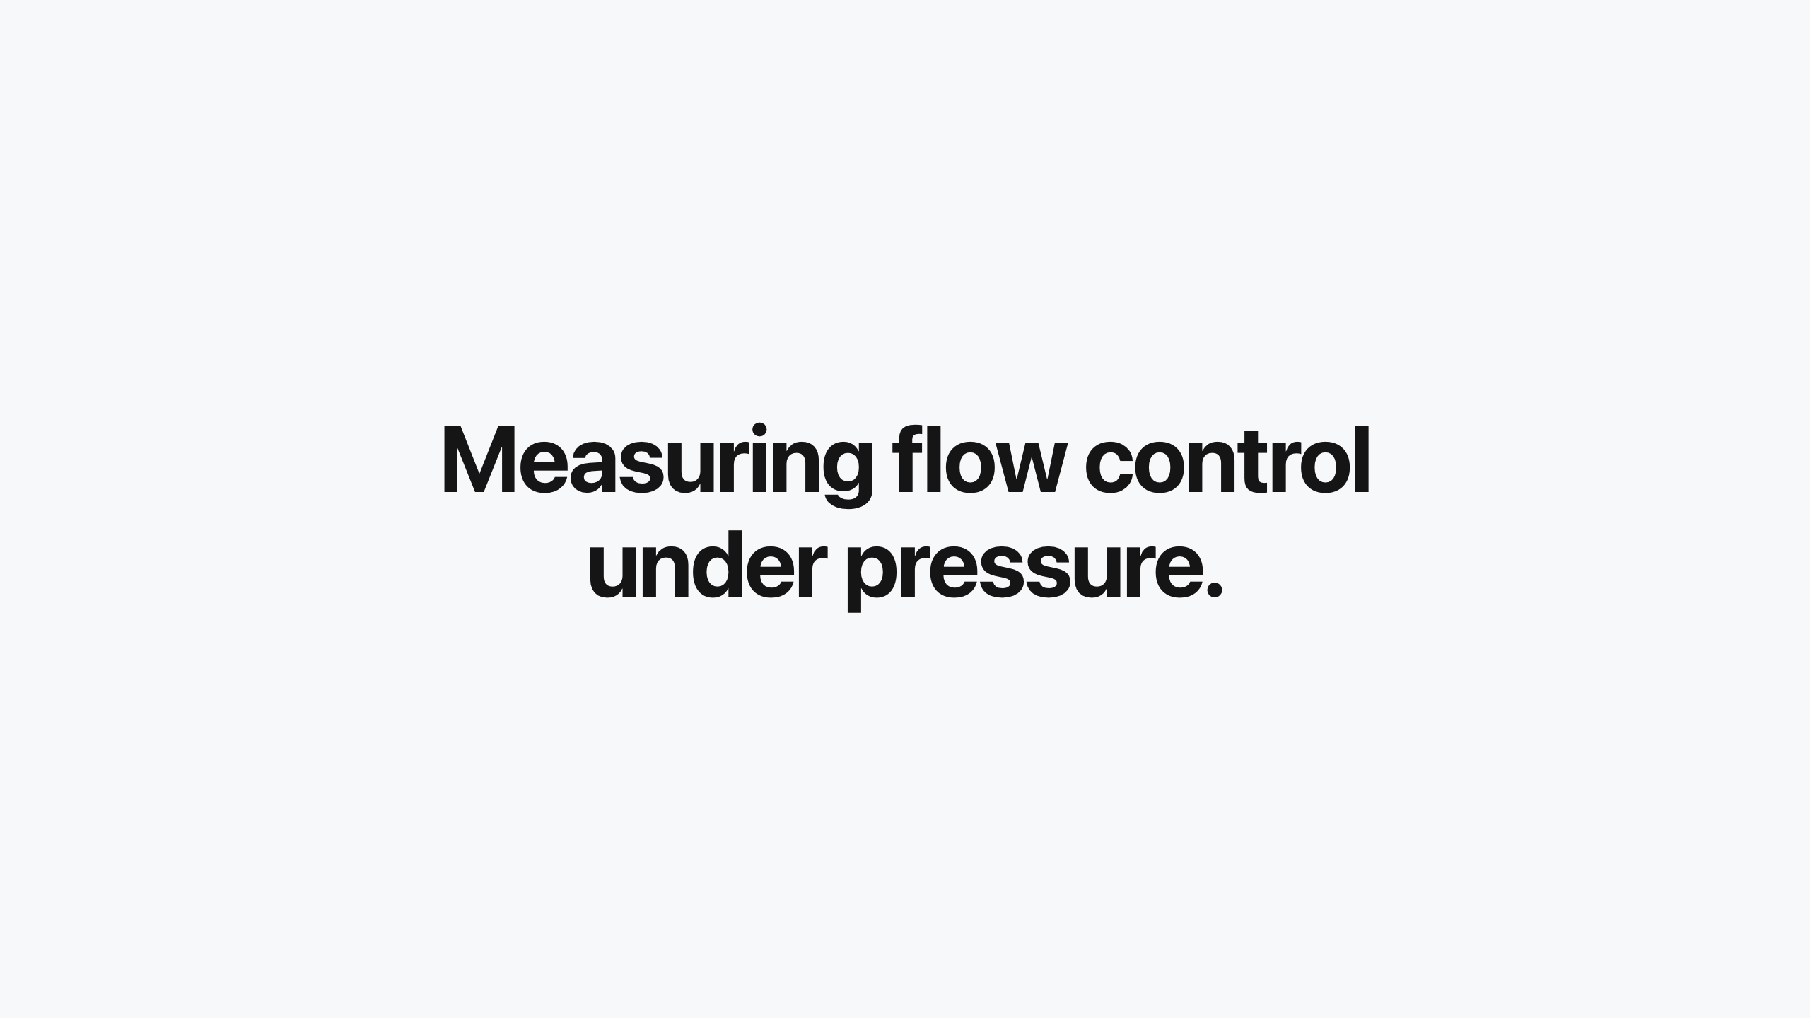
Measuring flow control under pressure.
Notes:
Measuring flow control under pressure.
Flow control enables intelligent request queuing on a shared pool.
Service tiers. On a saturated pool with flow control on, premium p95 time to first token (TTFT) holds at 1117 ms against 1406 ms for standard, a ~1.25x separation, stable across repeats.
Batch isolation. Overload is queued instead of dropped. 48,224 rejected requests become 0 at the same offered load.
Fairness. Round-robin bounds a bursty tenant inside its band: the burster's queue time runs ~2.6x its peers' while the peers hold steady and nobody starves.
Limits. Round-robin fairness handles tenants within one priority band. Flow control matters most when protecting one priority from another.
Service tiers. On a saturated pool with flow control on, premium p95 time to first token (TTFT) holds at 1117 ms against 1406 ms for standard, a ~1.25x separation, stable across repeats.
Batch isolation. Overload is queued instead of dropped. 48,224 rejected requests become 0 at the same offered load.
Fairness. Round-robin bounds a bursty tenant inside its band: the burster's queue time runs ~2.6x its peers' while the peers hold steady and nobody starves.
Limits. Round-robin fairness handles tenants within one priority band. Flow control matters most when protecting one priority from another.
Service tiers. On a saturated pool with flow control on, premium p95 time to first token (TTFT) holds at 1117 ms against 1406 ms for standard, a ~1.25x separation, stable across repeats.
Batch isolation. Overload is queued instead of dropped. 48,224 rejected requests become 0 at the same offered load.
Fairness. Round-robin bounds a bursty tenant inside its band: the burster's queue time runs ~2.6x its peers' while the peers hold steady and nobody starves.
Limits. Round-robin fairness handles tenants within one priority band. Flow control matters most when protecting one priority from another.
Flow control enables intelligent request queuing on a shared pool.

Slide 2
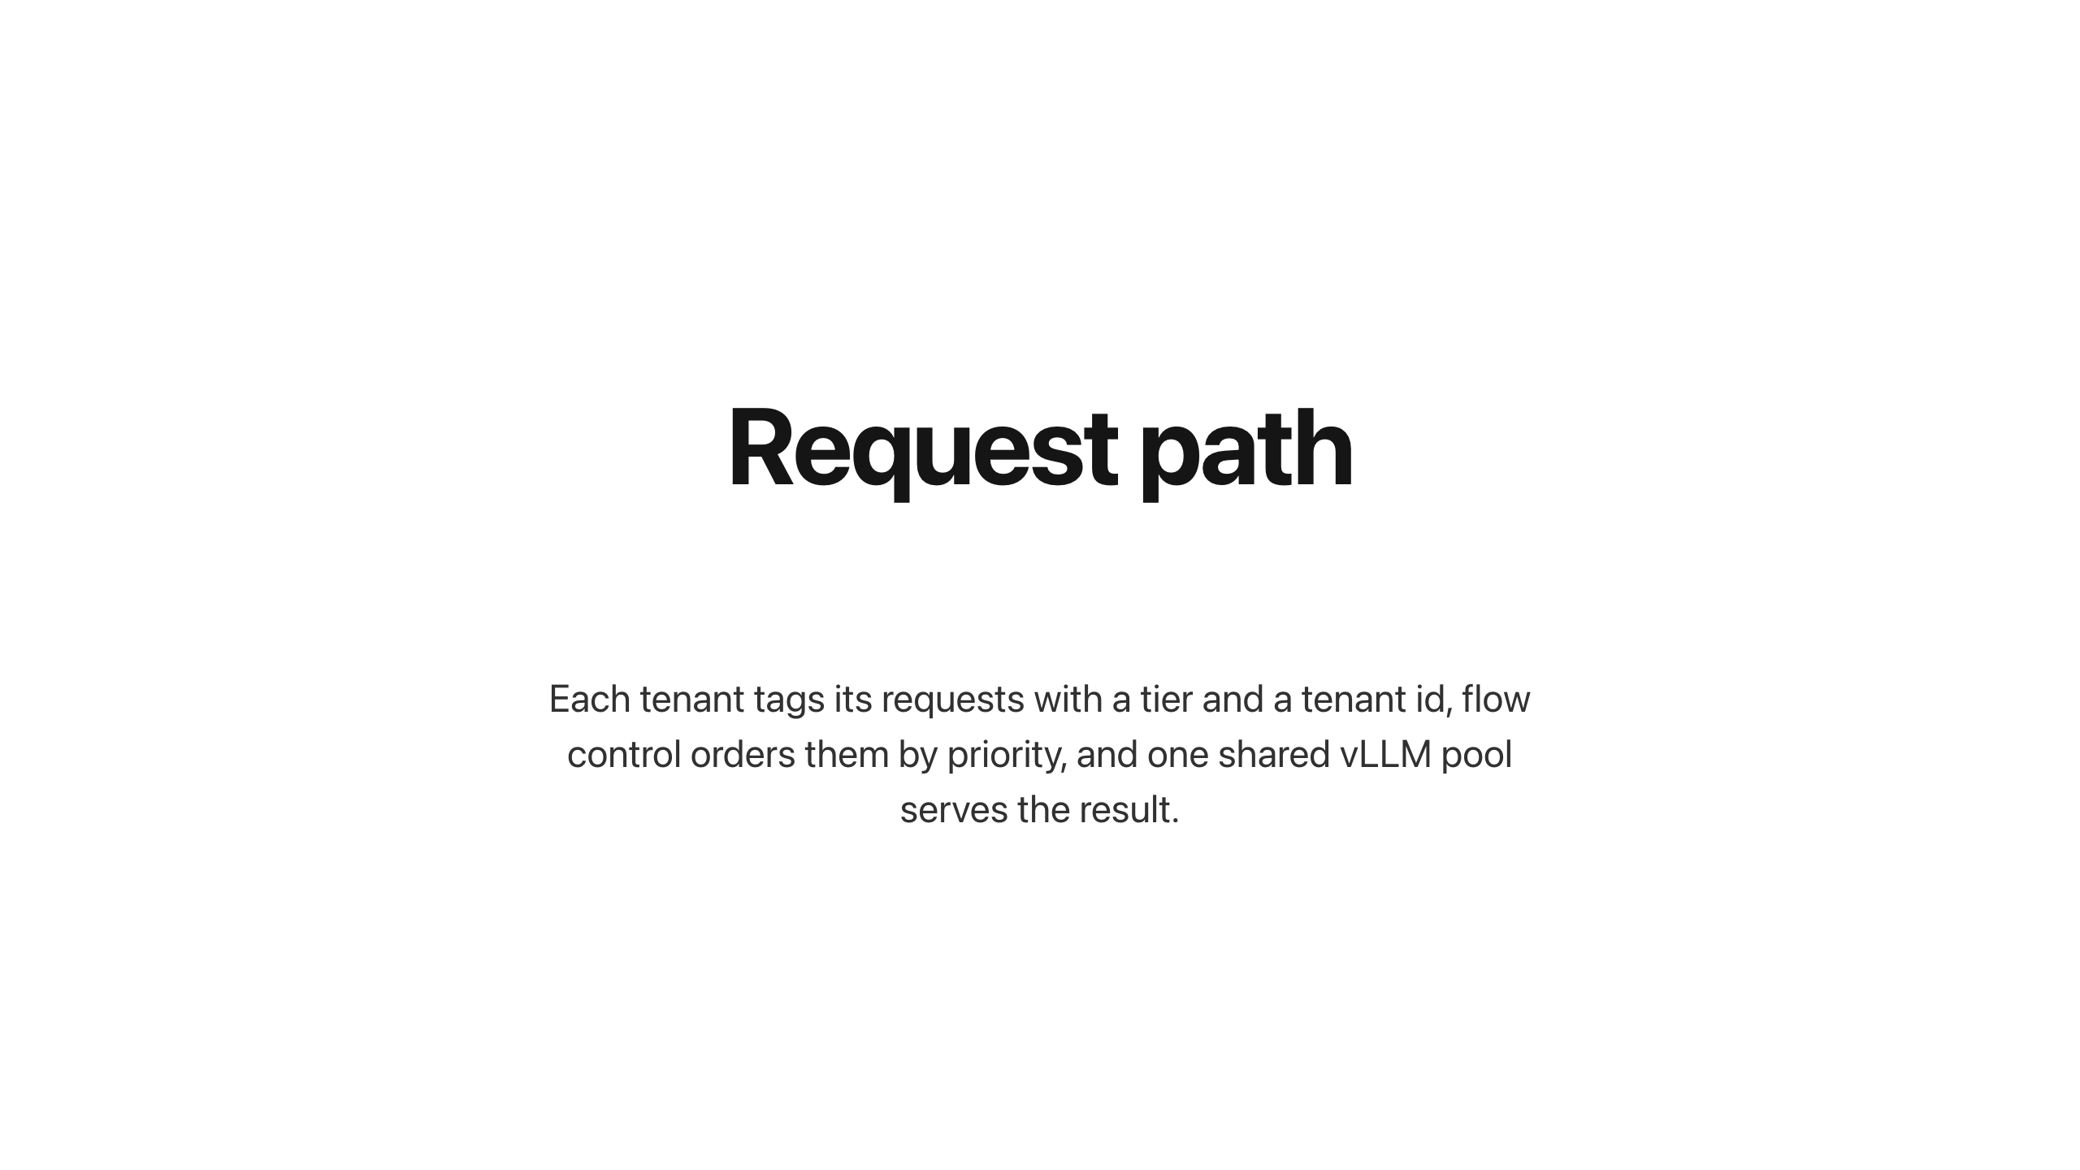
Request path
Notes:
Request path
Each tenant tags its requests with a tier and a tenant id, flow control orders them by priority, and one shared vLLM pool serves the result.
Three tenants share one H100. Flow control admits by priority and queues rather than rejects when the pool is full.
requestcontrol/director.go · requestcontrol/admission.go · flowcontrol/controller/controller.go

Slide 3
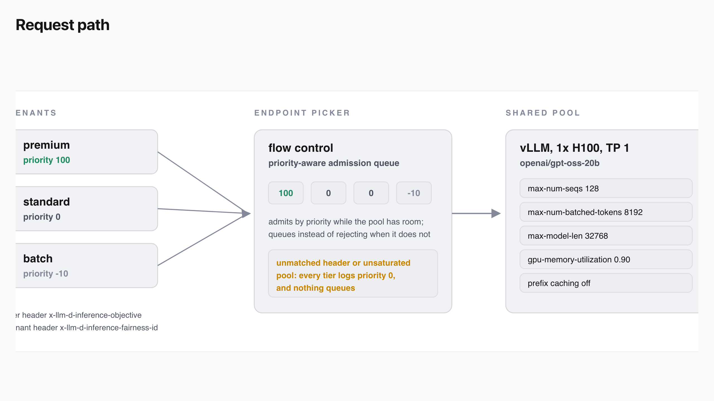
Request path
Notes:
Request path
Each tenant tags its requests with a tier and a tenant id, flow control orders them by priority, and one shared vLLM pool serves the result.
Three tenants share one H100. Flow control admits by priority and queues rather than rejects when the pool is full.
requestcontrol/director.go · requestcontrol/admission.go · flowcontrol/controller/controller.go

Slide 4
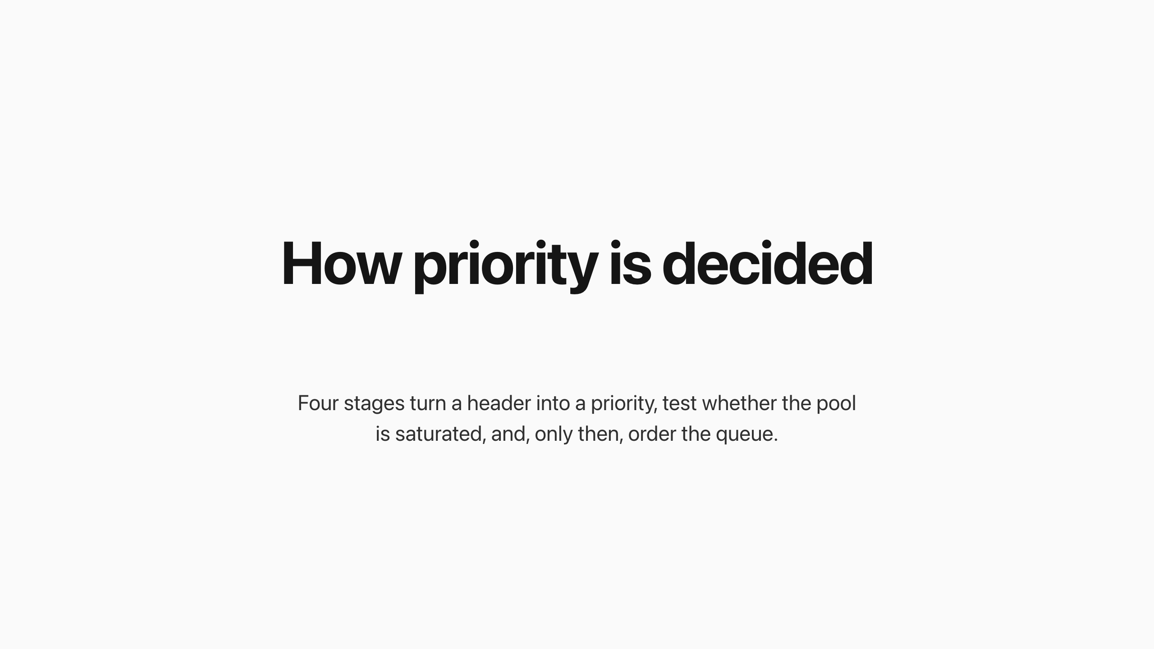
How priority is decided
Notes:
How priority is decided
Four stages turn a header into a priority, test whether the pool is saturated, and, only then, order the queue.
A header becomes an integer priority, the detector tests saturation as the worse of the queue-depth and key-value (KV) cache ratios, and only a saturated pool reaches the ordering stage.
requestcontrol/director.go:206–255 · plugins/flowcontrol/saturationdetector/utilization
Three states of the same mechanism
With capacity, priority is resolved but never used; under saturation, strict priority across bands lifts premium, and round-robin within a band gives same-priority tenants turns.
controller/internal/processor.go:343–400 · plugins/flowcontrol/fairness/roundrobin
Three states of the same mechanism
Four stages turn a header into a priority, test whether the pool is saturated, and, only then, order the queue.

Slide 5
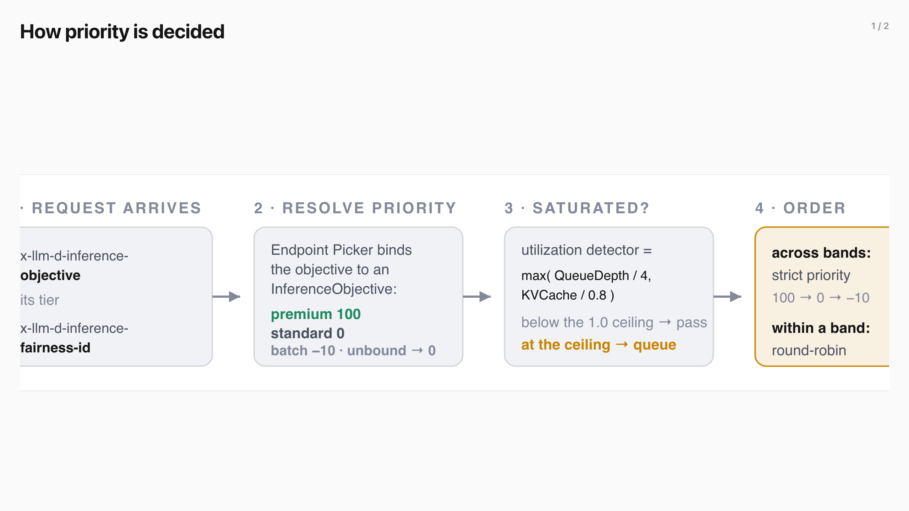
How priority is decided (1/2)
Notes:
How priority is decided
Four stages turn a header into a priority, test whether the pool is saturated, and, only then, order the queue.
A header becomes an integer priority, the detector tests saturation as the worse of the queue-depth and key-value (KV) cache ratios, and only a saturated pool reaches the ordering stage.
requestcontrol/director.go:206–255 · plugins/flowcontrol/saturationdetector/utilization
Three states of the same mechanism
With capacity, priority is resolved but never used; under saturation, strict priority across bands lifts premium, and round-robin within a band gives same-priority tenants turns.
controller/internal/processor.go:343–400 · plugins/flowcontrol/fairness/roundrobin
Three states of the same mechanism
Four stages turn a header into a priority, test whether the pool is saturated, and, only then, order the queue.

Slide 6
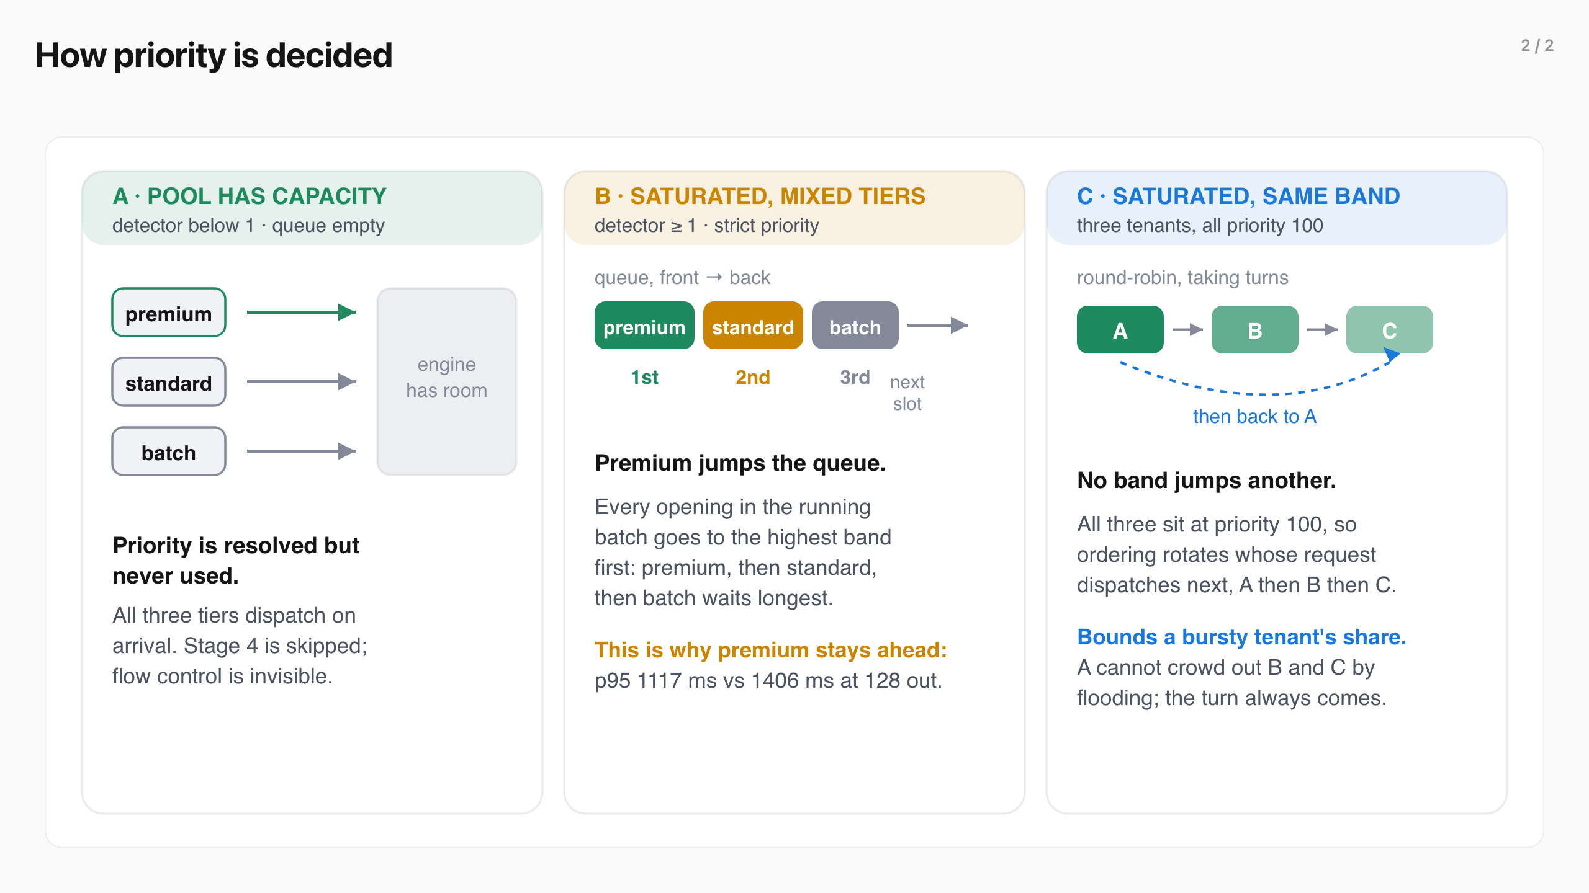
How priority is decided (2/2)
Notes:
How priority is decided
Four stages turn a header into a priority, test whether the pool is saturated, and, only then, order the queue.
A header becomes an integer priority, the detector tests saturation as the worse of the queue-depth and key-value (KV) cache ratios, and only a saturated pool reaches the ordering stage.
requestcontrol/director.go:206–255 · plugins/flowcontrol/saturationdetector/utilization
Three states of the same mechanism
With capacity, priority is resolved but never used; under saturation, strict priority across bands lifts premium, and round-robin within a band gives same-priority tenants turns.
controller/internal/processor.go:343–400 · plugins/flowcontrol/fairness/roundrobin
Three states of the same mechanism
Four stages turn a header into a priority, test whether the pool is saturated, and, only then, order the queue.

Slide 7
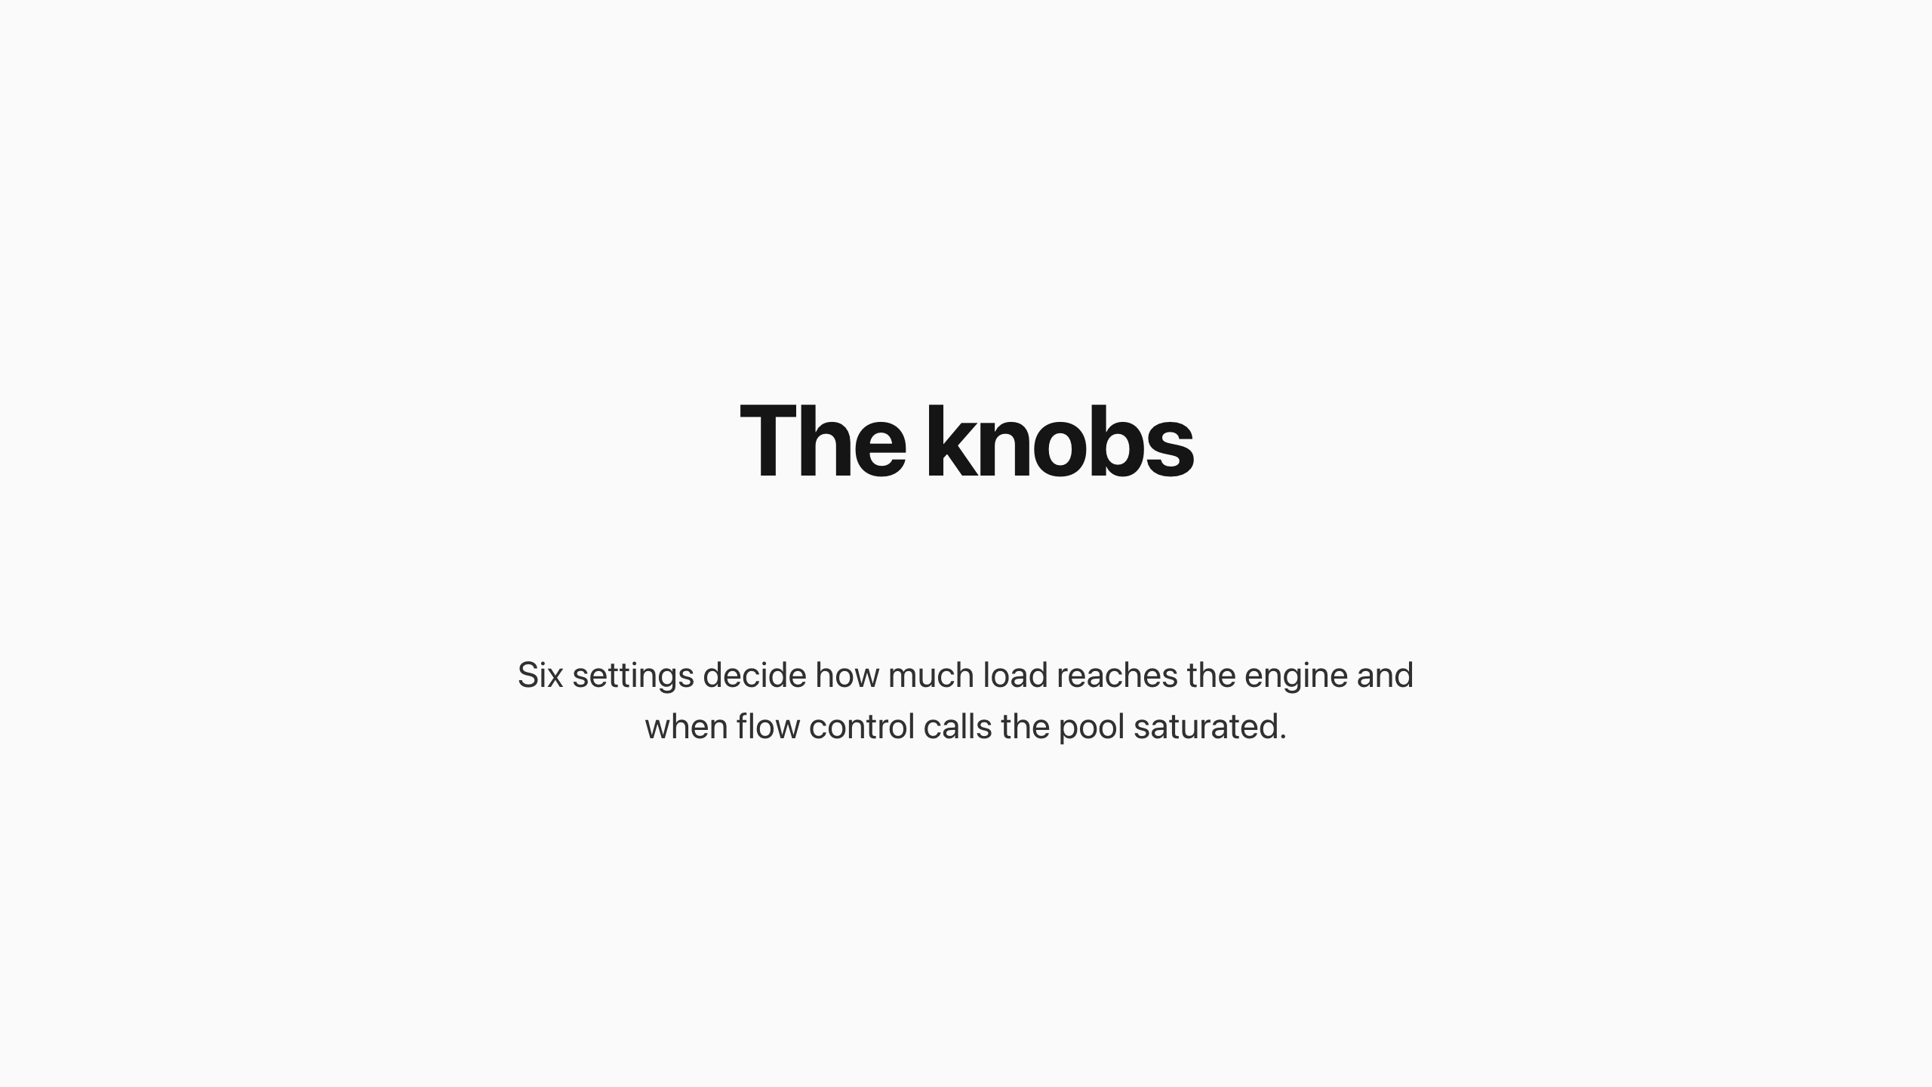
The knobs
Notes:
The knobs
Six settings decide how much load reaches the engine and when flow control calls the pool saturated. They are the only dials in every scenario.
Knob Owner What it does Set to
max-num-seqs vLLM engine Max requests the engine runs at once, the running-batch ceiling 128
queueDepthThreshold utilization detector Queue length that counts as saturated 4
kvCacheUtilThreshold utilization detector KV-cache fraction that counts as saturated 0.8
maxConcurrency concurrency detector Hard cap on in-flight requests; the only knob that reduces load on the engine swept 32–128
headroom concurrency detector Allowed burst above the cap 0 (default)
priority bands flow-control ordering The dispatch order, not a detector: premium 100, standard 0, batch −10 100 / 0 / −10
The scenarios run the utilization detector , which ships enabled and reads engine telemetry: the worse of QueueDepth / queueDepthThreshold and KVCacheUsage / kvCacheUtilThreshold per endpoint, averaged across the pool, with backpressure once that ratio crosses one. It reacts to a queue that already exists and cannot cap the running batch, so the engine still fills to max-num-seqs . Only the concurrency detector, characterized later, caps in-flight load before the engine.
The scenarios run the utilization detector , which ships enabled and reads engine telemetry: the worse of QueueDepth / queueDepthThreshold and KVCacheUsage / kvCacheUtilThreshold per endpoint, averaged across the pool, with backpressure once that ratio crosses one. It reacts to a queue that already exists and cannot cap the running batch, so the engine still fills to max-num-seqs . Only the concurrency detector, characterized later, caps in-flight load before the engine.
Six settings decide how much load reaches the engine and when flow control calls the pool saturated. They are the only dials in every scenario.

Slide 8
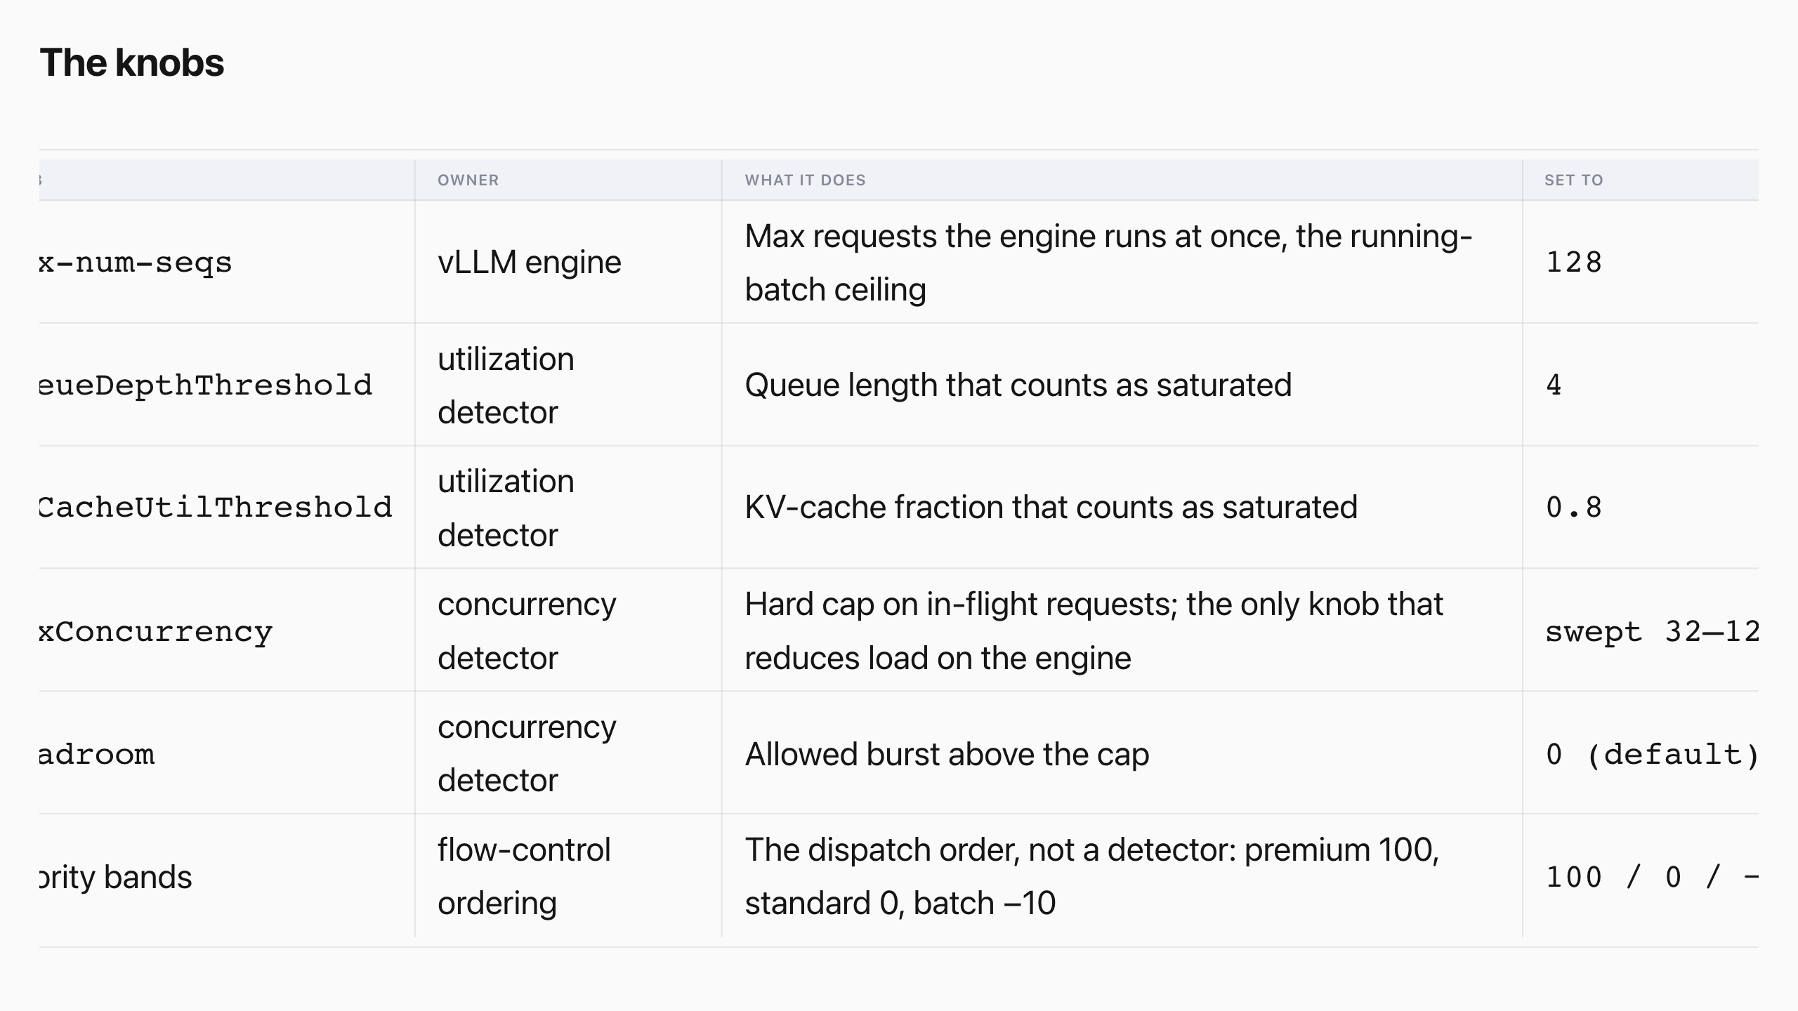
The knobs
Notes:
The knobs
Six settings decide how much load reaches the engine and when flow control calls the pool saturated. They are the only dials in every scenario.
Knob Owner What it does Set to
max-num-seqs vLLM engine Max requests the engine runs at once, the running-batch ceiling 128
queueDepthThreshold utilization detector Queue length that counts as saturated 4
kvCacheUtilThreshold utilization detector KV-cache fraction that counts as saturated 0.8
maxConcurrency concurrency detector Hard cap on in-flight requests; the only knob that reduces load on the engine swept 32–128
headroom concurrency detector Allowed burst above the cap 0 (default)
priority bands flow-control ordering The dispatch order, not a detector: premium 100, standard 0, batch −10 100 / 0 / −10
The scenarios run the utilization detector , which ships enabled and reads engine telemetry: the worse of QueueDepth / queueDepthThreshold and KVCacheUsage / kvCacheUtilThreshold per endpoint, averaged across the pool, with backpressure once that ratio crosses one. It reacts to a queue that already exists and cannot cap the running batch, so the engine still fills to max-num-seqs . Only the concurrency detector, characterized later, caps in-flight load before the engine.
The scenarios run the utilization detector , which ships enabled and reads engine telemetry: the worse of QueueDepth / queueDepthThreshold and KVCacheUsage / kvCacheUtilThreshold per endpoint, averaged across the pool, with backpressure once that ratio crosses one. It reacts to a queue that already exists and cannot cap the running batch, so the engine still fills to max-num-seqs . Only the concurrency detector, characterized later, caps in-flight load before the engine.
Six settings decide how much load reaches the engine and when flow control calls the pool saturated. They are the only dials in every scenario.

Slide 9
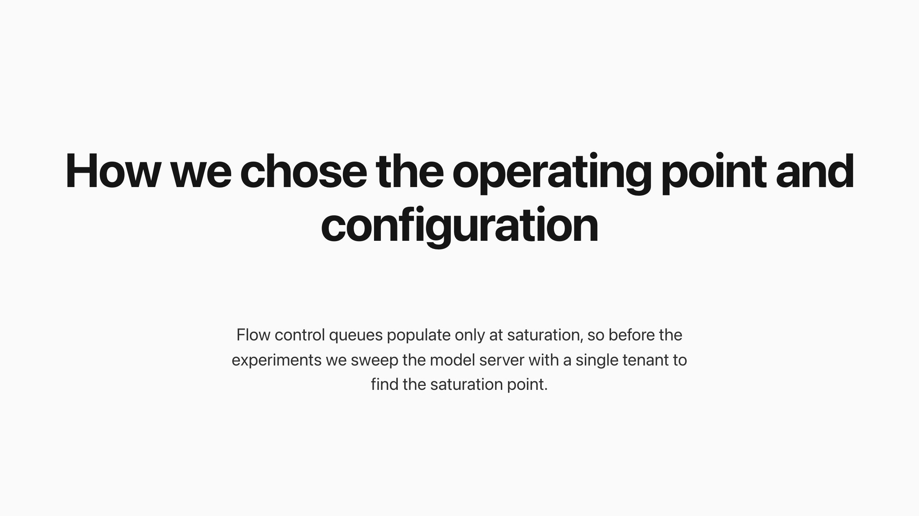
How we chose the operating point and configuration
Notes:
How we chose the operating point and configuration
Flow control queues populate only at saturation, so before the experiments we sweep the model server with a single tenant to find the saturation point. The sweep tested from 32 to 200 concurrent requests, twice, in reversed order.
Throughput peaks at 128 concurrent requests in flight and 52.0 requests per second, then falls, while the p95 TTFT tail keeps climbing. Both passes land on the same knee.
We set max-num-seqs to 128, the running-batch capacity chosen for this H100, so the sweep confirms saturation there. At 128 concurrent the batch pins at the cap and a real queue forms, so every scenario runs at this operating point.
View the data
Concurrency Throughput rps TTFT p50 ms TTFT p95 ms Running batch mean Waiting p95
32 24.1 171 261 28 4 64 37.1 307 744 54 23 96 45.5 427 948 82 45 128 52.0 566 967 99 68 160 47.1 708 1455 122 32 200 50.6 1523 1814 122 72
Input fixed at 512, output swept 64 / 128 / 512
Input is fixed at 512 tokens; output is swept across 64, 128, and 512, with 128 the headline. This stands in for short interactive work such as chat turns, retrieval-augmented generation (RAG) answers, and tool calls, where a brief reply makes time to first token the felt latency. Output length is the limiter under saturation: a longer generation holds its GPU slot for more decode steps.
The 128-token shape is the headline; the full ladder appears in the service-tiers result.
Choice Value Why
Input length 512 in (fixed) Short interactive work; held constant across every scenario Output length 64 / 128 / 512 (swept) Output is the saturation limiter, so we swept it; 128 is the headline max-num-seqs 128 (set) The engine's running-batch cap we set; the sweep confirmed the knee lands here max-num-batched-tokens 8192 Prefill budget per step for this model and GPU Prefix caching off Latencies reflect scheduling, not a warm cache Repeats 3 counted Each headline is the median of the three per-repeat p95s, steady-state trimmed, with the min–max range shown
The sweep ran 180 s per point over two passes in randomized order, and both agreed. Data in data-v4/operating-point-sweep .
We set max-num-seqs to 128, the running-batch capacity chosen for this H100, so the sweep confirms saturation there. At 128 concurrent the batch pins at the cap and a real queue forms, so every scenario runs at this operating point.
View the data
Concurrency Throughput rps TTFT p50 ms TTFT p95 ms Running batch mean Waiting p95
32 24.1 171 261 28 4 64 37.1 307 744 54 23 96 45.5 427 948 82 45 128 52.0 566 967 99 68 160 47.1 708 1455 122 32 200 50.6 1523 1814 122 72
Input fixed at 512, output swept 64 / 128 / 512
Input is fixed at 512 tokens; output is swept across 64, 128, and 512, with 128 the headline. This stands in for short interactive work such as chat turns, retrieval-augmented generation (RAG) answers, and tool calls, where a brief reply makes time to first token the felt latency. Output length is the limiter under saturation: a longer generation holds its GPU slot for more decode steps.
The sweep ran 180 s per point over two passes in randomized order, and both agreed. Data in data-v4/operating-point-sweep .
Flow control queues populate only at saturation, so before the experiments we sweep the model server with a single tenant to find the saturation point. The sweep tested from 32 to 200 concurrent requests, twice, in reversed order.

Slide 10
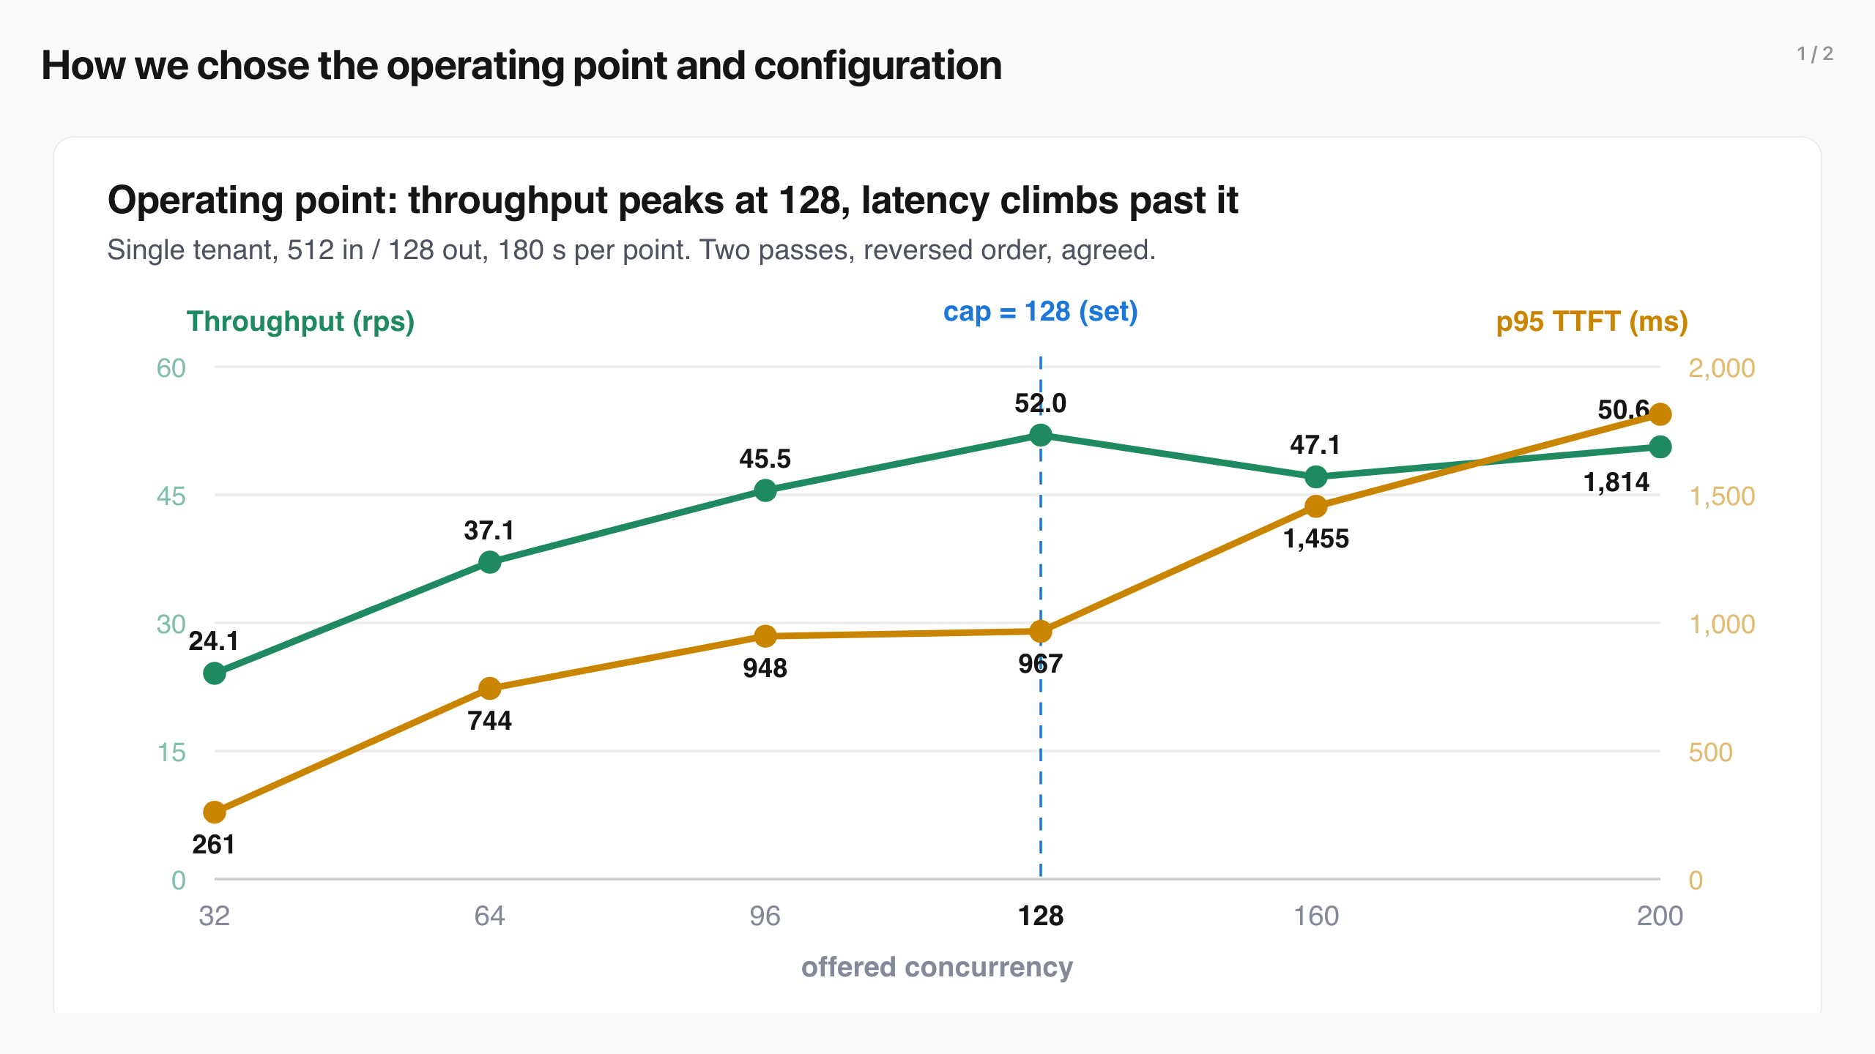
How we chose the operating point and configuration (1/2)
Notes:
How we chose the operating point and configuration
Flow control queues populate only at saturation, so before the experiments we sweep the model server with a single tenant to find the saturation point. The sweep tested from 32 to 200 concurrent requests, twice, in reversed order.
Throughput peaks at 128 concurrent requests in flight and 52.0 requests per second, then falls, while the p95 TTFT tail keeps climbing. Both passes land on the same knee.
We set max-num-seqs to 128, the running-batch capacity chosen for this H100, so the sweep confirms saturation there. At 128 concurrent the batch pins at the cap and a real queue forms, so every scenario runs at this operating point.
View the data
Concurrency Throughput rps TTFT p50 ms TTFT p95 ms Running batch mean Waiting p95
32 24.1 171 261 28 4 64 37.1 307 744 54 23 96 45.5 427 948 82 45 128 52.0 566 967 99 68 160 47.1 708 1455 122 32 200 50.6 1523 1814 122 72
Input fixed at 512, output swept 64 / 128 / 512
Input is fixed at 512 tokens; output is swept across 64, 128, and 512, with 128 the headline. This stands in for short interactive work such as chat turns, retrieval-augmented generation (RAG) answers, and tool calls, where a brief reply makes time to first token the felt latency. Output length is the limiter under saturation: a longer generation holds its GPU slot for more decode steps.
The 128-token shape is the headline; the full ladder appears in the service-tiers result.
Choice Value Why
Input length 512 in (fixed) Short interactive work; held constant across every scenario Output length 64 / 128 / 512 (swept) Output is the saturation limiter, so we swept it; 128 is the headline max-num-seqs 128 (set) The engine's running-batch cap we set; the sweep confirmed the knee lands here max-num-batched-tokens 8192 Prefill budget per step for this model and GPU Prefix caching off Latencies reflect scheduling, not a warm cache Repeats 3 counted Each headline is the median of the three per-repeat p95s, steady-state trimmed, with the min–max range shown
The sweep ran 180 s per point over two passes in randomized order, and both agreed. Data in data-v4/operating-point-sweep .
We set max-num-seqs to 128, the running-batch capacity chosen for this H100, so the sweep confirms saturation there. At 128 concurrent the batch pins at the cap and a real queue forms, so every scenario runs at this operating point.
View the data
Concurrency Throughput rps TTFT p50 ms TTFT p95 ms Running batch mean Waiting p95
32 24.1 171 261 28 4 64 37.1 307 744 54 23 96 45.5 427 948 82 45 128 52.0 566 967 99 68 160 47.1 708 1455 122 32 200 50.6 1523 1814 122 72
Input fixed at 512, output swept 64 / 128 / 512
Input is fixed at 512 tokens; output is swept across 64, 128, and 512, with 128 the headline. This stands in for short interactive work such as chat turns, retrieval-augmented generation (RAG) answers, and tool calls, where a brief reply makes time to first token the felt latency. Output length is the limiter under saturation: a longer generation holds its GPU slot for more decode steps.
The sweep ran 180 s per point over two passes in randomized order, and both agreed. Data in data-v4/operating-point-sweep .
Flow control queues populate only at saturation, so before the experiments we sweep the model server with a single tenant to find the saturation point. The sweep tested from 32 to 200 concurrent requests, twice, in reversed order.

Slide 11
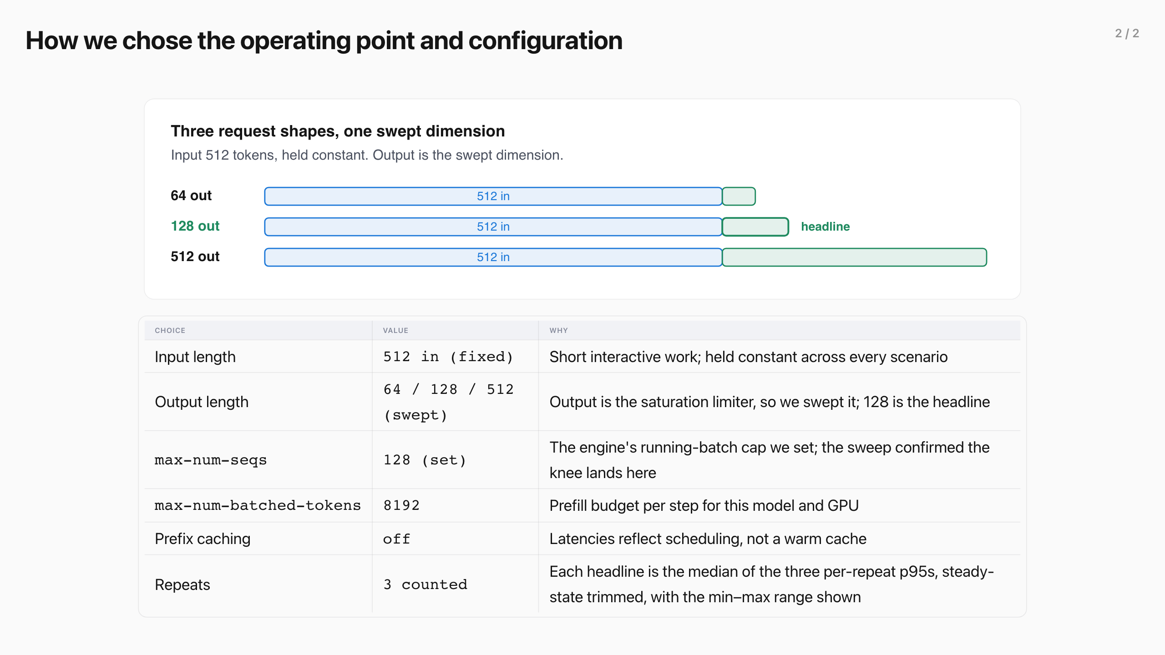
How we chose the operating point and configuration (2/2)
Notes:
How we chose the operating point and configuration
Flow control queues populate only at saturation, so before the experiments we sweep the model server with a single tenant to find the saturation point. The sweep tested from 32 to 200 concurrent requests, twice, in reversed order.
Throughput peaks at 128 concurrent requests in flight and 52.0 requests per second, then falls, while the p95 TTFT tail keeps climbing. Both passes land on the same knee.
We set max-num-seqs to 128, the running-batch capacity chosen for this H100, so the sweep confirms saturation there. At 128 concurrent the batch pins at the cap and a real queue forms, so every scenario runs at this operating point.
View the data
Concurrency Throughput rps TTFT p50 ms TTFT p95 ms Running batch mean Waiting p95
32 24.1 171 261 28 4 64 37.1 307 744 54 23 96 45.5 427 948 82 45 128 52.0 566 967 99 68 160 47.1 708 1455 122 32 200 50.6 1523 1814 122 72
Input fixed at 512, output swept 64 / 128 / 512
Input is fixed at 512 tokens; output is swept across 64, 128, and 512, with 128 the headline. This stands in for short interactive work such as chat turns, retrieval-augmented generation (RAG) answers, and tool calls, where a brief reply makes time to first token the felt latency. Output length is the limiter under saturation: a longer generation holds its GPU slot for more decode steps.
The 128-token shape is the headline; the full ladder appears in the service-tiers result.
Choice Value Why
Input length 512 in (fixed) Short interactive work; held constant across every scenario Output length 64 / 128 / 512 (swept) Output is the saturation limiter, so we swept it; 128 is the headline max-num-seqs 128 (set) The engine's running-batch cap we set; the sweep confirmed the knee lands here max-num-batched-tokens 8192 Prefill budget per step for this model and GPU Prefix caching off Latencies reflect scheduling, not a warm cache Repeats 3 counted Each headline is the median of the three per-repeat p95s, steady-state trimmed, with the min–max range shown
The sweep ran 180 s per point over two passes in randomized order, and both agreed. Data in data-v4/operating-point-sweep .
We set max-num-seqs to 128, the running-batch capacity chosen for this H100, so the sweep confirms saturation there. At 128 concurrent the batch pins at the cap and a real queue forms, so every scenario runs at this operating point.
View the data
Concurrency Throughput rps TTFT p50 ms TTFT p95 ms Running batch mean Waiting p95
32 24.1 171 261 28 4 64 37.1 307 744 54 23 96 45.5 427 948 82 45 128 52.0 566 967 99 68 160 47.1 708 1455 122 32 200 50.6 1523 1814 122 72
Input fixed at 512, output swept 64 / 128 / 512
Input is fixed at 512 tokens; output is swept across 64, 128, and 512, with 128 the headline. This stands in for short interactive work such as chat turns, retrieval-augmented generation (RAG) answers, and tool calls, where a brief reply makes time to first token the felt latency. Output length is the limiter under saturation: a longer generation holds its GPU slot for more decode steps.
The sweep ran 180 s per point over two passes in randomized order, and both agreed. Data in data-v4/operating-point-sweep .
Flow control queues populate only at saturation, so before the experiments we sweep the model server with a single tenant to find the saturation point. The sweep tested from 32 to 200 concurrent requests, twice, in reversed order.

Slide 12
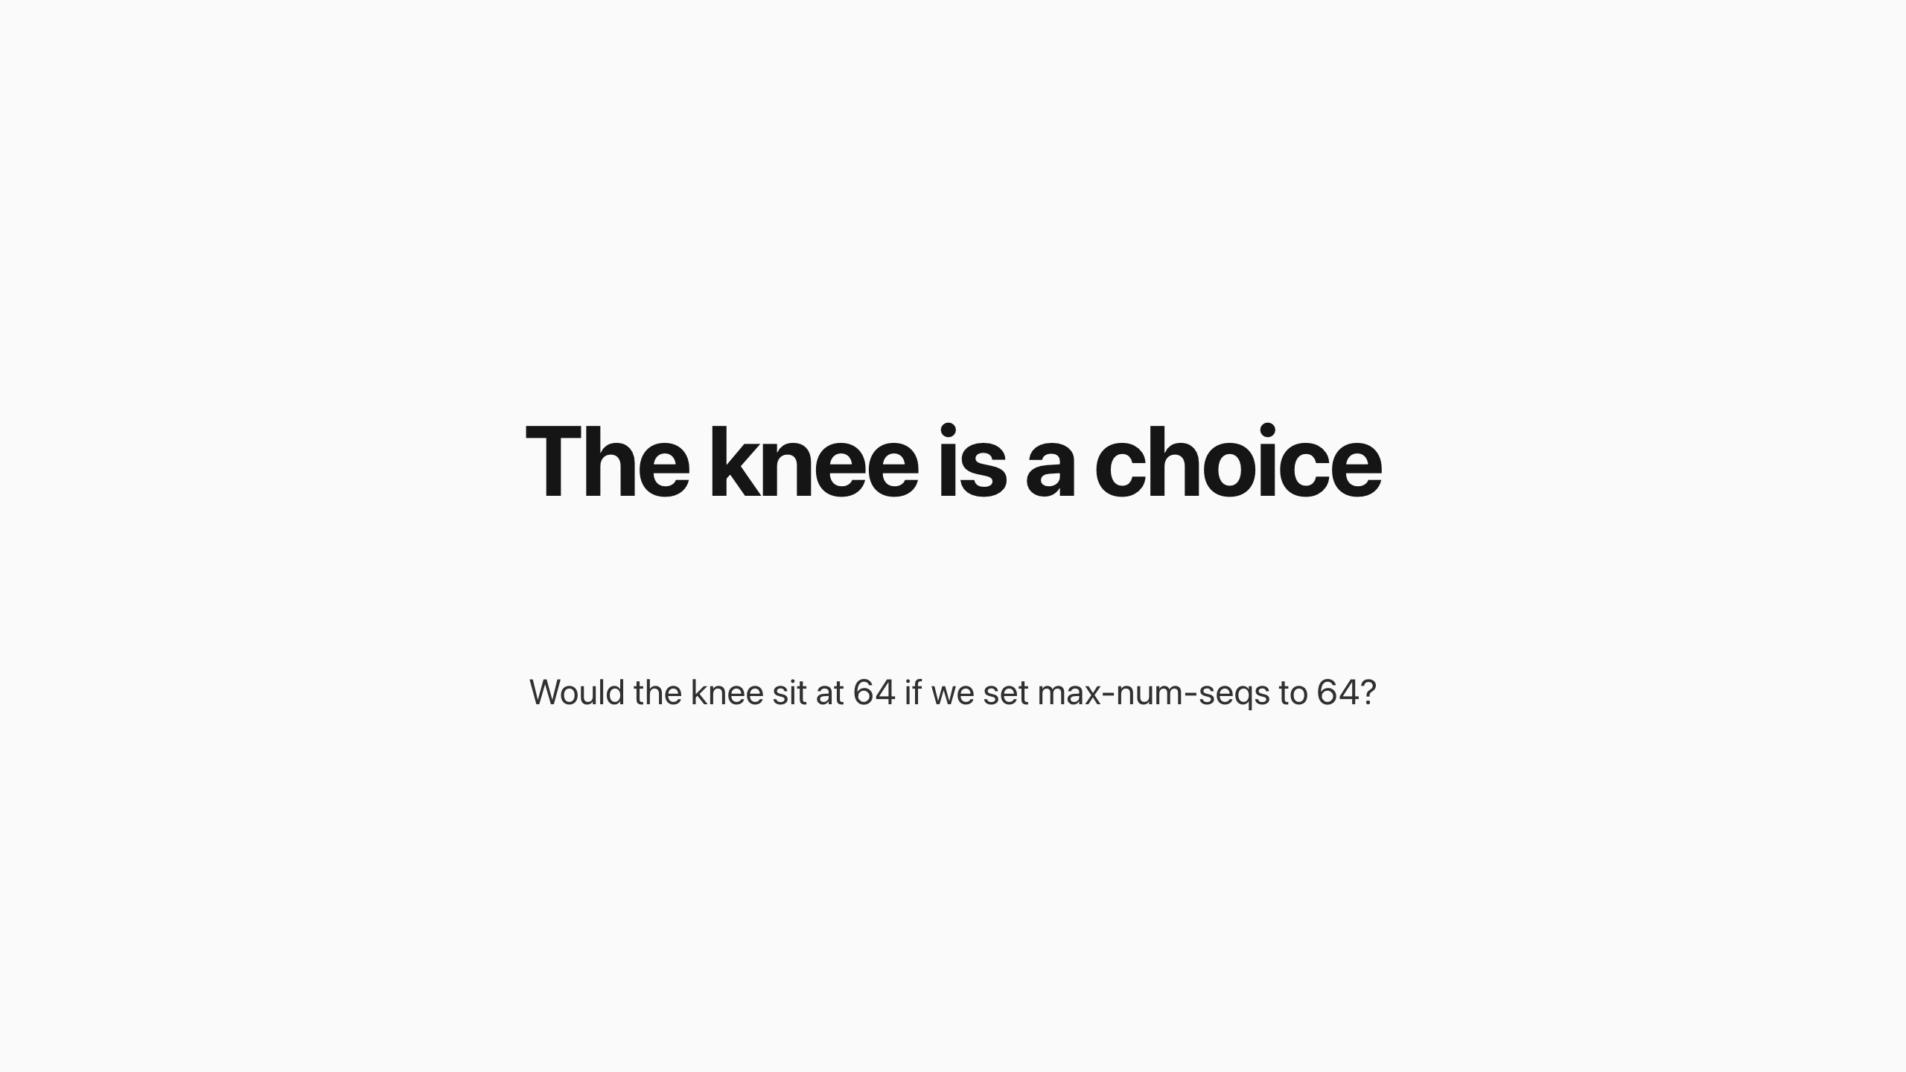
The knee is a choice
Notes:
The knee is a choice
Would the knee sit at 64 if we set max-num-seqs to 64? Yes — the knee follows the cap, mostly, and the reason why is the most useful thing this chart teaches.
The knee we measured is an admission knee : throughput climbs with offered concurrency until the running batch pins at the max-num-seqs ceiling, and past that point extra offered load can only queue. Set the cap to 64 and the running batch pins at 64, the queue forms behind 64, and the knee in offered-concurrency space moves to about 64. In that sense the knee is a config value looking back at you.
But there is a second knee underneath, and it is the one that prices your choice. The GPU has its own compute knee — the batch size where adding more sequences stops buying token throughput because the hardware is saturated. Our sweep locates it: 24.1 requests per second at 32 running, 37.1 at 64, 45.5 at 96, 52.0 at 128 — still climbing all the way to the cap. The hardware knee for this model, GPU, and shape sits at or beyond 128.
Cap at 64 — the knee moves to 64, and you give up real throughput the GPU could have delivered: roughly 37 against 52 requests per second, about 30% less.
In exchange — a lighter running batch means faster decode steps, so lower time to first token and time per output token, plus more key-value (KV) cache headroom. It is the latency-throughput dial, set at the engine.
Lower the cap and the knee follows it: at 64 the pool queues sooner and serves ≈37 requests per second; at 128 it reaches the measured 52. The curve was still climbing at the cap, so the hardware's own knee sits at or beyond 128 — every point below it is a latency-for-throughput trade you choose.
sweep: 32/64/96/128 concurrent → 24.1/37.1/45.5/52.0 requests per second · two passes agreed
The cap that binds is workload-shaped. max-num-seqs limits how many requests run; max-num-batched-tokens limits how many tokens each step may carry; the key-value (KV) cache limits how much context the pool can hold. Whichever fills first sets the real ceiling — at 512 input and 128 output tokens, sequences fill first, so the knee lands exactly on the cap.
The upstream concurrency detector's maxConcurrency is the same dial implemented in software, at the Endpoint Picker instead of the engine. Capping admission at 32, 48, 64, and 96 pinned the running batch at 29, 39, 46, and 61 — a movable knee below the engine's — and traded latency against throughput exactly this way. The knee is not found, it is chosen; the sweep tells you what each choice costs.
The knee we measured is an admission knee : throughput climbs with offered concurrency until the running batch pins at the max-num-seqs ceiling, and past that point extra offered load can only queue. Set the cap to 64 and the running batch pins at 64, the queue forms behind 64, and the knee in offered-concurrency space moves to about 64. In that sense the knee is a config value looking back at you.
But there is a second knee underneath, and it is the one that prices your choice. The GPU has its own compute knee — the batch size where adding more sequences stops buying token throughput because the hardware is saturated. Our sweep locates it: 24.1 requests per second at 32 running, 37.1 at 64, 45.5 at 96, 52.0 at 128 — still climbing all the way to the cap. The hardware knee for this model, GPU, and shape sits at or beyond 128.
Cap at 64 — the knee moves to 64, and you give up real throughput the GPU could have delivered: roughly 37 against 52 requests per second, about 30% less.
In exchange — a lighter running batch means faster decode steps, so lower time to first token and time per output token, plus more key-value (KV) cache headroom. It is the latency-throughput dial, set at the engine.
Cap at 64 — the knee moves to 64, and you give up real throughput the GPU could have delivered: roughly 37 against 52 requests per second, about 30% less.
In exchange — a lighter running batch means faster decode steps, so lower time to first token and time per output token, plus more key-value (KV) cache headroom. It is the latency-throughput dial, set at the engine.
The cap that binds is workload-shaped. max-num-seqs limits how many requests run; max-num-batched-tokens limits how many tokens each step may carry; the key-value (KV) cache limits how much context the pool can hold. Whichever fills first sets the real ceiling — at 512 input and 128 output tokens, sequences fill first, so the knee lands exactly on the cap.
The upstream concurrency detector's maxConcurrency is the same dial implemented in software, at the Endpoint Picker instead of the engine. Capping admission at 32, 48, 64, and 96 pinned the running batch at 29, 39, 46, and 61 — a movable knee below the engine's — and traded latency against throughput exactly this way. The knee is not found, it is chosen; the sweep tells you what each choice costs.
Would the knee sit at 64 if we set max-num-seqs to 64? Yes — the knee follows the cap, mostly, and the reason why is the most useful thing this chart teaches.

Slide 13
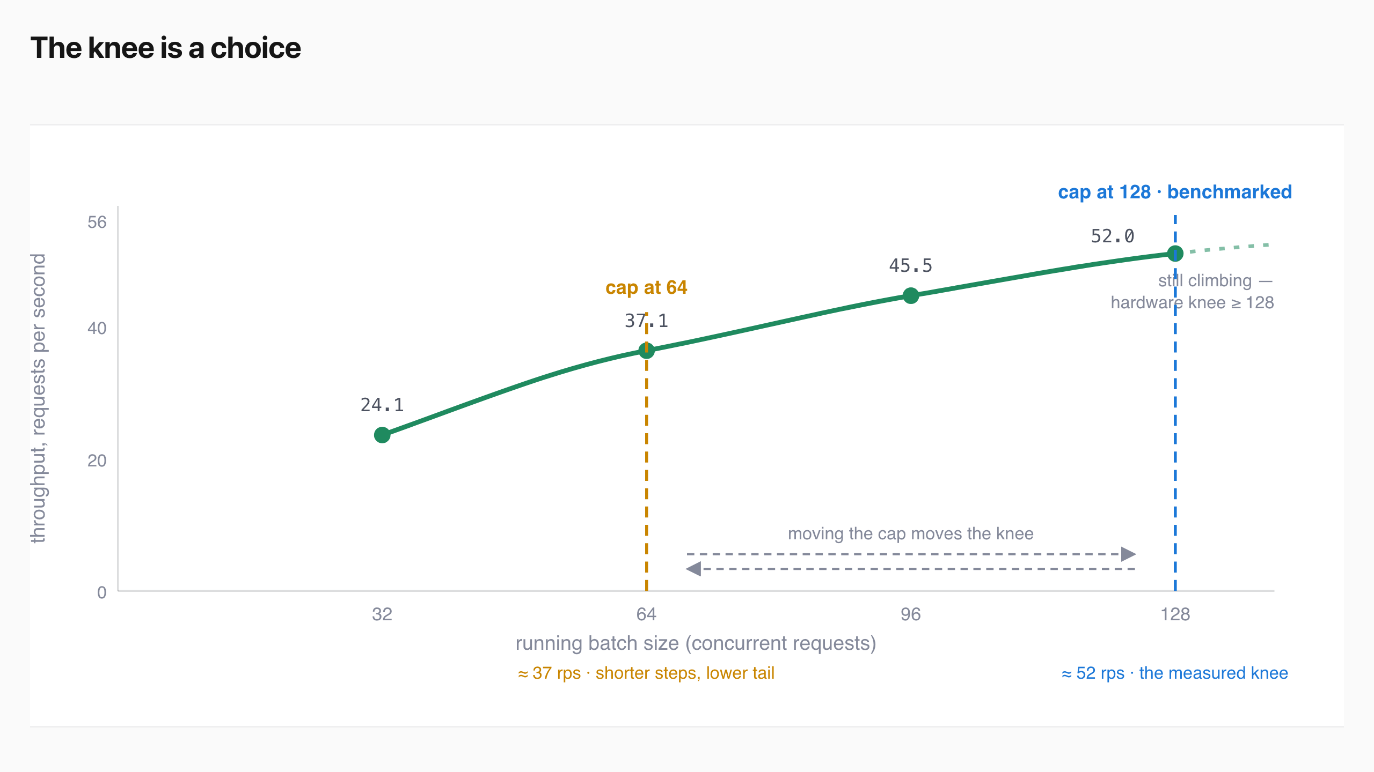
The knee is a choice
Notes:
The knee is a choice
Would the knee sit at 64 if we set max-num-seqs to 64? Yes — the knee follows the cap, mostly, and the reason why is the most useful thing this chart teaches.
The knee we measured is an admission knee : throughput climbs with offered concurrency until the running batch pins at the max-num-seqs ceiling, and past that point extra offered load can only queue. Set the cap to 64 and the running batch pins at 64, the queue forms behind 64, and the knee in offered-concurrency space moves to about 64. In that sense the knee is a config value looking back at you.
But there is a second knee underneath, and it is the one that prices your choice. The GPU has its own compute knee — the batch size where adding more sequences stops buying token throughput because the hardware is saturated. Our sweep locates it: 24.1 requests per second at 32 running, 37.1 at 64, 45.5 at 96, 52.0 at 128 — still climbing all the way to the cap. The hardware knee for this model, GPU, and shape sits at or beyond 128.
Cap at 64 — the knee moves to 64, and you give up real throughput the GPU could have delivered: roughly 37 against 52 requests per second, about 30% less.
In exchange — a lighter running batch means faster decode steps, so lower time to first token and time per output token, plus more key-value (KV) cache headroom. It is the latency-throughput dial, set at the engine.
Lower the cap and the knee follows it: at 64 the pool queues sooner and serves ≈37 requests per second; at 128 it reaches the measured 52. The curve was still climbing at the cap, so the hardware's own knee sits at or beyond 128 — every point below it is a latency-for-throughput trade you choose.
sweep: 32/64/96/128 concurrent → 24.1/37.1/45.5/52.0 requests per second · two passes agreed
The cap that binds is workload-shaped. max-num-seqs limits how many requests run; max-num-batched-tokens limits how many tokens each step may carry; the key-value (KV) cache limits how much context the pool can hold. Whichever fills first sets the real ceiling — at 512 input and 128 output tokens, sequences fill first, so the knee lands exactly on the cap.
The upstream concurrency detector's maxConcurrency is the same dial implemented in software, at the Endpoint Picker instead of the engine. Capping admission at 32, 48, 64, and 96 pinned the running batch at 29, 39, 46, and 61 — a movable knee below the engine's — and traded latency against throughput exactly this way. The knee is not found, it is chosen; the sweep tells you what each choice costs.
The knee we measured is an admission knee : throughput climbs with offered concurrency until the running batch pins at the max-num-seqs ceiling, and past that point extra offered load can only queue. Set the cap to 64 and the running batch pins at 64, the queue forms behind 64, and the knee in offered-concurrency space moves to about 64. In that sense the knee is a config value looking back at you.
But there is a second knee underneath, and it is the one that prices your choice. The GPU has its own compute knee — the batch size where adding more sequences stops buying token throughput because the hardware is saturated. Our sweep locates it: 24.1 requests per second at 32 running, 37.1 at 64, 45.5 at 96, 52.0 at 128 — still climbing all the way to the cap. The hardware knee for this model, GPU, and shape sits at or beyond 128.
Cap at 64 — the knee moves to 64, and you give up real throughput the GPU could have delivered: roughly 37 against 52 requests per second, about 30% less.
In exchange — a lighter running batch means faster decode steps, so lower time to first token and time per output token, plus more key-value (KV) cache headroom. It is the latency-throughput dial, set at the engine.
Cap at 64 — the knee moves to 64, and you give up real throughput the GPU could have delivered: roughly 37 against 52 requests per second, about 30% less.
In exchange — a lighter running batch means faster decode steps, so lower time to first token and time per output token, plus more key-value (KV) cache headroom. It is the latency-throughput dial, set at the engine.
The cap that binds is workload-shaped. max-num-seqs limits how many requests run; max-num-batched-tokens limits how many tokens each step may carry; the key-value (KV) cache limits how much context the pool can hold. Whichever fills first sets the real ceiling — at 512 input and 128 output tokens, sequences fill first, so the knee lands exactly on the cap.
The upstream concurrency detector's maxConcurrency is the same dial implemented in software, at the Endpoint Picker instead of the engine. Capping admission at 32, 48, 64, and 96 pinned the running batch at 29, 39, 46, and 61 — a movable knee below the engine's — and traded latency against throughput exactly this way. The knee is not found, it is chosen; the sweep tells you what each choice costs.
Would the knee sit at 64 if we set max-num-seqs to 64? Yes — the knee follows the cap, mostly, and the reason why is the most useful thing this chart teaches.

Slide 14

Setup and verification
Notes:
Setup and verification
All runs follow the same basic setup.
Arg Value
Model openai/gpt-oss-20b Hardware one H100, TP 1 max-num-seqs 128 max-num-batched-tokens 8192 max-model-len 32768 gpu-memory-utilization 0.90 enable_prefix_caching False input / output tokens 512 in / 64,128,512 out
Engine args are set in the serving pod spec and verified in the pod startup log. Prefix caching is confirmed by vllm:prefix_cache_queries_total staying flat, and the request shape comes from the client config — input fixed, output swept.
Prefix caching off
Automatic Prefix Caching (APC) is off, so latencies reflect scheduling and not a warm cache, and no cache is used even if one exists.
Per-request headers
Each request carries two headers.
Header Carries
x-llm-d-inference-objective the priority tier, premium, standard, or batch x-llm-d-inference-fairness-id the tenant, used for same-band fairness
The older x-gateway-inference-objective and x-gateway-inference-fairness-id forms are deprecated aliases and still accepted; the harness sent them; they resolve identically.
How a tier becomes a priority
The header becomes a real priority only once the Endpoint Picker resolves it against a matching objective in a saturated pool, so we verify premium resolves to 100 before every run.
Tier Resolves to
premium 100 standard 0 batch -10
Verification
Two conditions are checked before any latency is trusted.
Check Where Passes when
Priority routing Endpoint Picker /metrics queue_duration_seconds{priority="100"} present for premium Pool saturated vLLM /metrics num_requests_running pinned at 128 and num_requests_waiting > 0
Engine args are set in the serving pod spec and verified in the pod startup log. Prefix caching is confirmed by vllm:prefix_cache_queries_total staying flat, and the request shape comes from the client config — input fixed, output swept.
Prefix caching off
Automatic Prefix Caching (APC) is off, so latencies reflect scheduling and not a warm cache, and no cache is used even if one exists.
Per-request headers
Each request carries two headers.
The older x-gateway-inference-objective and x-gateway-inference-fairness-id forms are deprecated aliases and still accepted; the harness sent them; they resolve identically.
How a tier becomes a priority
The header becomes a real priority only once the Endpoint Picker resolves it against a matching objective in a saturated pool, so we verify premium resolves to 100 before every run.
Verification
Two conditions are checked before any latency is trusted.
All runs follow the same basic setup.

Slide 15
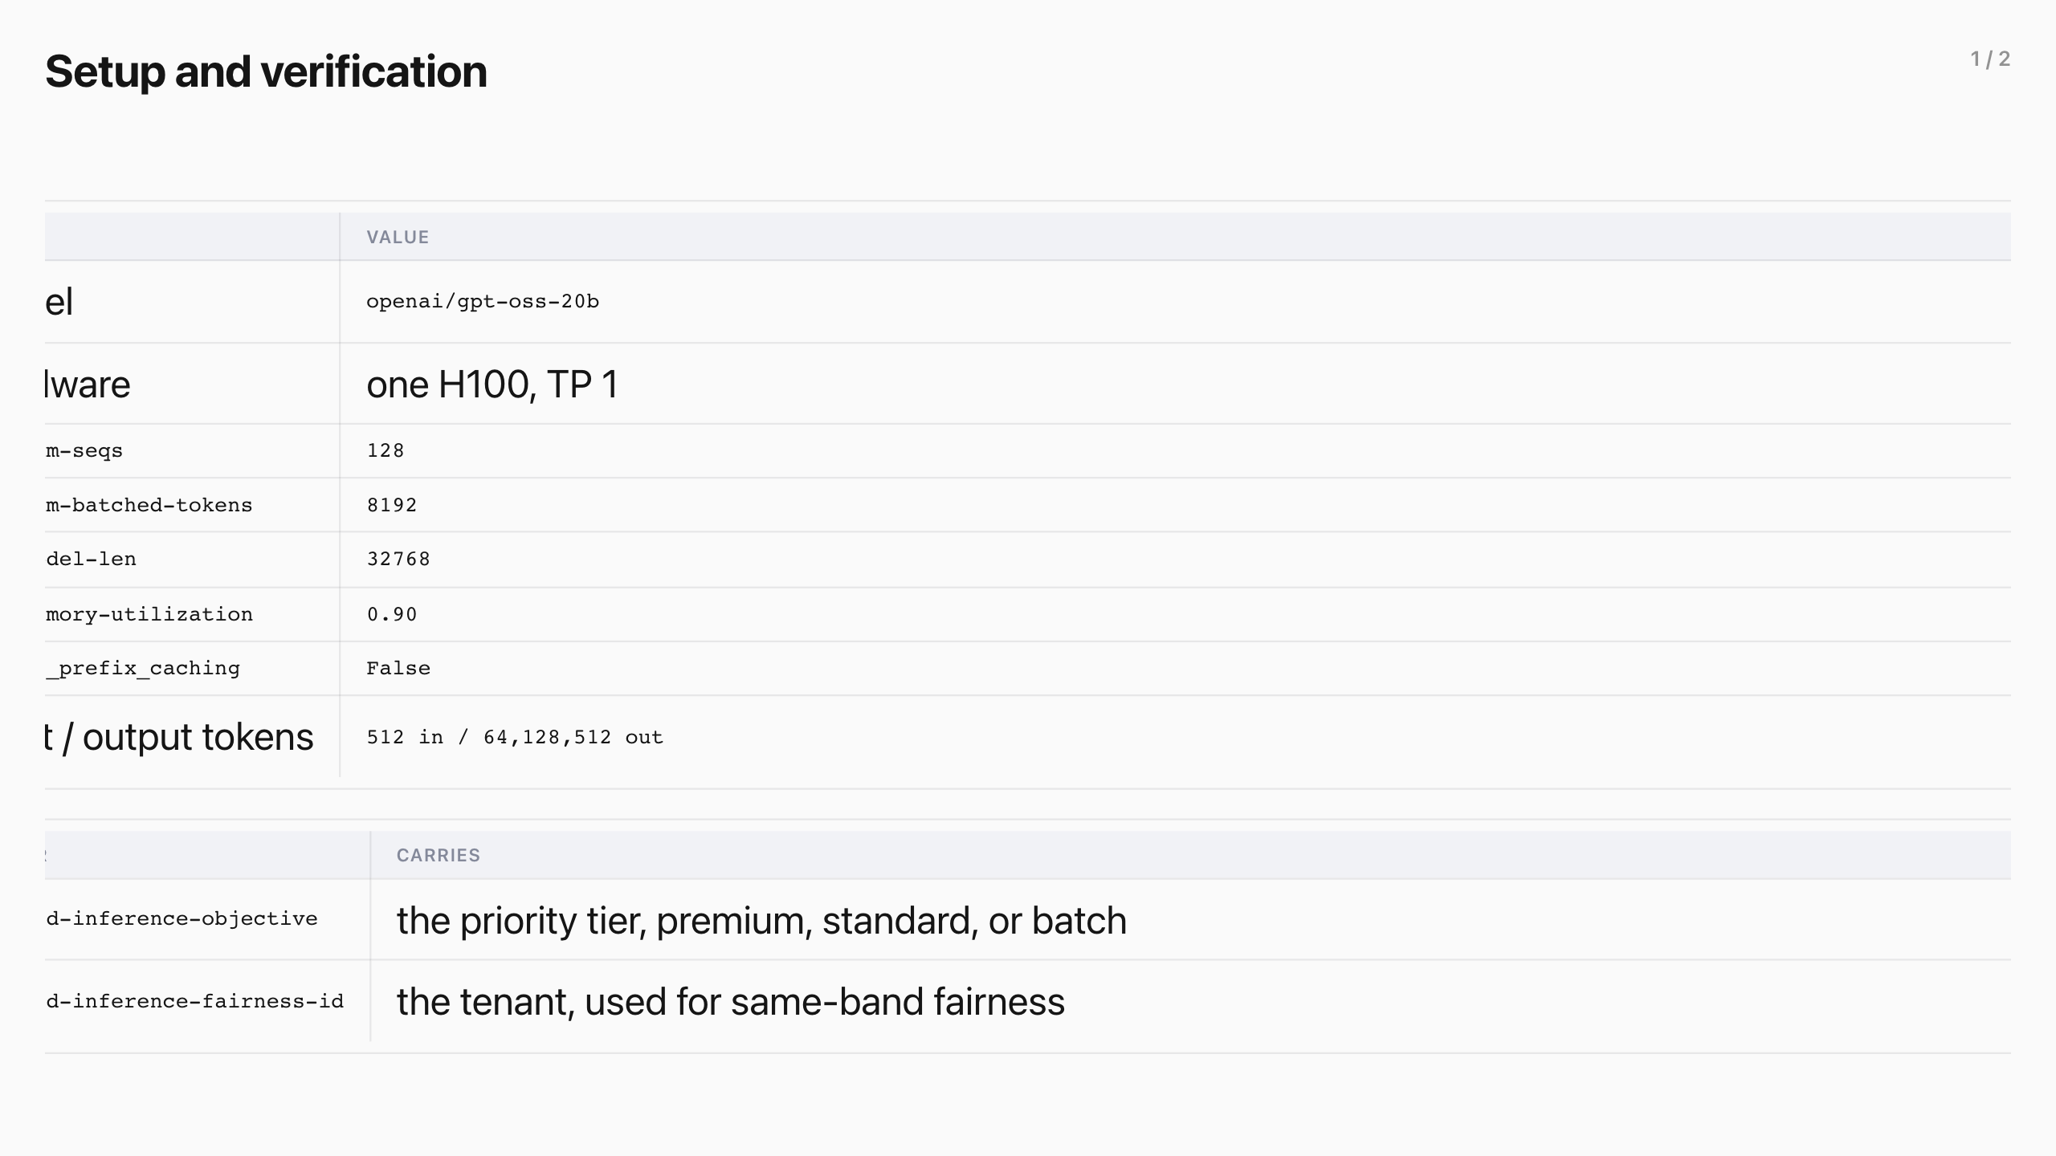
Setup and verification (1/2)
Notes:
Setup and verification
All runs follow the same basic setup.
Arg Value
Model openai/gpt-oss-20b Hardware one H100, TP 1 max-num-seqs 128 max-num-batched-tokens 8192 max-model-len 32768 gpu-memory-utilization 0.90 enable_prefix_caching False input / output tokens 512 in / 64,128,512 out
Engine args are set in the serving pod spec and verified in the pod startup log. Prefix caching is confirmed by vllm:prefix_cache_queries_total staying flat, and the request shape comes from the client config — input fixed, output swept.
Prefix caching off
Automatic Prefix Caching (APC) is off, so latencies reflect scheduling and not a warm cache, and no cache is used even if one exists.
Per-request headers
Each request carries two headers.
Header Carries
x-llm-d-inference-objective the priority tier, premium, standard, or batch x-llm-d-inference-fairness-id the tenant, used for same-band fairness
The older x-gateway-inference-objective and x-gateway-inference-fairness-id forms are deprecated aliases and still accepted; the harness sent them; they resolve identically.
How a tier becomes a priority
The header becomes a real priority only once the Endpoint Picker resolves it against a matching objective in a saturated pool, so we verify premium resolves to 100 before every run.
Tier Resolves to
premium 100 standard 0 batch -10
Verification
Two conditions are checked before any latency is trusted.
Check Where Passes when
Priority routing Endpoint Picker /metrics queue_duration_seconds{priority="100"} present for premium Pool saturated vLLM /metrics num_requests_running pinned at 128 and num_requests_waiting > 0
Engine args are set in the serving pod spec and verified in the pod startup log. Prefix caching is confirmed by vllm:prefix_cache_queries_total staying flat, and the request shape comes from the client config — input fixed, output swept.
Prefix caching off
Automatic Prefix Caching (APC) is off, so latencies reflect scheduling and not a warm cache, and no cache is used even if one exists.
Per-request headers
Each request carries two headers.
The older x-gateway-inference-objective and x-gateway-inference-fairness-id forms are deprecated aliases and still accepted; the harness sent them; they resolve identically.
How a tier becomes a priority
The header becomes a real priority only once the Endpoint Picker resolves it against a matching objective in a saturated pool, so we verify premium resolves to 100 before every run.
Verification
Two conditions are checked before any latency is trusted.
All runs follow the same basic setup.

Slide 16
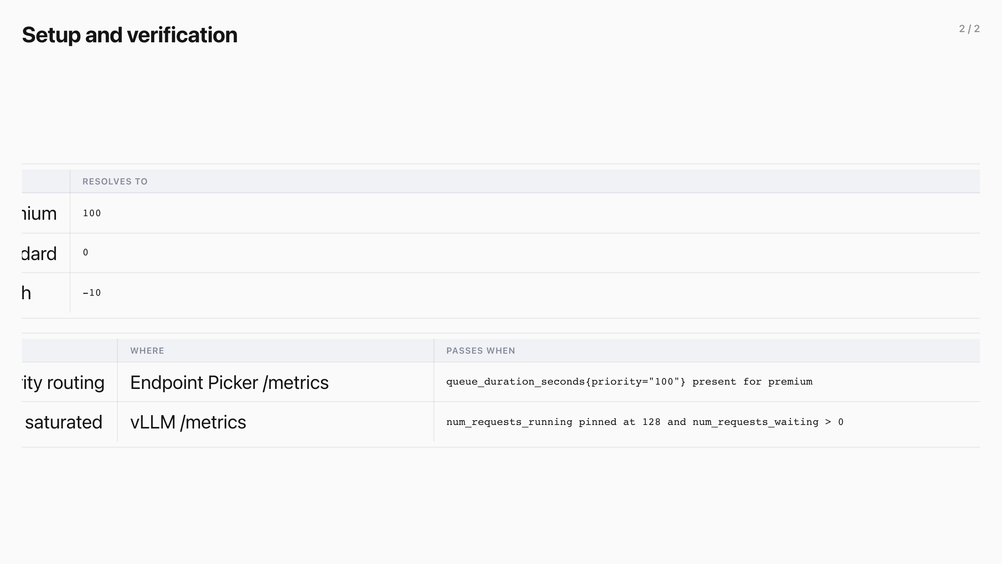
Setup and verification (2/2)
Notes:
Setup and verification
All runs follow the same basic setup.
Arg Value
Model openai/gpt-oss-20b Hardware one H100, TP 1 max-num-seqs 128 max-num-batched-tokens 8192 max-model-len 32768 gpu-memory-utilization 0.90 enable_prefix_caching False input / output tokens 512 in / 64,128,512 out
Engine args are set in the serving pod spec and verified in the pod startup log. Prefix caching is confirmed by vllm:prefix_cache_queries_total staying flat, and the request shape comes from the client config — input fixed, output swept.
Prefix caching off
Automatic Prefix Caching (APC) is off, so latencies reflect scheduling and not a warm cache, and no cache is used even if one exists.
Per-request headers
Each request carries two headers.
Header Carries
x-llm-d-inference-objective the priority tier, premium, standard, or batch x-llm-d-inference-fairness-id the tenant, used for same-band fairness
The older x-gateway-inference-objective and x-gateway-inference-fairness-id forms are deprecated aliases and still accepted; the harness sent them; they resolve identically.
How a tier becomes a priority
The header becomes a real priority only once the Endpoint Picker resolves it against a matching objective in a saturated pool, so we verify premium resolves to 100 before every run.
Tier Resolves to
premium 100 standard 0 batch -10
Verification
Two conditions are checked before any latency is trusted.
Check Where Passes when
Priority routing Endpoint Picker /metrics queue_duration_seconds{priority="100"} present for premium Pool saturated vLLM /metrics num_requests_running pinned at 128 and num_requests_waiting > 0
Engine args are set in the serving pod spec and verified in the pod startup log. Prefix caching is confirmed by vllm:prefix_cache_queries_total staying flat, and the request shape comes from the client config — input fixed, output swept.
Prefix caching off
Automatic Prefix Caching (APC) is off, so latencies reflect scheduling and not a warm cache, and no cache is used even if one exists.
Per-request headers
Each request carries two headers.
The older x-gateway-inference-objective and x-gateway-inference-fairness-id forms are deprecated aliases and still accepted; the harness sent them; they resolve identically.
How a tier becomes a priority
The header becomes a real priority only once the Endpoint Picker resolves it against a matching objective in a saturated pool, so we verify premium resolves to 100 before every run.
Verification
Two conditions are checked before any latency is trusted.
All runs follow the same basic setup.

Slide 17

Service tiers
Notes:
Service tiers
When the pool saturates, priority decides who waits. The runs below hold the pool at the operating point with flow control on and measure the separation between tiers.
Mean time per output token stayed at 19–21 ms in every repeat, read from vllm:inter_token_latency_seconds : the queue decides who starts; the pace of tokens already flowing barely moves.
Standard surges past the batch cap mid-run while premium holds a low steady rate.
With flow control on and the pool saturated, premium p95 TTFT settles at 1117 ms against 1406 ms for standard, a ~1.25x separation that held across all three repeats.
The three repeats land within a 1.15x band, so the 1117 ms headline is a stable scheduling result, not a lucky draw.
View the data
Repeat Premium p95 Premium p50 Steady samples
r01 1211 ms 510 ms 4108 r02 1117 ms 374 ms 4420 r03 1056 ms 345 ms 4537 median 1117 ms 374 ms —
Premium at roughly 48 aggregate requests per second competes for the 128 running slots, so its ~1.1 s steady-state tail is a real scheduling result; the separation comes from standard waiting the extra cycle behind it.
What we learned
An earlier cut of this result pooled every repeat into one percentile, and a startup transient in one repeat produced a headline the steady state could not reproduce. Every headline now passes four guards: per-repeat percentiles , never pooled across repeats; a steady-state trim before counting; a spread gate , max/min ≤ 1.5x across repeats; and saturation verified from the serving metrics, not assumed.
Output length ladder
The 64- and 512-output-token arms are being restated with per-repeat percentiles; their earlier pooled numbers are withdrawn, and the 128-output result above is the restated headline.
A latency-sensitive product keeps its experience through a surge it did not cause, which makes a tiered service-level agreement (SLA) enforceable on shared capacity.
Mean time per output token stayed at 19–21 ms in every repeat, read from vllm:inter_token_latency_seconds : the queue decides who starts; the pace of tokens already flowing barely moves.
View the data
Repeat Premium p95 Premium p50 Steady samples
r01 1211 ms 510 ms 4108 r02 1117 ms 374 ms 4420 r03 1056 ms 345 ms 4537 median 1117 ms 374 ms —
Premium at roughly 48 aggregate requests per second competes for the 128 running slots, so its ~1.1 s steady-state tail is a real scheduling result; the separation comes from standard waiting the extra cycle behind it.
What we learned
An earlier cut of this result pooled every repeat into one percentile, and a startup transient in one repeat produced a headline the steady state could not reproduce. Every headline now passes four guards: per-repeat percentiles , never pooled across repeats; a steady-state trim before counting; a spread gate , max/min ≤ 1.5x across repeats; and saturation verified from the serving metrics, not assumed.
Output length ladder
The 64- and 512-output-token arms are being restated with per-repeat percentiles; their earlier pooled numbers are withdrawn, and the 128-output result above is the restated headline.
A latency-sensitive product keeps its experience through a surge it did not cause, which makes a tiered service-level agreement (SLA) enforceable on shared capacity.
When the pool saturates, priority decides who waits. The runs below hold the pool at the operating point with flow control on and measure the separation between tiers.

Slide 18
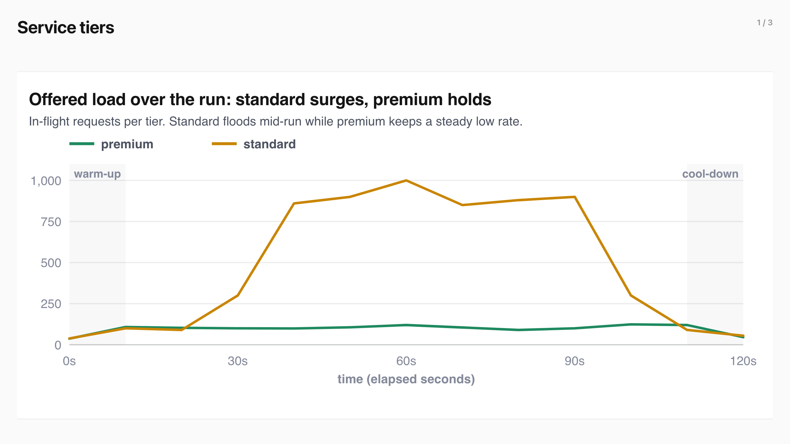
Service tiers (1/3)
Notes:
Service tiers
When the pool saturates, priority decides who waits. The runs below hold the pool at the operating point with flow control on and measure the separation between tiers.
Mean time per output token stayed at 19–21 ms in every repeat, read from vllm:inter_token_latency_seconds : the queue decides who starts; the pace of tokens already flowing barely moves.
Standard surges past the batch cap mid-run while premium holds a low steady rate.
With flow control on and the pool saturated, premium p95 TTFT settles at 1117 ms against 1406 ms for standard, a ~1.25x separation that held across all three repeats.
The three repeats land within a 1.15x band, so the 1117 ms headline is a stable scheduling result, not a lucky draw.
View the data
Repeat Premium p95 Premium p50 Steady samples
r01 1211 ms 510 ms 4108 r02 1117 ms 374 ms 4420 r03 1056 ms 345 ms 4537 median 1117 ms 374 ms —
Premium at roughly 48 aggregate requests per second competes for the 128 running slots, so its ~1.1 s steady-state tail is a real scheduling result; the separation comes from standard waiting the extra cycle behind it.
What we learned
An earlier cut of this result pooled every repeat into one percentile, and a startup transient in one repeat produced a headline the steady state could not reproduce. Every headline now passes four guards: per-repeat percentiles , never pooled across repeats; a steady-state trim before counting; a spread gate , max/min ≤ 1.5x across repeats; and saturation verified from the serving metrics, not assumed.
Output length ladder
The 64- and 512-output-token arms are being restated with per-repeat percentiles; their earlier pooled numbers are withdrawn, and the 128-output result above is the restated headline.
A latency-sensitive product keeps its experience through a surge it did not cause, which makes a tiered service-level agreement (SLA) enforceable on shared capacity.
Mean time per output token stayed at 19–21 ms in every repeat, read from vllm:inter_token_latency_seconds : the queue decides who starts; the pace of tokens already flowing barely moves.
View the data
Repeat Premium p95 Premium p50 Steady samples
r01 1211 ms 510 ms 4108 r02 1117 ms 374 ms 4420 r03 1056 ms 345 ms 4537 median 1117 ms 374 ms —
Premium at roughly 48 aggregate requests per second competes for the 128 running slots, so its ~1.1 s steady-state tail is a real scheduling result; the separation comes from standard waiting the extra cycle behind it.
What we learned
An earlier cut of this result pooled every repeat into one percentile, and a startup transient in one repeat produced a headline the steady state could not reproduce. Every headline now passes four guards: per-repeat percentiles , never pooled across repeats; a steady-state trim before counting; a spread gate , max/min ≤ 1.5x across repeats; and saturation verified from the serving metrics, not assumed.
Output length ladder
The 64- and 512-output-token arms are being restated with per-repeat percentiles; their earlier pooled numbers are withdrawn, and the 128-output result above is the restated headline.
A latency-sensitive product keeps its experience through a surge it did not cause, which makes a tiered service-level agreement (SLA) enforceable on shared capacity.
When the pool saturates, priority decides who waits. The runs below hold the pool at the operating point with flow control on and measure the separation between tiers.

Slide 19
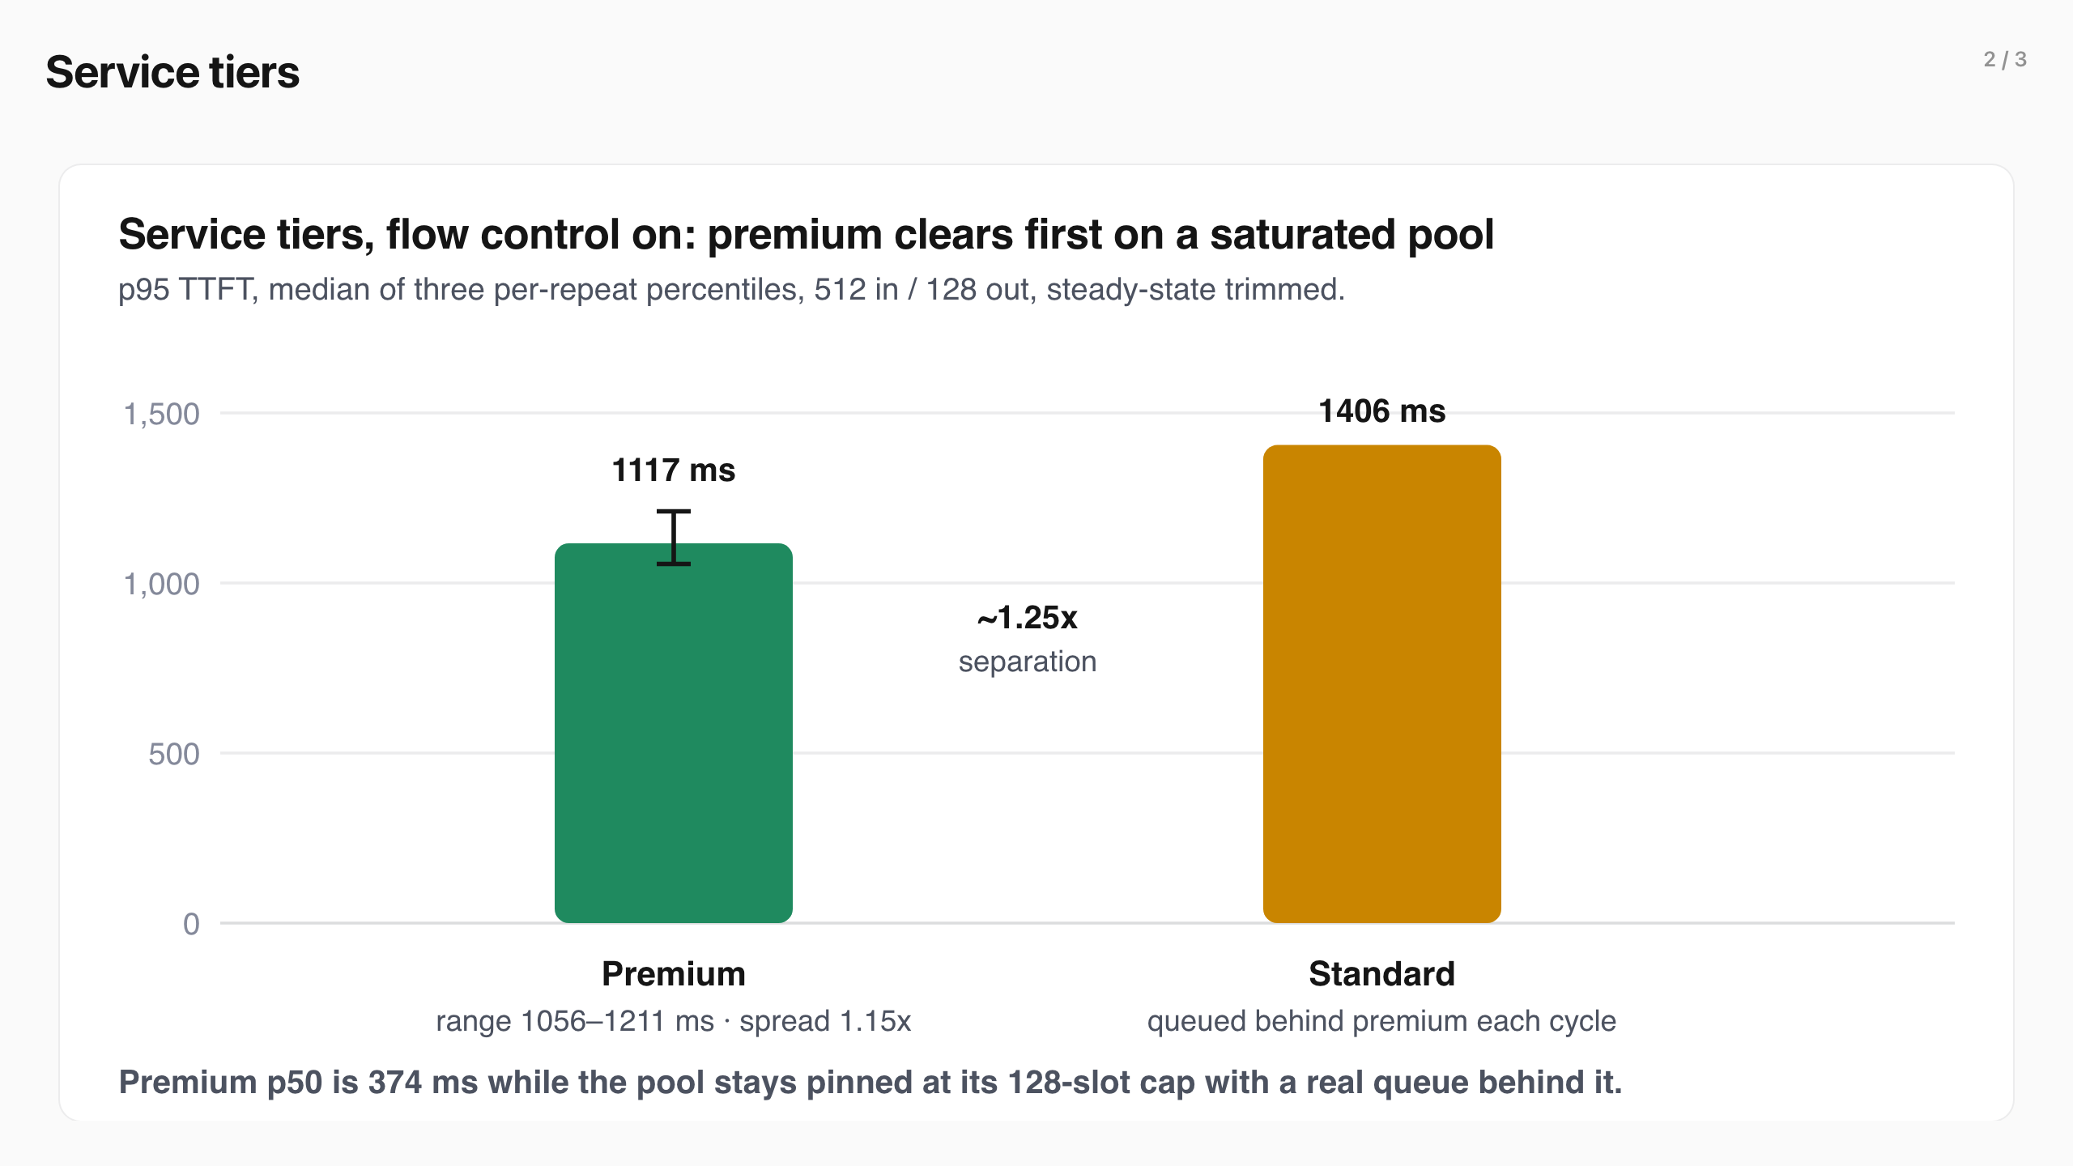
Service tiers (2/3)
Notes:
Service tiers
When the pool saturates, priority decides who waits. The runs below hold the pool at the operating point with flow control on and measure the separation between tiers.
Mean time per output token stayed at 19–21 ms in every repeat, read from vllm:inter_token_latency_seconds : the queue decides who starts; the pace of tokens already flowing barely moves.
Standard surges past the batch cap mid-run while premium holds a low steady rate.
With flow control on and the pool saturated, premium p95 TTFT settles at 1117 ms against 1406 ms for standard, a ~1.25x separation that held across all three repeats.
The three repeats land within a 1.15x band, so the 1117 ms headline is a stable scheduling result, not a lucky draw.
View the data
Repeat Premium p95 Premium p50 Steady samples
r01 1211 ms 510 ms 4108 r02 1117 ms 374 ms 4420 r03 1056 ms 345 ms 4537 median 1117 ms 374 ms —
Premium at roughly 48 aggregate requests per second competes for the 128 running slots, so its ~1.1 s steady-state tail is a real scheduling result; the separation comes from standard waiting the extra cycle behind it.
What we learned
An earlier cut of this result pooled every repeat into one percentile, and a startup transient in one repeat produced a headline the steady state could not reproduce. Every headline now passes four guards: per-repeat percentiles , never pooled across repeats; a steady-state trim before counting; a spread gate , max/min ≤ 1.5x across repeats; and saturation verified from the serving metrics, not assumed.
Output length ladder
The 64- and 512-output-token arms are being restated with per-repeat percentiles; their earlier pooled numbers are withdrawn, and the 128-output result above is the restated headline.
A latency-sensitive product keeps its experience through a surge it did not cause, which makes a tiered service-level agreement (SLA) enforceable on shared capacity.
Mean time per output token stayed at 19–21 ms in every repeat, read from vllm:inter_token_latency_seconds : the queue decides who starts; the pace of tokens already flowing barely moves.
View the data
Repeat Premium p95 Premium p50 Steady samples
r01 1211 ms 510 ms 4108 r02 1117 ms 374 ms 4420 r03 1056 ms 345 ms 4537 median 1117 ms 374 ms —
Premium at roughly 48 aggregate requests per second competes for the 128 running slots, so its ~1.1 s steady-state tail is a real scheduling result; the separation comes from standard waiting the extra cycle behind it.
What we learned
An earlier cut of this result pooled every repeat into one percentile, and a startup transient in one repeat produced a headline the steady state could not reproduce. Every headline now passes four guards: per-repeat percentiles , never pooled across repeats; a steady-state trim before counting; a spread gate , max/min ≤ 1.5x across repeats; and saturation verified from the serving metrics, not assumed.
Output length ladder
The 64- and 512-output-token arms are being restated with per-repeat percentiles; their earlier pooled numbers are withdrawn, and the 128-output result above is the restated headline.
A latency-sensitive product keeps its experience through a surge it did not cause, which makes a tiered service-level agreement (SLA) enforceable on shared capacity.
When the pool saturates, priority decides who waits. The runs below hold the pool at the operating point with flow control on and measure the separation between tiers.

Slide 20
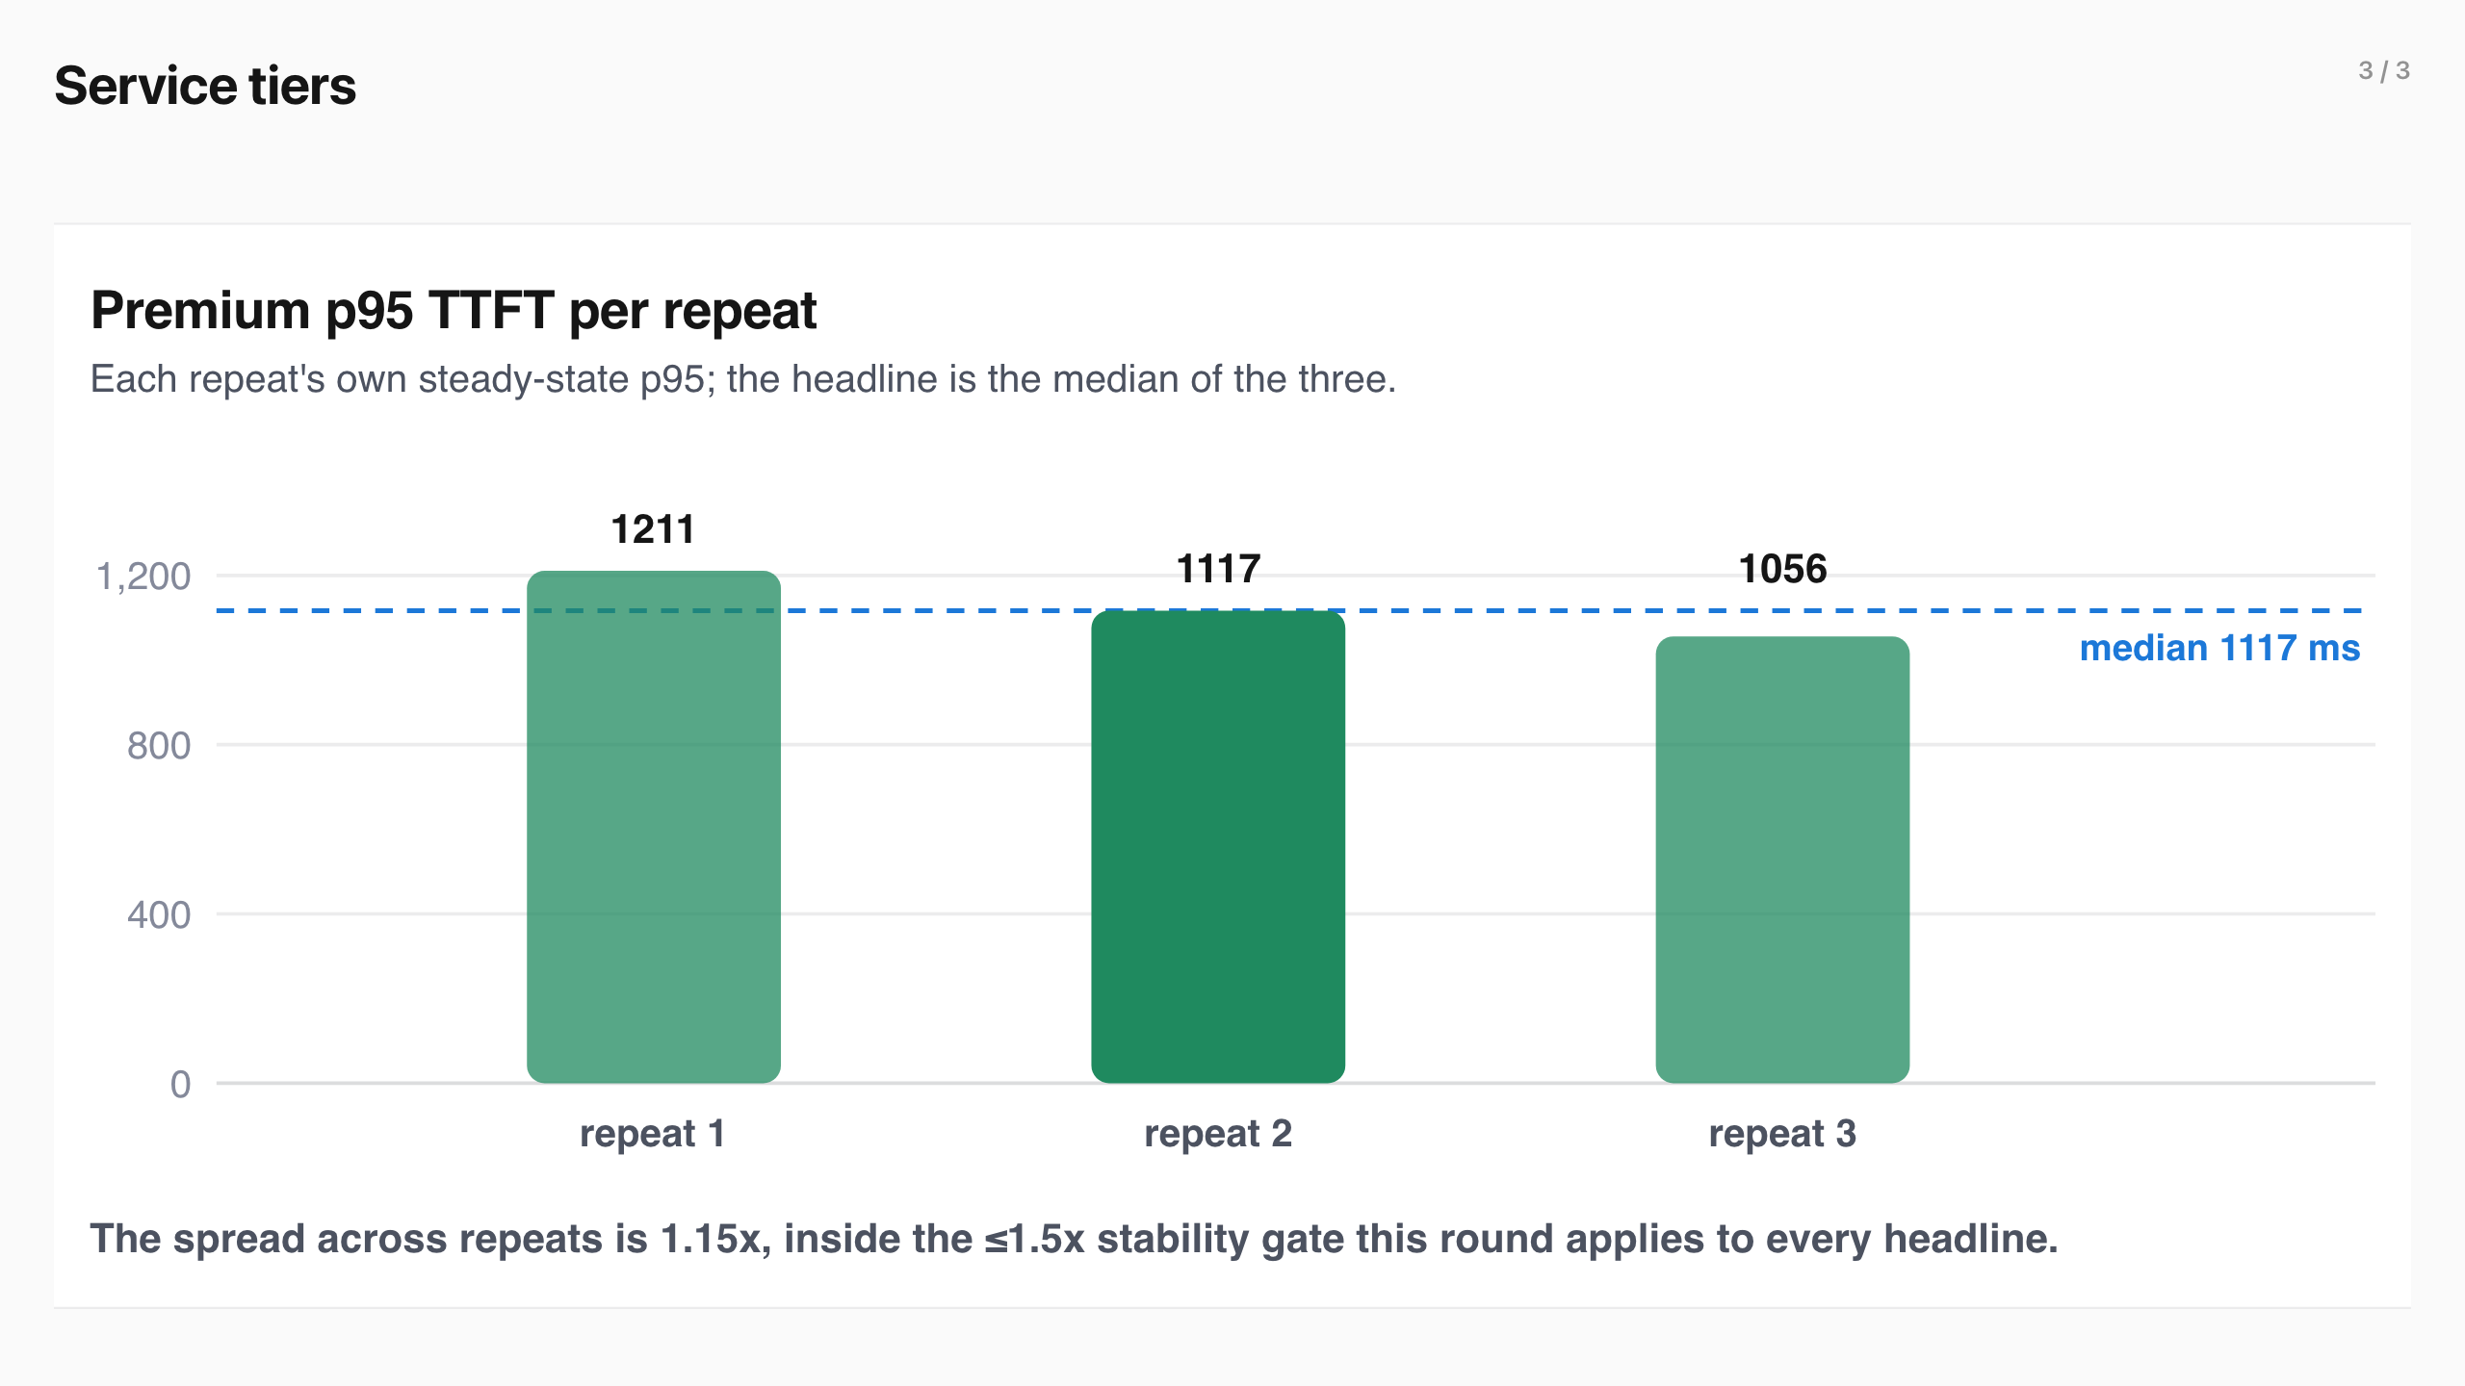
Service tiers (3/3)
Notes:
Service tiers
When the pool saturates, priority decides who waits. The runs below hold the pool at the operating point with flow control on and measure the separation between tiers.
Mean time per output token stayed at 19–21 ms in every repeat, read from vllm:inter_token_latency_seconds : the queue decides who starts; the pace of tokens already flowing barely moves.
Standard surges past the batch cap mid-run while premium holds a low steady rate.
With flow control on and the pool saturated, premium p95 TTFT settles at 1117 ms against 1406 ms for standard, a ~1.25x separation that held across all three repeats.
The three repeats land within a 1.15x band, so the 1117 ms headline is a stable scheduling result, not a lucky draw.
View the data
Repeat Premium p95 Premium p50 Steady samples
r01 1211 ms 510 ms 4108 r02 1117 ms 374 ms 4420 r03 1056 ms 345 ms 4537 median 1117 ms 374 ms —
Premium at roughly 48 aggregate requests per second competes for the 128 running slots, so its ~1.1 s steady-state tail is a real scheduling result; the separation comes from standard waiting the extra cycle behind it.
What we learned
An earlier cut of this result pooled every repeat into one percentile, and a startup transient in one repeat produced a headline the steady state could not reproduce. Every headline now passes four guards: per-repeat percentiles , never pooled across repeats; a steady-state trim before counting; a spread gate , max/min ≤ 1.5x across repeats; and saturation verified from the serving metrics, not assumed.
Output length ladder
The 64- and 512-output-token arms are being restated with per-repeat percentiles; their earlier pooled numbers are withdrawn, and the 128-output result above is the restated headline.
A latency-sensitive product keeps its experience through a surge it did not cause, which makes a tiered service-level agreement (SLA) enforceable on shared capacity.
Mean time per output token stayed at 19–21 ms in every repeat, read from vllm:inter_token_latency_seconds : the queue decides who starts; the pace of tokens already flowing barely moves.
View the data
Repeat Premium p95 Premium p50 Steady samples
r01 1211 ms 510 ms 4108 r02 1117 ms 374 ms 4420 r03 1056 ms 345 ms 4537 median 1117 ms 374 ms —
Premium at roughly 48 aggregate requests per second competes for the 128 running slots, so its ~1.1 s steady-state tail is a real scheduling result; the separation comes from standard waiting the extra cycle behind it.
What we learned
An earlier cut of this result pooled every repeat into one percentile, and a startup transient in one repeat produced a headline the steady state could not reproduce. Every headline now passes four guards: per-repeat percentiles , never pooled across repeats; a steady-state trim before counting; a spread gate , max/min ≤ 1.5x across repeats; and saturation verified from the serving metrics, not assumed.
Output length ladder
The 64- and 512-output-token arms are being restated with per-repeat percentiles; their earlier pooled numbers are withdrawn, and the 128-output result above is the restated headline.
A latency-sensitive product keeps its experience through a surge it did not cause, which makes a tiered service-level agreement (SLA) enforceable on shared capacity.
When the pool saturates, priority decides who waits. The runs below hold the pool at the operating point with flow control on and measure the separation between tiers.

Slide 21
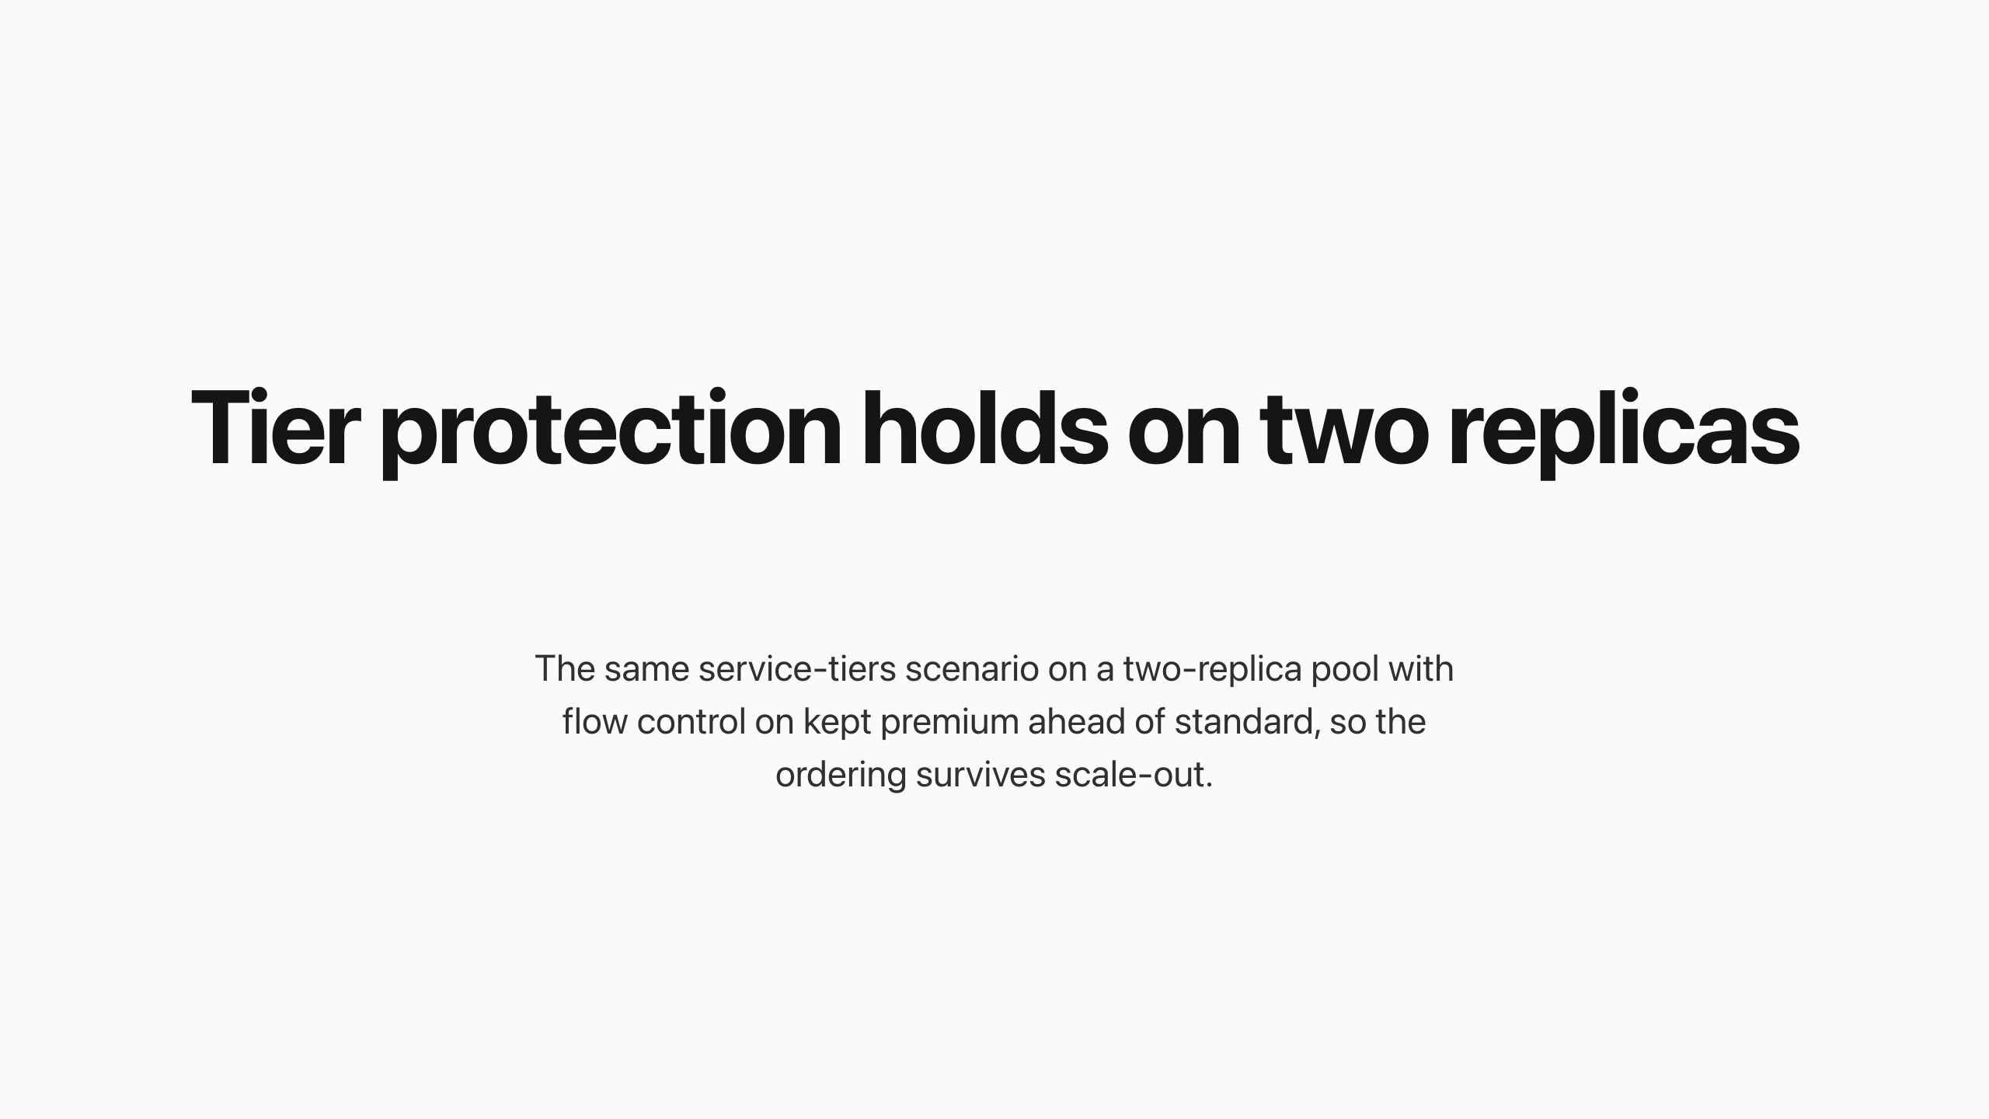
Tier protection holds on two replicas
Notes:
Tier protection holds on two replicas
The same service-tiers scenario on a two-replica pool with flow control on kept premium ahead of standard, so the ordering survives scale-out.
The two-replica percentiles are being restated with per-repeat percentiles; the ordering and zero rejections stand. Data in data-v4/multi-replica-tiers .

Slide 22
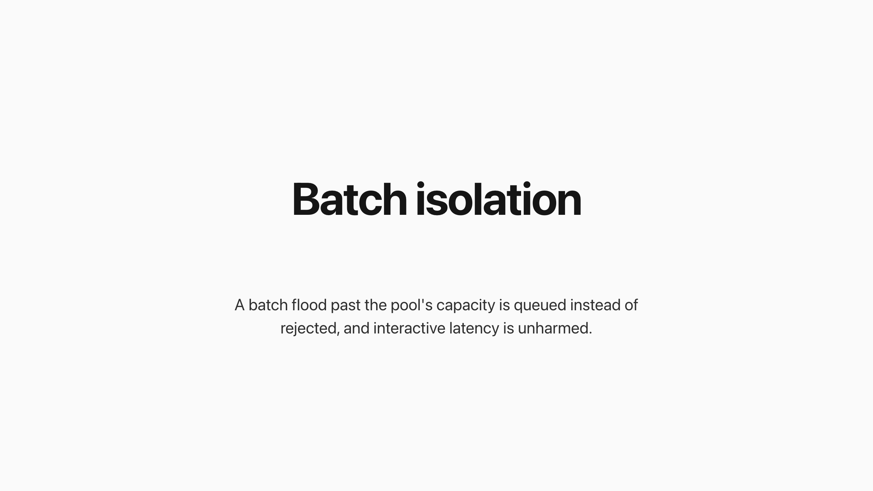
Batch isolation
Notes:
Batch isolation
A batch flood past the pool's capacity is queued instead of rejected, and interactive latency is unharmed.
Batch ramps in behind the interactive tiers and floods the pool well past the batch cap.
Same offered load, same GPU. Flow control off sheds 48,224 requests with HTTP 429; flow control on rejects zero and holds the deferrable work.
Batch’s own TTFT percentiles under the flood are being restated with per-repeat percentiles. The mechanism is unchanged: held work waits longer because it queues behind the interactive tiers instead of being shed.
Overnight document and report pipelines can fill the same GPUs that serve interactive traffic by day: the platform holds the work until capacity exists instead of pushing retries back to the application. Rejections at every output length are shown below.
View the data
Output tokens 429s off 429s on
64 44,485 0 128 48,224 0 512 53,940 0
Batch’s own TTFT percentiles under the flood are being restated with per-repeat percentiles. The mechanism is unchanged: held work waits longer because it queues behind the interactive tiers instead of being shed.
Overnight document and report pipelines can fill the same GPUs that serve interactive traffic by day: the platform holds the work until capacity exists instead of pushing retries back to the application. Rejections at every output length are shown below.
View the data
Output tokens 429s off 429s on
64 44,485 0 128 48,224 0 512 53,940 0
A batch flood past the pool's capacity is queued instead of rejected, and interactive latency is unharmed.

Slide 23
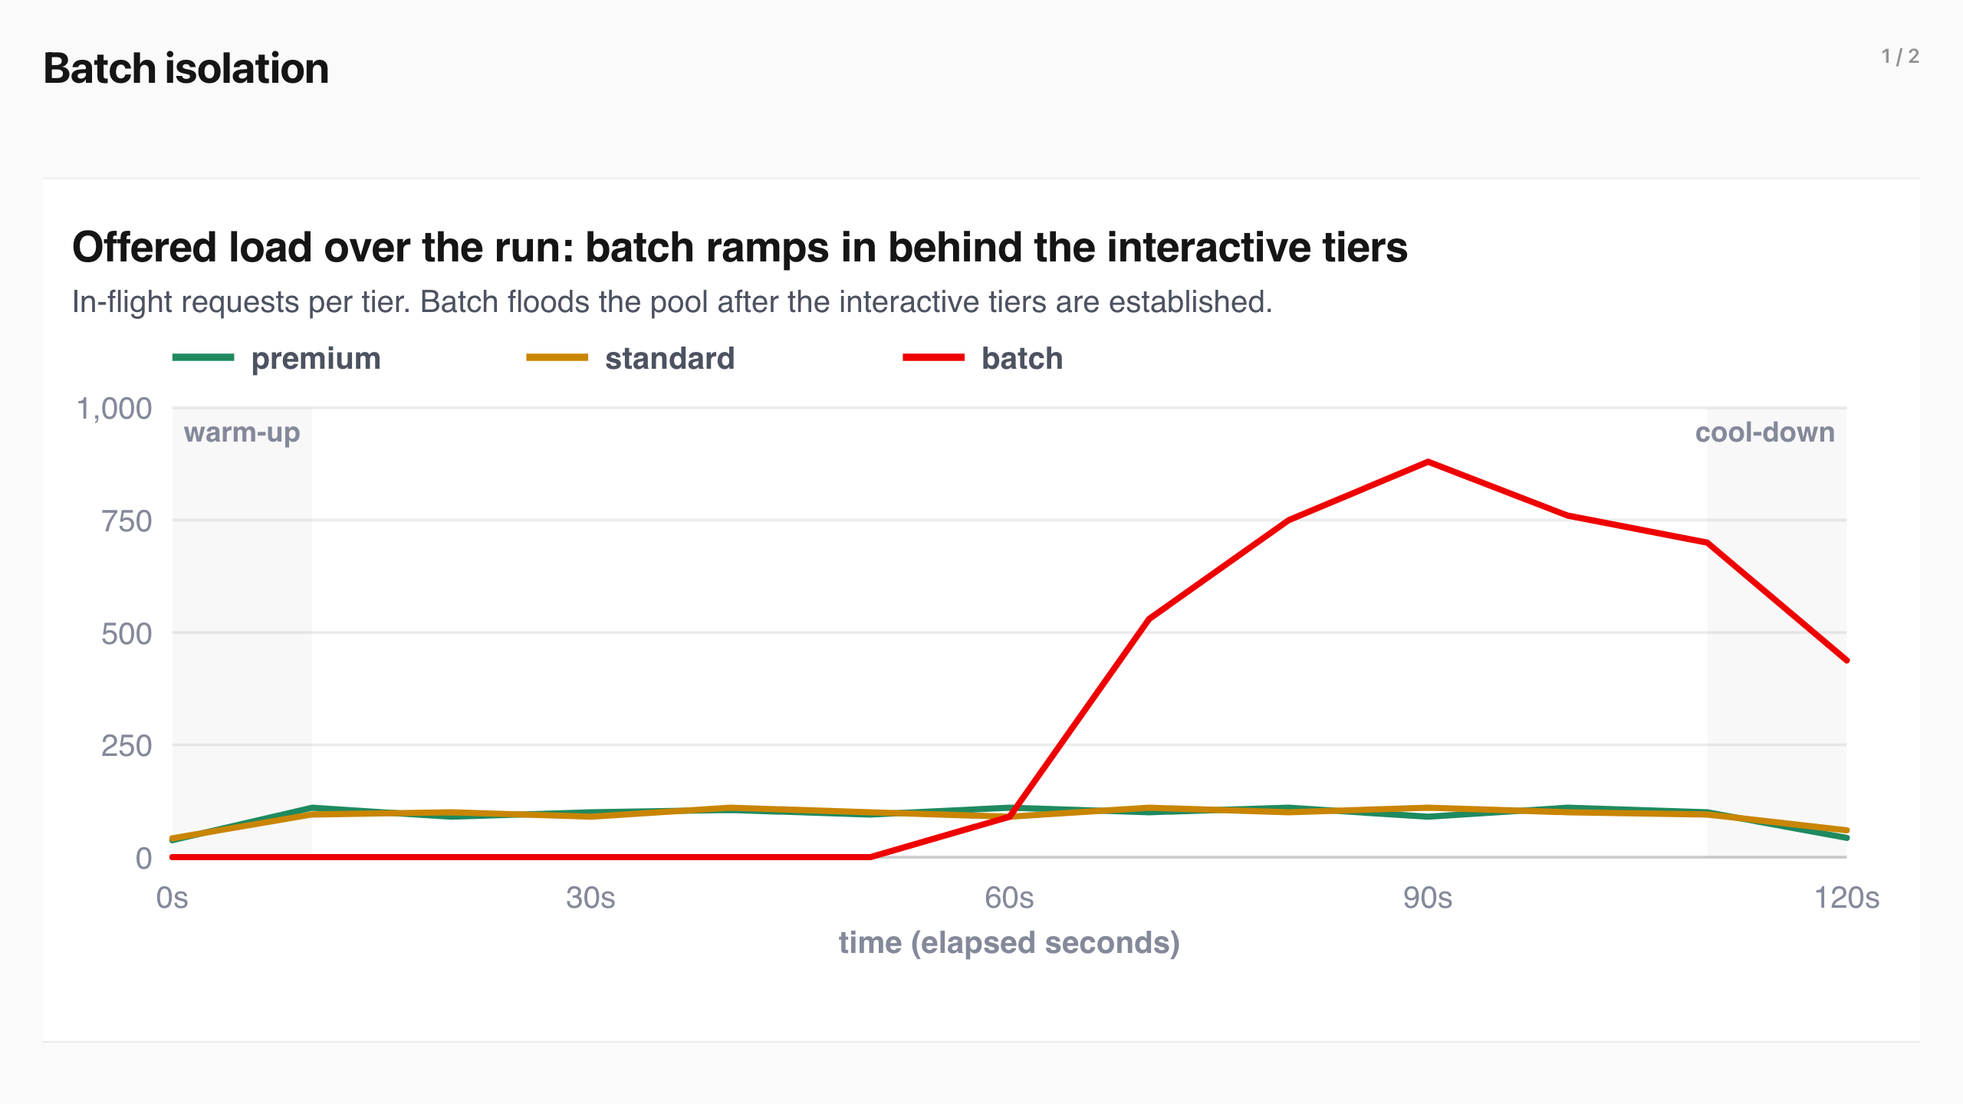
Batch isolation (1/2)
Notes:
Batch isolation
A batch flood past the pool's capacity is queued instead of rejected, and interactive latency is unharmed.
Batch ramps in behind the interactive tiers and floods the pool well past the batch cap.
Same offered load, same GPU. Flow control off sheds 48,224 requests with HTTP 429; flow control on rejects zero and holds the deferrable work.
Batch’s own TTFT percentiles under the flood are being restated with per-repeat percentiles. The mechanism is unchanged: held work waits longer because it queues behind the interactive tiers instead of being shed.
Overnight document and report pipelines can fill the same GPUs that serve interactive traffic by day: the platform holds the work until capacity exists instead of pushing retries back to the application. Rejections at every output length are shown below.
View the data
Output tokens 429s off 429s on
64 44,485 0 128 48,224 0 512 53,940 0
Batch’s own TTFT percentiles under the flood are being restated with per-repeat percentiles. The mechanism is unchanged: held work waits longer because it queues behind the interactive tiers instead of being shed.
Overnight document and report pipelines can fill the same GPUs that serve interactive traffic by day: the platform holds the work until capacity exists instead of pushing retries back to the application. Rejections at every output length are shown below.
View the data
Output tokens 429s off 429s on
64 44,485 0 128 48,224 0 512 53,940 0
A batch flood past the pool's capacity is queued instead of rejected, and interactive latency is unharmed.

Slide 24
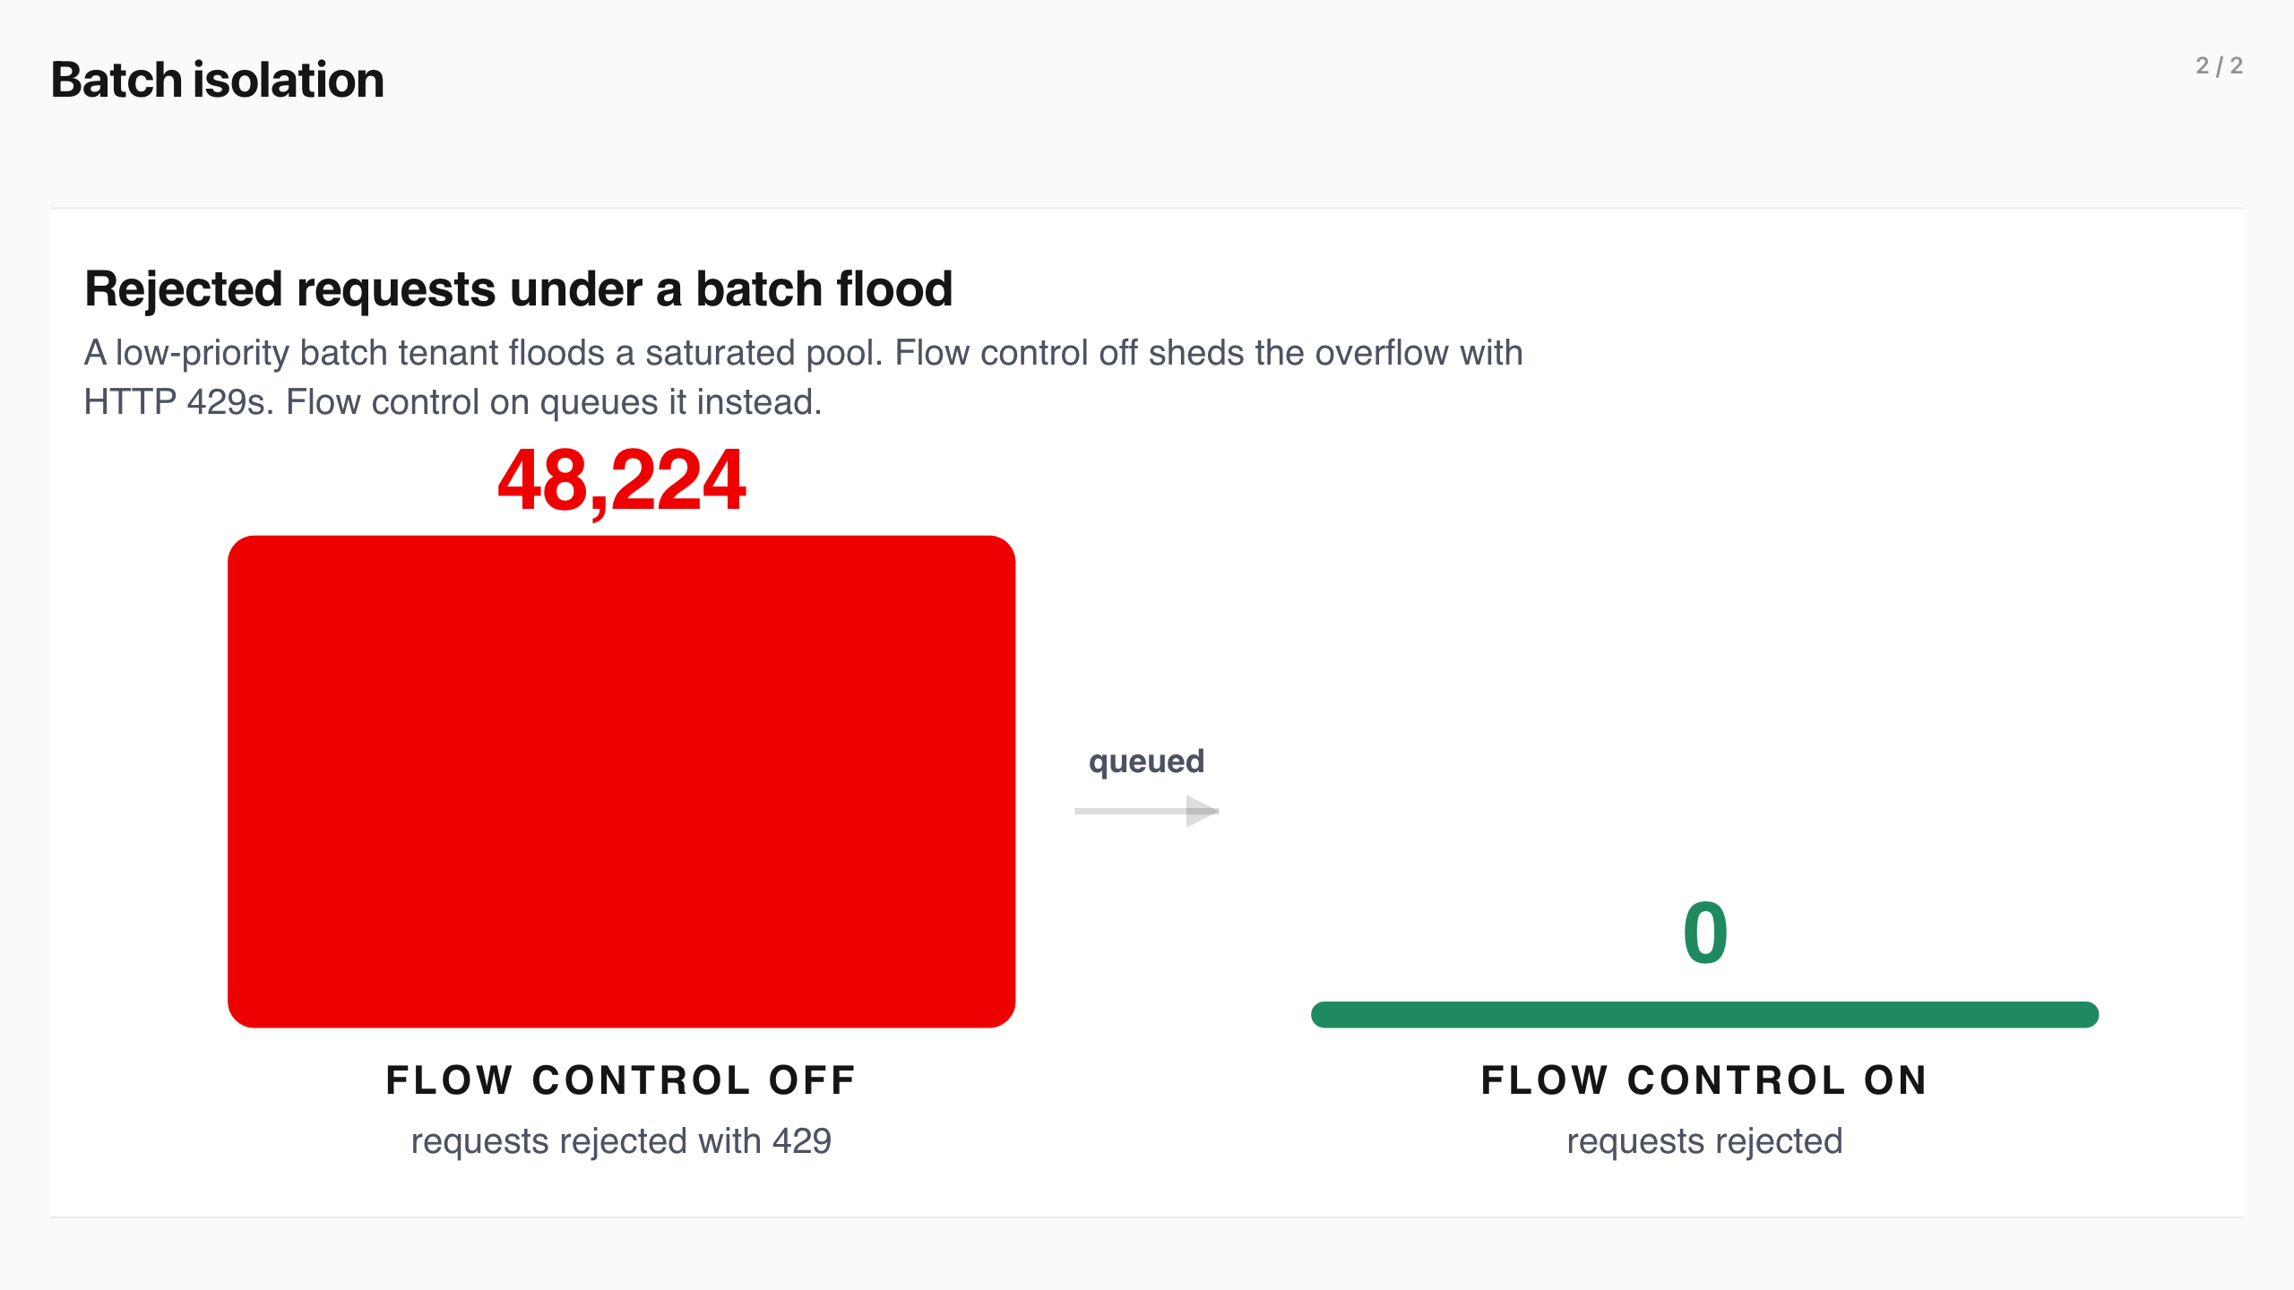
Batch isolation (2/2)
Notes:
Batch isolation
A batch flood past the pool's capacity is queued instead of rejected, and interactive latency is unharmed.
Batch ramps in behind the interactive tiers and floods the pool well past the batch cap.
Same offered load, same GPU. Flow control off sheds 48,224 requests with HTTP 429; flow control on rejects zero and holds the deferrable work.
Batch’s own TTFT percentiles under the flood are being restated with per-repeat percentiles. The mechanism is unchanged: held work waits longer because it queues behind the interactive tiers instead of being shed.
Overnight document and report pipelines can fill the same GPUs that serve interactive traffic by day: the platform holds the work until capacity exists instead of pushing retries back to the application. Rejections at every output length are shown below.
View the data
Output tokens 429s off 429s on
64 44,485 0 128 48,224 0 512 53,940 0
Batch’s own TTFT percentiles under the flood are being restated with per-repeat percentiles. The mechanism is unchanged: held work waits longer because it queues behind the interactive tiers instead of being shed.
Overnight document and report pipelines can fill the same GPUs that serve interactive traffic by day: the platform holds the work until capacity exists instead of pushing retries back to the application. Rejections at every output length are shown below.
View the data
Output tokens 429s off 429s on
64 44,485 0 128 48,224 0 512 53,940 0
A batch flood past the pool's capacity is queued instead of rejected, and interactive latency is unharmed.

Slide 25

Consolidation
Notes:
Consolidation
Two premium tenants share one GPU at higher utilization while a lower-priority tenant floods the pool. This scenario prices whether the interactive tenants keep their tail through the flood.
Two premium tenants hold a steady packed load while a standard tenant floods the shared pool mid-run.
The consolidation percentiles are being restated with per-repeat percentiles; the earlier pooled numbers are withdrawn. The business case is unchanged: consolidate tenants onto one GPU, keep the same interactive SLA, and raise utilization instead of buying dedicated hardware. Consolidation only pays off if a noisy neighbor cannot take the interactive tenants down with it, and flow control holds that line once the pool saturates.
The consolidation percentiles are being restated with per-repeat percentiles; the earlier pooled numbers are withdrawn. The business case is unchanged: consolidate tenants onto one GPU, keep the same interactive SLA, and raise utilization instead of buying dedicated hardware. Consolidation only pays off if a noisy neighbor cannot take the interactive tenants down with it, and flow control holds that line once the pool saturates.
Two premium tenants share one GPU at higher utilization while a lower-priority tenant floods the pool. This scenario prices whether the interactive tenants keep their tail through the flood.

Slide 26
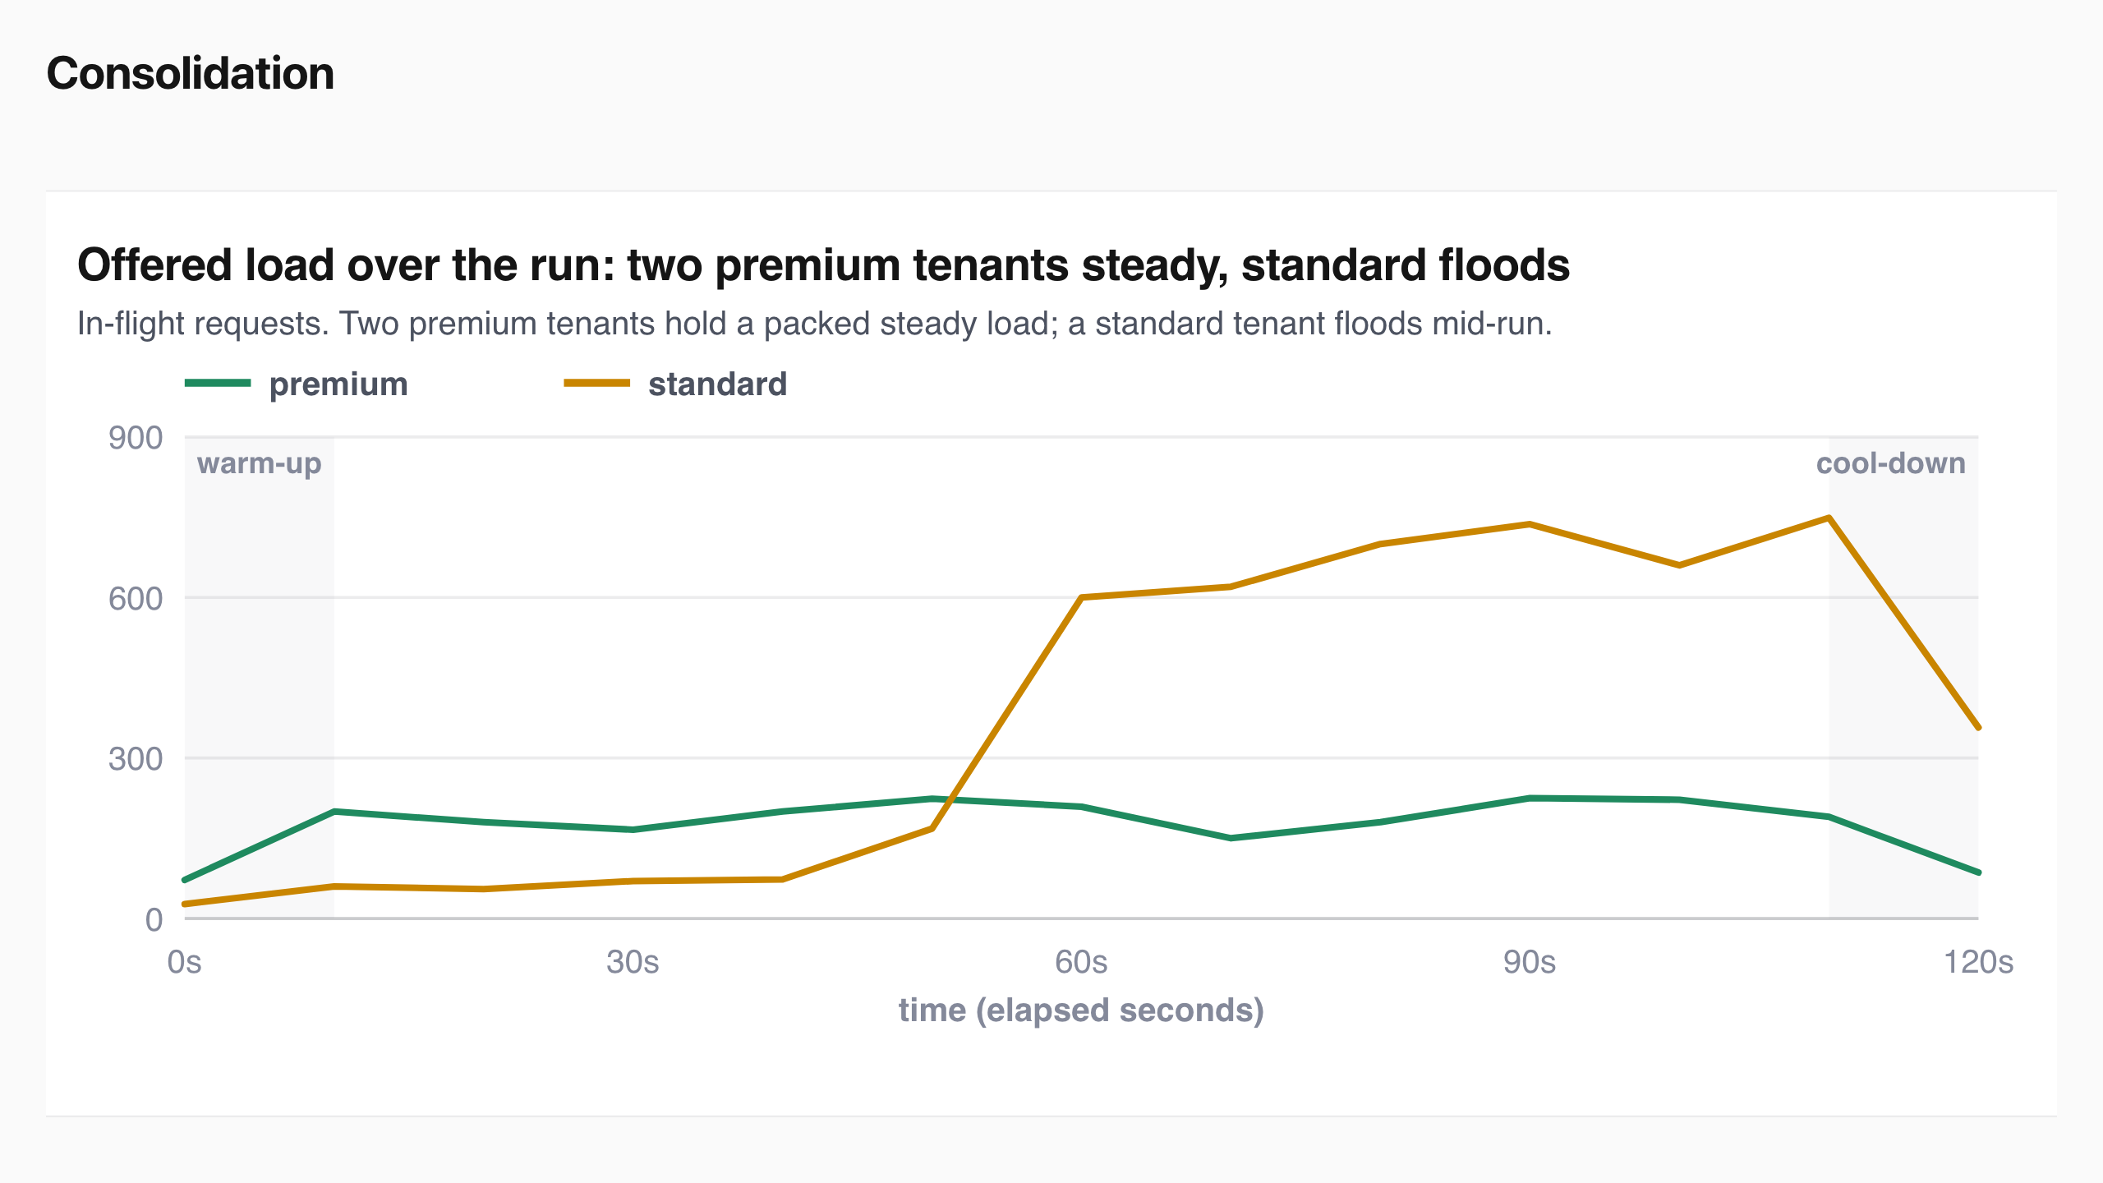
Consolidation
Notes:
Consolidation
Two premium tenants share one GPU at higher utilization while a lower-priority tenant floods the pool. This scenario prices whether the interactive tenants keep their tail through the flood.
Two premium tenants hold a steady packed load while a standard tenant floods the shared pool mid-run.
The consolidation percentiles are being restated with per-repeat percentiles; the earlier pooled numbers are withdrawn. The business case is unchanged: consolidate tenants onto one GPU, keep the same interactive SLA, and raise utilization instead of buying dedicated hardware. Consolidation only pays off if a noisy neighbor cannot take the interactive tenants down with it, and flow control holds that line once the pool saturates.
The consolidation percentiles are being restated with per-repeat percentiles; the earlier pooled numbers are withdrawn. The business case is unchanged: consolidate tenants onto one GPU, keep the same interactive SLA, and raise utilization instead of buying dedicated hardware. Consolidation only pays off if a noisy neighbor cannot take the interactive tenants down with it, and flow control holds that line once the pool saturates.
Two premium tenants share one GPU at higher utilization while a lower-priority tenant floods the pool. This scenario prices whether the interactive tenants keep their tail through the flood.

Slide 27
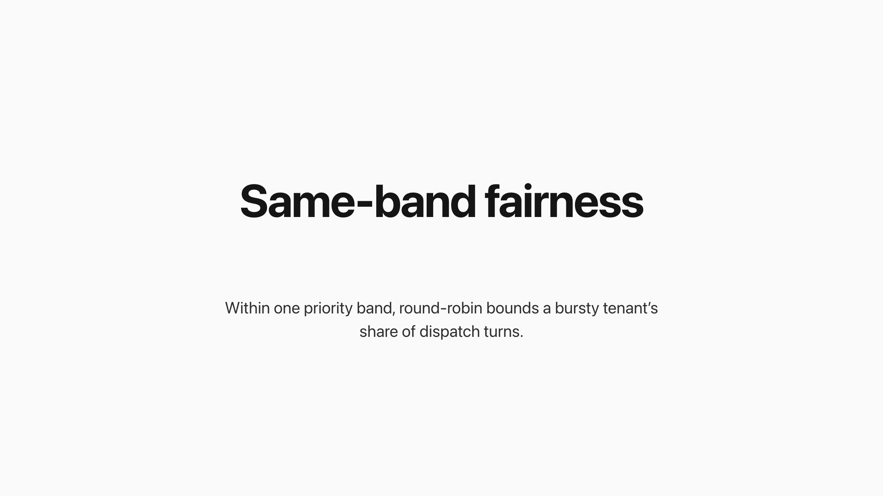
Same-band fairness
Notes:
Same-band fairness
Within one priority band, round-robin bounds a bursty tenant’s share of dispatch turns. Three premium tenants ran at the same priority while tenant A burst to roughly ten times its peers’ rate.
Round-robin gives every flow a turn, so the burster is served at 82 requests per second and nobody starves, but its excess waits in its own queue, ~2.6x the peers’ queue time, while the peers hold flat.
plugins/flowcontrol/fairness/roundrobin
View the data
Tenant Offered pattern Served rate Queue time
A (burster) steady, then a sustained burst 82 rps 45 ms
B (peer) steady 6 rps 17.5 ms
C (peer) steady 6 rps 17.3 ms
Round-robin’s unit of fairness is the dispatch turn , so it bounds the burster’s share of turns rather than the peers’ latency; peers’ TTFT under saturation is set by the shared running batch, which the burst raised for everyone. Every request from every tenant completed with zero errors in all three repeats.
A second arm demoted the burster to a lower priority band mid-burst. That changed dispatch ordering, not the outcome: the peers’ queue time was already flat, so the demotion had nothing left to fix.
View the data
Tenant Offered pattern Served rate Queue time
A (burster) steady, then a sustained burst 82 rps 45 ms
B (peer) steady 6 rps 17.5 ms
C (peer) steady 6 rps 17.3 ms
Round-robin’s unit of fairness is the dispatch turn , so it bounds the burster’s share of turns rather than the peers’ latency; peers’ TTFT under saturation is set by the shared running batch, which the burst raised for everyone. Every request from every tenant completed with zero errors in all three repeats.
A second arm demoted the burster to a lower priority band mid-burst. That changed dispatch ordering, not the outcome: the peers’ queue time was already flat, so the demotion had nothing left to fix.
Within one priority band, round-robin bounds a bursty tenant’s share of dispatch turns. Three premium tenants ran at the same priority while tenant A burst to roughly ten times its peers’ rate.

Slide 28
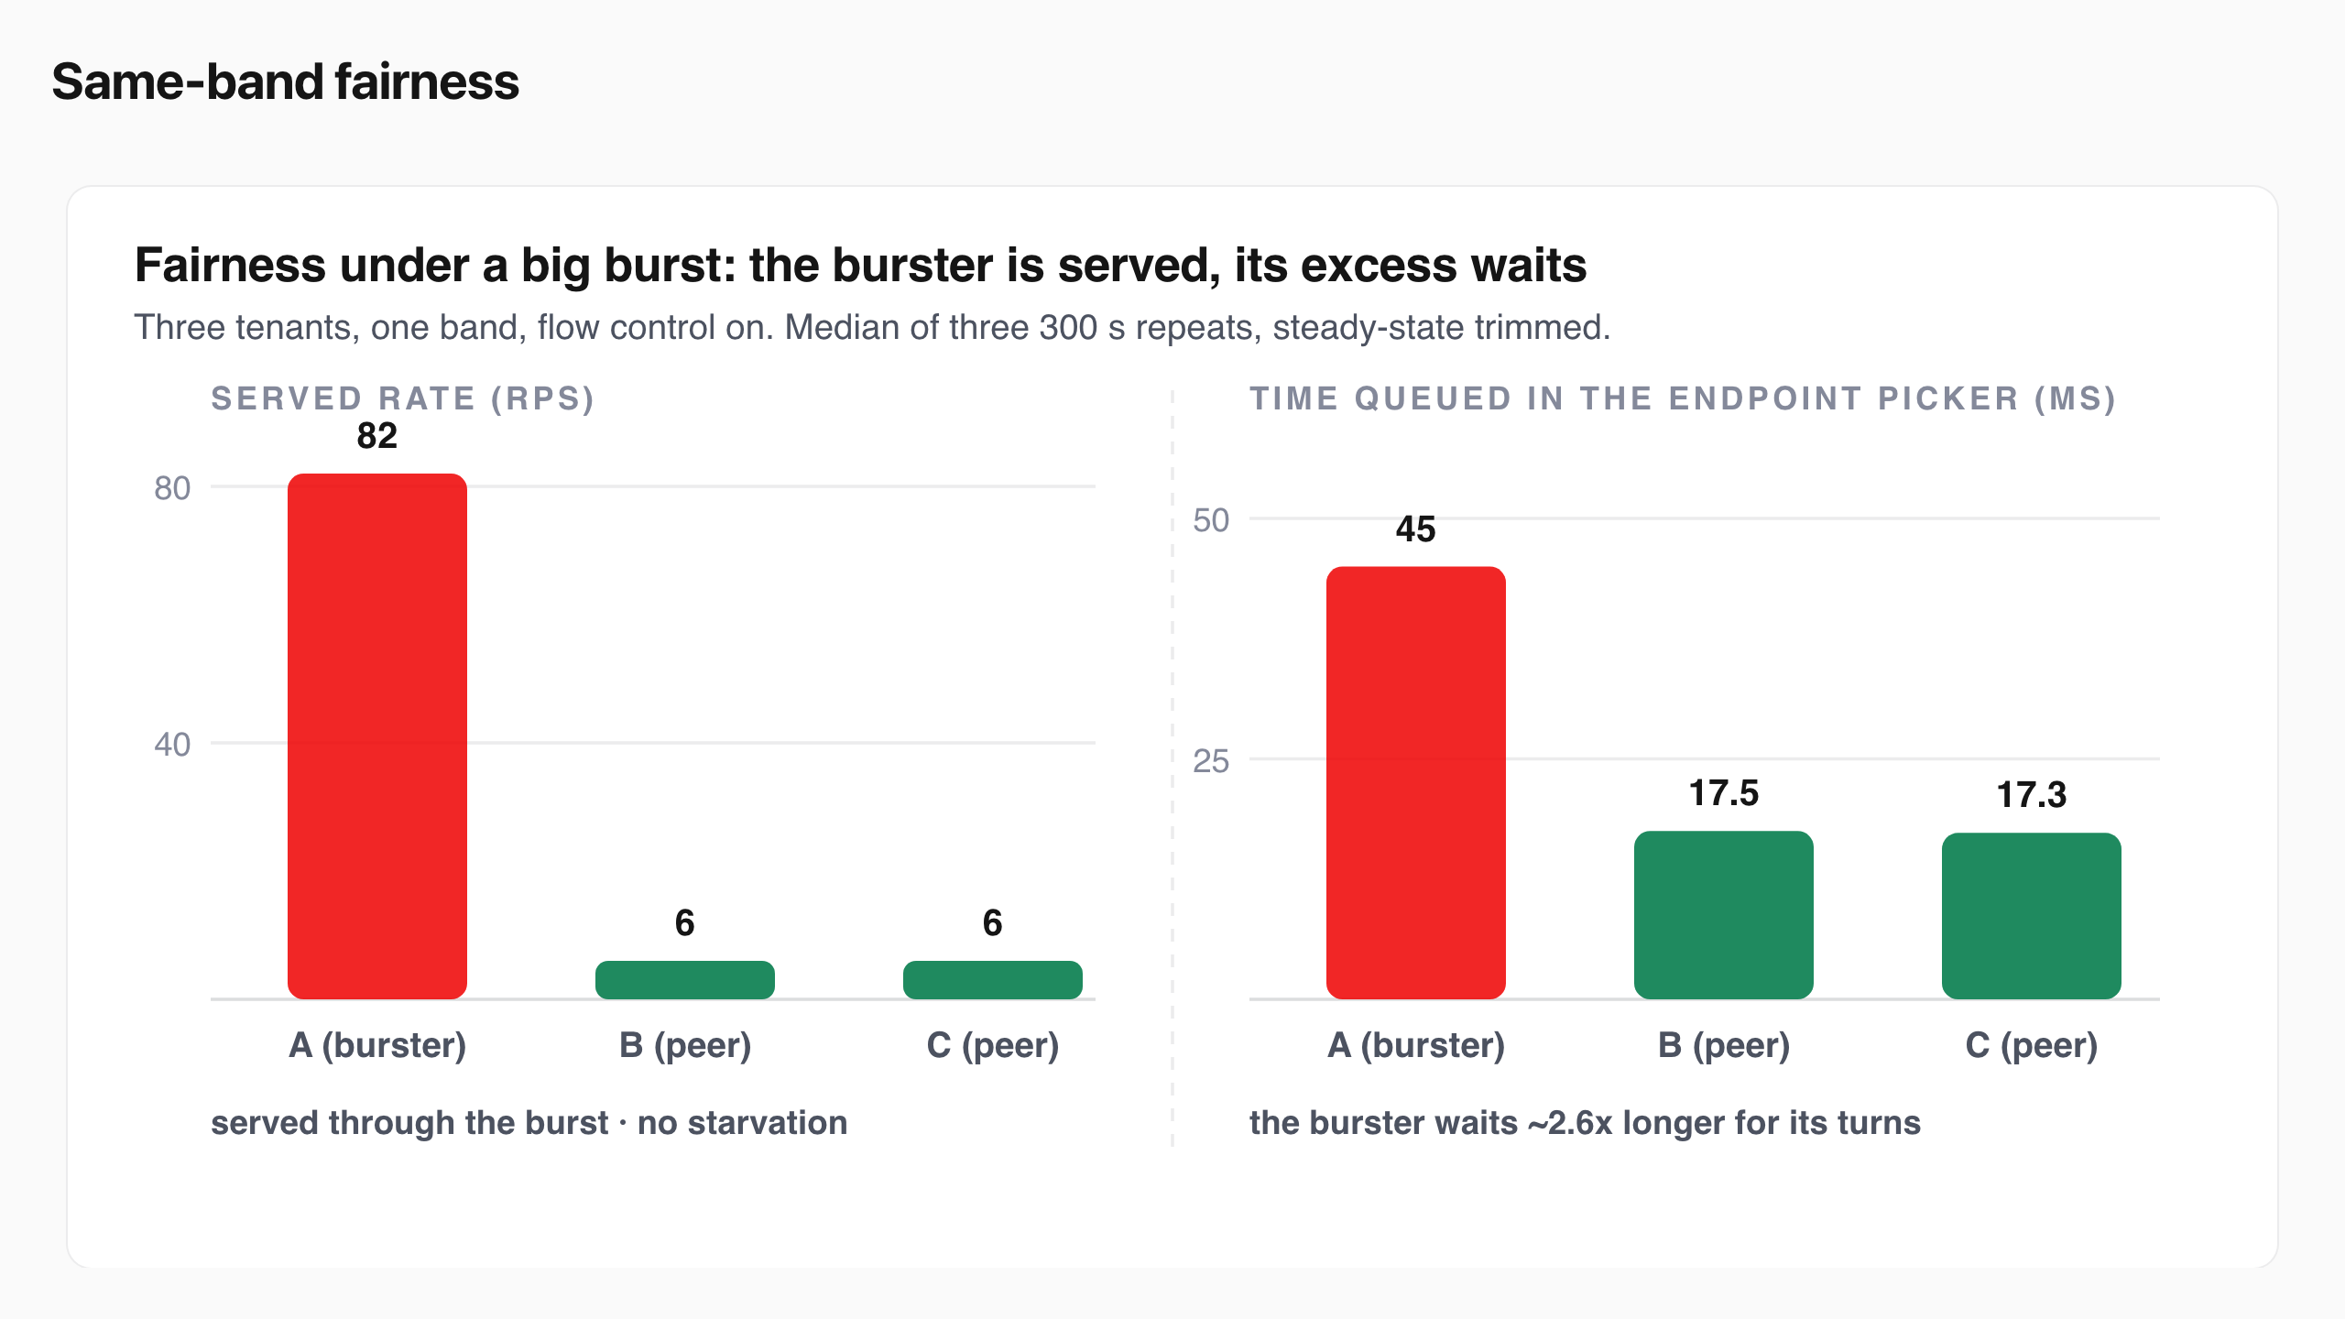
Same-band fairness
Notes:
Same-band fairness
Within one priority band, round-robin bounds a bursty tenant’s share of dispatch turns. Three premium tenants ran at the same priority while tenant A burst to roughly ten times its peers’ rate.
Round-robin gives every flow a turn, so the burster is served at 82 requests per second and nobody starves, but its excess waits in its own queue, ~2.6x the peers’ queue time, while the peers hold flat.
plugins/flowcontrol/fairness/roundrobin
View the data
Tenant Offered pattern Served rate Queue time
A (burster) steady, then a sustained burst 82 rps 45 ms
B (peer) steady 6 rps 17.5 ms
C (peer) steady 6 rps 17.3 ms
Round-robin’s unit of fairness is the dispatch turn , so it bounds the burster’s share of turns rather than the peers’ latency; peers’ TTFT under saturation is set by the shared running batch, which the burst raised for everyone. Every request from every tenant completed with zero errors in all three repeats.
A second arm demoted the burster to a lower priority band mid-burst. That changed dispatch ordering, not the outcome: the peers’ queue time was already flat, so the demotion had nothing left to fix.
View the data
Tenant Offered pattern Served rate Queue time
A (burster) steady, then a sustained burst 82 rps 45 ms
B (peer) steady 6 rps 17.5 ms
C (peer) steady 6 rps 17.3 ms
Round-robin’s unit of fairness is the dispatch turn , so it bounds the burster’s share of turns rather than the peers’ latency; peers’ TTFT under saturation is set by the shared running batch, which the burst raised for everyone. Every request from every tenant completed with zero errors in all three repeats.
A second arm demoted the burster to a lower priority band mid-burst. That changed dispatch ordering, not the outcome: the peers’ queue time was already flat, so the demotion had nothing left to fix.
Within one priority band, round-robin bounds a bursty tenant’s share of dispatch turns. Three premium tenants ran at the same priority while tenant A burst to roughly ten times its peers’ rate.

Slide 29
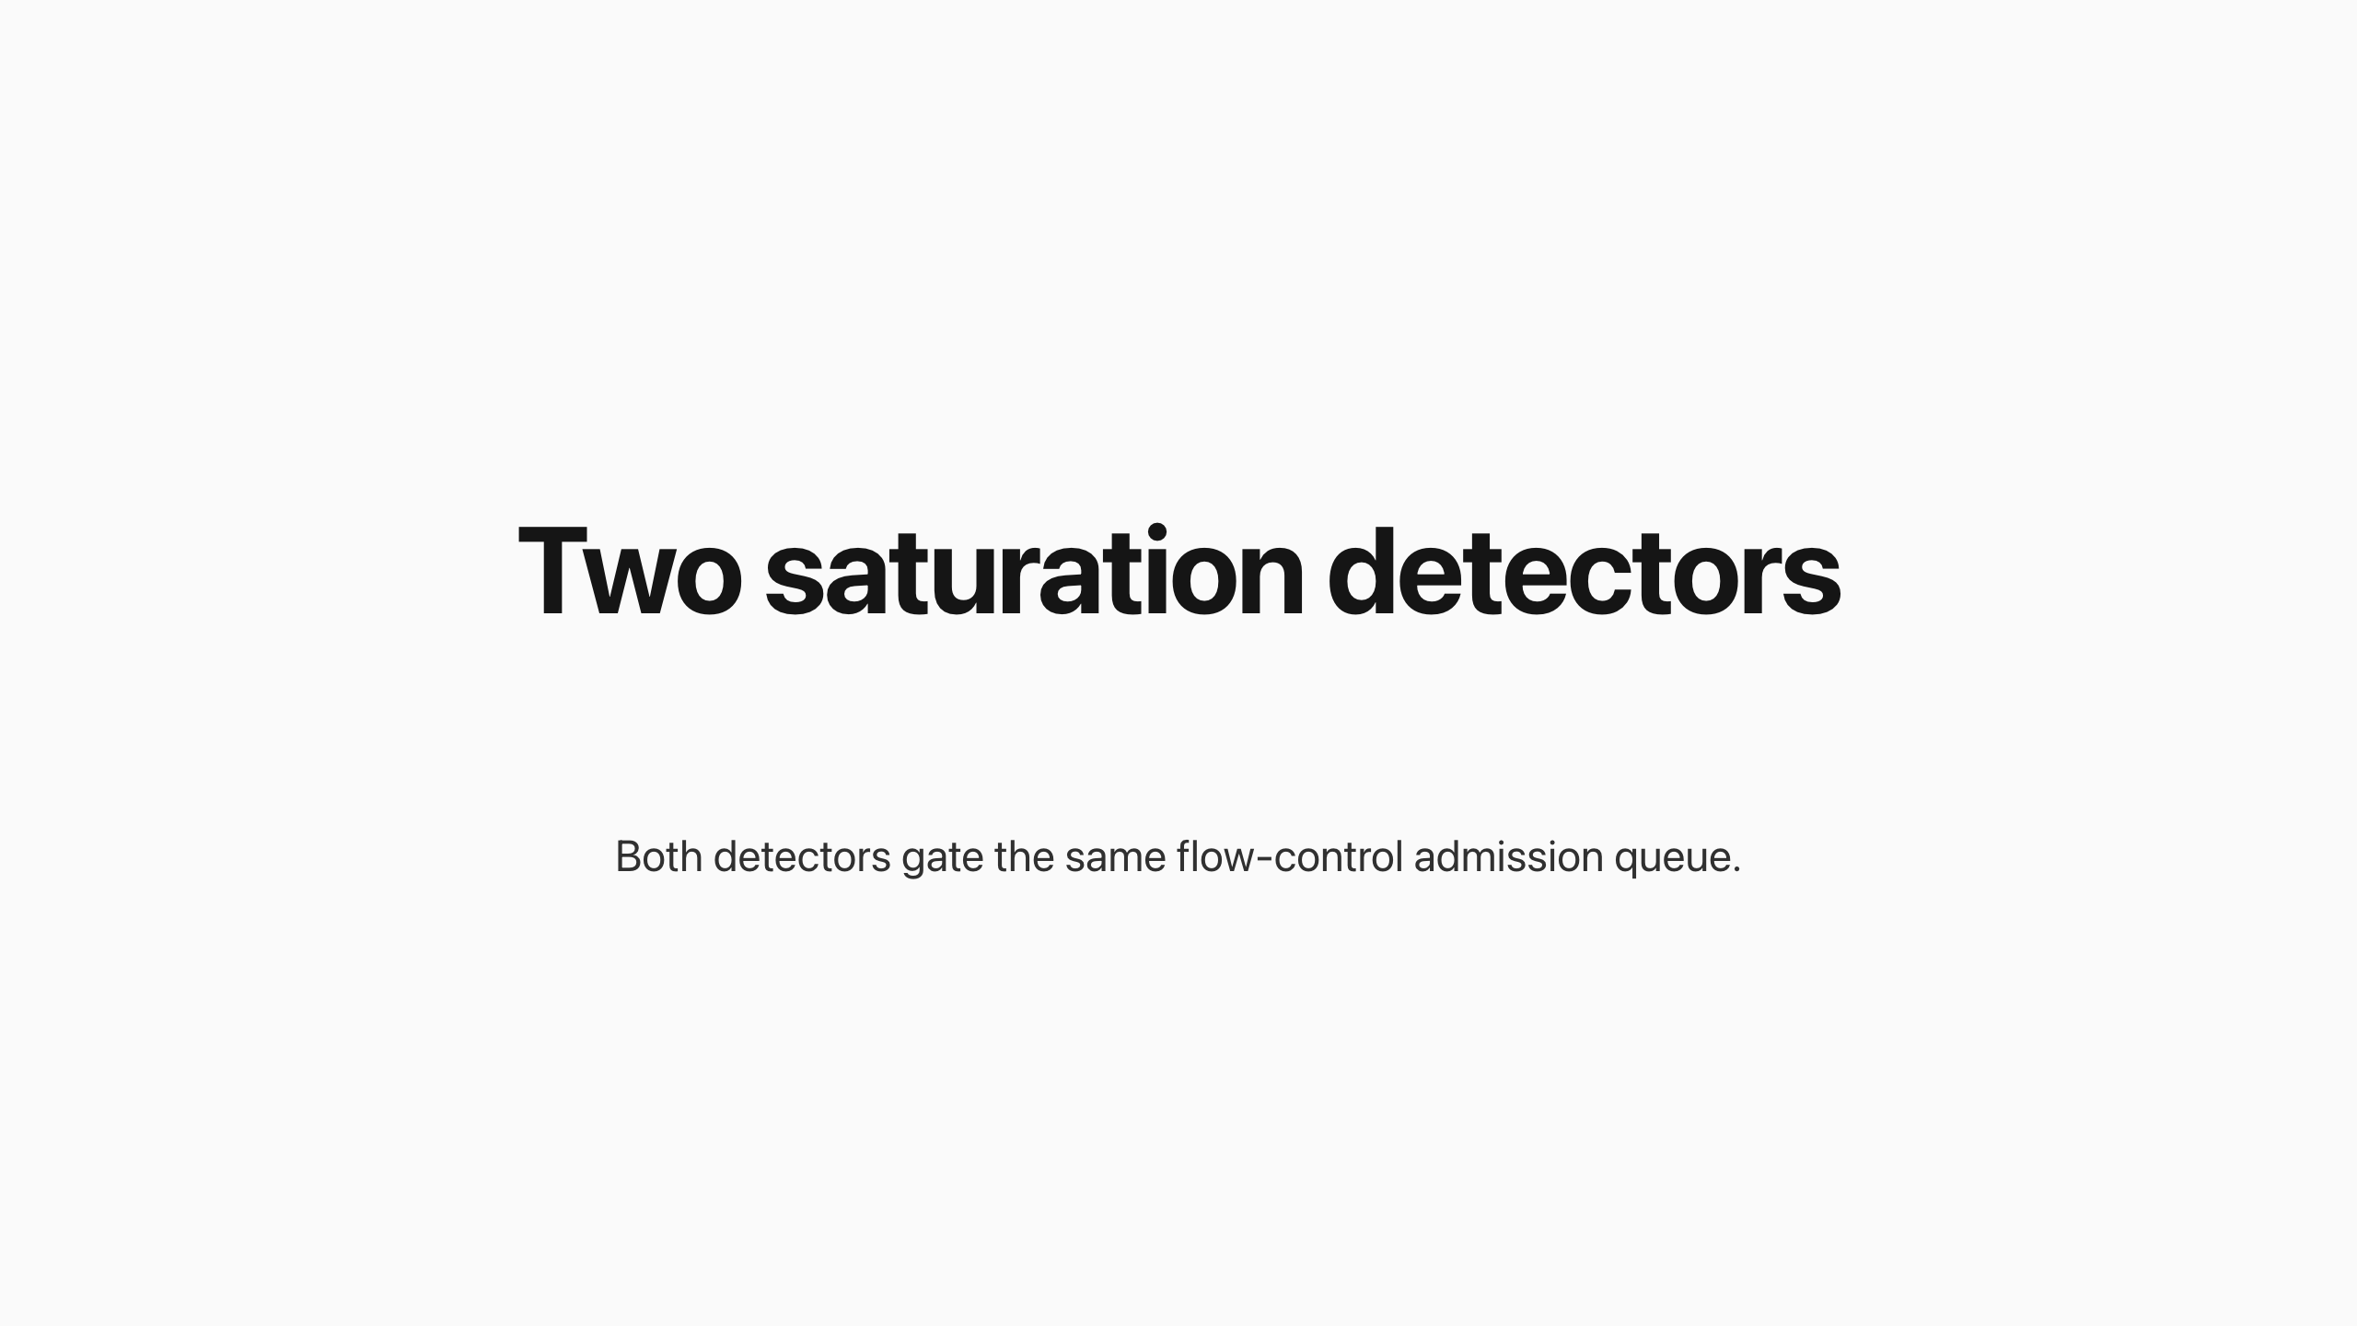
Two saturation detectors
Notes:
Two saturation detectors
Both detectors gate the same flow-control admission queue. They differ only in how they decide the pool is saturated, and that difference decides whether the running batch can be thinned at all.
The utilization detector , the shipped default, ran every scenario above. It reads engine telemetry, queue depth and KV-cache usage, and computes saturation as the worse of the two ratios, averaged across the pool. Because it reads telemetry, it reacts after queue or KV pressure has built, and because it only applies backpressure, it cannot cap the running batch: the engine still fills to max-num-seqs , 128, and the detector decides who waits behind it.
The concurrency detector is the upstream maxConcurrency variant. It computes saturation as in-flight load over pool capacity and hooks the request lifecycle synchronously, reacting to a new request before telemetry updates. It is the only detector that caps in-flight load: maxConcurrency is a hard ceiling on requests reaching the engine at once, which thins the running batch. Its documented tradeoff: it runs open-loop, blind to GPU telemetry, so if token estimates drift or generations run long the KV cache can fill and the engine preempts or swaps to CPU with severe decode-latency spikes it never sees.
Same admission queue, two ways to call saturation: the utilization detector lets the batch fill to 128; the concurrency detector caps admissions before the engine.
plugins/flowcontrol/saturationdetector/utilization · saturationdetector
We characterized the concurrency detector alone by sweeping maxConcurrency under a single saturating load, so the chart below is a real tuning result.
Premium p95 TTFT traces a U with its floor of 461 ms at maxConcurrency 48; standard p95 falls from 12,722 ms at cap 32 to 2,697 ms at cap 128. Note the standard panel spans thirteen times the premium panel's range.
View the data
maxConcurrency Running batch Premium p95 Standard p95
32 29 568 ms 12722 ms 48 39 461 ms 7808 ms 64 46 582 ms 5207 ms 96 61 761 ms 3714 ms 128 70 907 ms 2697 ms
Flow control always orders the queue, so premium is dispatched before standard regardless of the cap. What maxConcurrency changes is batch crowding : a looser cap admits more requests into the running batch, so once premium is in that crowded batch its own decode slows and its tail rises. At a tight cap (32) few requests are admitted, so premium clears fast, 568 ms, but standard is starved, 12,722 ms. At a loose cap (128) the batch crowds and both tails climb, premium 907 ms and standard 2,697 ms.
The concurrency detector gives a better, tunable premium tail: its best premium p95 is 461 ms at maxConcurrency 48. Because it can thin the batch, it protects premium harder than the shipped utilization detector under the same load, which leaves premium in the full 128-request batch. The cost is standard's tail, which lengthens as the cap tightens.
maxConcurrency is a dial, not a switch. The premium-optimal point is 48, not the tightest cap. Below it even premium queues against the cap; above it the batch crowds and premium's decode slows. Standard moves the opposite way, so the cap sets where the pain lands between the tiers.
Output length sets how hard the cap bites. A longer generation holds each admitted slot for more decode steps, so at a fixed cap a longer output pushes more work into the queue and lengthens every tail. The output-length ladder in the tiers scenario is being restated with the same per-repeat method.
The four scenarios above were not run under the concurrency detector — it was characterized only through the maxConcurrency sweep; that head-to-head is future work.
The utilization detector , the shipped default, ran every scenario above. It reads engine telemetry, queue depth and KV-cache usage, and computes saturation as the worse of the two ratios, averaged across the pool. Because it reads telemetry, it reacts after queue or KV pressure has built, and because it only applies backpressure, it cannot cap the running batch: the engine still fills to max-num-seqs , 128, and the detector decides who waits behind it.
The concurrency detector is the upstream maxConcurrency variant. It computes saturation as in-flight load over pool capacity and hooks the request lifecycle synchronously, reacting to a new request before telemetry updates. It is the only detector that caps in-flight load: maxConcurrency is a hard ceiling on requests reaching the engine at once, which thins the running batch. Its documented tradeoff: it runs open-loop, blind to GPU telemetry, so if token estimates drift or generations run long the KV cache can fill and the engine preempts or swaps to CPU with severe decode-latency spikes it never sees.
We characterized the concurrency detector alone by sweeping maxConcurrency under a single saturating load, so the chart below is a real tuning result.
View the data
maxConcurrency Running batch Premium p95 Standard p95
32 29 568 ms 12722 ms 48 39 461 ms 7808 ms 64 46 582 ms 5207 ms 96 61 761 ms 3714 ms 128 70 907 ms 2697 ms
Flow control always orders the queue, so premium is dispatched before standard regardless of the cap. What maxConcurrency changes is batch crowding : a looser cap admits more requests into the running batch, so once premium is in that crowded batch its own decode slows and its tail rises. At a tight cap (32) few requests are admitted, so premium clears fast, 568 ms, but standard is starved, 12,722 ms. At a loose cap (128) the batch crowds and both tails climb, premium 907 ms and standard 2,697 ms.
The concurrency detector gives a better, tunable premium tail: its best premium p95 is 461 ms at maxConcurrency 48. Because it can thin the batch, it protects premium harder than the shipped utilization detector under the same load, which leaves premium in the full 128-request batch. The cost is standard's tail, which lengthens as the cap tightens.
maxConcurrency is a dial, not a switch. The premium-optimal point is 48, not the tightest cap. Below it even premium queues against the cap; above it the batch crowds and premium's decode slows. Standard moves the opposite way, so the cap sets where the pain lands between the tiers.
Output length sets how hard the cap bites. A longer generation holds each admitted slot for more decode steps, so at a fixed cap a longer output pushes more work into the queue and lengthens every tail. The output-length ladder in the tiers scenario is being restated with the same per-repeat method.
The concurrency detector gives a better, tunable premium tail: its best premium p95 is 461 ms at maxConcurrency 48. Because it can thin the batch, it protects premium harder than the shipped utilization detector under the same load, which leaves premium in the full 128-request batch. The cost is standard's tail, which lengthens as the cap tightens.
maxConcurrency is a dial, not a switch. The premium-optimal point is 48, not the tightest cap. Below it even premium queues against the cap; above it the batch crowds and premium's decode slows. Standard moves the opposite way, so the cap sets where the pain lands between the tiers.
Output length sets how hard the cap bites. A longer generation holds each admitted slot for more decode steps, so at a fixed cap a longer output pushes more work into the queue and lengthens every tail. The output-length ladder in the tiers scenario is being restated with the same per-repeat method.
The four scenarios above were not run under the concurrency detector — it was characterized only through the maxConcurrency sweep; that head-to-head is future work.
Both detectors gate the same flow-control admission queue. They differ only in how they decide the pool is saturated, and that difference decides whether the running batch can be thinned at all.

Slide 30
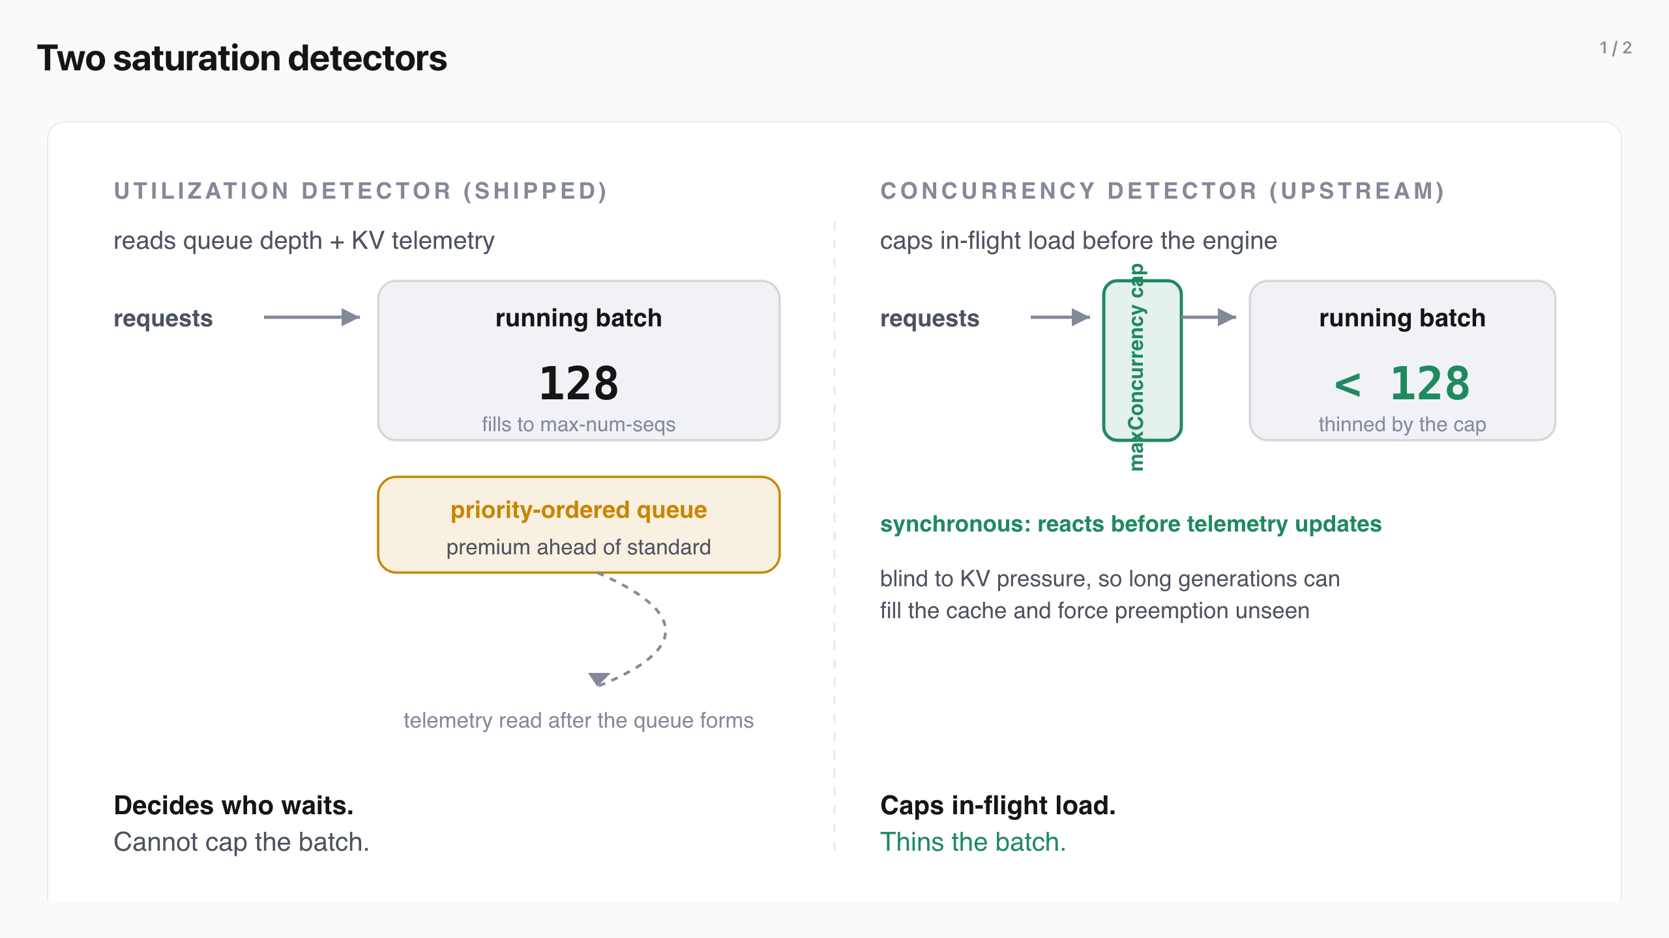
Two saturation detectors (1/2)
Notes:
Two saturation detectors
Both detectors gate the same flow-control admission queue. They differ only in how they decide the pool is saturated, and that difference decides whether the running batch can be thinned at all.
The utilization detector , the shipped default, ran every scenario above. It reads engine telemetry, queue depth and KV-cache usage, and computes saturation as the worse of the two ratios, averaged across the pool. Because it reads telemetry, it reacts after queue or KV pressure has built, and because it only applies backpressure, it cannot cap the running batch: the engine still fills to max-num-seqs , 128, and the detector decides who waits behind it.
The concurrency detector is the upstream maxConcurrency variant. It computes saturation as in-flight load over pool capacity and hooks the request lifecycle synchronously, reacting to a new request before telemetry updates. It is the only detector that caps in-flight load: maxConcurrency is a hard ceiling on requests reaching the engine at once, which thins the running batch. Its documented tradeoff: it runs open-loop, blind to GPU telemetry, so if token estimates drift or generations run long the KV cache can fill and the engine preempts or swaps to CPU with severe decode-latency spikes it never sees.
Same admission queue, two ways to call saturation: the utilization detector lets the batch fill to 128; the concurrency detector caps admissions before the engine.
plugins/flowcontrol/saturationdetector/utilization · saturationdetector
We characterized the concurrency detector alone by sweeping maxConcurrency under a single saturating load, so the chart below is a real tuning result.
Premium p95 TTFT traces a U with its floor of 461 ms at maxConcurrency 48; standard p95 falls from 12,722 ms at cap 32 to 2,697 ms at cap 128. Note the standard panel spans thirteen times the premium panel's range.
View the data
maxConcurrency Running batch Premium p95 Standard p95
32 29 568 ms 12722 ms 48 39 461 ms 7808 ms 64 46 582 ms 5207 ms 96 61 761 ms 3714 ms 128 70 907 ms 2697 ms
Flow control always orders the queue, so premium is dispatched before standard regardless of the cap. What maxConcurrency changes is batch crowding : a looser cap admits more requests into the running batch, so once premium is in that crowded batch its own decode slows and its tail rises. At a tight cap (32) few requests are admitted, so premium clears fast, 568 ms, but standard is starved, 12,722 ms. At a loose cap (128) the batch crowds and both tails climb, premium 907 ms and standard 2,697 ms.
The concurrency detector gives a better, tunable premium tail: its best premium p95 is 461 ms at maxConcurrency 48. Because it can thin the batch, it protects premium harder than the shipped utilization detector under the same load, which leaves premium in the full 128-request batch. The cost is standard's tail, which lengthens as the cap tightens.
maxConcurrency is a dial, not a switch. The premium-optimal point is 48, not the tightest cap. Below it even premium queues against the cap; above it the batch crowds and premium's decode slows. Standard moves the opposite way, so the cap sets where the pain lands between the tiers.
Output length sets how hard the cap bites. A longer generation holds each admitted slot for more decode steps, so at a fixed cap a longer output pushes more work into the queue and lengthens every tail. The output-length ladder in the tiers scenario is being restated with the same per-repeat method.
The four scenarios above were not run under the concurrency detector — it was characterized only through the maxConcurrency sweep; that head-to-head is future work.
The utilization detector , the shipped default, ran every scenario above. It reads engine telemetry, queue depth and KV-cache usage, and computes saturation as the worse of the two ratios, averaged across the pool. Because it reads telemetry, it reacts after queue or KV pressure has built, and because it only applies backpressure, it cannot cap the running batch: the engine still fills to max-num-seqs , 128, and the detector decides who waits behind it.
The concurrency detector is the upstream maxConcurrency variant. It computes saturation as in-flight load over pool capacity and hooks the request lifecycle synchronously, reacting to a new request before telemetry updates. It is the only detector that caps in-flight load: maxConcurrency is a hard ceiling on requests reaching the engine at once, which thins the running batch. Its documented tradeoff: it runs open-loop, blind to GPU telemetry, so if token estimates drift or generations run long the KV cache can fill and the engine preempts or swaps to CPU with severe decode-latency spikes it never sees.
We characterized the concurrency detector alone by sweeping maxConcurrency under a single saturating load, so the chart below is a real tuning result.
View the data
maxConcurrency Running batch Premium p95 Standard p95
32 29 568 ms 12722 ms 48 39 461 ms 7808 ms 64 46 582 ms 5207 ms 96 61 761 ms 3714 ms 128 70 907 ms 2697 ms
Flow control always orders the queue, so premium is dispatched before standard regardless of the cap. What maxConcurrency changes is batch crowding : a looser cap admits more requests into the running batch, so once premium is in that crowded batch its own decode slows and its tail rises. At a tight cap (32) few requests are admitted, so premium clears fast, 568 ms, but standard is starved, 12,722 ms. At a loose cap (128) the batch crowds and both tails climb, premium 907 ms and standard 2,697 ms.
The concurrency detector gives a better, tunable premium tail: its best premium p95 is 461 ms at maxConcurrency 48. Because it can thin the batch, it protects premium harder than the shipped utilization detector under the same load, which leaves premium in the full 128-request batch. The cost is standard's tail, which lengthens as the cap tightens.
maxConcurrency is a dial, not a switch. The premium-optimal point is 48, not the tightest cap. Below it even premium queues against the cap; above it the batch crowds and premium's decode slows. Standard moves the opposite way, so the cap sets where the pain lands between the tiers.
Output length sets how hard the cap bites. A longer generation holds each admitted slot for more decode steps, so at a fixed cap a longer output pushes more work into the queue and lengthens every tail. The output-length ladder in the tiers scenario is being restated with the same per-repeat method.
The concurrency detector gives a better, tunable premium tail: its best premium p95 is 461 ms at maxConcurrency 48. Because it can thin the batch, it protects premium harder than the shipped utilization detector under the same load, which leaves premium in the full 128-request batch. The cost is standard's tail, which lengthens as the cap tightens.
maxConcurrency is a dial, not a switch. The premium-optimal point is 48, not the tightest cap. Below it even premium queues against the cap; above it the batch crowds and premium's decode slows. Standard moves the opposite way, so the cap sets where the pain lands between the tiers.
Output length sets how hard the cap bites. A longer generation holds each admitted slot for more decode steps, so at a fixed cap a longer output pushes more work into the queue and lengthens every tail. The output-length ladder in the tiers scenario is being restated with the same per-repeat method.
The four scenarios above were not run under the concurrency detector — it was characterized only through the maxConcurrency sweep; that head-to-head is future work.
Both detectors gate the same flow-control admission queue. They differ only in how they decide the pool is saturated, and that difference decides whether the running batch can be thinned at all.

Slide 31
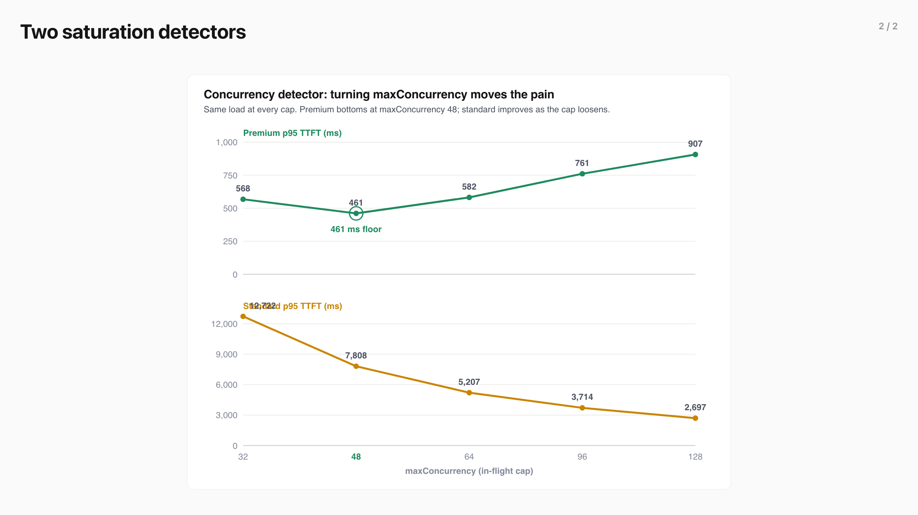
Two saturation detectors (2/2)
Notes:
Two saturation detectors
Both detectors gate the same flow-control admission queue. They differ only in how they decide the pool is saturated, and that difference decides whether the running batch can be thinned at all.
The utilization detector , the shipped default, ran every scenario above. It reads engine telemetry, queue depth and KV-cache usage, and computes saturation as the worse of the two ratios, averaged across the pool. Because it reads telemetry, it reacts after queue or KV pressure has built, and because it only applies backpressure, it cannot cap the running batch: the engine still fills to max-num-seqs , 128, and the detector decides who waits behind it.
The concurrency detector is the upstream maxConcurrency variant. It computes saturation as in-flight load over pool capacity and hooks the request lifecycle synchronously, reacting to a new request before telemetry updates. It is the only detector that caps in-flight load: maxConcurrency is a hard ceiling on requests reaching the engine at once, which thins the running batch. Its documented tradeoff: it runs open-loop, blind to GPU telemetry, so if token estimates drift or generations run long the KV cache can fill and the engine preempts or swaps to CPU with severe decode-latency spikes it never sees.
Same admission queue, two ways to call saturation: the utilization detector lets the batch fill to 128; the concurrency detector caps admissions before the engine.
plugins/flowcontrol/saturationdetector/utilization · saturationdetector
We characterized the concurrency detector alone by sweeping maxConcurrency under a single saturating load, so the chart below is a real tuning result.
Premium p95 TTFT traces a U with its floor of 461 ms at maxConcurrency 48; standard p95 falls from 12,722 ms at cap 32 to 2,697 ms at cap 128. Note the standard panel spans thirteen times the premium panel's range.
View the data
maxConcurrency Running batch Premium p95 Standard p95
32 29 568 ms 12722 ms 48 39 461 ms 7808 ms 64 46 582 ms 5207 ms 96 61 761 ms 3714 ms 128 70 907 ms 2697 ms
Flow control always orders the queue, so premium is dispatched before standard regardless of the cap. What maxConcurrency changes is batch crowding : a looser cap admits more requests into the running batch, so once premium is in that crowded batch its own decode slows and its tail rises. At a tight cap (32) few requests are admitted, so premium clears fast, 568 ms, but standard is starved, 12,722 ms. At a loose cap (128) the batch crowds and both tails climb, premium 907 ms and standard 2,697 ms.
The concurrency detector gives a better, tunable premium tail: its best premium p95 is 461 ms at maxConcurrency 48. Because it can thin the batch, it protects premium harder than the shipped utilization detector under the same load, which leaves premium in the full 128-request batch. The cost is standard's tail, which lengthens as the cap tightens.
maxConcurrency is a dial, not a switch. The premium-optimal point is 48, not the tightest cap. Below it even premium queues against the cap; above it the batch crowds and premium's decode slows. Standard moves the opposite way, so the cap sets where the pain lands between the tiers.
Output length sets how hard the cap bites. A longer generation holds each admitted slot for more decode steps, so at a fixed cap a longer output pushes more work into the queue and lengthens every tail. The output-length ladder in the tiers scenario is being restated with the same per-repeat method.
The four scenarios above were not run under the concurrency detector — it was characterized only through the maxConcurrency sweep; that head-to-head is future work.
The utilization detector , the shipped default, ran every scenario above. It reads engine telemetry, queue depth and KV-cache usage, and computes saturation as the worse of the two ratios, averaged across the pool. Because it reads telemetry, it reacts after queue or KV pressure has built, and because it only applies backpressure, it cannot cap the running batch: the engine still fills to max-num-seqs , 128, and the detector decides who waits behind it.
The concurrency detector is the upstream maxConcurrency variant. It computes saturation as in-flight load over pool capacity and hooks the request lifecycle synchronously, reacting to a new request before telemetry updates. It is the only detector that caps in-flight load: maxConcurrency is a hard ceiling on requests reaching the engine at once, which thins the running batch. Its documented tradeoff: it runs open-loop, blind to GPU telemetry, so if token estimates drift or generations run long the KV cache can fill and the engine preempts or swaps to CPU with severe decode-latency spikes it never sees.
We characterized the concurrency detector alone by sweeping maxConcurrency under a single saturating load, so the chart below is a real tuning result.
View the data
maxConcurrency Running batch Premium p95 Standard p95
32 29 568 ms 12722 ms 48 39 461 ms 7808 ms 64 46 582 ms 5207 ms 96 61 761 ms 3714 ms 128 70 907 ms 2697 ms
Flow control always orders the queue, so premium is dispatched before standard regardless of the cap. What maxConcurrency changes is batch crowding : a looser cap admits more requests into the running batch, so once premium is in that crowded batch its own decode slows and its tail rises. At a tight cap (32) few requests are admitted, so premium clears fast, 568 ms, but standard is starved, 12,722 ms. At a loose cap (128) the batch crowds and both tails climb, premium 907 ms and standard 2,697 ms.
The concurrency detector gives a better, tunable premium tail: its best premium p95 is 461 ms at maxConcurrency 48. Because it can thin the batch, it protects premium harder than the shipped utilization detector under the same load, which leaves premium in the full 128-request batch. The cost is standard's tail, which lengthens as the cap tightens.
maxConcurrency is a dial, not a switch. The premium-optimal point is 48, not the tightest cap. Below it even premium queues against the cap; above it the batch crowds and premium's decode slows. Standard moves the opposite way, so the cap sets where the pain lands between the tiers.
Output length sets how hard the cap bites. A longer generation holds each admitted slot for more decode steps, so at a fixed cap a longer output pushes more work into the queue and lengthens every tail. The output-length ladder in the tiers scenario is being restated with the same per-repeat method.
The concurrency detector gives a better, tunable premium tail: its best premium p95 is 461 ms at maxConcurrency 48. Because it can thin the batch, it protects premium harder than the shipped utilization detector under the same load, which leaves premium in the full 128-request batch. The cost is standard's tail, which lengthens as the cap tightens.
maxConcurrency is a dial, not a switch. The premium-optimal point is 48, not the tightest cap. Below it even premium queues against the cap; above it the batch crowds and premium's decode slows. Standard moves the opposite way, so the cap sets where the pain lands between the tiers.
Output length sets how hard the cap bites. A longer generation holds each admitted slot for more decode steps, so at a fixed cap a longer output pushes more work into the queue and lengthens every tail. The output-length ladder in the tiers scenario is being restated with the same per-repeat method.
The four scenarios above were not run under the concurrency detector — it was characterized only through the maxConcurrency sweep; that head-to-head is future work.
Both detectors gate the same flow-control admission queue. They differ only in how they decide the pool is saturated, and that difference decides whether the running batch can be thinned at all.

