Slide 1
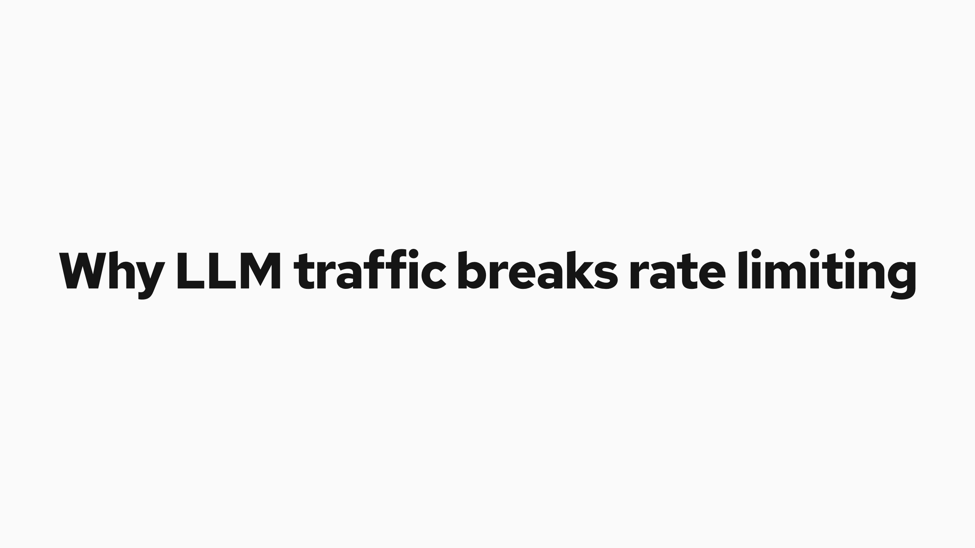
Why LLM traffic breaks rate limiting
Notes:
Why LLM traffic breaks rate limiting
Traditional gateways limit requests per second and assume every request costs about the same. LLM requests break that assumption.
Cost is driven by input length and by the autoregressive decode loop. One request can consume orders of magnitude more compute and memory than another at the same request rate.
Noisy neighbor
One tenant with heavy prompts monopolizes key-value (KV) cache and queue space, starving the rest.
Scheduling regret
Once a request enters a server's local queue it cannot move, even when a better endpoint frees up.
Priority inversion
Model servers batch by arrival, not business priority. Real-time work gets stuck behind offline batches.
Resource asymmetry
One huge-context request can outweigh hundreds of small ones. Request counts miss it.
Flow control answers by governing physical capacity, KV cache and queue saturation, instead of request counts, and by holding the queue where policy can still act on it.
Cost is driven by input length and by the autoregressive decode loop. One request can consume orders of magnitude more compute and memory than another at the same request rate.
Noisy neighbor One tenant with heavy prompts monopolizes key-value (KV) cache and queue space, starving the rest.
Scheduling regret Once a request enters a server's local queue it cannot move, even when a better endpoint frees up.
Priority inversion Model servers batch by arrival, not business priority. Real-time work gets stuck behind offline batches.
Resource asymmetry One huge-context request can outweigh hundreds of small ones. Request counts miss it.
Flow control answers by governing physical capacity, KV cache and queue saturation, instead of request counts, and by holding the queue where policy can still act on it.
Traditional gateways limit requests per second and assume every request costs about the same.
Traditional gateways limit requests per second and assume every request costs about the same. LLM requests break that assumption.

Slide 2
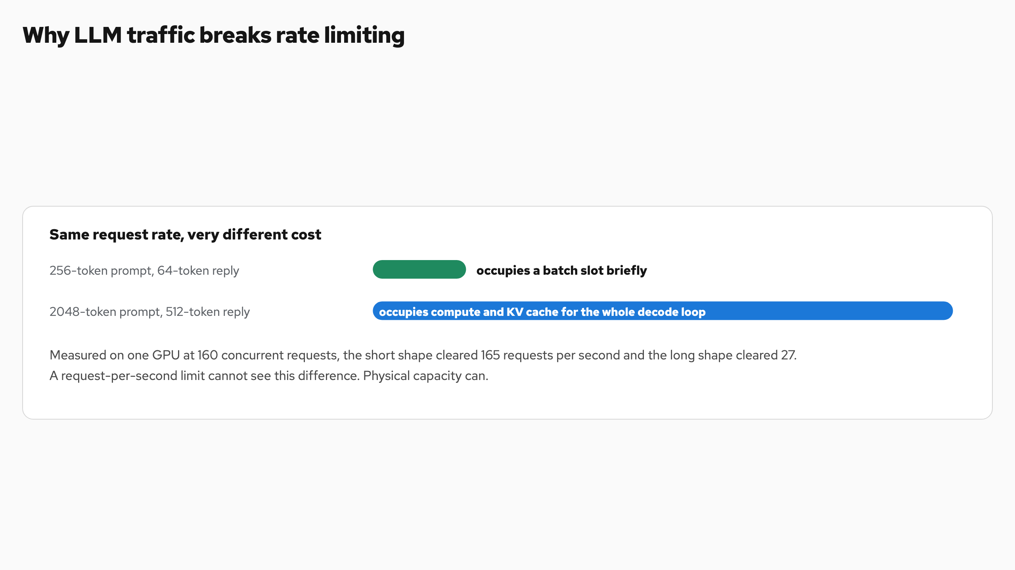
Why LLM traffic breaks rate limiting
Notes:
Why LLM traffic breaks rate limiting
Traditional gateways limit requests per second and assume every request costs about the same. LLM requests break that assumption.
Cost is driven by input length and by the autoregressive decode loop. One request can consume orders of magnitude more compute and memory than another at the same request rate.
Noisy neighbor
One tenant with heavy prompts monopolizes key-value (KV) cache and queue space, starving the rest.
Scheduling regret
Once a request enters a server's local queue it cannot move, even when a better endpoint frees up.
Priority inversion
Model servers batch by arrival, not business priority. Real-time work gets stuck behind offline batches.
Resource asymmetry
One huge-context request can outweigh hundreds of small ones. Request counts miss it.
Flow control answers by governing physical capacity, KV cache and queue saturation, instead of request counts, and by holding the queue where policy can still act on it.
Cost is driven by input length and by the autoregressive decode loop. One request can consume orders of magnitude more compute and memory than another at the same request rate.
Noisy neighbor One tenant with heavy prompts monopolizes key-value (KV) cache and queue space, starving the rest.
Scheduling regret Once a request enters a server's local queue it cannot move, even when a better endpoint frees up.
Priority inversion Model servers batch by arrival, not business priority. Real-time work gets stuck behind offline batches.
Resource asymmetry One huge-context request can outweigh hundreds of small ones. Request counts miss it.
Flow control answers by governing physical capacity, KV cache and queue saturation, instead of request counts, and by holding the queue where policy can still act on it.
Traditional gateways limit requests per second and assume every request costs about the same.
Traditional gateways limit requests per second and assume every request costs about the same. LLM requests break that assumption.

Slide 3
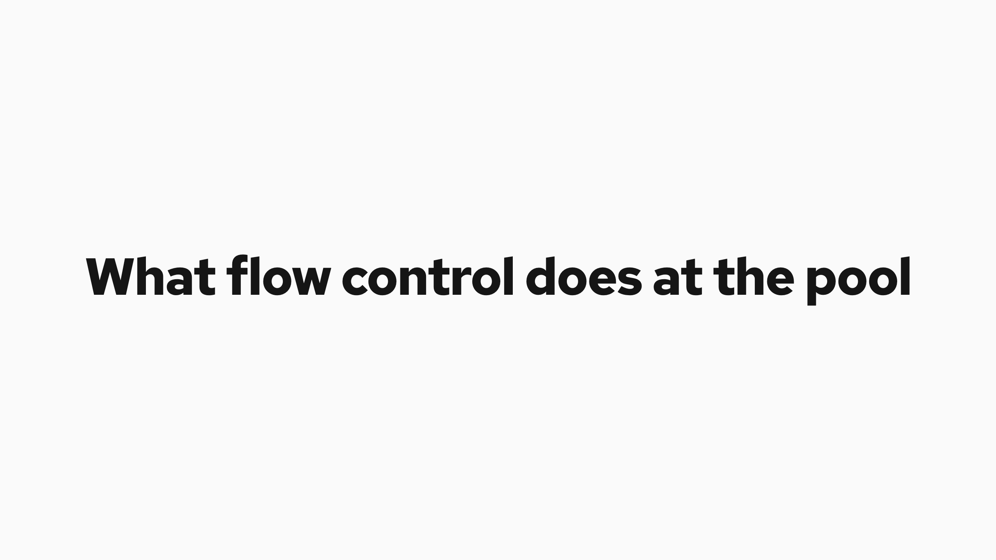
What flow control does at the pool
Notes:
What flow control does at the pool
What it does Where its reach ends
A centralized, policy-aware queue in the Endpoint Picker, in front of the model servers. It enforces priority across traffic classes, fairness across tenants, and ordering within a tenant.
It is work-conserving. If the pool has capacity, it dispatches.
It routes late. A dispatched request lands on the endpoint that just freed up or holds its prefix cache.
More capacity. Flow control decides when and in what order requests dispatch, and it cannot make the pool faster.
When demand exceeds capacity, the wait still exists. Flow control moves it into the Endpoint Picker (EPP) queue and decides where and for whom time to first token is accrued, protecting generation speed for everything already running.
That trade is the honest core of the system. Enabling flow control is an explicit choice to protect time per output token, the reading pace of every stream already in flight, at the price of queue time for new arrivals when the pool is full.
Where the gradient comes from
The saturation number both regimes compare against the ceiling is computed per endpoint, then averaged across the pool. The more constrained resource wins.
plugins/flowcontrol/saturationdetector/utilization

Slide 4
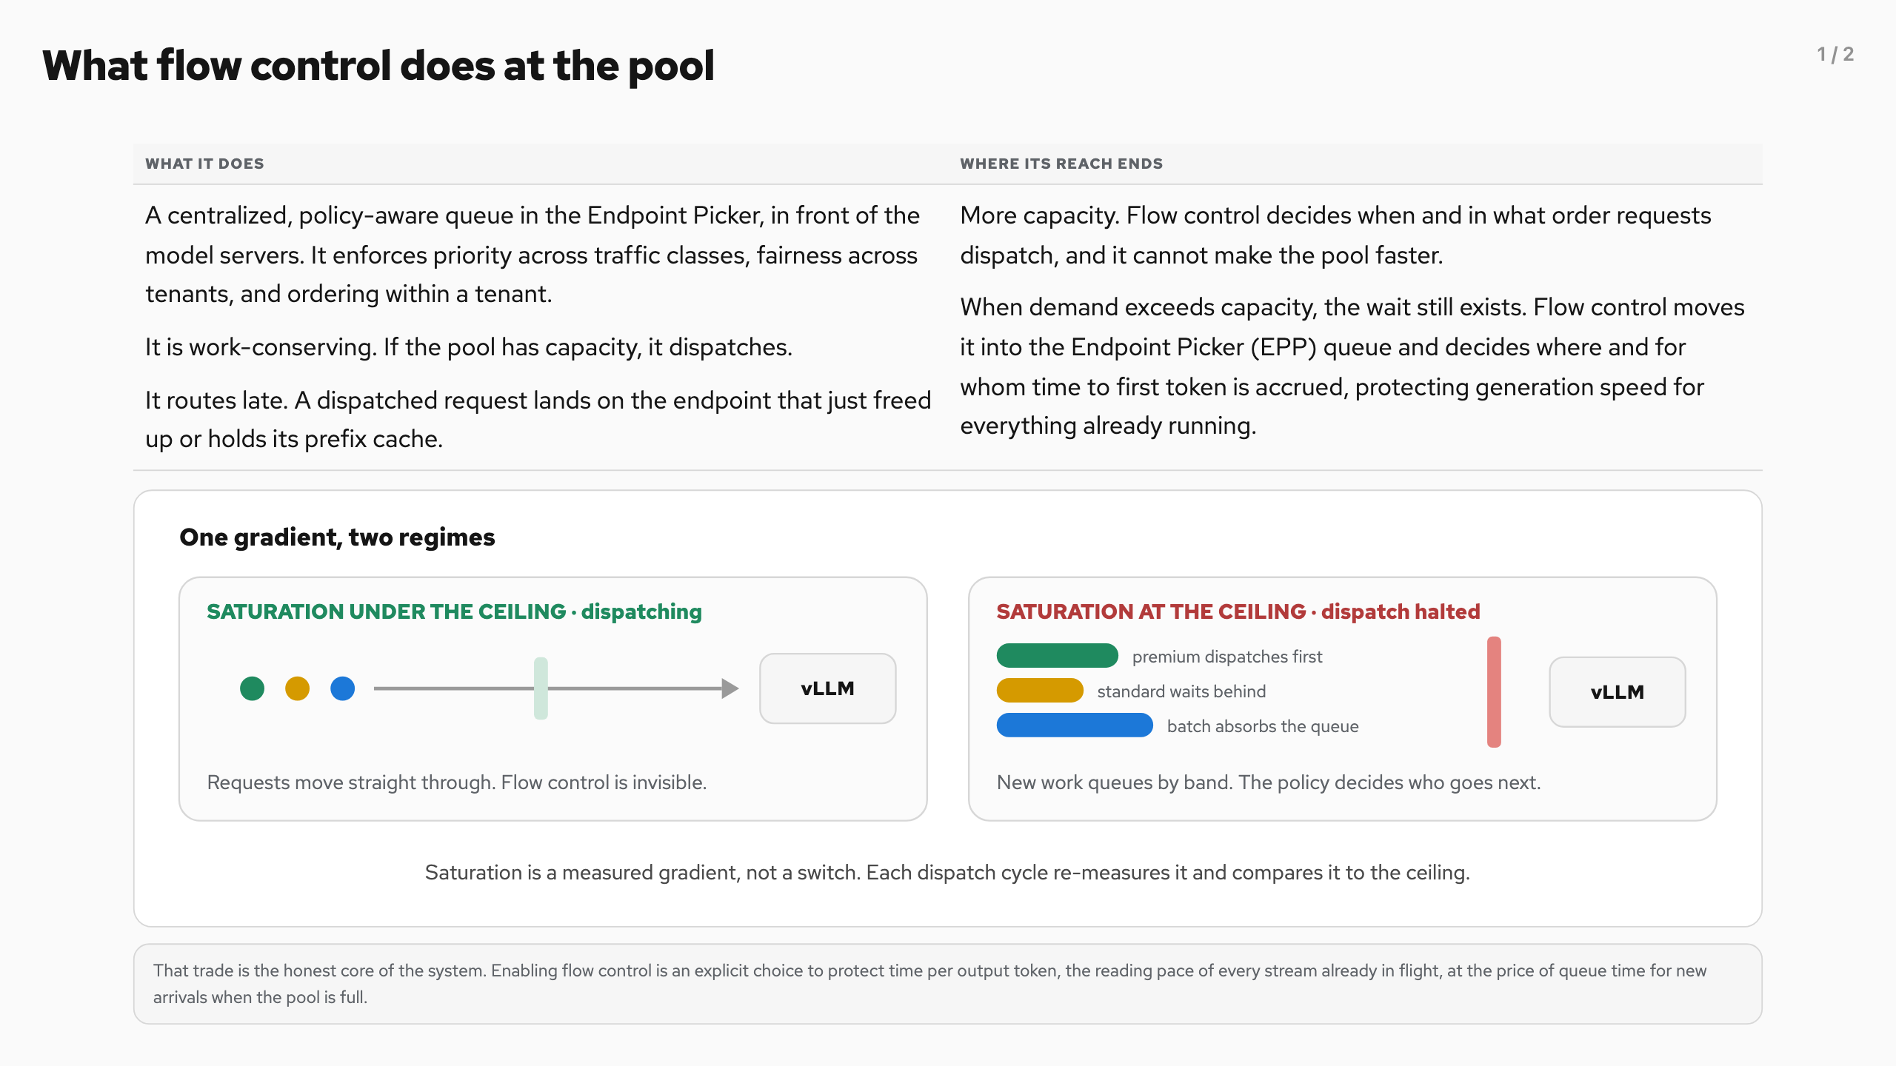
What flow control does at the pool (1/2)
Notes:
What flow control does at the pool
What it does Where its reach ends
A centralized, policy-aware queue in the Endpoint Picker, in front of the model servers. It enforces priority across traffic classes, fairness across tenants, and ordering within a tenant.
It is work-conserving. If the pool has capacity, it dispatches.
It routes late. A dispatched request lands on the endpoint that just freed up or holds its prefix cache.
More capacity. Flow control decides when and in what order requests dispatch, and it cannot make the pool faster.
When demand exceeds capacity, the wait still exists. Flow control moves it into the Endpoint Picker (EPP) queue and decides where and for whom time to first token is accrued, protecting generation speed for everything already running.
That trade is the honest core of the system. Enabling flow control is an explicit choice to protect time per output token, the reading pace of every stream already in flight, at the price of queue time for new arrivals when the pool is full.
Where the gradient comes from
The saturation number both regimes compare against the ceiling is computed per endpoint, then averaged across the pool. The more constrained resource wins.
plugins/flowcontrol/saturationdetector/utilization

Slide 5
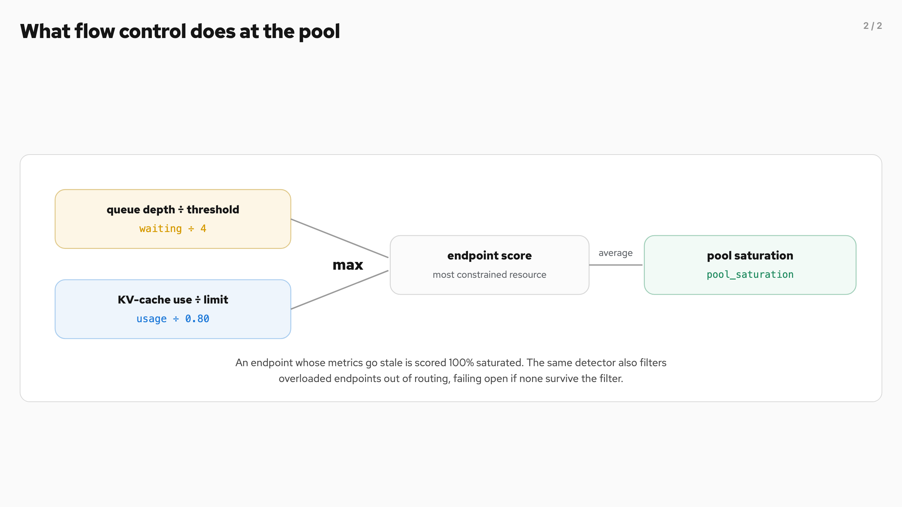
What flow control does at the pool (2/2)
Notes:
What flow control does at the pool
What it does Where its reach ends
A centralized, policy-aware queue in the Endpoint Picker, in front of the model servers. It enforces priority across traffic classes, fairness across tenants, and ordering within a tenant.
It is work-conserving. If the pool has capacity, it dispatches.
It routes late. A dispatched request lands on the endpoint that just freed up or holds its prefix cache.
More capacity. Flow control decides when and in what order requests dispatch, and it cannot make the pool faster.
When demand exceeds capacity, the wait still exists. Flow control moves it into the Endpoint Picker (EPP) queue and decides where and for whom time to first token is accrued, protecting generation speed for everything already running.
That trade is the honest core of the system. Enabling flow control is an explicit choice to protect time per output token, the reading pace of every stream already in flight, at the price of queue time for new arrivals when the pool is full.
Where the gradient comes from
The saturation number both regimes compare against the ceiling is computed per endpoint, then averaged across the pool. The more constrained resource wins.
plugins/flowcontrol/saturationdetector/utilization

Slide 6
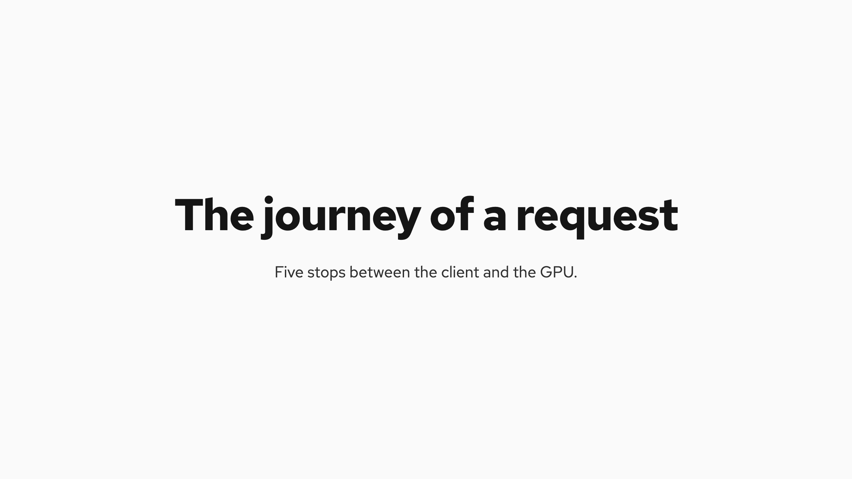
The journey of a request
Notes:
The journey of a request
Five stops between the client and the GPU. The first two classify, the middle two decide, the last one routes.
x-llm-d-inference-objective and x-llm-d-inference-fairness-id are the canonical header names. The older x-gateway-inference-objective and x-gateway-inference-fairness-id forms are accepted as deprecated aliases.
requestcontrol/director.go · requestcontrol/admission.go · flowcontrol/controller/controller.go
Where priority comes from
The priority half of the FlowKey is resolved, never asserted. The header names an InferenceObjective , and every lookup failure lands on the same silent default.
requestcontrol/director.go:206–255
requestcontrol/director.go · requestcontrol/admission.go · flowcontrol/controller/controller.go
Where priority comes from
The priority half of the FlowKey is resolved, never asserted. The header names an InferenceObjective , and every lookup failure lands on the same silent default.
requestcontrol/director.go:206–255
Five stops between the client and the GPU. The first two classify, the middle two decide, the last one routes.

Slide 7
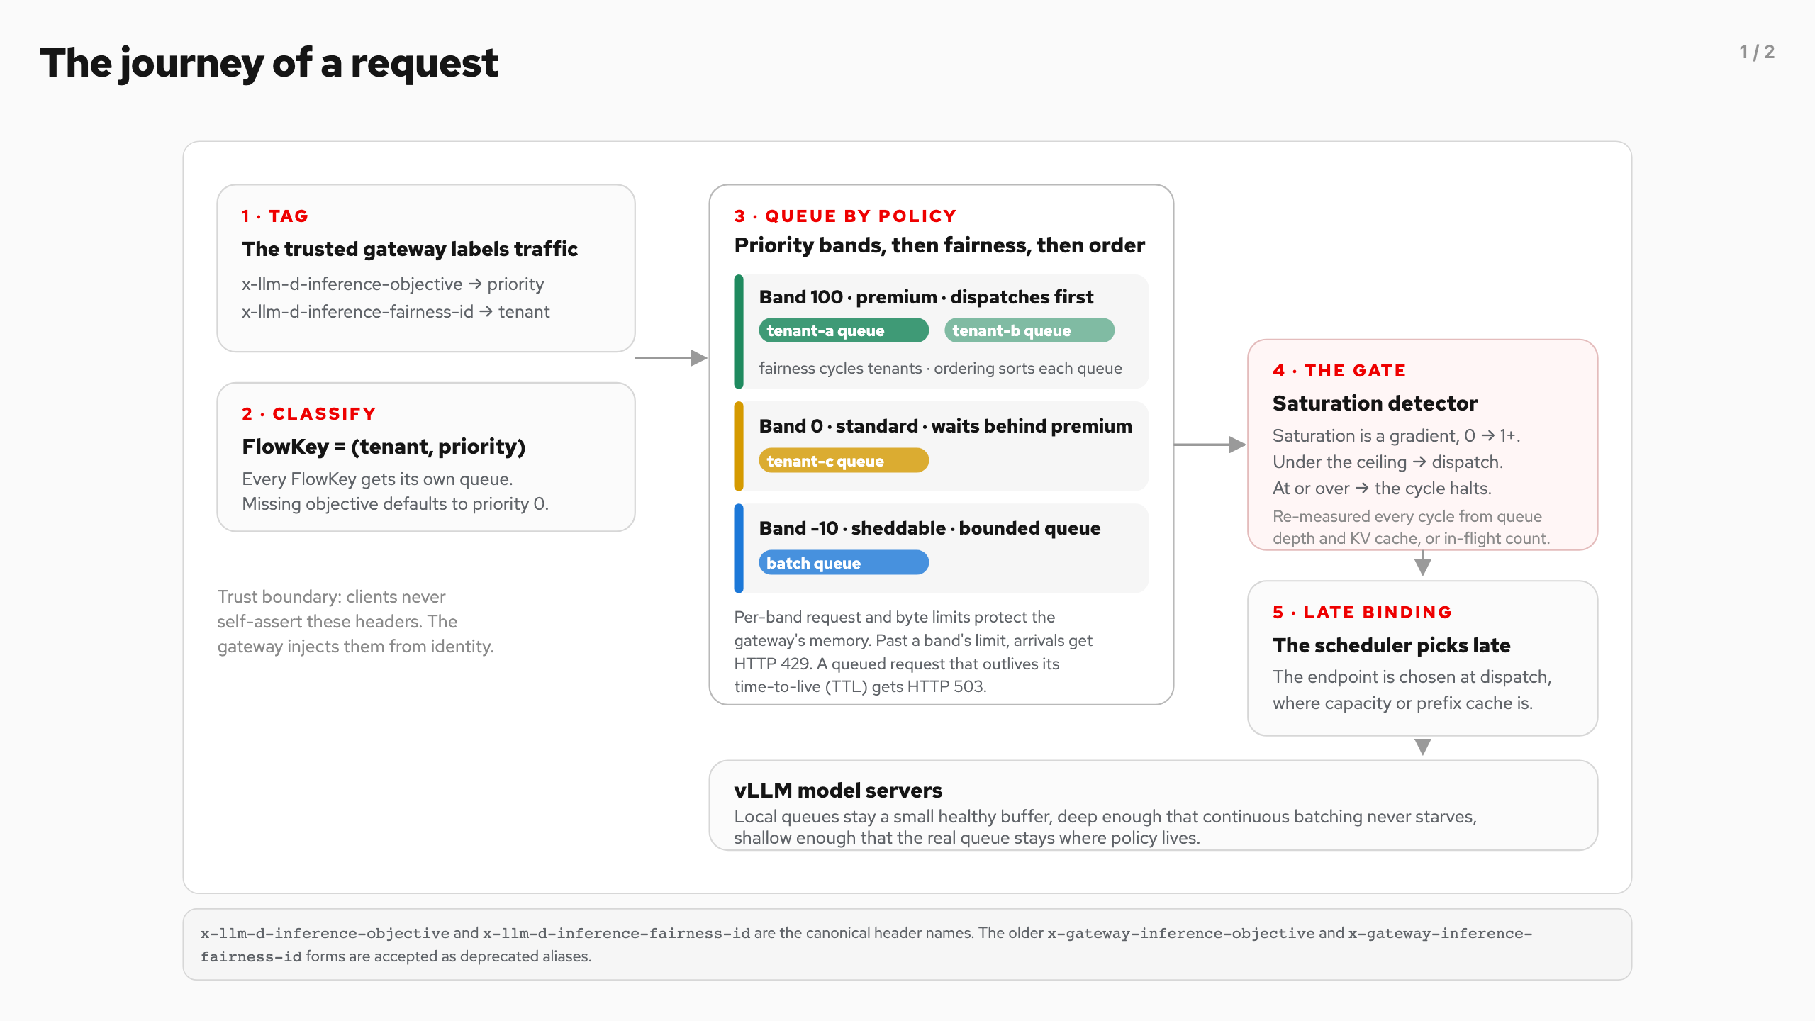
The journey of a request (1/2)
Notes:
The journey of a request
Five stops between the client and the GPU. The first two classify, the middle two decide, the last one routes.
x-llm-d-inference-objective and x-llm-d-inference-fairness-id are the canonical header names. The older x-gateway-inference-objective and x-gateway-inference-fairness-id forms are accepted as deprecated aliases.
requestcontrol/director.go · requestcontrol/admission.go · flowcontrol/controller/controller.go
Where priority comes from
The priority half of the FlowKey is resolved, never asserted. The header names an InferenceObjective , and every lookup failure lands on the same silent default.
requestcontrol/director.go:206–255
requestcontrol/director.go · requestcontrol/admission.go · flowcontrol/controller/controller.go
Where priority comes from
The priority half of the FlowKey is resolved, never asserted. The header names an InferenceObjective , and every lookup failure lands on the same silent default.
requestcontrol/director.go:206–255
Five stops between the client and the GPU. The first two classify, the middle two decide, the last one routes.

Slide 8
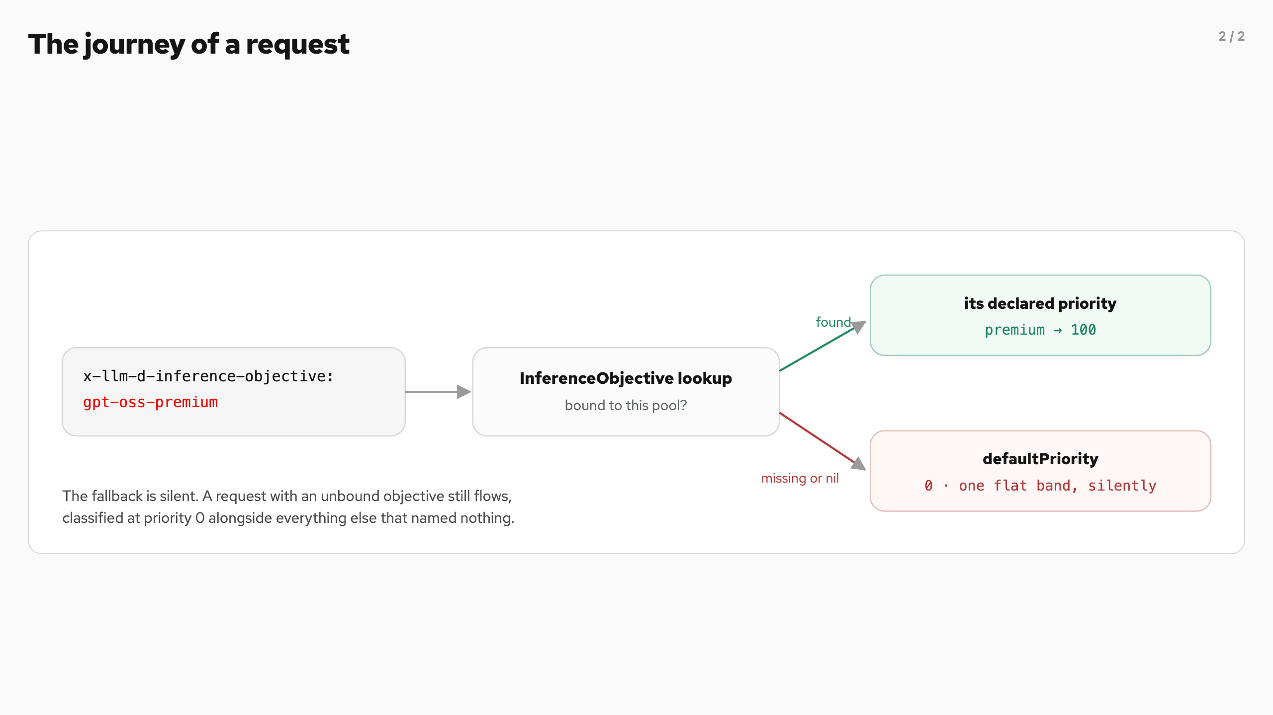
The journey of a request (2/2)
Notes:
The journey of a request
Five stops between the client and the GPU. The first two classify, the middle two decide, the last one routes.
x-llm-d-inference-objective and x-llm-d-inference-fairness-id are the canonical header names. The older x-gateway-inference-objective and x-gateway-inference-fairness-id forms are accepted as deprecated aliases.
requestcontrol/director.go · requestcontrol/admission.go · flowcontrol/controller/controller.go
Where priority comes from
The priority half of the FlowKey is resolved, never asserted. The header names an InferenceObjective , and every lookup failure lands on the same silent default.
requestcontrol/director.go:206–255
requestcontrol/director.go · requestcontrol/admission.go · flowcontrol/controller/controller.go
Where priority comes from
The priority half of the FlowKey is resolved, never asserted. The header names an InferenceObjective , and every lookup failure lands on the same silent default.
requestcontrol/director.go:206–255
Five stops between the client and the GPU. The first two classify, the middle two decide, the last one routes.

Slide 9

The architecture, one level up
Notes:
The architecture, one level up
The journey above happens inside one Endpoint Picker serving a pool of model servers. Late binding is why the queue lives centrally. The endpoint is chosen at dispatch, when the picker knows which server just freed capacity or already holds the request's prefix cache.

Slide 10
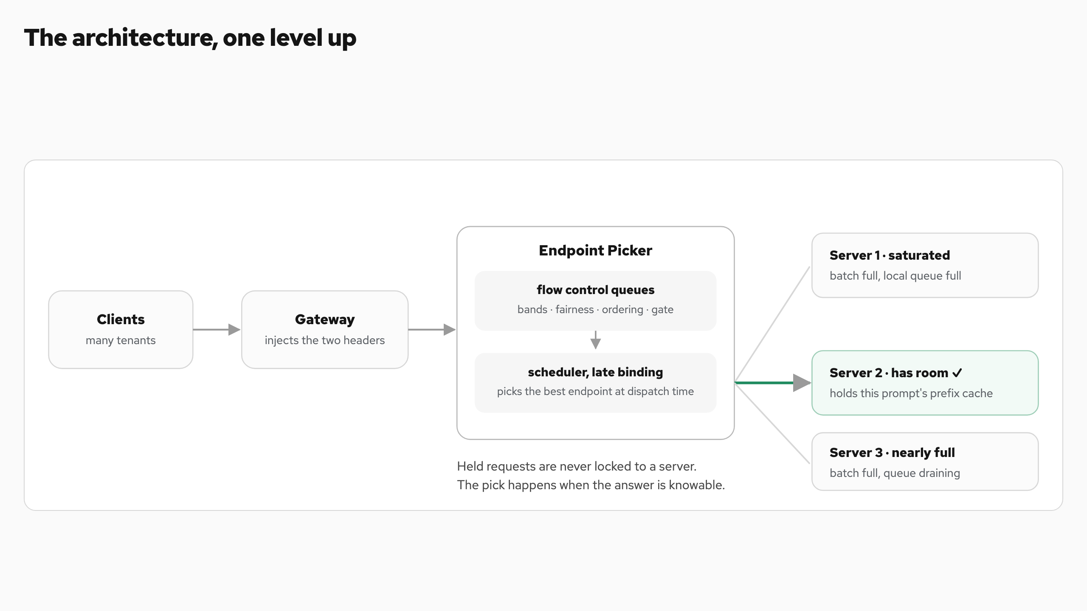
The architecture, one level up
Notes:
The architecture, one level up
The journey above happens inside one Endpoint Picker serving a pool of model servers. Late binding is why the queue lives centrally. The endpoint is chosen at dispatch, when the picker knows which server just freed capacity or already holds the request's prefix cache.

Slide 11
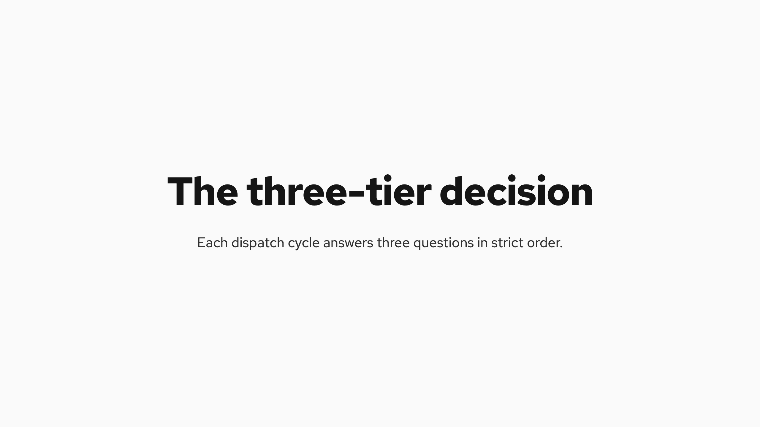
The three-tier decision
Notes:
The three-tier decision
Each dispatch cycle answers three questions in strict order. One is fixed, two are pluggable.
Tier Question Who decides Options
1 · Priority Which band goes first? Fixed. Highest band with work always wins Bands come from InferenceObjective , negative values mark sheddable work
2 · Fairness Which tenant inside the band? Fairness policy plugin Round-robin across tenants, or global strict ordering
3 · Ordering Which request from that tenant? Ordering policy plugin First-come first-served, earliest deadline first, or a deadline from a service-level-objective (SLO) header
Priority is absolute by design. When the pool is saturated, every premium request dispatches before any standard request, and fairness only referees between equals. If two workloads should compete, put them in the same band. If one should never wait for the other, put them in different bands.
flowcontrol/registry/managedqueue.go · plugins/flowcontrol/fairness · plugins/flowcontrol/ordering
The dispatch cycle
The three tiers run inside a loop that moves exactly one request per pass. The ceiling check comes first, and it can stop everything.
One dispatch per cycle, highest band first. In the benchmarked configuration the ceilings are uniform across bands, so that traversal order is the entire prioritization mechanism.
flowcontrol/controller/internal/processor.go:343–400
Priority is absolute by design. When the pool is saturated, every premium request dispatches before any standard request, and fairness only referees between equals. If two workloads should compete, put them in the same band. If one should never wait for the other, put them in different bands.
flowcontrol/registry/managedqueue.go · plugins/flowcontrol/fairness · plugins/flowcontrol/ordering
The dispatch cycle
The three tiers run inside a loop that moves exactly one request per pass. The ceiling check comes first, and it can stop everything.
flowcontrol/controller/internal/processor.go:343–400
Each dispatch cycle answers three questions in strict order. One is fixed, two are pluggable.
Priority is absolute by design.

Slide 12
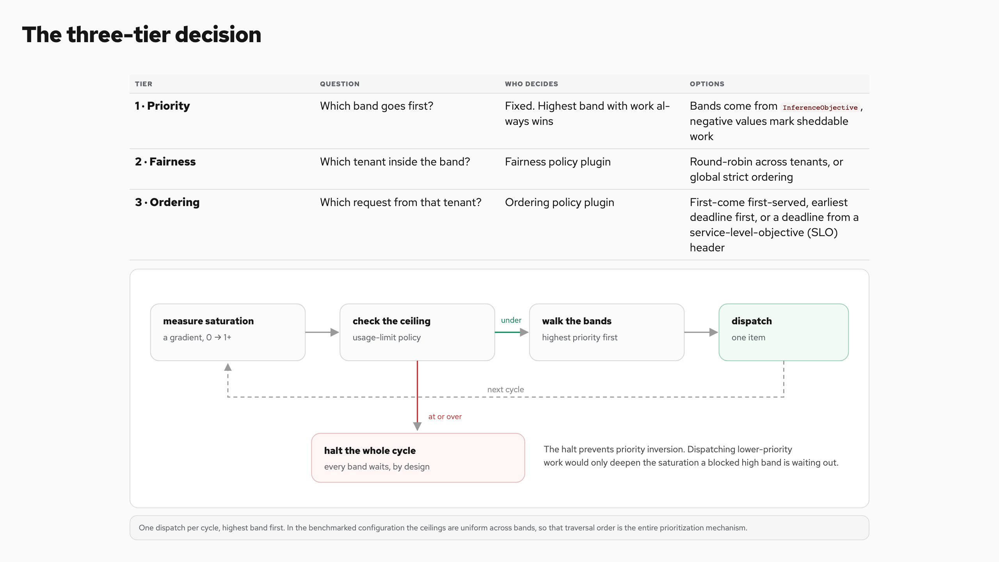
The three-tier decision
Notes:
The three-tier decision
Each dispatch cycle answers three questions in strict order. One is fixed, two are pluggable.
Tier Question Who decides Options
1 · Priority Which band goes first? Fixed. Highest band with work always wins Bands come from InferenceObjective , negative values mark sheddable work
2 · Fairness Which tenant inside the band? Fairness policy plugin Round-robin across tenants, or global strict ordering
3 · Ordering Which request from that tenant? Ordering policy plugin First-come first-served, earliest deadline first, or a deadline from a service-level-objective (SLO) header
Priority is absolute by design. When the pool is saturated, every premium request dispatches before any standard request, and fairness only referees between equals. If two workloads should compete, put them in the same band. If one should never wait for the other, put them in different bands.
flowcontrol/registry/managedqueue.go · plugins/flowcontrol/fairness · plugins/flowcontrol/ordering
The dispatch cycle
The three tiers run inside a loop that moves exactly one request per pass. The ceiling check comes first, and it can stop everything.
One dispatch per cycle, highest band first. In the benchmarked configuration the ceilings are uniform across bands, so that traversal order is the entire prioritization mechanism.
flowcontrol/controller/internal/processor.go:343–400
Priority is absolute by design. When the pool is saturated, every premium request dispatches before any standard request, and fairness only referees between equals. If two workloads should compete, put them in the same band. If one should never wait for the other, put them in different bands.
flowcontrol/registry/managedqueue.go · plugins/flowcontrol/fairness · plugins/flowcontrol/ordering
The dispatch cycle
The three tiers run inside a loop that moves exactly one request per pass. The ceiling check comes first, and it can stop everything.
flowcontrol/controller/internal/processor.go:343–400
Each dispatch cycle answers three questions in strict order. One is fixed, two are pluggable.
Priority is absolute by design.

Slide 13
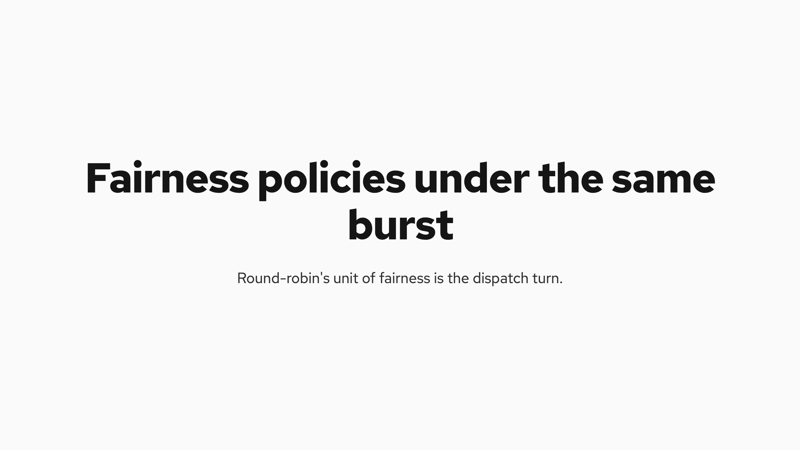
Fairness policies under the same burst
Notes:
Fairness policies under the same burst
Round-robin's unit of fairness is the dispatch turn. Global-strict has no unit at all; it melts the band into one arrival-ordered queue.
Same tenants, opposite outcome. Round-robin bounds the burster's share of dispatches; global-strict hands the band to it. To see fairness in data, measure per-tenant served share — latency alone hides it. A third registered policy, program-aware-fairness , exists but is not covered here.
plugins/flowcontrol/fairness/roundrobin · plugins/flowcontrol/fairness/globalstrict
plugins/flowcontrol/fairness/roundrobin · plugins/flowcontrol/fairness/globalstrict
Round-robin's unit of fairness is the dispatch turn. Global-strict has no unit at all; it melts the band into one arrival-ordered queue.

Slide 14
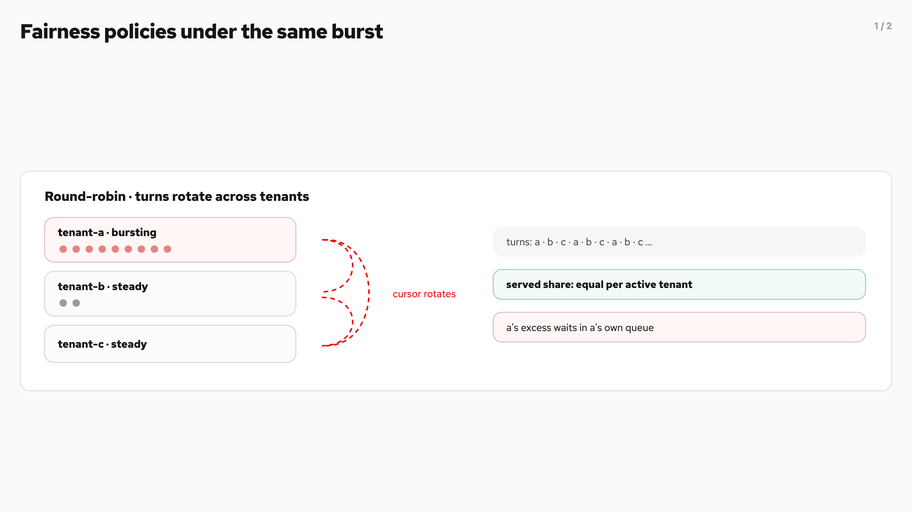
Fairness policies under the same burst (1/2)
Notes:
Fairness policies under the same burst
Round-robin's unit of fairness is the dispatch turn. Global-strict has no unit at all; it melts the band into one arrival-ordered queue.
Same tenants, opposite outcome. Round-robin bounds the burster's share of dispatches; global-strict hands the band to it. To see fairness in data, measure per-tenant served share — latency alone hides it. A third registered policy, program-aware-fairness , exists but is not covered here.
plugins/flowcontrol/fairness/roundrobin · plugins/flowcontrol/fairness/globalstrict
plugins/flowcontrol/fairness/roundrobin · plugins/flowcontrol/fairness/globalstrict
Round-robin's unit of fairness is the dispatch turn. Global-strict has no unit at all; it melts the band into one arrival-ordered queue.

Slide 15
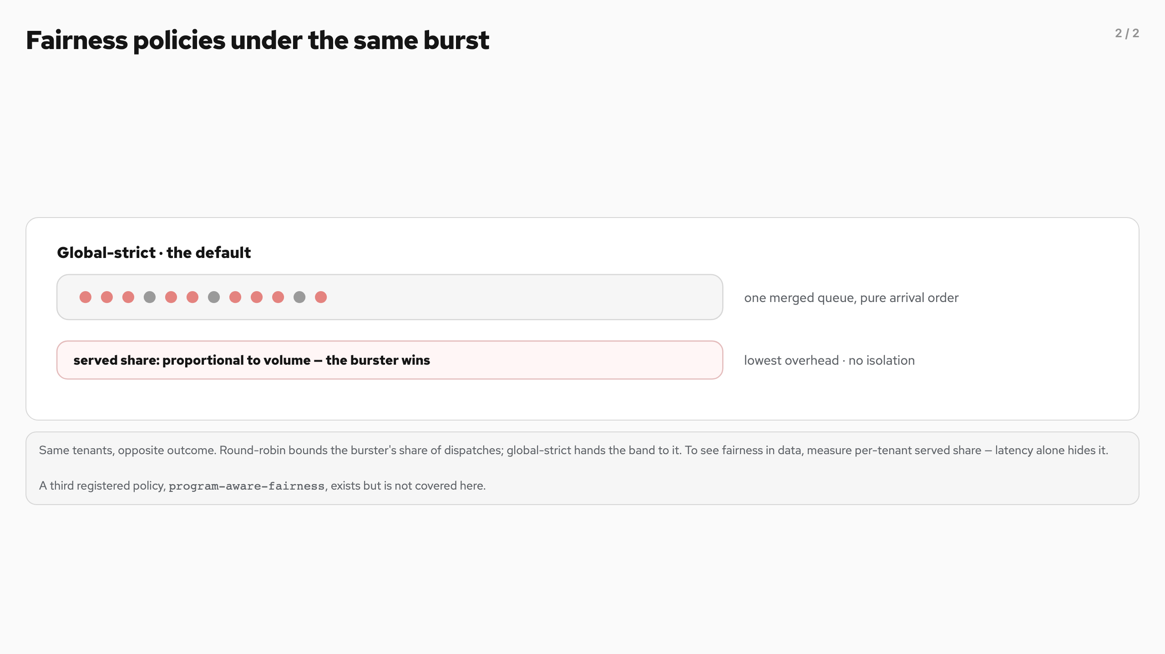
Fairness policies under the same burst (2/2)
Notes:
Fairness policies under the same burst
Round-robin's unit of fairness is the dispatch turn. Global-strict has no unit at all; it melts the band into one arrival-ordered queue.
Same tenants, opposite outcome. Round-robin bounds the burster's share of dispatches; global-strict hands the band to it. To see fairness in data, measure per-tenant served share — latency alone hides it. A third registered policy, program-aware-fairness , exists but is not covered here.
plugins/flowcontrol/fairness/roundrobin · plugins/flowcontrol/fairness/globalstrict
plugins/flowcontrol/fairness/roundrobin · plugins/flowcontrol/fairness/globalstrict
Round-robin's unit of fairness is the dispatch turn. Global-strict has no unit at all; it melts the band into one arrival-ordered queue.

Slide 16
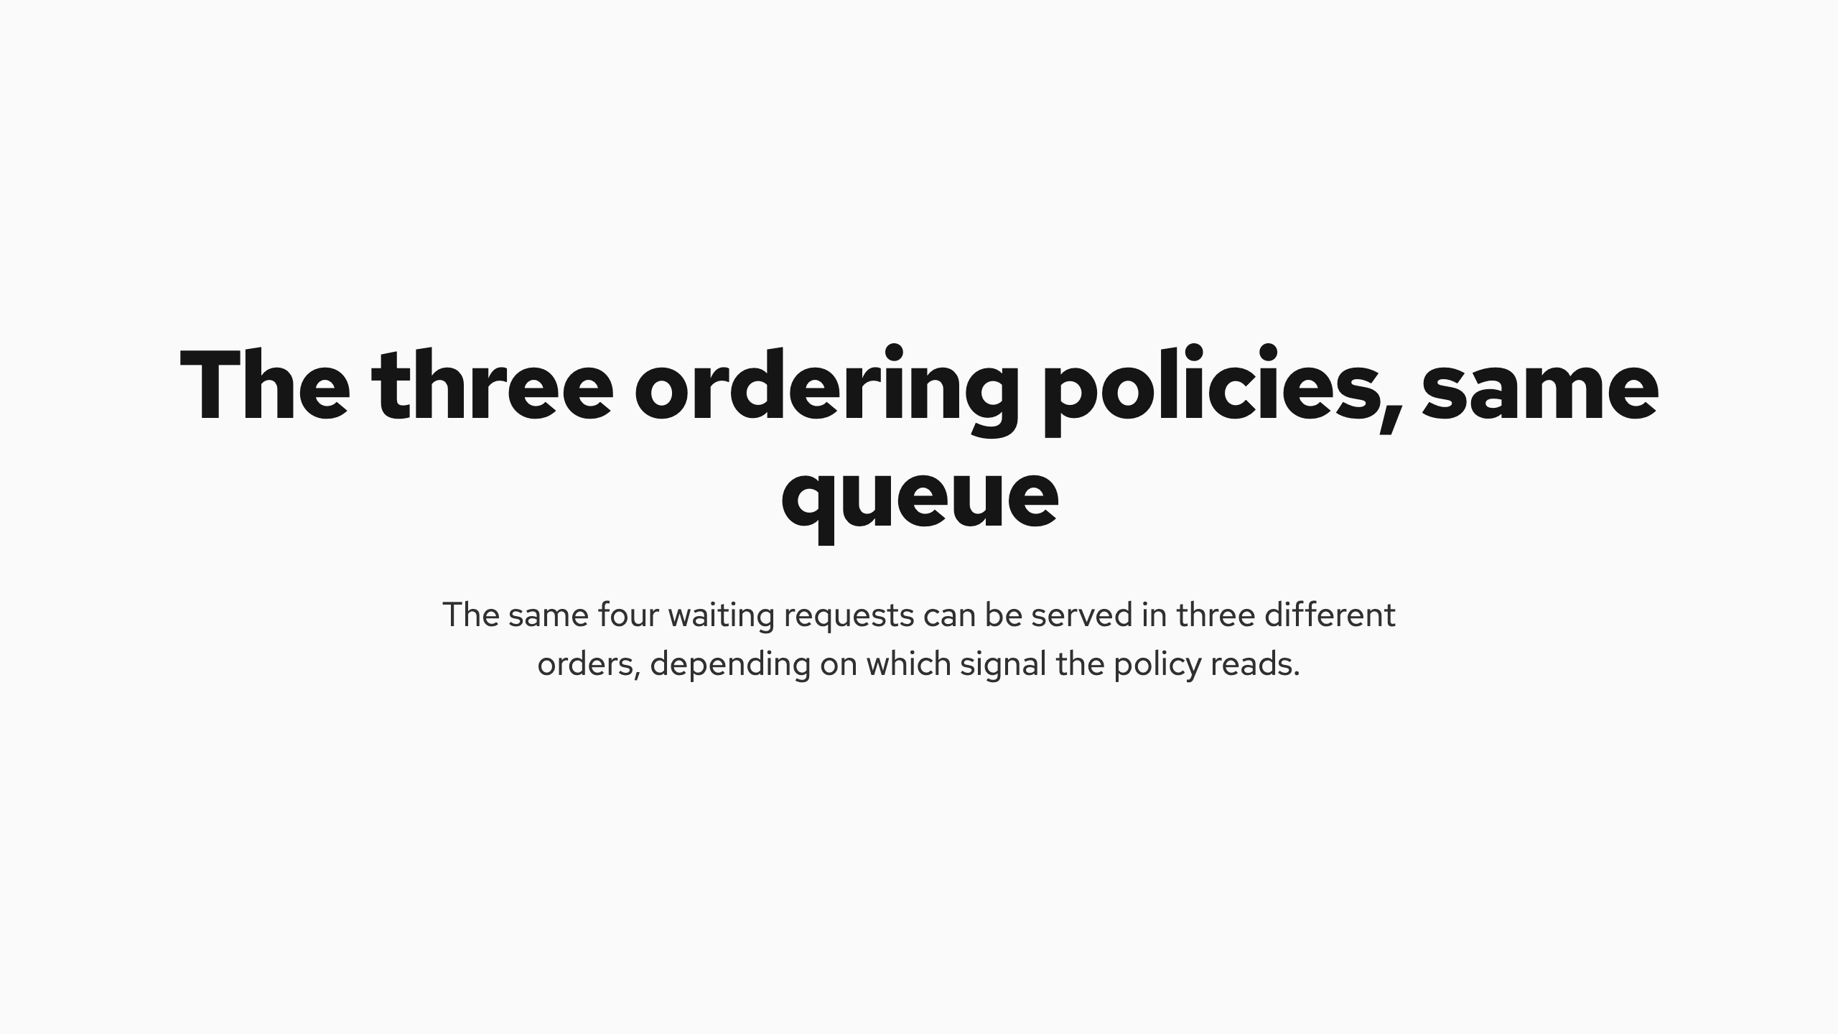
The three ordering policies, same queue
Notes:
The three ordering policies, same queue
The same four waiting requests can be served in three different orders, depending on which signal the policy reads.
Ordering acts inside one tenant's queue. Fairness decides between tenants; ordering decides within one.
plugins/flowcontrol/ordering · fcfs · edf · slodeadline
plugins/flowcontrol/ordering · fcfs · edf · slodeadline
The same four waiting requests can be served in three different orders, depending on which signal the policy reads.

Slide 17
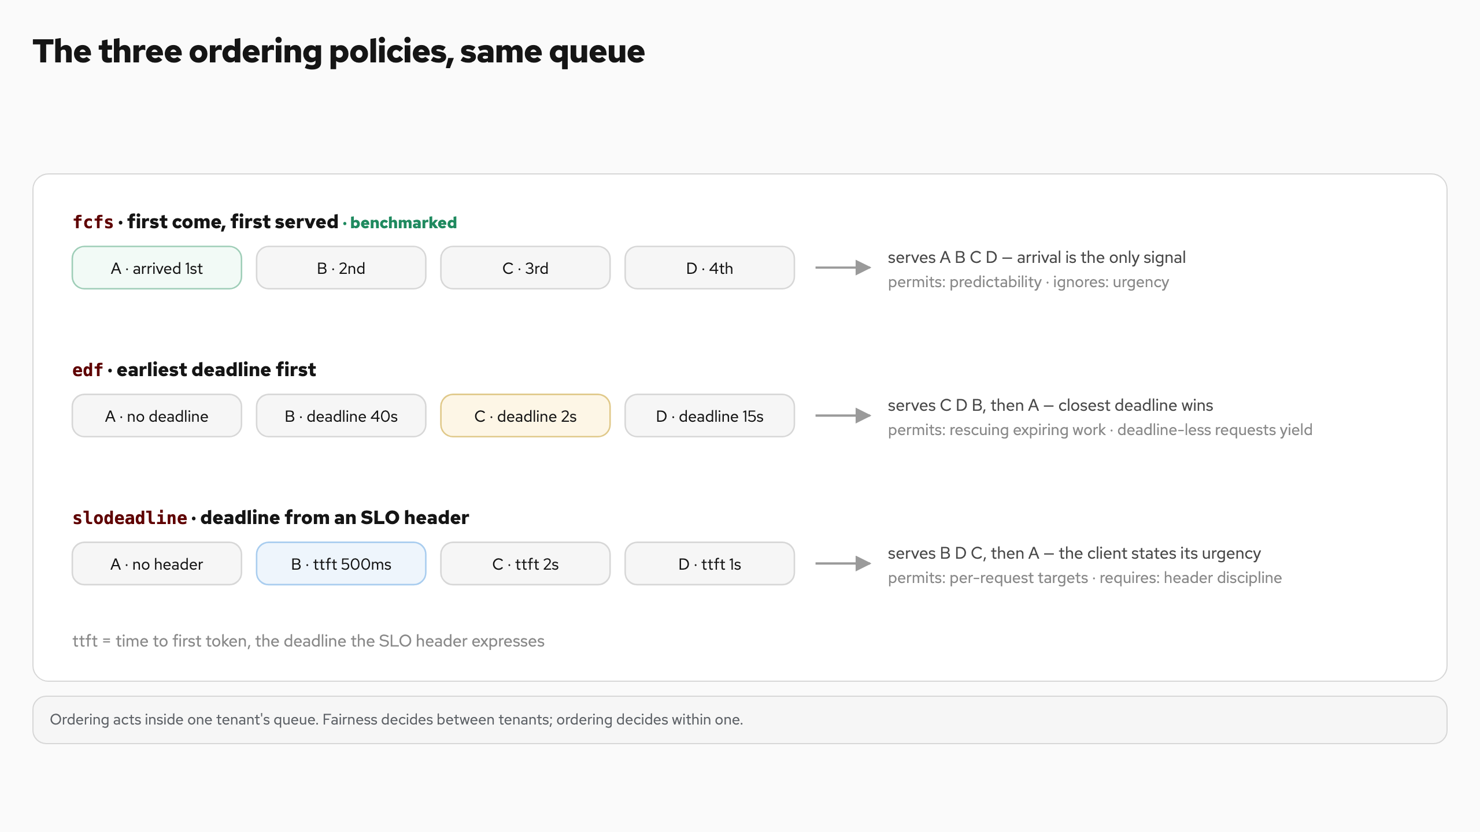
The three ordering policies, same queue
Notes:
The three ordering policies, same queue
The same four waiting requests can be served in three different orders, depending on which signal the policy reads.
Ordering acts inside one tenant's queue. Fairness decides between tenants; ordering decides within one.
plugins/flowcontrol/ordering · fcfs · edf · slodeadline
plugins/flowcontrol/ordering · fcfs · edf · slodeadline
The same four waiting requests can be served in three different orders, depending on which signal the policy reads.

Slide 18
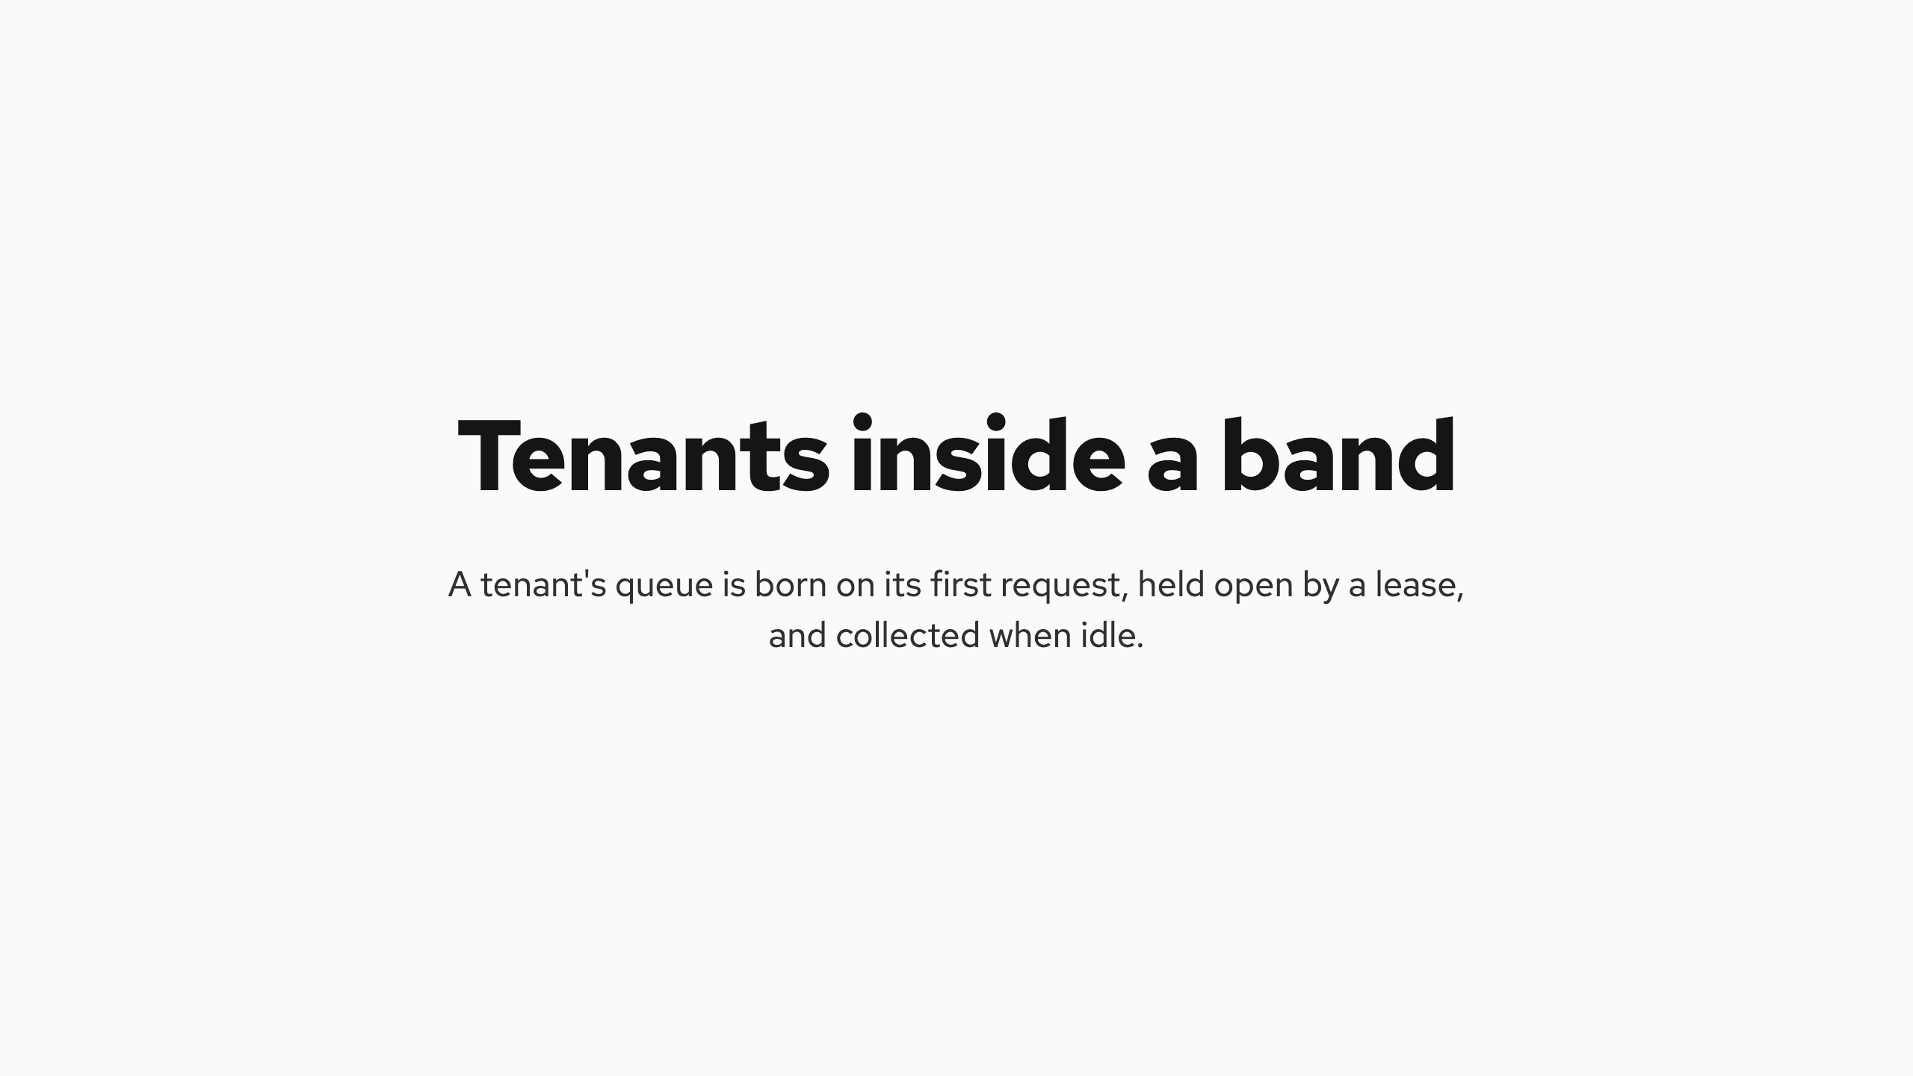
Tenants inside a band
Notes:
Tenants inside a band
A tenant's queue is born on its first request, held open by a lease, and collected when idle. There is no tenant registry to maintain.
Tenants appear, serve, and vanish on their own. Idle bands are collected the same way, on their own timeout.
flowcontrol/registry/leasing.go · flowcontrol/registry/managedqueue.go
flowcontrol/registry/leasing.go · flowcontrol/registry/managedqueue.go
A tenant's queue is born on its first request, held open by a lease, and collected when idle. There is no tenant registry to maintain.

Slide 19
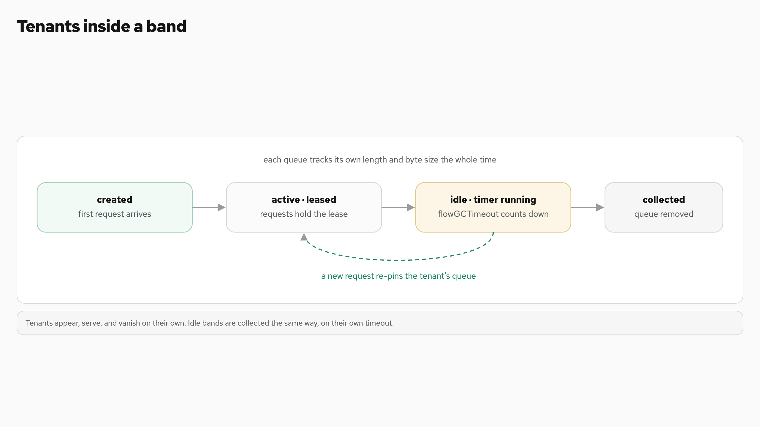
Tenants inside a band
Notes:
Tenants inside a band
A tenant's queue is born on its first request, held open by a lease, and collected when idle. There is no tenant registry to maintain.
Tenants appear, serve, and vanish on their own. Idle bands are collected the same way, on their own timeout.
flowcontrol/registry/leasing.go · flowcontrol/registry/managedqueue.go
flowcontrol/registry/leasing.go · flowcontrol/registry/managedqueue.go
A tenant's queue is born on its first request, held open by a lease, and collected when idle. There is no tenant registry to maintain.

Slide 20
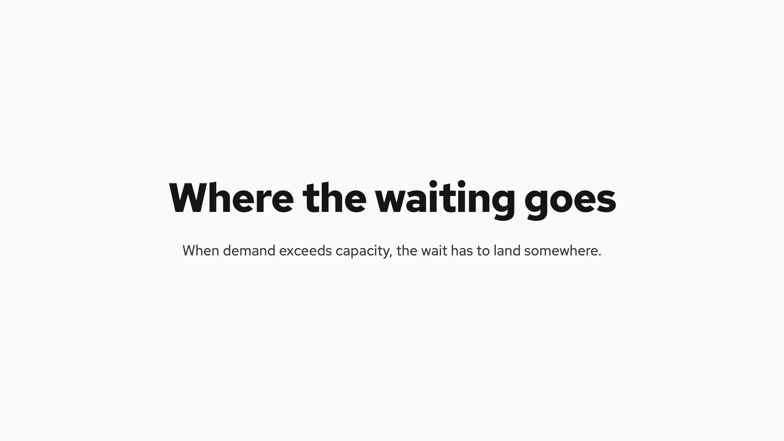
Where the waiting goes
Notes:
Where the waiting goes
When demand exceeds capacity, the wait has to land somewhere. There are only two places, and only one of them obeys policy.

Slide 21
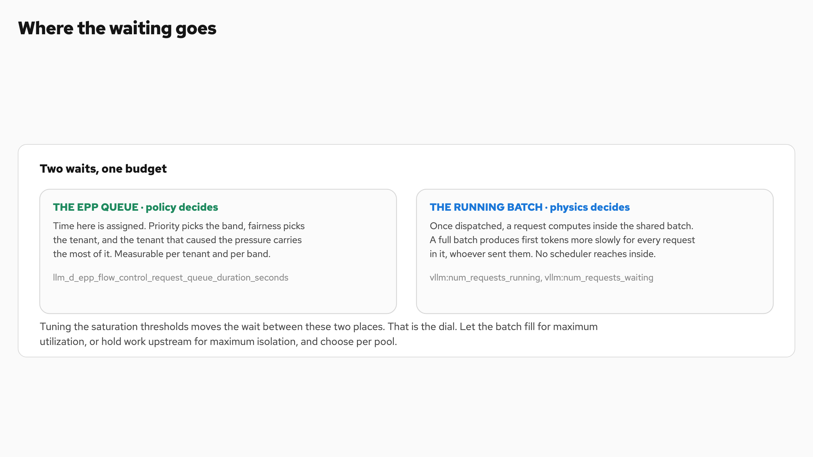
Where the waiting goes
Notes:
Where the waiting goes
When demand exceeds capacity, the wait has to land somewhere. There are only two places, and only one of them obeys policy.

Slide 22
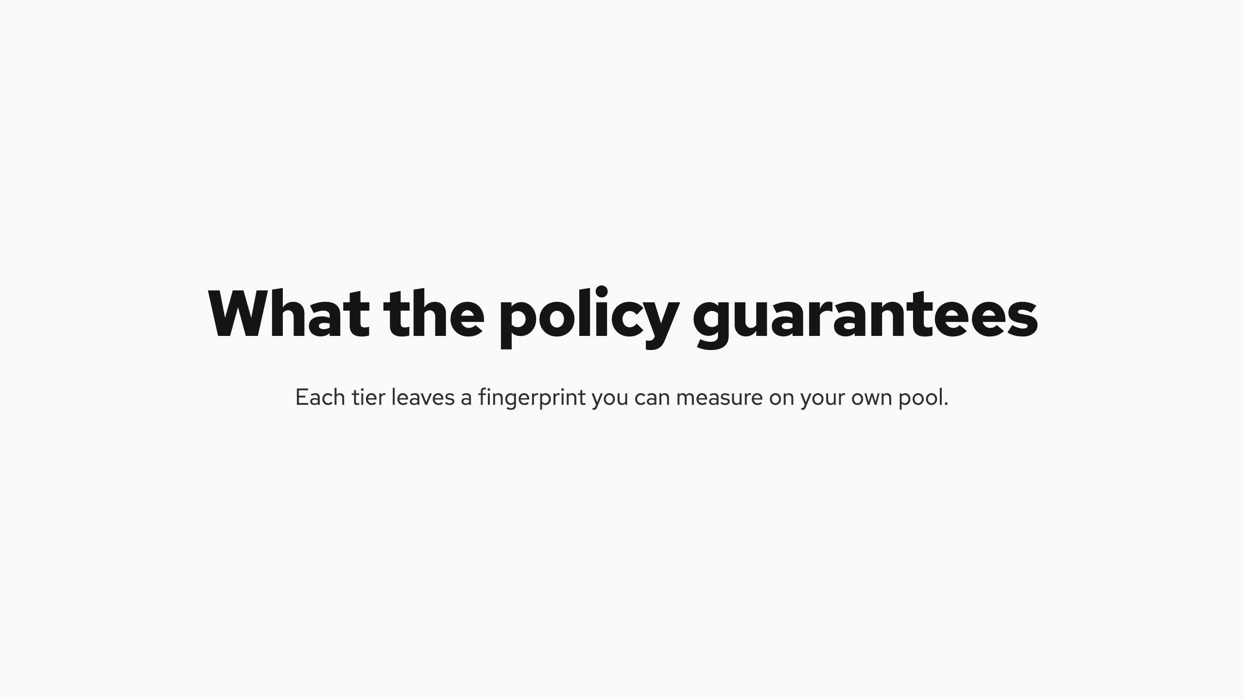
What the policy guarantees
Notes:
What the policy guarantees
Each tier leaves a fingerprint you can measure on your own pool.
Priority
A latency-sensitive class stays fast through a surge it did not cause. The lower class absorbs the queue.
Fairness
Tenants at equal load within a band are treated identically, without anyone tuning per-tenant rate limits.
Cost assignment
The tenant that creates the pressure carries the most queue time. The wait is assigned, not ambient.
Sheddable isolation
Batch traffic can dominate arrivals and still absorb the waiting instead of causing it, inside a bounded queue.
Absolute latencies always track your hardware, model, and tuning. The pattern is the guarantee. Targets hold while capacity lasts. Past capacity the policy, not arrival order, decides who waits.
Priority A latency-sensitive class stays fast through a surge it did not cause. The lower class absorbs the queue.
Fairness Tenants at equal load within a band are treated identically, without anyone tuning per-tenant rate limits.
Cost assignment The tenant that creates the pressure carries the most queue time. The wait is assigned, not ambient.
Sheddable isolation Batch traffic can dominate arrivals and still absorb the waiting instead of causing it, inside a bounded queue.
Absolute latencies always track your hardware, model, and tuning. The pattern is the guarantee. Targets hold while capacity lasts. Past capacity the policy, not arrival order, decides who waits.
Absolute latencies always track your hardware, model, and tuning.

Slide 23
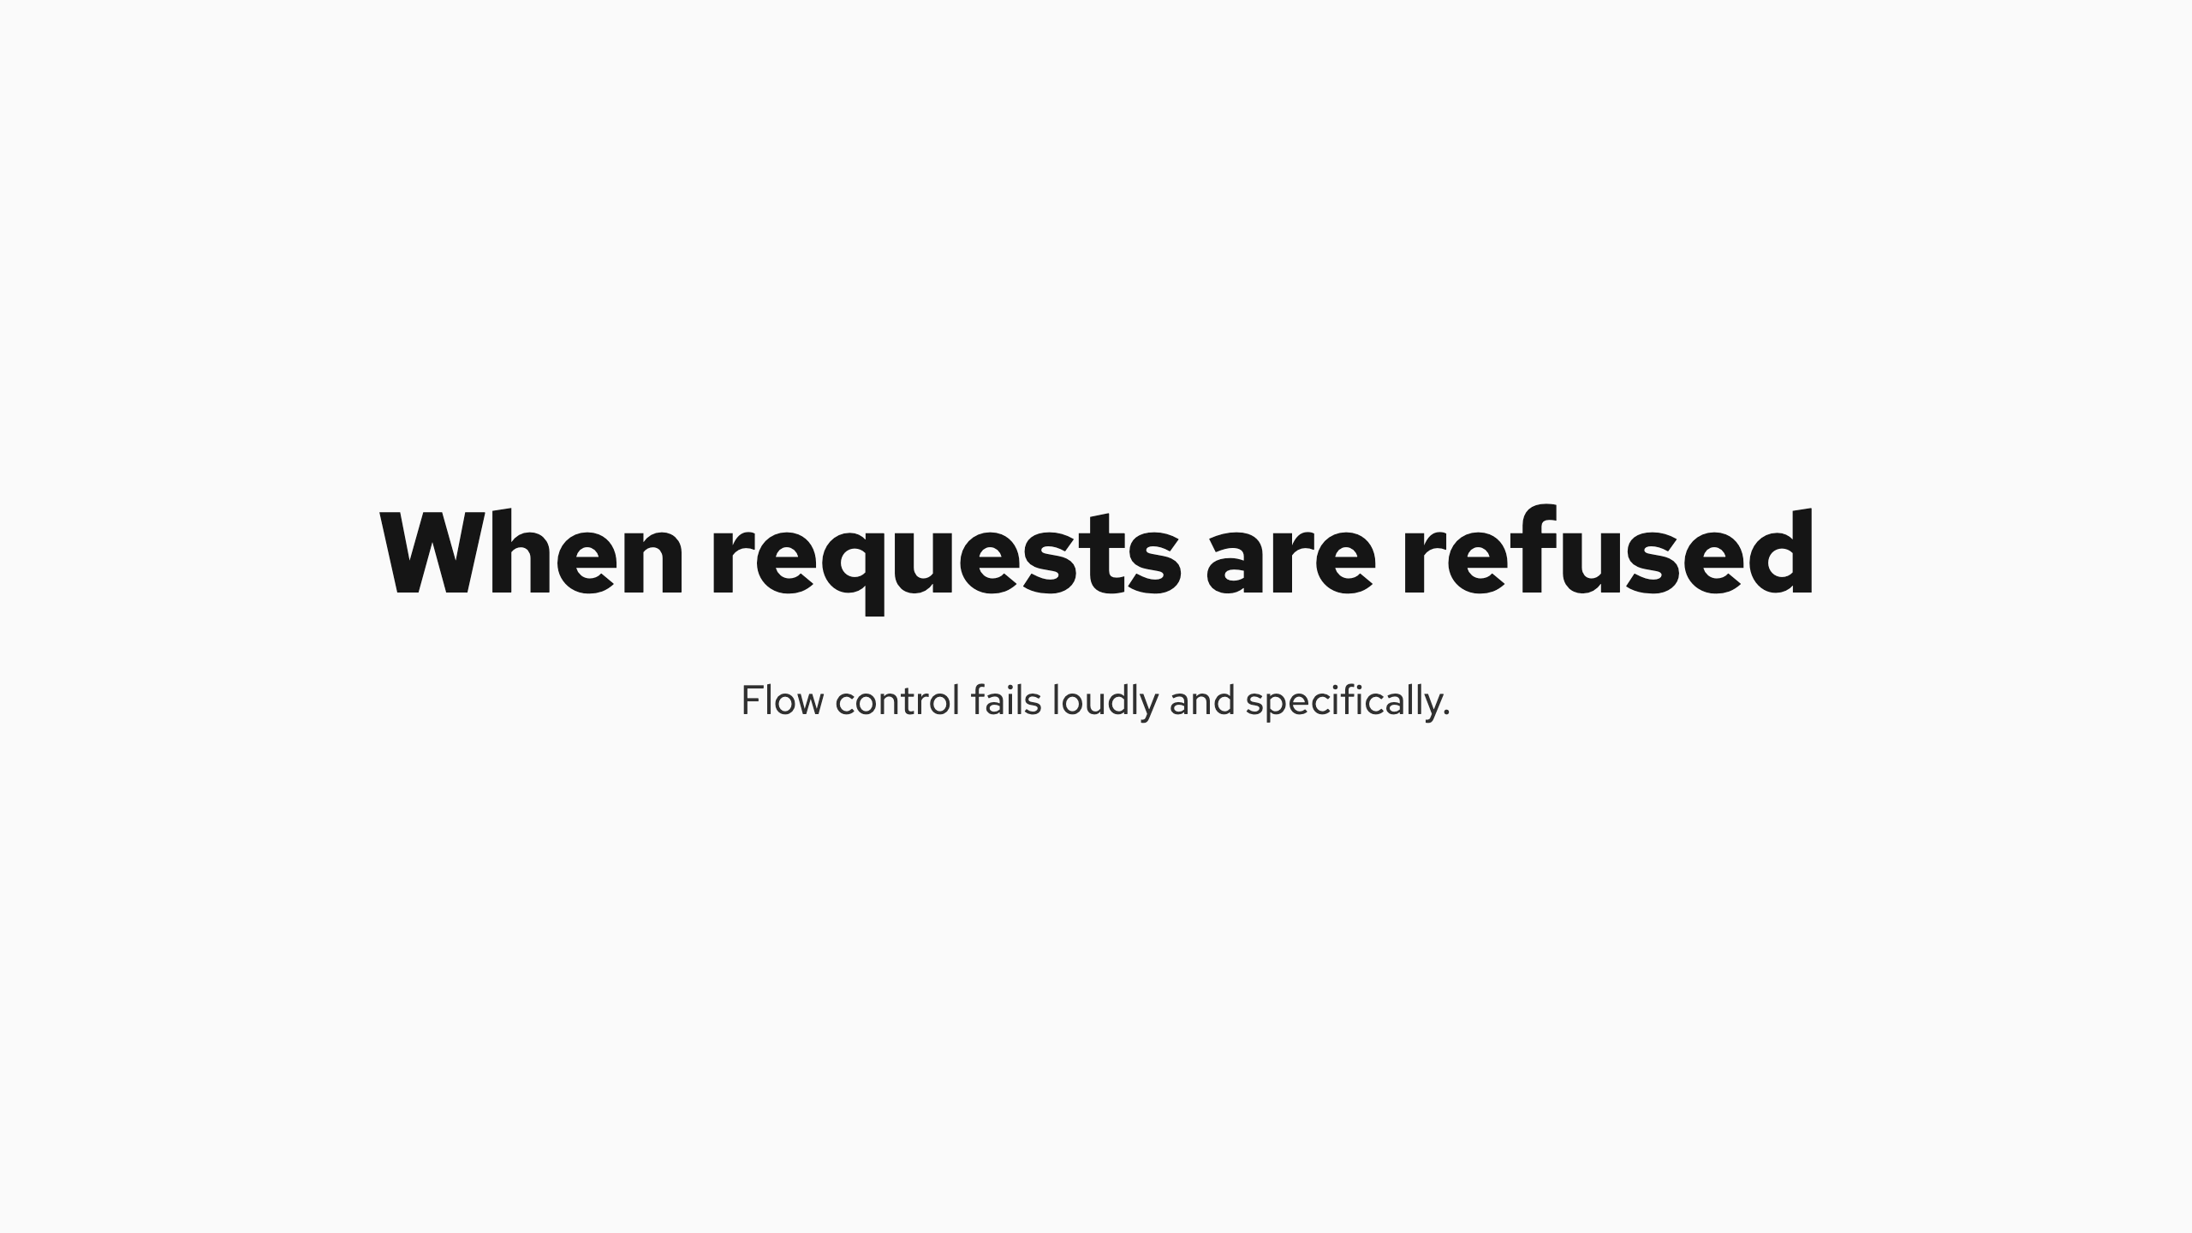
When requests are refused
Notes:
When requests are refused
Flow control fails loudly and specifically. Every refusal carries a reason on the wire in the x-llm-d-request-dropped-reason header.
Inside the Endpoint Picker, every request ends in one of six terminal outcomes. The wire table below is how those outcomes reach the client.
flowcontrol/types/outcomes.go · flowcontrol/eviction/request_evictor.go
What happened Status Reason on the wire
A band's queue limit was hit, controlled load shedding 429 rejected-saturated
A request waited past its TTL 503 rejected-ttl-expired
The client disconnected while queued 503 rejected-context-cancelled
Graceful shutdown drained the queue, retryable 503 rejected-shutting-down
Queues are in-memory. If the EPP itself dies, the default llm-d configuration fails open, Envoy routes directly to the servers, and requests keep flowing without protection until the EPP returns.
flowcontrol/types/outcomes.go · requestcontrol/admission.go
Inside the Endpoint Picker, every request ends in one of six terminal outcomes. The wire table below is how those outcomes reach the client.
flowcontrol/types/outcomes.go · flowcontrol/eviction/request_evictor.go
Queues are in-memory. If the EPP itself dies, the default llm-d configuration fails open, Envoy routes directly to the servers, and requests keep flowing without protection until the EPP returns.
flowcontrol/types/outcomes.go · requestcontrol/admission.go
Flow control fails loudly and specifically. Every refusal carries a reason on the wire in the x-llm-d-request-dropped-reason header.
Queues are in-memory.

Slide 24
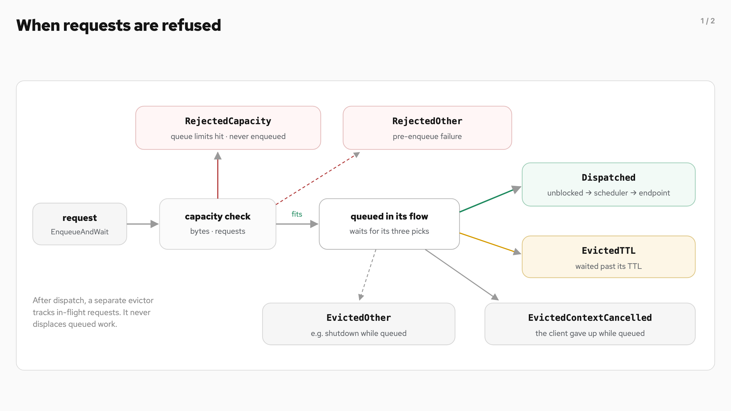
When requests are refused (1/2)
Notes:
When requests are refused
Flow control fails loudly and specifically. Every refusal carries a reason on the wire in the x-llm-d-request-dropped-reason header.
Inside the Endpoint Picker, every request ends in one of six terminal outcomes. The wire table below is how those outcomes reach the client.
flowcontrol/types/outcomes.go · flowcontrol/eviction/request_evictor.go
What happened Status Reason on the wire
A band's queue limit was hit, controlled load shedding 429 rejected-saturated
A request waited past its TTL 503 rejected-ttl-expired
The client disconnected while queued 503 rejected-context-cancelled
Graceful shutdown drained the queue, retryable 503 rejected-shutting-down
Queues are in-memory. If the EPP itself dies, the default llm-d configuration fails open, Envoy routes directly to the servers, and requests keep flowing without protection until the EPP returns.
flowcontrol/types/outcomes.go · requestcontrol/admission.go
Inside the Endpoint Picker, every request ends in one of six terminal outcomes. The wire table below is how those outcomes reach the client.
flowcontrol/types/outcomes.go · flowcontrol/eviction/request_evictor.go
Queues are in-memory. If the EPP itself dies, the default llm-d configuration fails open, Envoy routes directly to the servers, and requests keep flowing without protection until the EPP returns.
flowcontrol/types/outcomes.go · requestcontrol/admission.go
Flow control fails loudly and specifically. Every refusal carries a reason on the wire in the x-llm-d-request-dropped-reason header.
Queues are in-memory.

Slide 25
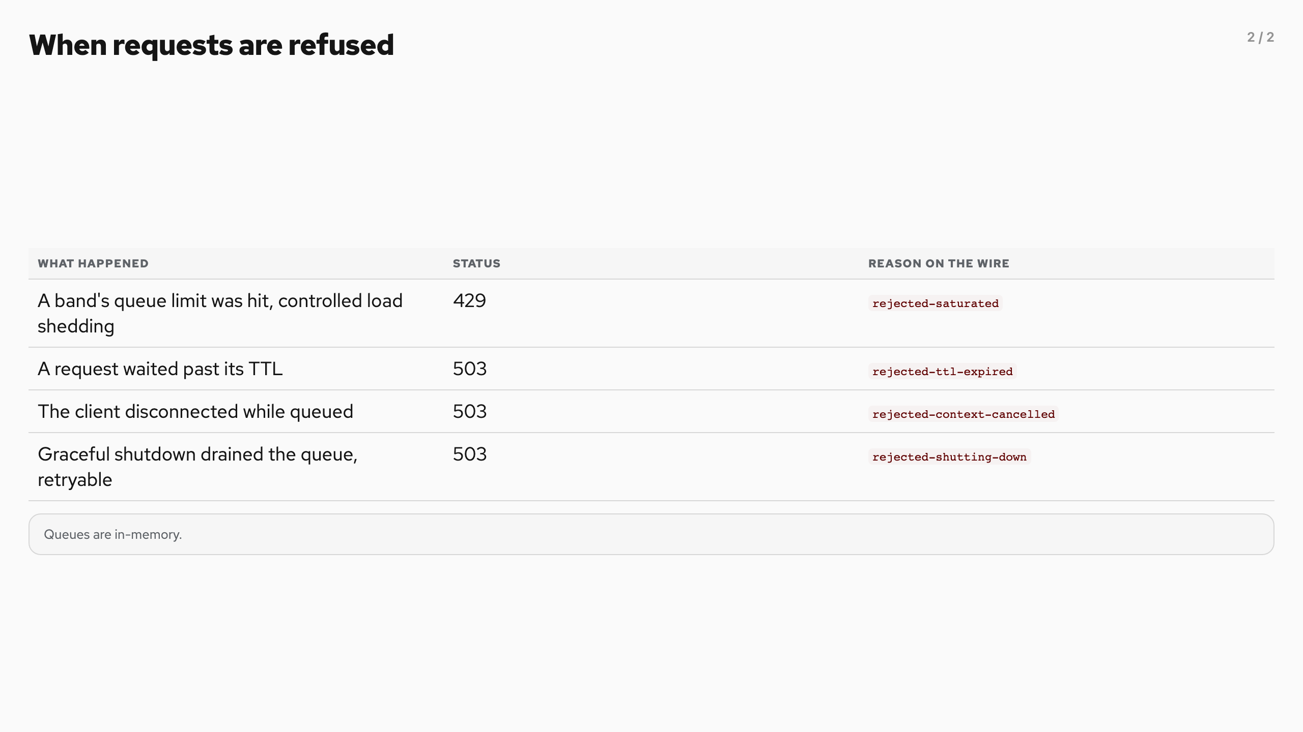
When requests are refused (2/2)
Notes:
When requests are refused
Flow control fails loudly and specifically. Every refusal carries a reason on the wire in the x-llm-d-request-dropped-reason header.
Inside the Endpoint Picker, every request ends in one of six terminal outcomes. The wire table below is how those outcomes reach the client.
flowcontrol/types/outcomes.go · flowcontrol/eviction/request_evictor.go
What happened Status Reason on the wire
A band's queue limit was hit, controlled load shedding 429 rejected-saturated
A request waited past its TTL 503 rejected-ttl-expired
The client disconnected while queued 503 rejected-context-cancelled
Graceful shutdown drained the queue, retryable 503 rejected-shutting-down
Queues are in-memory. If the EPP itself dies, the default llm-d configuration fails open, Envoy routes directly to the servers, and requests keep flowing without protection until the EPP returns.
flowcontrol/types/outcomes.go · requestcontrol/admission.go
Inside the Endpoint Picker, every request ends in one of six terminal outcomes. The wire table below is how those outcomes reach the client.
flowcontrol/types/outcomes.go · flowcontrol/eviction/request_evictor.go
Queues are in-memory. If the EPP itself dies, the default llm-d configuration fails open, Envoy routes directly to the servers, and requests keep flowing without protection until the EPP returns.
flowcontrol/types/outcomes.go · requestcontrol/admission.go
Flow control fails loudly and specifically. Every refusal carries a reason on the wire in the x-llm-d-request-dropped-reason header.
Queues are in-memory.

Slide 26
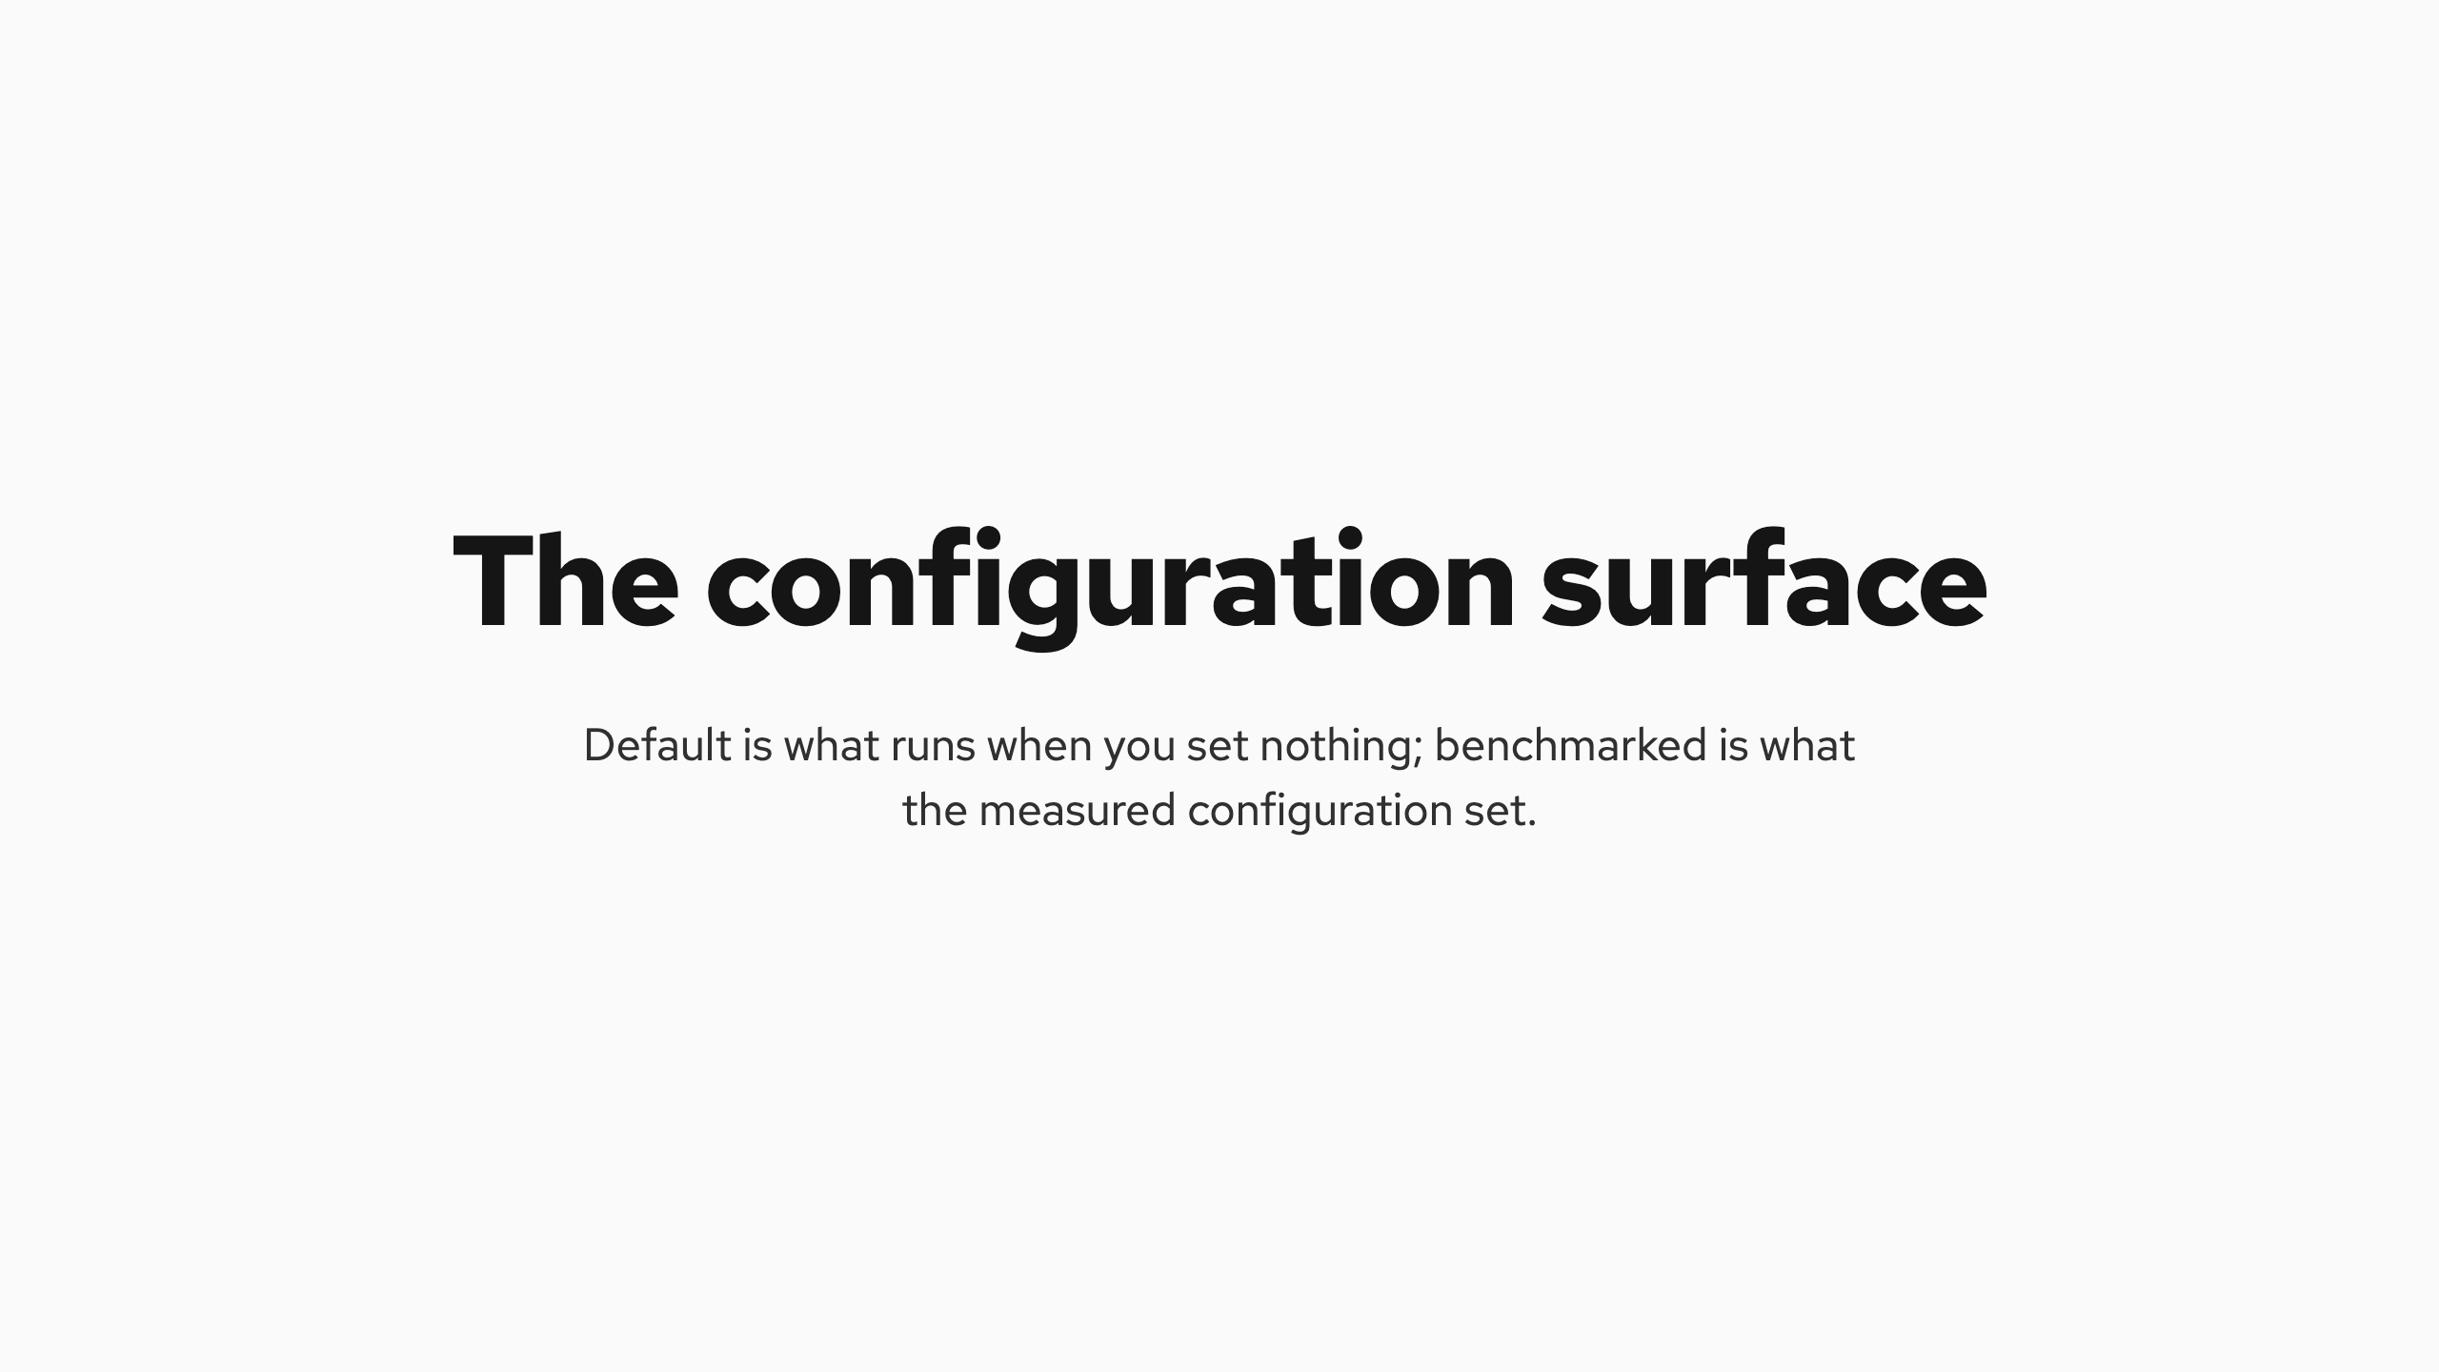
The configuration surface
Notes:
The configuration surface
Default is what runs when you set nothing; benchmarked is what the measured configuration set. The cap that actually binds is the per-band 1 GB, never the 10 GiB global.
Setting Default Benchmarked
priorityBands[].priority — 100 / 0 / −10
fairnessPolicyRef (per band) global-strict round-robin
orderingPolicyRef (per band) fcfs fcfs
maxBytes (per band) 1 GB each — the cap that binds unset → 1 GB × 3 bands
maxBytes (global) — 10 GiB · never binds
maxRequests unlimited unset
defaultRequestTTL 0 · client context only 60s
expiryCleanupInterval 1s 1s
saturationDetector.queueDepthThreshold — 4
saturationDetector.kvCacheUtilThreshold — 0.80
usageLimitPolicy threshold 1.0 · no gating 1.0
flowGCTimeout · priorityBandGCTimeout idle flows and bands collected defaults
flowcontrol/controller/config.go · flowcontrol/registry/config.go
flowcontrol/controller/config.go · flowcontrol/registry/config.go
Default is what runs when you set nothing; benchmarked is what the measured configuration set. The cap that actually binds is the per-band 1 GB, never the 10 GiB global.

Slide 27
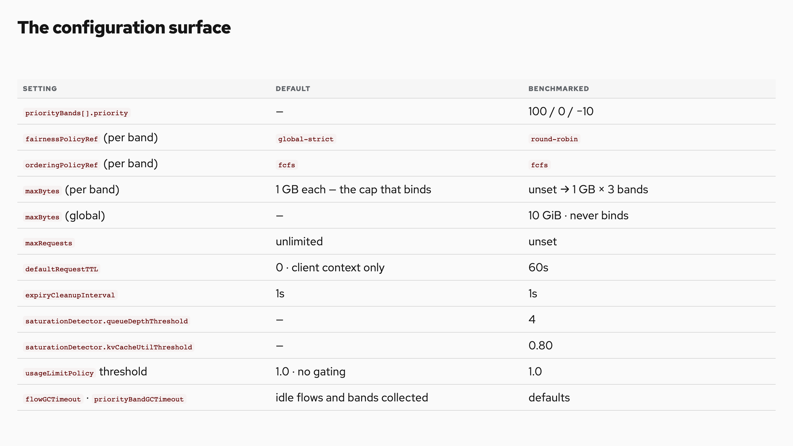
The configuration surface
Notes:
The configuration surface
Default is what runs when you set nothing; benchmarked is what the measured configuration set. The cap that actually binds is the per-band 1 GB, never the 10 GiB global.
Setting Default Benchmarked
priorityBands[].priority — 100 / 0 / −10
fairnessPolicyRef (per band) global-strict round-robin
orderingPolicyRef (per band) fcfs fcfs
maxBytes (per band) 1 GB each — the cap that binds unset → 1 GB × 3 bands
maxBytes (global) — 10 GiB · never binds
maxRequests unlimited unset
defaultRequestTTL 0 · client context only 60s
expiryCleanupInterval 1s 1s
saturationDetector.queueDepthThreshold — 4
saturationDetector.kvCacheUtilThreshold — 0.80
usageLimitPolicy threshold 1.0 · no gating 1.0
flowGCTimeout · priorityBandGCTimeout idle flows and bands collected defaults
flowcontrol/controller/config.go · flowcontrol/registry/config.go
flowcontrol/controller/config.go · flowcontrol/registry/config.go
Default is what runs when you set nothing; benchmarked is what the measured configuration set. The cap that actually binds is the per-band 1 GB, never the 10 GiB global.

Slide 28

Choosing knobs together
Notes:
Choosing knobs together
No knob acts alone. You choose a posture, and the posture implies the stack.
Multi-tenant isolation · benchmarked
bands round-robin + fcfs
detector utilization · 4 / 0.80
queue TTL 60s · ~1 GB per band
Buys per-tenant turns in every band, floods absorbed with zero rejections.
Costs no latency help among equals; memory held while work waits.
SLO-driven interactive
bands global-strict + slodeadline
detector concurrency · maxConcurrency
queue short TTL
Buys the only in-flight cap — the latency lever — plus per-request time-to-first-token targets from headers.
Costs throughput sacrificed to the cap; clients must set the SLO header.
Batch-heavy consolidation
bands per-band maxBytes / maxRequests
detector utilization
queue long TTL on the batch band
Buys a bounded appetite — batch cannot eat the shared queue budget.
Costs the capped band rejects earlier, by design.
Max throughput, minimum machinery
bands global-strict + fcfs · defaults
detector utilization · defaults
ceiling usage-limit 1.0 · no gating
Buys strict arrival order at the lowest overhead.
Costs a burster wins share by volume; no isolation anywhere.
Policies compose per band — a premium band can run slodeadline while batch runs fcfs . A usage-limit threshold below 1.0 reserves headroom in any posture.
Policies compose per band — a premium band can run slodeadline while batch runs fcfs . A usage-limit threshold below 1.0 reserves headroom in any posture.
No knob acts alone. You choose a posture, and the posture implies the stack.

Slide 29
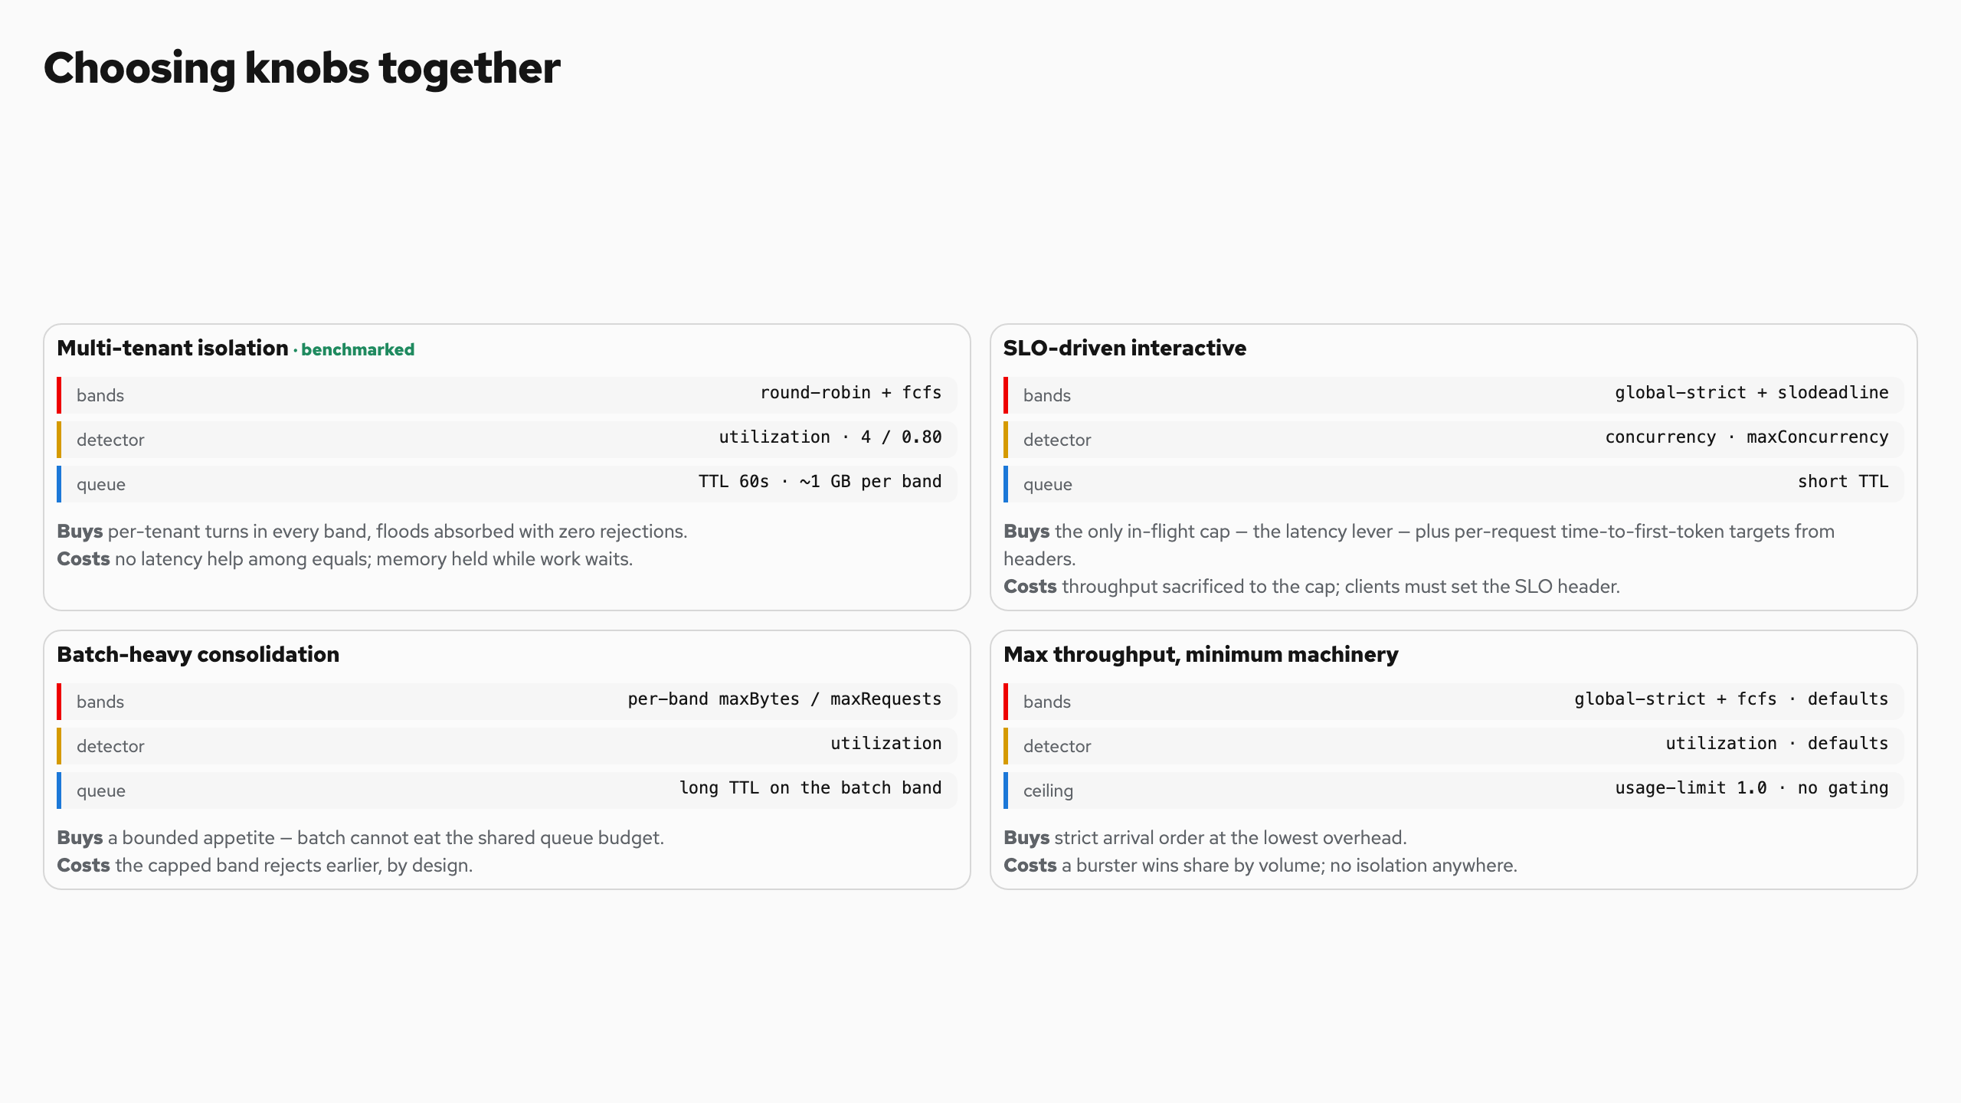
Choosing knobs together
Notes:
Choosing knobs together
No knob acts alone. You choose a posture, and the posture implies the stack.
Multi-tenant isolation · benchmarked
bands round-robin + fcfs
detector utilization · 4 / 0.80
queue TTL 60s · ~1 GB per band
Buys per-tenant turns in every band, floods absorbed with zero rejections.
Costs no latency help among equals; memory held while work waits.
SLO-driven interactive
bands global-strict + slodeadline
detector concurrency · maxConcurrency
queue short TTL
Buys the only in-flight cap — the latency lever — plus per-request time-to-first-token targets from headers.
Costs throughput sacrificed to the cap; clients must set the SLO header.
Batch-heavy consolidation
bands per-band maxBytes / maxRequests
detector utilization
queue long TTL on the batch band
Buys a bounded appetite — batch cannot eat the shared queue budget.
Costs the capped band rejects earlier, by design.
Max throughput, minimum machinery
bands global-strict + fcfs · defaults
detector utilization · defaults
ceiling usage-limit 1.0 · no gating
Buys strict arrival order at the lowest overhead.
Costs a burster wins share by volume; no isolation anywhere.
Policies compose per band — a premium band can run slodeadline while batch runs fcfs . A usage-limit threshold below 1.0 reserves headroom in any posture.
Policies compose per band — a premium band can run slodeadline while batch runs fcfs . A usage-limit threshold below 1.0 reserves headroom in any posture.
No knob acts alone. You choose a posture, and the posture implies the stack.

Slide 30
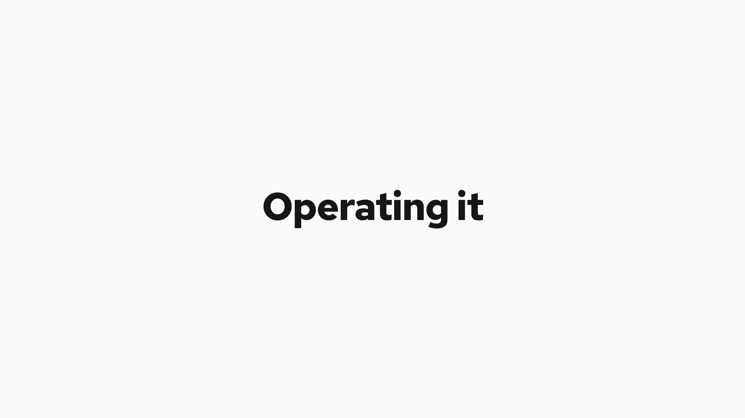
Operating it
Notes:
Operating it
The knobs that matter
Band priorities in InferenceObjective map business tiers to dispatch order. Per-band limits bound how much low-priority work can queue.
Request TTL caps how stale queued work can get.
The saturation detector's threshold sets the healthy buffer, deep enough that batching never starves, shallow enough that the queue stays where policy lives. It is a trigger, not a queue cap.
What to watch
pool_saturation is the detector's gradient; dispatch halts when it reaches the ceiling.
queue_size per tenant and band tells you who is waiting and how much. The same depth is a true-demand signal an autoscaler can act on.
Proving it is on
Two metric checks make the queueing visible. Anything less measures light load.
Check Where Pass when
Priority routing Endpoint Picker /metrics queue_duration with priority="100" is present, so premium requests really carry their band
Queues active vLLM pod /metrics num_requests_running sits at the cap and num_requests_waiting is above zero
metrics/metrics.go · flowcontrol/controller/internal/processor.go
One sweep per hardware and model pair finds the knee, the point where queueing begins. Size latency-sensitive pools below it, and let flow control govern everything that arrives past it.
That is the whole operating model. Know your envelope, place your operating point, and let the policy own the overflow.
Proving it is on
Two metric checks make the queueing visible. Anything less measures light load.
metrics/metrics.go · flowcontrol/controller/internal/processor.go
One sweep per hardware and model pair finds the knee, the point where queueing begins. Size latency-sensitive pools below it, and let flow control govern everything that arrives past it.
That is the whole operating model. Know your envelope, place your operating point, and let the policy own the overflow.

Slide 31
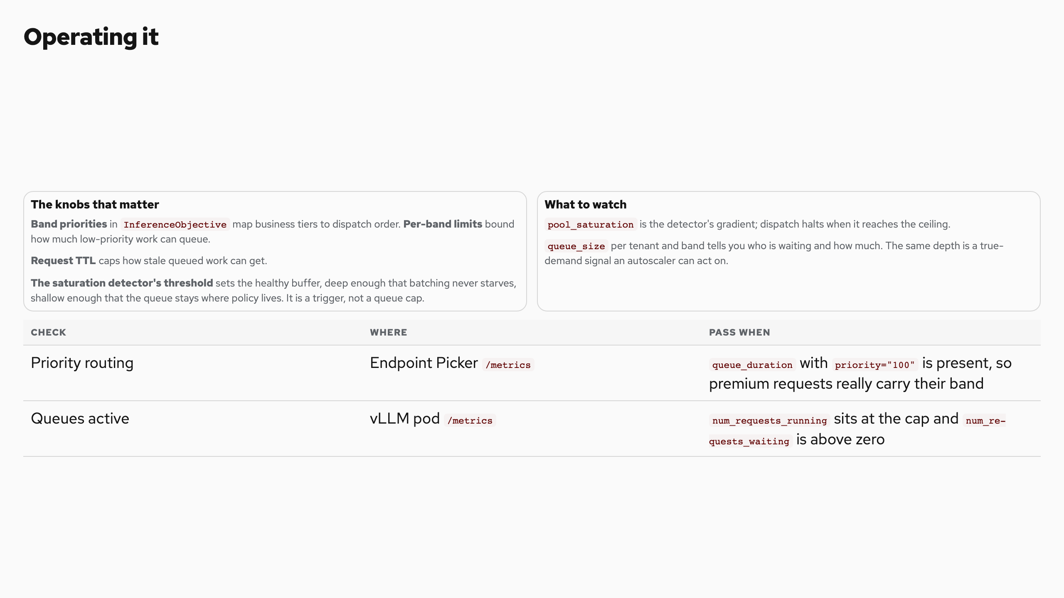
Operating it
Notes:
Operating it
The knobs that matter
Band priorities in InferenceObjective map business tiers to dispatch order. Per-band limits bound how much low-priority work can queue.
Request TTL caps how stale queued work can get.
The saturation detector's threshold sets the healthy buffer, deep enough that batching never starves, shallow enough that the queue stays where policy lives. It is a trigger, not a queue cap.
What to watch
pool_saturation is the detector's gradient; dispatch halts when it reaches the ceiling.
queue_size per tenant and band tells you who is waiting and how much. The same depth is a true-demand signal an autoscaler can act on.
Proving it is on
Two metric checks make the queueing visible. Anything less measures light load.
Check Where Pass when
Priority routing Endpoint Picker /metrics queue_duration with priority="100" is present, so premium requests really carry their band
Queues active vLLM pod /metrics num_requests_running sits at the cap and num_requests_waiting is above zero
metrics/metrics.go · flowcontrol/controller/internal/processor.go
One sweep per hardware and model pair finds the knee, the point where queueing begins. Size latency-sensitive pools below it, and let flow control govern everything that arrives past it.
That is the whole operating model. Know your envelope, place your operating point, and let the policy own the overflow.
Proving it is on
Two metric checks make the queueing visible. Anything less measures light load.
metrics/metrics.go · flowcontrol/controller/internal/processor.go
One sweep per hardware and model pair finds the knee, the point where queueing begins. Size latency-sensitive pools below it, and let flow control govern everything that arrives past it.
That is the whole operating model. Know your envelope, place your operating point, and let the policy own the overflow.

