Slide 1
Validation Methodology
Main and only metric for forecasting validation is MAPE (Mean Absolute Percentage Error). MAPE is calculated as
MAPE = abs(Forecast – Actual)/Actual
Validation is done on Holdout samples, meaning that the model do not see the future;
Performance window is 6 months ahead. Observation period is from January’15 to October’15:
MAPE benchmark is 5% cum. 6 months

Slide 2
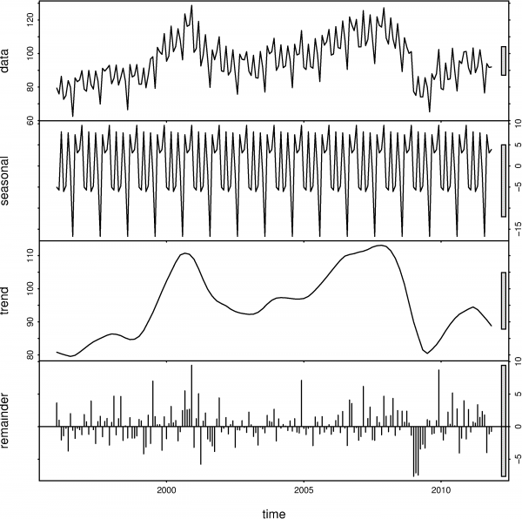
Forecasting Methodology
AVG Delinquent accounts are forecasted based on net flows forecast;
Forecasting model is STL (Seasonal and Trend decomposition using Loess);
This is auto regression model and do not occupies external regressors;
The model decomposes time series into trend, seasonal and reminder part as shown on the example to the right:
The model has several advantages over ARIMA like controlled seasonal and trend cycle. Alts it is easer in development then multiple regression.

Slide 3
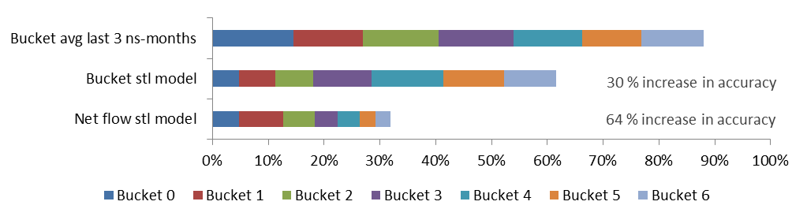
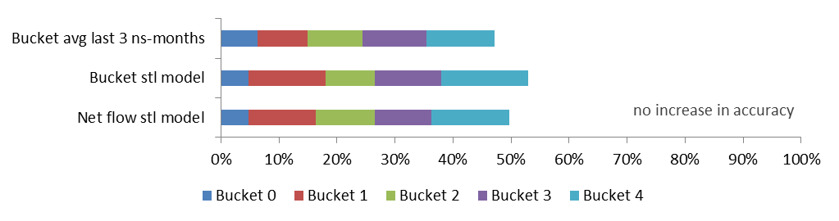
Validation Results – MAPE @ 6
CC
PIL
For CC the model demonstrated noticeable increase in accuracy
For PIL the model do not
show any increase in accuracy
due to the trend which has changed during validation
The model works perfectly with stable trend while do not show any increase in accuracy in changing environment

Slide 4
Forecasting Results – May’16 outlook
Model Output
R Script

