Slide 1


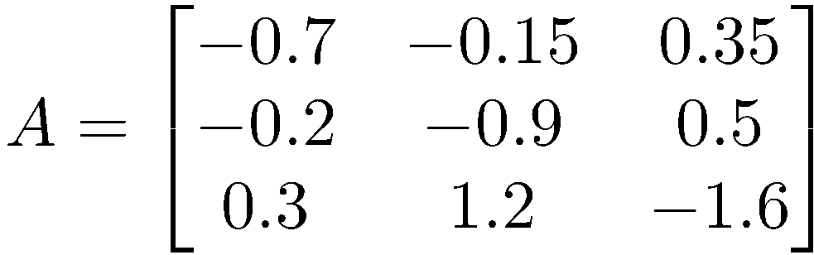
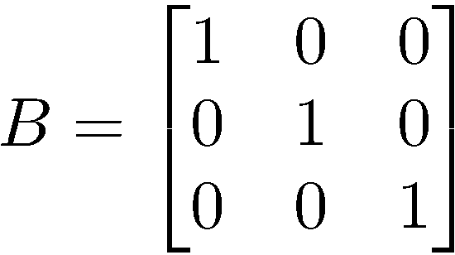
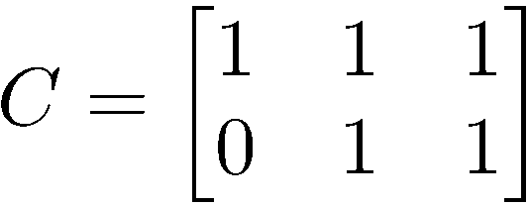
Random Linear System
This continuous system is stable
The data are generated based on the discretization of this continuous system

Slide 2
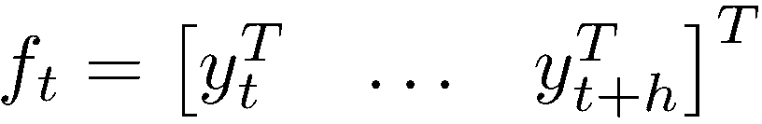
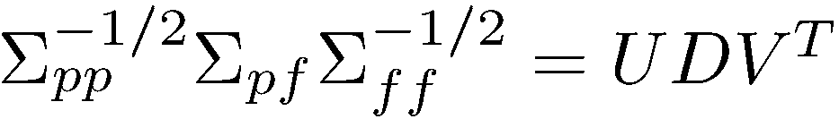
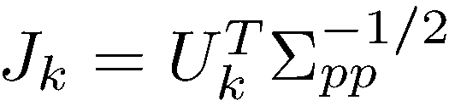

Subspace Identification (CVA)
Past data
Future data
Singular value decomposition
Assume the dimension of the state is k, first k columns of U is employed to calculate J
Estimate the state

Slide 3
State Estimation

Slide 4
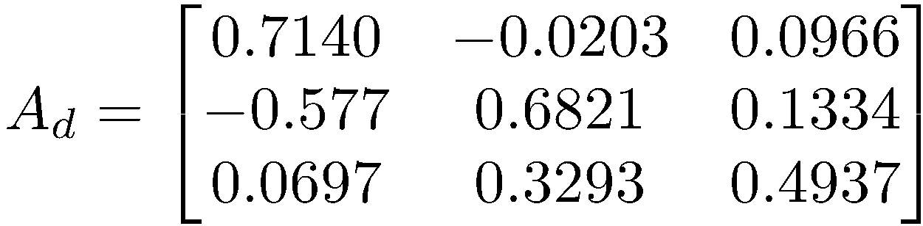
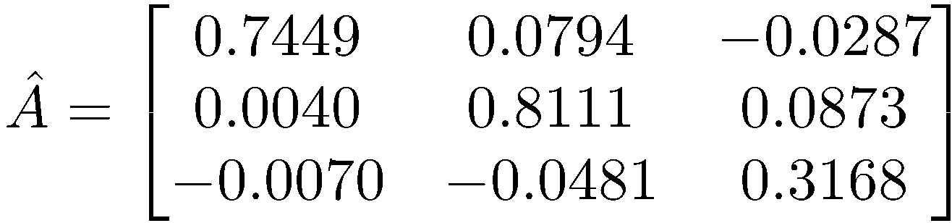
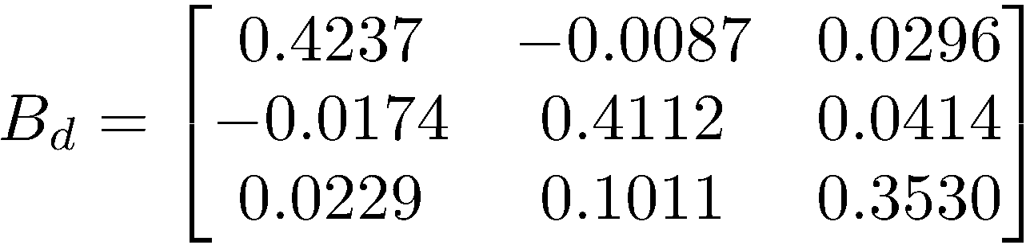
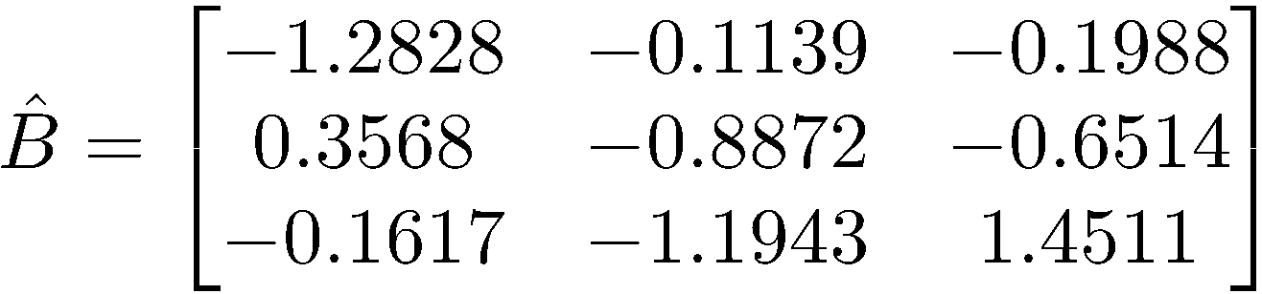
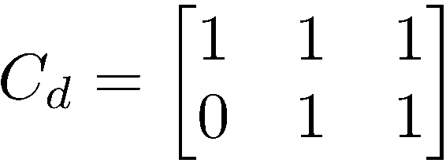
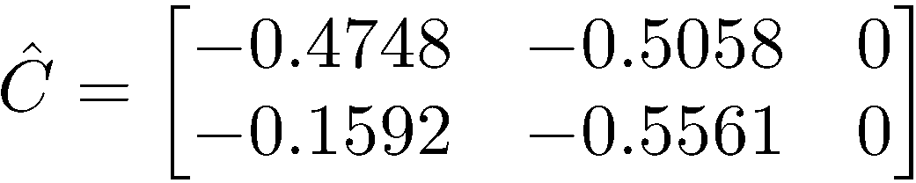
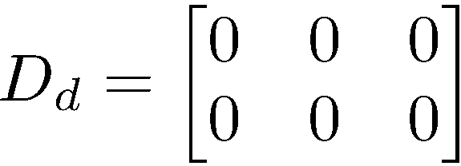
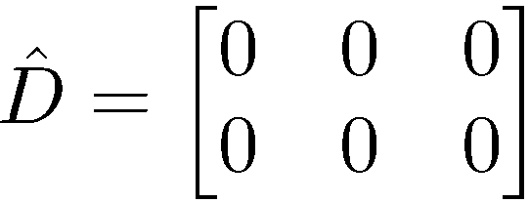
System Identification

Slide 5
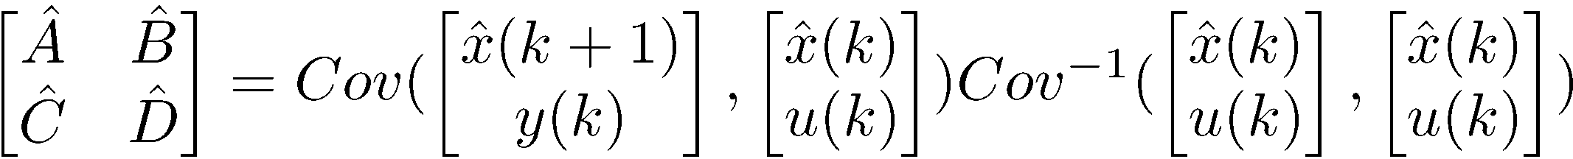
System Identification
The eigenvalues for the continuous are [-2.19, -0.52, -0.49]
The eigenvalues for the discrete system are [0.78, 0.77, 0.33]
The eigenvalues for the identified discrete system are [0.8, 0.74, 0.32]

Slide 6
Measurement Prediction
R2=1

Slide 7
Measurement Prediction
R2=1

Slide 8
Non-stationary Input

Slide 9
State Estimation

Slide 10
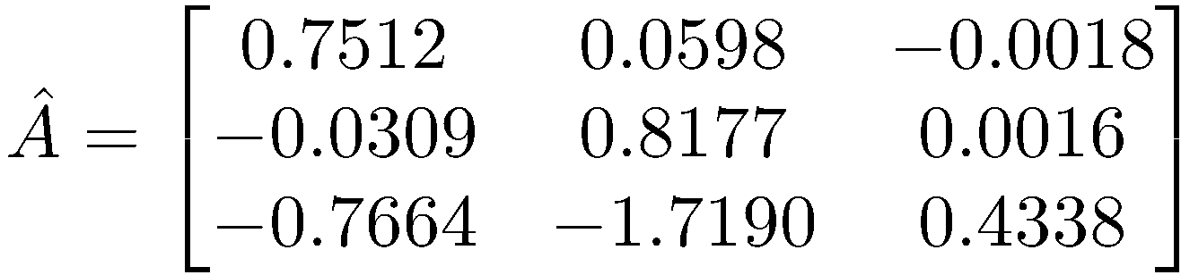
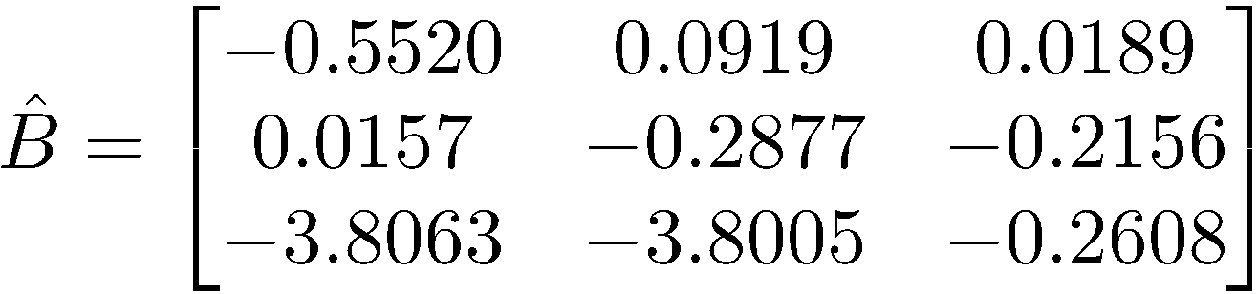
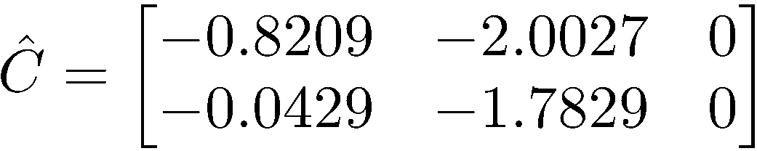
System Identification

Slide 11
Measurement Prediction

Slide 12
Comparison of Identified Systems
Stationary Inputs
Non-stationary Inputs

Slide 13
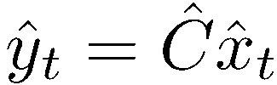
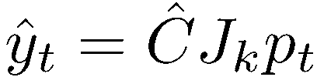

Least Squares Solution
Past data
Estimate the state by using the canonical loading

