Slide 1
Random Linear System
Brandon developed a random linear system and distributed it to us
We use this bench mark system to generate data an do system identifications
The focus is on the linear system with non-stationary inputs

Slide 2
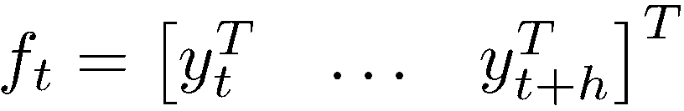
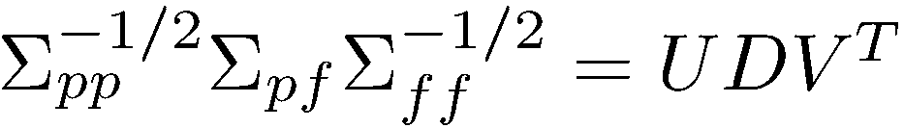
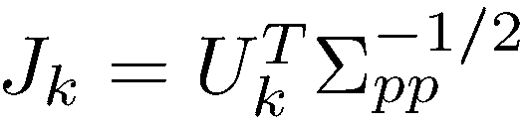

Subspace Identification (CVA)
Past data
Future data
Singular value decomposition
Assume the dimension of the state is k, first k columns of U is employed to calculate J
Estimate the state

Slide 3
Simulated Data
Input: random walk with PRBS signals

Slide 4
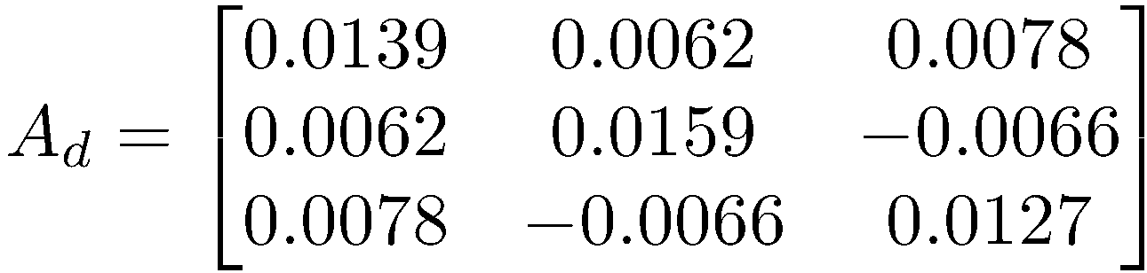
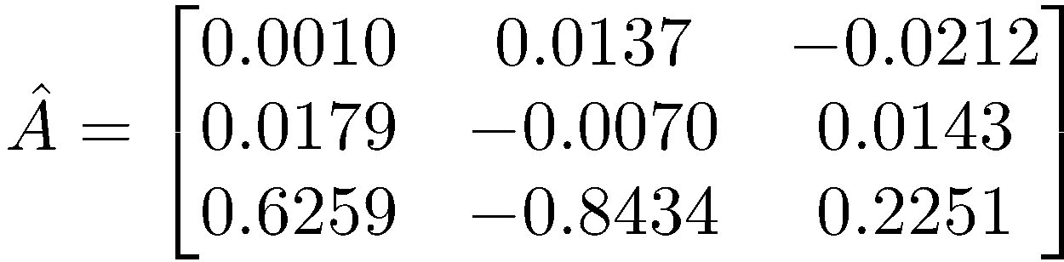
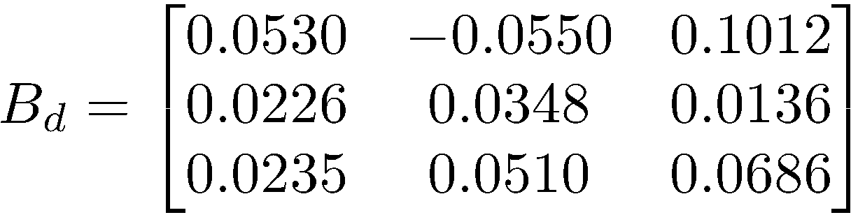
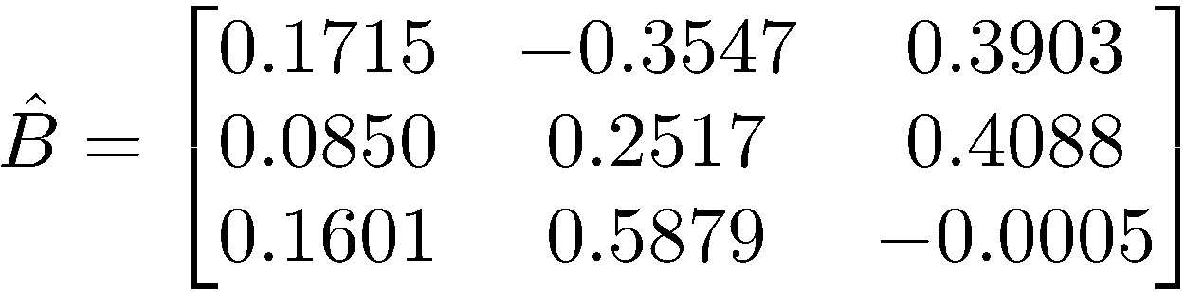
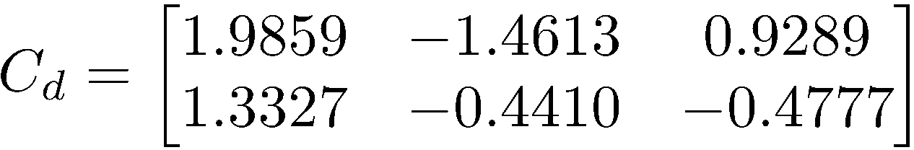
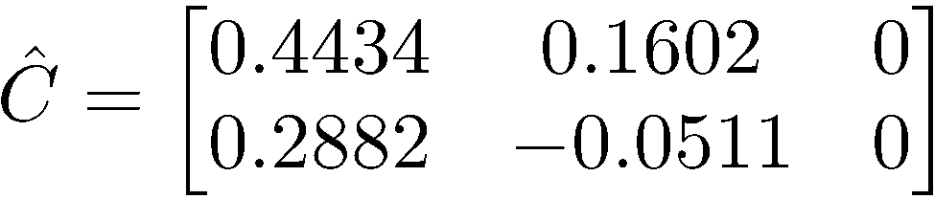
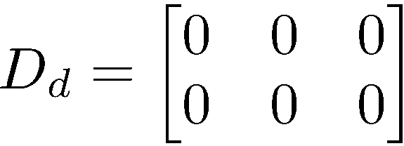
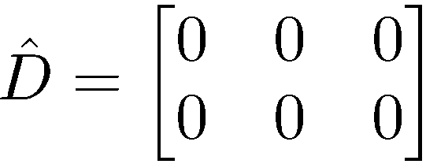
System Identification

Slide 5
State Estimation

Slide 6
Measurement Prediction
R2=1
R2=1

Slide 7
Penicillin Process
Penicillin process is a nonlinear process with 7 states, 6 outputs and 3 inputs
The control input is not stationary
The focus is on a linear system to approximate the Penicillin process

Slide 8
Measurement Prediction
R2=0.9959
R2=0.9992
R2=0.9996
R2=0.9999
R2=0.9999
R2=0.9999

Slide 9
How to handle the ill-conditioned covariance matrix
In chemical processes, the outputs can be linear correlated to each other, leading a ill-conditioned covariance of past and/or future data
If the covariance is ill-conditioned, the SVD can not be performed correctly
It seems that this problem is not discussed in the literature
I encountered this problem in identifying the Penicillin process and some simulated processes
Currently, I handle this problem by finding the nearest positive definite matrix for the ill-conditioned covariance (Higham, 1988)

Slide 10

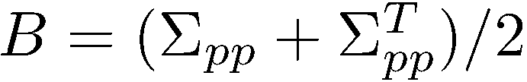



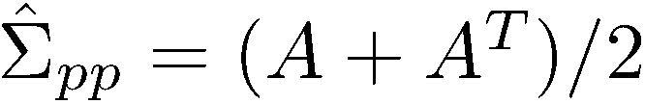
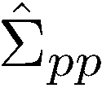
Nearest Positive Definite Matrix
If is not positive definite
is positive definite

