Slide 1


Development of an inter-satellite network for space debris evasion
Alexander Popov
Peter the Great St. Petersburg Polytechnic University

Slide 2

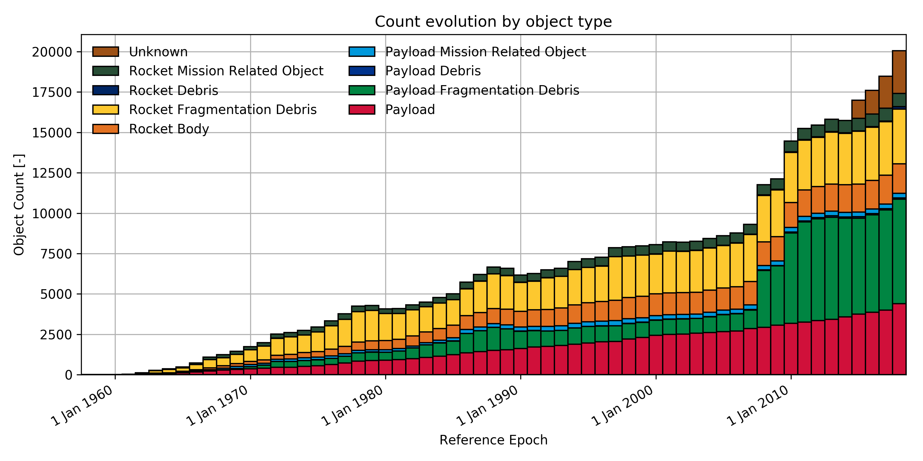
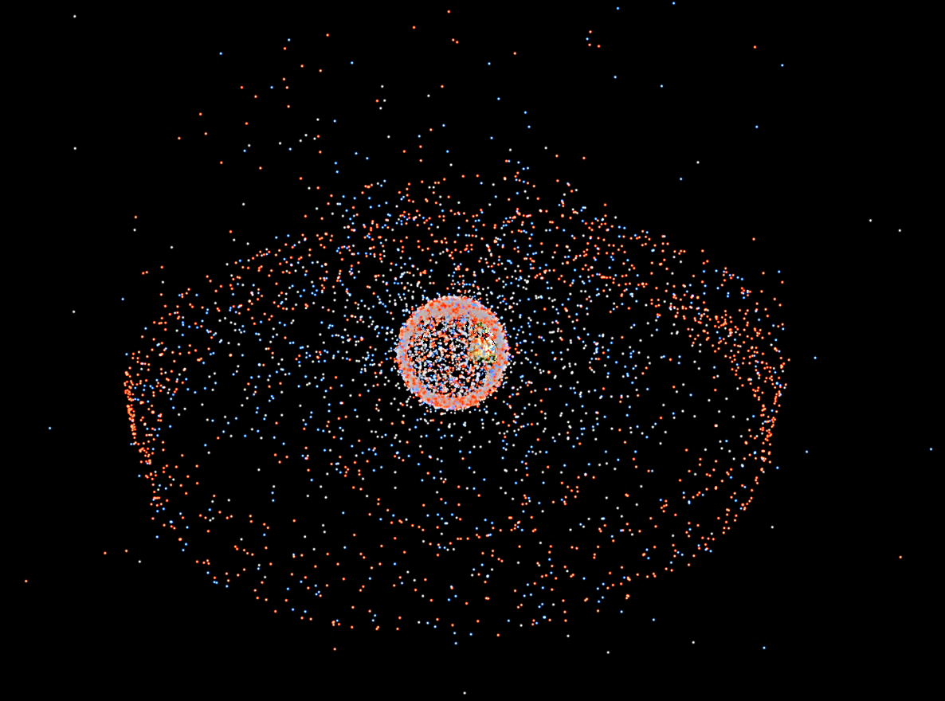
Research relevance
The Kessler syndrome is a theoretical scenario describing the evolution of events in near-Earth orbit, in which space debris generated by numerous artificial satellite launches leads to the complete unsuitability of near-Earth space for practical use.
Space debris

Slide 3
Purpose and tasks
Purpose: develop an autonomous system for space debris mitigation based on an inter-satellite network.
.
Tasks:
To analyze existing solutions and define the requirements for a new protection system.
To identify the optimal approach for space debris mitigation.
To justify the network topology and select a suitable communication technology.
To simulate network operation under various scenarios.

Slide 4
Concept
Functional diagram of the system
1 – Satellite with onboard radar
2 – Space debris
3 – CubeSat connected to a mesh network
4 – Endangered satellite
Visualization of simulation
”Purple” path is optimal for pair of nodes with biggest distance.
“Red” path has the worst time delay between any of satellites in the network

Slide 5
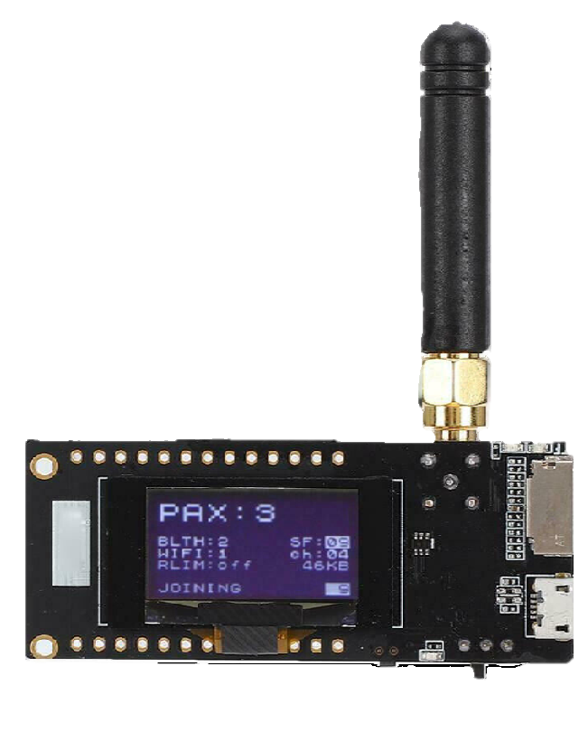
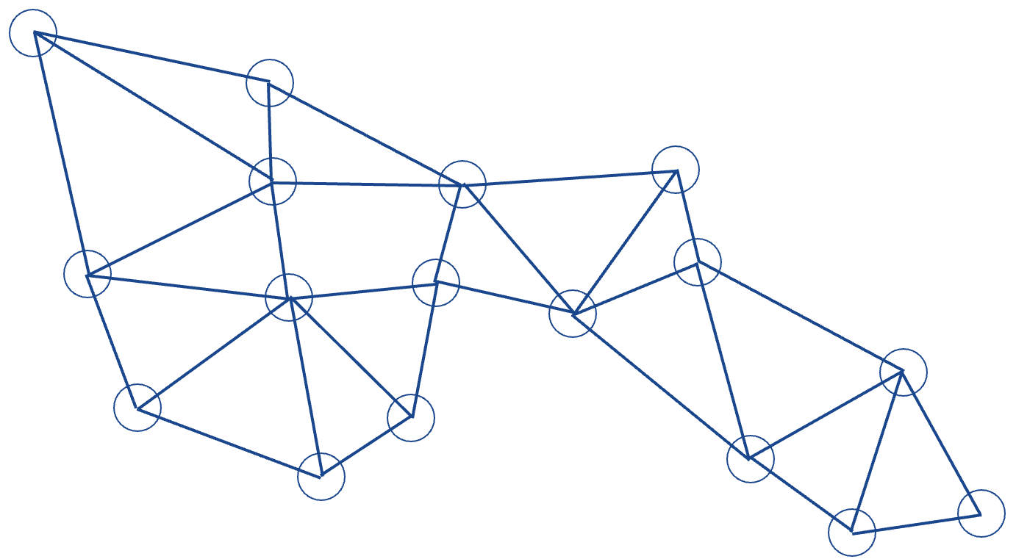
Table 1. Specifications of ttgo LoRa 32 platform
Specification | discription
Chip | SX1276
Carrier | 868/915 MHz
Maximal power | +20 dBm
Sensitivity | -136 dBm (125 kHz, SF=12, 293 bps)
Data rate | from 0.018 to 37,5 kbps
Mesh topology

Slide 6

Table 3. intersatellite channels BER calculation
Results
Channel | BER
30 - 31 | 6.8143e-02
31 – 11 | 6.7670e-05
11 – 12 | 2.8415e-02
12 – 13 | 2.8415e-02
13 – 14 | 2.8415e-02
14 – 35 | 2.1785e-04
35 – 36 | 6.8143e-02
36 – 16 | 6.7670e-05
16 – 17 | 2.8415e-02
17 – 38 | 2.1785e-04
38 - 18 | 6.7670e-05
18 – 39 | 2.1785e-04
39 – 19 | 6.7670e-05
19 - 40 | 2.1785e-04
BER $=A∙exp\left(−\frac{B∙{(SNR}_{real}−{SNR}_{treshold})}{R}\right)$
Table 2. Comparison of qualitative data transmission characteristics for two routes
Parameter | «Purple» path | «red» path
Length, km | 15256 | 14548
Total packet delivery time, s | 21.430 | 22.941
Time delay, s | 0.080 | 0.081
Average SNR, dB | -14.53 | -14.22
Relative data rate | 11.20 | 10.46

Slide 7
Conclusion
An analysis of existing space debris evasion systems was conducted, and their disadvantages were identified.
An optimal protection method for the proposed system was selected.
A model for evaluating the performance of an inter-satellite data transmission network was developed.
The simulation results indicate that this solution can be used for transmitting small volumes of service data.
Further directions for the development of the proposed system were defined.

Slide 8
Development of an inter-satellite network for space debris evasion
Thanks for your attention

