Slide 1
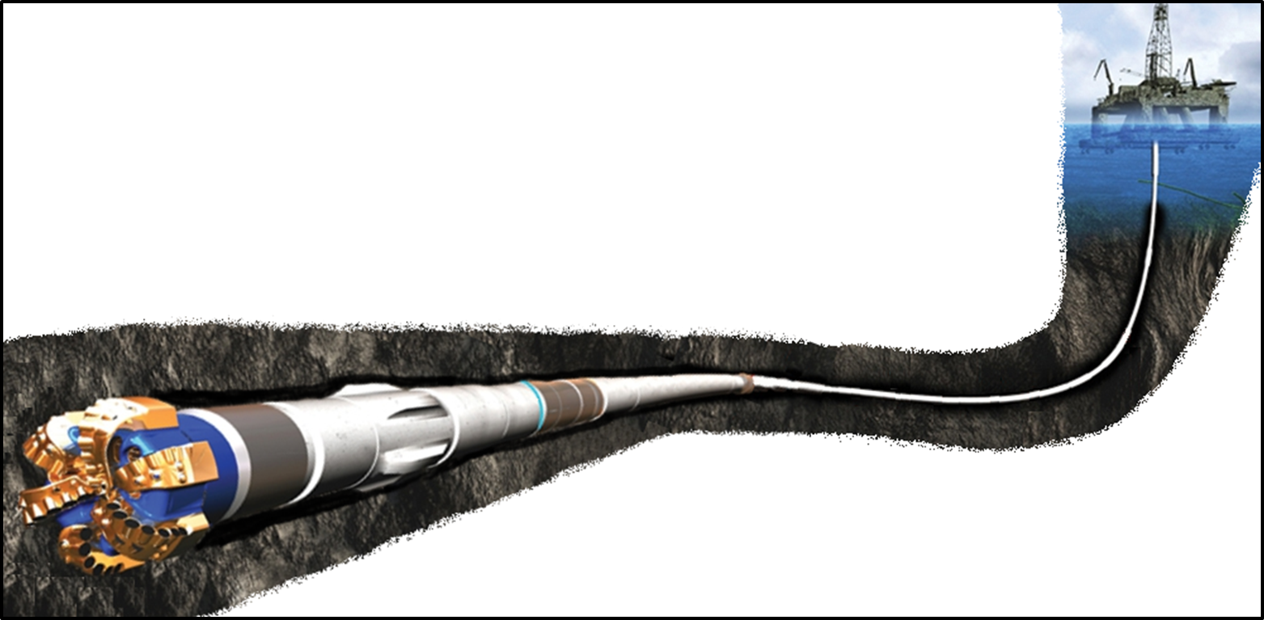
Real drilling process
1D RT/ mechanistic/ phenomenologic models
Prediction & Validation
Wellbore scale
Improvement
1D RT/ mechanistic/ phenomenologic models
Experimental laboratory models
Prediction & Validation
Improvement
3D CFD models
Prediction & Validation
Annular scale

