Slide 1
311 Call Data Analysis
Jason Cheves, David Edison, Dan Fisher, Ahmed Raza, Saagar Sarin, Jason Walston
Notes:
“Saahhgur”

Slide 2
Problem Statement
“We’re increasing requests every month, but an operator can only handle so many calls a day, I’m trying to push as much mobile as we can.”
- Jeanne Holm
Los Angeles Deputy Chief Information Officer
Source: Citydata.com, 11/18/2016
Notes:
Jason C (genie)

Slide 3
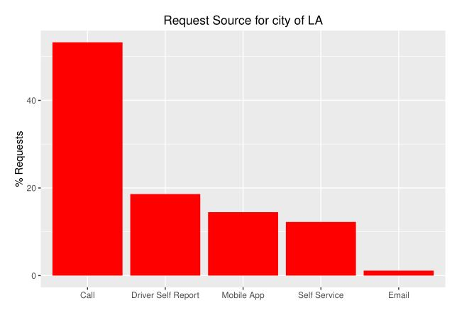
Preliminary Analysis

Slide 4
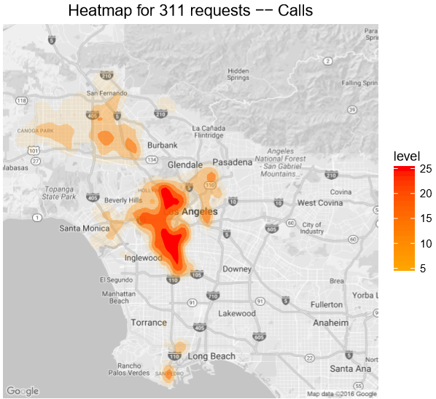
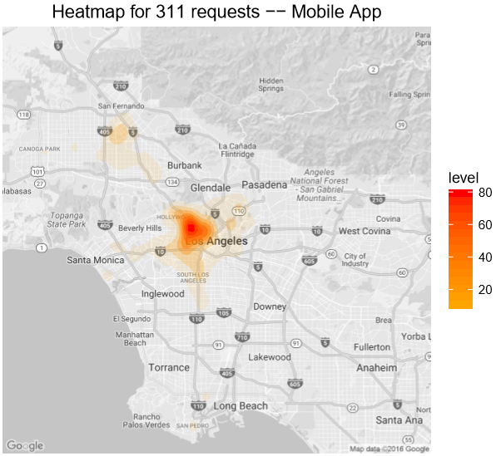
Preliminary Analysis

Slide 5
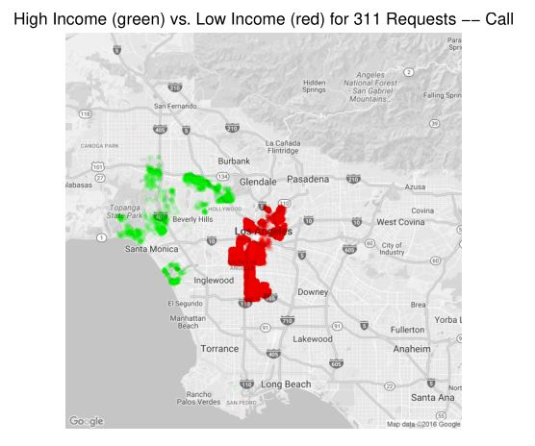
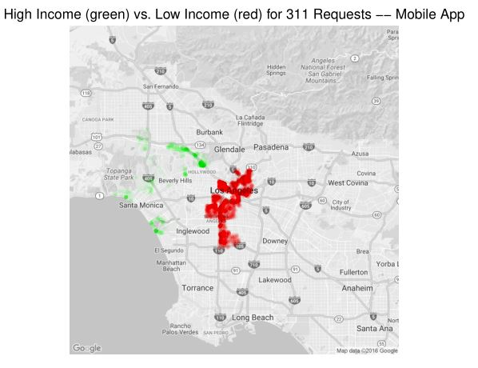
Income Analysis
Note: high income = income per capita > 50,000, Low Income = income per capita < 16,000.
Notes:
David
“High Income” zipcodes have per-capita income of $50000 or more
“Low Income” zipcodes have per-capita income of $16000 or less

Slide 6
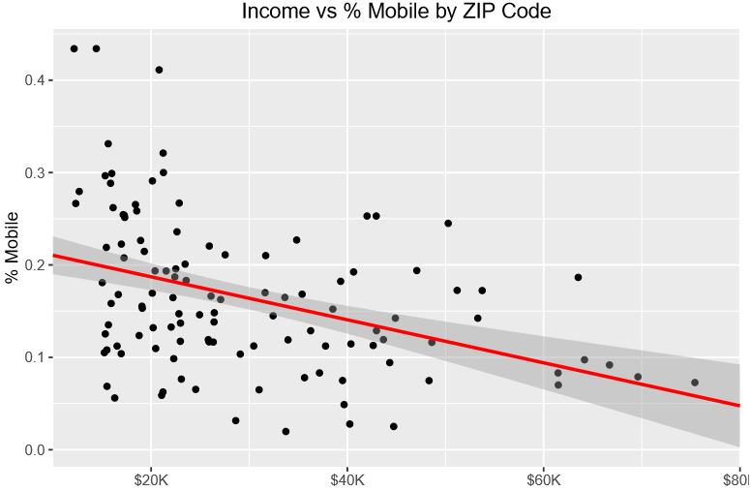
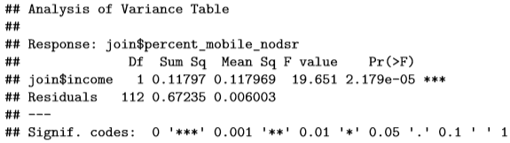
Notes:
First thing to go

Slide 7
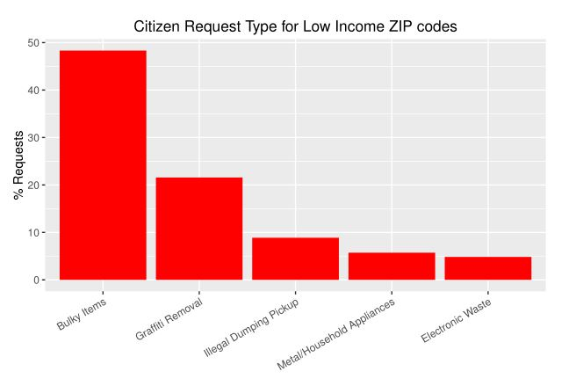
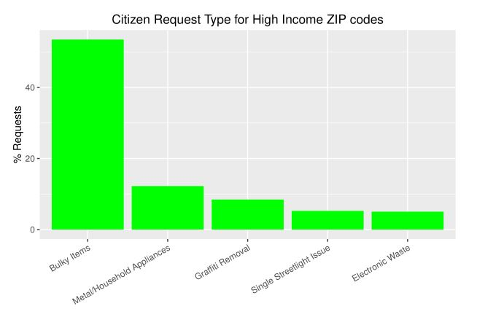
Notes:
David

Slide 8
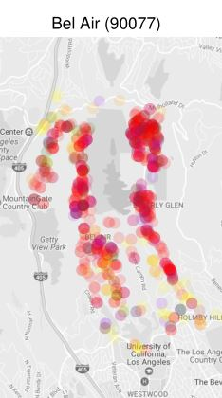
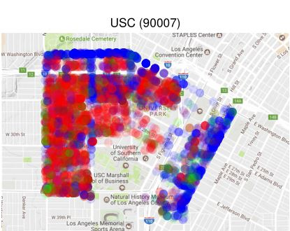
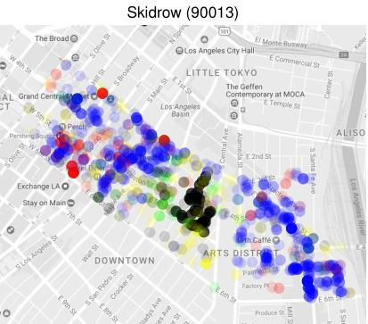
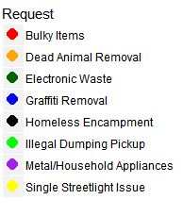
Request Types for Sample ZIP Codes
Notes:
2:45

Slide 9
Recommendation 1: Target Specific Locations

Slide 10
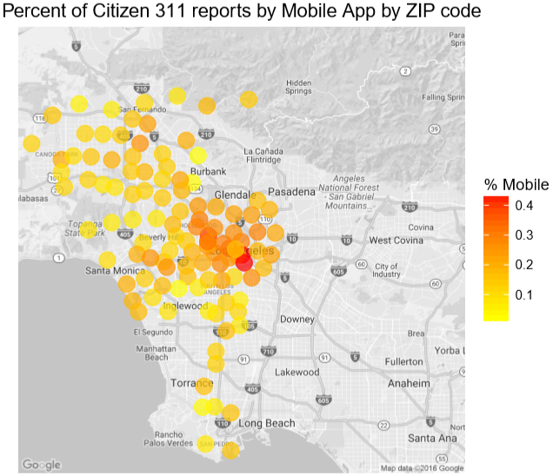
Limited data to ZIP codes with at least 100 total requests
Calculated a variable for % of citizen (not driver self report) requests from the app for each ZIP code
Found that ZIP codes with high percentages and low percentages were geographically clustered.

Slide 11
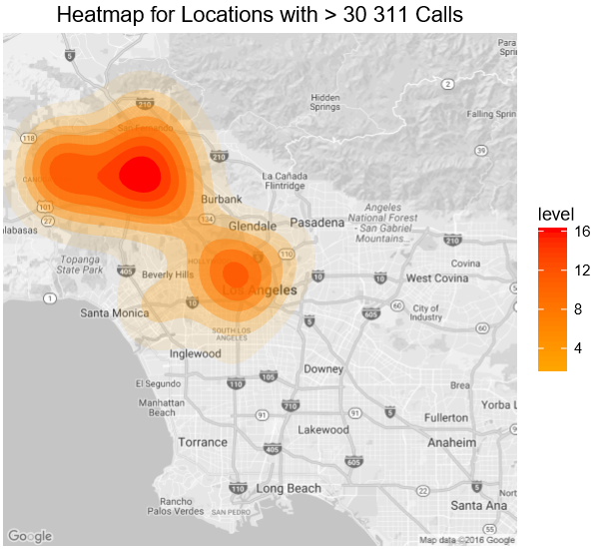
We looked at addresses with more than 30 calls
These address made proportionally way fewer mobile app requests
Specifically target these addresses through contacting apartment managers/ putting up fliers

Slide 12
Recommendation 2: Target Commuters/ High-propensity Users

Slide 13
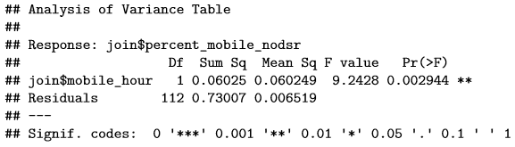
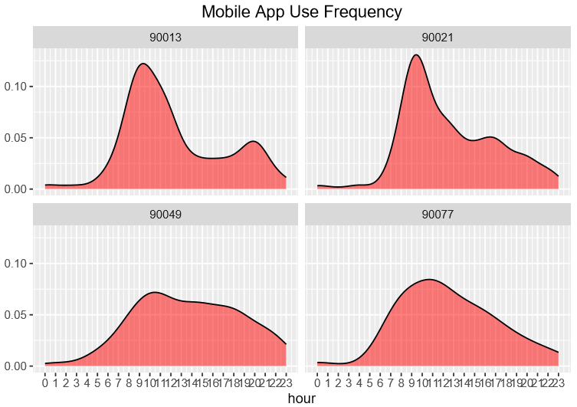
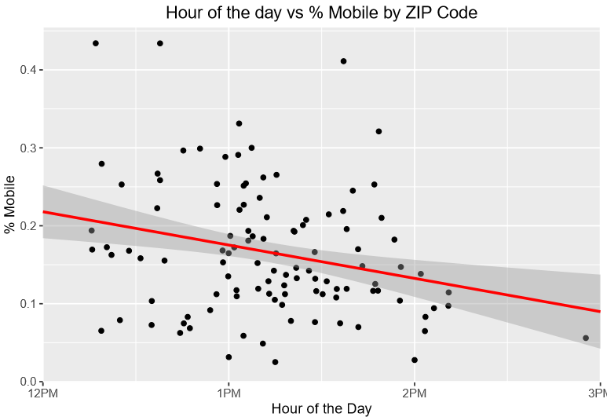
Time of Day Analysis
Notes:
90013 - arts district
90021 - fashion district,
90049 Brentwood

Slide 14
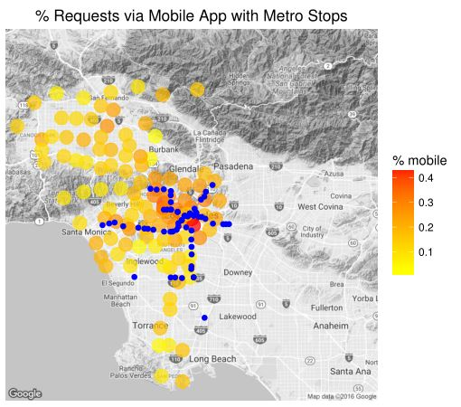
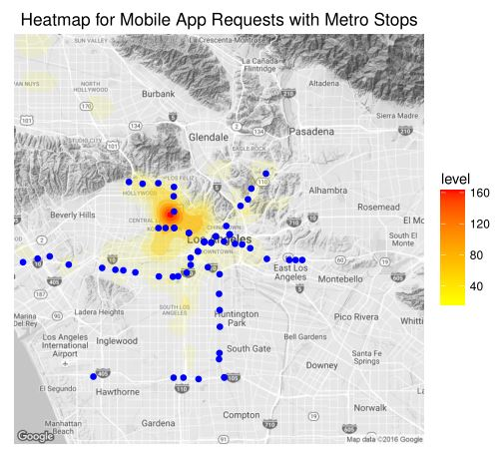
Metro Analysis

Slide 15
Recommendation 3: 311 Call Directory

Slide 16
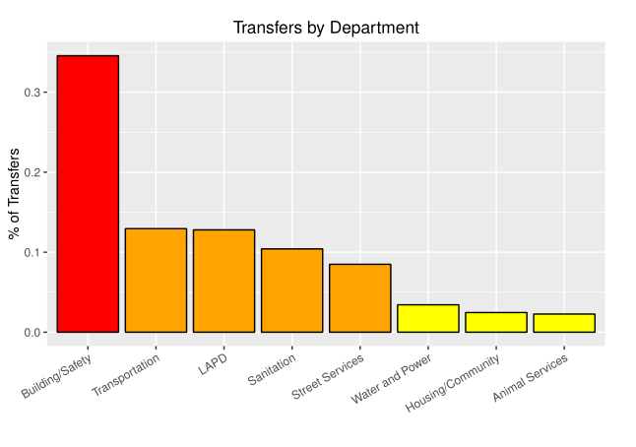
Recommendation 3: 311 Call Directory
Redirect 38.4% of calls that ultimately get transferred anyways
Automatically transfer calls to other city departments.
Ease massive strain on the city and create an easier workflow
Can also automate elements of the service requests.
Note: Data from June 2014 to May 2015
Notes:
87%
Jason
-A 311 Menu Directory would allow the call center to automatically redirect some of the 38.4% of calls that ultimately get transferred to other city departments. Options to automatically transfer calls concerning Building Safety, Transportation, LAPD, and Sanitation could ease the strain on the call center roughly 30%.

Slide 17
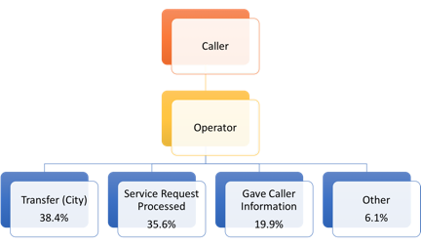
Current Call Directory
Notes:
Jason

Slide 18
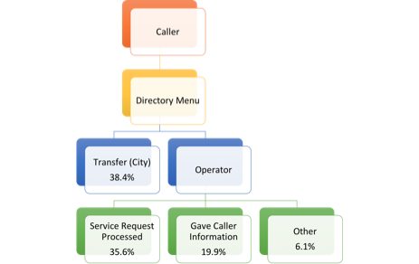
Potential Call Directory
Notes:
Jason

Slide 19
Recommendations Summary
Target High Volume Callers
Marketing Campaign around City Metro
Create Automated 311 Directory
Notes:
Jason

Slide 20
Questions for the team?

