Slide 1
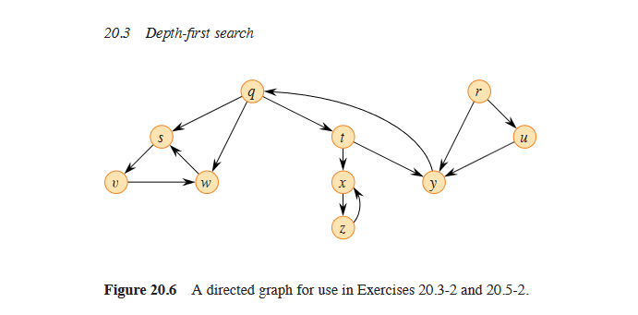
Node | color | u.d | u.f | u.pi
q | Black | 1 | 16 | NIL
r | Black | 16 | 19 | NIL
s | Black | 2 | 7 | q
t | Black | 8 | 15 | q
u | Black | 17 | 18 | r
v | Black | 3 | 6 | s
w | Black | 4 | 5 | v
x | Black | 9 | 12 | t
y | Black | 13 | 14 | t
z | Black | 10 | 11 | x

Slide 2
Tree Edge
qs
sv
vw
qt
tx
xz
ty
ru
Back Edge
yq
zx
ws
Forward Edge
qw
Cross Edge
uy
ry

Slide 3
Graph G
Depth First Forest
A
A
U
B
B
C
C
C
V

Slide 4
a
b
c
d
e
f
g
h
i
j
a,d,e,b,c,f,i,j,g,h

Slide 5
G1
 | (1) u.d | (1) u.f | (2) u.d | (2) u.f
a | 1 | 8 | 4 | 7
b | 2 | 7 | 5 | 6
c | 3 | 6 | 3 | 8
d | 4 | 5 | 1 | 2
A
B
ABC
D
C
D
G2
A
 | (1) u.d | (1) u.f | (2) u.d | (2) u.f
a | 1 | 6 | 2 | 5
b | 2 | 3 | 1 | 6
c | 4 | 5 | 3 | 4
B
C
ABC

Slide 6
5
a
b
c
Kruskal Edges | values
fg | 1
gb | 2
ji | 2
dh | 2
ad | 2
fi | 3
gi | X (loop)
eb | X (loop)
gc | 4
bc | X (loop)
fe | 5
cj | X (loop)
ae | 8
2
8
7
4
2
4
5
1
d
10
e
f
g
6
8
8
3
3
11
2
9
2
h
i
j

Slide 7
5
a
b
c
Prim Edges | values
ad | 2
dh | 2
ae | 8
ef | 5
fg | 1
gb | 2
fi | 3
ij | 2
gc | 4
2
8
7
4
2
4
5
1
d
10
e
f
g
6
8
8
3
3
11
2
9
2
h
i
j

Slide 8
Graph G
Depth First Forest
A
D
V
W
Y
Y
Z
D
V
A
B
E
X
Z
E
W
B
C
F
F
X
C

