Slide 1

Dramatic Arts Integration:
Elementary and the Imagination
Lisa Castaneda and Chelsea LeValley

Slide 2

Who we are…
Lisa Castaneda Chelsea LeValley
Co-Founder and CEO of foundry10 dramatic arts program development
Seattle, WA Seattle, WA
lisa@foundry10.org Chelsea@foundry10.org
Notes:
Lisa background info
Chelsea background info: Chelsea works on the dramatic arts program development for foundry10. She coordinates schedules, programs, and curriculum with schools and teaching artists interested in the integration of dramatic arts into the traditional classroom. She has been a teaching artist for the last three years in the Seattle area working with students ages 3-21.

Slide 3
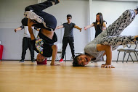
foundry10
A not-for-profit organization
Research, programs and outreach on non-traditional learning
Group of educators, artists, tech people, psychologists, youth advocates
Provide opportunities for students to explore their creativity and voice
Notes:
Lisa

Slide 4

Integrated Dramatic Arts
You don’t have to be a specialist to do it!
There are all kinds of resources out there to help you.
Promotes the student voice!

Slide 5
Research by Bridget Kiger Lee (2015) demonstrated that dramatic arts at the pre-kindergarten level has positive impacts on student learning in a variety of areas. In addition, dramatic arts work in upper level elementary students showed positive impacts on “21st Century Skills” like collaboration and motivation.
Notes:
Lisa give info on why we are including these quotes

Slide 6


The best way to connect dramatic arts and imagination…
Is not by sitting in front of a PowerPoint for 40 minutes!
Notes:
Intro activity…who is here and what do they teach (briefly) Insert first game; we will intersperse useful related tidbits from research but we really want to give you examples of how you can integrate it into the classroom.
This can be the superheroes exercise. Students are instructed to choose a super power they have and state their name and the grade for which they teach/for which that superhero power is relevant. We all will copy their movement. They’ll say thank you.
When this activity ends we should be 8-10 minutes into our program.

Slide 7
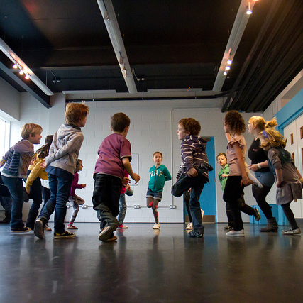
Topics we think are highly relevant to IERG
Creative Drama
Story Drama
Creative Movement
Within subjects imagining

Slide 8
Creative Drama…
Let’s try some!

Slide 9
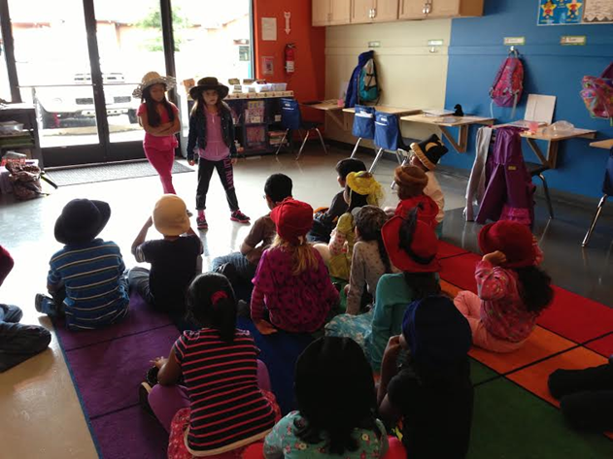
What is Creative Drama?
Creative Drama uses basic actor tools including the body, voice, and imagination to engage students in story dramatization exercises. It can be highly structured or incredibly open ended depending on teacher preference.

Slide 10
Creative Drama- ACTIVITY
Four Part Stories
From a circle students tell a four part story:
Once upon a time there was….and every day….
But one day….
And because of that….
And ever since….
Pop-Up Story Books
Students are actors or narrators.
Actors freeze depicting the part of the story the narrator creates.
Notes:
Chelsea (3 minutes) Take volunteers

Slide 11
Creative Drama- ACTIVITY
“I know let’s be….!”
Students walk around the room until the teacher claps and says “I know let’s be….____!” Students then become whatever the teacher suggested until the teacher claps again and this time calls on another student to fill in the blank.
Scene creation from pictures
Students must create a scene with a beginning, middle, and end, that starts or ends with their bodies in the same configuration as the characters in a given picture.
Notes:
Chelsea: Mention other things like soundscape, blast back
Lisa: These activities can be really super quick or you can built them into something else. You can use I know lets be as a physical transition point to get them moving to a new location.

Slide 12
Creative Drama can also be…
Less Structured like in Magic Doorway, Treasure Trunk, other…
Travel via set ritual to imaginative location
Meet reoccurring character who presents a clue or object
Plot unfolds based on student ideas/suggestions
Informal performance of imaginative language
Interpreting poetry or prose
Defining imaginary words
Reader’s Theater
Performance of a book written as narration with character dialogue
Can be performed in groups of students on the spot or as scripted and memorized
Notes:
Chelsea: mention treasure trunk and magic doorway
We should now be 20 minutes into our presentation

Slide 13
Now for some…
Story Drama

Slide 14
What is story drama?
Story drama is the dramatization of literature, using an imaginative problem that parallels the problem of a written story. Through suggestions to solve the problem, students engage in dramatic play.
Let’s talk about a specific format you can use time and time again for your favorite stories!

Slide 15
Story Drama Structure
A Story Drama lesson begins with a teacher presenting a problem that parallels the problem in a piece of literature.
Transition activity
Designed to transfer from real world to world of the story, could be drawing circle or physicalized activity where students draw or become something they think they will encounter that day or a plan to solve the problem teacher has just introduced.
Warm-Up/Motivation
Students and leader solve a parallel problem, related to the story to no avail!
Could be using tableau to see if solutions work, have a meeting where you take student suggestions, in-role the leader can become different experts to help the group try solutions

Slide 16
Story Drama Structure…continued.
Transition to story
Students will visit with a character who recaps what they’ve done and drives them to read the story for additional advice.
Story Time
Students engage with their imaginations as they use hand signals to interact with key points in the story.
Dramatic Play
The leader guides the class through solving the problem through interaction, movement, collaboration and voice.
Reflection!!!!

Slide 17
Story Drama Tips
Examples of imaginative class rituals for transitioning
Travel Blanket, rope, class suggestions
Treasure box, magic dust, magic phrase
Zipping and un-zipping in role
Look for sensory opportunities
Choosing a story with a clear dramatic problem

Slide 18

Here’s an abridged example…
Goodnight Moon
I have a problem: I can’t sleep!
Take suggestions. Visit wise person. Travel to the moon.
Visit woman on the moon. Solve it. Travel back. Reflect.

Slide 19

Considerations….
“The brink of chaos is often scary and just as often the most educational moments”
(Seattle Children’s Theater dramatic connections p. 2)
Choose stories with dramatic conflict, that can be read quickly, and have repeated lines
Notes:
Lisa

Slide 20
“Preschool curricula that emphasize active engagement with children, promote positive interaction between classmates and with the teacher(s), and are motivating and challenging for children, are more likely to be successful in closing the achievement gap.”
(Klein & Knitzer, 2007)
Notes:
We should now be 30 minutes into our presentation

Slide 21
Creative Movement
Let’s do some!...

Slide 22
Moving as a group- Activity
From Red Light, Green Light to Ann Bogart’s Viewpoints
Students identify certain colors which get assigned to actions
Students move around the room at 90 degree angles as if on a grid
When prompted students vary their movement using tempo, duration, shape, and repetition
Flocking- students move as an ensemble, copying each other without a leader

Slide 23
Movement to generate character- Activity
Character Creation using gestures/movement phrases
Students are instructed to choose a series of three gestures they can repeat
Students perform those gestures for the group
Students walk around using those gestures adapted for movement
Students create a character name and fact based on the emotional connection to the movement.
Notes:
Lisa describes, Chelsea models

Slide 24
Research and Movement
Research shows that mental life builds hierarchically on earlier developing abilities. The inference then is that connecting the body with the mind leads to increased mental productivity. (Bornstein, 2013)
“When there is a match between the abstract idea and our actions, performance (in language comprehension) improves. Exchanging ideas is seen as an extension of exchanging objects and therefore is linked to many of the same motor and perceptual processes.” (Beilock, pp 120)
Notes:
Lisa

Slide 25
Research and Movement…continued.
“Even though reading seems to be an activity entirely confined to the brain, it also involves the body. And since printing practice helps jump-start areas of the brain needed for letter identification, it is not hard to imagine all sorts of other ways in which motor experience can change the brain. In short, we learn by doing.”
(Beilock, How the Body Knows Its Mind, p 39)
Notes:
Lisa
We will be about 38 minutes into our program

Slide 26
Drama Within Subjects
Let’s explore…

Slide 27
Drama Within Subject Areas
Ideas for integrating drama into the traditional classroom through specific subjects such as Math, Science, Reading, Social Studies, etc.

Slide 28
Tableaux- Activity
Students work solo simultaneously, then in pairs, then in small groups to form still-life pictures depicting class material.
Starting with to create shapes, letters, settings, or abstract ideas, related to class curriculum.
Examples:
Science: Water cycle and cell division
History: Timeline sequence of historical events
Reading: Settings from stories
Math: Number sentences
Notes:
MAYBE? Deasy’s study showed that acting out stories enhances writing skills. They write, then, with engagement and energy, shaping their stories to entertain their peers…A study done by scholar, Horn, suggested that writing skills greatly increased, in a study done after a drama experiment with struggling high school students, writing, conceiving, and directing their own play. He said, “It created great habits of mind.”
(Deasy, **)

Slide 29
Four Corners- Activity
There are four corners of the room designated differently depending on the theme or class.
Examples:
Periods of history represented in each corner
Math shapes
Emotions
Colors
Animal kingdoms
Students sneak into a corner of their choice. The student in center guesses which corner has most students in it without looking.
Notes:
This scaffolds up into a themed game. While one student in the center of the room with his or her eyes closed and singing a known song or counting from 10 to zero, the other students quickly move to one of the four corners and wait. The student with his or her eyes closed must guess the name of the corner he or she thinks has the most students in it. If she guesses it right, the students in that corner must perform some pre-set task related to the theme.

Slide 30
Context!!!
Dramatic arts CAN work in other subject areas, but it takes clear identification of objectives as well as thorough reflection
Notes:
Dramatic arts can bridge the gap between traditional classroom learning and imaginative education

Slide 31
Student Voice and Self Advocacy
A theme throughout the dramatic arts integration curriculum today….
Where did you notice it today?☺

Slide 32
Student Voice and Self Advocacy Cont. …
Empowering students to make bold choices through dramatic arts exercises
Allowing students the freedom to express ideas that compel them, with affirming responses by adults
Saying, “Yes, AND” to student ideas in order to foster a sense of playfulness and openness
Guiding students to unite over universal truths found in storytelling

Slide 33
Concluding thoughts…
We hope you have some new ideas of how to utilize dramatic arts to further the development of imagination in your students.
Drama is suited for both STEM and Common Core.
There are many styles and structures to incorporating dramatic arts into the classroom. Create your own! Risk and Play!
Still feeling nervous incorporating it yourself? Contact us, or, your contact your local theatres or performing arts centers for the education outreach departments to find teaching artists to invite to your school

Slide 34
RESOURCES
Theatre Education Department resources:
For the following theaters please visit their website, contact the education department, request to purchase a handbook as a classroom tool.
Seattle Children’s Theater handbook
Studio East Education handbook
Minneapolis Children’s Theater handbook
Other theater’s near you…
Professional training development opportunities:
Teaching/Theater Artist Training Lab (TAT Lab)
Seattle Children’s Theater story drama dramatic connections workbook/classes

Slide 35
RESOURCES
Reading:
How the Body Knows its Mind by Sian Beilock
Theater Games for the Classroom: A Teacher's Handbook by Viola Spolin, Mary Ann Brandt, Arthur Morey
Creative Drama in the Primary Grades by Nellie McCaslin
Online resources:
The Drama Game File from Drama Education Network (www.DramaEd.net)
www.childdrama.com/lessons
www.perpetualpreschool.com
www.ufoc.org/imges/stories

Slide 36
Questions?
Please feel free to reach out to us beyond this presentation...
Lisa Castaneda Chelsea LeValley
Co-Founder and CEO of foundry10 dramatic arts program development
Seattle, WA Seattle, WA
lisa@foundry10.org Chelsea@foundry10.org

