Slide 1


Fast Lane Group
Worldwide Education &
Professional Services
www.flane.de
Notes:
Die Fast Lane Gruppe.
Fast Lane … Dienstleister u. Spezialist für High-End Technologie und Business Trainings
IT Trainings zu den unterschiedlichsten Herstellern wie Microsoft, Google, Cisco oder AWS. Und vielen weiteren wichtigen IT Herstellern.
Sei es Cloud, Security, Netzwerk oder allgemein digitale Transformationsprojekte
Und das seit 2003.
Das spannende ist, dass die Fast Lane Gruppe bereits seit 2009 durchgängig zu den Top 20 Unternehmen in der IT Trainingsbranche weltweit zählt.
Aber auch Footprint ebenso im klassischen Professional Services Bereich für unsere wichtigsten Hersteller
PreSales Support, Deployment Services und Adoption Trainings
Additional Information:
Im Jahr 2021 sind wir zur „most strategic IT Education company worldwide“ von der IDC im „magic quadrant“ aufgeführt worden !
1 mio Teilnehmer insgesamt seit bestehen, 50.000+ Students ww p.A, 20.000 in DE pro Jahr

Slide 2






AGENTIC AI: FROM STRATEGY TO PRODUCTION.
Alexander
Kastil
AGENTIC AI CONSULTING · VIENNA
For Austrian SMEs, software teams and enterprise programmes.
AI at Work
Enterprise AI
Value discovery, KPI mapping and roadmap
Copilot, Foundry and multi-agent systems with governance
Agentic Software Engineering
Training & Team Enablement
State of art harness for Claude Code and GitHub Copilot
Master classes, custom course production and AI-tutored learning
integrations.at
github.com/alexander-kastil
SCAN TO CONNECT
alexander.kastil@integrations.at
linkedin.com/in/alexander-kastil
integrations.at
Notes:
Intro: Alexander Kastil, integrations.at. Four practice areas from AI at Work to team enablement. Certifications: Agentic AI Business Solutions Architect, Azure AI App and Agent Developer Associate, DevOps Engineer Expert.

Slide 3

MODULE 1
Fundamentals & Agent Mode Basics
GitHub Copilot Essentials
Agentic Software Engineering using GitHub Copilot

Slide 4
01
02
03
04
Getting Started & Configuring Copilot
Modes, settings and keeping secrets out
Selecting Models
Context size, cost and task fit
Shaping the Context Window
Prompt caching and deliberate context
AI-Assisted Coding Essentials
Prompting, inline suggestions and slash commands
05
06
07
Agent Mode Basics
Local agents for multi-step work
Pull Requests & Code Reviews
PR descriptions and review feedback
Working in the Terminal
Agent-aware output and compression
Agentic Software Engineering using GitHub Copilot

Slide 5

Fundamentals & Agent Mode Basics
GitHub Copilot Essentials
Essentials: inline suggestions, chat, prompting, context engineering and model selection
Agent Mode: a local agent driving real, multi-step work
Guardrails: pull requests, secrets kept out of context and a terminal built for agents
Notes:
This is the opening slide for the module: it sets out what the class covers first and where it pivots.
Essentials: inline suggestions, chat interactions, prompting techniques, context engineering and multi-model selection are the core capabilities and foundational concepts of Copilot.
Agent Mode: the module pivots early to Agent Mode, so you leave the fundamentals already driving a local agent through real, multi-step work.
Guardrails: pull requests and code reviews, settings that keep secrets out of context, and a terminal that gives agents machine-readable output round out the module.

Slide 6
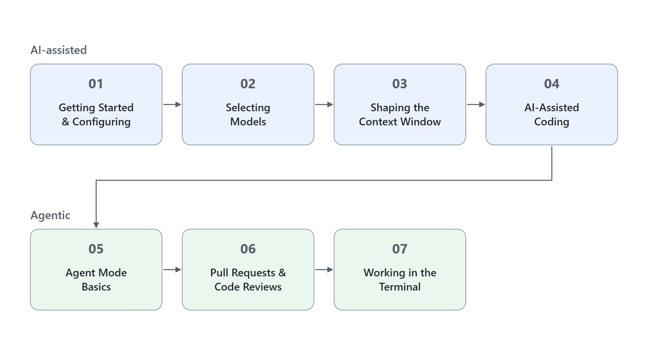
Overview
The path through the fundamentals
Start with Copilot's two modes and settings, model selection and the context window
Prompting, inline suggestions, slash commands and context variables in one place
Pivot to Agent Mode: scaffold a project, fix an error, run an update
Finish with pull requests and the terminal the agent works in
Notes:
This slide walks the path through the module's seven topics once, following on from the three themes of the title slide.
Getting started: the path opens with Copilot's two modes and the settings that keep secrets out, then selecting a model by context size, cost and task, then what fills the context window.
One place for AI-assisted coding: prompting techniques, inline suggestions, slash commands and context variables are taught together in a single topic.
The pivot to Agent Mode: a local agent scaffolds a project, fixes an error and runs an update. This is where the class stops typing code and starts assigning work.
Guardrails: the path finishes with pull requests and code reviews and the terminal the agent works in.

Slide 7
01
Getting Started & Configuring Copilot
Modes, settings and keeping secrets out
Agentic Software Engineering using GitHub Copilot

Slide 8
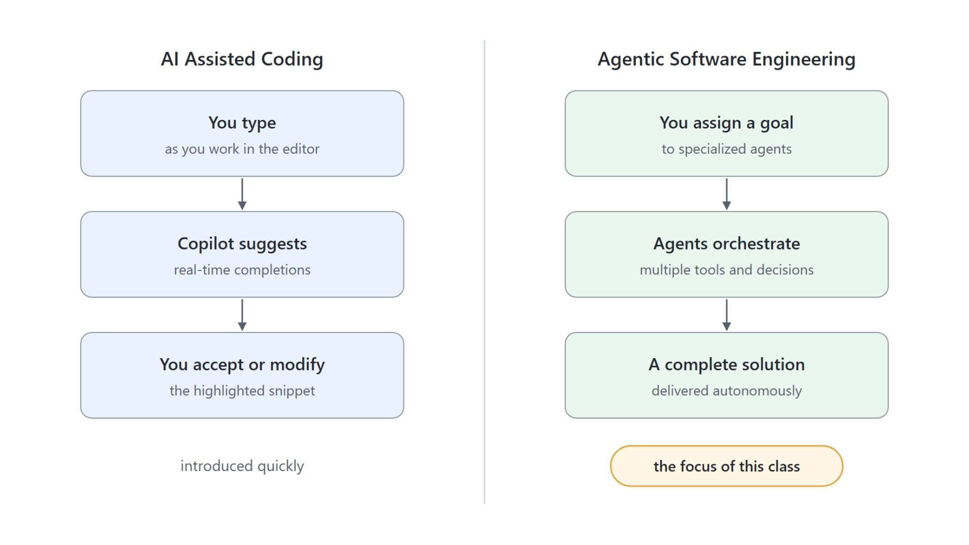
AI-assisted coding and agentic engineering
AI Assisted Coding and Agentic Software Engineering
AI Assisted Coding: real-time completions and suggestions as you type
You accept or modify the highlighted snippet directly
Agentic Software Engineering: specialized agents work autonomously toward an assigned goal
Agents orchestrate multiple tools and decisions to deliver complete solutions
Notes:
The first topic starts with the two ways Copilot works, because the rest of the class is built on the difference.
AI Assisted Coding: Copilot provides real-time completions and suggestions as you type.
Accept or modify: you stay in control of each highlighted snippet, taking it as is or changing it directly.
Agentic Software Engineering: specialized agents work autonomously toward an assigned goal instead of completing the line you are typing.
Orchestration: agents orchestrate multiple tools and decisions to deliver complete solutions. The class introduces AI Assisted Coding quickly and focuses on this mode.

Slide 9
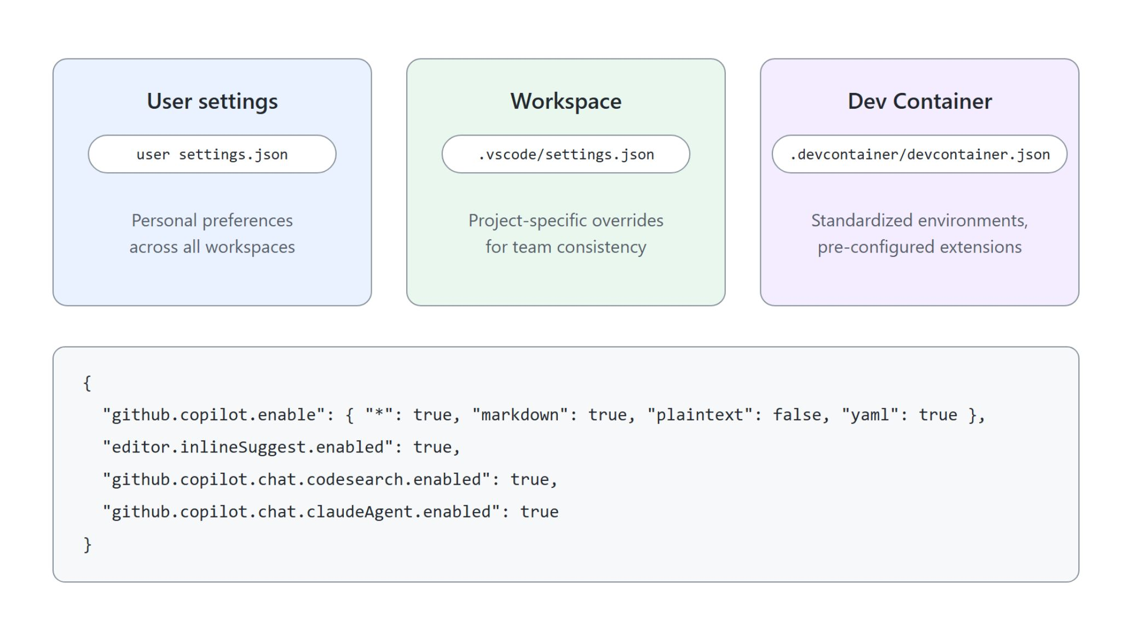
Copilot settings scopes
User, workspace and dev container
User settings: personal preferences across all workspaces
Workspace .vscode/settings.json: project overrides for team consistency
Dev Container .devcontainer/devcontainer.json: standardized environments with extensions and tools
github.copilot.enable switches Copilot per language; editor.inlineSuggest.enabled turns on inline suggestions
Notes:
With the two modes clear, the next question is where Copilot is configured. Settings control Copilot behavior, inline suggestions, model selection and workspace consistency across a team.
User settings: personal preferences that apply across all your workspaces.
Workspace settings: .vscode/settings.json holds project-specific overrides, so the whole team works with the same configuration.
Dev Container: .devcontainer/devcontainer.json gives a standardized environment with pre-configured extensions and tools.
Two essential settings: github.copilot.enable switches Copilot on or off per language, and editor.inlineSuggest.enabled turns on inline suggestions.

Slide 10
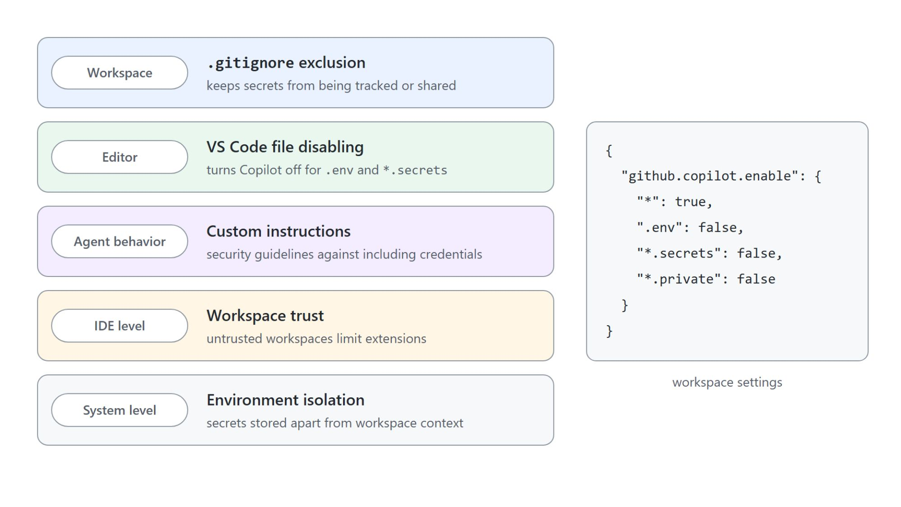
Keeping credentials out of context
Five controls that keep credentials out of context
Copilot sees open files, workspace content, terminal output and attachments
.gitignore keeps .env files out of the repository
github.copilot.enable turns Copilot off for .env, *.secrets and *.private
Custom instructions require placeholders; workspace trust limits untrusted projects
Notes:
After the settings scopes, this slide covers keeping credentials out, and the key consideration is that Copilot only sees what you show it.
What Copilot sees: open editor files, workspace content, terminal output shown in VS Code and whatever you attach to a chat. Keeping credentials out of that view is your job.
.gitignore: store secrets in .env files and add them to .gitignore, so they are never tracked or committed.
File patterns: github.copilot.enable set to false for .env, *.secrets and *.private turns Copilot off for those files in the editor.
Placeholders and trust: custom instructions require placeholder values instead of real keys, and workspace trust limits extension functionality in untrusted projects.

Slide 11
02
Selecting Models
Context size, cost and task fit
Agentic Software Engineering using GitHub Copilot

Slide 12
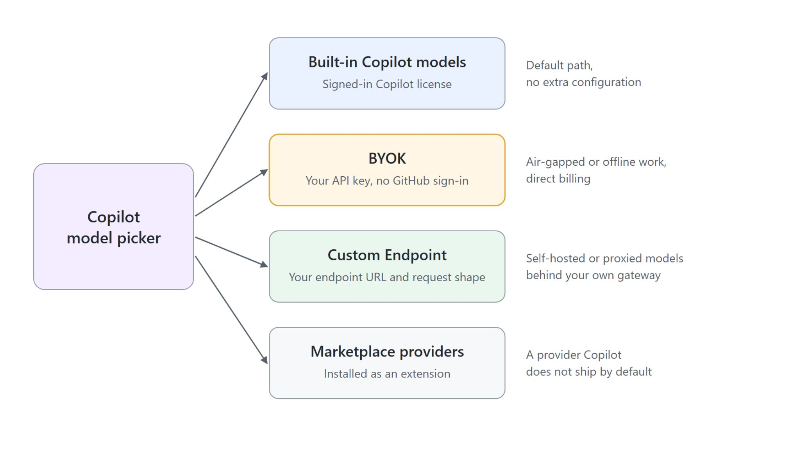
Model providers in Copilot
Four provider types behind one model picker
Built-in models need only a signed-in Copilot license
BYOK: your own API key, for air-gapped or offline work and direct billing
Custom Endpoint: your URL and request shape, for models behind your own gateway
Marketplace providers install like any other extension
Notes:
This slide opens model selection, which is a capability decision rather than a brand-name decision: context size, reasoning depth and cost per request.
Built-in: built-in Copilot models need only a signed-in Copilot license and no extra configuration.
BYOK: bring your own key lets you use your own API key without signing in to GitHub. Reach for it for air-gapped or offline work and direct billing.
Custom Endpoint: you supply your endpoint URL and request shape, for self-hosted or proxied models behind your own gateway.
Marketplace providers: a provider Copilot does not ship by default installs from the Marketplace like any other extension.

Slide 13
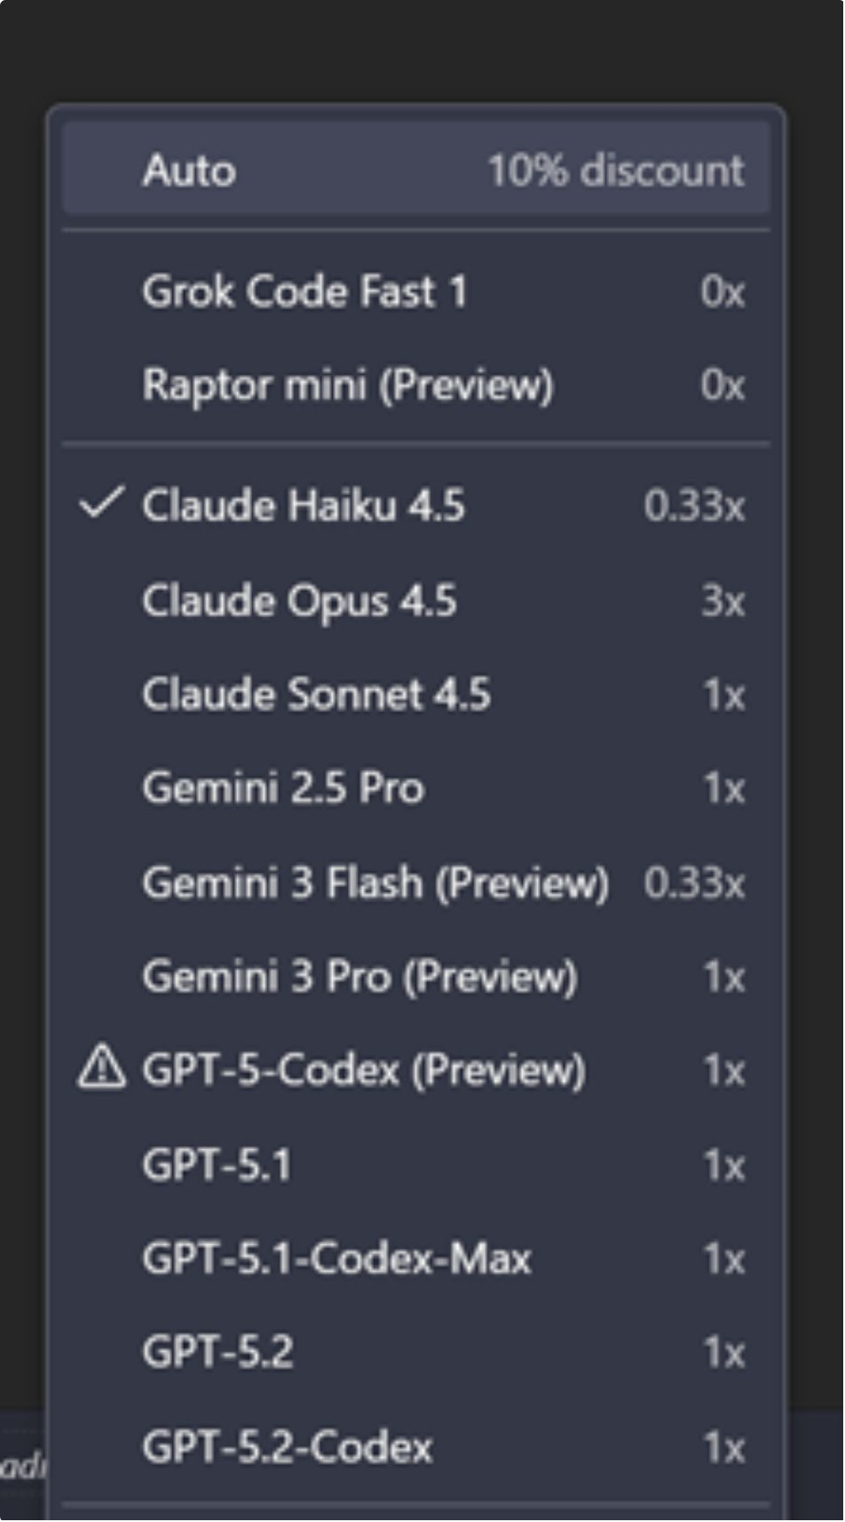
The model picker
Model selection becomes a spending decision
Supported Anthropic and OpenAI models offer 1M-token context windows
Pick context size and reasoning effort for a model in the same place
The picker shows each model's cost beside its name
Copilot and Anthropic models share one list: switch providers between turns
Notes:
Once a model is reachable, the picker is where you tune it, and where model selection becomes a spending decision.
1M-token context: supported Anthropic and OpenAI models can hold a large codebase, long conversation history and detailed instructions at once. A wider window costs more per request.
Reasoning effort: context size and reasoning effort are chosen in the same place. Raise effort for hard debugging or design work and keep it low for routine edits.
Cost beside the name: the budget impact of a choice is visible at the moment you make it. Hovering a response footer shows input, cached input and output tokens per model (1.135).
One list: Copilot and Anthropic models share one list, so a deep-reasoning turn and a cheaper cleanup turn can use different providers in the same conversation.

Slide 14
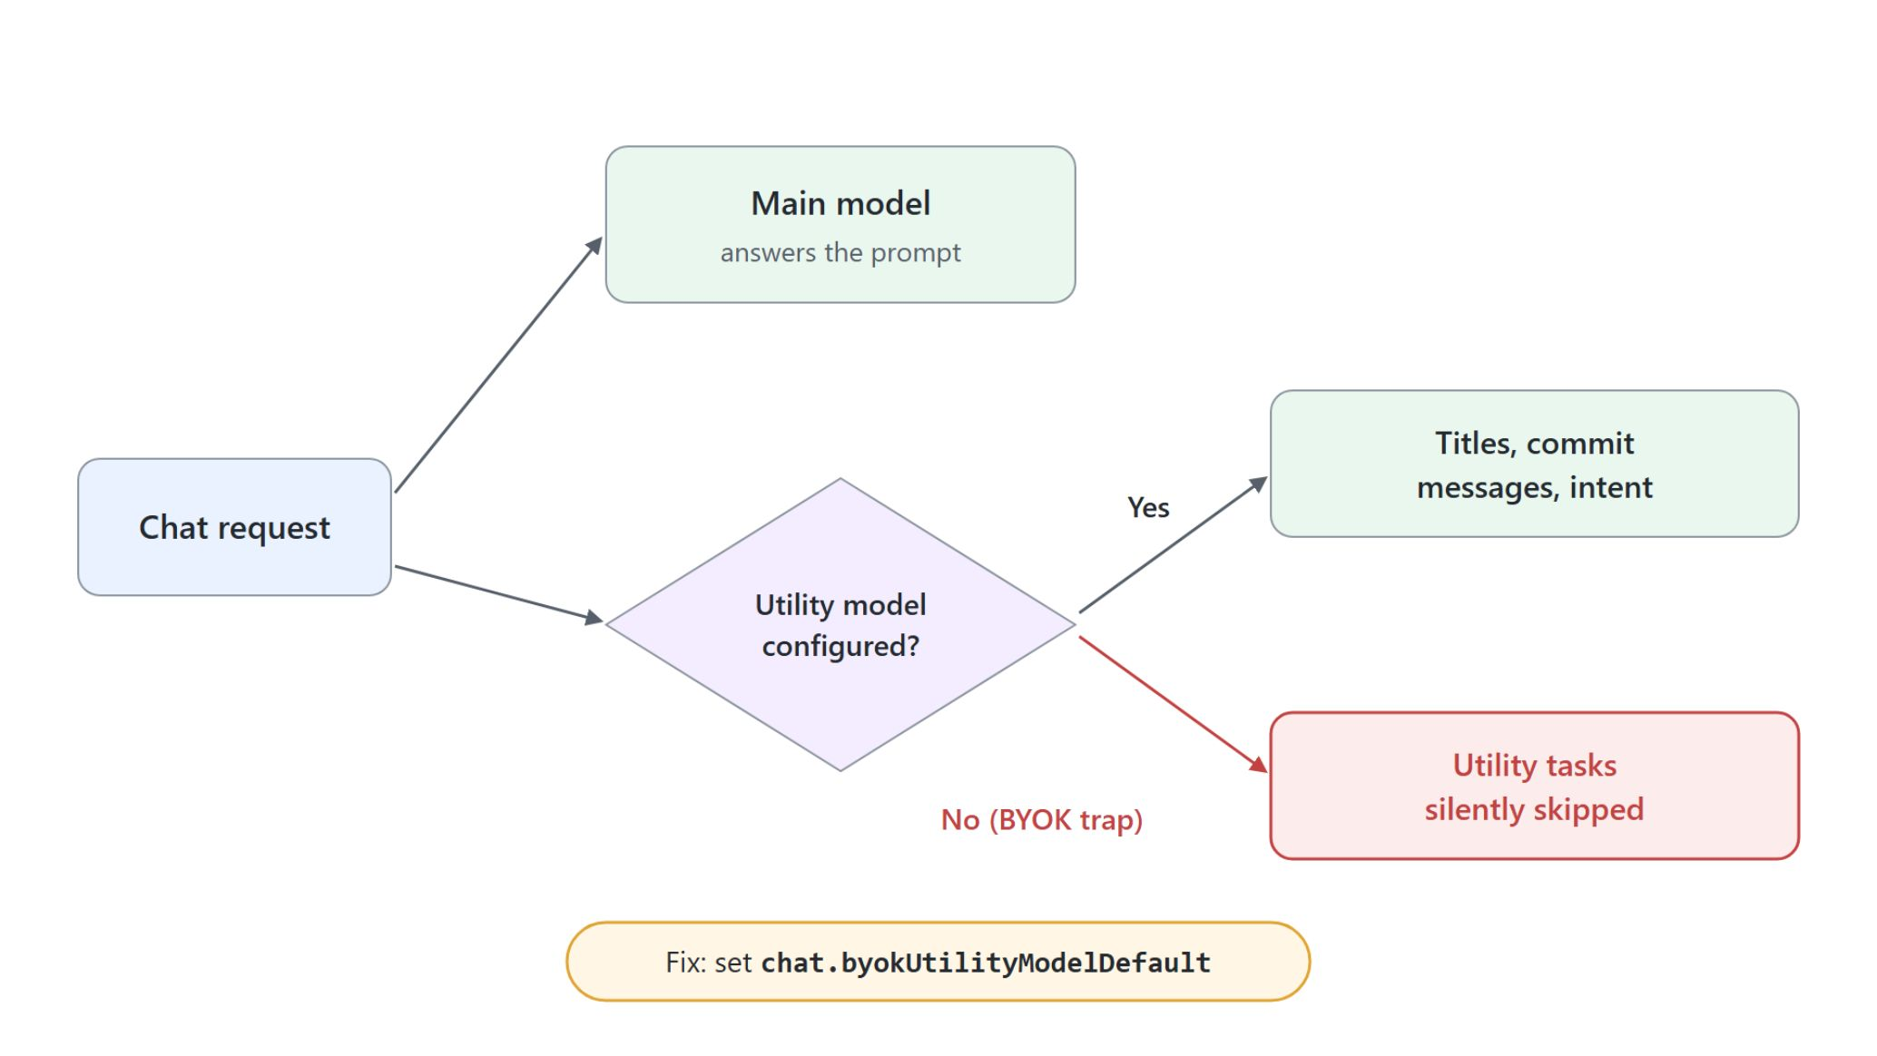
BYOK and background tasks
Background tasks that stop without an error
BYOK runs chat and agents on your own key with no GitHub sign-in
Inline suggestions and Next Edit Suggestions still need a signed-in license
chat.utilityModel drives chat titles, commit messages and intent detection
Go BYOK without a utility model and those tasks silently stop: set chat.byokUtilityModelDefault
Notes:
BYOK has one trap worth a slide of its own, because it fails without an error.
No GitHub sign-in: BYOK runs Copilot chat and agent sessions on your own key, which unlocks air-gapped and fully offline workflows.
Inline suggestions: inline suggestions and Next Edit Suggestions still require a signed-in Copilot license. A BYOK-only setup gives you chat and agents but not ghost-text completions.
Utility model: chat.utilityModel drives chat titles, commit messages and intent detection. These background tasks run on dedicated settings so they do not consume your strongest model.
Silent stop: built-in utility defaults do not apply to a BYOK main model, so those tasks silently stop with no error. Set chat.byokUtilityModelDefault whenever you go BYOK.

Slide 15
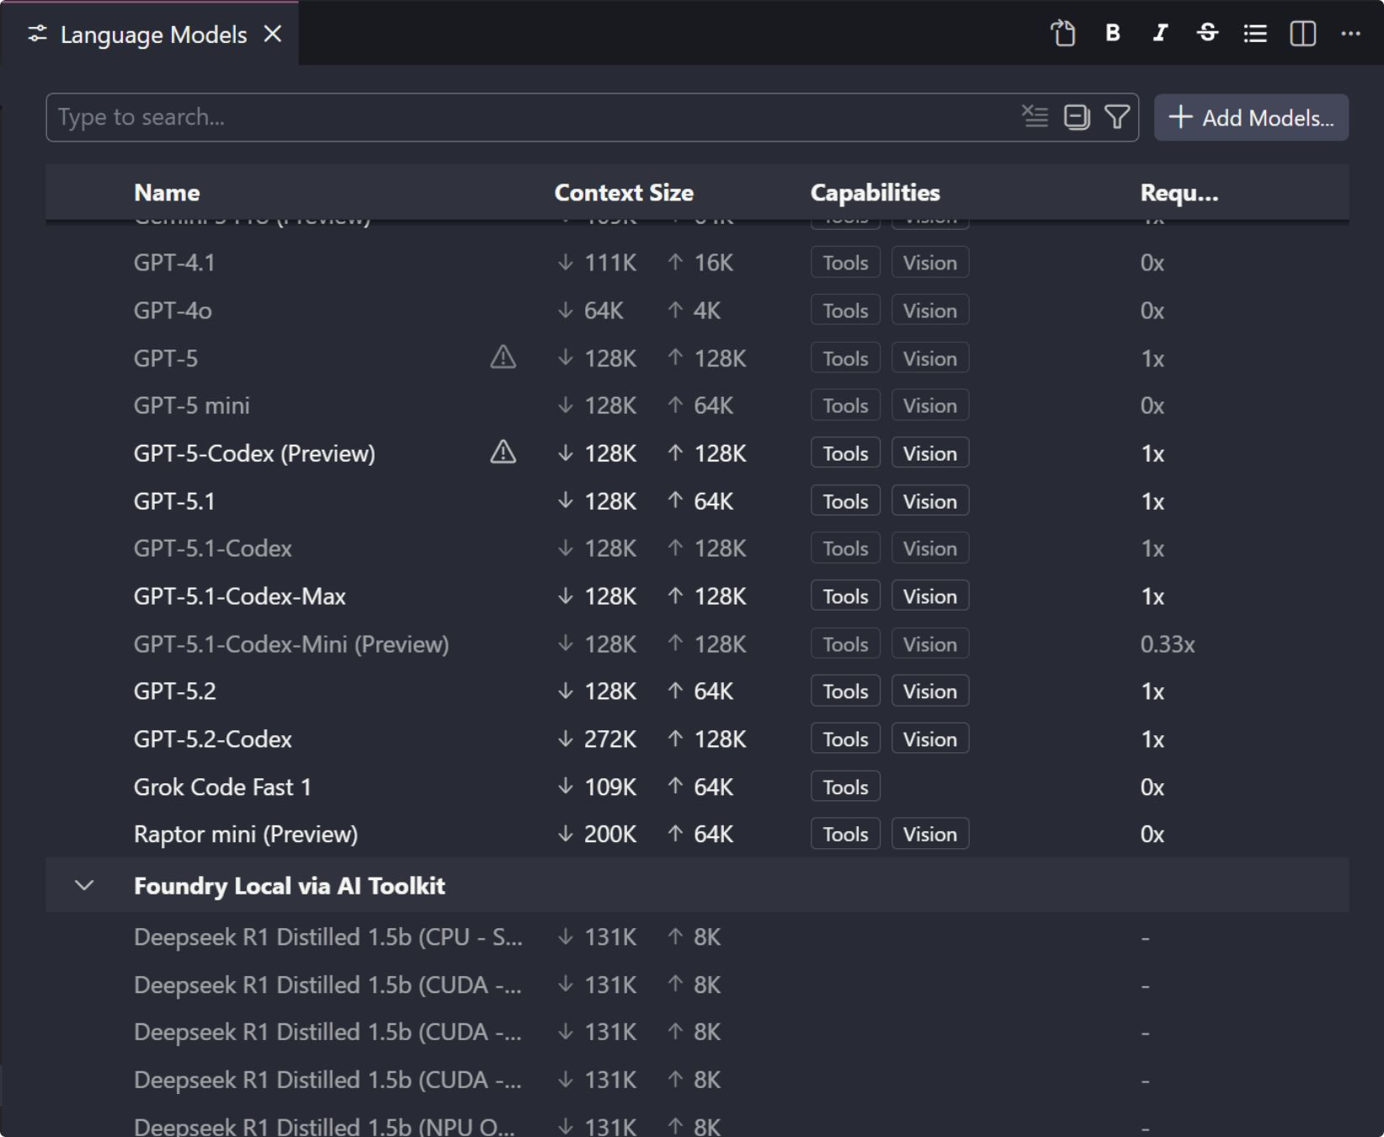
Custom Endpoint and per-model tuning
Front your own models without a shim
Custom Endpoint replaces the OpenAI-compatible provider
Three request shapes: chat-completions, responses, messages
Per-model modelOptions set temperature and top_p
The built-in Ollama provider is deprecated: install the official Ollama extension
Notes:
The last model slide covers the Custom Endpoint provider and tuning a single model.
Custom Endpoint: the provider replaces the legacy OpenAI-compatible provider.
Three request shapes: chat-completions for OpenAI-style chat APIs, responses for the OpenAI Responses API, and messages for Anthropic-style endpoints. Pick the shape your endpoint speaks and Copilot formats requests accordingly.
modelOptions: temperature and top_p are set per model. Lower the temperature for deterministic refactors and raise it to explore alternatives; both can live in one workspace.
Ollama: the previously built-in Ollama provider is deprecated. Install the official Ollama extension from the Marketplace to keep receiving updates.

Slide 16
03
Shaping the Context Window
Prompt caching and deliberate context
Agentic Software Engineering using GitHub Copilot

Slide 17
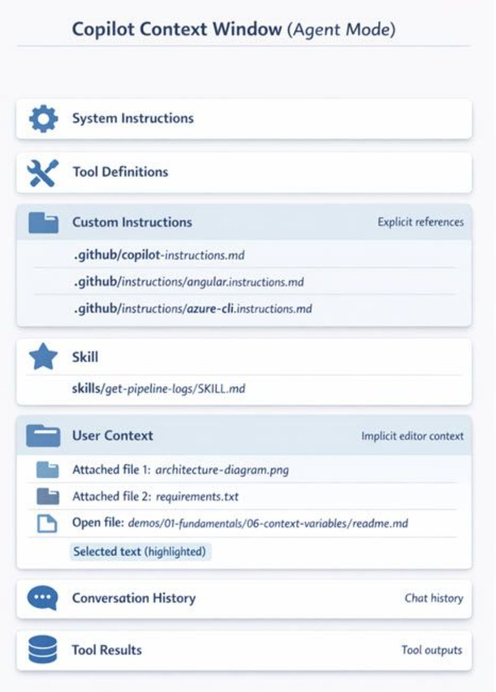
Context window contents
From system instructions to conversation history
System instructions and tool definitions form the foundation
Custom instructions and skills add project rules and capabilities
User context: open files, selections and attached references
Conversation history carries previous exchanges forward
Notes:
After choosing a model, the next topic looks at what that model actually receives: the context window and the layers that fill it.
Foundation: system instructions and tool definitions are provided by Copilot and form the base of every request.
Custom instructions and skills: custom instructions provide explicit references to your project rules, and skills add specialized capabilities.
User context: open files, selections and attached references supply the immediate problem details from the remaining budget.
Conversation history: previous exchanges are carried forward. Every layer spends the same budget, whether it is Claude Haiku 4.5 with 200K tokens or Gemini 3 Pro with about 1,000,000.

Slide 18
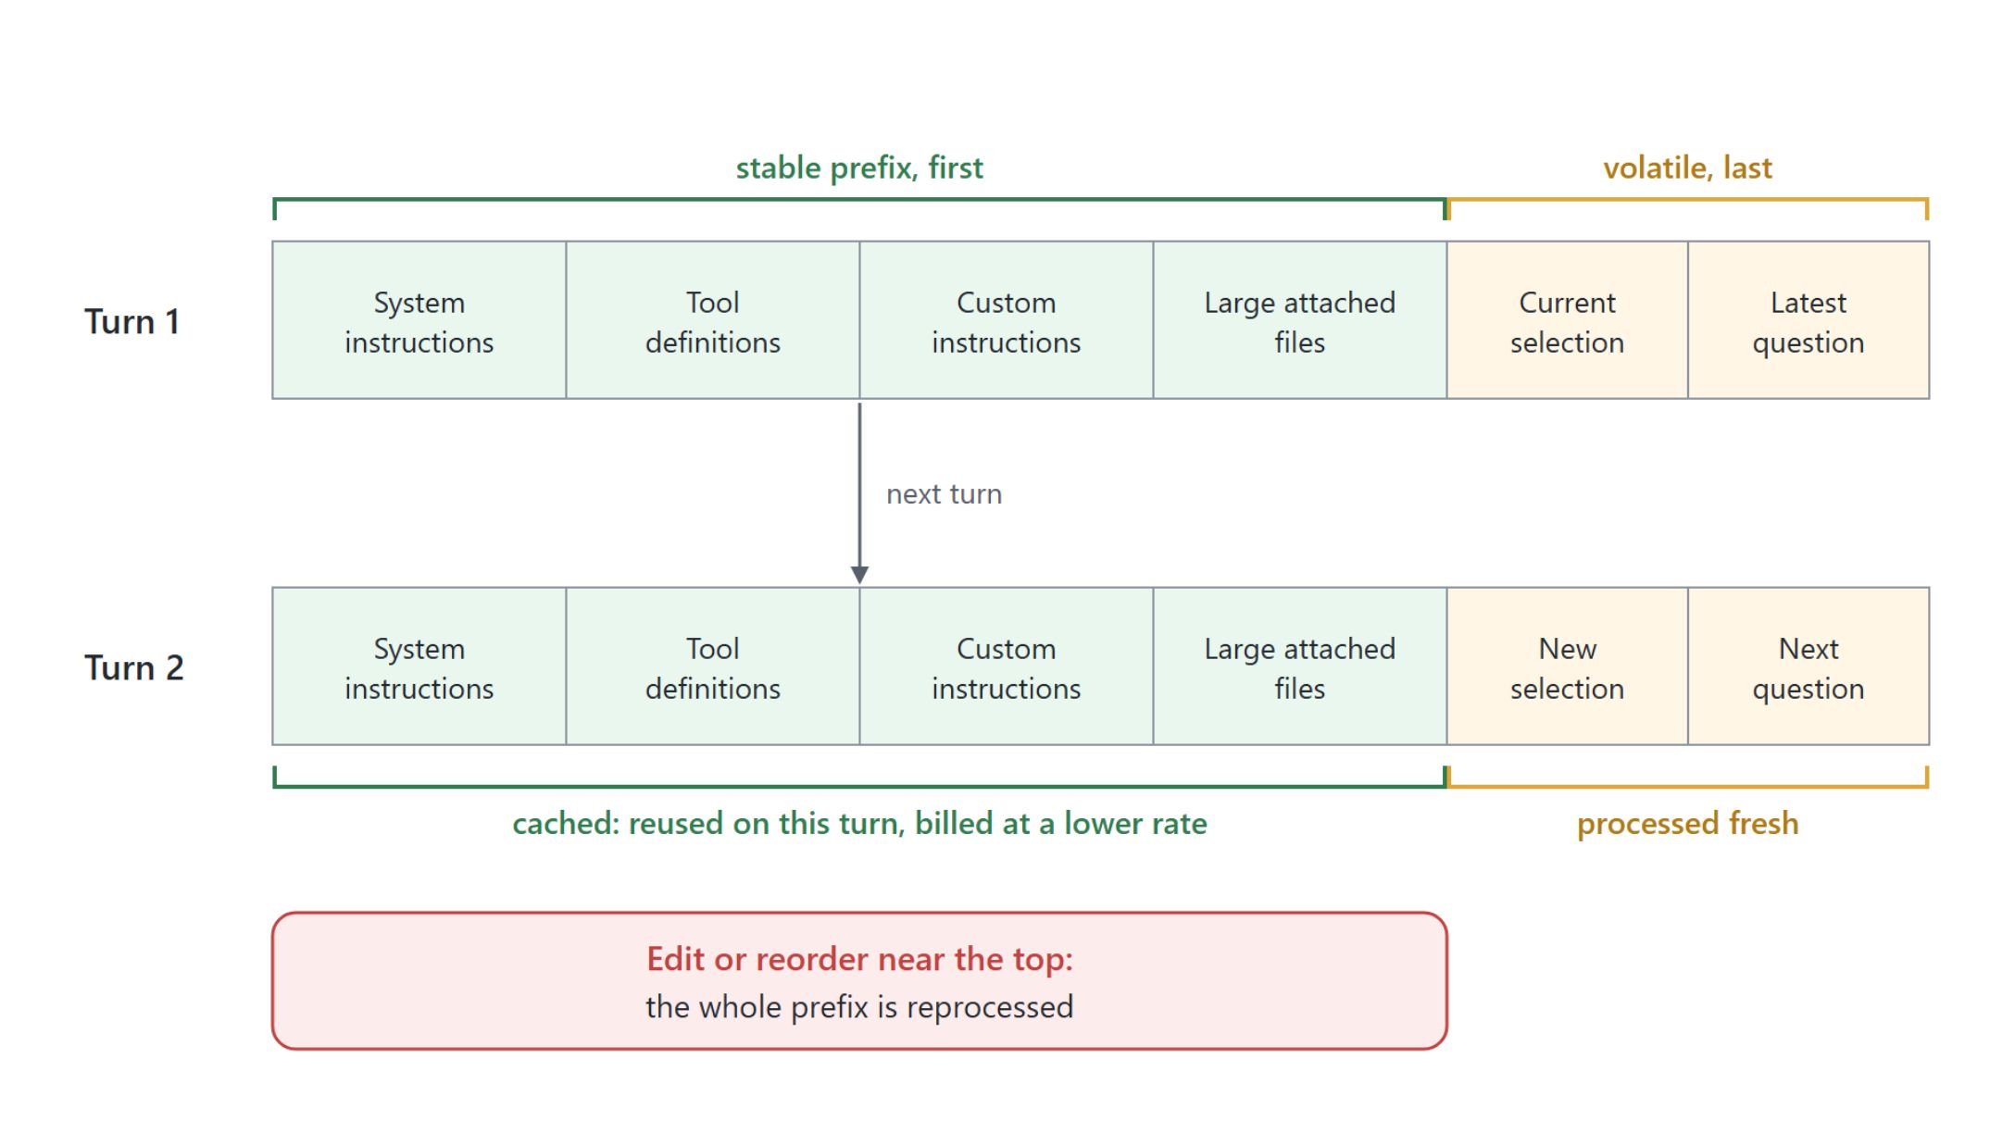
Prompt caching
Context engineering becomes a decision about ordering
The stable prefix is processed once and reused on the next turn
Put instructions and big reference files first, the latest question last
Editing or reordering early context invalidates the cache
Cached tokens are billed at a lower rate
Notes:
Knowing the layers leads to a decision about their order, because many of the models behind Copilot now cache the stable prefix of a request.
Reused on the next turn: system instructions, tool definitions, custom instructions and large attached files are processed once and reused, so a repeated prefix costs less and returns faster.
Order matters: put instructions and big reference files first, and let the volatile part, your latest question or current selection, come last.
Invalidation: editing or reordering early context invalidates the cache, so a small change near the top can force the whole prefix to be reprocessed.
Lower rate: cached tokens are billed at a lower rate, so a stable prefix is a budget decision as much as a quality one. The cost model is covered in the Governance module.

Slide 19
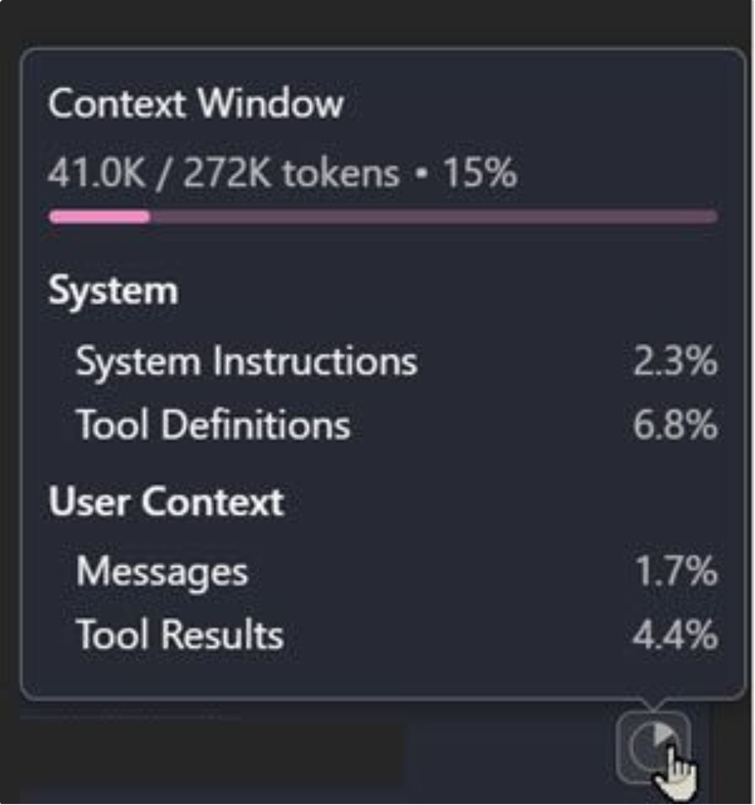
Managing context size
Attach what the task needs, not everything
The context window indicator shows token usage as you work
Attach project instructions, reference relevant files, include style samples
You do not need every file attached at once
ProTip: summarize into a feature-xxx.md and continue in a fresh conversation
Notes:
The last context slide turns the layers into practice: compose the context deliberately for each task.
Indicator: the context window indicator shows token usage as you work, so you can see how much of the budget is spent.
What to attach: project instructions for naming conventions, libraries and patterns, relevant source files to ground suggestions, and code samples that show your style.
Not every file: be intentional about what helps Copilot understand the specific problem. This keeps token usage efficient and puts the most relevant context first.
ProTip: summarize your context into a feature-xxx.md file, start a new conversation and attach that file to get a fresh context window with the most relevant information.

Slide 20
04
AI-Assisted Coding Essentials
Prompting, inline suggestions and slash commands
Agentic Software Engineering using GitHub Copilot

Slide 21
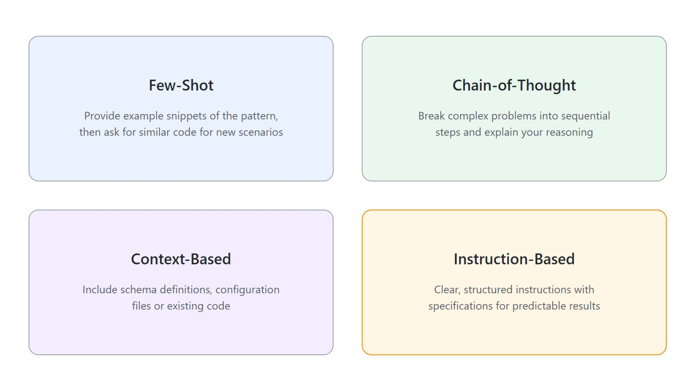
Four prompting techniques
Clear context and intent produce the code you need
Few-Shot: show example snippets, ask for the same pattern
Chain-of-Thought: break the problem into sequential steps
Context-Based: include schemas, config files or existing code
Instruction-Based: structured specifications for predictable results
Notes:
This topic brings the AI-assisted coding skills together, starting with prompting, the foundation of quality results.
Few-Shot: provide example snippets showing the desired pattern, then ask Copilot to generate similar code for new scenarios.
Chain-of-Thought: break complex problems into sequential steps and explain your reasoning for more logical solutions.
Context-Based: include schema definitions, configuration files or existing code to give Copilot a complete picture.
Instruction-Based: clear, structured instructions with specifications give consistent, predictable results.

Slide 22
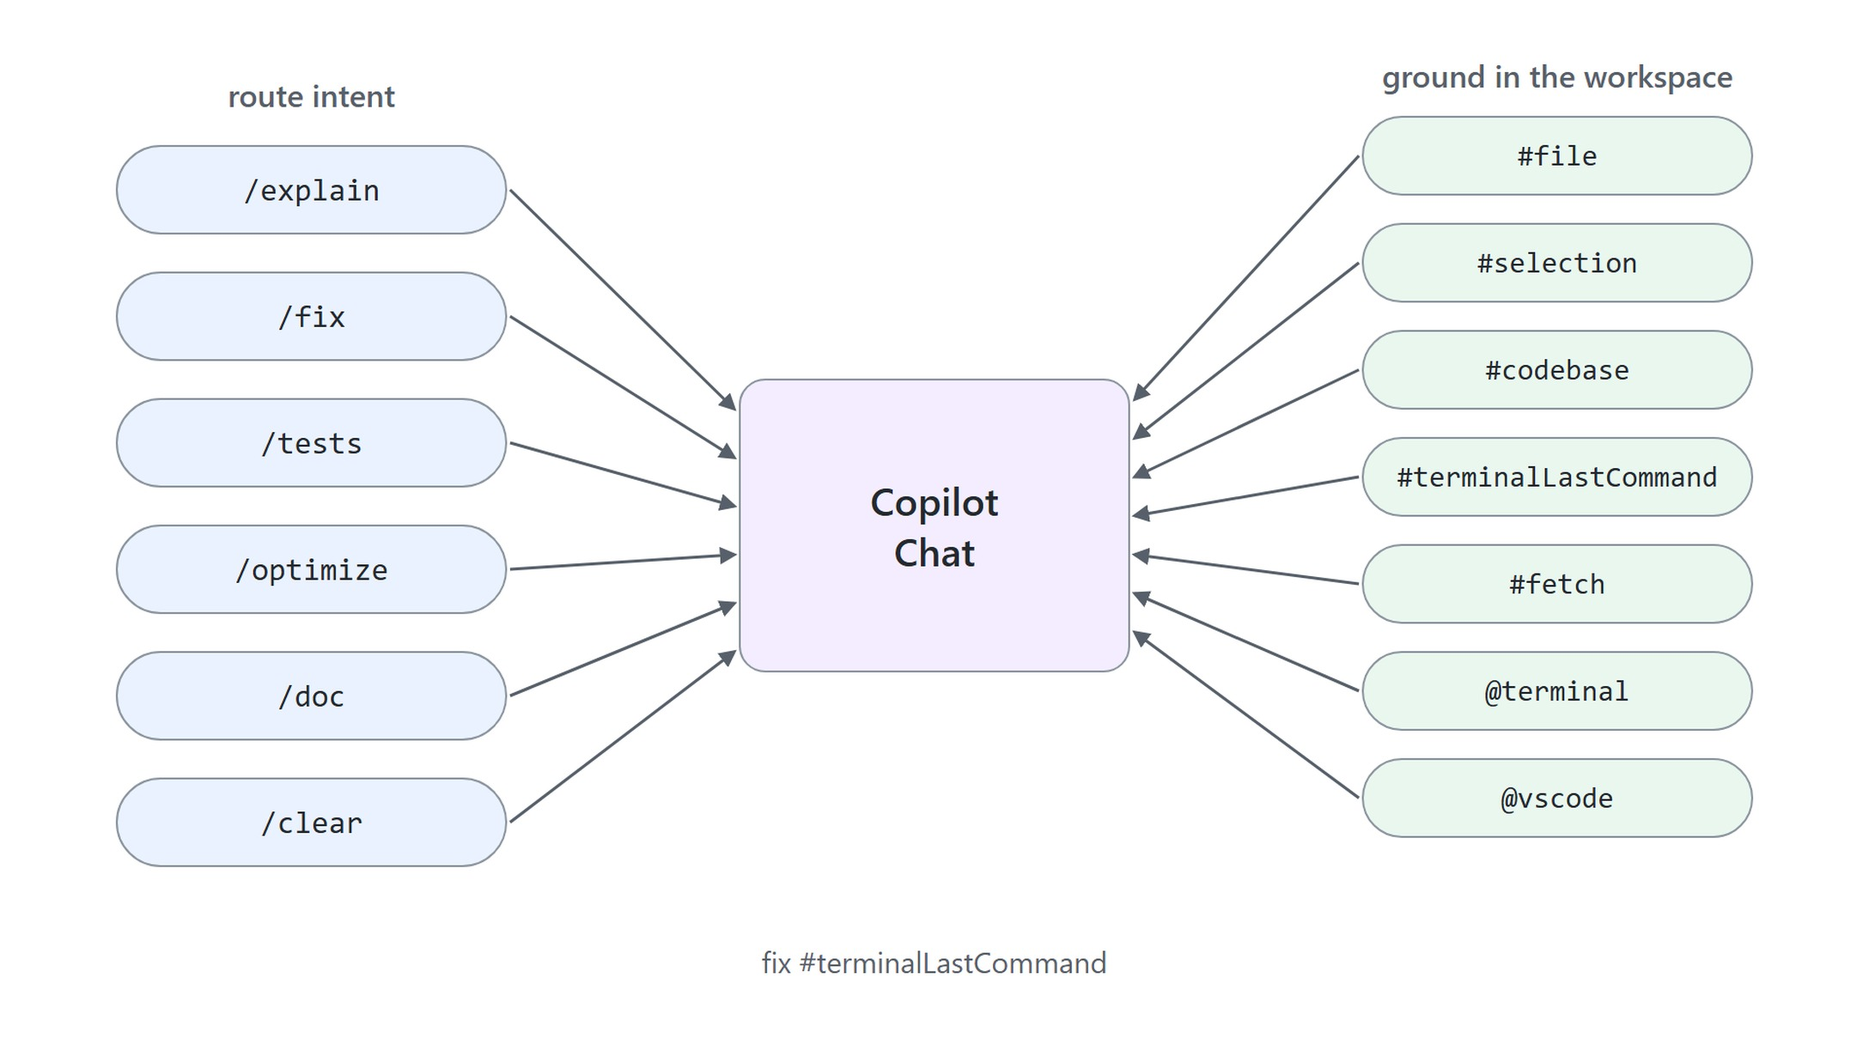
Slash commands and context variables
Route the intent, ground the request
Slash commands route intent: /explain, /fix, /tests, /optimize
#file, #selection and #codebase point at workspace code
#terminalLastCommand and @terminal bring in terminal output and errors
#fetch pulls in content from a URL
Notes:
Beyond the prompt text, two chat features steer a request: slash commands route intent, and context variables ground it in the workspace.
Slash commands: /explain, /fix, /tests and /optimize route intent directly to the right capability without a full natural-language prompt. They combine well with a code selection.
Workspace code: #file references a specific file, #selection the selected code, and #codebase gives codebase-wide context for architecture and patterns.
Terminal: #terminalLastCommand references the last command run, and @terminal includes output or errors from the active terminal. The demo runs tasks-api with dotnet run, then sends fix #terminalLastCommand.
URLs: #fetch fetches and includes content from URLs or external sources.

Slide 23

Scaffolding an app with #fetch
One prompt, a running Agent Framework app
#fetch retrieves the Microsoft Agent Framework quick start from Microsoft Learn
One prompt: a Python 3.12 hello world, requirements.txt, .venv, .gitignore and .env
"Implement the sample and run it until all errors are fixed"
A beginner readme explains where the .env values come from in Microsoft Foundry
Notes:
The #fetch demo shows a context variable scaffolding a whole project from an article.
Fetch the docs: #fetch retrieves the Microsoft Agent Framework quick start from Microsoft Learn, so the code is written against current documentation.
One prompt: it asks for a Python 3.12 hello world plus requirements.txt, an activated .venv, a Python .gitignore and a .env with PROJECT_ENDPOINT and MODEL_DEPLOYMENT.
Run until fixed: the prompt tells the model to implement the sample and run it until all errors are fixed. That instruction is the small step into Agent Mode.
Beginner readme: the result includes short instructions for running the app and for finding the .env values in Microsoft Foundry. The solution is in the maf-starter-solution folder.

Slide 24
05
Agent Mode Basics
Local agents for multi-step work
Agentic Software Engineering using GitHub Copilot

Slide 25
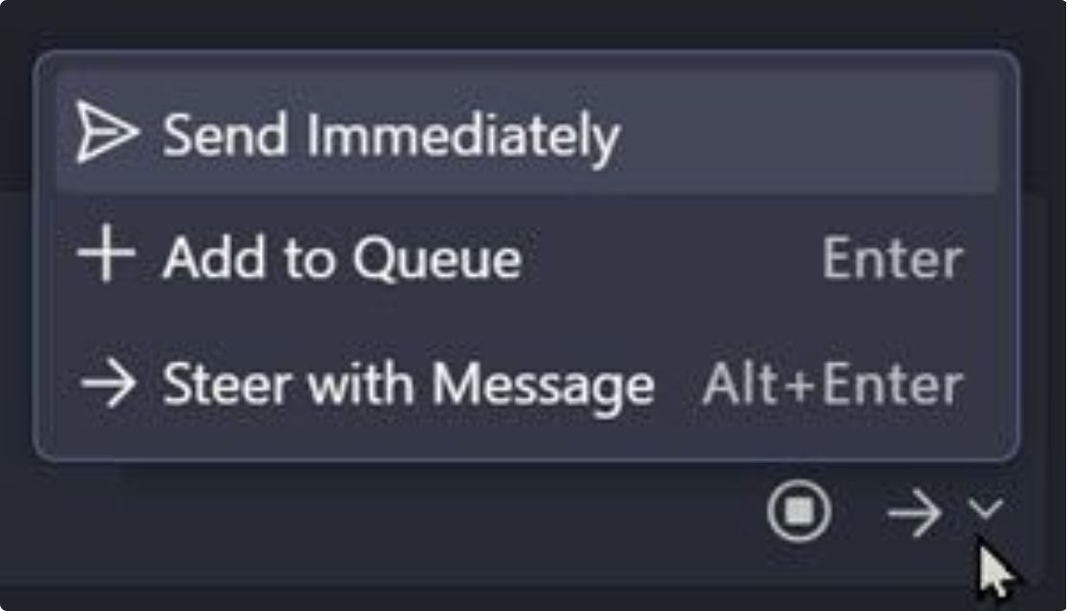
Local agents in Agent Mode
Real-time, multi-step work inside your editor
Runs in your VS Code session: workspace files, terminal, editor state, npm scripts
Synchronous and blocking: one sequential task at a time
Full local auth: Azure CLI credentials, Git tokens, SSH keys, environment variables
Steering and queueing mid-run follow in module 3, Local Agents
Notes:
Here the module pivots to Agent Mode, where a local agent works inside your VS Code session instead of suggesting code.
Integration: the agent has direct access to workspace files, the terminal, editor state and npm scripts, with real-time feedback.
Synchronous and blocking: it runs a single sequential task at a time. That makes it best for focused tasks, debugging and rapid iteration, but it blocks the editor and cannot parallelize.
Local auth: it uses your Azure CLI credentials, Git tokens, SSH keys and environment variables, and reaches online resources through local tools such as Microsoft Learn MCP.
Steering and queueing: correcting or stacking up messages while the agent runs is covered in module 3, in the Local Agents topic.

Slide 26
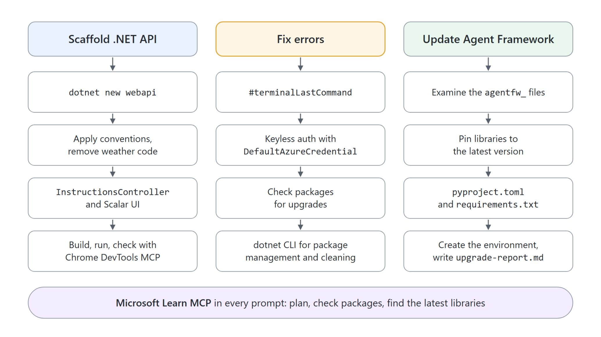
Agent Mode demo tasks
Scaffold, fix, update
Scaffold: dotnet new webapi, an InstructionsController and Scalar UI, checked in the browser
Fix: from #terminalLastCommand to keyless auth with DefaultAzureCredential
Update: pin the agentfw_ agents to the latest Agent Framework, write upgrade-report.md
Each prompt sends the agent to Microsoft Learn MCP and to build, run and fix until clean
Notes:
Three demos put the local agent through real, multi-step work, each driven by a single prompt.
Scaffold: the agent runs dotnet new webapi, removes the weather sample, adds an InstructionsController and Scalar UI, then checks the running API in the browser with Chrome DevTools MCP.
Fix: starting from #terminalLastCommand, the agent moves a C# console app to keyless authentication with the Project Endpoint and DefaultAzureCredential.
Update: the agent pins the agentfw_ agents to the latest Microsoft Agent Framework libraries, updates pyproject.toml and requirements.txt, and writes upgrade-report.md.
Learn MCP and run until clean: each prompt sends the agent to Microsoft Learn MCP and to build, run and fix. Read one aloud: it is a task list, not a question.

Slide 27
06
Pull Requests & Code Reviews
PR descriptions and review feedback
Agentic Software Engineering using GitHub Copilot

Slide 28

Pull requests and code reviews
Descriptions from the diff, feedback before merge
Copilot drafts the PR description from the diff and commit history
It summarizes what changed, why, and the impact
In review it flags potential issues and suggests improvements
It explains complex logic and recommends best practices before merge
Notes:
With the agent writing code, the next topic is how that code gets reviewed: Copilot assists on both sides of a pull request.
PR description: Copilot analyzes the diff and commit history to suggest a clear, well-structured description.
What, why and impact: the description summarizes what changed, why, and the impact, which saves documentation time and keeps descriptions consistent across the team.
Review feedback: during review Copilot identifies potential issues and suggests improvements, so reviewers catch bugs and inconsistencies more efficiently.
Before merge: it explains complex logic and recommends best practices, so authors understand the suggestions and improve code quality before merge.

Slide 29
07
Working in the Terminal
Agent-aware output and compression
Agentic Software Engineering using GitHub Copilot

Slide 30
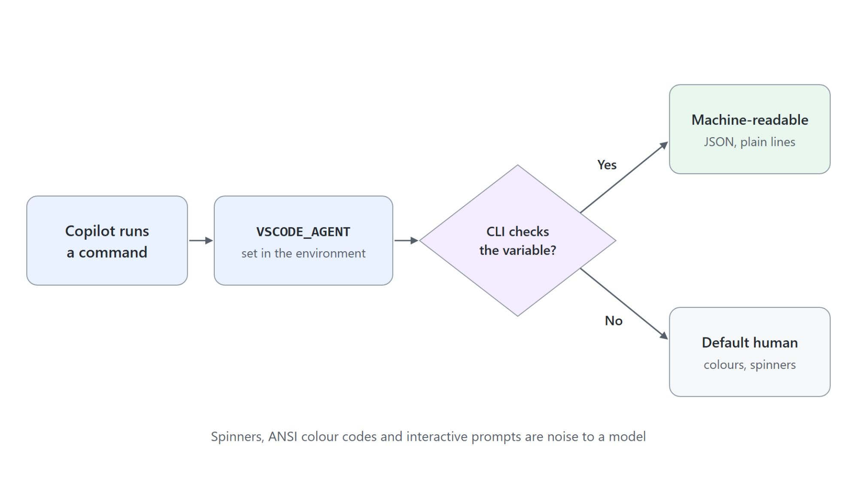
The VSCODE_AGENT variable
Tools that know an agent is calling
Copilot sets VSCODE_AGENT in the environment of every command it runs
A CLI that checks it can emit JSON or plain, parseable lines
Spinners, ANSI colours and prompts are noise that can mislead the model
Run echo $VSCODE_AGENT yourself: empty, because you are not an agent
Notes:
The last topic is the terminal, because agents interact with the shell differently from humans.
VSCODE_AGENT: when Copilot runs a command on your behalf, it sets VSCODE_AGENT in that command's environment.
Machine output: a CLI that checks the variable can tell it is talking to an agent and emit stable, parseable text such as JSON or plain lines.
Noise: progress spinners, ANSI color codes and interactive prompts can push the model toward wrong conclusions about whether a command succeeded. The payoff is fewer parsing mistakes.
Your own terminal: run echo $VSCODE_AGENT yourself and it is empty, because you are a human, not an agent.

Slide 31
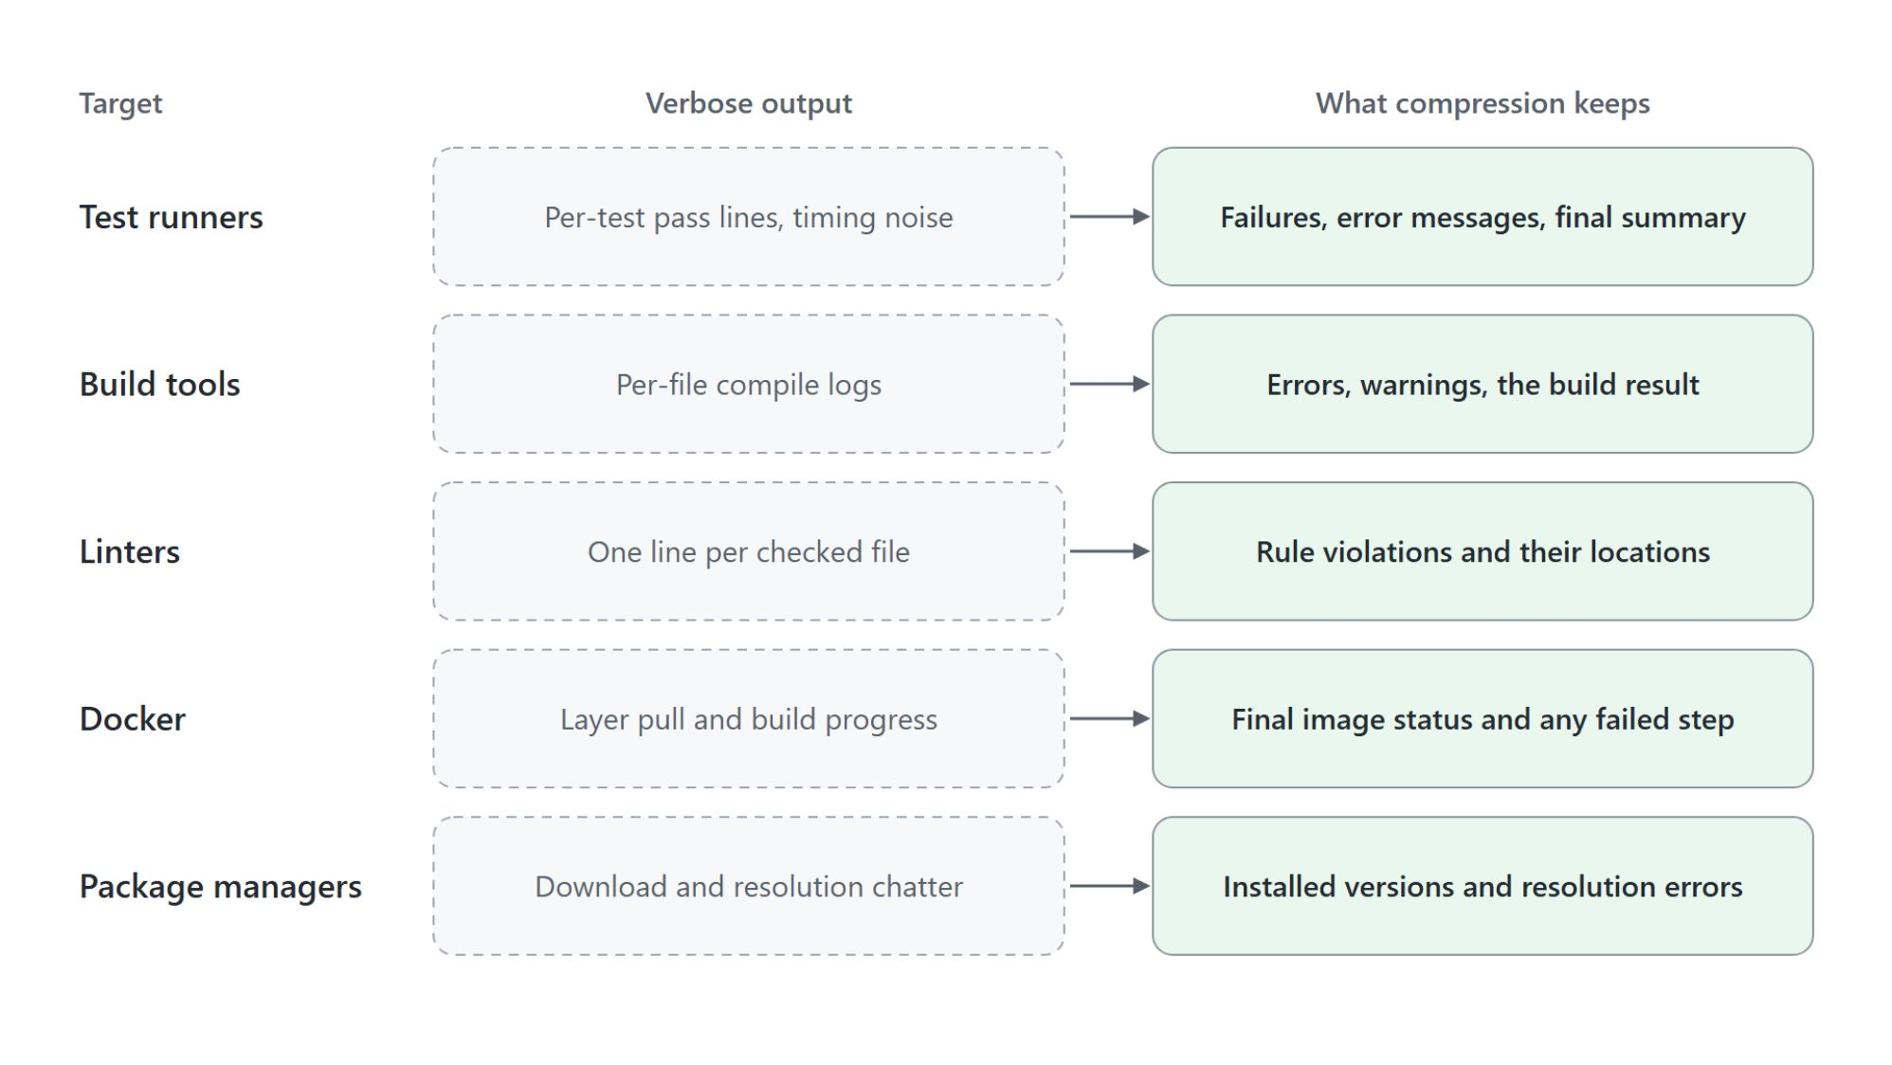
Terminal output compression
Keep the signal, drop the padding
Condenses verbose output before it enters the context window
Keeps failures, warnings and summary lines
Drops progress bars, repeated success lines and download chatter
No flags or redirects needed: the model sees a tight summary
Notes:
The second terminal feature handles commands that produce far more output than a model needs, such as a full test run, a clean build or a large install.
Before the context window: compression condenses verbose output before it enters the context window, so the model spends fewer tokens on boilerplate.
What stays: failures, error messages, warnings and summary lines survive, across test runners, build tools, linters, Docker and package managers.
What goes: progress bars, repeated success lines and download chatter are collapsed.
No flags: you do not add flags or redirect output. The model sees a tight summary and reaches the real signal faster.

Slide 32

Takeaways
What to take into the next module
Pick the model by context size, reasoning effort and cost
Keep the prefix stable and the context focused
Ground requests with slash commands and context variables
Hand multi-step work to a local agent in Agent Mode
Keep secrets out with .gitignore, file patterns and custom instructions
Notes:
Close with the habits the module was built around, from the first suggestion to the first assigned task.
Pick the model: choose by context size, reasoning effort and cost, not by brand name.
Shape the context: keep the prefix stable so caching pays off, and keep the context focused on what the task needs.
Ground the request: slash commands route intent, and context variables point at the code, docs or terminal output that matter.
Hand off and guard: give multi-step work to a local agent in Agent Mode, and keep secrets out with .gitignore, file patterns and custom instructions. Ask the room which task from their own week they would hand to Agent Mode first.

