Slide 1

Implementing agentic coding
Putting agents to work, from your laptop to the cloud
Five ways to put an agent to work: local, cloud, orchestrated, browser-verified, modernization
Start small in Agent Mode, then scale out
Leave able to pick the right delegation model for the job

Slide 2
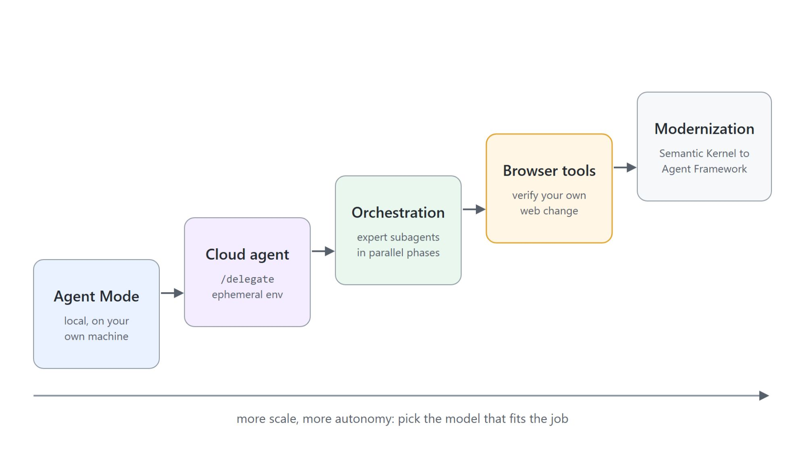
Five ways to put agents to work
From one local loop to a team and a migration
Agent Mode: the baseline, on your machine with your tools and auth
Cloud agents: heavy jobs in an ephemeral remote environment
Orchestration: expert subagents in parallel phases
Browser tools and modernization: verify web changes, migrate frameworks

Slide 3
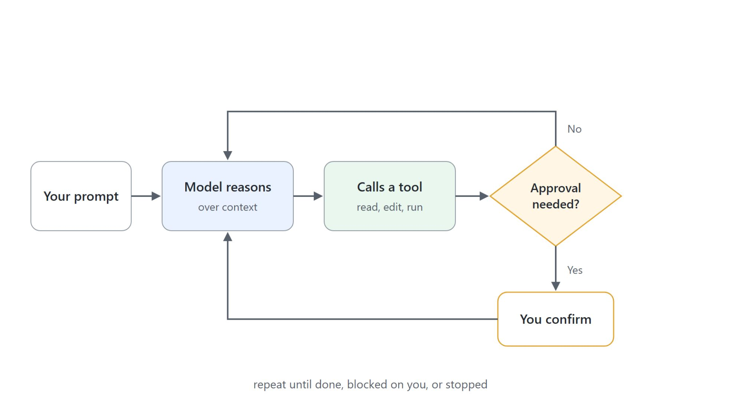
The agent loop
Reason, call a tool, observe, repeat
An agent turn is not one model call: it reasons, calls a tool, reads the result, reasons again
Tools are the verbs: read a file, edit a file, run a command, call an MCP server
Some verbs change your machine, so the loop has an approval gate
The gate is the part you configure

Slide 4
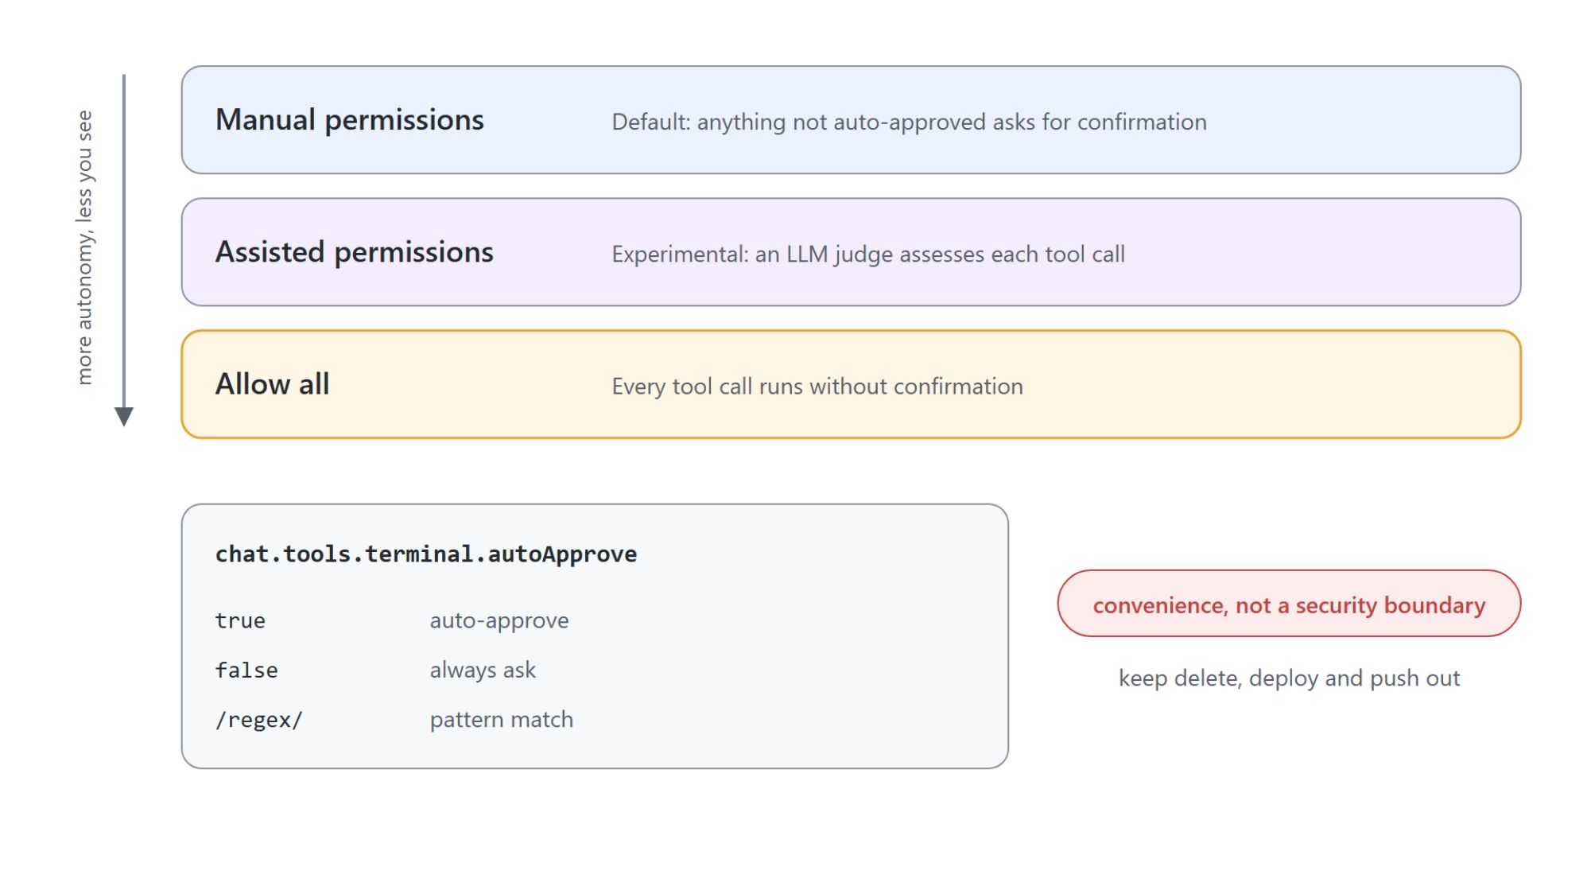
Approvals and permission levels
Chosen per session, loosened deliberately
Manual permissions: the default, anything not auto-approved asks
Assisted permissions: an LLM judge assesses each tool call
Allow all: every tool call runs without confirmation
chat.tools.terminal.autoApprove: true, false, or a /regex/; keep delete, deploy, and push out

Slide 5

Steering, queueing, and checkpoints
A long run is a conversation, not a submission
Steering injects a correction into the request in flight
Queueing waits for it to finish, then runs next (chat.requestQueuing.defaultAction)
A ! prefix skips the model and runs a terminal command
Checkpoints roll back workspace files and chat history together; stopping does not undo

Slide 6
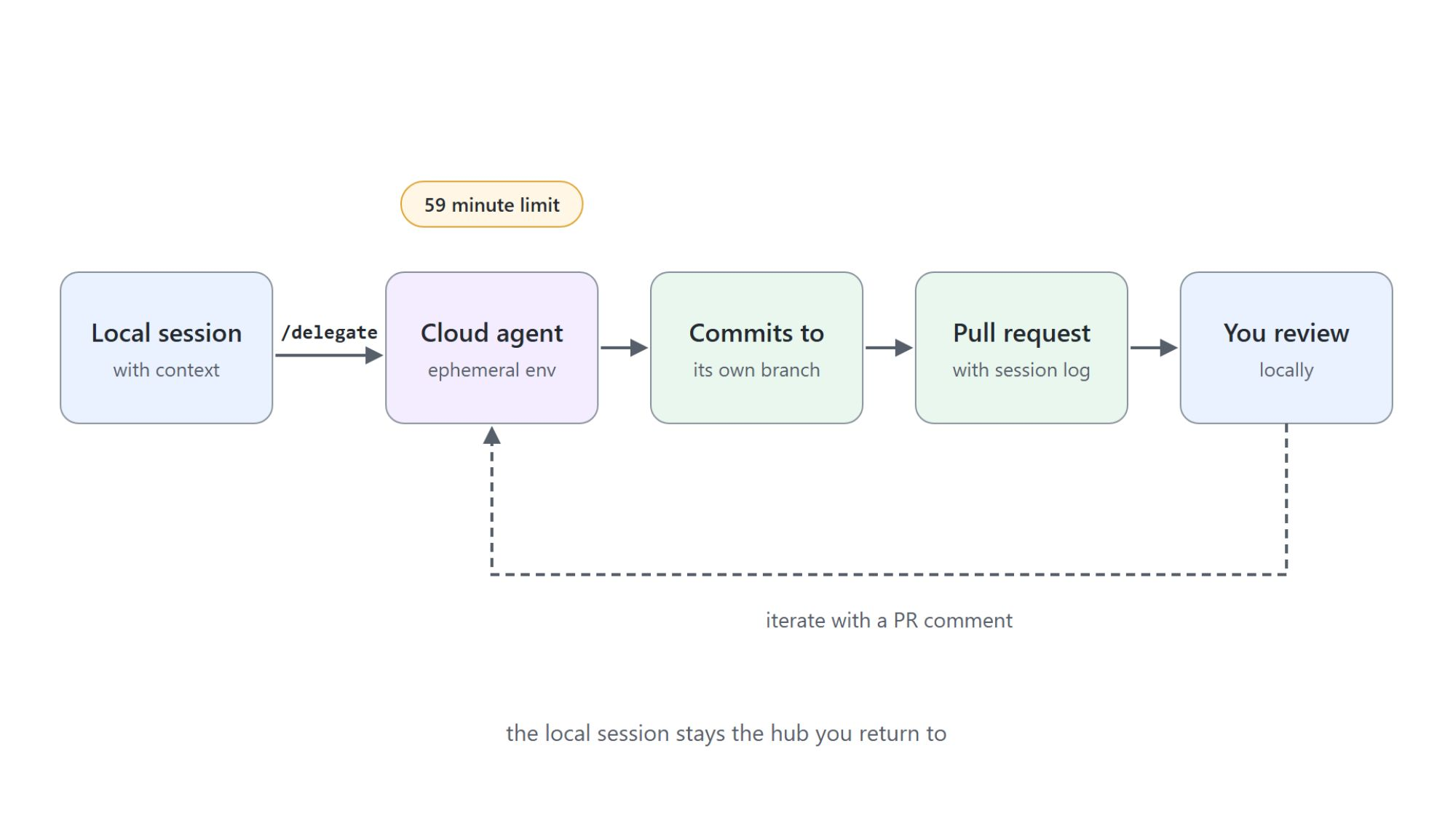
Handing off to a cloud agent
/delegate carries the conversation to the cloud
Type /delegate in a running session, or pick Cloud as the session target
History and context travel with the task
The agent works on its own branch, commits, and opens a pull request
Iterate with a PR comment instead of starting over

Slide 7
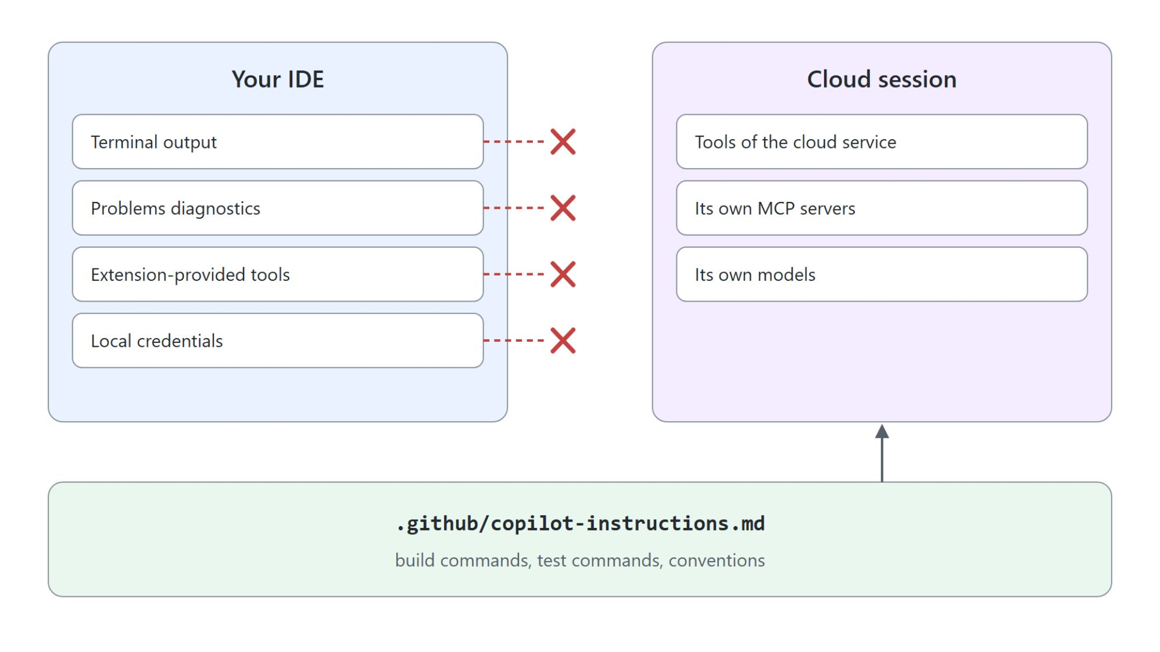
What the cloud agent cannot see
The repository has to carry the context
Cloud sessions use the cloud service's tools, MCP servers, and models
No terminal output, no Problems panel, no extension tools, no local credentials
.github/copilot-instructions.md carries build, test, and conventions
Most disappointing cloud runs trace back to missing context

Slide 8

Scoping a task worth delegating
A written brief, not a conversation
Nobody is there to answer a mid-run question
A good brief: problem, acceptance criteria, which files change
Fits: test coverage, reproducible bugs, config and docs, mechanical refactors
Keep exploratory or turn-by-turn work local

Slide 9
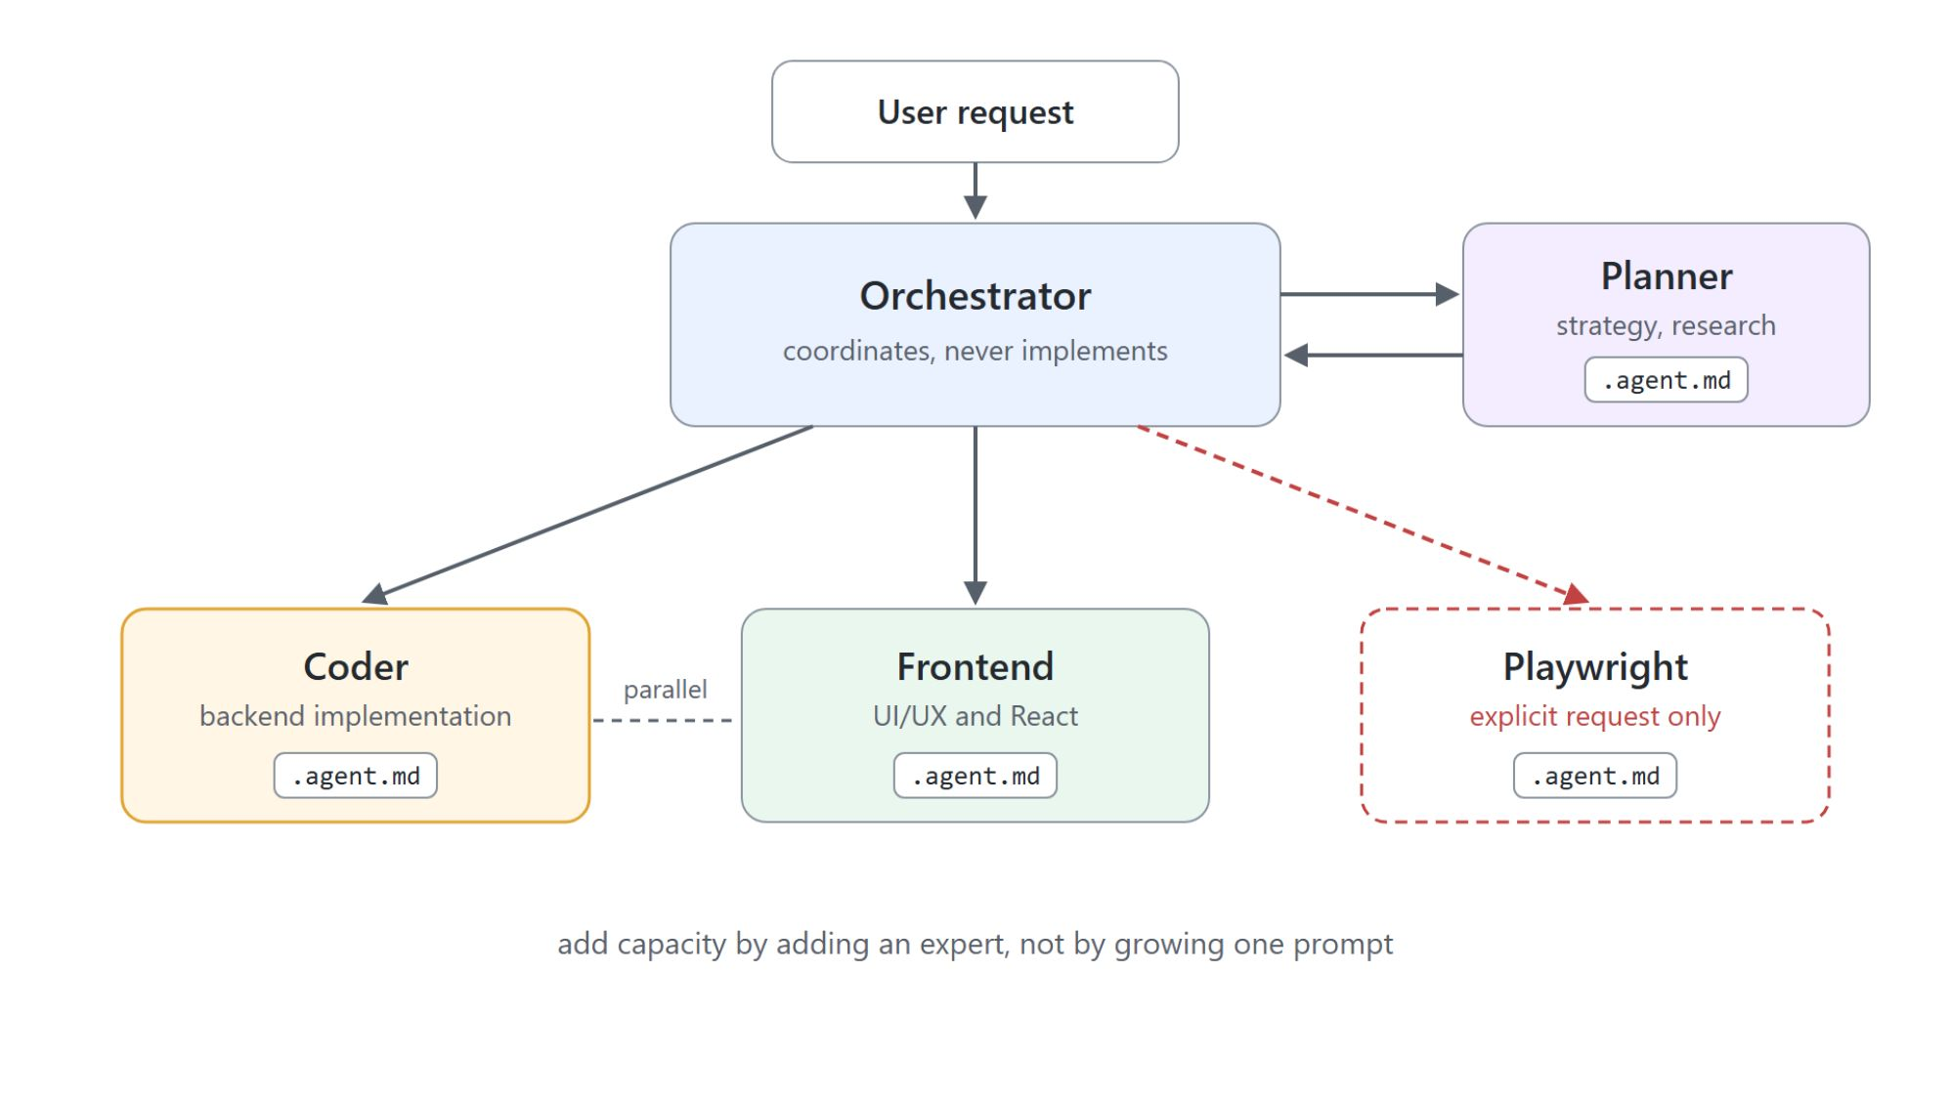
Subagents as subject-matter experts
One orchestrator, a team of focused experts
A subagent works in its own transcript, keeping the primary context clean
Backed by an .agent.md: focused scope, instructions, curated tools, right model
Orchestrator delegates to Planner, then Coder and Frontend in parallel
You add capacity by adding an expert, not by growing one prompt

Slide 10
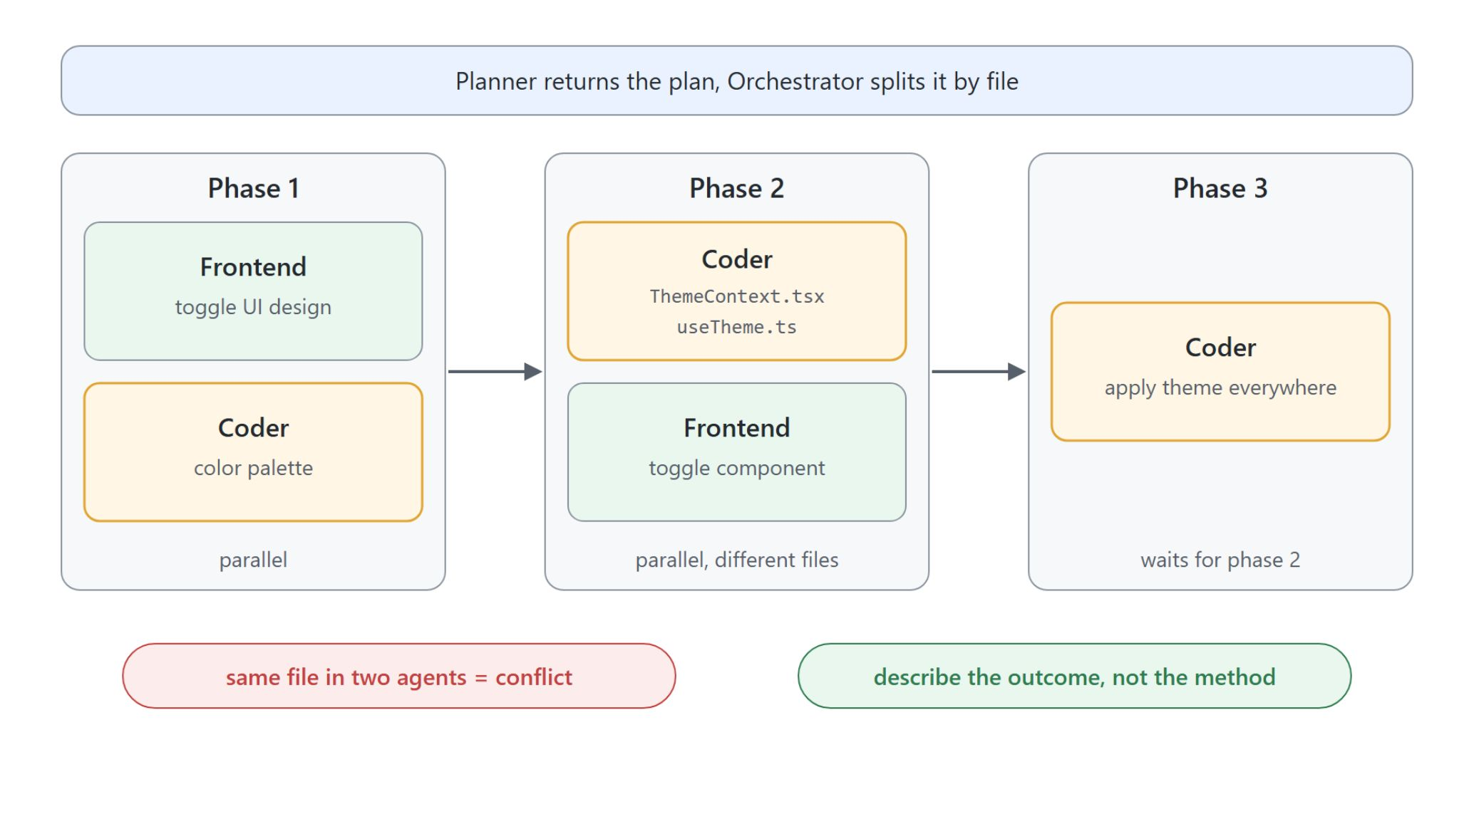
Parallel phases without file conflicts
Different files run together, shared files wait
Orchestrator: plan, parse phases, execute, verify
Tasks with no overlapping files run in parallel
Tasks with shared files run sequentially
Scope each agent to distinct files

Slide 11

Describe the outcome, not the method
"Instead of fix the bug by wrapping with useShallow, say fix the infinite loop error in SideMenu."

Slide 12

Observe and account for delegated work
Read-only peer chats, live status, credits per expert
Open a subagent's transcript as a read-only peer chat: follow it, never steer it
Agents window shows model, elapsed time, current tool call per subagent
Activity pills: live counts for Changes, Previews, Subagents, Browsers
Each subagent shows its own credit cost on hover; pin an exact model ID

Slide 13

Agentic browser automation
Built in, on by default, no MCP server
Open and navigate, read the console, screenshot into chat, click and type
Device emulation through generated Playwright code you can keep as a test
Favorites, history, and a remote proxy for corporate networks
Governed by the BrowserChatTools policy

Slide 14
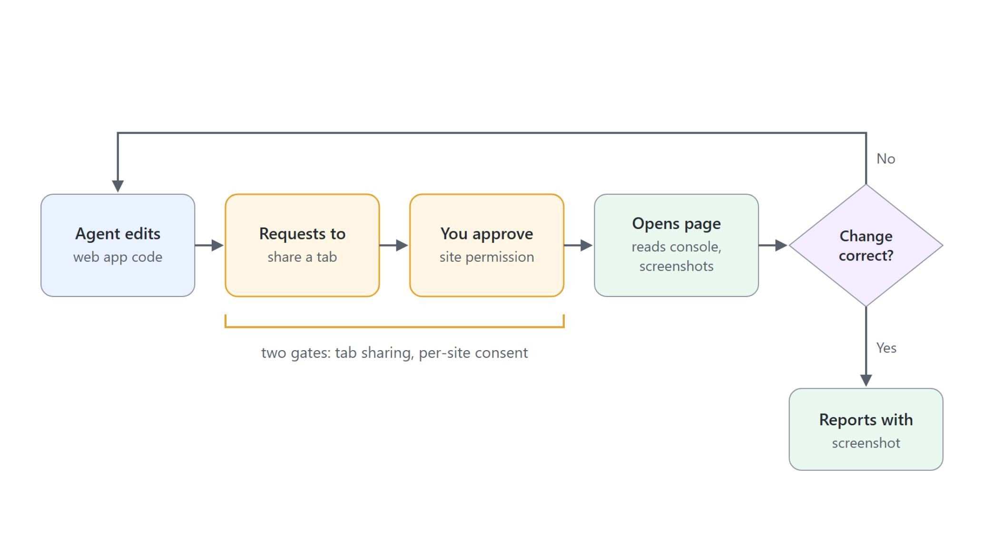
The change-then-verify loop
Tab sharing and per-site consent keep you in the loop
The agent never grabs a tab: it sends a share request, you pick the tab
First visit to a site raises a per-site permission prompt
Approving localhost does not grant the admin portal on another host
Nothing is shared with the agent silently

Slide 15

Annotating a page for the agent
Point at the element instead of describing it
Select an element with Ctrl+Alt+C (Option+Cmd+C on macOS) and comment on it
The agent gets the element and your note together
workbench.browser.autoReloadOnFileChange reloads local HTML on every edit
Edit and rendered result stay in step without a manual refresh

Slide 16
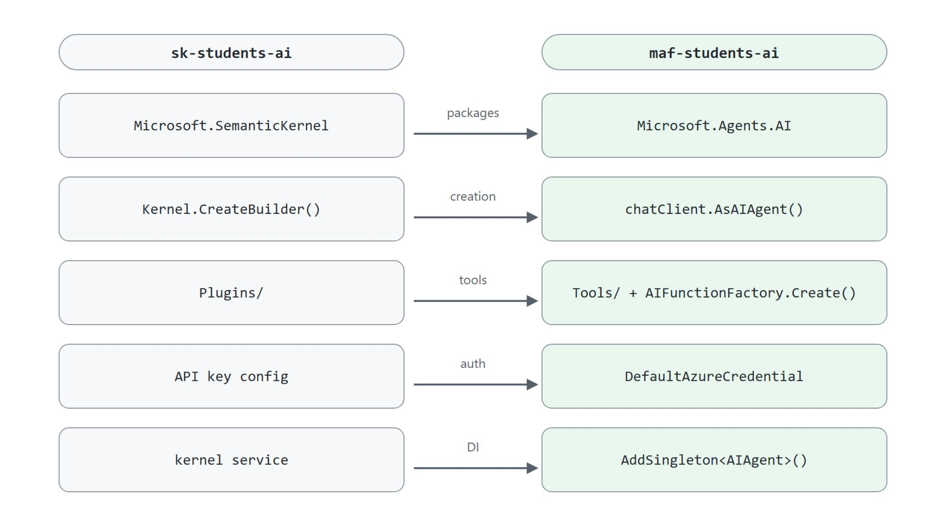
Semantic Kernel to Agent Framework
The same RAG app, migrated by an agent
Packages: Microsoft.SemanticKernel to Microsoft.Agents.AI
Creation: kernel builder to chatClient.AsAIAgent()
Tools: Plugins to Tools with AIFunctionFactory.Create()
Auth and DI: DefaultAzureCredential, agent as a singleton

Slide 17

Let the agent research the migration
Microsoft Learn MCP for versions, APIs, and breaking changes
Ask Learn MCP for the latest stable versions and breaking changes
Research ChatClientAgent before refactoring Program.cs
Compare plugins and tools before renaming the folder
One prompt per migration step: packages, creation, tools, auth, DI

Slide 18

Pick the right way to delegate
Match the job to the agent
Bounded and interactive: Agent Mode
Well-scoped and long: cloud agent with /delegate
Spans domains: orchestrator with expert subagents
Web change or migration: let the agent verify and research

