Slide 1

Agent sessions and the Agents window
From an in-editor assistant to long-lived agent sessions
Copilot has moved from an in-editor assistant to an agent-session model
The Agents window is the companion surface where that model lives
Sessions run across projects, locally or on remote hosts, as first-class, long-lived objects

Slide 2
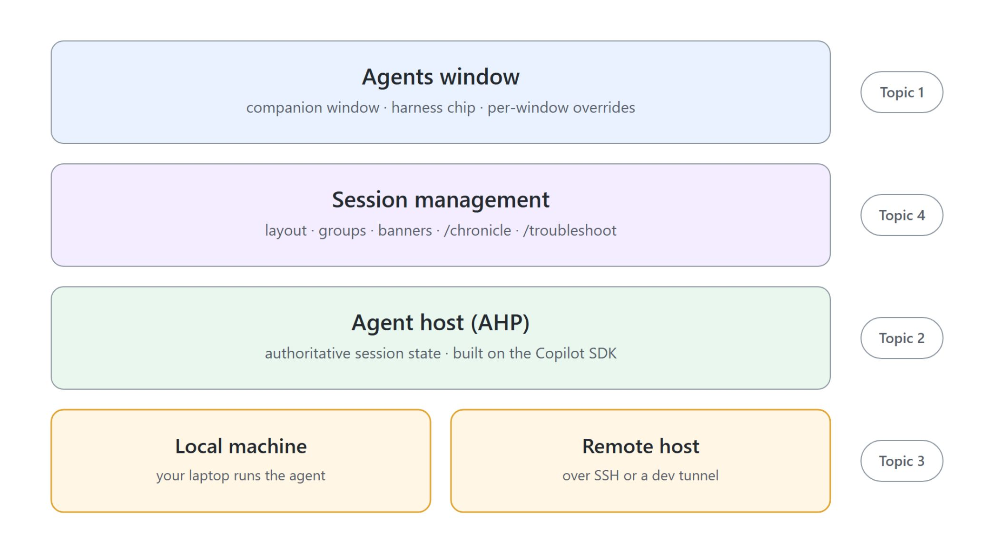
The session-centric product
Four topics, one stack from window to host
The Agents window: a dedicated companion window with a selectable harness
Agent Host Protocol: session state lives on a long-lived host, not in the client
Remote sessions: the agent runs over SSH or a dev tunnel, your editor stays local
Session management: side by side, groups, background send, /chronicle, /troubleshoot

Slide 3

Read-first slash commands
Safe to reach for while a session is live
/chronicle: query session history with standup, search, reindex
/troubleshoot: analyze the session's own record to diagnose a stall or a failed tool call
/btw: ask a side question without interrupting the running turn
Ctrl+R opens the Sessions picker to jump between sessions

Slide 4

The Agents window
The primary surface for agent work, beside the editor
A companion window for agent sessions, kept out of the main editor layout
A selectable harness per window: Copilot, Claude, or Codex
Remote execution and per-window overrides for model, project, and host
Open it with Open in Agents, Chat: Open Agents window, or code --agents

Slide 5
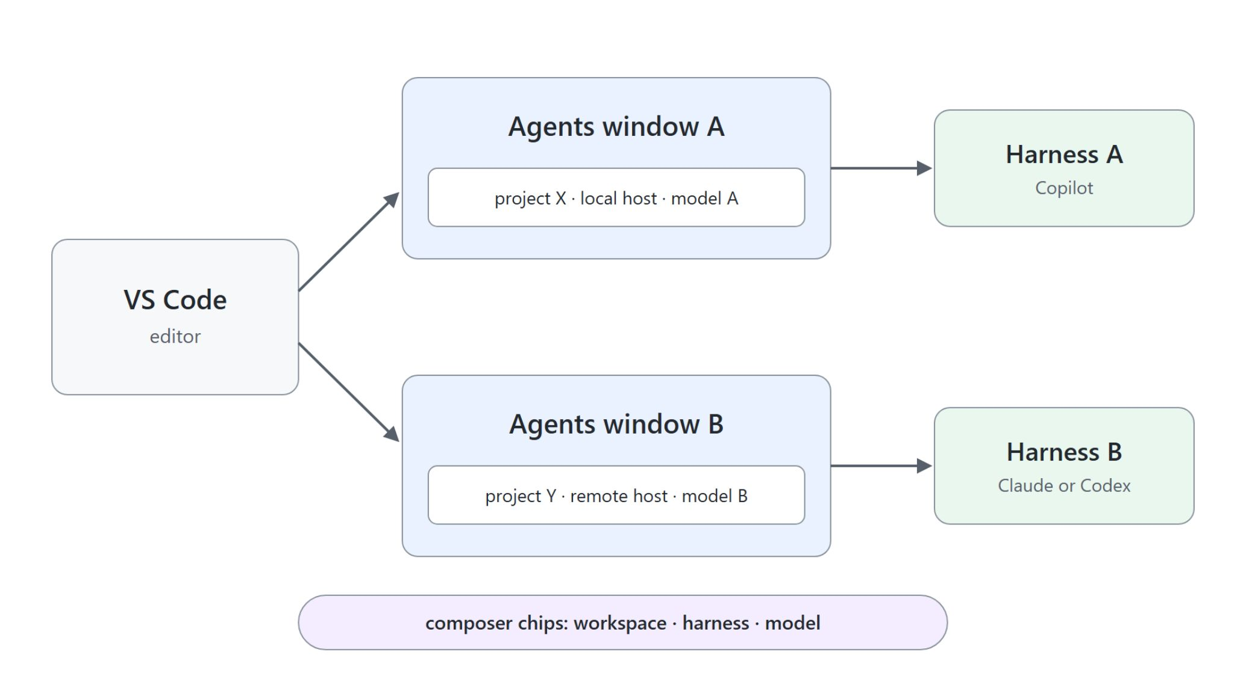
How one window differs from the next
Each window carries its own context and target
New or Ctrl+N opens the composer with three chips: workspace, harness, model
A window overriding model and host changes no other window
Several projects run at the same time without interfering
Ctrl+R walks the Sessions picker, Ctrl+Shift+T reopens the last closed chat

Slide 6
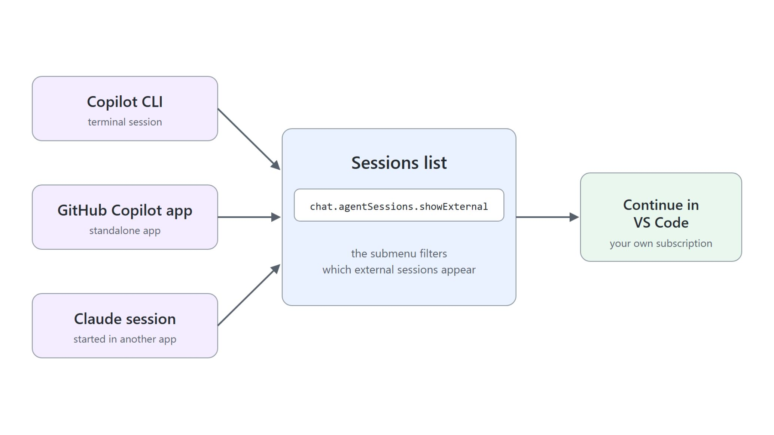
Sessions started somewhere else
Continue CLI and app sessions in VS Code
chat.agentSessions.showExternal shows Copilot or Claude sessions from other applications
Sources include the Copilot CLI and the standalone GitHub Copilot app
Select one to see its conversation and continue it against your own subscription
The Sessions list submenu filters what appears on a busy machine

Slide 7
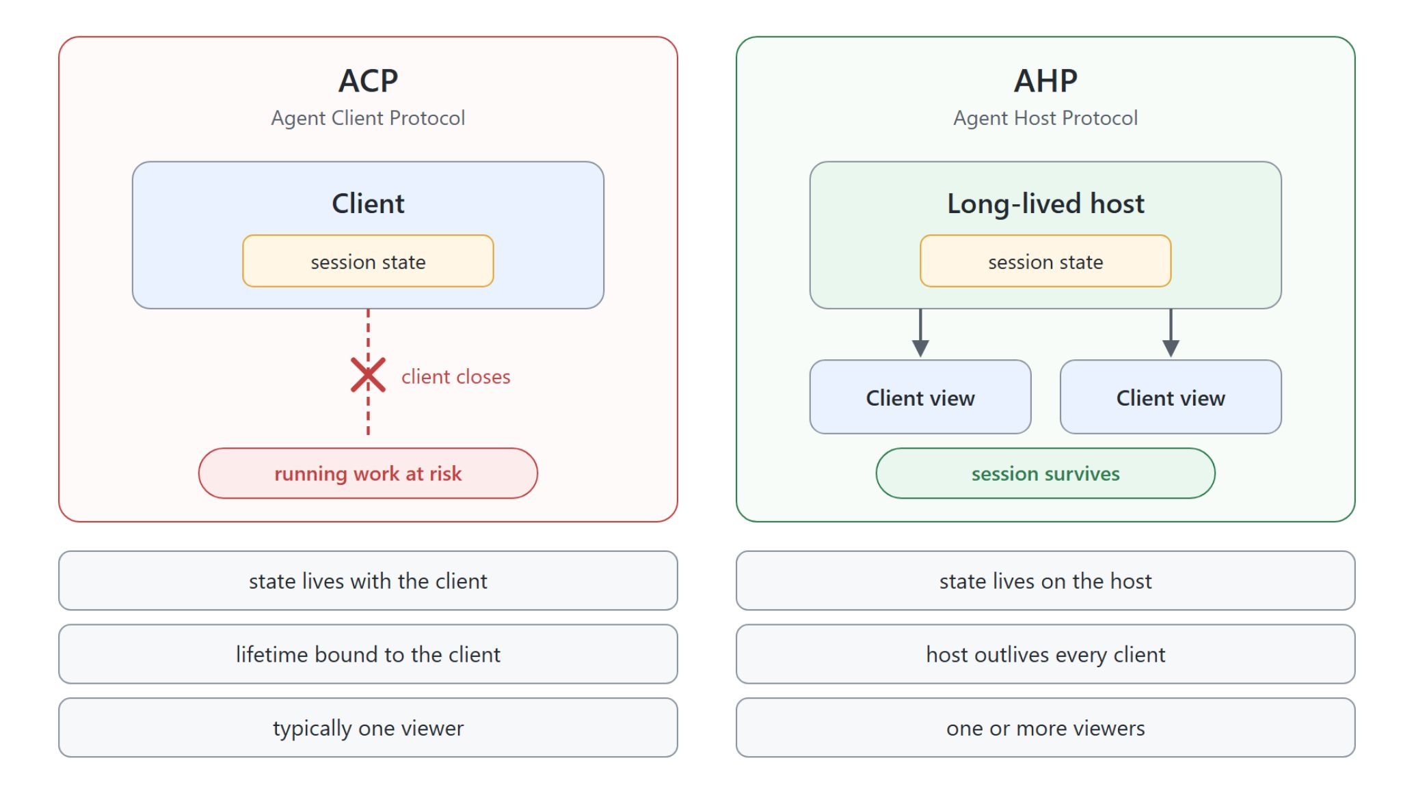
AHP vs ACP at a glance
Where session state lives decides what survives
ACP: authoritative state lives with the client; closing it risks the running work
AHP: authoritative state lives on a long-lived host that outlives clients
Under AHP the client is a view, and one session can have several viewers
An architect-track topic: the boundary between where state lives and where you view it

Slide 8
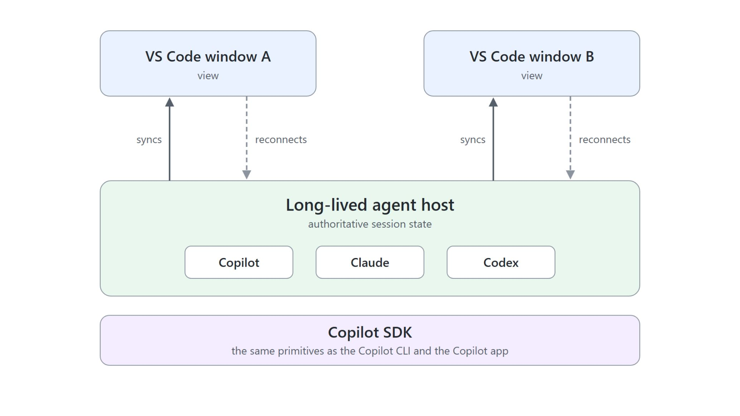
Host-authoritative state
Built on the Copilot SDK, shared by every harness
Every Agents window session already runs on the host; nothing to switch on
Copilot, Claude, and Codex share the same host
The Copilot agent is powered by the Copilot SDK, matching the CLI and the Copilot app
Settings control which harnesses and hosts are offered, not the protocol

Slide 9

The session, not the window, owns the work
Close the window mid-run and come back
Start a task long enough to still be running a minute from now
Close the window while the agent works
Reopen it: the session is still running, carrying the turns that completed
Open it in a second window: both views track one session

Slide 10
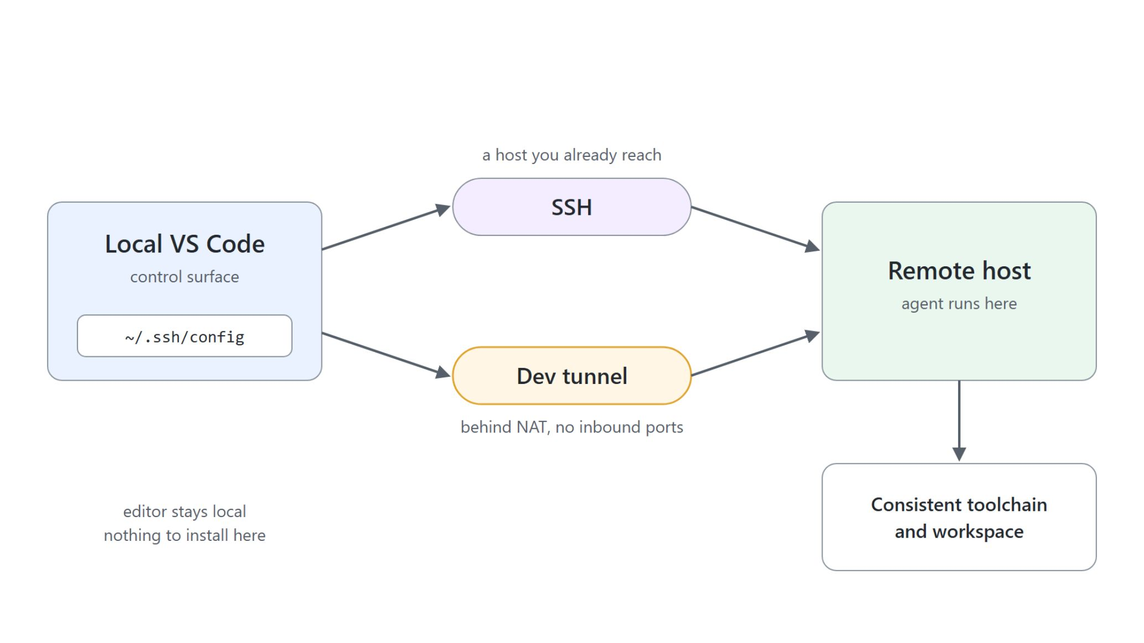
Remote agent sessions
SSH and dev tunnels to a reproducible host
The agent executes on a consistent, cloud-backed host, not your laptop
SSH: a host you already reach, whose runtimes and credentials the agent inherits
Dev tunnel: hosts behind NAT or a firewall, no inbound ports
Replaces the Codespaces and Dev Container workflow in this course

Slide 11

Hello world on a Raspberry Pi
Nothing installed on the laptop
An entry in ~/.ssh/config makes raspi-4 selectable by name; pin the key with IdentityFile
Workspace chip: Local to Remote tab, pick the host, select /home/alex
First connect installs the VS Code CLI on the Pi; nothing else
The agent writes, runs, and curls the service on the Pi; port 8000 is forwarded to you

Slide 12
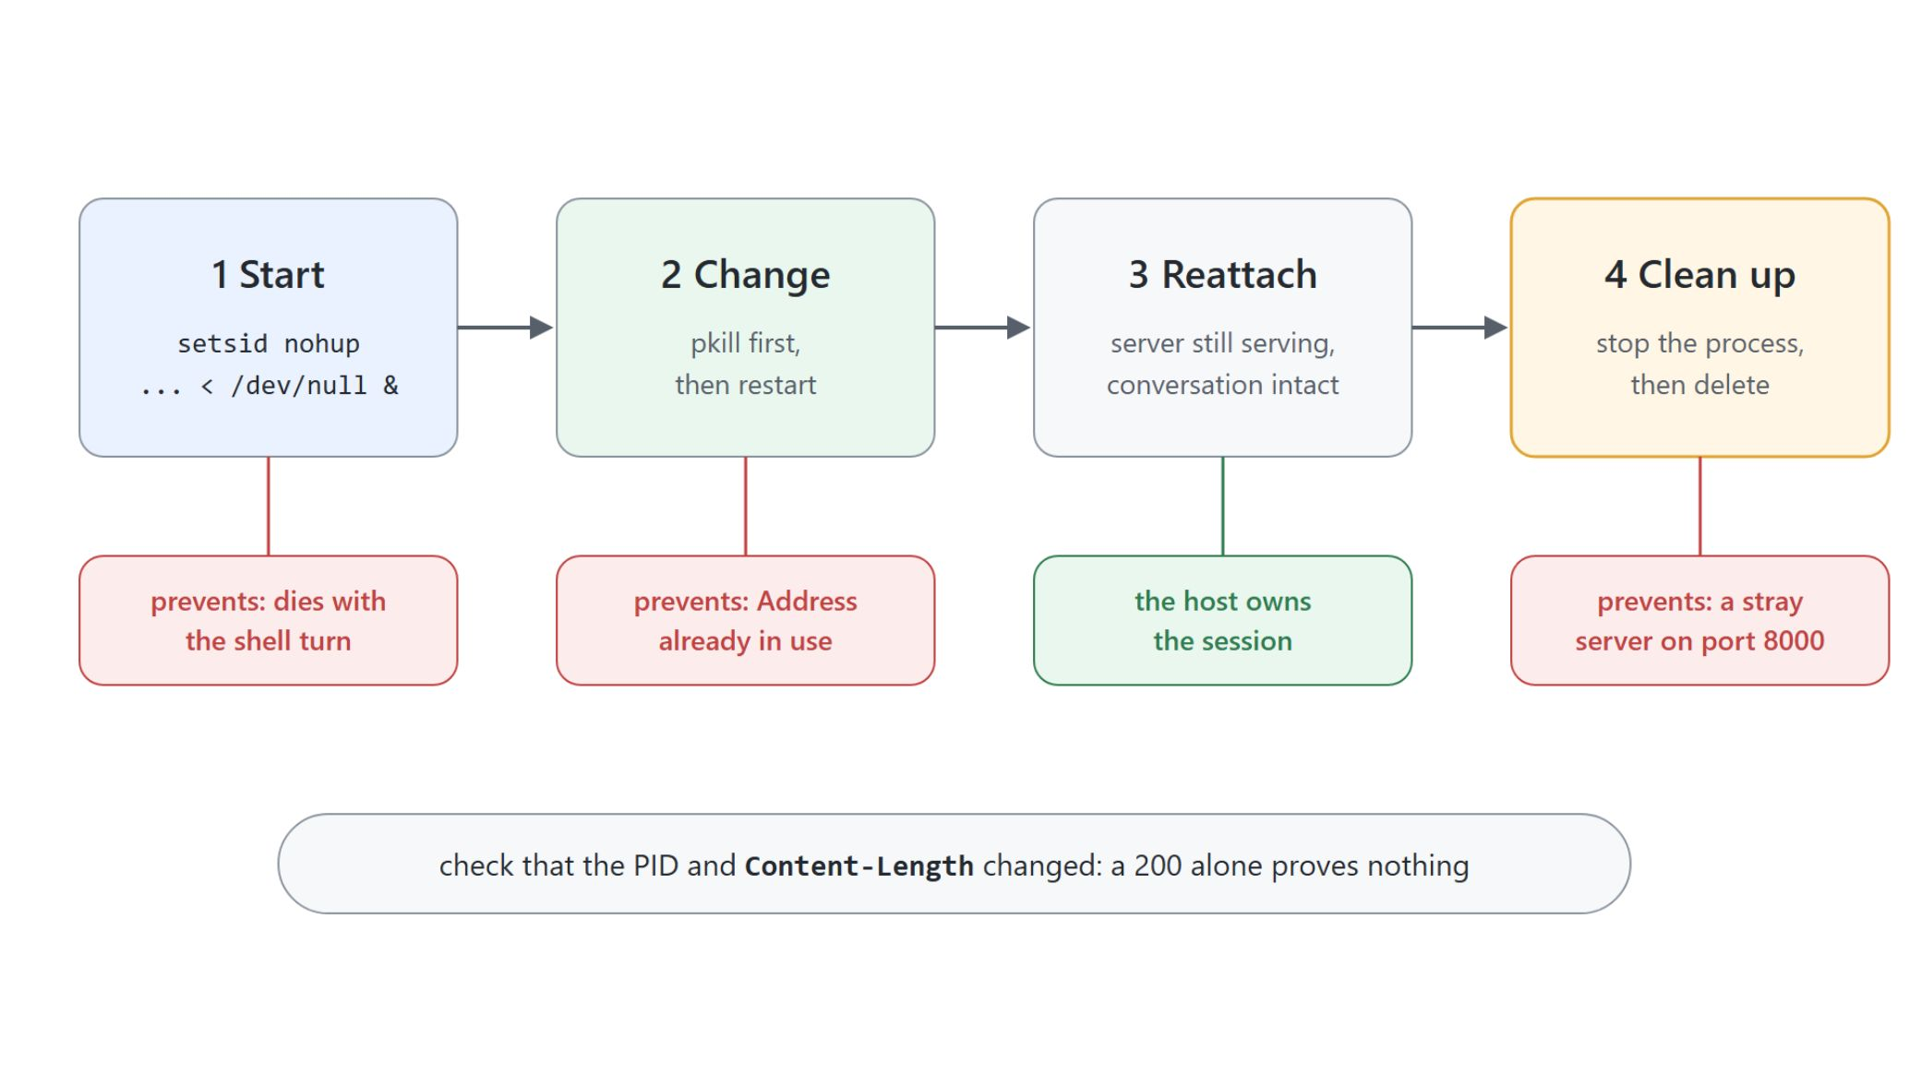
The load-bearing details
Start detached, stop first, clean up in order
setsid nohup ... < /dev/null &: a plain background start dies with the shell turn
Stop before restart, or Address already in use hides in the log while old code answers
[p]ython3 stops pkill from killing the agent's own shell
Clean up in order: stop, then delete; check that the PID and Content-Length changed

Slide 13

Layout, navigation, and background work
Managing many sessions becomes the bottleneck
Side by side, pin, and maximize keep two related sessions visible
Ctrl+R Sessions picker; Ctrl+Shift+O jumps within the current session
Background send keeps a session working while you move on
Restore on reload keeps in-flight sessions; Close All clears them

Slide 14
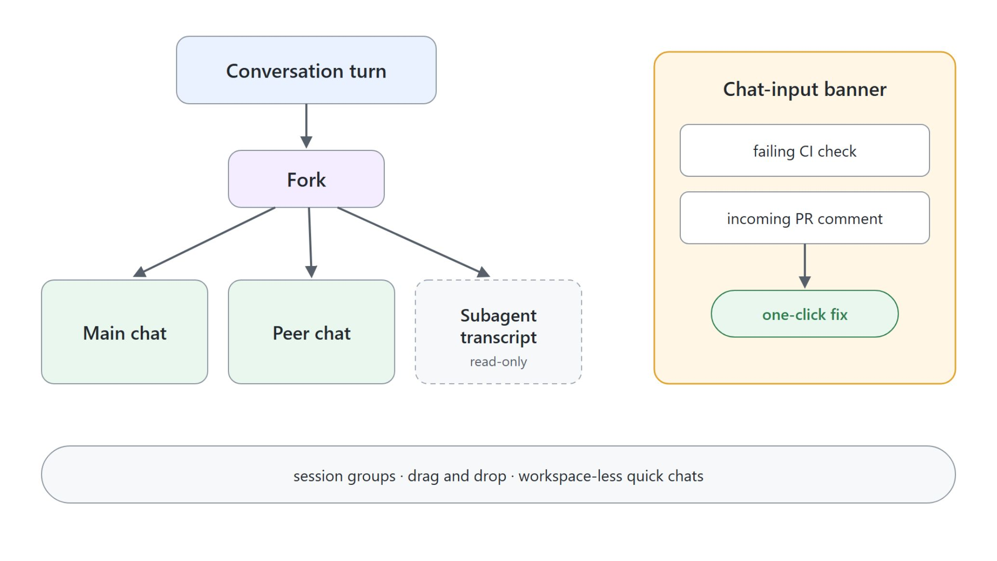
Groups, banners, and multi-chat
Signals and responses in the same place
Session groups with drag and drop, like organizing files
Chat-input banners surface failing CI checks and PR comments with one-click actions
Multi-chat forks a turn into peer chats; Claude subagent transcripts are read-only
Review threads via addComment, listComments, resolveComments

Slide 15
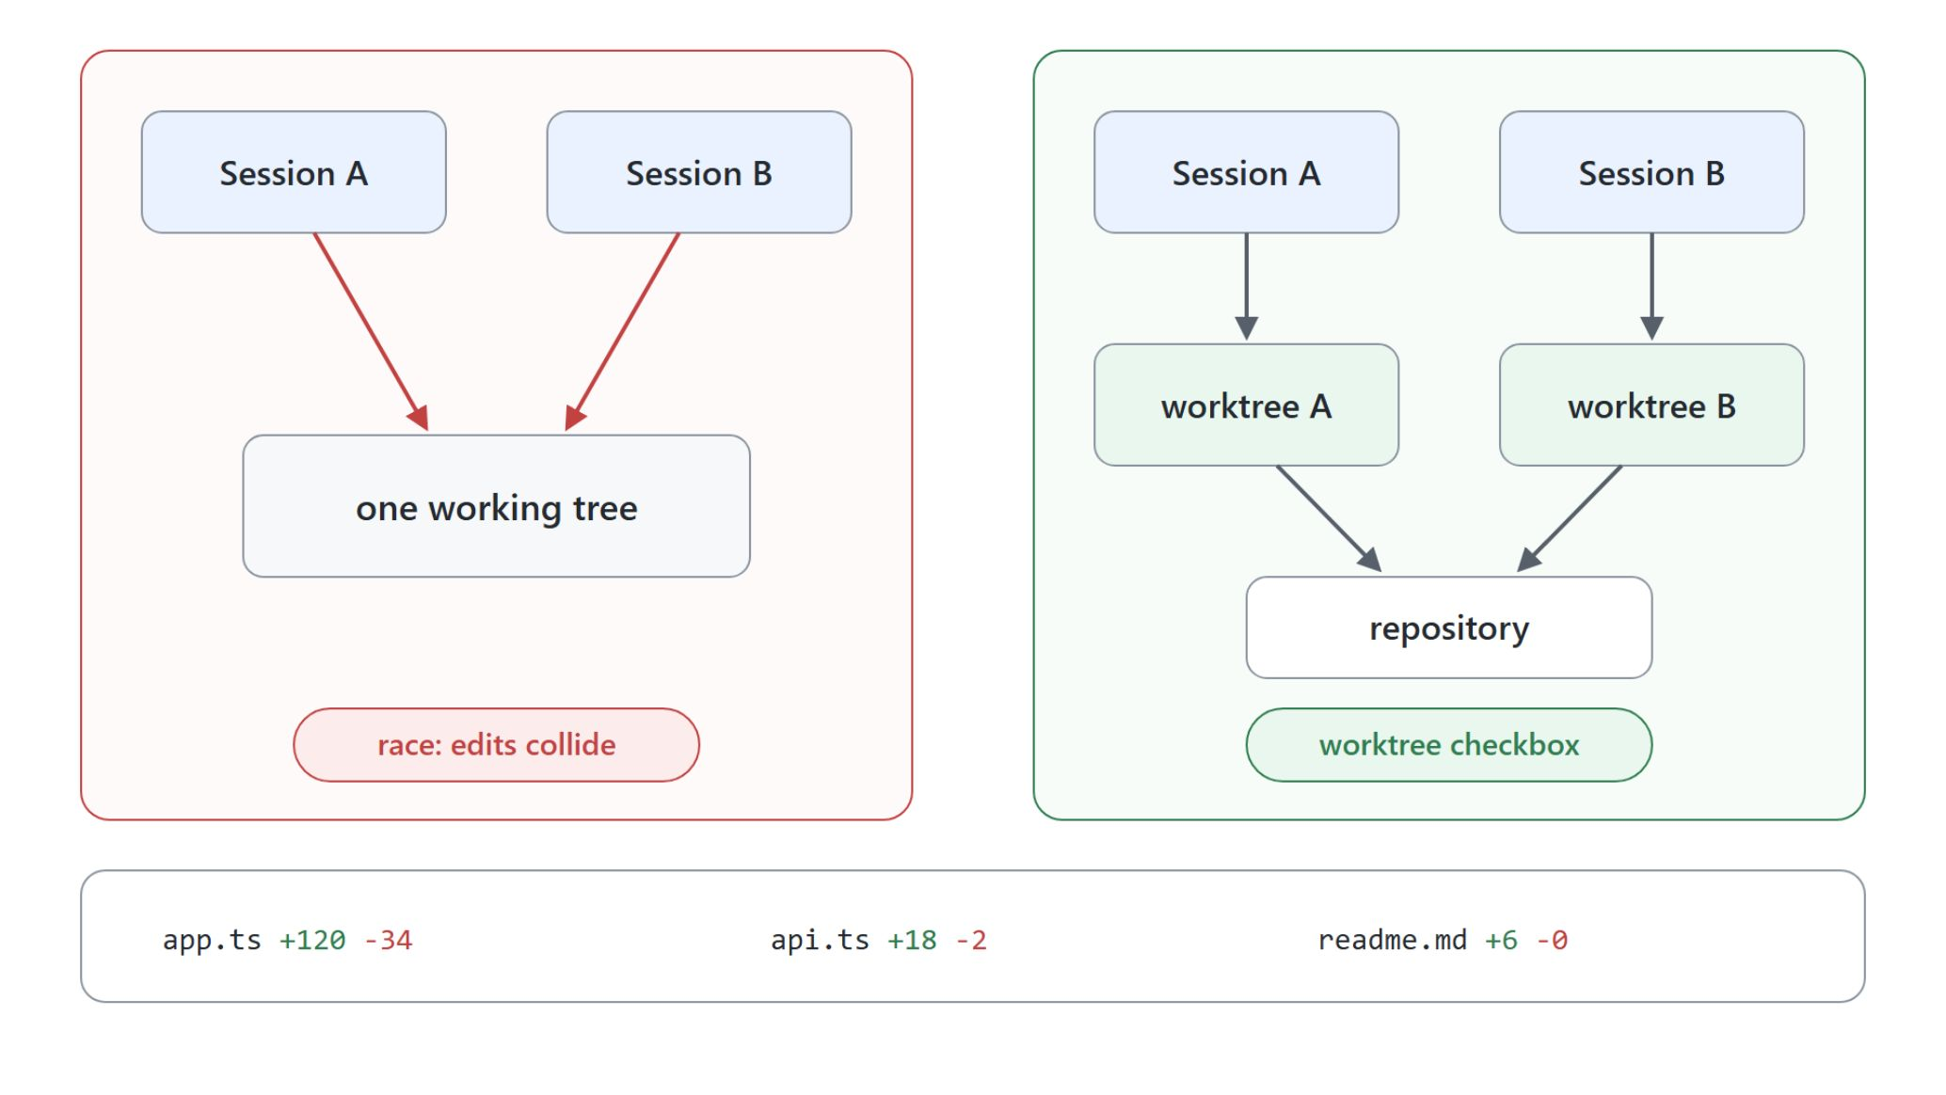
Isolation, diffs, and side chats
Two sessions on one working tree is a race
The worktree checkbox puts a session in its own Git worktree, on every harness
File-level diff stats and a compact multi-file diff view for long runs
/btw side chats share the turn's context and prompt cache
Find in Chat (Ctrl+F) searches collapsed work summaries too

Slide 16
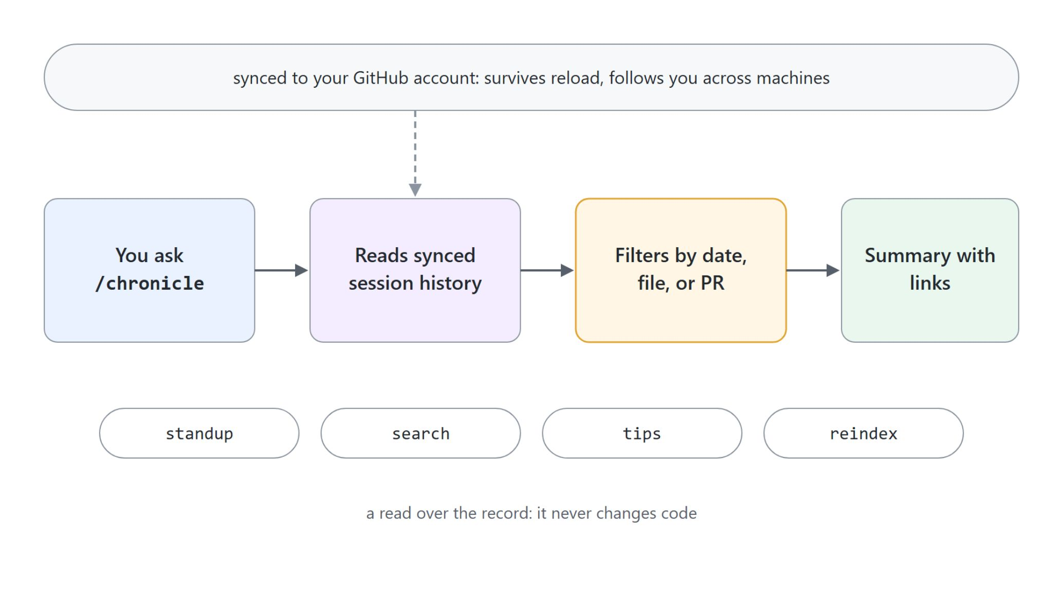
Session persistence and /chronicle
A searchable record of what was attempted
Sessions sync to your GitHub account and survive reload
Cross-machine: start on the laptop, resume on the desktop
/chronicle standup and /chronicle search query the record, never the workspace
/chronicle reindex when a query misses: the index goes stale, not the history

Slide 17

Diagnosing a session with /troubleshoot
Name the failing step, not the error text
Reads the session's own record: prompts, tool calls, failures
Reports what went wrong and where, with a likely cause and fix
For stalls, failed tool calls, and runs that end with no visible reason
Works in local and Copilot CLI sessions: the diagnosis travels with the session

Slide 18

Sessions are durable objects
Run many, run remote, find them again
The window runs sessions side by side, the host owns their state
Remote hosts give every session the same toolchain
/chronicle and /troubleshoot turn history into answers

