Slide 1

GitHub Copilot CLI & SDK
Running the agent outside the editor
CLI: the agent in your terminal, interactive or headless with copilot -p
Agentic Workflows: a prompt that runs on a schedule with gh aw
SDK: the same runtime inside your own applications, in six stacks

Slide 2
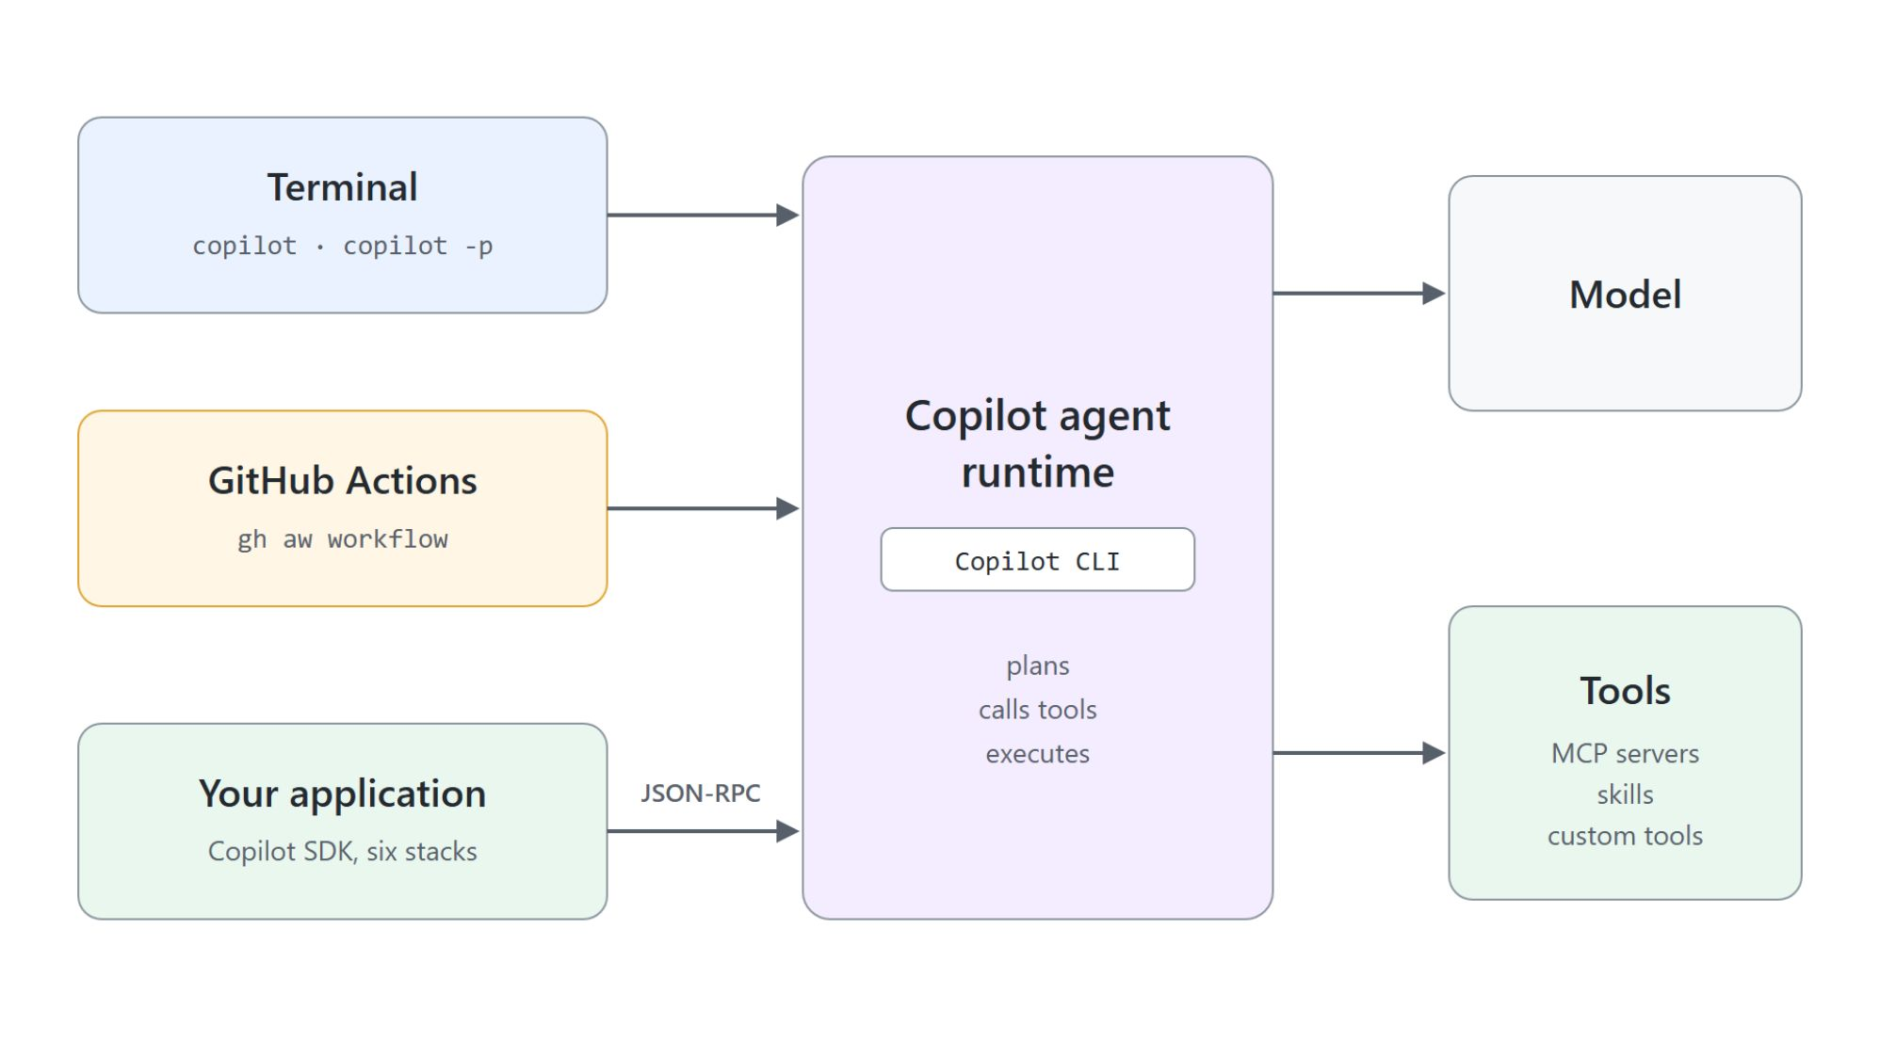
One runtime, two surfaces
The CLI in your terminal, the SDK in your code
The Copilot CLI drives the agent from an interactive shell or a headless -p run
GitHub Agentic Workflows put a CLI-driven agent on an Actions runner
The SDK embeds the same production-tested runtime in your own apps
Every SDK talks to the CLI over JSON-RPC and manages that process for you

Slide 3
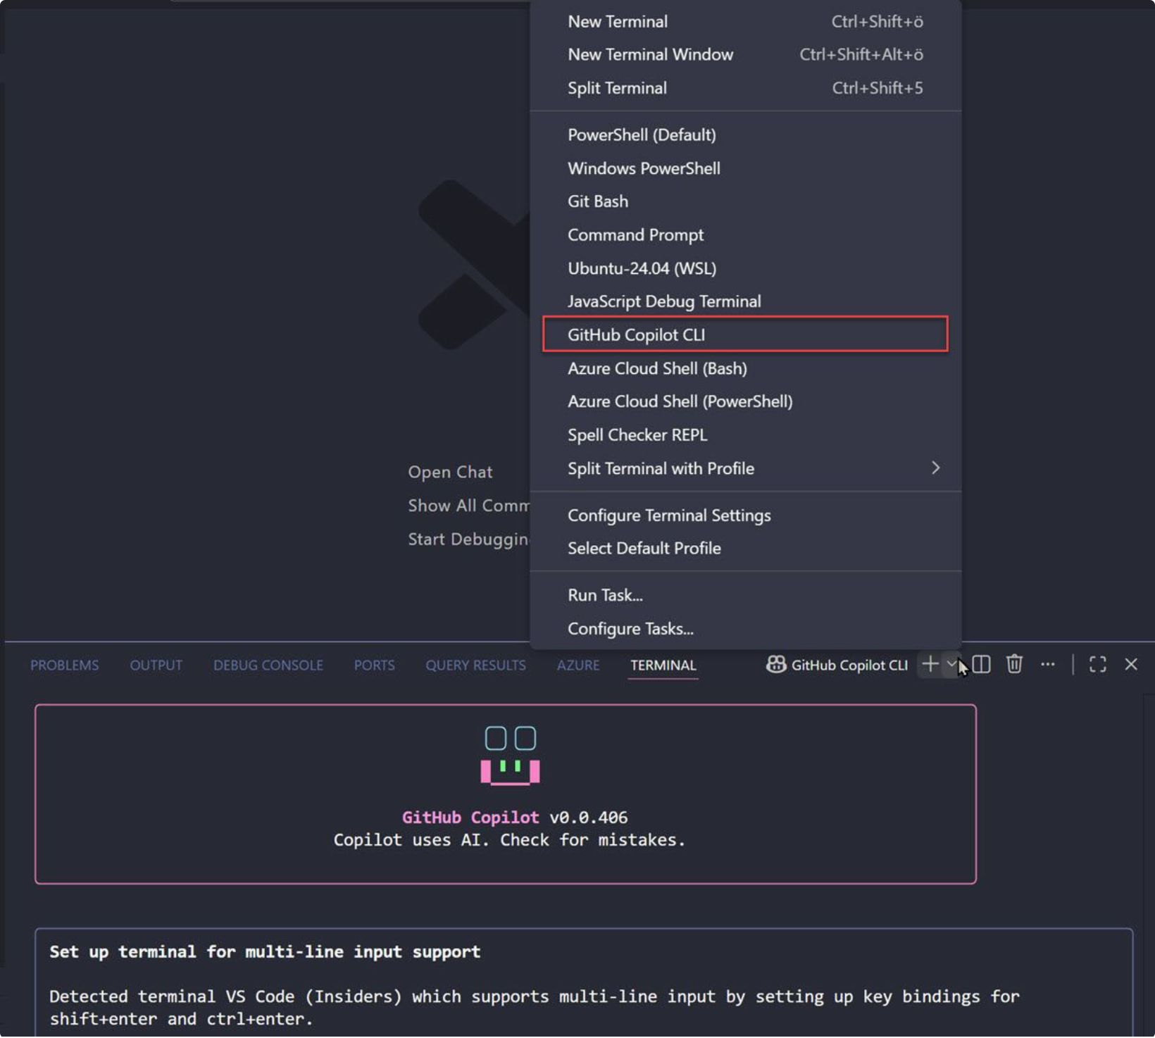
The Copilot CLI in your terminal
Install, sign in, ask in plain language
Install with npm install -g @github/copilot or winget install GitHub.Copilot
Start copilot, then run /login once
@ pulls a file into context, ! runs a shell command yourself
/model picks the model; the list depends on your plan and organization policy

Slide 4
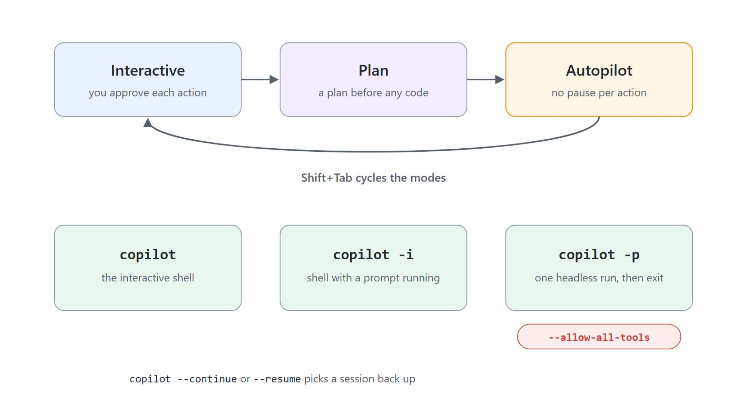
Three modes, three ways to run
Interactive, plan and autopilot; shell, -i and -p
Shift+Tab cycles interactive, plan and autopilot mode
Autopilot works through multi-step tasks without pausing: trusted repositories only
copilot -i "<prompt>" opens the shell with a prompt already running
copilot -p "<prompt>" --allow-all-tools runs headless and exits; add -s for scripts

Slide 5
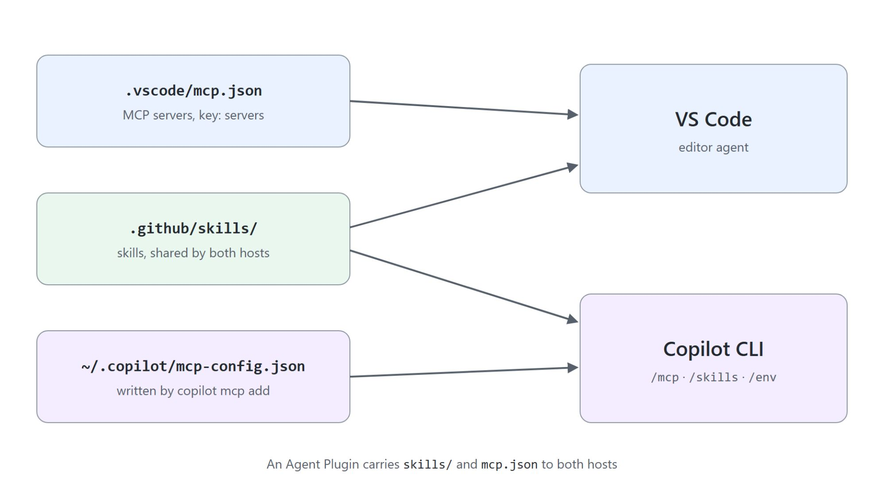
MCP servers and skills in the CLI
Skills are shared by both hosts, MCP registries are not
/mcp in the shell, or copilot mcp add, list, get, remove from your normal shell
The CLI reads ~/.copilot/mcp-config.json, VS Code reads .vscode/mcp.json
/skills or copilot skill list: discovered from .github/skills/ in the working directory
/env shows what actually reached the session; a plugin bundles servers and skills for both hosts

Slide 6
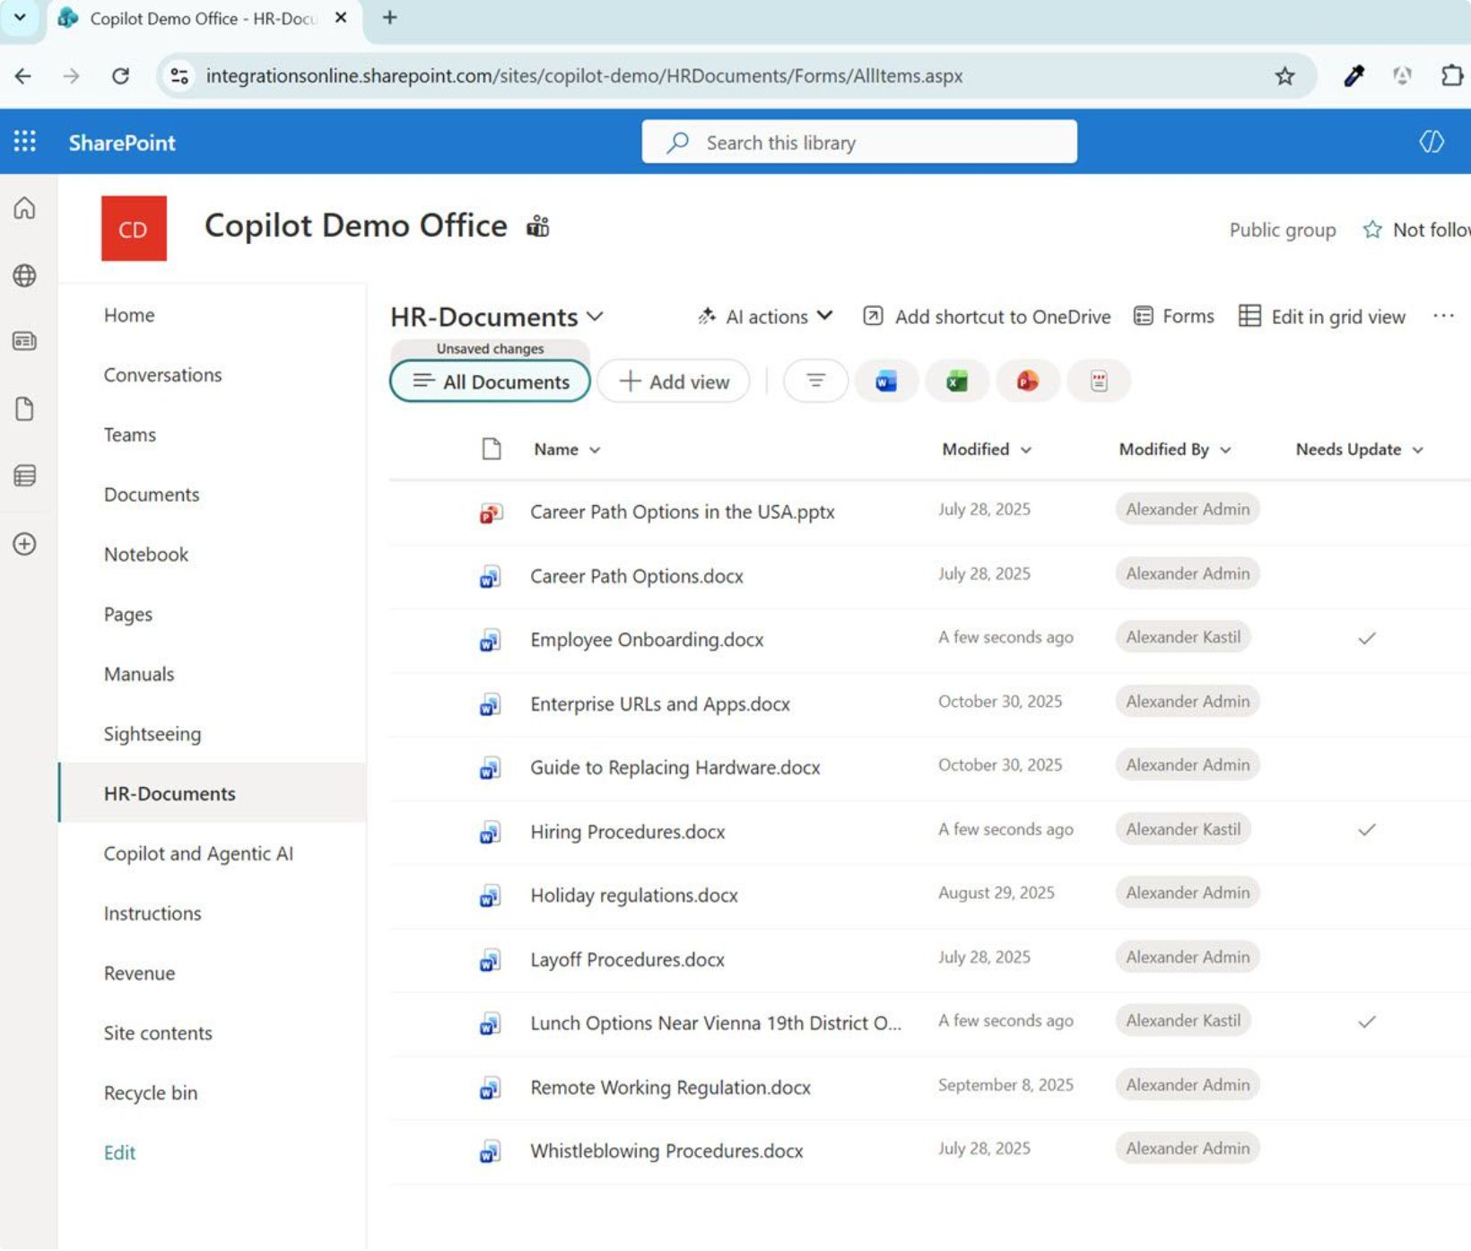
HR document updates, automated
A SharePoint library with a Needs Update flag
The HR-Documents library flags stale policies in a Needs Update column
Manual checks are slow; update notifications are delayed or missed
Copilot CLI queries the library through the Work IQ MCP server, as the signed-in user
It collects name, modified date and modified by, then mails a summary to HR leadership

Slide 7
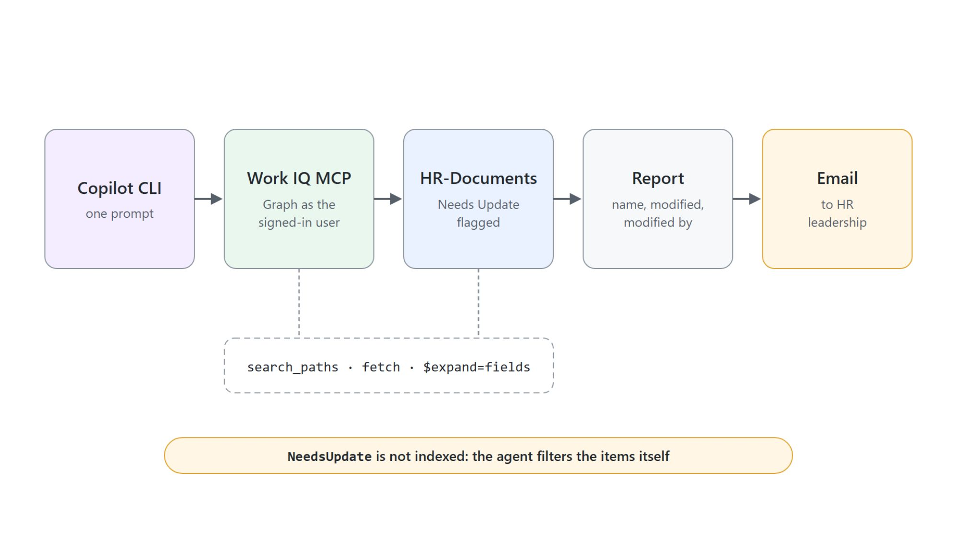
From the flagged list to an email
What the agent works out through Work IQ
The agent resolves the site, lists the libraries, reads the columns, fetches items with $expand=fields
NeedsUpdate is not indexed, so the agent filters the items itself
Test the query before the send: three rows out of twelve is a correct answer
Verify the mail in Outlook, not in the transcript

Slide 8
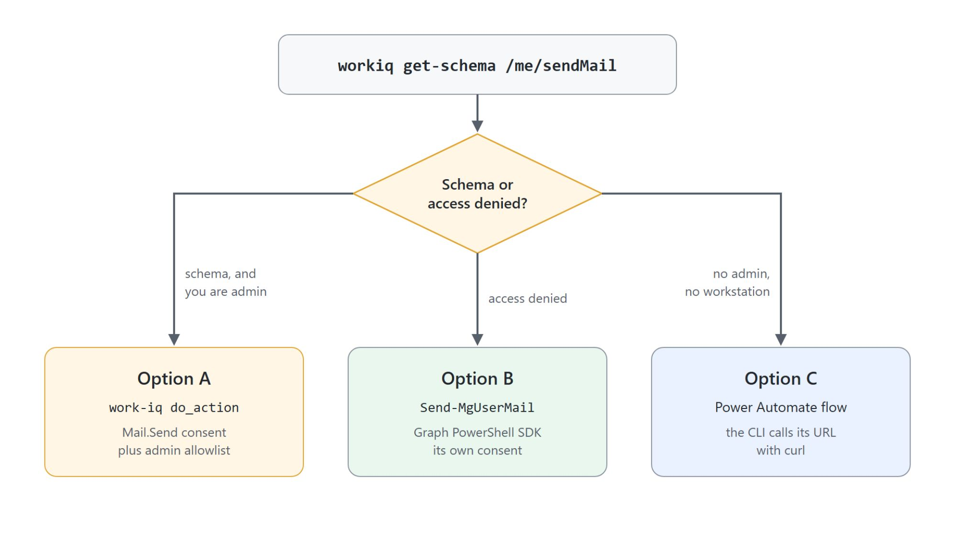
Reading is not sending
Mail.Send is a write scope a read-only Work IQ lacks
Check first: workiq get-schema --path /me/sendMail --method post
Option A: Work IQ sends, after Mail.Send consent and a tenant admin allowlist
Option B: Send-MgUserMail from the Graph PowerShell SDK, with its own consent
Option C: a Power Automate flow the CLI calls with curl

Slide 9

Schedule it where the tokens live
A workstation task, not a hosted runner
Unattended runs use -p with --allow-all-tools, never -i
Task Scheduler runs update-report.ps1 daily at 8:00
Run only if user is logged in: Work IQ and Graph cache their tokens in your profile
A GitHub Actions runner has no profile, no token cache and no registered MCP server

Slide 10
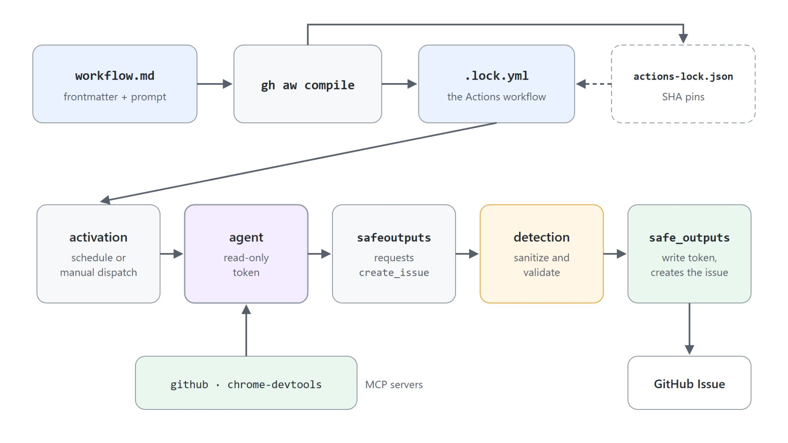
GitHub Agentic Workflows
A prompt compiled into an Actions workflow
A Markdown file: frontmatter for trigger, engine, tools and permissions, the prompt below
gh aw compile writes the executable .lock.yml and pins actions in actions-lock.json
The agent runs with a read-only token and requests writes through safe-outputs
A separate detection job validates the request before a write job creates the issue

Slide 11
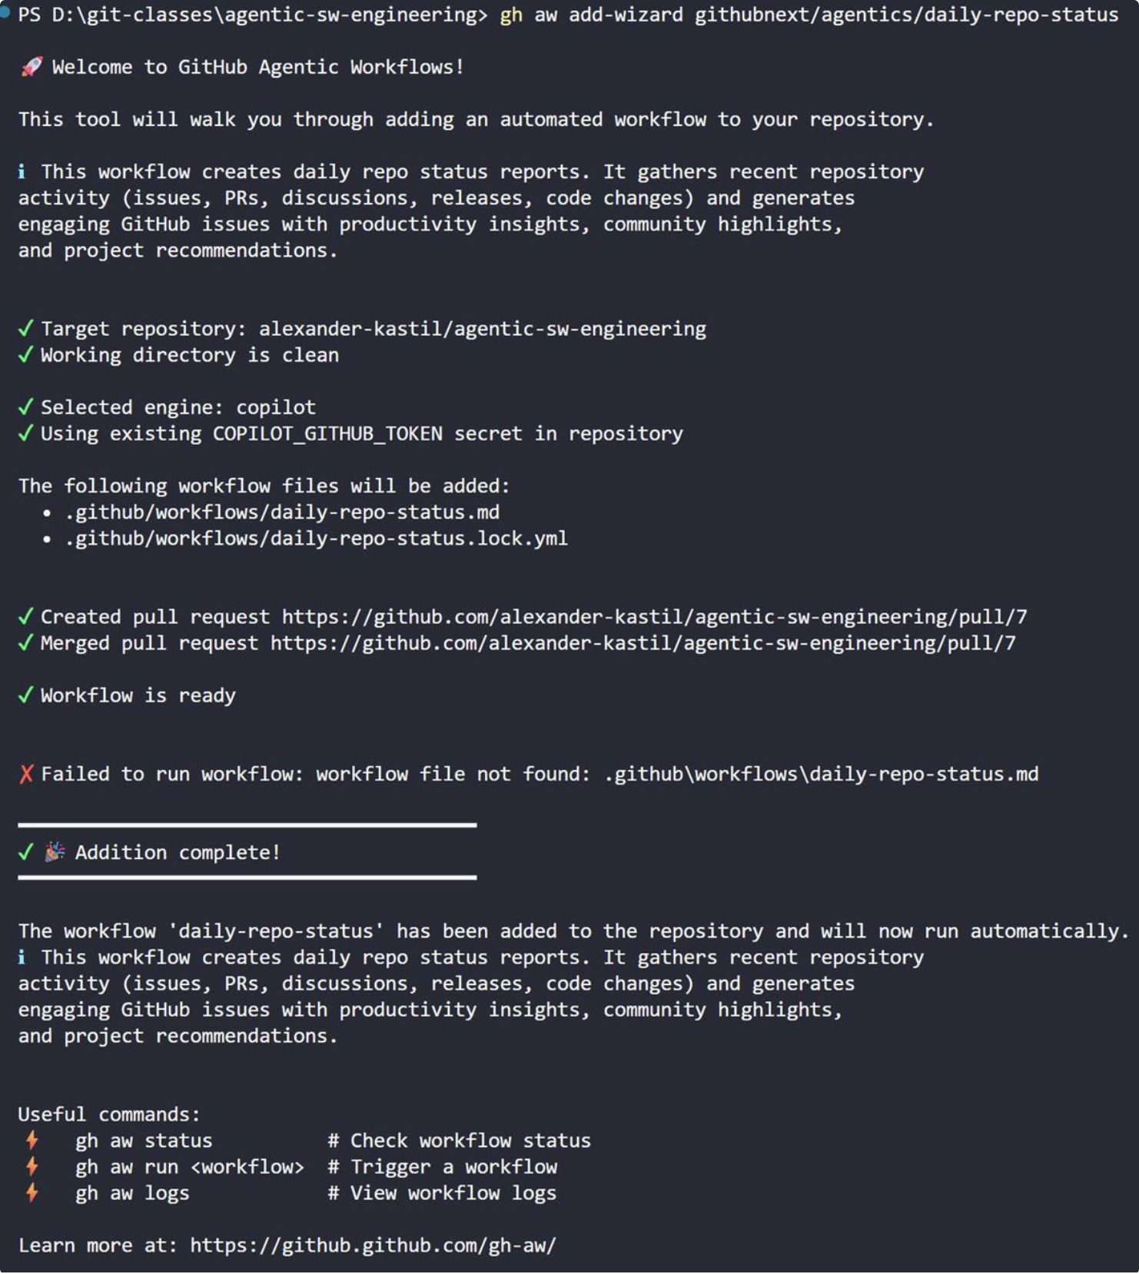
Add a workflow with the wizard
gh aw add-wizard opens a pull request
Install with gh extension install github/gh-aw after gh auth login
gh aw add-wizard githubnext/agentics/daily-repo-status picks engine and secrets
The workflow lands on a new branch and a pull request: start from a clean repo
gh aw run triggers it now; run gh aw upgrade after every extension upgrade

Slide 12

Ask the codebase
Onboarding as a conversation in the terminal
Ask where a request enters, how auth is enforced, which module owns the logic
The answer cites files and lines: follow them before you trust it
Ask for an architecture overview or a "start here" guide for one subsystem
/share saves the session; copilot init writes an AGENTS.md for the next question

Slide 13
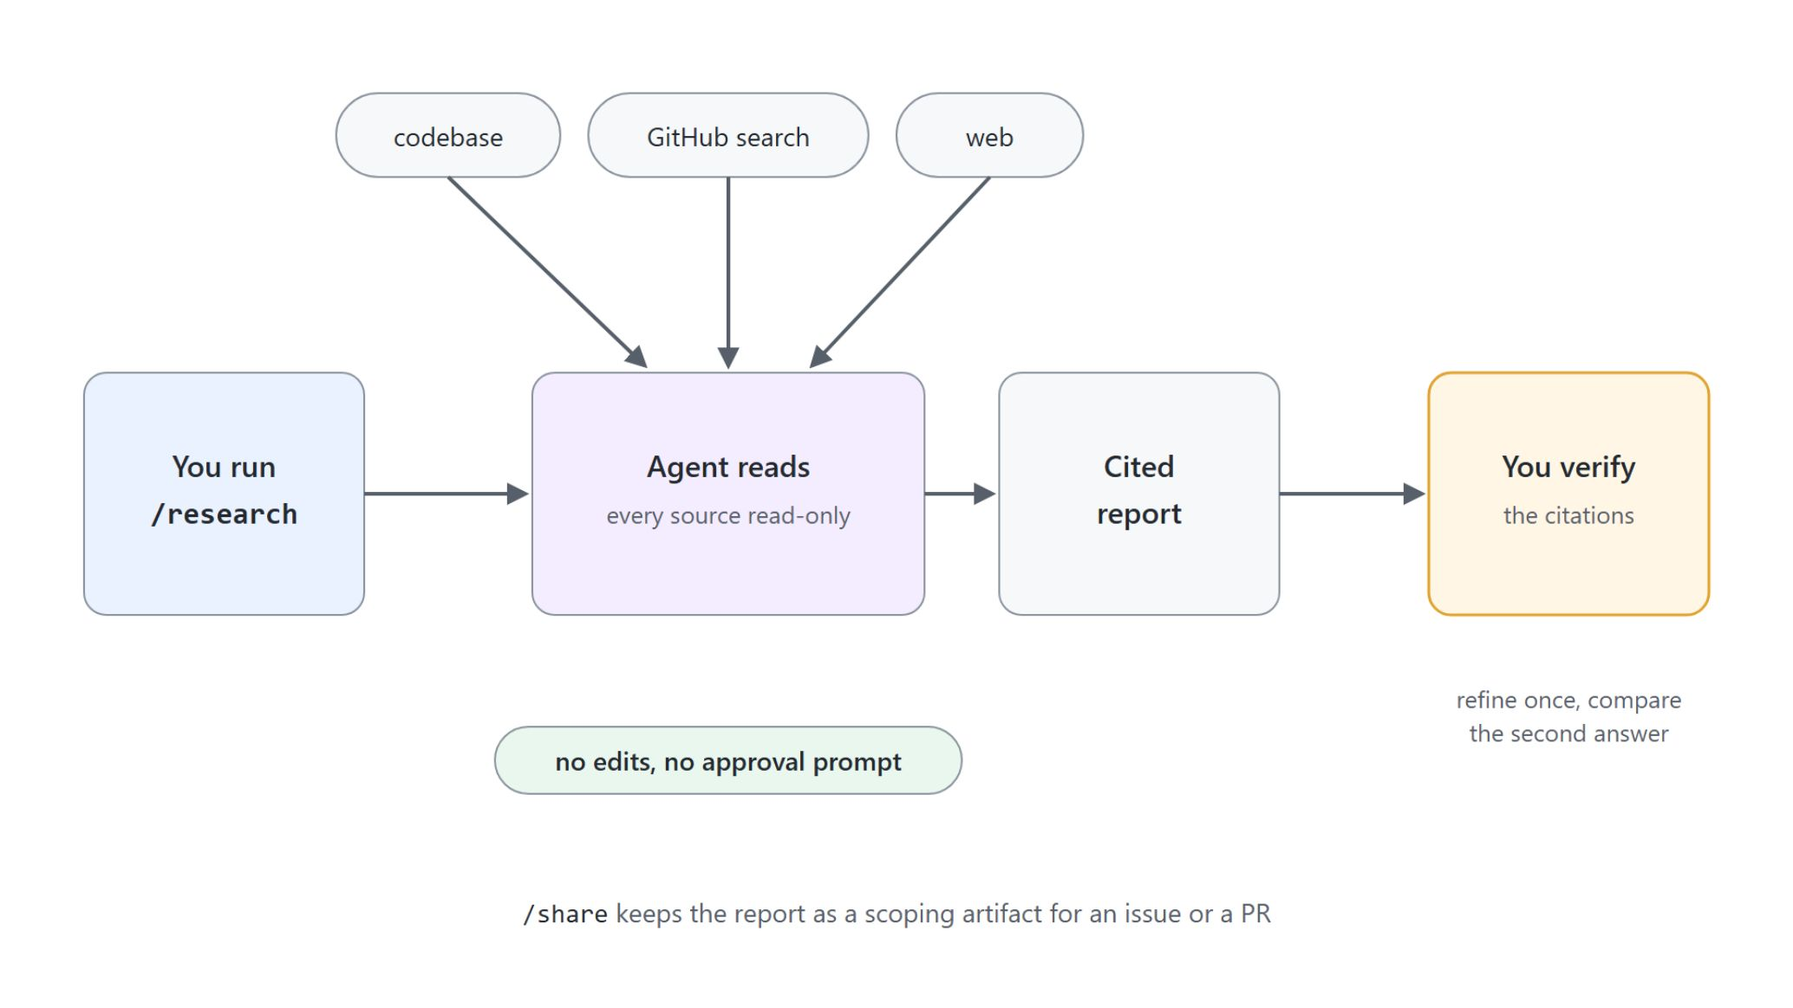
/research: read-only and cited
The lowest-risk agent in the course
Reads across your codebase and GitHub sources; never writes to the repository
No elevated permissions: nothing to approve, nothing to sandbox
Every claim carries a citation: open two or three before you act
Scope the question so a good answer must name concrete files

Slide 14

/rubber-duck: a second opinion
A critic that argues the opposite case
The agent that wrote the code is the worst reviewer of it
/rubber-duck reads what the session did and reports what was missed
Review only: nothing changes on disk
Call it after planning and before implementing, where a bad approach is cheapest to kill

Slide 15
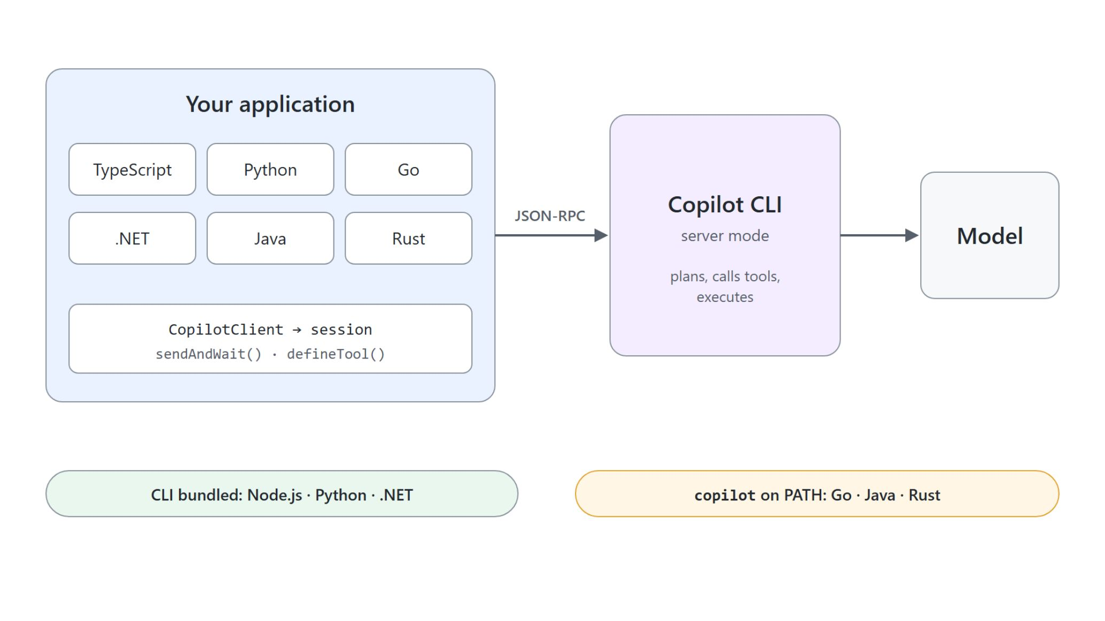
The SDK: the agent inside your app
Six stacks on the same runtime
One first-party package per stack: TypeScript, Python, Go, .NET, Java, Rust
Node.js, Python and .NET bundle the CLI; Go, Java and Rust need copilot on PATH
Create a CopilotClient, open a session, send with sendAndWait() or stream deltas
client.listModels() asks the runtime which models your account may use

Slide 16

Custom tools the agent decides to call
A weather assistant and a code reviewer in TypeScript
defineTool() takes a name, a description, a parameter schema and a handler
Copilot decides when to call the tool from the user's prompt
Stream with assistant.message_delta and read event.data.deltaContent
The temperatures come from your handler, not from the model

Slide 17
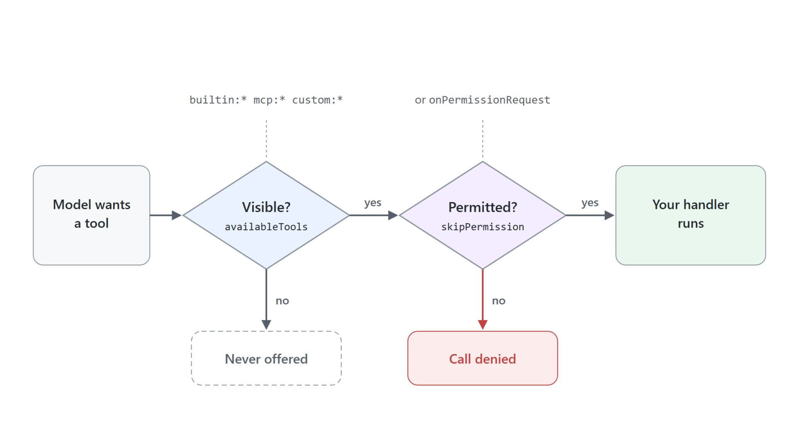
Visible, then permitted
Two gates stand in front of every tool call
availableTools and excludedTools decide which tools the model is offered
Patterns are source-qualified: builtin:*, mcp:*, custom:*
A session with no onPermissionRequest handler denies the call
skipPermission: true for handlers that only compute; decide per call otherwise

Slide 18
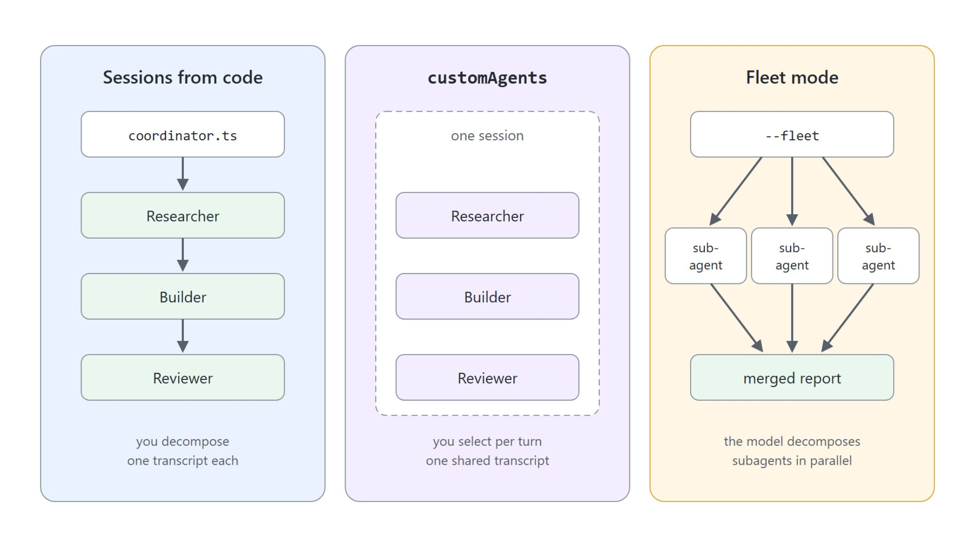
Three ways to orchestrate specialists
Who decomposes the work, and who sees what
Several sessions from your code: you decompose, each specialist fully isolated
customAgents on one session: select a persona per turn, one shared transcript
Fleet mode: the model decomposes and runs subagents in parallel
availableTools: ["custom:*"] keeps each specialist to the tools you gave it

Slide 19
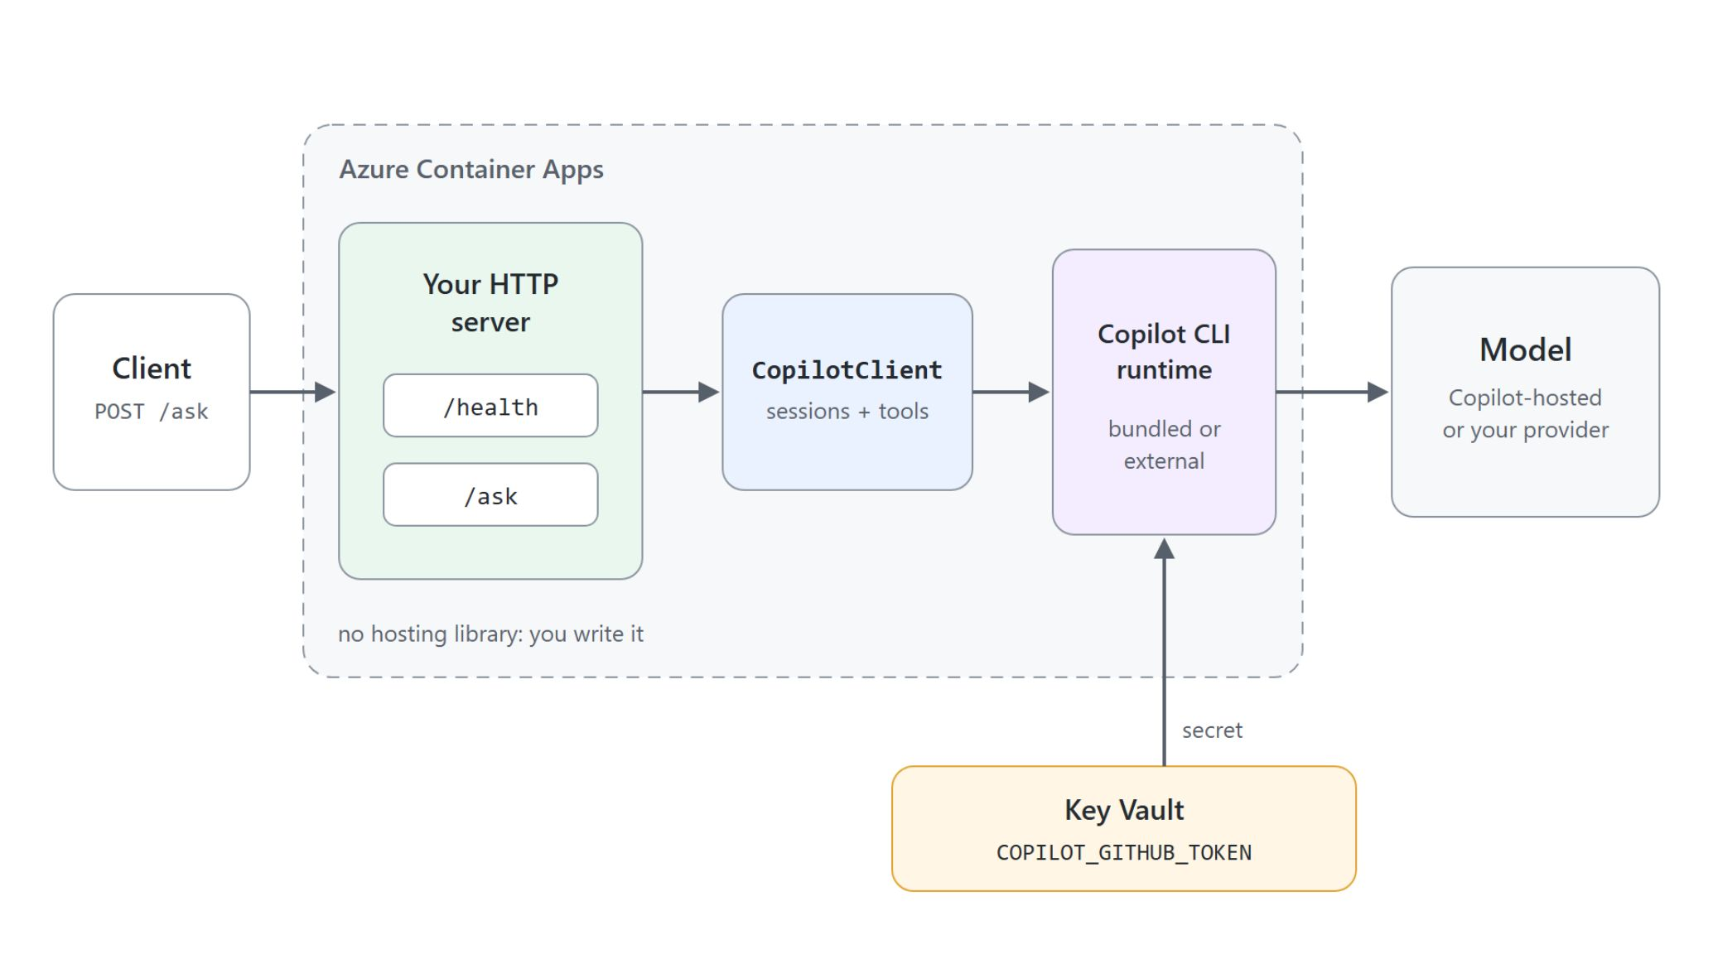
Hosting an SDK agent on Azure
Your HTTP server, a token from Key Vault
No hosting library: you write the HTTP server, the routes and the health check
Bundled runtime per container, or external copilot --headless --port 4321
No /login in a container: COPILOT_GITHUB_TOKEN as a Key Vault secret
A provider block swaps in Azure OpenAI or Foundry; the agent code does not change

Slide 20

The agent outside the editor
Pick the surface, keep the runtime
Ask and automate from the terminal: copilot and copilot -p
Put a recurring job on a schedule: gh aw
Embed the runtime in your product: the SDK
Check what reached the session: /env

