Slide 1

The GitHub Copilot harness
Shaping what Copilot knows, can do, and may do
Nine layers around the model: instructions, prompts, MCP, skills, agents, plugins, memory, hooks, interop
Each layer answers one question: what Copilot knows, what it can do, or what it may do
The goal: the right context at the right moment, and nothing more

Slide 2
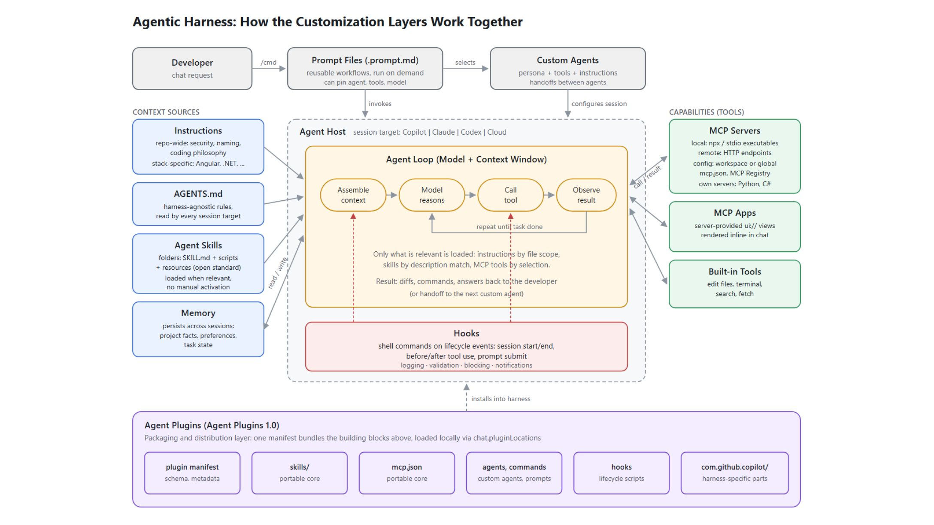
How the customization layers work together
One agent loop, fed by context sources and capabilities
Entry points: the developer's chat request, a / prompt file, or a selected custom agent
Agent loop: assemble context, reason, call a tool, observe, repeat until done
Context sources: instructions, AGENTS.md, skills, memory
Capabilities and guards: MCP servers and apps; hooks on lifecycle events

Slide 3
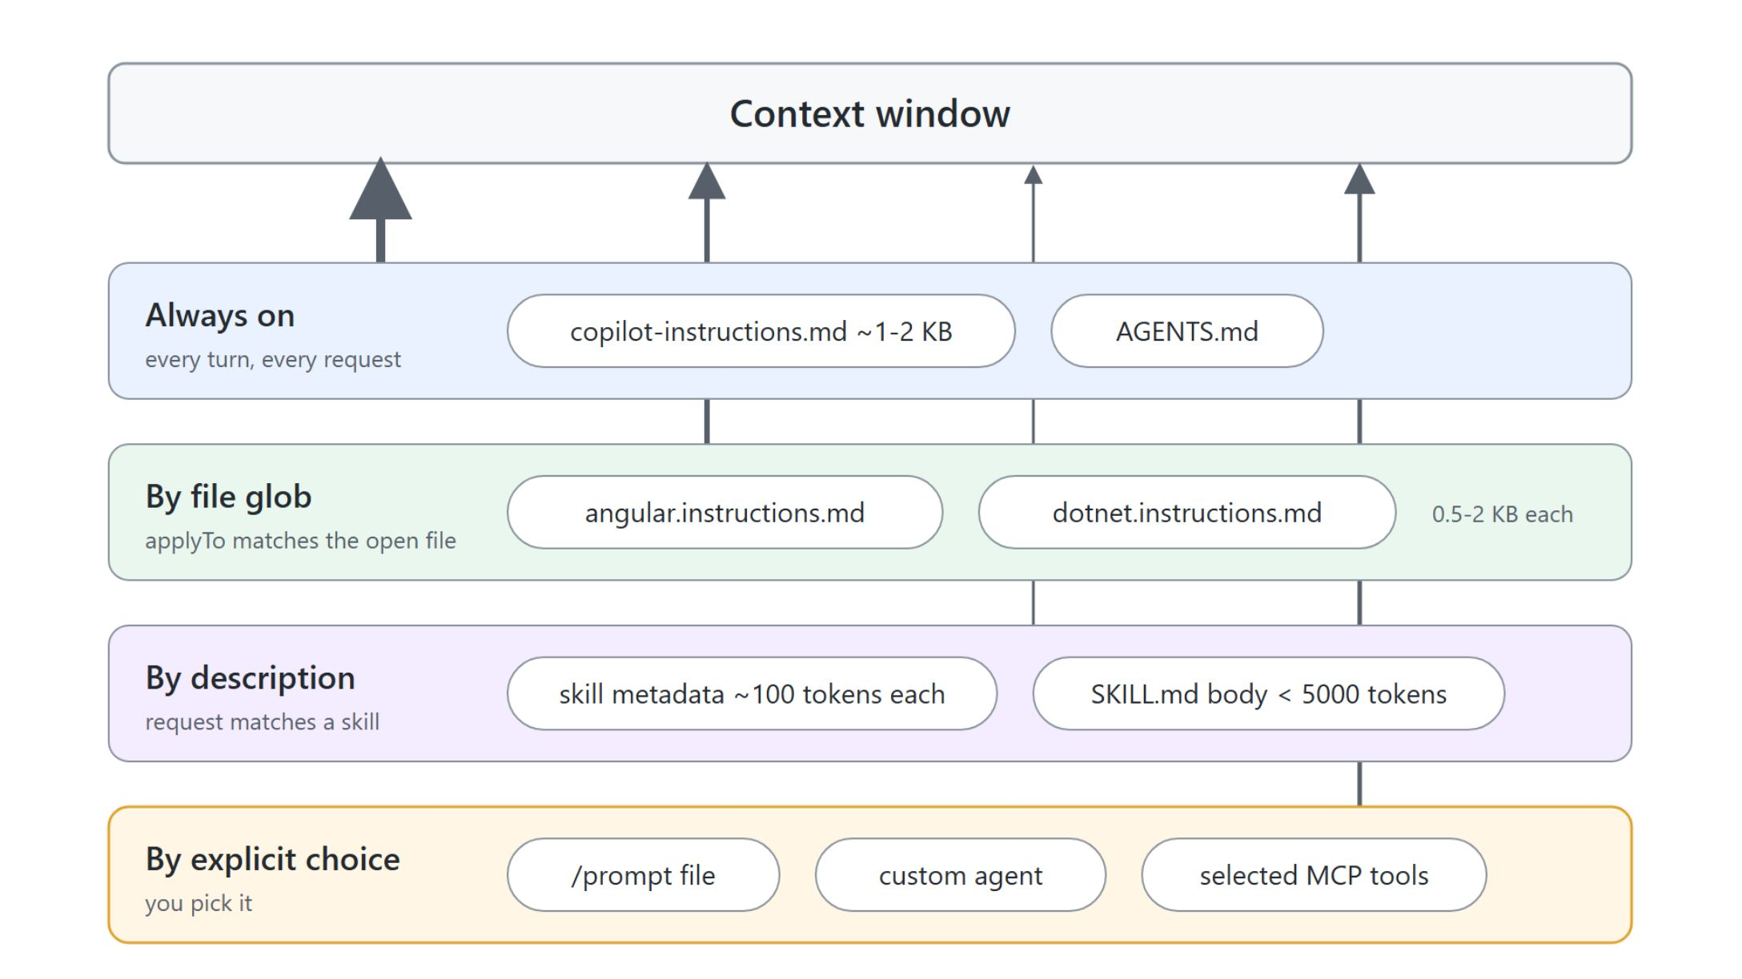
Context is the budget
Every layer loads on a different trigger
Always on: repository-wide instructions and AGENTS.md, reloaded on every turn
By file glob: stack instructions activate only for matching files
By description: skills cost about 100 tokens each until a request matches
By explicit choice: prompt files, custom agents, selected MCP tools

Slide 4
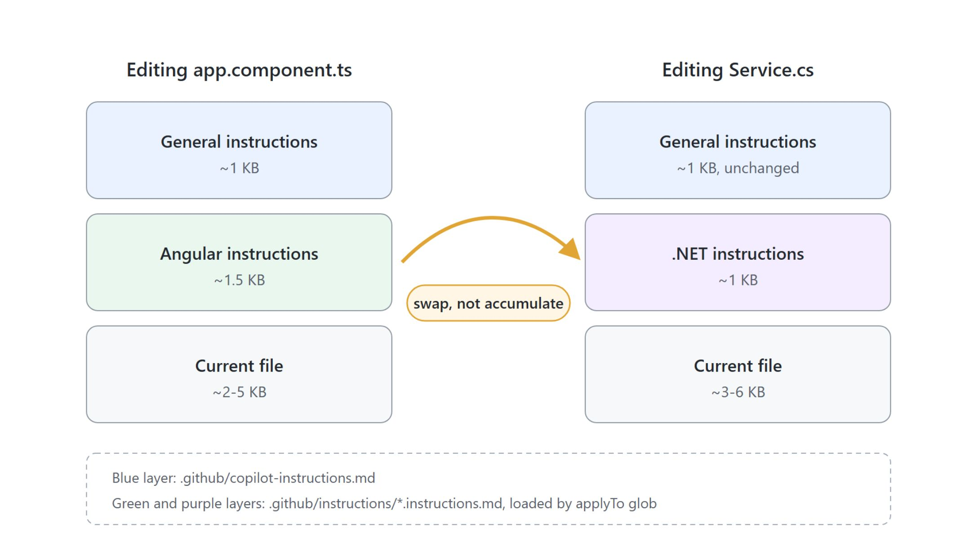
Instructions: always on, or scoped by file
General rules plus stack rules that swap in and out
.github/copilot-instructions.md: security, naming, coding philosophy, loaded every turn
.github/instructions/*.instructions.md: one file per stack, activated by an applyTo glob
Opening a .NET file swaps the Angular rules out instead of stacking both
Enable with chat.instructionsFilesLocations

Slide 5

Prompt files: workflows on demand
A request you package once and fire with a slash
.prompt.md files in .github/prompts/, run by typing /name in chat
Frontmatter can pin an agent, tools, and a model
All documentation in this class repo was produced with /describe-module
VS Code 1.129 migrates prompt files to skills (chat.customizations.promptMigration.enabled)

Slide 6
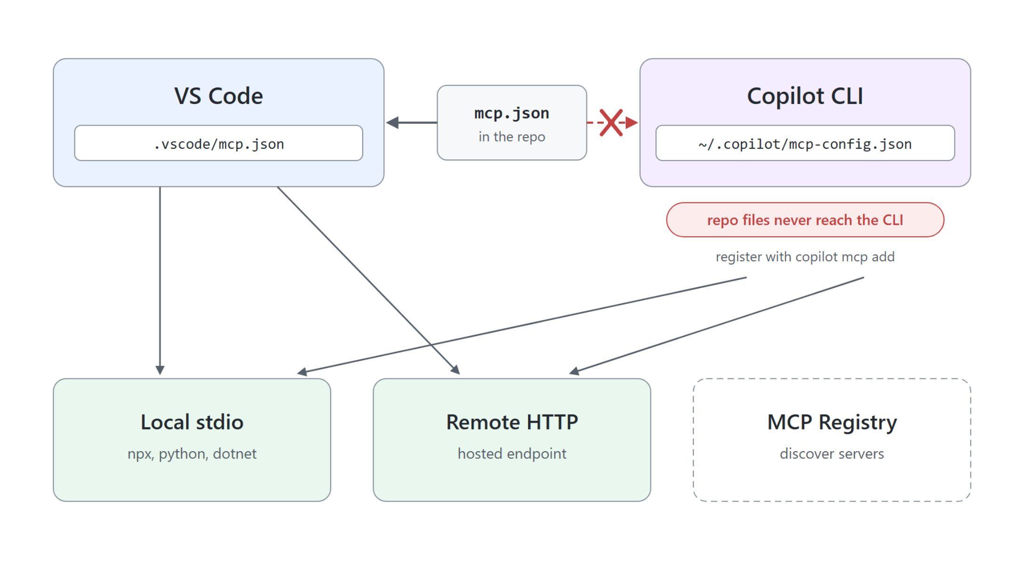
MCP: tools beyond the editor
Local or remote servers, and who reads which config
MCP connects Copilot to external tools and data: browsers, docs, business systems
Servers run local (stdio executables) or remote (HTTP endpoints)
VS Code reads .vscode/mcp.json, top-level key servers
The CLI reads only ~/.copilot/mcp-config.json, written by copilot mcp add

Slide 7
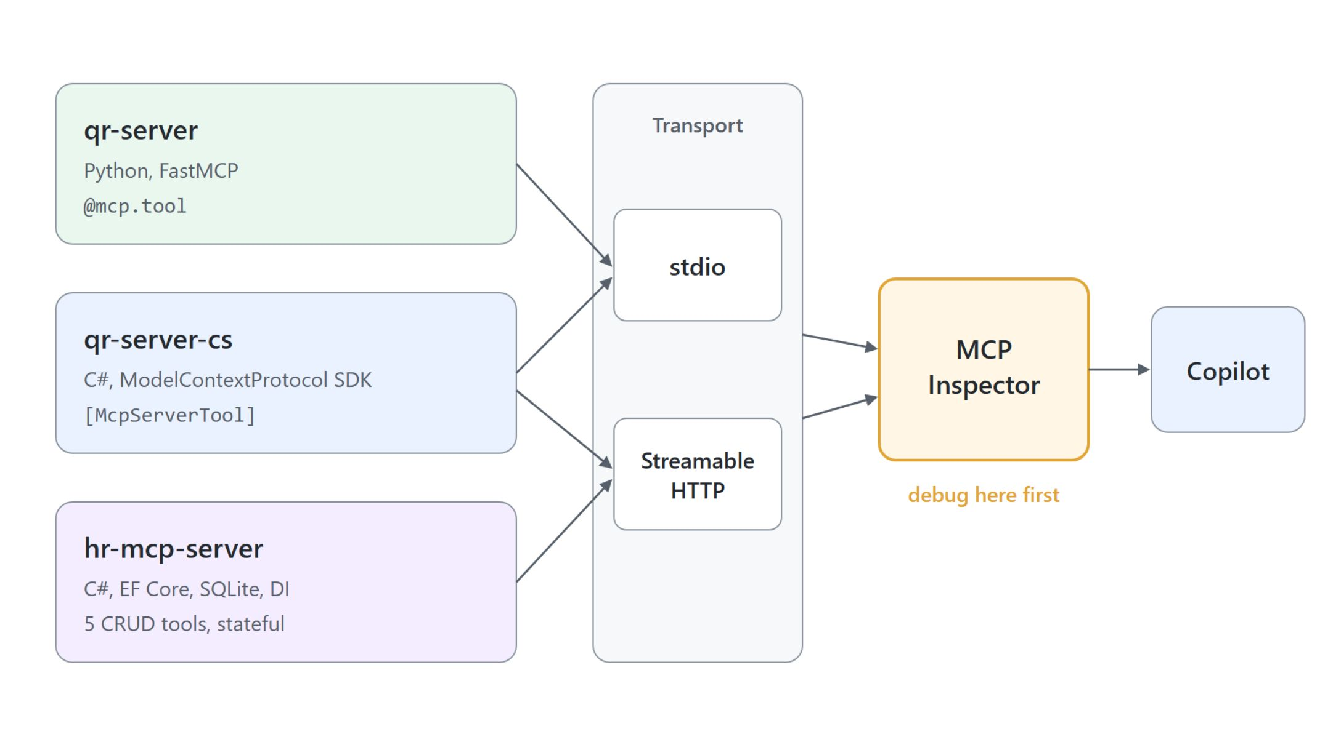
Build your own MCP server
Python or C#, one contract, tested before any client sees it
Python: FastMCP, one decorator turns a function into a tool
C#: the same tool contract expressed with attributes
State: hr-mcp-server adds dependency injection, EF Core, and five CRUD tools
Pick stdio or Streamable HTTP, then debug in the MCP Inspector first

Slide 8
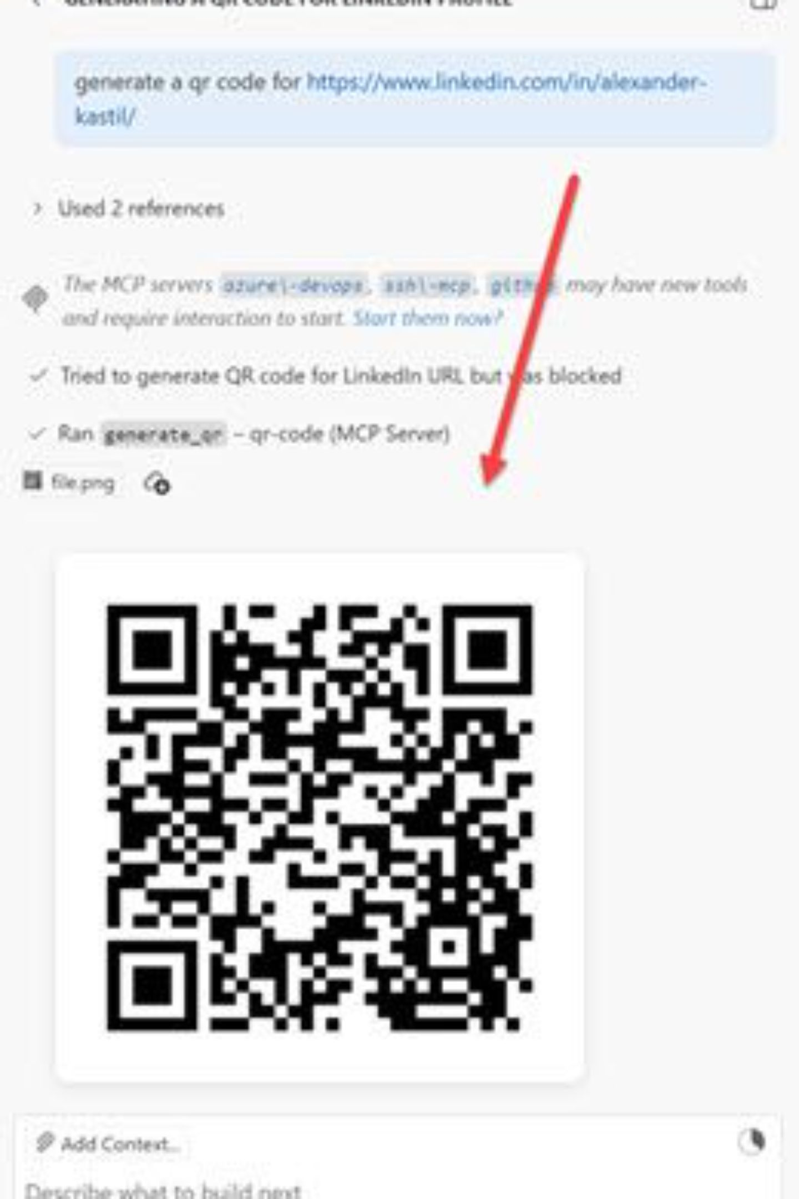
MCP Apps: UI inside the chat
A tool result that renders instead of printing
The server declares a ui:// resource next to its tool
The chat renders it as an interactive UI: charts, forms, QR codes
Demo: a Python FastMCP server that draws its QR code in Copilot Chat

Slide 9
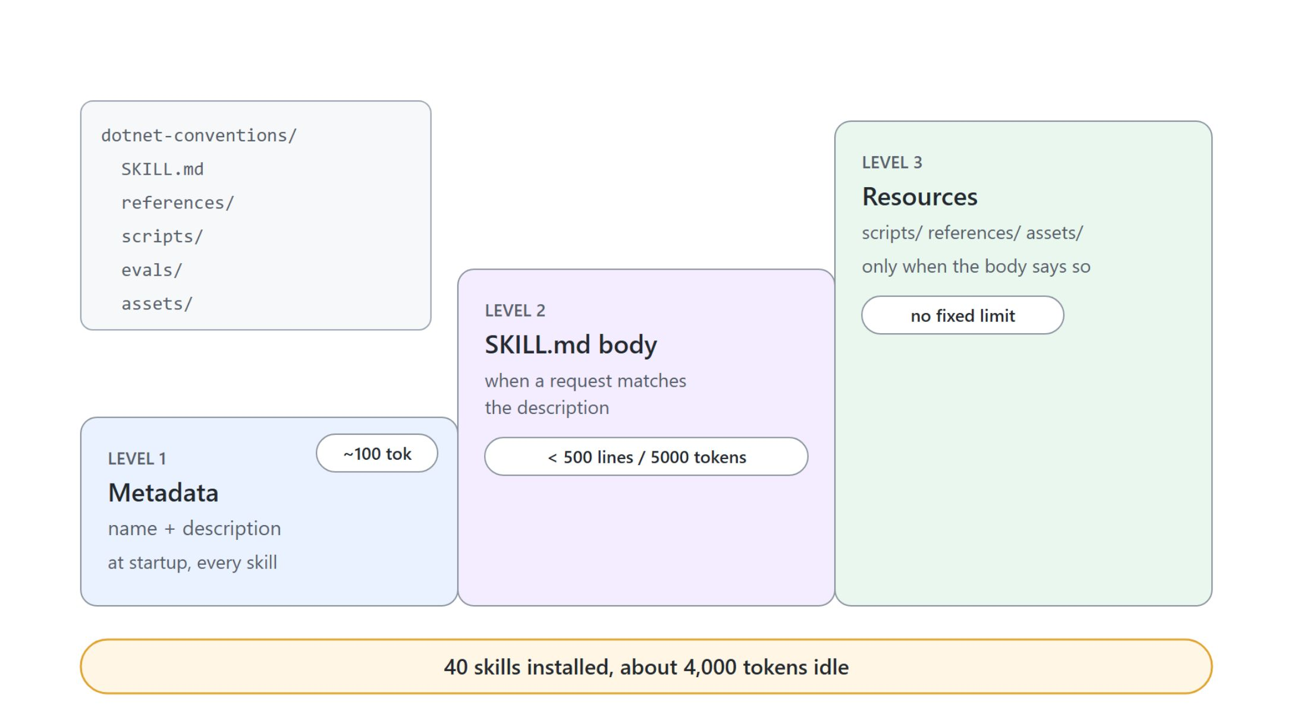
Skills: knowledge that loads itself
Progressive disclosure in three levels
A folder with SKILL.md plus optional scripts, references, and assets
Open Agent Skills standard: Copilot CLI, coding agent, code review, VS Code, Claude Code
Only name and description load at startup; the body loads on a match
The description is the trigger: name the user's intent, not the implementation

Slide 10
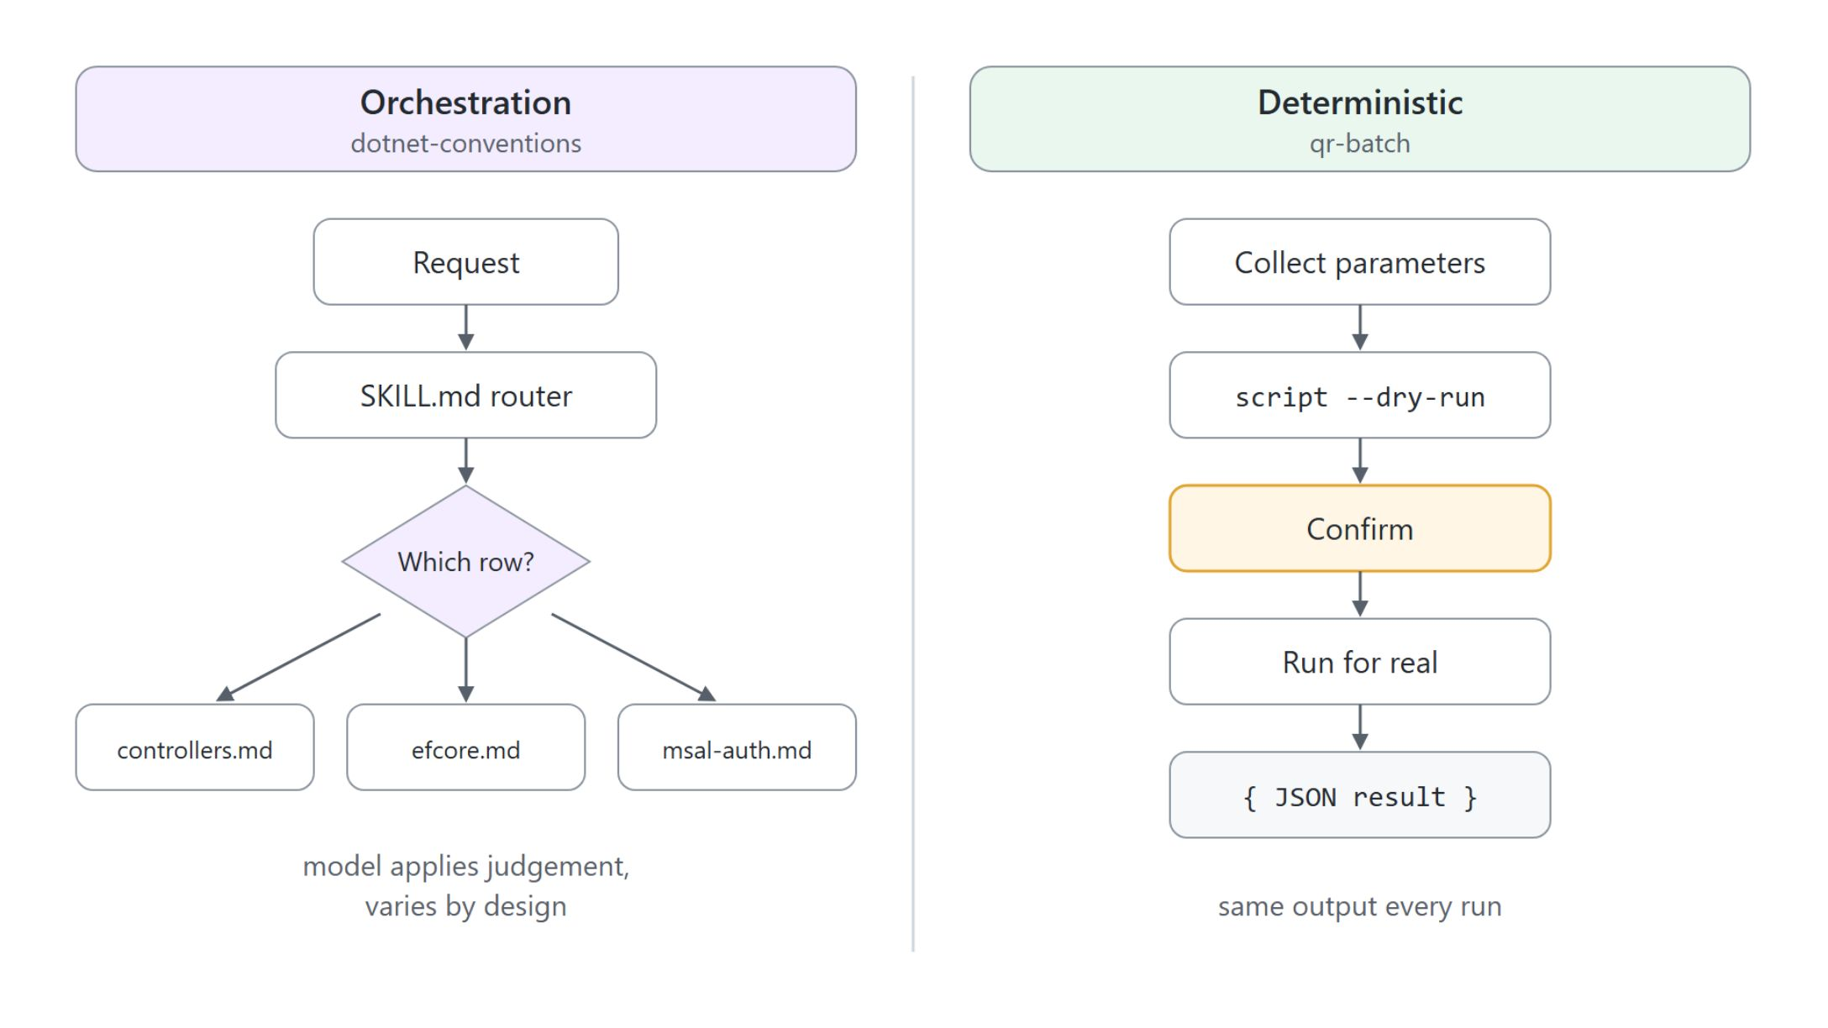
Orchestration or deterministic
Judgement from the model, or output from a script
Orchestration: SKILL.md holds the procedure, the model does the work
Deterministic: the model collects parameters, a bundled script produces the output
Bundle a script when output must be exact or the model cannot produce it (PNG, PPTX, QR code)

Slide 11

Test the trigger, then the output
Two failure modes, two tests, in that order
Trigger: about 20 prompts, half should load, half are near-misses that must not
Run each prompt three times; a positive passes above a 0.5 trigger rate
Tune the description on 60 percent, pick the best score on the other 40
Output: run each eval with and without the skill and read the delta

Slide 12

"The runbook was passive text somebody had to remember to open; the skill loads itself the moment somebody says ship the API."
The onboarding doc nobody reads

Slide 13

Custom agents and handoffs
Personas with their own tools, handing over the task
.agent.md files in .github/agents/: persona, instructions, tool list, model
Handoffs in frontmatter: label, agent, prompt, optional send and model
A handoff button moves the session on: plan, implement, review
This class ships planner, coder, frontend, orchestrator, GitHub Actions, Terraform, and more

Slide 14
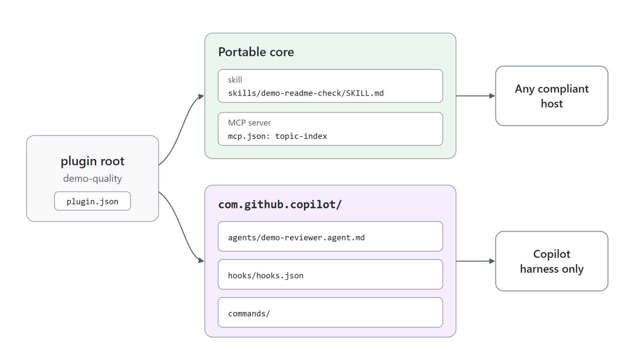
Plugins: one bundle, a portable core
Agent Plugins 1.0 is an open standard
One plugin bundles skills, MCP servers, agents, hooks, and slash commands
Portable: skills/ and mcp.json, understood by any compliant host
Copilot only: agents, hooks, commands under com.github.copilot/
Sample demo-quality ships a skill, an MCP server, an agent, and a hook

Slide 15

Discovered by convention, not declared
The manifest names the plugin, the folders name the parts
plugin.json requires only $schema and name; extra keys are rejected
No skills or mcpServers key: a file in the right folder is found
VS Code: chat.pluginLocations; CLI: copilot --plugin-dir <path> skill list
{
"$schema": "https://agent-plugins.org/schemas/1.0.0/plugin.schema.json",
"name": "demo-quality"
}

Slide 16
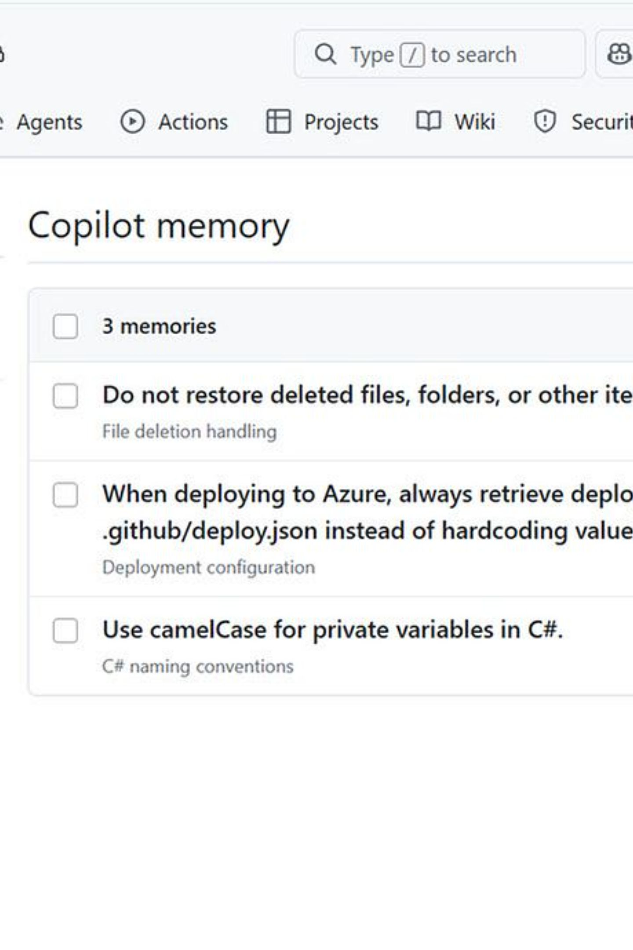
Copilot Memory
Repository facts Copilot learns and keeps
Repository-scoped facts Copilot deduces, such as "deployment config always from deploy.json"
Validated against code citations; deleted after 28 days unused
Used by the coding agent, code review, and the Copilot CLI
Off by default: github.copilot.chat.copilotMemory.enabled

Slide 17
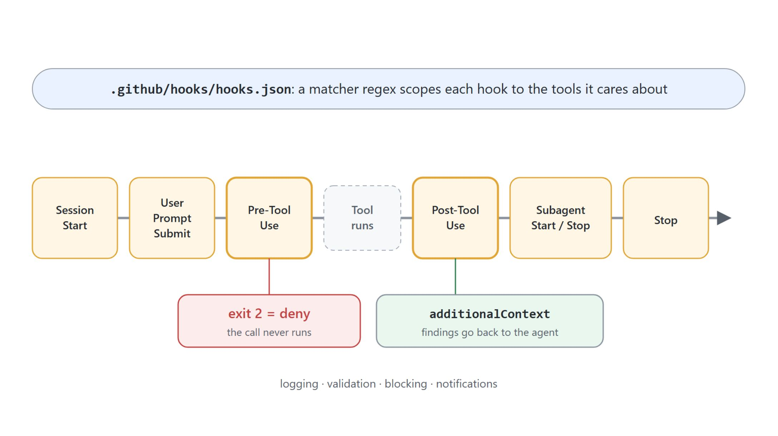
Hooks: policy at lifecycle events
Shell commands the agent cannot skip
Configured in .github/hooks/hooks.json, scoped with a matcher regex
preToolUse exit code 2 denies the call outright
postToolUse returns additionalContext: instructions-guard.ps1 lints the instructions file and hands findings back

Slide 18

Three gates between agent and machine
Sandbox, assisted approvals, hooks
Sandbox: what the agent process can touch at all; opt-in, off by default since VS Code 1.135
Assisted approvals: a model auto-approves low-risk tool calls (chat.assistedPermissions.enabled, 1.130)
Hooks: the policy only you can express, your conventions, audit trail, and integrations

Slide 19
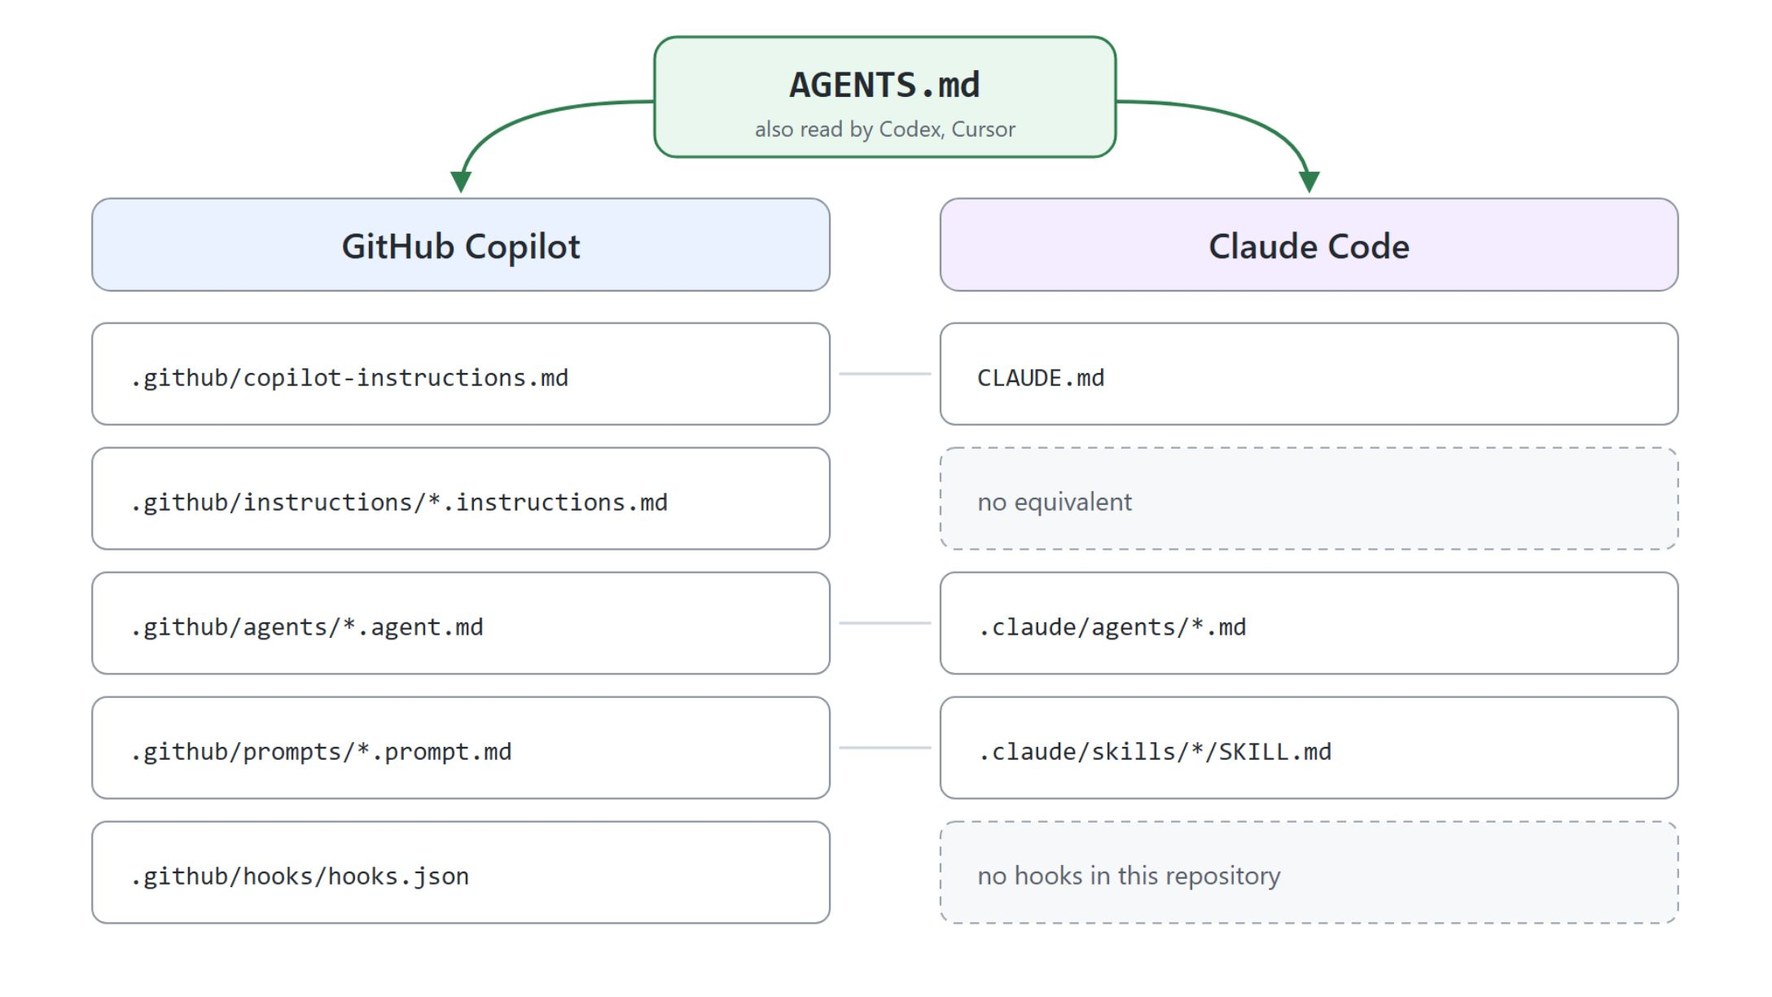
One repository, two harnesses
AGENTS.md is the rule you write once
Each harness reads different filenames for the same job: a mapping, not a merge
AGENTS.md: plain Markdown, always on, read by Copilot, Claude Code, Codex, Cursor
The nearest AGENTS.md wins; enable with chat.useAgentsMdFile
A rule in both copilot-instructions.md and CLAUDE.md is paid twice on every turn

Slide 20

Where a rule belongs
Pick the layer, then pay only for what you use
True for everyone, any harness: AGENTS.md
Scoped to one stack: .instructions.md with applyTo
A procedure a colleague would walk you through: skill
Output that must be exact: skill with a script
Must be enforced or audited: hook

