Slide 1



Fast Lane Group
Worldwide Education &
Professional Services
www.flane.de | © 2026 Fast Lane Institute for Knowledge Transfer GmbH
Notes:
Die Fast Lane Gruppe.
Fast Lane … Dienstleister u. Spezialist für High-End Technologie und Business Trainings
IT Trainings zu den unterschiedlichsten Herstellern wie Microsoft, Google, Cisco oder AWS. Und vielen weiteren wichtigen IT Herstellern.
Sei es Cloud, Security, Netzwerk oder allgemein digitale Transformationsprojekte
Und das seit 2003.
Das spannende ist, dass die Fast Lane Gruppe bereits seit 2009 durchgängig zu den Top 20 Unternehmen in der IT Trainingsbranche weltweit zählt.
Aber auch Footprint ebenso im klassischen Professional Services Bereich für unsere wichtigsten Hersteller
PreSales Support, Deployment Services und Adoption Trainings
Additional Information:
Im Jahr 2021 sind wir zur „most strategic IT Education company worldwide“ von der IDC im „magic quadrant“ aufgeführt worden !
1 mio Teilnehmer insgesamt seit bestehen, 50.000+ Students ww p.A, 20.000 in DE pro Jahr

Slide 2






AGENTIC AI: FROM STRATEGY TO PRODUCTION.
Alexander
Kastil
AGENTIC AI CONSULTING · VIENNA
Full stack, from enterprise software to agentic AI. Since 1996
AI at Work
Enterprise AI
Value discovery, KPI mapping and roadmap
Governed multi-agent systems on Microsoft Copilot and Foundry
Agentic Software Engineering
Team Enablement
Harness architecture for Claude Code and GitHub Copilot
AI driven content production and delivery
integrations.at
github.com/alexander-kastil
SCAN TO CONNECT
alexander.kastil@integrations.at
linkedin.com/in/alexander-kastil
integrations.at
Notes:
Intro: Alexander Kastil, integrations.at. Four practice areas from AI at Work to team enablement. Certifications: Agentic AI Business Solutions Architect, Azure AI App and Agent Developer Associate, DevOps Engineer Expert.

Slide 3

MODULE 1
Designing Event-Driven Distributed Systems
Where the seams of Contoso Logistics belong before anyone writes a service
Event-Driven Distributed Apps on Azure: Aspire, Dapr & Durable Execution

Slide 4
01
02
03
Modular Monolith vs. Microservices
When a service boundary earns its cost
Sync vs. Async: Commands & Events
Request/reply, messages and temporal coupling
Event Storming: Find Service Boundaries
Bounded contexts and the Contoso service list
04
05
06
Event Types: Domain, Integration, CloudEvents
Payload styles and the CloudEvents 1.0 envelope
Reliability Patterns: Outbox, Saga, Idempotency
The failures that break event flows
Azure Messaging: Pick the Broker
Service Bus, Event Grid, Event Hubs, Dapr pub/sub
Event-Driven Distributed Apps on Azure: Aspire, Dapr & Durable Execution

Slide 5

Designing event-driven distributed systems
Where the seams of Contoso Logistics belong before anyone writes a service
Boundaries: a modular monolith or microservices, and event storming to find the seams
Messages: HTTP or asynchronous commands and events, named and wrapped in CloudEvents
Reliability and brokers: outbox, saga and idempotency, then one Azure broker per flow
Notes:
This module sets the design vocabulary for the rest of the class, on Contoso Logistics, one application that books shipments, tracks parcels and assigns vans. It has no hands-on demo: the topics use diagrams, tables and small C# records, and the later modules build the patterns named here.
Boundaries: you learn when a modular monolith is the right first step and when a service boundary earns its cost. Event storming then finds those boundaries with the domain experts in the room.
Messages: you choose between synchronous calls and asynchronous messages, and you name the commands and events the services exchange. CloudEvents 1.0 gives those events a common envelope.
Reliability and brokers: outbox, saga and idempotency keep each flow correct under failure. The broker comparison then matches each flow to Service Bus, Event Grid, Event Hubs or Dapr pub/sub.

Slide 6
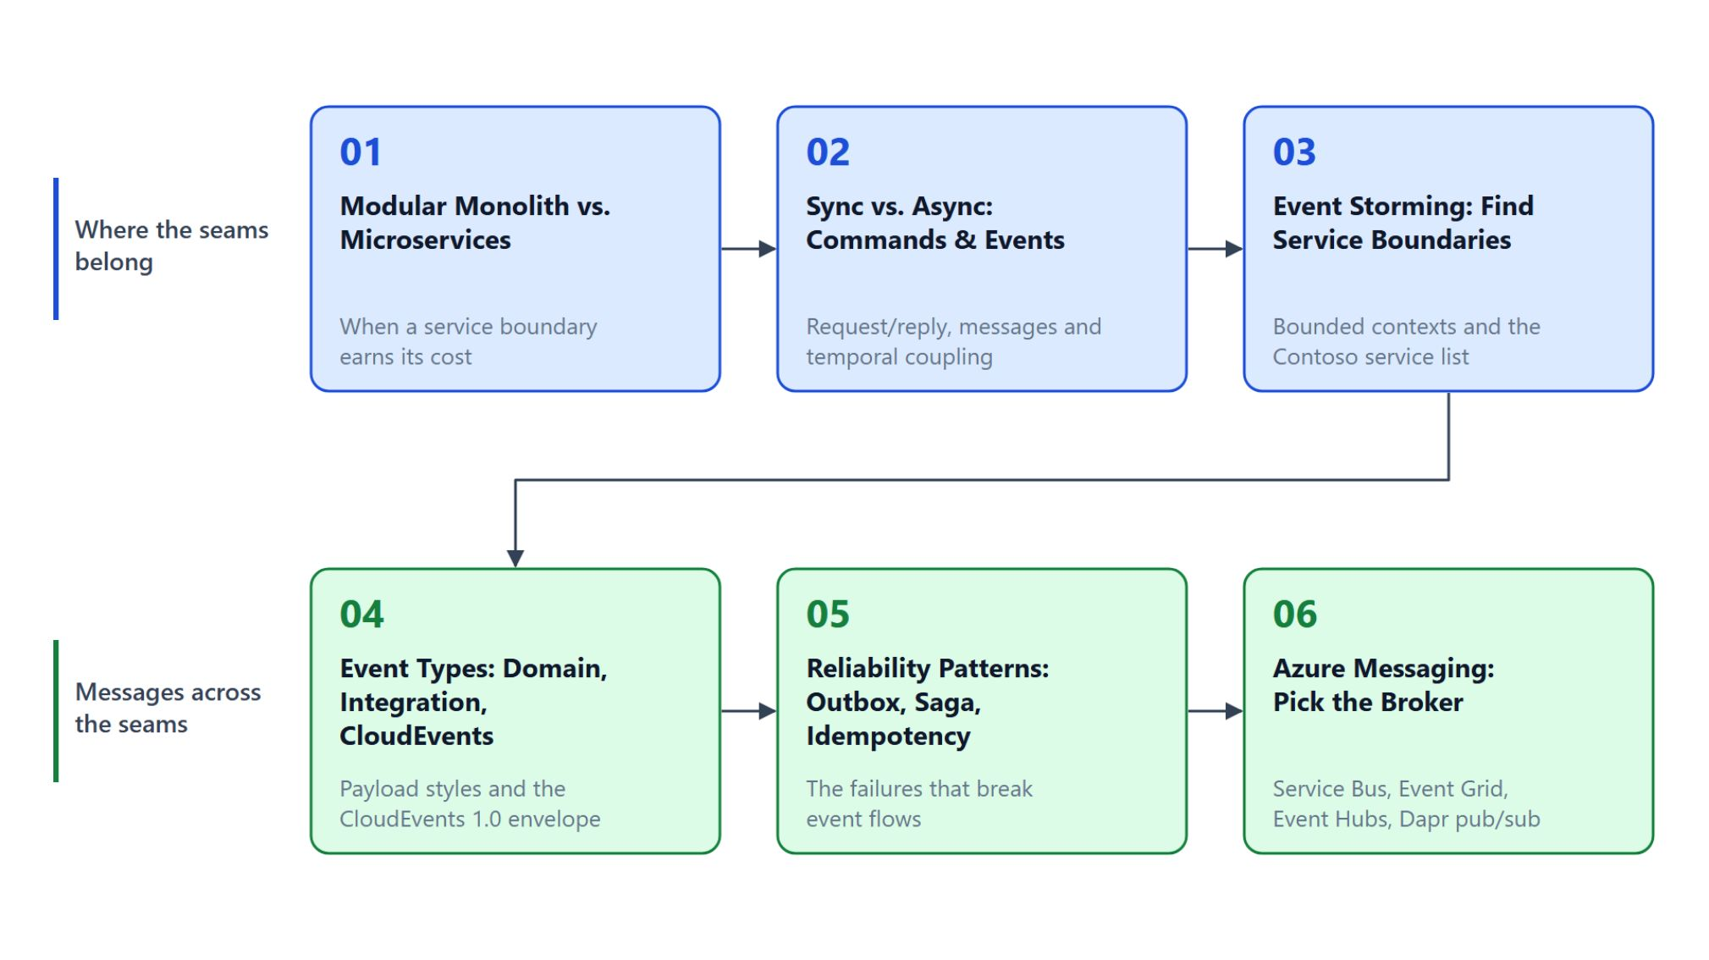
Overview
The topics follow the order of a design decision
Decide when a modular monolith is enough and when a split earns its cost
Choose HTTP when the caller needs the answer, messages when the work only has to happen
Find the boundaries with event storming, then name the events that cross them
Keep each flow correct under failure with reliability patterns
Match each flow to an Azure broker, then design the parcel flow in the lab
Notes:
This slide walks the six topics once, in the order a design decision takes. The top row finds where the seams belong, the bottom row decides which messages cross them.
Monolith or microservices: four criteria decide whether a split pays off, and a modular monolith keeps the same seams inside one deployable.
Sync or async: commands, events and queries differ in what the sender expects. HTTP stays right when the caller needs the answer to continue.
Boundaries and event types: event storming finds the bounded contexts with the domain experts. Event types then decide what crosses them: domain or integration, notification or state transfer, in a CloudEvents envelope.
Reliability: dual writes, duplicates, partial failures, poison messages and transient faults each have a pattern that prevents them, such as the transactional outbox or dead-lettering.
Brokers and the lab: Service Bus, Event Grid, Event Hubs and Dapr pub/sub are compared by delivery, ordering and retention. The lab then turns the parcel delivery flow into `docs/events.md` and `docs/architecture.md`.

Slide 7
01
Modular Monolith vs. Microservices
When a service boundary earns its cost
Event-Driven Distributed Apps on Azure: Aspire, Dapr & Durable Execution

Slide 8
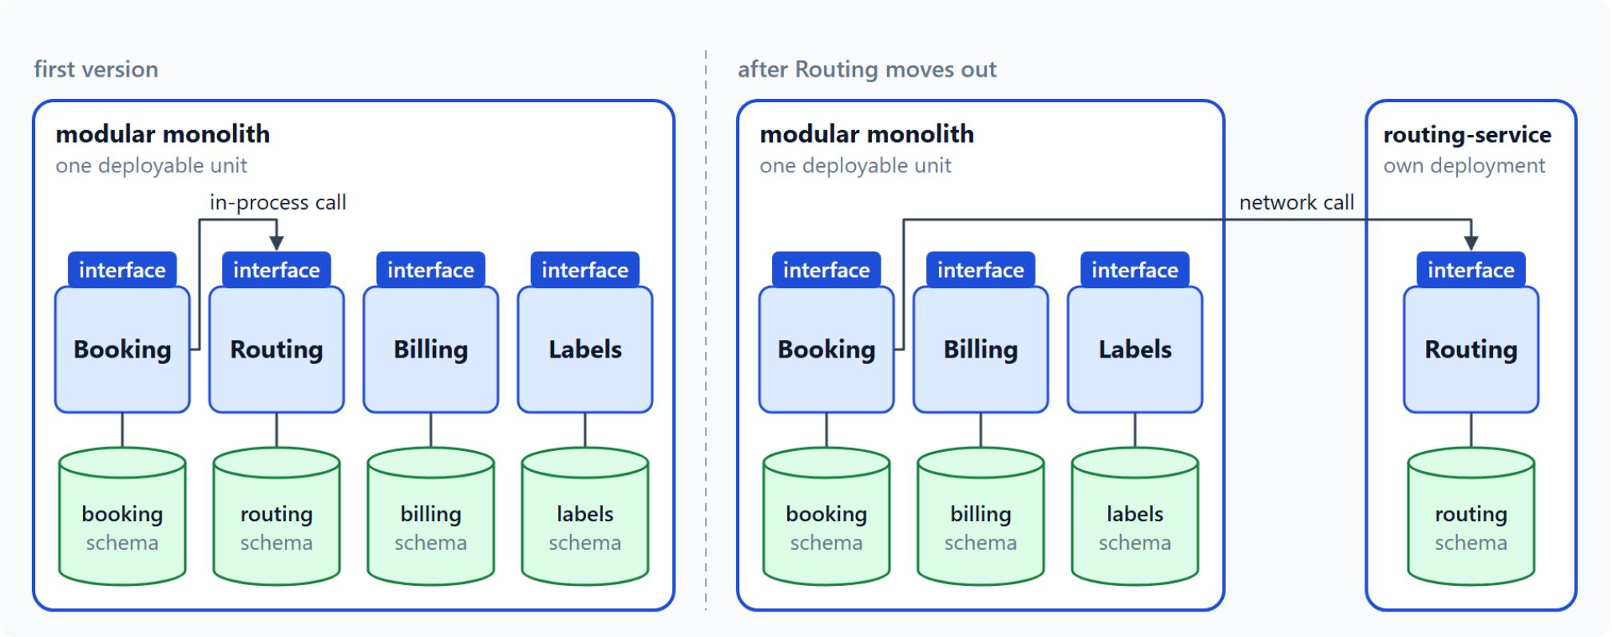
A modular monolith as the starting point
Service boundaries inside one deployable unit
Split for team size, independent deployment, scaling or data ownership
A modular monolith deploys as one unit, organized into modules
Each module owns its tables and exposes a small public interface
Moving a module out turns its interface into the service contract
Notes:
Contoso could make booking, routing, billing and labels separate services from day one, because each looks like it needs its own team. This slide gives the criteria for that call and the first step the class recommends.
Team size, deployment, scaling and data: a service should be small enough for one feature team and ship without its neighbours. Routing grows with the number of vans while the tracking page grows with viewers, and two services that share a data store still behave as one.
One deployable unit: a modular monolith ships as one unit, but its code follows the boundaries a service would have. For Contoso, the first version hosts booking, routing, billing and labels in one process, after a check of team and infrastructure maturity.
Own tables, small interface: other modules call the interface and never read another module's tables. Each module keeps its own schema, so the seams show up in the code and in the database.
Moving a module out: when one module needs its own scaling, release train or team, it becomes a service. The interface already written becomes its contract, so the change stays small, as Routing shows on the right.

Slide 9
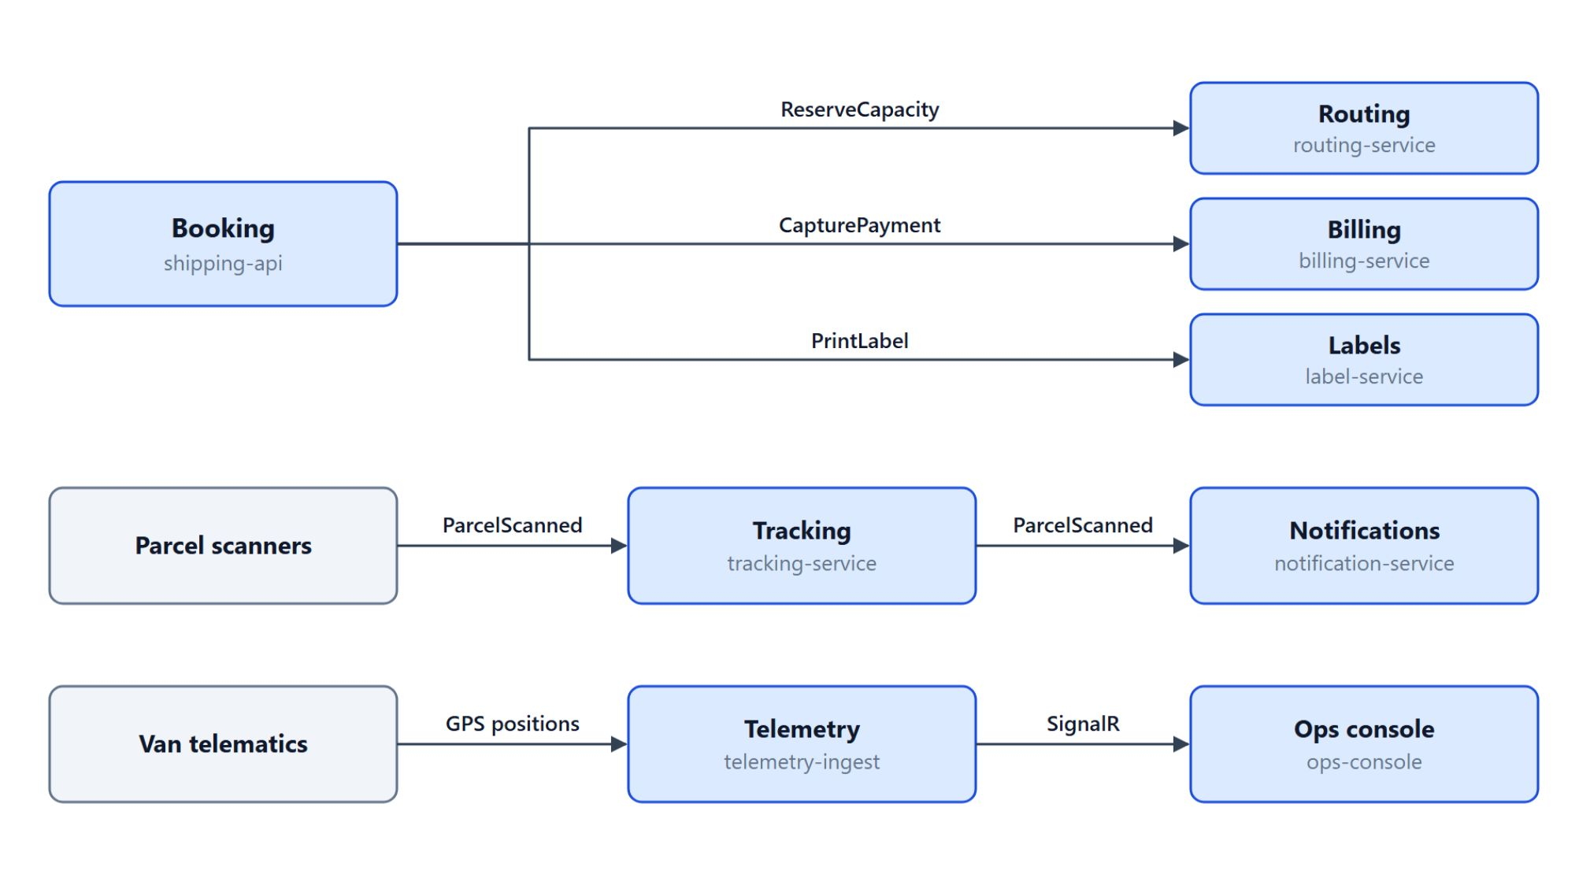
The cost of distribution
Each arrow between Contoso services is a call that can fail
With eventual consistency, a booking can be confirmed before its van is assigned
Booking calls routing and billing, and each network call can fail on its own
Every service needs its own pipeline, dashboards and rollback path
A new field on ShipmentBooked must not break consumers of the old shape
Draw each boundary where the business language changes
Notes:
Every split adds costs that a single process never pays. The diagram shows the Contoso boundaries, and each arrow is a place where a boundary costs something.
Eventual consistency: a booking that captures a payment and then fails to reserve a van cannot roll back as one ACID transaction across two services. The Azure guidance for that case is to embrace eventual consistency where possible.
Network calls: Booking calls routing and billing, and each call can fail on its own. Latency also adds up along every call chain.
Operations: every service needs its own pipeline, dashboards and rollback path.
Versioning: a new field on ShipmentBooked must not break the consumers that still read the old shape.
Business language: Booking changes when booking rules change and Routing when dispatch rules change, so that is where the boundary sits. Every boundary also passes a test: the service does one job, avoids chatty calls and deploys without its neighbours.

Slide 10
02
Sync vs. Async: Commands & Events
Request/reply, messages and temporal coupling
Event-Driven Distributed Apps on Azure: Aspire, Dapr & Durable Execution

Slide 11
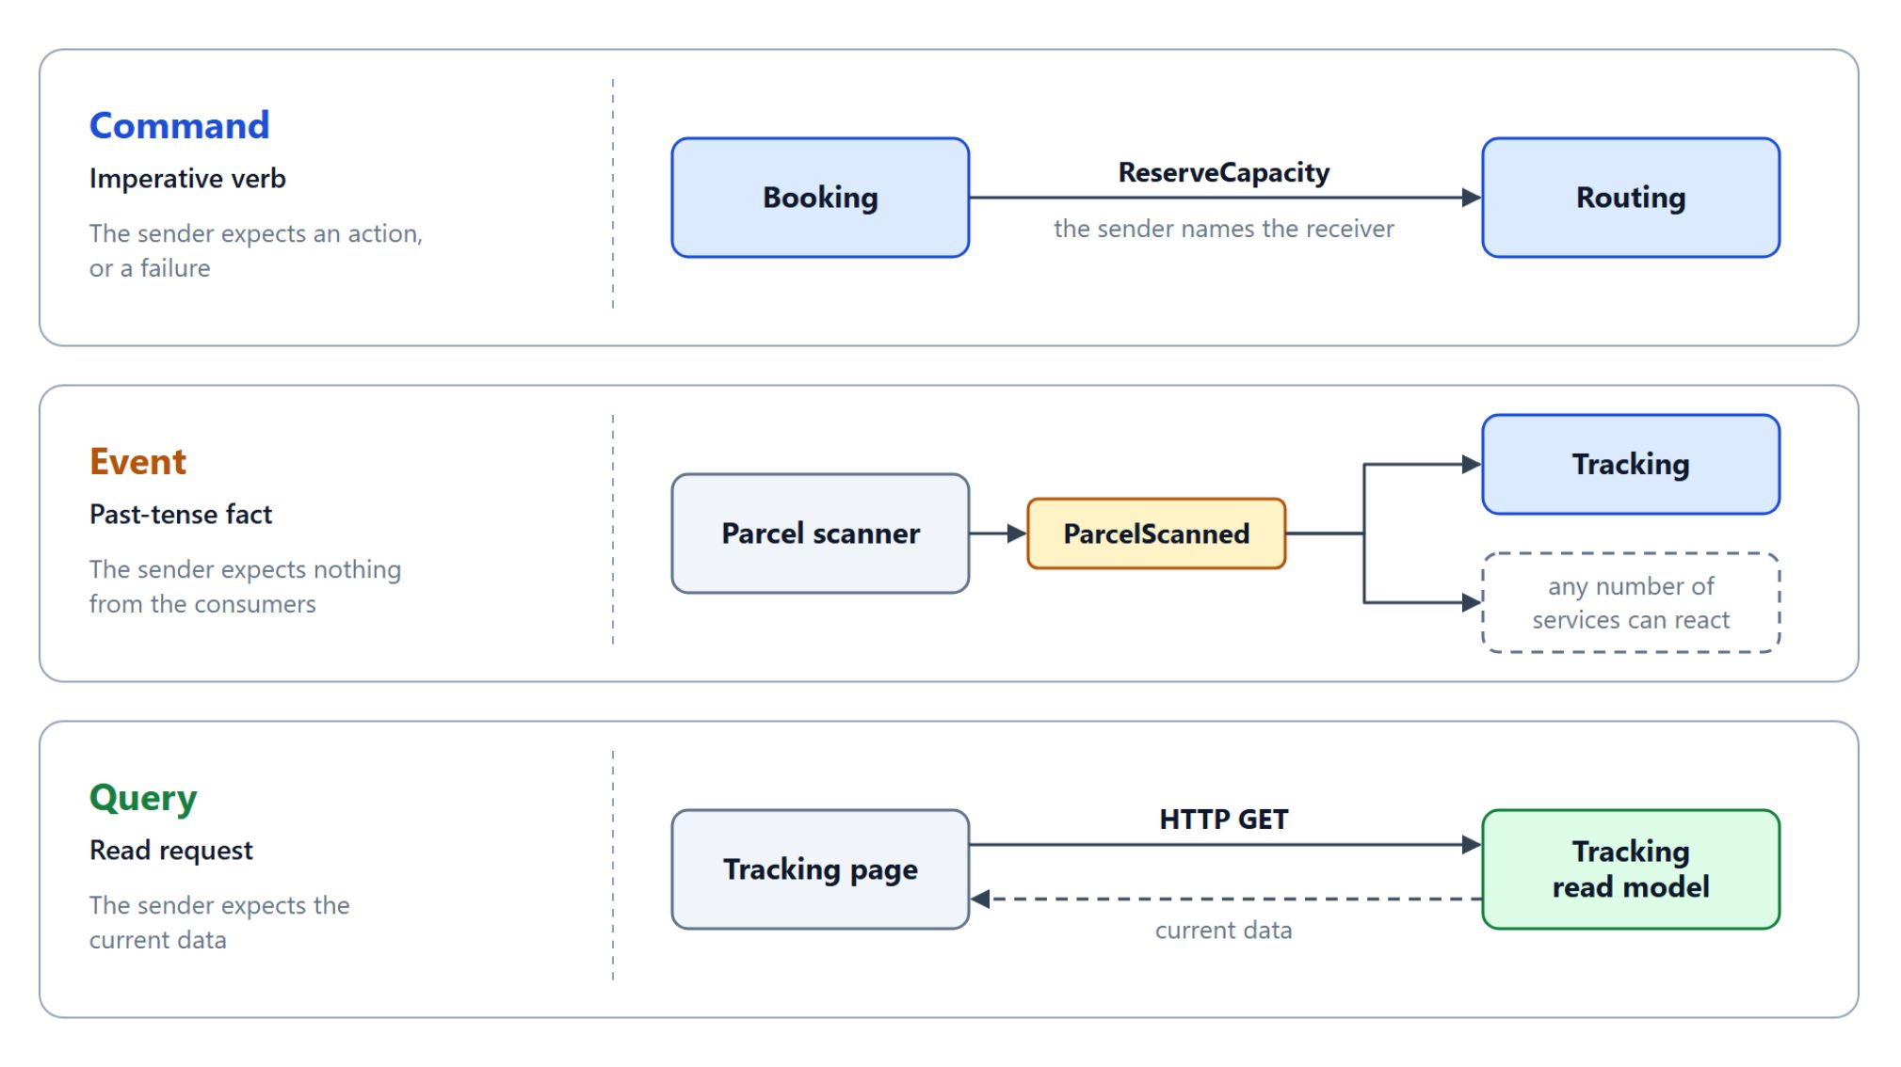
Commands, events and queries
What the sender expects decides the kind of message
A command asks a named service to act and expects an action or a failure
An event reports a fact, and the publisher does not know who listens
A query reads current data and changes nothing, so HTTP GET fits
Commands use imperative verbs, events use the past tense
Notes:
Contoso has a booking flow that must answer the customer now and a scan flow that must never lose a parcel. Before choosing a transport, name what each message is.
Command: BookShipment, ReserveCapacity, CapturePayment and PrintLabel ask a service to act. The sender names the receiver, so it knows what it asked for.
Event: ShipmentBooked and ParcelScanned report facts that already happened, and any number of services can react without the publisher changing. The Microsoft Learn comparison of Azure messaging services makes the same split between an event and a message that carries data under a contract.
Query: the tracking page is a query served from a read model. Repeating a query is harmless, which is why queries suit HTTP GET.
Naming: a command is an imperative verb such as ReserveCapacity, an event a past-tense fact such as ParcelScanned.

Slide 12
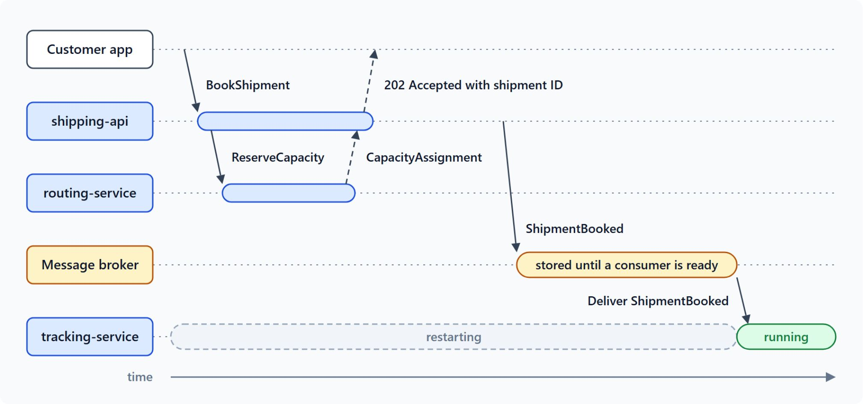
Request/reply and fire-and-forget
Both styles appear in one booking
With request/reply the caller waits, and HTTP is the default transport
With fire-and-forget the broker stores the message until a consumer is ready
Booking waits for ReserveCapacity, while ShipmentBooked waits in the broker
Temporal coupling means both services must be up at the same moment
Set each request/reply timeout from how long the customer will wait
Notes:
A customer who books a shipment expects the answer in the same request, while a parcel scanner sends updates that nobody waits on. The time axis puts both styles into one booking.
Request/reply: the BookShipment call waits until shipping-api validates the request and returns the shipment ID. The caller holds the connection while that happens.
Fire-and-forget: the sender publishes and continues, and a crashed consumer does not lose the message. The producer stays unblocked unless it loses its connection to the broker.
One booking, both styles: the reservation is a synchronous call that Booking waits for. ShipmentBooked travels through the broker and reaches tracking-service once it has restarted.
Temporal coupling: with HTTP, if routing is down while a customer books, the booking fails unless you add a retry or a queue. A broker removes that dependency for commands and events.
Timeouts: set the timeout from how long the customer will wait, so the app shows an error before the customer gives up. Timeouts also release threads and connections that would otherwise pile up during an outage.

Slide 13
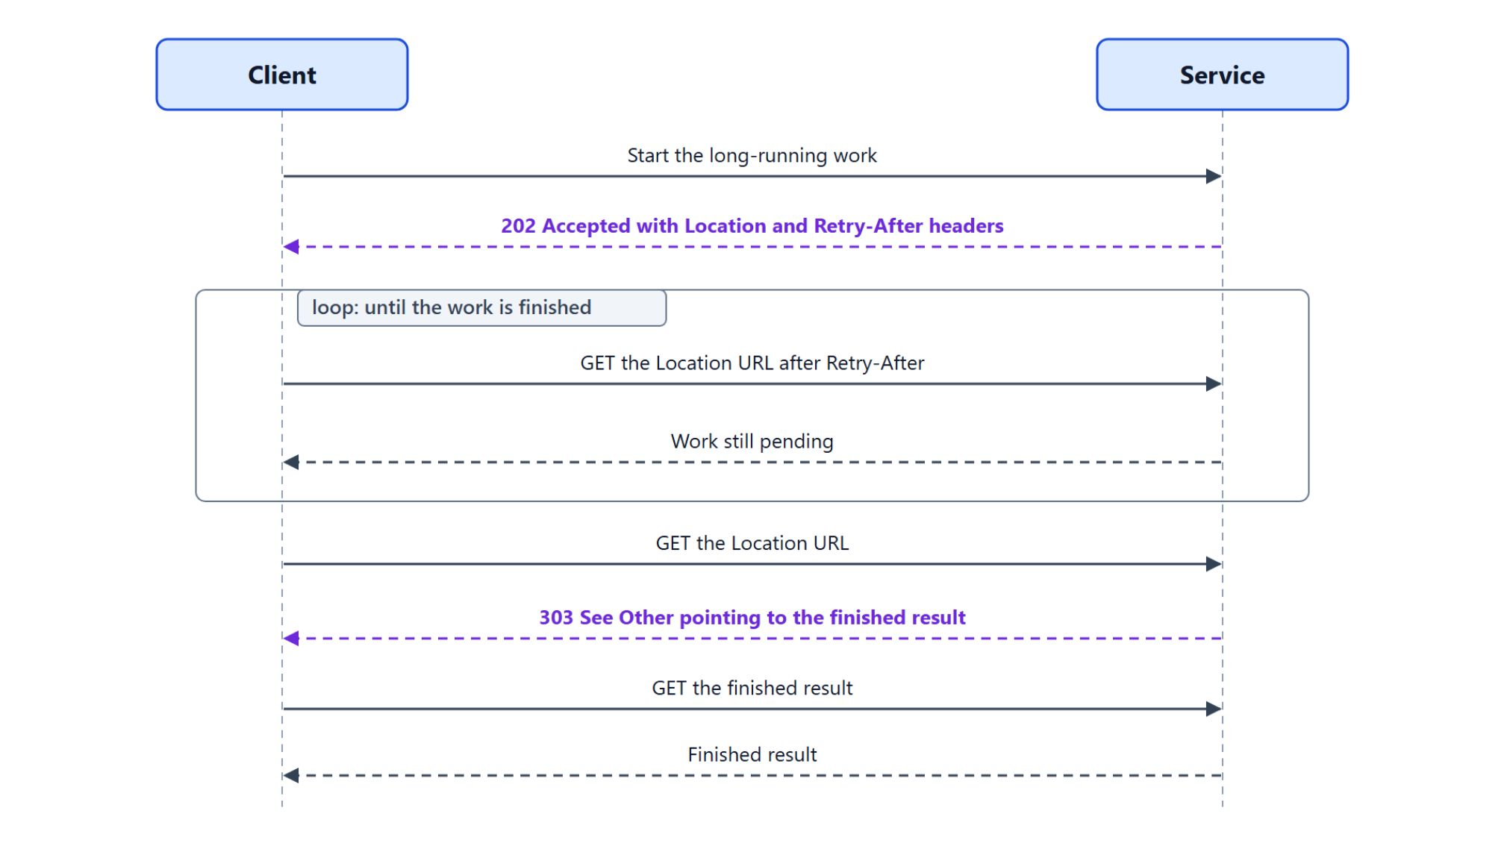
When HTTP is the right choice
The Asynchronous Request-Reply pattern for long-running work
The caller needs the answer for its next step, such as a shipment ID
A query asks for current data
Long-running work returns 202 Accepted with Location and Retry-After
The client polls until 303 See Other points to the finished result
If the caller only needs the work to happen, publish a command or an event
Notes:
A broker removes temporal coupling, yet HTTP stays the right choice in three cases. The diagram shows the third, long-running work that the caller polls.
Answer for the next step: a validation error or a shipment ID decides what the app shows next, so the caller waits for it.
Query: a request for current data changes nothing and is safe to repeat.
202 Accepted: the service accepts the work at once and returns a Location header and a Retry-After header. While the work is pending, the client calls the Location URL again after each Retry-After interval.
303 See Other: once the work is finished, the Location URL redirects the client to the finished result, which it then fetches.
The deciding question: if the caller needs the answer to continue, use HTTP; if it only needs the work to happen, publish a command or an event. Messaging brings eventual consistency, duplicates and out-of-order processing, which the reliability topic handles.

Slide 14
03
Event Storming: Find Service Boundaries
Bounded contexts and the Contoso service list
Event-Driven Distributed Apps on Azure: Aspire, Dapr & Durable Execution

Slide 15

The sticky-note grammar
Business events on a wall, with the domain experts in the room
Events are orange notes in the past tense, such as ShipmentBooked
Commands are blue notes written as imperatives, such as BookShipment
Actors issue commands, policies react to events, and aggregates decide
Hotspots mark open questions, each with an owner and a date
The big picture comes first, then the process level for one flow
Notes:
Booking calls a parcel a shipment, Tracking calls it a tracking number and Billing a charge, and a service boundary belongs where the words change meaning. Event storming finds those boundaries in a workshop with the domain experts in the room.
Events: orange notes written in the past tense, such as ShipmentBooked or ParcelScanned, placed along one long timeline.
Commands: blue notes written as imperatives, such as BookShipment or PrintLabel. Published colour conventions differ for the other notes, so the workshop picks those colours.
Actors, policies and aggregates: an actor such as a customer, a dispatcher or a parcel scanner issues a command, and a policy reads "whenever ParcelScanned reports AtHub, notify the customer". The aggregate is the consistency unit that decides, such as the Shipment that accepts BookShipment.
Hotspots: a hotspot marks an open question, such as who approves a refund when a van is late. Each one gets an owner and a date, so the question does not turn into a hidden dependency.
Two levels: the big-picture session maps every event on one timeline and postpones arguments about services. The process level zooms into one flow, such as booking through delivery, and adds commands, actors, policies and aggregates.

Slide 16
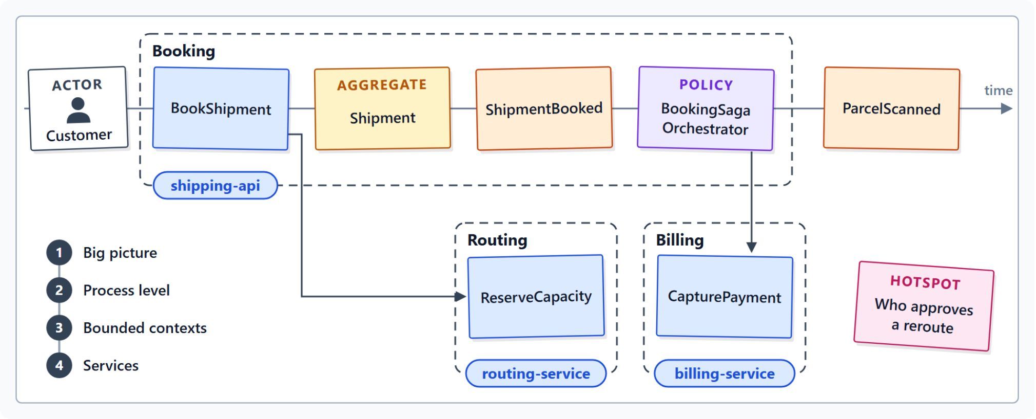
From contexts to the Contoso service list
A microservice spans at most one bounded context
In the booking flow, BookShipment invokes ReserveCapacity and the saga issues CapturePayment
Aggregates that share one language form a bounded context
A context map names the relationship between two contexts
Eight Contoso contexts, each with its own service, such as Booking on shipping-api
Each candidate passes the boundary tests or goes back to the storm
Notes:
Once the wall is full, clusters of aggregates turn into contexts and then into services. The diagram shows that path for Booking, Routing and Billing.
The booking flow: a customer issues BookShipment, the Shipment aggregate emits ShipmentBooked, and the booking request itself invokes ReserveCapacity on routing. The booking saga issues CapturePayment, and each step names one aggregate that decides and becomes the unit of ownership.
Bounded contexts: the team draws a context around each cluster of aggregates that share one language. The Azure Architecture Center states that a microservice shouldn't span more than one bounded context.
Context map: between contexts, the map names the relationship, such as customer-supplier, open host service or anti-corruption layer.
The Contoso list: Booking on shipping-api owns the Shipment aggregate and its event store, Routing runs one Dapr actor per van, and Billing owns payments. Labels, Tracking, Notifications, Telemetry and Exceptions complete the list, and the ops console reads from these contexts.
Boundary tests: one responsibility, no chatty calls, a team that can own it, deployment without its neighbours and loose coupling. A candidate that fails a test goes back to the storm for another round.

Slide 17
04
Event Types: Domain, Integration, CloudEvents
Payload styles and the CloudEvents 1.0 envelope
Event-Driven Distributed Apps on Azure: Aspire, Dapr & Durable Execution

Slide 18
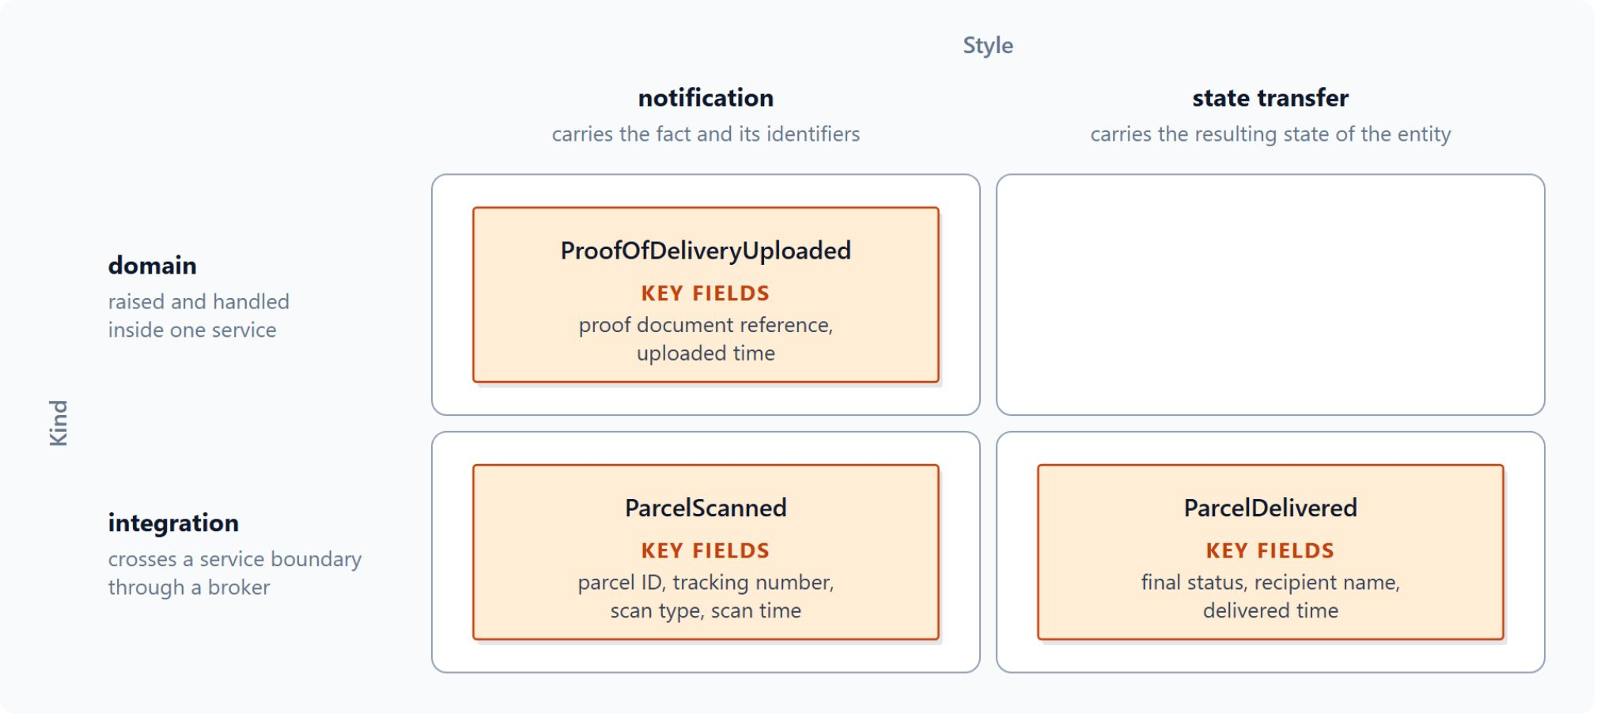
Domain events and integration events
The same fact inside one service or across a broker
A domain event is raised and handled inside one bounded context
An integration event crosses a service boundary through a broker
Integration events leave only after the entity is persisted
The publisher owns the contract; the labs keep it in Contoso.Contracts
Every event also has a style: notification or state transfer
Notes:
When Booking confirms a shipment, the same fact travels in different forms. The grid sorts events by kind, inside one service or across a broker, and by style, which the next slide covers.
Domain event: the Shipment aggregate raises ShipmentBooked, and a handler in the booking module updates the customer account in the same process. The eShop reference application sends its domain events to an in-process dispatcher in the same way.
Integration event: it travels through a broker to other services, such as Tracking and the exception agent.
After the commit: the .NET architecture guidance says integration events occur only after the entity is persisted, because otherwise the operation never happened for the consumers. ShipmentBooked leaves Booking only after the Shipment commits.
Contracts: integration event contracts belong to the publishing service. The labs keep every record in one `Contoso.Contracts` project, so a record change reaches every consumer at once.
Style: in the grid, ProofOfDeliveryUploaded is a domain notification, ParcelScanned an integration notification and ParcelDelivered an integration state transfer.

Slide 19
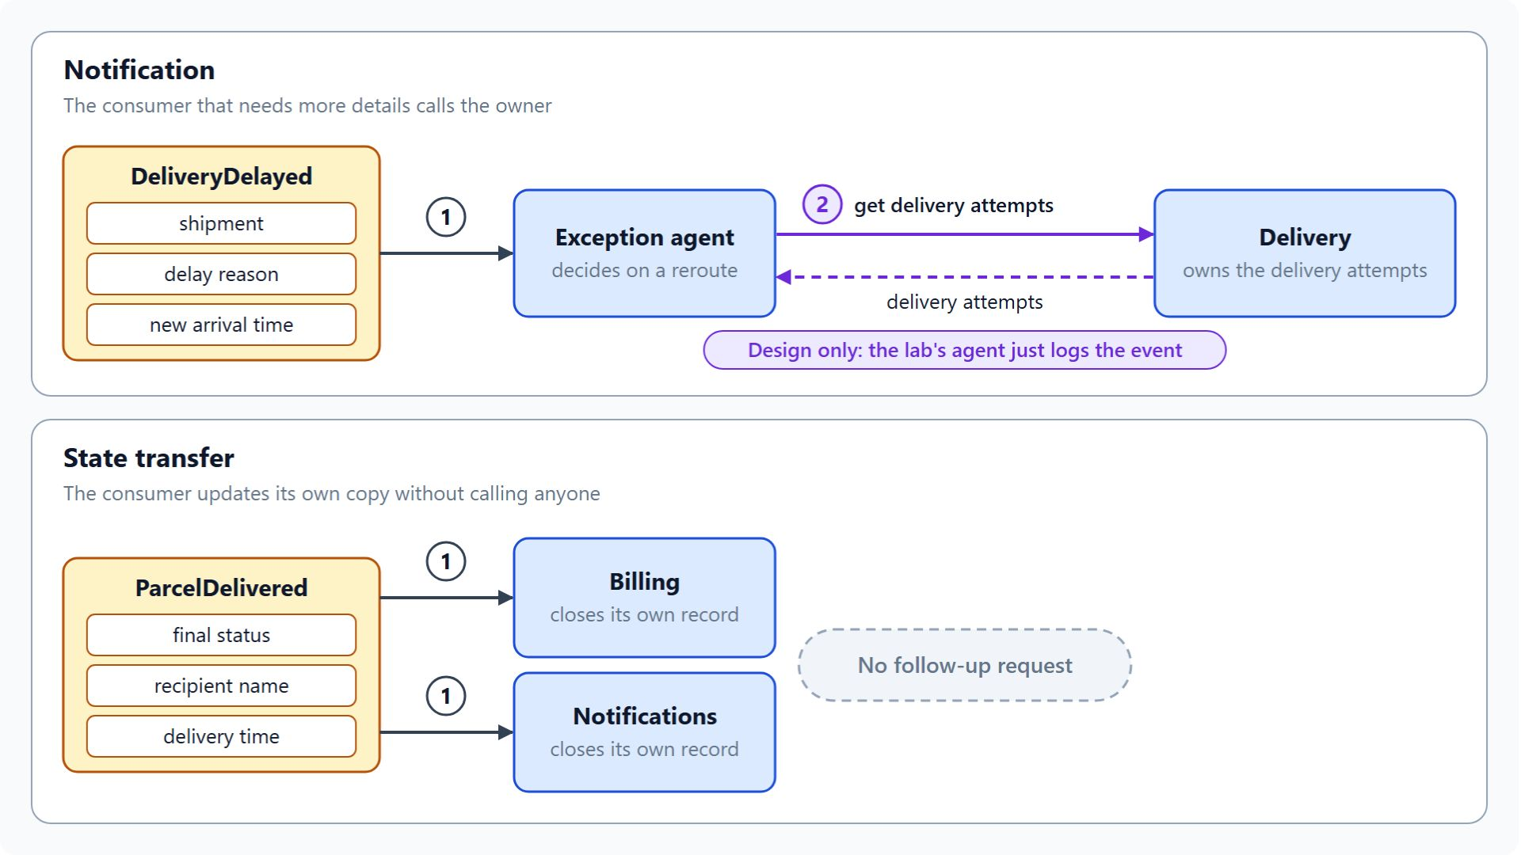
Notification and state transfer events
What the payload holds decides whether the consumer asks back
A notification carries the fact, the identifiers and the time
A consumer that needs more detail calls the owner in a second request
A state transfer event carries the new state, and the consumer upserts its copy
DeliveryDelayed is a notification, ParcelDelivered a state transfer
Name events after business facts, such as ParcelDelivered
Notes:
Once an event crosses a boundary, its payload decides how often the consumer must ask back. The two lanes show one Contoso example of each style.
Notification: ParcelScanned carries the parcel ID and the scan type, and Tracking appends it to its own read model without calling Booking.
Second request: DeliveryDelayed carries the shipment, the delay reason and the new arrival time, but a reroute decision also needs the delivery attempts that Delivery owns. In the design the exception agent calls Delivery for them; the lab's agent only logs the event.
State transfer: the Azure Architecture Center describes a message that carries the resulting absolute state, which the consumer applies as an upsert to its own copy.
ParcelDelivered: it carries the final status, the recipient name and the delivery time, so Billing and Notifications close their own records without a follow-up request.
Business names: publishing database rows leaks internal structure, and a generic name such as RecordChanged makes every consumer inspect the payload. A name such as ParcelDelivered tells the consumer what happened.

Slide 20
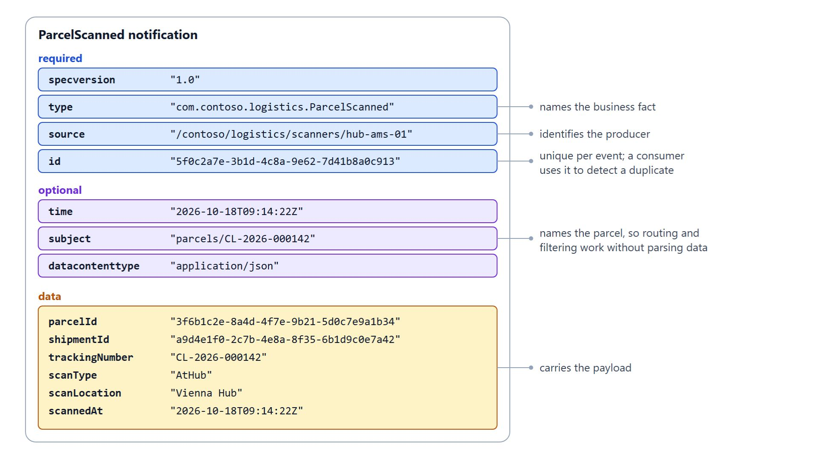
The CloudEvents 1.0 envelope
One envelope that consumers read without the producer's format
Four required attributes: id, source, specversion and type
Optional attributes are datacontenttype, subject and time; data carries the payload
The id is unique per event, so consumers use it to detect duplicates
The subject names the parcel, so brokers filter without parsing data
Event Grid namespace topics and Dapr carry it; Service Bus carries plain JSON
Notes:
Brokers and routing services need one envelope, so a consumer can read the type, source and ID without knowing the producer's internal format. CloudEvents is a CNCF graduated project, and the diagram shows a ParcelScanned notification inside its envelope.
Required attributes: specification version 1.0.2 defines four, id, source, specversion and type. The source identifies the producer and the type names the business fact.
Optional attributes: datacontenttype, subject and time are optional. Data carries the payload, here the parcel and shipment IDs, the tracking number, the scan type, the location and the scan time.
Duplicates: the id must be unique per event, and it is the attribute a consumer uses to detect a duplicate.
Filtering: brokers that route by attribute can match on type and subject, so a subscriber selects ParcelScanned events for one parcel without reading the payload.
Where it applies: Event Grid namespace topics accept CloudEvents 1.0 over HTTP in JSON, and Dapr wraps every pub/sub message in the envelope. The Service Bus messages in the labs carry plain JSON with a subject.

Slide 21
05
Reliability Patterns: Outbox, Saga, Idempotency
The failures that break event flows
Event-Driven Distributed Apps on Azure: Aspire, Dapr & Durable Execution

Slide 22
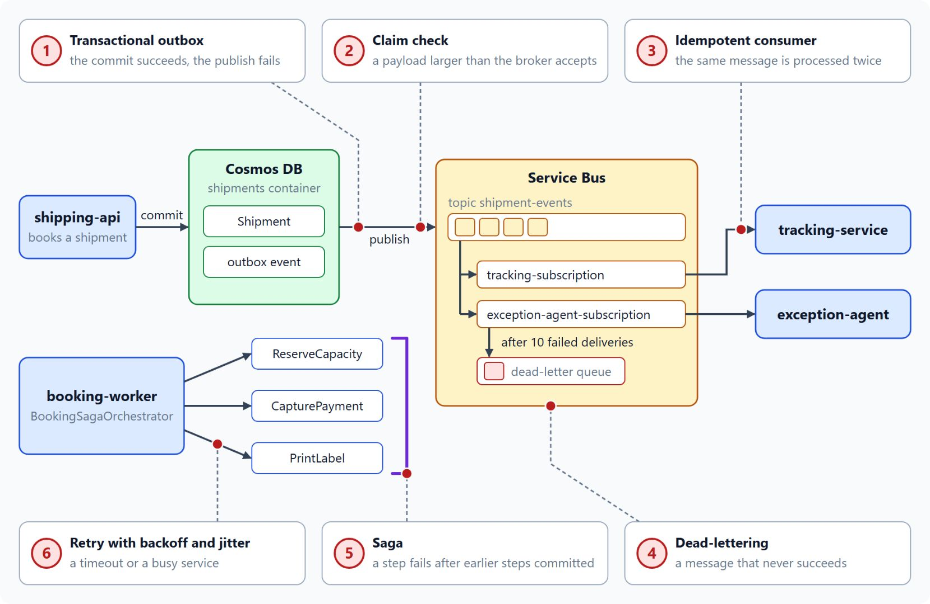
Failures that break event flows
Each failure in one booking and the pattern that prevents it
The transactional outbox stores the change and the event in one transaction
The idempotent consumer records each message it has processed
A saga undoes committed steps when a later step fails
Retries with exponential backoff and jitter handle transient faults
Dead-lettering moves poison messages aside; a claim check carries large payloads
Notes:
A booking saves a shipment, reserves a van, captures a payment and prints a label, and any step can fail after an earlier one has committed. The failure map numbers each failure at the step where it happens; the linked topics later in the class build each pattern.
Dual write: a service commits its change and then fails to publish the event, or the reverse. The transactional outbox writes both in one local transaction, and a relay publishes the stored event later.
Duplicates: brokers deliver at least once, so a producer retry, a lost acknowledgment or a consumer crash can deliver a message twice. The idempotent consumer keys its records on a producer-assigned message ID or a business-level idempotency key, because one correlation ID covers several related messages.
Partial failure: a step that fails after earlier steps committed cannot roll back across services. A saga undoes the earlier steps with compensating transactions.
Transient faults: a momentary loss of network connectivity or a busy service usually clears when the operation runs again later, so a bounded retry handles it.
Poison messages and large payloads: a message that never succeeds is dead-lettered after the maximum delivery count, so the queue keeps moving. A payload larger than the broker accepts goes to external storage, and only a claim check reference travels through the broker.

Slide 23
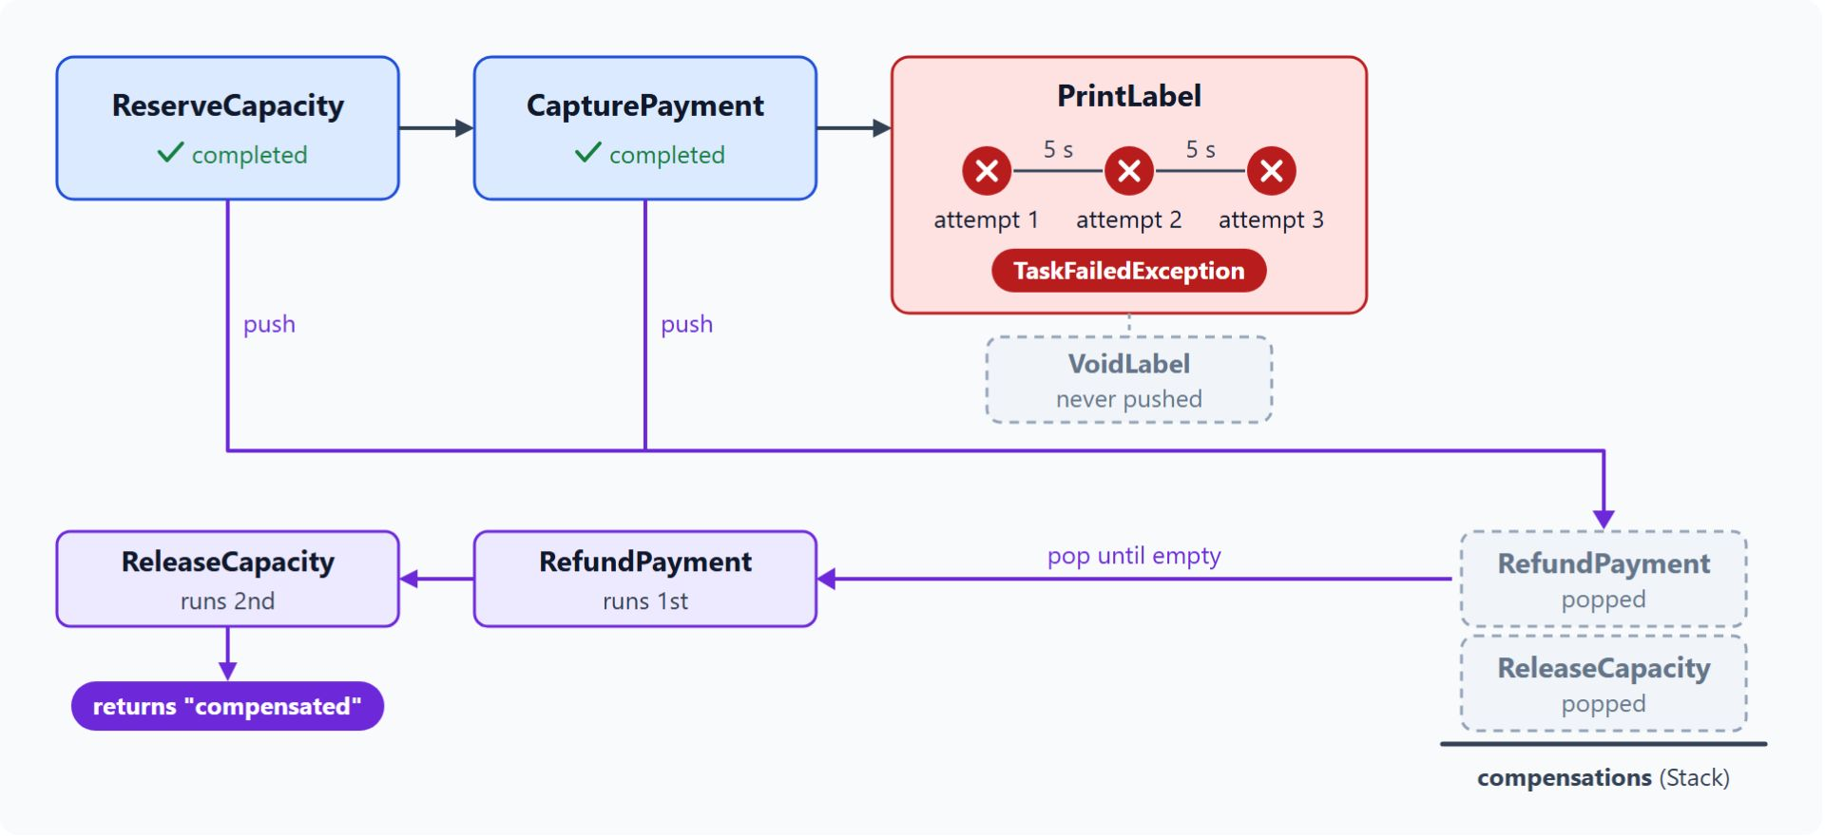
The booking saga
Local transactions with compensations in reverse order
A saga replaces one distributed transaction with local transactions
Forward steps: ReserveCapacity, CapturePayment, PrintLabel
Compensations release the capacity, refund the payment and void the label
Compensations run in the reverse order of the forward steps
Choreography fits a short flow, orchestration a growing one
Notes:
The saga covers the failure the outbox cannot: a step that fails after other services have committed their steps. The diagram shows the Contoso booking saga when PrintLabel fails.
Local transactions: each step commits in its own service, and when a later step fails, compensating transactions undo the earlier ones.
Forward steps: the booking saga reserves capacity, captures the payment and prints the label.
Compensations: ReleaseCapacity, RefundPayment and VoidLabel undo the three forward steps one by one.
Reverse order: in the diagram PrintLabel fails after three attempts, so the saga runs RefundPayment first and ReleaseCapacity second.
Choreography or orchestration: in choreography each service reacts to the others' events with no coordinator, which suits a short flow with few services. An orchestrator sends commands and tracks each step, which suits a growing flow or one whose state someone must see at any moment.

Slide 24
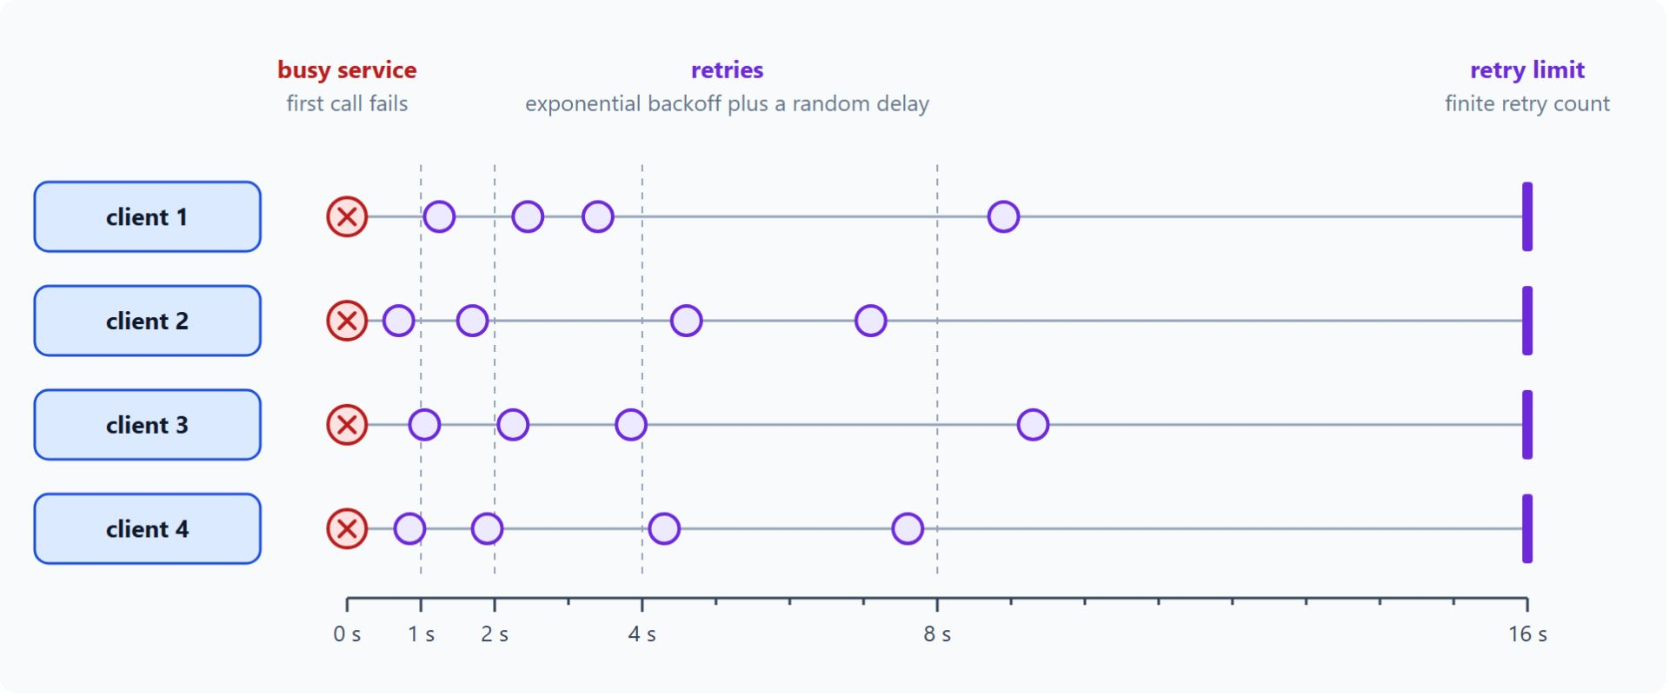
Retries and dead-letters
Bounded retries for transient faults, a side queue for the rest
Retry transient faults with exponential backoff and jitter
Keep a finite retry count and a retry budget per dependency
Give every outbound call a timeout
Service Bus dead-letters a message after ten failed deliveries by default
Event Grid dead-letters to a storage account once you configure it
Notes:
A retry suits a transient fault, because the fault clears on its own. The chart shows four clients that fail against a busy service and then retry on their own schedules.
Backoff and jitter: the Azure Architecture Center recommends exponential backoff plus a random delay, so many clients do not retry in the same instant.
Bounded retries: use a finite retry count, a retry budget per dependency and at most one immediate retry. Retries without a limit keep a struggling service down.
Timeouts: retries multiply latency, so every outbound call also needs a timeout.
Service Bus: after ten failed deliveries by default it moves the message to the dead-letter queue and records the reason, such as MaxDeliveryCountExceeded. The queue holds the evidence for an operator to inspect, replay or discard.
Event Grid: it sends undelivered events to a storage account after its retry policy finishes, once you configure dead-lettering on the subscription. It does not turn dead-lettering on by default.

Slide 25
06
Azure Messaging: Pick the Broker
Service Bus, Event Grid, Event Hubs, Dapr pub/sub
Event-Driven Distributed Apps on Azure: Aspire, Dapr & Durable Execution

Slide 26
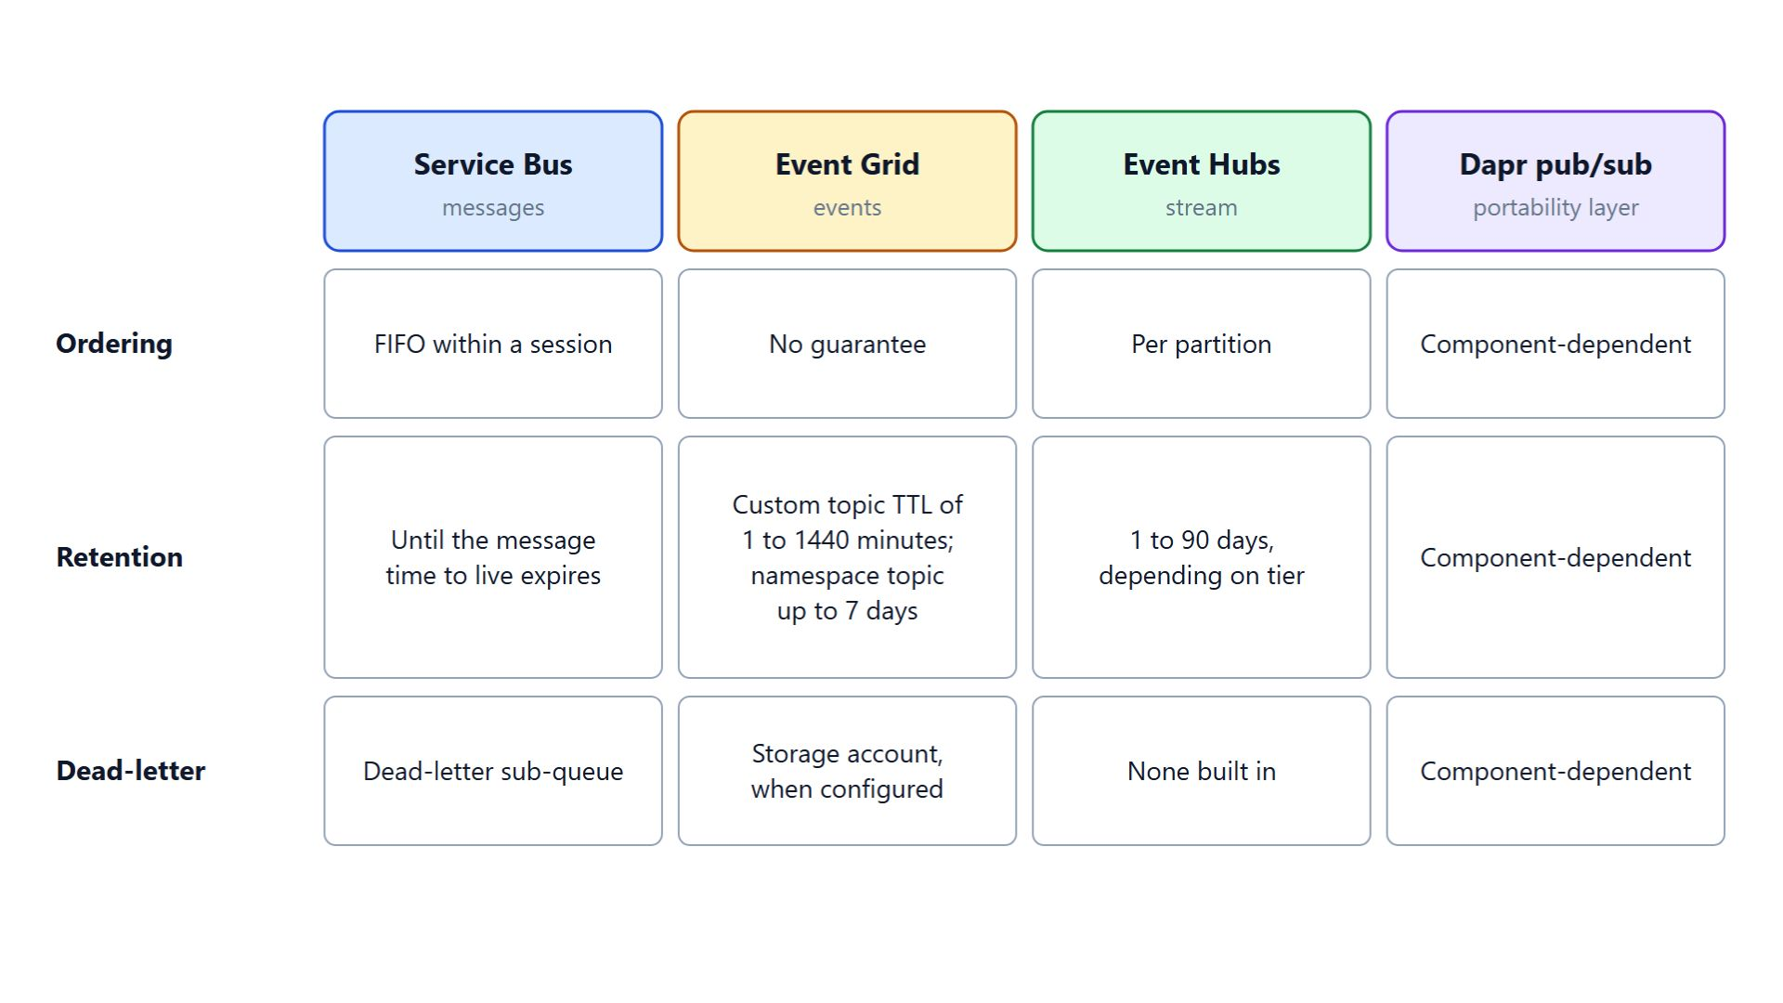
Messages, events and streams
Service Bus, Event Grid, Event Hubs and Dapr pub/sub compared
A message carries data under a contract, the shape Service Bus fits
An event is a lightweight notification of a state change, for Event Grid
A stream is a time-ordered series each consumer reads at its own pace, for Event Hubs
Dapr pub/sub is a portability layer that sits on top of brokers
Ordering, retention and dead-lettering decide most designs
Notes:
Contoso carries four kinds of traffic, and a wrong broker choice costs ordering, retention or replay later. This slide uses the terms Microsoft Learn uses and compares the rows that decide most designs.
Messages: the publisher expects a consumer to act on the message. Service Bus offers transactions, sessions, duplicate detection and dead-lettering for high-value payloads in enterprise workflows.
Events: the publisher expects no particular reaction. Event Grid routes discrete events to subscribers, filters them and retries delivery on a schedule.
Streams: Event Hubs keeps events in partitions for a configured retention period, and each consumer group keeps its own position. Telemetry, log aggregation and real-time analytics are its main scenarios.
Dapr pub/sub: services publish to the Dapr API, and a component decides which broker carries the message. The Dapr component index lists Service Bus topics, Service Bus queues and Event Hubs as Azure components, and no Event Grid component.
The deciding rows: read the grid by column to choose a service and by row to compare two. A missing feature in ordering, retention or dead-lettering is expensive to build around later.

Slide 27
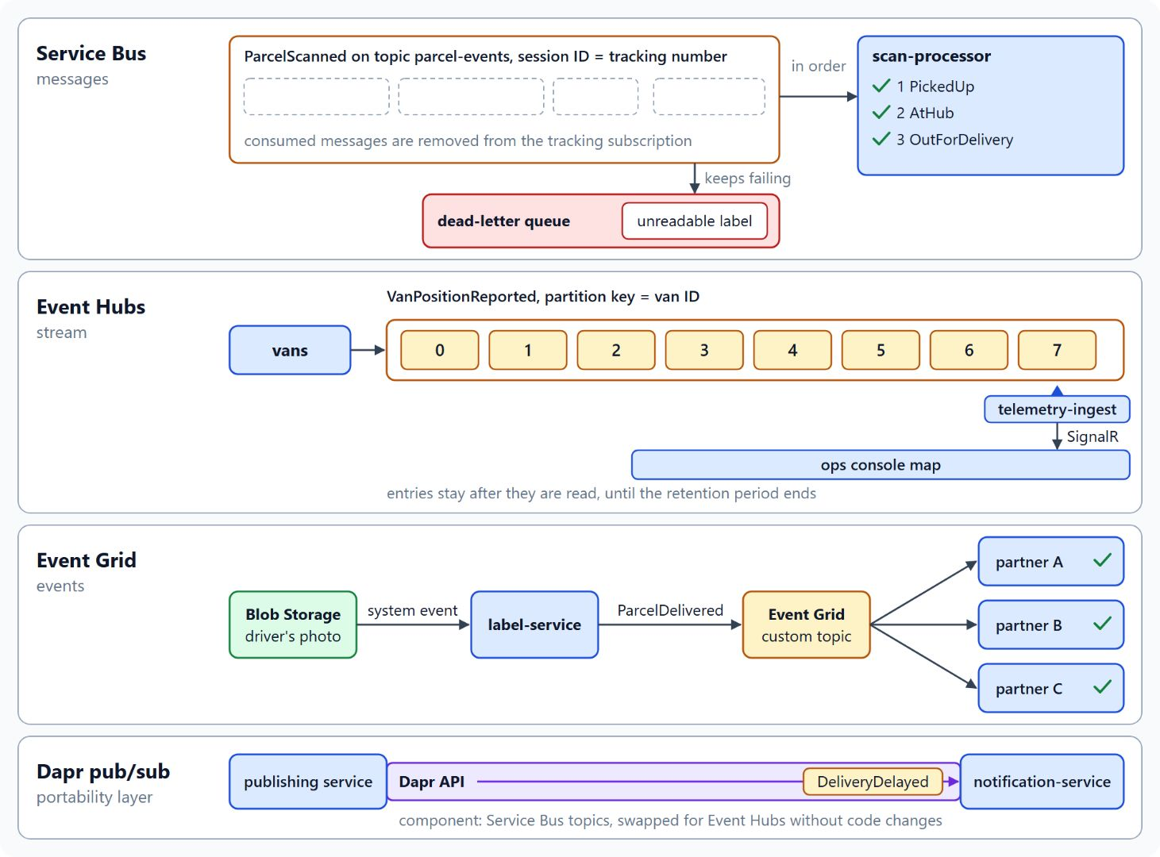
Contoso traffic on each service
Three Azure brokers side by side, Dapr pub/sub on the notification path
Service Bus carries the booking commands and ParcelScanned, one session per tracking number
Event Hubs carries VanPositionReported over Kafka, keyed by van ID
Event Grid sends ParcelDelivered to partners after the driver's photo upload
Dapr pub/sub carries DeliveryDelayed to notification-service
Check ordering first, then retention
Notes:
Each lane shows one Contoso flow on the service that fits its shape. Together they explain why the system runs three Azure brokers side by side.
Service Bus: ReserveCapacity and PrintLabel travel as messages, and each parcel scan is a ParcelScanned message with the tracking number as its session ID, so scans of one parcel run in order. An unreadable label scan that keeps failing ends in the dead-letter queue, where an operator can inspect it.
Event Hubs: the van simulator publishes VanPositionReported over the Kafka endpoint with the van ID as the message key, which keeps each van's positions in order. telemetry-ingest reads the stream with EventProcessorClient and pushes each position to the ops console map through SignalR.
Event Grid: a driver's photo uploaded to Blob Storage raises a system event, and partners receive ParcelDelivered through a custom topic or by pulling from a namespace. Event Grid suits this shape because the publisher is an Azure resource and the consumers are reactive.
Dapr pub/sub: the publishing service calls the Dapr API with DeliveryDelayed, and notification-service subscribes without a dependency on a broker SDK. Swapping Service Bus topics for Event Hubs then becomes a component change.
Order of checks: ordering is the hardest property to add later, and replay depends on retention.

Slide 28
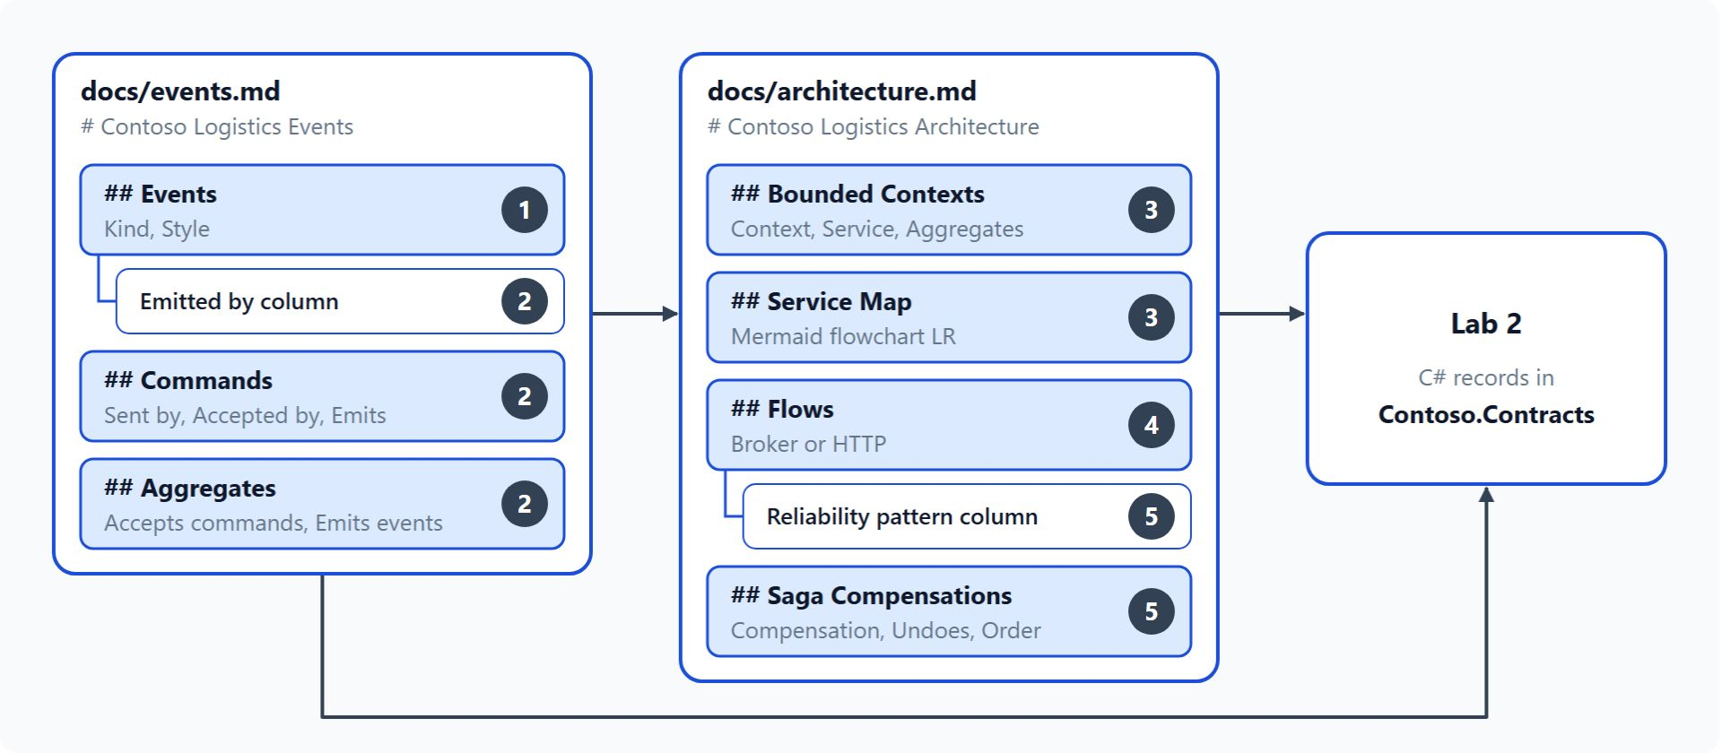
Lab: event-storm the parcel delivery flow
Two design documents that lab 2 turns into C# records
Starts from an empty workspace with agent instructions and an empty docs/ folder
docs/events.md holds 13 events, 7 commands and the aggregates behind them
docs/architecture.md holds contexts, the service map, flows and saga compensations
Five steps in about 45 minutes, with no code and no tests
Design checks confirm both documents before lab 2
Notes:
The lab turns the module into a design for Contoso Logistics, which exists only as a business brief. Participants open `labs/01-distributed-design/contoso-logistics/` with GitHub Copilot agent mode or Claude Code.
Starting point: the workspace holds only agent instruction files, an MCP server configuration and an empty `docs/` folder, and the agent reads `AGENTS.md` for the class stack.
events.md: steps 1 and 2 add the Events table with kind and style, the Emitted by column, and the Commands and Aggregates sections.
architecture.md: step 3 adds the Bounded Contexts and Service Map sections, step 4 the Flows section, and step 5 the Reliability pattern column and the Saga Compensations section.
Format: the lab practices all six topics of the module and produces documents only, so `src/` and `tests/` get no new files.
Design checks: they confirm, for example, that the scan flow keys on the tracking number, the telemetry flow partitions on the van ID and the compensations run in reverse order. The finished design in `contoso-logistics-solution` is there for comparison once every check passes.

Slide 29
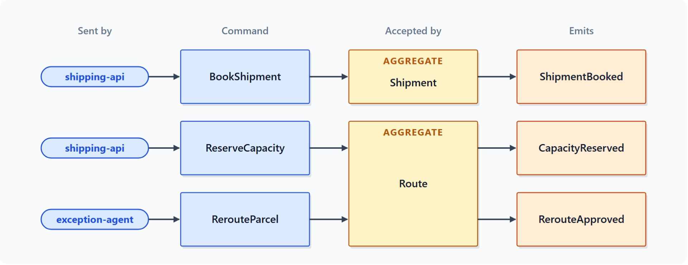
Events, commands and aggregates in the lab
Steps 1 and 2 write docs/events.md
Step 1 lists 13 events, each with a kind and a style
ParcelScanned carries the scan types PickedUp, AtHub and OutForDelivery
Step 2 adds an Emitted by column and 7 commands
Every Accepted by value matches a row in the Aggregates table
Steps 3 to 5 draw the contexts, pick a broker per flow and add the patterns
Notes:
Events come first, because each one records a fact that already happened and every later decision refers back to them. The diagram shows how each command reaches the one aggregate that accepts it.
Kind and style: each of the 13 events gets a journey stage, a kind and a style. The kind decides whether a fact stays inside one service, the style whether a consumer must call back for detail.
Scan types: ParcelScanned carries the parcel ID and a scan type with the values PickedUp, AtHub and OutForDelivery.
Commands: BookShipment, ReserveCapacity, CapturePayment, PrintLabel, AssignRoute, RerouteParcel and NotifyCustomer, each with Sent by, Accepted by and Emits.
Aggregates: every command has one aggregate that decides, such as Shipment for BookShipment and Route for ReserveCapacity and RerouteParcel.
The rest of the lab: step 3 groups the aggregates into bounded contexts, step 4 assigns each of seven flows to HTTP or one Azure broker, and step 5 names a reliability pattern per flow and the saga compensations.

Slide 30

Takeaways
What to carry into the Aspire module
Start with a modular monolith and split when team, deployment, scaling or data demand it
Use HTTP when the caller needs the answer, messages when the work only has to happen
Draw boundaries where the business language changes
Publish integration events after the commit, named after business facts
Protect every flow with a pattern, and pick the broker by ordering, then retention
Notes:
Close with the decisions this module prepared, each one made before anyone writes a service.
Monolith first: a modular monolith keeps the seams in the code and in the database. A module moves out when it needs its own scaling, release train or team.
HTTP or messages: start with the question the caller asks. HTTP serves an answer the caller needs to continue, a command or an event serves work that only has to happen.
Boundaries: event storming with the domain experts finds the bounded contexts, and a microservice spans at most one of them.
Events: integration events leave only after the entity is persisted, carry a business name such as ParcelDelivered, and travel in a CloudEvents envelope on Event Grid and Dapr.
Patterns and brokers: outbox, idempotent consumer, saga, retries and dead-letters protect each flow, and ordering and retention decide the broker. Module 2 turns these boundaries into a running system with Aspire.

