Slide 1

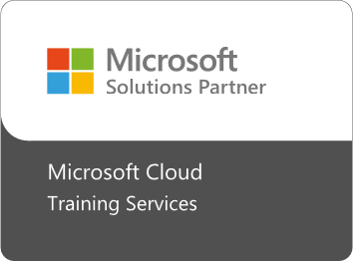

Fast Lane Group
Worldwide Education &
Professional Services
www.flane.de | © 2026 Fast Lane Institute for Knowledge Transfer GmbH
Notes:
Die Fast Lane Gruppe.
Fast Lane … Dienstleister u. Spezialist für High-End Technologie und Business Trainings
IT Trainings zu den unterschiedlichsten Herstellern wie Microsoft, Google, Cisco oder AWS. Und vielen weiteren wichtigen IT Herstellern.
Sei es Cloud, Security, Netzwerk oder allgemein digitale Transformationsprojekte
Und das seit 2003.
Das spannende ist, dass die Fast Lane Gruppe bereits seit 2009 durchgängig zu den Top 20 Unternehmen in der IT Trainingsbranche weltweit zählt.
Aber auch Footprint ebenso im klassischen Professional Services Bereich für unsere wichtigsten Hersteller
PreSales Support, Deployment Services und Adoption Trainings
Additional Information:
Im Jahr 2021 sind wir zur „most strategic IT Education company worldwide“ von der IDC im „magic quadrant“ aufgeführt worden !
1 mio Teilnehmer insgesamt seit bestehen, 50.000+ Students ww p.A, 20.000 in DE pro Jahr

Slide 2



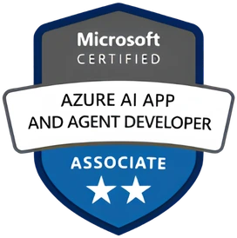


AGENTIC AI: FROM STRATEGY TO PRODUCTION.
Alexander
Kastil
AGENTIC AI CONSULTING · VIENNA
Full stack, from enterprise software to agentic AI. Since 1996
AI at Work
Enterprise AI
Value discovery, KPI mapping and roadmap
Governed multi-agent systems on Microsoft Copilot and Foundry
Agentic Software Engineering
Team Enablement
Harness architecture for Claude Code and GitHub Copilot
AI driven content production and delivery
integrations.at
github.com/alexander-kastil
SCAN TO CONNECT
alexander.kastil@integrations.at
linkedin.com/in/alexander-kastil
integrations.at
Notes:
Intro: Alexander Kastil, integrations.at. Four practice areas from AI at Work to team enablement. Certifications: Agentic AI Business Solutions Architect, Azure AI App and Agent Developer Associate, DevOps Engineer Expert.

Slide 3

MODULE 2
Building Distributed Apps with Aspire
Start, trace and test the Contoso system from one AppHost
Event-Driven Distributed Apps on Azure: Aspire, Dapr & Durable Execution

Slide 4
01
02
03
Aspire AppHost: Model the System
Resources, references, waits and parameters
ServiceDefaults: Telemetry, Resilience, Discovery
One call for OpenTelemetry, retries and health
Aspire Integrations: Hosting & Client
Hosting packages, client packages and emulators
04
05
06
Aspire Dashboard: Traces Across Services
Logs, traces, metrics and MCP for agents
Polyglot AppHost: Angular & Python
Vite and uvicorn apps beside .NET services
Aspire Testing: Distributed Integration Tests
Start the AppHost in a test, gate each step
Event-Driven Distributed Apps on Azure: Aspire, Dapr & Durable Execution

Slide 5

Building distributed apps with Aspire
Start, trace and test the Contoso system from one AppHost
Model the system: one AppHost starts every Contoso service and resource in order
Connect and observe: shared defaults, emulated Azure resources and one dashboard
Extend and test: Angular and Python apps in the same AppHost, tests that start it
Notes:
This opening slide sets out the three themes of the module: Module 1 decided where the service boundaries sit, and this module turns them into a running Contoso system.
Model the system: the AppHost describes the shipping API, the tracking service, the message bus and the database in C#, and one command starts them in the right order.
Connect and observe: ServiceDefaults gives every service the same telemetry, retries and discovery, and integrations connect Service Bus and Cosmos DB through local emulators. The dashboard then follows one booking across services.
Extend and test: the Angular ops console and the Python exception agent run under the same AppHost. Distributed integration tests start the real AppHost and check the event flow end to end.

Slide 6
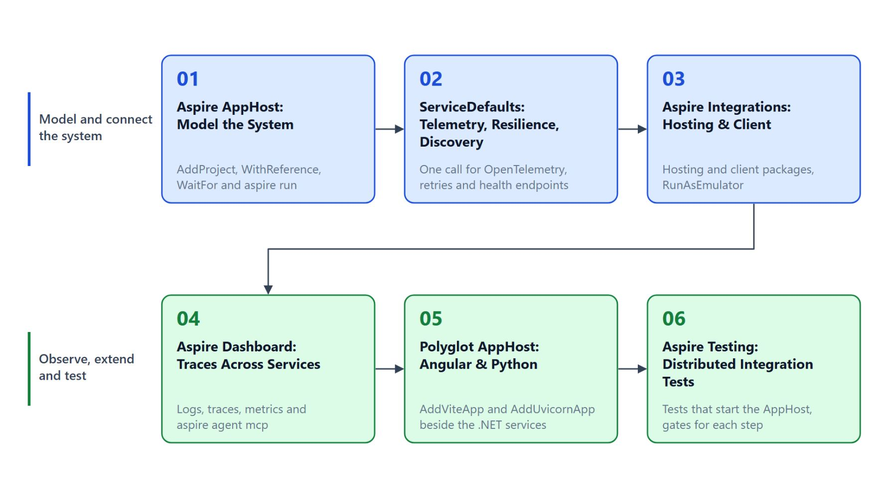
Overview
From the AppHost model to distributed tests
Model the system in an AppHost and start it with aspire run
Give every service the same ServiceDefaults for telemetry, retries and discovery
Connect Service Bus, Cosmos DB and Storage through integrations and emulators
Follow one booking across services in the dashboard
Host Angular and Python beside .NET, then test the event flow end to end
Notes:
This slide walks the path through the six topics once, following on from the three themes of the title slide.
Model and run: the AppHost declares every resource in C#, WithReference wires the connections and WaitFor orders the startup. `aspire run` starts the whole model together with the dashboard.
Shared behaviour: ServiceDefaults adds OpenTelemetry, the standard resilience handler, service discovery and health endpoints with one call. Integrations split the hosting package in the AppHost from the client package in the service.
Observe: the dashboard shows resources, logs, traces and metrics in one browser tab, and an AI coding agent reads the same telemetry through MCP.
Extend and test: the Angular ops console and the Python exception agent run under the same AppHost. DistributedApplicationTestingBuilder starts that AppHost inside a test and checks the booking flow end to end.

Slide 7
01
Aspire AppHost: Model the System
Resources, references, waits and parameters
Event-Driven Distributed Apps on Azure: Aspire, Dapr & Durable Execution

Slide 8
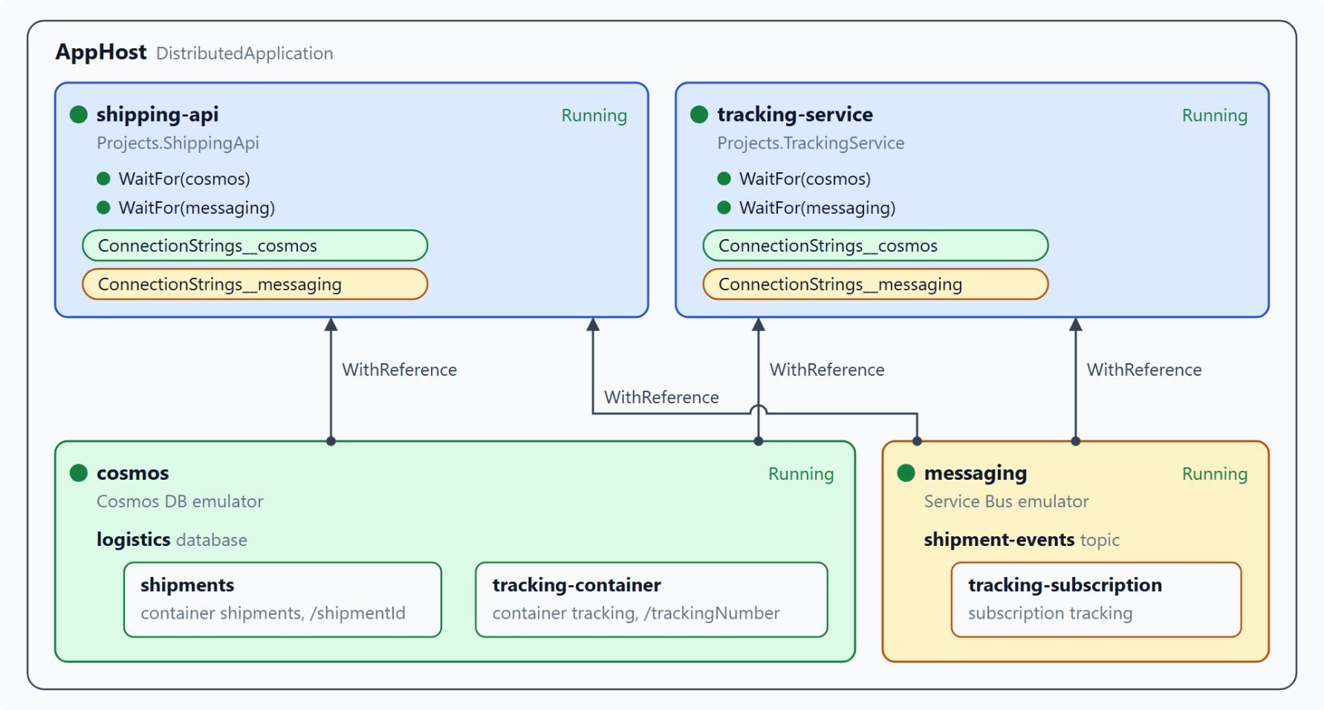
Declaring and wiring resources
WithReference passes the connections, WaitFor orders the startup
Each builder call adds a resource; the generated Projects type catches a wrong reference at compile time
WithReference hands a service the connection details as environment variables
WaitFor holds a service until its dependency is Running; client retries still apply
aspire run starts every resource and the dashboard; --isolated runs a second copy
Notes:
Contoso runs several services, a message bus and a database, and each one needs the others' addresses before it starts. The AppHost describes that system in C#, so one command starts every resource in the right order.
Resources: every call on the builder adds a resource to the model, and `Build().Run()` starts them. `Projects.ShippingApi` is generated from the AppHost's project references, so a wrong reference fails at compile time and a topology change shows up as a reviewable diff.
WithReference: the arrows in the diagram run from cosmos and messaging up into each service and carry a connection string such as `ConnectionStrings__cosmos`. The service reads it through its client package, so connection strings stay out of source.
WaitFor: it delays a service until the resource it names reaches the Running state, so the tracking service cannot start before the bus is ready. The wait orders the startup and does not replace retries in the client code.
aspire run: it builds the project, starts every resource and the dashboard, and prints the dashboard URL with a login token. `--isolated` randomizes the ports and separates user secrets, so a second copy of the Contoso system can run beside the first.

Slide 9
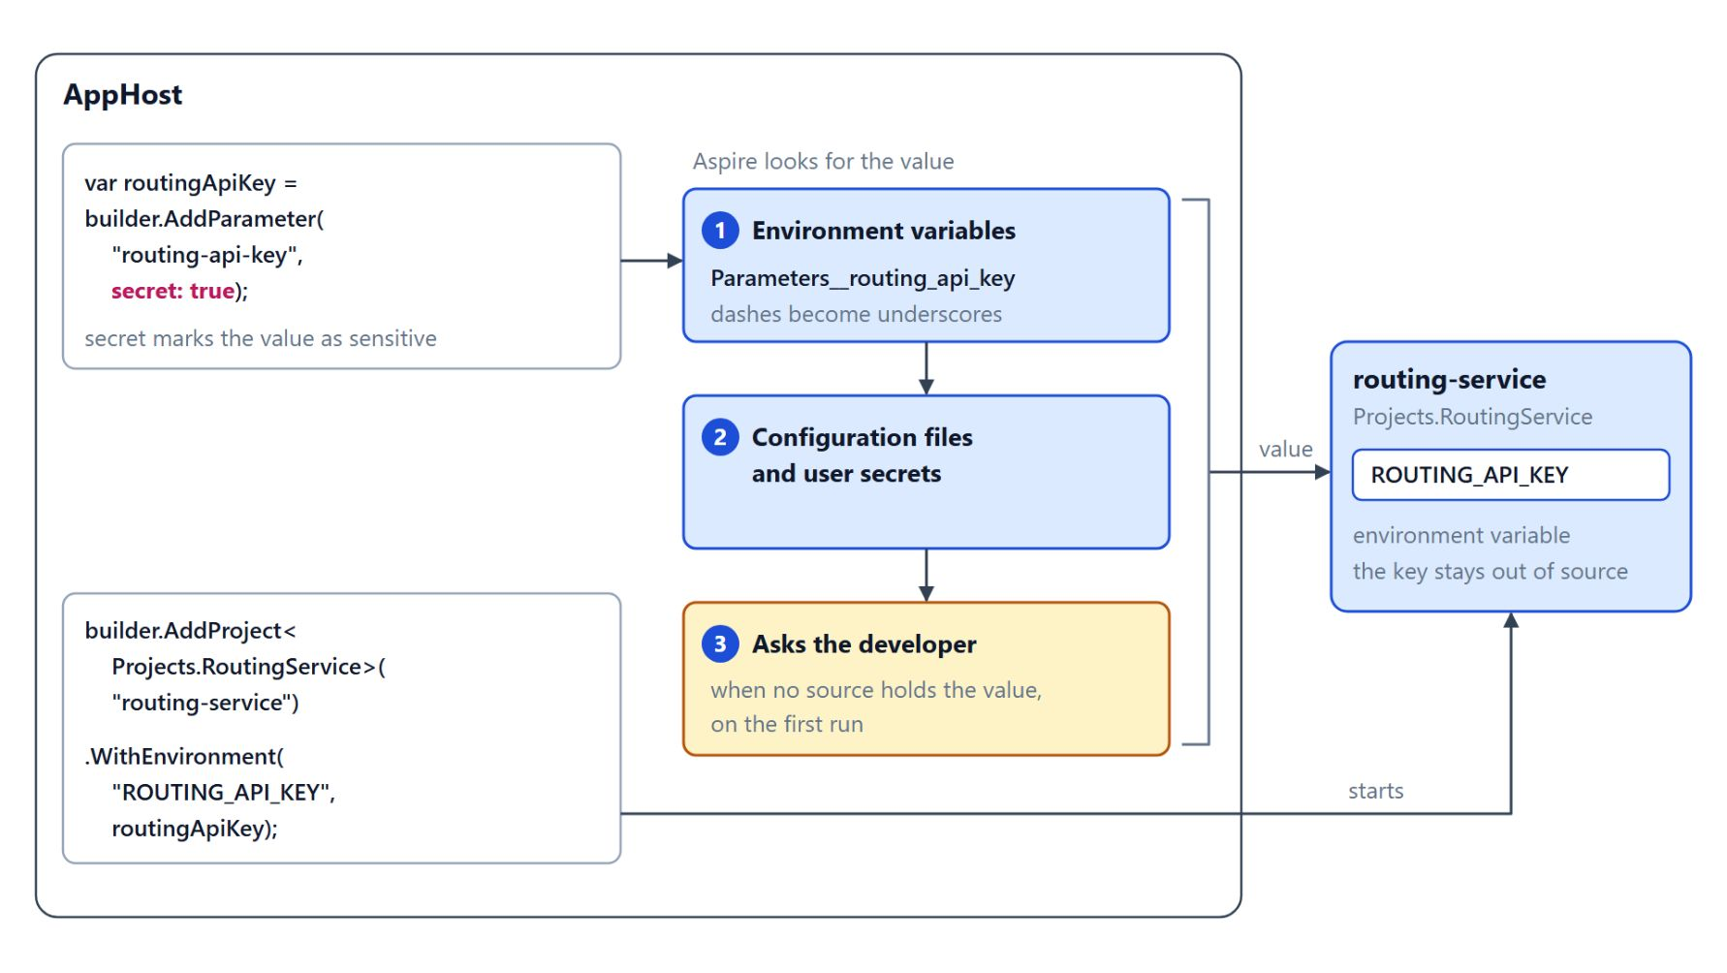
Parameters for secrets and settings
AddParameter keeps the routing API key out of source
AddParameter declares a value the AppHost needs but does not hard-code
secret: true marks it as sensitive, such as the routing service's API key
Aspire reads environment variables first, then configuration files and user secrets
With no value anywhere, Aspire asks the developer on the first run
Notes:
After the connections, the AppHost still needs values it must not contain, such as the API key of the routing service.
AddParameter: it declares a value that the AppHost needs but does not hard-code. The same model then runs on every developer machine with that developer's own key.
Secret flag: `secret: true` marks the value as sensitive, and `WithEnvironment` hands it to the routing service as `ROUTING_API_KEY` without the key appearing in source.
Lookup order: Aspire looks in environment variables first, then in configuration files and user secrets. The environment variable form is `Parameters__routing_api_key`, with dashes replaced by underscores.
First run: when no source holds the value, Aspire asks the developer. A new team member therefore sees exactly which settings the system needs.

Slide 10
02
ServiceDefaults: Telemetry, Resilience, Discovery
One call for OpenTelemetry, retries and health
Event-Driven Distributed Apps on Azure: Aspire, Dapr & Durable Execution

Slide 11
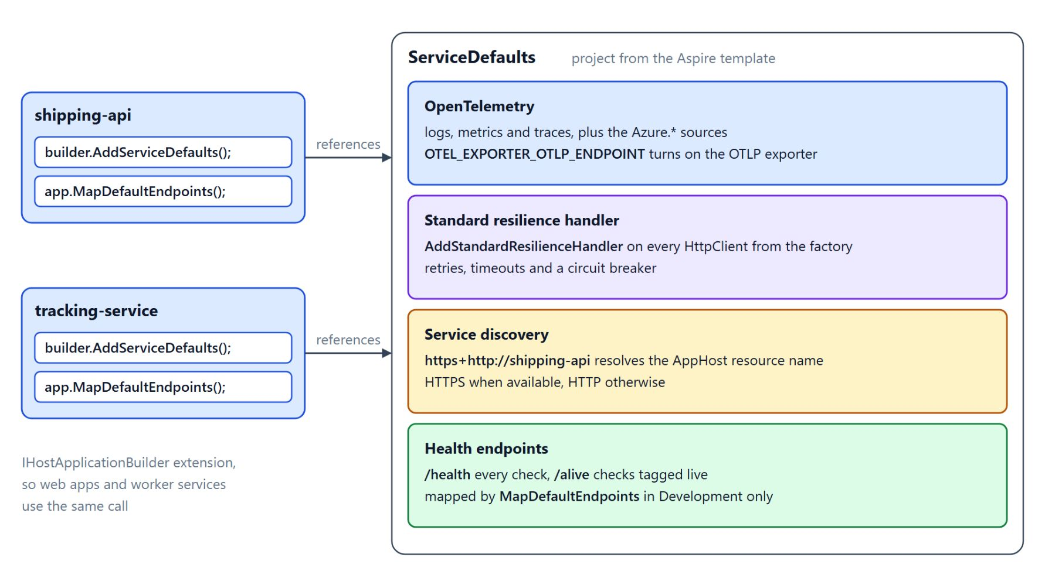
The ServiceDefaults project
One call gives a service telemetry, resilience, discovery and health checks
Each service references ServiceDefaults and calls AddServiceDefaults once
OpenTelemetry wires logs, metrics and traces; OTEL_EXPORTER_OTLP_ENDPOINT sets the target
Every factory HttpClient gets the resilience handler and service discovery
MapDefaultEndpoints maps /health and /alive, in Development only
Notes:
Every Contoso service needs the same telemetry, retry and discovery behaviour, and services that each configure it on their own drift apart. The ServiceDefaults project that the Aspire template generates holds that behaviour once.
One call: `AddServiceDefaults` extends `IHostApplicationBuilder`, so web apps and worker services use the same call. It also sets the `Azure.Experimental.EnableActivitySource` switch.
OpenTelemetry: logs, metrics and traces go to OpenTelemetry, and `UseOtlpExporter` runs only when `OTEL_EXPORTER_OTLP_ENDPOINT` is set, so that variable redirects every signal without a code change. A domain area such as shipment booking adds its own source with `AddSource("Contoso.Shipping")`.
Resilience and discovery: `ConfigureHttpClientDefaults` adds the standard resilience handler and service discovery to every client the factory creates. A base address such as `https+http://shipping-api` prefers HTTPS, falls back to HTTP and resolves the resource name from the AppHost.
Health endpoints: `/health` reports every registered check and `/alive` only the checks tagged live, so a liveness probe does not depend on downstream services. Both are mapped only in Development, because exposing them has security implications.

Slide 12
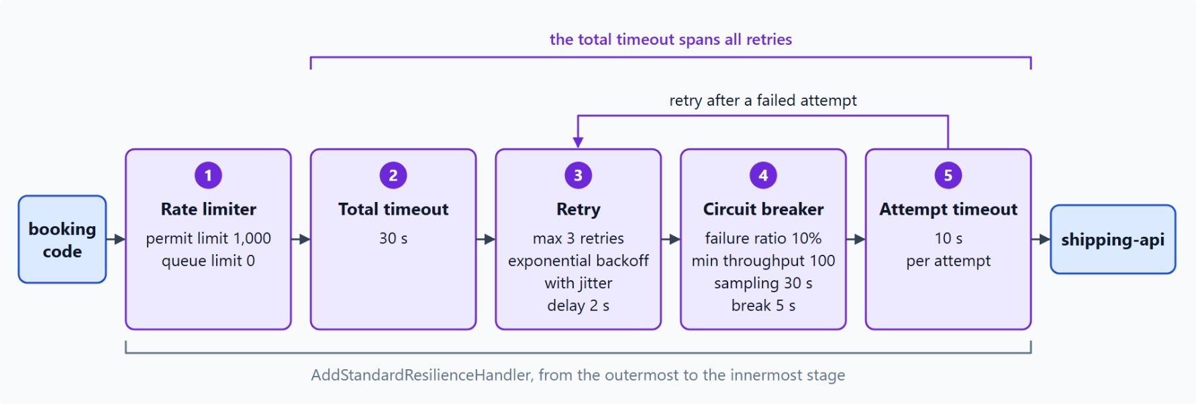
The standard resilience handler
Five stages between the booking code and shipping-api
AddStandardResilienceHandler adds retries, timeouts and a circuit breaker
The total timeout of 30 s spans every retry; each attempt gets 10 s
Retries replay requests, so the booking call to shipping-api must be idempotent
Request clients through IHttpClientFactory or a typed client to get the handler
Notes:
Calls between Contoso services fail for ordinary reasons, such as a restarting container or a slow database, and the standard resilience handler absorbs them on every `HttpClient` that the factory creates.
Five stages: a call passes the rate limiter, the total timeout, the retry, the circuit breaker and the attempt timeout, from the outermost to the innermost stage. The retry stage allows at most 3 retries with exponential backoff and jitter.
Timeouts: the total timeout of 30 s covers all retries and the attempt timeout caps each try at 10 s. A slow dependency therefore never holds a request open indefinitely.
Idempotency: retries replay requests, so a booking call to the shipping API must be idempotent, and the wait between attempts spares a recovering service a burst of requests. The reliability patterns topic in Module 1 covers that design rule.
Factory clients: a bare `new HttpClient()` outside the factory gets no retries. The booking code requests its client through `IHttpClientFactory` or a typed client.

Slide 13
03
Aspire Integrations: Hosting & Client
Hosting packages, client packages and emulators
Event-Driven Distributed Apps on Azure: Aspire, Dapr & Durable Execution

Slide 14
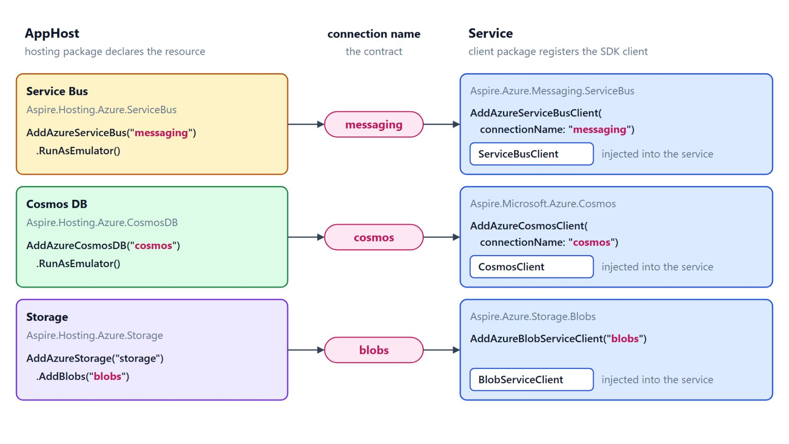
Hosting and client packages
The AppHost declares the resource, the service consumes the connection
A hosting package runs in the AppHost and adds calls such as AddAzureServiceBus
aspire add azure-service-bus adds the package and records its version
A client package registers the SDK client with its health checks and OpenTelemetry
connectionName must match the AppHost resource name: the name is the contract
Notes:
Contoso needs Service Bus for events, Cosmos DB for shipment history and Storage for proof-of-delivery photos, and each dependency comes as two packages.
Hosting packages: they add `AddAzureServiceBus`, `AddAzureCosmosDB` and `AddAzureStorage` to the builder and carry the provisioning logic, including the `RunAsEmulator` option. A service that references only the client package never creates a Service Bus namespace.
aspire add: the command adds the hosting package and writes its version to `aspire.config.json`.
Client packages: they register `ServiceBusClient`, `CosmosClient` or `BlobServiceClient` with dependency injection, so the service receives the client through its constructor and never builds a connection itself. The readiness endpoint reports a broken Service Bus connection without extra code.
The contract: `AddAzureServiceBusClient(connectionName: "messaging")` reads `ConnectionStrings__messaging`, which `WithReference` supplies for the resource named messaging. A developer who knows that rule reads a value from the environment without opening the AppHost.

Slide 15
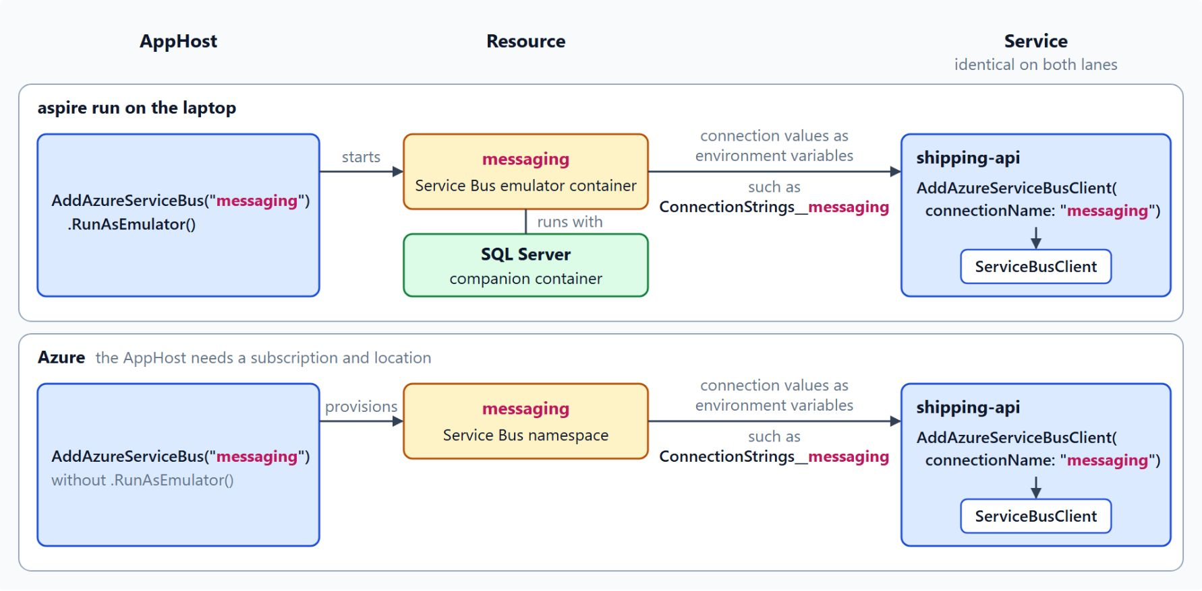
Local emulators and Azure deployment
The same messaging resource and client code on both lanes
RunAsEmulator swaps the Azure resource for a local container during aspire run
Service Bus runs with a SQL Server companion, Cosmos DB as vNext Linux emulator, Storage as Azurite
Every emulator needs a container runtime; the first run pulls the images
Without RunAsEmulator, Aspire provisions the real resource and the client code stays the same
Notes:
The same AppHost code runs on a laptop and against Azure, and the diagram puts the messaging resource on both lanes.
RunAsEmulator: it replaces the Azure resource with a named container that the AppHost starts. The emulator's logs appear in the dashboard next to the services that use it.
Three emulators: the Service Bus emulator runs with a SQL Server companion container and has no Entra ID sign-in, Cosmos DB uses the vNext Linux emulator, and Azurite emulates blob, queue and table storage. `WithDataVolume()` keeps the Cosmos DB data across runs.
Container runtime: every emulator needs one on the developer machine. The Service Bus emulator pulls its images on first use, so the first `aspire run` takes longer than the ones after it.
Deploy time: without `RunAsEmulator`, Aspire provisions a real Service Bus namespace and the AppHost needs an Azure subscription and location, while shipping-api keeps the same `connectionName`. A flow that passes against the emulator still needs a run on the Azure path before a release, and Module 3 covers `aspire deploy`.

Slide 16
04
Aspire Dashboard: Traces Across Services
Logs, traces, metrics and MCP for agents
Event-Driven Distributed Apps on Azure: Aspire, Dapr & Durable Execution

Slide 17

Dashboard views
Resources, logs, traces and metrics in one browser tab
Resources shows state and health, and restarts one resource without the rest
Console and configuration show why a service failed to start
Structured logs keep TrackingNumber as a field the dashboard filters on
Metrics find the time window of a slowdown, a trace finds the request
Notes:
A parcel scan that takes four seconds to reach the tracking page could lose that time in any of several services, and the console of each terminal rarely shows where. The Aspire dashboard puts the resources, logs, traces and metrics of the running system in one browser tab.
Resources: the page lists every resource from the AppHost with its state and health. A developer can stop, start or restart a single resource without stopping the rest of the Contoso system.
Console and configuration: console output shows standard output and standard error of each process, and the configuration view shows the settings a resource received. When a service fails to start, its state shows whether the process crashed or a health check failed.
Structured logs: each field stays data, and the message template defines the field names. Every service that logs a `TrackingNumber` field gives the dashboard the same key to filter by, without parsing text.
Metrics: the defaults register ASP.NET Core, `HttpClient` and runtime metrics, charted per resource. The chart finds the time window of a slowdown, and the trace finds the request and the step that caused it.

Slide 18
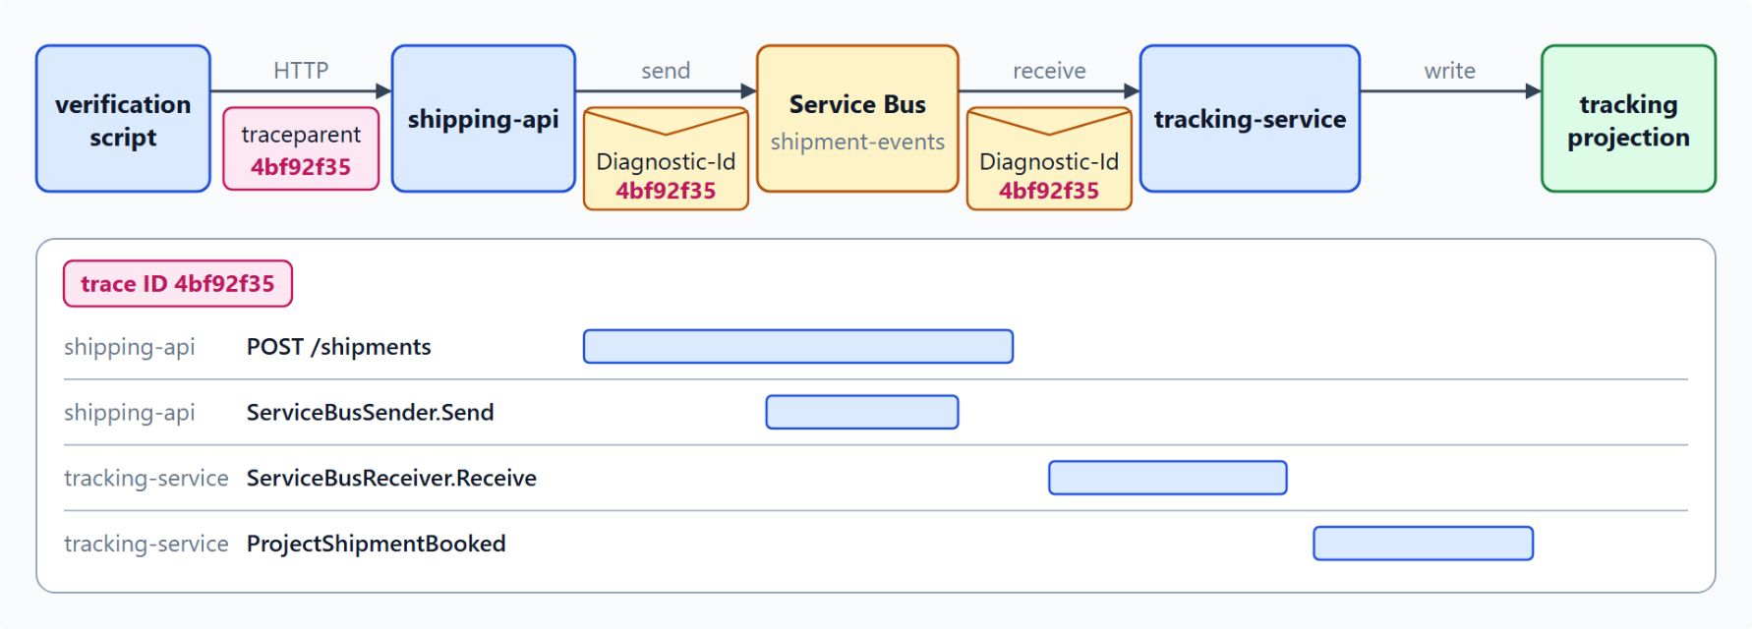
Traces across HTTP and Service Bus
One trace ID follows the booking from shipping-api to tracking-service
HTTP calls carry the W3C trace context in the traceparent header
Service Bus carries it in the Diagnostic-Id property of each message
The waterfall adds a span per step; the longest bar names the slowest step
The defaults switch on the Azure SDK spans and register the Azure.* source
Notes:
Traces connect the requests of one booking across services, and the diagram follows a single trace ID from the booking POST to the tracking projection.
traceparent: the defaults instrument both ends of an HTTP call, so the caller and the callee each create a span and both spans share one trace identifier.
Diagnostic-Id: the Azure SDK writes the trace context to this application property and creates spans such as `ServiceBusSender.Send` and `ServiceBusReceiver.Receive`. One trace therefore covers the booking from `POST /shipments` in shipping-api to the projection in tracking-service.
Waterfall: each span shows its start time, its duration and its parent. The developer reads the cause from the longest bar before opening any log.
Defaults: the Service Bus spans appear when the `Azure.Experimental.EnableActivitySource` switch is set and the `Azure.*` source is registered, and the service defaults do both. The CLI reads the same spans with `aspire otel traces --format Json --limit 100`, which the lab's verification script uses.

Slide 19
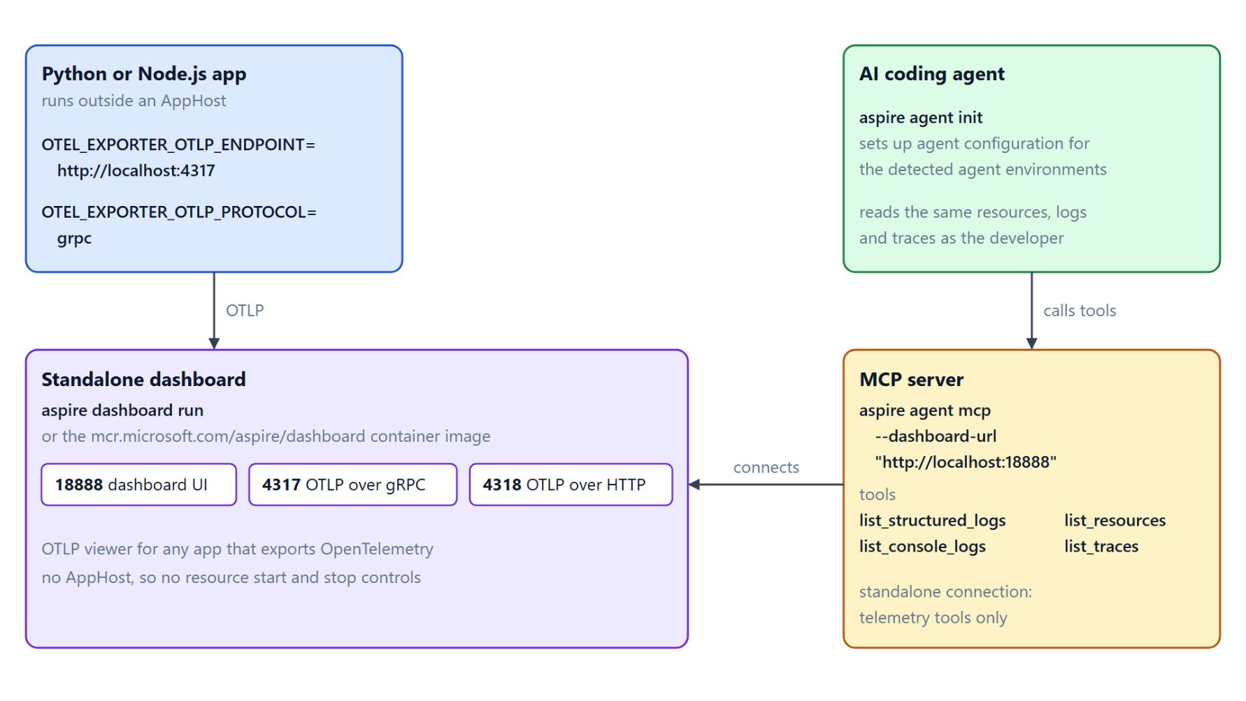
MCP access and the standalone dashboard
Coding agents read the telemetry, any OTLP app can send it
aspire agent init sets up agent configuration for the detected agent environments
aspire agent mcp exposes telemetry as tools such as list_traces and list_structured_logs
aspire dashboard run starts a standalone dashboard for apps outside an AppHost
Apps send OTLP to port 4317 (gRPC) or 4318 (HTTP); the UI runs on 18888
Notes:
The dashboard's telemetry is useful beyond the browser: an AI coding agent can read it, and apps without an AppHost can send to it.
aspire agent init: it sets up agent configuration for the agent environments that the CLI detects.
MCP server: `aspire agent mcp` starts the Model Context Protocol server with tools such as `list_resources`, `list_structured_logs`, `list_traces` and `list_console_logs`, so an agent reads the same telemetry as the developer. Connected to a standalone dashboard with `--dashboard-url` and `--api-key`, it exposes telemetry tools only and cannot manage AppHost resources.
Standalone dashboard: it is an OTLP viewer for any app that exports OpenTelemetry, including Python and Node.js apps, started with `aspire dashboard run` or the container image. It has no AppHost, so it has no resource start and stop controls.
Ports: `OTEL_EXPORTER_OTLP_ENDPOINT` points the app at the dashboard, with gRPC on port 4317 and HTTP on 4318. The UI opens at `http://localhost:18888`.

Slide 20
05
Polyglot AppHost: Angular & Python
Vite and uvicorn apps beside .NET services
Event-Driven Distributed Apps on Azure: Aspire, Dapr & Durable Execution

Slide 21
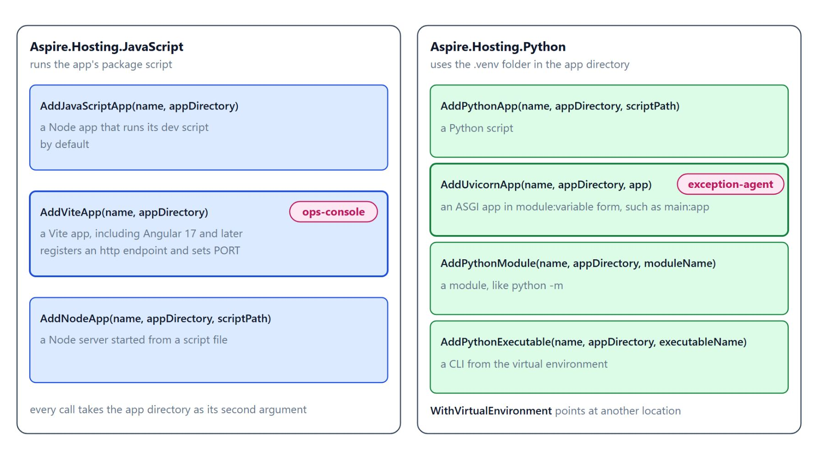
Hosting calls for JavaScript and Python
The call follows how the app starts
AddJavaScriptApp runs a Node app's dev script, AddNodeApp a script file
AddViteApp hosts Vite apps, including Angular 17 and later, and sets PORT
AddPythonApp runs a worker script, AddUvicornApp an ASGI app such as a FastAPI agent
Aspire uses the .venv in the app directory; WithVirtualEnvironment points elsewhere
Notes:
Contoso's operations console is an Angular app and its exception agent is a Python service, so the AppHost needs hosting calls for apps that are not .NET.
JavaScript apps: `Aspire.Hosting.JavaScript` creates a resource that runs the app's package script when the AppHost starts. Every call takes the app directory as its second argument, relative to the AppHost project.
Vite and Angular: `AddViteApp` registers an `http` endpoint and sets `PORT`, so a Vite resource needs no `WithHttpEndpoint` call. Older samples use `AddNpmApp`, while the current JavaScript page documents the three calls in the diagram.
Python apps: `Aspire.Hosting.Python` adds `AddPythonApp` for a script and `AddUvicornApp` for an ASGI app in `module:variable` form. `AddPythonModule` runs a module like `python -m`, and `AddPythonExecutable` runs a CLI from the virtual environment.
Virtual environment: Aspire detects the `.venv` folder from `requirements.txt` or `pyproject.toml`, so the agent's packages never mix with other Python tools on the machine. `WithVirtualEnvironment` points at another location.

Slide 22
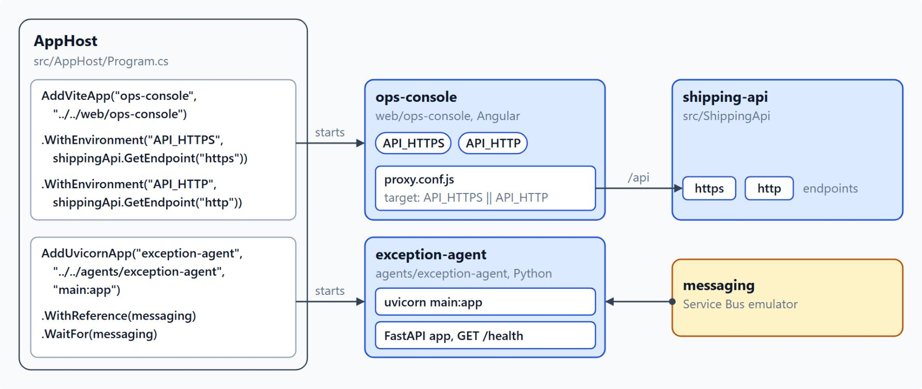
Ops console and exception agent in the AppHost
One aspire run starts Angular and Python beside the .NET services
AddViteApp starts ops-console; two WithEnvironment calls pass API_HTTPS and API_HTTP
The Angular proxy forwards /api to shipping-api, so the browser needs no CORS setup
AddUvicornApp runs the exception agent's main:app with a reference to messaging
The dashboard lists each app beside an installer resource that reads Finished
Notes:
This slide puts the two hosting calls to work for Contoso, in the same wiring that the lab builds.
Ops console: `AddViteApp` starts the console from `web/ops-console`, and `WithEnvironment` sets `API_HTTPS` and `API_HTTP` to the shipping API endpoints. `WaitFor` holds the dev server until shipping-api runs, and `WithExternalHttpEndpoints` gives it an address a browser can open.
Proxy: the browser talks only to the Angular dev server, whose proxy reads the API address from those variables and forwards the relative `/api` paths. Confirm the variables in the dashboard's resource view before you rely on them.
Exception agent: `AddUvicornApp` runs the FastAPI app with `WithReference` and `WaitFor` on messaging. The agent takes its own subscription on `shipment-events`, so it receives `DeliveryDelayed` events without any change to the publisher.
Installer resources: one `aspire run` starts everything with no second terminal. The dashboard shows `ops-console-installer` and `exception-agent-installer` beside the apps, each reading Finished once its install step completes.

Slide 23
06
Aspire Testing: Distributed Integration Tests
Start the AppHost in a test, gate each step
Event-Driven Distributed Apps on Azure: Aspire, Dapr & Durable Execution

Slide 24
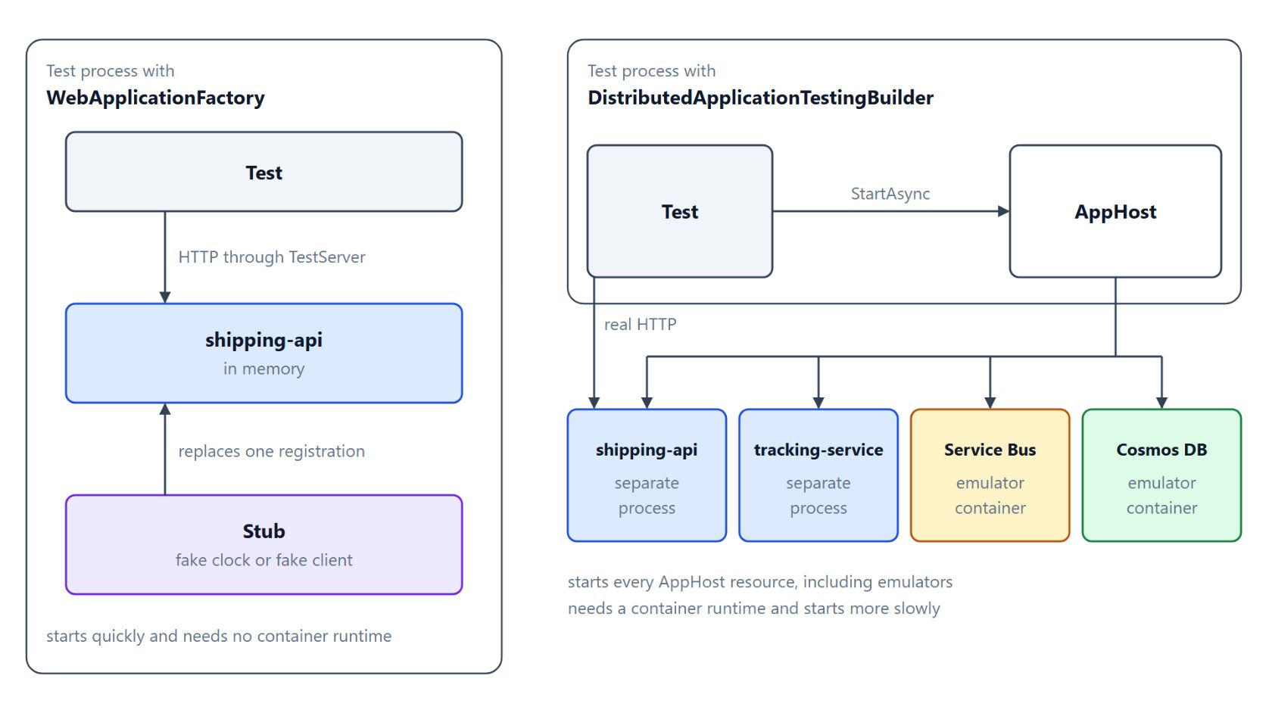
Testing the real AppHost
Aspire.Hosting.Testing starts every resource inside a test
DistributedApplicationTestingBuilder.
CreateAsync takes the AppHost type and starts it in the test
CreateHttpClient("shipping-api") sends real HTTP to a real process
await using stops the containers; a cancellation token caps the whole test
WebApplicationFactory hosts one app in memory for logic inside a single service
Notes:
A parcel booking crosses the shipping API, the message bus and the tracking projection, and a unit test of any one of them misses the handoffs. `Aspire.Hosting.Testing` runs the real AppHost inside a test.
CreateAsync: the test project references the AppHost project, and `CreateAsync` takes the AppHost type as its generic argument. The test then builds and starts the application with the same wiring that `aspire run` uses.
CreateHttpClient: it returns an `HttpClient` whose base address points at the named resource. The test sends its first request after `WaitForResourceHealthyAsync` reports the resource healthy.
Cleanup: the `await using` declaration disposes the application and stops the containers the test started. The cancellation token makes a stuck resource fail the test instead of hanging the build agent.
WebApplicationFactory: it starts quickly, needs no container runtime and can replace one registration with a stub such as a fake clock. The testing builder fits flows that cross services and brokers, and the two tools combine well.

Slide 25
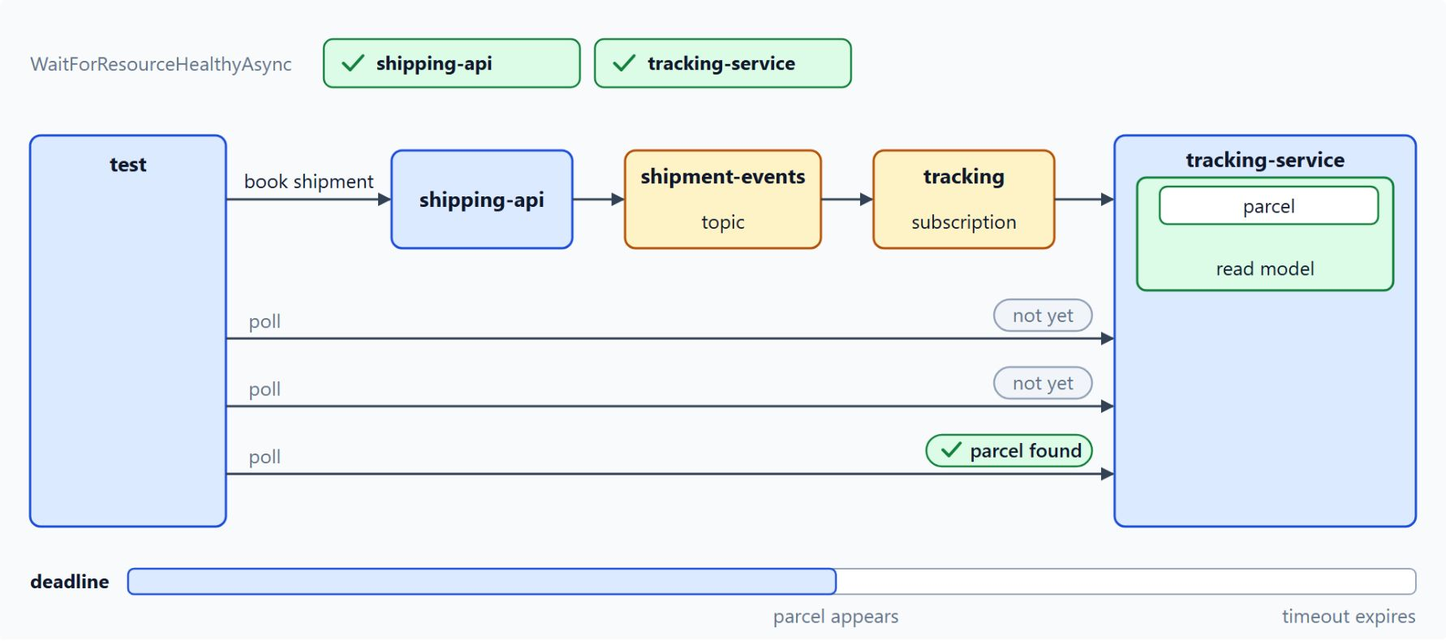
Testing the booking flow end to end
Wait for health, book a shipment, poll until the parcel appears
WaitForResourceHealthyAsync waits for each resource the flow uses
Health waits replace a guessed Task.Delay startup time
The test books through shipping-api, then polls tracking-service with a deadline
One assertion per flow stage, so a failure names the stage that broke
Notes:
A started application is not yet a ready application, so the end-to-end test waits before it sends its first request.
Health waits: the booking flow needs shipping-api and tracking-service, so the test waits for both. Each waited resource adds startup time, so the test waits only for the resources that the flow uses.
No fixed delay: a `Task.Delay` guesses a startup time, and the guess passes on a fast laptop and fails on a busy build agent.
Polling: the booking happens asynchronously, so the test polls tracking-service until the parcel appears, which proves the HTTP call, the event on the topic, the subscription and the read model. A deadline that is too short fails on a slow build agent, and one that is too long hides a stuck flow.
One assertion per stage: a failure then names the stage that broke. The endpoint paths belong to the service code, and later modules add them.

Slide 26
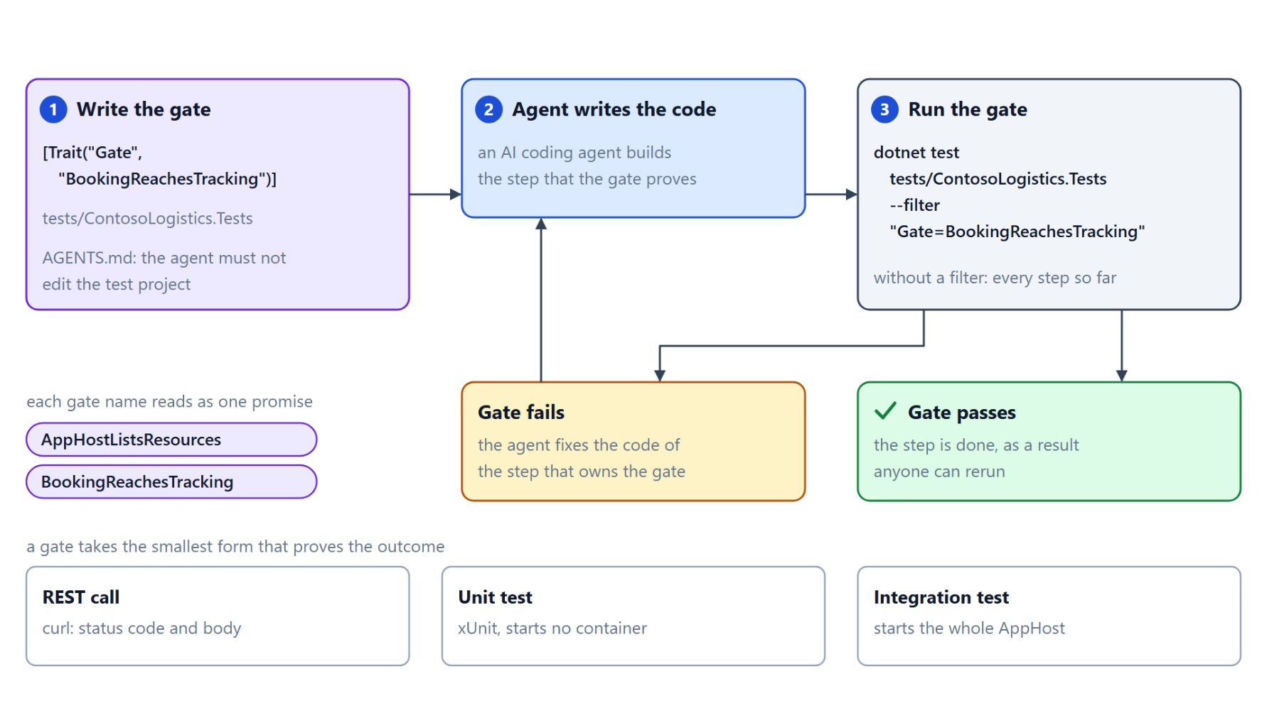
Gate tests
A fixed test proves each step that an agent builds
A gate proves one step is done, checked from outside the code the step changes
Write the gate first; AGENTS.md tells the agent to leave the test project unchanged
[Trait("Gate", ...)] lets dotnet test --filter run exactly one step's gate
A gate takes the smallest form: a curl call, a unit test or a full AppHost test
Notes:
When an AI coding agent writes the code, a gate turns done from a claim into a result anyone can rerun.
What a gate is: it names the outcome a step promises, such as a booking reaching the tracking service, and fails until the code delivers it. Gates also catch a later step that breaks an earlier one, and each gate name reads as one promise the design makes.
A fixed target: write the gates before the agent writes the code and state in `AGENTS.md` that it must not edit the test project, because an agent that may change a failing test can always make it pass. When a gate fails, the agent fixes the code of the step that owns it.
The Gate trait: one command runs exactly the gate of one step, and a run without a filter checks every step built so far.
Smallest form: a gate can be a `curl` request whose status code and body show a booking was accepted, an xUnit test that starts no container, or an integration test that starts the whole AppHost. The labs write one gate, `BookingReachesTracking` in lab 2, and note what the others would check.

Slide 27
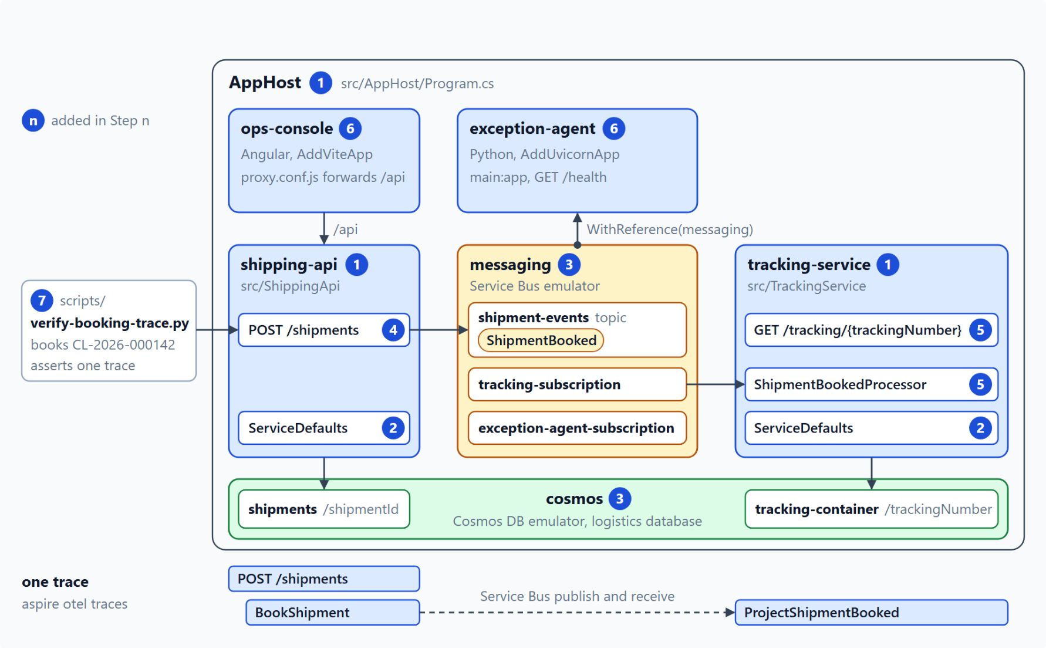
What the lab builds
Seven steps from design documents to one traced booking
Start from the lab 1 design documents, with no service running
One aspire start runs both emulators, shipping-api, tracking-service, ops-console and exception-agent
A booking travels through Service Bus from shipping-api to tracking-service
verify-booking-trace.py asserts one trace across both services
Notes:
The lab practises every topic of the module on Contoso Logistics in about 55 minutes, with GitHub Copilot agent mode or Claude Code writing the code.
Starting point: the `contoso-logistics` starter folder holds only the design documents from lab 1, and `AGENTS.md` gives the agent the class stack. Setup needs the .NET 10 SDK, the Aspire CLI, Node.js, Python 3 and a container runtime, and the lab provisions nothing in Azure.
The finished AppHost: the diagram marks each piece with the step that adds it, from the five projects in step 1 and ServiceDefaults in step 2 to the emulators in step 3 and the ops console and exception agent in step 6.
The booking flow: shipping-api saves the shipment and publishes `ShipmentBooked` in step 4, and tracking-service projects it through its own subscription in step 5.
The proof: step 7 adds a Python script that books shipment `CL-2026-000142`, checks the tracking page and asserts that the trace titled `POST /shipments` holds spans from both services. It runs `aspire stop` in a `finally` block, so no AppHost keeps running.

Slide 28
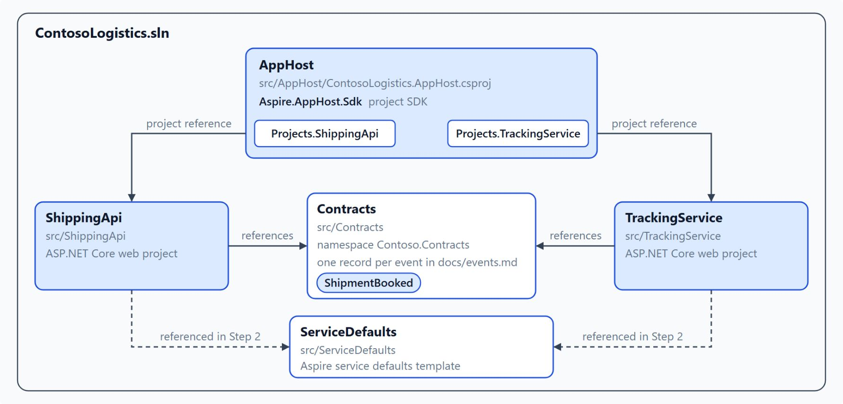
Solution projects
Step 1 shapes ContosoLogistics.sln from the design
The agent reads docs/architecture.md and docs/events.md and proposes the projects first
Five projects: AppHost, ServiceDefaults, Contracts, ShippingApi and TrackingService
AppHost references become Projects.ShippingApi and Projects.TrackingService
Contracts holds one record per event, such as ShipmentBooked
Notes:
Every later step adds code to a project that already exists, so step 1 creates the solution that holds them.
Research first: the research prompt asks the agent to propose the projects and resources from the design documents without writing code. Push back if it adds billing, routing or label services, because this lab does not build them.
Five projects: the AppHost uses the `Aspire.AppHost.Sdk` project SDK, ShippingApi and TrackingService are ASP.NET Core web projects, and ServiceDefaults comes from the Aspire template. Both services reference ServiceDefaults in step 2.
Typed references: each AppHost project reference adds a typed entry to the generated `Projects` class, the model the AppHost topic explains.
Contracts: `src/Contracts` holds the event records that every service shares, in the namespace `Contoso.Contracts`. The step is done when `dotnet sln list` shows the five projects and the build ends with `0 Error(s)`.

Slide 29
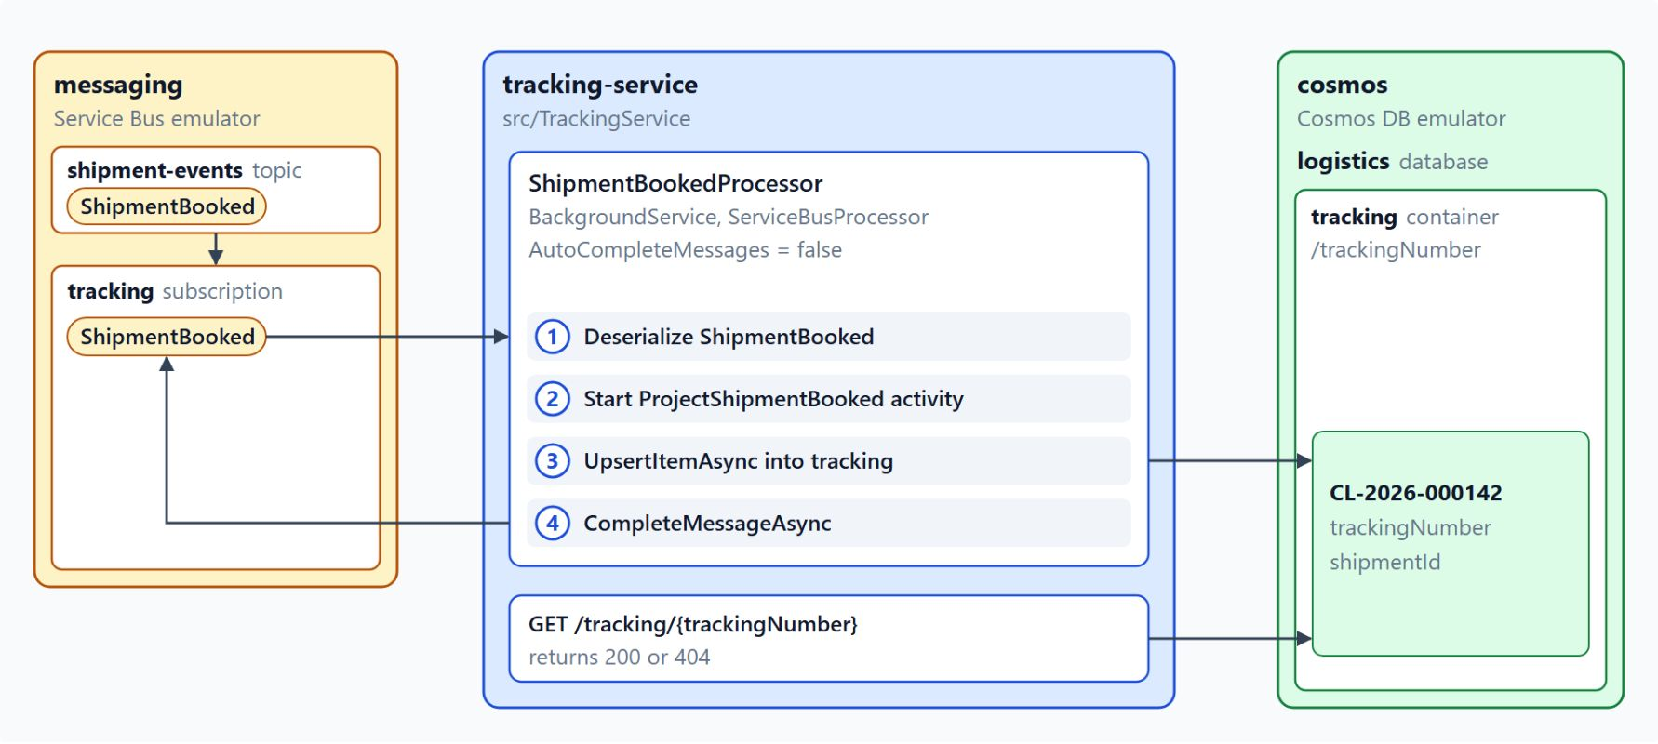
Projecting the booking in tracking-service
Step 5 writes the tracking document before it completes the message
ShipmentBookedProcessor reads ShipmentBooked from the tracking subscription
It upserts the tracking document in Cosmos DB, then completes the message
GET /tracking/{trackingNumber} returns 200 with the document, or 404
The BookingReachesTracking gate is written before the code and passes after it
Notes:
Step 5 is where the booking from step 4 reaches the read model, and it is the one step of the lab that carries a gate.
The processor: it is a `BackgroundService` with a `ServiceBusProcessor` on the `shipment-events` topic and the `tracking` subscription, so its traffic stays separate from the other consumers.
Order of work: with `AutoCompleteMessages` set to false, it deserializes `ShipmentBooked`, upserts the document inside a `ProjectShipmentBooked` activity and completes the message only after that write.
The lookup: before a booking the endpoint returns 404, and after the booking from step 4 it returns 200 with the tracking number `CL-2026-000142` in the JSON body.
The gate: `BookingReachesTracking` starts the AppHost, posts a booking and polls tracking-service every two seconds for up to 60 seconds. It fails while the tracking endpoint is missing and passes once the code exists.

Slide 30

Takeaways
What to carry into the hosting module
Describe the system once in the AppHost; one command starts it in order
Opt every service into ServiceDefaults with one call
Keep connectionName equal to the resource name; emulators run the same code
Follow one booking as one trace across HTTP and Service Bus
Write gates before the agent writes code, and wait for health in every test
Notes:
Close with the habits this module built, each one a decision about how the Contoso system is described, run and checked.
AppHost and defaults: the AppHost is reviewable C# that starts every resource in order, and ServiceDefaults gives each service the same telemetry, resilience, discovery and health endpoints with one call.
Connections: the connection name is the contract between the AppHost and the client package, so the same code runs against the emulator on the laptop and against Azure.
Tracing: the trace context rides `traceparent` over HTTP and `Diagnostic-Id` over Service Bus. The dashboard, or an agent through MCP, shows where a booking spent its time.
Testing: tests start the real AppHost, wait for health and poll with a deadline, and gates written first give the agent a target it cannot move. Module 3 puts the same services on Azure Container Apps and AKS.

