Slide 1

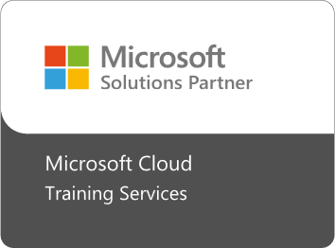

Fast Lane Group
Worldwide Education &
Professional Services
www.flane.de | © 2026 Fast Lane Institute for Knowledge Transfer GmbH
Notes:
Die Fast Lane Gruppe.
Fast Lane … Dienstleister u. Spezialist für High-End Technologie und Business Trainings
IT Trainings zu den unterschiedlichsten Herstellern wie Microsoft, Google, Cisco oder AWS. Und vielen weiteren wichtigen IT Herstellern.
Sei es Cloud, Security, Netzwerk oder allgemein digitale Transformationsprojekte
Und das seit 2003.
Das spannende ist, dass die Fast Lane Gruppe bereits seit 2009 durchgängig zu den Top 20 Unternehmen in der IT Trainingsbranche weltweit zählt.
Aber auch Footprint ebenso im klassischen Professional Services Bereich für unsere wichtigsten Hersteller
PreSales Support, Deployment Services und Adoption Trainings
Additional Information:
Im Jahr 2021 sind wir zur „most strategic IT Education company worldwide“ von der IDC im „magic quadrant“ aufgeführt worden !
1 mio Teilnehmer insgesamt seit bestehen, 50.000+ Students ww p.A, 20.000 in DE pro Jahr

Slide 2


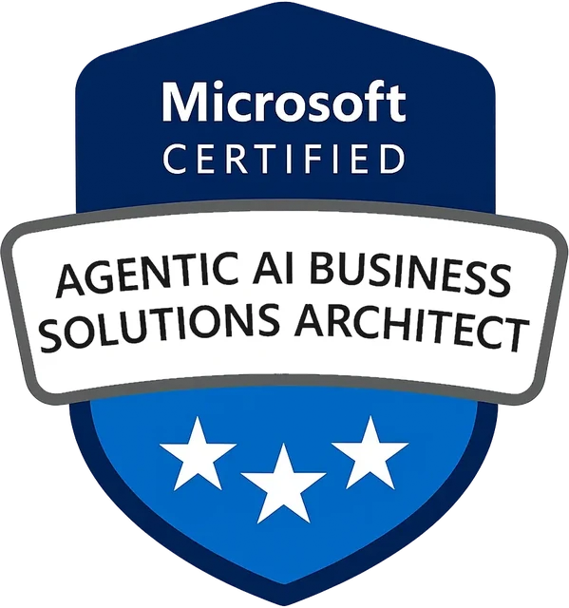
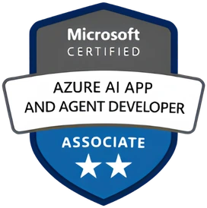
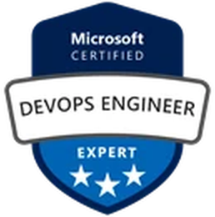

AGENTIC AI: FROM STRATEGY TO PRODUCTION.
Alexander
Kastil
AGENTIC AI CONSULTING · VIENNA
Full stack, from enterprise software to agentic AI. Since 1996
AI at Work
Enterprise AI
Value discovery, KPI mapping and roadmap
Governed multi-agent systems on Microsoft Copilot and Foundry
Agentic Software Engineering
Team Enablement
Harness architecture for Claude Code and GitHub Copilot
AI driven content production and delivery
integrations.at
github.com/alexander-kastil
SCAN TO CONNECT
alexander.kastil@integrations.at
linkedin.com/in/alexander-kastil
integrations.at
Notes:
Intro: Alexander Kastil, integrations.at. Four practice areas from AI at Work to team enablement. Certifications: Agentic AI Business Solutions Architect, Azure AI App and Agent Developer Associate, DevOps Engineer Expert.

Slide 3

MODULE 3
Hosting on Container Apps & AKS
Putting the Contoso Logistics services on Azure
Event-Driven Distributed Apps on Azure: Aspire, Dapr & Durable Execution

Slide 4
01
02
03
Aspire Deploy: ACR & Container Apps
The registry, the environment and the apps from the AppHost
Key Vault & App Configuration
Managed identity, secrets, settings and feature flags
Revisions: Traffic Splitting & Draining
Revision modes, traffic weights and graceful shutdown
04
05
AKS: Aspire-Generated Kubernetes Manifests
Helm charts, the AKS environment and the Dapr extension
Application Insights: Traces & KQL
The Azure Monitor distro, trace context and KQL
Event-Driven Distributed Apps on Azure: Aspire, Dapr & Durable Execution

Slide 5

Hosting on Container Apps and AKS
Putting the Contoso Logistics services on Azure
Deploy: aspire deploy puts the AppHost on Container Apps, the routing service runs on AKS
Configure: secrets from Key Vault and settings from App Configuration over a managed identity
Release and trace: revisions shift traffic, Application Insights follows a parcel scan
Notes:
This module takes the Contoso Logistics services that modules 1 and 2 designed and modeled in an Aspire AppHost, and puts them on Azure.
Deploy: most services run on Azure Container Apps, the managed host for this class, and `aspire deploy` provisions the registry, the environment and the apps. The routing service runs on AKS because it depends on Dapr actors.
Configure: secrets live in Key Vault and settings in App Configuration, and each service reads them through a managed identity, so no password is stored.
Release and trace: revisions shift traffic to a new version and drain message consumers, and Application Insights follows a parcel scan from the HTTP request to the Service Bus handler.

Slide 6
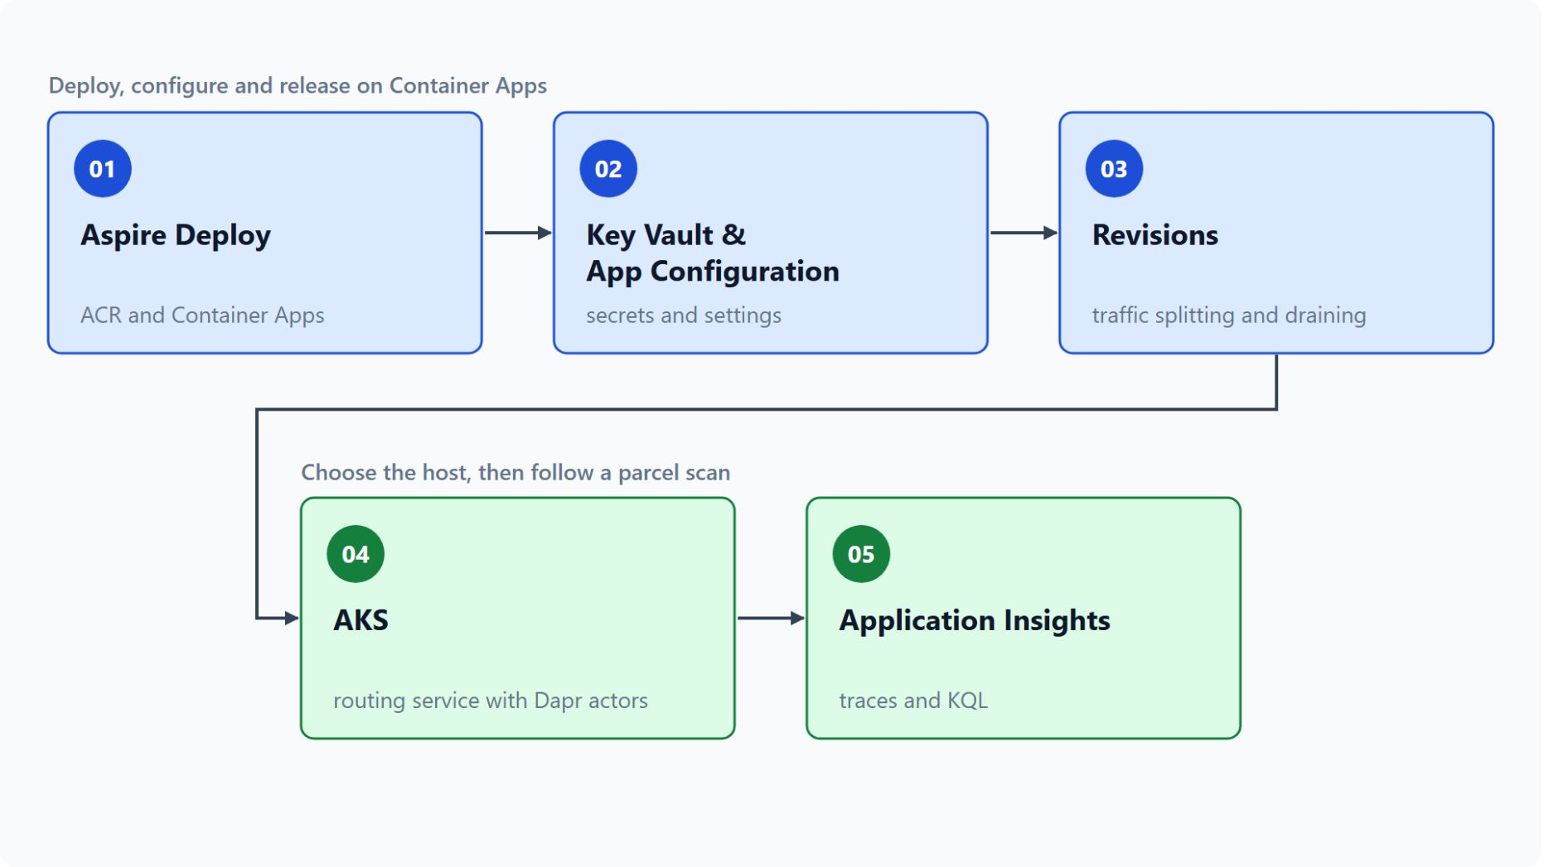
Overview
The path through the five topics
Deploy the AppHost to Container Apps with aspire deploy
Keep secrets in Key Vault and settings in App Configuration
Release a new version behind a traffic split and drain consumers
Host the routing service on AKS with the Dapr extension
Follow a parcel scan in Application Insights with KQL
Notes:
This slide walks the five topics once, in the order the module teaches them.
Aspire Deploy: the AppHost declares the Container Apps environment, and `aspire deploy` provisions the registry, the environment and one container app per service.
Key Vault and App Configuration: secrets and settings reach the services through a managed identity, and feature flags refresh on their own every 30 seconds by default.
Revisions: a new release starts with a small traffic weight while the previous revision stays active for rollback. Consumers finish their in-flight messages before the platform stops the replica.
AKS: the routing service keeps one Dapr actor per van, which Container Apps managed Dapr doesn't support, so Aspire generates its Kubernetes deployment from the same AppHost.
Application Insights: the Azure Monitor distro sends the telemetry, and KQL joins the rows of one transaction by `OperationId`.

Slide 7
01
Aspire Deploy: ACR & Container Apps
The registry, the environment and the apps from the AppHost
Event-Driven Distributed Apps on Azure: Aspire, Dapr & Durable Execution

Slide 8
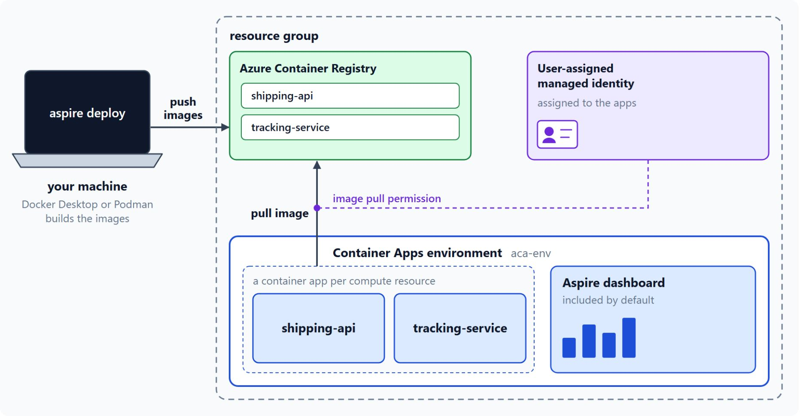
Deploying with aspire deploy
The AppHost declares the environment, one command provisions the rest
AddAzureContainerAppEnvironment declares the environment in the AppHost
aspire deploy provisions, builds and pushes the images, then deploys the apps
The managed identity pulls the images, so you pass no registry credentials
A CI job can build in the registry with az acr build
aspire destroy --yes deletes the whole resource group
Notes:
Contoso Logistics has nine components, and each one needs an image, a registry, an environment and an identity that can pull the image. This slide shows how the AppHost and one command create all of that.
The environment as a resource: since Aspire 9.4 removed the hybrid mode, an app that targets Container Apps must declare the environment with `AddAzureContainerAppEnvironment`. The AppHost needs the `Aspire.Hosting.Azure.AppContainers` package for that call.
One command: after `az login`, `aspire deploy` provisions the infrastructure, builds and pushes the images, deploys the apps and prints the dashboard URL. With `Azure__SubscriptionId`, `Azure__Location` and `Azure__ResourceGroup` set, `--non-interactive` skips the prompts.
Image pull: the deployment creates the registry and a user-assigned managed identity with the image pull permission, so no registry credentials go into the deployment. Azure Files shares are created only when the model declares a volume or bind mount.
Builds in the registry: `aspire deploy` builds on your machine with Docker Desktop or Podman, and a CI job can skip the local runtime with `az acr build`. `az containerapp update --image` then points the app at the new image and creates a new revision.
Cleanup: `aspire destroy --yes` deletes the entire resource group. The Aspire CLI reference labels `aspire deploy` as preview, so confirm its status before a production pipeline depends on it.

Slide 9
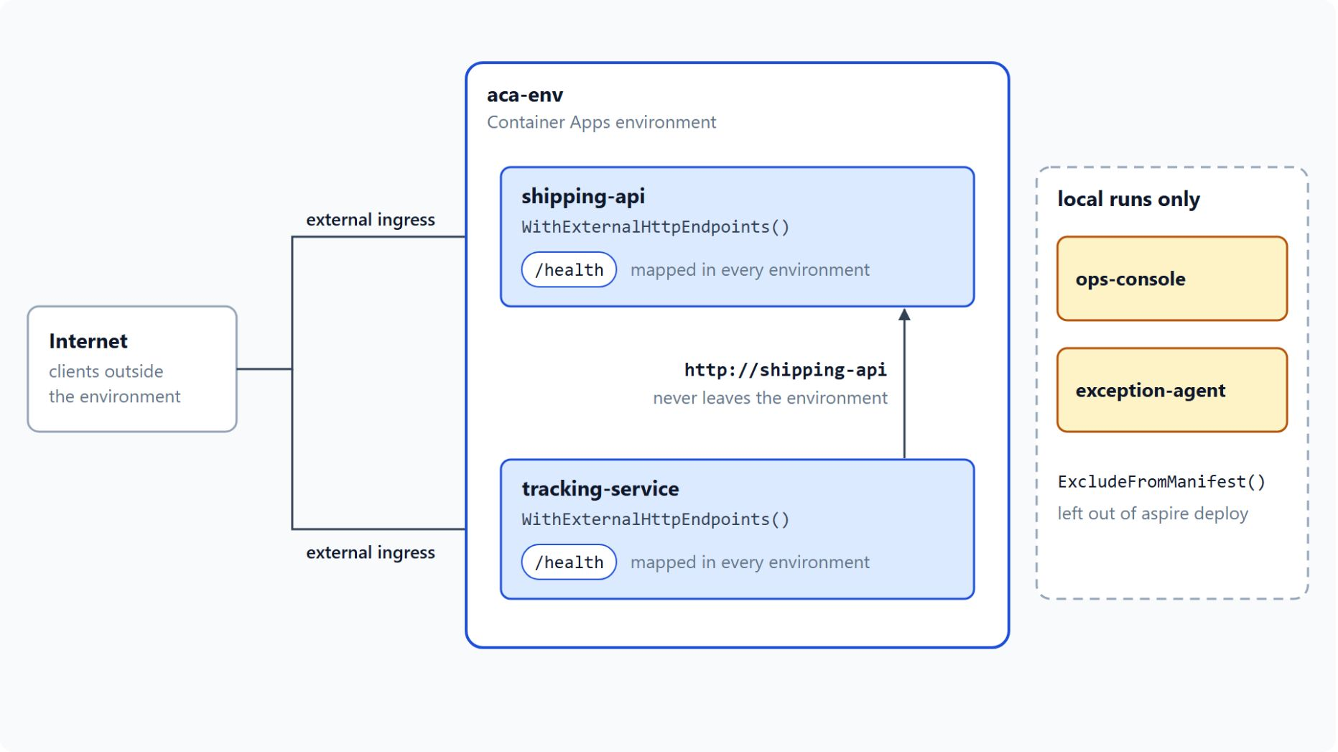
Ingress and calls by app name
Public endpoints only where outside clients need them
WithExternalHttpEndpoints publishes an endpoint; without it a service stays internal
shipping-api and tracking-service are the two public services
Apps in the environment call each other by name: http://shipping-api
/health maps in every environment, so it can be probed from outside
ExcludeFromManifest() keeps ops-console and exception-agent local
Notes:
Once the apps are deployed, ingress decides which services receive traffic from outside the environment.
External or internal: `WithExternalHttpEndpoints` publishes an endpoint, and a service without it is reachable only from apps in the same environment. Use the external call only for endpoints that clients outside the environment must reach.
The two public services: the lab's AppHost calls `WithExternalHttpEndpoints` on `shipping-api` and `tracking-service`, the two services that clients reach from outside.
Calls by app name: `tracking-service` reaches `shipping-api` at `http://shipping-api`, and that traffic never leaves the environment. App names are 2 to 32 lowercase letters, numbers and hyphens, starting with a letter and ending with a letter or number.
Health from outside: the shared service defaults map `/health` in every environment, not only Development, so an external endpoint can be probed from outside your machine.
Local only: `ops-console` and `exception-agent` call `ExcludeFromManifest()`, so `aspire deploy` leaves them out and they run only in local runs.

Slide 10
02
Key Vault & App Configuration
Managed identity, secrets, settings and feature flags
Event-Driven Distributed Apps on Azure: Aspire, Dapr & Durable Execution

Slide 11
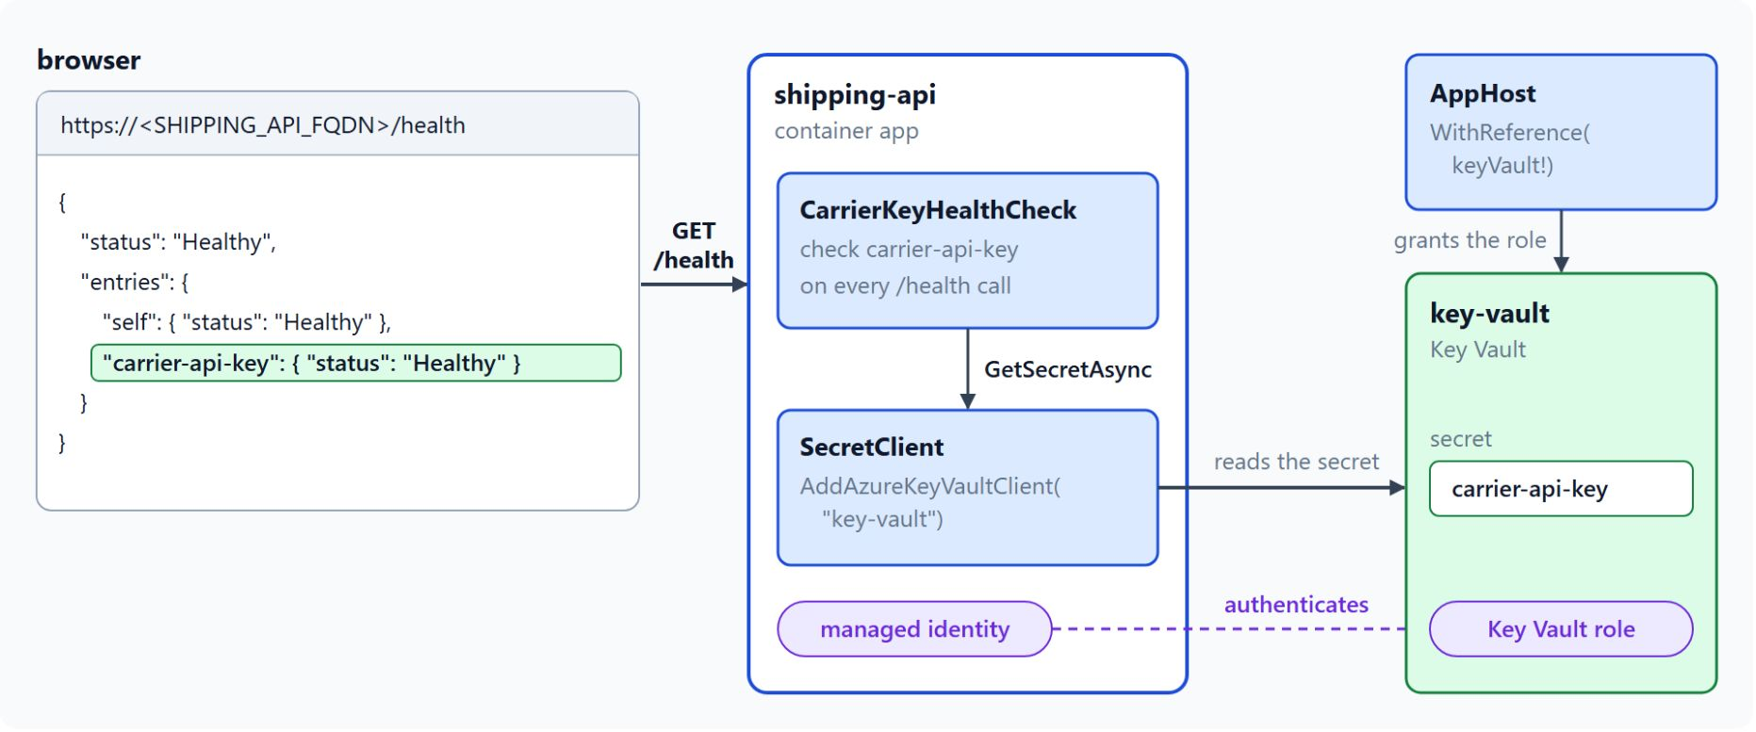
Key Vault access with a managed identity
The same code runs on a laptop and in Azure
DefaultAzureCredential uses the Azure CLI sign-in locally and the managed identity in Azure
SecretClient reads secrets with that credential, so no password is stored
Read access comes from the Key Vault Secrets User role, scoped to the vault
AddAzureKeyVault and WithReference let Aspire assign the role
The default is Key Vault Administrator; WithRoleAssignments narrows it
Notes:
Carrier API keys and connection details must not sit in `appsettings.json` or in plain environment variables. Key Vault holds them, and a managed identity removes the password.
One credential type: `DefaultAzureCredential` decides at runtime, using the Azure CLI sign-in on a developer machine and the app's managed identity in Azure. The same code runs in both places without environment checks.
The client: `SecretClient` takes the vault URI and that credential. The diagram shows the lab's health check reading `carrier-api-key` this way on every `/health` call.
The role: grant the identity Key Vault Secrets User with `az role assignment create`, scoped to the vault's resource ID.
Aspire wiring: the AppHost declares the vault with `AddAzureKeyVault` and references it from the service, and Aspire assigns roles on the vault. The AppHost needs the `Aspire.Hosting.Azure.KeyVault` package.
Least privilege: by default the consuming project gets Key Vault Administrator. For read-only access, call `WithRoleAssignments` with `KeyVaultBuiltInRole.KeyVaultSecretsUser`, as the Aspire example does.

Slide 12
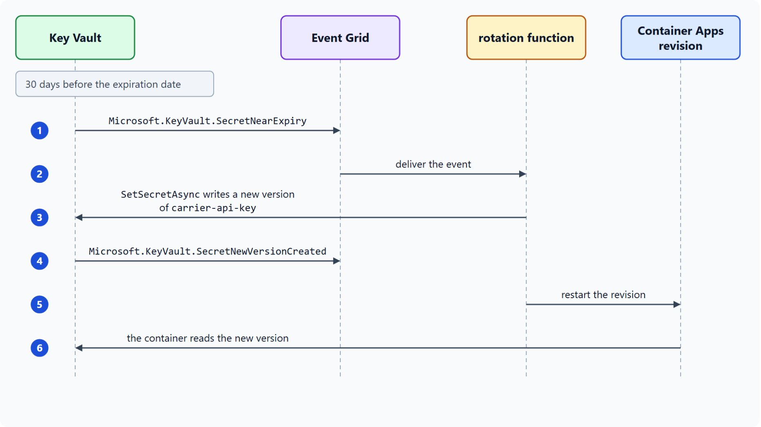
Secret versions and rotation
Key Vault events drive the rotation
Each write creates a new secret version: SetSecretAsync
Key Vault raises SecretNearExpiry 30 days before the expiration date
Event Grid delivers it to a rotation function that writes the new version
Restart the Container Apps revision so the container reads it
Prefer managed identity; rotate only where a key is still needed
Notes:
Some workloads still need a password or a key, such as the carrier API key. For those, Key Vault versions and events drive the rotation.
Versions: each write to a secret creates a new version, so `SetSecretAsync` on `carrier-api-key` stores the rotated key as a new version of the secret that the shipping API reads.
Events: Key Vault raises `SecretNearExpiry` 30 days before the expiration date, `SecretNewVersionCreated` when a new version is written, and `SecretExpired` when the current version has expired.
The rotation function: the Learn tutorials route `SecretNearExpiry` through Event Grid to a function that writes a new version and updates the consumer.
Restart: Container Apps secret values need a revision restart before a container sees them, so plan rotations that restart the affected revision.
Managed identity first: prefer managed identity over shared secrets, and use rotation only where a workload still needs a password or a key.

Slide 13
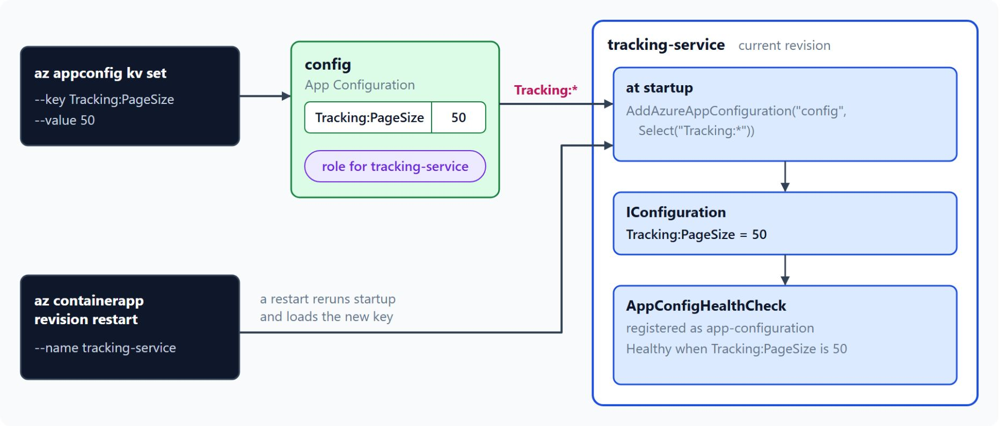
App Configuration and feature flags
Settings load at startup, flags refresh on their own
The .NET provider loads key-values and feature flags into IConfiguration
A Key Vault reference points to a secret that stays in the vault
The AppHost declares the store in publish mode, WithReference grants a role
Keys load at startup, so a new key needs a revision restart
UseFeatureFlags and IFeatureManager, refreshed every 30 seconds
Notes:
Settings that change between releases belong in App Configuration, not in a file that ships with the build.
The provider: App Configuration stores key-values and feature flags, and the .NET provider loads them into `IConfiguration`. The tracking service selects its keys with `Select("Tracking:*")`.
Key Vault references: a key in App Configuration can point to a secret in Key Vault, and the app reads it like any other key. The provider resolves it with its own credential when you call `ConfigureKeyVault`, so App Configuration never holds the secret value.
Aspire wiring: the AppHost declares the store only in publish mode and never calls `RunAsEmulator`, so `aspire deploy` provisions it in Azure. The service references the store, and Aspire grants it a role on the store.
Startup load: the provider loads key-values when the service starts, so a key added later needs a revision restart, as the diagram shows for `Tracking:PageSize`.
Feature flags: flags are key-values with the `.appconfig.featureflag/` prefix, loaded by `UseFeatureFlags` and checked through `IFeatureManager`. The provider refreshes them on its own, every 30 seconds by default.

Slide 14
03
Revisions: Traffic Splitting & Draining
Revision modes, traffic weights and graceful shutdown
Event-Driven Distributed Apps on Azure: Aspire, Dapr & Durable Execution

Slide 15
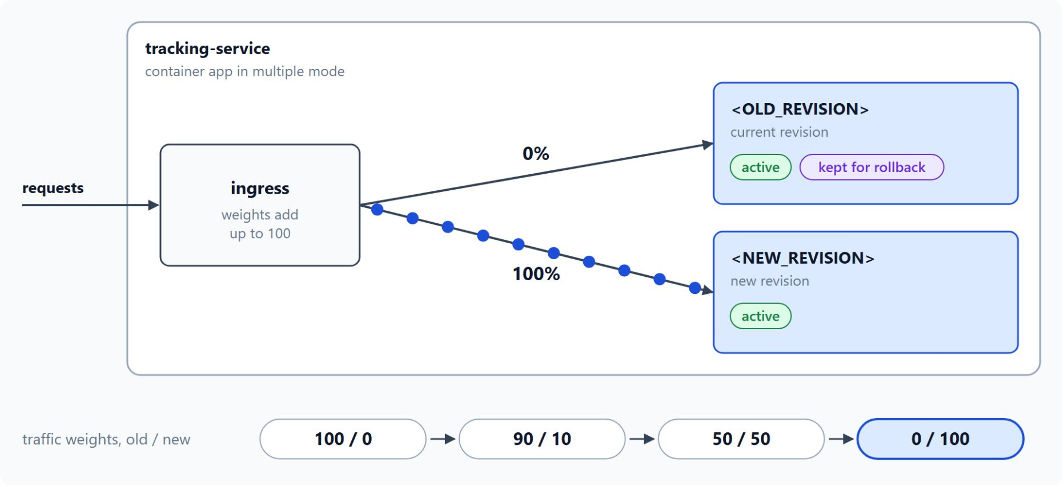
Revision modes and traffic splitting
Weighted traffic per revision and rollback
Single mode is the default: the new revision takes over once ready
Multiple mode keeps several revisions active for blue-green and canary
az containerapp ingress traffic set sets weights that add up to 100
Roll back with the same command and the previous revision at 100
Labels (preview) give a revision a stable URL
Notes:
A new tracking-service release must not reach every parcel at once. Container Apps keeps each version of an app as a revision, and you decide how much traffic each revision receives.
Single mode: the default, where the new revision takes over after its replicas pass their probes and the old revision deactivates on its own. Most services in the class use it.
Multiple mode: several revisions stay active and you set the weight of each, for blue-green and canary releases. A later `aspire deploy` returns the app to single mode, so run `az containerapp revision set-mode` again after each deploy.
Weights: they must add up to 100, set by revision name or by label. The readme command sends 90 percent to the current revision and 10 percent to the new one.
Rollback: the same command with the previous revision at 100. Keep the previous revision active until the new one proves itself, and the rollback needs only a traffic change.
Labels: a preview mode in which named revisions such as `dev`, `staging` and `prod` each get a stable URL. Moving a label to another revision promotes it and keeps the URL, which suits a canary group.

Slide 16
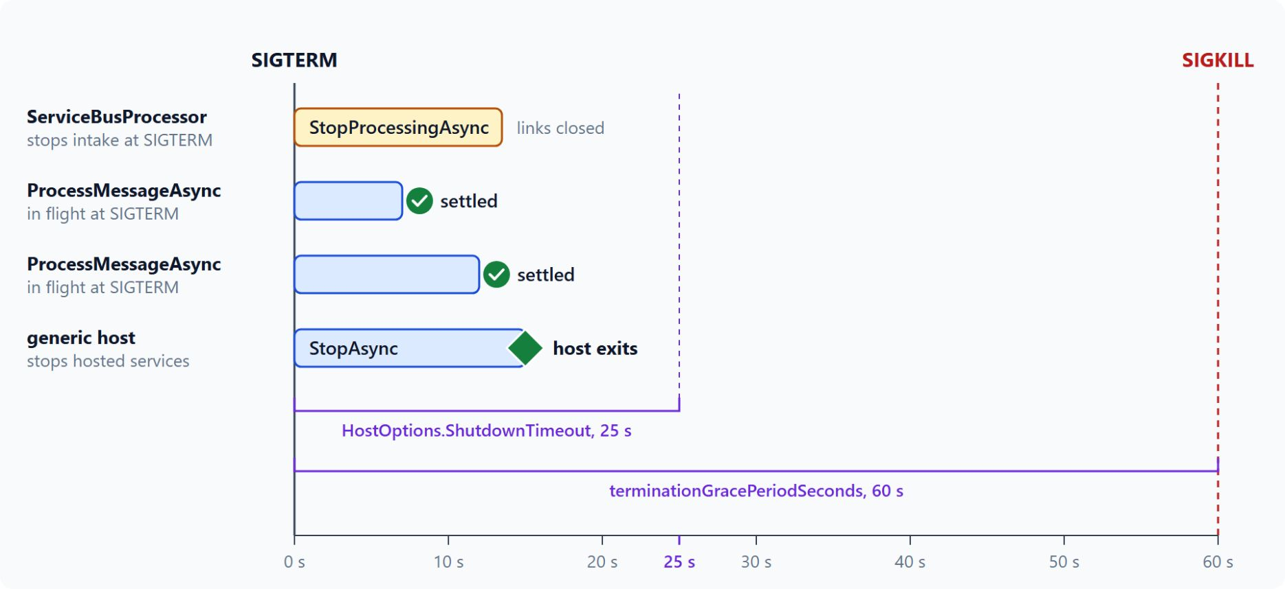
Graceful shutdown for message consumers
In-flight messages settle before SIGKILL
A change to the template creates a revision; app-wide settings do not
SIGTERM, then terminationGracePeriodSeconds (default 30 s), then SIGKILL
Set the grace period longer than HostOptions.ShutdownTimeout
StopProcessingAsync stops intake and waits for in-flight handlers
Settle each message before the handler returns
Notes:
Every new revision deactivates an old one, and a message consumer must not lose the messages it is handling at that moment.
What creates a revision: a change to the template, which holds the container image, the environment variables, the resources and the scale rules. Secrets, the revision mode, ingress, traffic weights and labels apply to every revision and don't create one.
The shutdown signal: when a replica scales in, the app is deleted or a revision deactivates, the platform sends SIGTERM. After the termination grace period, 30 seconds by default, it sends SIGKILL.
Two timeouts: `HostOptions.ShutdownTimeout` sets how long the generic host waits in `StopAsync`, also 30 seconds by default. The diagram sets 25 s inside a 60 s grace period, so the host finishes before the platform kills the replica.
Draining: the consumer's `StopAsync` calls `StopProcessingAsync`, which stops intake and waits for the in-flight message handlers to complete.
Settlement: an unsettled message returns to the queue when its lock expires, and its delivery count goes up. Call `AbandonMessageAsync` for a message the handler can't finish, so the next receiver gets it at once.

Slide 17
04
AKS: Aspire-Generated Kubernetes Manifests
Helm charts, the AKS environment and the Dapr extension
Event-Driven Distributed Apps on Azure: Aspire, Dapr & Durable Execution

Slide 18
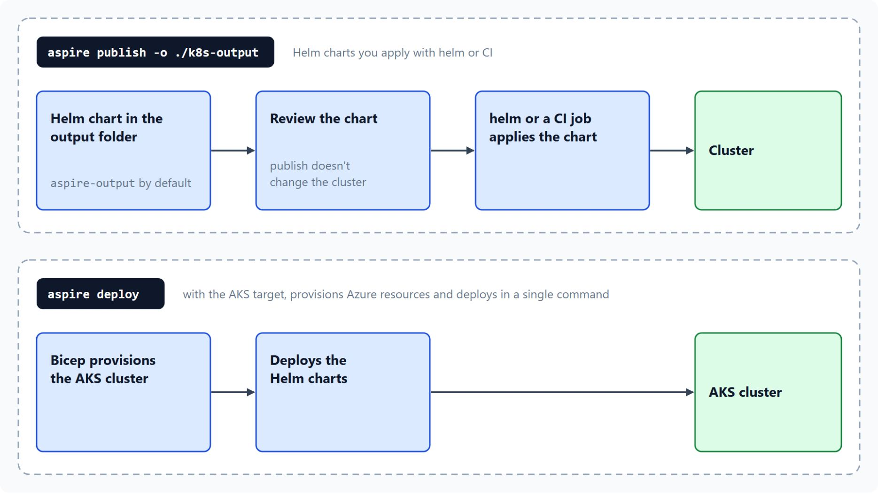
Helm charts and the AKS target
Publish for a pipeline or deploy in one step
aspire publish writes a Helm chart to aspire-output; -o changes the folder
A pipeline applies the chart with helm or a CI job
Publishing leaves the cluster unchanged, so you can review the chart first
The AKS target adds Bicep: aspire deploy provisions and deploys in one command
The Aspire CLI reference labels both commands as preview
Notes:
The routing service keeps one Dapr actor per van, and Container Apps managed Dapr doesn't support the actor SDK package. Aspire generates its Kubernetes deployment from the same AppHost, so the service graph stays in one place.
Helm charts: for the Kubernetes target, `aspire publish` writes a Helm chart to `aspire-output` beside the AppHost, and the `-o` option changes the folder.
Applying the chart: a pipeline applies the chart with `helm` or a CI job. For the plain Kubernetes target, `aspire deploy` runs `helm install` against the current `kubectl` context.
Review first: the publish step doesn't change the cluster, so you can review the chart before it reaches an environment. Learn's Orleans Kubernetes guide describes plain YAML files in the same output, so open the folder before you apply anything.
The AKS target: `aspire publish` produces Helm charts and Bicep infrastructure, and `aspire deploy` provisions the Azure resources and deploys in a single command.
Preview status: the Aspire CLI reference labels both `aspire publish` and `aspire deploy` as preview.

Slide 19
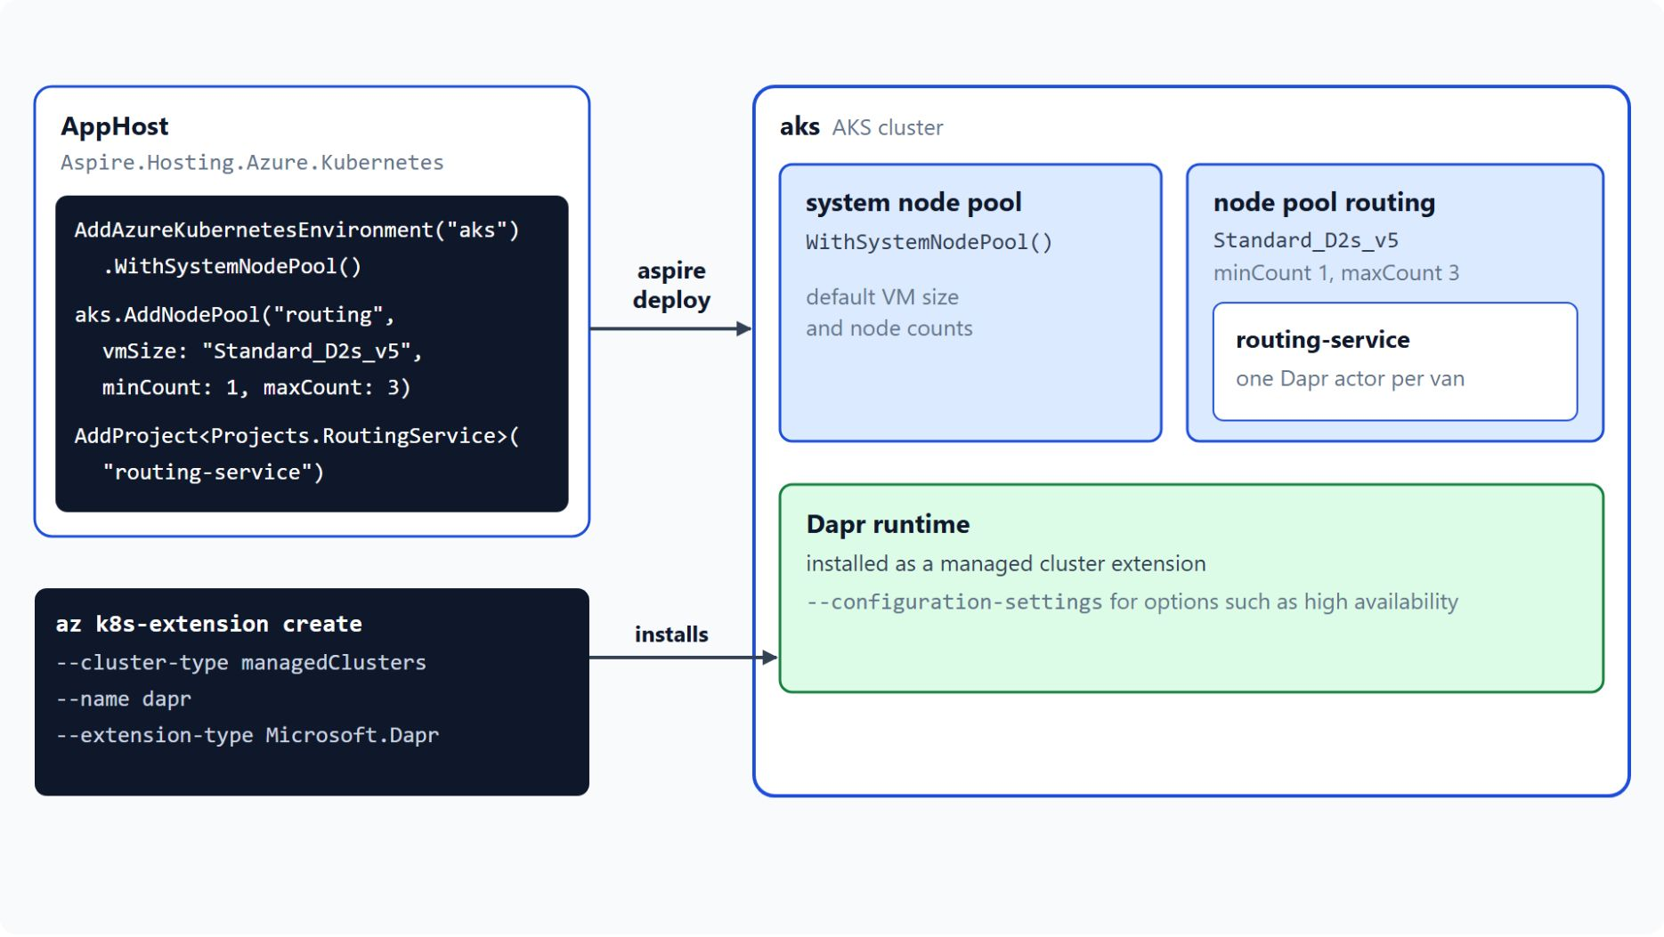
AKS environment and the Dapr extension
A host where you control the Dapr extension
AddAzureKubernetesEnvironment declares the cluster as a compute environment
WithSystemNodePool and AddNodePool("routing", ...) set the node pools
WithContainerRegistry, WithWorkloadIdentity and WithSubnet fit existing resources
The Dapr extension installs the runtime as a managed cluster extension
Ingress and Gateway API on AKS are preview in the Aspire documentation
Notes:
This slide shows how the AppHost declares the AKS cluster and how the Dapr runtime gets onto it.
The environment: `AddAzureKubernetesEnvironment` from the `Aspire.Hosting.Azure.Kubernetes` package declares the cluster, and `aspire deploy` creates it the first time it runs. The cluster bills until you delete its resource group.
Node pools: `WithSystemNodePool` uses the default VM size and node counts, and `AddNodePool` adds a second pool named `routing` with `Standard_D2s_v5` nodes for the routing workload.
Existing resources: `WithContainerRegistry` attaches the registry that holds the images, `WithWorkloadIdentity` turns workload identity on or off, and `WithSubnet` joins a subnet you already defined.
The Dapr extension: `az k8s-extension create` with `--extension-type Microsoft.Dapr` installs the runtime as a managed cluster extension, so you don't install or upgrade it yourself. It accepts `--configuration-settings` for Dapr options such as high availability.
Ingress: ingress and Gateway API on AKS are preview features, so check the Aspire reference for the current API before routing-service depends on them. Module 7 compares the two hosts for actors.

Slide 20
05
Application Insights: Traces & KQL
The Azure Monitor distro, trace context and KQL
Event-Driven Distributed Apps on Azure: Aspire, Dapr & Durable Execution

Slide 21
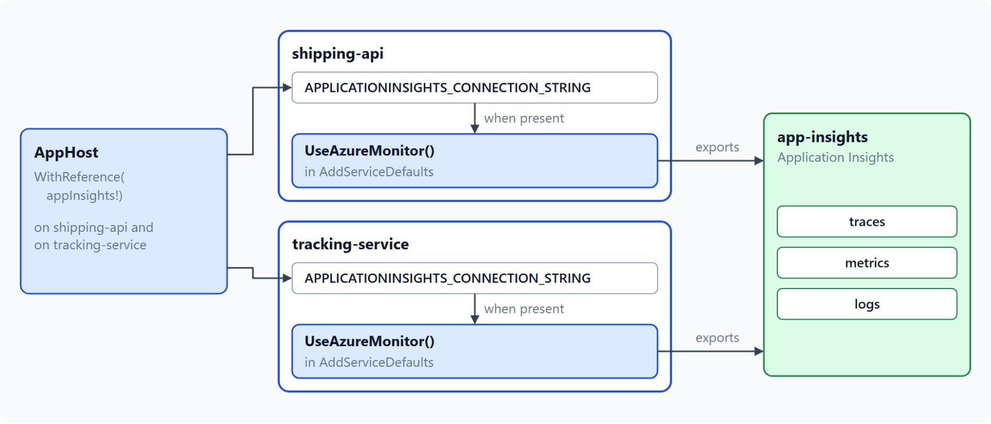
Sending telemetry to Application Insights
The Azure Monitor distro in the shared service defaults
UseAzureMonitor adds traces, metrics and logs to an ASP.NET Core service
The distro reads APPLICATIONINSIGHTS_CONNECTION_STRING
AddAzureApplicationInsights and WithReference set it in publish mode
The managed OpenTelemetry agent receives OTLP over gRPC (preview)
Learn recommends the Microsoft OpenTelemetry Distro for new .NET apps
Notes:
When a parcel scan fails, the cause can sit in the HTTP request, the Service Bus message, the database write or a consumer exception. One trace across those hops starts with every service sending telemetry.
The distro: install `Azure.Monitor.OpenTelemetry.AspNetCore` and call `UseAzureMonitor` on the OpenTelemetry builder to add traces, metrics and logs to an ASP.NET Core service.
The connection string: the distro reads `APPLICATIONINSIGHTS_CONNECTION_STRING`, and the lab's shared service defaults call `UseAzureMonitor` only when that variable is set.
Aspire wiring: in the AppHost, `AddAzureApplicationInsights` and `WithReference` set the variable for each service, and only in publish mode.
The managed agent: a preview alternative for apps that send OTLP over gRPC, running inside the Container Apps environment as one replica with a fixed 0.5 vCPU and 1.5 GB of memory. Its configuration lives at the environment level, and it sends logs and traces to Application Insights, which takes no metrics from it.
Distro choice: Learn now recommends the Microsoft OpenTelemetry Distro for new .NET apps, and existing Azure Monitor distro users need no action. This module teaches the Azure Monitor distro and its `UseAzureMonitor` call.

Slide 22
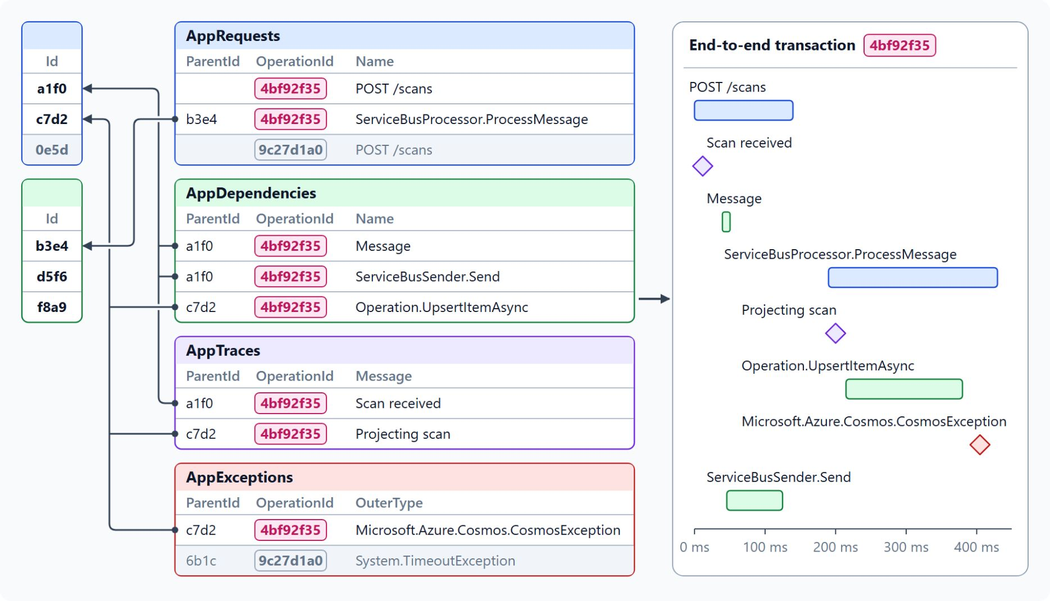
Trace context and telemetry tables
OperationId and ParentId join the rows of one scan
The Service Bus SDK writes the trace context as Diagnostic-Id in traceparent format
Send, receive, process and complete spans link through a Message span
AppRequests, AppDependencies, AppTraces and AppExceptions: one table per type
OperationId and ParentId join the rows of one transaction
The end-to-end transaction view draws them as a Gantt chart
Notes:
Correlation depends on one identifier that travels with every hop, across the HTTP call and across the Service Bus message.
Trace context in the message: the Azure Service Bus SDK writes the W3C trace context into the `Diagnostic-Id` application property, in `traceparent` format. You don't write the propagation code, but both services need a tracing setup that exports the spans.
SDK spans: `ServiceBusSender.Send`, `ServiceBusReceiver.Receive`, `ServiceBusProcessor.ProcessMessage` and `ServiceBusReceiver.Complete` link through a `Message` span. A scan that starts at tracking-service and ends in a consumer appears as one transaction.
One table per type: `AppRequests` holds inbound requests, `AppDependencies` outbound calls, `AppTraces` log messages and `AppExceptions` exceptions.
The join: every row carries `OperationId` and `ParentId`, and a `union` over the four tables filtered by one `OperationId` returns the whole transaction in time order.
The portal view: transaction search opens the end-to-end transaction details, a Gantt chart of each event with its duration and response code. With sampling on, a missing row can mean the sampler dropped it.

Slide 23
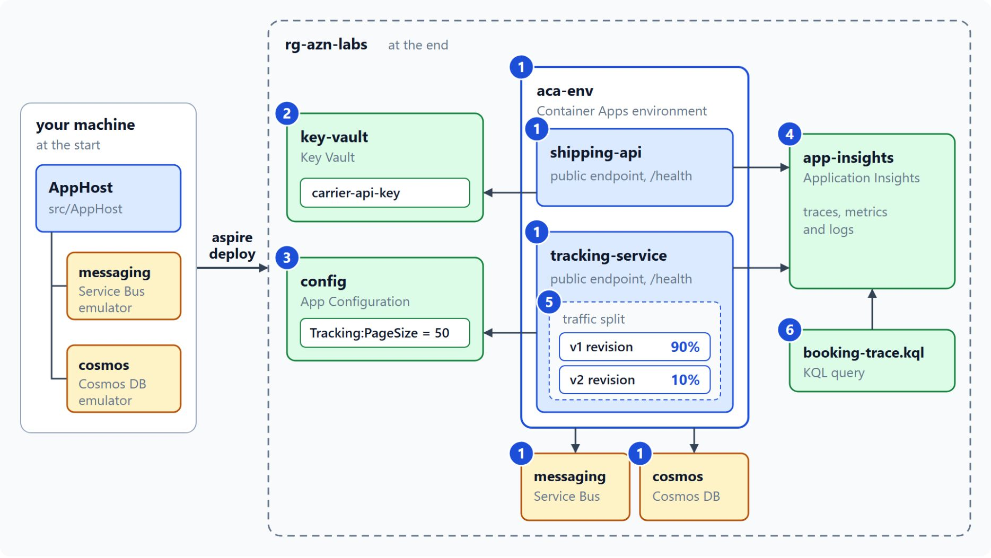
Shipping Contoso Logistics to Container Apps
What runs in rg-azn-labs at the end of the lab
Step 1: aspire deploy creates aca-env with public shipping-api and tracking-service
Steps 2 and 3: carrier-api-key from Key Vault, Tracking:PageSize from App Configuration
Step 4: both services export telemetry to Application Insights
Step 5: tracking-service v2 behind a 90/10 traffic split
Step 6: booking-trace.kql follows one booking across both services
Notes:
In the lab, Contoso Logistics moves from your machine, where the AppHost starts the Service Bus and Cosmos DB emulators, into the resource group `rg-azn-labs`. It takes about 55 minutes, and each step adds one piece of the diagram.
Deploy: step 1 declares `aca-env`, gives `shipping-api` and `tracking-service` external endpoints and maps `/health` in every environment. Then `aspire deploy --non-interactive` creates the apps.
Secrets and settings: step 2 adds a Key Vault and a `carrier-api-key` health check, and step 3 adds an App Configuration store with `Tracking:PageSize` set to 50. Each step proves the read with a health check that reports Healthy.
Telemetry: step 4 adds an Application Insights resource and the Azure Monitor distro in the shared service defaults, so one booking can be followed across both services.
Release: step 5 adds a `schemaVersion` field to the tracking response, switches tracking-service to multiple revision mode and sends 10 percent of requests to v2. The previous revision stays active for rollback.
Query: step 6 writes `docs/booking-trace.kql` and sends one booking to `shipping-api`. Keep the environment afterwards, because the next lab deploys into the same resource group.

Slide 24
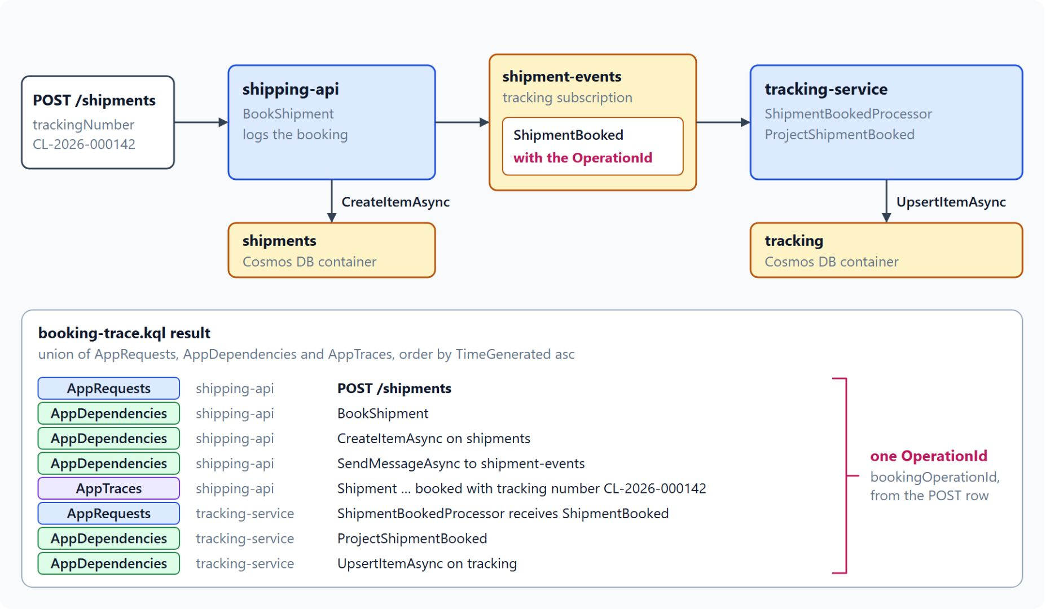
Following one booking with KQL
One query returns every row of the booking
POST /shipments with tracking number CL-2026-000142 returns 201 Created
shipping-api writes to shipments and sends ShipmentBooked to shipment-events
ShipmentBookedProcessor in tracking-service writes the booking to tracking
booking-trace.kql takes the OperationId of the latest shipping-api POST
It unions AppRequests, AppDependencies and AppTraces in time order
Notes:
The last lab step proves that the telemetry from step 4 works: one query follows one booking across both services.
The booking: send the JSON booking with tracking number `CL-2026-000142` to `https://<SHIPPING_API_FQDN>/shipments` with any HTTP client, and the response is 201 Created.
Shipping side: `POST /shipments` writes the shipment to the Cosmos DB container `shipments` and sends a `ShipmentBooked` message to the `shipment-events` topic.
Tracking side: `ShipmentBookedProcessor` handles the message from the tracking subscription and writes to the `tracking` container. The Service Bus SDK carries the `OperationId` across that hop.
Finding the operation: the query takes the most recent POST from the shipping-api role in the last 30 minutes. `AppRoleName` carries the environment name as a prefix, so it matches with `endswith`.
The union: it returns every `AppRequests`, `AppDependencies` and `AppTraces` row with that `OperationId` in time order, and projects `Message` as `Name` because `AppTraces` has no `Name` column. Give Application Insights a few minutes to ingest the telemetry before you run it in Logs.

Slide 25

Takeaways
What to carry into reliable messaging with Service Bus
Declare the environment in the AppHost and let aspire deploy build the rest
Read secrets and settings through a managed identity, so no password is stored
Release behind a traffic split and keep the previous revision for rollback
Give consumers a grace period longer than the host shutdown timeout
Run Dapr actors on AKS, and join one scan's telemetry by OperationId
Notes:
Close with the habits this module built for every service that goes to Azure.
Deploy from the AppHost: the Container Apps environment is a resource you declare, and `aspire deploy` creates the registry, the identity and one container app per service.
Managed identity: `DefaultAzureCredential` runs the same code on a laptop and in Azure, with secrets in Key Vault and settings in App Configuration.
Traffic split: multiple revision mode and weights that add up to 100 let a release start at 10 percent, and the rollback is only a traffic change.
Draining: set `terminationGracePeriodSeconds` longer than `HostOptions.ShutdownTimeout`, and settle every message before the handler returns.
Host and trace: the routing service runs on AKS with the Dapr extension because Container Apps managed Dapr doesn't support the actor SDK package, and `OperationId` joins one scan across the telemetry tables. Module 4 connects the services with Service Bus.

