Slide 1



Fast Lane Group
Worldwide Education &
Professional Services
www.flane.de | © 2026 Fast Lane Institute for Knowledge Transfer GmbH
Notes:
Die Fast Lane Gruppe.
Fast Lane … Dienstleister u. Spezialist für High-End Technologie und Business Trainings
IT Trainings zu den unterschiedlichsten Herstellern wie Microsoft, Google, Cisco oder AWS. Und vielen weiteren wichtigen IT Herstellern.
Sei es Cloud, Security, Netzwerk oder allgemein digitale Transformationsprojekte
Und das seit 2003.
Das spannende ist, dass die Fast Lane Gruppe bereits seit 2009 durchgängig zu den Top 20 Unternehmen in der IT Trainingsbranche weltweit zählt.
Aber auch Footprint ebenso im klassischen Professional Services Bereich für unsere wichtigsten Hersteller
PreSales Support, Deployment Services und Adoption Trainings
Additional Information:
Im Jahr 2021 sind wir zur „most strategic IT Education company worldwide“ von der IDC im „magic quadrant“ aufgeführt worden !
1 mio Teilnehmer insgesamt seit bestehen, 50.000+ Students ww p.A, 20.000 in DE pro Jahr

Slide 2






AGENTIC AI: FROM STRATEGY TO PRODUCTION.
Alexander
Kastil
AGENTIC AI CONSULTING · VIENNA
Full stack, from enterprise software to agentic AI. Since 1996
AI at Work
Enterprise AI
Value discovery, KPI mapping and roadmap
Governed multi-agent systems on Microsoft Copilot and Foundry
Agentic Software Engineering
Team Enablement
Harness architecture for Claude Code and GitHub Copilot
AI driven content production and delivery
integrations.at
github.com/alexander-kastil
SCAN TO CONNECT
alexander.kastil@integrations.at
linkedin.com/in/alexander-kastil
integrations.at
Notes:
Intro: Alexander Kastil, integrations.at. Four practice areas from AI at Work to team enablement. Certifications: Agentic AI Business Solutions Architect, Azure AI App and Agent Developer Associate, DevOps Engineer Expert.

Slide 3

MODULE 4
Reliable Messaging with Service Bus
Parcel events from the shipping API and scanners to their consumers
Event-Driven Distributed Apps on Azure: Aspire, Dapr & Durable Execution

Slide 4
01
02
03
Topic Subscriptions: SQL Filters
Correlation and SQL filters, rule actions and Bicep
Azure Functions: Service Bus Triggers
Isolated worker trigger, settlement and host.json
Competing Consumers: KEDA Scale Rules
ServiceBusProcessor concurrency and KEDA scaling
04
05
06
Sessions: Ordered Message Processing
Session IDs, session state and session locks
Dead-Letter Queues: Poison Messages
Delivery limits, reasons and resubmitting
Idempotent Consumers: Duplicate Detection
Duplicate detection and a Cosmos DB marker
Event-Driven Distributed Apps on Azure: Aspire, Dapr & Durable Execution

Slide 5

Reliable messaging with Service Bus
Parcel events from the shipping API and scanners to their consumers
Routing and consuming: filtered subscriptions, a Functions trigger and consumers scaled by KEDA
Order and poison messages: one session per parcel, unreadable label scans in the dead-letter queue
Duplicates: duplicate detection at the broker and an idempotent consumer
Notes:
This module connects the Contoso Logistics services with Azure Service Bus, which carries parcel events from the shipping API and the scanners to the consumers that need them. Every SDK call uses `Azure.Messaging.ServiceBus`, because the legacy `Microsoft.Azure.ServiceBus` and `WindowsAzure.ServiceBus` packages retired on September 30, 2026.
Routing and consuming: one topic feeds filtered subscriptions, and a Functions trigger or Container Apps replicas consume them. KEDA scales the consumer with its backlog.
Order and poison messages: sessions keep the scans of one parcel in order, and unreadable label scans move to the dead-letter queue, where an operator can inspect them.
Duplicates: duplicate detection drops a repeated send at the broker, and an idempotent consumer stores each scan once even when it arrives twice.

Slide 6
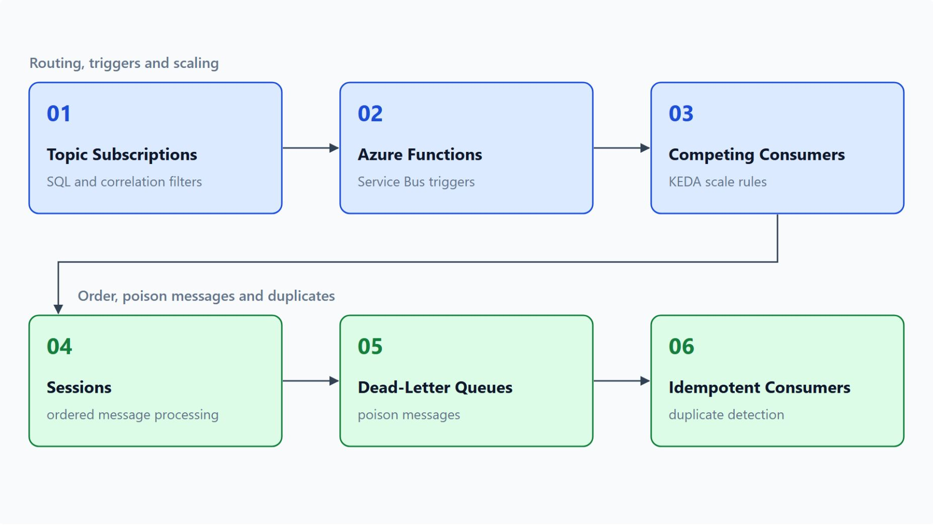
Overview
Six reliability features for the parcel event flow
Route each parcel event to the subscriptions whose filters select it
Consume tracking with a Functions trigger that settles after its work
Scale competing consumers with a KEDA rule on the backlog
Keep each parcel's scans in order with sessions
Dead-letter poison messages and drop duplicates with an idempotent consumer
Notes:
This slide walks the six topics once. Each topic adds one reliability feature to the same parcel event flow, and every example uses Contoso Logistics names.
Routing: the `parcel-events` topic copies each event into the subscriptions whose rules select it, so tracking, notifications and exceptions each receive only their own events.
Triggers: the scan processor runs as an isolated Azure Functions app, and each scan on the `tracking` subscription starts one invocation that settles only after its work succeeds.
Scaling: more consumer instances share the subscription, and a KEDA rule in Container Apps adds replicas as the backlog grows and scales to zero when no scans wait.
Order: sessions use the tracking number as the session ID, so the scans of one parcel apply in the order they were sent.
Poison messages and duplicates: unreadable label scans move to the dead-letter queue with a reason. Duplicate detection and a Cosmos DB marker keep a repeated scan from being stored twice.

Slide 7
01
Topic Subscriptions: SQL Filters
Correlation and SQL filters, rule actions and Bicep
Event-Driven Distributed Apps on Azure: Aspire, Dapr & Durable Execution

Slide 8
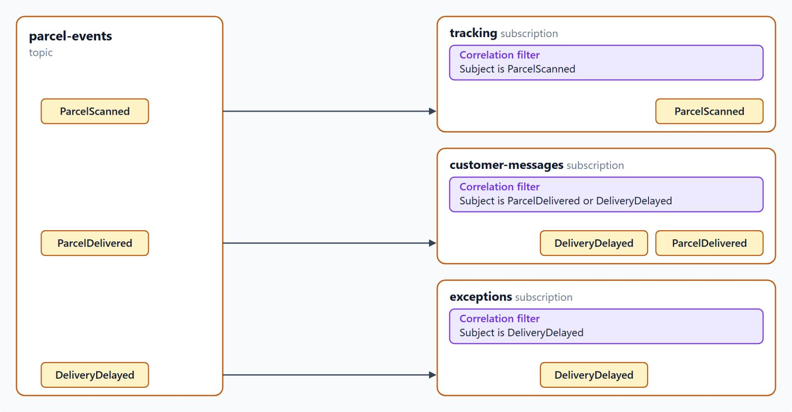
Topics, subscriptions and filters
Each subscription keeps its own copy of the events it selects
Each subscription receives a copy of every message its rules match
tracking gets ParcelScanned, customer-messages gets ParcelDelivered and DeliveryDelayed, exceptions gets DeliveryDelayed
A slow consumer builds a backlog on its own subscription only
On Azure, every new subscription starts with a default rule that matches every message
Rules on one subscription combine with OR, so delete the default rule
Notes:
Contoso Logistics publishes every parcel event to one topic, `parcel-events`. Three services need different events, so each one gets its own subscription with rules that select them.
Copies per subscription: a topic accepts messages from publishers, and each subscription receives a copy of every message that matches its rules. One scan can reach several consumers, and each subscription also has its own dead-letter queue.
Three subscriptions: `tracking` feeds the tracking service, `customer-messages` the notification service, and `exceptions` the exception agent. Each one uses a correlation filter on `Subject`.
Separate backlogs: each subscription holds its own copy of the messages it selects, so a slow consumer builds a backlog on its own subscription and doesn't hold up the others.
Default rule: each new subscription on Azure starts with a default rule whose true filter matches every message. The Service Bus emulator doesn't add one.
OR between rules: rules on one subscription combine with a logical OR, so the default rule keeps selecting everything until you delete it.

Slide 9
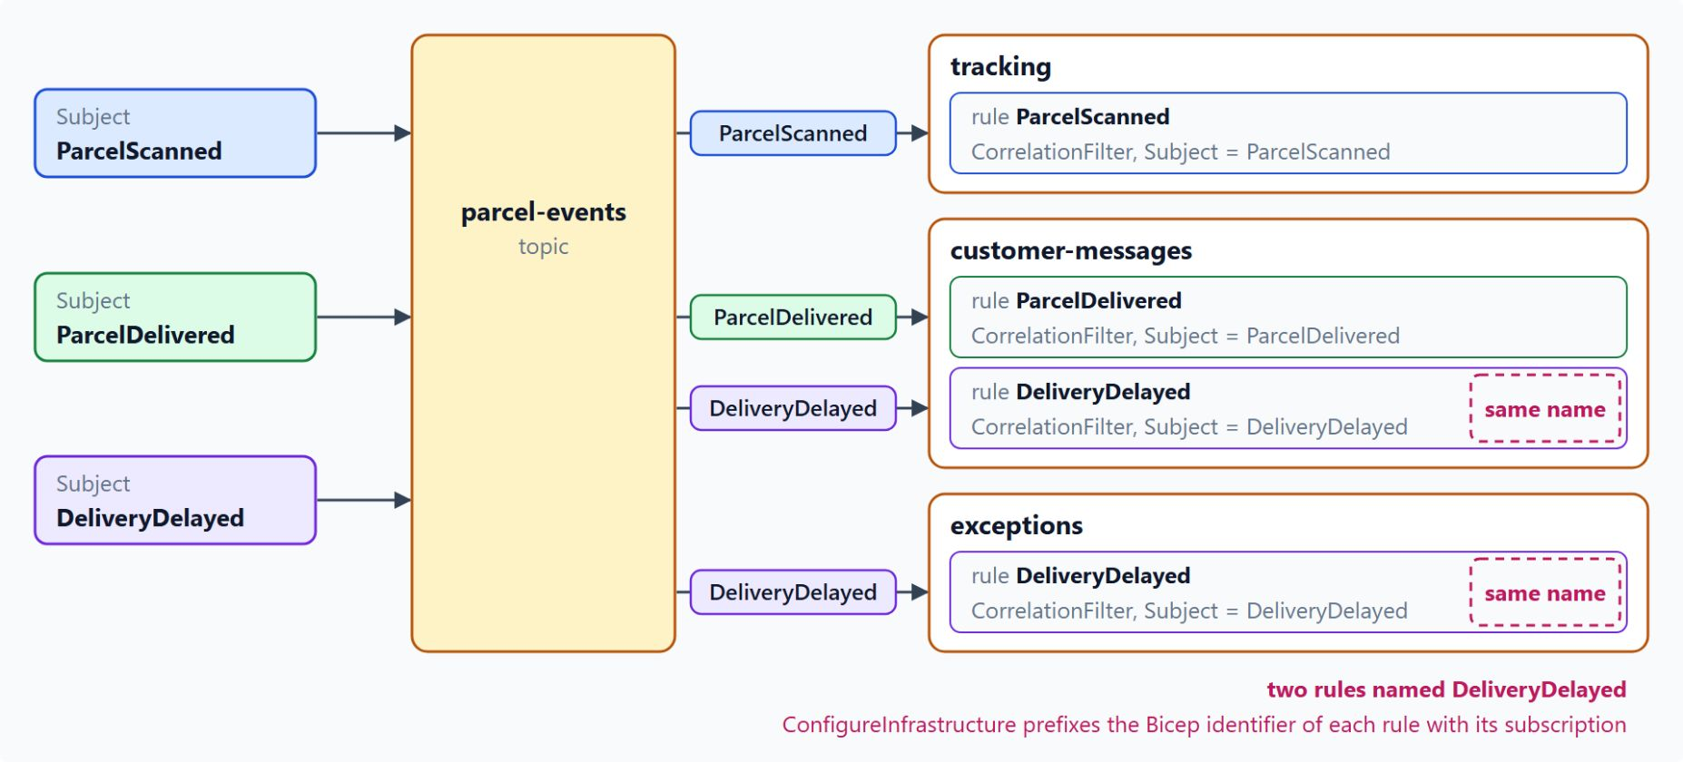
Subscription rules in code and Bicep
Correlation filters on Subject for every Contoso Logistics subscription
Correlation filters match fixed properties exactly; Microsoft Learn recommends them whenever they fit
SQL filters add LIKE, IS NULL and EXISTS over properties, never the message body
A rule action runs SET or REMOVE on the copy the subscription receives
ServiceBusAdministrationClient.
CreateRuleAsync creates rules in code
The AppHost declares AzureServiceBusRule, and Aspire generates the Bicep
Notes:
The previous slide showed what each subscription selects. This one shows the filter types behind those rules and how Contoso Logistics declares them, one correlation rule per subject.
Correlation filters: they compare properties such as `Subject`, `CorrelationId` or user properties for equality, and the comparison is case-sensitive. Microsoft Learn recommends them whenever they fit, because SQL filters reduce throughput.
SQL filters: choose them only when a rule needs an operator such as `LIKE` or `IS NULL`. System properties need the `sys.` prefix, so `sys.Label` addresses `Subject`, and every value a rule needs must sit in a property.
Rule actions: an action runs after the filter matches and uses `SET` and `REMOVE` statements. It changes only the copy the subscription receives, and that copy carries a `RuleName` property.
Rules in code: `ServiceBusAdministrationClient` takes the namespace and a `TokenCredential`, and the identity needs the Azure Service Bus Data Owner role. A duplicate rule name fails with `MessagingEntityAlreadyExists`.
Rules in the AppHost: Contoso Logistics declares its rules with `AzureServiceBusRule` in `src/AppHost/Program.cs`, and Aspire generates the Bicep; hand-written Bicep uses the 2026-01-01 rules resource. Two subscriptions hold a rule named `DeliveryDelayed`, so the lab's `ConfigureInfrastructure` prefixes each rule's Bicep identifier with its subscription.

Slide 10
02
Azure Functions: Service Bus Triggers
Isolated worker trigger, settlement and host.json
Event-Driven Distributed Apps on Azure: Aspire, Dapr & Durable Execution

Slide 11
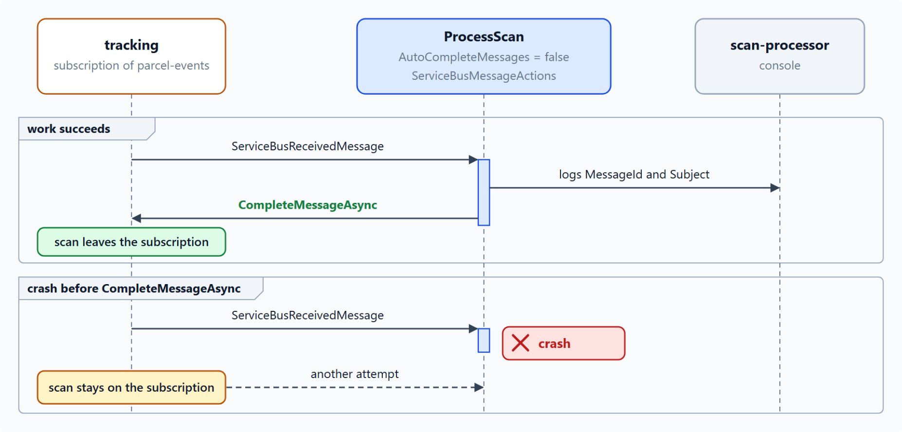
Service Bus trigger and settlement
The function completes a scan only after its work succeeds
Isolated worker model with Microsoft.Azure.Functions.Worker.
Extensions.ServiceBus 5.14.1 or later
Bind ServiceBusReceivedMessage for metadata and ServiceBusMessageActions to settle
Set AutoCompleteMessages = false whenever the function binds message actions
Settlement: complete on success, abandon to retry, dead-letter a poison message
An unhandled exception or an expired lock returns the message with a higher delivery count
Notes:
Contoso Logistics runs the scan processor as an Azure Functions app. Each scan on the `tracking` subscription starts one function invocation that updates the tracking read model.
Isolated worker: the code runs in a process separate from the Functions host, and version 5.14.1 or later of the extension provides the two types on this slide. The in-process model reaches end of support on November 10, 2026, so new C# work uses the isolated model.
Bindings: `ServiceBusReceivedMessage` exposes `MessageId`, `Subject`, `DeliveryCount` and `ApplicationProperties`. A `ServiceBusMessageActions` parameter lets the function settle the message itself.
AutoCompleteMessages: when it is true, the runtime completes the message after a successful run, before your code can decide. The Functions documentation requires false when the function binds message actions.
Settlement: `CompleteMessageAsync` removes the message from the subscription, and `AbandonMessageAsync` returns it with a higher delivery count. `DeadLetterMessageAsync` moves it to the dead-letter subqueue with a reason and a description.
Redelivery: after an unhandled exception the extension abandons the message, so it can be received again immediately. A message still unsettled when its lock expires also returns to the subscription, and topic 05 covers what repeated redeliveries lead to.

Slide 12
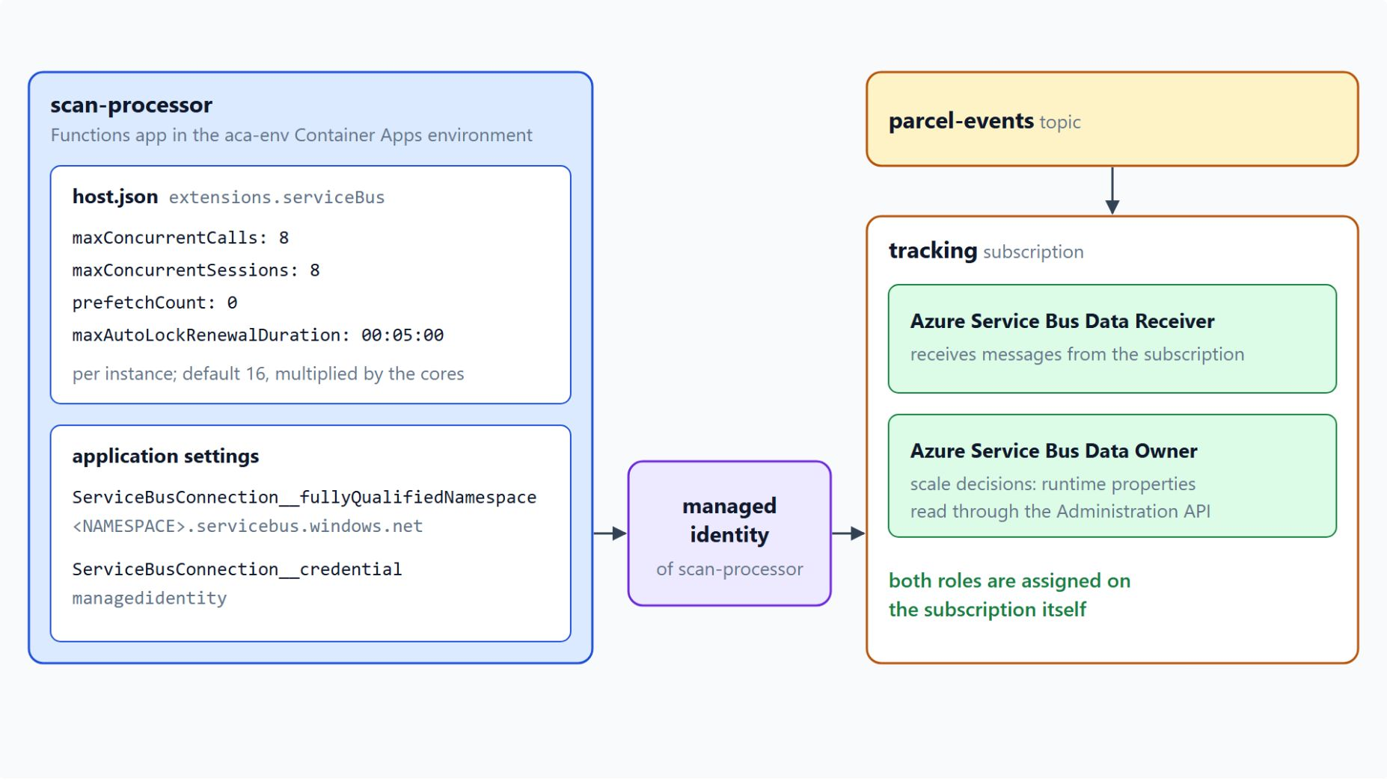
Concurrency, connections and hosting
The trigger connects through the app's managed identity
maxConcurrentCalls limits callbacks per instance: 16 by default, multiplied by the cores
maxConcurrentSessions 8 caps the parcel sessions one instance works on
ServiceBusConnection__
fullyQualifiedNamespace and __credential replace the connection string
Roles on the subscription: Data Receiver to receive, Data Owner for scale decisions
AddAzureFunctionsProject places scan-processor in the aca-env Container Apps environment
Notes:
With settlement in place, the next settings decide how much one instance processes at once, how the trigger signs in, and where the app runs.
maxConcurrentCalls: the `extensions.serviceBus` section of `host.json` limits the callbacks that run at once per instance, and the default is 16. The runtime multiplies the value by the core count, so lower it when handlers call a database with a fixed connection limit.
Sessions and locks: the `tracking` trigger uses sessions, so the Contoso Logistics `host.json` sets `maxConcurrentSessions` to 8. `prefetchCount` stays at its default of 0, and `maxAutoLockRenewalDuration` renews a message lock for up to five minutes.
Identity-based connection: settings that share the `ServiceBusConnection` prefix name the namespace and set the credential to `managedidentity`. The function app's managed identity then needs a role on the subscription.
Roles: Azure Service Bus Data Receiver receives the messages, and Data Owner lets the extension read runtime properties for scale decisions. The assignment must reach the subscription itself, because a scope on the topic alone fails when the trigger starts.
Hosting: `AddAzureFunctionsProject` in `src/AppHost/Program.cs` registers the app in the `aca-env` Container Apps environment, and `aspire deploy` publishes it there. Custom scale rules need `allowScalingRuleOverride` set to true, which the next topic uses.

Slide 13
03
Competing Consumers: KEDA Scale Rules
ServiceBusProcessor concurrency and KEDA scaling
Event-Driven Distributed Apps on Azure: Aspire, Dapr & Durable Execution

Slide 14
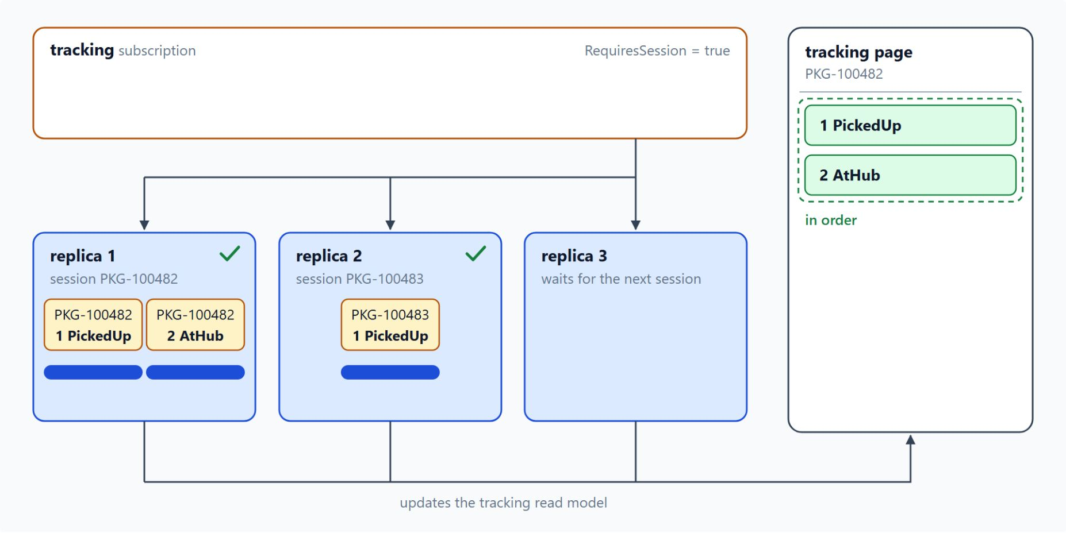
Competing consumers
Replicas share the tracking subscription, and sessions keep each parcel in order
Several instances receive from one subscription, and each message reaches one of them
More instances raise throughput, and a failed instance doesn't block the others
Parallel consumers give up ordering, so tracking requires sessions
ServiceBusProcessor: MaxConcurrentCalls defaults to 1, PrefetchCount to 0
Set PrefetchCount at least as high as MaxConcurrentCalls, and keep it small for slow handlers
Notes:
A depot scan burst can fill the `tracking` subscription faster than one consumer drains it. Contoso Logistics adds consumer instances that share the subscription, so each scan reaches exactly one of them.
One message, one consumer: in the competing consumers pattern, several instances receive from one queue or subscription, and the broker delivers each message to one of them.
Throughput and resilience: adding instances raises throughput, and the remaining instances keep receiving when one fails. Microsoft Learn recommends the Premium tier for production workloads with varied throughput.
Ordering: the order in which instances receive messages isn't guaranteed, so handlers should process messages idempotently. The `tracking` subscription requires sessions, so its replicas keep each parcel's scans in order.
Processor concurrency: `ServiceBusProcessor` runs a message handler on a pool of callbacks inside one process. `MaxConcurrentCalls` sets how many handlers run at once, and `PrefetchCount` sets how many messages wait in a local buffer.
Prefetch: the buffer is a strict upper limit, so a `PrefetchCount` below `MaxConcurrentCalls` leaves some handlers without work. Prefetched messages can lose their locks while they wait, so keep the buffer small when handlers are slow.

Slide 15
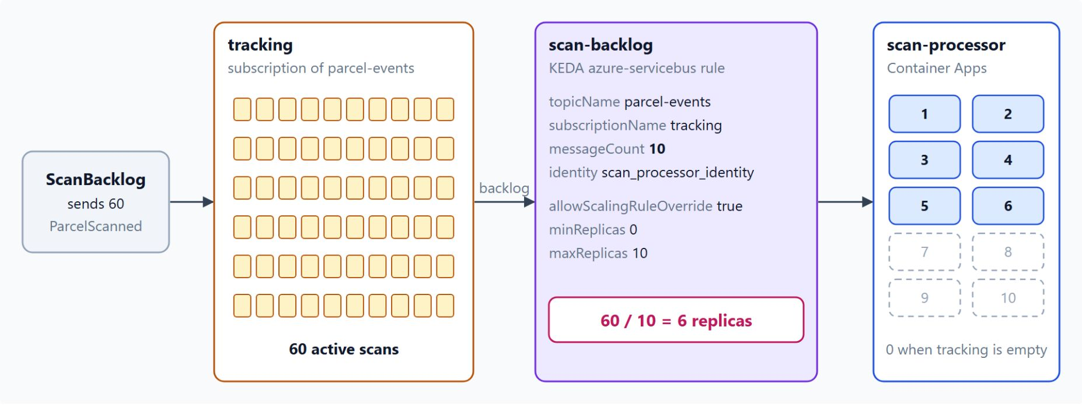
KEDA scale rule in Container Apps
Replicas follow the backlog of the tracking subscription
A custom azure-servicebus rule reads the depth of the tracking subscription
messageCount sets the messages per replica: 5 by default, 10 in the lab
The rule's identity reads the backlog with a managed identity instead of a connection string
minReplicas 0 scales to zero, and maxReplicas caps the cost
60 waiting scans with messageCount 10 give 6 of the 10 replicas
Notes:
Concurrency inside one process has a ceiling, so Container Apps adds replicas with KEDA. The number of replicas follows the backlog, and the app scales to zero when no scans wait.
The rule: a custom rule of type `azure-servicebus` reads a queue through `queueName`, or a topic subscription through `topicName` and `subscriptionName`. The lab's `scan-backlog` rule counts `tracking` on `parcel-events`.
messageCount: each replica handles that many messages, and the default is 5. The lab sets 10, so the rule adds one replica for every ten active scans.
Identity: the `identity` property sits inside the `custom` rule, set to `system` or to the resource ID of a user-assigned identity. That identity needs Azure Service Bus Data Owner, or a custom role that can read the subscription's runtime properties.
Replica limits: with `minReplicas` 0 the app scales to zero, and the 300-second cooldown applies only to that last step. Every added replica adds cost, so `maxReplicas` caps the scale-out.
The lab run: `ScanBacklog` sends 60 scans, and the replica count rises toward six over several 30-second polling intervals. Functions on Container Apps rejects custom rules until `allowScalingRuleOverride` is true, so `infra/scan-consumer.azcli` sets that flag.

Slide 16
04
Sessions: Ordered Message Processing
Session IDs, session state and session locks
Event-Driven Distributed Apps on Azure: Aspire, Dapr & Durable Execution

Slide 17
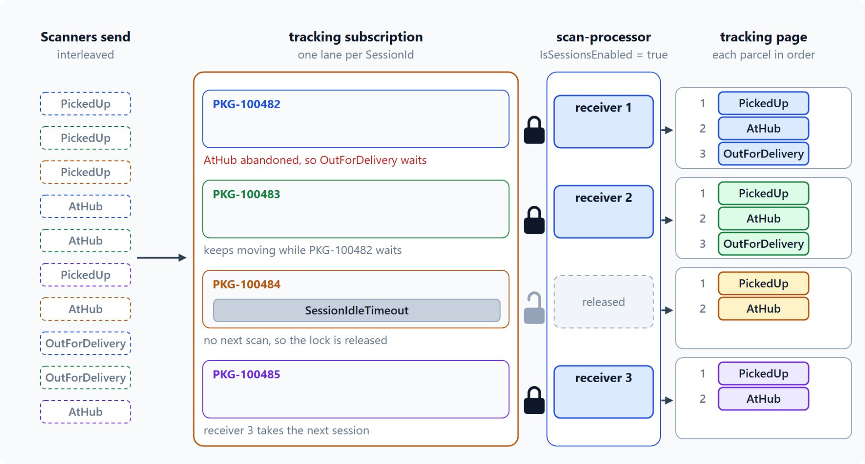
Session-enabled subscriptions
The tracking number is the session ID, so each parcel gets one ordered lane
RequiresSession: messages that share a SessionId form a first-in, first-out sequence
The tracking number is the session ID, so every scan of a parcel shares a session
Different sessions run in parallel, and one receiver at a time holds a session's lock
An abandoned scan holds back only the later scans of its own parcel
A message without a session ID dead-letters with Session ID is null
Notes:
A parcel scanned `PickedUp`, then `AtHub`, then `OutForDelivery` must show that sequence on the tracking page. If two scans of the same parcel run in parallel, the page can show the van leaving before the hub scan lands.
First in, first out: a session-enabled queue or subscription sets `RequiresSession` when you create it. Messages that share a `SessionId` then form a first-in, first-out sequence.
Session ID: Contoso uses the tracking number as the session ID. The scan processor receives these sessions through a Functions trigger with `IsSessionsEnabled = true`.
Parallel lanes: different sessions run in parallel, while the messages inside one session stay in order. Only one receiver can hold a session's lock at a time.
Abandon: the next receive serves the abandoned message again, so a failing scan holds back the later scans of its parcel until it succeeds or moves to the dead-letter queue. The other parcels keep moving.
Missing session ID: a message sent to a session-enabled entity without a session ID dead-letters with the reason `Session ID is null`, so the publisher sets the parcel ID as the session ID on every scan.

Slide 18
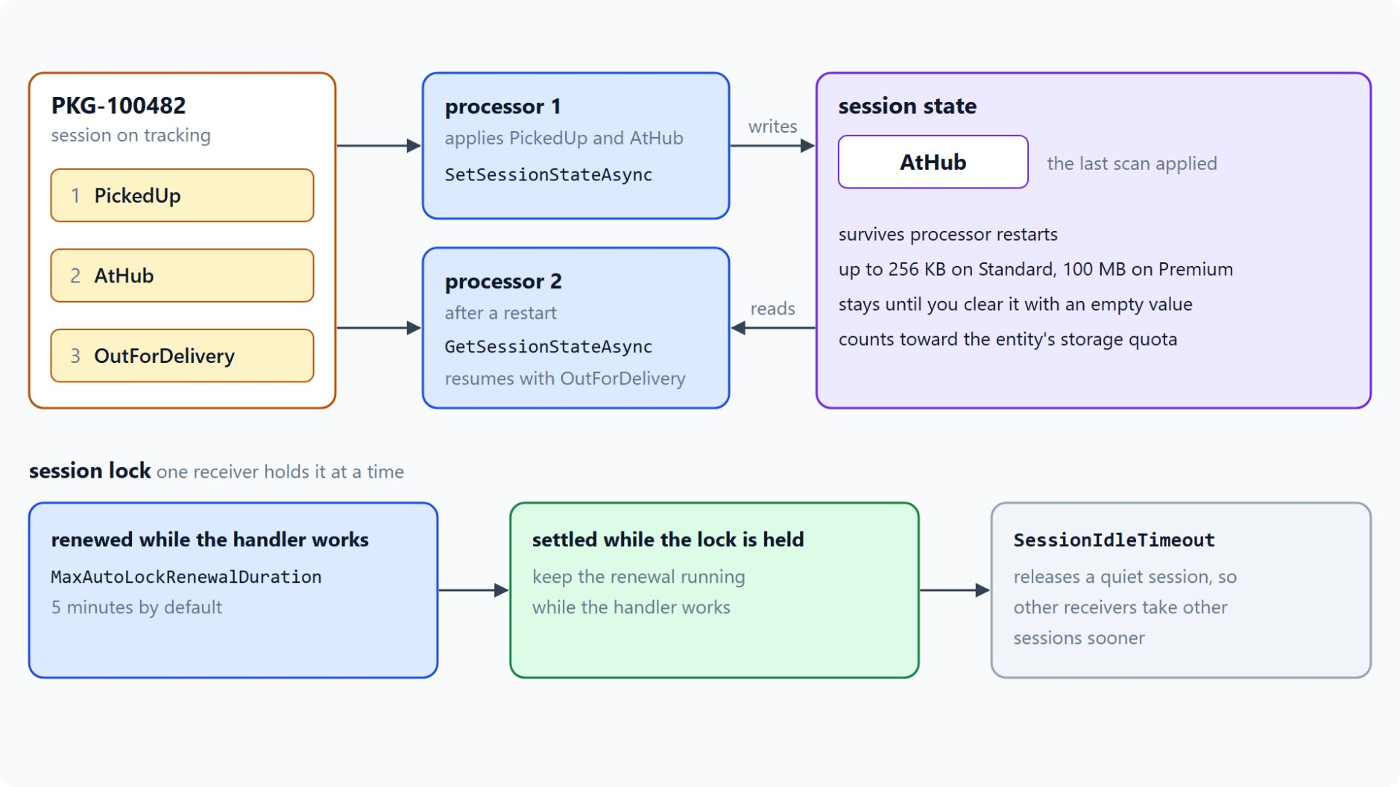
Session state and session locks
A checkpoint that survives restarts and a lock renewed while the handler works
ServiceBusSessionProcessor works on up to MaxConcurrentSessions sessions, 8 by default
Session state is a checkpoint that survives processor restarts
The processor renews the lock up to MaxAutoLockRenewalDuration, 5 minutes by default
SessionIdleTimeout closes a quiet session, so the processor moves on to another
Sessions need the Standard or Premium tier
Notes:
The previous slide showed how sessions keep order. This one covers the processor that receives them, the state a session carries and the lock that guards it.
Session processor: `ServiceBusSessionProcessor` delivers each session's messages in the order they were sent, and different sessions run in parallel. Microsoft Learn names a very high `MaxConcurrentSessions` relative to the core count as a frequent cause of thread starvation.
Session state: `SetSessionStateAsync` stores a small value and `GetSessionStateAsync` reads it, so a new processor can resume from the last step a parcel reached. The state holds up to 256 KB on Standard and 100 MB on Premium and stays until you clear it with an empty value.
Lock renewal: the processor renews the session lock while it works, up to `MaxAutoLockRenewalDuration`. If the lock expires, the session fails with `SessionLockLost` and another receiver can take it, so keep the renewal running until the handler settles.
Idle timeout: `SessionIdleTimeout` closes a session when the processor waits that long for its next message. Set it low for sparse sessions and high for parcels whose scans arrive over hours.
Tier: the Basic tier supports queues only, and Standard adds topics, subscriptions, sessions, transactions and duplicate detection. Premium adds dedicated messaging units, larger messages and private networking, so plan the tier before you create the namespace.

Slide 19
05
Dead-Letter Queues: Poison Messages
Delivery limits, reasons and resubmitting
Event-Driven Distributed Apps on Azure: Aspire, Dapr & Durable Execution

Slide 20
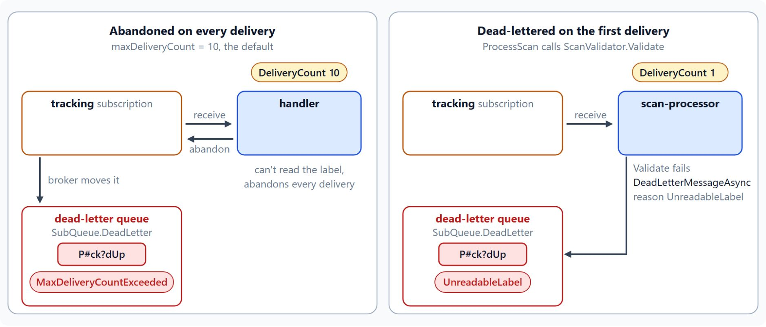
Delivery limit and dead-letter reasons
The broker moves a message once its delivery count passes maxDeliveryCount
Every abandon and every expired lock adds one to the delivery count
Past maxDeliveryCount, 10 by default, the broker dead-letters with MaxDeliveryCountExceeded
Other system reasons: TTLExpiredException, HeaderSizeExceeded, Session ID is null, MaxTransferHopCountExceeded
deadLetteringOnMessageExpiration moves every expiring message to the dead-letter queue
Dead-letter a scan yourself on its first delivery when it can't succeed
Notes:
Some scans can't be read: a label scanner that prints a malformed barcode produces a message that no handler can parse. Every redelivery wastes handler time on it, so Contoso Logistics moves these messages to the dead-letter queue of the `tracking` subscription.
Delivery count: each abandon and each expired lock adds one. A handler that never settles its messages exhausts the count, and so does a receiver that closes before it settles.
Delivery limit: each queue and subscription sets `maxDeliveryCount`, which defaults to 10. When the count passes it, the broker moves the message with the reason `MaxDeliveryCountExceeded`; the limit is adjustable and the behaviour is always on.
System reasons: the broker also dead-letters expired messages, oversized headers, messages without a session ID on a session-enabled entity, and auto-forwarding past four hops. The system sets the reason and description, and your code can read both.
Expiry: set `deadLetteringOnMessageExpiration` to true on the queue or subscription to move every expiring message to the dead-letter queue. Deferred messages don't move there when they expire, by design.
Explicit dead-lettering: when a handler knows a scan can't succeed, it dead-letters the scan on the first delivery with its own reason. The right side of the diagram shows `ScanValidator.Validate` failing and `scan-processor` using the reason `UnreadableLabel`.

Slide 21
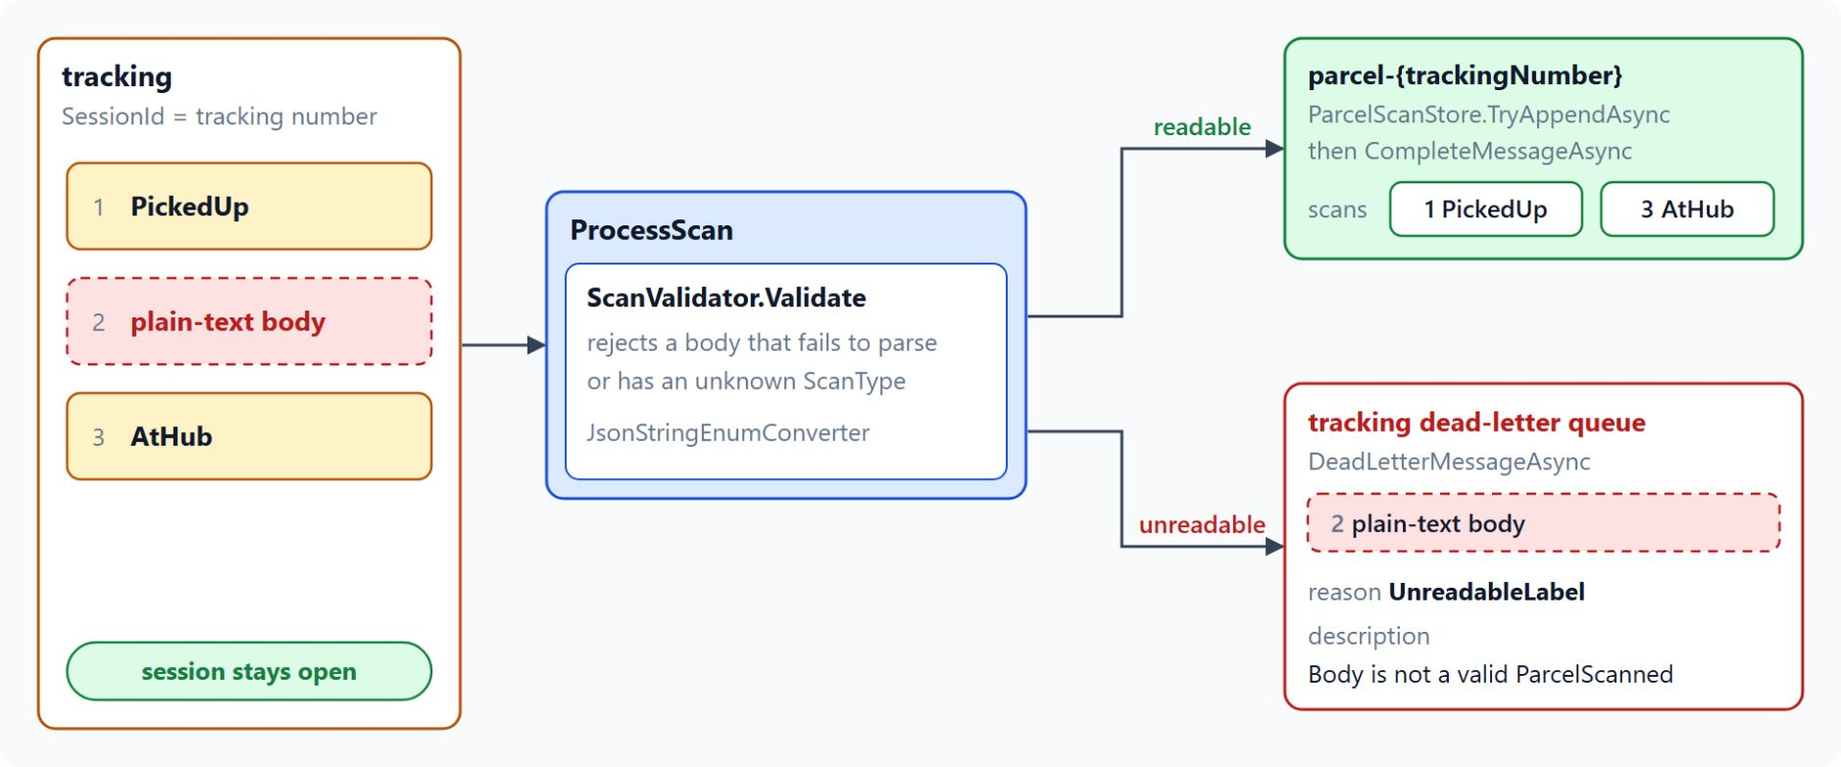
Dead-lettering and resubmitting unreadable scans
The reason travels with the message while the parcel's other scans keep moving
DeadLetterMessageAsync takes a reason and a description, each up to 4,096 characters
Use a short, stable reason code such as UnreadableLabel
Only that message moves, so the parcel's session stays open
Read dead letters with SubQueue.DeadLetter and their DeadLetterReason
Send a repaired copy first, then complete the original
Notes:
The Contoso Logistics scan processor dead-letters unreadable scans from its Functions trigger, through `ServiceBusMessageActions`. The diagram shows the lab case: a plain-text body between two readable scans of one parcel.
Reason and description: both values are limited to 4,096 characters, and the call works only in `PeekLock` mode. PeekLock is the default receive mode, so the receiver holds a lock on each message until it settles it.
Reason code: a short, stable code lets dashboards and operators group failures by cause. `ScanValidator.Validate` rejects a body that fails to parse or has an unknown `ScanType`.
One message only: dead-lettering moves just that message to the dead-letter subqueue. The session stays open, and the parcel's readable scans still apply in order around it.
Reading dead letters: a receiver with `SubQueue.DeadLetter` in its `ServiceBusReceiverOptions` reads them. `DeadLetterReason` and `DeadLetterErrorDescription` travel with each message, so an operator sees the cause next to the payload.
Resubmitting: fix the cause, send a repaired copy, then complete the original in the dead-letter queue. Sending first means a failed send leaves the original in place.

Slide 22
06
Idempotent Consumers: Duplicate Detection
Duplicate detection and a Cosmos DB marker
Event-Driven Distributed Apps on Azure: Aspire, Dapr & Durable Execution

Slide 23
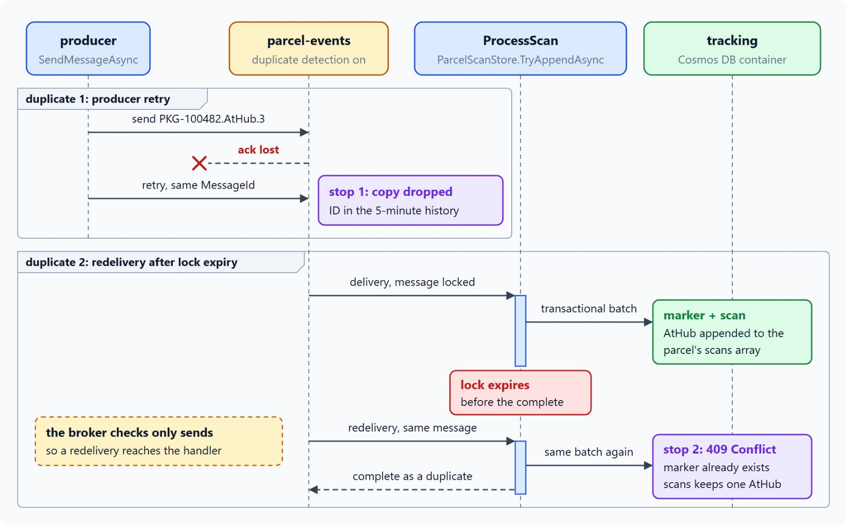
Duplicate detection at the broker
A stable MessageId lets the broker drop a producer retry
Service Bus delivers each message at least once, so the same scan can arrive twice
The broker keeps MessageId values for a window: 10 minutes by default, 20 seconds to 7 days
The parcel-events topic uses a five-minute window
A stable MessageId such as PKG-100482.AtHub.3 makes a retry match
The broker checks only sends, so a redelivery still reaches the handler
Notes:
A lock can expire during a slow write, a consumer can crash after it updates the tracking read model, and a producer can retry a send that already succeeded. The handler must produce the same result both times.
At least once: Service Bus delivers each message at least once, so the same scan can reach a handler twice.
The window: when a send carries a `MessageId` that is already in the history, the send succeeds and the broker drops the new message. A larger window keeps more IDs to match, which lowers throughput.
Contoso Logistics: you turn on duplicate detection when you create the queue or topic, and it needs the Standard or Premium tier. The `parcel-events` topic sets `requiresDuplicateDetection` with a five-minute `duplicateDetectionHistoryTimeWindow`.
Stable MessageId: the producer composes it from the parcel ID, the scan type and a sequence number, so a retry of the same scan produces the same ID.
Consumer side: a redelivery of a message the consumer already processed passes the broker and reaches the handler. The consumer has to stay idempotent on its own, which is the second stop in the diagram and the next slide.

Slide 24
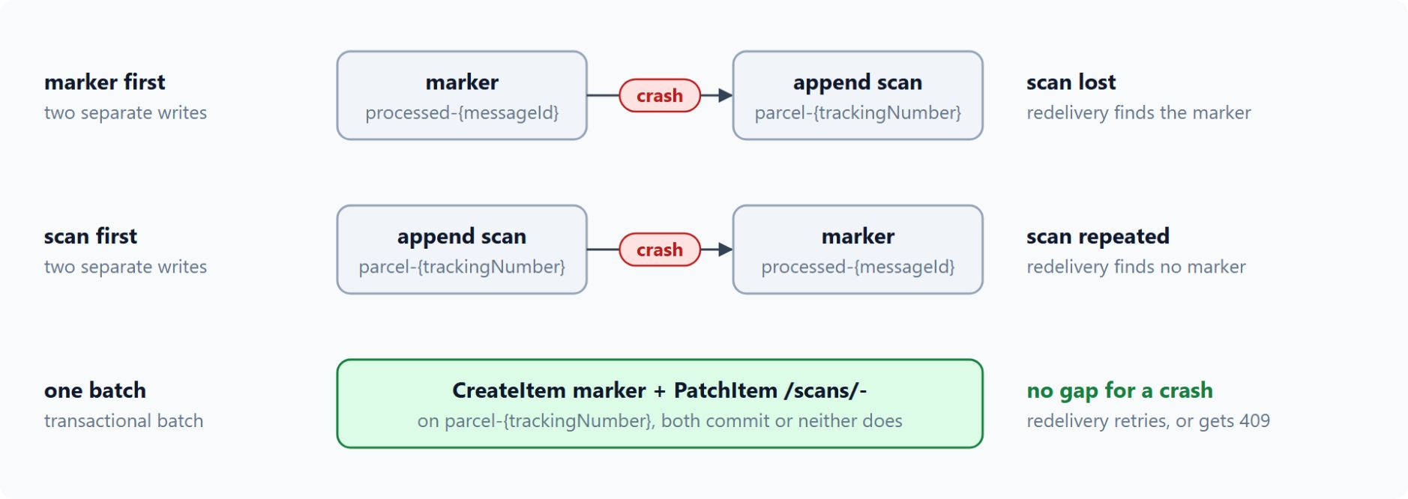
Marker and scan in one transactional batch
Cosmos DB commits both writes or neither
The Idempotent Consumer pattern records each processed key in a store that enforces uniqueness
Cosmos DB answers a repeated item ID with a CosmosException whose status is Conflict (409)
One transactional batch creates processed-{messageId} and patches parcel-{trackingNumber}
Marker and parcel share the /trackingNumber partition, up to 100 operations and 2 MB
A 409 on the marker completes the message as a duplicate; any other failure retries
Notes:
Duplicate detection stops only repeated sends, so the consumer needs its own protection. Contoso Logistics stores a processed-message marker next to the parcel document.
Idempotent Consumer: the consumer treats a write that conflicts with an existing key as a duplicate. The store must enforce uniqueness itself, because two consumer instances can check the same key at the same moment.
409 Conflict: Cosmos DB enforces unique item IDs within a partition, and a create that reuses an ID fails with HTTP 409. The .NET SDK throws a `CosmosException` with `HttpStatusCode.Conflict`, which the handler treats as a duplicate.
One batch: two separate writes leave a window, where a crash after the side effect repeats the scan and a crash after the marker loses it. A transactional batch commits the marker and the scan together, or neither.
Same partition: a batch covers items that share a partition key, so the marker sits in the `tracking` container on the parcel's `/trackingNumber`. One batch allows up to 100 operations and 2 MB.
Outcome: on a repeated marker the batch fails with 409, the scan operation returns 424, and `TryAppendAsync` returns false, so the consumer completes the message. Any other failure throws, Service Bus abandons the message, and it is retried.

Slide 25
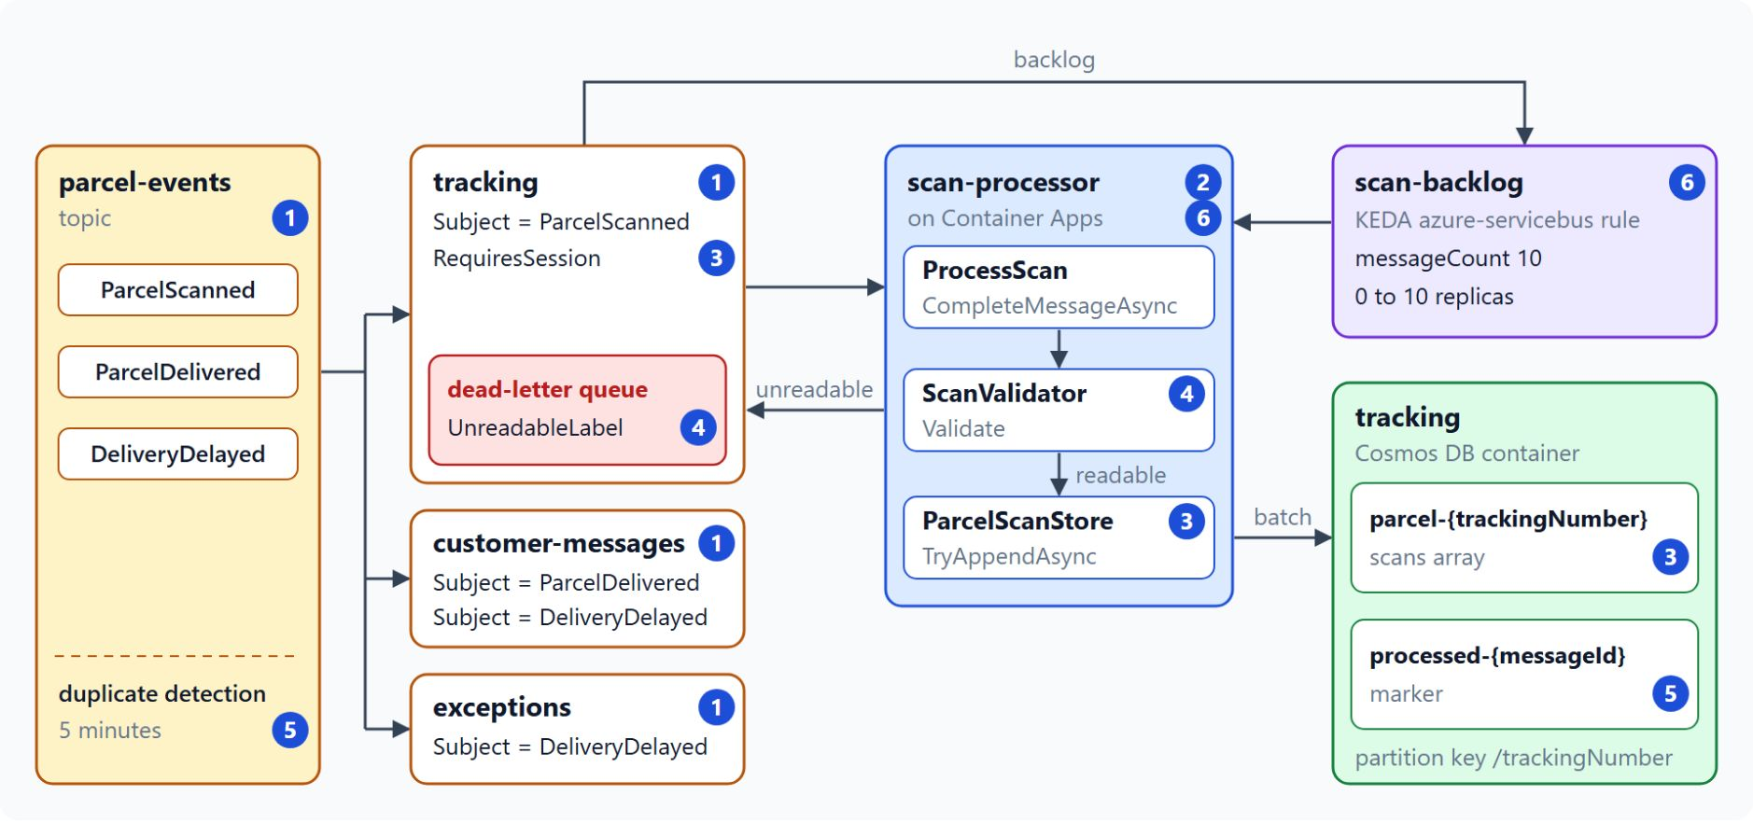
The scan processing lab
Seven steps from the parcel-events topic to a consumer that scales on its backlog
Steps 1 and 2: parcel-events with three filtered subscriptions, and a Functions trigger that settles after its work
Step 3: sessions on tracking keep each parcel's scans in order
Step 4: unreadable scans dead-letter with the reason UnreadableLabel
Step 5: duplicate detection and a marker in one Cosmos DB batch
Steps 6 and 7: deploy once, scale with KEDA, record the patterns in docs/scan-processing.md
Notes:
The lab turns the module into running code in about 55 minutes. You open `labs/04-service-bus/contoso-logistics/` with Claude Code or GitHub Copilot agent mode, and Docker Desktop runs the Service Bus and Cosmos DB emulators.
Topic and trigger: step 1 defines the topic and its subscriptions in the AppHost, so the emulator and Azure get the same topology. Step 2 adds the isolated Functions app, whose `ProcessScan` completes a scan only after its work succeeds.
Order: step 3 sets `RequiresSession` on `tracking` and `IsSessionsEnabled` on the trigger. `ParcelScanStore` appends each scan to the `scans` array of the `parcel-{trackingNumber}` document.
Poison scans: step 4 checks each scan with `ScanValidator.Validate` and dead-letters an unreadable one with the reason `UnreadableLabel`, so the session stays open for the parcel's later scans.
Duplicates: step 5 turns on a five-minute duplicate detection window, the largest the emulator accepts, and writes the scan and the `processed-{messageId}` marker in one transactional batch.
Azure: step 6 deploys `scan-processor` to Container Apps and adds the `scan-backlog` KEDA rule, because the emulator has no autoscale. Step 7 writes `docs/scan-processing.md`, which maps each pattern to the file that implements it.

Slide 26

Takeaways
What to carry into the Event Grid and Event Hubs module
Give each consumer a filtered subscription and delete the default rule
Settle after the work: AutoCompleteMessages = false with message actions
Scale on the backlog with a KEDA rule and a managed identity
Use the parcel ID as the session ID to keep each parcel's scans in order
Dead-letter unreadable scans with a reason, and write each scan once with a marker batch
Notes:
Close with the habits this module built, each one a decision in the topology or in the consumer.
Filtered subscriptions: a correlation filter on `Subject` gives each consumer only its own events. On Azure the default rule matches every message until you delete it.
Settle after the work: with `ServiceBusMessageActions` bound and `AutoCompleteMessages` set to false, a crash leaves the scan on the subscription for another attempt.
Scale on the backlog: the `azure-servicebus` KEDA rule adds replicas as `tracking` fills and scales the app to zero when it empties. It reads the backlog with a managed identity, so no connection string is involved.
Order per parcel: the tracking number as session ID gives each parcel one ordered lane, while different parcels run in parallel.
Poison messages and duplicates: dead-letter a scan that can't succeed with a stable reason, and write the scan and its marker in one batch so a redelivery stores nothing twice. Module 5 adds the broadcast side with Event Grid, Event Hubs and SignalR.

