Slide 1



Fast Lane Group
Worldwide Education &
Professional Services
www.flane.de | © 2026 Fast Lane Institute for Knowledge Transfer GmbH
Notes:
Die Fast Lane Gruppe.
Fast Lane … Dienstleister u. Spezialist für High-End Technologie und Business Trainings
IT Trainings zu den unterschiedlichsten Herstellern wie Microsoft, Google, Cisco oder AWS. Und vielen weiteren wichtigen IT Herstellern.
Sei es Cloud, Security, Netzwerk oder allgemein digitale Transformationsprojekte
Und das seit 2003.
Das spannende ist, dass die Fast Lane Gruppe bereits seit 2009 durchgängig zu den Top 20 Unternehmen in der IT Trainingsbranche weltweit zählt.
Aber auch Footprint ebenso im klassischen Professional Services Bereich für unsere wichtigsten Hersteller
PreSales Support, Deployment Services und Adoption Trainings
Additional Information:
Im Jahr 2021 sind wir zur „most strategic IT Education company worldwide“ von der IDC im „magic quadrant“ aufgeführt worden !
1 mio Teilnehmer insgesamt seit bestehen, 50.000+ Students ww p.A, 20.000 in DE pro Jahr

Slide 2






AGENTIC AI: FROM STRATEGY TO PRODUCTION.
Alexander
Kastil
AGENTIC AI CONSULTING · VIENNA
Full stack, from enterprise software to agentic AI. Since 1996
AI at Work
Enterprise AI
Value discovery, KPI mapping and roadmap
Governed multi-agent systems on Microsoft Copilot and Foundry
Agentic Software Engineering
Team Enablement
Harness architecture for Claude Code and GitHub Copilot
AI driven content production and delivery
integrations.at
github.com/alexander-kastil
SCAN TO CONNECT
alexander.kastil@integrations.at
linkedin.com/in/alexander-kastil
integrations.at
Notes:
Intro: Alexander Kastil, integrations.at. Four practice areas from AI at Work to team enablement. Certifications: Agentic AI Business Solutions Architect, Azure AI App and Agent Developer Associate, DevOps Engineer Expert.

Slide 3

MODULE 5
Events & Streams with Event Grid & Event Hubs
Connecting Contoso Logistics to partners and the live map
Event-Driven Distributed Apps on Azure: Aspire, Dapr & Durable Execution

Slide 4
01
02
03
Event Grid: Custom Topics & Subscriptions
Publish ParcelDelivered as a CloudEvent
Event Grid: Filters, Retries, Dead-Letter
Retry schedule, dead-letter storage, errors without retry
Event Grid Namespaces: Pull Delivery
Partners receive, acknowledge and release at their pace
04
05
06
Event Hubs: Partitions & Checkpoints
Keys, consumer groups, checkpoints and ownership
Event Hubs: Kafka-Compatible Streaming
Kafka clients on port 9093 with PLAIN or OAUTHBEARER
SignalR Service: Push to Browsers
Default and Serverless modes, the ops console client
Event-Driven Distributed Apps on Azure: Aspire, Dapr & Durable Execution

Slide 5

Events and streams with Event Grid and Event Hubs
Connecting Contoso Logistics to partners and the live map
Discrete events: publish ParcelDelivered with Event Grid, then filter, retry and pull it
Telemetry: stream van positions through Event Hubs partitions, checkpoints and Kafka
Push to browsers: SignalR Service brings each position to the ops console
Notes:
This opening slide sets out the three themes of the module. Module 4 taught the queues that carry commands between services, and this module adds the broadcast side.
Discrete events: the label-service publishes `ParcelDelivered` as a CloudEvent to Event Grid, and partners and functions react to it. Filters, retries, dead-lettering and namespace pull delivery decide how each partner receives it.
Telemetry: every van reports its GPS position as a steady stream into Event Hubs. Partition keys, consumer groups and checkpoints keep the results correct, and the Kafka endpoint lets telematics vendors keep their Kafka clients.
Push to browsers: Azure SignalR Service pushes each position to the ops console, so a dispatcher watches vans move across the map without a page reload.

Slide 6
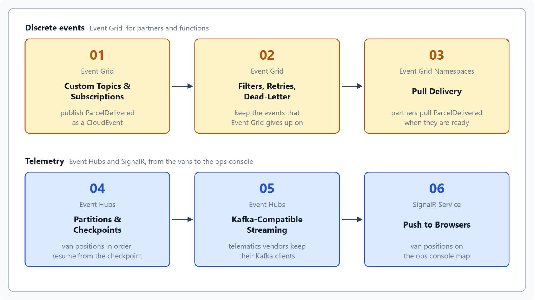
Overview
The path from ParcelDelivered to the live map
Publish ParcelDelivered to a custom topic and validate each partner endpoint
Filter and retry deliveries, and dead-letter the ones that fail
Let partners pull from a namespace topic when they are ready
Stream van positions through partitions, checkpoints and the Kafka endpoint
Push each position to the ops console with SignalR Service
Notes:
This slide walks the path through the six topics once, following on from the three themes of the title slide. Every topic uses the same Contoso Logistics events, so the pieces fit together by the end.
Custom topics: the label-service publishes `ParcelDelivered` as a CloudEvent, and Event Grid validates each partner endpoint before it sends the first event.
Filters, retries and dead-letter: filters decide which events reach a subscription, the retry policy decides how long Event Grid keeps trying, and dead-lettering keeps the events it gives up on.
Pull delivery: partners that can't open an inbound port pull from a namespace topic, with queue-like semantics and explicit acknowledgment.
Partitions and Kafka: van positions keyed by van ID stay in order in Event Hubs, consumers track their progress with checkpoints, and telematics vendors produce over the Kafka endpoint.
SignalR: the telemetry-ingest service pushes each position through Azure SignalR Service to the live map in the ops console.

Slide 7
01
Event Grid: Custom Topics & Subscriptions
Publish ParcelDelivered as a CloudEvent
Event-Driven Distributed Apps on Azure: Aspire, Dapr & Durable Execution

Slide 8
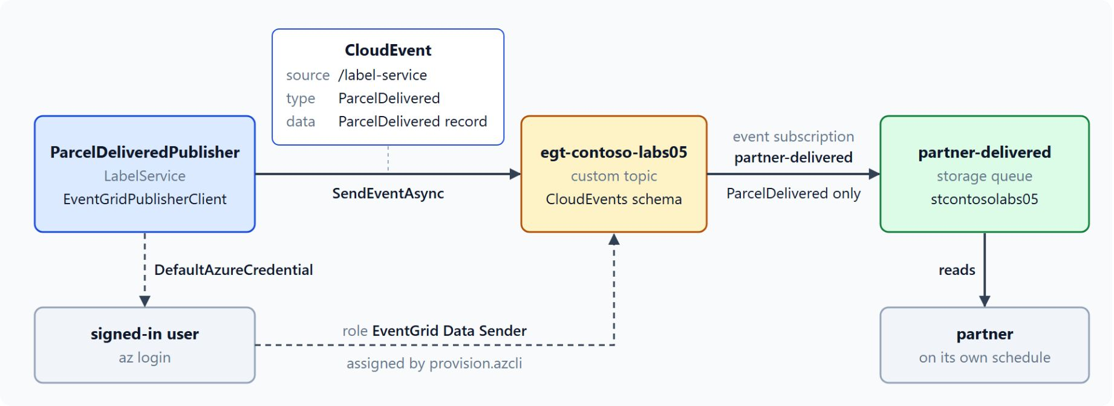
Publishing CloudEvents to a custom topic
The label-service publishes once, each partner gets a subscription
A custom topic has an endpoint and keys; a system topic belongs to an Azure service
EventGridPublisherClient sends a CloudEvent with a source, a type and data
DefaultAzureCredential needs the EventGrid Data Sender role on the topic
Handlers: HTTPS webhooks, Azure Functions, Service Bus, Event Hubs and Storage queues
The event type name is the contract with every subscriber
Notes:
Contoso Logistics needs to tell partners when a parcel reaches its destination, and today no partner can see that moment. The diagram shows the lab's version: the label-service publishes `ParcelDelivered` to a custom topic, and a subscription delivers it to the partner's storage queue.
Custom and system topics: your application publishes to a custom topic, which has an endpoint, access keys and a schema you choose. Only Azure services publish to a system topic, so it has no endpoint or keys.
EventGridPublisherClient: `SendEventAsync` sends one event and `SendEventsAsync` a batch, both with `CloudEvent` objects when the topic uses the CloudEvents schema. The constructor takes the source, the event type and the data, which the SDK serializes as JSON.
Entra ID instead of keys: the label-service authenticates with `DefaultAzureCredential`, and its identity holds the EventGrid Data Sender role on the topic. An access key works for a quick test, but a key doesn't tell you which service sent an event.
Handlers: partners with their own HTTPS endpoint use a webhook, and internal consumers use the Azure Functions Event Grid trigger. A Service Bus queue fits a partner that must keep messages while it is slow or offline.
A stable contract: event type names are the contract between the publisher and every subscriber, so the label-service keeps them stable.

Slide 9
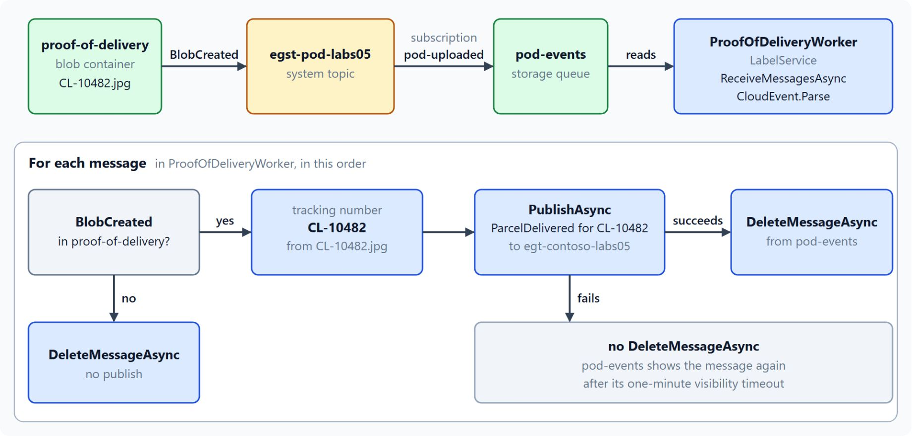
Blob Storage system topic for proof of delivery
A finished photo upload becomes ParcelDelivered
Blob Storage raises Microsoft.Storage.BlobCreated once a block blob is fully committed
A system topic turns those storage events into Event Grid events
subjectBeginsWith limits the subscription to the proof-of-delivery container
The worker reads the tracking number from the blob name and publishes ParcelDelivered
Create the account as general purpose v2, because v1 can't publish to Event Grid
Notes:
A delivery app uploads each proof-of-delivery photo to Blob Storage, and that upload is the moment the parcel counts as delivered. This slide follows one photo until a partner receives `ParcelDelivered`.
BlobCreated: the storage account publishes `Microsoft.Storage.BlobCreated` when a block blob is completely committed, which means the upload has finished.
System topic: it represents the blob events of one storage account and turns them into Event Grid events that subscriptions can route. Event Grid recommends creating the system topic first, so it stays in place after its last subscription is deleted.
Subject filter: the event carries the blob path in its subject, and `subjectBeginsWith` on the proof-of-delivery path keeps other blobs away from the handler.
The worker: it reads each event from the `pod-events` storage queue, takes the tracking number from the file name without downloading the photo, and publishes `ParcelDelivered` to the custom topic. In the lab it deletes the queue message only after the publish succeeds, so a failed publish shows the message again after one minute.
General purpose v2: a general purpose v1 account can't publish to Event Grid, so create the storage account as v2.

Slide 10
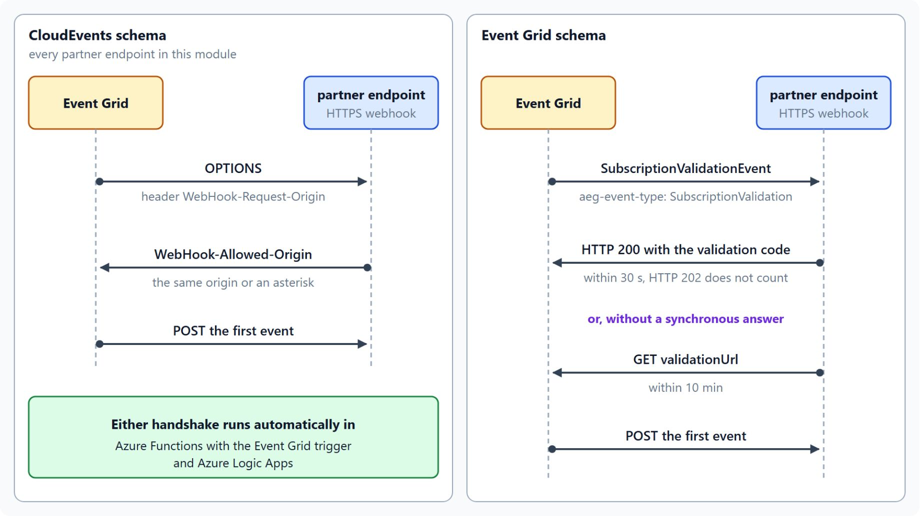
Endpoint validation
Event Grid proves you own the endpoint before the first event
CloudEvents schema: OPTIONS with WebHook-Request-Origin, answered by WebHook-Allowed-Origin
Event Grid schema: a SubscriptionValidationEvent, answered with HTTP 200 and the code within 30 seconds
Without a synchronous answer, open the validationUrl with a GET within 10 minutes
Azure Functions with the Event Grid trigger and Logic Apps answer automatically
HTTP 202 doesn't count, and self-signed certificates aren't supported
Notes:
Before Event Grid sends the first event to a webhook, it checks that you own the endpoint, which stops a third party from flooding it. The handshake depends on the schema of the subscription.
CloudEvents schema: Event Grid sends an HTTP OPTIONS request with a `WebHook-Request-Origin` header, and the endpoint agrees by returning `WebHook-Allowed-Origin` with the same origin or an asterisk. The label-service publishes CloudEvents, so every partner endpoint in this module must answer OPTIONS.
Event Grid schema: Event Grid sends a `SubscriptionValidationEvent` with the `aeg-event-type` header set to `SubscriptionValidation`. The endpoint returns HTTP 200 with the validation code in the body within 30 seconds.
The asynchronous path: if the endpoint can't answer synchronously, the event data carries a `validationUrl` that you open with a GET request within 10 minutes.
Automatic handshakes: Azure Functions with the Event Grid trigger and Azure Logic Apps run the handshake for you, which is one reason internal consumers usually use the trigger.
Common failures: HTTP 202 doesn't count as a valid answer, and self-signed certificates aren't supported for validation.

Slide 11
02
Event Grid: Filters, Retries, Dead-Letter
Retry schedule, dead-letter storage, errors without retry
Event-Driven Distributed Apps on Azure: Aspire, Dapr & Durable Execution

Slide 12
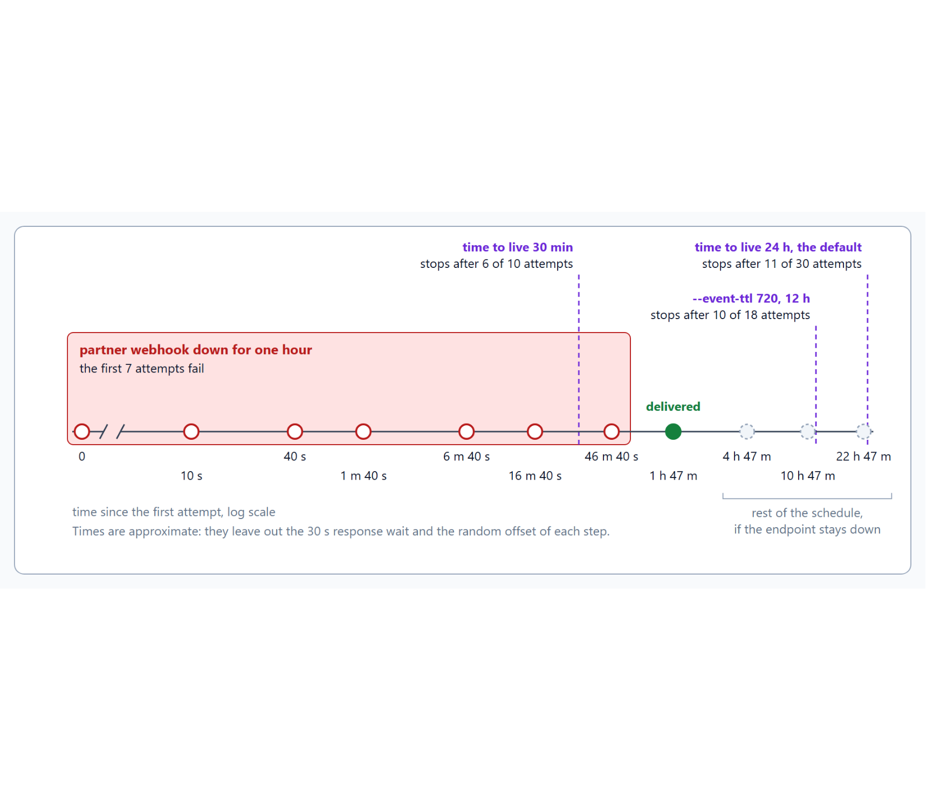
Filters and the retry schedule
Which events reach a subscription, and how long Event Grid keeps trying
Filter on event type, the start or end of the subject, and fields under data
The retry policy allows 1 to 30 attempts and a time to live of 1 to 1440 minutes
Event Grid stops at whichever limit it reaches first
Waits grow from 10 seconds to every 12 hours, plus a small random offset
Order isn't guaranteed and a retry can duplicate, so handlers accept both
Notes:
A partner's webhook goes down for an hour on the busiest day of the year, and `ParcelDelivered` must not disappear without a trace. The timeline shows the attempts during that outage and where each time to live cuts them off.
Filters: they run before delivery, so a subscription receives only the events it asks for. Advanced filters compare a field such as `data.region` with values, ignore case, and can't look inside an array of objects.
Retry policy: maximum attempts default to 30 and the event time to live to 1440 minutes, which is 24 hours. Set both on the subscription with the Azure CLI or on the Additional features tab of the portal.
First limit wins: the time to live is checked only at the next scheduled attempt, so with 30 minutes only six attempts fit and a maximum of 10 attempts has no effect.
The schedule: Event Grid waits 30 seconds for a response, then retries after 10 seconds, 30 seconds, 1 minute and onward up to every 12 hours. It can skip retries for an endpoint that stays unhealthy, so the schedule is best effort.
Order and duplicates: Event Grid doesn't guarantee order, and a retry can produce a duplicate, so every partner handler must tolerate out-of-order events and repeats.

Slide 13
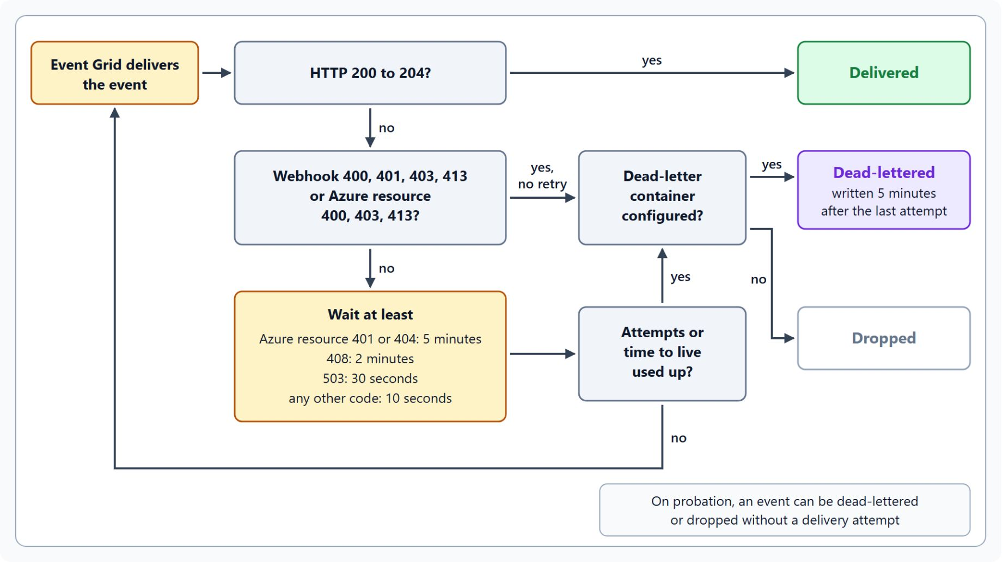
Dead-lettering and errors without retries
Where an event ends up when delivery fails
Dead-lettering is off by default: give the subscription a blob container
Webhook 400, 401, 403 and 413 and Azure resource 400, 403 and 413 are never retried
The dead-letter write comes five minutes after the last attempt
Each event in the blob carries deadLetterReason, deliveryAttempts and lastDeliveryOutcome
On probation, an event can be dead-lettered without a delivery attempt
Notes:
Retries end somewhere, and this slide shows where an event lands: delivered, dead-lettered or dropped. The flow follows one event from the delivery attempt to its outcome.
A container to switch it on: dead-lettering is off by default, so create a blob container and give the subscription its full resource path. With a managed identity, grant that identity a write role on the storage account.
Errors without retry: Event Grid treats only HTTP 200 to 204 as success, and these status codes mean that delivery will never succeed. Event Grid dead-letters such an event at once, or drops it when no dead-letter location exists.
Timing: the write comes five minutes after the last attempt, and the event is dropped if the container stays unavailable for four hours. Other codes retry after their own minimum waits, such as two minutes for 408 and 30 seconds for 503.
What the blob holds: an array of events, each with `deadLetterReason`, usually `MaxDeliveryAttemptsExceeded`, plus `deliveryAttempts` and `lastDeliveryOutcome`. Blob names contain the subscription name in upper case.
Probation: when deliveries keep failing, Event Grid puts the subscription on probation, and events can be dead-lettered or dropped without an attempt. Check the dead-letter container first when a partner reports missing events.

Slide 14
03
Event Grid Namespaces: Pull Delivery
Partners receive, acknowledge and release at their pace
Event-Driven Distributed Apps on Azure: Aspire, Dapr & Durable Execution

Slide 15
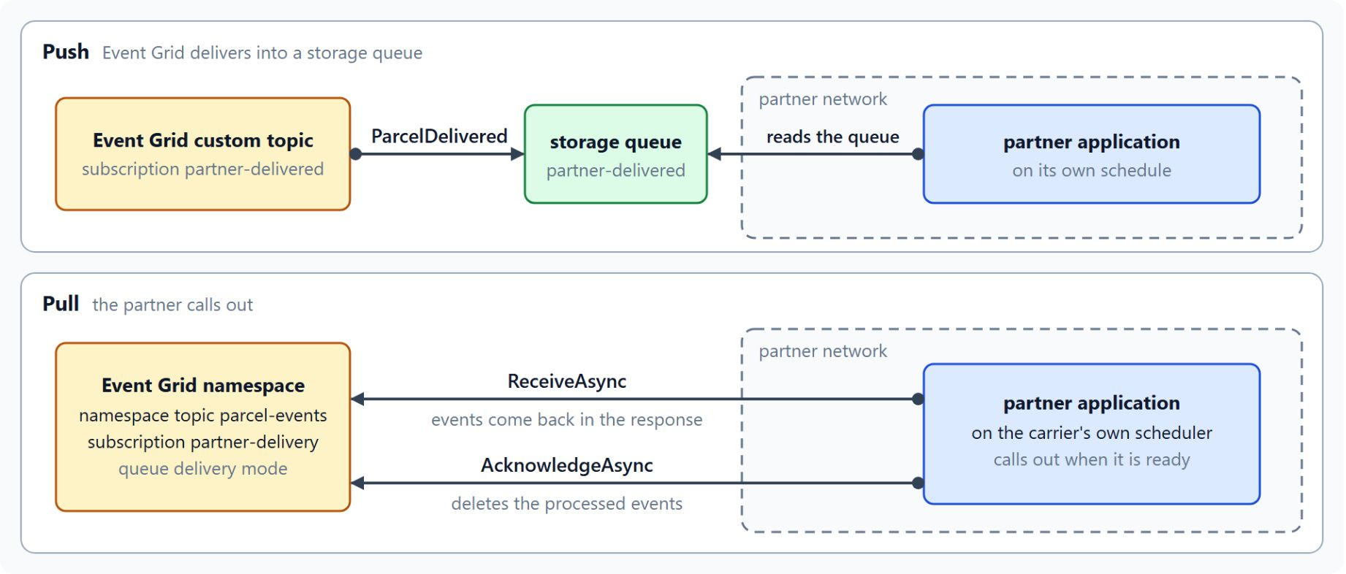
Pull delivery with Event Grid namespaces
Partners without an inbound port call out when they are ready
A namespace topic receives CloudEvents 1.0; each subscription picks queue or push
With pull, the partner calls out, so its network needs no inbound port
Each partner gets its own subscription and its own state for every event
Limits: 7 days retention, 500 subscriptions per topic, 1 MB per event
Push mode delivers to Event Hubs, the only destination supported today
Notes:
Not every partner can open an inbound HTTPS port: a regional carrier might run its own scheduler, or its security team might refuse webhooks. The diagram puts push into a storage queue next to pull from a namespace.
Namespaces: a namespace is a container for topics, clients, client groups, topic spaces and permission bindings, and a namespace topic receives CloudEvents 1.0 events. Each event subscription selects `queue` for pull or `push` for delivery to a destination.
Pull: the consumer controls the rate and timing, and calls `ReceiveAsync` and then `AcknowledgeAsync` from its own network. The `Azure.Messaging.EventGrid.Namespaces` package holds `EventGridSenderClient` for publishing and `EventGridReceiverClient` for pulling.
One subscription per partner: the label-service publishes once, every partner pulls at its own pace, and a slow partner delays only its own subscription. Entra ID roles give each partner an identity that you can revoke on its own.
Limits: a namespace topic keeps events for at most 7 days, accepts up to 500 subscriptions and takes events of up to 1 MB. Ingress and egress limits are set per TU, so measure the expected throughput before you size the partner traffic.
Push to Event Hubs: use it when the analytics team needs the same `ParcelDelivered` stream in an event hub, for example to archive it with Capture. The namespace also includes an MQTT broker, which this module only points to for later work.

Slide 16
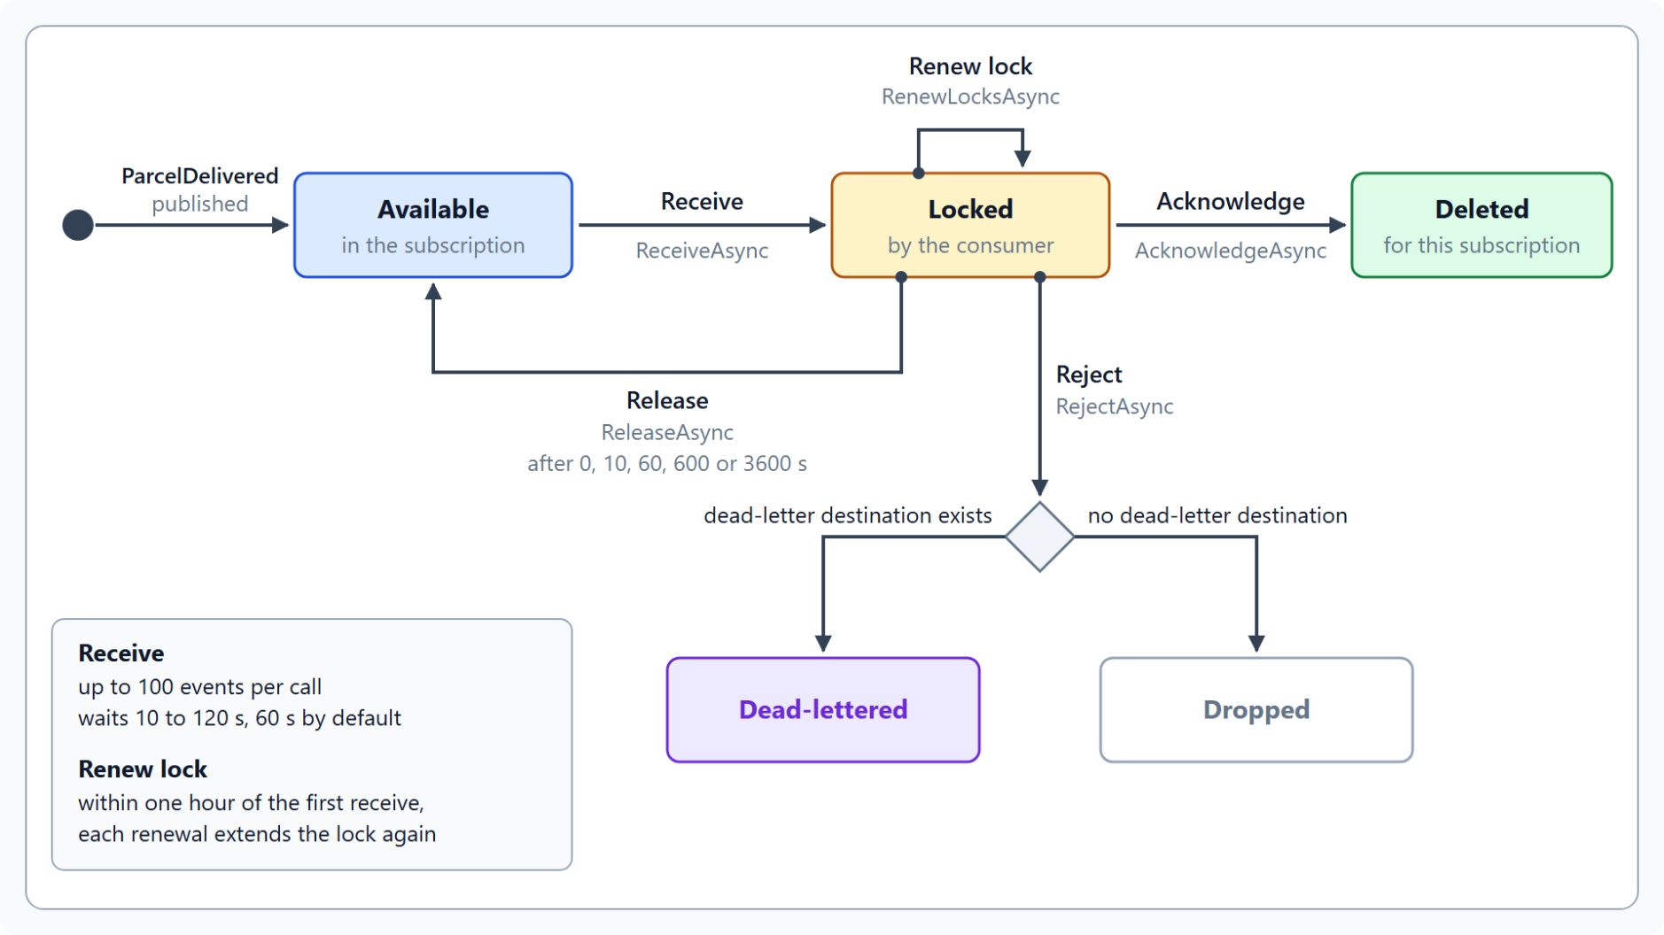
Lock tokens in pull delivery
Every received event stays locked until the consumer settles it
ReceiveAsync reads up to 100 events and locks them for the consumer
AcknowledgeAsync deletes the event for this subscription only
ReleaseAsync makes it available again after 0, 10, 60, 600 or 3600 seconds
RejectAsync dead-letters it, or drops it when no destination exists
RenewLocksAsync extends the lock while the consumer still works on it
Notes:
Each received event carries a lock token, which identifies the event and controls its state. The five operations of pull delivery all work on those tokens.
Receive: one call reads up to 100 events and waits 60 seconds by default, within a range of 10 to 120 seconds. Each `ReceiveDetails` item holds the CloudEvent in `Event` and the lock token in `BrokerProperties`.
Acknowledge: it deletes the event from the subscription, so no consumer receives it again. Acknowledgment applies only to the subscription that received the event, and other subscriptions keep their own copy.
Release: the sample releases events it can't process yet with `ReleaseDelay.OneMinute`. A release delay must be 0, 10, 60, 600 or 3600 seconds.
Reject: the sample rejects events without a parcel ID, which dead-letters them when a dead-letter destination exists and drops them otherwise.
Renew lock: a lock can be renewed within one hour of the first receive, and each renewal can extend it again. The partner's receive loop stops only after it has acknowledged, released or rejected every lock token it holds.

Slide 17
04
Event Hubs: Partitions & Checkpoints
Keys, consumer groups, checkpoints and ownership
Event-Driven Distributed Apps on Azure: Aspire, Dapr & Durable Execution

Slide 18
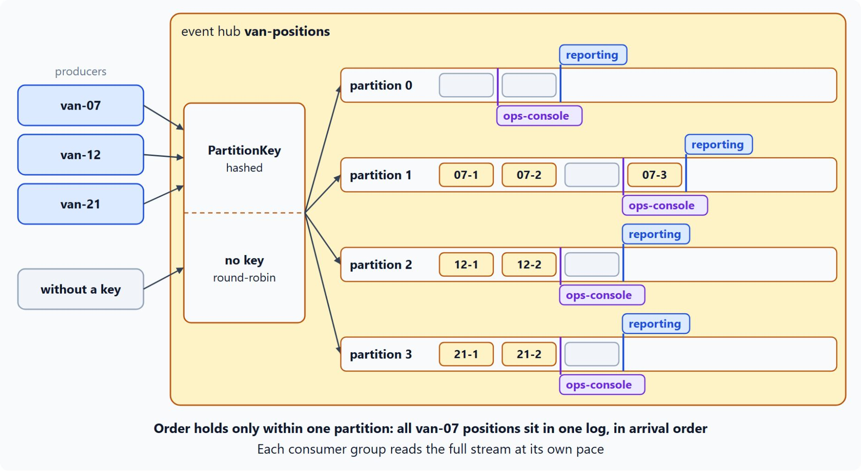
Partitions and consumer groups
Order holds within one partition, each group reads the whole stream
Each partition is an ordered log, and order holds only inside one
The van ID as partition key keeps one van's positions together, in order
Events without a key go round-robin; a fixed partition ID lowers availability
A consumer group reads the full stream at its own pace
One active reader per partition and group, one checkpoint container per group
Notes:
A further consumer such as a reporting job could need every position of one van in order, while the ops console needs the latest position of every van. The keys that producers set and the consumer groups that read decide whether both stay correct.
Ordered logs: an event hub splits its stream into partitions, and Event Hubs guarantees order only within one partition. The design question is which events must stay in order together.
Partition key: the producer sets the key and Event Hubs hashes it to choose the partition, and `CreateBatchOptions` carries one key for a whole batch. With the van ID as key, every position of `van-07` lands in one partition in arrival order.
Without a key: events without a key go to partitions in round-robin order. Sending to a partition ID ties the producer to that partition and lowers availability, so most designs use keys.
Consumer groups: each group is a separate view of the whole event hub, so `ops-console` and an example `reporting` group both read every position. Each group keeps its own cursor in every partition.
One reader each: Event Hubs allows up to five concurrent readers per partition in a group, but two active readers in one group process the same events twice. Give each consuming service its own consumer group and its own checkpoint container.

Slide 19
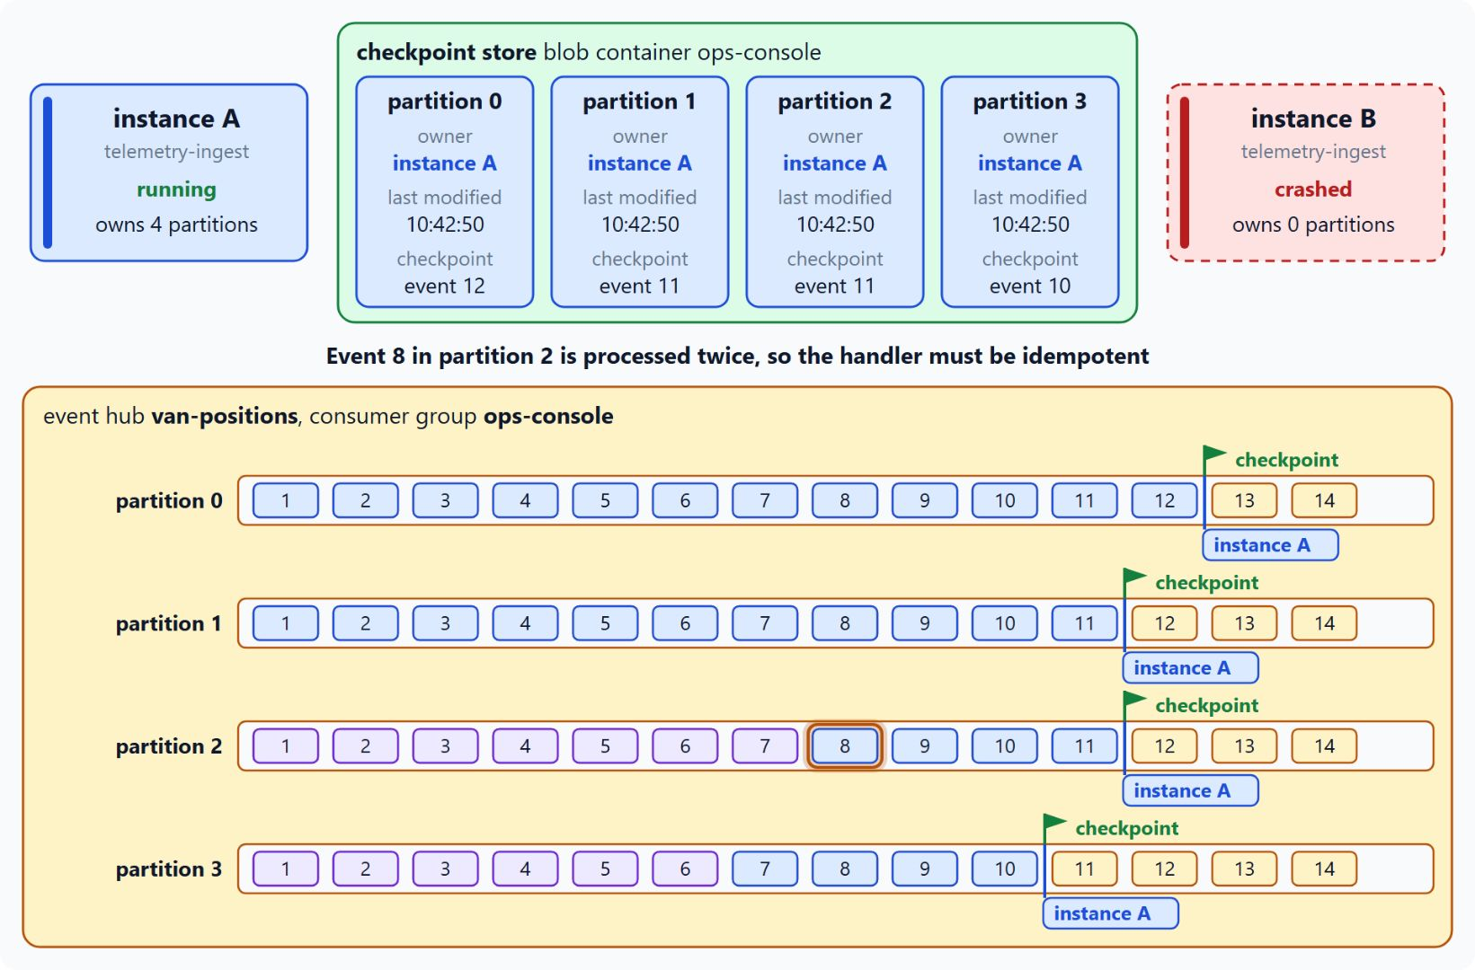
Checkpoints and partition ownership
A crashed instance's partitions resume from the last checkpoint
EventProcessorClient stores ownership and checkpoints in a BlobContainerClient
Instances claim partitions until the load is balanced
After a crash, another instance takes over from the last checkpoint
Delivery is at least once, so the handler must be idempotent
Capture archives the stream to storage in Avro format
Notes:
The ops console reads van positions with the `EventProcessorClient`, and its checkpoint store decides where reading resumes. The diagram shows instance B crashing and instance A taking over its partitions.
Processor and checkpoint store: the processor writes ownership and checkpoint records to a blob container that must exist before it starts, so the lab calls `CreateIfNotExistsAsync` first. Register the error handler, and call `StopProcessingAsync` before the process exits so other instances can take the partitions over promptly.
Load balancing: each instance writes an ownership record and claims partitions until the load is balanced, and at most one processor reads a partition at any moment. The partition count caps the parallel readers in a group, so an instance beyond it stays idle.
Takeover: a crashed instance's records stop changing, and the others see the old last-modified time and take over from the last checkpoint. In the diagram, event 8 of partition 2 is processed a second time.
At least once: make the handler idempotent, for example by storing each event ID and skipping IDs it has already processed. A checkpoint after every event costs a blob write per event, while fewer checkpoints cost less and replay a few more events after a crash.
Capture and retention: Capture writes the stream to Blob Storage or Data Lake Storage in Avro format, and only for events that arrive after you enable it. Standard keeps events for up to 7 days, Premium and Dedicated for up to 90 days.

Slide 20
05
Event Hubs: Kafka-Compatible Streaming
Kafka clients on port 9093 with PLAIN or OAUTHBEARER
Event-Driven Distributed Apps on Azure: Aspire, Dapr & Durable Execution

Slide 21
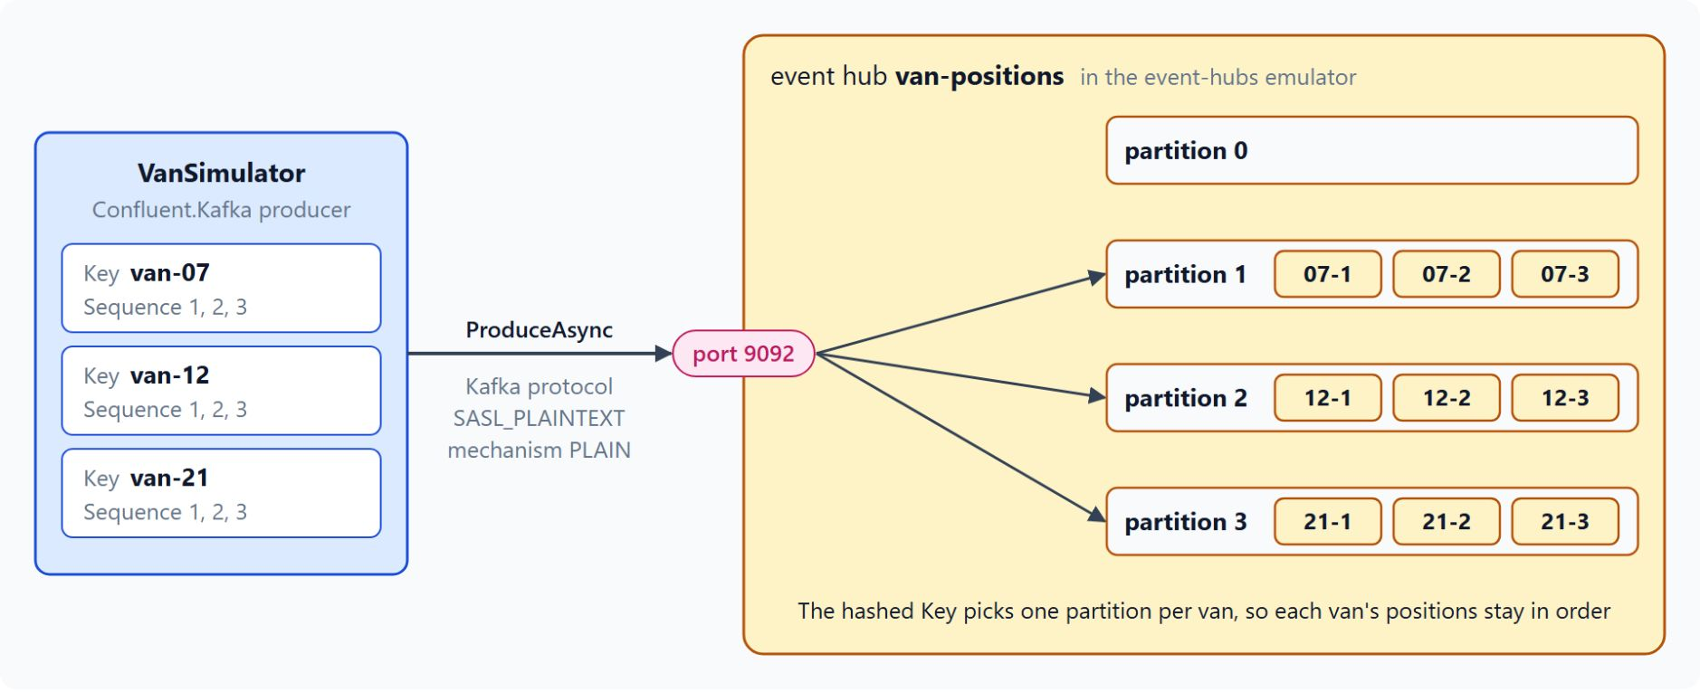
The Kafka endpoint of Event Hubs
Kafka clients keep their code and change their connection settings
Port 9093 on the namespace (9092 in the emulator); a Kafka topic is an event hub
Standard, Premium and Dedicated tiers; Basic has no Kafka endpoint
SASL_SSL with PLAIN and a connection string, or OAUTHBEARER and an Entra ID token
The message key picks the partition, so each van's positions stay in order
Only gzip compression; treat Kafka Streams and transactions as preview
Notes:
Several Contoso Logistics telematics vendors already publish to Kafka, and telemetry-ingest has to accept those streams without a rewrite. The diagram shows the lab's van simulator producing keyed positions into the four partitions of `van-positions`.
Endpoint and mapping: the namespace takes the place of the cluster, a Kafka topic maps to an event hub, and partitions and consumer groups keep their Kafka meaning. Event Hubs serves Kafka next to AMQP and HTTPS, so a Kafka producer and an AMQP consumer can share one event hub.
Tiers: Basic doesn't support Kafka, and a TopicAuthorizationException on a Basic namespace is one of the first things to check. Learn recommends Premium or Dedicated for full Kafka protocol compatibility.
Authentication: PLAIN sends `$ConnectionString` as the user name and the connection string as the password, OAUTHBEARER sends an Entra ID token, and both use `SASL_SSL`. Prefer OAUTHBEARER in production; the lab's emulator listens on port 9092 with `SASL_PLAINTEXT` and no TLS.
Keyed producer: Confluent.Kafka takes the librdkafka keys as a dictionary, and the message key `VanId` decides the partition. The Kafka topic name in `ProduceAsync` is the event hub name.
Compression and preview: Event Hubs accepts only gzip on Kafka producers, so avoid snappy, lz4 and zstd. Learn pages disagree on the status of Kafka Streams and transactions, so treat both as preview until the documentation agrees.

Slide 22
06
SignalR Service: Push to Browsers
Default and Serverless modes, the ops console client
Event-Driven Distributed Apps on Azure: Aspire, Dapr & Durable Execution

Slide 23
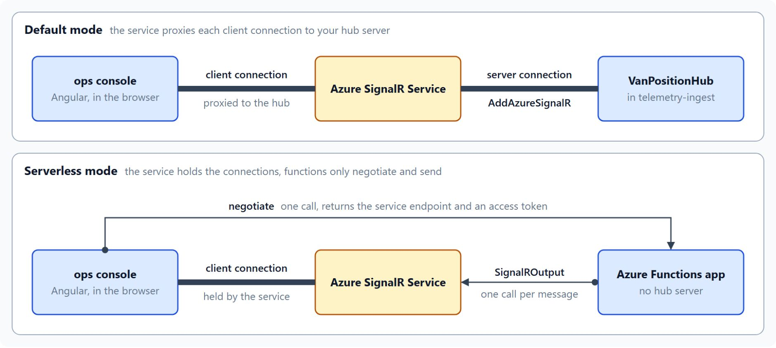
SignalR Service modes
Who holds the browser connections
Default: your server hosts the hub, and the service proxies each client to it
AddAzureSignalR on the AddSignalR registration, only when the connection string is set
Serverless: a negotiate function and SignalROutput, with no hub server
withAutomaticReconnect retries after 0, 2, 10 and 30 seconds
Web PubSub fits when you need a WebSocket protocol of your own
Notes:
The browser can't hold a stable connection to every backend service, so van positions pass through a managed push service on their way to the map. The service mode decides who owns the client connections, and Learn advises against Classic mode except as a last resort.
Default mode: the telemetry-ingest ASP.NET Core service hosts `VanPositionHub`, and the service proxies the clients to it. `VanPositionProcessor` sends each position with `Clients.All` through `IHubContext<VanPositionHub>`.
AddAzureSignalR: add the `Microsoft.Azure.SignalR` package and call it after `AddSignalR`, with the connection string in configuration rather than source code. Learn recommends Azure Key Vault with Entra ID authorization for production.
Serverless mode: no hub server exists, a `negotiate` function returns the endpoint and an access token, and `SignalROutput` sends messages from other functions. Enable CORS when the ops console calls the function app from a browser, and protect the negotiate endpoint in production.
The client: the ops console uses `@microsoft/signalr` and registers its handlers before it starts the connection. `withAutomaticReconnect` stops after four failed attempts, and the reconnecting state can show a banner that the map may be stale.
Web PubSub: choose it for your own WebSocket protocol, publish and subscribe over WebSockets, or a lightweight server that sends without a backend. It doesn't replace SignalR, so the ops console keeps SignalR for the browser.

Slide 24
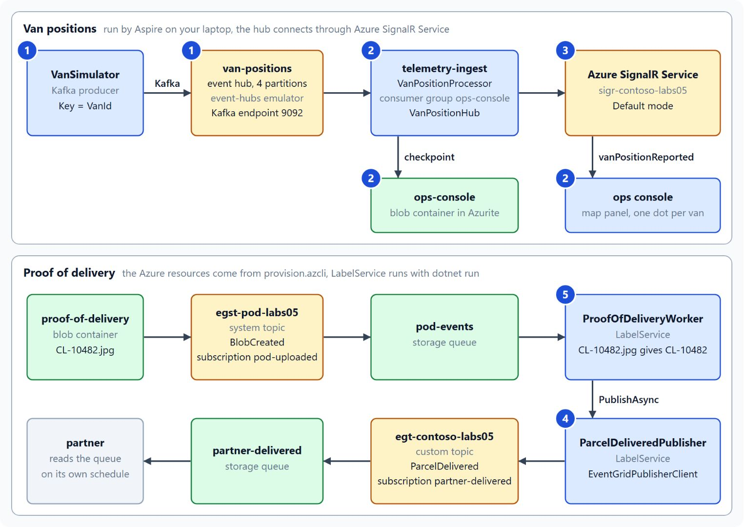
Streaming van positions to a live map
The lab in five steps, from the van simulator to the partner queue
The lab starts from the lab 4 solution, with an empty map and no partner events
Step 1: a van simulator sends keyed positions over Kafka
Steps 2 and 3: a checkpointed processor pushes them through Azure SignalR Service
Steps 4 and 5: a proof-of-delivery photo publishes ParcelDelivered to the partner queue
About 45 minutes, with Docker Desktop and provision.azcli
Notes:
The lab ties the module together: at the start the ops console shows no vans, and no partner learns when a parcel is delivered. The diagram marks each piece with the step that adds it.
Starting point: the lab begins from the lab 4 solution in `labs/05-event-grid-hubs/contoso-logistics/`, worked with an AI coding agent that reads `AGENTS.md` for the class stack.
Step 1: `VanSimulator` sends one `VanPositionReported` per van every second to `van-positions`, over the Kafka endpoint of the Event Hubs emulator and keyed by `VanId`.
Steps 2 and 3: `telemetry-ingest` reads through the `ops-console` consumer group, checkpoints to Azurite and pushes to a map panel that draws one dot per van. A configuration value then switches the hub to Azure SignalR Service in Default mode, and the hub route stays the same.
Steps 4 and 5: `ParcelDeliveredPublisher` sends `ParcelDelivered` as a CloudEvent to the custom topic, and the `partner-delivered` subscription puts it in the partner's queue. A background worker then turns a photo in `proof-of-delivery` into that event without a manual publish.
Setup: Docker Desktop must run for steps 1 and 2, and `provision.azcli` creates every Azure resource for steps 3 to 5 in `rg-azn-labs`. Keep that resource group afterwards, because the next lab deploys into it.

Slide 25
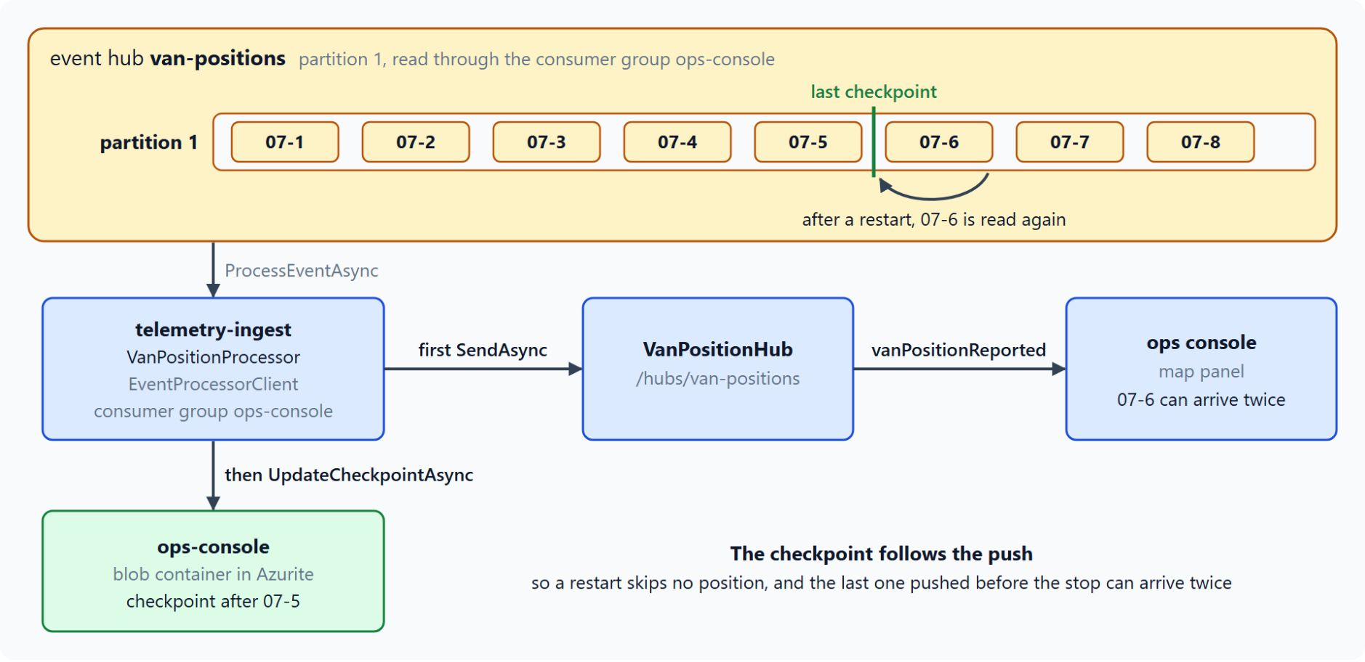
Checkpointing the van position processor
A restart replays from the last checkpoint and skips no position
VanPositionProcessor reads van-positions through the ops-console consumer group
Each position goes out with SendAsync before UpdateCheckpointAsync stores the checkpoint
Checkpoints live in the ops-console blob container in Azurite
After a restart, the last pushed position can reach the map twice
Test it: stop and start telemetry-ingest, and every van's sequence continues without a gap
Notes:
Step 2 of the lab puts the checkpoint trade-off from the partitions topic into code. The processor must resume where it stopped, and the map must show each position as it arrives.
The processor: an `EventProcessorClient` on the `ops-console` consumer group of `van-positions`, with a `BlobContainerClient` for the `ops-console` container as its checkpoint store.
Push, then checkpoint: each `VanPositionReported` goes to `VanPositionHub` at `/hubs/van-positions` with `SendAsync("vanPositionReported", ...)`, and only then does the processor call `UpdateCheckpointAsync`. The map in `van-map.ts` listens for `vanPositionReported` through a `HubConnectionBuilder`.
Azurite: the lab runs the storage account as the Azurite emulator, and the processor uses the connection strings that Aspire injects.
Replays: a restart reads from the last stored checkpoint, so a position pushed just before the stop can arrive twice, and none is skipped. The research prompt asks the agent to weigh one blob write per position against those replays, and to push back on any claim of exactly-once delivery.
Expected outcome: stop `telemetry-ingest` in the Aspire dashboard and start it again, and the dots keep moving with no gap in any van's sequence numbers.

Slide 26

Takeaways
What to carry into event sourcing and CQRS
Publish ParcelDelivered once and keep its event type stable
Give every subscription filters, a retry policy and a dead-letter container
Offer pull delivery to partners that can't open an inbound port
Key by van ID, read with one consumer group per service, keep handlers idempotent
Push to browsers through SignalR Service in Default mode
Notes:
Close with the decisions this module made for Contoso Logistics. Each one is a setting or a line of code you can point to in the lab.
One stable event: the label-service publishes `ParcelDelivered` once as a CloudEvent, and its event type is the contract every subscriber relies on.
Delivery that keeps its failures: filters, maximum attempts and time to live are set per subscription, and a dead-letter container keeps the events Event Grid gives up on.
Pull for partners: a namespace topic lets each partner receive, acknowledge and release at its own pace, without opening an inbound port.
Correct streams: the van ID key keeps each van's positions in order, each service reads through its own consumer group, and idempotent handlers absorb the replays of at-least-once delivery.
Push to the browser: telemetry-ingest hosts `VanPositionHub`, `AddAzureSignalR` routes it through Azure SignalR Service in Default mode, and the ops console map shows each position as it arrives.

