Slide 1



Fast Lane Group
Worldwide Education &
Professional Services
www.flane.de | © 2026 Fast Lane Institute for Knowledge Transfer GmbH
Notes:
Die Fast Lane Gruppe.
Fast Lane … Dienstleister u. Spezialist für High-End Technologie und Business Trainings
IT Trainings zu den unterschiedlichsten Herstellern wie Microsoft, Google, Cisco oder AWS. Und vielen weiteren wichtigen IT Herstellern.
Sei es Cloud, Security, Netzwerk oder allgemein digitale Transformationsprojekte
Und das seit 2003.
Das spannende ist, dass die Fast Lane Gruppe bereits seit 2009 durchgängig zu den Top 20 Unternehmen in der IT Trainingsbranche weltweit zählt.
Aber auch Footprint ebenso im klassischen Professional Services Bereich für unsere wichtigsten Hersteller
PreSales Support, Deployment Services und Adoption Trainings
Additional Information:
Im Jahr 2021 sind wir zur „most strategic IT Education company worldwide“ von der IDC im „magic quadrant“ aufgeführt worden !
1 mio Teilnehmer insgesamt seit bestehen, 50.000+ Students ww p.A, 20.000 in DE pro Jahr

Slide 2






AGENTIC AI: FROM STRATEGY TO PRODUCTION.
Alexander
Kastil
AGENTIC AI CONSULTING · VIENNA
Full stack, from enterprise software to agentic AI. Since 1996
AI at Work
Enterprise AI
Value discovery, KPI mapping and roadmap
Governed multi-agent systems on Microsoft Copilot and Foundry
Agentic Software Engineering
Team Enablement
Harness architecture for Claude Code and GitHub Copilot
AI driven content production and delivery
integrations.at
github.com/alexander-kastil
SCAN TO CONNECT
alexander.kastil@integrations.at
linkedin.com/in/alexander-kastil
integrations.at
Notes:
Intro: Alexander Kastil, integrations.at. Four practice areas from AI at Work to team enablement. Certifications: Agentic AI Business Solutions Architect, Azure AI App and Agent Developer Associate, DevOps Engineer Expert.

Slide 3

MODULE 6
Event Sourcing & CQRS with Cosmos DB
Contoso Logistics keeps every shipment change as an event
Event-Driven Distributed Apps on Azure: Aspire, Dapr & Durable Execution

Slide 4
01
02
03
04
Transactional Outbox: Atomic Publishing
One batch for the event and its outbox, relayed to Service Bus
Change Feed Processor: Projections
Builder, leases, lag and change feed modes
CQRS: Separate Writes from Reads
Command and query handlers over separate containers
Read Models: Indexing, RUs, Consistency
Indexing policy, request charge and session tokens
05
06
07
Managed Redis: Change-Feed Cache Invalidation
Cache-aside, cleared by the projection after each scan
Event Store: Aggregates & Snapshots
Version-checked appends, replay and snapshots
Event Versioning: Evolve Schemas Safely
Additive changes, upcasting and CloudEvents
Event-Driven Distributed Apps on Azure: Aspire, Dapr & Durable Execution

Slide 5

Event sourcing and CQRS with Cosmos DB
Contoso Logistics keeps every shipment change as an event
Atomic publishing: the booking and its outbox event in one batch, relayed to Service Bus
Read models: change feed projections, tuned queries and a Redis cache
Event store: version-checked appends, replay, snapshots and safe schema changes
Notes:
This module is where Contoso Logistics keeps its history: shipping-api stores every shipment change as an immutable event in Cosmos DB, and the tracking page reads from a separate model built from those events. It follows the event streams of Module 5 and comes before the Dapr portability work of Module 7.
Atomic publishing: a booking and its events are saved in one atomic batch, and a change feed relays the events to Service Bus without losses. The later topics reuse this batch writer and its relay.
Read models: a change feed processor projects the events into a tracking read model, which you tune for indexing, request units and consistency. Azure Managed Redis serves the tracking queries, and the change feed invalidates the cached page.
Event store: the Shipment aggregate is rebuilt by replaying its events, with snapshots for long streams. Event schemas evolve without breaking the consumers that already run.

Slide 6
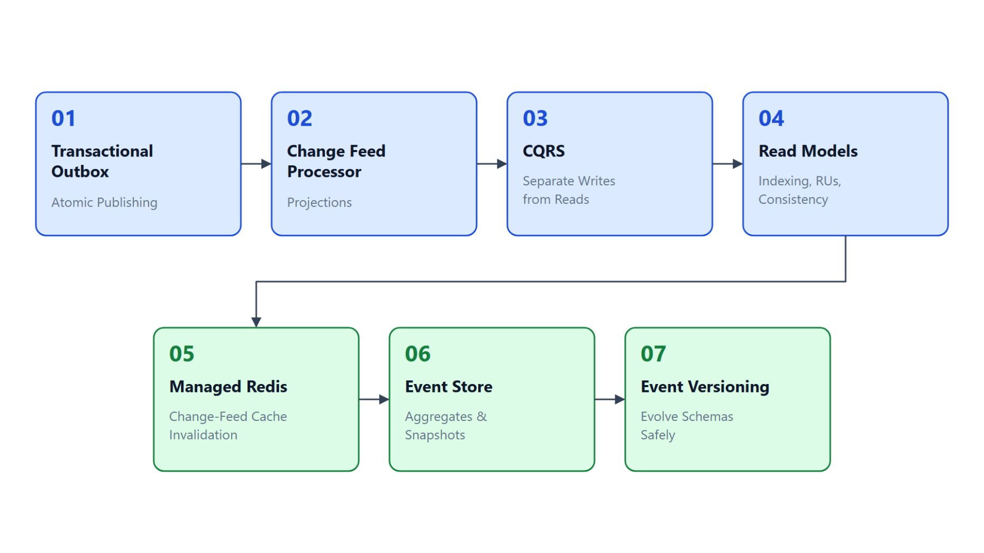
Overview
The path through event sourcing and CQRS
Save the booking and its outbox event in one batch, relay it with the change feed
Project the events into the tracking read model with a change feed processor
Split commands from queries, then tune indexing, RUs and session tokens
Serve the tracking page from Azure Managed Redis, cleared after each scan
Store events per shipment, replay with snapshots and version the schemas
Notes:
This slide walks the seven topics once, in the order the module builds them. The outbox comes first because later topics reuse its batch writer and its relay.
Outbox: the ShipmentBooked event and its outbox event commit in one Cosmos DB transactional batch. A change feed processor relays the outbox event to the shipment-events topic with duplicate detection on.
Projections: a change feed processor turns ParcelScanned events into ScanRecord documents in the tracking read model. It survives restarts, shares work across instances and never skips a change.
CQRS and read models: shipping-api accepts commands and tracking-service answers queries from its own container. The read model is then tuned with an indexing policy, request charge measurements and session tokens.
Cache: Azure Managed Redis answers repeat reads of the tracking page with cache-aside, and the change feed projection deletes the cached page after each scan commits.
Event store and versioning: each change is an immutable event, a version in the ID guards appends, and snapshots keep replay short. Schemas evolve through additive changes, upcasting on read and the CloudEvents type and dataschema attributes.

Slide 7
01
Transactional Outbox: Atomic Publishing
One batch for the event and its outbox, relayed to Service Bus
Event-Driven Distributed Apps on Azure: Aspire, Dapr & Durable Execution

Slide 8
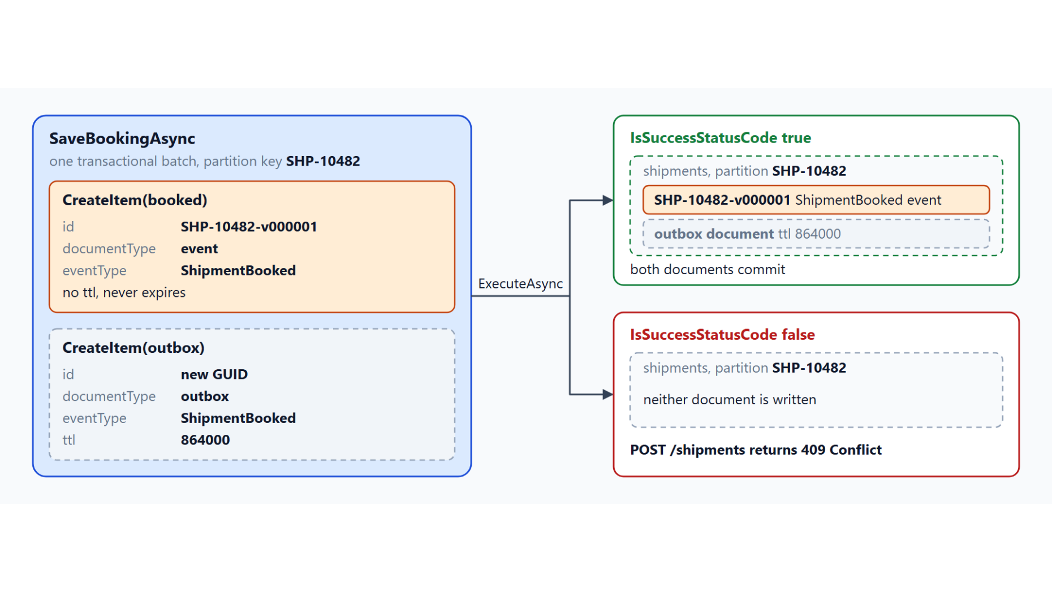
Transactional batch for the booking
The event and its outbox document commit together or not at all
A dual write to Cosmos DB and Service Bus can lose the event or announce a missing shipment
The ShipmentBooked event and its outbox event share the partition key /shipmentId
One transactional batch: one logical partition, up to 100 operations, at most 2 MB
Check IsSuccessStatusCode before the caller hears success
The outbox event carries ttl 864000 (ten days), the event document never expires
Notes:
Booking a shipment has to store the shipment and get ShipmentBooked to the subscribers of shipment-events. This slide shows how the outbox turns those two writes into one.
Dual write: the database and the message broker don't share a transaction, so one write can succeed while the other fails. Save then publish can lose the event, and publish then save announces a shipment that doesn't exist.
Shared partition: the shipments container uses /shipmentId as its partition key. The ShipmentBooked event document and its outbox event therefore sit in one logical partition and can commit together.
One batch: a Cosmos DB transaction is a transactional batch on one logical partition, with up to 100 operations and a request of at most 2 MB. SaveBookingAsync adds both documents with CreateItem and runs ExecuteAsync.
One status: the batch returns one status for the whole unit, and when one operation fails, for example with 409 Conflict, every other operation reports 424. In the lab, POST /shipments answers 409 Conflict when the batch fails.
TTL: the outbox event carries a ttl of 864000 seconds, ten days, so every consumer has time to recover from an outage first. Event documents leave out ttl, so the history never expires.

Slide 9
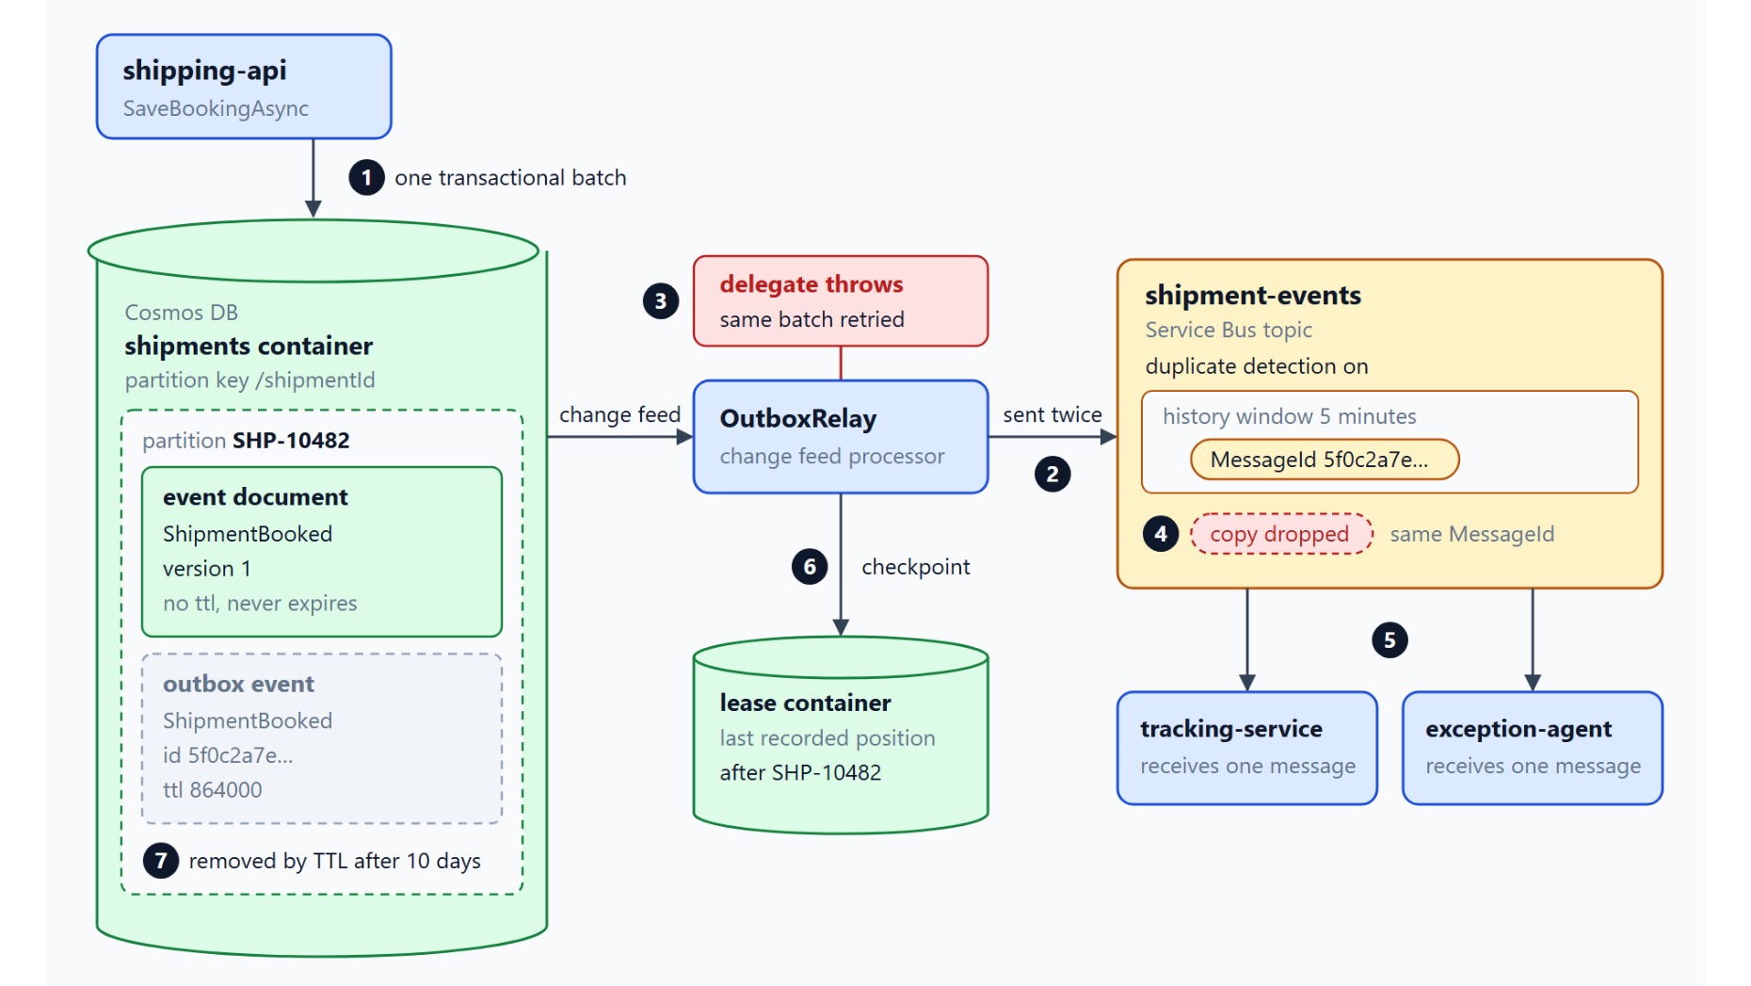
Relaying outbox events with the change feed
MessageId and duplicate detection drop the copies a retry sends
A change feed processor reads new outbox documents and checkpoints in a lease container
MessageId is the document id, SessionId is the shipment ID
Every send is awaited; a throw retries the same batch, so some events go out twice
Duplicate detection on shipment-events drops the copies (lab window: five minutes)
TTL removes the outbox event after ten days, the event document stays
Notes:
With both documents stored, the outbox event still has to reach Service Bus. The diagram follows one booking from the batch to tracking-service and exception-agent.
Change feed: the change feed is a persistent log of changes, ordered within one logical partition. The relay records its position in a lease container and resumes from there after a restart.
Message fields: the relay filters for outbox documents and sets MessageId to the document id and SessionId to the shipment ID. The session ID keeps each shipment in order.
Await and retry: the delegate awaits every send, because a processor can checkpoint before unawaited work finishes. If the delegate throws, the processor retries the same batch and sends some events twice.
Duplicate detection: the topic compares MessageId within a history window, 10 minutes by default and at most 7 days, on the Standard or Premium tier. The lab's AppHost sets five minutes, which the Service Bus emulator accepts.
TTL cleanup: Cosmos DB deletes the outbox event in the background on leftover request units once its ttl has passed. Item-level ttl needs DefaultTimeToLive on the container, and -1 turns TTL on without expiring other items.

Slide 10
02
Change Feed Processor: Projections
Builder, leases, lag and change feed modes
Event-Driven Distributed Apps on Azure: Aspire, Dapr & Durable Execution

Slide 11
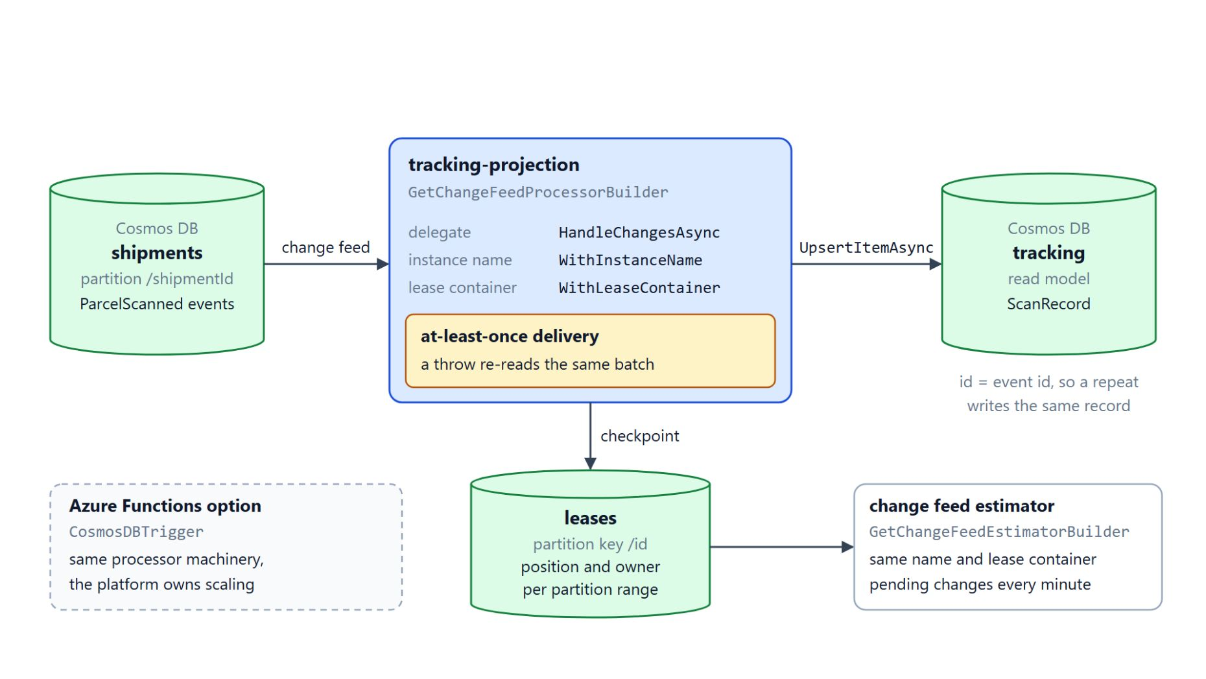
Building the tracking projection
Processor name, delegate, lease container and the estimator
GetChangeFeedProcessorBuilder takes a processor name and a delegate
The lease container (partition key /id) stores each range's position and owner
Delivery is at least once: a delegate that throws reads the same batch again
The event ID is the ScanRecord ID, so a repeated upsert writes the same record
The change feed estimator reports pending changes; CosmosDBTrigger is the Functions option
Notes:
The tracking page needs ScanRecord documents built from ParcelScanned events in the shipments container. The change feed processor is the .NET SDK component that does the reading, scaling and checkpointing for that projection.
Builder: you call GetChangeFeedProcessorBuilder on the monitored container with a processor name and a delegate, then Build and StartAsync. A first start reads only new changes, unless WithStartTime(DateTime.MinValue.ToUniversalTime()) asks for the beginning of the container.
Lease container: it stores the position of each partition range and the instance that owns it, and a partitioned lease container needs /id as its partition key. Create the CosmosClient with the global endpoint, because lease documents are scoped to the endpoint that created them.
At least once: when the delegate throws, the processor reads the same batch again from the last saved position. A batch that always throws blocks its partition range, so Learn suggests an errored-message store inside the handler.
Idempotent upsert: the tracking document ID is the event ID, so a second upsert of the same event overwrites the record with identical content. The delegate awaits each upsert.
Lag and the Functions option: the estimator uses the same processor name and lease container and reports the pending count, best run as its own deployment. The Azure Functions CosmosDBTrigger uses the same machinery and lets the platform handle scaling and checkpoints.

Slide 12
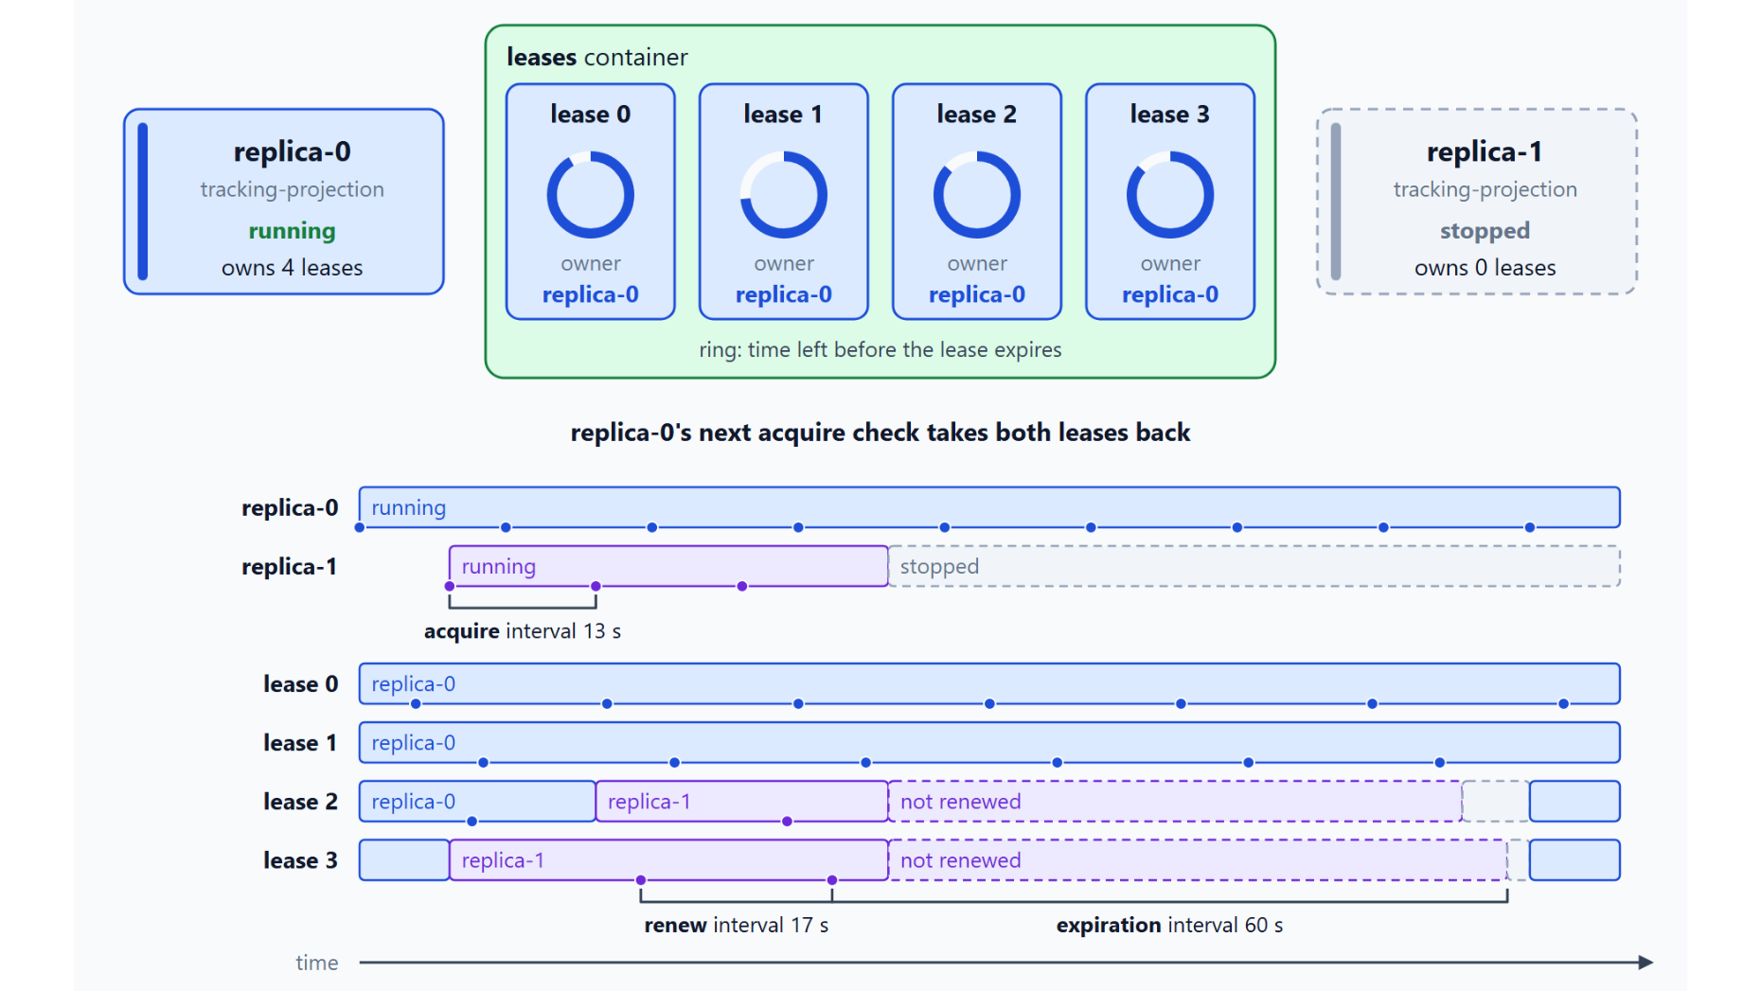
Leases and instances
Stable instance names and three intervals decide how work moves
Each running copy of the service is one instance of the processor
A lease belongs to one instance at a time, and leases rebalance as instances join or stop
Give every replica a stable WithInstanceName instead of a new GUID per start
Acquire 13 s, renew 17 s, expiration 60 s: the Azure Functions trigger defaults
Notes:
With the projection running, the next question is how it scales. The diagram follows the four leases of tracking-projection between replica-0 and replica-1.
Instances: instances share the lease container, and each lease belongs to one instance at a time. When you add an instance, the processor rebalances the leases across the group.
Instance names: every instance needs a unique name, set with WithInstanceName. A GUID meets that rule, but a restarted instance then gets a new name and leaves its old leases behind until they expire.
Three intervals: the acquire interval sets how often an instance checks that leases are spread evenly, and the renew interval how often a live instance renews its leases. The expiration interval sets how long a lease stays with an instance that stops renewing it.
In the diagram: each 13 s acquire check of replica-1 takes one lease, and after replica-1 stops, its two leases expire 60 s after their last renew and return to replica-0. These values match the Azure Functions trigger defaults.

Slide 13
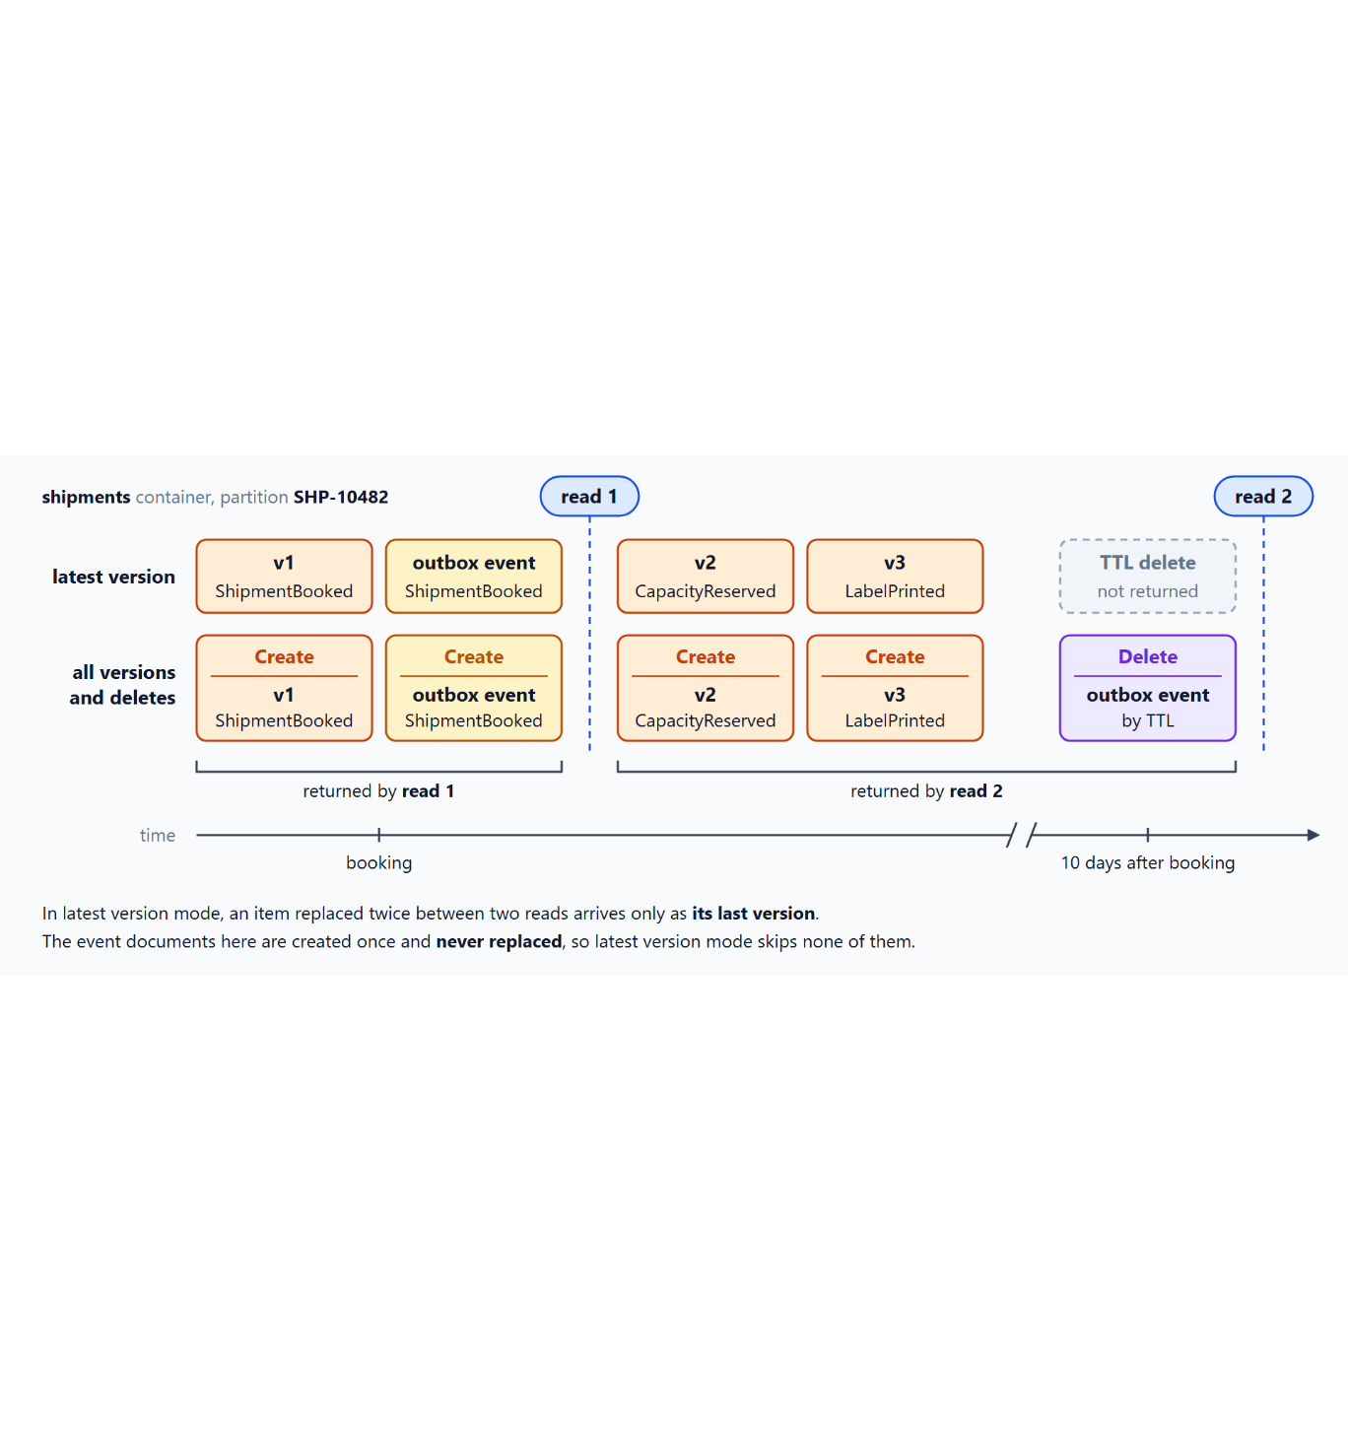
Latest version or all versions and deletes
What each change feed mode returns from the shipments container
Latest version is the default and returns the newest state of each changed item
It has no fixed retention and can start from the beginning, but it misses deletes
All versions and deletes records every create, replace and delete, TTL included
It needs continuous backup and starts only from now or a checkpoint
The shipment audit needs deletes, so it uses GetChangeFeedProcessorBuilderWithAllVersionsAndDeletes
Notes:
The processor reads the change feed in one of two modes, and the mode decides which changes it ever sees. The diagram shows two reads of partition SHP-10482, the second one ten days after the booking.
Latest version: the default mode returns the newest state of each changed item and can skip intermediate updates between two reads. The event documents are created once and never replaced, so this mode skips none of them.
Retention and start: latest version has no fixed retention and can start from the beginning, a point in time, now or a checkpoint. It doesn't capture deletes, so the TTL delete of the outbox event never comes back.
All versions and deletes: this mode records each create, replace and delete, including deletes caused by TTL. In the diagram, read 2 returns the delete of the outbox event by TTL.
Requirements: the mode needs continuous backup on the account and the all versions and deletes feature enabled, and its retention equals the continuous backup window. It starts only from now or a saved continuation token and needs .NET SDK 3.60.0 or later.
Shipment audit: the audit needs deletes, so it builds its processor with GetChangeFeedProcessorBuilderWithAllVersionsAndDeletes. Its handler reads change.Previous for a delete and change.Current for every other operation.

Slide 14
03
CQRS: Separate Writes from Reads
Command and query handlers over separate containers
Event-Driven Distributed Apps on Azure: Aspire, Dapr & Durable Execution

Slide 15
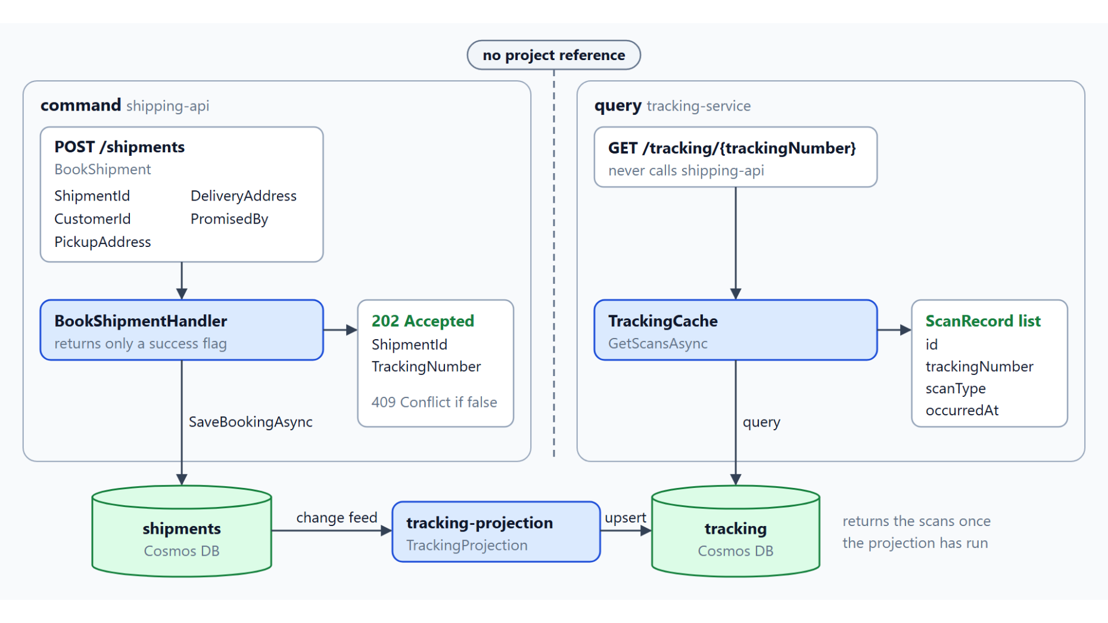
Command side and query side
shipping-api writes the aggregate, tracking-service reads its own model
A command names a business task such as BookShipment and returns only a success flag
A query never changes state and returns a view shaped for one screen
The event store partitions by /shipmentId, the read model by /trackingNumber
The read model can be rebuilt from the event store at any time
Plain handler classes registered in DI, no mediator library
Notes:
Shipments are written by customers and dispatchers and read by the tracking page, the ops console and notification emails. This topic separates the two sides so that each can change for its own reasons.
Command side: BookShipmentHandler builds the ShipmentBooked event document and its outbox document and saves both through the outbox writer from the first topic. It returns only a success flag, which POST /shipments turns into 202 Accepted.
Query side: TrackingQueryHandler reads only the tracking read model, with a query scoped to the tracking number. It knows nothing about the aggregate and never calls shipping-api.
Separate containers: each side picks its own partition key, because every write touches one shipment and every tracking page asks for one parcel. The two sides meet only through the change feed and tracking-projection, with no project reference between the services.
Rebuildable read model: the event store stays the source of truth, so the read model can be rebuilt at any time. A second read model, such as an ops search index, can subscribe to the same events without any change to the write side.
No mediator: the handlers are plain classes that the DI container registers, so a unit test can pass in a fake outbox writer or container. MediatR 13 and later is commercially licensed, so the module doesn't depend on it.

Slide 16
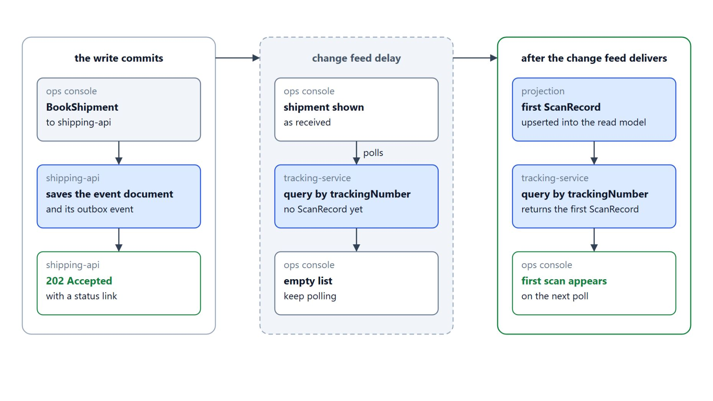
Eventual consistency in the ops console
202 Accepted first, the first scan once the projection has run
The projection runs after the write commits, so the read model can lag
The booking endpoint answers 202 Accepted with a status link
The console shows the shipment as received and polls the tracking query
An empty list means keep polling until the first scan appears
Session consistency can close the gap for the same user
Notes:
Splitting writes from reads has a cost: the tracking container can lag the event store by the change feed delay. The UI has to show that state instead of assuming the window is zero.
Lag: the projection runs after the write commits, so a customer who books and opens the tracking page at once might see nothing yet. The window is usually short, but the UI must not assume it is zero.
202 Accepted: the booking endpoint returns the accepted booking, usually with HTTP 202 and a status link. That response makes the in-between state explicit.
Received and polling: the console shows the shipment as received and polls the tracking query. While the change feed delay lasts, the query finds no ScanRecord and returns an empty list.
First scan: once the change feed delivers the event, the projection upserts the first ScanRecord and the next poll shows it. The Architecture Center describes the same trade-off and warns that a user can act on stale data.
Session consistency: for the same user, session consistency can close the gap. The next topic shows how to pass the session token between requests.

Slide 17
04
Read Models: Indexing, RUs, Consistency
Indexing policy, request charge and session tokens
Event-Driven Distributed Apps on Azure: Aspire, Dapr & Durable Execution

Slide 18
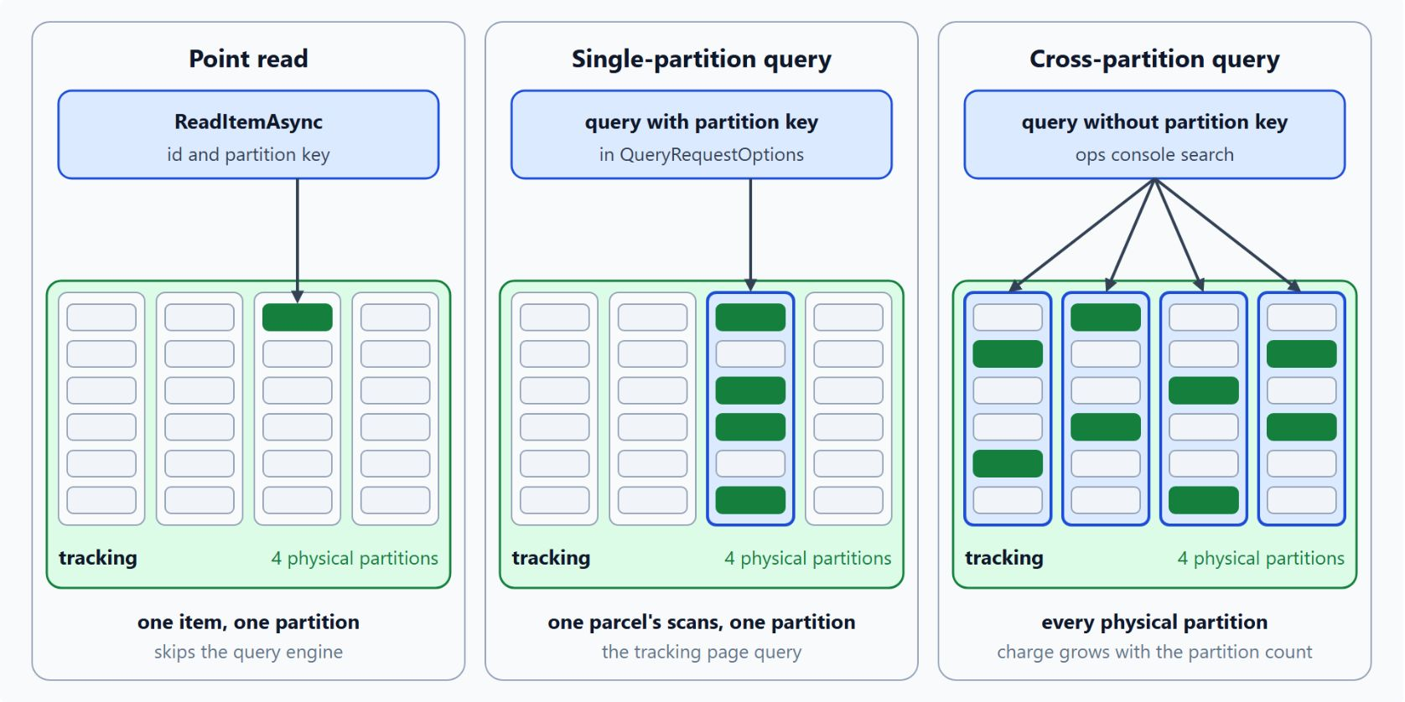
Point reads and queries
Indexing and request charge on the tracking container
Opt-out indexing: include /*, exclude /_etag/?
A composite index on scanType ascending and occurredAt descending matches the ops console sort
Log RequestCharge and ActivityId on every read you tune
A point read by id and partition key skips the query engine and costs the least
The partition key in QueryRequestOptions keeps the page query on one partition
Notes:
Cosmos DB charges request units for every read, and the bill depends on the indexing policy, the shape of the query and the consistency level. This slide tunes the tracking container for the tracking page and the ops console.
Indexing policy: Cosmos DB indexes every property by default, and Learn recommends an opt-out policy that excludes only the paths you never filter on. The tracking policy includes /* and excludes /_etag/?, so new properties get indexed automatically.
Composite index: a query that sorts on more than one property needs a composite index in the same sort order. The ops console query sorts by scanType ascending and occurredAt descending, and composite paths never use wildcards.
Request charge: ItemResponse.RequestCharge returns the RUs of each response, and ActivityId identifies the request in diagnostics. Measure before you change the indexing policy, because index changes can take time to apply.
Point read: a read by id and partition key skips the query engine and costs the least. The tracking page can't use one for every scan of a parcel, because it doesn't know the scan IDs in advance.
Query scope: with the partition key in QueryRequestOptions, the page query stays on one partition. Without it, the query fans out across every physical partition and the charge grows with the partition count, a cost only the ops console search accepts.

Slide 19
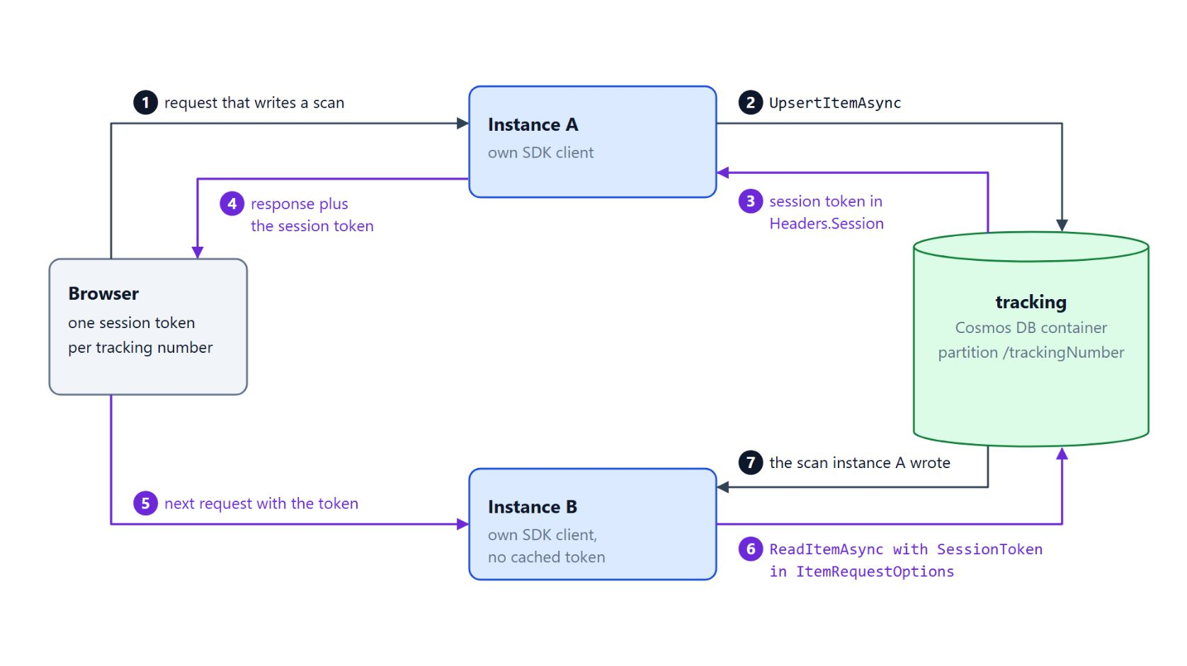
Session tokens for read-your-writes
The token travels with the next request to another instance
Session is the default consistency level: a client reads its own writes
Each write returns a session token in Headers.Session
Several web instances don't share the SDK's cached token
The browser gets the token and sends it back with the next request
Tokens are partition bound, so keep one per tracking number
Notes:
The last setting on the read model is consistency, and it decides whether a user sees their own scan right away. The diagram follows one write on instance A and the next read on instance B.
Session level: session is the default consistency level for Cosmos DB accounts, and within one session a client reads its own writes and sees writes in order. The five levels are strong, bounded staleness, session, consistent prefix and eventual.
Session token: each write returns a token in Headers.Session, and the SDK keeps the most recent token for each client. That works while the same client instance serves the user.
Several instances: a web tier with several instances loses that cache, because instance B has its own SDK client. Learn notes that a client without a token for a partition reads with eventual behavior, so the scan can be missing.
Token round trip: the response carries the token to the browser, and the next request brings it back. Instance B passes it as SessionToken in ItemRequestOptions on ReadItemAsync and reads the scan that instance A wrote.
Partition bound: session tokens are bound to a partition, so the browser keeps one token per tracking number. Pass the token along with the request that reads back the write.

Slide 20
05
Managed Redis: Change-Feed Cache Invalidation
Cache-aside, cleared by the projection after each scan
Event-Driven Distributed Apps on Azure: Aspire, Dapr & Durable Execution

Slide 21
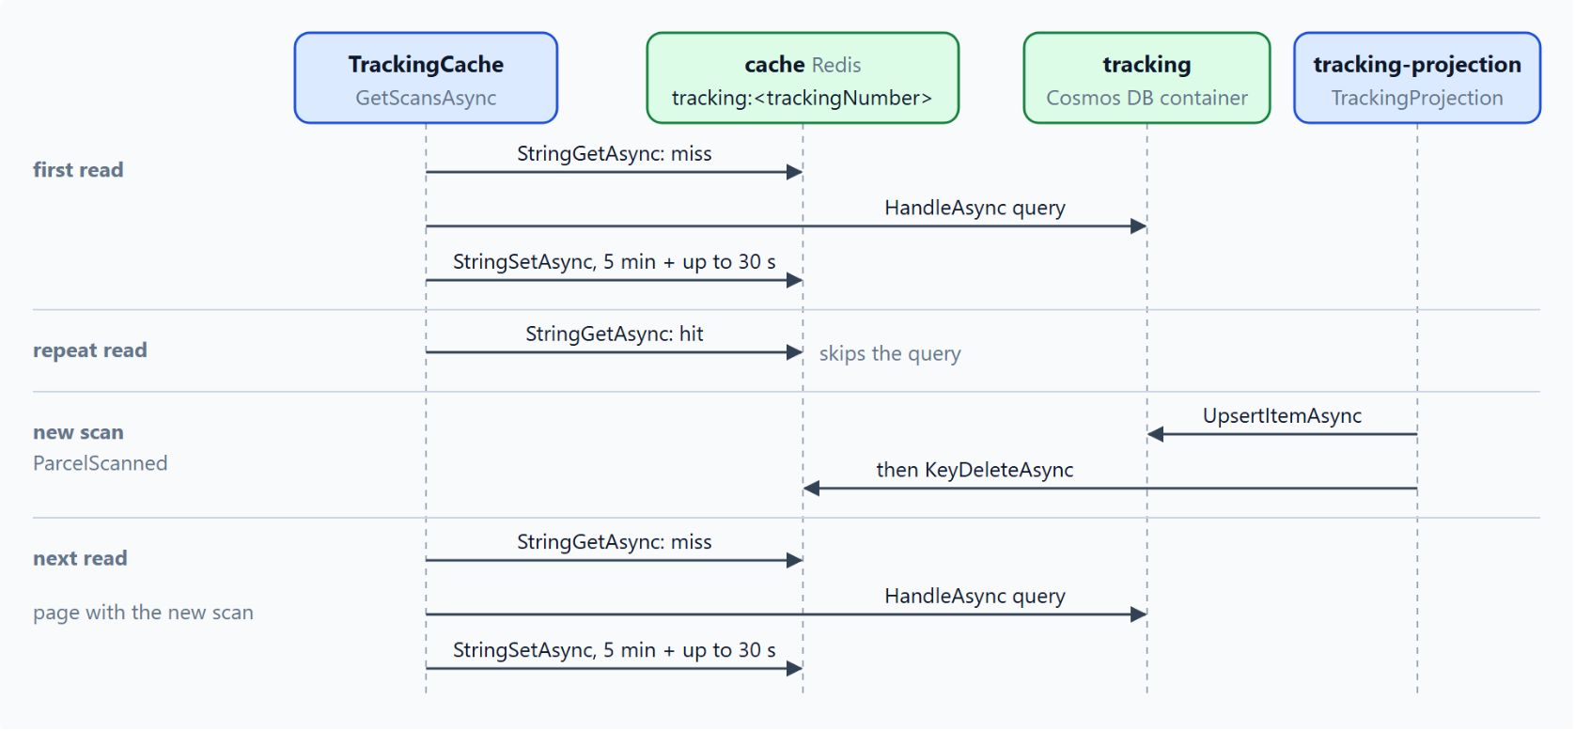
Cache-aside with change feed invalidation
The projection deletes the cached tracking page after each scan
Cache-aside: read tracking:<trackingNumber>, query on a miss, store with an expiration
Five minutes plus up to 30 seconds of jitter spreads the expirations
The projection upserts the scan first, then calls KeyDeleteAsync
A retry repeats the idempotent upsert, and the TTL bounds a stale page
In Azure: Entra ID through Microsoft.Azure.StackExchangeRedis, wired by Aspire
Notes:
A parcel's tracking page can be opened hundreds of times while the parcel is in transit, and each open would otherwise run a query against the tracking container. Azure Managed Redis answers the repeat reads from memory, and the change feed keeps the cache correct.
Cache-aside: TrackingCache reads the key tracking:<trackingNumber> and returns the page on a hit. On a miss it queries the tracking container, stores the serialized page with an expiration and returns it.
Jitter: pages loaded in the same minute would otherwise expire together and send a burst of queries to Cosmos DB at once. The random offset of up to 30 seconds spreads the expirations, as Learn recommends.
Invalidation order: the projection runs after the scan commits, so the cache never removes a page for a write that failed. It upserts the ScanRecord first and then deletes the key, so the next read loads a fresh copy.
Retries: if the delete fails after the upsert, the processor retries the batch, and the idempotent upsert makes that safe. The TTL bounds how long the old page can survive if the retries keep failing.
Wiring: in Azure the connection authenticates with a Microsoft Entra token through Microsoft.Azure.StackExchangeRedis, and the AppHost passes AddAzureManagedRedis to the service with WithReference. The lab runs a local Redis container with AddRedis, and the service registers the same name with AddRedisClient.

Slide 22
06
Event Store: Aggregates & Snapshots
Version-checked appends, replay and snapshots
Event-Driven Distributed Apps on Azure: Aspire, Dapr & Durable Execution

Slide 23
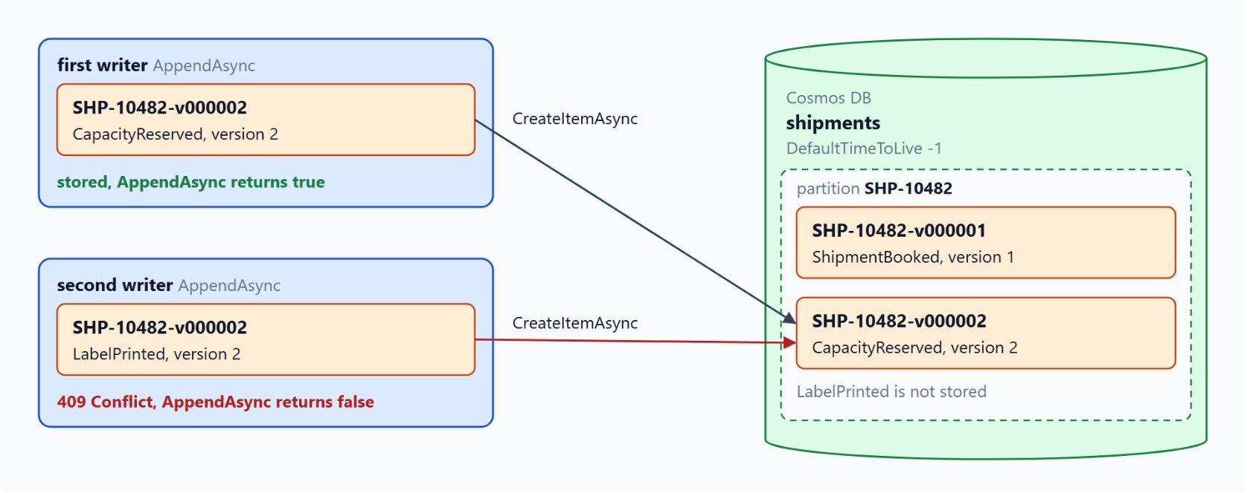
Appending events with a version check
The event ID carries the version, so a second append gets 409 Conflict
One immutable event document per change, partition key /shipmentId, no ttl
A correction is a new event: PaymentRefunded follows PaymentCaptured
The ID {shipmentId}-v{version:D6} makes a second append for the same version collide
CreateItemAsync answers 409 Conflict and AppendAsync returns false
IfMatchEtag protects documents that get replaced; append-only events don't need it
Notes:
The Shipment has no row that holds its current state: each change is an immutable event such as ShipmentBooked, CapacityReserved or LabelPrinted. The event store is the write side, so it must reject two conflicting writes to the same shipment.
Event documents: each one holds the shipment ID, a version that counts events per shipment, the event type, the time and the data of the change. All events of one shipment live in one logical partition, and event documents never carry a ttl.
Corrections: Learn advises events that record business intent, and a mistaken PaymentCaptured is never edited. The PaymentRefunded event that follows records the reversal, and both events stay in the store.
Version in the ID: two dispatchers can both read version 6 and both try to append version 7. The ID encodes the shipment and the version, so the second create collides with the first.
409 Conflict: the store returns false and doesn't retry, and POST /shipments answers 409 Conflict so the caller decides what to do next. In the lab diagram CapacityReserved is stored as version 2, and LabelPrinted is not stored.
ETags: a replace that sends the last ETag it read with IfMatchEtag succeeds only while the stored item still has it, and a stale replace returns 412 Precondition Failed. Use it for a document that a process rewrites, such as a current-state document; append-only events don't need it.

Slide 24
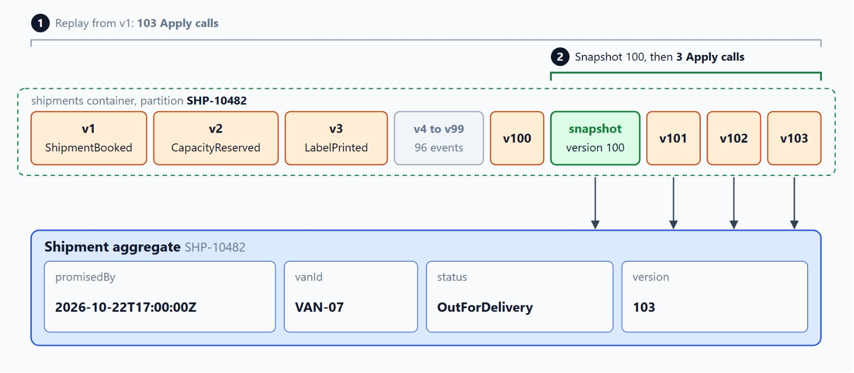
Replay and snapshots
Load from the newest snapshot and apply only the events after it
LoadAsync queries one partition in version order and calls Apply per event
The aggregate reads nothing but its own events
A snapshot stores the state at one version, in the same partition
103 events: snapshot 100, then 3 Apply calls instead of 103
The snapshot ID encodes its version, so a duplicate create gets a 409 to ignore
Notes:
Current state comes from replaying the events in order. This slide shows the replay and how snapshots keep it short once a stream grows long.
Replay: ShipmentRepository queries the events of one shipment in version order, scoped to the partition key, and applies each one to an empty aggregate. Apply switches on the event type and returns a new aggregate for each event.
Own events only: the aggregate never reads the store for anything except its own events, so its behavior depends only on what it replays. The replay cost grows with the number of events.
Snapshot: a snapshot document stores the aggregate state at one version, with the same partition key. Learn calls it an optimization, because the event stream stays the source of truth and any snapshot can be rebuilt from it.
Loading from a snapshot: loading starts from the newest snapshot and replays only the events after it, with a version filter in the query. In the diagram the Shipment loads from the snapshot at version 100 and applies only v101 to v103.
Choosing N: the writer creates a snapshot whenever the version reaches a multiple of N, such as 100, and a second writer that creates the same snapshot gets a 409 Conflict it can ignore. A small N stores more snapshots and keeps replay short, while a large N stores fewer and makes replay longer.

Slide 25
07
Event Versioning: Evolve Schemas Safely
Additive changes, upcasting and CloudEvents
Event-Driven Distributed Apps on Azure: Aspire, Dapr & Durable Execution

Slide 26
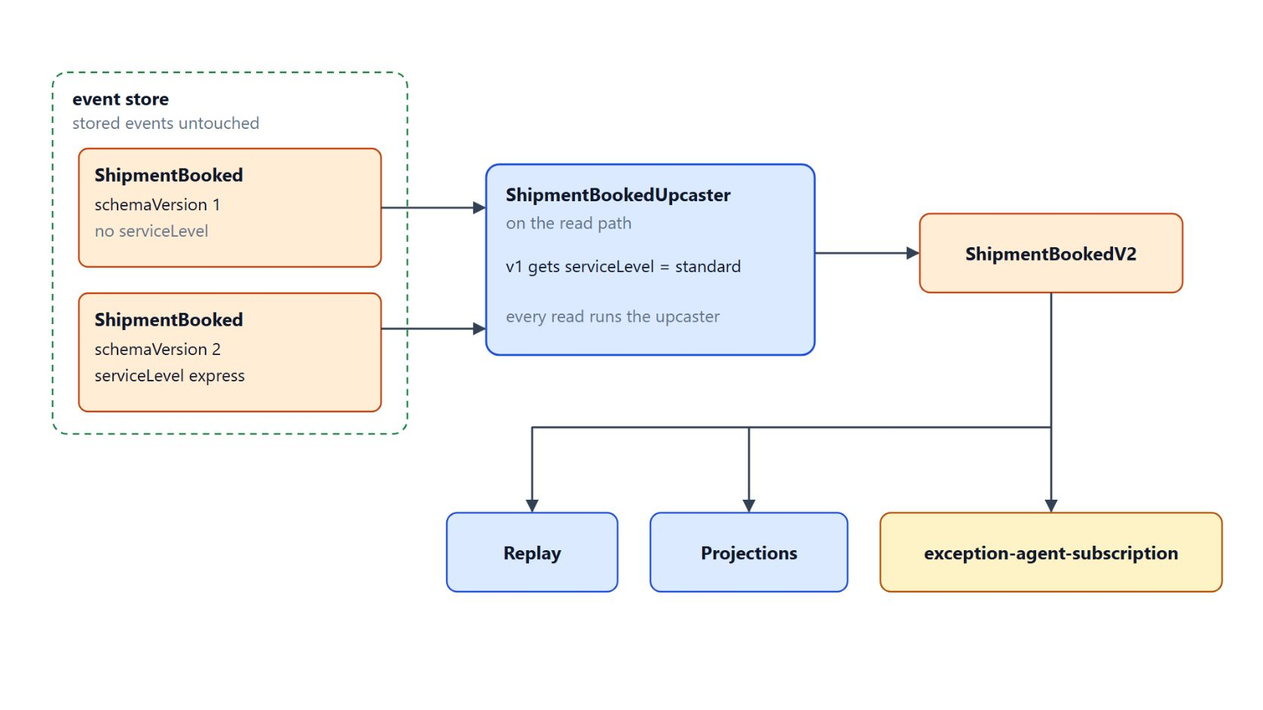
Upcasting on read
Stored events stay untouched, readers see the newest shape
Past events are immutable: correct them with a compensating event or an upcaster
An additive change adds an optional field, and tolerant readers ignore unknown fields
A missing serviceLevel deserializes as null, and the reader applies standard
ShipmentBookedUpcaster turns schemaVersion 1 into ShipmentBookedV2 on read
Upcasters chain one version per step, and every read runs them
Notes:
ShipmentBooked events have sat in the event store since the first release, and the business now wants a serviceLevel on every booking. Old events can't change, and consumers deployed last year still read them.
Immutable history: a bug in an old event stays in the store, and a fix in the code doesn't repair it. Learn offers a compensating event or an upcaster, and lists in-place migration as the last resort because rewriting history breaks the audit trail.
Additive change: an optional new field keeps every existing consumer working, because tolerant readers ignore fields they don't know and default the missing ones. System.Text.Json ignores unknown properties by default.
Defaults: a missing serviceLevel deserializes as null, and the reader applies standard. While the new field is optional, the reader needs no second class for the old shape.
Upcasting: when a change can't be additive, the envelope carries a schemaVersion and the reader upcasts each stored event to the newest shape. ShipmentBookedUpcaster gives version 1 events serviceLevel standard, so replay, projections and exception-agent-subscription only see ShipmentBookedV2.
Cost: upcasting leaves the stored event untouched, so the history stays immutable. Upcasters can chain one version change per step, but every read runs them, so a long chain slows replay.

Slide 27
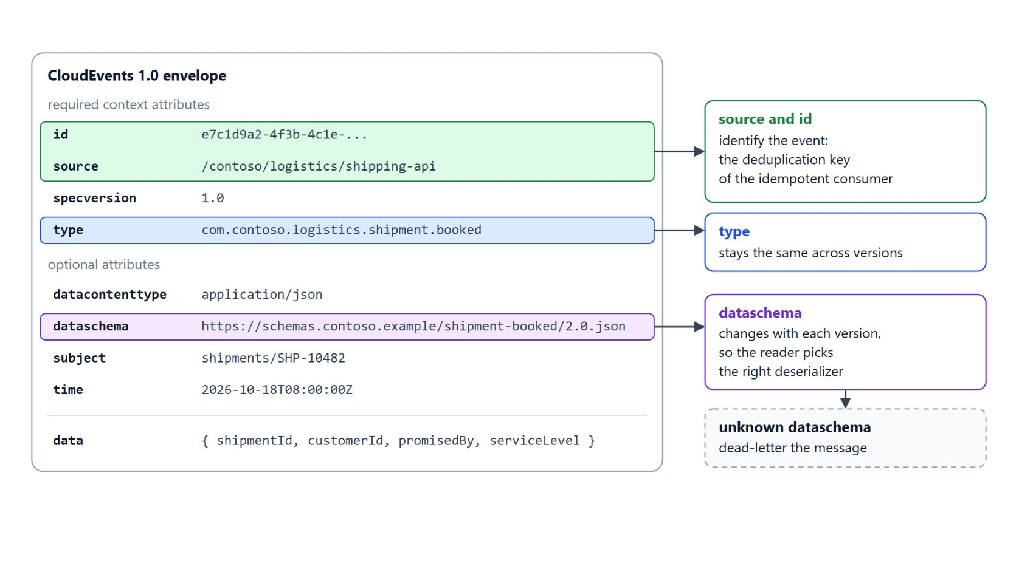
CloudEvents type and dataschema
Consumer rules for each kind of schema change
type stays the same across versions, dataschema changes with each one
source plus id is the idempotent consumer's deduplication key
Adding an optional field is safe for consumers that already run
A rename writes both names for one release; a new meaning gets a new type or dataschema
A consumer dead-letters a message whose dataschema it doesn't know
Notes:
Consumers and producers deploy at different times, so each event has to tell its reader which shape it carries. CloudEvents 1.0 gives every event a standard envelope, with id, source, specversion and type as the required context attributes.
Type and dataschema: type describes the kind of event and stays the same across versions, so a subscriber that handles every booking still matches. dataschema identifies the schema of the data and changes with each version, so a reader can pick the right deserializer.
Deduplication key: the source and id pair identifies the event. The idempotent consumer from the first topic uses that pair as its deduplication key.
Safe changes: adding an optional field is safe, because consumers ignore unknown fields. A new required field starts as optional and becomes required only in a later version.
Renames, removals and new meanings: a rename writes both names for one release before the old name goes, and a removed field is first no longer written but still read until consumers move on. A field that changes meaning gets a new event type or a new dataschema.
Unknown schema: a consumer that receives a dataschema it doesn't know should dead-letter the message. Module 4 covers the dead-letter queue that holds such messages for review.

Slide 28
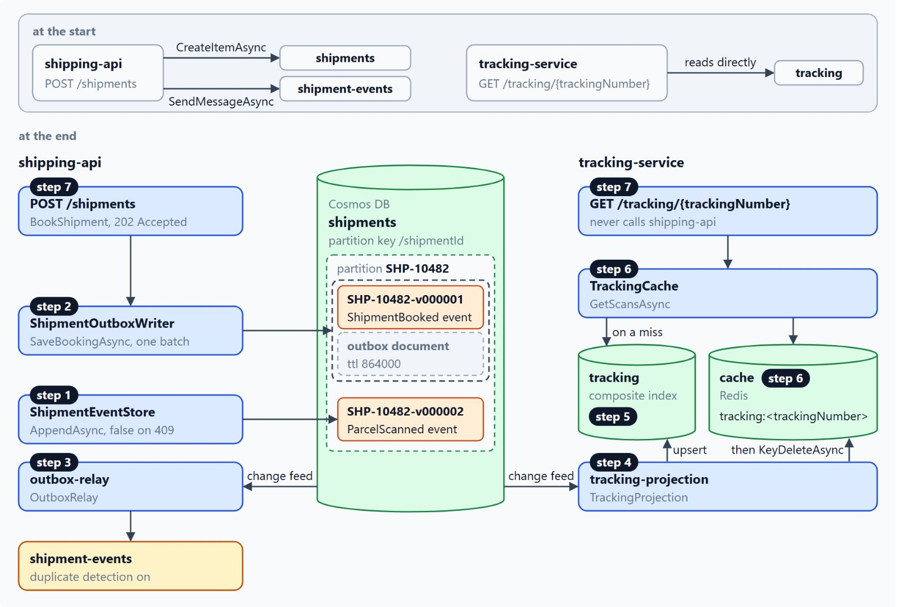
Lab: event-source shipments with an outbox
From two separate calls to an event store, an outbox and a cached read model
Steps 1 and 2: an event store that rejects a second event per version, booking and outbox in one batch
Step 3: outbox-relay publishes the outbox documents to shipment-events
Steps 4 and 5: tracking-projection fills the indexed tracking container
Step 6: Redis caches the tracking page and drops it after each scan
Step 7: BookShipment answers 202 Accepted, GET /tracking/{trackingNumber} reads the model
Notes:
In about 60 minutes the lab takes Contoso Logistics from the start state at the top of the diagram to the end state below it. You open contoso-logistics with an AI coding agent, and Docker Desktop runs the Cosmos DB and Redis emulators from the AppHost.
Event store and batch: ShipmentEventStore creates each event with the ID {shipmentId}-v{version:D6} and returns false on 409 Conflict. ShipmentOutboxWriter saves the ShipmentBooked event and its outbox document in one transactional batch.
Relay: outbox-relay is a change feed processor on shipments with the leases container and a stable instance name. It sends each outbox document with MessageId, SessionId and Subject set, and the topic's duplicate detection drops the copies a retry creates.
Projection and index: tracking-projection upserts a ScanRecord for each ParcelScanned event and starts from the beginning of the container. The tracking container gets a consistent indexing policy with a composite index on scanType and occurredAt.
Cache: the AppHost adds a Redis container named cache, and TrackingCache stores the page for five minutes plus up to 30 seconds. The projection deletes the key after each upsert, never before.
Command and query: BookShipmentHandler returns only a success flag, which the endpoint maps to 202 Accepted with the shipment ID and tracking number. The tracking endpoint returns TrackingCache.GetScansAsync, and the two services share no project reference.

Slide 29

Takeaways
What to carry into the Dapr module
Commit the event and its outbox event in one batch, relay with duplicate detection
Make every projection idempotent: upsert under the event ID, await every write
Keep reads on one partition, and send session tokens back for read-your-writes
Delete the cached page after the upsert, and let the TTL bound the rest
Put the version in the event ID, and evolve schemas additively or by upcasting
Notes:
Close with the habits this module built, each one a decision about where an event goes and who reads it.
Outbox: one transactional batch on one partition key removes the dual write. MessageId plus duplicate detection drops the copies that a retried relay sends.
Idempotent projections: the change feed processor delivers at least once, so the projection upserts under the event ID. Awaiting every write keeps the checkpoint from running ahead of unfinished work.
Reads: point reads and single-partition queries keep the RU charge low, and the composite index matches the ops console sort. A session token sent back with the next request lets a user read their own write on another instance.
Cache: the projection deletes the Redis key only after the upsert, so a failed write never clears a page. A TTL with jitter bounds how long any stale page can stay.
Event store and versioning: a version in the event ID turns a conflicting append into 409 Conflict, and snapshots keep replay short. Schemas change additively or through upcasters, and Module 7 continues with the Dapr portability work.

