Slide 1



Fast Lane Group
Worldwide Education &
Professional Services
www.flane.de | © 2026 Fast Lane Institute for Knowledge Transfer GmbH
Notes:
Die Fast Lane Gruppe.
Fast Lane … Dienstleister u. Spezialist für High-End Technologie und Business Trainings
IT Trainings zu den unterschiedlichsten Herstellern wie Microsoft, Google, Cisco oder AWS. Und vielen weiteren wichtigen IT Herstellern.
Sei es Cloud, Security, Netzwerk oder allgemein digitale Transformationsprojekte
Und das seit 2003.
Das spannende ist, dass die Fast Lane Gruppe bereits seit 2009 durchgängig zu den Top 20 Unternehmen in der IT Trainingsbranche weltweit zählt.
Aber auch Footprint ebenso im klassischen Professional Services Bereich für unsere wichtigsten Hersteller
PreSales Support, Deployment Services und Adoption Trainings
Additional Information:
Im Jahr 2021 sind wir zur „most strategic IT Education company worldwide“ von der IDC im „magic quadrant“ aufgeführt worden !
1 mio Teilnehmer insgesamt seit bestehen, 50.000+ Students ww p.A, 20.000 in DE pro Jahr

Slide 2



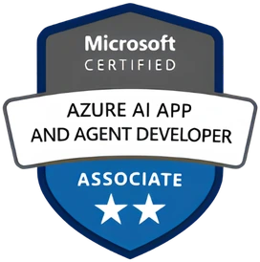


AGENTIC AI: FROM STRATEGY TO PRODUCTION.
Alexander
Kastil
AGENTIC AI CONSULTING · VIENNA
Full stack, from enterprise software to agentic AI. Since 1996
AI at Work
Enterprise AI
Value discovery, KPI mapping and roadmap
Governed multi-agent systems on Microsoft Copilot and Foundry
Agentic Software Engineering
Team Enablement
Harness architecture for Claude Code and GitHub Copilot
AI driven content production and delivery
integrations.at
github.com/alexander-kastil
SCAN TO CONNECT
alexander.kastil@integrations.at
linkedin.com/in/alexander-kastil
integrations.at
Notes:
Intro: Alexander Kastil, integrations.at. Four practice areas from AI at Work to team enablement. Certifications: Agentic AI Business Solutions Architect, Azure AI App and Agent Developer Associate, DevOps Engineer Expert.

Slide 3

MODULE 7
Dapr Building Blocks for Portable Services
The Contoso Logistics flow on sidecars and component files
Event-Driven Distributed Apps on Azure: Aspire, Dapr & Durable Execution

Slide 4
01
02
03
04
Dapr Sidecar: Run with Aspire
dapr init, AddDapr, WithDaprSidecar and component YAML
Service Invocation: mTLS & Retries
App IDs, InvokeMethodAsync and Sentry certificates
State Stores: ETags & Concurrency
ETag checks, transactions and the Cosmos DB store
Pub/Sub: Swap Brokers via Components
The Topic attribute, dead-letter topics and Service Bus
05
06
07
Resiliency Policies: Retries & Breakers
Timeouts, retries and circuit breakers in one spec
Dapr Actors: Virtual Actor Model
VanActor, turn-based calls, timers and reminders
Managed Dapr: Container Apps vs. AKS
Component tiers, platform limits and the version window
Event-Driven Distributed Apps on Azure: Aspire, Dapr & Durable Execution

Slide 5

Dapr building blocks for portable services
The Contoso Logistics flow on sidecars and component files
Sidecar and service calls: Dapr beside each service in the Aspire AppHost, calls by app ID
State and events: ETag checks on writes, pub/sub through a broker set in a component file
Policies, actors and hosting: retries and breakers, one VanActor per van, Container Apps or AKS
Notes:
Modules 4 to 6 connected Contoso Logistics to Service Bus, Event Hubs and Cosmos DB through their Azure SDKs. This module runs the same flow through Dapr building blocks, and the component files decide which Azure service sits behind each call.
Sidecar and service calls: every service gets a Dapr sidecar from the Aspire AppHost, and services call each other by app ID instead of a host name.
State and events: state writes carry ETag checks, and events go through a pub/sub component whose broker you can swap without touching the code.
Policies, actors and hosting: retry and circuit breaker rules live in one resiliency spec, each van becomes a `VanActor`, and the last topic decides whether a service belongs on Container Apps or AKS.

Slide 6
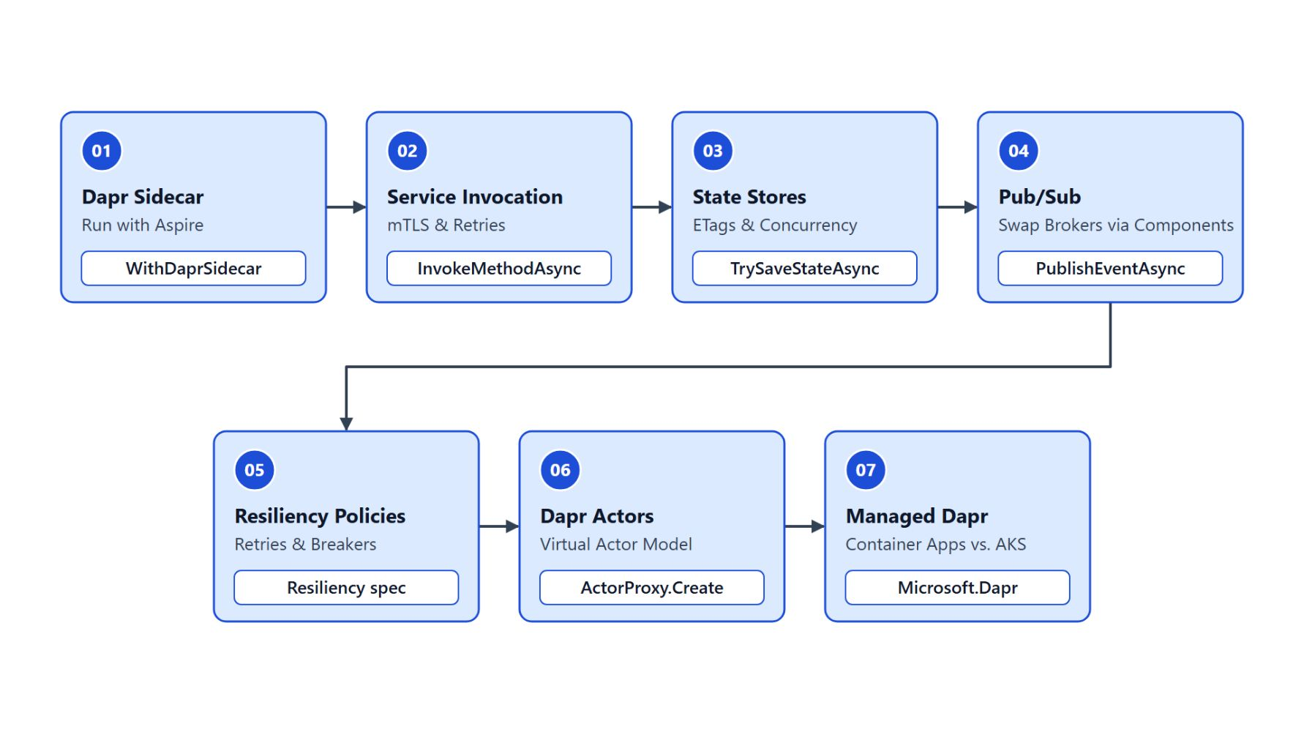
Overview
The path through the seven topics
Start the sidecar from the Aspire AppHost and load the component files
Call routing-service by app ID, then write state with ETag checks
Publish scan events through a broker you can swap in YAML
Put timeouts, retries and breakers in one resiliency spec, model each van as an actor
Decide per service: Container Apps or AKS
Notes:
This slide walks once through the seven topics, which take one building block at a time. Each topic keeps the Contoso domain, so `shipping-api`, `tracking-service` and `routing-service` stay the same while the calls change.
Sidecar first: the Aspire AppHost starts a Dapr sidecar beside each service, and component YAML describes the stores and brokers behind each block.
Calls and state: `shipping-api` reaches `routing-service` by app ID over mTLS, and state writes use ETags so two writers cannot both win a transition that must happen once.
Events: `ParcelScanned` events go through the pub/sub API, and swapping Service Bus for Redis or Kafka means replacing the component file.
Policies, actors and hosting: one resiliency spec holds timeouts, retries and circuit breakers, `VanActor` gives each van one owner, and the last topic compares Container Apps with the AKS Dapr extension.

Slide 7
01
Dapr Sidecar: Run with Aspire
dapr init, AddDapr, WithDaprSidecar and component YAML
Event-Driven Distributed Apps on Azure: Aspire, Dapr & Durable Execution

Slide 8
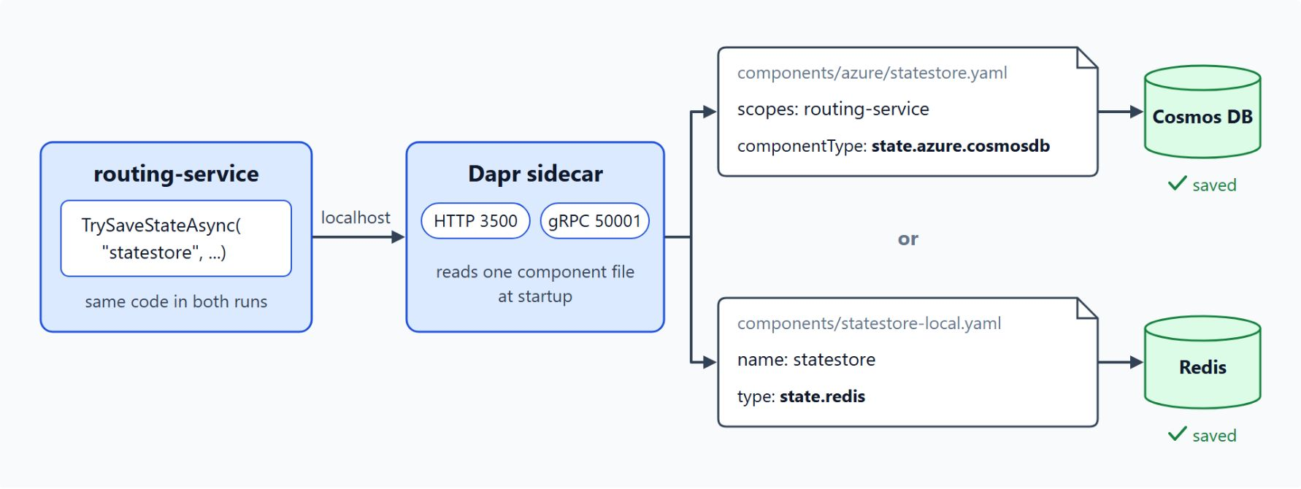
The sidecar model
The service calls localhost and the component file picks the store
Dapr runs as a separate process next to each service
The service calls its sidecar on localhost: HTTP on port 3500, gRPC on 50001
Building blocks: service invocation, state, pub/sub, bindings, actors, secrets, configuration
Each block delegates to a component: Cosmos DB, Service Bus or Redis
TrySaveStateAsync("statestore", ...) stays the same in both runs
Notes:
Contoso Logistics runs booking, tracking, routing and billing as separate processes, and each needs to find the others, save state and publish events without importing one cloud product's SDK. Dapr gives each service that portability through a sidecar and a set of building blocks.
Separate process: Dapr runs beside the application, and the sidecar handles the connection to the infrastructure.
Localhost calls: the application calls the sidecar over HTTP or gRPC on localhost. In Azure Container Apps the sidecar serves HTTP on port 3500 and gRPC on port 50001.
Building blocks: these are the APIs the sidecar exposes. Service invocation, state management, pub/sub, bindings, actors, secrets and configuration are generally available in Container Apps.
Components: each block delegates to a component, so the same call reaches Cosmos DB, Service Bus or Redis depending on the file the sidecar loads. The diagram shows `routing-service` saving state to Cosmos DB in one run and to Redis in the other with the same code.

Slide 9
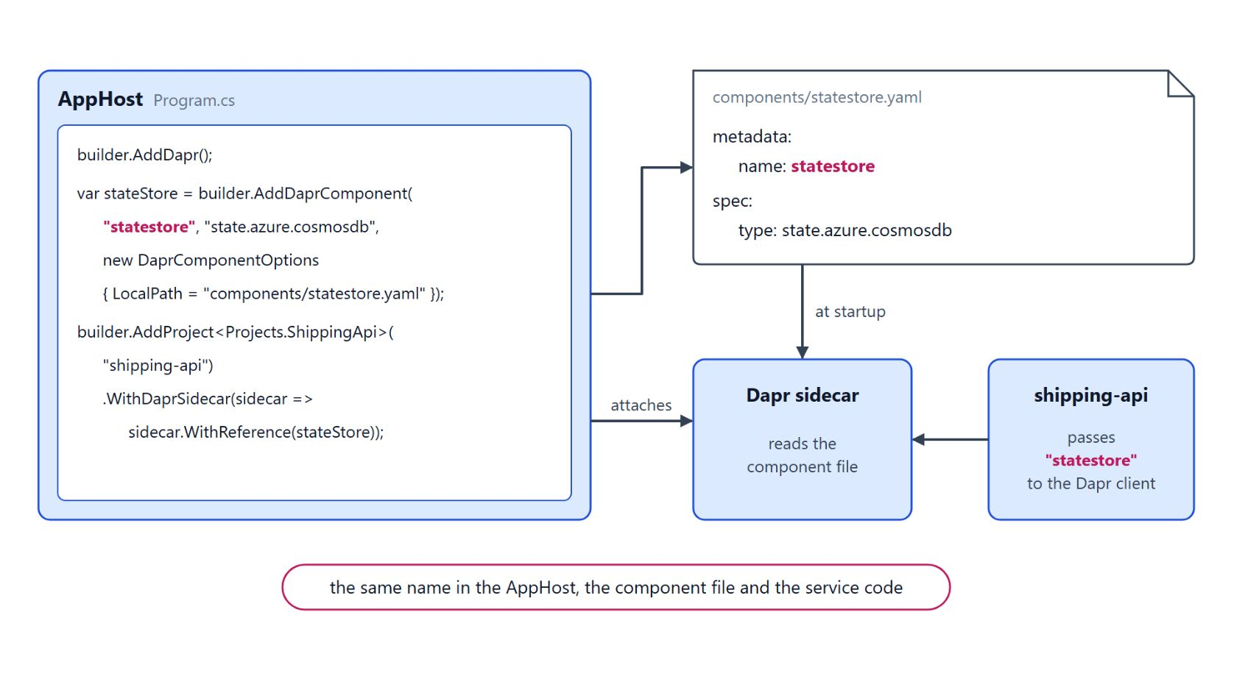
Dapr in the Aspire AppHost
Install the CLI and attach a sidecar to each service
winget install Dapr.CLI, then dapr init, then check dapr --version
dapr init starts Redis, Zipkin, placement and scheduler; --slim skips them
AddDapr, AddDaprComponent and WithDaprSidecar come from CommunityToolkit.Aspire.Hosting.Dapr
Use one component name in the AppHost, the YAML metadata.name and the service code
This class targets Dapr 1.18: CLI and runtime both report 1.18.0
Notes:
With the sidecar model in place, this slide shows how a developer machine and the Aspire AppHost get Dapr running beside a service.
Install and initialize: on Windows install the CLI with winget, run `dapr init` for the runtime, and check both versions with `dapr --version`.
What init starts: a default self-hosted initialization starts Redis and Zipkin containers plus the placement and scheduler services that actors need, and writes default component files under `.dapr` in your profile. The `--slim` flag skips the containers and default files for teams that bring their own infrastructure.
AppHost wiring: the Community Toolkit package adds `AddDapr`, `AddDaprComponent` registers a component, and `WithDaprSidecar` with `WithReference` gives the sidecar access to it. `DaprComponentOptions.LocalPath` points at the component file the sidecar reads at startup.
One name: keep the component name in the AppHost identical to `metadata.name` in the file and use the same name in the service code. Production component files reference a secret store, because the file is usually committed.
Dapr 1.18: the CLI and the runtime must both report 1.18.0, so rerun the version check after every CLI upgrade. The Community Toolkit README still names 1.15, so treat it as dated and follow the Dapr documentation.

Slide 10
02
Service Invocation: mTLS & Retries
App IDs, InvokeMethodAsync and Sentry certificates
Event-Driven Distributed Apps on Azure: Aspire, Dapr & Durable Execution

Slide 11
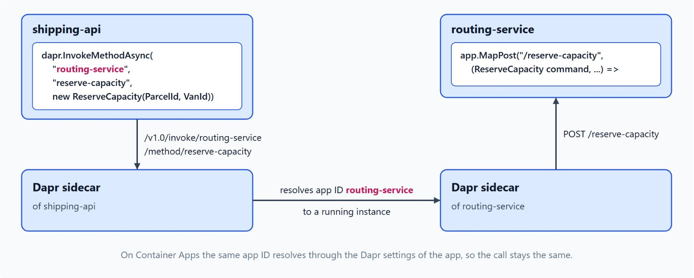
Calling a service by app ID
The sidecar resolves routing-service to a running instance
Every Dapr app has an app ID, shared by all of its replicas
Callers use /v1.0/invoke/routing-service/method/reserve-capacity on the sidecar
The sidecar resolves the ID through Kubernetes DNS, or mDNS when self-hosted
InvokeMethodAsync handles serialization, CreateInvokeHttpClient returns an HttpClient
The HttpRequestMessage overloads are obsolete in the current SDK
Notes:
When `shipping-api` books a parcel, it asks `routing-service` for van capacity and waits for the answer. Service invocation lets the sidecar find the target, so no service carries its own discovery logic.
App IDs: callers use the app ID in place of a host name, and every replica of `routing-service` answers to the same ID. Naming app IDs after the Contoso services keeps the URLs in traces readable.
The invoke URL: the segment after `invoke` is the app ID and the segment after `method` is the route on the callee.
Name resolution: on Kubernetes the sidecar uses Kubernetes DNS, on a self-hosted machine it uses mDNS. In Azure Container Apps you set the ID with `--dapr-app-id`, and the diagram shows that the call stays the same there.
Two .NET options: the typed `InvokeMethodAsync` overload serializes the request and deserializes the response. `CreateInvokeHttpClient` suits code that already uses typed HTTP clients.
Obsolete overloads: the overloads that take an `HttpRequestMessage` are marked obsolete, so the helper is the supported path for raw HTTP calls.

Slide 12
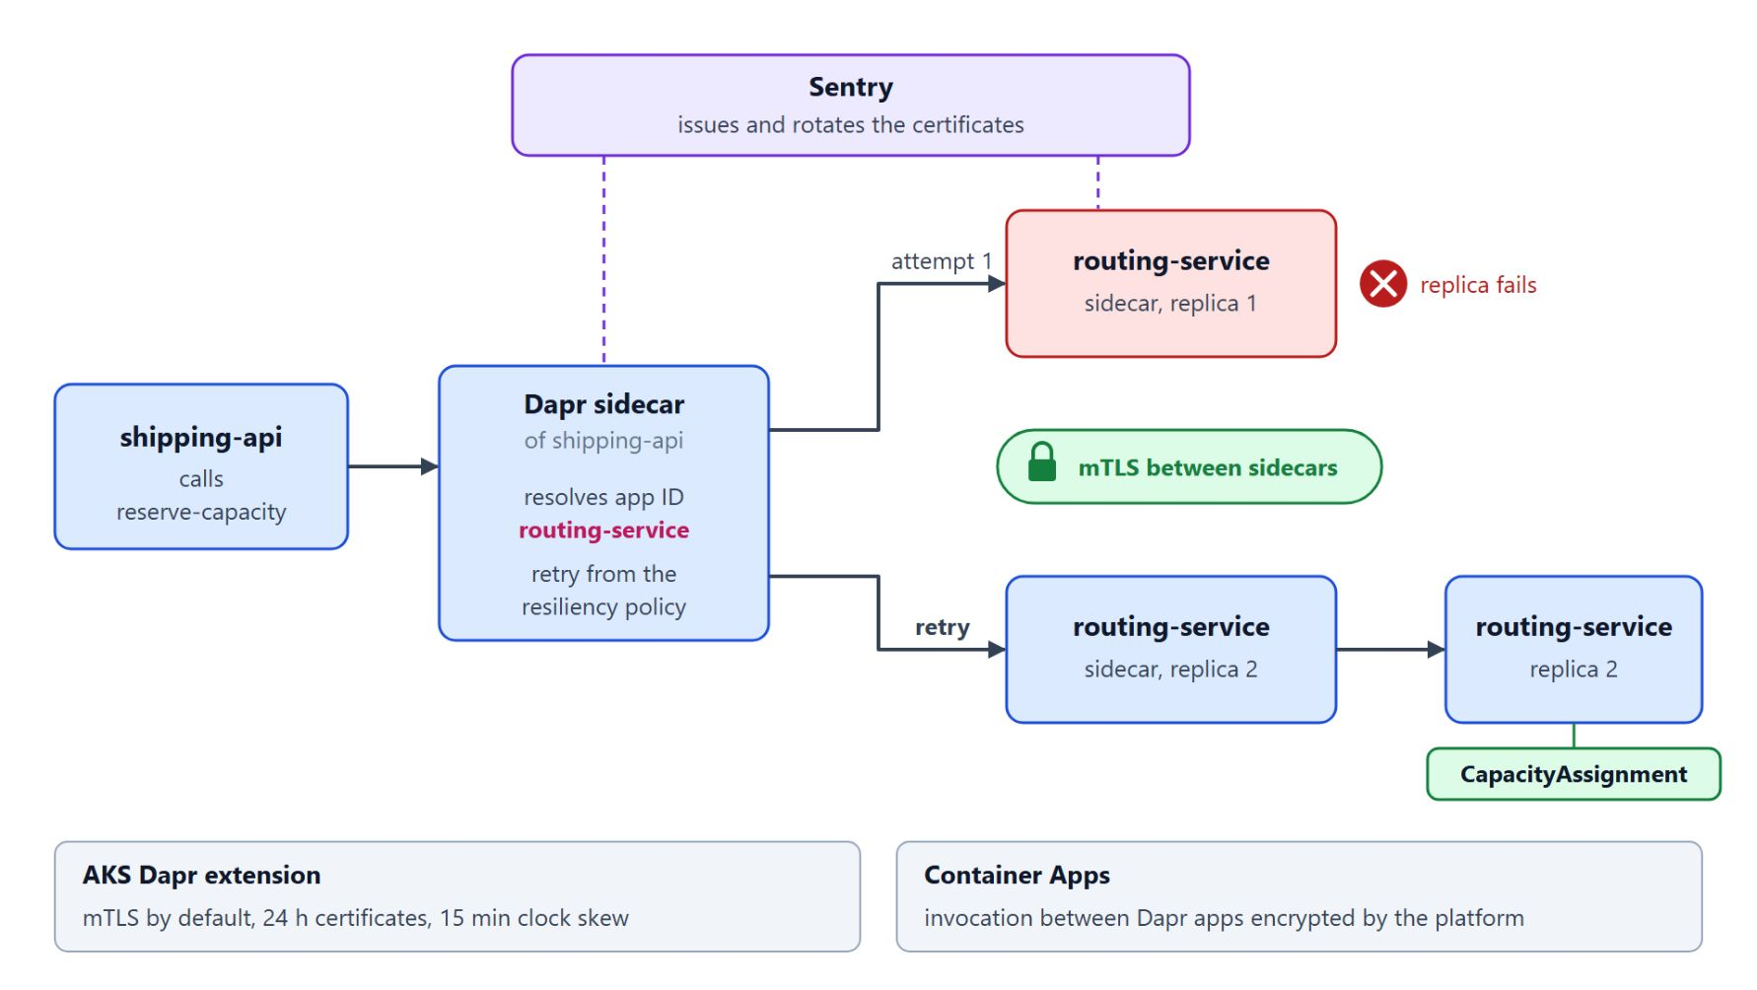
Mutual TLS and retries
Sentry issues the certificates, the resiliency policy decides the retries
Sentry issues and rotates the certificates; application code never handles them
The AKS extension turns mTLS on by default: 24 h certificates, 15 min clock skew
Container Apps encrypts invocation between Dapr-enabled apps through the platform
Retries with backoff come from the resiliency policy for routing-service
When the caller needs no answer, publish an event instead
Notes:
The call to `routing-service` has to travel over an encrypted connection and survive a brief outage of one replica. Both come from the platform, not from code in the caller.
Sentry: Dapr secures every call between applications with mutual TLS, and the Sentry service issues and rotates the certificates.
AKS defaults: the AKS Dapr extension enables mTLS by default with a workload certificate lifetime of 24 hours and a clock skew allowance of 15 minutes. Operations should know which certificate settings apply to each environment.
Container Apps: invocation between Dapr-enabled apps is encrypted through the platform, and your code configures none of it.
Retries: service invocation retries with backoff, driven by a resiliency spec that targets the app ID `routing-service`. The policies skip streaming requests, and the Container Apps service discovery resiliency feature does not apply to Dapr service invocation.
Invocation or pub/sub: invocation is synchronous, so a slow callee slows the caller. When the caller needs no answer, such as a `ParcelScanned` event for the read model, pub/sub is the better fit.

Slide 13
03
State Stores: ETags & Concurrency
ETag checks, transactions and the Cosmos DB store
Event-Driven Distributed Apps on Azure: Aspire, Dapr & Durable Execution

Slide 14
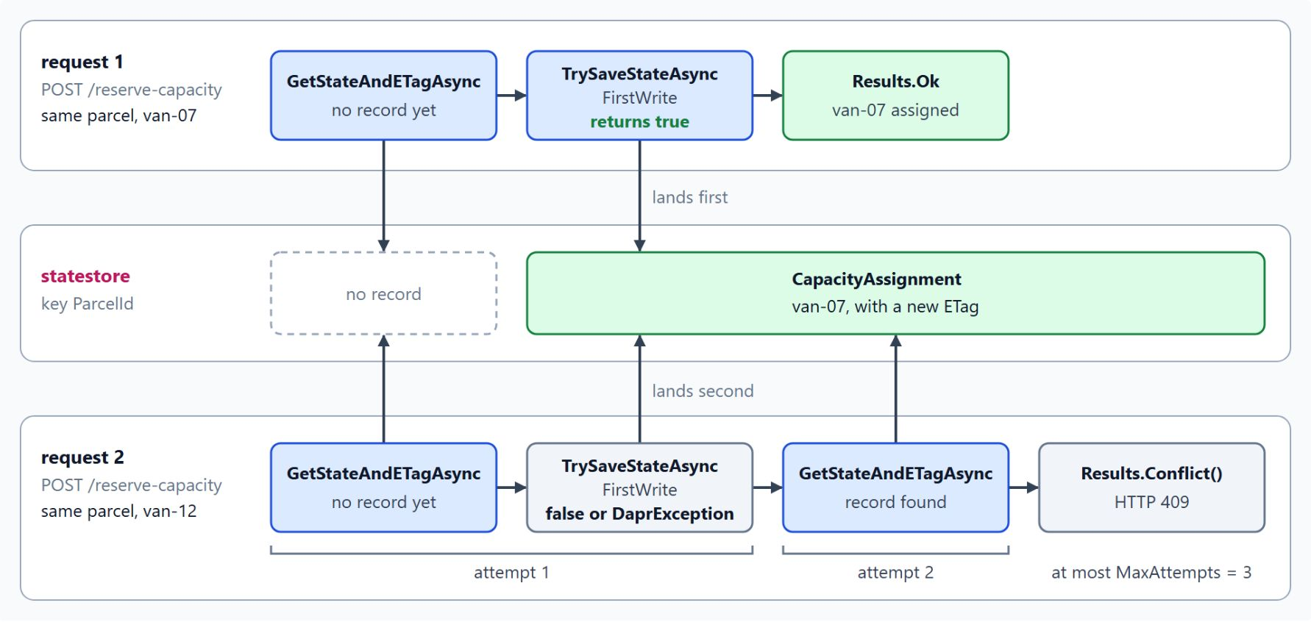
ETags and first-write-wins
A write succeeds only while the ETag still matches
GetStateAndETagAsync returns the value together with its ETag
TrySaveStateAsync with ConcurrencyMode.FirstWrite returns false when another writer won
The Redis state store throws a DaprException for the same conflict
On a conflict, read again and recompute in a short loop
After a fixed number of attempts, return a conflict to the caller
Notes:
A customer cancels a shipment while a scanner marks the same parcel as picked up. Without a rule for conflicts, the last write silently replaces the first.
Read with the ETag: the ETag is an opaque version token the store issues on every write. Keep it with the value you read, because the store compares it when you write again.
First write wins: a write that carries an ETag succeeds only while that ETag still matches the stored one. `TrySaveStateAsync` returns `false` when another writer got there first.
Redis behaves differently: the Redis state store throws a `DaprException` for the same conflict, so the caller catches it and treats it as a lost race.
The retry loop: the handler reads, computes the change and tries again. The diagram shows the lab's version, where a second `reserve-capacity` request for the same parcel rereads, finds the record and returns `Results.Conflict()` after at most three attempts.
Bounded attempts: after a fixed number of attempts the handler returns a conflict, so a customer request never loops forever.

Slide 15
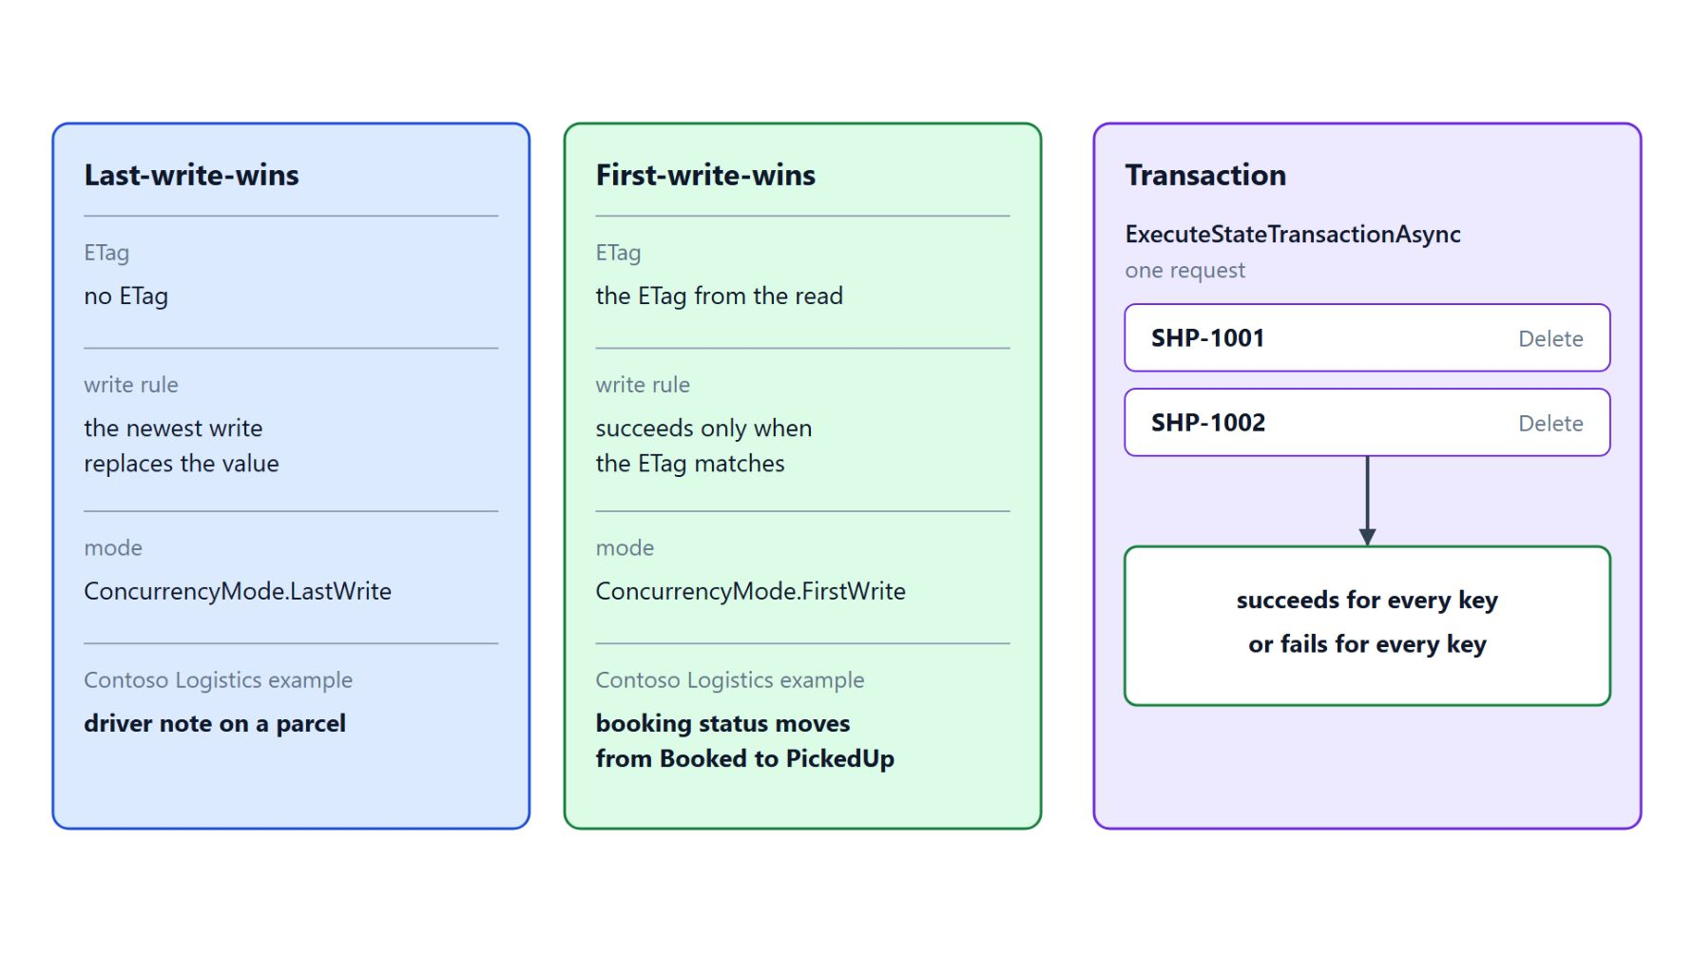
Write modes and transactions
Choosing a concurrency mode and changing several keys at once
Without an ETag the newest write replaces the value: last-write-wins
Use first-write-wins for a transition that must happen once
StateOptions.Consistency: eventual by default, strong waits for replicas or a quorum
ExecuteStateTransactionAsync succeeds for every key or fails for every key
state.azure.cosmosdb is Tier 1 and needs the partition key path /partitionKey
Notes:
The ETag check is one of two write modes, and the right one depends on the data. This slide also covers changes that touch several keys and the Cosmos DB store behind the booking data.
Last-write-wins: without an ETag the newest write replaces the stored value. That is fine where only the latest value matters, such as a driver's note on a parcel.
First-write-wins: use it when two writers race for a transition that must happen once, such as a booking status moving from Booked to PickedUp.
Consistency is a separate choice: eventual consistency, the default, acknowledges as soon as the store accepts the write. Strong consistency waits for all replicas or a designated quorum.
Transactions: `ExecuteStateTransactionAsync` takes a list of `StateTransactionRequest` entries, and the store applies them atomically. A transaction covers one request and does not replace the ETag check for a read-modify-write across separate requests.
Cosmos DB store: the `state.azure.cosmosdb` component is Tier 1 on Container Apps and needs URL, key, database and collection. With a managed identity, grant Cosmos DB Built-in Data Contributor and drop `masterKey`.

Slide 16
04
Pub/Sub: Swap Brokers via Components
The Topic attribute, dead-letter topics and Service Bus
Event-Driven Distributed Apps on Azure: Aspire, Dapr & Durable Execution

Slide 17
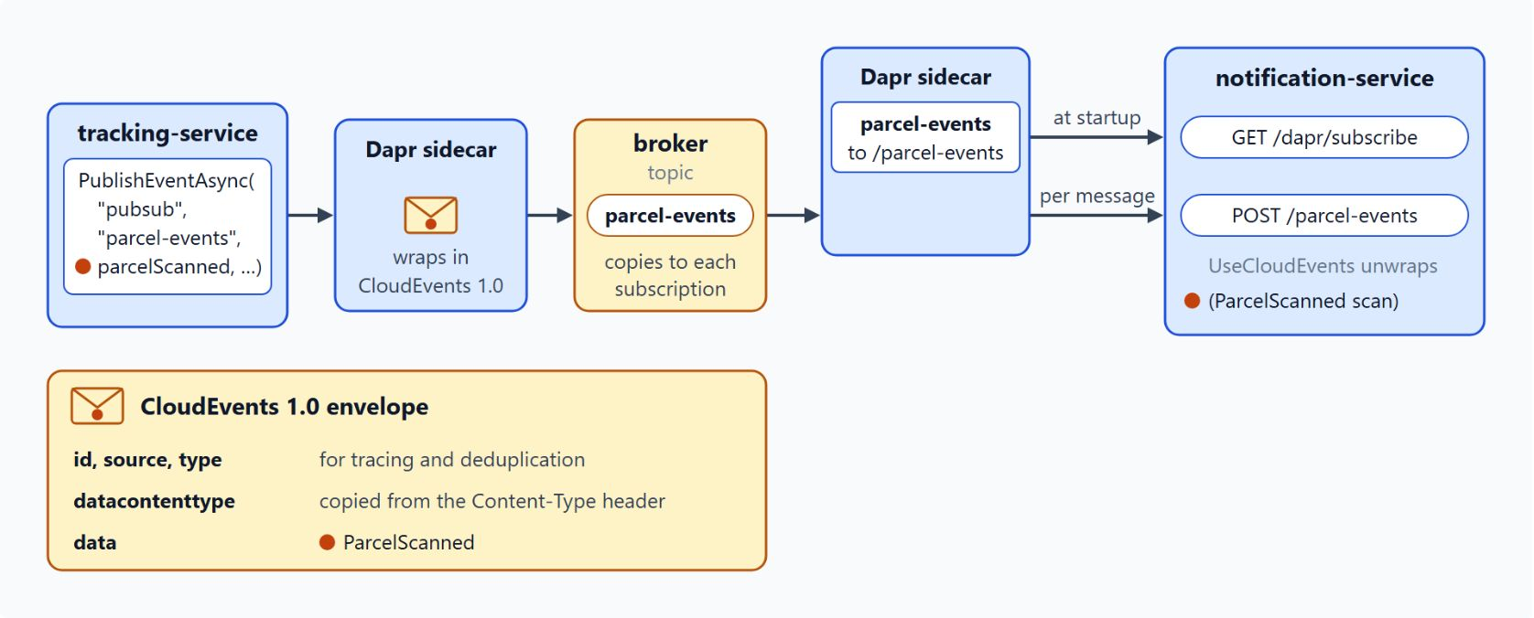
Publishing and subscribing
The code names the component pubsub and the topic parcel-events
PublishEventAsync("pubsub", "parcel-events", scan) names no broker
[Topic("pubsub", "parcel-events")] or WithTopic declares the subscription
MapSubscribeHandler lists the subscriptions, UseCloudEvents unwraps the CloudEvents envelope
Swap the broker in the component file: Service Bus, Event Hubs, Redis or Kafka
Use the native Service Bus SDK when the logic depends on session state
Notes:
Every scan at a hub produces a `ParcelScanned` event that `tracking-service` and `notification-service` both need. The scanner should not know who listens or wait for them, and the code should not be tied to one broker.
Publish: the publisher passes the component name, the topic and the payload, so the code holds no connection string and no broker type. An overload takes publish metadata, such as the `SessionId` the Service Bus component reads.
Subscribe: the `Topic` attribute on a controller action, or `WithTopic` on a minimal API endpoint, takes the component name and the topic. The sidecar posts each matching message to that action.
Startup and envelope: the sidecar calls the endpoint from `MapSubscribeHandler` at startup to read the subscriptions. Dapr wraps each payload in a CloudEvents 1.0 envelope whose id, source and type support tracing and deduplication.
Broker swap: replace the component file and keep the code. Service Bus topics and Event Hubs are Tier 1 on Container Apps, Redis Streams and Kafka are Tier 2, and a local run can use the Redis container that `dapr init` starts.
What Dapr hides: the component renews message locks and exposes settings such as `maxConcurrentHandlers`. Session state and the session receiver are not documented for Dapr, so use the native SDK when the processing depends on them.

Slide 18
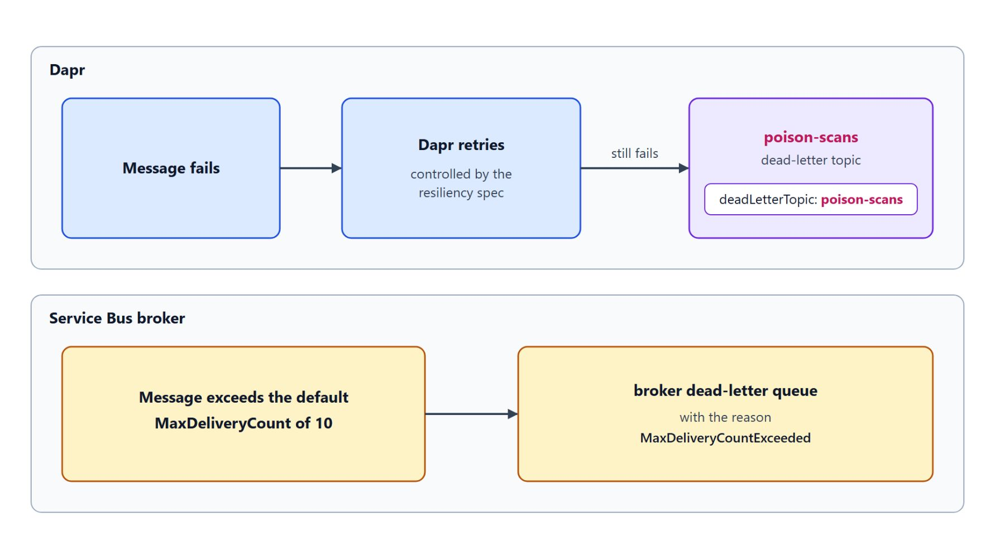
Dead-letter topics
Messages that still fail after the retries land on poison-scans
Declare a subscription in a dapr.io/v2alpha1 Subscription file or in code
deadLetterTopic: poison-scans takes what still fails after the retries
The resiliency spec controls how Dapr retries
Service Bus dead-letters a message after the default MaxDeliveryCount of 10
maxDeliveryCount takes effect only when Dapr creates the subscription
Notes:
A scan message that keeps failing needs a place to go, and two mechanisms decide where: Dapr's own dead-letter topic and the Service Bus broker's dead-letter queue.
Subscription file: the Dapr 1.18 documentation uses the `dapr.io/v2alpha1` form of the `Subscription` kind, which routes `parcel-events` to `/parcel-events`. The `Topic` attribute overload with a dead-letter topic sets the same value in code.
Dead-letter topic: a message that still fails after the retries lands on `poison-scans`.
Dapr retries: the resiliency spec controls them, which the resiliency topic covers next.
Broker limit: Service Bus has its own rule, and a message that exceeds the default `MaxDeliveryCount` of 10 moves to the broker dead-letter queue with the reason `MaxDeliveryCountExceeded`.
Creation-time settings: component settings apply to every topic that uses the component. `maxDeliveryCount` and the other subscription settings apply only when Dapr creates the subscription, so a later change does not alter an existing one.

Slide 19
05
Resiliency Policies: Retries & Breakers
Timeouts, retries and circuit breakers in one spec
Event-Driven Distributed Apps on Azure: Aspire, Dapr & Durable Execution

Slide 20
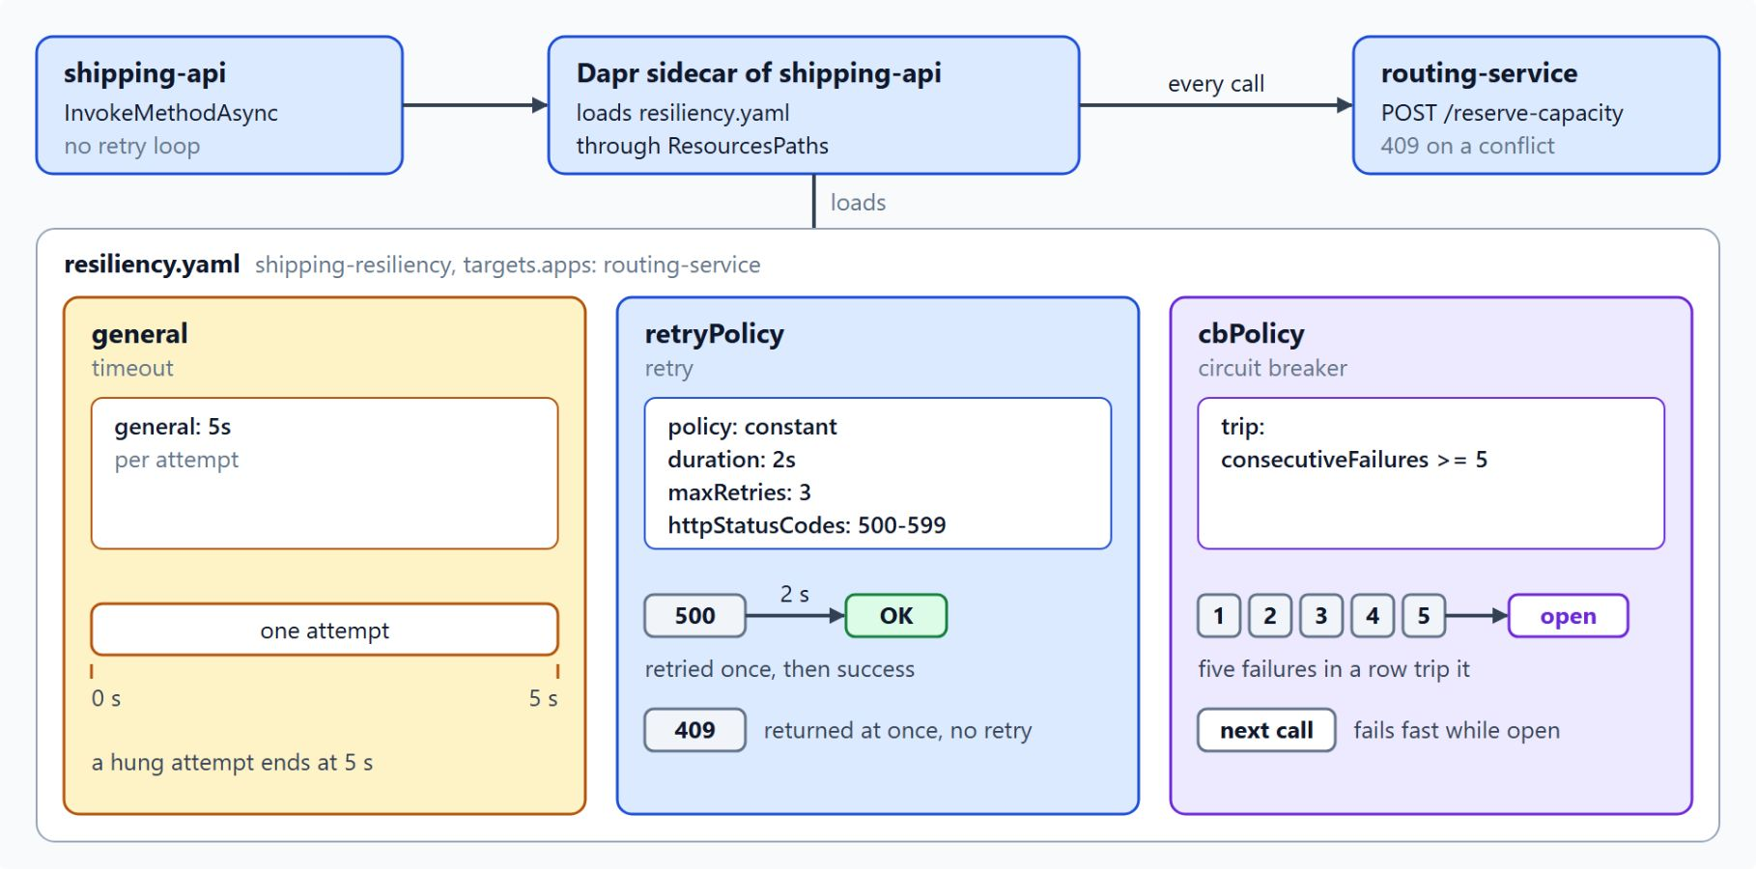
The resiliency spec
Named policies in one file, applied to calls to routing-service
policies names timeouts, retries and circuit breakers; targets attaches them
general: each attempt waits at most 5 s
retryPolicy: constant 2 s delay, 3 retries, only status codes 500 to 599
A full call can take the timeout times the attempts, plus the delays
The sidecar loads the file only when the AppHost sets ResourcesPaths
Notes:
On a busy evening `routing-service` slows down, and every waiting request from `shipping-api` holds a connection and a thread. The fix is a small set of rules: give up after a fixed time, retry a few times with spacing, and stop calling a service that keeps failing.
Two parts: the `policies` section defines named timeouts, retry policies and circuit breakers, and the `targets` section attaches those names to what Dapr calls. Change a policy in one place and every target that uses it follows.
Timeout: `shipping-resiliency` limits each attempt to five seconds, and a timeout that fires ends only that attempt.
Retry: the policy retries a failed attempt up to three times with a constant two-second delay, only for HTTP 500 to 599. The diagram shows the lab's version, where a 409 conflict returns at once without a retry.
Total wait: the full call can take the timeout multiplied by the number of attempts, plus the delays between them. Set the timeout for one attempt, then budget the total.
Loading the file: the sidecar reads the spec only when the AppHost sets `ResourcesPaths` in the sidecar options to the folder that holds it.

Slide 21
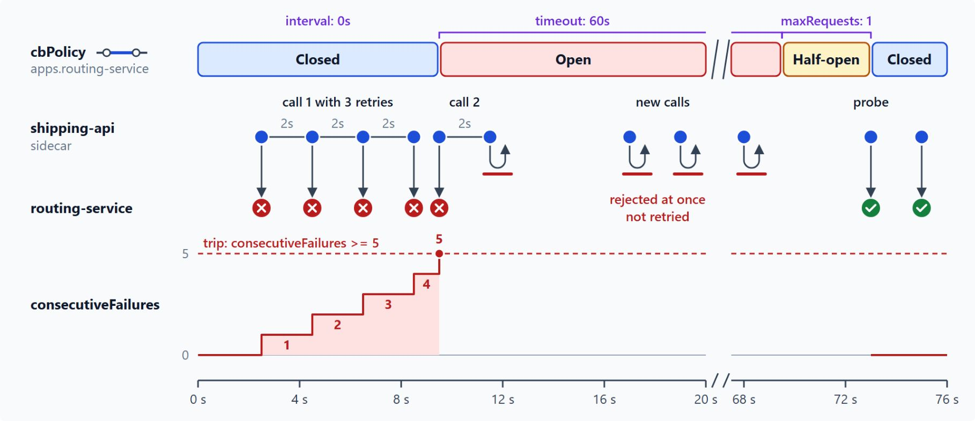
How the circuit breaker opens and closes
cbPolicy trips after five consecutive failures
trip: consecutiveFailures >= 5 opens the breaker
While open, the breaker rejects calls at once for its timeout of 60 s
Half-open lets maxRequests (1) probe through, and a success closes it
interval stays at 0 s, so nothing clears the count while the breaker is closed
Dapr creates breakers per component and per app instance
Notes:
A timeout ends one attempt and a retry repeats it, while a circuit breaker stops attempts entirely once a target has failed too often. That gives the target room to recover.
Trip condition: the `trip` field holds a condition such as `consecutiveFailures >= 5`. In the diagram, the four failed attempts of call 1 and the first attempt of call 2 make five failures in a row.
Open: the breaker's `timeout` controls how long it stays open before it allows a probe, and the lab's `cbPolicy` keeps the default of 60 seconds. During that time the retry of call 2 and every new call are rejected at once.
Half-open: `maxRequests` limits how many requests pass while the breaker probes, with a default of 1. One successful probe closes the breaker again.
Interval: the lab's policy sets only `trip`, so `interval` keeps its default of 0 seconds, which never clears the failure count while the breaker is closed.
Scope: Dapr creates circuit breakers per component and per app instance, so one unhealthy replica does not block the whole service.

Slide 22
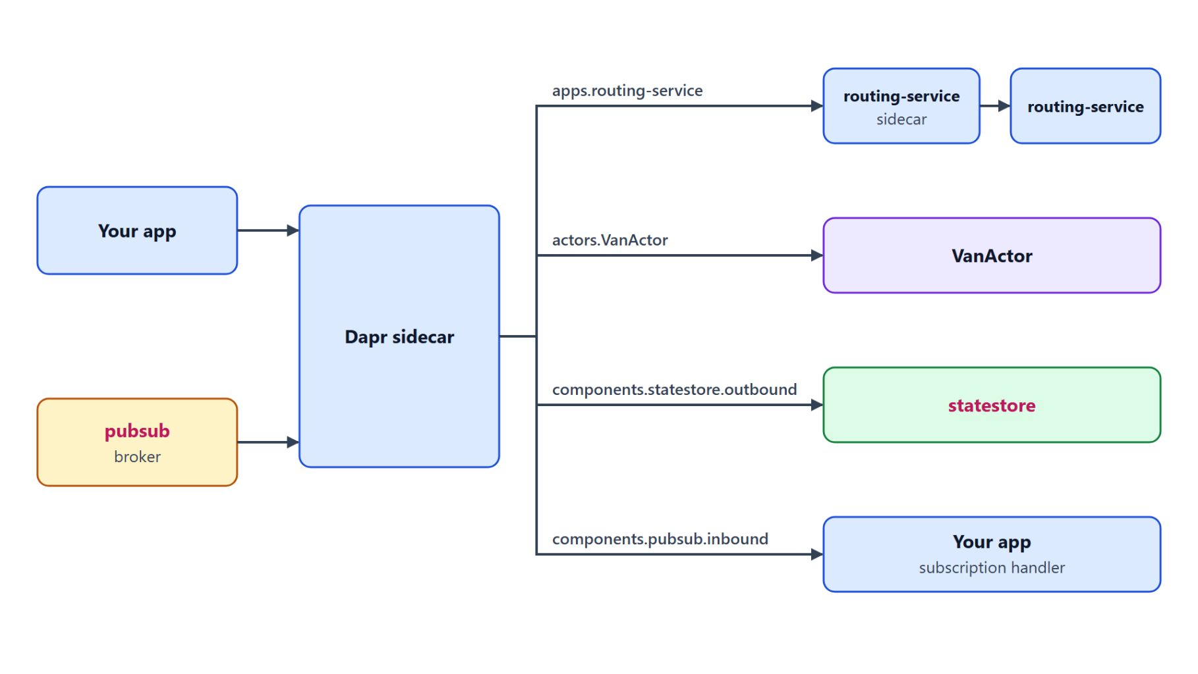
Resiliency targets
Policies keyed by app ID, actor type or component name
apps keys policies by app ID, actors by actor type, components by component name
outbound protects the call to the store, inbound the delivery to your app
Container Apps offers Dapr component resiliency as a preview feature
az containerapp env dapr-component resiliency create attaches a policy to a component
Service discovery resiliency does not apply to Dapr service invocation
Notes:
A target decides where a policy applies. The same named policies can protect a peer service, an actor type, a store and a broker.
Three sections: the `apps` section keys entries by app ID, the `actors` section by actor type such as `VanActor`, and the `components` section by component name.
Direction: component targets split into `outbound` for calls from the sidecar to the component, such as the state write, and `inbound` for delivery of a subscription message from the component to your app.
Container Apps: the preview feature offers the same policy model for components on a managed Dapr environment, with timeouts, HTTP retries and circuit breakers. You attach a policy to a component already registered on the environment.
The CLI: the command attaches, for example, an outbound timeout to the component `pubsub`, then you restart the Dapr applications. The portal supports only timeout and retry policies, so check circuit breaker behaviour against your CLI version.
Service discovery: that separate Container Apps feature covers requests addressed by container app name, not calls through the Dapr Service Invocation API. Dapr calls use the Dapr spec or the component policy.

Slide 23
06
Dapr Actors: Virtual Actor Model
VanActor, turn-based calls, timers and reminders
Event-Driven Distributed Apps on Azure: Aspire, Dapr & Durable Execution

Slide 24
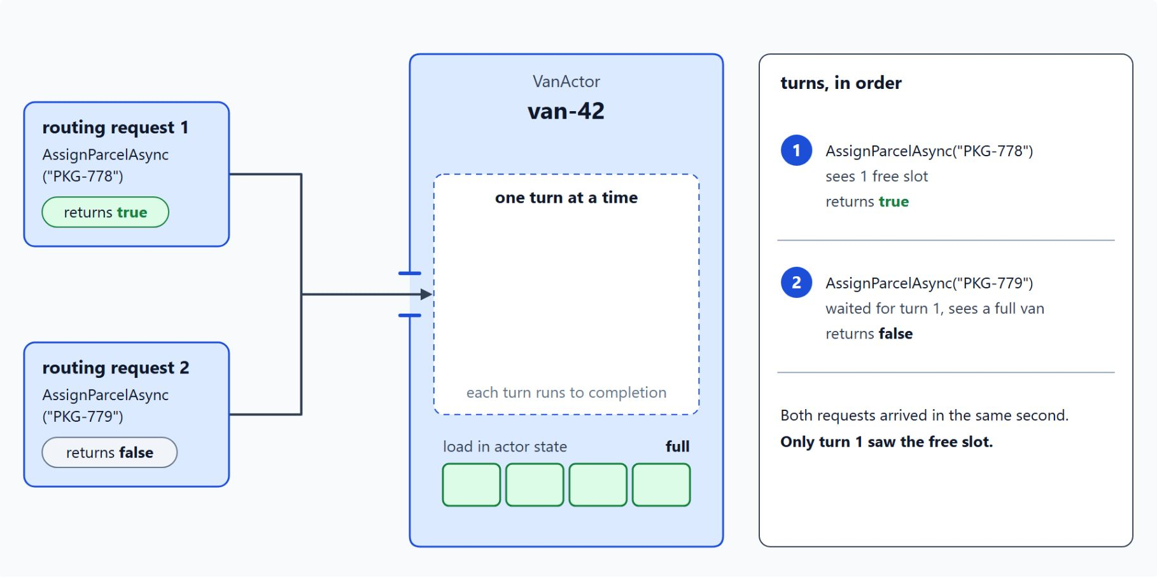
Virtual actors and turn-based access
Each van is an actor that handles one call at a time
The runtime activates an actor on the first request for its ID
Idle actors are garbage-collected and come back with their saved state
Calls run one at a time, so two assignments for van-42 never share a free slot
IVanActor derives from IActor, VanActor from Actor; callers use ActorProxy.Create
All actor types share one actor state store that supports transactions
Notes:
Each van has one piece of state that changes all day: the parcels on it and its last position. Two routing requests can arrive for the same van in the same second, and both must see the true load.
Activation: an actor is a unit of state and behaviour with an identity, and the runtime activates it the first time a request arrives for its ID. You never create or destroy one explicitly.
Deactivation: when an actor stays idle, the runtime garbage-collects the in-memory object but keeps the actor known. The next request reactivates it with its saved state.
Turn-based access: each method call or timer callback runs to completion before the next one starts, so actor code needs no locks for its own data. In the diagram `PKG-778` takes the last slot on `van-42`, and `PKG-779` waits, sees a full van and gets `false`.
The .NET shape: the interface derives from `IActor`, the class derives from `Actor` and receives an `ActorHost`. `AddActors` and `MapActorsHandlers` host it, and `ActorProxy.Create<IVanActor>` routes each call to the instance that holds the state.
State store: the runtime persists actor state in the state store, so the load survives restarts. The Cosmos DB component marks itself as the actor store with `actorStateStore` set to `"true"`.

Slide 25
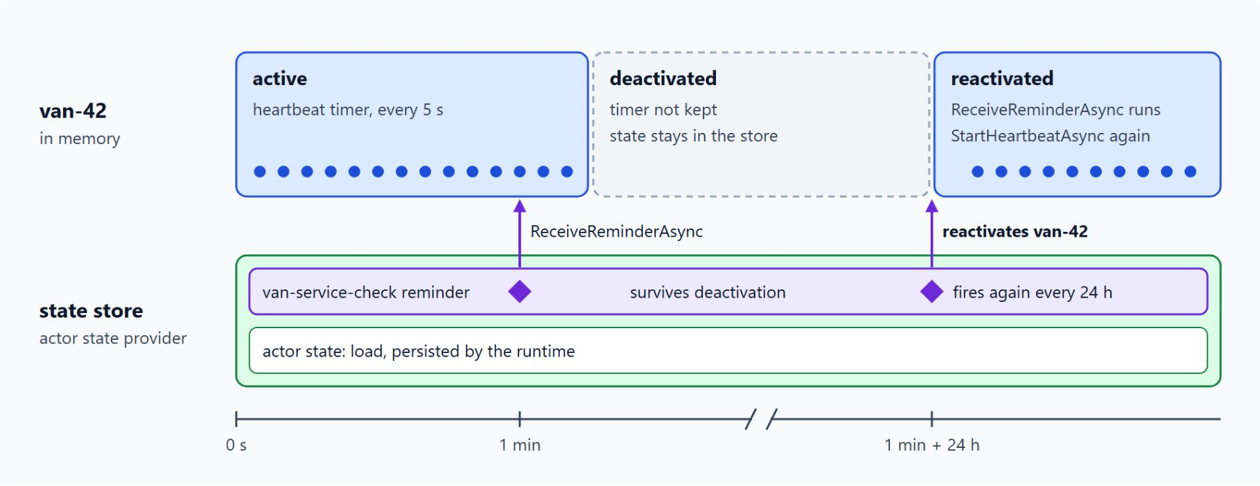
Timers and reminders
A heartbeat while the actor is active, a service check that survives deactivation
RegisterTimerAsync: a heartbeat every 5 s, only while the actor is active
RegisterReminderAsync: van-service-check every 24 h, persisted in the state store
The runtime calls ReceiveReminderAsync for every reminder that fires
Reminders cost more than timers, because the runtime writes them to storage
Container Apps does not run the actor packages: use the AppHost or AKS
Notes:
Actors can schedule their own work, and the choice between a timer and a reminder decides whether that work survives deactivation.
Timers: a timer calls back into the actor on a schedule and lives only while the actor is active. That suits a heartbeat check on an active van, which can restart on the next activation.
Reminders: a reminder is persisted through the actor state provider and survives deactivation and restarts. `VanActor` registers `van-service-check` with a due time of one minute and a period of 24 hours, a daily service check that must fire after hours of idle time.
Callbacks: the callback named in `RegisterTimerAsync` must match a method on the same class, and the runtime invokes `ReceiveReminderAsync` for every reminder that fires.
Cost: reminders cost more than timers because the runtime writes them to storage, and in Container Apps they need at least one replica to fire reliably.
Hosting rule: Container Apps states that the Dapr actor and workflow SDK packages are not compatible with it. Run `VanActor` locally with the Aspire AppHost or on AKS with the Dapr extension.

Slide 26
07
Managed Dapr: Container Apps vs. AKS
Component tiers, platform limits and the version window
Event-Driven Distributed Apps on Azure: Aspire, Dapr & Durable Execution

Slide 27
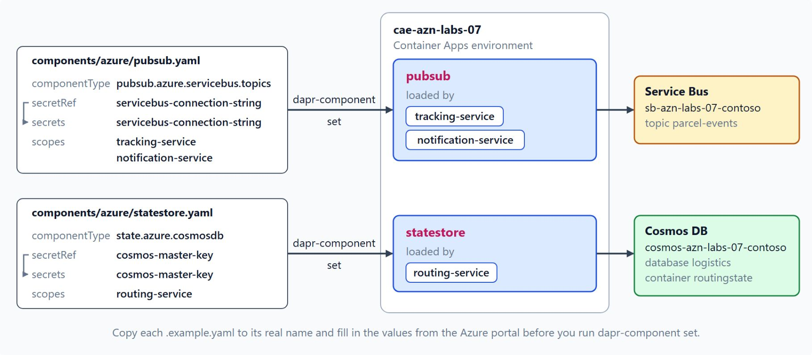
Dapr on Container Apps
Components live on the environment and scopes pick the app IDs
--enable-dapr and --dapr-app-id turn Dapr on per app
Components are defined once on the environment and scoped to app IDs
Tier 1 and Tier 2 only: Cosmos DB state and Service Bus topics are Tier 1
The platform picks and upgrades the Dapr version, with a suffix such as -msft.1
No actor or workflow SDK packages, and no Dapr for jobs or Container Apps Express
Notes:
Booking and tracking are stateless request handlers that suit Container Apps. This slide shows how managed Dapr works there and which limits come with it.
Per app: Container Apps enables Dapr through each app's Dapr settings, and the sidecar exposes the building block APIs on port 3500. Only the listed sidecar options are available, and the Dapr configuration spec is not supported.
Environment components: components are defined once on the managed environment, and their scopes list the app IDs that load each one. The diagram shows the lab's environment `cae-azn-labs-07`, where `pubsub` goes to `tracking-service` and `notification-service`, and `statestore` to `routing-service`.
Tiers: Tier 1 components get immediate investigation for security or serious regressions, Tier 2 components a lower priority. The Cosmos DB state store and the Service Bus topics component are both Tier 1.
Versions: you cannot choose a Dapr version, and the environment is upgraded automatically on a best-effort basis. Planned maintenance controls when upgrades happen, not which version arrives.
Limits: the Dapr server extensions, actor and workflow SDK packages are not compatible with Container Apps, and Dapr is not supported for jobs. Container Apps Express supports neither Dapr nor jobs.

Slide 28
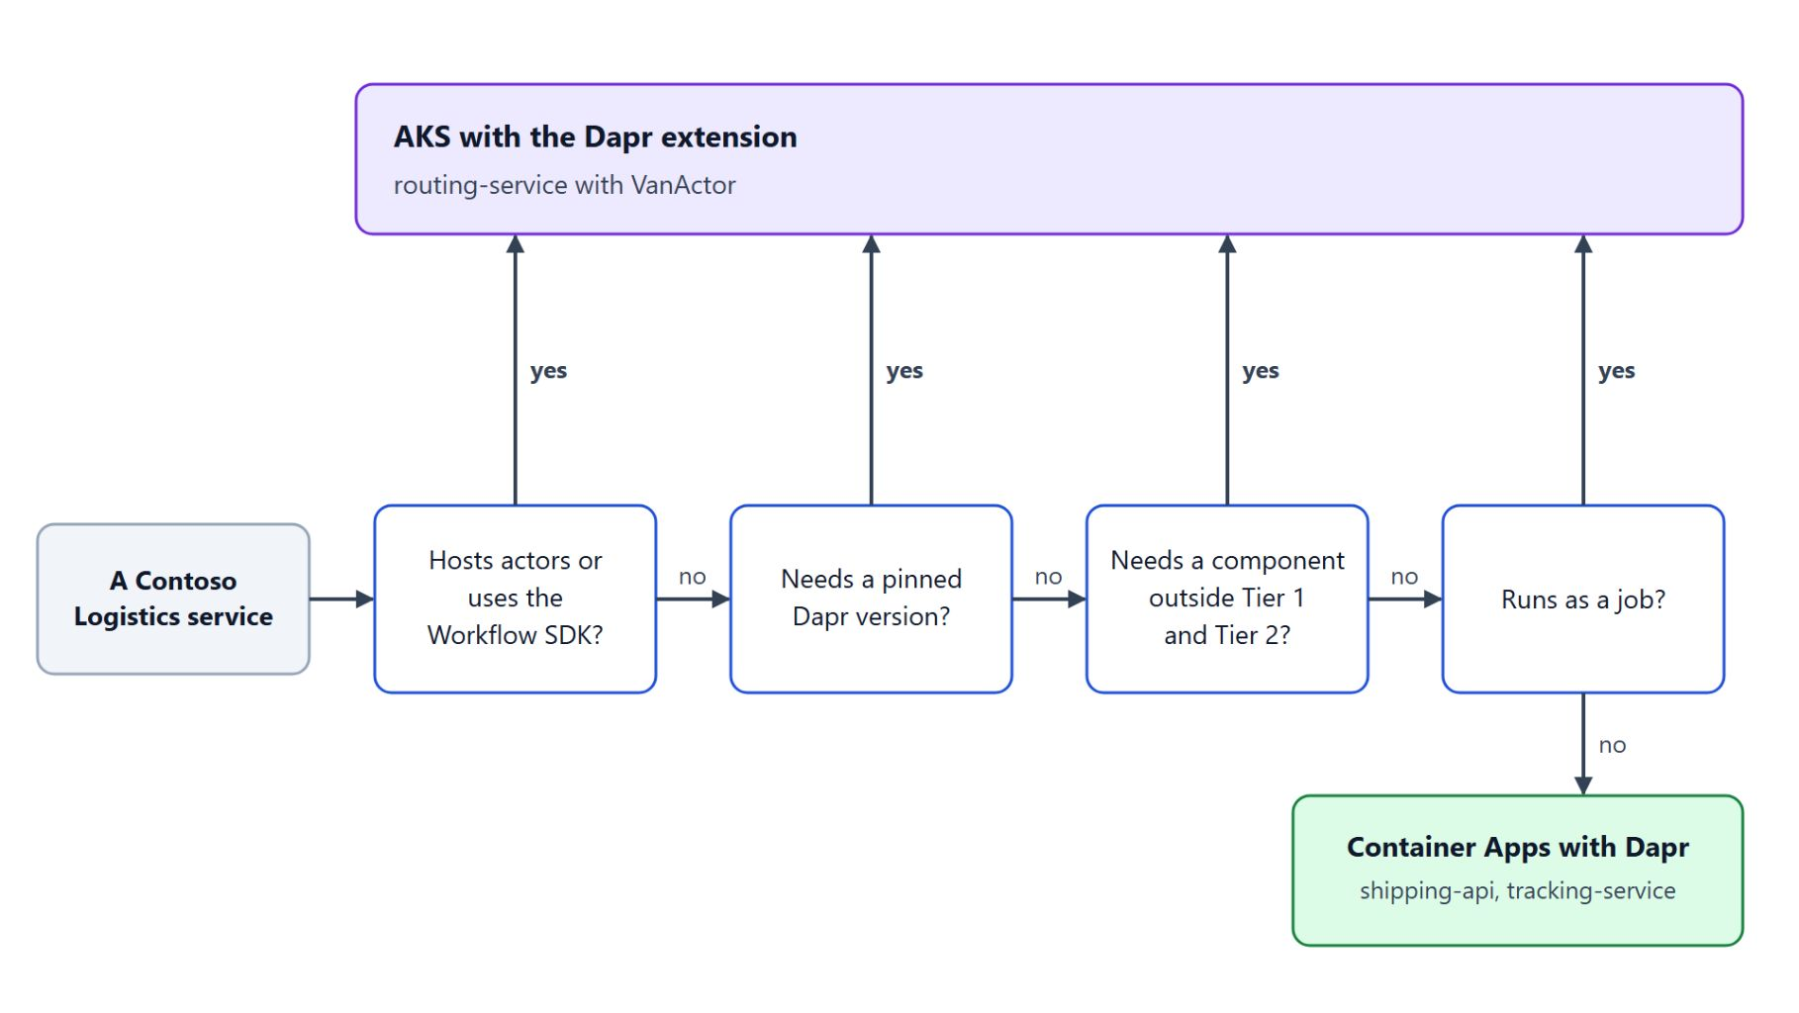
Choosing Container Apps or AKS
Four questions decide where a service runs
AKS installs Dapr as the Microsoft.Dapr cluster extension
The extension supports the current and the previous Dapr version
Pin a version with --version and --auto-upgrade-minor-version false
High availability and mTLS are on by default: three control-plane replicas
Container Apps for stateless Tier 1 services, AKS for actors and pinned versions
Notes:
Both platforms offer Dapr, but they differ in who picks the version, which components are supported and which features exist at all. The decision flow asks four questions per service.
The extension: the Dapr extension for AKS is a cluster extension of type `Microsoft.Dapr`, so it follows the AKS support policy.
Version window: the extension supports the current and the previous Dapr versions, and keeping inside that window is the cluster owner's job. An old cluster may need intermediate upgrades.
Pinning: `stable` is the default release train, and `dev` carries experimental features unsuitable for production. Set `--version` together with `--auto-upgrade-minor-version false` to pin a version.
Defaults: a new cluster starts with three control-plane replicas and workload certificates that last 24 hours. The Container Apps actor restriction does not apply, so AKS is the path for `routing-service` with `VanActor`.
The rule: choose Container Apps for stateless services on Tier 1 components and accept the platform's upgrade timing. Choose AKS for services that host actors, need a pinned version or depend on a component outside the Container Apps list.

Slide 29
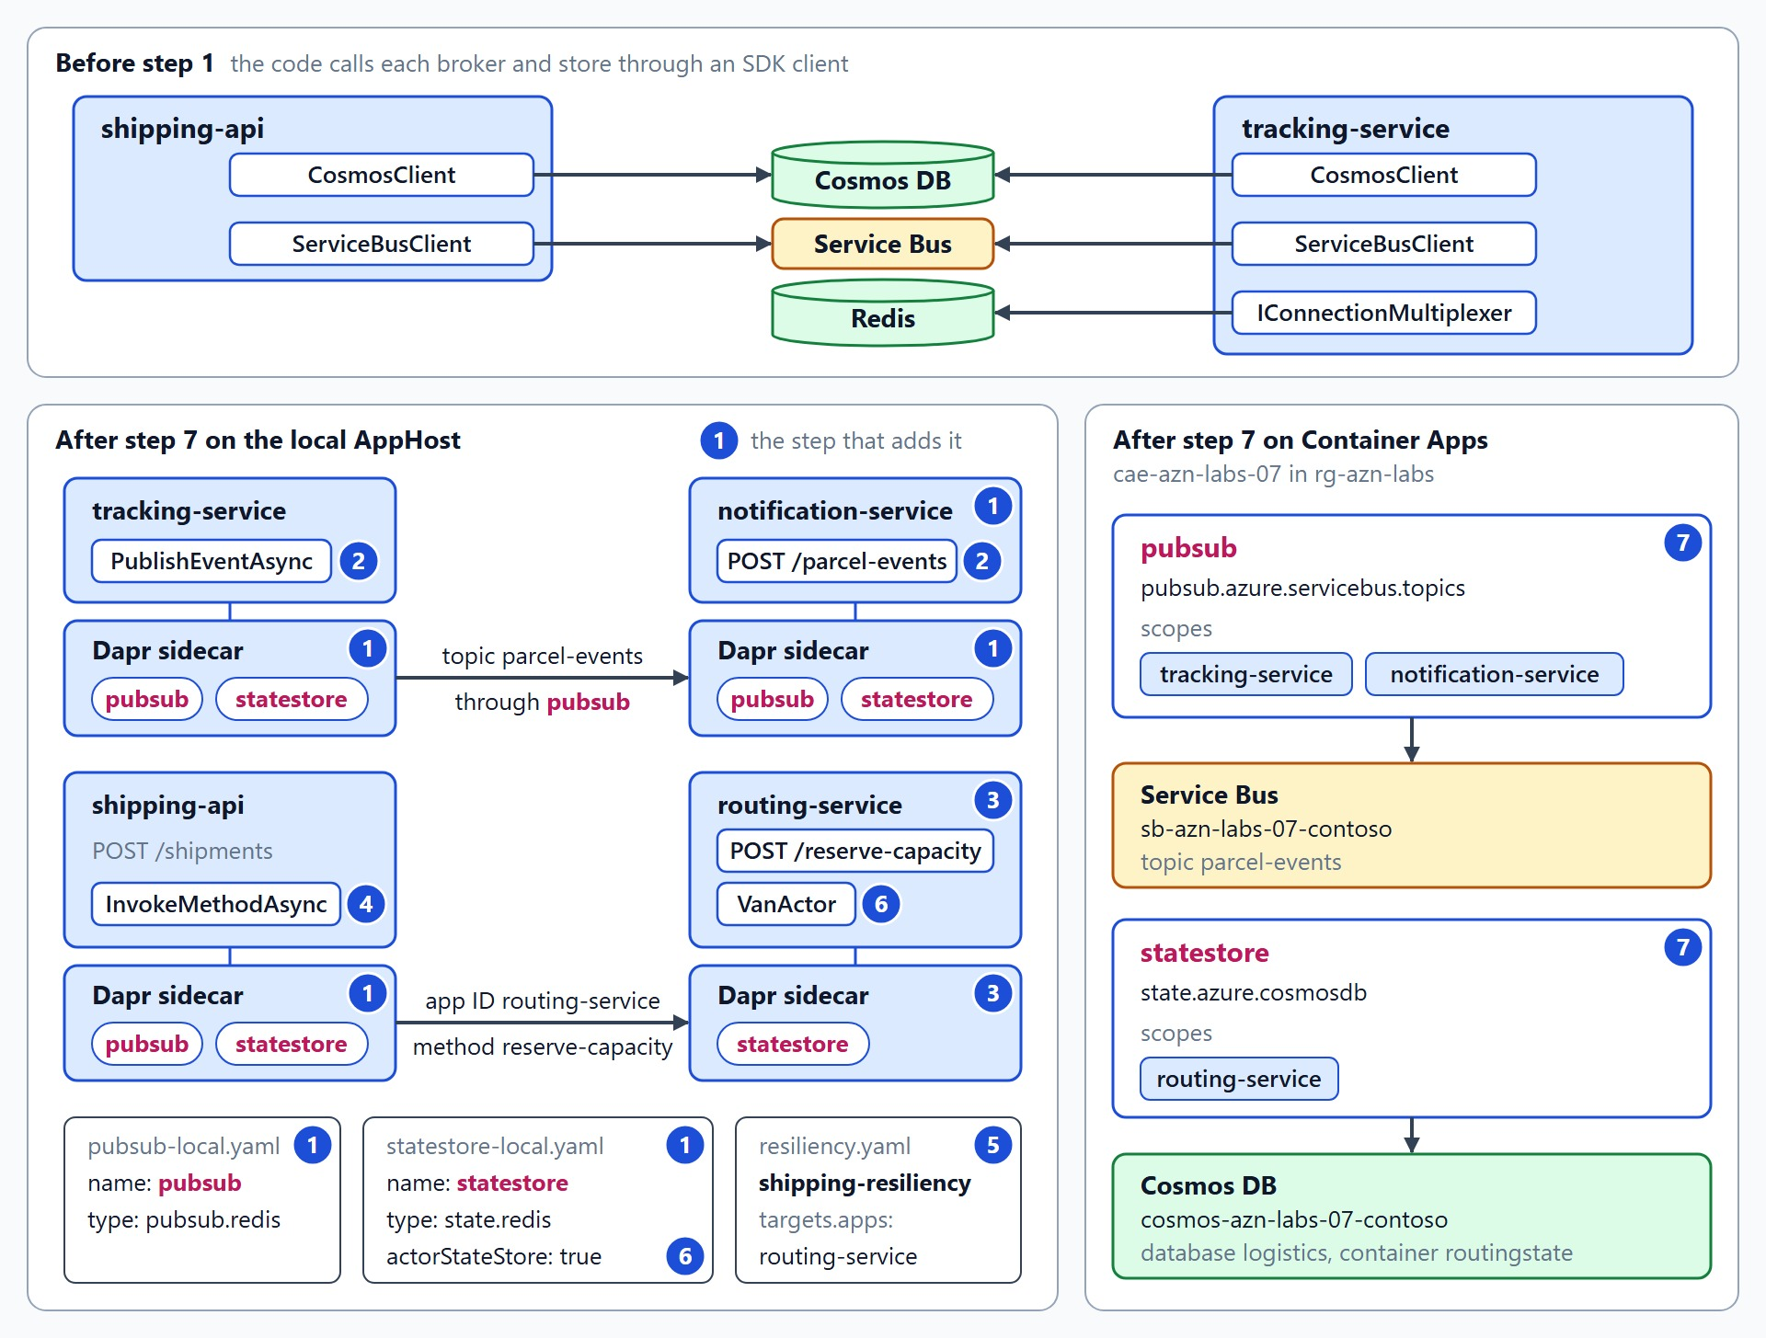
What the lab builds
Scan, tracking, notification and routing flows on Dapr building blocks
Sidecars with the Redis components pubsub and statestore (step 1)
Scan events on parcel-events, with the tracking number as SessionId (step 2)
routing-service: an assignment with an ETag check, called by app ID (steps 3 and 4)
One resiliency spec and one VanActor per van (steps 5 and 6)
The same component names on cae-azn-labs-07, backed by Service Bus and Cosmos DB (step 7)
Notes:
The lab starts with the Contoso Logistics services calling Service Bus, Cosmos DB and Redis through their own SDKs, and moves them onto Dapr building blocks in about 65 minutes. What you practise is swapping an infrastructure dependency behind a named building block.
Step 1: a new `notification-service` joins, and the AppHost gives `tracking-service`, `notification-service` and `shipping-api` sidecars that load `pubsub` and `statestore`, both on the Redis container from `dapr init`. Push back if a sidecar starts with no component file behind it.
Step 2: `tracking-service` publishes each `ParcelScanned` through `pubsub` to `parcel-events` with the tracking number as `SessionId`, and `notification-service` receives it through a Dapr subscription. No `Azure.Messaging.ServiceBus` type stays in this flow.
Steps 3 and 4: the new `routing-service` stores each parcel assignment with first-write-wins and returns a conflict for a second van. `shipping-api` reaches it with `InvokeMethodAsync` by app ID and builds no host name.
Steps 5 and 6: one resiliency spec holds the timeout, the retries on 500 to 599 and the breaker, so `shipping-api` keeps no retry loop. `VanActor` keeps each van within its capacity and runs on the local AppHost only.
Step 7: the Azure component files register `pubsub` and `statestore` on `cae-azn-labs-07` with Tier 1 types and scopes. Push back if an Azure file uses a Redis type, because Redis is Tier 2 on Container Apps.

Slide 30

Takeaways
What to carry into durable execution
The code names a component, and the component file picks the Azure service
Call services by app ID and leave the retries to the resiliency spec
Write once-only transitions with an ETag and first-write-wins
Give each van a VanActor, hosted on the AppHost or AKS
Stateless Tier 1 services go to Container Apps, actors and pinned versions to AKS
Notes:
Close with the decisions this module asks for, each one made in a file or a hosting choice rather than in scattered SDK code.
Components: the code names `pubsub` and `statestore`, and the YAML decides whether Cosmos DB, Service Bus or Redis sits behind them. A broker swap replaces a file and leaves the publisher and subscriber alone.
Calls and policies: services reach each other by app ID over mTLS, and timeouts, retries and breakers live in one resiliency spec instead of retry loops in the caller.
State: a transition that must happen once, such as a booking moving from Booked to PickedUp, uses an ETag with first-write-wins and a bounded reread loop.
Actors: `VanActor` runs one call at a time per van, so capacity holds without locks. The actor packages do not run on Container Apps, so it lives on the AppHost or AKS.
Hosting: Container Apps manages the version and limits the components, AKS hands you the version window. The next module, durable execution, builds on these services to make long-running processes survive restarts.

