Slide 1



Fast Lane Group
Worldwide Education &
Professional Services
www.flane.de | © 2026 Fast Lane Institute for Knowledge Transfer GmbH
Notes:
Die Fast Lane Gruppe.
Fast Lane … Dienstleister u. Spezialist für High-End Technologie und Business Trainings
IT Trainings zu den unterschiedlichsten Herstellern wie Microsoft, Google, Cisco oder AWS. Und vielen weiteren wichtigen IT Herstellern.
Sei es Cloud, Security, Netzwerk oder allgemein digitale Transformationsprojekte
Und das seit 2003.
Das spannende ist, dass die Fast Lane Gruppe bereits seit 2009 durchgängig zu den Top 20 Unternehmen in der IT Trainingsbranche weltweit zählt.
Aber auch Footprint ebenso im klassischen Professional Services Bereich für unsere wichtigsten Hersteller
PreSales Support, Deployment Services und Adoption Trainings
Additional Information:
Im Jahr 2021 sind wir zur „most strategic IT Education company worldwide“ von der IDC im „magic quadrant“ aufgeführt worden !
1 mio Teilnehmer insgesamt seit bestehen, 50.000+ Students ww p.A, 20.000 in DE pro Jahr

Slide 2

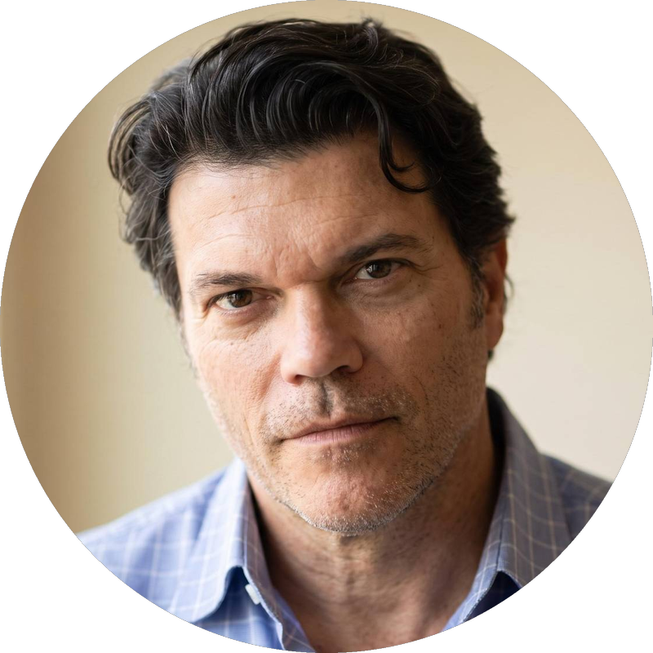




AGENTIC AI: FROM STRATEGY TO PRODUCTION.
Alexander
Kastil
AGENTIC AI CONSULTING · VIENNA
Full stack, from enterprise software to agentic AI. Since 1996
AI at Work
Enterprise AI
Value discovery, KPI mapping and roadmap
Governed multi-agent systems on Microsoft Copilot and Foundry
Agentic Software Engineering
Team Enablement
Harness architecture for Claude Code and GitHub Copilot
AI driven content production and delivery
integrations.at
github.com/alexander-kastil
SCAN TO CONNECT
alexander.kastil@integrations.at
linkedin.com/in/alexander-kastil
integrations.at
Notes:
Intro: Alexander Kastil, integrations.at. Four practice areas from AI at Work to team enablement. Certifications: Agentic AI Business Solutions Architect, Azure AI App and Agent Developer Associate, DevOps Engineer Expert.

Slide 3

MODULE 8
Durable Execution, Workflows & Sagas
Code that lets a long-running process survive restarts
Event-Driven Distributed Apps on Azure: Aspire, Dapr & Durable Execution

Slide 4
01
02
03
04
Durable Execution: Replay & Determinism
Event history, replay and the determinism rules
Durable Task Scheduler: Managed Backend
Task hubs, SKUs, the emulator and managed identity
Durable Functions: Orchestrations & Entities
Isolated worker, entities and the azureManaged provider
Durable Timers: External Events & Approvals
Delivery deadlines, approvals and RaiseEventAsync
05
06
07
Durable Task SDK: KEDA-Scaled Workers
Generic host workers that scale on the backlog
Dapr Workflow: Portable Orchestrations
Dapr.Workflow, Dapr 1.18 and AKS hosting
Saga Orchestration: Compensating Activities
Compensations in reverse, step roles and coordination
Event-Driven Distributed Apps on Azure: Aspire, Dapr & Durable Execution

Slide 5

Durable execution, workflows and sagas
Code that lets a long-running process survive restarts
Replay and determinism: the event history that lets an orchestration resume where it stopped
Backends and hosts: the Durable Task Scheduler, Durable Functions, KEDA-scaled workers and Dapr Workflow
The booking saga: delivery deadlines, customer approvals and compensations that undo finished steps
Notes:
This opening slide sets out the three themes of the module. Contoso Logistics books a parcel across capacity, payment and label services, and a process that restarts halfway has to resume where it stopped and undo the steps it already finished.
Replay and determinism: the runtime stores the result of each completed step in an event history and rebuilds state by replaying the orchestrator code. Every later topic depends on these rules.
Backends and hosts: the Durable Task Scheduler keeps orchestration state for Durable Functions and the Durable Task SDKs, and SDK workers scale with KEDA on Container Apps. Dapr Workflow is the portable option for services that already run on AKS with Dapr.
The booking saga: durable timers and external events wait for a delivery deadline or a customer decision without holding a worker. The saga refunds the payment and releases the capacity when a later step fails.

Slide 6
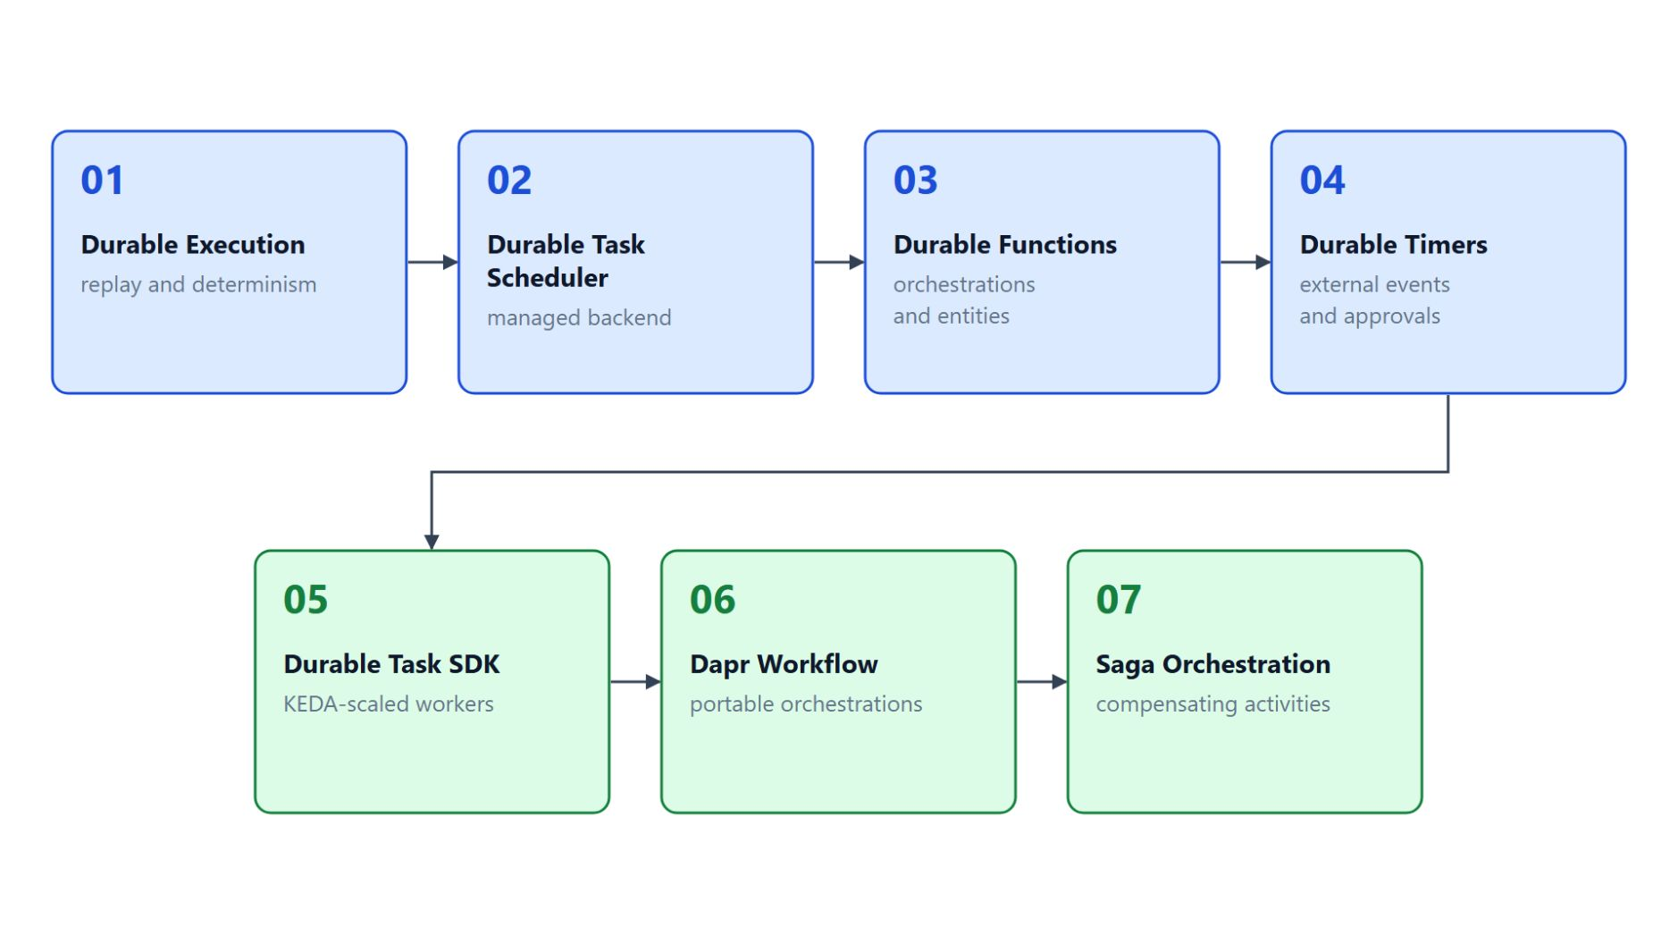
Overview
The path through durable execution
Start with replay and determinism, the rules every later topic depends on
Keep orchestration state in the Durable Task Scheduler and run it with Durable Functions
Wait for deadlines and approvals with durable timers and external events
Scale SDK workers with KEDA, or pick Dapr Workflow as the portable option
Combine the pieces into the booking saga with compensating activities
Notes:
This slide walks the path through the module's seven topics once, following the three themes of the title slide.
Replay and determinism: topic 1 explains how the event history rebuilds state and which calls an orchestrator must avoid. Every later topic depends on it.
The managed backend: topic 2 covers schedulers, task hubs, the two SKUs and the emulator, and topic 3 runs orchestrations and entities on that backend with Durable Functions.
Timers and events: topic 4 pauses an orchestration for a delivery deadline or a customer's reroute approval without holding a worker.
Workers and portability: topic 5 runs Durable Task SDK workers on Container Apps with a KEDA scale rule, and topic 6 shows Dapr Workflow as the portable alternative on AKS.
The booking saga: topic 7 combines the pieces into a saga that undoes completed steps in reverse order when a later step fails.

Slide 7
01
Durable Execution: Replay & Determinism
Event history, replay and the determinism rules
Event-Driven Distributed Apps on Azure: Aspire, Dapr & Durable Execution

Slide 8
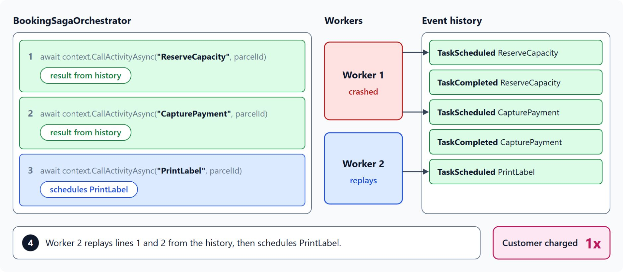
How replay rebuilds state
The event history lets a second worker finish the booking
Every scheduled activity, completed activity, timer and external event lands in the instance's event history
A worker runs the orchestrator from the first line, and each await with a recorded result returns it at once
After a crash, the next worker replays the history and schedules only PrintLabel, so the customer pays once
Local variables come back from the history; the code never writes them to a database
Between checkpoints the orchestrator leaves memory, so a long wait holds no worker
Notes:
A parcel booking touches capacity, payment and label services, and a plain function call loses its progress when the process crashes after the payment. This slide shows how durable execution stores each completed step, so the code resumes after the last step it finished.
Event history: the runtime appends an event for every scheduled activity, completed activity, timer and external event. The Durable Task Scheduler dashboard shows them as TaskScheduled, TaskCompleted, TimerCreated and EventRaised.
Replay from the first line: a worker that picks up an instance runs the orchestrator code from the top, and each await on a durable task receives its recorded result. The first await without a recorded result is the point where the instance waits.
The crash case: if the worker crashes after CapturePayment completes, the next worker receives the stored results for both earlier calls and schedules PrintLabel. The customer pays once, and the label prints on the second attempt.
Event sourcing: the Durable Functions docs describe this approach as event sourcing. Local variables survive a restart because the runtime rebuilds them from the history.
No memory while waiting: between checkpoints the runtime removes the orchestrator from memory, so a long wait for a customer decision holds no worker memory. For a stuck instance, the last completed event shows which step is blocked.

Slide 9
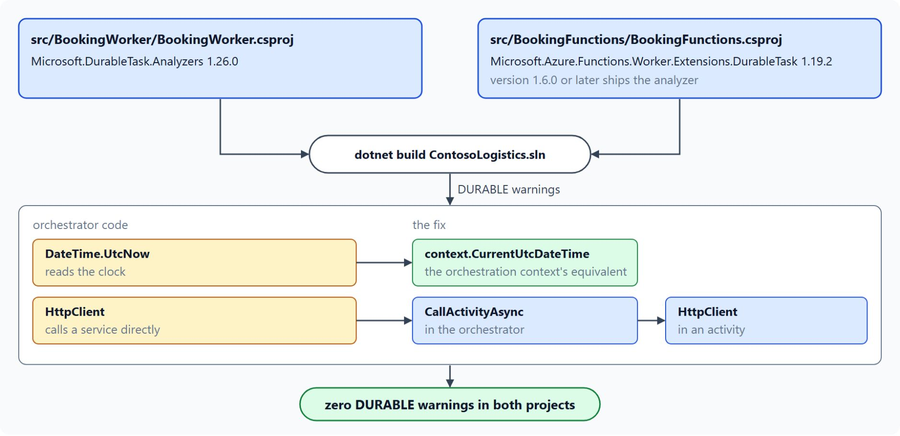
Determinism rules
Context APIs and activities replace calls that change on replay
Every replay must make the same decisions, so the clock, random values and network calls stay out
context.CurrentUtcDateTime, context.NewGuid() and context.CreateTimer replace the clock, GUIDs and delays
Activities hold the side effects: HttpClient, storage clients and Random
Activities run at least once, so each one must be idempotent
The Roslyn analyzer reports DURABLE0001 to DURABLE0011 before you merge
Notes:
Replay runs the orchestrator code again, and this slide turns that mechanism into rules for what the code may call. The diagram comes from the lab, where the analyzer finds two of these calls in the booking projects.
Same decisions on every replay: the test for any call is whether it returns the same value each time. Arithmetic and string formatting pass, while the clock, random values, network calls, static variables and environment variables fail.
Context replacements: context.CurrentUtcDateTime replaces DateTime.UtcNow, context.NewGuid replaces Guid.NewGuid, and context.CreateTimer replaces Task.Delay and Thread.Sleep. ILogger becomes context.CreateReplaySafeLogger.
Activities hold the side effects: HttpClient, storage SDK clients and Random belong in an activity whose result the history keeps. Several activities can run in parallel with Task.WhenAll, and each input or output is limited to 1 MB.
At least once: the runtime guarantees that each called activity runs at least once, so a retry after a crash can call it twice. A repeated call with the same input must produce the same outcome.
The analyzer: the Durable Task Roslyn Analyzer reports most of these cases as DURABLE0001 through DURABLE0011, including an unbounded while (true) loop without ContinueAsNew. Run it on every orchestrator project before you merge a workflow change.

Slide 10
02
Durable Task Scheduler: Managed Backend
Task hubs, SKUs, the emulator and managed identity
Event-Driven Distributed Apps on Azure: Aspire, Dapr & Durable Execution

Slide 11
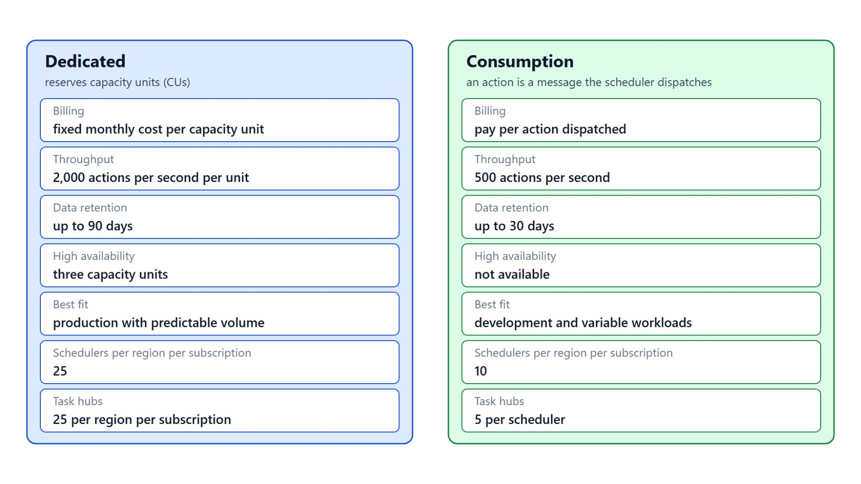
Schedulers, task hubs and SKUs
Dedicated reserves capacity, Consumption bills per action
A scheduler is the Azure resource; a task hub inside it holds the state of a set of orchestrations
Each app connects to one task hub, created with the durabletask CLI extension
Dedicated reserves capacity units at a fixed monthly cost, 2,000 actions per second each
Consumption bills per dispatched action, at 500 actions per second
Inputs and outputs are limited to 1 MB, instance IDs to 100 printable ASCII characters
Notes:
Orchestration state has to survive restarts and grow with the number of workers, and Contoso does not want to run and tune a state store for every booking service. The Durable Task Scheduler is the managed backend that keeps that state for Durable Functions and the Durable Task SDKs.
Scheduler and task hub: the scheduler is the Azure resource, and a task hub is a container inside it that holds the state of a set of orchestrations. The class creates the scheduler contoso-dts and the task hub bookings.
One task hub per app: each app connects to one task hub, and both are created after adding the durabletask extension to the Azure CLI. The example allow list 0.0.0.0/0 permits any IP address, so restrict it to your network ranges before production traffic.
Dedicated SKU: you reserve capacity units at a fixed monthly cost, each with 2,000 actions per second and up to 90 days of data retention. A single unit gives no redundancy, so a high-availability deployment needs three units.
Consumption SKU: you pay per action, a message the scheduler dispatches to an orchestrator, activity or entity, at 500 actions per second and up to 30 days of retention. It fits development and variable workloads and reached general availability in April 2026.
Limits on every SKU: an orchestrator, activity or entity input or output is limited to 1 MB, and a work item completion request to 3.9 MB. Instance IDs stay within 100 printable ASCII characters, and IDs that start with @ are reserved for entities.

Slide 12
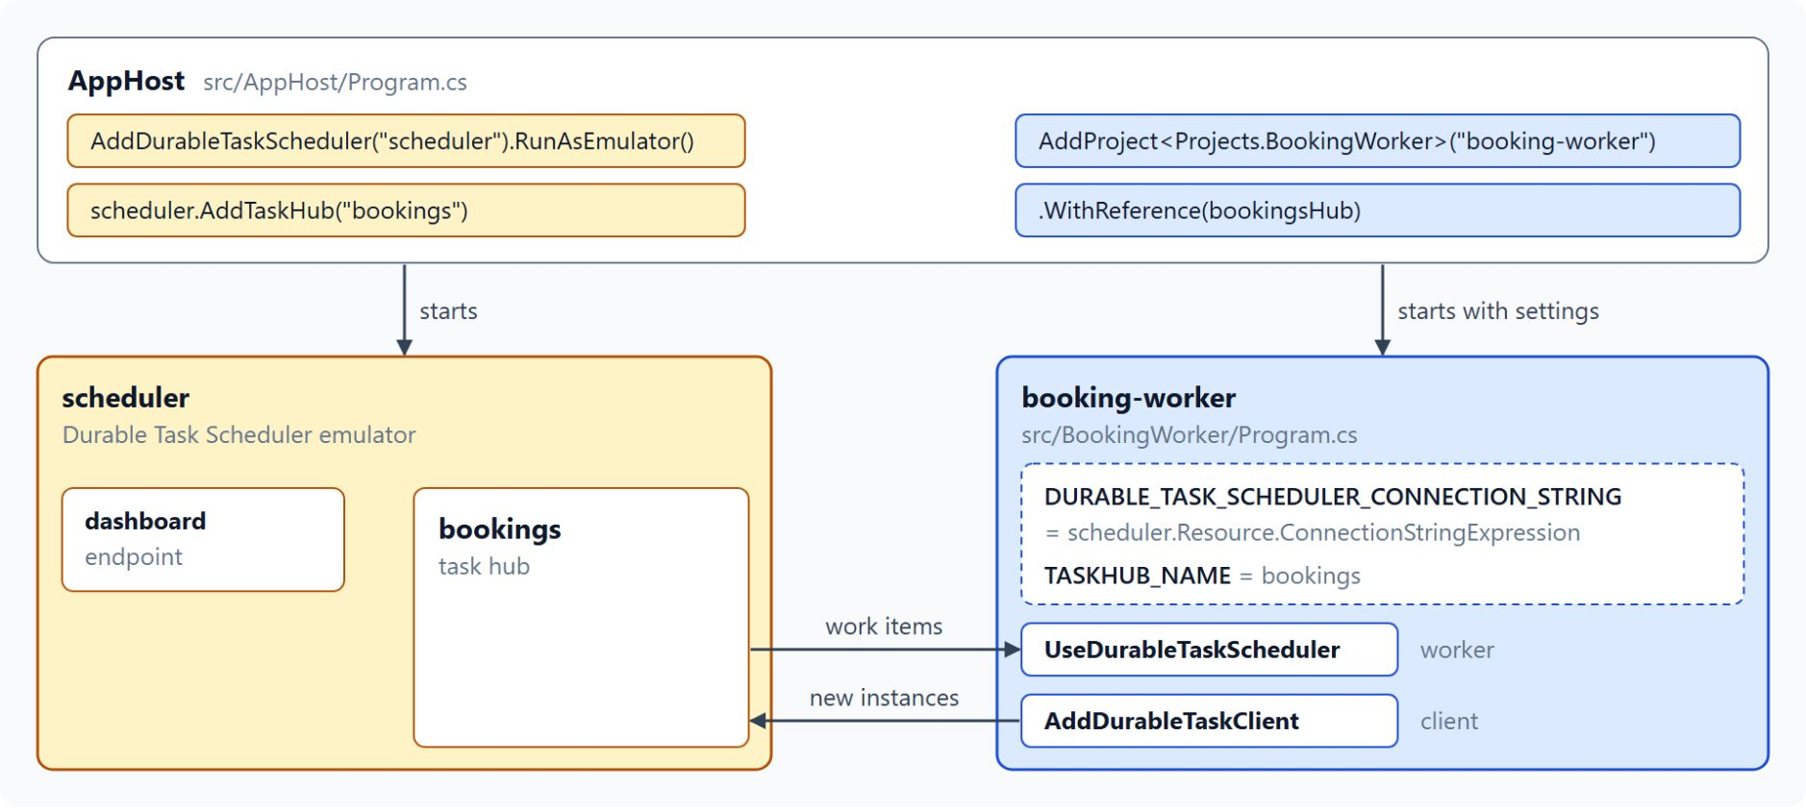
Emulator and connection strings
Local runs on the emulator, Azure apps use managed identity
The emulator runs the same protocol in Docker: port 8080 for the endpoint, 8082 for the dashboard
Under Aspire, RunAsEmulator() starts it and passes ConnectionStringExpression to the app
Local: Endpoint=http://localhost:8080;Authentication=None, with the task hub from TASKHUB_NAME
Azure: Authentication=ManagedIdentity with the client ID of a user-assigned identity
Grant Durable Task Data Contributor at the task hub scope
Notes:
This slide moves from the Azure resource to the connection your app opens to it, locally and in Azure. The diagram comes from lab step 1, where the AppHost wires the emulator to the booking worker.
Emulator: it runs the same protocol in a Docker container, so you can develop without an Azure subscription. Bind ports 8080 and 8082 to loopback, because the emulator accepts unauthenticated requests.
Aspire: the AppHost starts the emulator with RunAsEmulator() and passes the scheduler's ConnectionStringExpression to the app, so no port is hard-coded. The dashboard endpoint of the scheduler resource opens the emulator dashboard.
Local connection string: it names the endpoint and Authentication=None, and the worker appends ;TaskHub= with the value of the TASKHUB_NAME setting.
Managed identity in Azure: the connection string carries the scheduler endpoint and the ClientID of a user-assigned identity, which Learn recommends because it outlives the app. The scheduler accepts managed identity only, never connection strings with storage keys.
Role at the task hub scope: Durable Task Data Contributor includes every other data role, and assigning it at the task hub follows least privilege. The dashboard also needs a role, and Learn names two different ones, so check the current dashboard page before you grant access to a team.

Slide 13
03
Durable Functions: Orchestrations & Entities
Isolated worker, entities and the azureManaged provider
Event-Driven Distributed Apps on Azure: Aspire, Dapr & Durable Execution

Slide 14
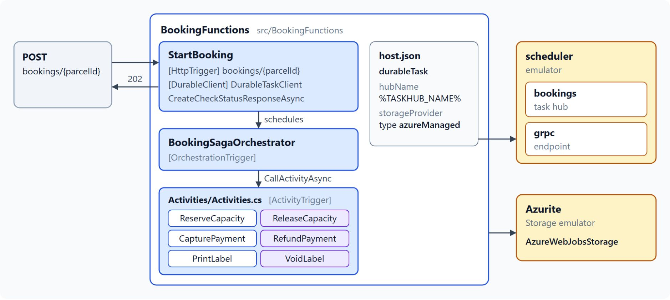
Orchestrations in the isolated worker
Orchestrator, activities and client on the azureManaged provider
The in-process model ends support on 10 November 2026, so use the .NET isolated worker
[OrchestrationTrigger] runs the orchestrator, [ActivityTrigger] the activities that do the I/O
The starter schedules through [DurableClient] and returns CreateCheckStatusResponseAsync
host.json selects the azureManaged provider and names the connection string setting
hubName must match the task hub that holds the instances
Notes:
Durable Functions adds orchestrations and entities to Azure Functions, and their state persists on the Durable Task Scheduler without a database you manage. The diagram shows the lab's BookingFunctions app, the booking saga hosted in Functions.
Isolated worker: the in-process model reaches end of support on 10 November 2026. The scheduler backend needs the Microsoft.Azure.Functions.Worker.Extensions.DurableTask.AzureManaged package, which the lab pins at version 1.10.4.
Orchestrator and activities: the orchestrator takes a TaskOrchestrationContext and calls activities by name, and an activity is an ordinary function that can perform I/O. Only orchestrators must stay deterministic, so route every service call through an activity.
Client start: the starter schedules the instance through the DurableClient binding and returns CreateCheckStatusResponseAsync. A GET on statusQueryGetUri returns the runtimeStatus and, once the instance completes, its output.
host.json: the azureManaged storage provider points the extension at the scheduler, and connectionStringName names the app setting that holds the connection string. The connection string itself belongs in an app setting, never in host.json.
Task hub name: hubName must match the task hub that holds the instances, because a mismatch makes the worker poll a different hub.

Slide 15
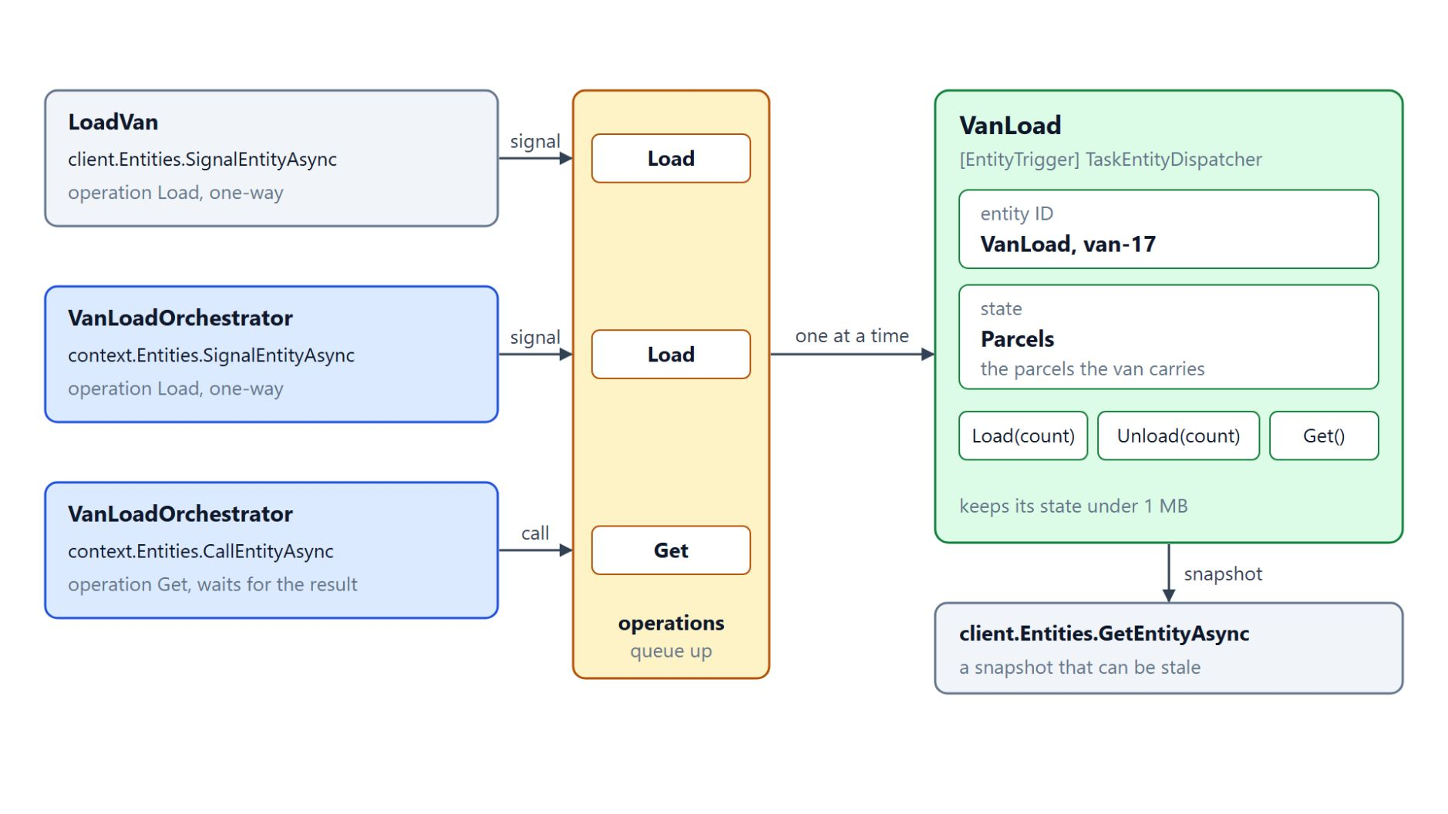
Durable entities for van load
One entity per van handles its operations one at a time
An entity holds a small piece of state and accepts operations from many callers
Contoso models each van as one VanLoad entity keyed by the van ID, such as van-17
A signal is one-way; a call from an orchestrator waits for the result
Concurrent signals queue up, so no two operations update the state at once
A read returns a snapshot that can be stale; keep each entity under 1 MB
Notes:
Contoso tracks how many parcels each van carries, and many scanners change that count at the same time. A durable entity gives that count a home that the scheduler persists.
Entities: an entity holds a small piece of state and accepts operations from many callers. VanLoad uses the POCO form, where the framework serializes the whole object, and TaskEntity<TState> is the other form, with a State property and constructor injection.
One entity per van: the entity ID combines the name VanLoad with the van ID, and the state counts the parcels with the operations Load, Unload and Get. The entity function dispatches them with TaskEntityDispatcher.
Signals and calls: clients and orchestrators send operations through the Entities property. A signal is one-way, so the caller never sees the result, while CallEntityAsync in an orchestrator waits for the operation's result.
One at a time: an entity processes its operations one after another, so concurrent signals to the same van queue up on that entity. No two operations update its state at once.
Reads and limits: GetEntityAsync returns a snapshot of the state, which can be stale by the time your code uses it. The isolated model serializes state with System.Text.Json, which compares property names case-sensitively, so keep the state type simple and under the 1 MB limit.

Slide 16
04
Durable Timers: External Events & Approvals
Delivery deadlines, approvals and RaiseEventAsync
Event-Driven Distributed Apps on Azure: Aspire, Dapr & Durable Execution

Slide 17
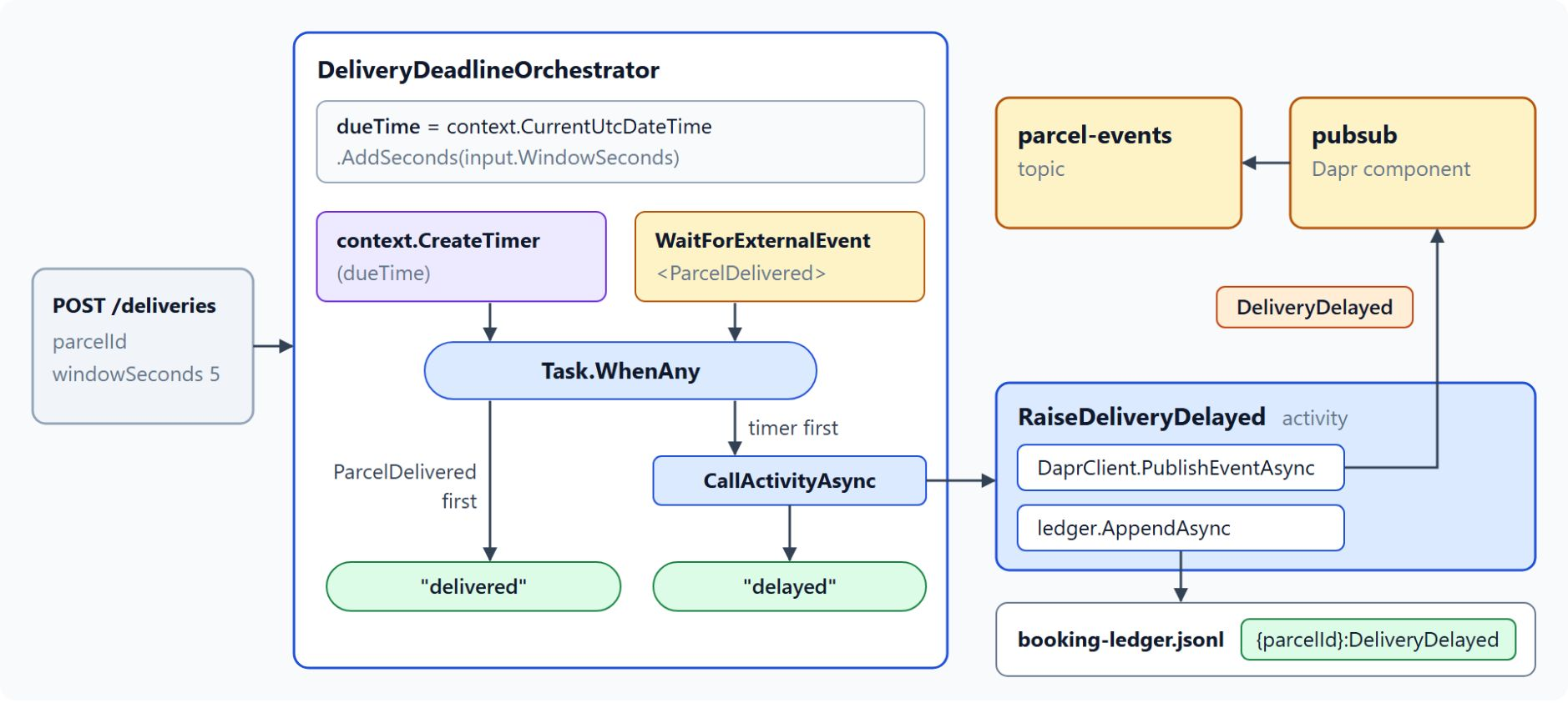
Durable timers and the delivery deadline
A durable timer races the ParcelDelivered event
CreateTimer completes at a future time; the timer is stored with the instance and survives a restart
Compute the due time from context.CurrentUtcDateTime, never DateTime.UtcNow
WaitForExternalEvent<ParcelDelivered> and the timer race in Task.WhenAny
When the timer wins, RaiseDeliveryDelayed publishes DeliveryDelayed to parcel-events
Cancel the timer that loses, because an outstanding timer keeps the orchestration open
Notes:
Every Contoso parcel has a promised delivery window, and when the window closes without a delivery the company must tell the customer. This slide shows how an orchestration waits for time without holding a worker.
Durable timers: the orchestrator awaits CreateTimer and sleeps until the due time, and the scheduler wakes the instance when the timer fires. While the timer is pending, the orchestration keeps processing other events.
Due time: pass the promised window from the booking as input and compute the due time from context.CurrentUtcDateTime. In Durable Functions, .NET and Java apps support timers of any length, while JavaScript and Python apps limit a single timer to six days.
The race: the orchestrator starts the window timer and WaitForExternalEvent for ParcelDelivered, then awaits whichever finishes first with Task.WhenAny. A scan that confirms delivery before the deadline returns delivered.
DeliveryDelayed: when the timer wins, the RaiseDeliveryDelayed activity publishes the event through the Dapr pubsub component to the parcel-events topic. Other services react to that event without knowing about this orchestration.
Cancel what you no longer need: the orchestration does not complete while a timer is still outstanding, so cancel the timer that lost the race.

Slide 18
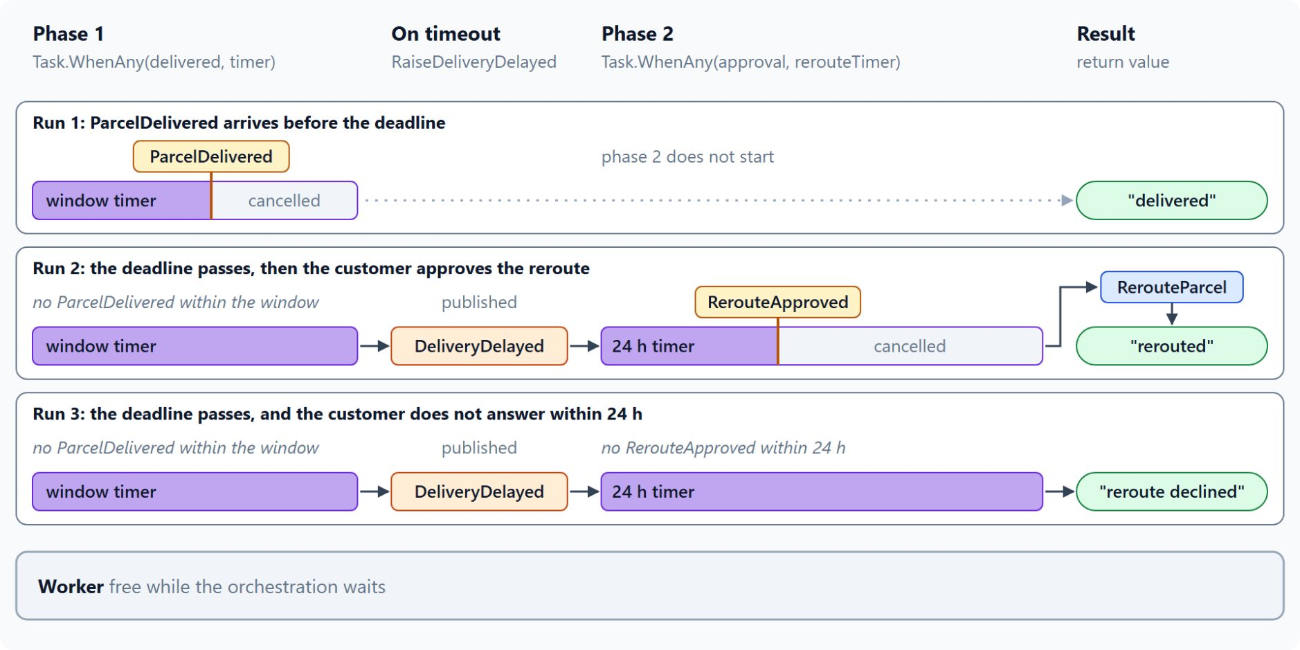
Reroute approval with external events
The approval races a 24-hour timer, RaiseEventAsync delivers it
An external event is a named message, and the name must match on both sides
Early events are buffered; events for unknown instances are discarded
Delivery is at least once, so put a unique ID in the payload
RerouteApproved races a 24-hour timer; a timeout returns reroute declined
RaiseEventAsync or the HTTP raiseEvent API delivers the approval behind a function key
Notes:
After a delayed delivery the customer decides whether to accept a reroute, and that decision may never arrive. This slide pairs the wait for a person with a timer and shows how the decision reaches the orchestration.
Named events: the orchestrator waits with WaitForExternalEvent<T>, and the event payload must serialize to T. A misspelled event name waits forever.
Buffered and discarded: an event that arrives before the orchestrator waits is buffered until the orchestrator asks for it. An event sent to an unknown instance is discarded, so check the instance ID before you raise an event.
At least once: a duplicate event can reach the orchestrator, so put a unique ID in the payload and check it where a duplicate would cause harm.
The approval race: after DeliveryDelayed the orchestrator waits up to 24 hours for RerouteApproved, runs RerouteParcel when the approval wins, and returns reroute declined on a timeout. On the Functions Consumption plan, no billing charges accrue while an orchestrator awaits an external event.
Raising the event: a web handler or a queue consumer calls RaiseEventAsync with the instance ID, the event name and the payload, and Durable Functions exposes the same operation as an HTTP API. Protect that endpoint with a function key and validate the approval before you send the event.

Slide 19
05
Durable Task SDK: KEDA-Scaled Workers
Generic host workers that scale on the backlog
Event-Driven Distributed Apps on Azure: Aspire, Dapr & Durable Execution

Slide 20
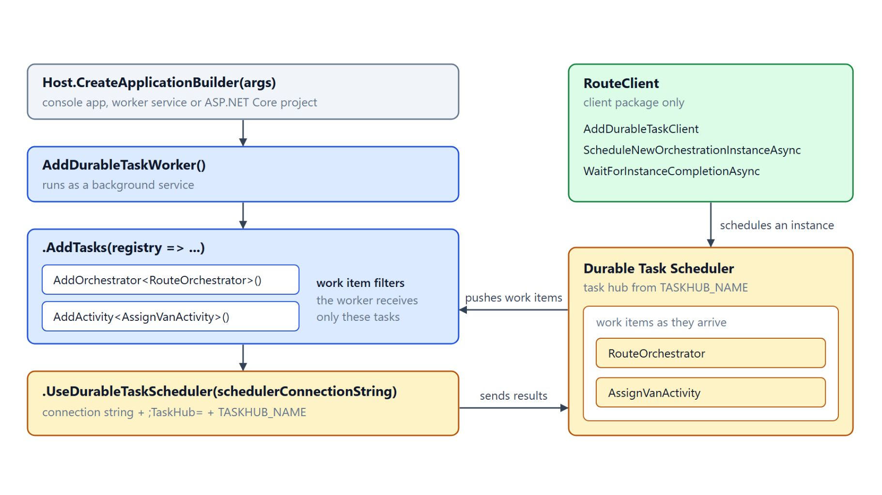
Worker and client packages
Orchestrations and activities on a generic host
The AzureManaged worker and client packages add UseDurableTaskScheduler to the builder
The worker registers RouteOrchestrator and AssignVanActivity during host setup
It runs as a background service in a console app, worker service or ASP.NET Core project
The scheduler pushes work items, and filters send each worker only the tasks it hosts
A service that starts instances installs only the client package
Notes:
Contoso's routing workers assign vans to parcels and do not need the Functions host, so they run as plain .NET services. The Durable Task SDK provides the worker and client libraries for them.
AzureManaged packages: Microsoft.DurableTask.Worker.AzureManaged and Microsoft.DurableTask.Client.AzureManaged connect to the Durable Task Scheduler and add UseDurableTaskScheduler to the builder. The worker project installs both.
Registration: AddDurableTaskWorker registers RouteOrchestrator and AssignVanActivity in AddTasks, and the worker appends the task hub from TASKHUB_NAME to the connection string. The orchestrator calls the activity with nameof, so renaming the class fails the build.
Generic host: the worker runs as a background service, so the same code works in a console app, a worker service or an ASP.NET Core project.
Push and filters: the scheduler pushes work items as they arrive, so the worker does not poll, and each replica processes several work items in parallel. The .NET SDK generates work item filters from the registered tasks, so a worker receives only the orchestrations and activities it hosts.
Client: a service that starts instances registers AddDurableTaskClient with the same connection string. RouteClient schedules the orchestration, waits with WaitForInstanceCompletionAsync and reads the output.

Slide 21
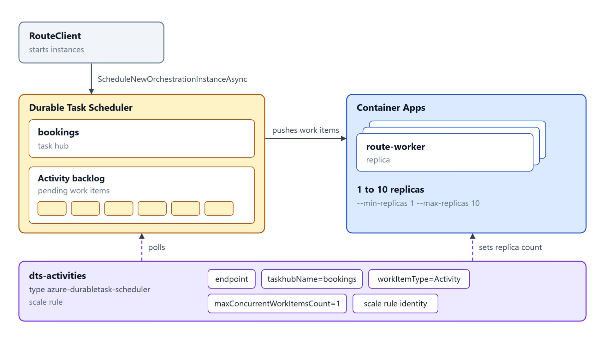
KEDA scale rule for workers
Container Apps adds replicas as the activity backlog grows
A custom rule of type azure-durabletask-scheduler polls the scheduler for pending work items
It sets endpoint, taskhubName, workItemType and maxConcurrentWorkItemsCount, plus a managed identity
A lower maxConcurrentWorkItemsCount adds replicas sooner; start at 1 for CPU-bound work
minReplicas 0 scales to zero, at the cost of a cold start
A CLI update replaces the rule, so add the orchestration rule with YAML or Bicep
Notes:
Worker load rises and falls with the number of waiting activities, so the replica count should follow the backlog. This slide shows the KEDA scale rule that Container Apps uses for Durable Task SDK workers.
Rule type: the worker container app scales with a custom rule of type azure-durabletask-scheduler. The rule polls the scheduler for pending work items of one work item type.
Metadata: endpoint names the scheduler, taskhubName the task hub, workItemType is Orchestration, Activity or Entity, and maxConcurrentWorkItemsCount sets how many work items one replica runs at once. The scale rule identity is a managed identity linked to the scheduler and task hub.
Tuning: a lower maxConcurrentWorkItemsCount makes the scaler add replicas sooner, so start with 1 for CPU-intensive work. Raise the value for I/O-bound work such as HTTP calls, which spends most of its time waiting on the network.
Scale to zero: minReplicas 0 removes every replica when no work is waiting, and the first work item after an idle period waits for a cold start. Keep one replica for latency-sensitive routes.
Revisions and the second rule: adding or changing a scale rule creates a new revision, so confirm that each revision holds the activity rule. Learn documents a second rule for orchestrations, which needs YAML or Bicep because a CLI update replaces the existing rule.

Slide 22
06
Dapr Workflow: Portable Orchestrations
Dapr.Workflow, Dapr 1.18 and AKS hosting
Event-Driven Distributed Apps on Azure: Aspire, Dapr & Durable Execution

Slide 23
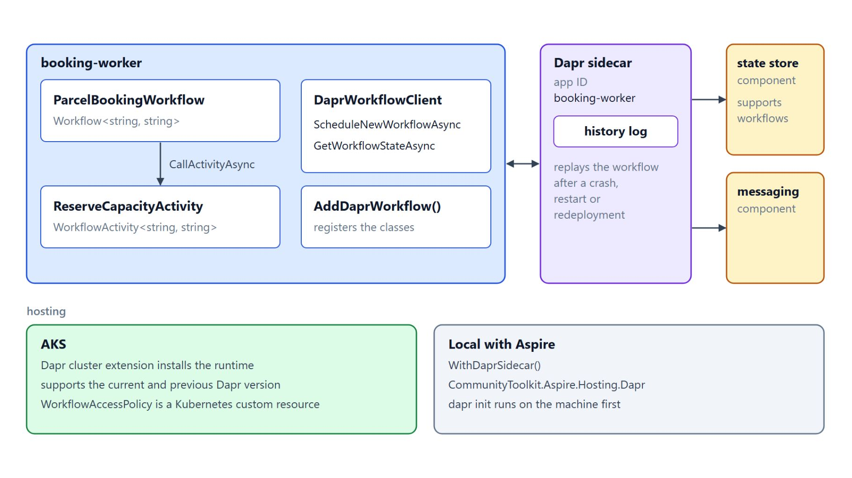
Workflows and activities in Dapr
A sidecar next to each service keeps the workflow history
A workflow derives from Workflow<TInput, TOutput>, an activity from WorkflowActivity<TInput, TOutput>
DaprWorkflowClient starts with ScheduleNewWorkflowAsync and reads GetWorkflowStateAsync
Dapr replays the code against its history log, so the determinism rules still apply
Dapr 1.18 can sign the history, and WorkflowAccessPolicy controls which apps invoke a workflow
Run it on AKS with the Dapr extension; locally, Aspire attaches the sidecar
Notes:
Contoso runs several services on AKS through Dapr, and the booking workflow should use the same sidecar model as the services it calls. Dapr Workflow gives durable behavior similar to the Durable Task model, with a runtime next to each service.
Workflow and activity: ParcelBookingWorkflow derives from Workflow<string, string> and calls ReserveCapacityActivity by name with CallActivityAsync. AddDaprWorkflow registers the services, and Dapr 1.18 registers the workflow and activity classes itself.
Client: an injected DaprWorkflowClient schedules the workflow and returns the instance ID, and GetWorkflowStateAsync reads the current state of that instance. The state store and messaging components are configuration, so the workflow code does not change when they do.
Replay: Dapr appends each step to the workflow's history log and replays the code against it after a crash, restart or redeployment, so the code must be deterministic. Read the workflow features and concepts page before you port an orchestrator from the Durable Task model.
Dapr 1.18: the release of 10 June 2026 can sign workflow history and verify it on every state load, which needs mTLS. The WorkflowAccessPolicy custom resource controls which app IDs can invoke which workflows and activities.
Hosting: Container Apps managed Dapr is not compatible with the workflow SDK packages, so the code runs on AKS, where the Dapr cluster extension installs the runtime. Locally, CommunityToolkit.Aspire.Hosting.Dapr attaches the sidecar after dapr init, but its tested Dapr version is older than 1.18, so check its compatibility notes.

Slide 24
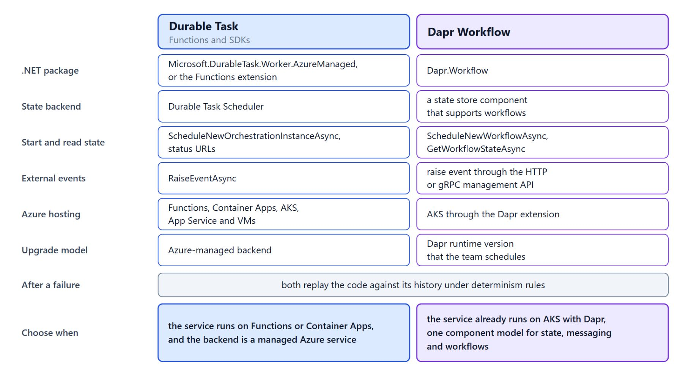
Dapr Workflow and Durable Task compared
Choose by hosting, portability and operations
Both persist progress and replay the code under determinism rules after a failure
Durable Task keeps its state in the managed Durable Task Scheduler
Dapr Workflow keeps it in a state store component and runs on AKS
Choose Durable Task on Functions or Container Apps with a managed backend
Choose Dapr Workflow when the service already runs on AKS with Dapr
Notes:
Both models persist progress and resume after a failure, so the choice depends on hosting, portability and operations. This slide compares them on the properties that matter for a service in this class.
Shared model: both replay the code against its history under determinism rules, which is why topics 1, 4 and 7 apply to either one.
Durable Task: it uses Microsoft.DurableTask.Worker.AzureManaged or the Functions extension, keeps state in the Durable Task Scheduler and starts instances with ScheduleNewOrchestrationInstanceAsync. It runs on Functions, Container Apps, AKS, App Service and VMs with an Azure-managed backend.
Dapr Workflow: it uses Dapr.Workflow, keeps state in a state store component that supports workflows and starts with ScheduleNewWorkflowAsync. It runs on AKS through the Dapr extension, on a Dapr runtime version the team schedules.
Choosing Durable Task: pick it when the service runs on Functions or Container Apps and the backend should be a managed Azure service.
Choosing Dapr Workflow: pick it when the service already runs on AKS with Dapr and the team wants the same component model for state, messaging and workflows.

Slide 25
07
Saga Orchestration: Compensating Activities
Compensations in reverse, step roles and coordination
Event-Driven Distributed Apps on Azure: Aspire, Dapr & Durable Execution

Slide 26
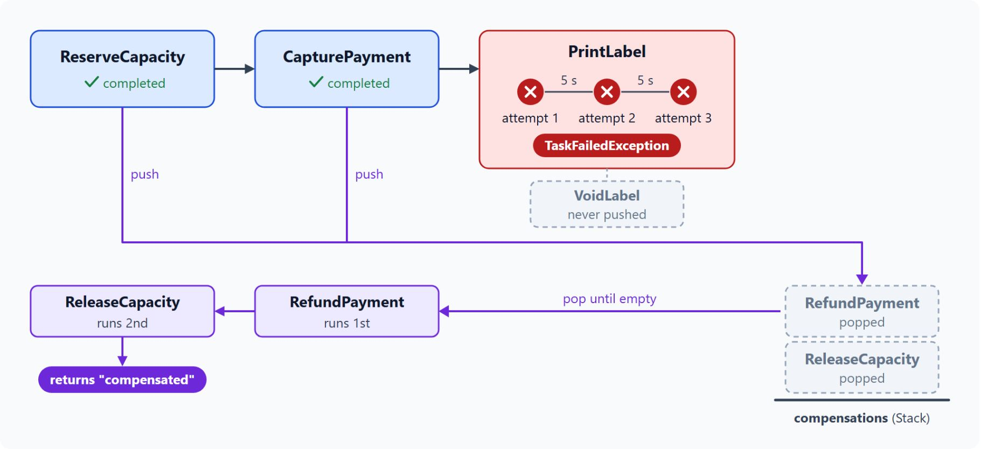
The booking saga and its compensations
Completed steps are undone in reverse order
Capacity, payment and the label each change their own database, so no single transaction covers them
Each forward step has one compensation: ReleaseCapacity, RefundPayment, VoidLabel
The orchestrator pushes a compensation onto a stack as each step completes
A TaskFailedException pops the stack, so the refund runs before the capacity release
A compensation that throws fails the orchestration, so make each one retryable
Notes:
Contoso books a shipment across three services, and if printing the label fails, the company must release the capacity and refund the payment. The saga pattern does this with a sequence of local transactions and a compensating action for each one.
Separate databases: capacity, payment and the label each change state in their own database, so no single transaction covers all three. The system still has to reach a consistent state when a step fails halfway.
Pairs: ReleaseCapacity reverses ReserveCapacity, RefundPayment reverses CapturePayment, and VoidLabel reverses PrintLabel.
The stack: the orchestrator records each compensation on a Stack<Func<Task>> as its forward step succeeds, so the last one pushed runs first.
Failure at PrintLabel: a TaskFailedException from any forward step pops the stack, so RefundPayment runs before ReleaseCapacity and the orchestrator returns compensated. VoidLabel never runs in this booking, because PrintLabel is the last forward step.
Retryable compensations: a compensation that throws fails the orchestration, so design each compensation to be retryable as well. Compensations can still fail, so alert in the dashboard on any orchestration that ends compensated or failed.

Slide 27
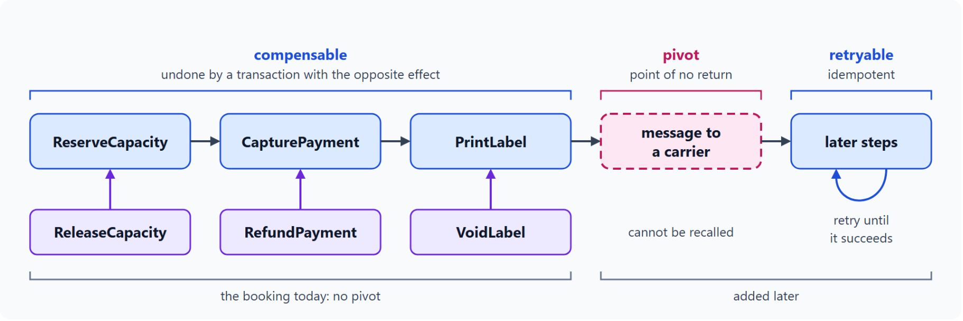
Pivot, retryable and compensable steps
The booking has no pivot today
A compensable step can be undone by a transaction with the opposite effect
The pivot is the point of no return, after which compensations no longer apply
A retryable step follows the pivot and must succeed eventually, so it has to be idempotent
All three booking steps are compensable, so the booking has no pivot
A message to a carrier would become the pivot, and the steps after it would need retries
Notes:
The Architecture Center sorts saga steps into three roles, and mapping the booking onto them comes before writing the orchestrator.
Compensable: another transaction with the opposite effect can undo the step.
Pivot: the pivot is the point of no return, after which compensations no longer apply.
Retryable: a step after the pivot must succeed eventually, so it has to be idempotent.
The booking today: ReserveCapacity, CapturePayment and PrintLabel are compensable, because ReleaseCapacity, RefundPayment and VoidLabel reverse them. The booking has no irreversible step, so it has no pivot.
A future pivot: a later step that cannot be recalled, such as a message to a carrier, would become the pivot, and the steps after it would need retries.

Slide 28
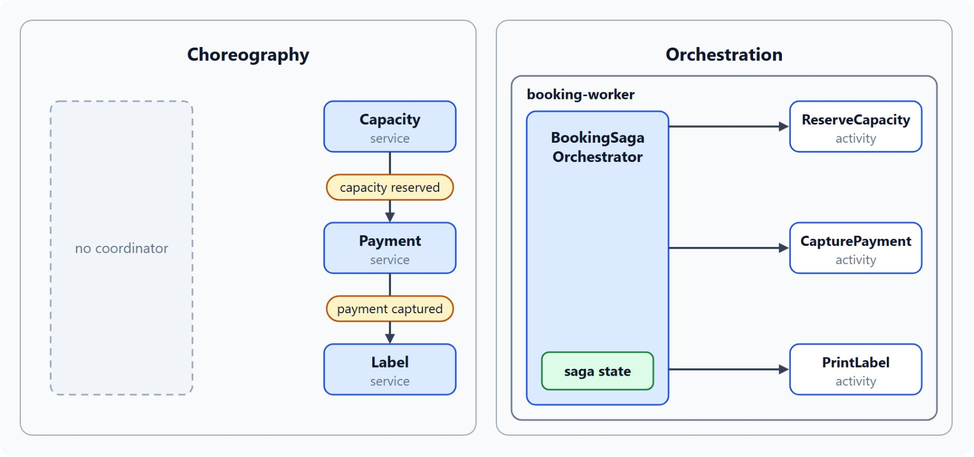
Choreography and orchestration
The booking uses one orchestrator for its three services
In choreography, each service publishes events and reacts to the events of others
It suits few services and simple flows, but grows hard to follow and to test end to end
In orchestration, one controller calls each participant and stores the saga state
It suits complex flows and growing service counts, and needs coordination logic
The booking uses orchestration; the Module 6 tracking projection uses choreography
Notes:
The Architecture Center describes two ways to coordinate a saga, and this slide places the booking on one side of that choice.
Choreography: each service publishes events and reacts to the events of others, and no coordinator exists.
Its trade-offs: choreography fits few services and simple flows, with no coordinator and no single point of failure. As the steps grow it gets hard to follow, risks cyclic dependencies and is hard to test end to end.
Orchestration: one controller calls each participant and stores the state of the saga.
Its trade-offs: orchestration fits complex flows and growing service counts, with clear responsibilities and no cyclic dependencies. It needs coordination logic, and the orchestrator manages the whole flow.
The booking: it has three services, a fixed order and compensations that must run in reverse, so it suits orchestration. The tracking projection from Module 6 suits choreography, because each event feeds an independent read model.

Slide 29
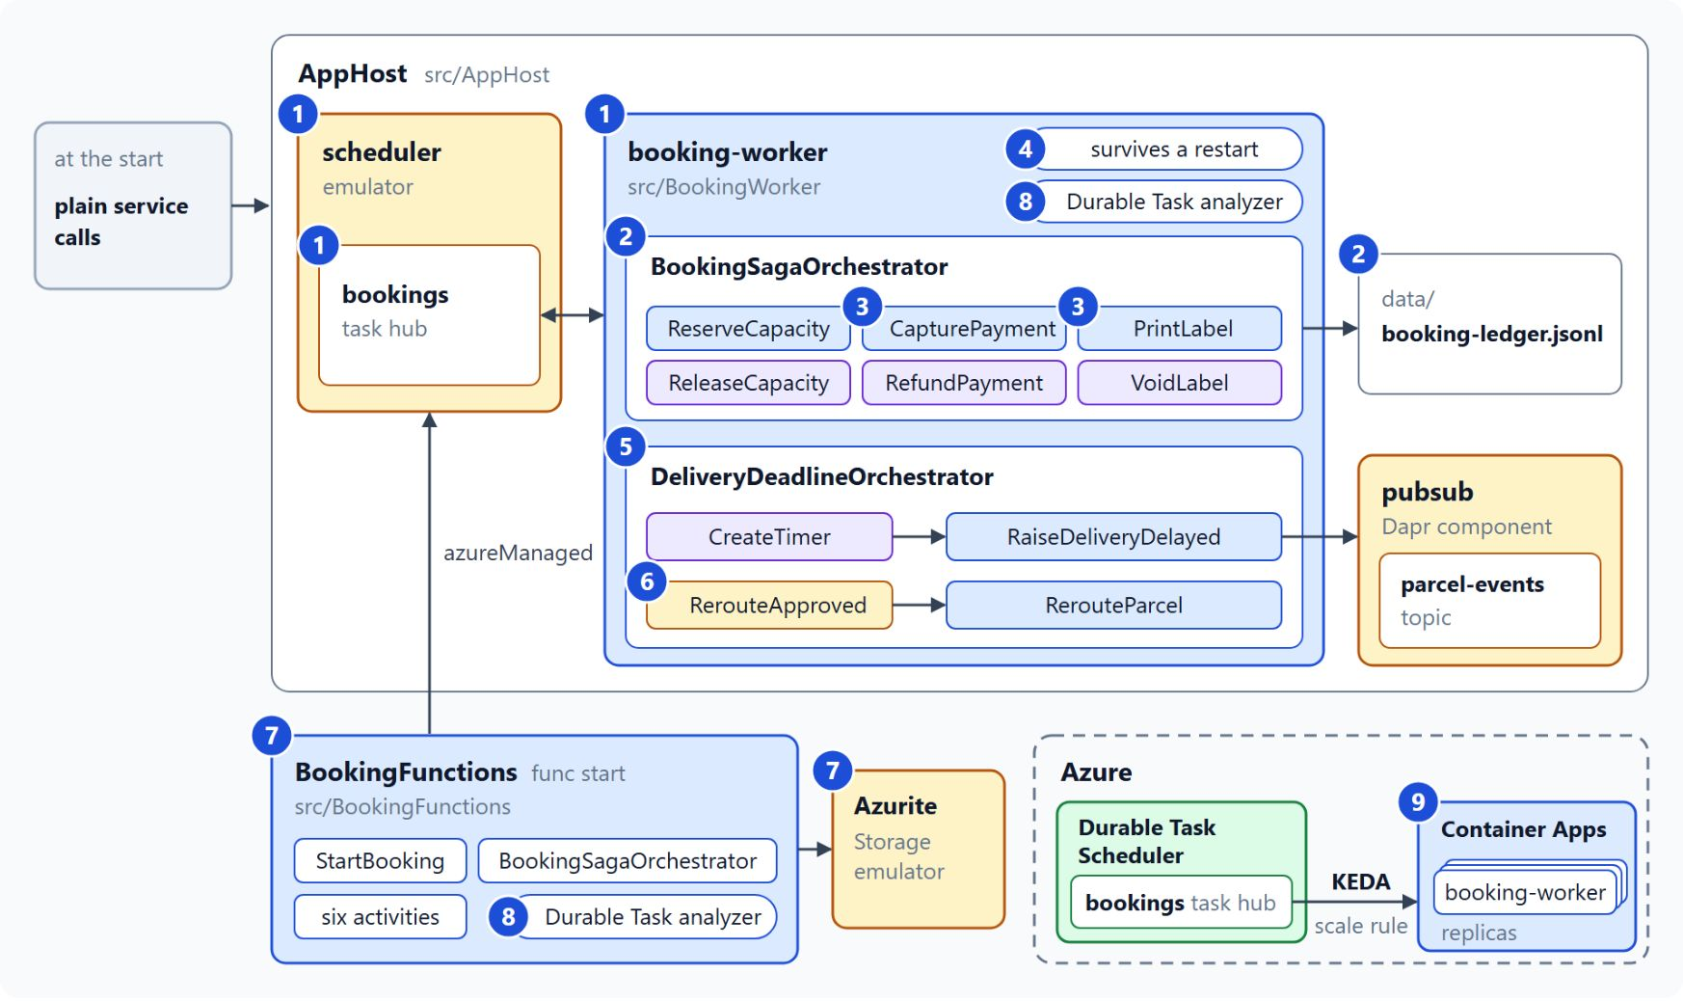
Orchestrate the booking saga
What the lab builds in nine steps
Steps 1 to 4: the saga on the emulator, its compensations, safe retries and a worker restart
Steps 5 and 6: a delivery deadline timer and the customer's reroute approval
Step 7: the same saga as Durable Functions on the azureManaged provider
Step 8: the Durable Task analyzer in both projects
Step 9: a KEDA scale rule for booking-worker on Container Apps
Notes:
Today the booking runs as plain service calls, so a crash between two calls can charge a customer and never print a label. The lab turns it into a durable saga in about 70 minutes, and the diagram marks each part with the step that adds it.
Saga and restart: steps 1 to 4 host booking-worker on the scheduler emulator, write BookingSagaOrchestrator with six activities and their compensations, add a retry policy and idempotency checks, then restart the worker in the middle of a saga. The saga resumes from its stored history.
Deadline and approval: steps 5 and 6 add DeliveryDeadlineOrchestrator, which raises DeliveryDelayed when the window closes and then waits up to 24 hours for RerouteApproved.
Durable Functions: step 7 adds BookingFunctions, a standalone copy of the saga that reaches the same emulator through the azureManaged provider, with Azurite beside it.
Analyzer: step 8 turns on the Durable Task analyzer in both projects, so the build reports replay-unsafe calls and ends with zero DURABLE warnings.
KEDA on Container Apps: step 9 deploys booking-worker with a managed identity and the azure-durabletask-scheduler rule, so replicas follow the activity backlog. Run provision.azcli before step 1, because scheduler creation can take up to 15 minutes.

Slide 30
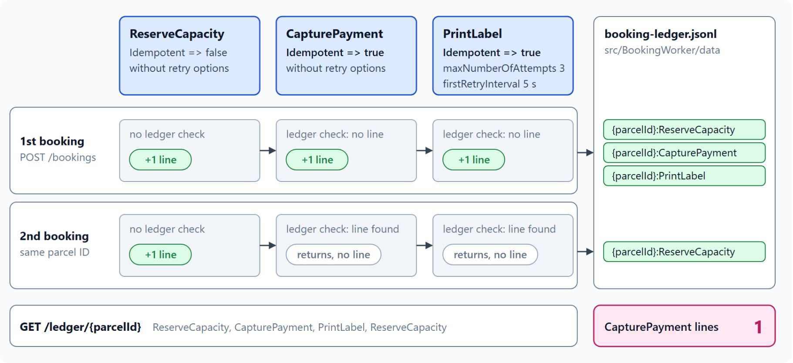
Safe retries and a worker restart
One payment line per parcel, even after a restart
Only PrintLabel gets a retry policy: three attempts, the first retry after 5 seconds
CapturePayment and PrintLabel look up the parcel ID plus the activity name in the ledger
Two bookings with the same parcel ID leave one CapturePayment line
A worker stopped mid-saga hands the instance to the restarted worker, which replays the history
Parcel IDs with FAIL- or SLOW make failures and the restart visible
Notes:
The runtime runs each activity at least once, so a retry or a restart can repeat a payment. Lab steps 3 and 4 make the saga safe against both, and the diagram shows the ledger after two bookings of one parcel.
Retry policy: only the PrintLabel call gets TaskOptions with a RetryPolicy of three attempts and a first retry after 5 seconds. The other forward activities and the compensations run without retry options.
Idempotency key: before CapturePayment or PrintLabel does its work, it looks in booking-ledger.jsonl for a line keyed with the parcel ID, a colon and the activity name. If that line exists, the activity returns without writing a second one.
The proof: two bookings with the same parcel ID leave one CapturePayment line in GET /ledger/{parcelId}. The key uses the parcel ID and the activity name only, never a timestamp or a GUID.
Worker restart: stop booking-worker in the Aspire dashboard while a SLOW booking runs, then start it again. The scheduler hands the abandoned work item to the new worker, which replays the history, and the instance completes with the output booked.
Test markers: a parcel ID with FAIL- followed by an activity name makes that activity throw before it writes its line. SLOW makes each forward activity wait 3 seconds, long enough to stop the worker in the middle.

Slide 31

Takeaways
What to carry into the AI agents module
Keep orchestrators deterministic and put every side effect in an activity
Give every activity a stable idempotency key, because it runs at least once
Bound every wait for a person with a durable timer, and cancel the timer that loses
Scale SDK workers on the scheduler backlog with the KEDA rule
Undo completed saga steps in reverse order, and alert on compensated sagas
Notes:
Close with the habits this module built, each one a rule to apply before a long-running process goes to production.
Deterministic orchestrators: replay runs the code again, so clock reads, GUIDs, delays and network calls move to the context APIs or into activities. The analyzer flags them before a merge.
Idempotent activities: the runtime runs each activity at least once, so a stable key such as the parcel ID plus the step name keeps a retry from charging the customer twice.
Timers with events: a durable timer bounds every wait for a delivery scan or a customer decision, and the worker stays free while the instance waits. Cancel the timer that loses, or the orchestration stays open.
Scale on the backlog: the azure-durabletask-scheduler rule adds worker replicas as pending activities grow and removes them as the load falls.
Compensate in reverse: the saga pops its compensation stack, so the most recent completed step is undone first. Module 9 builds on this when the exception agent subscribes to DeliveryDelayed and proposes a reroute that a person approves.

