Slide 1



Fast Lane Group
Worldwide Education &
Professional Services
www.flane.de | © 2026 Fast Lane Institute for Knowledge Transfer GmbH
Notes:
Die Fast Lane Gruppe.
Fast Lane … Dienstleister u. Spezialist für High-End Technologie und Business Trainings
IT Trainings zu den unterschiedlichsten Herstellern wie Microsoft, Google, Cisco oder AWS. Und vielen weiteren wichtigen IT Herstellern.
Sei es Cloud, Security, Netzwerk oder allgemein digitale Transformationsprojekte
Und das seit 2003.
Das spannende ist, dass die Fast Lane Gruppe bereits seit 2009 durchgängig zu den Top 20 Unternehmen in der IT Trainingsbranche weltweit zählt.
Aber auch Footprint ebenso im klassischen Professional Services Bereich für unsere wichtigsten Hersteller
PreSales Support, Deployment Services und Adoption Trainings
Additional Information:
Im Jahr 2021 sind wir zur „most strategic IT Education company worldwide“ von der IDC im „magic quadrant“ aufgeführt worden !
1 mio Teilnehmer insgesamt seit bestehen, 50.000+ Students ww p.A, 20.000 in DE pro Jahr

Slide 2

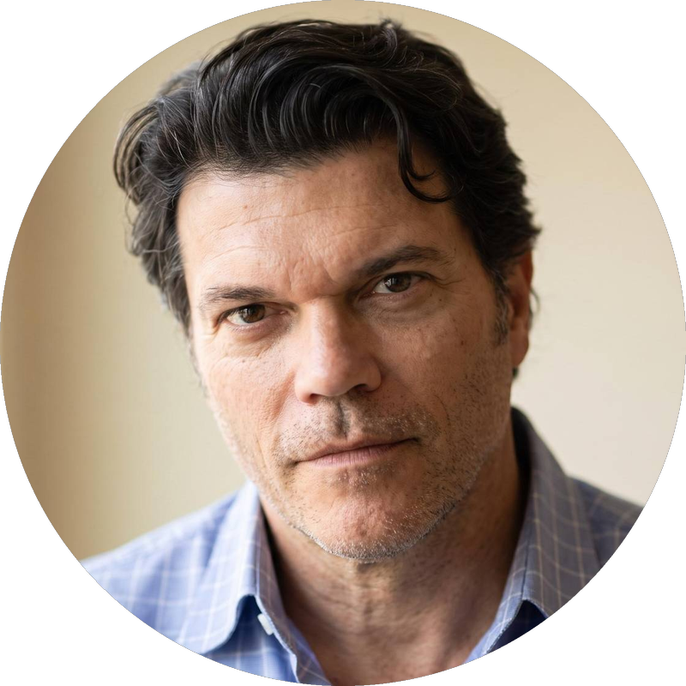




AGENTIC AI: FROM STRATEGY TO PRODUCTION.
Alexander
Kastil
AGENTIC AI CONSULTING · VIENNA
Full stack, from enterprise software to agentic AI. Since 1996
AI at Work
Enterprise AI
Value discovery, KPI mapping and roadmap
Governed multi-agent systems on Microsoft Copilot and Foundry
Agentic Software Engineering
Team Enablement
Harness architecture for Claude Code and GitHub Copilot
AI driven content production and delivery
integrations.at
github.com/alexander-kastil
SCAN TO CONNECT
alexander.kastil@integrations.at
linkedin.com/in/alexander-kastil
integrations.at
Notes:
Intro: Alexander Kastil, integrations.at. Four practice areas from AI at Work to team enablement. Certifications: Agentic AI Business Solutions Architect, Azure AI App and Agent Developer Associate, DevOps Engineer Expert.

Slide 3

MODULE 9
AI Agents in Event-Driven Systems
The exception-agent joins the Contoso Logistics event flow
Event-Driven Distributed Apps on Azure: Aspire, Dapr & Durable Execution

Slide 4
01
02
03
Microsoft.Extensions.AI: Foundry Model Client
IChatClient, Entra ID and middleware on every call
Agent Subscribers: React to Events
DeliveryDelayed in, RerouteRequested out, once per event
LLM Calls: Durable Activities
The model call as a retried, replay-safe activity
04
05
06
Rate Limits: Priority Queues & KEDA
Urgent work first, replicas capped by the quota
Vector Search: Change Feed Embeddings
Delivery notes found by meaning
Agent Choreography: Events vs. A2A
Published events or a direct call between agents
Event-Driven Distributed Apps on Azure: Aspire, Dapr & Durable Execution

Slide 5

AI agents in event-driven systems
The exception-agent joins the Contoso Logistics event flow
Calling the model: IChatClient on a Foundry deployment, run from a subscriber and a durable activity
Staying in quota: priority queues and a KEDA replica cap sized from tokens per minute
Search and coordination: change feed embeddings, vector search, and events or A2A between agents
Notes:
This module closes the class storyline: the exception-agent joins the event flow and reacts when a parcel misses its window. It drafts the customer message and proposes a reroute that a person approves.
Calling the model: the agent reaches a Microsoft Foundry deployment through Microsoft.Extensions.AI, subscribes to DeliveryDelayed, and runs each model call as a durable activity.
Staying in quota: priority queues keep urgent exceptions ahead of bulk work, and KEDA caps the replicas so the agent stays inside its token quota.
Search and coordination: a change feed and a Cosmos DB vector index make delivery notes searchable by meaning. The last topic decides when agents coordinate through events and when they call each other with A2A.

Slide 6
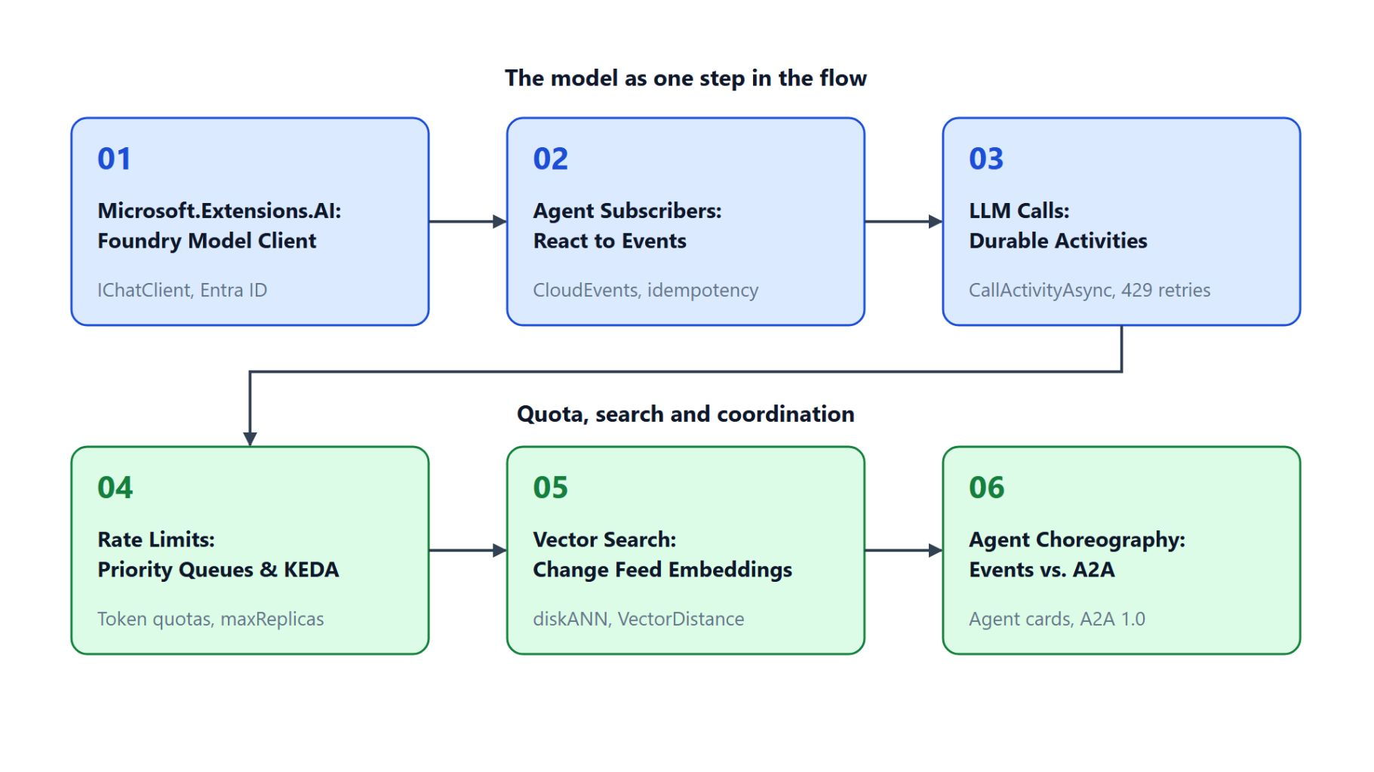
Overview
The path through the AI agents module
Call a Foundry model through IChatClient with Entra ID and OpenTelemetry
Subscribe the agent to DeliveryDelayed and keep it idempotent
Run the model call as a durable activity that retries on 429
Hold the agent inside its quota with priority queues and a KEDA cap
Index delivery notes for vector search, then choose events or A2A
Notes:
This slide walks the six topics once, following the three themes of the title slide. Throughout the module the model is one slow, non-deterministic, non-idempotent step in a larger flow.
Model client: IChatClient over AzureOpenAIClient with DefaultAzureCredential, with logging and OpenTelemetry middleware on every call.
Subscriber and activity: the agent consumes DeliveryDelayed like any other service and checks a processed marker, and the model call runs as a durable activity that retries on 429. The lab combines both, with the subscriber starting the orchestration that calls the activity.
Quota: separate priority queues and a KEDA scale rule with maxReplicas hold the agent to the deployment's token and request quotas.
Search and coordination: change feed triggers fill a diskANN vector index for VectorDistance queries, and the module ends with choreography against A2A agent cards. Agent fundamentals, MCP servers and A2A hosting in depth belong to the pro-code-agents class.

Slide 7
01
Microsoft.Extensions.AI: Foundry Model Client
IChatClient, Entra ID and middleware on every call
Event-Driven Distributed Apps on Azure: Aspire, Dapr & Durable Execution

Slide 8
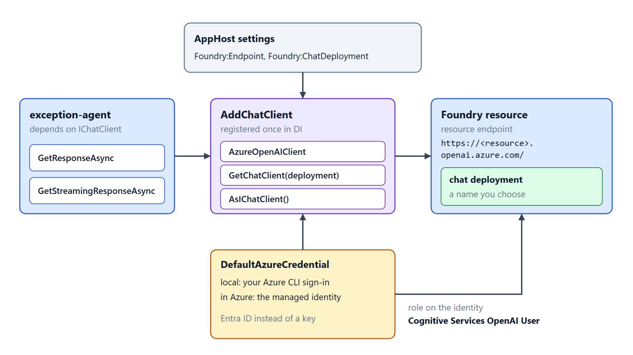
Connecting to a Foundry model deployment
IChatClient, DefaultAzureCredential and the resource endpoint
IChatClient offers GetResponseAsync and GetStreamingResponseAsync, so the agent needs no vendor client
`AzureOpenAIClient` takes the resource endpoint and `DefaultAzureCredential`, then `AsIChatClient`
The identity holds Cognitive Services OpenAI User: Azure CLI sign-in locally, managed identity in Azure
`AddChatClient` registers the pipeline once; the project endpoint is for Agent Framework clients
`Aspire.Hosting.Foundry` (13.6.0-preview) adds `AddFoundry`; the lab passes `Foundry:Endpoint` and `Foundry:ChatDeployment`
Notes:
Topic 01 starts with the client the exception-agent uses to reach its model. The model runs as a Microsoft Foundry deployment, but the service should not depend on the vendor SDK underneath.
IChatClient: the contract between a service and a chat model, with GetResponseAsync for a complete reply and GetStreamingResponseAsync for incremental updates. Any library that implements it plugs into the same consumer code.
Resource endpoint: AzureOpenAIClient takes the resource endpoint and DefaultAzureCredential, GetChatClient picks the deployment by the name you gave it, and AsIChatClient adapts it. The project endpoint with the api/projects path belongs to the Agent Framework and Foundry Agent Service clients.
Identity and role: assign Cognitive Services OpenAI User to the identity that runs the service. DefaultAzureCredential uses your Azure CLI sign-in locally and the managed identity in Azure, and Entra ID avoids keys that grant every caller the same rights and need manual rotation.
Registration and Aspire: AddChatClient registers the pipeline once in dependency injection, so every consumer resolves the same one. Aspire.Hosting.Foundry with AddFoundry is a 13.6.0 preview, and the lab's AppHost passes Foundry:Endpoint and Foundry:ChatDeployment as settings instead.

Slide 9
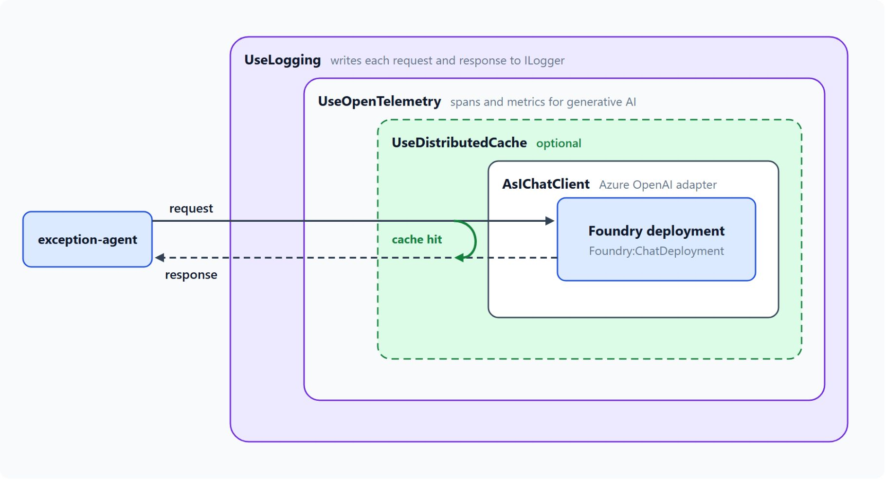
Middleware on every model call
Logging and OpenTelemetry around the Foundry deployment
`ChatClientBuilder` applies the Use methods in reverse order, so the first Use is outermost
UseLogging writes each request and response through ILogger
UseOpenTelemetry emits generative AI spans beside the HTTP and messaging spans
The conventions are experimental: pin the package and check span names after each upgrade
UseDistributedCache answers a repeated prompt without a model call; custom middleware derives from `DelegatingChatClient`
Notes:
With the client connected, this slide shows what wraps every call between the exception-agent and the Foundry deployment. The request goes in through each ring, and the response comes back out the same way.
Order and logging: ChatClientBuilder applies the Use methods in reverse order, so UseLogging sees each request first, then UseOpenTelemetry, and the AsIChatClient adapter sits innermost. UseLogging writes an entry for each request and response through ILogger.
OpenTelemetry: UseOpenTelemetry emits spans and metrics under the OpenTelemetry semantic conventions for generative AI, so the model spans sit beside the HTTP and messaging spans of the same operation. The conventions are experimental, so pin the package version in production, check the span names after each upgrade, and pass a source name you add to the tracer configuration.
Cache and custom middleware: UseDistributedCache stores complete responses keyed by the message history, so a repeated prompt turns back before the model, as the cache hit in the diagram shows. Custom middleware derives from DelegatingChatClient and keeps rate limiting and redaction out of the business code.

Slide 10
02
Agent Subscribers: React to Events
DeliveryDelayed in, RerouteRequested out, once per event
Event-Driven Distributed Apps on Azure: Aspire, Dapr & Durable Execution

Slide 11
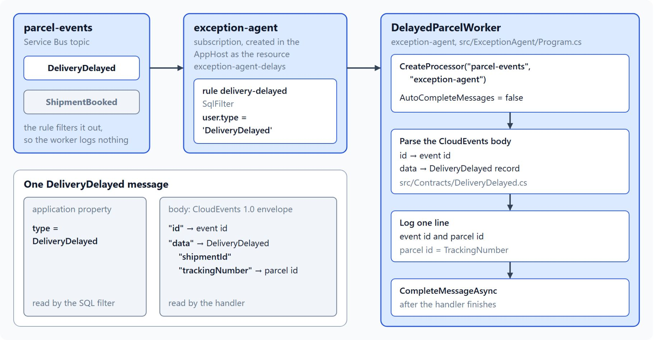
The agent as an event consumer
A filtered subscription and the CloudEvents envelope
A topic subscription with a SQL rule passes only DeliveryDelayed, the filter pattern from Module 4
The body is a CloudEvents 1.0 envelope: `id` is the event id, `data` holds shipmentId and trackingNumber
The publisher owns the schema; the agent reads only the fields it needs
A new optional field breaks nothing, a removed or renamed field does
Customer details enter a prompt only when the draft needs them
Notes:
Topic 02 treats the agent as one more subscriber: when a parcel misses its window, the durable deadline raises DeliveryDelayed, and the exception-agent reacts the way any other service does. The diagram is the lab's first step, the subscription, its rule and the worker that reads the event.
Filtered subscription: the exception-agent subscription on parcel-events has the rule delivery-delayed, a SQL filter on the application property type, so ShipmentBooked never reaches the worker. It is the same filter pattern as Module 4.
CloudEvents input: the handler reads a CloudEvents 1.0 envelope whose id is the event id and whose data holds shipmentId and trackingNumber. In the lab the tracking number is the parcel id.
Schema ownership: the publisher owns the schema and the agent declares the subset it reads, so a new optional field breaks nothing while a removed or renamed field does. Choreography guidance asks for a schema registry and backward-compatible changes for this reason.
Minimal prompt data: customer details enter a prompt only when the draft needs them, so the prompt carries no field that the task does not use.

Slide 12
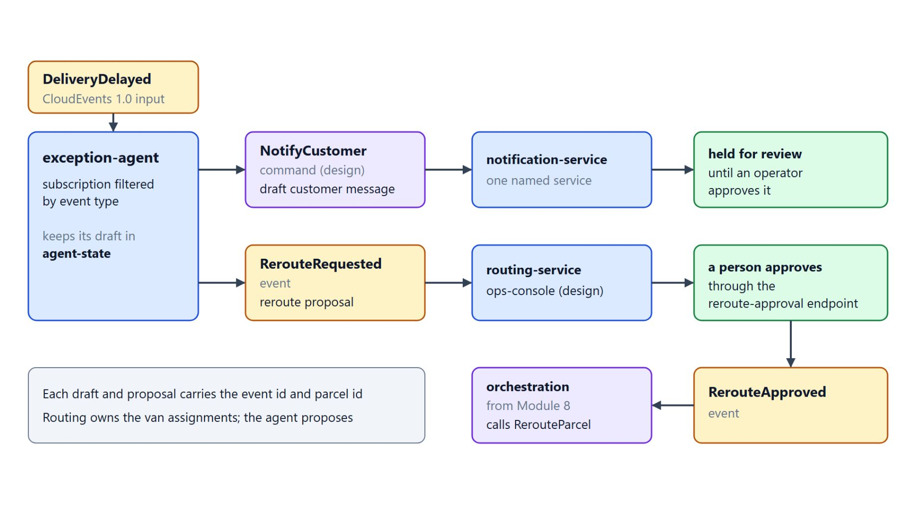
Output as a command or an event
A draft for review, a reroute proposal for a person to approve
A command asks one named service to act; an event states a fact any service can use
The draft customer message is the `NotifyCustomer` command (design), held until an operator approves it
The reroute proposal is the `RerouteRequested` event, the one message the lab's agent sends
A person approves through the reroute-approval endpoint, which raises `RerouteApproved`
The agent never calls RerouteParcel: the routing service owns the van assignments
Notes:
After reading the event, the agent writes back, and this slide shows what it sends and who acts on it. In the lab the agent sends one kind of message, an event, and keeps its draft in the agent-state container.
Command or event: a command asks one named service to act, and an event states a fact that any interested service can use. The NotifyCustomer command to notification-service is a design, and the draft is held for review until an operator approves it.
Reroute proposal: RerouteRequested goes to routing-service and the ops-console, both a design with no lab consumer. A person approves through the reroute-approval endpoint, which raises RerouteApproved, and the durable orchestration from Module 8 then calls RerouteParcel.
Traceability: the draft and the proposal are both decisions made by a model, so both carry the event id and parcel id that produced them. Downstream services can then trace each suggestion to the delay that caused it.
Ownership: the agent never calls RerouteParcel directly, because the routing service owns the van assignments. The human approval closes the loop.

Slide 13
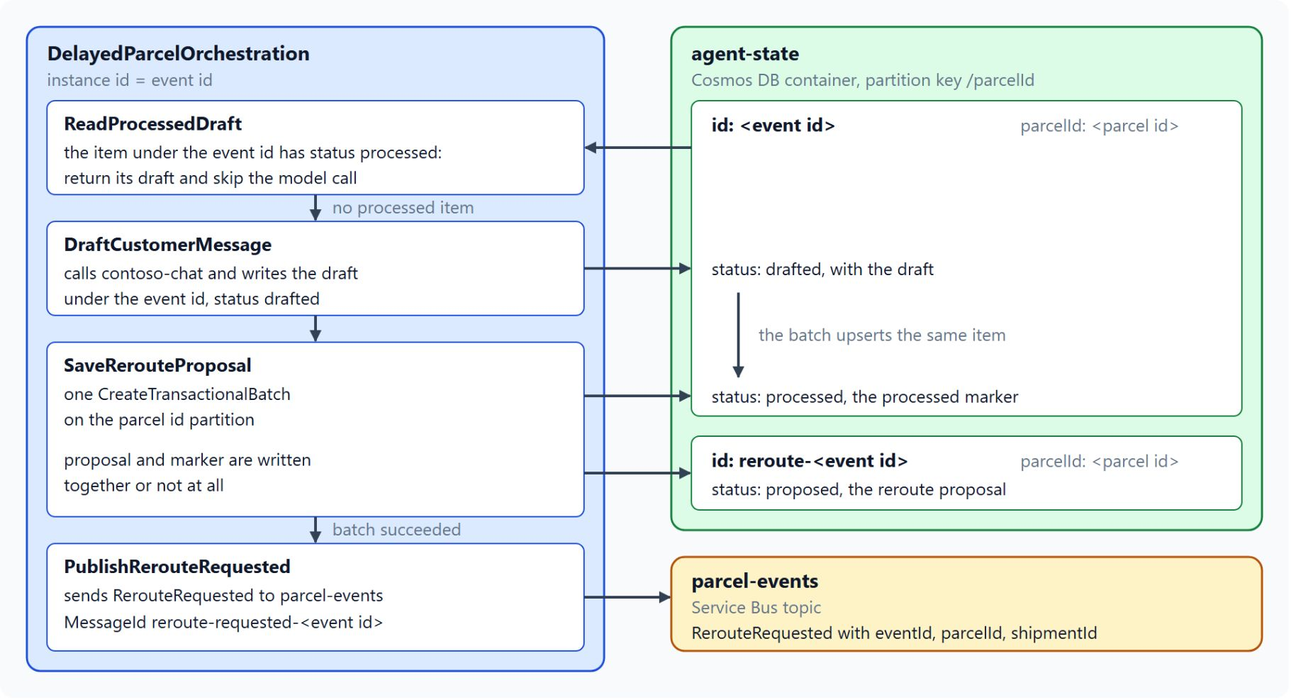
Idempotency for agent consumers
Check the processed marker before the model call
Brokers deliver at least once: duplicate detection does not stop a redelivery after a lock expires
`ReadProcessedDraft` checks agent-state for the event id before the model call
A retry reuses the stored draft, because a second model call words it differently
`SaveRerouteProposal` writes the `reroute-` proposal and the processed marker in one transactional batch
`RerouteRequested` goes to parcel-events only after the batch succeeds
Notes:
The broker can deliver DeliveryDelayed twice, and a model-driven consumer has to handle that without a second draft or a second proposal. The diagram is the lab's step 4, the orchestration with its processed check and its batch.
At least once: Service Bus duplicate detection suppresses repeated sends inside its history window, but not a redelivery after a lock expires, and Event Hubs checkpoints can replay a range after a restart. The idempotent consumer pattern handles both by recording what it has already processed.
Check first: the order of the steps decides the outcome, so the agent looks up the processed marker keyed by the event id and only then calls the model. Model output is not deterministic, so a retry must reuse the stored draft.
One batch: the reroute proposal, keyed reroute- plus the event id in the parcel's partition, and the processed marker go into one transactional batch, so a crash cannot leave a marker without its proposal. A duplicate delivery upserts the same proposal and creates no second one.
Publish after the batch: RerouteRequested goes to parcel-events once the batch succeeds. Module 6 shows the same pattern with the transactional outbox.

Slide 14
03
LLM Calls: Durable Activities
The model call as a retried, replay-safe activity
Event-Driven Distributed Apps on Azure: Aspire, Dapr & Durable Execution

Slide 15
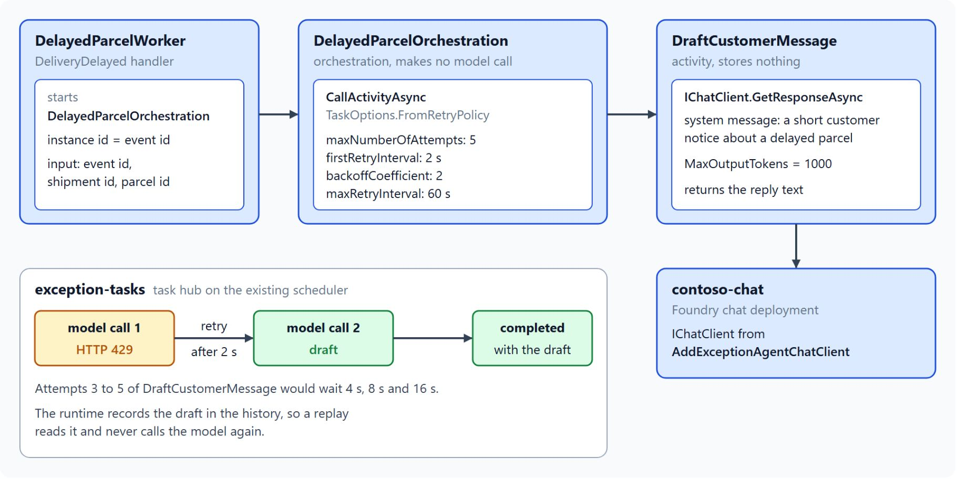
Why the model call belongs in an activity
Replay reads the recorded draft
An orchestrator replays its history each time it resumes, so every call must return the same result
A model returns different text for the same prompt, which breaks the first replay
An activity runs once per attempt, and the runtime records its output in the history
`CallActivityAsync` with `TaskOptions.FromRetryPolicy`: 5 attempts, 2 s first interval, backoff 2, 60 s maximum
A waiting orchestration has no model call in flight, so a parcel can wait a day for a person
Notes:
Topic 03 gives the model call a durable home: the delayed-parcel workflow runs for hours, while a model call takes seconds, can be throttled and can fail after it was billed. The diagram is the lab's step 3, where the worker starts the orchestration and the activity calls contoso-chat.
Replay: an orchestrator replays its history each time it resumes, and every call must return the same result on replay. A model returns different text for the same prompt, so a model call in the orchestrator breaks determinism on the first replay.
The activity: an activity runs once for each attempt, and the runtime records its output in the history. On replay the orchestrator reads the recorded draft and never calls the model again.
Retry policy: the input carries the parcel id and the event id, and the policy allows 5 attempts with a 2-second first interval, a backoff coefficient of 2 and a 60-second maximum. The 5 counts the first call too, and an unbounded retry would keep the orchestration running with no clear failure.
Waiting for approval: after the draft the orchestrator publishes RerouteRequested, and the booking workflow waits for RerouteApproved or the deadline timer. A waiting orchestration has no model call in flight, and Module 8 teaches the external event pattern behind that wait.

Slide 16
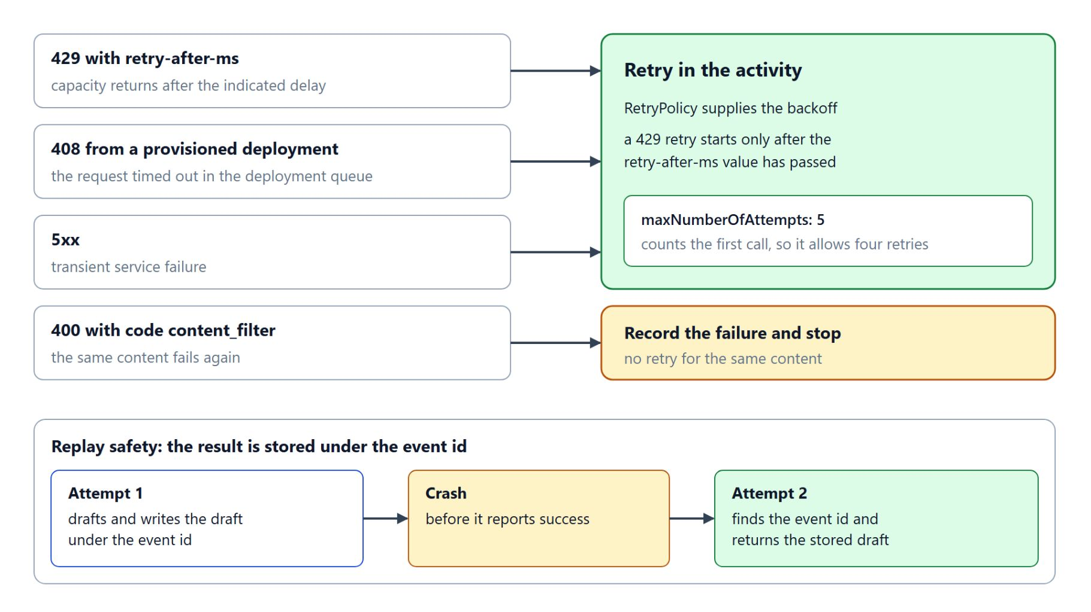
Retries on throttling
Which responses retry, and how a retry reuses the stored result
429 carries retry-after-ms, and the next attempt waits at least that long
408 from a provisioned deployment and 5xx retry as transient failures
400 with code content_filter fails again, so the activity records the failure and stops
An attempt can crash after the model answered, and the runtime runs the activity again
The activity stores its result under the event id and returns it on the next attempt
Notes:
A throttled model call is the common failure, and this slide sorts the responses the activity sees into retry and stop. The sorting follows the throttling guidance in the Azure Well-Architected Framework.
429: the tokens-per-minute or requests-per-minute budget is spent, and the response carries retry-after-ms and retry-after headers. The retry policy supplies the backoff, and the next attempt should not start before the header value has passed.
408 and 5xx: a 408 from a provisioned deployment means the request timed out in the deployment queue, and a 5xx is a transient service failure, so both retry. A 400 with code content_filter fails again with the same content, so the activity records the failure and stops.
Replay safety: an activity can receive the model's answer and crash before it reports success, and the runtime then runs it again. Because the activity writes its result under the event id and returns the stored result when that key exists, the second attempt makes no new model call.

Slide 17
04
Rate Limits: Priority Queues & KEDA
Urgent work first, replicas capped by the quota
Event-Driven Distributed Apps on Azure: Aspire, Dapr & Durable Execution

Slide 18
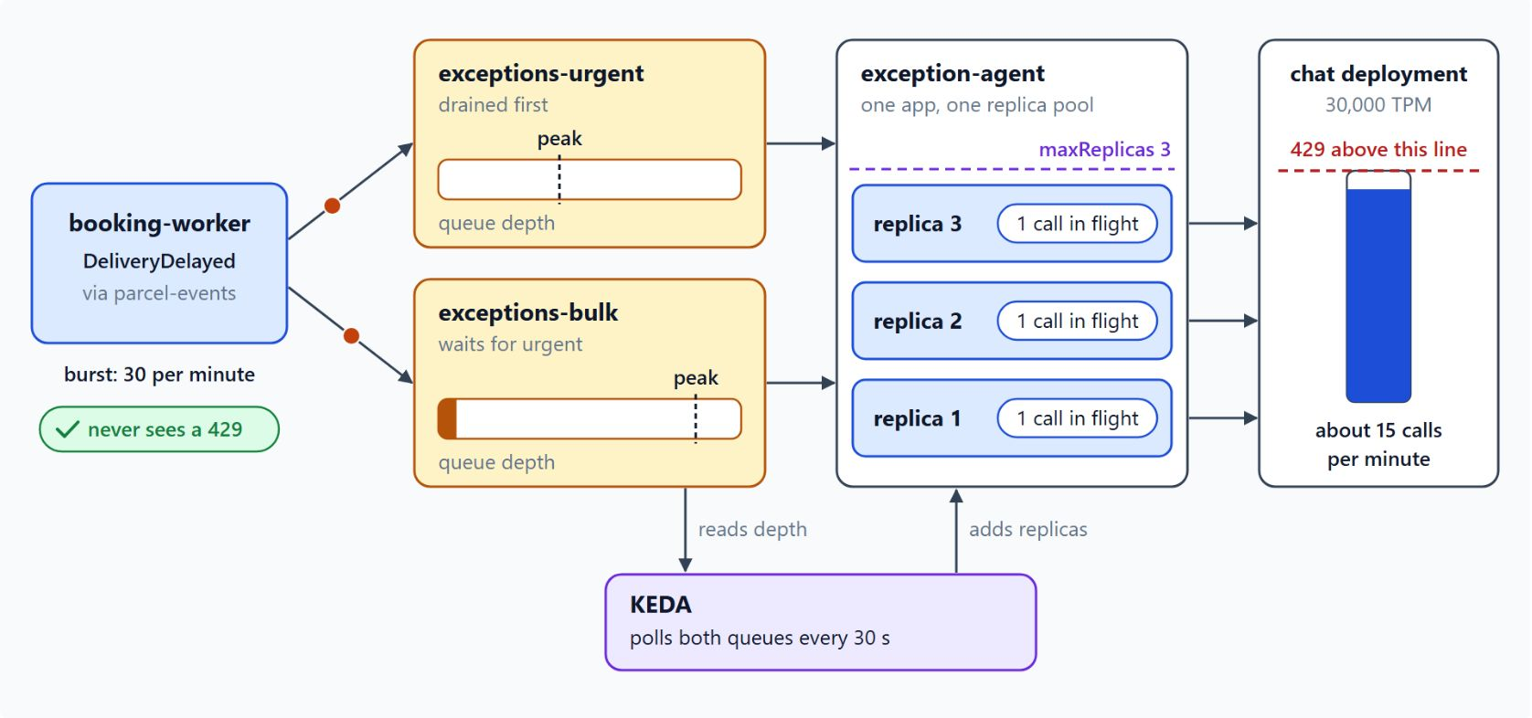
Model quotas and back pressure
The queues absorb a burst below the 429 line
Each deployment has a TPM allocation, the RPM limit follows from it, and either limit returns 429
The token estimate counts the prompt plus max_tokens, so size max_tokens to a customer notice
Failed requests count against the budget; back off with jitter and a fixed maximum
The queues absorb the burst: booking-worker keeps publishing, the agent drains at the quota's rate
Producers never see the 429; the backlog shows up as queue depth
Notes:
Topic 04 starts from a burst: a van breakdown can delay 300 parcels in ten minutes, and the Foundry deployment has a fixed budget of tokens and requests per minute. The diagram shows the plan that keeps the deployment below its 429 line.
Quotas: each deployment receives a tokens-per-minute allocation, the requests-per-minute limit follows from it, and a request over either limit gets a 429. The RPM limit is checked over short windows, so a burst can be throttled while the minute total is still below the limit.
Token estimate: each request counts as its prompt plus its max_tokens value, because the rate limit does not wait for the real output size. A large max_tokens reserves budget the model may never spend, so set it to the size of a customer notice.
Backing off: failed requests still count, so retries during a burst make throttling worse unless they back off. The Azure OpenAI SDKs retry 429 by default and respect the retry-after headers, and the Foundry quota guidance recommends exponential backoff with jitter and a fixed maximum.
Back pressure: booking-worker keeps publishing DeliveryDelayed at its own pace while the agent drains the queues at the rate the quota allows. Producers never see the 429, and operators see the backlog as queue depth on the dashboard.

Slide 19
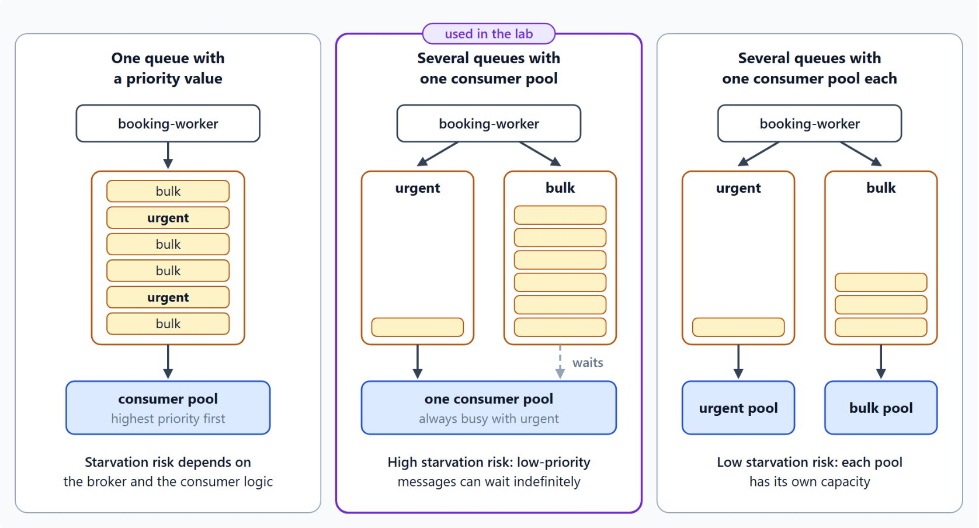
Priority queues for urgent and bulk work
Three layouts and their starvation risk
Urgent exceptions need a draft within minutes; bulk sweeps can wait an hour
One queue with a priority value: the risk depends on the broker and the consumer logic
Several queues with one consumer pool: low-priority messages can wait indefinitely
One pool per queue: each drains at its own pace, with low starvation risk
The lab uses the middle layout, so a bulk backlog can still take every replica
Notes:
Two kinds of work reach the agent, and the Priority Queue pattern makes sure urgent work reaches the model first. The layout decides whether low-priority work can starve.
Two priorities: an urgent exception, such as a parcel with a medical or time-critical label, needs a draft within minutes. A bulk exception, such as a weekly sweep of delayed parcels for analytics, can wait an hour.
One queue with a priority value: consumers take the highest priority message first, and the starvation risk depends on the broker and the consumer logic.
Several queues: with one consumer pool, consumers drain the high queue before the low queue, and low-priority messages can wait indefinitely. With one pool per queue, each pool drains its own queue at its own pace and has its own capacity.
The lab: its replicas form one pool, the middle layout, so a bulk backlog can still scale every replica, and a started bulk orchestration competes with urgent calls for the same activity slots. The guidance is to give each priority its own queue and its own scaling rule.

Slide 20
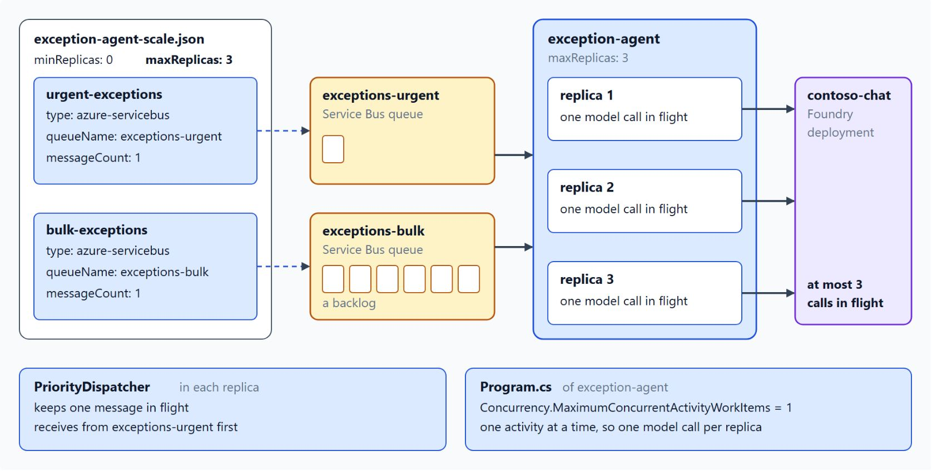
Replica cap from the model quota
KEDA rules on both queues, at most three calls in flight
An azure-servicebus rule scales on queue depth; maxReplicas is the fixed cap
30,000 TPM at about 2,000 tokens per call allows 15 calls per minute
At 10 s per call, 2.5 calls run at once, so the cap is three replicas
MaximumConcurrentActivityWorkItems of 1 keeps one model call in flight per replica
API Management's llm-token-limit policy is the gateway option: 429 per minute, 403 when the quota runs out
Notes:
Azure Container Apps scales the agent with KEDA rules, and the model quota does not grow with the replicas. The diagram is the lab's step 6: the scale file, its two rules and the three replicas.
Scale rules: one azure-servicebus rule per queue, exceptions-urgent and exceptions-bulk, each with messageCount 1. KEDA polls about every 30 seconds, computes the replica count from queue length and messageCount, and maxReplicas is the fixed cap where the quota enters the design.
The arithmetic: the lab's chat deployment has 30,000 TPM and each call uses about 2,000 tokens, so it allows 15 calls per minute, one every four seconds. A call takes 10 seconds, so 2.5 calls must run at once and the cap is three.
Concurrency: keep replicas times per-replica concurrency at or below three in-flight calls. The lab sets MaximumConcurrentActivityWorkItems to 1 in Program.cs, so each replica holds one call.
Gateway option: the Azure API Management llm-token-limit policy limits tokens per minute for each counter key and returns 429 at the limit. It returns 403 when a longer token quota runs out, so the gateway can tell a short burst from an exhausted budget.

Slide 21
05
Vector Search: Change Feed Embeddings
Delivery notes found by meaning
Event-Driven Distributed Apps on Azure: Aspire, Dapr & Durable Execution

Slide 22
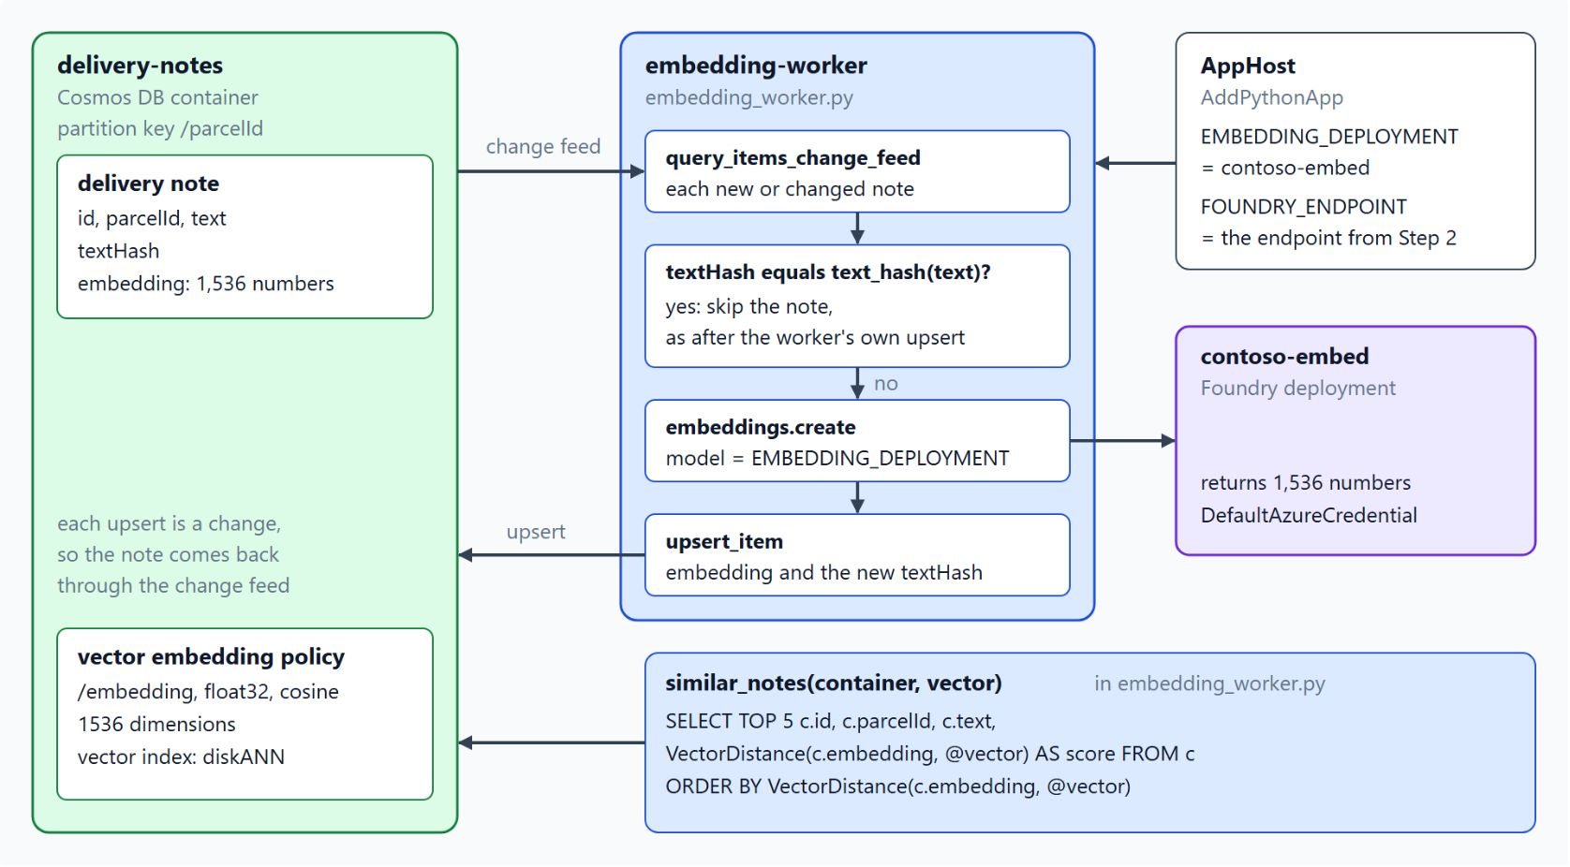
Embeddings from the change feed
A text hash check ends the write-back loop
Every insert or update of a delivery note appends a change feed entry
The embedding-worker embeds each changed note; scanner and driver apps never call the model
Writing the vector back is another change, so the worker skips notes whose textHash is unchanged
A separate embeddings container removes the loop by construction
Change feed consumers run at least once: a replay costs a model call and nothing else
Notes:
Topic 05 makes delivery notes searchable by meaning, because drivers phrase the same problem in many ways and keyword search misses most of them. The diagram is the lab's step 7, the Python embedding-worker on the delivery-notes change feed.
The trigger: every insert or update in the delivery-notes container appends a change feed entry, and the worker computes an embedding for each changed note. The write path stays simple, because the scanner and driver apps never call the embedding model.
The loop: writing the vector back into the container triggers another change feed entry, so the worker skips any note whose text hash has not changed. A separate embeddings container removes the loop by construction, and then the worker must also see deletes, which the AllVersionsAndDeletes mode returns.
At least once: the worker is a projection like the tracking read model from Module 6, so it must be idempotent. A replay overwrites the vector with one for the same text, which costs a model call and nothing else.
Updates: an edit produces a new entry, and the worker replaces the vector in the same upsert. A reader in between sees the old vector, which matches the eventual consistency the design already accepts, and the worker should log the lag.

Slide 23
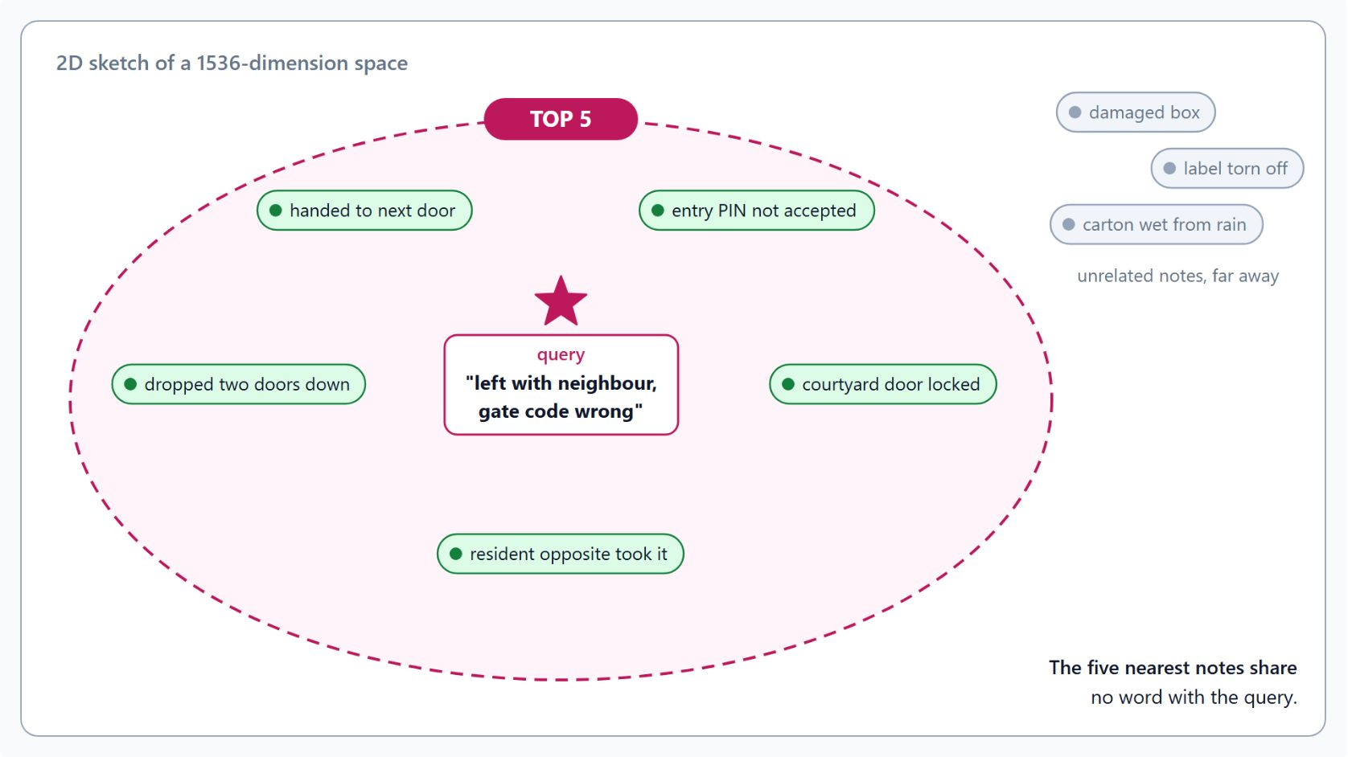
Vector index and similarity query
DiskANN on /embedding, TOP 5 by VectorDistance
vectorEmbeddings: /embedding, float32, 1536 dimensions, cosine distance
A diskANN index on the same path; both policies are immutable after creation
flat accepts at most 505 dimensions, so 1536 needs quantizedFlat for a brute-force scan
TOP 5 ... ORDER BY VectorDistance; raise searchListSizeMultiplier when recall matters
A model change means a new container and a full re-embedding run
Notes:
The vectors become useful through two container policies and one query, and the sketch shows what that query finds. The five nearest notes share no word with the query "left with neighbour, gate code wrong", yet they describe the same situation.
Policies: the vector embedding policy describes /embedding as float32 vectors of 1536 dimensions, the default size of text-embedding-3-small, compared with cosine distance. The indexing policy adds a diskANN index on that path, the index type for large collections, and excludes the path from the range index.
Index types: DiskANN is approximate, so the same query can return slightly different results across runs. The flat type is exact but accepts at most 505 dimensions, so 1536-dimension embeddings need quantizedFlat for a brute-force scan with a small accuracy loss.
The query: VectorDistance orders by distance with TOP, because an unbounded vector query costs more request units and adds latency. Raise searchListSizeMultiplier for one query when recall matters more than latency, and allow cross-partition execution when there is no partition key filter.
Model changes: Microsoft documents the vector policy and the vector index as immutable after creation. A new model or dimension count means a new container, a full re-embedding run, and switching the reads once the backfill finishes.

Slide 24
06
Agent Choreography: Events vs. A2A
Published events or a direct call between agents
Event-Driven Distributed Apps on Azure: Aspire, Dapr & Durable Execution

Slide 25
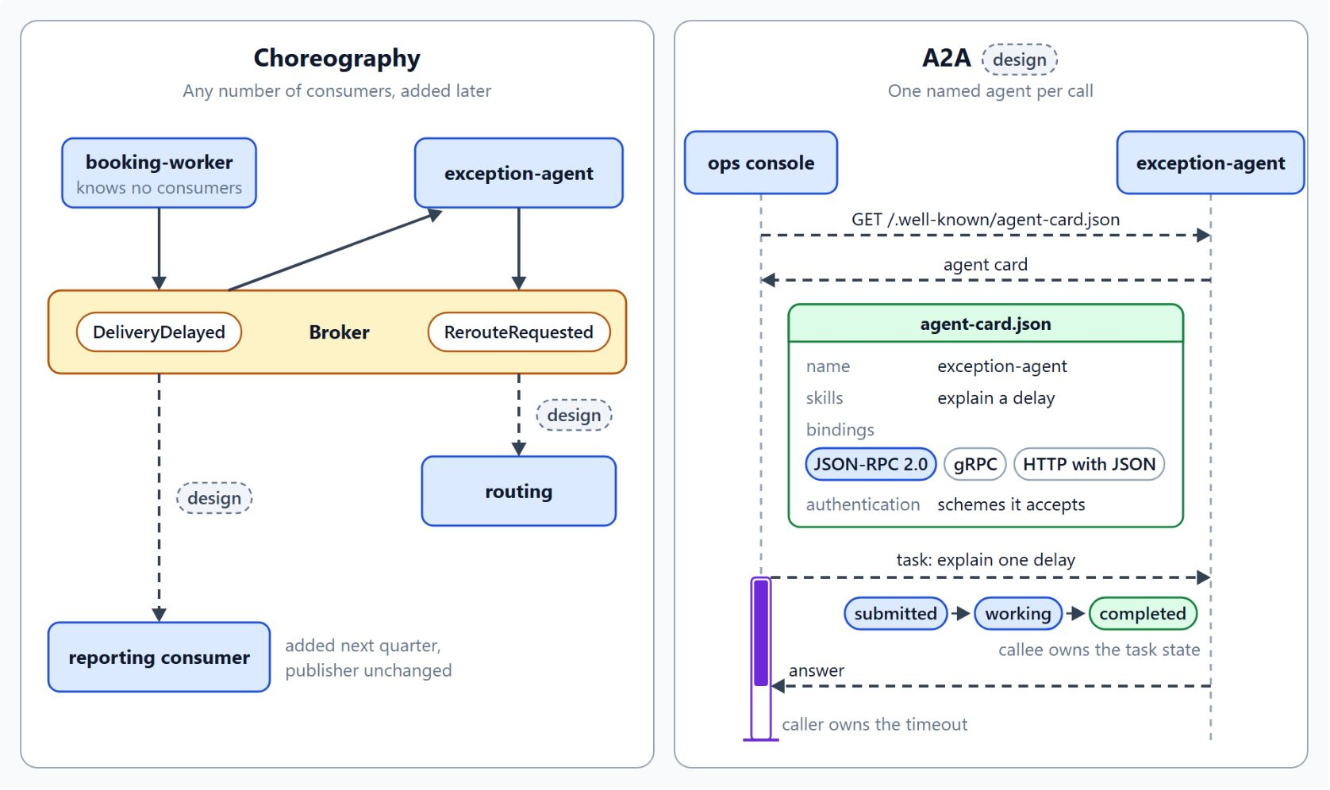
Choreography and A2A
Published events or a direct call to one agent
Choreography: a producer publishes a fact, and every interested service subscribes
Guard against event storms with event filters, consumer concurrency limits and explicit rules
A2A: the callee publishes an agent card at /.well-known/agent-card.json
A2A 1.0 defines JSON-RPC 2.0, gRPC and HTTP with JSON bindings, and permits custom ones
The caller owns the timeout, the callee owns the task state
Notes:
Topic 06 asks how agents coordinate once a delayed parcel touches several services: by reacting to published events, or by one agent calling another and waiting for the answer. The diagram puts both styles side by side, with the parts the lab does not build tagged design.
Choreography: booking-worker publishes DeliveryDelayed, the exception-agent reacts, and no central component tells each service what to do next. Add a reporting consumer next quarter, and the publisher changes nothing.
Guardrails: choreography brings duplicate and out-of-order messages, schema changes that break consumers, and event storms, where one event triggers a chain of reactions. Event filters, consumer concurrency limits and explicit rules keep those chains in check.
Agent cards: the callee publishes a card at /.well-known/agent-card.json with its name, skills, interfaces and accepted authentication. A caller reads the card, picks one of the advertised bindings, JSON-RPC 2.0, gRPC or HTTP with JSON, and sends a task.
Ownership: A2A fits when the caller needs one answer and waits, such as the ops console asking the exception-agent to explain one delay. The caller owns the timeout, and the callee owns the task state.

Slide 26
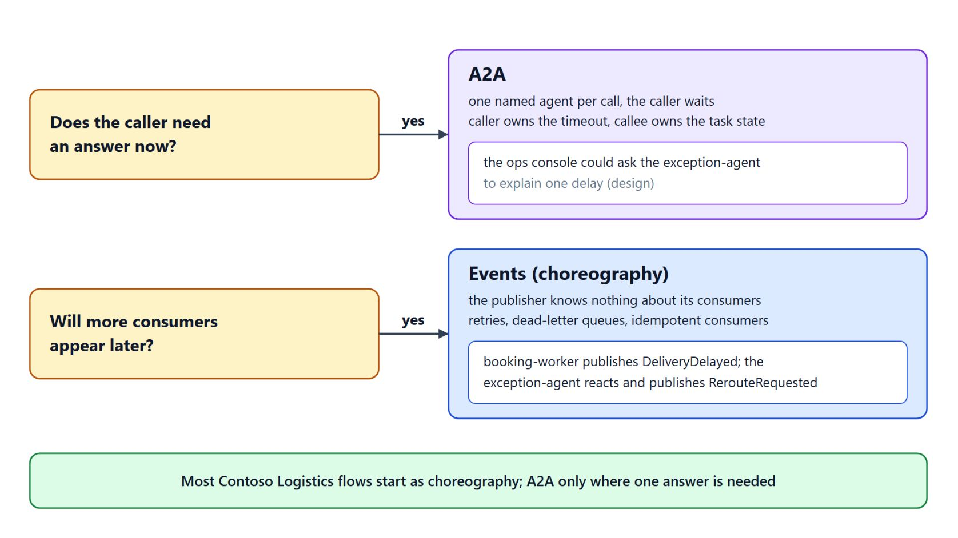
Choosing events or A2A
Two questions decide each interaction
Does the caller need an answer now? Then A2A
Will more consumers appear later? Then events
Most Contoso Logistics flows start as choreography
A2A 1.0, announced on April 9, 2026, has more than 150 supporting organizations
Since August 17, 2026, A2A is a hosted project of the Agentic AI Foundation
Notes:
The decision table in the topic comes down to two questions per interaction. Most flows in the Contoso Logistics system should start as choreography, and only interactions that need a single answer should use A2A.
Answer now: a yes points to A2A, one named agent per call, with timeouts and retries in the caller and the task state in the callee. Each agent keeps its task records as the audit trail.
More consumers later: a yes points to events, where the publisher knows nothing about its consumers and new ones join without a change to it. Failures go through retries, dead-letter queues and idempotent consumers, and the event log is the audit trail.
Governance: A2A 1.0 is the first stable release, announced by the Linux Foundation on April 9, 2026 with more than 150 supporting organizations, and since August 17, 2026 it is a hosted project of the Agentic AI Foundation. Agents built on different platforms can rely on the same card format and the same bindings.

Slide 27
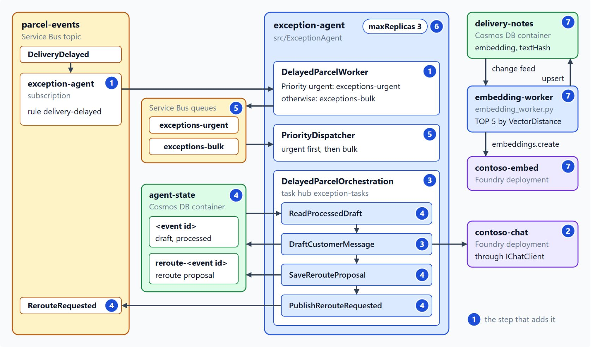
What the lab builds
An exception agent on DeliveryDelayed, in seven steps
At the start no service reacts to DeliveryDelayed, and operators write the message and reroute by hand
Steps 1 and 2: a filtered subscription and IChatClient on contoso-chat with Entra ID
Steps 3 and 4: a durable draft activity with retries, and one batch per event in agent-state
Steps 5 and 6: urgent work ahead of bulk, and KEDA capped at three replicas
Step 7: a Python embedding-worker indexes delivery notes for VectorDistance search
Notes:
The lab turns the module into one running agent, in about 55 minutes. At the start Contoso Logistics publishes DeliveryDelayed and no service reacts, so operators still write the customer message and the reroute by hand.
Subscribe and connect: step 1 adds the ExceptionAgent worker with its own subscription to DeliveryDelayed. Step 2 connects IChatClient to the contoso-chat deployment with Entra ID, so the agent holds no key.
Draft once: step 3 moves the draft into DraftCustomerMessage, called by DelayedParcelOrchestration with a retry policy. Step 4 adds the processed check and writes the proposal and the marker in one batch before RerouteRequested goes out.
Stay in quota: step 5 sends urgent exceptions to their own queue, which PriorityDispatcher drains first. Step 6 caps the agent at three replicas, sized from the chat deployment's quota.
Search and setup: step 7 adds the Python embedding worker on the delivery-notes change feed and a VectorDistance query. Run provision.azcli after az login before step 2 and deprovision.azcli at the end; the finished state is in contoso-logistics-solution.

Slide 28

Takeaways
The agent is a service like any other
The exception-agent subscribes with the same contracts, retries and idempotency rules as any service
Call the model through IChatClient with Entra ID, and only from a durable activity
Check the processed marker before the model call, and reuse the stored draft
Size replicas from the token quota and queue urgent work ahead of bulk
Start agent coordination as choreography; use A2A when one answer is needed now
Notes:
Close the module, and the class storyline, with the habits that let a model run inside an event-driven system. The model stays one slow, non-deterministic, non-idempotent step in a larger flow.
Same rules: the exception-agent is a subscriber like any other, with the same contracts, retries and idempotency rules as the first modules taught.
Model calls and idempotency: IChatClient with DefaultAzureCredential keeps keys out of the service, and the durable activity records the draft so a replay never calls the model again. The processed marker comes before the model call, and a retry reuses the stored draft.
Quota: keep replicas times per-replica concurrency within the calls the token quota allows, and give urgent exceptions their own queue.
Coordination: start with choreography, where consumers join without a change to the publisher, and use A2A only where a caller needs one answer now. Agent fundamentals, MCP servers and durable agents in depth continue in the pro-code-agents class.

