Slide 1



Fast Lane Group
Worldwide Education &
Professional Services
www.flane.de | © 2026 Fast Lane Institute for Knowledge Transfer GmbH
Notes:
Die Fast Lane Gruppe.
Fast Lane … Dienstleister u. Spezialist für High-End Technologie und Business Trainings
IT Trainings zu den unterschiedlichsten Herstellern wie Microsoft, Google, Cisco oder AWS. Und vielen weiteren wichtigen IT Herstellern.
Sei es Cloud, Security, Netzwerk oder allgemein digitale Transformationsprojekte
Und das seit 2003.
Das spannende ist, dass die Fast Lane Gruppe bereits seit 2009 durchgängig zu den Top 20 Unternehmen in der IT Trainingsbranche weltweit zählt.
Aber auch Footprint ebenso im klassischen Professional Services Bereich für unsere wichtigsten Hersteller
PreSales Support, Deployment Services und Adoption Trainings
Additional Information:
Im Jahr 2021 sind wir zur „most strategic IT Education company worldwide“ von der IDC im „magic quadrant“ aufgeführt worden !
1 mio Teilnehmer insgesamt seit bestehen, 50.000+ Students ww p.A, 20.000 in DE pro Jahr

Slide 2






AGENTIC AI: FROM STRATEGY TO PRODUCTION.
Alexander
Kastil
AGENTIC AI CONSULTING · VIENNA
Full stack, from enterprise software to agentic AI. Since 1996
AI at Work
Enterprise AI
Value discovery, KPI mapping and roadmap
Governed multi-agent systems on Microsoft Copilot and Foundry
Agentic Software Engineering
Team Enablement
Harness architecture for Claude Code and GitHub Copilot
AI driven content production and delivery
integrations.at
github.com/alexander-kastil
SCAN TO CONNECT
alexander.kastil@integrations.at
linkedin.com/in/alexander-kastil
integrations.at
Notes:
Intro: Alexander Kastil, integrations.at. Four practice areas from AI at Work to team enablement. Certifications: Agentic AI Business Solutions Architect, Azure AI App and Agent Developer Associate, DevOps Engineer Expert.

Slide 3

MODULE 1
Introduction to Copilot Cowork & Copilot Studio
The foundation for the whole course
Automate Business Processes with Copilot Studio and Copilot Cowork

Slide 4
01
02
03
Agents & Copilots for Microsoft 365
The vocabulary, the ecosystem map and the step to an agent
How Agents Work
The agentic loop, the three parts of every agent and the design patterns
Agent Harnesses: Choose the Runtime
The four harnesses of Copilot Studio and how to choose one
04
05
06
Where to Build and What It Costs
The build paths and how Copilot Credits pay for them
Copilot Chat & Productivity Agents
Researcher, Analyst, SharePoint agents and Agent Builder
Prepare the Tenant: Licenses & Credits
Optional: the licenses, credit sources and costs behind each module
Automate Business Processes with Copilot Studio and Copilot Cowork

Slide 5

Introduction to Copilot Cowork and Copilot Studio
The foundation for the whole course
Concepts: what copilots and agents are, and how every agent works
Decide before you build: the agent harness, the build paths and what Copilot Credits cost
Productivity surface: Copilot Chat, Researcher, Analyst and SharePoint agents
Notes:
This slide opens the course. Before anyone touches Copilot Studio or Cowork, the module builds a clear model of agents, so the later modules have somewhere to land.
Concepts: the first two topics fix the vocabulary (copilot, agent, assistant) and show how every agent works: a goal pursued in a loop, built from instructions, knowledge and tools.
Decide before you build: the third topic compares the four harnesses Copilot Studio runs agents on and how to choose one, and the fourth places the build paths on one effort scale and shows how Copilot Credits pay for what agents do.
Productivity surface: the fifth topic tours Copilot Chat and the agents that come ready to use. An optional sixth topic prepares the class tenant with the licenses and credits each module needs.

Slide 6
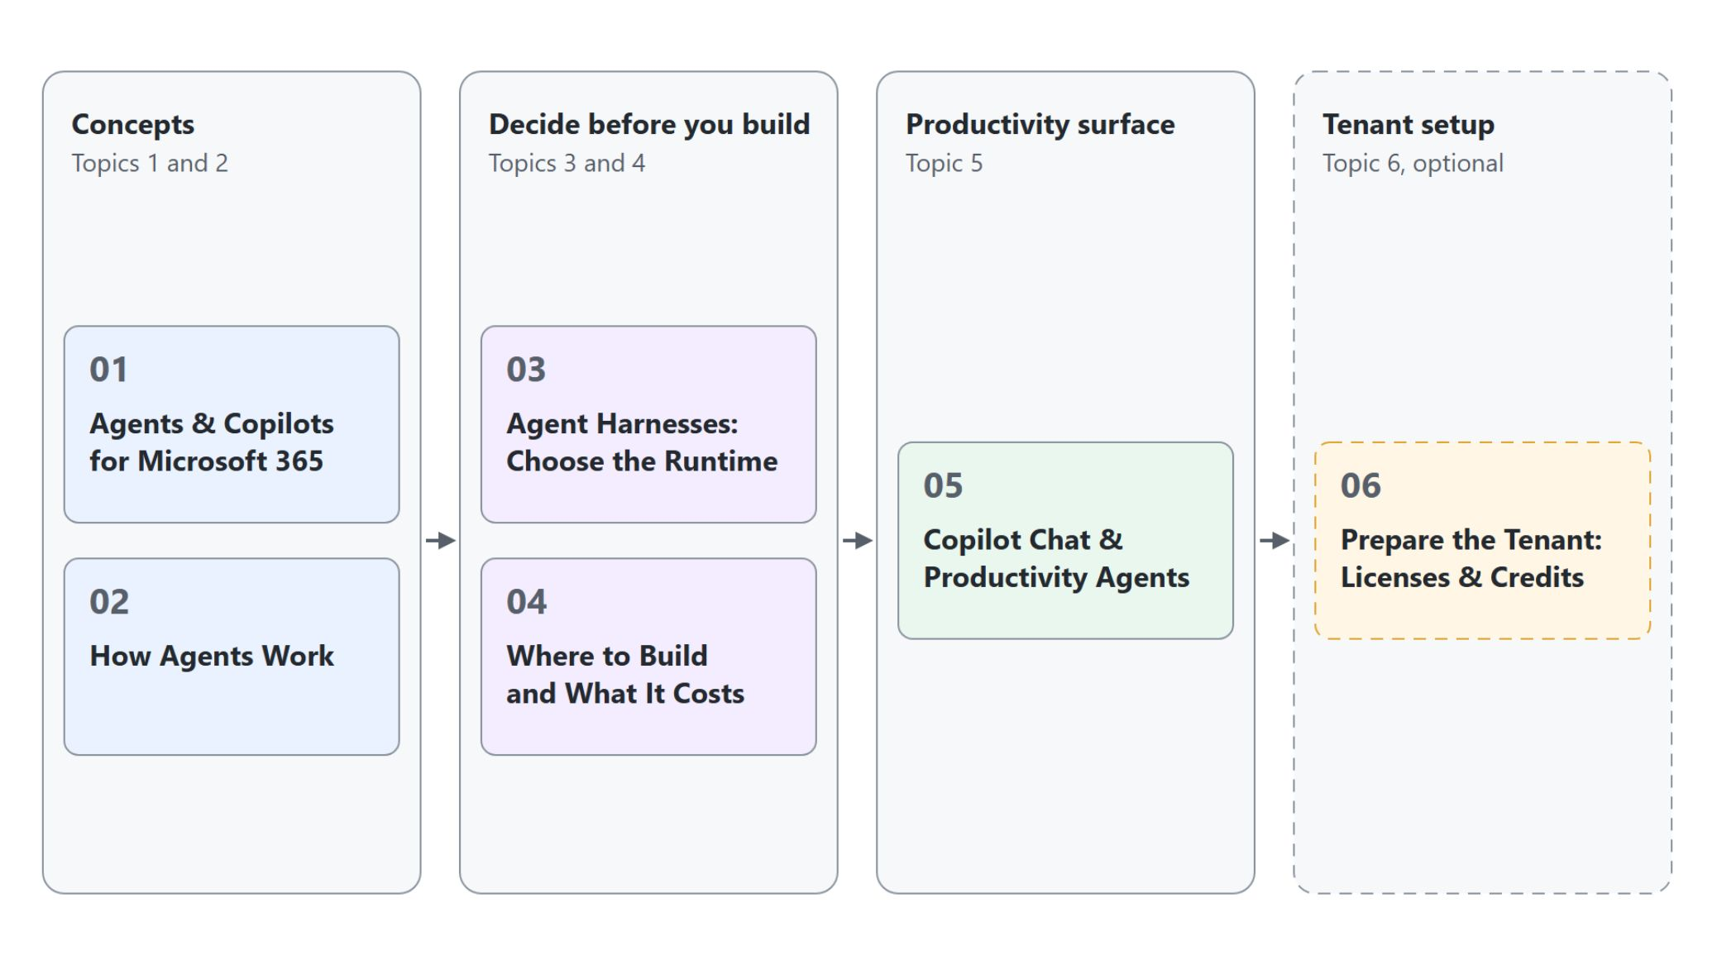
Overview
The path through the six topics
The vocabulary and how agents work: the loop, the agent, the model and the harness
Agent harnesses: the four runtimes in Copilot Studio and how to choose one
Where to build, and how Copilot Credits pay for it
Copilot Chat and the productivity agents that come ready to use
Optional: prepare the tenant with the licenses and credits each module needs
Notes:
This slide walks the path through the module once, following on from the three themes of the title slide.
Concepts: topic one fixes what a copilot, an agent and an assistant are and places Copilot Chat, Cowork, Copilot Studio and SharePoint agents on one map. Topic two explains how an agent pursues a goal in a loop, how the agent, the model and the harness divide the work, and the patterns you design with.
Decide before you build: topic three compares the four harnesses of Copilot Studio and how to choose one before you create an agent. Topic four places Agent Builder, Cowork, Copilot Studio and pro-code on one effort scale, then shows the three billing routes for Copilot Credits and the spending limits to set at activation.
Productivity surface: topic five covers Copilot Chat, Researcher, Analyst, SharePoint agents and Agent Builder, the baseline before you build your own agent.
Tenant setup: topic six is optional. Take it when you prepare a class tenant, or when a demo stops at its first message for lack of credits.

Slide 7
01
Agents & Copilots for Microsoft 365
The vocabulary, the ecosystem map and the step to an agent
Automate Business Processes with Copilot Studio and Copilot Cowork

Slide 8
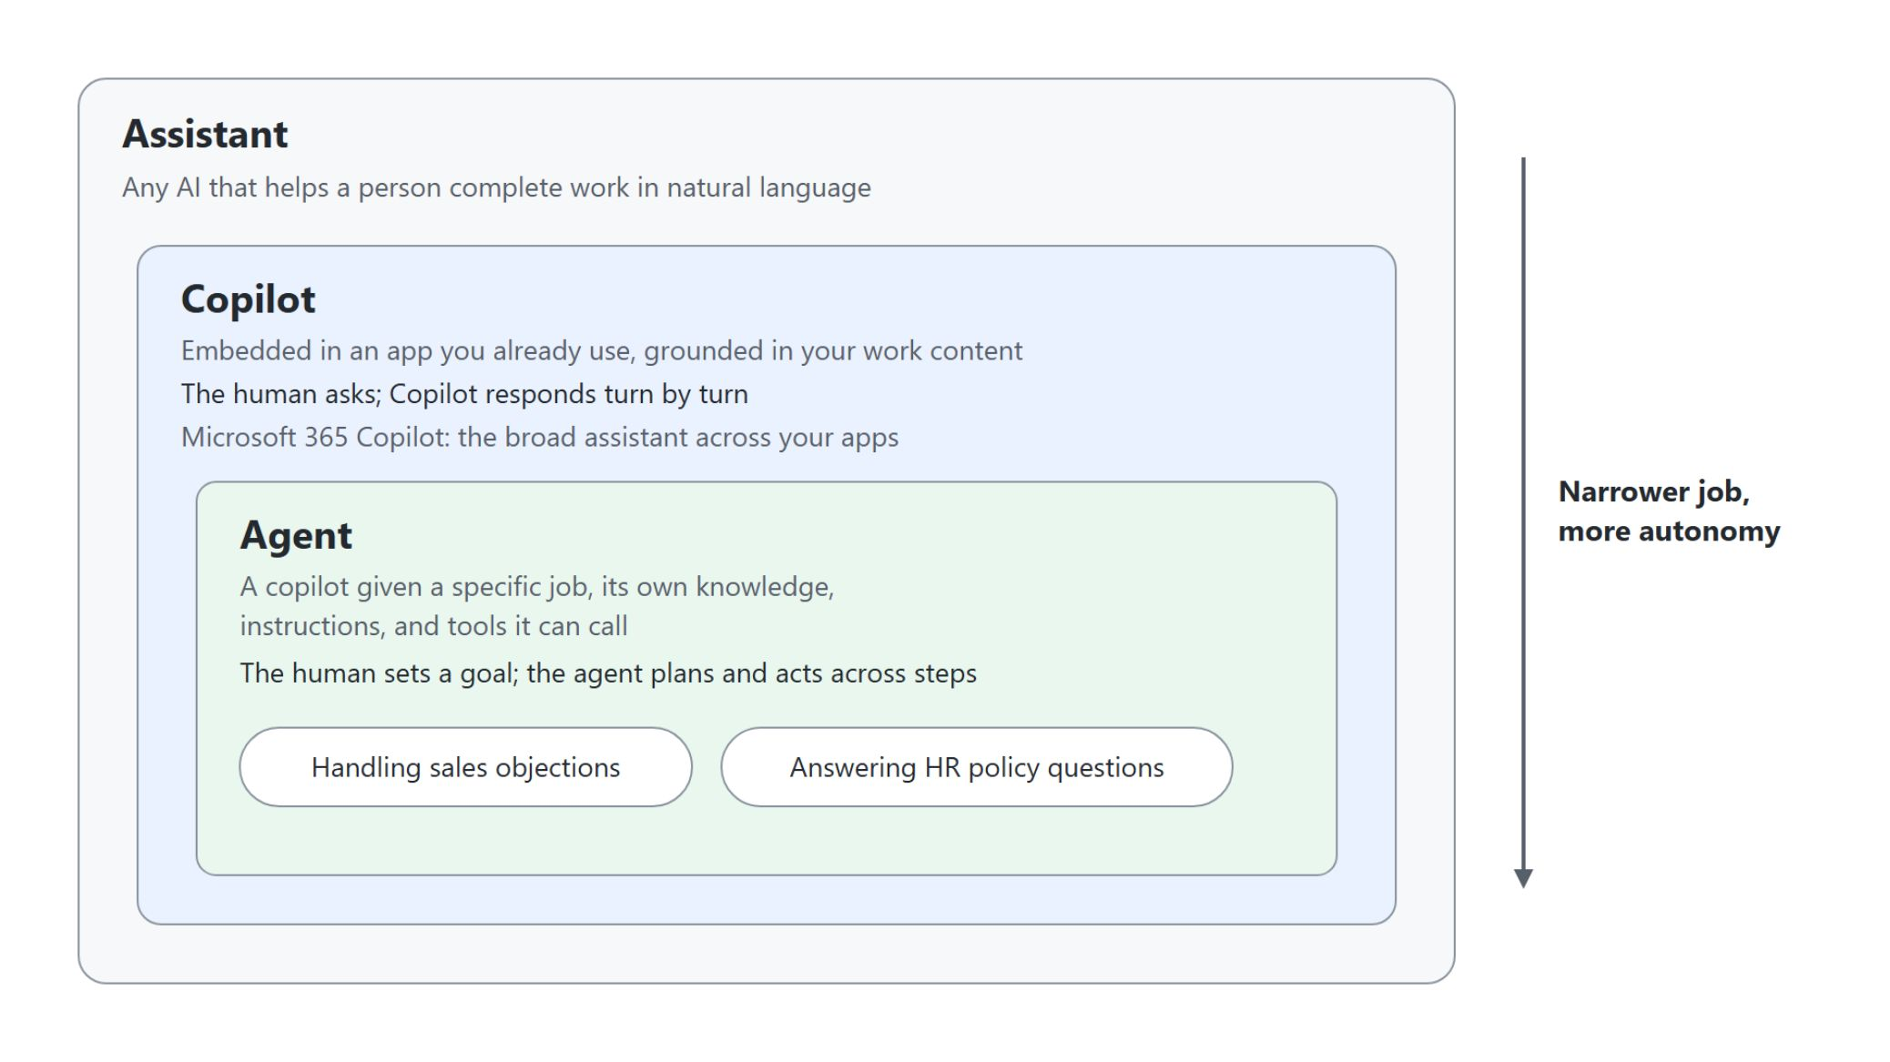
Copilot, agent and assistant
Three terms the course uses with fixed meanings
Assistant: any AI that helps a person complete work in natural language
Copilot: embedded in an app you already use, grounded in your work content
Agent: a copilot with a specific job, its own knowledge, instructions and tools
With a copilot the human asks; with an agent the human sets a goal
Notes:
This slide fixes the vocabulary for the whole course, because these words get used loosely.
Assistant: the general category, any AI that helps a person complete work in natural language.
Copilot: an assistant embedded in an app or surface you already use and grounded in your work content. Microsoft 365 Copilot is the broad assistant across your apps.
Agent: a copilot given a specific job, its own knowledge, instructions and tools it can call. An agent built in Copilot Studio is a focused copilot for one process, for example handling sales objections or answering HR policy questions.
Who drives: with a copilot the human asks and Copilot responds turn by turn; with an agent the human sets a goal and the agent plans and acts across steps. Every agent is a copilot with a narrower job and more autonomy.

Slide 9
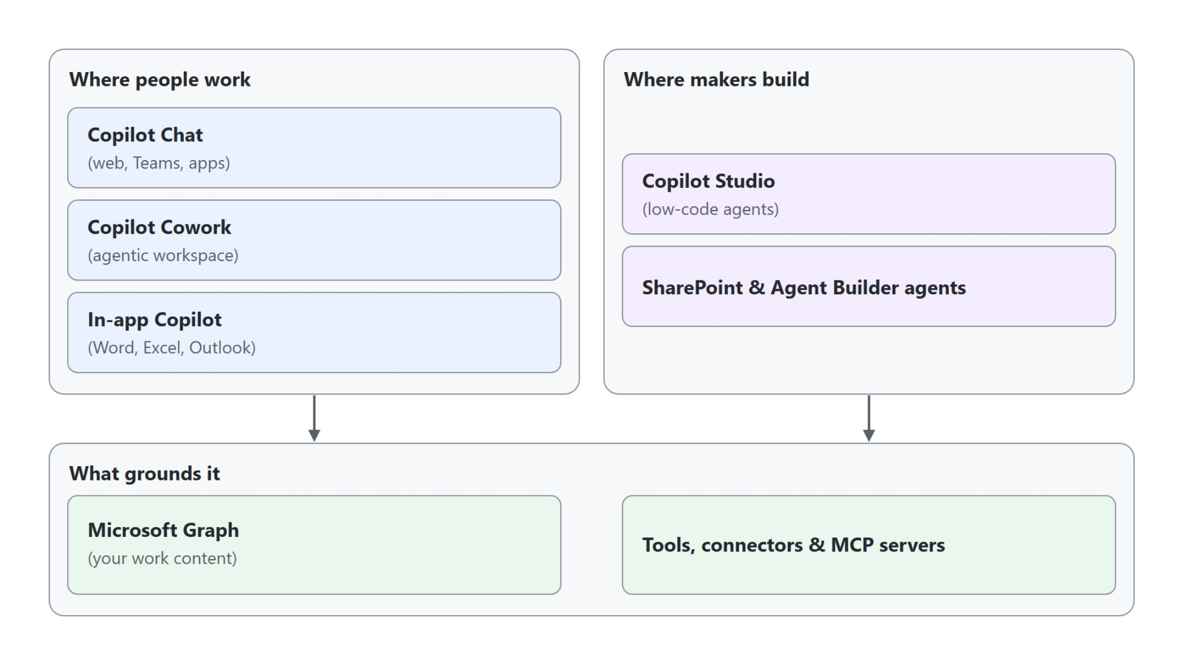
The Microsoft 365 Copilot ecosystem
Experiences, build surfaces and the foundation that grounds them
What people use and what makers build both stand on Microsoft Graph and the tools that reach other systems
Notes:
Copilot is a layer that spans the platform, and the pieces in this course sit at different levels of it.
Where people work: the experiences layer is what end users touch, Copilot Chat on the web and in Teams, the agentic workspace Cowork, and Copilot inside Word, Excel and Outlook.
Where makers build: the build layer is where makers and developers assemble agents, low-code in Copilot Studio or with SharePoint and Agent Builder agents.
Microsoft Graph: both layers stand on a shared foundation, and Graph grounds Copilot in your emails, files, chats and meetings.
Tools, connectors and MCP servers: they let agents reach beyond Graph into other systems, which is where the later modules on tools pick up.

Slide 10
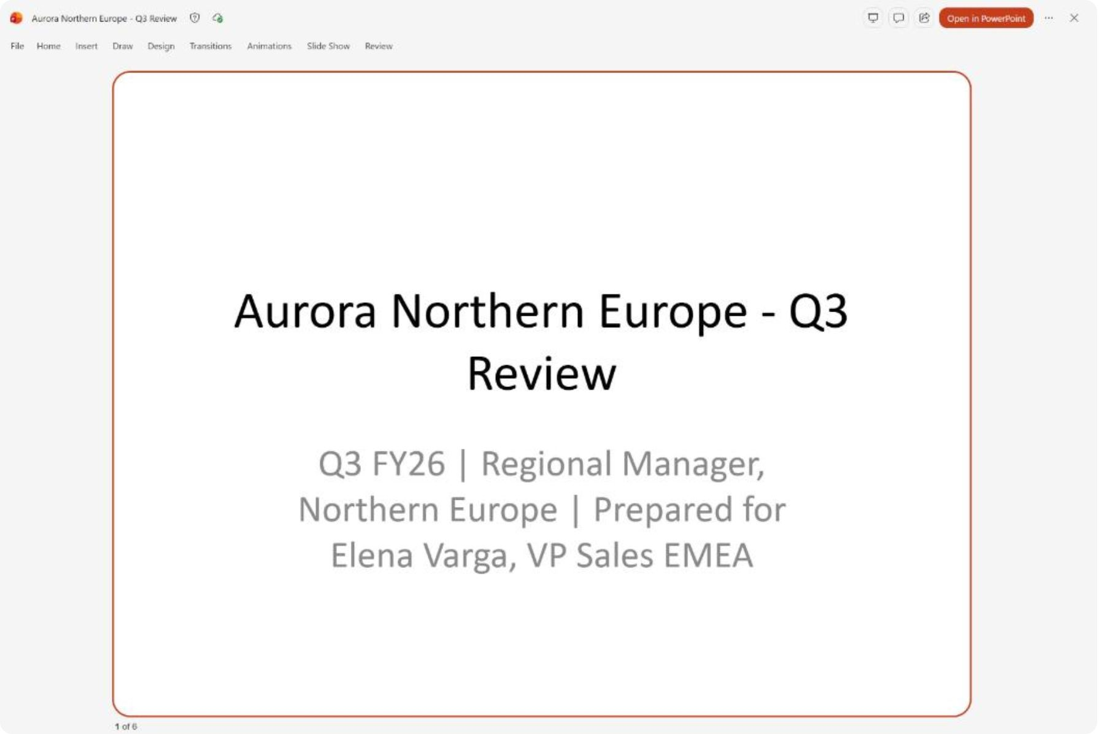
From copilot to agent
Cowork turns an outcome into a finished deck
Copilot Chat answers one question at a time while you do the planning
Cowork takes the outcome you describe and proposes the plan
It works the steps itself, here a six-slide Q3 review built from three files
The finished deck comes back for your review, with a list of what to check before you present
Notes:
Topic one ends on the step from copilot to agent, which is autonomy. The screenshot comes from the first demo of the Cowork module, where a regional manager at Aurora Outdoor needs the Q3 review deck for Thursday.
One question at a time: in Copilot Chat you drive the work turn by turn and do the planning yourself.
The outcome: in Cowork you attach three files and name the result you want, and Cowork proposes a plan before it builds anything. An agent is a copilot given a goal, the tools to pursue it, and a loop to keep going until the goal is met.
Working the steps: Cowork read the sales workbook, the regional notes and last quarter's deck, then built Aurora Northern Europe - Q3 Review with the same six slides as the Q2 deck. The screenshot shows its title slide, prepared for Elena Varga, in the preview beside the task.
For your review: next to the deck, the task reply lists what changed on each slide and what to fix before you present, such as the hiring-cost placeholder that no file could fill. How that loop works, and what an agent is made of, is the next topic.

Slide 11
02
How Agents Work
The agentic loop, the three parts of every agent and the design patterns
Automate Business Processes with Copilot Studio and Copilot Cowork

Slide 12
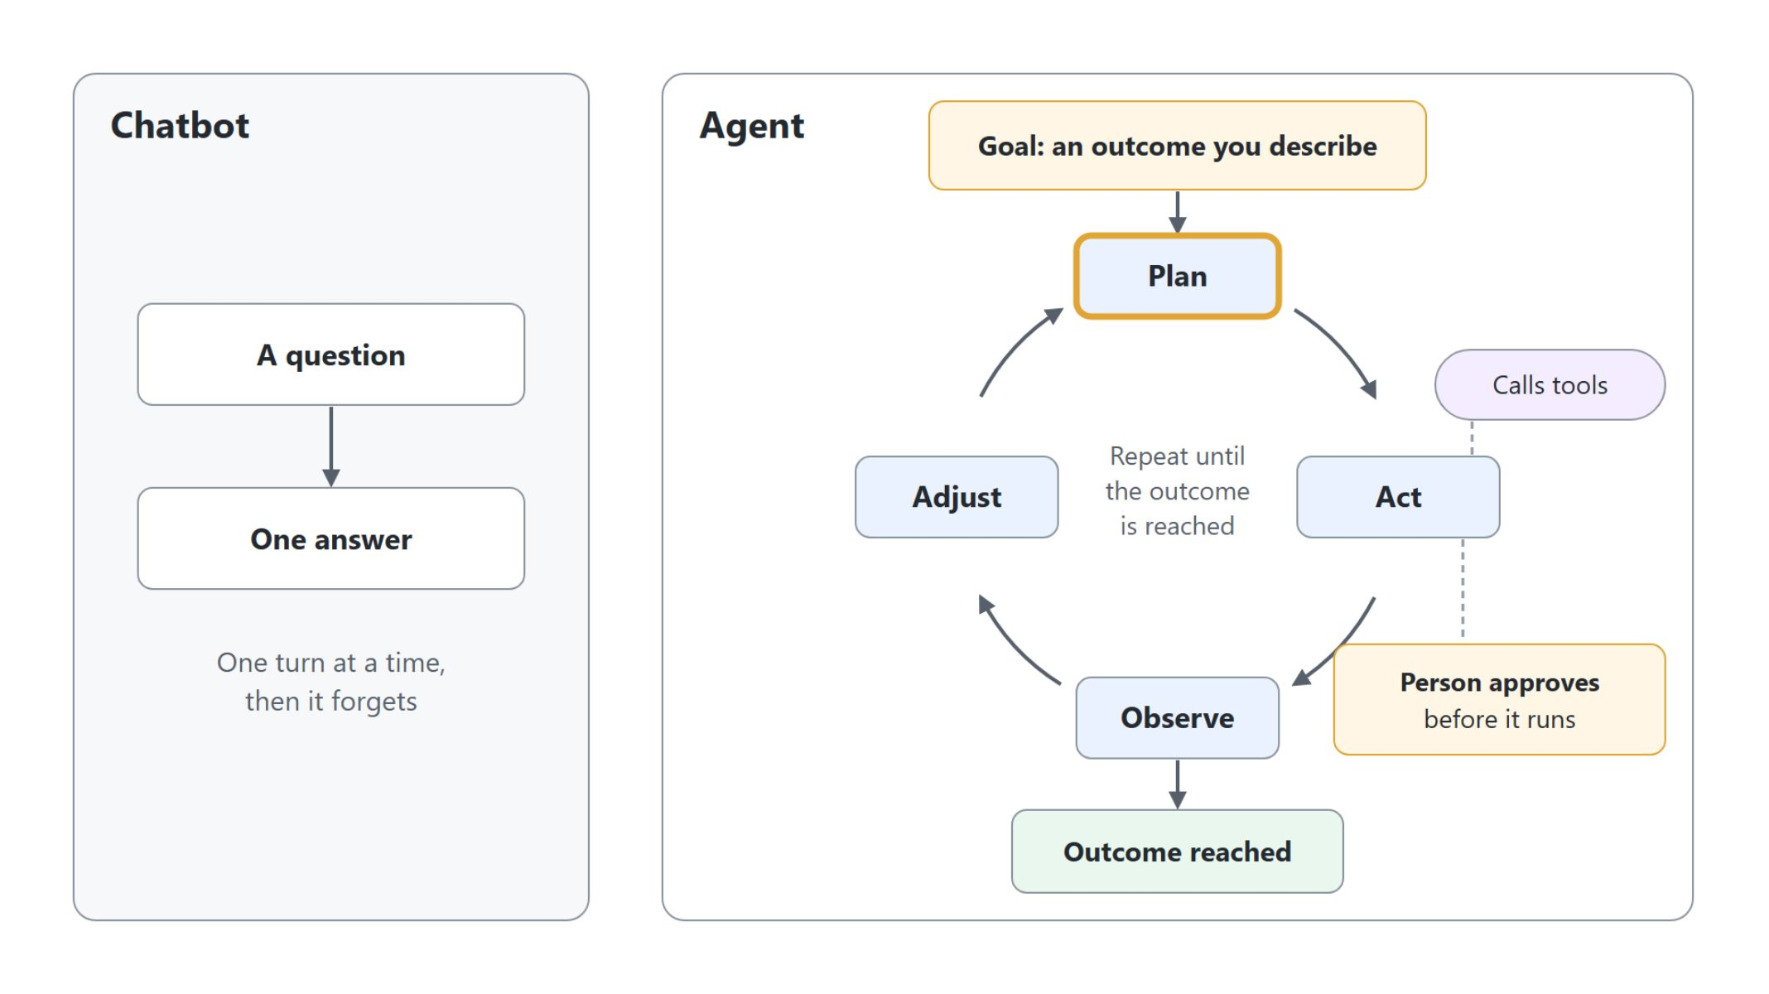
What makes an AI agentic
From answering a question to working toward a goal
A chatbot answers once, while an agent plans, acts, observes and adjusts until the goal is reached, and a person approves before an action runs
Notes:
A plain chatbot answers one turn at a time and forgets; an agent takes a goal, breaks it into steps and loops until the outcome is reached. Topic two starts with that shift from answering to pursuing a goal.
Goal-driven: the agent works toward an outcome you describe rather than producing a single reply.
Tool-using: it calls functions, searches knowledge, reads data and acts in other systems.
Iterative: it loops through plan, act, observe and adjust instead of answering once.
Human-in-the-loop: the agent proposes an action such as sending an email, and a person approves before it runs. This control theme runs through Cowork and Copilot Studio for the rest of the course.

Slide 13
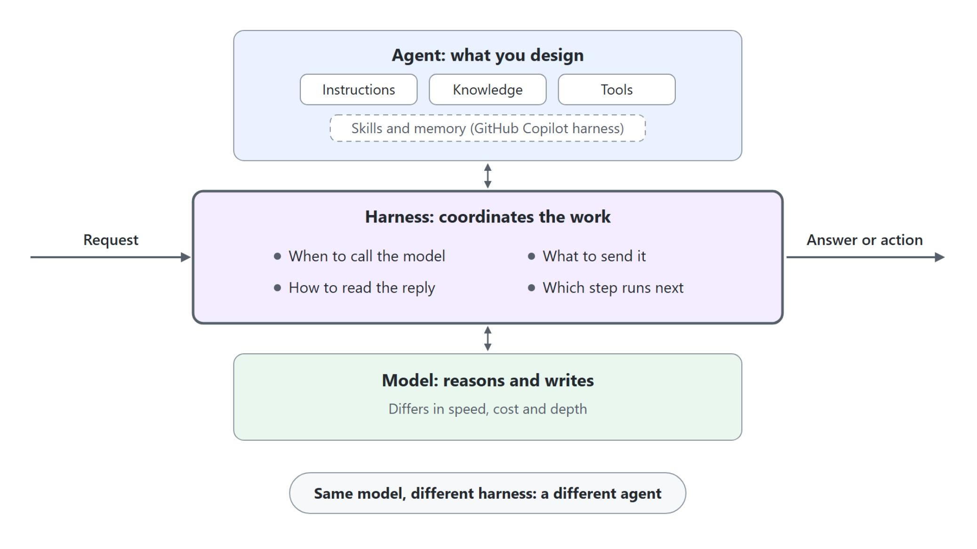
Agent, model and harness
What you design, what reasons, what coordinates
The agent is what you design: instructions, knowledge, tools and boundaries
The model reasons and writes, and models differ in speed, cost and depth
The harness coordinates: when to call the model, what to send, which step runs next
Same model, different harness: a different agent
Notes:
Three parts shape how a Copilot Studio agent works, and only one of them is the part you write.
The agent is your design: its purpose, instructions, knowledge, tools and the limits it must respect. It defines the job, but it doesn't run itself.
The model generates language and makes the decision for one call. Picking a model trades speed and cost against how deep it reasons.
The harness is the runtime around the model. It decides when to call the model, what to send with the call, how to read the reply and whether a topic, a tool, another agent or an answer comes next. That's why two agents with the same model can behave differently, and why the next topic treats the harness as the first decision you make.

Slide 14
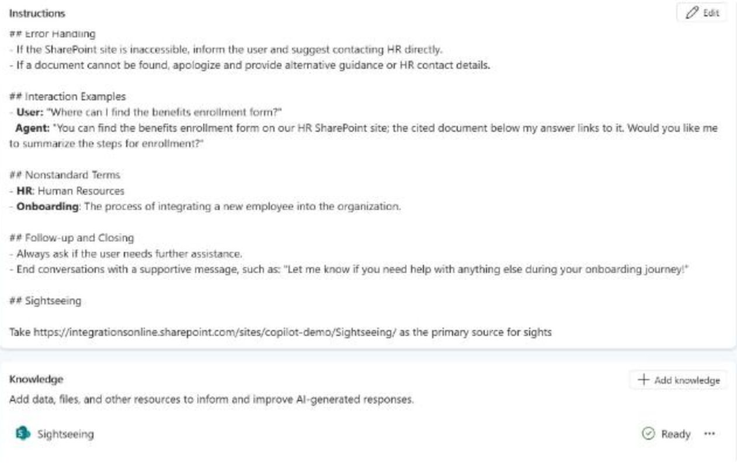
What you design in every agent
Instructions, knowledge and tools in a Copilot Studio agent
Instructions set the role, tone and scope, here the onboarding agent's rules and examples
Knowledge grounds answers in your content through RAG, here a SharePoint site
Tools act on live systems, often through an MCP server; this agent has none yet
A weak agent is thin in one part: name which one to fix it
Notes:
Every agent in this course, on any surface, is designed from the same three parts; the model and the harness run that design. The screenshot shows the CS-Employee Onboarding Assistant from Copilot Studio Basics, with all three on its overview page.
Instructions: the system prompt sets the agent's role, tone and rules, and good instructions name the scope and what to do when the answer is missing. In the test panel the agent declines the off-topic question about the capital of Australia and a limerick.
Knowledge: Retrieval Augmented Generation fetches relevant snippets from your content at question time, and the semantic index finds them by meaning, so a search for time off policy also matches annual leave. This agent grounds its answers in the HR Documents SharePoint site.
Tools: they are functions the agent calls for live data or to act, such as a REST connector, an MCP server or a Power Automate flow. An MCP server describes its tools once, and any MCP-aware host, Copilot Studio or Claude, discovers and calls them.
Name the thin part: confident but wrong answers point to knowledge or instructions, off-topic answers to instructions, and no access to current data to tools. This agent has no tools yet, so it can answer from documents but cannot act.

Slide 15
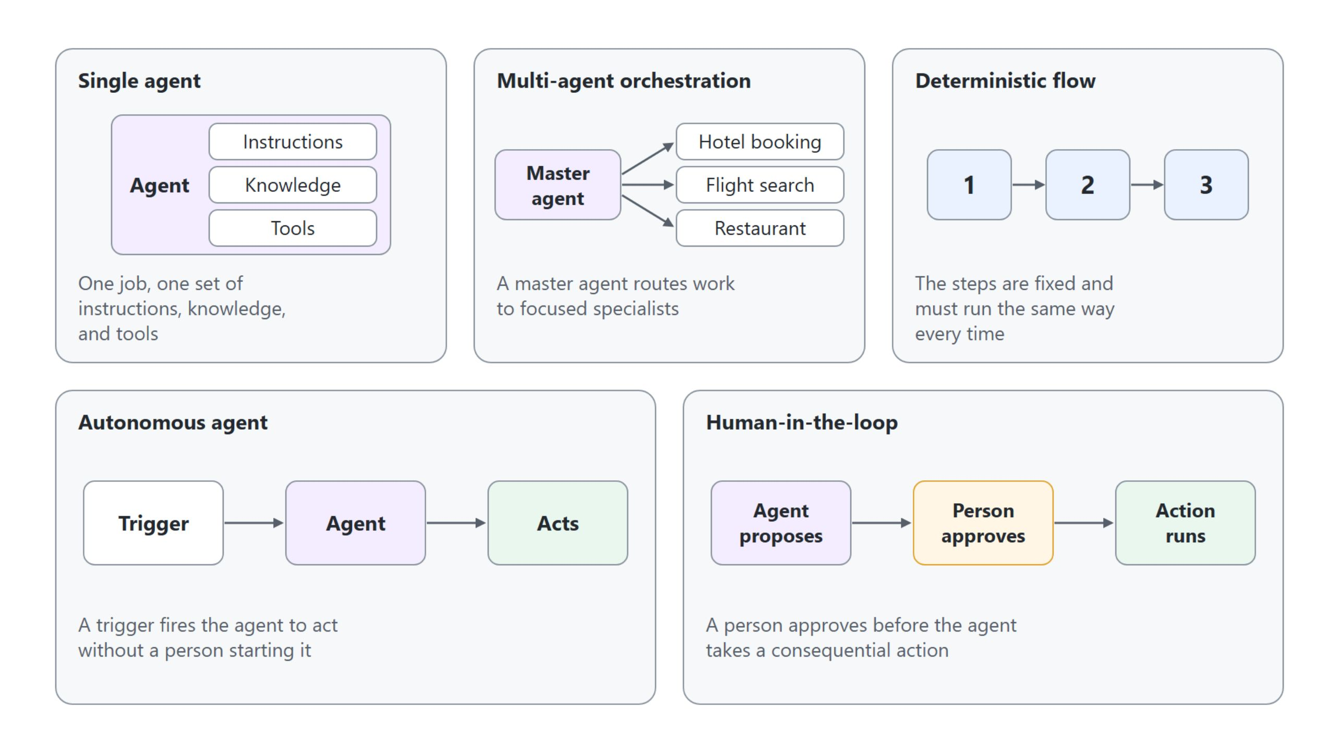
Design patterns in agentic AI
Five patterns to choose and combine
Choose a pattern for the shape of the problem, and combine several in one solution
Notes:
Most agent solutions are assembled from a small set of recurring patterns. You choose a pattern for the shape of the problem, and you can combine several in one solution.
Single agent: one job, one set of instructions, knowledge and tools. Single-agent design starts in Copilot Studio Basics.
Multi-agent orchestration: a master agent routes work to focused specialists, sketched here as hotel booking, flight search and restaurant agents. You build it in the advanced module.
Deterministic flow: the steps are fixed and must run the same way every time. It is covered in the advanced module.
Autonomous agent and human-in-the-loop: a trigger fires an autonomous agent with no person starting it, while human-in-the-loop pauses for a person before a consequential action. Autonomous agents also come in the advanced module.

Slide 16
03
Agent Harnesses: Choose the Runtime
The four harnesses of Copilot Studio and how to choose one
Automate Business Processes with Copilot Studio and Copilot Cowork

Slide 17
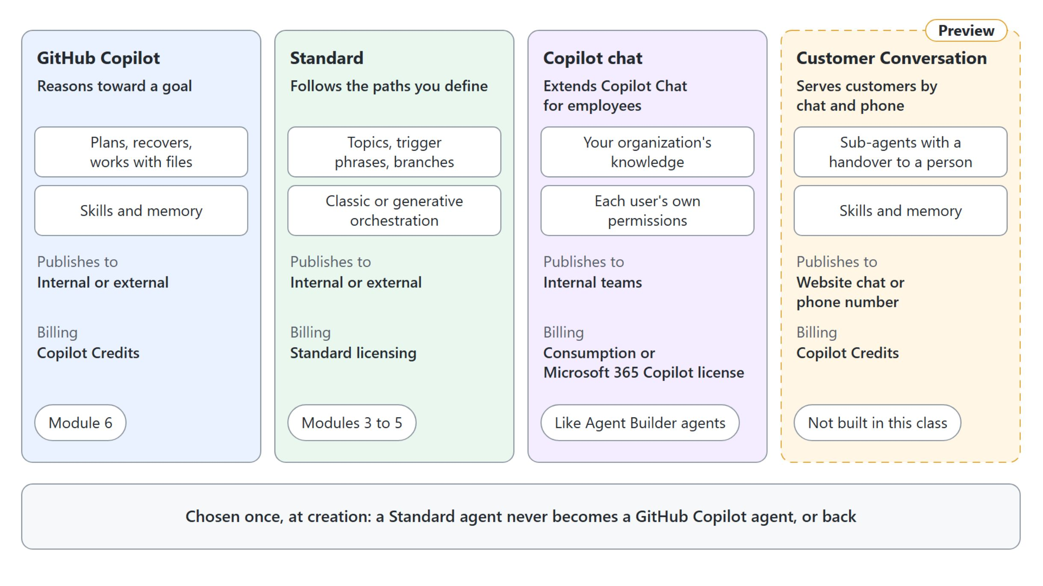
Four harnesses in Copilot Studio
The runtime you pick decides behavior, features and billing
The harness is chosen once, at creation, and fixes behavior, features, publishing and billing
Notes:
Copilot Studio runs everything you build on a harness, and today there are four.
GitHub Copilot: for multistep business processes whose path depends on what each step returns. It plans, recovers from failed steps, creates and edits Office files and PDFs, and supports skills and memory. It bills Copilot Credits from the first build step; module 6 builds on it.
Standard: for rule-based agents and agent flows that must answer the same way every time. You define topics, trigger phrases and branches and choose classic or generative orchestration. Modules 3 to 5 build on it.
Copilot chat: extends Microsoft 365 Copilot Chat with your organization's knowledge for employees, retrieved with each user's own permissions. It is the same kind of declarative agent that Agent Builder builds.
Customer Conversation: in preview, shown in Copilot Studio as the Customer Assist Agent. It serves customers through website chat or a phone number, with sub-agents that hand over to a person. This class builds voice on Standard agents instead.
The banner is the rule to remember: you can't convert an agent between the standard and GitHub Copilot harnesses, so decide before you build.

Slide 18
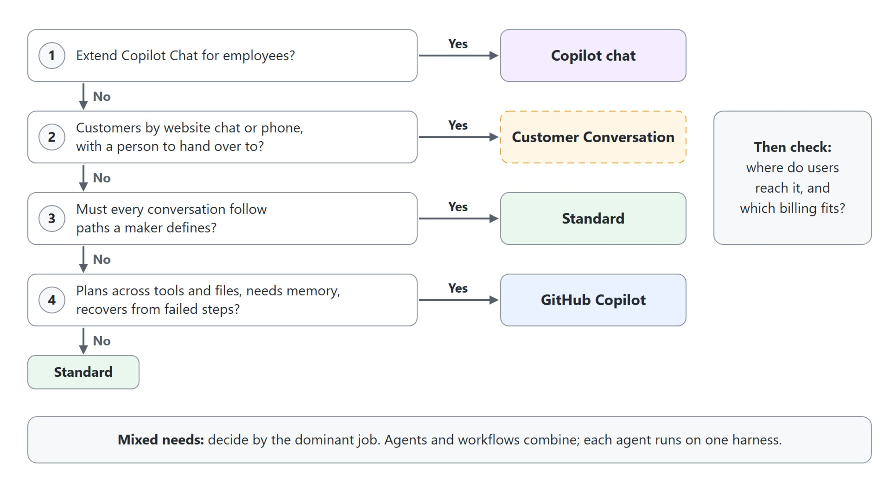
Choose the harness
Answer before you create the agent
Walk the questions top to bottom; the first Yes names the harness, then check reach and billing
Notes:
Five questions separate what a solution needs from the appeal of one feature, and the diagram walks four of them in order.
Copilot Chat first: when the requirement is grounded answers for employees inside the Copilot Chat they already use, the Copilot chat harness fits, and no separate agent experience is needed.
Customers second: when customers reach the agent through a website or a phone number and need a person behind it, the Customer Conversation harness fits.
Fixed paths third: when every conversation must follow questions and branches a maker controls, the standard harness fits. When the work plans across several tools and files, needs memory or must recover from a failed step, the GitHub Copilot harness fits; otherwise Standard is the simpler choice.
Then check where users reach the agent and which billing model the organization accepts. A requirement that mixes answers goes by its dominant job, and a solution can combine several agents and workflows, each on one harness.

Slide 19
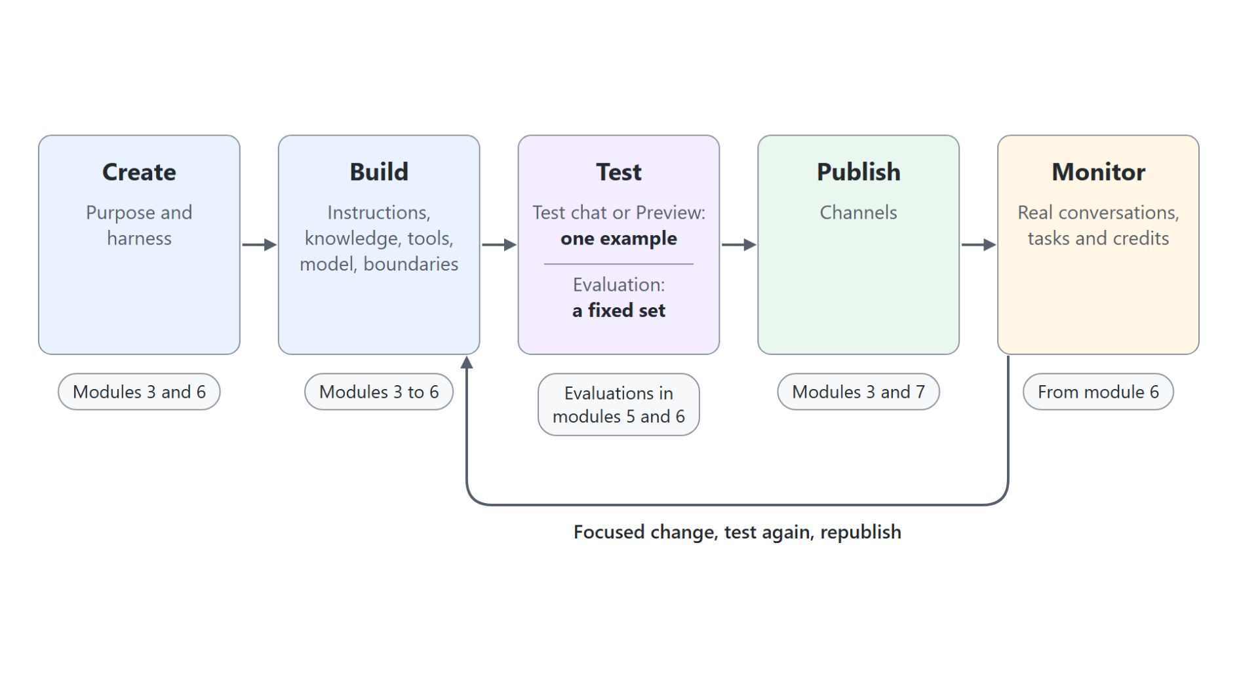
One lifecycle on every harness
Create, build, test, publish, monitor, then improve
Every agent is created, built, tested, published and monitored, whatever harness runs it
A test chat shows one example; an evaluation runs a fixed set you can compare
Monitor shows real use, and each finding becomes one focused change
The tab names differ by harness; the stages don't
Notes:
The course itself follows this loop, so this slide doubles as a map of the modules ahead.
Create and build: you name the purpose, pick the harness, then add instructions, knowledge, tools, the model and the boundaries. Standard agents are built from module 3, GitHub Copilot agents in module 6.
Test: a test chat or Preview answers one question once. An evaluation runs the same set of cases every time, so two versions of an agent are compared on the same evidence; modules 5 and 6 each have an evaluations topic.
Publish and monitor: publishing releases the agent to its channels, and Monitor shows what real users did and what it cost. An unclear instruction, two overlapping tools or an answer without a source each lead to one focused change, a new test and a new publish.

Slide 20
04
Where to Build and What It Costs
The build paths and how Copilot Credits pay for them
Automate Business Processes with Copilot Studio and Copilot Cowork

Slide 21
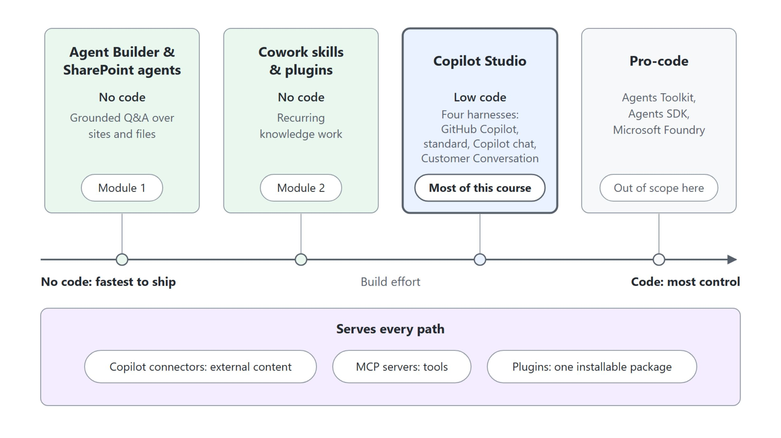
Where to build an agent
The lowest-effort path that meets the need
Start on the lowest-effort path that meets the need, and move up when a tool call, a channel or a multi-step process requires it
Notes:
The build paths trade ease of building against control, so start with the lowest-effort path that meets the need. A common pattern is to prototype without code, then rebuild in Copilot Studio when the process needs custom tools, multi-agent orchestration or governance.
No code: Agent Builder and SharePoint agents answer from your sites and files, and Cowork skills and plugins automate recurring knowledge work. Both come in the first two modules.
Copilot Studio: the low-code path for process agents with tools, triggers, channels and governance, and the home of most of this course. Its harness decides how an agent runs and bills; the previous topic compared the four harnesses and how to choose one.
Pro-code: the Microsoft 365 Agents Toolkit, the Agents SDK and Microsoft Foundry bring your own orchestrator, models or hosting. They are out of scope here.
Every path: Copilot connectors bring external content in, MCP servers bring tools, and a Microsoft 365 Copilot plugin packages agents, skills, connectors and MCP servers into one installable unit that admins govern.

Slide 22
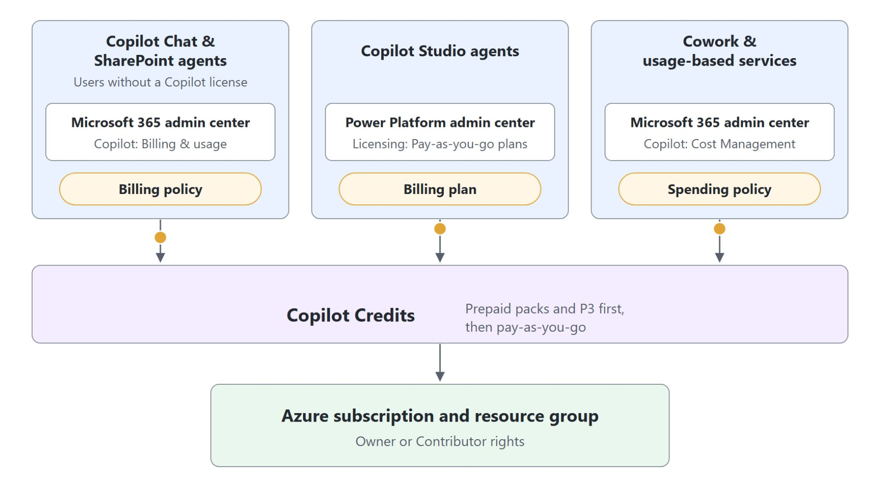
What agents cost
Copilot Credits and the three billing routes
Copilot Credits: one currency for agent usage since September 2025
A Copilot license zero-rates Copilot Studio agents in Chat, Teams and SharePoint
Three routes: billing policy, billing plan, spending policy
Prepaid first, then pay-as-you-go to one Azure subscription
Notes:
Since September 2025, Copilot Credits are the common currency for agent usage across Microsoft 365 Copilot and Copilot Studio.
Copilot license: licensed users run Copilot Studio agents in Copilot Chat, Teams and SharePoint at zero-rated usage for classic answers, generative answers and Graph grounding. Everything else draws credits.
Three routes: agents in Copilot Chat and SharePoint agents for unlicensed users bill through a billing policy in the Microsoft 365 admin center, and Copilot Studio agents through a billing plan in the Power Platform admin center. Cowork, the Work IQ API and other usage-based services bill through a spending policy under Copilot, Cost Management.
Prepaid first: prepaid capacity packs and the Copilot Credit Pre-Purchase Plan are drawn down first, then pay-as-you-go bills an Azure subscription and resource group on which the admin holds Owner or Contributor rights.

Slide 23
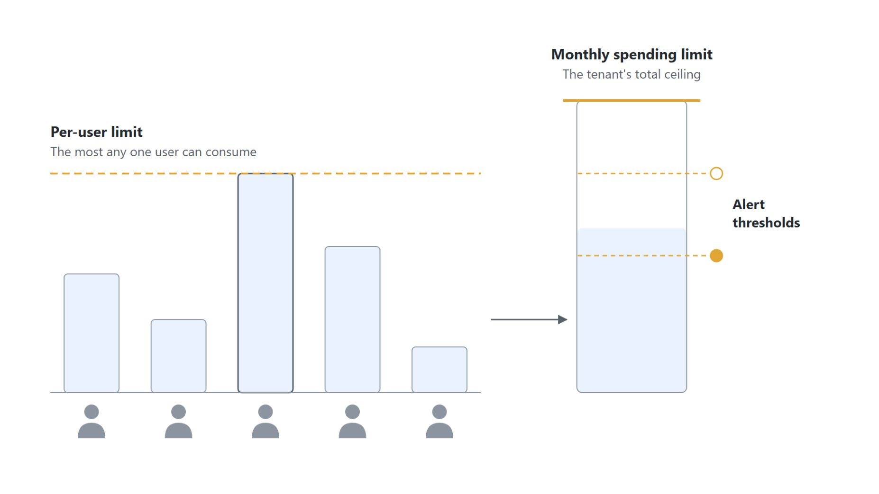
Spending limits
Guardrails set when you activate Copilot Credits
Monthly spending limit: the tenant's total ceiling for the billing period
Per-user limit: the most any one user can consume, at least 2,000 credits a month
Alert thresholds below the ceiling notify you before it is reached
Set them at activation, with numbers from the Copilot Credit Estimator
Notes:
This slide covers the guardrails you set when you activate Copilot Credits, before the first bill arrives.
Monthly spending limit: a spending policy caps the tenant's monthly total for the billing period.
Per-user limit: it caps each user's share, so a single heavy user cannot use up the tenant's credits. Microsoft sets the minimum at 2,000 credits a month, and a user who reaches it loses access until credits reset on the first of the month.
Alert thresholds: alerts fire at thresholds below the ceiling, so you hear about the spend before the limit is reached.
At activation: set all three when you activate, not after the first bill. The Copilot Credit Estimator models realistic numbers first.

Slide 24
05
Copilot Chat & Productivity Agents
Researcher, Analyst, SharePoint agents and Agent Builder
Automate Business Processes with Copilot Studio and Copilot Cowork

Slide 25
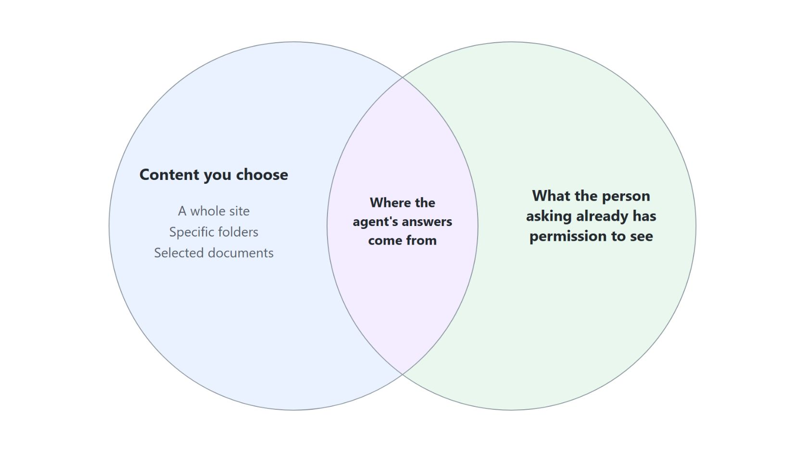
Productivity and SharePoint agents
Ready-to-use agents with nothing to build
Researcher: multi-step research across work content and the web, returned as a source-cited report
Analyst: reasons over your data to produce analysis, tables and charts
SharePoint agent: scoped to a whole site, specific folders or selected documents
It answers only from what the person asking already has permission to see
Created with no code, published to SharePoint and Microsoft 365 Copilot
Copilot in OneDrive and SharePoint works on the files: trends across spreadsheets, folder sorting, interactive HTML reports
Notes:
The Copilot Chat basics are pre-class homework, so the topic opens here: the first-party agents a Microsoft 365 Copilot license brings with nothing to build.
Researcher: it runs multi-step research across your work content and the web and returns a structured, source-cited report. It fits a cited market scan that combines your files and the web.
Analyst: it reasons over your data to produce analysis, tables and charts you can act on.
SharePoint agent: an assistant scoped to the content you choose, a whole site, specific folders or selected documents. It only surfaces what the person asking already has permission to see, which makes it the fit for policy questions over a document library.
No code: you create one from a site or from selected files, then publish it so people can chat with it in SharePoint and in Microsoft 365 Copilot.
Copilot in OneDrive and SharePoint: it became generally available in October 2026 and works where the files live. Select several spreadsheets and ask for trends and charts, point it at a crowded folder to sort it into a structure, or turn existing files into an interactive HTML report that you refine with follow-up prompts. OneDrive opens that HTML, and any Markdown output, for editing, anchored comments and live coauthoring.

Slide 26

Agent Builder
Your own agent in Microsoft 365 Copilot, with no code
Describe the job in plain language, or configure each field by hand or from a template, then test on Try it
Knowledge: SharePoint, OneDrive, Teams chats, your email, public sites, uploaded files and Copilot connectors
Share it with people, or submit it to the org catalog for the Agent Store
No actions: copy the agent to Copilot Studio when it needs connectors or workflows
Notes:
Researcher, Analyst and SharePoint agents come ready-made. Agent Builder is the next step: your own declarative agent, built inside Microsoft 365 Copilot with no code. Copilot Studio builds the same kind of agent on its Copilot chat harness, one of the four harnesses compared in the previous topics.
Describe: select New agent and describe the job on the Describe tab, and Agent Builder fills in the name, description, instructions, knowledge sources and suggested prompts. Skip to configure opens the same fields for manual editing, templates give you a preconfigured start, and the Try it tab tests the agent before anyone else sees it.
Knowledge: an agent grounds on up to four public URLs, up to 100 SharePoint files, folders or sites plus one SharePoint list, OneDrive files, Teams chats and meetings, your Outlook email, uploaded files and the Copilot connectors your admin enabled. Which sources a builder can add depends on their license.
Share: share with specific people, or with the whole organization when your admin allows it, and submit to the org catalog so an admin can approve the agent into Built by your org in the Agent Store. SharePoint agents are moving into Agent Builder from mid-November 2026.
No actions: Agent Builder can't author actions that call external services. When the onboarding agent needs a connector, a workflow or a custom tool, copy it to Copilot Studio, where Module 3 picks up.

Slide 27
06
Prepare the Tenant: Licenses & Credits
Optional: the licenses, credit sources and costs behind each module
Automate Business Processes with Copilot Studio and Copilot Cowork

Slide 28
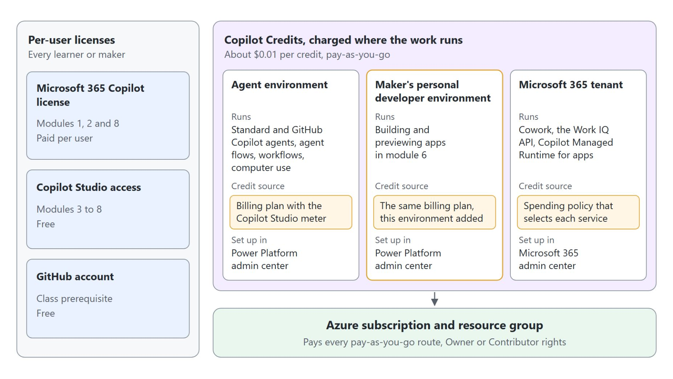
Licenses and credit sources
Few seats, and credits charged where the work runs
Per user: a Microsoft 365 Copilot license, Copilot Studio access and a GitHub account
Everything else is Copilot Credits or an Azure resource on one subscription
Credits are charged where the work runs: agent environment, developer environment or tenant
Each maker's personal developer environment needs the billing plan too
Notes:
This optional topic collects what setting up the class tenant taught us. Few of the licenses are per-user seats, and each credit source has to be in place before the module that uses it starts.
Per user: every learner needs a Microsoft 365 account with a Microsoft 365 Copilot license, every maker needs Copilot Studio access, and a GitHub account is a class prerequisite. Copilot Studio access is free through the Copilot license, the Copilot Studio user license or the trial.
Credits or Azure: everything else is usage in Copilot Credits, about one cent each, or an Azure resource. One Azure subscription and resource group, with Owner or Contributor rights for the admin, pays every pay-as-you-go route.
Where the work runs: agents, agent flows, workflows and computer use bill to the billing plan of the agent environment. Cowork, the Work IQ API and Copilot Managed Runtime bill through a Microsoft 365 spending policy that selects each service.
Personal developer environment: Copilot Studio builds every maker's apps there, with no picker, and creates it the first time the maker opens the App tile. An agent environment can be fully billed while the app build in the same browser tab fails, because the app is built somewhere else.

Slide 29
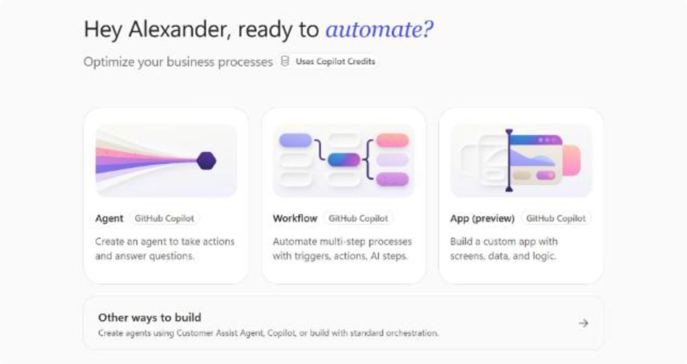
What a Copilot license covers
The harness decides whether building draws credits
Standard agents run zero-rated for licensed users in Microsoft 365 channels
Their test chat costs nothing: every Standard agent demo ran at 0 credits
GitHub Copilot agents, workflows and apps bill from the first build step
The Copilot Studio home page marks the paths that use Copilot Credits
Notes:
A Microsoft 365 Copilot license covers Microsoft's own Copilot experiences and the Standard agents a licensed user runs inside Microsoft 365. The screenshot shows where the difference starts: the Copilot Studio home page.
Standard agents: classic answers, generative answers and Microsoft Graph grounding are zero-rated in Copilot Chat, Teams and SharePoint. The same agent draws credits when the user has no Copilot license or it runs in a channel outside Microsoft 365.
Test chat at zero: answers, actions and Graph grounding in a Standard agent's test chat aren't counted, which is why every Standard agent demo in this class ran at 0 credits.
GitHub Copilot harness: it charges for model tokens, tools and the harness itself from the first build step, including authoring, Preview, tests and evaluations. Plan its credits before module 6 begins.
The credits label: the home page puts Agent, Workflow and App, all on the GitHub Copilot harness, under the label Uses Copilot Credits, and moves standard orchestration to Other ways to build. Computer use and the Work IQ API are never covered by the license, and Cowork needs the license plus a spending policy.

Slide 30
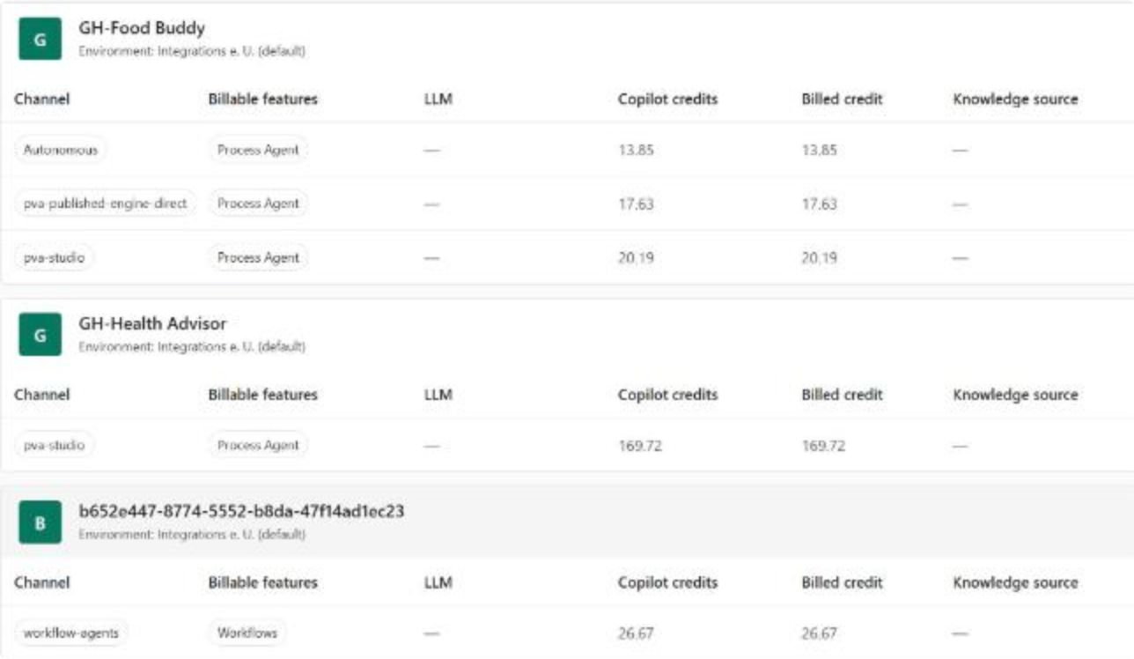
Where a run's cost shows
Billed credits per agent in the Power Platform admin center
Manage Agents lists billed credits per agent, channel and feature
A GitHub Copilot agent: 169.72 credits for five Preview sessions
One workflow run: 26.67 credits on the workflow-agents channel
Work IQ API and Cowork costs show only in Microsoft 365 Cost management
Notes:
Every demo in this class was run live and its cost read back from the portals, and no portal shows all of it. The screenshot is the per-agent table of the Agents page under Copilot Studio in the Power Platform admin center, known as Manage Agents, after the class runs.
Manage Agents: it is the per-agent source of truth, split by channel and billable feature, and an agent appears there only after it has billed credits. Copilot Studio usage posts within hours.
GitHub Copilot agent: GH-Health Advisor shows 169.72 credits on the pva-studio channel, the cost of five Preview sessions. Per-session detail stays in Preview, History, because the Monitor page counts Preview credits without listing the sessions.
Workflow: one workflow run billed 26.67 credits, listed under the workflow-agents channel with the Workflows feature.
Microsoft 365 services: Work IQ API calls show in Microsoft 365 Cost management per service and per user only, and Cowork only account-wide. Work IQ API, app and Azure costs had not posted on the day of the run, so record such a cost as not measured, never as 0.

Slide 31

Takeaways
What to carry into the Cowork module
Every agent is a copilot with a narrower job and more autonomy
An agent works toward a goal in a loop, and a person approves consequential actions
Fix a weak agent by naming its thin part: instructions, knowledge or tools
Choose the harness before you create the agent: it fixes behavior, features and billing
Take the lowest-effort path that meets the need, and set Copilot Credit limits before the first bill
Notes:
Close the module with the habits it built, each one a decision you make before you start building.
Narrower job, more autonomy: a copilot answers turn by turn, while an agent takes a specific job with its own knowledge, instructions and tools.
Goal and approval: an agent plans, acts, observes and adjusts until the outcome is reached, and a person approves before an action such as sending an email runs.
Name the thin part: confident but wrong answers, off-topic replies and no access to current data each point to one of instructions, knowledge or tools.
Harness first: the standard, GitHub Copilot, Copilot chat and Customer Conversation harnesses run the same agent design differently, and an agent can't move from one to another, so the harness is decided before the build starts.
Lowest-effort path and limits: start with Agent Builder, a SharePoint agent or a Cowork skill, and move to Copilot Studio when a tool call, a channel or a multi-step process requires it. Agents bill in Copilot Credits, so set monthly and per-user limits at activation; the Cowork module builds on this next.

