Slide 1



Fast Lane Group
Worldwide Education &
Professional Services
www.flane.de | © 2026 Fast Lane Institute for Knowledge Transfer GmbH
Notes:
Die Fast Lane Gruppe.
Fast Lane … Dienstleister u. Spezialist für High-End Technologie und Business Trainings
IT Trainings zu den unterschiedlichsten Herstellern wie Microsoft, Google, Cisco oder AWS. Und vielen weiteren wichtigen IT Herstellern.
Sei es Cloud, Security, Netzwerk oder allgemein digitale Transformationsprojekte
Und das seit 2003.
Das spannende ist, dass die Fast Lane Gruppe bereits seit 2009 durchgängig zu den Top 20 Unternehmen in der IT Trainingsbranche weltweit zählt.
Aber auch Footprint ebenso im klassischen Professional Services Bereich für unsere wichtigsten Hersteller
PreSales Support, Deployment Services und Adoption Trainings
Additional Information:
Im Jahr 2021 sind wir zur „most strategic IT Education company worldwide“ von der IDC im „magic quadrant“ aufgeführt worden !
1 mio Teilnehmer insgesamt seit bestehen, 50.000+ Students ww p.A, 20.000 in DE pro Jahr

Slide 2






AGENTIC AI: FROM STRATEGY TO PRODUCTION.
Alexander
Kastil
AGENTIC AI CONSULTING · VIENNA
Full stack, from enterprise software to agentic AI. Since 1996
AI at Work
Enterprise AI
Value discovery, KPI mapping and roadmap
Governed multi-agent systems on Microsoft Copilot and Foundry
Agentic Software Engineering
Team Enablement
Harness architecture for Claude Code and GitHub Copilot
AI driven content production and delivery
integrations.at
github.com/alexander-kastil
SCAN TO CONNECT
alexander.kastil@integrations.at
linkedin.com/in/alexander-kastil
integrations.at
Notes:
Intro: Alexander Kastil, integrations.at. Four practice areas from AI at Work to team enablement. Certifications: Agentic AI Business Solutions Architect, Azure AI App and Agent Developer Associate, DevOps Engineer Expert.

Slide 3

MODULE 2
Microsoft 365 Copilot Cowork
Delegate multi-step work across Microsoft 365
Automate Business Processes with Copilot Studio and Copilot Cowork

Slide 4
01
02
03
Getting Started with Cowork
What Cowork is, setup, and how a task runs
Understanding Skills: Built-in Skills & the Side Panel
The built-in catalog and the Workspace panel
Creating Custom Skills with SKILL.md
Your own skills in plain language
04
05
06
Scheduled Prompts & Event-Driven Tasks
On a schedule or when a message arrives
Extending Cowork with Plugins
Outside data and expertise from plugins
Human-in-the-Loop: Approving Actions & Staying in Control
Approvals, risk levels, and governance
Automate Business Processes with Copilot Studio and Copilot Cowork

Slide 5

Microsoft 365 Copilot Cowork
Delegate multi-step work across Microsoft 365
Delegate an outcome in plain language, and Cowork plans and runs the steps
Extend it with skills, schedules and plugins
Approve before anything is sent or saved
Notes:
This module covers Microsoft 365 Copilot Cowork, the agentic AI in Microsoft 365 that does work on your behalf. It has been generally available since June 2026, and access comes from a Copilot Credits spending policy rather than Frontier enrollment.
Delegate: you describe an outcome in plain language, and Cowork plans and runs the steps across your apps. Most demos share one scenario: you are the Regional Manager for Northern Europe at Aurora Outdoor, a Nordic outdoor-gear retailer, closing out Q3.
Extend: built-in and custom skills, scheduled prompts and plugins decide what Cowork can do and when it runs. The module adds them one topic at a time.
Approve: Cowork pauses before anything is sent or saved, so you stay in the loop for every action that leaves a mark. The last topic covers approvals, risk levels and admin governance.

Slide 6
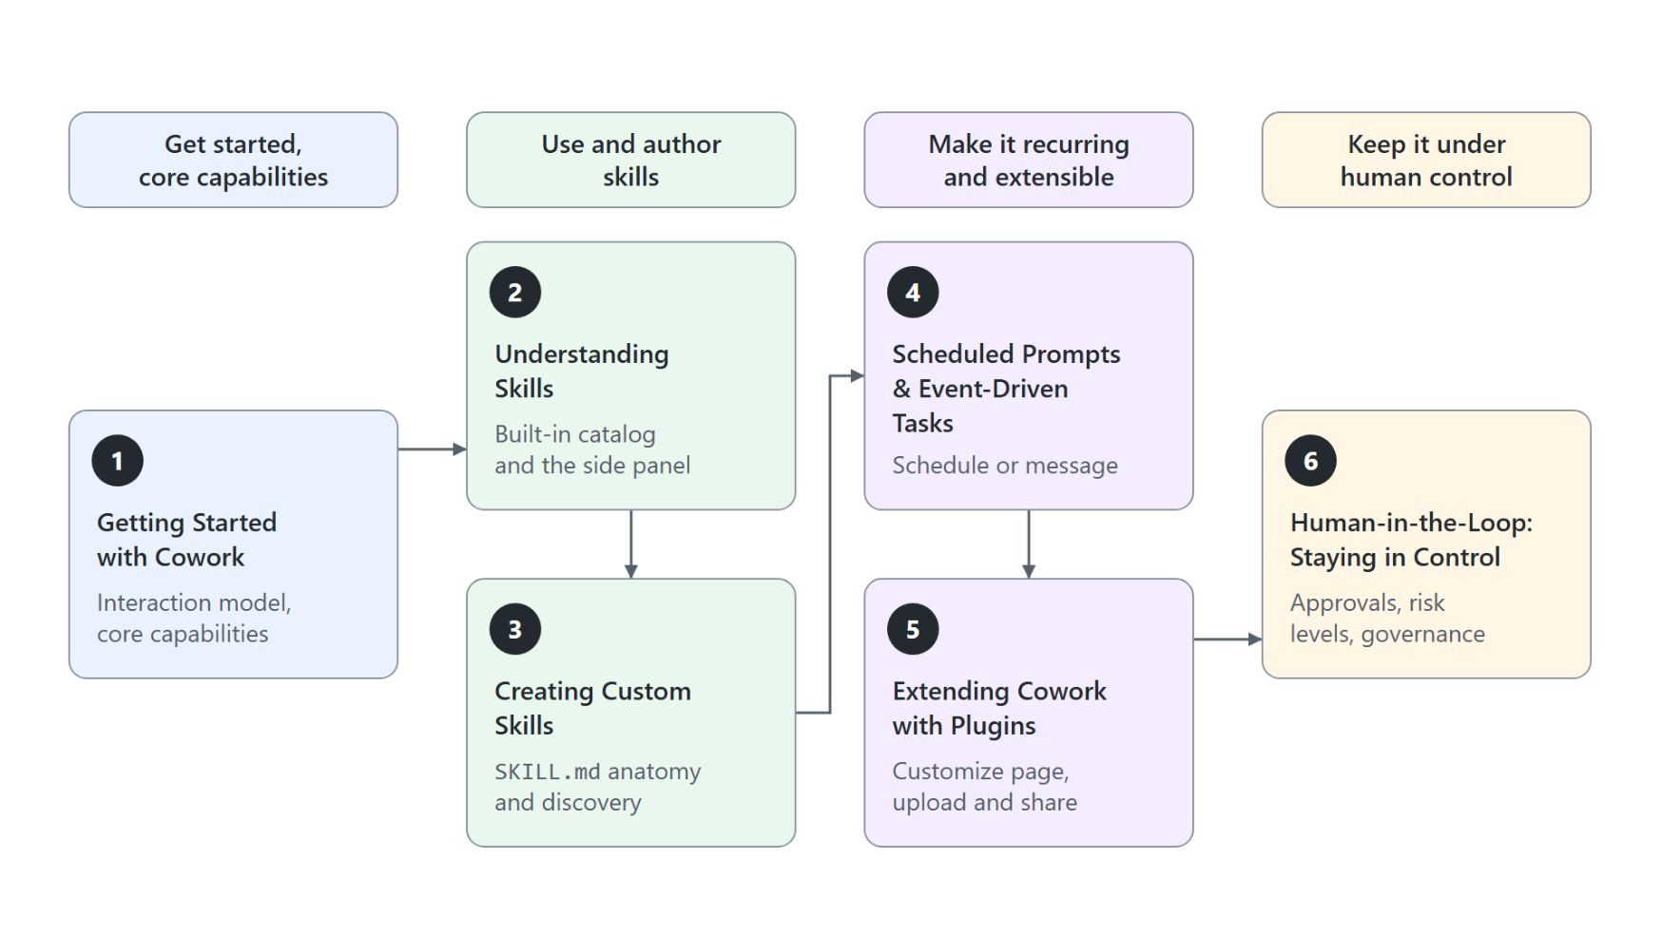
Overview
The path through six topics
Get started: what Cowork is, how it differs from Chat, tenant setup and how a task runs
Use and author skills: the built-in catalog, the Workspace panel and your own SKILL.md
Make the work recurring with scheduled prompts and event-driven tasks
Make it extensible with plugins that add external data and expertise
Keep it under human control with approvals, risk levels and governance
Notes:
This slide walks the path through the module before the first topic starts. The six topics fall into four phases, shown left to right in the diagram.
Get started: topic 1 explains what Cowork is, how it differs from Copilot Chat, how an admin enables it, where to open it, what it remembers, which model and reasoning effort to choose, its core capabilities and how a typical task runs. Its two demos build a Q3 business review deck and book a meeting from live calendar data.
Use and author skills: topic 2 covers the built-in skill catalog and the Workspace panel that shows Cowork's live work. Topic 3 teaches you to write your own skill in plain language as a `SKILL.md` file.
Recurring work: topic 4 runs a prompt or custom skill on a schedule, or when an email or Teams message arrives. Sends and posts in those runs still wait for your approval.
Extensible: topic 5 adds plugins from the Customize page and shows how to upload and share your own. Plugins bring in external data and expertise you cannot write yourself.
Human control: topic 6 explains the approval model, risk levels, pausing a task and feedback. It ends with the controls admins use to govern Cowork.

Slide 7
01
Getting Started with Cowork
What Cowork is, setup, and how a task runs
Automate Business Processes with Copilot Studio and Copilot Cowork

Slide 8
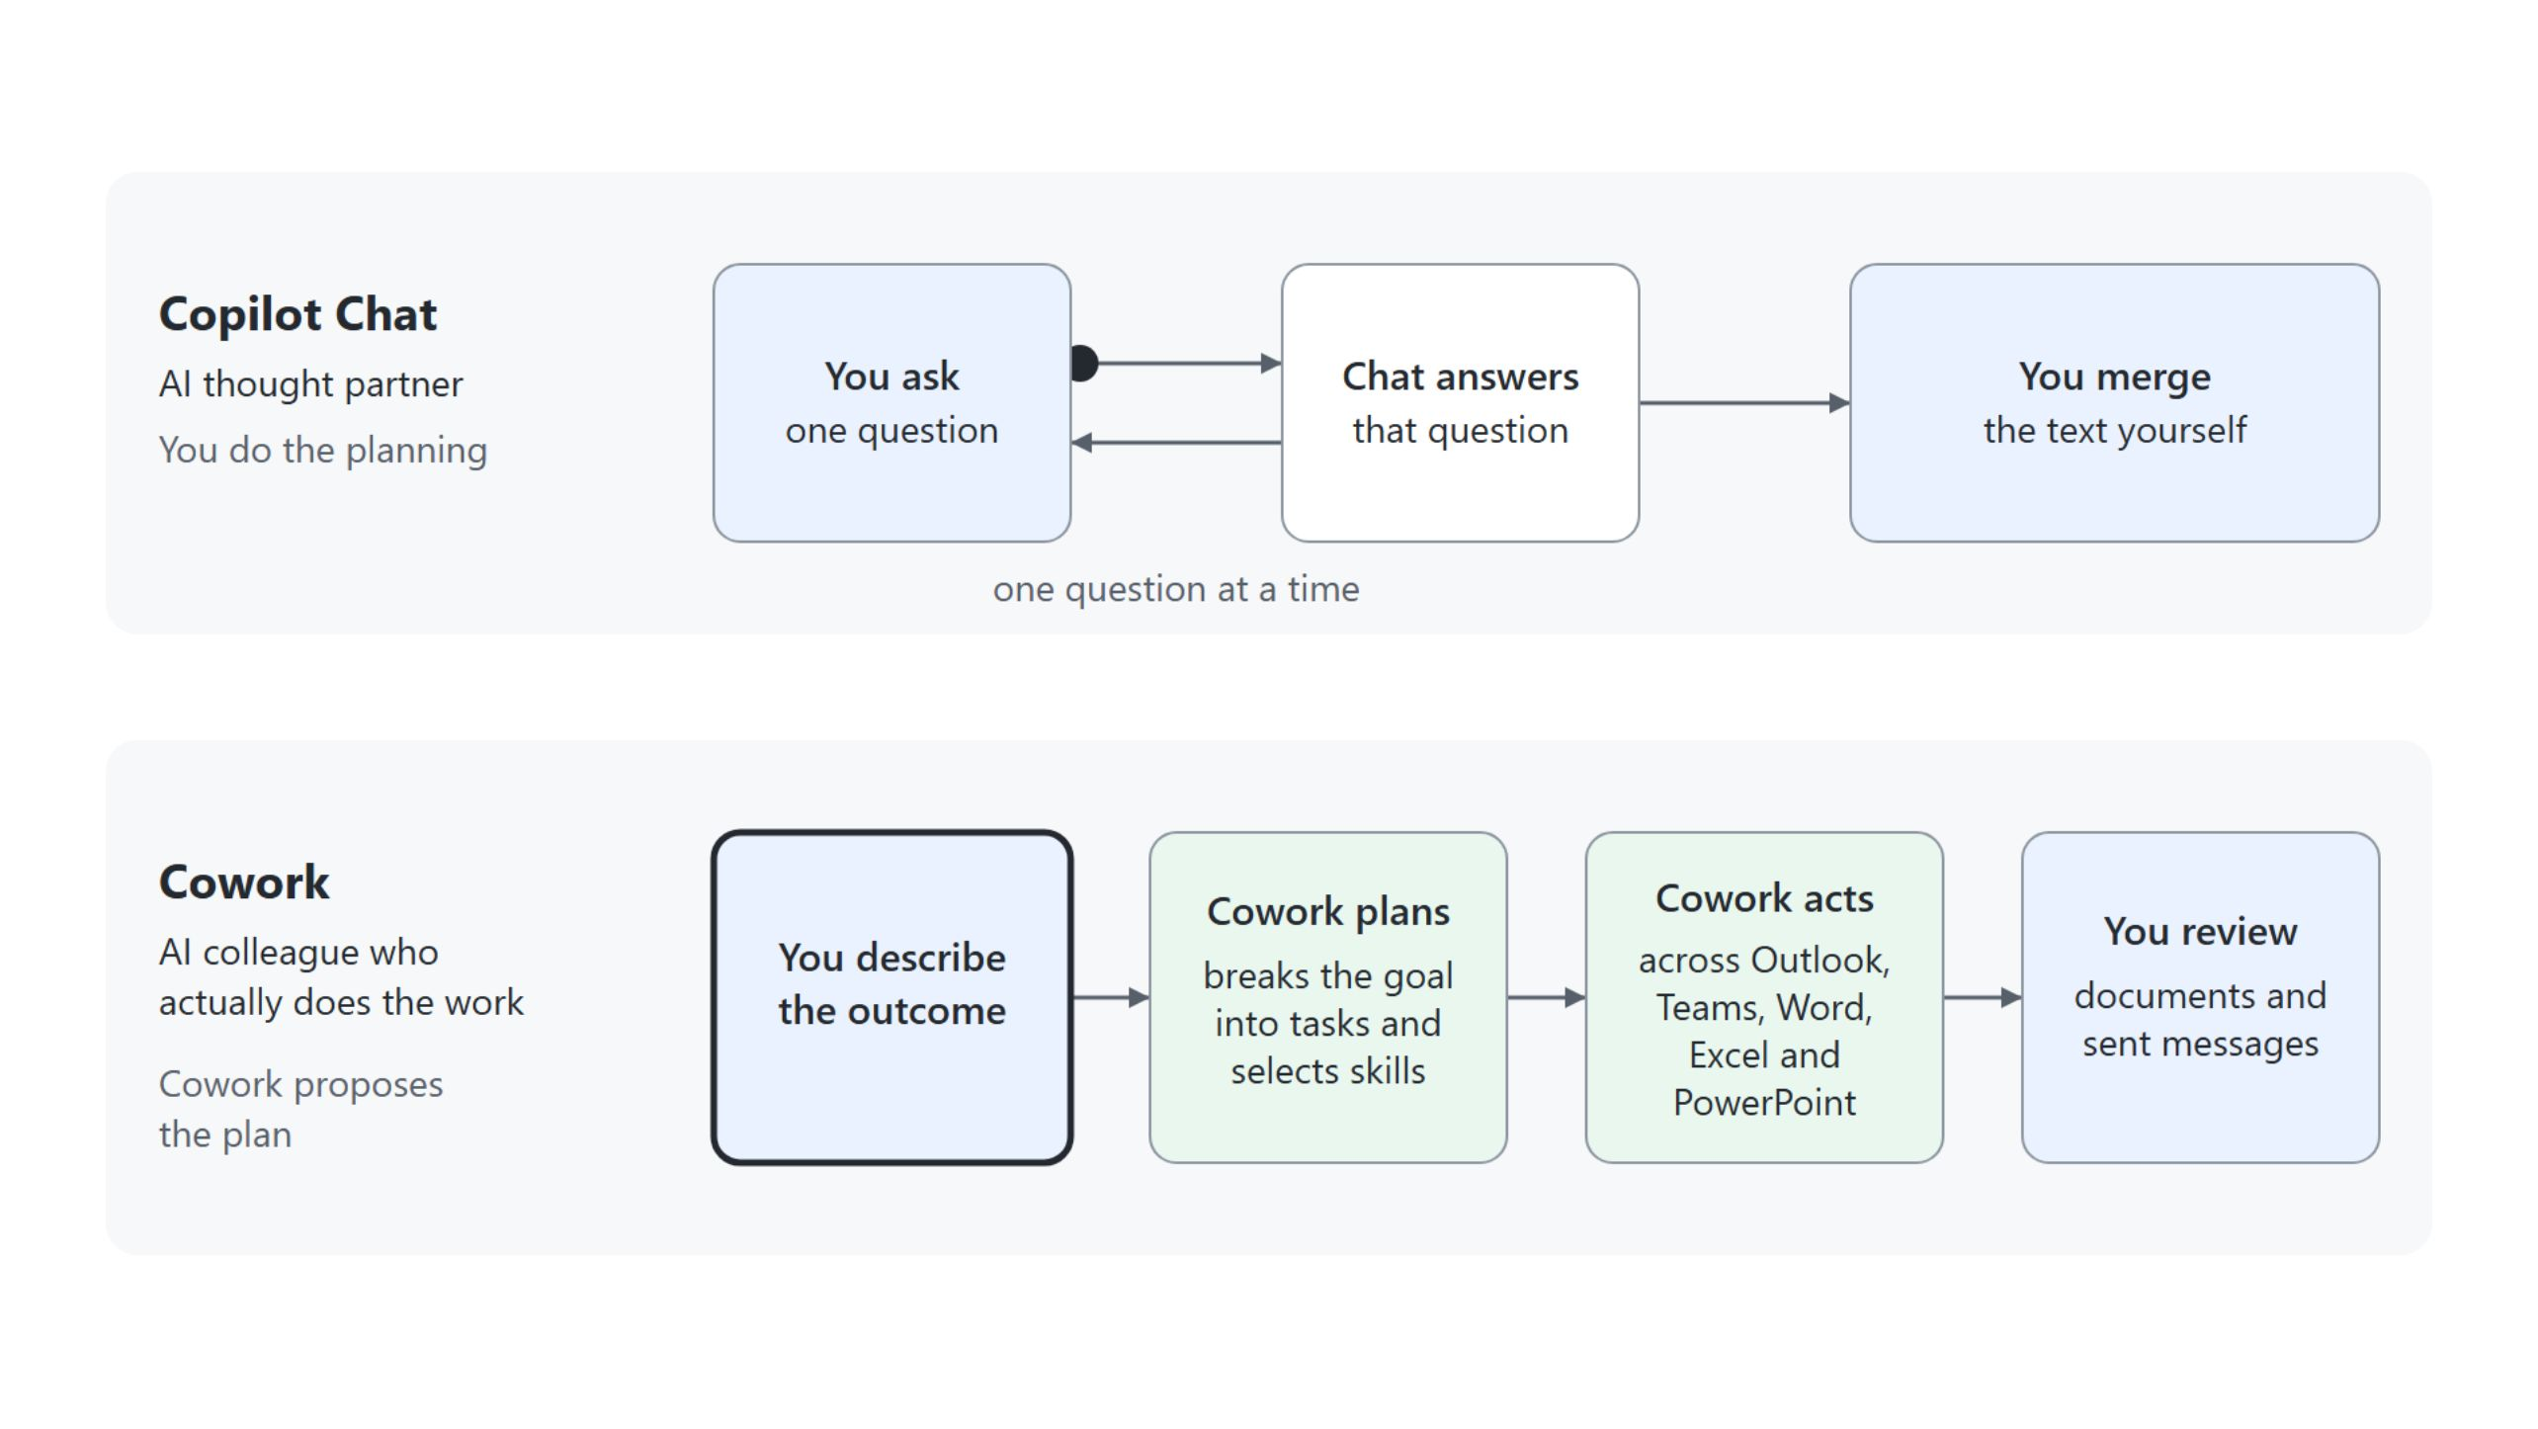
Cowork and Copilot Chat
Who plans the work
In Chat you ask one question at a time; in Cowork you describe the outcome, and it plans and acts across Microsoft 365
Notes:
This slide sets Cowork apart from Copilot Chat, which the class already knows. Think of Chat as your AI thought partner and Cowork as your AI colleague who actually does the work.
Copilot Chat: it gives fast, single-task support, a quick draft, answer or insight in seconds to minutes. You drive it one question at a time and merge the text yourself, the loop in the upper lane.
Cowork: it completes multi-step work across apps and data, and a task can run from minutes to hours. You name the outcome, it breaks the goal into tasks, selects skills and acts in Outlook, Teams, Word, Excel and PowerPoint.
Your job shifts: instead of asking good questions, you judge a plan before work starts and review what comes back. Use Cowork when you need Copilot to take action, not just suggest.
Copilot Home: announced on September 25, 2026, it brings Chat and Cowork into one starting point and routes each request to Chat, Cowork or Code. Home and Code roll out through the Frontier program first.

Slide 9
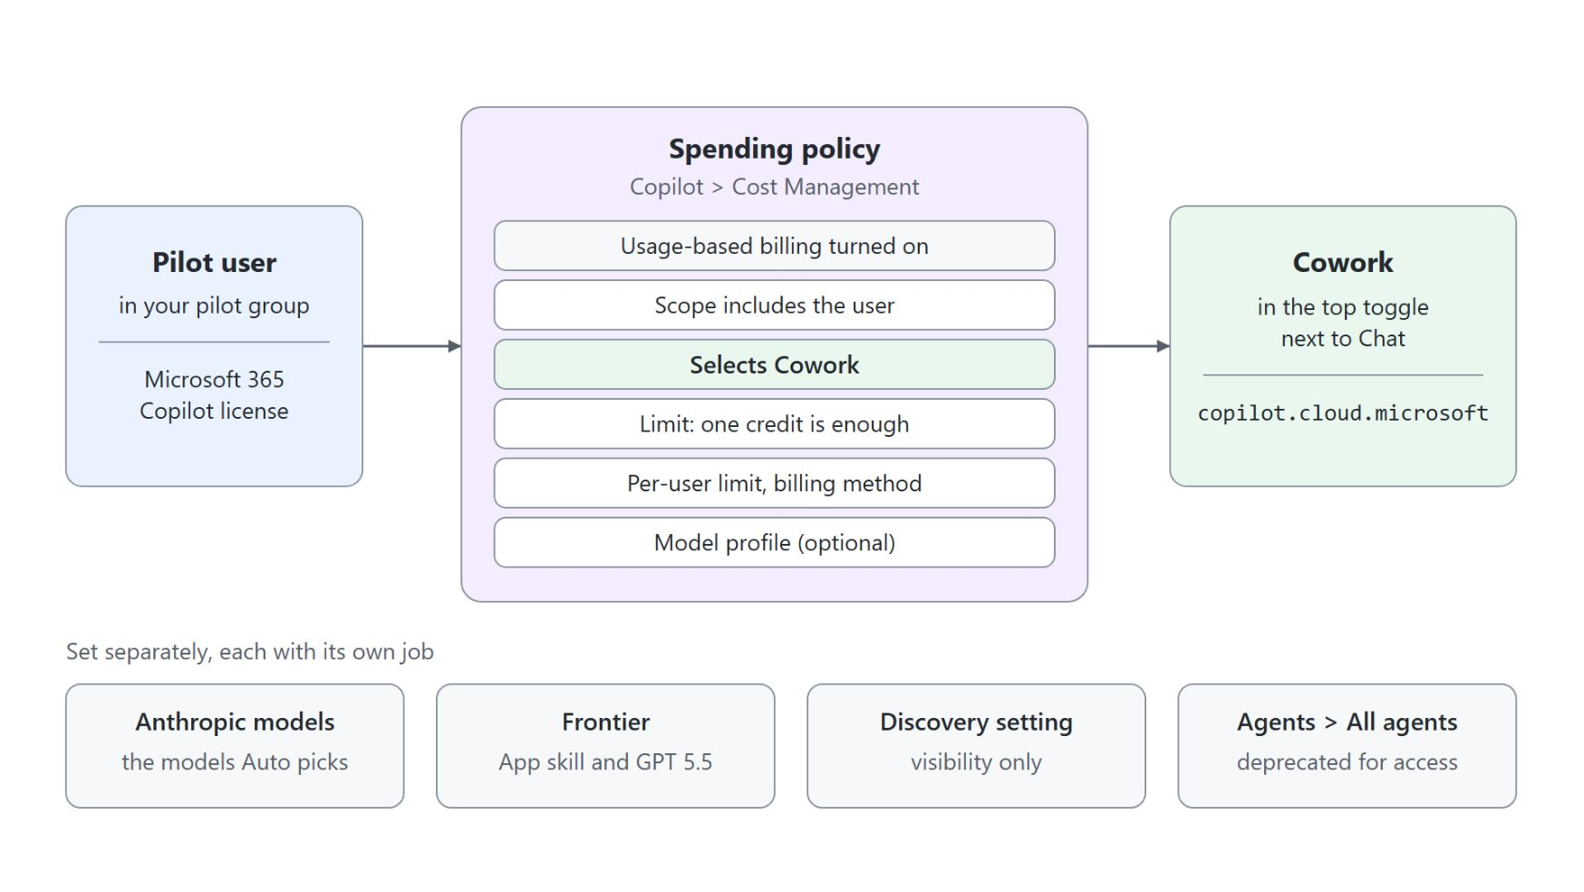
Setting up Cowork access
A spending policy that selects Cowork
Every pilot user and the setup admin need a Microsoft 365 Copilot license
Turn on usage-based billing under Copilot > Cost Management
A spending policy scoped to the pilot group with Cowork selected grants access; one credit is enough
Anthropic models and Frontier are optional for access
The discovery setting controls visibility only
Notes:
Before anyone opens Cowork, a tenant admin enables a few things, and this is admin work rather than maker work. A user gets Cowork when a spending policy that selects Cowork covers them.
Copilot license: every pilot user, and the admin account doing the setup, needs an active Microsoft 365 Copilot license. Global or Billing administrators create spending policies; AI or License administrators can edit them but not create them.
Usage-based billing: a Global or Billing administrator opens Copilot > Cost Management in the Microsoft 365 admin center and selects Get Started. Cowork is metered in Copilot Credits, not a per-user seat.
Spending policy: scope it to your pilot group and select Cowork under Select agents and services. A one-credit limit grants access, and a per-user limit keeps one person from draining the whole budget.
Optional settings: Anthropic models default to No users in the EU, EFTA and the UK and are excluded from the EU Data Boundary, so route that choice through compliance review. Frontier is needed only for the App skill and GPT 5.5.
Discovery: the AI experiences enabled by usage-based billing setting controls visibility only. If Cowork still does not appear, first check whether the user is in scope of a spending policy that selects Cowork.

Slide 10
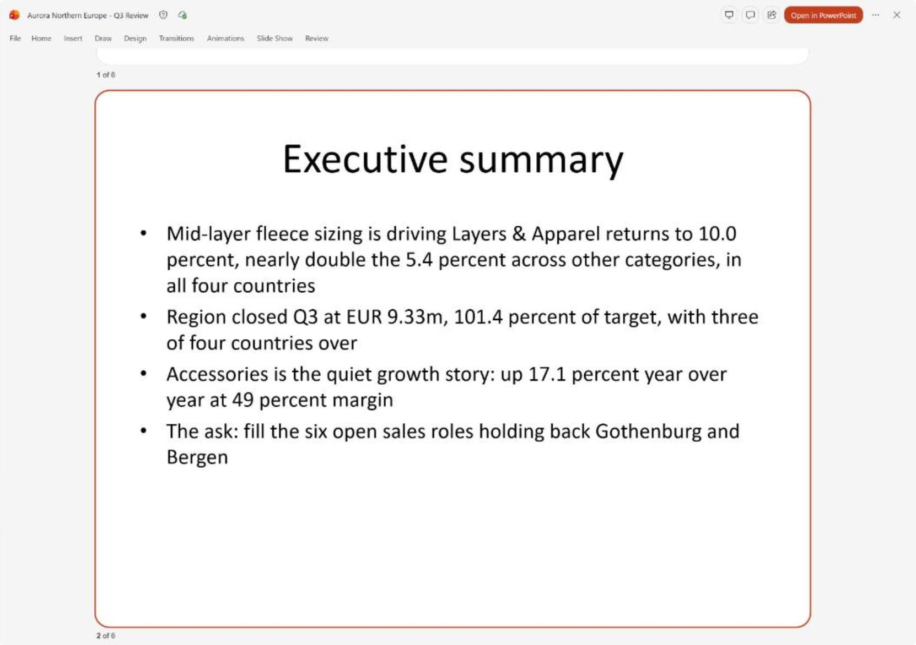
A typical Cowork interaction
The Q3 review deck from brief to approved send
Describe the outcome: three attached files and one brief for the Q3 review
Watch the numbered plan, then the steps as Cowork builds the deck
Steer the plan: open with the fleece returns, close with the six open roles
Approve the send at a Send draft? card marked Medium risk
Review the deck under Output, with speaker notes saved in the same file
Notes:
Every Cowork task follows five steps, and the first demo walks them on the Q3 business review for your VP, Elena Varga. The screenshot shows the finished deck in the PowerPoint preview, open on slide 2, the executive summary.
Describe: you attach q2-review.pptx, q3-sales-by-region.xlsx and q3-regional-notes.docx and name the outcome without saying which file is for what. Cowork works out that the Q2 deck is the template, the workbook holds the figures and the notes carry the story.
Watch: Cowork returns a numbered plan and waits, because you asked to see it first. After your go-ahead the Workspace panel adds Steps, and after several minutes the deck appears under Output.
Steer: you redirect the plan like a colleague's outline, leading with the fleece returns across all four countries and closing with the six open roles. The executive summary in the screenshot keeps that order: it opens on the fleece returns and ends with the ask to fill the six open sales roles.
Approve: sending the deck leaves your workspace, so Cowork holds it at a Send draft? card with a Medium risk badge even though the prompt said to send. In the demo the mail goes to your own address, standing in for Elena.
Review: the speaker notes land in the same file, and Output still lists one deck rather than an original plus a copy. The preview hides the notes; Open in PowerPoint shows them.

Slide 11
02
Understanding Skills: Built-in Skills & the Side Panel
The built-in catalog and the Workspace panel
Automate Business Processes with Copilot Studio and Copilot Cowork

Slide 12
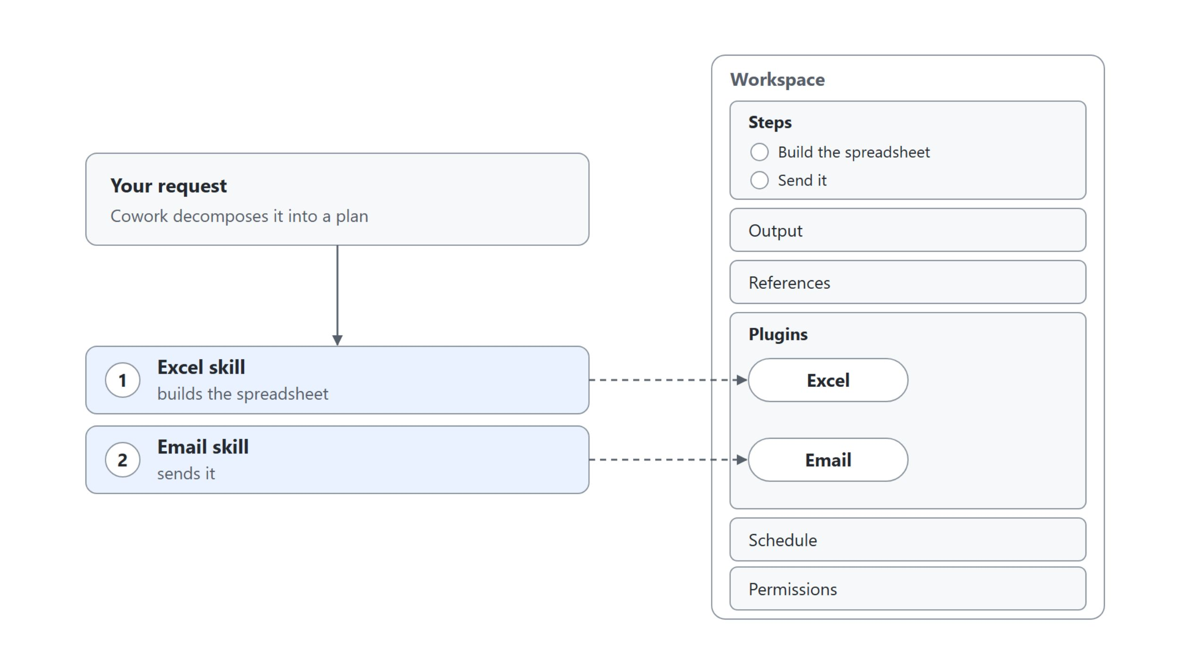
Built-in skills and the Workspace panel
Cowork picks the skills; the panel shows them at work
Each skill Cowork loads for a step appears under Plugins in the Workspace panel, beside Steps, Output and References
Notes:
This slide opens the skills topic with what ships in the box and where you watch it work. Cowork chooses the skills from the task you describe, and you can also call one by name.
Built-in skills: Word, Excel, PowerPoint, PDF, Email, Scheduling, Calendar Management, Meetings, Daily Briefing, Enterprise Search, Deep Research, Communications, Adaptive Cards and App (Frontier) ship with Cowork. Image generation ships too: it runs on ChatGPT Images 2.0, asks clarifying questions when a prompt lacks detail, and saves the image to your session and your OneDrive output folder. Every PowerPoint deck Cowork creates gets your organization's brand template.
Workspace panel: Steps shows the plan with each step ticked when done, Output the files Cowork created and References the files you attached. Schedule lists scheduled prompts, and Permissions the actions you approved with don't ask again.
Plugins: in the diagram the Excel skill builds the spreadsheet and the Email skill sends it, and each chip lights up as its step runs. In the market-brief demo, Deep Research and Web Search appear while Cowork researches, and Word joins them when it writes the brief.
Which skill to steer: when a step stalls or produces the wrong output, the Plugins list tells you which skill was at work. Long steps such as Deep Research run for a few minutes as a background task.

Slide 13
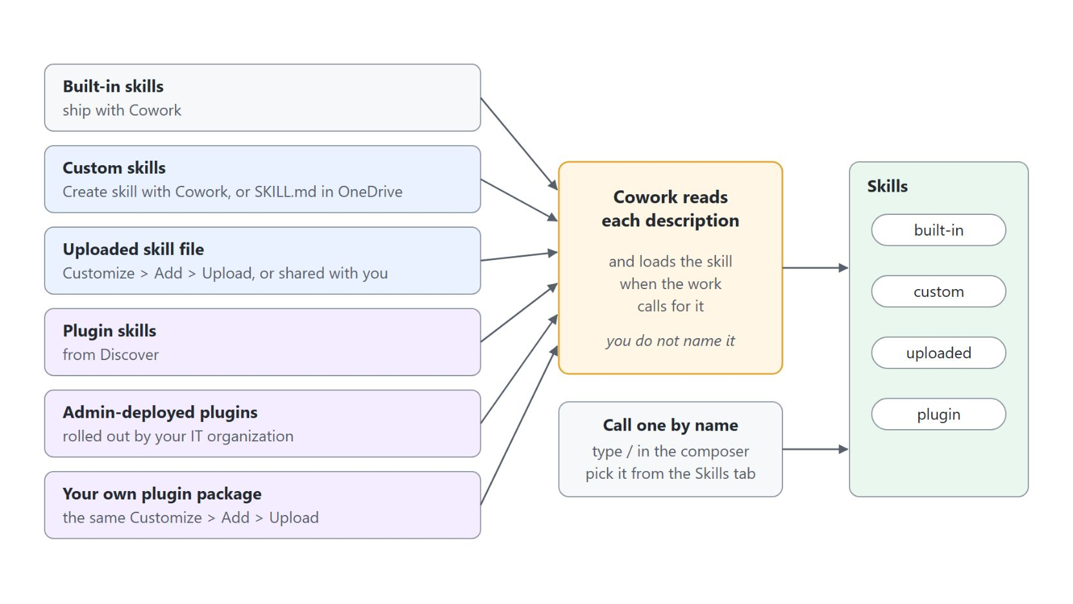
Where skills come from
Built-in, custom and plugin skills load the same way
Create a skill with Customize > Add > Create skill with Cowork, or as a SKILL.md in OneDrive
Upload a skill file with Customize > Add > Upload, or use one a colleague shares
Plugins come from Discover, from your IT organization, or as your own uploaded package
Cowork reads each description and loads the skill when the work calls for it
Type / in the composer to call a skill by name from the Skills tab
Notes:
Built-in skills are only the starting point. The diagram shows the six ways a skill reaches Cowork and the two ways it gets loaded: Cowork matches its description, or you call it by name.
Create: Customize > Add > Create skill with Cowork starts a guided conversation, and you can also write a SKILL.md into OneDrive yourself. The next topic teaches both.
Upload: Customize > Add > Upload takes a skill file, and a colleague can share a skill with you. The same Upload also takes a plugin package of your own.
Plugins: they come from Discover, as admin-deployed plugins your IT organization rolls out, or as a package you upload. Plugins get their own topic later in the module.
Reads each description: custom, uploaded and plugin skills appear in the same Plugins list and activate the same way. Cowork loads a skill when the work calls for it, so you rarely name one.
Slash: to call a skill on purpose, type / in the composer and pick it from the Skills tab, where your own skills sit under Custom skills. Customize lists everything under Added, each with its own switch.

Slide 14
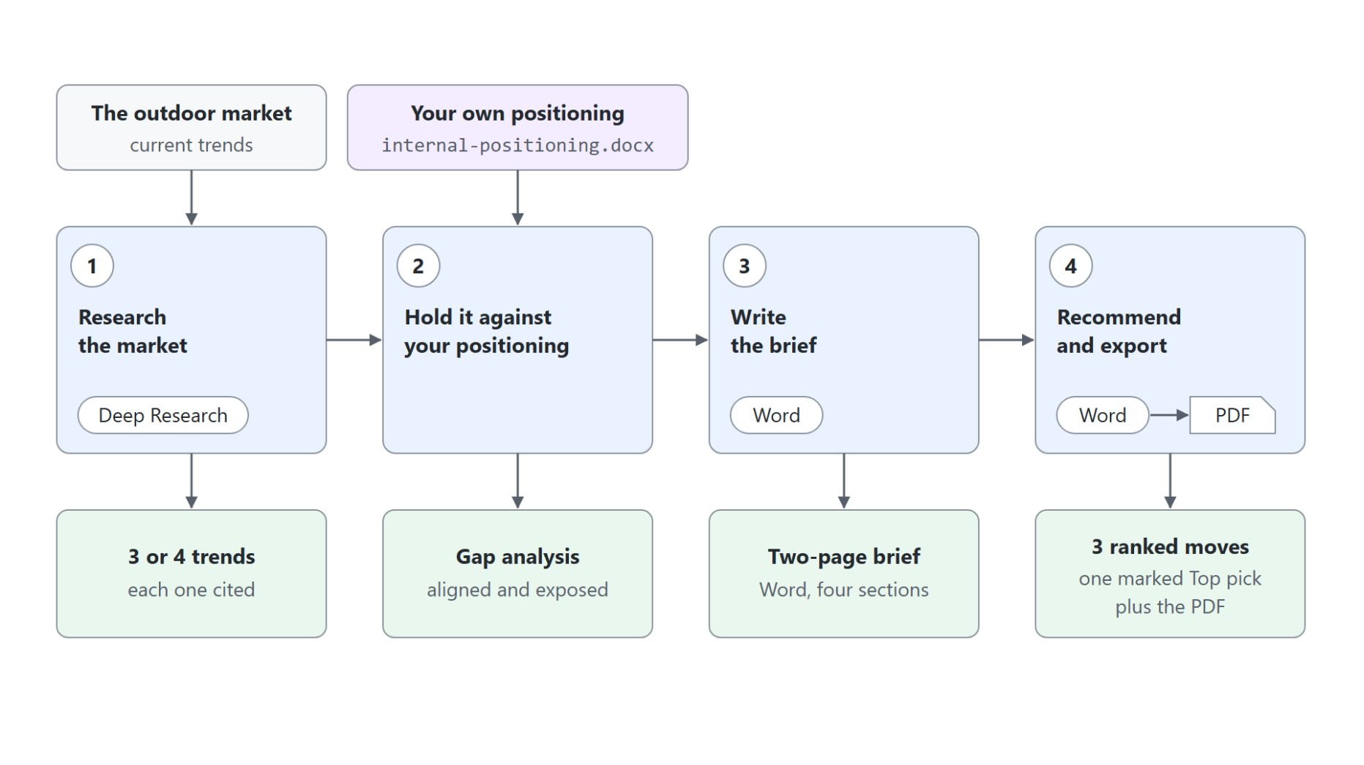
Producing a market brief
Deep Research, your positioning, then a Word brief and a PDF
Deep Research surveys the European outdoor market in a background task of about four minutes
internal-positioning.docx turns the trends into an aligned and exposed gap analysis
The Word skill writes AW26 Market Brief - Aurora Outdoor in four sections
Recommendations rank three moves and mark one Top pick
One background task saves the .docx and exports the PDF for leadership
Notes:
This slide shows the topic's demo, which prepares Aurora Outdoor's AW26 brand planning. The diagram follows its four prompts, with the skill each one uses and what it returns.
Deep Research: the first prompt asks for the trends shaping premium outdoor brands, each with its source. The chat reads Working on 1 background task, and Deep Research and Web Search appear under Plugins.
Gap analysis: the attached positioning document is held against the research in the same task. The repair programme aligns with the circular trend, while the missing sustainability metrics, the thin trail-running presence and the fleece sizing returns come back as exposed.
Word: Cowork writes an executive summary, market trends, where Aurora stands and risks to watch, about two pages. Word joins Deep Research and Web Search under Plugins.
Recommendations: the last prompt asks for a point of view, three moves in priority order with the first marked Top pick. In the class run the top pick was checking and backing up every environmental claim in market.
PDF: one background task, Add recommendations and export PDF, saves the Word file and exports the PDF with the same name. No separate PDF entry appears under Plugins.

Slide 15
03
Creating Custom Skills with SKILL.md
Your own skills in plain language
Automate Business Processes with Copilot Studio and Copilot Cowork

Slide 16
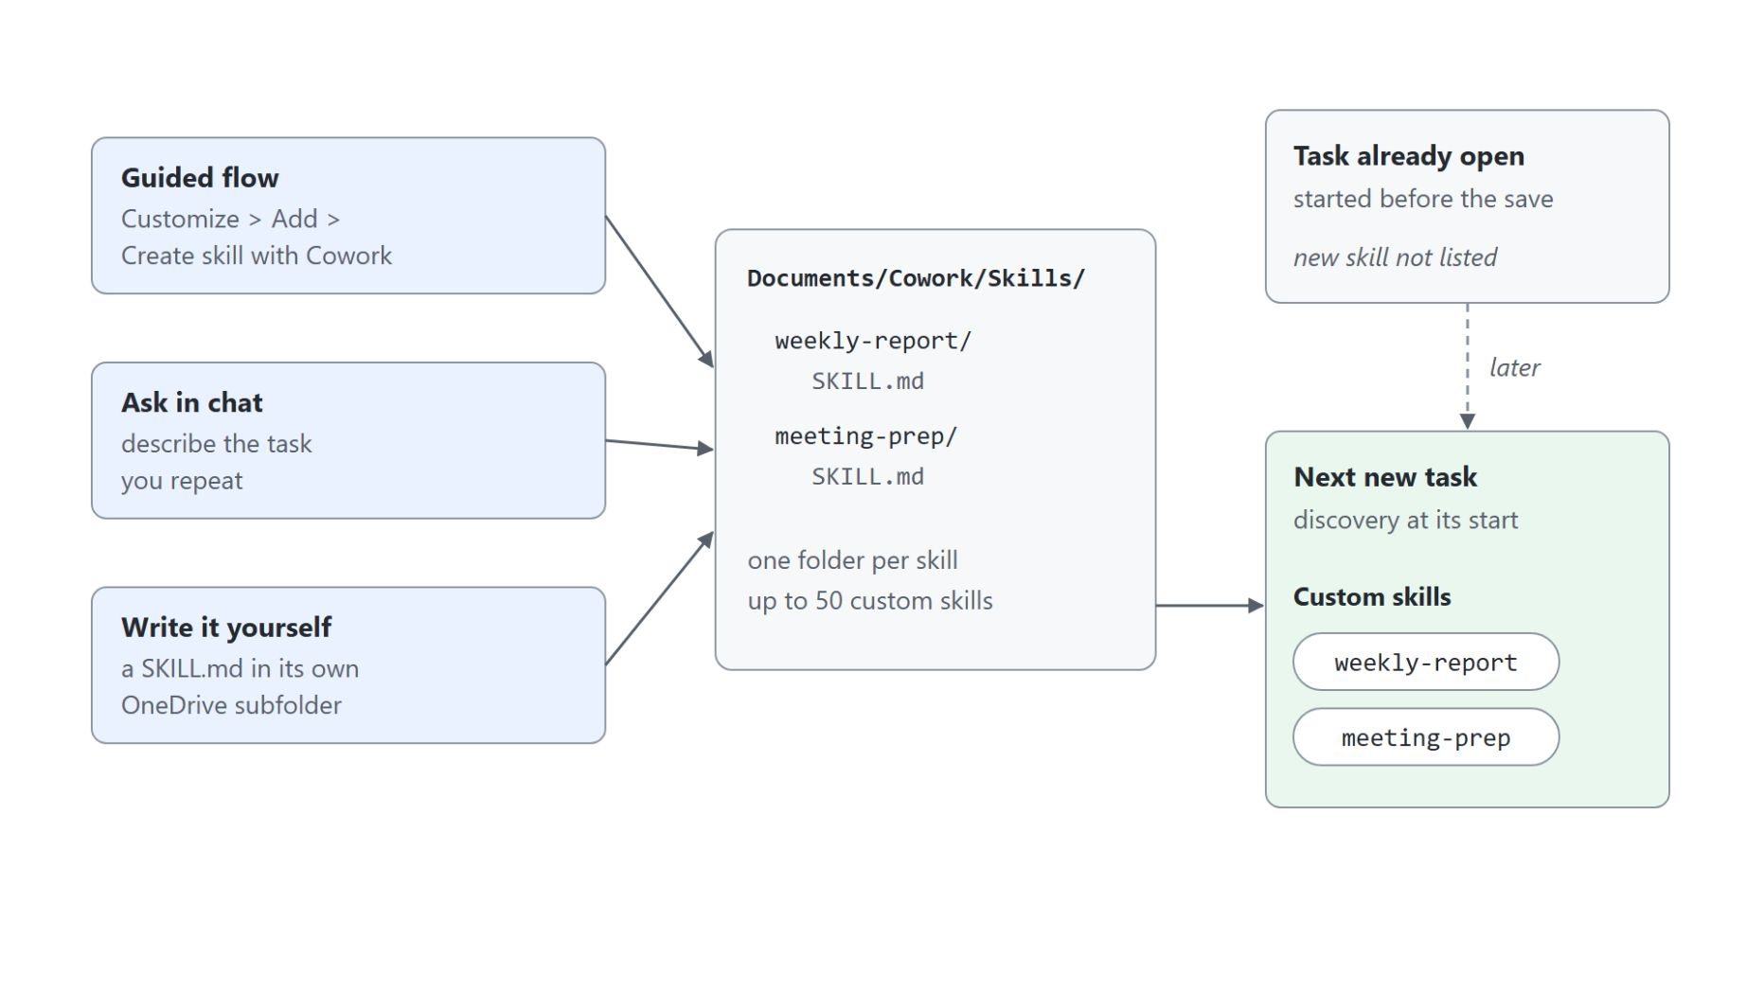
Three ways to create a skill
Every path ends in one OneDrive folder
Guided flow: Customize > Add > Create skill with Cowork
Ask in chat: describe the task you repeat
Write it yourself: a SKILL.md in its own folder under Documents/Cowork/Skills/
Cowork discovers your skills at the start of each conversation, up to 50
Upload a .md, .zip or .skill file and share it with specific users
Notes:
This slide shows how a custom skill comes into being and when Cowork first sees it. A custom skill teaches Cowork your own recurring work in plain language, with no coding.
Guided flow: Customize > Add > Create skill with Cowork starts a guided conversation, and Cowork saves the result.
Ask in chat: describe the task you repeat and ask Cowork to build a skill for it. The result lands in the same folder as the other paths.
Write it yourself: place a SKILL.md inside its own subfolder of Documents/Cowork/Skills/ in your OneDrive. A file written straight into OneDrive can take several minutes to sync, so reload Customize until it shows under Added.
Discovers: Cowork finds your custom skills at the start of each conversation, up to 50 of them. A skill you just added shows up in the next new task, not in the one already open.
Upload: Customize > Add > Upload takes a single .md up to 1 MB, or a .zip or .skill archive with SKILL.md at its root, up to 10 MB compressed. Share offers Only you or Specific users in your organization, and Re-share sends the latest version after an edit.

Slide 17
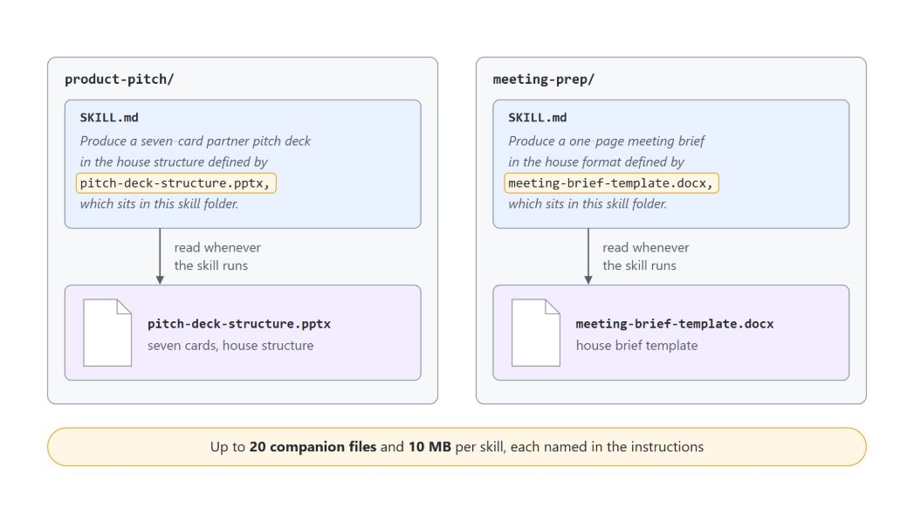
Anatomy of a SKILL.md
A YAML header plus plain-language instructions
The name matches its folder, and the description is what Cowork reads to decide when the skill applies
Companion files sit beside SKILL.md, up to 20 files and 10 MB, each named in the instructions
---
name: product-pitch
description: Turns a market brief, research report, or product document into a wholesale partner pitch deck in Aurora Outdoor house structure, with every claim traced back to a named source. Use whenever I say build a pitch, pitch this to partners, turn this brief into a deck, or name a range or season to pitch.
---
Produce a seven-card partner pitch deck in the house structure defined by pitch-deck-structure.pptx, which sits in this skill folder.
Notes:
This slide takes apart the product-pitch skill from the first demo of the topic. A skill file has two parts: a YAML header with a name and a description, and plain-language instructions.
Name: lowercase letters, numbers and hyphens, up to 64 characters, and it must match its folder, so product-pitch/ carries name: product-pitch. A mismatch is the most common reason a skill silently fails to load.
Description: Cowork reads only the description to decide whether the skill applies, so it names the phrases you would actually type, such as build a pitch or turn this brief into a deck. A vague description like helps with reports rarely matches.
Instructions: the body is the step-by-step recipe Cowork follows, up to 1 MB. This one fills seven cards in order and never invents pricing, order tiers or terms.
Companion files: the diagram shows both demo skills, product-pitch naming pitch-deck-structure.pptx and meeting-prep naming meeting-brief-template.docx. Cowork reads the companion file whenever the skill runs.

Slide 18
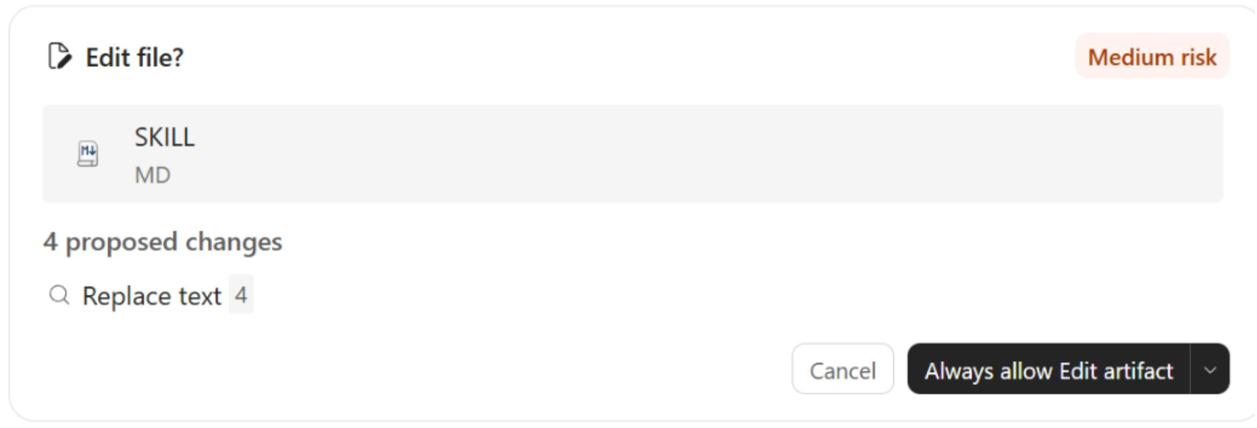
Running and tuning a skill
From the first run to a skill that triggers on its own
Run it by name in a new task, then check every claim against the source
Ask which phrasings miss the skill and which instruction let weak claims through
Cowork folds the fixes into SKILL.md through an Edit file? card at Medium risk
The Skill Report scores the skill out of 100; 70 counts as ready to share
Done when it fires without being named and saves Aurora Trail Capsule AW26.pptx
Notes:
This slide closes the topic with the loop the product-pitch demo follows once the skill is saved. The screenshot is the card Cowork holds before it writes your fixes into SKILL.md.
Run it by name: start a new task, because discovery happens at the start of a conversation, and run the skill against aw26-market-brief.docx. Then ask Cowork to quote the line in the brief behind every claim on The shift, The gap and Why Aurora.
Miss the skill: ask which pitch requests phrased the way you talk would fail to trigger it, such as a sell-in deck for your accounts. Tie each weak claim to the instruction that let it through.
Edit file?: accept Cowork's offer to apply the fixes, and it holds an Edit file? card for SKILL.md at Medium risk, here with four text replacements, before it overwrites anything. Approve it with Approve once from the arrow beside Always allow Edit artifact; a new task started a few minutes later already uses the edited skill.
Skill Report: Cowork scores every skill you create or update from 0 to 100 across trigger clarity, instruction specificity, scope boundaries and robustness, 25 points each. A low trigger clarity score usually points at the description.
Fires without being named: ask for a partner deck for the AW26 trail-running capsule in your own words, and the step log reads Reviewed custom skill Product pitch. The commercial cards stay as bracketed placeholders until you supply the input, and in the class run the title card's promise did too.

Slide 19
04
Scheduled Prompts & Event-Driven Tasks
On a schedule or when a message arrives
Automate Business Processes with Copilot Studio and Copilot Cowork

Slide 20
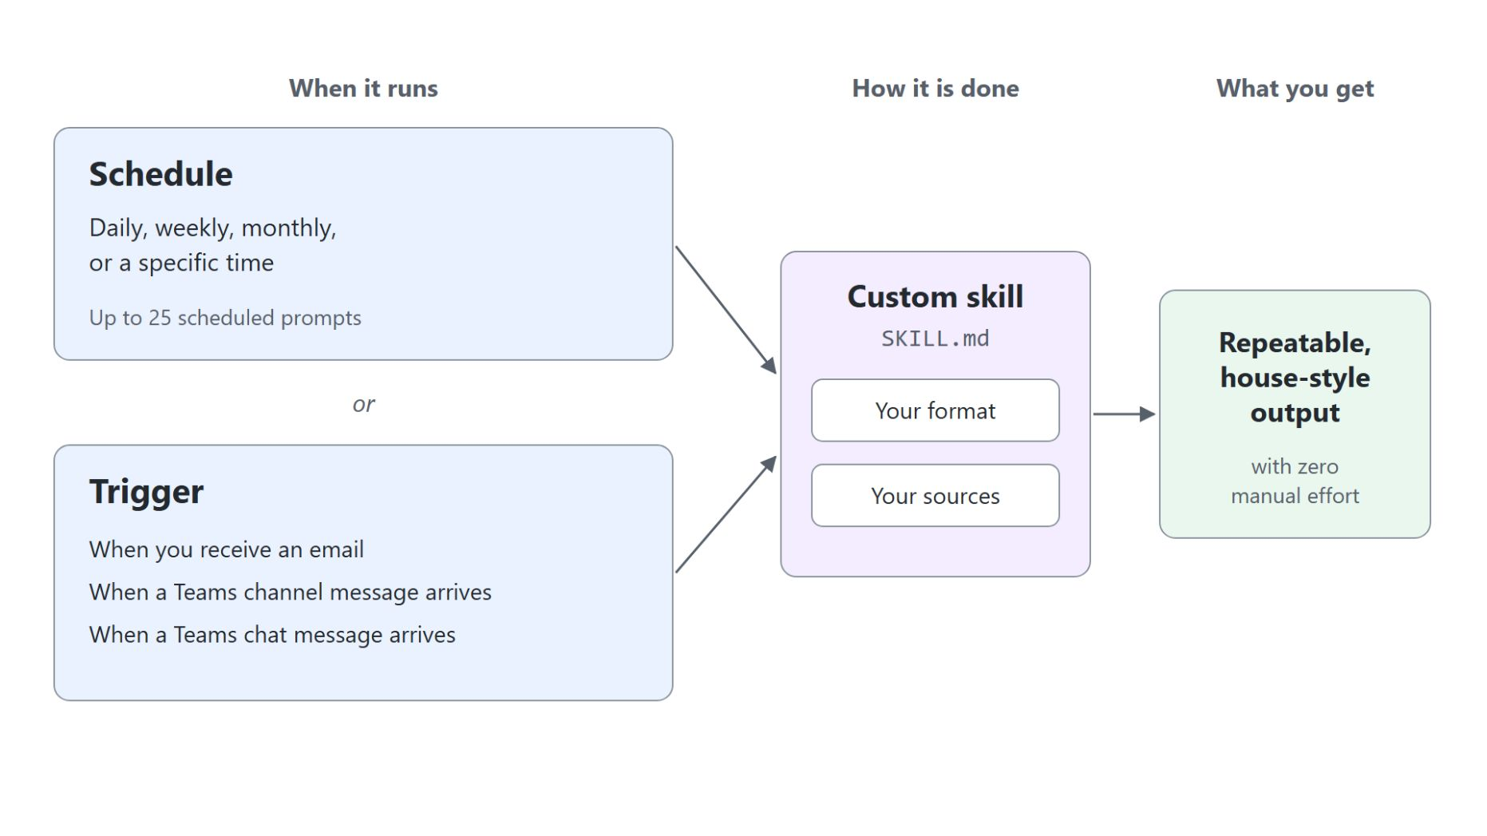
Schedules and triggers
Repeat a prompt on a cadence or when something happens
A schedule repeats a prompt daily, weekly, monthly or at a set time, up to 25 of them
A trigger starts the task when an email, a Teams channel message or a Teams chat message arrives
The Automations page offers Add, templates such as Daily briefing, and the filters Scheduled, Triggers and Paused
Each automation has an Enable switch and a ... menu to edit, run now, pause or delete it
The custom skill decides how the work is done; the schedule or trigger decides when
Notes:
This topic turns a prompt you would run once into work that repeats. Cowork runs it on a schedule or when something happens, and delivers the result without you.
Schedule: write the prompt as usual, describing the full outcome, then set a recurrence of daily, weekly, monthly or a specific time. Asked in chat, Cowork proposes a Create recurring task? card, and you can have up to 25 scheduled prompts.
Trigger: describe the trigger and the job in chat, and Cowork proposes a Set up trigger? card that you arm with Set up. Teams triggers can be limited to messages that mention you.
Automations page: Add creates an automation directly, and templates such as Daily briefing and Weekly wrap start from a ready-made prompt. The filters All, Scheduled, Triggers and Paused sort the list, and event-driven tasks show Active, Draft or Paused.
Enable switch: each automation shows its recurrence and next run, and its ... menu offers Edit, Run now, Pause or Resume, and Delete. A paused automation keeps its settings and does not run until you resume it.
Custom skill: the skill carries your format and sources, the schedule or trigger carries the cadence. Point a schedule at a custom skill and you get repeatable, house-style output with no manual effort.

Slide 21

Good candidates for automation
Recurring reports and incoming messages
Every weekday at 8 AM, a Daily Briefing of meetings, priority emails and newly shared documents
Every Friday at 4 PM, a Word status report on your week for your manager
On the first of the month, a one-page digest of the Marketing Teams channel
When your manager emails about supplier delays, a summary and draft reply for your review
When you are @mentioned in the Aurora Outdoor Operations channel, a one-line summary by email
Notes:
These five examples show the work worth handing over: the same output from the same sources, on a fixed rhythm or in response to a message. The first three run on a schedule, the last two on a trigger.
Daily Briefing: every weekday at 8 AM, Cowork gathers today's meetings, unread priority emails and any documents shared with you since yesterday.
Status report: every Friday at 4 PM, it summarizes your sent emails and calendar for the week into a Word status report for your manager. The topic's demo builds exactly this, and the send still waits for your approval.
Monthly digest: on the first of the month, it compiles last month's project updates from the Marketing Teams channel into a one-page digest.
Email trigger: whenever your manager emails you about supplier delays, Cowork summarizes the message and drafts a reply for your review.
Teams trigger: when you are @mentioned in the Aurora Outdoor Operations channel, it emails you a one-line summary.

Slide 22
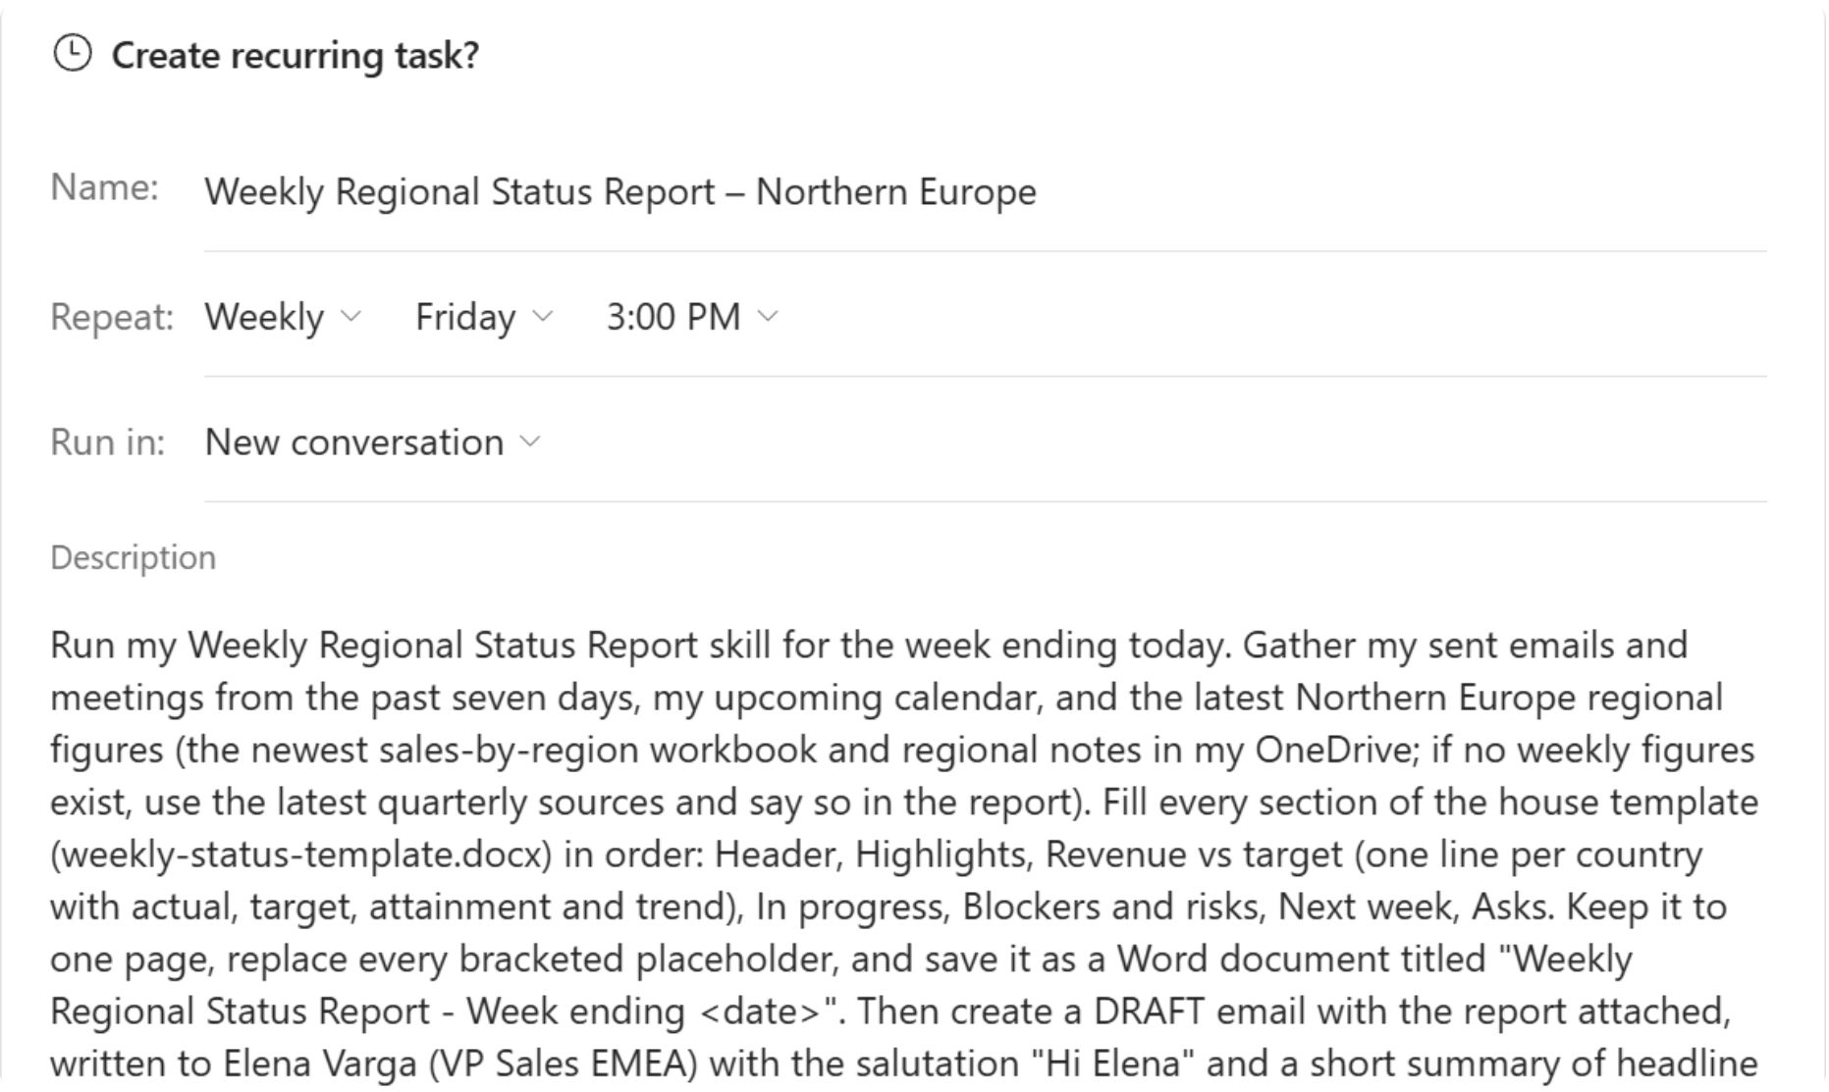
Approvals in automated tasks
The weekly status report runs every Friday; the send waits for you
Create recurring task? sets the name, Weekly, Friday, 3:00 PM, and a new conversation per run
The Description is the prompt every run receives, including where the draft goes
Run once now is ticked by default; clear it so the first run waits for Friday
Each run leaves the report under Output and a Hi Elena email in your Drafts folder
Scheduling the run does not approve the send: nothing leaves until you say so
Notes:
This slide shows what an automated task may do while you are not watching, on the weekly status report from the topic's demo. The screenshot is the card Cowork proposed when asked to run the weekly-status-report skill every Friday at 3 PM.
Create recurring task?: check that Repeat reads Weekly, Friday, 3:00 PM and that Run in starts a new conversation for each run. Select Schedule, and Cowork confirms the first run date.
Description: every run receives this text as its prompt, so read it before you schedule. In the class tenant it addresses the draft to you, because Elena Varga has no mailbox there.
Run once now: leave it ticked to watch a first run and its approvals straight away, or clear it so the first run lands on Friday. After the demo, pause the task on the Automations page, because each run spends Copilot Credits.
Drafts: each run writes a one-page Word report and saves an email that starts Hi Elena to your Drafts folder. New files in Output and a saved draft need no approval.
Not approved: by default scheduled and event-driven tasks hold any send, post or change for your approval, and pre-authorizing actions when you create a task trades control for speed. Tasks run with your permissions, are rate-limited and are guarded against triggering themselves in a loop.

Slide 23
05
Extending Cowork with Plugins
Outside data and expertise from plugins
Automate Business Processes with Copilot Studio and Copilot Cowork

Slide 24
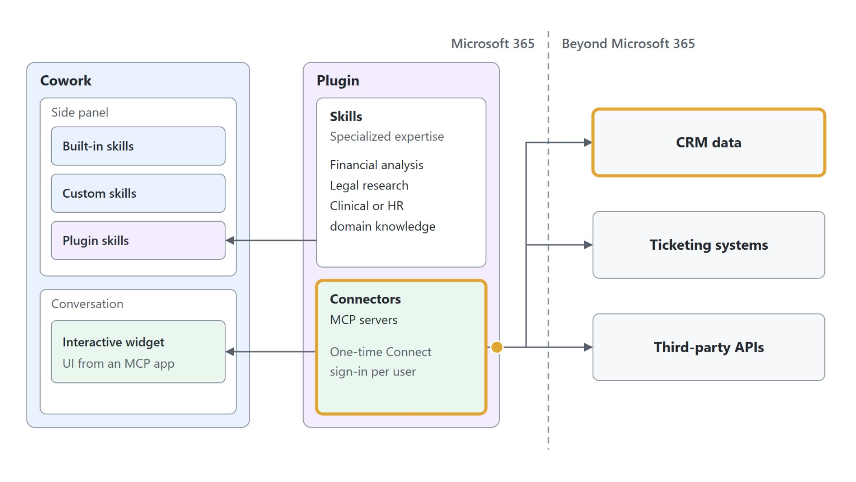
What plugins add
Skills and connectors that reach beyond Microsoft 365
Skills with specialized expertise: financial analysis, legal research, clinical or HR knowledge
MCP connectors reach CRM data, ticketing systems and third-party APIs
Each user completes a one-time Connect sign-in
An MCP app returns an interactive widget into the conversation
Plugins your admin rolls out show Managed by your organization
Notes:
Built-in skills handle common office tasks and custom skills capture your own recipes, but both live inside Microsoft 365. Plugins reach beyond it, and they come from Discover on the Customize page, from your admin, from a colleague or from a package you upload.
Specialized expertise: a plugin can carry skills for financial analysis, legal research, or clinical and HR domain knowledge. Microsoft offers Dynamics 365 Customer Service, Sales and ERP, Fabric IQ and Business Applications in Work IQ, plus role-based plugins for Legal, Sales, Service and Education.
MCP connectors: a plugin's connectors are MCP servers that reach CRM data, ticketing systems and third-party APIs. In the diagram they are the only part that crosses the Microsoft 365 line.
Connect sign-in: each user completes a one-time Connect sign-in before a connector works for them.
Widgets and admin rollout: an MCP app returns a UI that renders in the conversation. IT admins can roll plugins out to the whole organization, and those plugins show Managed by your organization.
Plugins button: message center item MC1484008 (2026-09-30) replaces the Agents, Agents & Skills and Customize buttons with one Plugins button as the rollout reaches your tenant. Until that change arrives, Cowork still shows Customize, and the Customize steps in this topic match your screen.

Slide 25
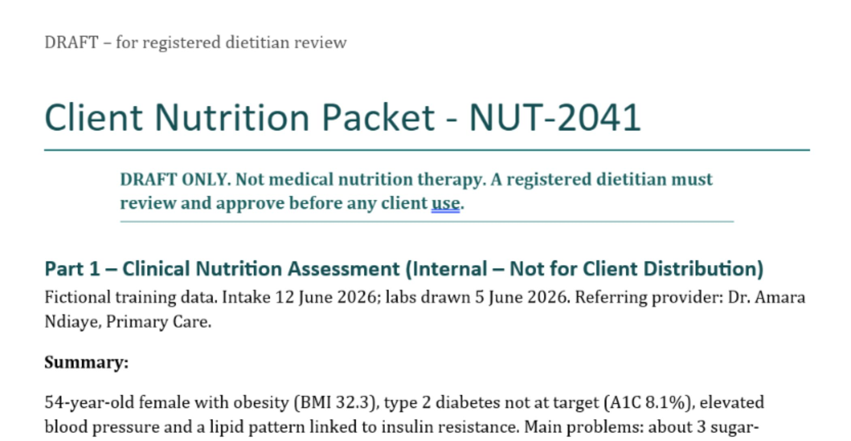
Where plugins fit
The dietitian plugin's skills beside the built-in Word skill
Upload the dietitian package under Customize > Add > Upload and publish it to Only you
Its skills clinical-nutrition and dietary-communication draft the assessment and the client handout
Each loads with a Reviewed custom skill step and joins Plugins next to the built-in Word
Word compiles both drafts into Client Nutrition Packet - NUT-2041, the DRAFT ONLY line on top
Sharing with specific people needs no admin; the whole organization waits for admin approval
Notes:
This demo steps out of the Aurora Outdoor scenario on purpose, because a plugin brings expertise from its own domain. You play a registered dietitian, and the screenshot is the packet Cowork compiled from a fictional client intake form.
Upload: the dietitian plugin comes from the community awesome-copilot-cowork-plugins repository as a manifest.json, icon PNGs and a skills/ folder. Zip them with manifest.json at the root, upload under Customize > Add > Upload and keep Only you in the Publish dialog.
Two skills: clinical-nutrition calculates energy and protein needs and interprets the labs, and dietary-communication turns that into a plain-language handout. The handout keeps the client's West African dishes and gives amounts in cups and spoons.
Plugins list: each plugin skill loads with a Reviewed custom skill step and appears under Plugins as dietitian (clinical-nutrition), next to the built-in Word. There is no separate mode to switch into.
Word: the built-in Word skill compiles both drafts in a background task of around ten minutes. The bold DRAFT ONLY line sits directly under the title, and the client handout starts on its own page.
Sharing: Only you and Specific users in your organization need no admin, while publishing to the whole organization waits for admin approval. Public store listings go through Partner Center.

Slide 26

Reviewing plugin output
The plugin drafts; the dietitian decides
A registered dietitian reviews and approves every packet before any of it reaches a client
Notes:
This slide stays with the dietitian demo for one rule that travels with every plugin. Every skill in the dietitian plugin is for drafting only, and its output is not medical nutrition therapy.
Review: before anything reaches a client, a registered dietitian reads every calculation, every lab interpretation and every handout claim, then approves or corrects it. The plugin speeds up the drafting; it does not replace the clinician.
Disclaimer: the DRAFT ONLY line at the top of the packet keeps an unreviewed draft from being mistaken for approved advice. If Cowork buries it, ask for it as the first line before anything else.
Effort: raising the reasoning effort to High or Max does not make clinical output more trustworthy. The dietitian's review is the control, not the effort level.

Slide 27
06
Human-in-the-Loop: Approving Actions & Staying in Control
Approvals, risk levels, and governance
Automate Business Processes with Copilot Studio and Copilot Cowork

Slide 28
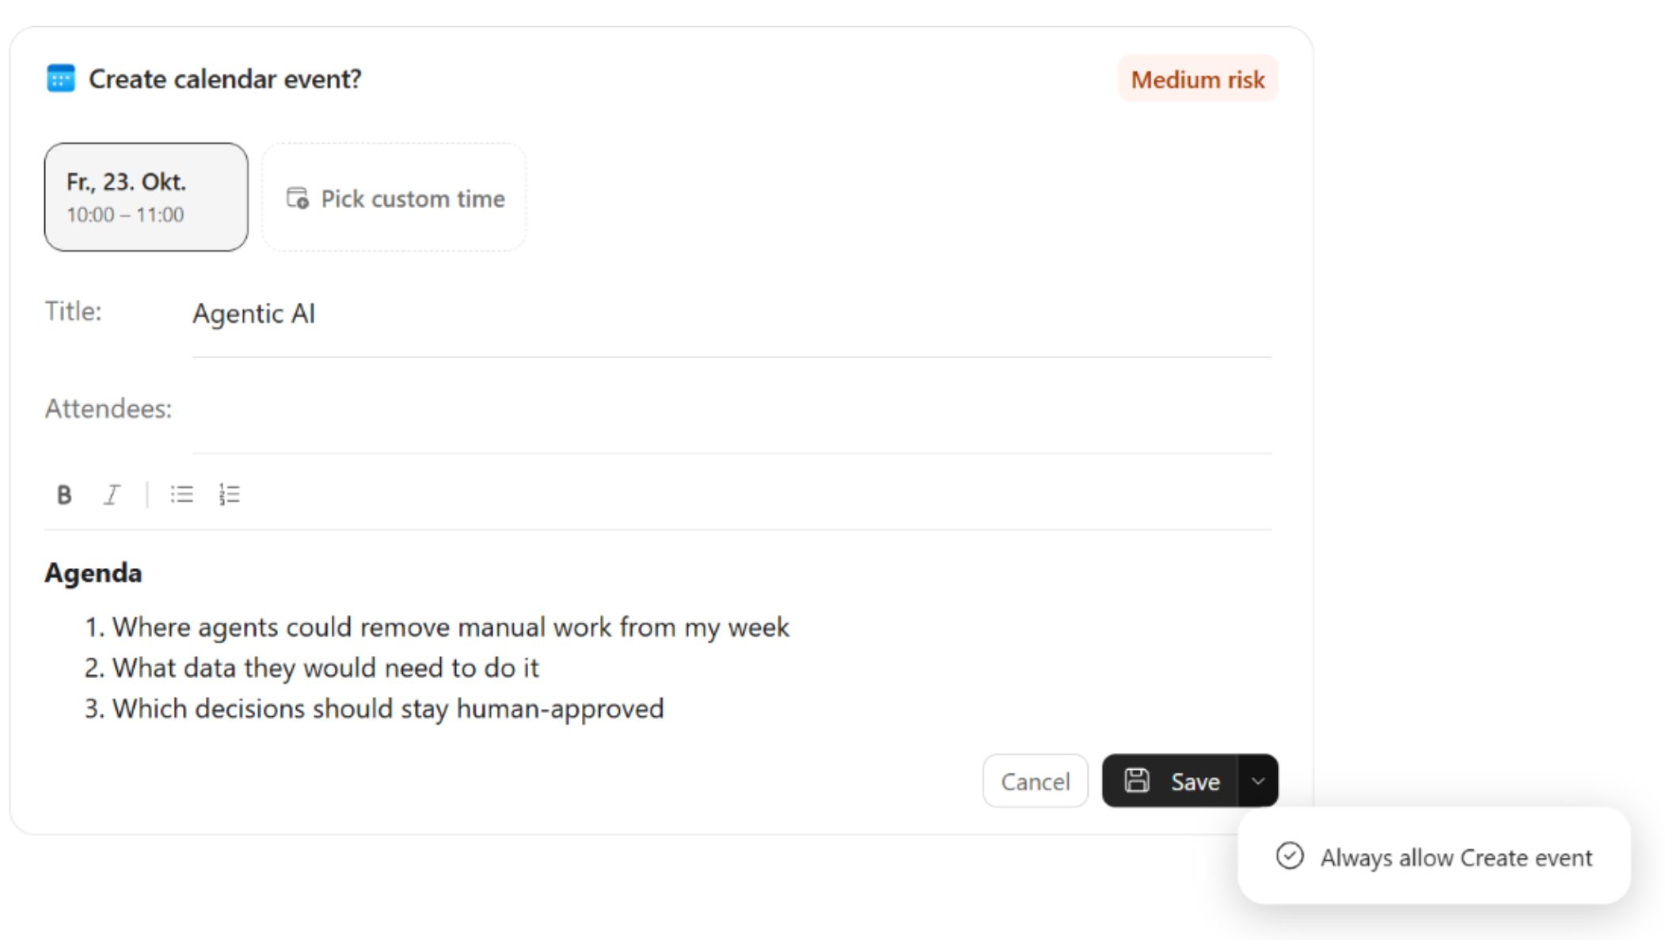
The approval model
Cowork pauses before anything that leaves your workspace
The card names the action as a question, here Create calendar event?, and shows what it will write
Save approves this one action, and the task records Approved 1 action
The arrow beside it offers Always allow Create event for the rest of the session
Medium risk changes your content or calendar; high risk reaches other people
New files in Output and saved drafts need no approval
Notes:
Cowork acts on your behalf, but never behind your back. The screenshot is the card from the Work IQ scheduling demo, where Cowork booked a one-hour Agentic AI session on your own calendar.
The card: before Cowork sends an email, posts in Teams, books or changes a meeting or edits an existing file, it pauses and shows what it will write. Here that is the date, the title, the attendees and the agenda, all still editable.
Approve once: the action button, here Save, approves that one action, and Cancel skips it while Cowork carries on. When several approvals are pending, Approve All (n) releases every one of them.
More options: the arrow approves and skips similar prompts for the rest of the session; for email and Teams it offers Only to a recipient, Only to a domain, or Always allow. The Permissions section of the Workspace panel lets you review or revoke those choices.
Risk levels: creating or updating an event, editing a file or mailing yourself shows Medium, while mail to other people or a Teams post shows High. The indicator on the card is the authority: the review deck sent to your own address showed Medium.
No approval: new files in the task's Output and an email saved to your Drafts folder need no approval, so a prompt that ends with do not send stops at a draft. The follow-up package demo of this topic relies on that: it saves the partner email as a draft with no approval, then books the follow-up call through a medium-risk approval.

Slide 29
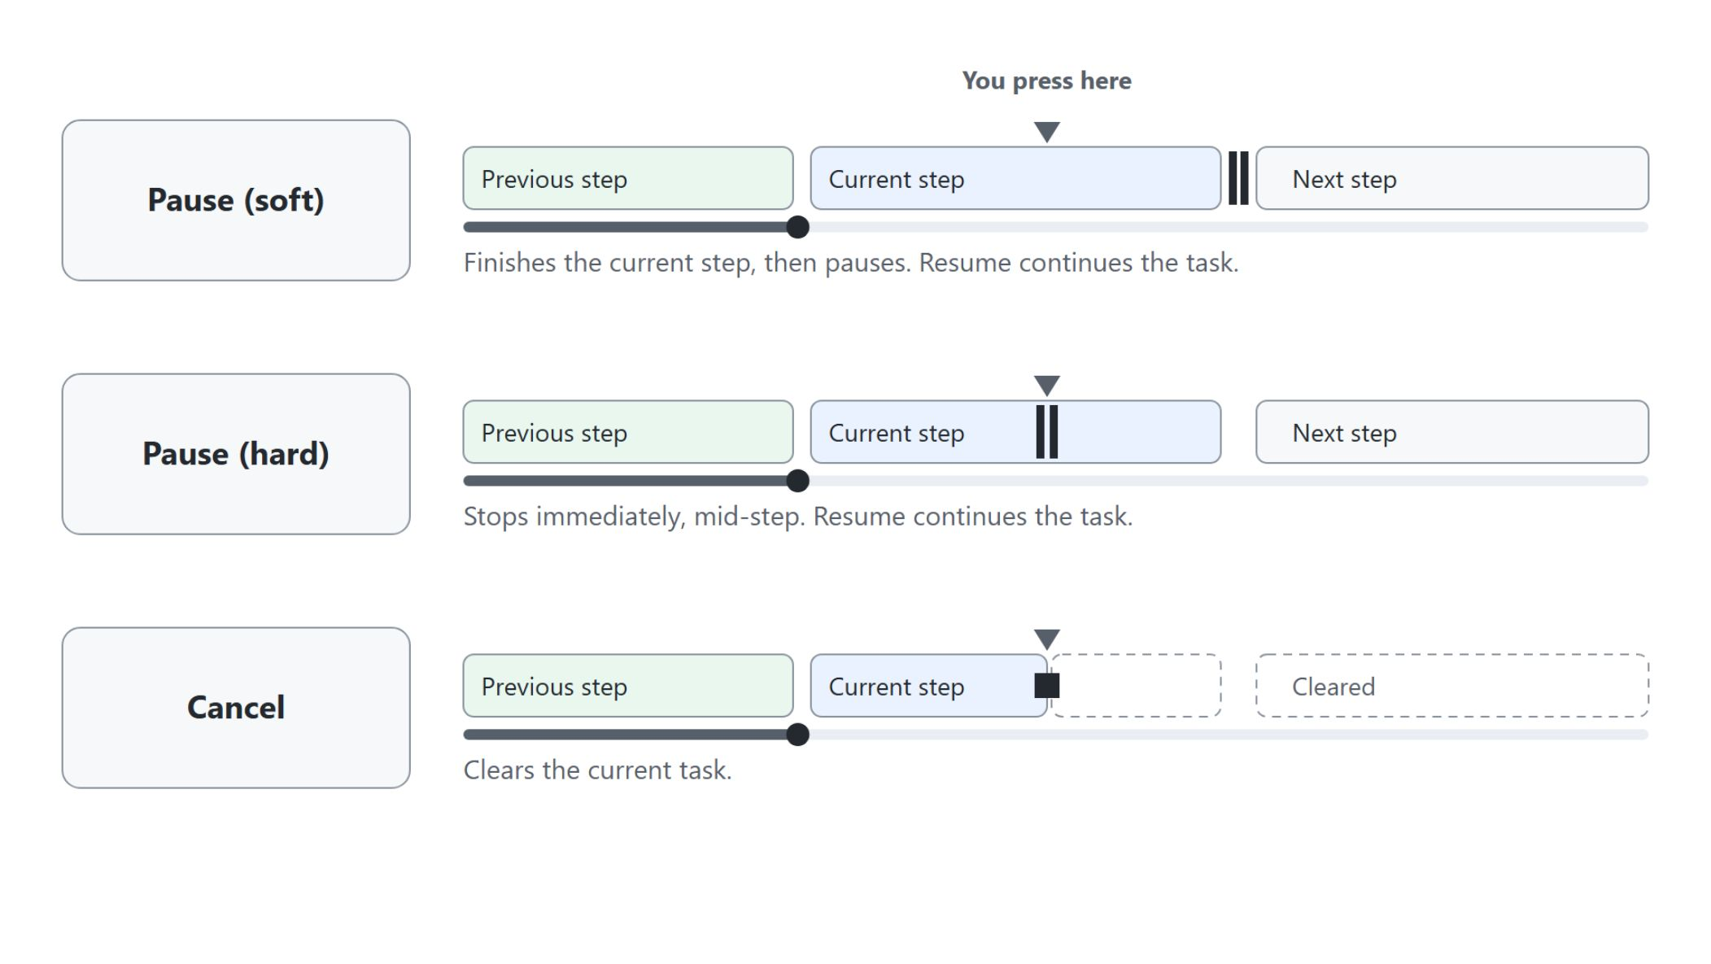
Steering an active task
Pause, resume or cancel while Cowork works
Pause (soft) finishes the current step, then pauses
Pause (hard) stops immediately, mid-step
Resume continues a paused task, Cancel clears the current one
Queued messages sent while Cowork works can redirect it
Rate responses and previewed documents with thumbs up or down, or comment inline
Notes:
You are never locked out while Cowork works. The diagram shows where each control stops a running task, measured against the step it is in.
Pause (soft): Cowork finishes the step it is on, then pauses.
Pause (hard): the task stops immediately, in the middle of the step.
Resume and Cancel: Resume continues the paused task. Cancel clears the current task.
Queued messages: anything you send while Cowork works is queued and can redirect it.
Feedback: rate responses and previewed documents with thumbs up or thumbs down, and leave inline comments on a message to explain what should change. General feedback goes through the header menu.

Slide 30
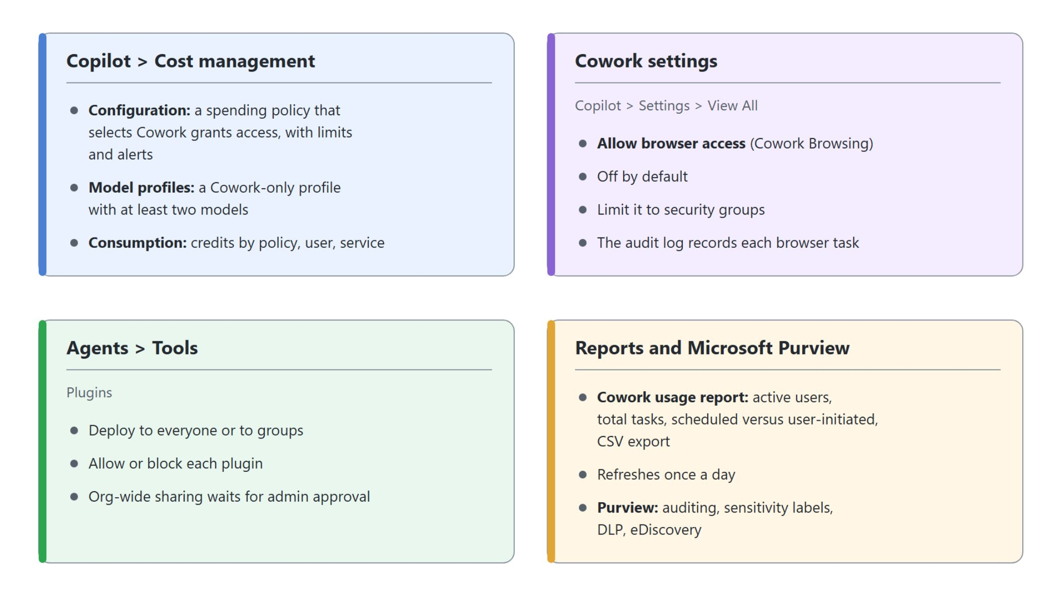
Governance for admins
Where each Cowork control lives
A spending policy grants access; browsing, plugins and reporting each have their own place in the admin center
Notes:
Control does not stop at the individual user. Admins decide whether Cowork is available at all, to whom, and what it may reach.
Cost management: a spending policy under Copilot > Cost management > Configuration grants access when its scope includes the user and it selects Cowork, and to block a user you remove them from the scope. Model profiles there hold a Cowork-only set of at least two models, and Consumption splits Copilot Credits by policy, user and service, never by task.
Visibility: the discovery setting AI experiences enabled by usage-based billing controls only who sees Cowork, not who can use it. The Agents > All agents control from the preview has no effect on access any more.
Cowork settings: the tenant setting Cowork Browsing is off by default. Turn on Allow browser access, limit it to security groups and review the audit log, which records each browser task.
Agents > Tools: deploy plugins to everyone or to groups and allow or block them there. Org-wide sharing needs admin approval, and no single setting turns off sharing with specific people.
Reports and Purview: the Cowork usage report shows active users, total tasks and scheduled versus user-initiated tasks, and it refreshes once a day. Purview supports Cowork for DSPM, auditing, sensitivity labels, DLP, Insider Risk Management, Communication Compliance, eDiscovery and Data Lifecycle Management.

Slide 31

Takeaways
From a first task to staying in control
Describe the outcome, and Cowork plans and acts across Microsoft 365
A spending policy that selects Cowork grants access, metered in Copilot Credits
Skills load on their own, and a SKILL.md teaches Cowork one of your recurring jobs
Schedules, triggers and plugins make the work recurring and bring in outside expertise
You approve every send, booking and file edit before it leaves your workspace
Notes:
This closing slide collects what the module covered, one point per phase of the path. Each point was practised in at least one demo, most of them on the Aurora Outdoor Q3 close.
Describe the outcome: Cowork plans and runs the steps across your apps. Your part is to judge the plan and steer it, as in the Q3 review deck.
Spending policy: a user can open Cowork once a spending policy that selects Cowork covers them, even with a one-credit limit. Start with a small pilot group and strict limits, then expand once you have seen real consumption.
Skills: Cowork loads the right built-in skills on its own and lists them under Plugins in the Workspace panel. A custom SKILL.md like product-pitch captures a job you repeat, and you tune it until it fires without being named.
Schedules, triggers and plugins: a prompt or custom skill can run every Friday or when an email or Teams message arrives. Plugins such as dietitian bring expertise you cannot write yourself.
You approve: Cowork pauses before anything that leaves your workspace, and a scheduled run still stops at a draft. Admins govern access, browsing and plugins for the whole organization.

