Slide 1



Fast Lane Group
Worldwide Education &
Professional Services
www.flane.de | © 2026 Fast Lane Institute for Knowledge Transfer GmbH
Notes:
Die Fast Lane Gruppe.
Fast Lane … Dienstleister u. Spezialist für High-End Technologie und Business Trainings
IT Trainings zu den unterschiedlichsten Herstellern wie Microsoft, Google, Cisco oder AWS. Und vielen weiteren wichtigen IT Herstellern.
Sei es Cloud, Security, Netzwerk oder allgemein digitale Transformationsprojekte
Und das seit 2003.
Das spannende ist, dass die Fast Lane Gruppe bereits seit 2009 durchgängig zu den Top 20 Unternehmen in der IT Trainingsbranche weltweit zählt.
Aber auch Footprint ebenso im klassischen Professional Services Bereich für unsere wichtigsten Hersteller
PreSales Support, Deployment Services und Adoption Trainings
Additional Information:
Im Jahr 2021 sind wir zur „most strategic IT Education company worldwide“ von der IDC im „magic quadrant“ aufgeführt worden !
1 mio Teilnehmer insgesamt seit bestehen, 50.000+ Students ww p.A, 20.000 in DE pro Jahr

Slide 2






AGENTIC AI: FROM STRATEGY TO PRODUCTION.
Alexander
Kastil
AGENTIC AI CONSULTING · VIENNA
Full stack, from enterprise software to agentic AI. Since 1996
AI at Work
Enterprise AI
Value discovery, KPI mapping and roadmap
Governed multi-agent systems on Microsoft Copilot and Foundry
Agentic Software Engineering
Team Enablement
Harness architecture for Claude Code and GitHub Copilot
AI driven content production and delivery
integrations.at
github.com/alexander-kastil
SCAN TO CONNECT
alexander.kastil@integrations.at
linkedin.com/in/alexander-kastil
integrations.at
Notes:
Intro: Alexander Kastil, integrations.at. Four practice areas from AI at Work to team enablement. Certifications: Agentic AI Business Solutions Architect, Azure AI App and Agent Developer Associate, DevOps Engineer Expert.

Slide 3

MODULE 3
Copilot Studio Basics
A working, grounded agent in Teams, built without code
Automate Business Processes with Copilot Studio and Copilot Cowork

Slide 4
01
02
03
Standard Agents: Create & Configure
Identity, instructions, model, orchestration and the test panel
Knowledge Sources & Suggested Prompts
Source types, citations and ungrounded answers
Topics, Entities & Variables
Nodes, entities, slot filling and variable scopes
04
05
06
Power Fx: Formulas in Topics
Where formulas run and the functions makers use most
Adaptive Cards: Collect Structured Input
Card JSON, schema versions and outputs as variables
Publishing to Teams & Copilot
Channels, authentication and who can use the agent
Automate Business Processes with Copilot Studio and Copilot Cowork

Slide 5

Copilot Studio Basics
A working, grounded agent in Teams, built without code
Create a Standard agent and set its instructions, model and orchestration
Ground it in knowledge and shape its conversations with topics, Power Fx and Adaptive Cards
Publish it to Teams and Microsoft 365 Copilot
Notes:
This module is where makers get their footing with Copilot Studio, Microsoft's low-code platform for building agents. It works with Standard agents, the ones many clients run in production today.
Standard agent: you create one in an environment, give it an identity and instructions, pick its model and decide how it orchestrates its answers. In the New agent menu it is Agent with the Standard badge under Other ways to build.
Knowledge and conversations: knowledge grounds the answers with citations, and topics, entities, variables, Power Fx and Adaptive Cards shape the conversations you want to control.
Publish: the goal is a working, grounded agent in Teams by the end, built without writing code. Everything here carries over to GitHub Copilot agents, which reuse the same concepts under a consolidated Build surface.

Slide 6
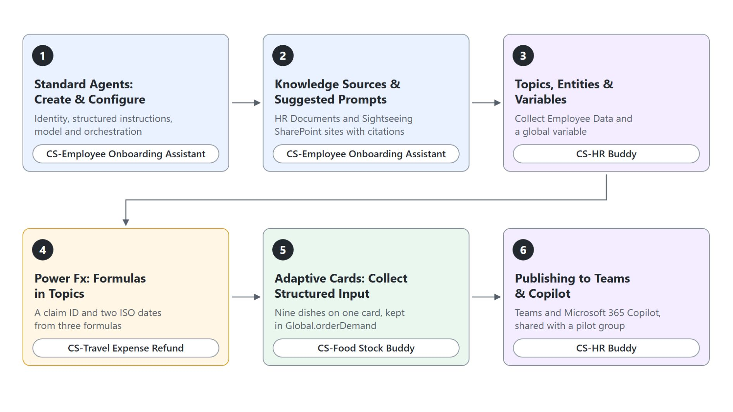
Overview
Six topics, four agents rebuilt in the demos
Create CS-Employee Onboarding Assistant and ground it in two SharePoint sites
Build CS-HR Buddy topics that identify an employee once
Turn a travel claim into values ready to save with Power Fx
Collect a canteen demand on one Adaptive Card
Publish CS-HR Buddy to Teams and Microsoft 365 Copilot
Notes:
This is the map of the module: six topics in delivery order, and every demo rebuilds one agent of the class environment with the CS- prefix.
Onboarding assistant: topics one and two create CS-Employee Onboarding Assistant with structured instructions, then ground it in the HR Documents and Sightseeing SharePoint sites and trace each answer to its citation.
HR Buddy: topic three rebuilds two HR topics in CS-HR Buddy, joined by a global variable, so an employee answers the four identity questions only once per session.
Power Fx and cards: topic four lets three formulas turn a travel expense claim into a claim ID and ISO dates, and topic five collects the canteen's demand for nine dishes on one Adaptive Card.
Publishing: topic six takes CS-HR Buddy to Teams and Microsoft 365 Copilot, shares it with a pilot group and rolls out a change with one publish.

Slide 7
01
Standard Agents: Create & Configure
Identity, instructions, model, orchestration and the test panel
Automate Business Processes with Copilot Studio and Copilot Cowork

Slide 8
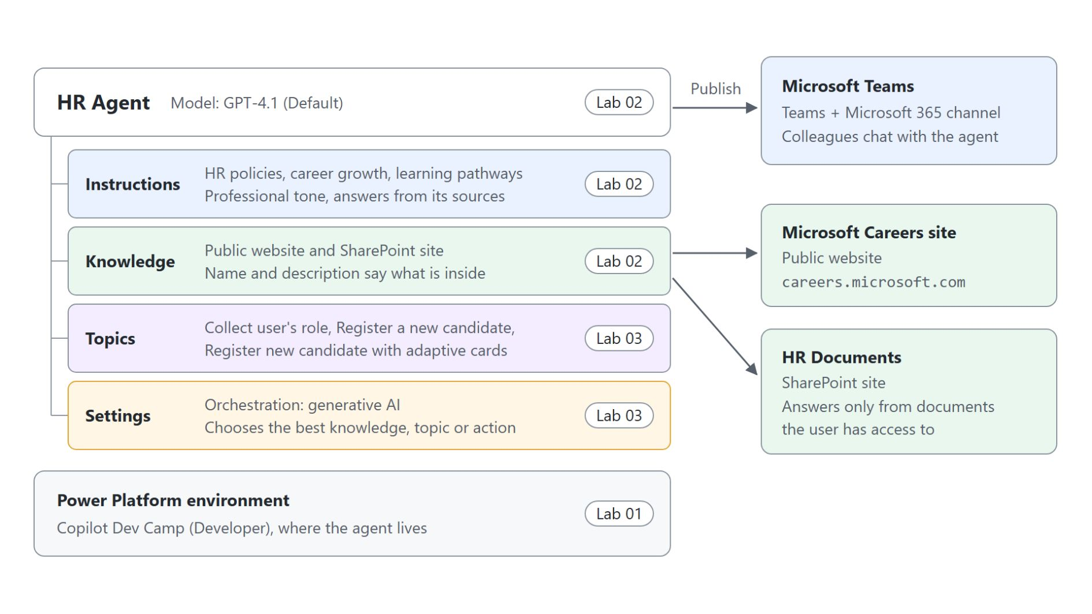
Parts of an agent
The HR Agent built in labs 01 to 03
Every agent lives in a Power Platform environment with its Dataverse database and solutions
Name, description and instructions set its identity and tone
Knowledge grounds its answers in websites, SharePoint, files or Dataverse
Topics carry the conversations you want to control precisely
Notes:
Before any feature, the class needs a picture of what an agent is made of. This diagram shows the HR Agent the labs build, part by part.
Environment: an agent belongs to the environment you select before you create it, and that environment holds its Dataverse database, its solutions and its connections. Use a trial or sandbox environment for a new class tenant, because new unmanaged developer environments can't be created from November 15, 2026.
Instructions: the name, description and instructions set the agent's identity and tone. The HR Agent's instructions keep it on HR policies, career growth and learning pathways.
Knowledge: public websites, SharePoint, files and Dataverse let the agent answer from real content. With SharePoint, users only get answers from documents they can already open.
Topics: a topic runs a fixed path of nodes on the authoring canvas. The orchestration setting decides whether generative AI picks between topics, tools and knowledge.

Slide 9
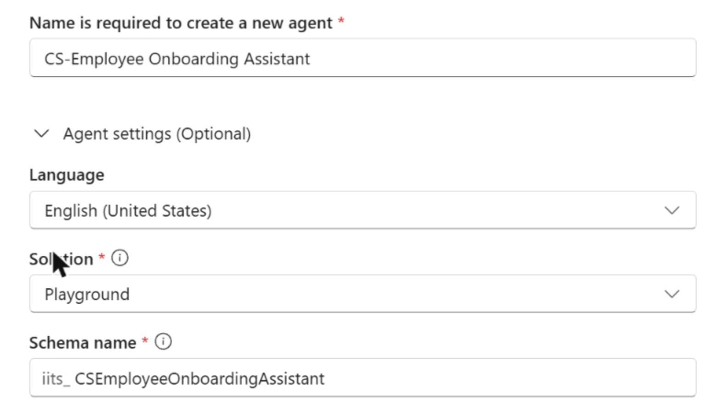
Creating a Standard agent
Create blank agent for CS-Employee Onboarding Assistant
Three starts: describe the agent, Create blank agent, or an agent template
A blank agent needs only a name
Agent settings show language, solution and schema name; the demo keeps the defaults
The agent stays in the environment selected before you create it
Notes:
With the parts in mind, the demo creates its first agent. The screenshot is the Name your agent dialog from the live run of CS-Employee Onboarding Assistant.
Three starts: a description of up to 1,024 characters generates the name, description and instructions, Create blank agent asks only for a name, and a template such as IT Helpdesk gives a working agent to tailor. The demo starts blank, so the instructions added next are the only behavior the agent has.
Name: the CS- prefix marks the agent as part of the class environment. After Create the agent shows Setting up for about a minute, so reload the Overview page before you edit.
Agent settings: the optional section shows the language, the solution and the schema name. The demo keeps all three defaults.
Environment: the environment you select before you create the agent is the one it stays in. Pick a dedicated development environment for anything you plan to move to production later.

Slide 10
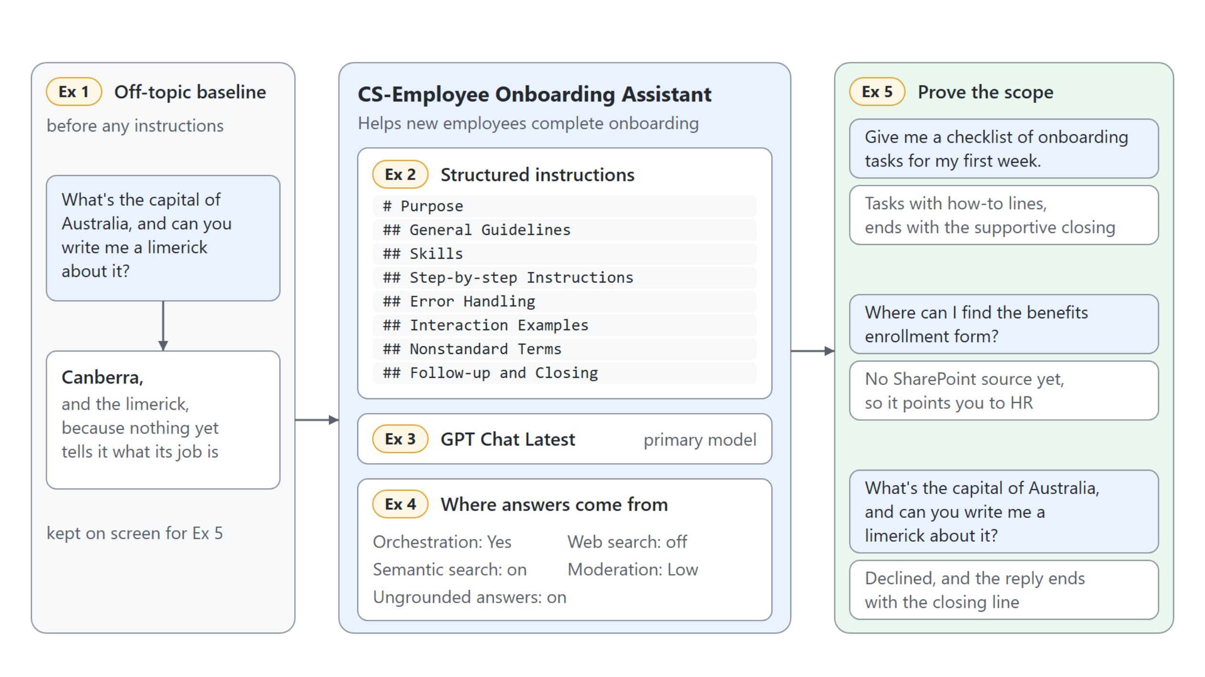
Instructions, model and answer settings
The same off-topic question before and after
Structured instructions, GPT Chat Latest and deliberate answer settings keep CS-Employee Onboarding Assistant on onboarding questions
Notes:
This diagram is the whole demo on one picture. Before any instructions, the capital of Australia question gets Canberra and a limerick, because nothing tells the agent what its job is.
Structured instructions: Purpose and General Guidelines set tone and limits, Skills and Step-by-step Instructions say how to answer, Error Handling covers a missing document, and Follow-up and Closing fixes how every conversation ends.
Model: the original runs on GPT-5.5 Chat, which the picker marks with will retire on 10/30/2026. The rebuild uses GPT Chat Latest, which always points to the current GPT chat model.
Orchestration and answer settings: generative orchestration picks topics, tools and knowledge by their descriptions, while classic orchestration matches trigger phrases. The demo keeps web search off, ungrounded answers and semantic search on, and moderation at Low.
Prove the scope: the checklist comes back with tasks and the supportive closing, the benefits question points to HR because no SharePoint source exists yet, and the capital question is declined. When an answer surprises you, read the activity map before you edit the instructions.

Slide 11
02
Knowledge Sources & Suggested Prompts
Source types, citations and ungrounded answers
Automate Business Processes with Copilot Studio and Copilot Cowork

Slide 12
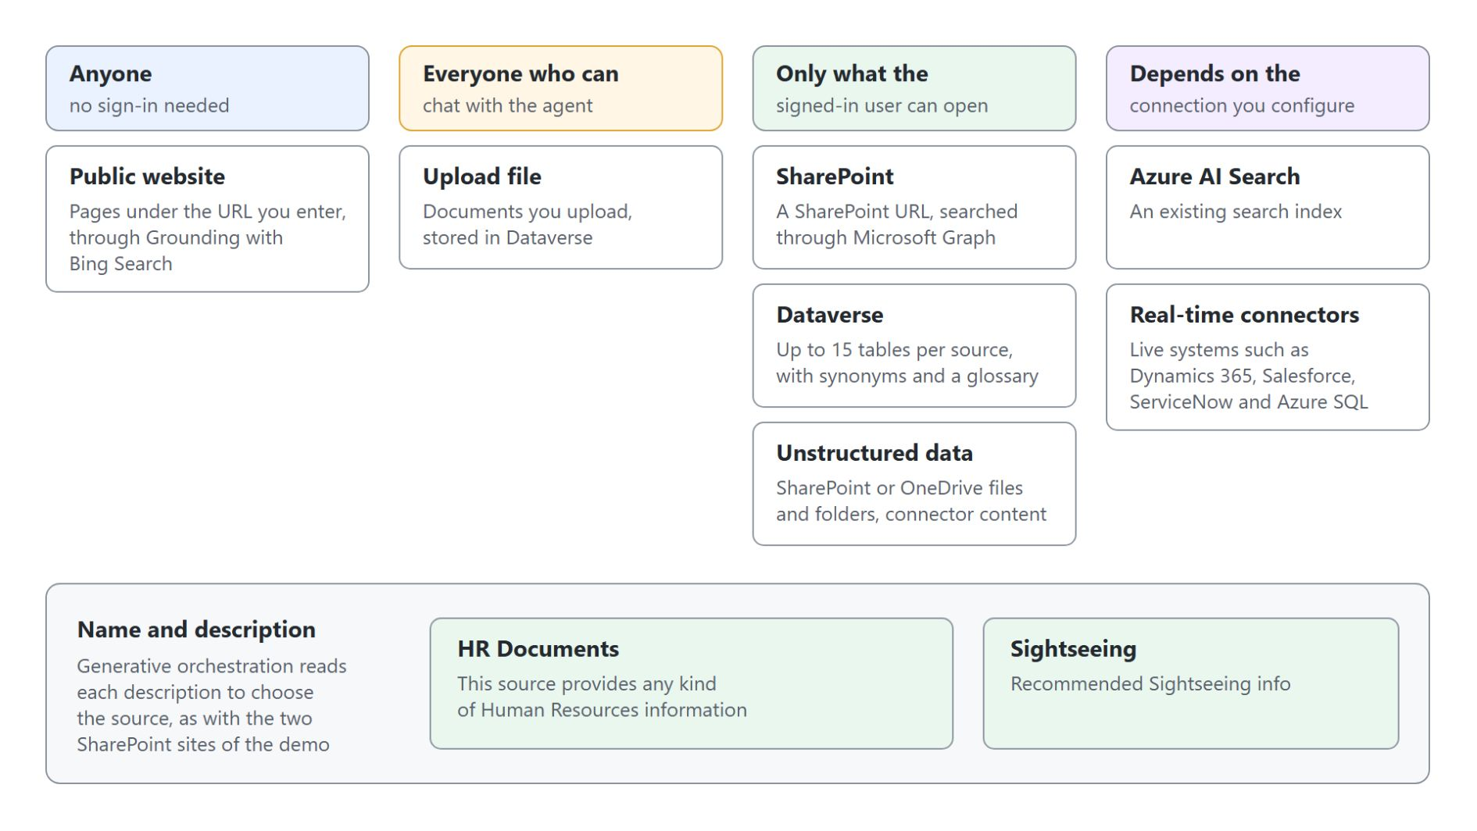
Knowledge source types
What the agent searches and who can see the content
Add knowledge offers websites, files, SharePoint, Dataverse, Azure AI Search and connectors
SharePoint and Dataverse answer within the signed-in user's permissions
An uploaded file can answer everyone who chats with the agent
Each source gets a name and description the orchestrator chooses by
Notes:
An agent with good instructions but no knowledge answers from the model's general training and cites nothing your company wrote. Knowledge sources change that: the agent searches the content you point it at and grounds its reply with citations.
Source types: the Add knowledge dialog offers public websites, uploaded files, SharePoint, Dataverse, Azure AI Search, real-time connectors and unstructured data. Every source added at agent level lands in the Conversational boosting system topic, so the agent answers from it without any topic work.
Signed-in user: SharePoint, Dataverse and Copilot connector sources use the user's Microsoft Entra ID sign-in, so two people asking the same question can get different answers. This is the column makers underestimate.
Uploaded files: an uploaded file has no such filter, so every user of the agent can be answered from it. Keep its name short, because a long name fails to sync with PropertyLengthTooLong.
Name and description: Learn asks for a description that is as detailed as possible, because generative orchestration uses it to decide which source to search. The demo adds HR Documents and Sightseeing, each with its own description.

Slide 13
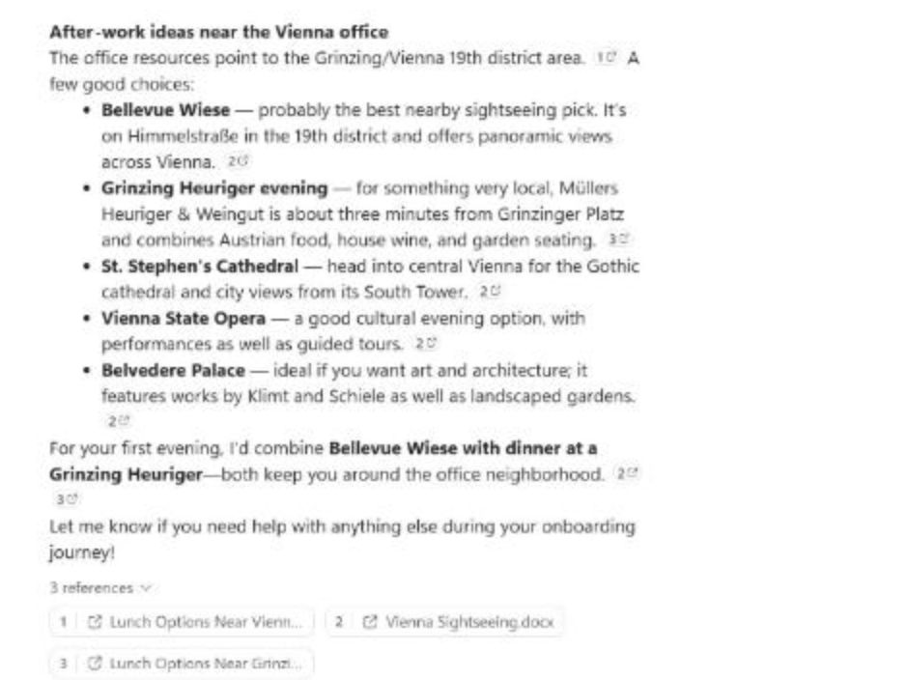
Answers with citations
The sightseeing question answered from SharePoint
The question: what to see near the office after work
The Sightseeing source and one instruction section steer it to the Sightseeing site
Five suggestions, each with a numbered citation
3 references under the answer link to the documents
Notes:
The onboarding assistant now has two SharePoint sources, HR Documents and Sightseeing. This is its live answer to I start next Monday. What should I see near the office after work?
Steering: the Sightseeing description and a Sightseeing section at the end of the instructions make that site the source for sights. In the activity map, the first search rewrote the question to search the Sightseeing site as the primary source.
Suggestions: the reply recommends Bellevue Wiese, a Heuriger evening in Grinzing, St. Stephen's Cathedral, the Vienna State Opera and Belvedere Palace, and ends with the supportive closing from the instructions.
References: the three references include Vienna Sightseeing.docx and a lunch options document per office. A second search asked where the office is located, which is fine when the question needs a fact from each source.
Benefits question: the same benefits question that ended with contact HR in the first demo now cites Employee Onboarding.docx. Read the citation, not just the reply.

Slide 14

Grounded and ungrounded answers
What Allow ungrounded responses changes
An ungrounded answer sounds just as right as a grounded one, so open the citation: the cited file proves grounding
Notes:
One setting decides what happens when no source finds anything: Allow ungrounded responses, in the Knowledge section of the Generative AI settings page. It is on for a new agent.
Setting on: the model may answer from general knowledge without a citation. In the demo the capital of Australia question got Canberra and a limerick with no reference.
Setting off: a turn that used no source or tool is blocked and the Fallback topic answers. The capital question then showed No information was found that could help answer this, followed by the Fallback message asking to rephrase.
Partly covered questions: the question about bringing a dog to the office stayed grounded either way, because the answer cited Employee Onboarding.docx. With the setting off, only an answer with an in-text citation counts as grounded.
Citations: instructions that tell the model to omit sources can suppress citations and make answers disappear. An instruction to always cite sources keeps them consistent.

Slide 15
03
Topics, Entities & Variables
Nodes, entities, slot filling and variable scopes
Automate Business Processes with Copilot Studio and Copilot Cowork

Slide 16
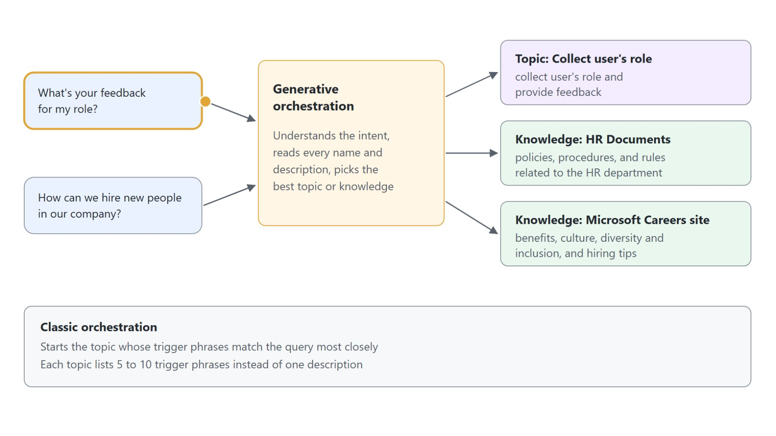
Topics and generative answers
How orchestration picks a topic or knowledge for each prompt
A topic runs a fixed path of nodes: questions, messages, conditions, redirects
Knowledge with generative answers covers open-ended questions over your content
Generative orchestration picks a topic by its description
Classic orchestration starts the topic whose trigger phrases match most closely
Notes:
Knowledge answers open questions, but some requests must follow a fixed path every time, such as reporting a broken device or registering a candidate. The diagram follows two prompts from the labs to show which part answers.
Topic: a topic asks the questions you wrote in your order, checks each answer and replies with exactly the message you designed. The role feedback prompt lands in the Collect user's role topic.
Knowledge: open-ended questions go to knowledge through generative answers. The hiring question draws on HR Documents and the Microsoft Careers site.
Descriptions: under generative orchestration the Trigger node switches to The agent chooses, and the topic needs a description of its purpose. Write descriptions that say what each topic does and doesn't do, because overlapping descriptions lead to unpredictable choices.
Trigger phrases: classic orchestration matches the user's message against 5 to 10 trigger phrases per topic, and the language model matches meaning rather than exact words.

Slide 17
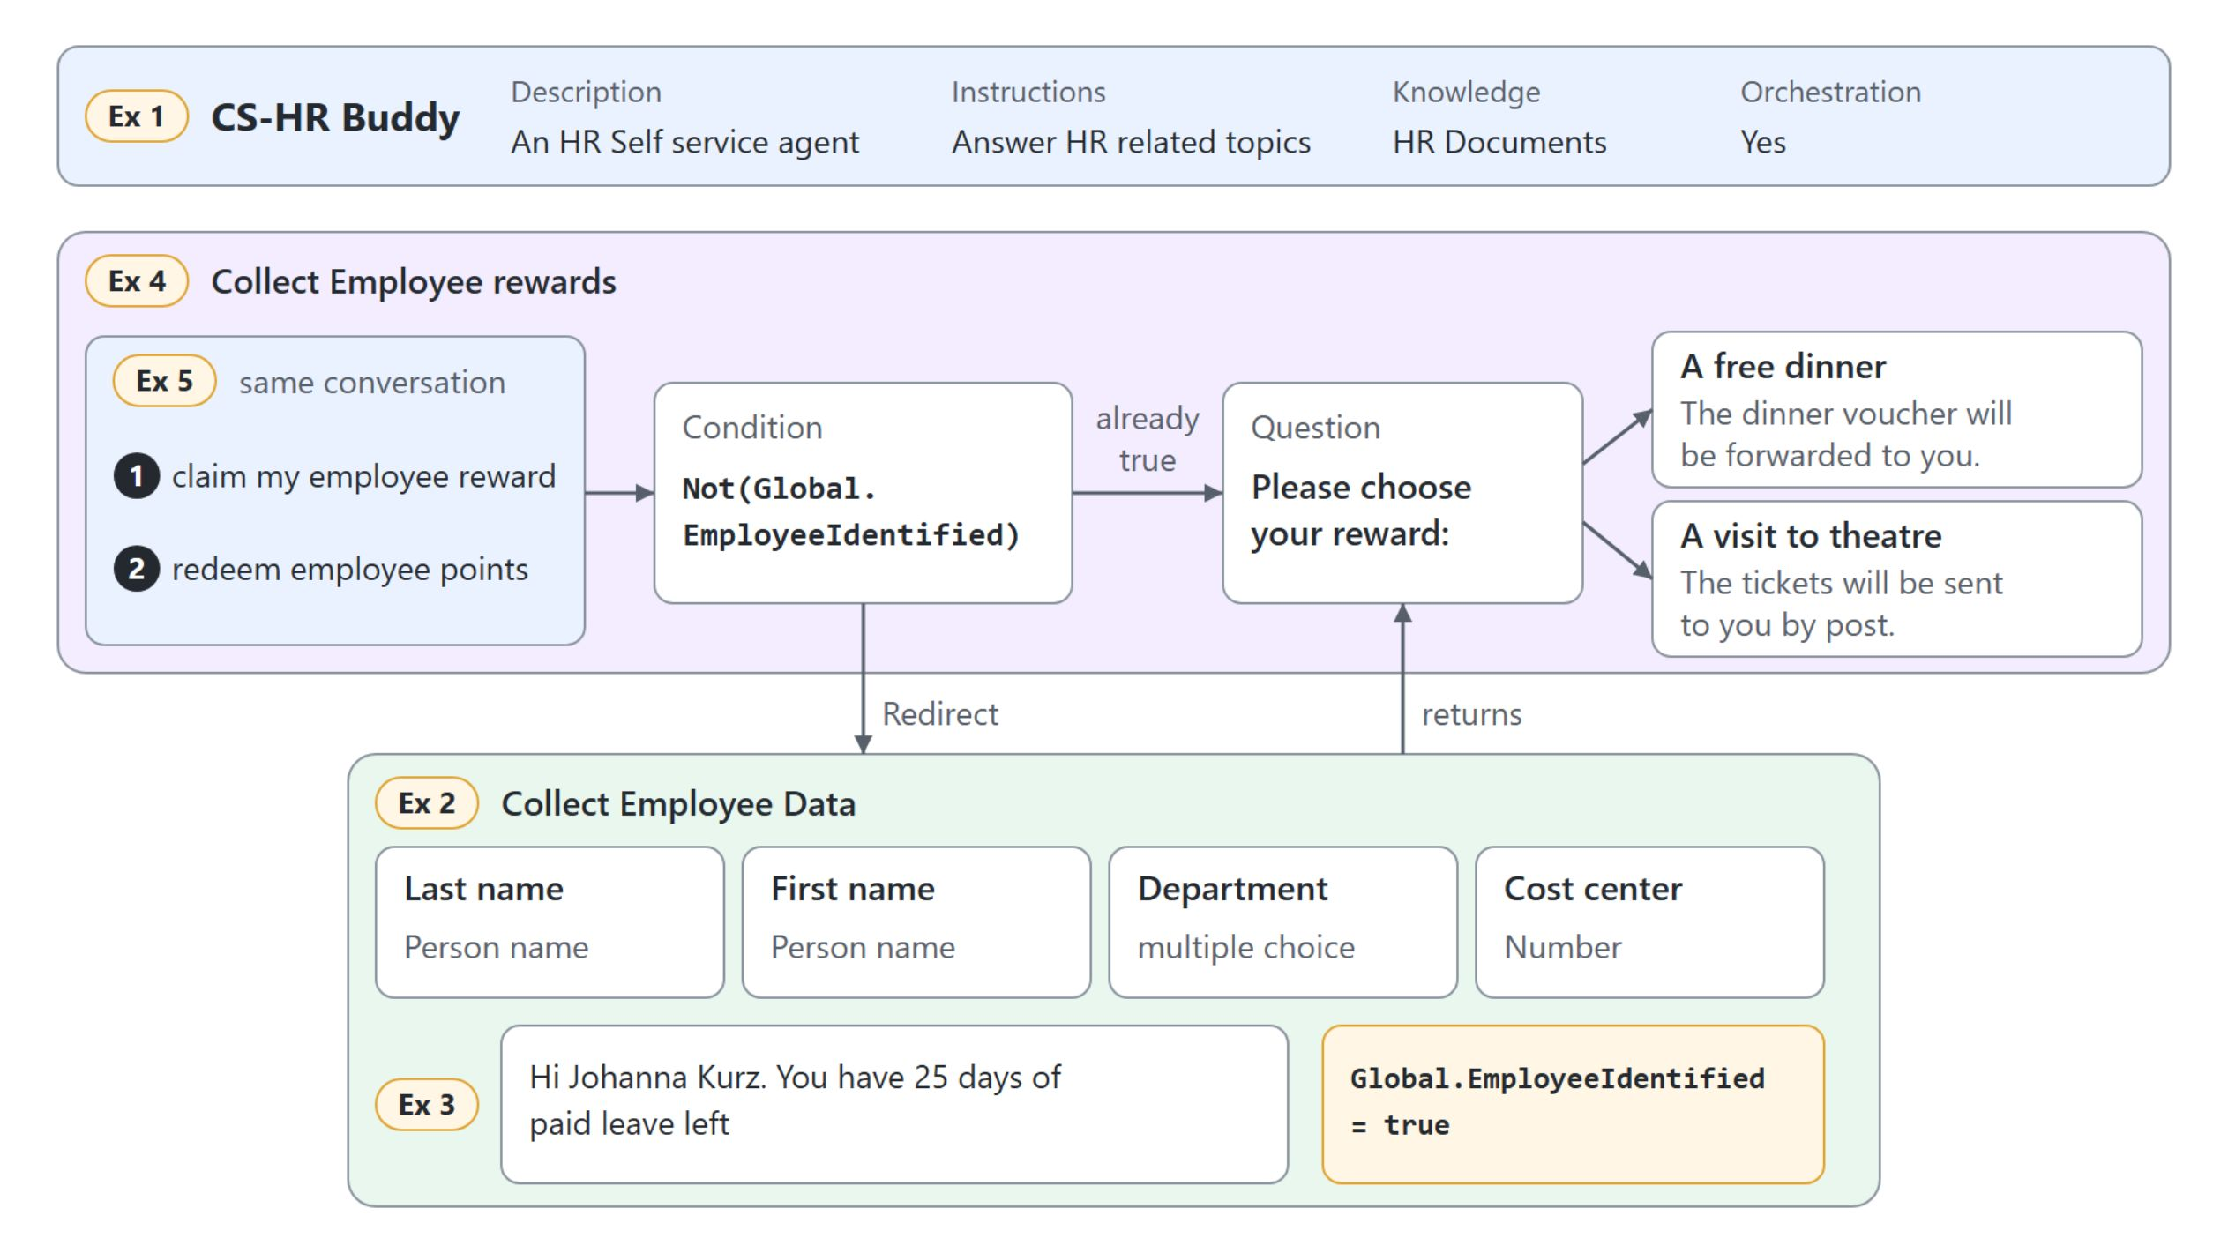
Sharing state between topics
CS-HR Buddy identifies an employee once
Collect Employee Data sets Global.EmployeeIdentified, so the rewards topic detours through it only until the employee is known
Notes:
CS-HR Buddy keeps its behavior in two topics, and one global variable connects them. The agent level stays thin: a one-line description, a one-line instruction and the HR Documents site.
Collect Employee Data: four questions bind to entities, Person name for both names, multiple choice options for the department and Number for the cost center. The topic confirms 25 days of paid leave and sets Global.EmployeeIdentified to true.
Collect Employee rewards: a Condition with Not(Global.EmployeeIdentified) redirects an unknown employee to Collect Employee Data, which returns to the reward question afterwards. The choices are a free dinner or a visit to theatre.
Variable scope: a topic variable lives only while its topic runs, a global variable keeps its value for the whole session. Start over resets global variables, so the next reward request detours again.
Descriptions: under generative orchestration the agent picks each topic by its name and the description on the Trigger node. The description therefore lists the requests the topic handles.

Slide 18
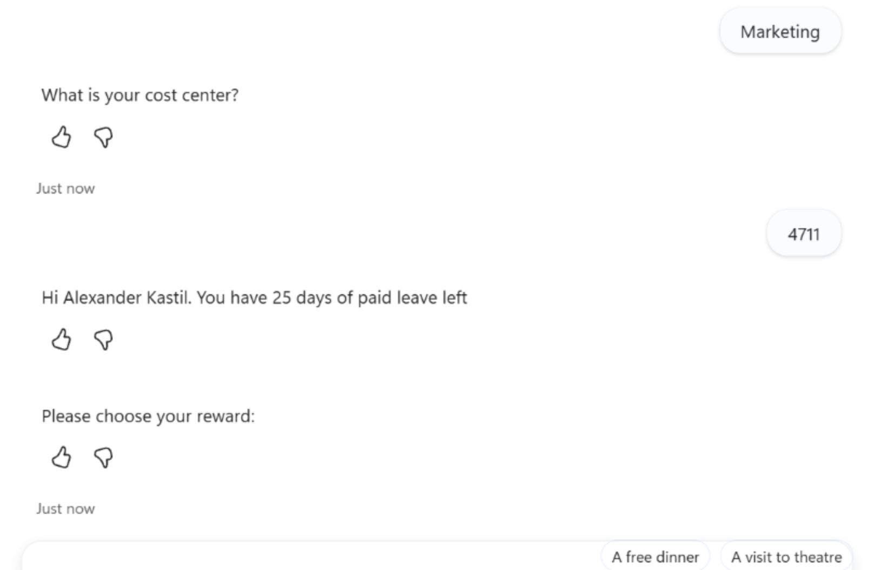
The rewards detour in the test chat
The first reward request runs the employee questions
A reward request from an unknown employee runs Collect Employee Data first
The cost center is recognized as a Number
The paid leave message confirms the employee
The redirect returns to Please choose your reward:
Notes:
This is the live test of CS-HR Buddy, cropped to the end of the detour: the employee questions finish and the rewards topic takes over again.
Detour: Global.EmployeeIdentified is still empty at the start of the session, so the condition sends the reward request through Collect Employee Data. The chat shows the last answers, the department Marketing and the cost center 4711.
Paid leave message: the topic greets the employee by first and last name and confirms 25 days of paid leave. In the same step it sets the global variable to true.
Return: the redirect hands control back to the rewards topic, which asks Please choose your reward: with A free dinner and A visit to theatre.
Second request: in the same session a new reward request asks only the reward question, because the employee is already identified. An extra Please choose your reward: right after the first confirmation comes from the orchestrator, not from the topic.

Slide 19
04
Power Fx: Formulas in Topics
Where formulas run and the functions makers use most
Automate Business Processes with Copilot Studio and Copilot Cowork

Slide 20
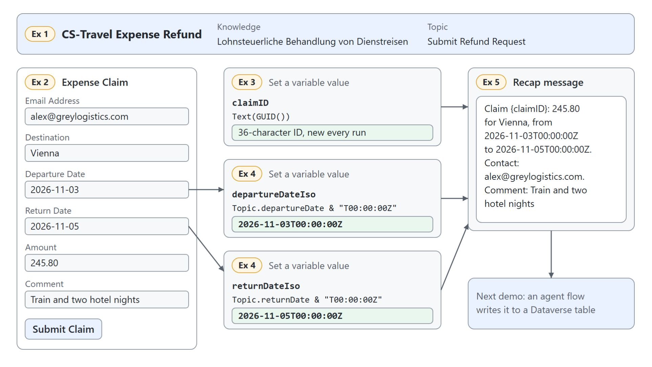
Power Fx in a topic
Three formulas turn the expense card into a claim ready to save
Formulas run wherever a node takes a value: Set variable value, Condition, Question
Text(GUID()) gives every claim its own claimID
& "T00:00:00Z" turns each card date into an ISO timestamp
Name variables with their scope prefix, separate arguments with commas
Notes:
Topics collect values, and Power Fx adds the logic on top. In the demo CS-Travel Expense Refund collects a claim on a six-field Adaptive Card, and three formulas prepare it for saving.
Where formulas run: the Formula tab sits next to the variable picker in a Set variable value node, a Condition node switches with Change to formula, and a Question node takes a formula under Additional entity validation. One calculation per node, with a variable name that says what it holds, keeps the canvas readable.
Claim ID: a saved claim needs a key that no other claim shares, and the user should never invent one. GUID() creates a unique identifier and Text() turns it into the string a Dataverse text column expects.
ISO dates: an Input.Date field returns a plain date such as 2026-11-03, while a Dataverse Date and time column takes a full ISO 8601 timestamp. The & operator appends the time and the UTC marker.
Syntax: a formula names a variable with its scope prefix, so write Topic.departureDate, never departureDate alone. Copilot Studio uses US-style numbers, so the comma separates arguments whatever the browser language.

Slide 21
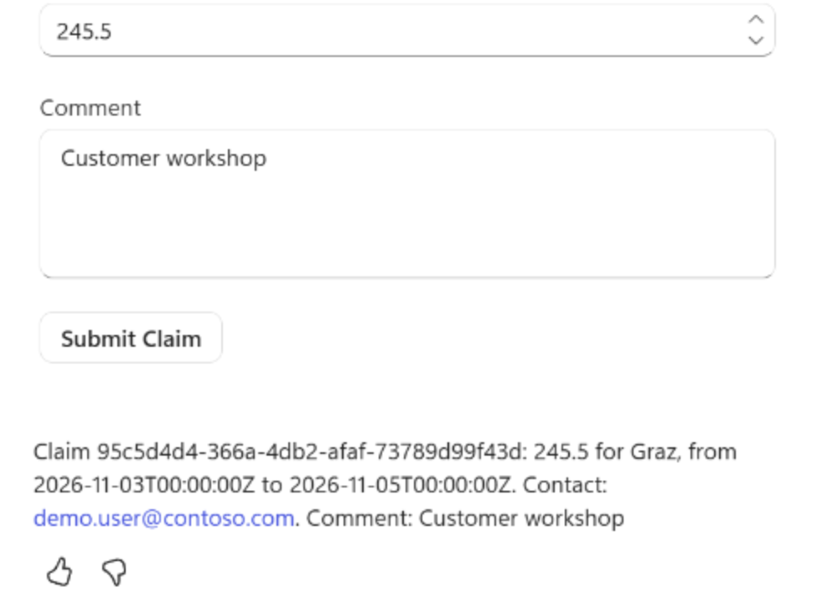
The claim recap
The values an agent flow receives next
Submit Claim fills one topic variable per card input
The recap starts with the claimID, a 36-character GUID
Both dates arrive as ISO timestamps ending in T00:00:00Z
A second test run gets a different claimID
Notes:
This is the recap from the live test of CS-Travel Expense Refund. The card was submitted, and the message shows what the formulas made of it.
Card input: each input id of the card becomes a variable, so Amount and Comment arrive as the user typed them. The card validates required fields before the submit.
Claim ID: the recap opens with the GUID that Text(GUID()) created. Every test run gets a new one, which proves it comes from the formula and not from the card.
ISO dates: the two dates read 2026-11-03T00:00:00Z and 2026-11-05T00:00:00Z, the format a Dataverse Date and time column accepts. Trace each computed variable to the node that consumes it: the cloned agent passed the raw dates to its flow, so its formulas never reached the database.
Next step: module 04 maps these values to the inputs of an agent flow that saves the claim to a Dataverse table. The Test tab of the Variables panel shows each value while the topic runs.

Slide 22
05
Adaptive Cards: Collect Structured Input
Card JSON, schema versions and outputs as variables
Automate Business Processes with Copilot Studio and Copilot Cowork

Slide 23

Canteen demand on one card
CS-Food Stock Buddy collects nine dishes in one submit
One Adaptive Card replaces nine questions: the canteen manager types a number per dish and submits once
Notes:
Topic five moves from questions to cards. The running example is the canteen: its manager sends the week's demand for nine dishes, from Wiener Schnitzel to Green Curry.
Questions: a question per dish would take nine turns and still return free text. A Question node stays the better choice for a single conversational value.
Card: an Adaptive Card shows the whole form at once and the host renders it natively, in Teams, on a website or in Copilot Chat. The values arrive in the topic as variables after one submit.
Channels: Copilot Studio supports schema 1.6 and earlier, but Teams renders up to 1.5. The demand card uses version 1.5, the highest that Teams renders.

Slide 24
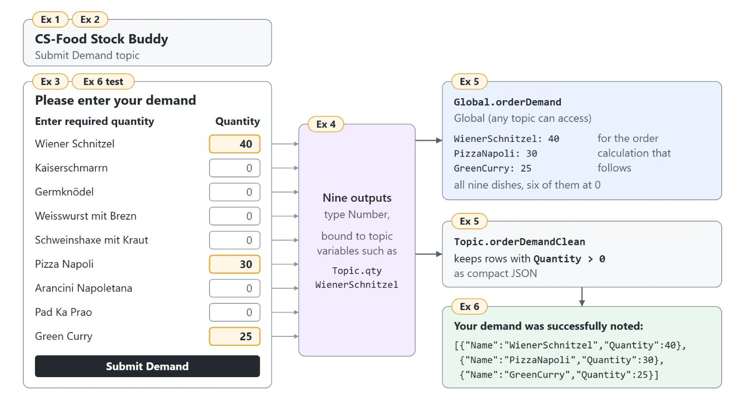
From card inputs to variables
Input id, binding and type must agree
Each input id becomes a typed output bound to a topic variable
Global.orderDemand keeps all nine numbers for the order calculation
output:
binding:
qty.WienerSchnitzel: Topic.qtyWienerSchnitzel
qty.PizzaNapoli: Topic.qtyPizzaNapoli
qty.GreenCurry: Topic.qtyGreenCurry
outputType:
properties:
qty.WienerSchnitzel: Number
Notes:
When the manager selects Submit Demand, every input id of the card becomes a node output. The diagram follows the nine numbers from the card to the confirmation.
Three-part contract: the input id in the JSON, the output binding that maps it to a variable and the output type must match. The excerpt shows three of the nine bindings and one type; numbers have to stay numbers, or the order calculation later works on text.
Edit Schema: if a generated variable has the wrong type, such as a number read as text, fix it with Edit Schema in the node properties or in the code editor.
Global record: a Set a variable value node stores all nine quantities as one record in Global.orderDemand, so the order topic of the next module can read it.
Confirmation: a second formula keeps only rows with a quantity above 0 and turns them into compact JSON. That filter also catches clients that ignore min on a number input.

Slide 25
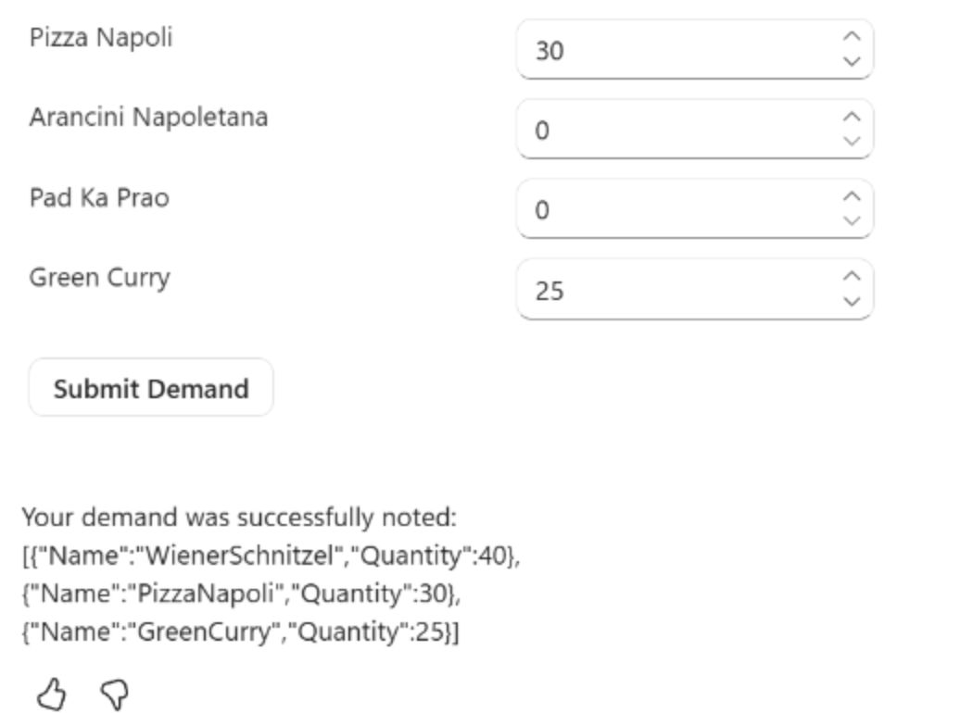
Submitting the demand
40 schnitzel, 30 pizza and 25 curry in one submit
Each dish row has a number field that starts at 0
Pizza Napoli 30 and Green Curry 25 typed, the other rows left at 0
Submit Demand sends every row in one step
The confirmation lists only the three dishes above 0
Notes:
This is the live test of CS-Food Stock Buddy. The message I want to submit demand starts the topic, and the card waits for numbers.
Number fields: every input starts at value 0, so an empty row submits 0 instead of nothing. The crop shows the last rows of the card, from Pizza Napoli to Green Curry.
Submit: the manager entered 40 for Wiener Schnitzel, 30 for Pizza Napoli and 25 for Green Curry, then selected Submit Demand once.
Confirmation: Your demand was successfully noted, followed by compact JSON with exactly three entries in the formula's order. On the Test tab of the Variables panel, Global.orderDemand still shows all nine dishes, six of them at 0.
Next step: in the live run the orchestrator added one more line of its own after the confirmation, which you can leave. The next module feeds Global.orderDemand to a prompt that works out what to order.

Slide 26
06
Publishing to Teams & Copilot
Channels, authentication and who can use the agent
Automate Business Processes with Copilot Studio and Copilot Cowork

Slide 27
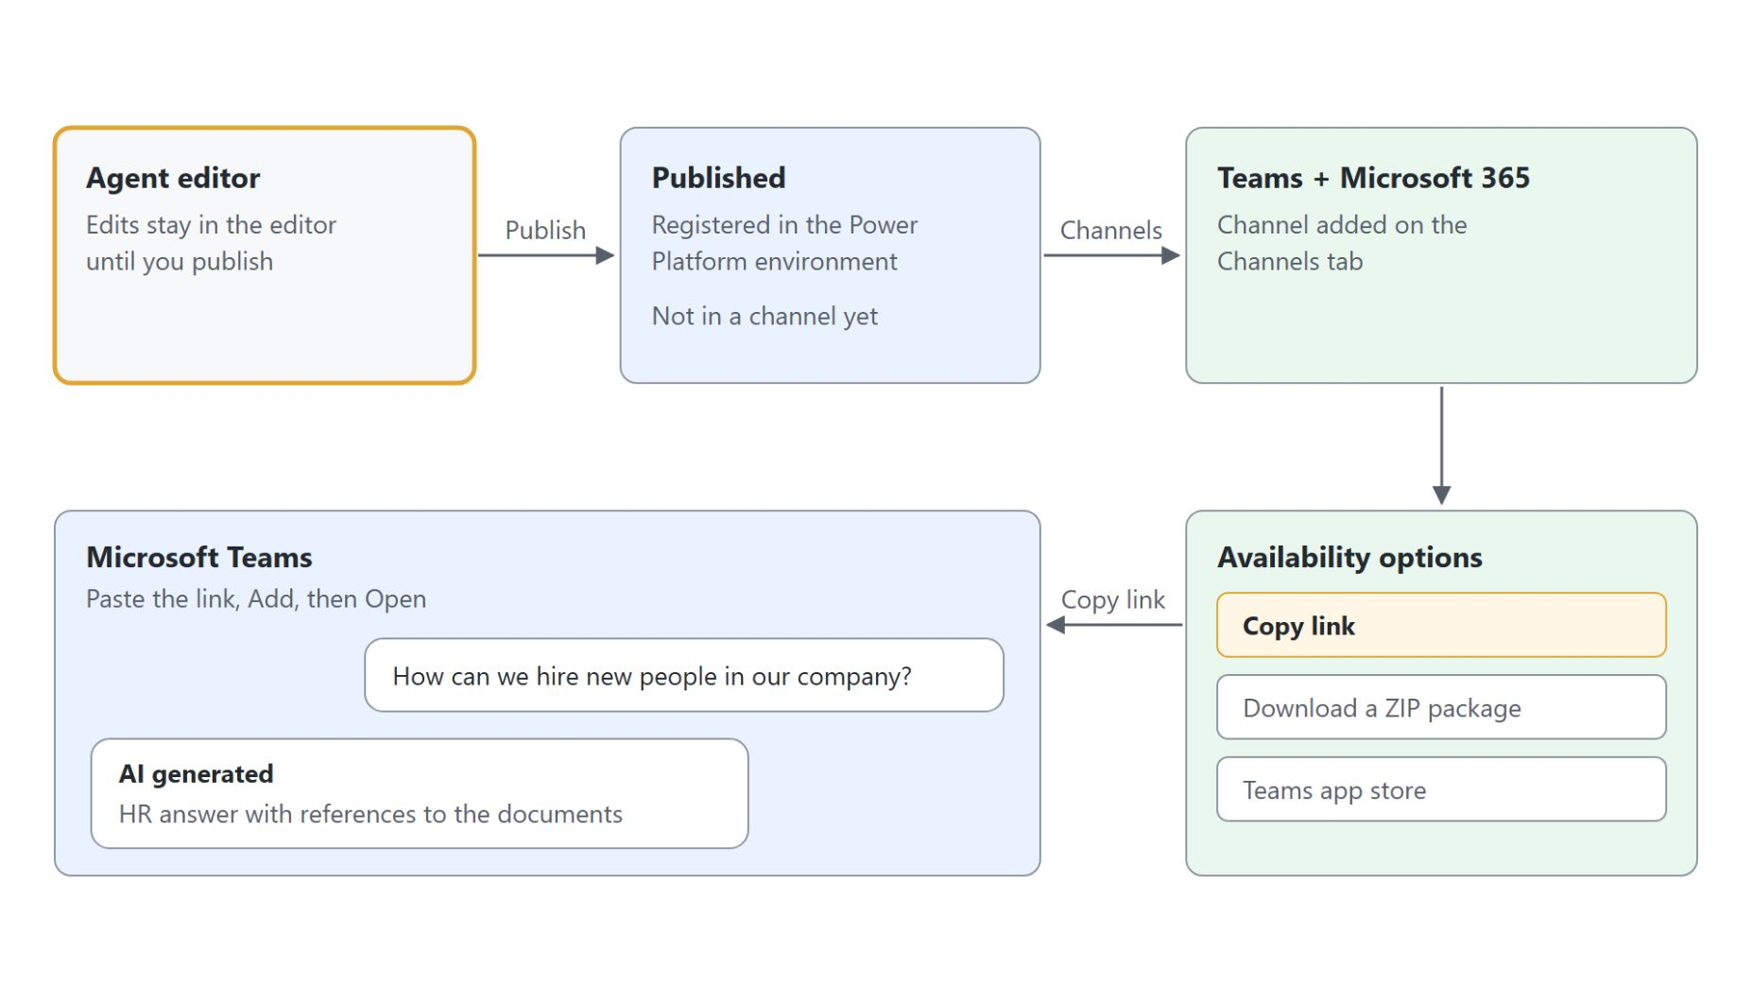
Publishing to channels
From the agent editor to a chat in Microsoft Teams
Publish copies the draft to every channel the agent is connected to
The Microsoft 365 and Microsoft Teams channel is added after the first publish
Availability options decide who finds the agent: link, shared users, the org, or a .zip
Authenticate with Microsoft opens Teams, Microsoft 365 Copilot and SharePoint
Notes:
An agent that only answers in the test panel helps nobody. Walk the diagram from the editor to the Teams chat.
Publish: selecting Publish copies the current draft to every connected channel, which can take a few minutes. Until you publish again, edits stay in the draft and users keep the old behavior.
Channel: after the first publish, open Channels and the Microsoft 365 and Microsoft Teams tile. Keep Make agent available in Microsoft 365 Copilot selected, so one channel serves Teams and Copilot Chat.
Availability options: a share link needs no approval, Show to my teammates and shared users lists the agent in the Built with Power Platform section, and Show to everyone in my org needs an administrator to approve. The app can also be downloaded as a .zip.
Authentication: new agents use Authenticate with Microsoft, which signs users in with Microsoft Entra ID in Teams, Power Apps and Microsoft 365 Copilot with no setup. It is also what SharePoint and Dataverse knowledge need to apply each user's permissions.

Slide 28
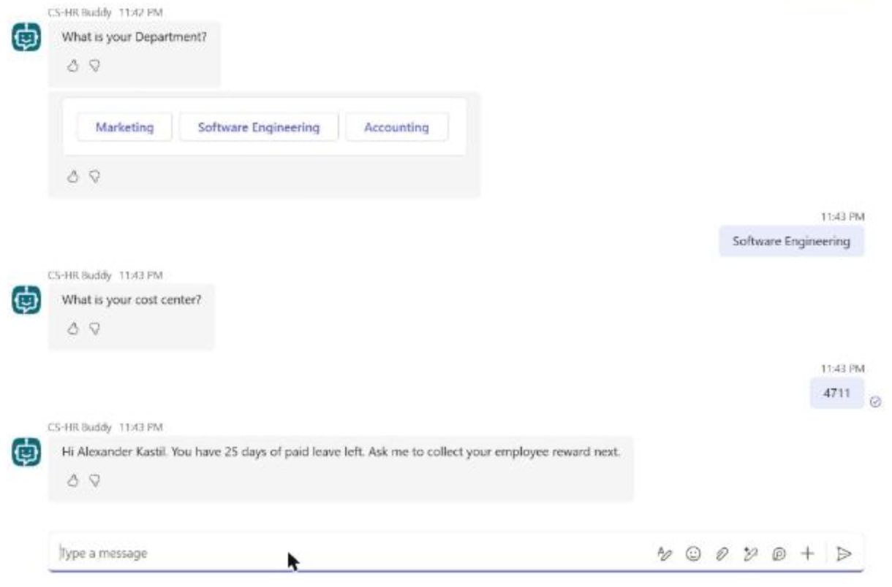
CS-HR Buddy in Teams
The republished message after start over
The published agent runs the same topics in a Teams chat
The department options appear as buttons
After Publish and start over, the message ends with the new sentence
Start over also clears Global.EmployeeIdentified
Notes:
The test panel runs the draft; Teams runs what you published. This is the live Teams chat with CS-HR Buddy after the change of the last exercise.
Same topics: the employee questions, the entities and the paid leave message work in the published version exactly as in the test panel. Microsoft 365 Copilot opened the same questions from Agents, More agents, because the agent was missing from the @ list right after the install.
Buttons: Teams renders the three department options as buttons, and it shows at most six suggested actions in a question.
Republish: the demo appends Ask me to collect your employee reward next. to the paid leave message, saves, publishes and types start over in Teams. A running Teams conversation keeps the old version until a new session starts.
Reset: Start Over also clears global variables, so a reward request right after it detours through the employee questions again. Force newest version in the Publish dialog moves ongoing Teams chats at once, but it can interrupt conversations in progress.

Slide 29

Draft and published version
Who sees which version, and who may chat
You edit a draft, colleagues chat with the published version, and sharing decides who may chat at all
Notes:
Two rules decide what colleagues experience once the agent is live.
Draft and published: the test panel always runs the latest draft, while channels run the last published version. Every change reaches users only through Publish.
Sessions: running conversations don't switch versions, and in most channels a session ends after 30 minutes of inactivity. In Teams, start over resets the session at once; otherwise an update can take up to an hour to arrive.
Sharing: installing the agent gives nobody permission to chat with it. Share it with a security group as End user access, shown as Viewer, and Show to my teammates and shared users lists it in the Teams app store without admin approval.
Rollout: Learn's advice is to publish for yourself first, test the published version in Teams, share with a small group and submit to the organization last.

Slide 30

Takeaways
What the tools module builds on
Write instructions that state the job, the limits and how a conversation ends
Give every knowledge source and topic a description the orchestrator can choose by
Trust an answer once its citation opens the source
Keep fixed paths in topics, logic in Power Fx and multi-field input on Adaptive Cards
Users chat with the published version, and only once you share it
Notes:
Close the module with the habits it built. The photo shows where CS-HR Buddy's conversation ends: a dinner voucher or theatre tickets for an identified employee.
Instructions: a blank agent answers anything. Purpose, guidelines, steps, error handling and a closing rule kept the onboarding assistant on onboarding questions.
Descriptions: generative orchestration reads the description of every source and topic to decide what answers, so HR Documents and Sightseeing each got their own.
Citations: with ungrounded answers allowed, a model answer sounds as right as a grounded one, so the citation is the proof.
Topics, Power Fx and cards: a global variable let two HR Buddy topics share who the employee is, three formulas made the expense claim ready to save, and one card took the canteen's demand for nine dishes.
Published and shared: the test panel runs the draft, Teams runs the published version, and sharing decides who may chat. The next module gives these agents tools, starting with the canteen order prompt and the expense claims table in Dataverse.

