Slide 1



Fast Lane Group
Worldwide Education &
Professional Services
www.flane.de | © 2026 Fast Lane Institute for Knowledge Transfer GmbH
Notes:
Die Fast Lane Gruppe.
Fast Lane … Dienstleister u. Spezialist für High-End Technologie und Business Trainings
IT Trainings zu den unterschiedlichsten Herstellern wie Microsoft, Google, Cisco oder AWS. Und vielen weiteren wichtigen IT Herstellern.
Sei es Cloud, Security, Netzwerk oder allgemein digitale Transformationsprojekte
Und das seit 2003.
Das spannende ist, dass die Fast Lane Gruppe bereits seit 2009 durchgängig zu den Top 20 Unternehmen in der IT Trainingsbranche weltweit zählt.
Aber auch Footprint ebenso im klassischen Professional Services Bereich für unsere wichtigsten Hersteller
PreSales Support, Deployment Services und Adoption Trainings
Additional Information:
Im Jahr 2021 sind wir zur „most strategic IT Education company worldwide“ von der IDC im „magic quadrant“ aufgeführt worden !
1 mio Teilnehmer insgesamt seit bestehen, 50.000+ Students ww p.A, 20.000 in DE pro Jahr

Slide 2






AGENTIC AI: FROM STRATEGY TO PRODUCTION.
Alexander
Kastil
AGENTIC AI CONSULTING · VIENNA
Full stack, from enterprise software to agentic AI. Since 1996
AI at Work
Enterprise AI
Value discovery, KPI mapping and roadmap
Governed multi-agent systems on Microsoft Copilot and Foundry
Agentic Software Engineering
Team Enablement
Harness architecture for Claude Code and GitHub Copilot
AI driven content production and delivery
integrations.at
github.com/alexander-kastil
SCAN TO CONNECT
alexander.kastil@integrations.at
linkedin.com/in/alexander-kastil
integrations.at
Notes:
Intro: Alexander Kastil, integrations.at. Four practice areas from AI at Work to team enablement. Certifications: Agentic AI Business Solutions Architect, Azure AI App and Agent Developer Associate, DevOps Engineer Expert.

Slide 3

MODULE 5
Advanced Copilot Studio Agents
Agents that run on their own and work with other agents
Automate Business Processes with Copilot Studio and Copilot Cowork

Slide 4
01
02
03
04
Autonomous Agents & Event Triggers
Event triggers, unattended runs and a shared returns mailbox
Deep Reasoning Models
The reason keyword on the one step that weighs the rules
Generative Orchestration & Multi-Agent Routing
The planner, child agents and connected agents
Microsoft Foundry Agents: Core Concepts
Prompt agents, versions and the stable endpoint
05
06
07
Foundry Agents in Copilot Studio
A Foundry specialist behind a Standard agent
Voice Agents: IVR & Post-Call
Optional: speech and keypad menus, then work after the call
Test and Evaluate Standard Agents
Optional: test sets, graders and one change per run
Automate Business Processes with Copilot Studio and Copilot Cowork

Slide 5

Advanced Copilot Studio Agents
Agents that run on their own and work with other agents
On its own: an event starts the agent, with nobody in the chat
With other agents: one front door routes work to child, connected and Microsoft Foundry agents
Harder problems: deep reasoning for the one step that has to weigh several rules
Notes:
Basics built a Standard agent that answers, and tools let it act. This module makes it run on its own and work with other agents.
On its own: an agent can wake on an event, such as a new email in a shared mailbox, and do its job with no person in the chat.
With other agents: a main agent routes work to child agents, connected agents and agents that a developer team built in Microsoft Foundry.
Harder problems: a deep reasoning model works through a step that weighs several rules, slower and more carefully. Generative orchestration sits under all three, and voice and evaluation follow as optional topics.

Slide 6
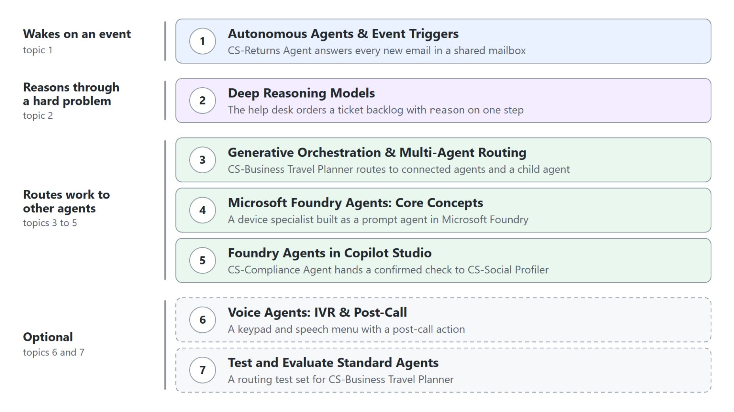
Overview
Seven topics in delivery order
Start with an agent that wakes on an event and answers by mail
Give one hard step a deep reasoning model with the reason keyword
Route work to child and connected agents through generative orchestration
Bring in Microsoft Foundry agents that developers build and own
Optional: voice menus on the phone and test sets that grade the agent
Notes:
This slide walks the path through the seven topics once. Each topic has a demo, and most of them run on an agent the class built in earlier modules.
Wakes on an event: topic one turns CS-Returns Agent into an autonomous agent that answers every new email in a shared returns mailbox.
Reasons through a hard problem: topic two orders a ticket backlog for the Grey Logistics IT Help Desk, once on the default model and once with reason on the ranking step.
Routes work to other agents: topic three puts CS-Business Travel Planner in front of the travel specialists, topic four builds a device specialist in Microsoft Foundry, and topic five connects the social-profiler Foundry agent to CS-Compliance Agent.
Optional: voice takes a help desk agent to the phone, and evaluation grades the travel planner's routes with a test set.

Slide 7
01
Autonomous Agents & Event Triggers
Event triggers, unattended runs and a shared returns mailbox
Automate Business Processes with Copilot Studio and Copilot Cowork

Slide 8
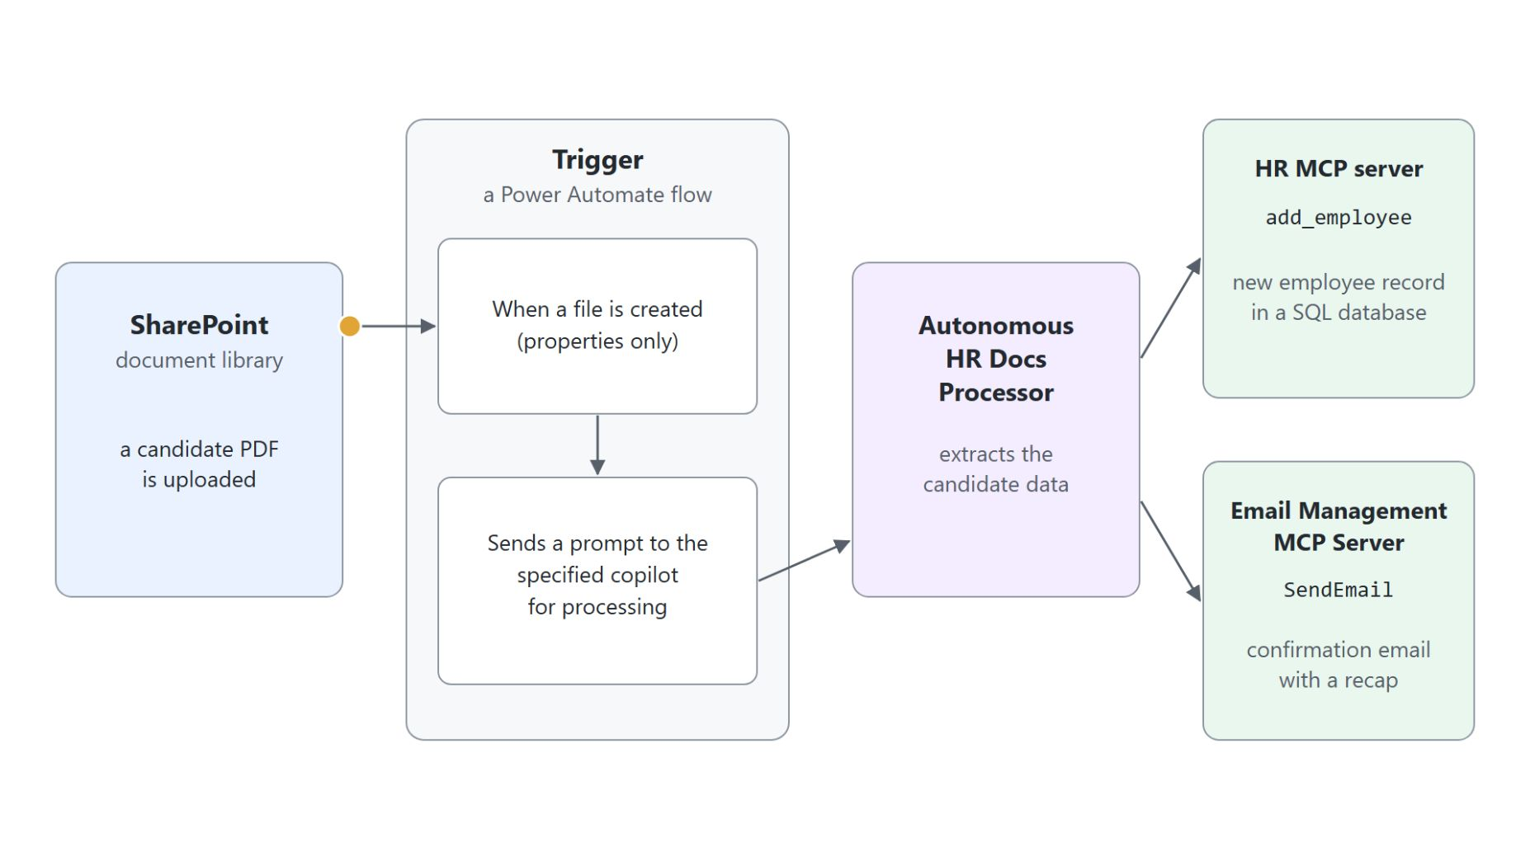
Autonomous agents and triggers
A trigger is a Power Automate flow that prompts the agent
An event trigger fires when something happens in another system, not when a user types
It sends the agent a payload with the event's data, and the instructions decide which tools run
Behind every trigger sits a small Power Automate flow that sends the agent a prompt
In the lab, a resume PDF in SharePoint becomes an employee record through the HR MCP server
Notes:
Every agent so far waited for someone to type. An autonomous agent reacts to an event instead: a new list item, an email, a completed Planner task or a set time.
Event trigger: Learn calls it one part of a three-part workflow. The trigger registers the event, sends a payload, and the agent's instructions choose among the tools and topics the maker gave it; it never invents a new action.
Payload: each trigger ships a default, such as "Use content from Body". The payload says how to react to this one event, and the agent instructions keep the rules that apply to every run.
The flow: Edit in Power Automate opens the flow behind the trigger, the event followed by an action that prompts the agent. Almost any event Power Automate can listen to can start an agent, and event triggers need generative orchestration.
The lab: an uploaded resume PDF makes the Autonomous HR Docs Processor call add_employee on the HR MCP server and confirm with SendEmail. Several files uploaded at once start one flow run and one agent session.

Slide 9

CS-Returns Agent on a shared mailbox
Every new return request gets an answer by mail
Instructions limit the agent to returns and set the reply format: an email with <p> and <br> tags
returns-policy.docx from SharePoint is its only knowledge source
CS-Work IQ Mail runs on maker-provided credentials, because no user is there to sign in
One sentence names the tool: "Send that email to the customer with CS-Work IQ Mail."
CS-When a new email arrives in a shared mailbox hands every new email to the agent
Notes:
The demo turns the concept into a returns desk that answers itself. CS-Returns Agent wakes for every new email in a shared mailbox, checks it against the returns policy and replies by mail.
Instructions: a run nobody watches has nobody to answer a question, so the instructions carry the whole job. The reply goes out as an email body, which is why they fix the HTML tags, and a flight request gets declined.
Knowledge: one policy document instead of a whole site keeps other content out of the answer. Its description, "Information about our returns policy", tells the orchestrator when to search it.
Mail tool: the Work IQ Mail MCP server, listed as Mail (Preview), is switched to Maker-provided credentials under Additional details. Every reply then goes out through your account, so keep this agent to the returns job.
The sentence and the trigger: without the sentence, the triggered run wrote its reply only into the test chat. The trigger hides under the All filter, keeps the default payload, and a new shared mailbox needs about 15 minutes before it can read the Inbox.

Slide 10
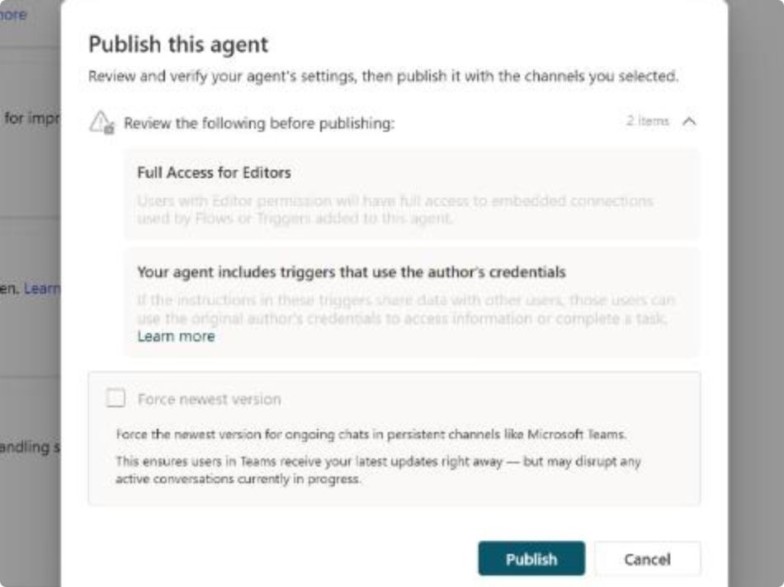
Testing and publishing the trigger
Replay a recorded email first, then let the agent work alone
Before you publish, the trigger records each email but its flow run stops at the agent call
The test icon replays a recorded email: Trigger detected, then Email sent citing returns-policy.docx
Publish lists two items to review: Full Access for Editors and triggers that use the author's credentials
After publishing, every run appears as an Automated row on the Activity page
Notes:
A trigger that goes live answers real customers through your credentials, so the demo tests it on one real email first and publishes second.
Safe test loop: until you publish, the trigger still records each event, but the flow run fails at the agent call and nothing is answered on its own.
Replay: the test icon next to the trigger lists the recorded emails, and Start testing runs the agent on one of them. The chat shows Trigger detected with the email as JSON, the agent answers with Email sent, and the second mailbox receives the reply that the 14-day return window has passed.
Publish: the dialog shown here lists Full Access for Editors and the warning that the trigger uses the author's credentials. Anyone who reaches the published agent might see data through those credentials, so review the trigger's scope and the tools before every publish.
Activity: in the live run, an email about a billing address became an Automated row with the status Completed, and the agent declined it because it only handles returns. A trigger never backfills, so mail that arrived before it existed is never answered.

Slide 11
02
Deep Reasoning Models
The reason keyword on the one step that weighs the rules
Automate Business Processes with Copilot Studio and Copilot Cowork

Slide 12
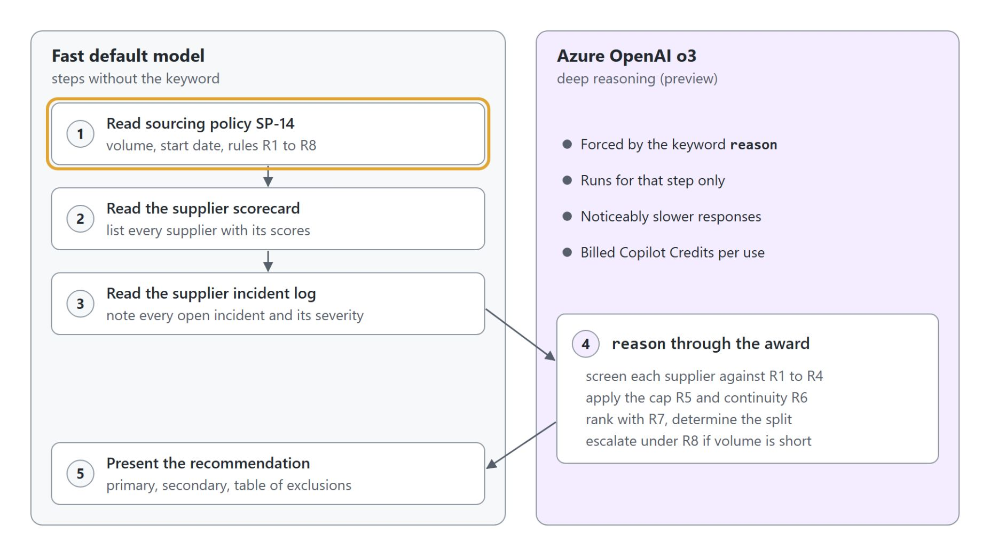
Deep reasoning and the reason keyword
Only the step that carries the keyword runs on the reasoning model
Deep reasoning (preview) is a switch in the agent's Settings and needs generative orchestration
The keyword reason in an instruction step forces the reasoning model for that step only
Learn's deep reasoning article names Azure OpenAI o3 for the reasoning steps
The activity map shows a deep reasoning node wherever the model ran
Notes:
Most agent steps are fast and shallow: look something up, call a tool, phrase an answer. Some steps weigh several rules at once, and a deep reasoning model works through them step by step, slower and more carefully.
The switch: turn on generative orchestration first, then Deep reasoning (preview) in Settings. It is available in the United States and in the EU outside the United Kingdom, with no data residency commitment.
The keyword: once it is on, the agent decides by itself which steps need it, and reason in an instruction step forces it for that step. The pattern in the diagram keeps retrieval and presentation on the fast model and puts reason on the one decision step.
The model: Learn's deep reasoning article names Azure OpenAI o3, while the model selection article mentions separate settings for the reasoning model, so check both pages before you promise one. A reasoning step is billed twice: the normal rate plus 10 Copilot Credits per 1,000 reasoning tokens.
Trace: expand the deep reasoning node to see its steps, the data it used and its result. A simple lookup shows no reasoning node at all, which proves the keyword sits where you meant it.

Slide 13
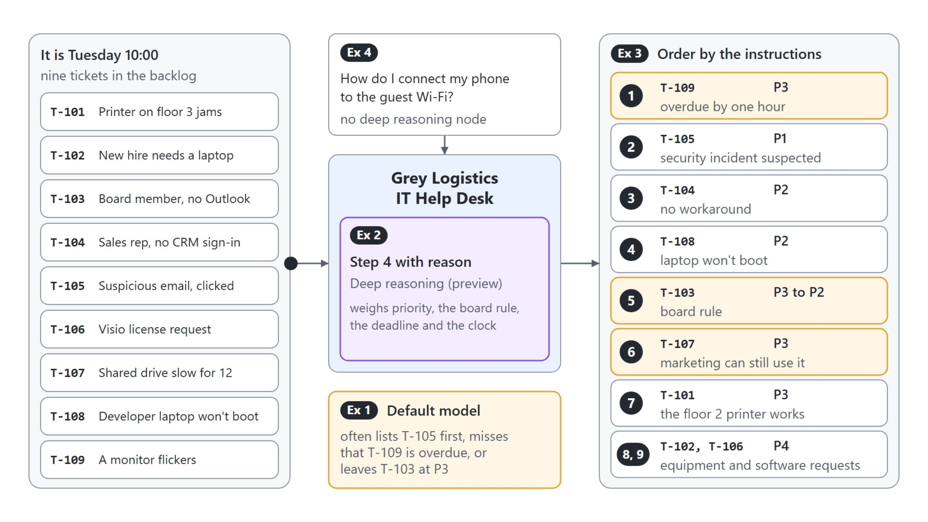
Ordering a ticket backlog
The same nine tickets on the default model and with reason on step 4
With reason on the ranking step, T-109 comes first as overdue, T-103 rises to P2 and T-107 stays at P3
Notes:
The demo gives the Grey Logistics IT Help Desk a job where several rules meet: priority, a rule for the executive board, deadlines and the clock. It runs the same nine tickets twice and compares the plans in the activity map.
Baseline: on the default model a table comes back within seconds and no reasoning node appears. The default model often lists T-105 first, misses that T-109 is overdue by an hour, or leaves board member Anna Berger's T-103 at P3.
With reason: only step 4, which orders the tickets by time left until the deadline, gets the keyword. The reply takes noticeably longer, and the activity map shows a reasoning node for that step alone.
Reading the node: a correct run puts T-109 first, raises T-103 to P2 under the board rule, and keeps T-107 at P3 because the marketing team can still use the shared drive. If the baseline already matched, that is a valid finding too: this backlog didn't need the slower model.
Fast path: a guest Wi-Fi question in the same conversation answers quickly with no reasoning node. The Model list on the Overview page, with its Deep tags, is a separate choice from this setting.

Slide 14
03
Generative Orchestration & Multi-Agent Routing
The planner, child agents and connected agents
Automate Business Processes with Copilot Studio and Copilot Cowork

Slide 15
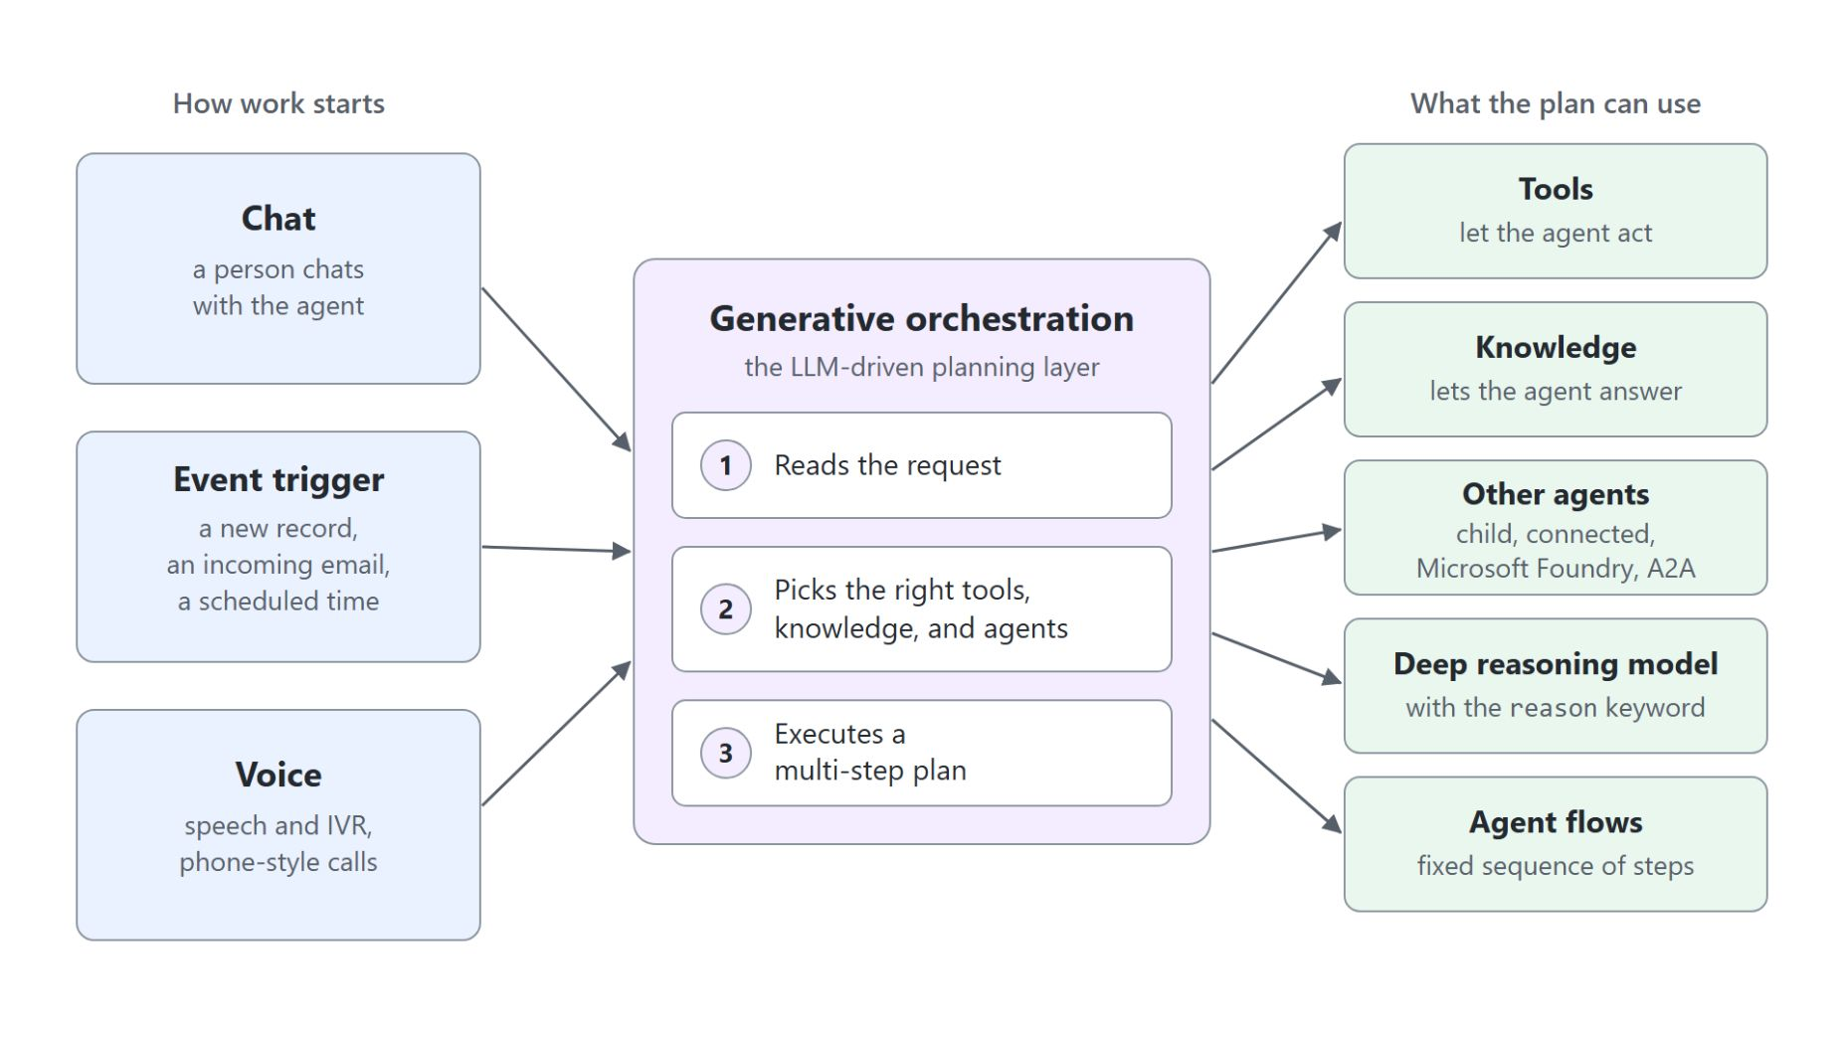
Generative orchestration
How the planner turns a request into a multi-step plan
The planner reads a request and picks topics, tools, knowledge and other agents to answer it
The description weighs most in that choice, then the name
One plan can chain several steps and writes one reply from what they returned
Event triggers, deep reasoning and other agents all need generative orchestration
Notes:
Every topic of this module sits on one planning layer, and this one opens it up: what the planner reads when it chooses, and how agents that call other agents follow from it.
How it chooses: Learn names the description as the most important factor, followed by the name and the names and descriptions of inputs and outputs. You describe what each component does instead of predicting every phrasing.
Several steps: "I need store hours and the nearest store" chains two topics in one turn. The planner asks for any required input it can't fill from context, then writes one answer from everything the steps returned.
Classic or generative: you switch under Settings, Generative AI, Orchestration. Classic picks one topic per turn by trigger phrases and keeps scripted voice agents predictable; triggers, MCP servers and other agents need generative orchestration.
Overlap: two similar descriptions make the choice unpredictable, and Learn's rule of thumb says one agent gets confused at about 30 to 40 choices. Sharpen the descriptions first, then split work into child or connected agents.

Slide 16
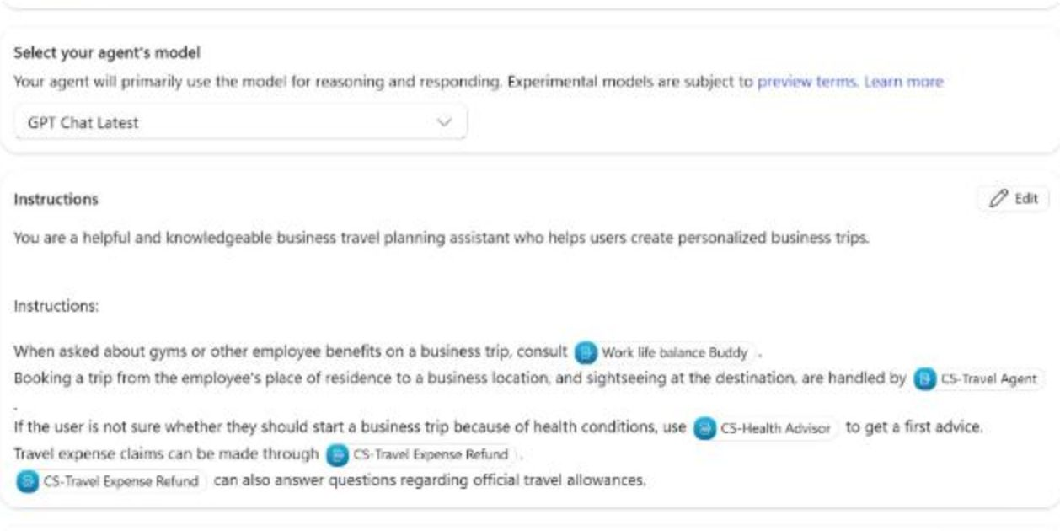
One front door for the travel specialists
CS-Business Travel Planner names a specialist for every request
Three connected agents: CS-Travel Agent, CS-Health Advisor and CS-Travel Expense Refund
One child agent, Work life balance Buddy, answers from a gym document only it can see
Each description says what the specialist covers and what it does not handle
Typing / on an agent name turns it into a reference, shown as a chip
Notes:
An employee planning a trip shouldn't need to know that booking, a health check and the expense claim live in three agents. CS-Business Travel Planner is the one agent they talk to, and it owns no knowledge of its own.
Connected agents: each is a separate published agent in the same environment with Let other agents connect to and use this one turned on. The planner always calls the last published version, so publish the specialists before the parent.
Child agent: Work life balance Buddy lives inside the planner and ships with it. It always receives the parent's context, and its gym document is invisible to every other agent.
Descriptions: the description on the planner side is a local copy you control. The CS-Travel Agent text ends with "Does not handle health questions, expense claims or gym benefits", which keeps the allowance question away from it.
References: select each agent name in the instructions, type a slash and pick the agent. With those chips, all five routes of the travel planner reached the right agent.

Slide 17
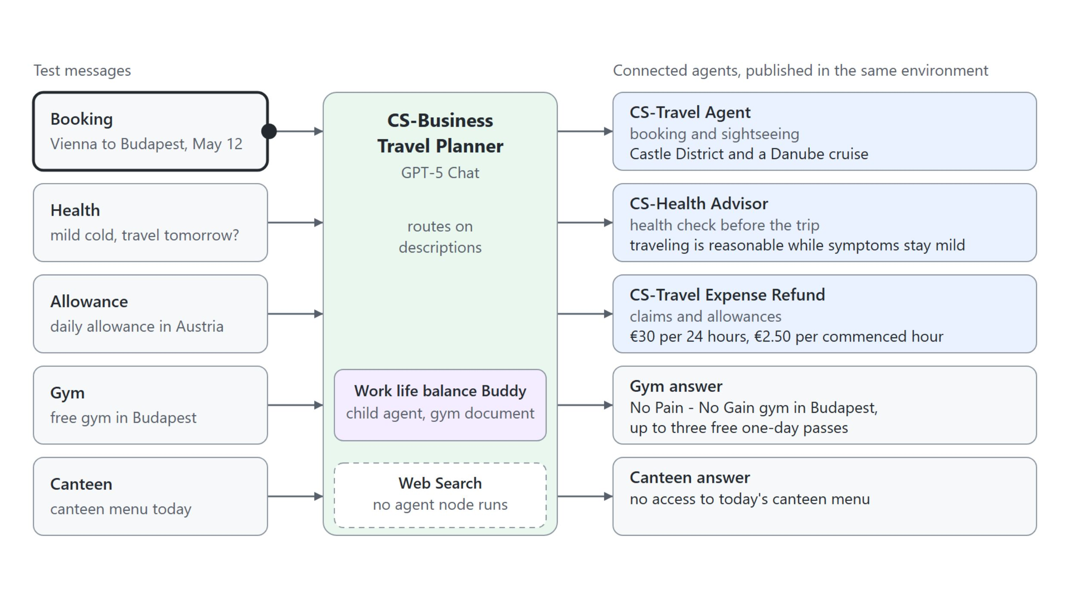
Proving every route
Five test messages, each answered by exactly one agent or by none
With the activity map on, each message shows the agent node that answered it, and the canteen question shows none
Notes:
The activity map shows which agent node ran, so you can catch a wrong route before an employee does. Turn on Show activity map when testing and send each message in a new test conversation.
Booking: a CS-Travel Agent node runs its Book Trip topic, asks for place, date and number of travelers, and returns evening tips such as the Castle District and a Danube cruise.
Health and allowance: CS-Health Advisor gives first advice that the trip is reasonable while the symptoms stay mild. CS-Travel Expense Refund answers with €30 per 24 hours and €2.50 per commenced hour.
Gym: Work life balance Buddy names the No Pain - No Gain gym in Budapest with up to three free one-day passes and cites the gym document.
Canteen: no agent node runs; with Web Search on, the planner searches the web and says it has no access to today's menu. A request no specialist covers is the test Learn's multi-agent guidance asks for.

Slide 18
04
Microsoft Foundry Agents: Core Concepts
Prompt agents, versions and the stable endpoint
Automate Business Processes with Copilot Studio and Copilot Cowork

Slide 19
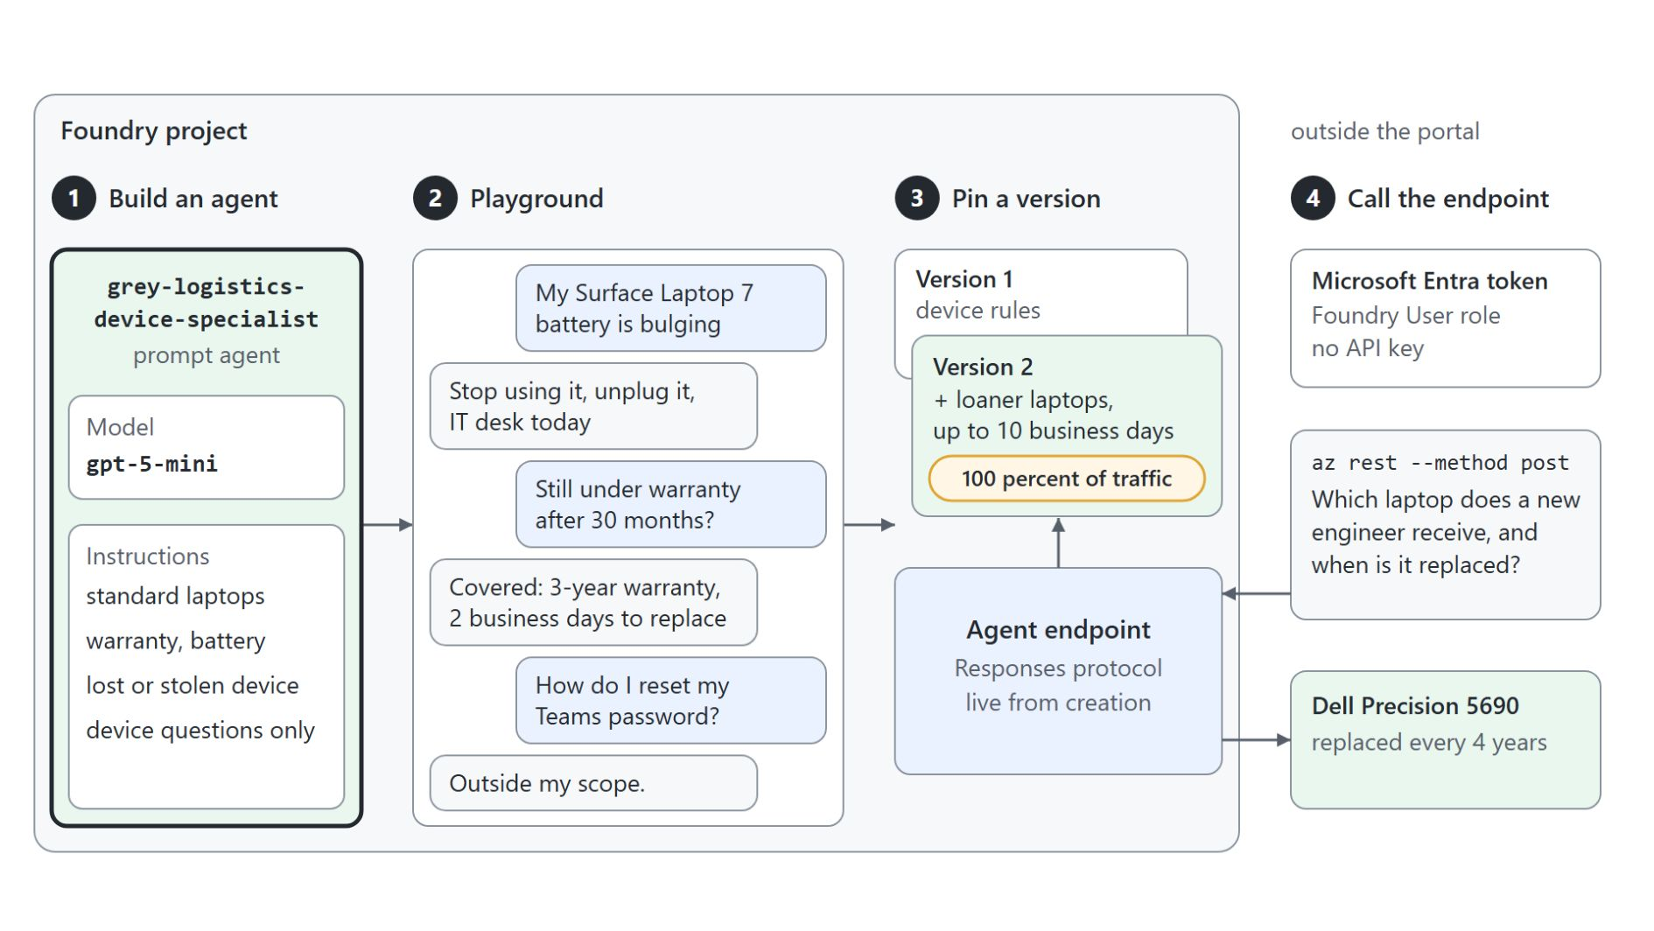
A prompt agent in Microsoft Foundry
Model, instructions and tools behind a stable endpoint
A Foundry project groups agents, files and tools inside an Azure subscription
A prompt agent is configuration only: a model, instructions and optional tools
Every saved change creates an immutable version; you pin the one the endpoint serves
The endpoint takes a Microsoft Entra sign-in; API keys aren't supported
Notes:
Sooner or later a maker meets an agent a developer team built in Microsoft Foundry. Knowing what such an agent is made of lets you reuse a specialist instead of copying its rules.
Project: everything lives in a Foundry project in the portal at ai.azure.com, and models come first: the demo deploys gpt-5-mini. The Foundry User role lets a person build and invoke agents.
Three types: a prompt agent is configuration, a voice-based prompt agent adds audio settings, and a hosted agent runs a team's own code. The demo builds grey-logistics-device-specialist as a prompt agent, and its name is permanent.
Versions: the loaner-laptop line added in the demo creates a new version. The endpoint serves the latest one by default, and the Publish dropdown pins the version callers receive.
Endpoint: az rest with your Microsoft Entra token calls the Responses protocol and gets back the Dell Precision 5690 with its 4-year cycle. Copilot Studio uses the Activity Protocol on the same endpoint, which is the next topic.

Slide 20

Foundry agents and Copilot Studio agents
Who builds, where it runs and how it reaches users
The maker keeps the conversation, the channels and the routing; the developer team keeps the specialist's model, tools and versions
Notes:
Both platforms build agents from instructions, a model and tools, and the shared words confuse mixed teams. The difference is who builds, where it runs and how it reaches users.
Who and where: Foundry agents are built by developers and AI engineers in a Foundry project in an Azure subscription. Standard Copilot Studio agents are built by makers in a Power Platform environment, inside a solution.
Behavior and models: a Foundry agent picks any deployed model from the Foundry catalog, and hosted agents add custom code. A Copilot Studio agent combines instructions, topics, knowledge, tools and agent flows on the models Copilot Studio offers.
Reaching users and paying: Foundry speaks endpoint protocols and bills Azure consumption under Azure RBAC. Copilot Studio publishes to channels such as Teams, websites and telephony, bills Copilot Credits and follows Power Platform security and data policies.
Where they meet: a Copilot Studio agent connects a Foundry agent as a specialist, and each team keeps its own part.

Slide 21
05
Foundry Agents in Copilot Studio
A Foundry specialist behind a Standard agent
Automate Business Processes with Copilot Studio and Copilot Cowork

Slide 22
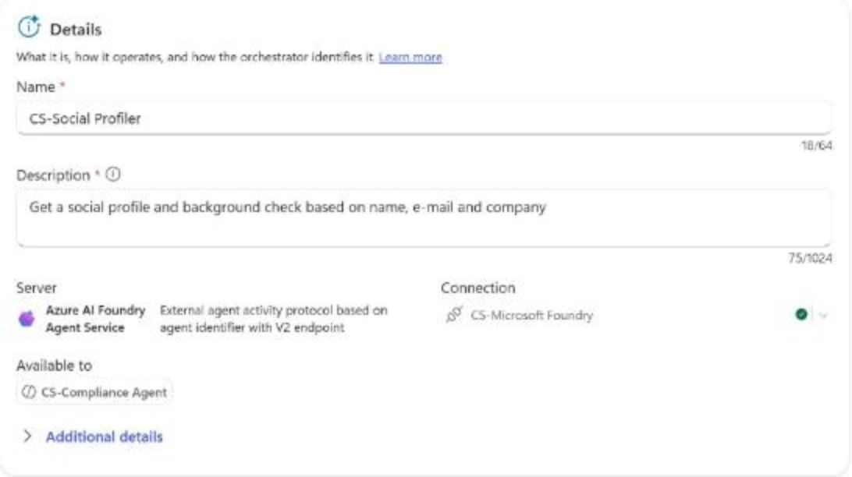
Connecting a Foundry agent
The Activity Protocol on the Foundry side, a connection and an Agent Id in Copilot Studio
{
"agent_endpoint": {
"protocol_configuration": {
"responses": {},
"activity": {},
"a2a": {}
},
"authorization_schemes": [
{ "type": "Entra" },
{ "type": "BotServiceRbac" }
]
}
}
Notes:
Connecting a Foundry agent keeps one source of truth: the maker owns the conversation, channels and routing in Copilot Studio, and the developers keep the specialist. Learn marks the connection as preview.
Foundry side: Copilot Studio talks to the agent over the Activity Protocol, which a new agent doesn't have. Without it you can still add the connection, but every call fails with an HTTP 400 error.
The update: this body goes to the agent with a PATCH and the content type application/merge-patch+json. It replaces the whole list, so it names responses and Entra as well; the portal keeps showing only Responses and A2A, which Learn calls expected.
Copilot Studio side: on the Agents page, Add, Connect to an external agent, Microsoft Foundry. The demo creates the connection CS-Microsoft Foundry with Microsoft Entra ID User Login and the project endpoint, then enters CS-Social Profiler, a description and the Agent Id social-profiler.
Routing: the planner picks the Foundry agent by the description entered here, like any other agent. An agent created in the previous Foundry portal fails with 404 - Version not found.

Slide 23
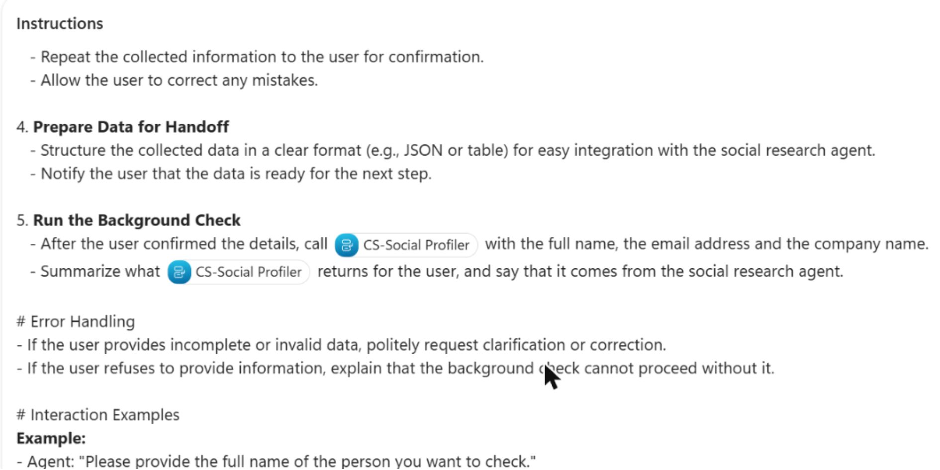
Collect, confirm, then hand off
CS-Compliance Agent calls CS-Social Profiler only after the user confirms
Claude Sonnet 4.6 runs CS-Compliance Agent, chosen for following long, ordered instructions
Numbered steps explain the check, collect name, email and company, then confirm them
New step 5 calls CS-Social Profiler only after the user confirmed the details
Error handling asks again for invalid data, so a broken email address stops the check
Notes:
Before a new hire starts, HR checks who the person is, and the research behind that check belongs to a data team that built it in Foundry. CS-Compliance Agent collects and confirms the details and hands them to that team's agent.
Model: Claude Sonnet 4.6 is an external model from Anthropic, and the admin has to allow external models first. A model that follows long, ordered instructions suits a check where skipping the confirmation is the real risk.
Steps: the instructions spell out explain, collect, confirm and prepare, so the agent asks one thing per turn and never sends unconfirmed data on.
Step 5: the original instructions only promised that the data is ready for the next step. The added step names CS-Social Profiler as a reference, typed with a slash, at the one point where the details are confirmed.
Error handling: in the second test run, jana.novak(at)example made the agent say the format looks invalid and ask for a corrected address. No CS-Social Profiler node appeared, so no data left the agent.

Slide 24
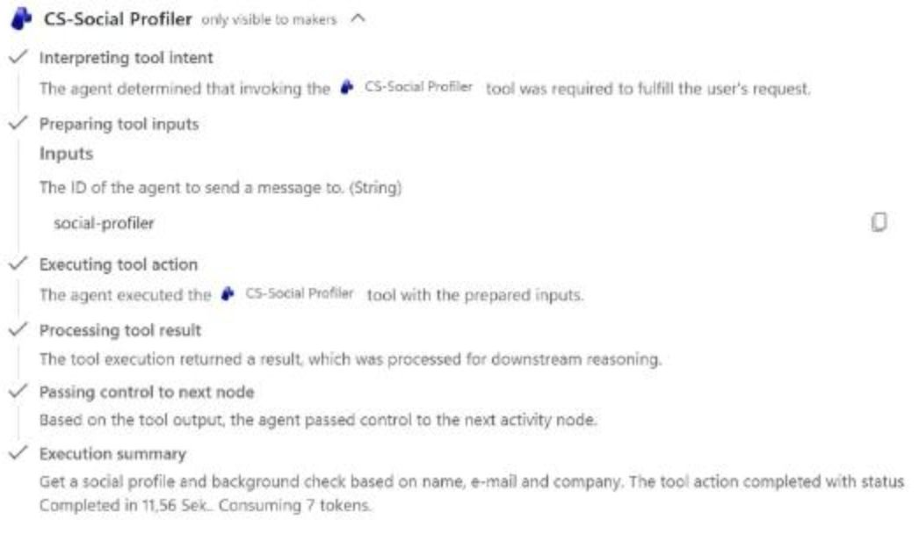
The Foundry call in the activity map
CS-Social Profiler runs once the details are confirmed
The CS-Social Profiler node appears only after "Yes, that's correct."
Its input carries the Agent Id social-profiler
The reply comes back in five sections, from Person to Notes for the compliance check
Each hop runs its own model, so expect more latency than for a tool
Notes:
The activity map proves the order of the instructions: three questions, a confirmation table, and only then the call to Microsoft Foundry.
The node: after the confirmation, the map shows CS-Social Profiler with Interpreting tool intent, Preparing tool inputs and Executing tool action. The input is the Agent Id social-profiler, the value that selects the agent inside the project.
The answer: social-profiler is a prompt agent on gpt-5.4-mini with Web search. Its reply carries Person, Company, Email domain check, Public sources and Notes for the compliance check, and for example.com it reports a reserved example domain that doesn't match the company.
Limits: every call adds a hop with its own model run, and Learn notes that citations aren't always kept when an answer comes back from another agent.
Responsibility: Learn puts a connected external agent on you, the maker. Check what data reaches Foundry and agree with the developer team whether your agent relies on a pinned version or on the latest one.

Slide 25
06
Voice Agents: IVR & Post-Call
Optional: speech and keypad menus, then work after the call
Automate Business Processes with Copilot Studio and Copilot Cowork

Slide 26

Voice agents
A phone menu that answers to speech and the keypad
Basic voice agents use classic orchestration; real-time voice agents use generative orchestration
DTMF keys map the keypad to the menu: 1 for Account, 2 for Device, 0 for a person
The Speech & DTMF chat mode tests a call in text, and /DTMFkey 1 presses a key
A post-call topic runs on End of conversation and filters on Conversation.EndReason
Notes:
This optional topic takes an agent to the phone through Dynamics 365 Contact Center. Callers who know what they need should be able to say it, and callers on a noisy train should be able to press a key.
Two kinds: a basic voice agent scripts the conversation in topics on classic orchestration, which keeps every step predictable. A real-time voice agent uses a real-time speech model on generative orchestration for free conversation.
Keypad and speech: the Grey Logistics IT Hotline asks whether the caller needs help with an account, a device or a person. Assign DTMF keys to options maps 1, 2 and 0, and 0 transfers the call to an external number.
Testing: the test panel simulates the call in text and reads options as "Press 1 or say Account". It doesn't recognize real speech or run silence detection, so a test call on the real line stays part of every release.
After the call: a topic triggered by End of conversation with Conversation.EndReason equal to CUSTOMER_HANGUP emails the help desk when a caller hangs up. Voice is billed per minute: 10, 35 or 75 Copilot Credits by tier.

Slide 27
07
Test and Evaluate Standard Agents
Optional: test sets, graders and one change per run
Automate Business Processes with Copilot Studio and Copilot Cowork

Slide 28
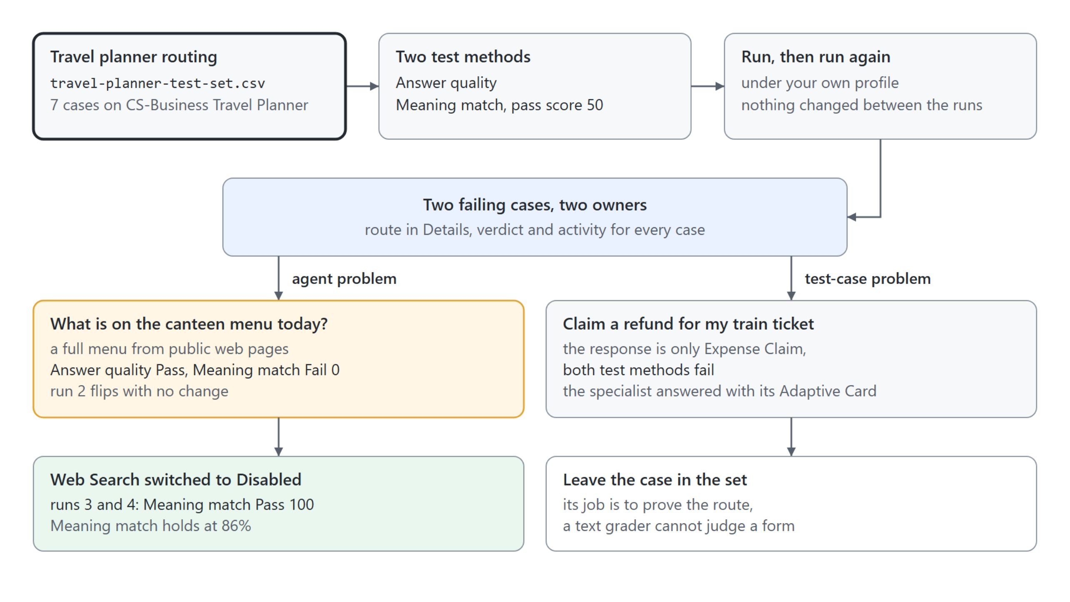
A routing test set for the travel planner
Seven cases, two test methods and two failing cases with different owners
The baseline run scored Answer quality 86% and Meaning match 71%, and its two failures had two different owners
Notes:
In the multi-agent demo each route looked right when you tried it once. A test set runs the same questions the same way every time, so a drop in the score points at the change you just made.
The set: Travel planner routing holds seven questions in the template's two columns, question and expectedResponse, one per specialist, one for the child agent and one that no agent owns. Answer quality comes by default, and Meaning match with a pass score of 50 is added.
Routes: Tool use can't grade them, because its Select tools picker lists the planner's 13 topics and no connected agents. Each case's Details panel names the connected or child agent instead.
Profile: the gym answer needs SharePoint and CS-Travel Agent posts to Teams, so the run uses your own account with a green Microsoft Teams connection.
Two failures: the canteen answer came from public web pages, an agent problem. The refund claim came back as the title of an Adaptive Card, a test-case problem that stays in the set to prove the route.

Slide 29
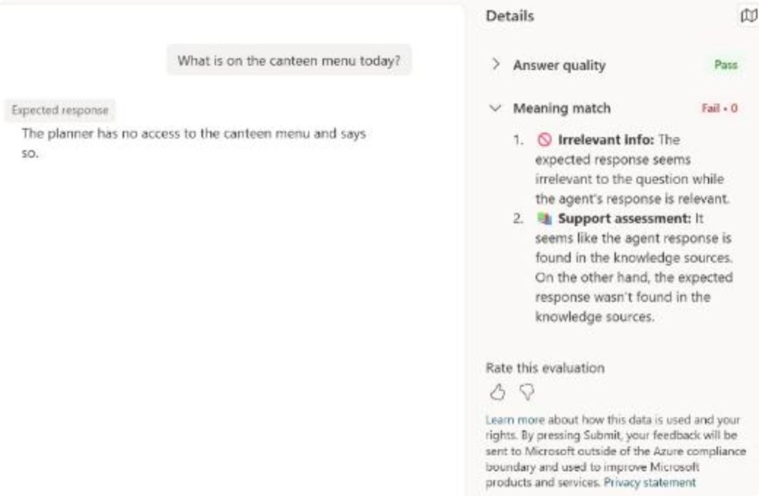
What Answer quality misses
A confident answer from the wrong source can pass it
Answer quality judges the reply alone and never reads the expected response
The planner answered the canteen question with a full menu from public school web pages
Answer quality passed it; Meaning match scored it 0 against "has no access"
Pair Answer quality with a comparing method on cases with one right answer
Notes:
The baseline run looked good at 86 percent, and the case that mattered hid behind that number. This slide opens it.
Answer quality: it checks relevance, groundedness, completeness and whether the agent attempted an answer. It never reads your expected response, so a confident reply built from the wrong source can pass.
The canteen case: the planner answered with breakfast, lunch and a second choice, and the case's activity listed public web pages as the referenced sources.
Meaning match: it compares the reply with "The planner has no access to the canteen menu and says so." and gave it Fail with a score of 0. Only the comparison caught that the agent should not have answered.
The reverse: in the next run the planner said it couldn't find a reliable menu. Meaning match gave it 100, and Answer quality failed the correct refusal as Not answered, so grade refusals with a comparing method or a Custom method.

Slide 30
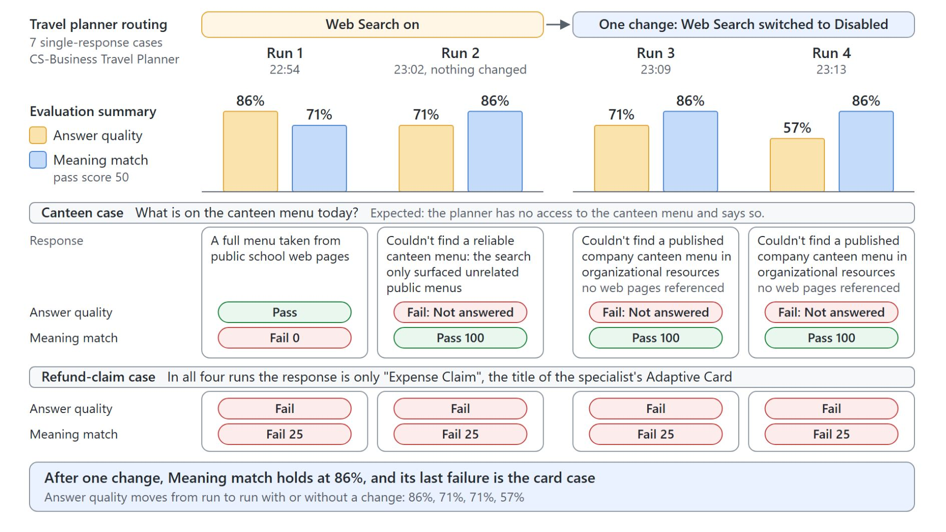
Comparing runs before and after a change
One change, Web Search switched to Disabled, fixed the canteen case
Run the unchanged agent twice first: 86% and 71%, then 71% and 86%
The canteen case flipped on its own, and its activity listed public web pages
One change: Web Search switched to Disabled on the planner
Meaning match held at 86% in both later runs, while Answer quality moved to 71% and 57%
Notes:
An unchanged agent doesn't score the same twice. So the demo runs the set again before changing anything, then changes exactly one component.
Two unchanged runs: ten minutes apart, the totals swapped from 86 and 71 percent to 71 and 86 percent, because one case answered differently. A case that flips on its own marks an unstable component, often the first thing to fix.
The cause: the planner needs no knowledge of its own, since every answer should come from a specialist. Web Search let it answer the canteen question from any public website.
The change: with Web Search disabled, both later runs answered that no published company canteen menu was found, Meaning match passed it with 100, and no web pages were referenced.
The gate: Meaning match held at 86 percent, and its one remaining failure is the refund-claim card. Answer quality kept moving while nothing changed, which makes it the wrong number to gate a release on.

Slide 31
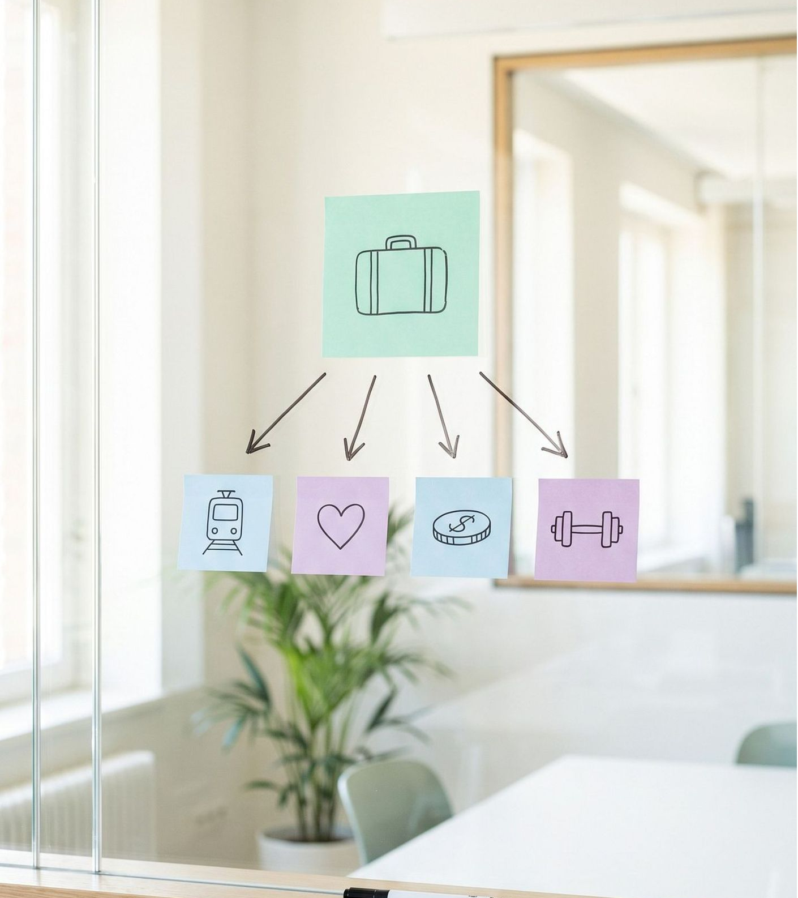
Takeaways
What to carry into the GitHub Copilot agents module
An unattended run has nobody to ask: the instructions carry the whole job, the tools use maker credentials
Put reason only on the step that has to weigh several rules
Route on descriptions that each claim one job, and prove every route in the activity map
Let developers own a Foundry specialist and connect it over the Activity Protocol
Gate changes on a test set with a comparing method, one change per run
Notes:
Close the module with the habits it built, one per topic.
Unattended runs: CS-Returns Agent answered by mail only after one sentence named the mail tool, and its tool ran on maker-provided credentials because nobody was there to sign in.
Reason on one step: the ticket backlog put reason on the ranking step only, and a simple question still ran on the fast path.
Descriptions and routes: the travel planner's descriptions each claim one job and name what they exclude, and the activity map showed each question landing in exactly one specialist.
Foundry and test sets: the developer team keeps the Foundry specialist's model, tools and versions, and a test set with Meaning match caught the answer Answer quality passed. GitHub Copilot agents in module 6 run the same orchestration idea always on.

