Slide 1

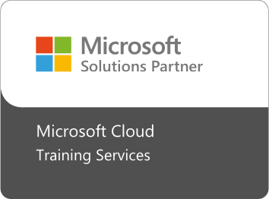

Fast Lane Group
Worldwide Education &
Professional Services
www.flane.de | © 2026 Fast Lane Institute for Knowledge Transfer GmbH
Notes:
Die Fast Lane Gruppe.
Fast Lane … Dienstleister u. Spezialist für High-End Technologie und Business Trainings
IT Trainings zu den unterschiedlichsten Herstellern wie Microsoft, Google, Cisco oder AWS. Und vielen weiteren wichtigen IT Herstellern.
Sei es Cloud, Security, Netzwerk oder allgemein digitale Transformationsprojekte
Und das seit 2003.
Das spannende ist, dass die Fast Lane Gruppe bereits seit 2009 durchgängig zu den Top 20 Unternehmen in der IT Trainingsbranche weltweit zählt.
Aber auch Footprint ebenso im klassischen Professional Services Bereich für unsere wichtigsten Hersteller
PreSales Support, Deployment Services und Adoption Trainings
Additional Information:
Im Jahr 2021 sind wir zur „most strategic IT Education company worldwide“ von der IDC im „magic quadrant“ aufgeführt worden !
1 mio Teilnehmer insgesamt seit bestehen, 50.000+ Students ww p.A, 20.000 in DE pro Jahr

Slide 2


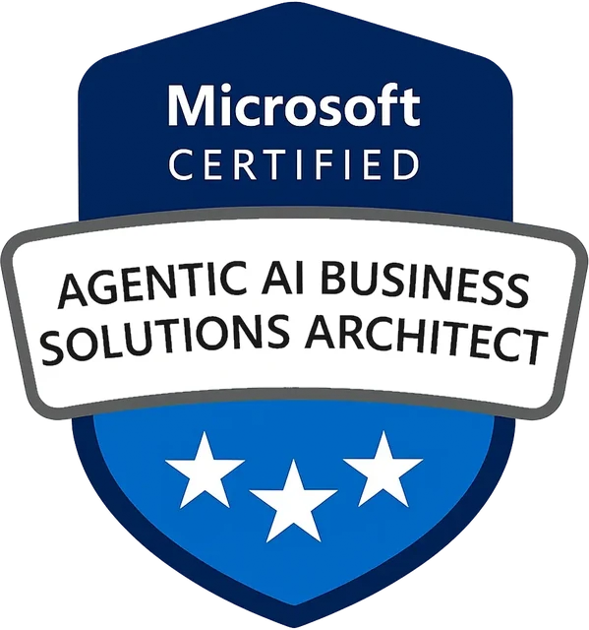
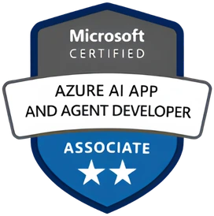


AGENTIC AI: FROM STRATEGY TO PRODUCTION.
Alexander
Kastil
AGENTIC AI CONSULTING · VIENNA
Full stack, from enterprise software to agentic AI. Since 1996
AI at Work
Enterprise AI
Value discovery, KPI mapping and roadmap
Governed multi-agent systems on Microsoft Copilot and Foundry
Agentic Software Engineering
Team Enablement
Harness architecture for Claude Code and GitHub Copilot
AI driven content production and delivery
integrations.at
github.com/alexander-kastil
SCAN TO CONNECT
alexander.kastil@integrations.at
linkedin.com/in/alexander-kastil
integrations.at
Notes:
Intro: Alexander Kastil, integrations.at. Four practice areas from AI at Work to team enablement. Certifications: Agentic AI Business Solutions Architect, Azure AI App and Agent Developer Associate, DevOps Engineer Expert.

Slide 3

MODULE 7
Publishing & Maintaining Copilot Studio Agents
Everything that happens after the agent works on your screen
Automate Business Processes with Copilot Studio and Copilot Cowork

Slide 4
01
02
03
Environments, Solutions & the Admin Center
Environment types, solutions and Dataverse
Publishing Agents & Microsoft Channels
Publish, authentication, Teams and SharePoint
Application Lifecycle Management & Source Control
Solutions, pipelines and Git
04
05
Using Advanced Channels: WhatsApp, Web & Direct Line
Optional: websites, Direct Line and WhatsApp
Agentic Building: Copilot Studio Plugins for Coding Agents
Build and migrate agents from the terminal
Automate Business Processes with Copilot Studio and Copilot Cowork

Slide 5

Publishing & Maintaining Copilot Studio Agents
Everything that happens after the agent works on your screen
Publish to the channels where people already work
Promote from development to test to production with solutions
Build and migrate agents from the terminal with coding agents
Notes:
Building an agent is only half the job. This module covers what comes after it works on your screen: taking it from a personal sandbox to a production environment.
Publish: one publish puts the agent into Teams, Microsoft 365 Copilot and SharePoint, and the optional topic adds websites, Direct Line and WhatsApp.
Promote: solutions, deployment pipelines and Git move the agent between development, test and production without rebuilding it by hand.
Build and migrate: the last topic hands the authoring to Claude Code with two Copilot Studio plugins, using the Grey Logistics IT Help Desk agent from module 3.

Slide 6
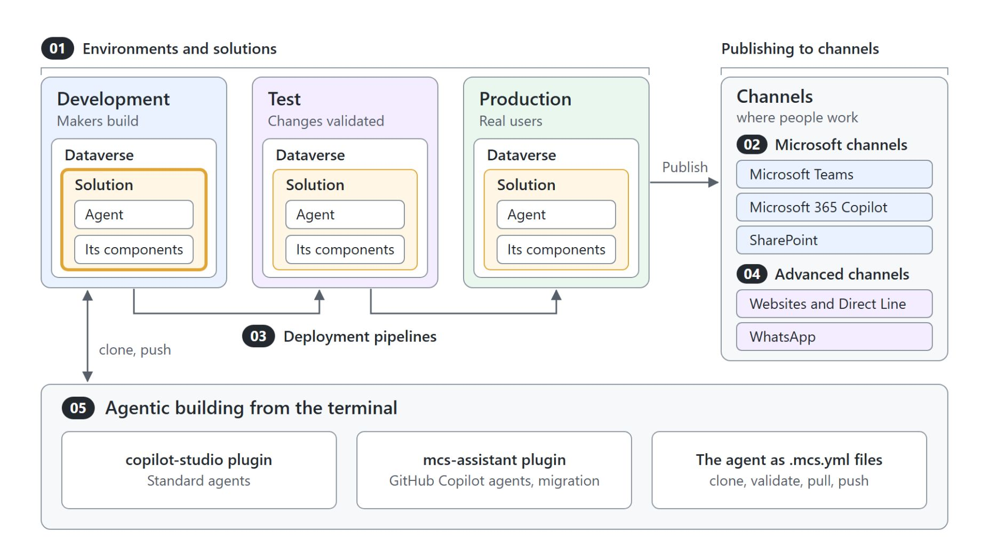
Overview
Five topics along the lifecycle of an agent
Environments and solutions: development, test and production, with Dataverse holding the solution
Microsoft channels: one publish reaches Teams, Microsoft 365 Copilot and SharePoint
ALM and source control: deployment pipelines and Git move the solution forward
Advanced channels (optional): websites, Direct Line and WhatsApp
Agentic building: a coding agent clones and pushes the agent as files
Notes:
The five topics follow the real lifecycle of a Copilot Studio agent, and the numbered pills map each one onto this picture.
Environments and solutions: a healthy setup uses development where makers build, test where changes are validated and production where agents reach real users. Solutions carry the agent between them, and Dataverse stores them.
Microsoft channels: publishing creates the live version, and one publish updates Teams, Microsoft 365 Copilot and SharePoint at once.
ALM and source control: deployment pipelines promote the solution from development to test to production. Git integration adds a source of truth outside Dataverse.
Advanced channels: this optional topic covers agents that must reach people outside Microsoft 365, on a website, in your own app or on WhatsApp.
Agentic building: Claude Code with the copilot-studio and mcs-assistant plugins clones the agent from development, edits it as .mcs.yml files and pushes it back.

Slide 7
01
Environments, Solutions & the Admin Center
Environment types, solutions and Dataverse
Automate Business Processes with Copilot Studio and Copilot Cowork

Slide 8
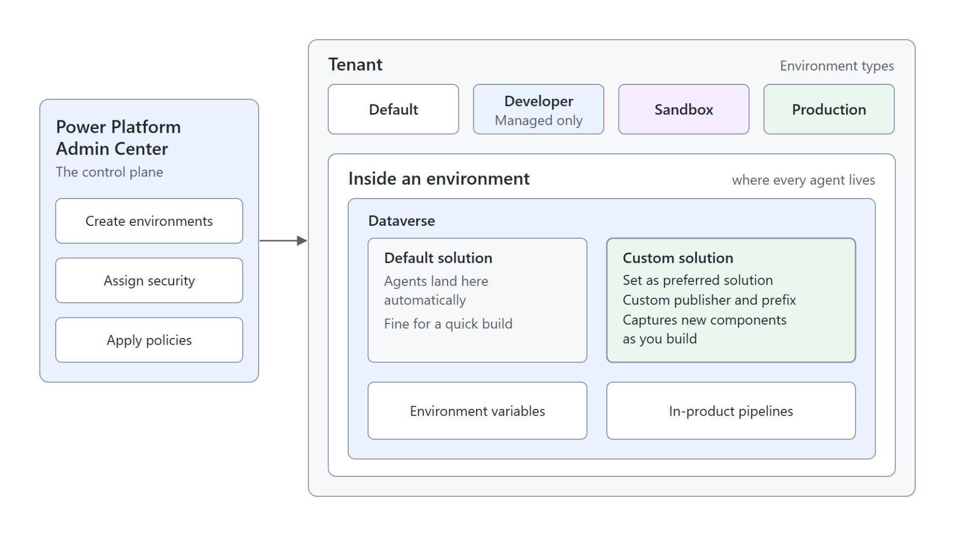
Environments, solutions and Dataverse
Where every agent lives and how it is packaged
Power Platform Admin Center: admins create environments, assign security and apply policies
Environment types: default, developer, sandbox and production
New agents land in the default solution; a custom solution set as preferred captures every component
Dataverse stores solutions, environment variables and in-product pipelines
Notes:
Every Copilot Studio agent lives inside a Power Platform environment and is packaged inside a solution. This slide sets the foundation the rest of the module builds on.
Power Platform Admin Center: this is the control plane. Admins create environments here, assign security and apply policies.
Environment types: a tenant holds default, developer, sandbox and production environments, and the strategy for agents is development, test and production.
Default and custom solution: agents land in the default solution automatically, which is fine for a quick build. For anything you plan to promote, create a custom solution with your own publisher and prefix and set it as your preferred solution before you build.
Dataverse: it stores the solutions, the environment variables and the in-product pipelines.

Slide 9
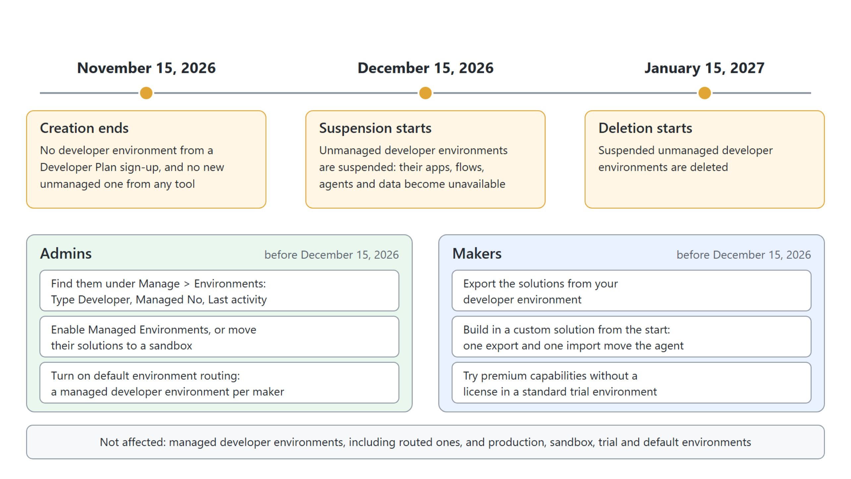
Unmanaged developer environments
Creation ends November 15, 2026; suspension follows on December 15
Export your solutions or move to a managed environment before December 15, 2026
Notes:
Microsoft is retiring unmanaged developer environments, including the ones the free Power Apps Developer Plan creates on sign-up. The developer type stays, but only as a managed environment, one per user.
The dates: creation of unmanaged developer environments ends on November 15, 2026. Suspension starts on December 15, 2026, and deletion of suspended environments on January 15, 2027.
Admins: they filter Manage, Environments to Type Developer and Managed No and use Last activity to spot the ones in use. For each one still needed they enable Managed Environments, which needs premium licensing, or move its solutions to a sandbox.
Default environment routing: admins turn it on so every maker gets a managed developer environment of their own.
Makers: export the solutions from your developer environment before December 15, 2026. This is one more reason to build in a custom solution from the start, and a standard trial environment still lets you try premium capabilities.
Not affected: managed developer environments, including the routed ones, and production, sandbox, trial and default environments.

Slide 10
02
Publishing Agents & Microsoft Channels
Publish, authentication, Teams and SharePoint
Automate Business Processes with Copilot Studio and Copilot Cowork

Slide 11
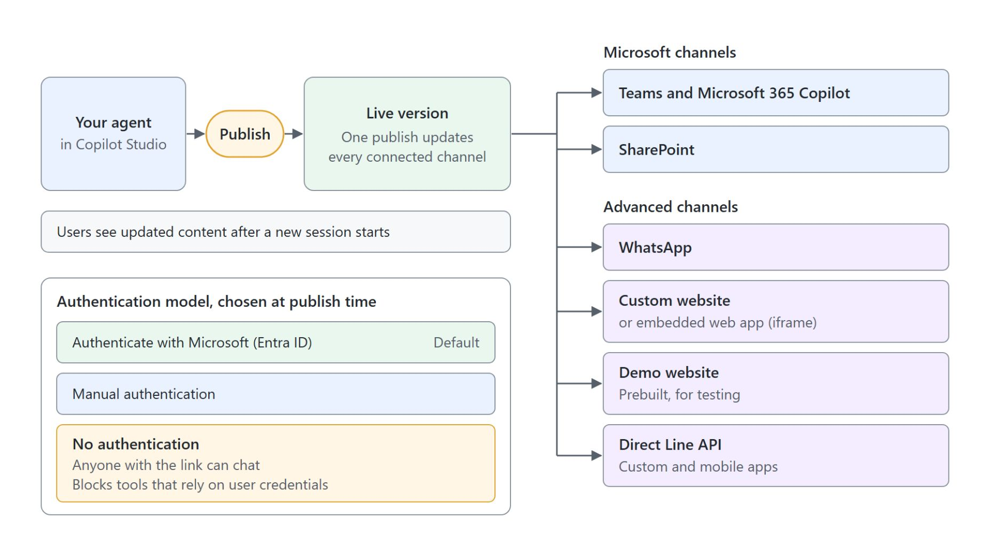
Publishing and channels
One publish updates every connected channel
Publishing creates the live version; nobody can use the agent before you publish
One publish updates every connected channel at once
Microsoft channels: Teams and Microsoft 365 Copilot, and SharePoint
The authentication model is chosen at publish time: Entra ID by default, manual or none
Notes:
With the agent packaged in a solution, the next step is to put it where users already work. Publishing and channels are the two halves of that step.
Publishing: it creates the live version of the agent, and you must publish before anyone can use it.
Every connected channel: publishing applies to all connected channels at once, so a single publish updates the agent everywhere.
Microsoft channels: Teams and Microsoft 365 Copilot, and SharePoint, put the agent where Microsoft 365 users already work. The advanced channels on the right side of the diagram are the optional topic 4.
Authentication model: Authenticate with Microsoft through Entra ID is the default; manual authentication and No authentication are the alternatives.

Slide 12
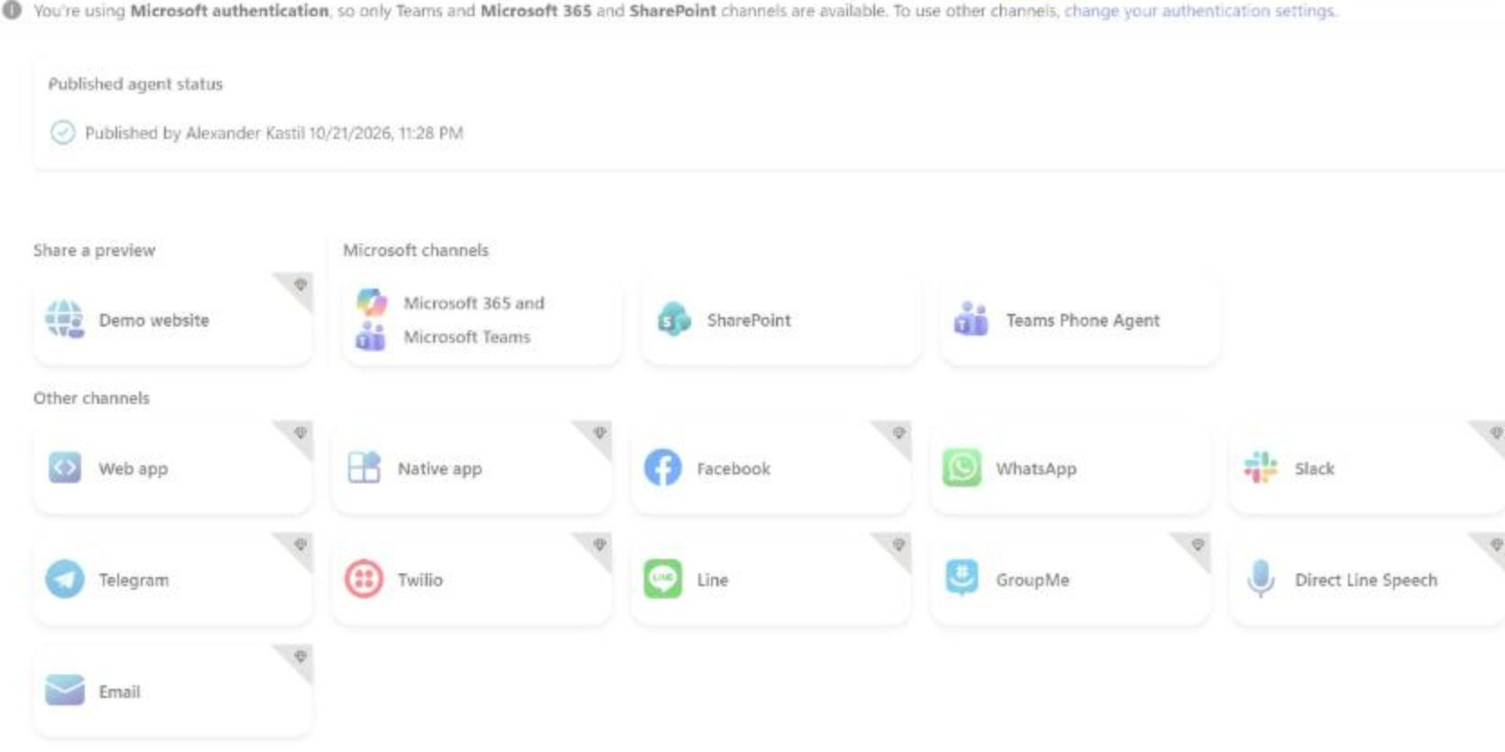
Authentication and channel choice
The Channels page of a published agent
Published agent status shows who published and when
With Microsoft authentication, only Teams and Microsoft 365 and SharePoint are available
Other channels need manual or No authentication
No authentication lets anyone with the link chat and blocks tools that rely on user credentials
Notes:
This is the Channels page of CS-HR Buddy right after its publish in the module 3 demo. It shows how the authentication choice decides which channels you can connect.
Published agent status: the page names who published the live version and when. Nothing appears in a channel before that first publish.
Microsoft authentication: the banner says it plainly, only Teams and Microsoft 365 and SharePoint channels are available. That is the right setting for an internal HR agent whose users always sign in.
Other channels: the tiles with the corner mark need manual authentication or No authentication. Each channel has its own connection steps, and some differ between Standard and GitHub Copilot agents.
No authentication: anyone with the link can chat with the agent, and tools that rely on user credentials stop working. Choose it only for an agent that is meant to be open.

Slide 13
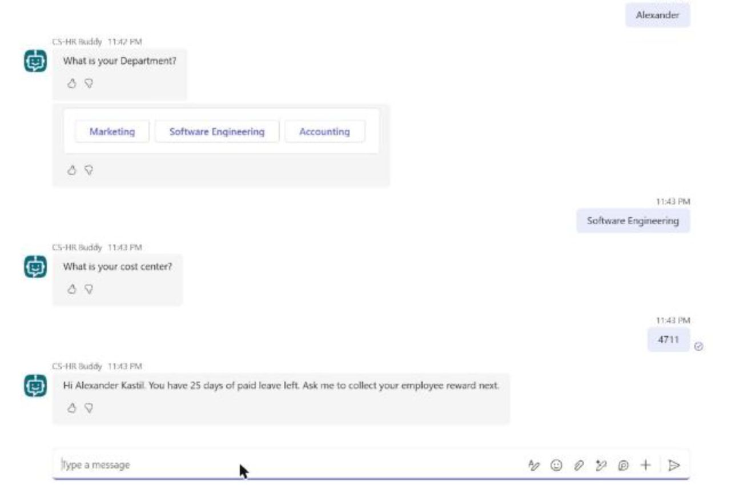
Republishing a change
One publish, then a new session in Teams
Every change reaches users only through Publish
A running conversation keeps the old version until a new session starts
start over forces the new session in Teams
The last answer ends with the new sentence from the republished topic
Notes:
Publishing once is easy; the question is what users see after the next change. This chat in Teams comes from the module 3 demo, where one sentence was added to the Collect Employee Data topic and the agent was published again.
Publish: every change reaches users only through Publish, and one publish updates Teams and Microsoft 365 Copilot at once.
New session: updated content reaches users only after a new session starts, so a conversation that is already running keeps the old version.
start over: typing start over in Teams forces that new session. The Publish dialog also offers Force newest version, which moves ongoing Teams chats at once but can interrupt them.
New sentence: after start over the confirmation ends with "Ask me to collect your employee reward next.", the sentence the republish added.

Slide 14
03
Application Lifecycle Management & Source Control
Solutions, pipelines and Git
Automate Business Processes with Copilot Studio and Copilot Cowork

Slide 15

ALM for Copilot Studio agents
Development, test and production, always in solutions
Three environments: development, test and production
Customize only in development
Always work in the context of solutions
Decide managed or unmanaged when you import
Pipelines and source control make each release automated and auditable
Notes:
Application Lifecycle Management is the discipline of moving an agent through development, test and production in a way that is reliable and repeatable. This slide gives the model and its golden rules.
Three environments: makers build in development, changes are validated in test, and agents reach real users in production.
Only in development: the first golden rule is never to customize outside development.
In the context of solutions: the second golden rule. Solutions are the carrier that transports the agent between the environments.
Managed or unmanaged: when you import a solution into the next environment, you decide whether it arrives managed or unmanaged.
Automated and auditable: without ALM, promoting an agent means rebuilding it by hand and hoping nothing drifts. Pipelines and source control turn that manual ritual into an automated, auditable release.

Slide 16
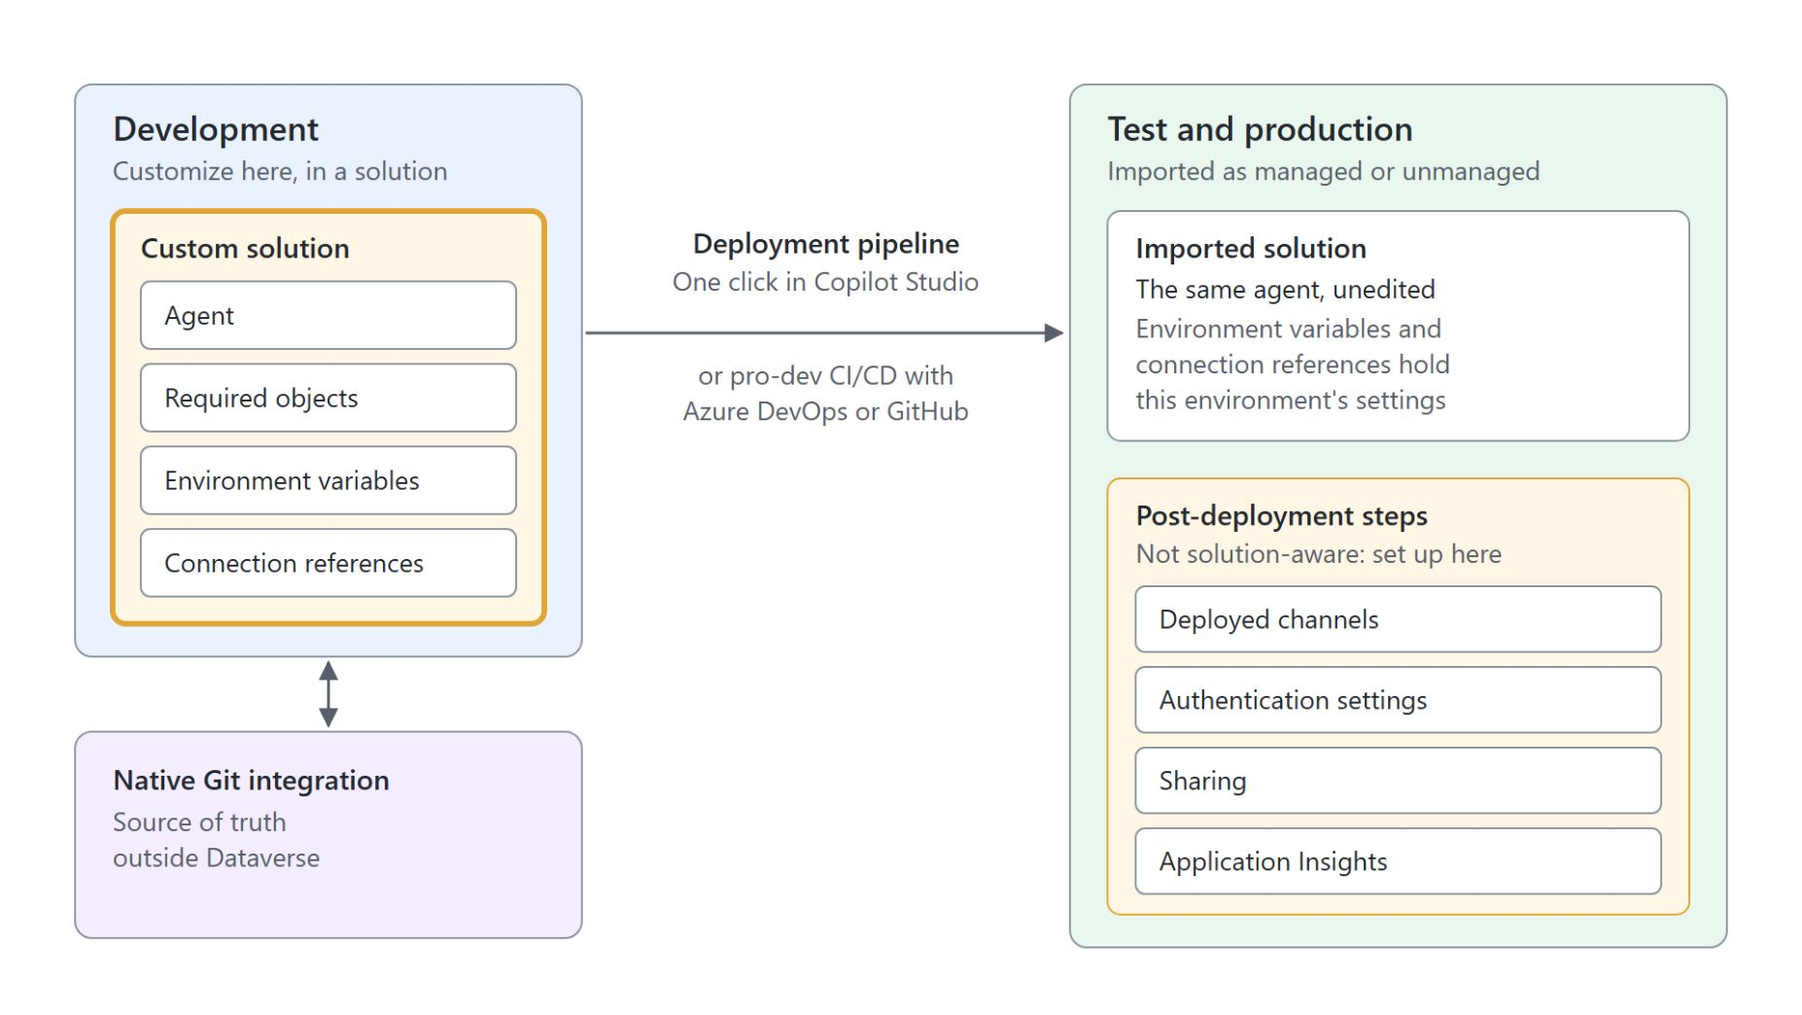
What a solution carries
And what you set up after deployment
A custom solution carries the agent and the objects it needs
Environment variables and connection references hold the settings that change per environment
Deployment pipelines promote in one click inside Copilot Studio; Azure DevOps or GitHub run pro-dev CI/CD
Native Git integration keeps a source of truth outside Dataverse
Deployed channels, authentication settings, sharing and Application Insights need post-deployment steps
Notes:
The ALM rules say to work in solutions; this slide shows what actually travels in one and what stays behind.
Custom solution: you create it and add the required objects, so the agent moves as one package between environments.
Environment variables and connection references: they hold the settings that change per environment. The same agent carries different settings in dev, test and production without anyone editing the agent itself.
Deployment pipelines: they deploy in one click from inside Copilot Studio. Pro-dev teams run the same promotion as CI/CD in Azure DevOps or GitHub.
Native Git integration: it gives you a source of truth outside Dataverse, next to the solution in development.
Post-deployment steps: deployed channels, authentication settings, sharing and Application Insights are not solution-aware. Plan them as steps in the target environment after every import.

Slide 17
04
Using Advanced Channels: WhatsApp, Web & Direct Line
Optional: websites, Direct Line and WhatsApp
Automate Business Processes with Copilot Studio and Copilot Cowork

Slide 18
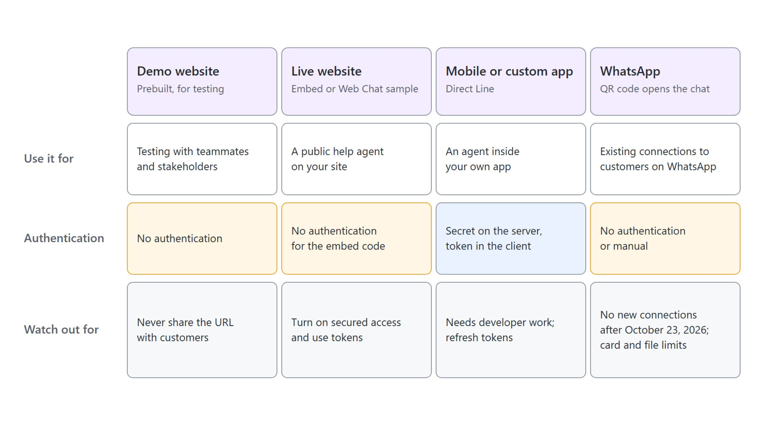
Choosing an advanced channel
Reach beyond Microsoft 365, with its own sign-in limits
Advanced channels are Standard-agent channels and trade Microsoft sign-in for reach
Notes:
This optional topic is for agents that must reach people outside Microsoft 365: on a public website, inside your own app or on a phone messenger. Each channel brings its own authentication limits.
Demo website: every published agent gets one for testing with teammates and stakeholders. Learn is explicit that its URL never goes to customers.
Live website: the embed code on the Web channel only appears with No authentication, because an anonymous visitor cannot sign in. Turn on secured access and use tokens.
Mobile or custom app: the app talks to the agent over the Direct Line API. That is developer work, with the secret on the server and a token in the client.
WhatsApp: it runs through Azure Communication Services and accepts only No authentication or manual authentication. Agents connected before October 23, 2026 keep working; no new connection can be set up after that date.
Agent types: everything here applies to Standard agents. GitHub Copilot agents publish to Microsoft 365, Teams and a website today.

Slide 19
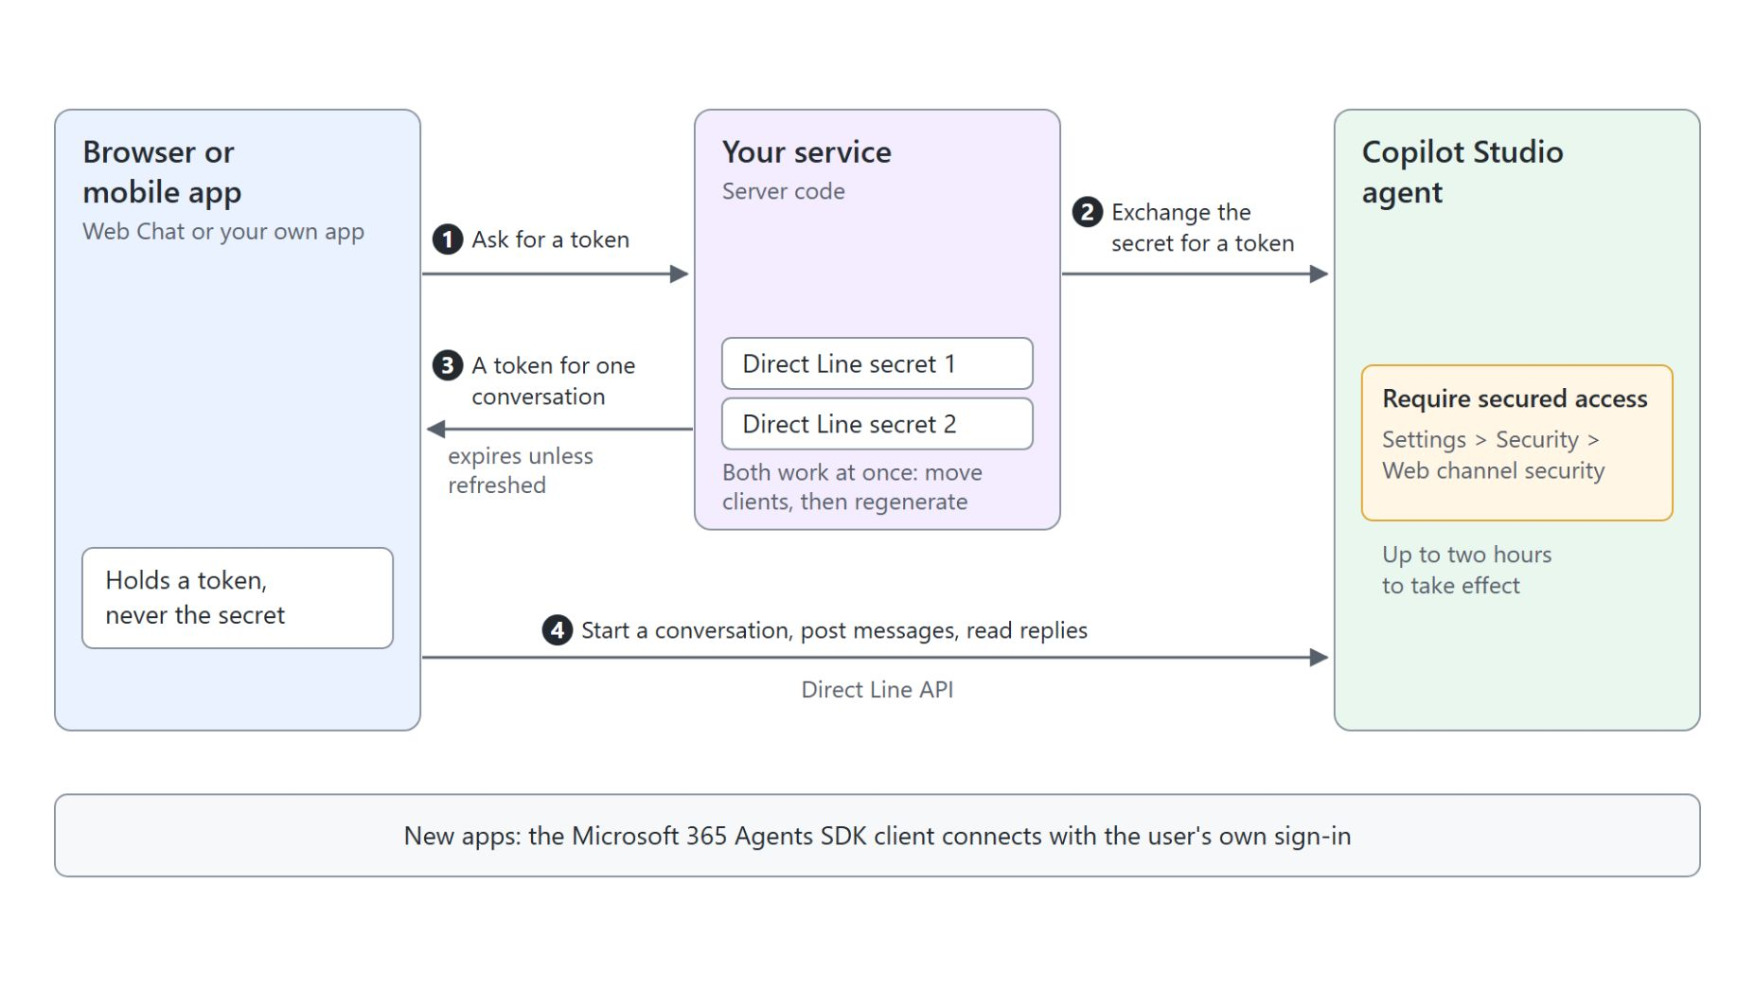
Web channel security and Direct Line
The secret stays on the server, the client gets a token
Require secured access makes every client present a secret or a token
The secret lives only in server code; browsers and apps get a token
Two secrets work at once, so you rotate without downtime
The app starts a conversation, posts messages and reads replies over Direct Line
Notes:
Without further settings, anyone who knows an agent's ID can reach it through the demo and custom website channels. This slide shows how to close that door.
Require secured access: it sits under Settings, Security, Web channel security. Every client must then present a Direct Line secret or a token generated from it, and the switch takes up to two hours to propagate, so plan it before a launch.
Secret and token: a secret belongs only in server code. Your service exchanges it for a token that is valid for one conversation and expires unless it is refreshed.
Two secrets: both work at the same time, so you move clients to the second secret and then regenerate the first.
Direct Line: an app requests a token, starts a conversation, posts the user's messages and reads the agent's replies. For new apps, Learn also points to the Microsoft 365 Agents SDK client, which connects with the user's own sign-in.

Slide 20

The demo website
For testing with teammates, never for customers
Share the demo website with teammates to test each change, and keep its URL away from customers
Notes:
Every published agent gets a prebuilt demo website, and it exists for testing. This slide keeps it in that role.
Testing with teammates: on the Demo website panel under Channels you set a welcome message and a few conversation starters, share the URL with teammates, and change the message whenever you want them to test something new.
Never for customers: Learn is explicit that the demo site is not for production and that its URL never goes to customers. A live website embeds the agent with the Web channel's code or the Web Chat sample instead.

Slide 21
05
Agentic Building: Copilot Studio Plugins for Coding Agents
Build and migrate agents from the terminal
Automate Business Processes with Copilot Studio and Copilot Cowork

Slide 22
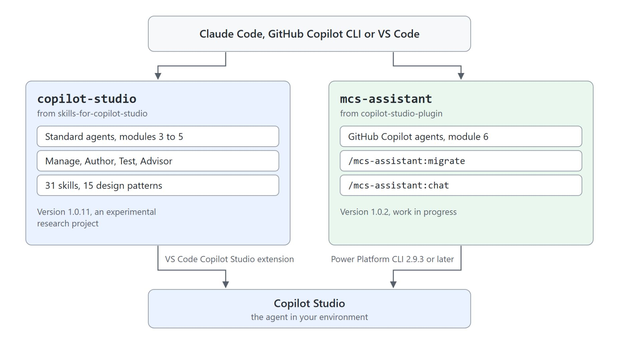
Copilot Studio plugins for coding agents
One plugin per agent type, one active at a time
{
"enabledPlugins": {
"mcs-assistant@copilot-studio-plugin": false
}
}
Notes:
Topic 3 put agents under source control; this topic hands the authoring itself to a coding agent. Microsoft publishes two open-source plugins, and the class needs both.
copilot-studio: it targets Standard agents in modules 3 to 5 and reaches Copilot Studio through the VS Code Copilot Studio extension. A session hook routes every request to one of four sub-agents, Manage, Author, Test and Advisor, which use 31 skills.
mcs-assistant: it targets GitHub Copilot agents in module 6 through the Power Platform CLI 2.9.3 or later. Its migrate command moves a Standard agent to the GitHub Copilot harness, and chat tests a published agent from the terminal.
One plugin per module: the migrate command warns that the two may conflict. Keep both installed and turn off the one the current module doesn't need in .claude/settings.local.json, as in the code on the left, then start a new session.
Sharp edges: both plugins are experimental and the YAML schema can change without notice, so review generated YAML before you push it.

Slide 23
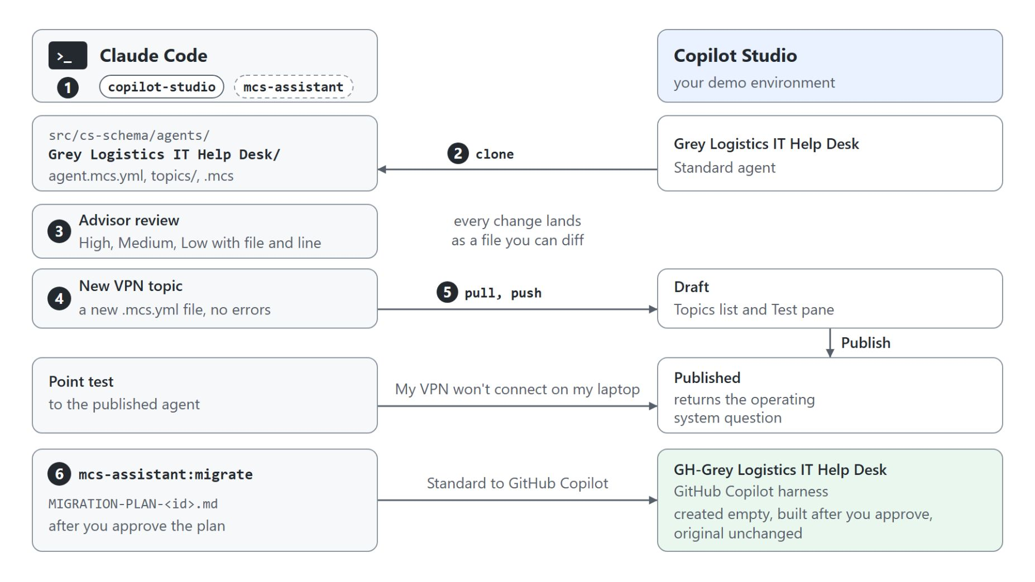
Building and migrating from the terminal
The Grey Logistics IT Help Desk, cloned, extended, published and migrated
Clone first: the plugin works only on an agent that already exists in an environment
The Advisor ranks findings High, Medium and Low; the Author writes a validated VPN topic
Pull before you push: the push lands as a draft for the Test pane
Publish, then point test with "My VPN won't connect on my laptop"
/mcs-assistant:migrate builds GH-Grey Logistics IT Help Desk; the original stays unchanged
Notes:
The demo hands three jobs on the Grey Logistics IT Help Desk agent to Claude Code: a review, a new topic and a move to the GitHub Copilot harness. Every change lands as a file you can diff.
Clone first: the plugin can't create an agent, so you clone the existing one into src/cs-schema/agents and commit the clone.
Advisor and Author: the Advisor reviews the agent and ranks its findings with file and line. The Author writes the VPN topic with three trigger phrases, a Windows or macOS question and numbered steps, and validation reports 0 errors.
Pull before you push: a push over stale files fails with ConcurrencyVersionMismatch. The push creates a draft that only the canvas, the Test pane and evaluations see.
Publish and point test: after you publish, the point test returns the operating system question from the new topic.
Migrate: /mcs-assistant:migrate writes a MIGRATION-PLAN file, waits for your Approve and builds a new agent in which the VPN topic becomes the skill vpn-wont-connect. The original Standard agent stays unchanged.

Slide 24

Takeaways
From a personal sandbox to production
Build in a custom solution, set as preferred, from the first component
Publish once to every channel and choose the authentication model with care
Promote with pipelines and Git, then finish the post-deployment steps
Let a coding agent author, validate and push the agent as files
Notes:
Close the module with the habits that take an agent from a personal sandbox to a production environment.
Custom solution: create it and set it as your preferred solution before you build, so every component is captured and the agent can move between environments.
Publish and authenticate: one publish updates every connected channel, and the authentication model decides who can chat with the agent and which channels and tools still work.
Pipelines and Git: promote the solution through development, test and production, then set up channels, authentication, sharing and Application Insights in the target.
Coding agent: with the copilot-studio and mcs-assistant plugins every change becomes a file you can diff and review, and the portal stays the place to publish.

